Slide 1
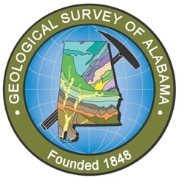

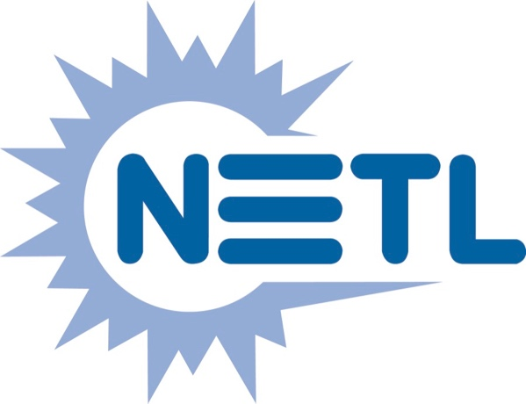
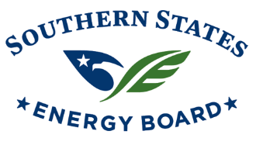

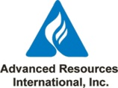
Southeast Offshore Storage Resource Assessment (SOSRA) Project Number: DE-FE0026086
Investigating the Eastern Gulf of Mexico for Potential Geologic Storage of CO₂
Denise J. Hills¹, Jack C. Pashin², and Marcella R. McIntyre-Redden¹
¹Geological Survey of Alabama, ²Oklahoma State University
Geological Society of America Annual Meeting 2016
Denver, Colorado
26 September 2016
This material is based upon work supported by the U.S. Department of Energy National Energy Technology Laboratory.
Cost share and research support are provided by the Project Partners and an Advisory Committee
Notes:
Prepared for the Geological Society of America’s 2016 Annual Meeting
Presented on Monday 26 September 2016 10:35AM

Slide 2
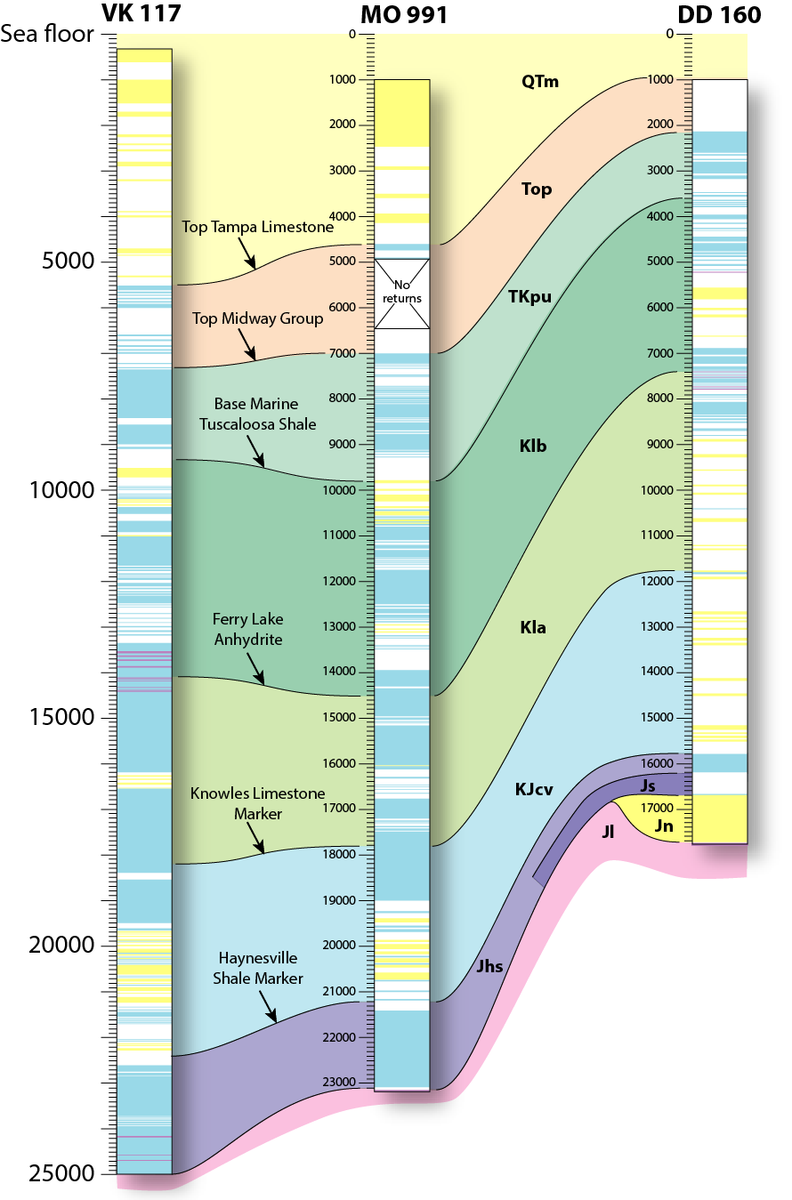
Why Offshore Reservoirs for CCUS?
Potentially giant CO₂ capacity
Abundant stacked saline formations and depleted oil and gas reservoirs
Significant infrastructure in place
Proven offshore sequestration technology
Favorable ownership and access
Notes:
Image (left): GOM OCS CO₂ storage potential: current vs “next generation” CO2-EOR technology
Image (right): offshore sections (from Hills and Pashin, 2010)
Why offshore?
Lots of CO₂ capacity (supplements onshore)
Abundant stacked saline formations and depleted oil and gas reservoirs Offshore storage capacity near high production (heavily populated areas)
Eliminates NIMBY
USDW protection
Fluids already have high TDS similar to sea water
Few USDW exist offshore
Significant infrastructure in place
Favorable ownership and access
Single entity primarily responsible for leasing, permitting, regulation
Potentially more economical despite higher capital costs
Proven offshore sequestration technology
Greatest volume of offshore potential is in saline reservoirs, with large volumes assessed in the GOM.
References:
Litynski, J.T., Brown, B.M, Vikara, D.M., and Srivastava, R.D., 2011. Carbon Capture and Sequestration: The U.S. Department of Energy’s R&D Efforts to Characterize Opportunities for Deep Geologic Storage of Carbon Dioxide in Offshore Resources. OTC Paper Number OTC-21987-PP, presented at Offshore Technology Conference, Houston, Texas, USA, 2-5 May 2011. 10 pp.
Tew, B.H., Armbrecht, C., Eugene, D.W., Hills, D., Duncan, I., Moody, J. Pashin, J.C., Sams, K., Hwang, L., Rogers, S.M., Esposito, R., Carpenter, S., and Meckel, T., 2013, Preliminary Evaluation of Offshore Transport and Geologic Storage of Carbon Dioxide, Report to NETL, 110 p.
Vidas, H., B. Hugman, A. Chikkatur, B. Venkatesh. 2012. Analysis of the Costs and Benefits of CO2 Sequestration on the U.S. Outer Continental Shelf. U.S. Department of the Interior, Bureau of Ocean Energy Management. Herndon, Virginia. OCS Study BOEM 2012-100.

Slide 3
Geological Considerations for CCUS
Notes:
(image from IOGC Report): Site characterization and selection requires the consideration of reservoir properties and infrastructure at multiple scales.
Geologic considerations
Reservoir thickness, extent, and heterogeneity
Depth, pressure, and temperature
Formation composition, geochemistry
Geologic structure (i.e., folding, faulting, fracturing)
Seal integrity
References:
Tew, B.H., Armbrecht, C., Eugene, D.W., Hills, D., Duncan, I., Moody, J. Pashin, J.C., Sams, K., Hwang, L., Rogers, S.M., Esposito, R., Carpenter, S., and Meckel, T., 2013, Preliminary Evaluation of Offshore Transport and Geologic Storage of Carbon Dioxide, Report to NETL, 110 p.

Slide 4
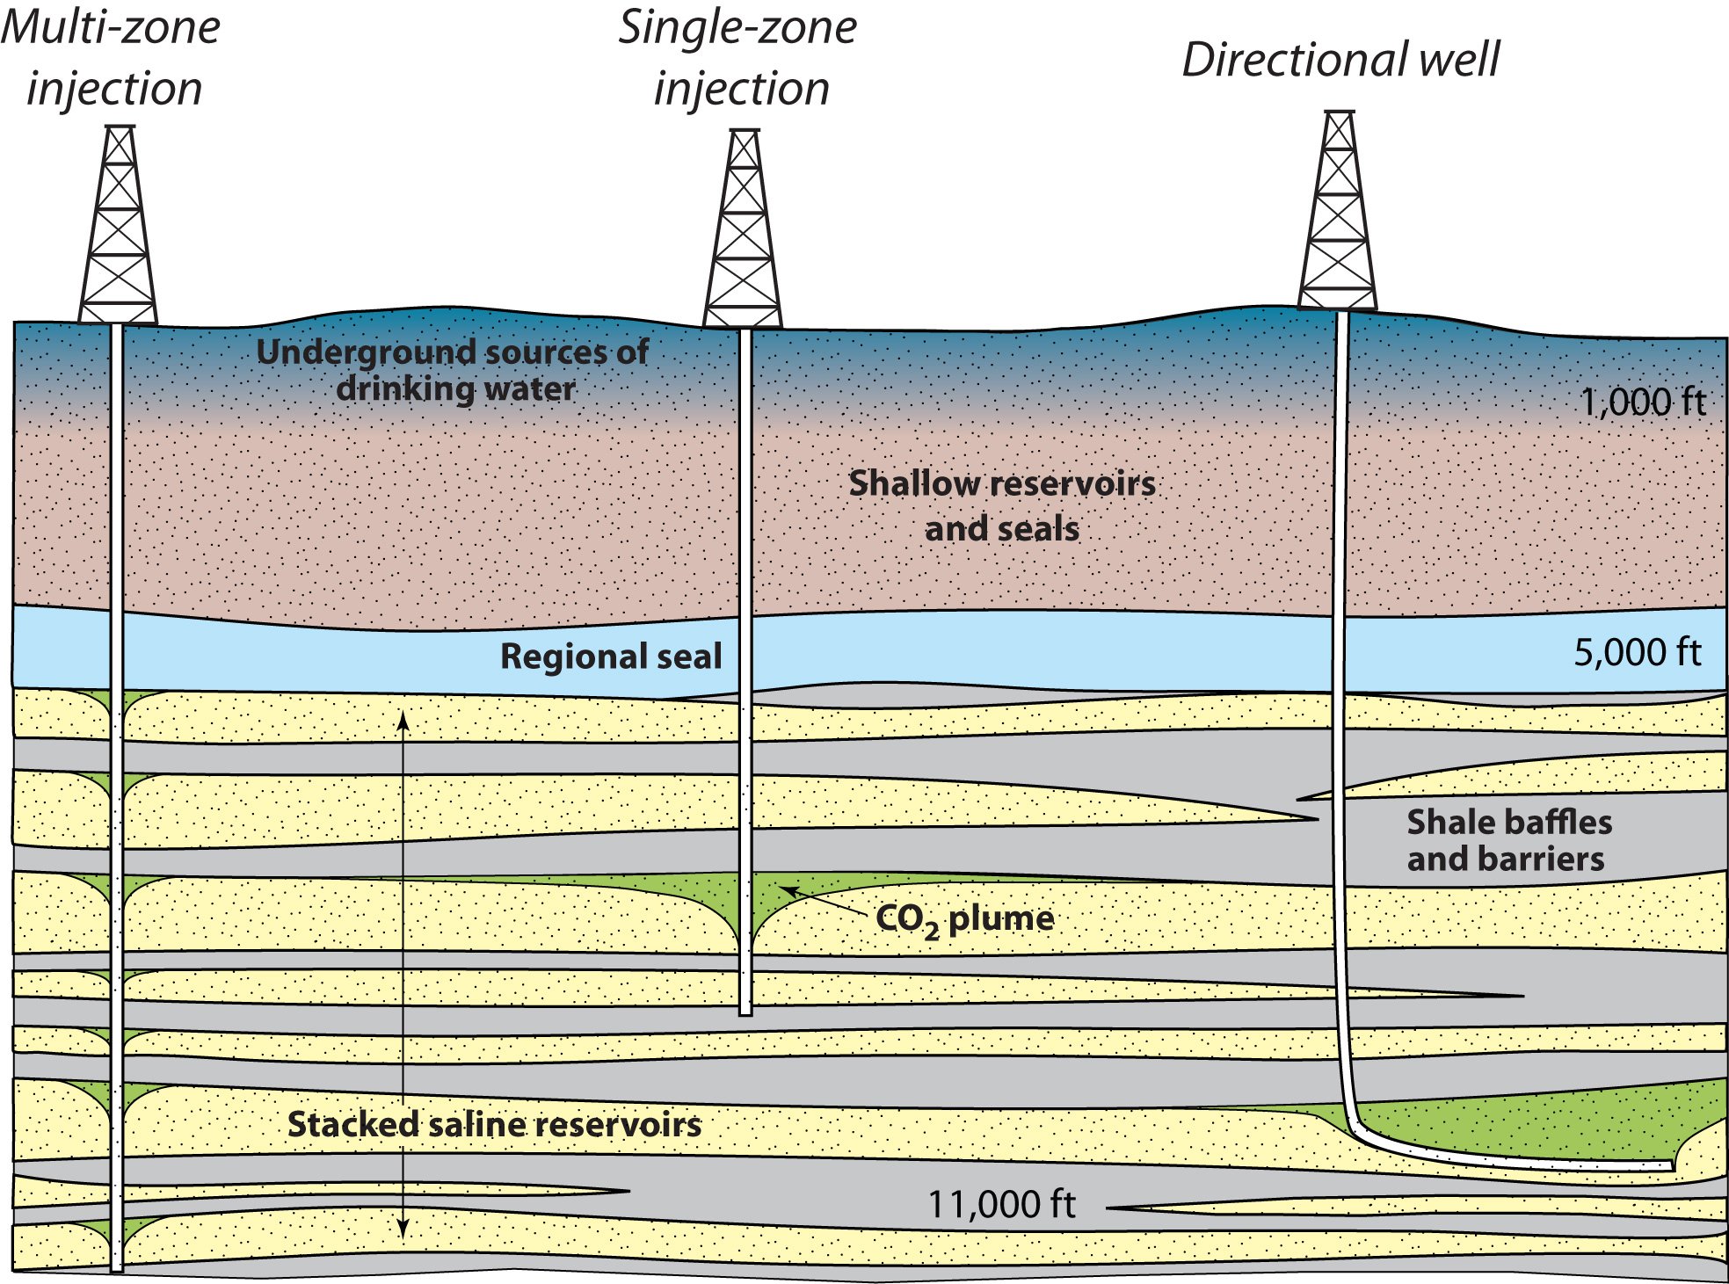
How Do We Adapt Proven Storage Strategies?
Notes:
lots of options for development in offshore areas. Which strategies will be most technically effective and cost-effective in offshore areas?
Potential risks:
Transport (pipeline)
Injection (overpressure, well integrity)
Leakage from confining zone (either through wells or faults)
Groundwater interaction (saltwater incursion)
Potential impacts on fauna
Legal, regulatory, engineering considerations
Ownership/leasing (may be easier offshore)
Well design, drilling, injection control
Well direction (vertical, directional, single-zone, multi-zone)
EOR (unlikely but discuss a bit more in another slide)
Navigation fairways
Tubulars and cement
Completion and injection design
Facilities (surface, subsea)
Pipeline infrastructure (what exists, can it handle CO2)

Slide 5
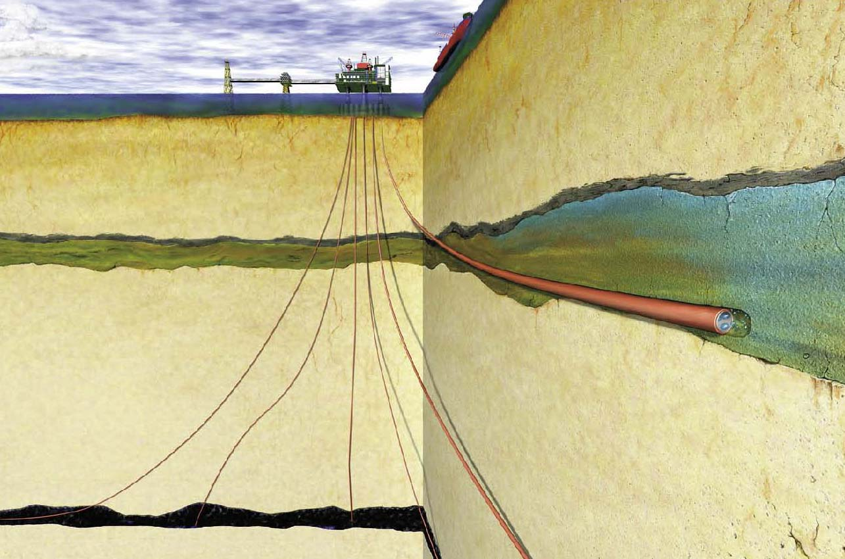

Offshore CO₂ Storage: Sleipner, North Sea
~1 Mt/yr stored in Utsira Fm. (Miocene-Pliocene) at ~1,000 m
World’s first commercial CO₂ storage project
Kaarstad (2004)
Notes:
Offshore sequestration technology established in North Sea, Barents Sea by Norwiegans. They have a ~$50/ton carbon tax that is significant driver.
Sleipner demonstrates feasibility of offshore sequestration. Sleipner directed at separation of CO2 from gas-condensate stream with sequestration in shallow saline formation above hydrocarbon target.
Summary of Sleipner project:
Located in the North Sea off Norway.
Run by Statoil
Stores 0.9 Mt/yr in the Utsira Formation, a deep saline reservoir 800-1000 m (2600-3000ft) below the sea floor
First commercial CO2 storage project. CO2 is removed from produced gas to meet export specifications and customer requirements. The CO2 is removed from the produced hydrocarbons at an offshore platform before being pumped back into the ground and the hydrocarbons pumped to land.
The Utsira Formation is a 200-250m thick massive sandstone. Estimated capacity of 600 billion tons of CO2.
Since the project’s inception through June 2015, around 15.5 million tonnes of CO2 have been injected.
Reference:
Kaarstad, O., (2004). "The Sleipner Project", Presented at the IEA Asia Pacific Conference on Zero Emissions Technologies - Fossil Fuels For Sustainable Development, Gold Coast, Queensland, Australia, 18 February 2004.
Other references:
Sleipner Fact Sheet: https://sequestration.mit.edu/tools/projects/sleipner.html
Statoil Project Page: http://www.statoil.com/en/OurOperations/ExplorationProd/ncs/sleipner/Pages/default.aspx
Sleipner Project Fact Sheet: http://www.globalccsinstitute.com/projects/sleipner%C2%A0co2-storage-project

Slide 6
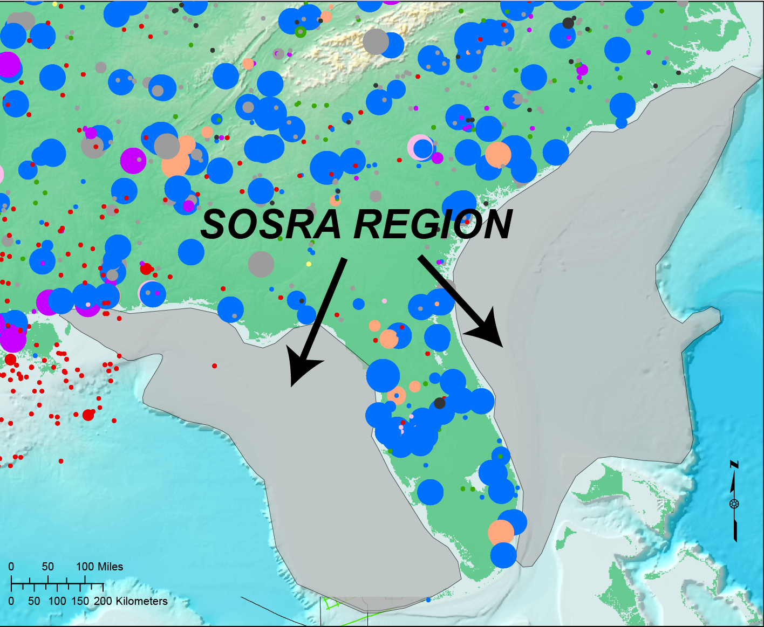

US CO₂ EMISSION SOURCES and SOSRA Region
Notes:
6
Emissions mainly east of MS. Offshore infrastructure primarily in GOM and CA Borderland basins.
US oil and gas production: Concentration of offshore activity in GOM, California, Alaska.
A look at SE potential from NETL atlas. Note offshore potential and onshore potential in Gulf Coast region. Note mainly offshore potential on Atlantic seaboard.
Southeast Offshore Storage Resource Assessment (SOSRA) Project Number: DE-FE0026086
Summary:
Southeast Offshore Storage Resource Assessment (SOSRA) project will assess prospective geologic storage resources for CO2 in the State and Federal waters of the Mid-Atlantic, South Atlantic, and the eastern Gulf of Mexico.
Goal: Develop a high-level approximation of the amount of CO2 that might be stored utilizing key geologic and environmental factors that influence the storage potential.
To date, only limited studies have been conducted.
OSU and GSA will be focused on work in the Eastern GOM.

Slide 7
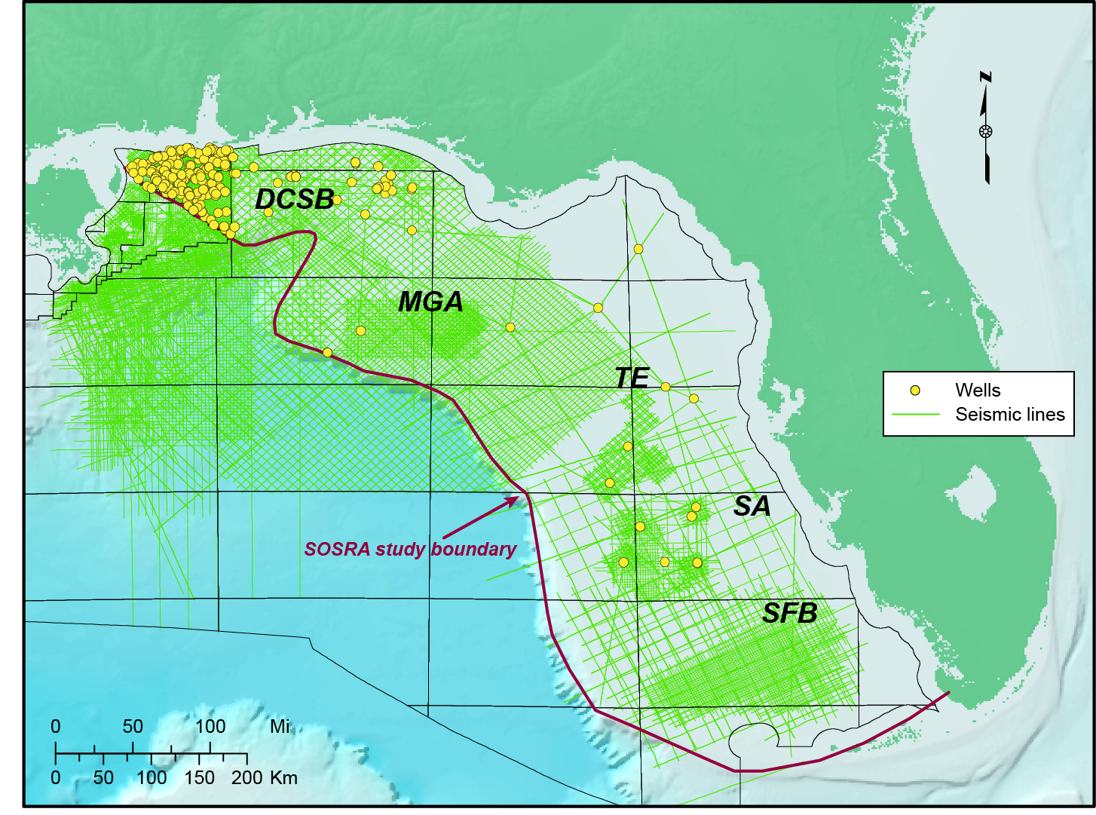
EGOM Study Area and Subregions
DCSB
MGA
TE
SA
SFB
DeSoto Canyon Salt Basin
Middle Ground Arch
Tampa Embayment
Sarasota Arch
South Florida Basin
Notes:
OSU and GSA will be focused on work in the Eastern GOM.
The EGOM Basin hosts a sedimentary succession that is generally 20,000-40,000 ft thick and includes the DeSoto Canyon Salt Basin and a giant carbonate platform (Tampa Embayment and South Florida Basin).
Paleozoic-Mesozoic basement rocks include large continental margin volcanic wedges. Triassic rift basins are developed locally, and a regionally extensive breakup unconformity is overlain the by Jurassic Louann Salt. Jurassic and Early Cretaceous strata above the salt contain a variety of extensional structures, including salt rollers, diapirs, and giant salt pillows.
Upper Cretaceous strata are gently deformed and were deposited mainly on a stable continental shelf. Mesozoic strata include a complex array of carbonate and siliciclastic rock types.
The Tampa Embayment and South Florida Basin constitute the West Florida Shelf, which has been a site of limited hydrocarbon exploration and thus sparse well control.
The West Florida Shelf is very shallow and is dominated by carbonate strata of Mesozoic and Cenozoic age. Regionally, stratigraphic markers can be traced across large regions of the shelf. The west margin of the shelf, called the West Florida Escarpment, is very steep and forms a distinctive curvilinear feature bound by the Cretaceous reef trend.
Although offshore petroleum production has yet to be proven in this area, the strata that form the shelf contain significant source rocks, reservoirs, and seals onshore in the Sunniland trend (Mitchell-Tapping, 1984) and have significant CO2 storage potential (Roberts-Ashby et al., in review).

Slide 8
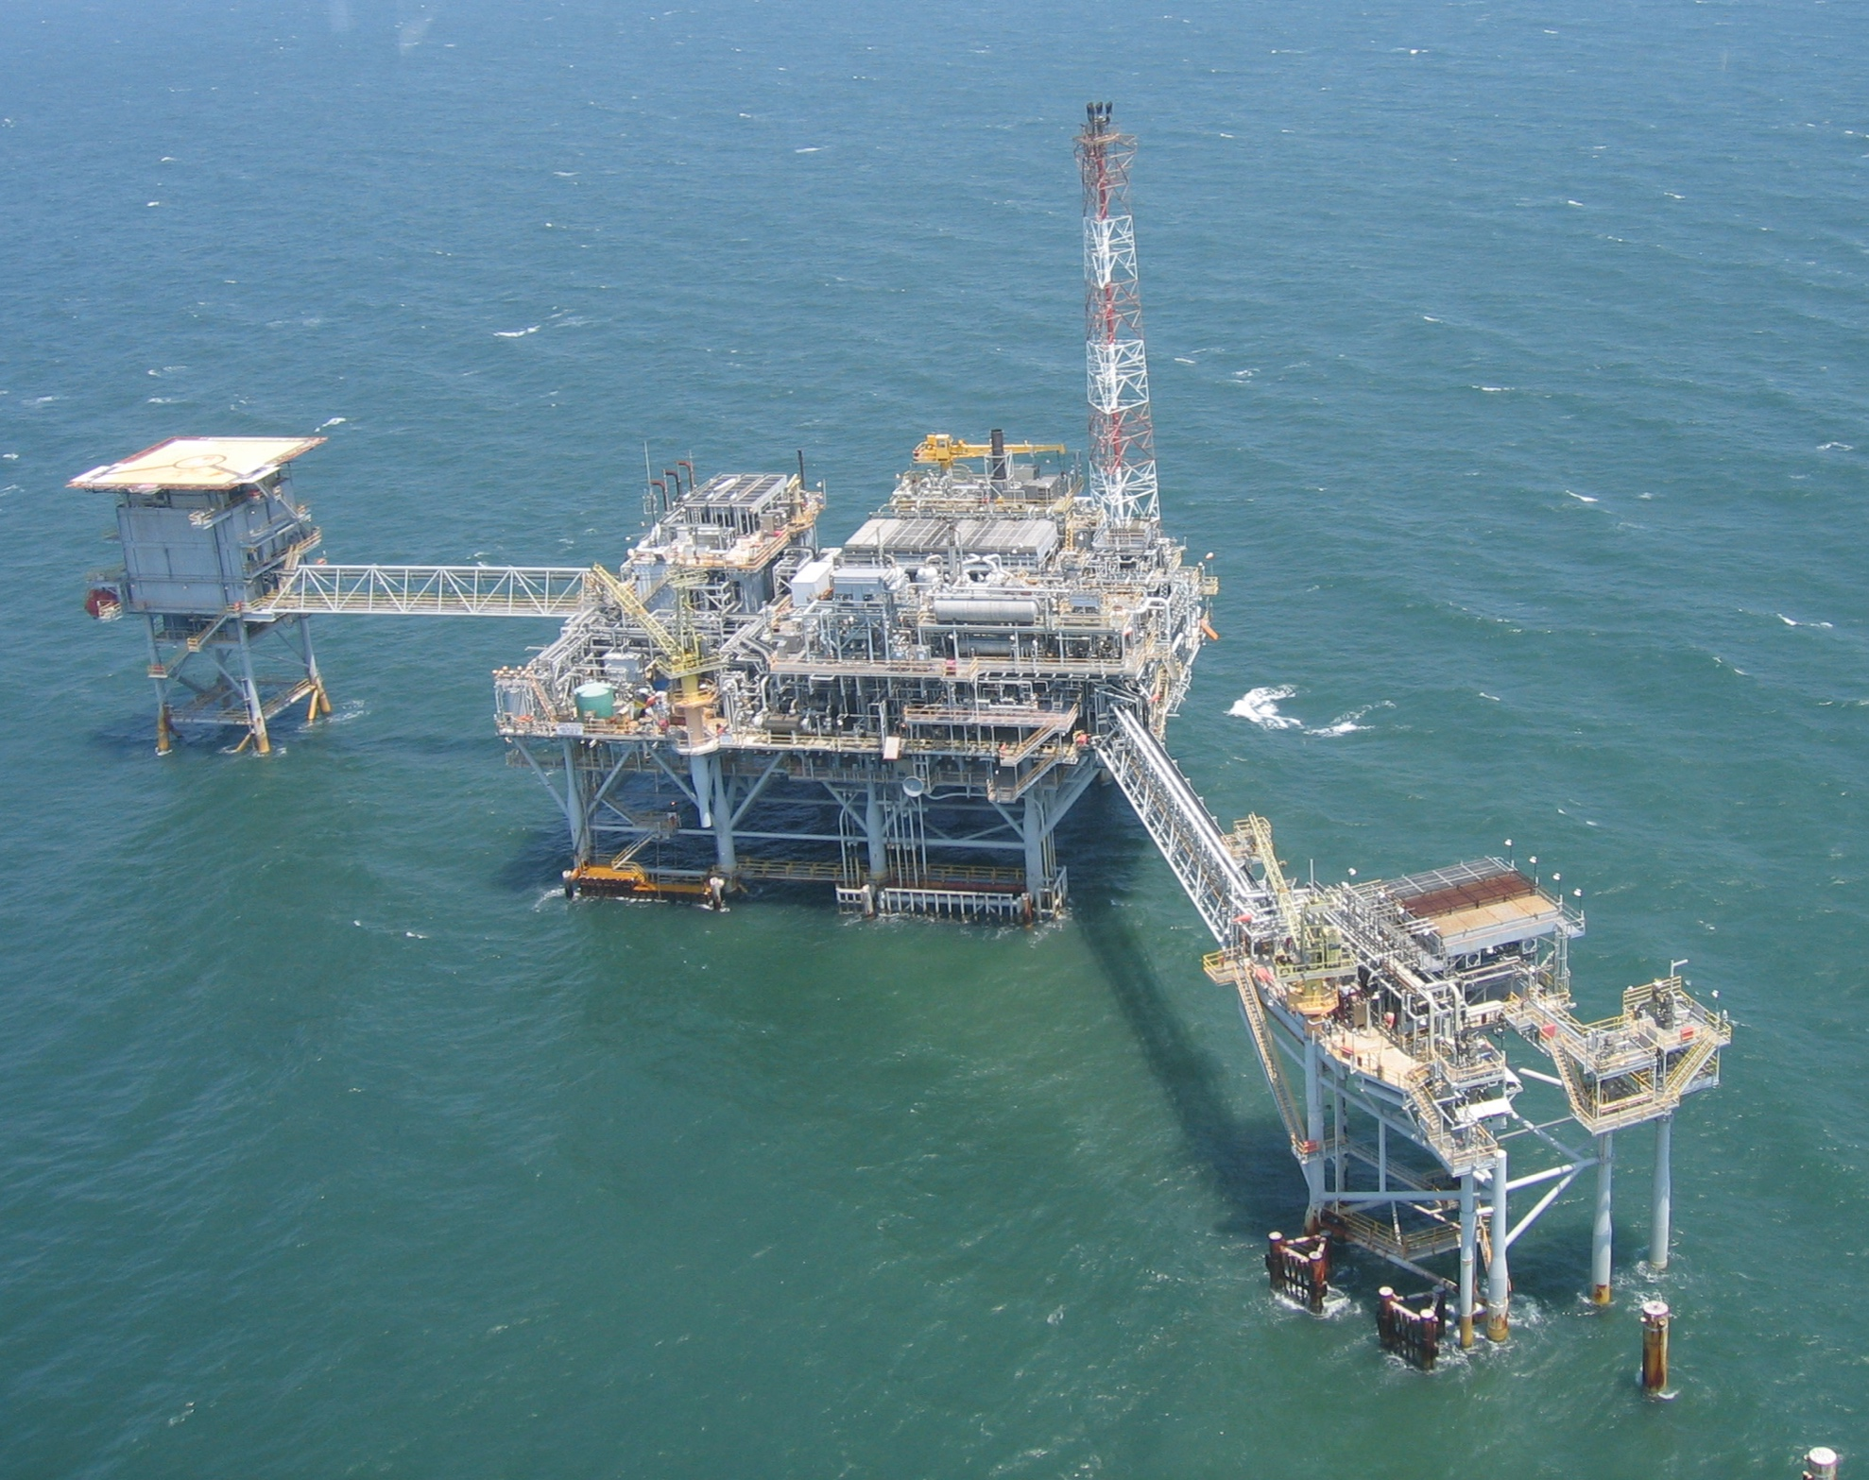
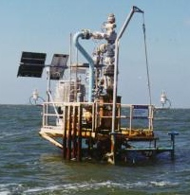
A Tale of Two Platforms
Ultradeep gas platform
Shallow gas well
Notes:
Preliminary targets for CO2 sequestration have been identified (e.g., Hills and Pashin, 2010) in northern part of study area
Miocene sands (both state and federal waters)
Cretaceous strata (federal waters)
Additional targets in Western FL escarpment
There are challenges in the EGOM:
Petroleum exploration, however, has proven technically challenging in the region, and the greatest success has been found in the ultra-deep (>20,000ft) natural gas reservoirs of the Mobile area. Although the proven petroleum reservoirs in the region are too deep to facilitate economically viable CO2- enhanced recovery operations, porous intervals have been identified in shallower carbonate and siliciclastic strata (Petty, 1997, 1999).
Offshore infrastructure quite variable. Giant Norphlet platform contrasted with tiny Miocene platform, all in AL state waters in Mobile area.
Viewshed issue major constraint on offshore development. Subsea operations could keep wells out of sight.
References:
Petty, A. J., 1997, Lower Tuscaloosa clastic facies distribution (Upper Cretaceous), Federal and State waters, eastern Gulf of Mexico: Gulf Coast Association of Geological Societies Transactions, v. 47, p. 454-462.
Petty, A. J., 1999, Petroleum exploration and stratigraphy of the Lower Cretaceous James Limestone (Aptian) and Andrew Formation (Albian): Main Pass, Viosca Knoll, and Mobile Areas, northeastern Gulf of Mexico: Gulf Coast Association of Geological Societies Transactions, v. 49, p. 441-450.

Slide 9
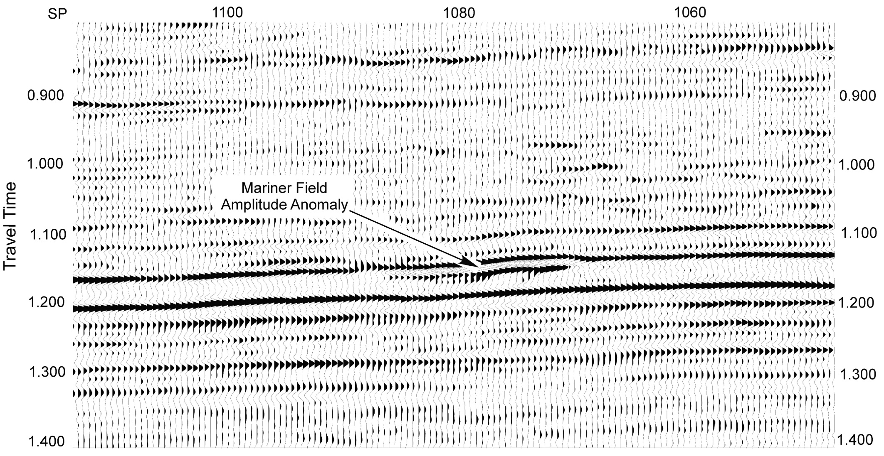
Miocene Gas Sands
Handford and Baria (2003)
Notes:
Seismic profile from Mariner Field, southern Mississippi, showing amplitude anomaly (bright spot) associated with gas accumulation.
Miocene bright spot plays provide shallow opportunities. Amplitude anomalies associated with gas accumulations readily identified in seismic, but these are just tips of the iceberg. Water-filled sands don't image as bright spots.
Preliminary analysis indicates that the bulk of the storage capacity in Miocene sandstone resides in saline formations below the commercial gas accumulations.
References:
Handford, C.R., and Baria, L.R., 2003, Exploration Potential and High-Resolution Sequence Stratigraphy of Shelf-Sand Reservoirs, Miocene, South Mississippi, AAPG Search and Discover Article #90021, GCAGS Annual Convention, Baton Rouge, LA, Oct. 22-24, 2003.

Slide 10
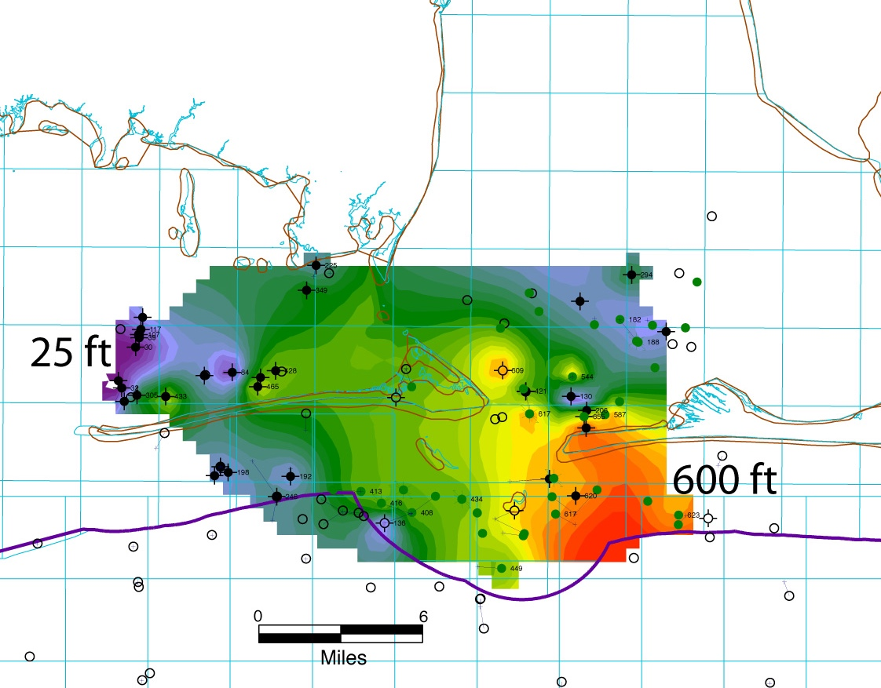
Net Miocene Sand > 2500 ft Deep
Hills (2008)
Notes:
Preliminary work:
Preliminary work (Hills and Pashin, 2010):
Figure: Net Miocene Sand, AL State waters. Sands shallower than 2480 were excluded (to reach CO2 super-critical/be below any potential USDW)
Variable sand distribution, but major sequestration potential where the sands are stacked. Pore volume was calculated using a porosity of 25%. Using an efficiency factor of 10%, and a CO2 density of 0.7 g/cc
Storage of 9.1 x 10^9 mt (Fed), 1.0 x10^9 mt (state)
Capacity 3.4 x 10^7 (fed), 9.4 x 10^5 mt/mi2( state)
References:
Hills, D. J.,. and Pashin, J. C., 2010, Preliminary assessment of offshore transport and storage of CO2: Southeastern Regional Carbon Sequestration Partnership Final Report, prepared for Southern States Energy Board, 11 p.

Slide 11
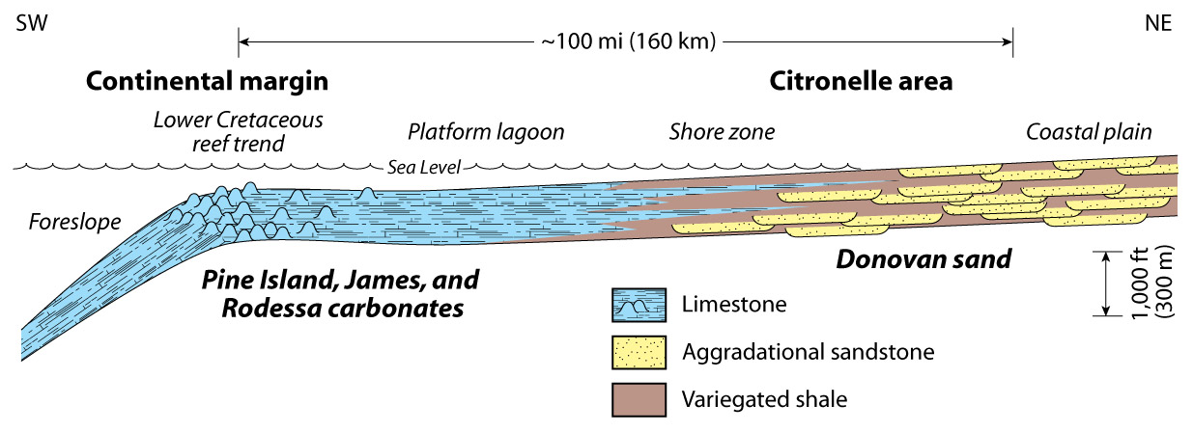
Cretaceous Facies
NETL EOR TEST
SECARB ANTHROPOGENIC TEST
SOSRA REGION
Pashin et al. (2014)
Notes:
Diverse sandstone and carbonate facies in Cretaceous, including reef-rimmed continental margin. Cretaceous facies in the region are dominated by sliliciclastic coastal plain deposits that pass basinward into reef-rimmed carbonate platform deposits. Siliciclastic strata include formations that have been tested for CO2 storage potential onshore, whereas the storage potential of carbonate formations is less certain.
Previous work on the Cretaceous strata has largely been on-shore.
Preliminary offshore capacity estimates (Hills and Pashin, 2010):
min volume >8.9 x 10^10 mt;
min capacity of 3.3 x 10^6 mt/mi2
References:
Pashin, J.C., McIntyre-Redden, M.R., Jin, G., and Mann, S.D., 2014, Site Characterization for CO2 Storage from Coal-fired Power Facilities in the Black Warrior Basin, Alabama, Geological Survey of Alabama Open File Report 1401, 154 p.
Hills, D. J.,. and Pashin, J. C., 2010, Preliminary assessment of offshore transport and storage of CO2: Southeastern Regional Carbon Sequestration Partnership Final Report, prepared for Southern States Energy Board, 11 p.

Slide 12
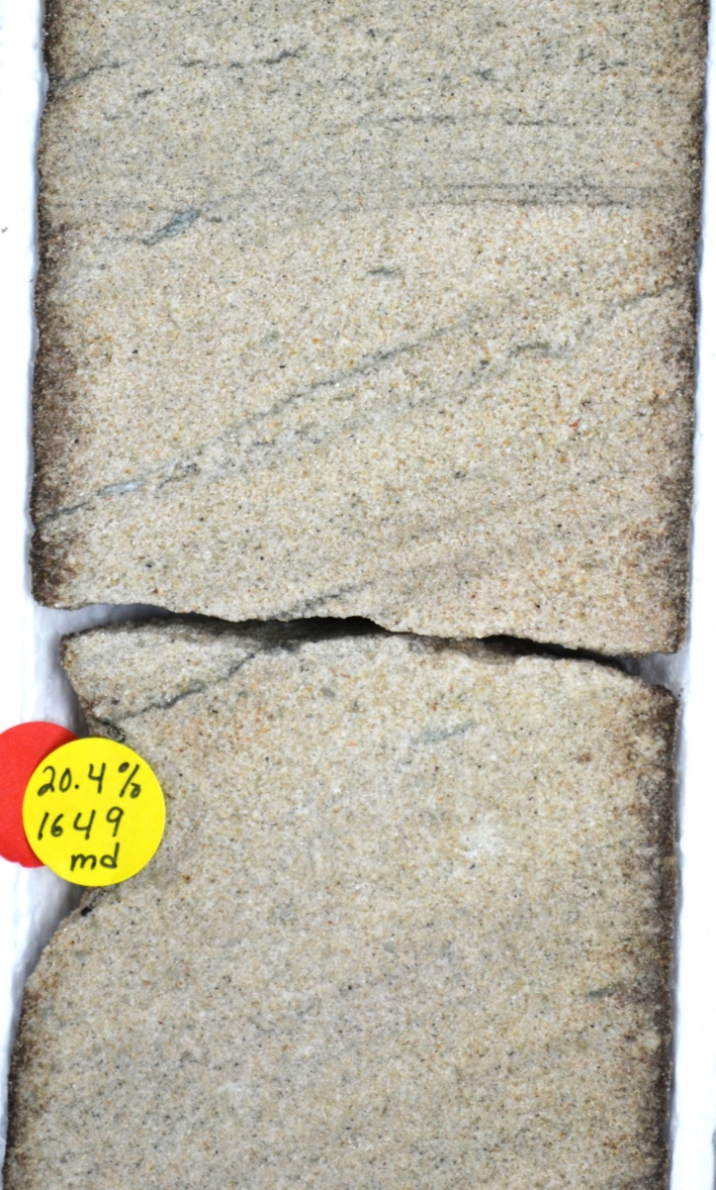
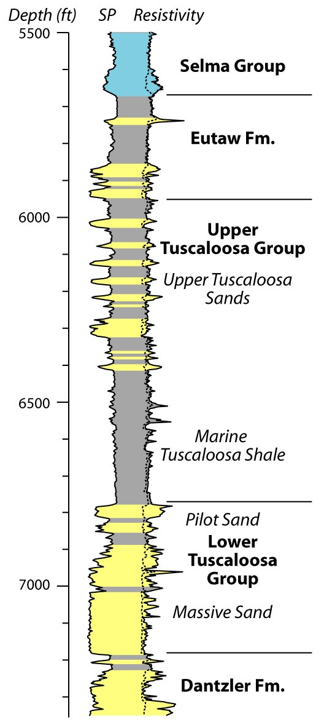
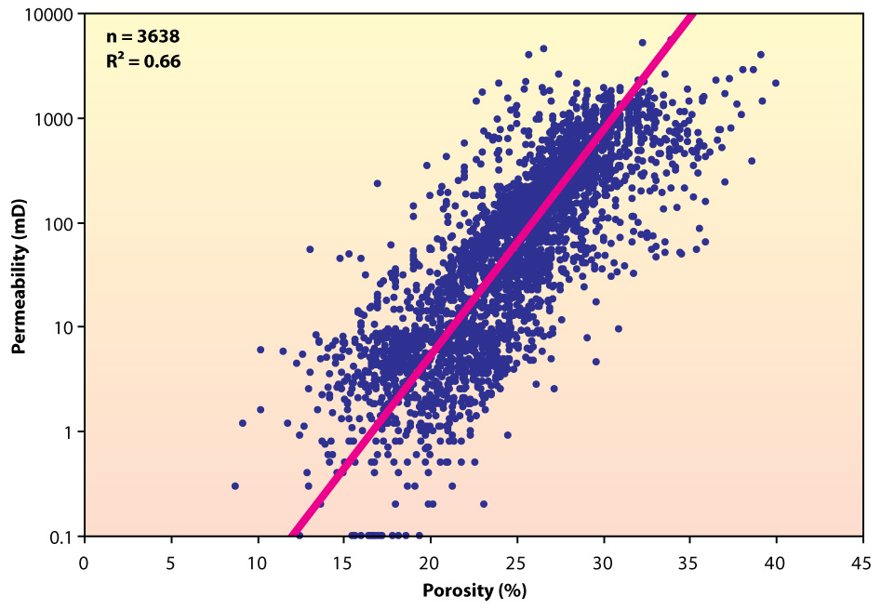
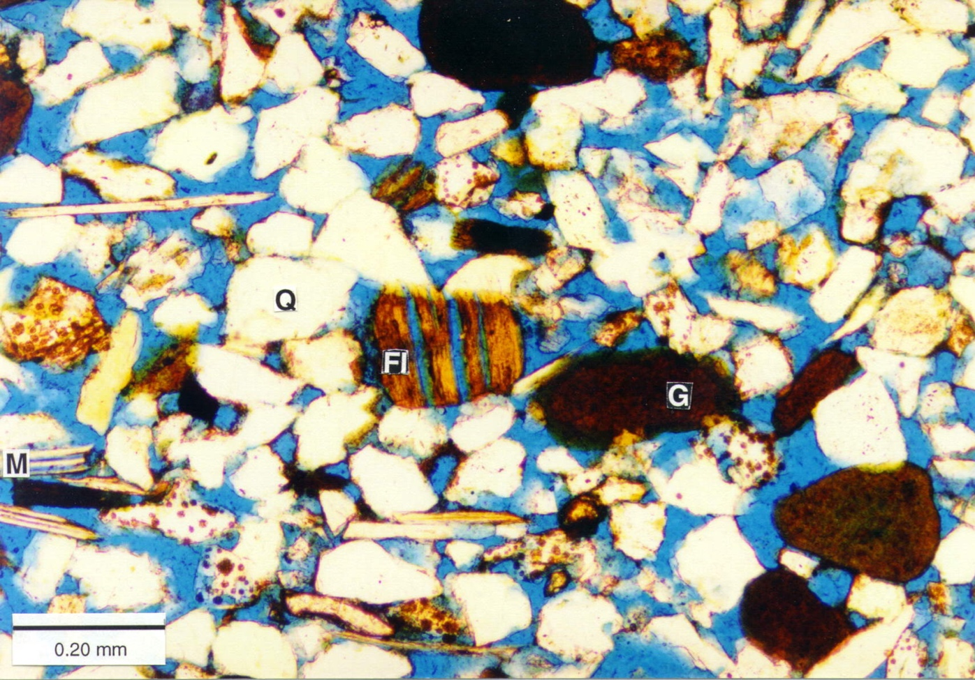
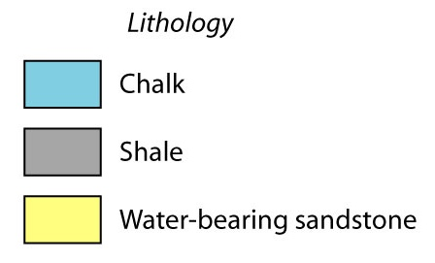
Cretaceous Sandstone
Notes:
Cretaceous Gulf Coast sands are trés bien. Lots of stuff like this in Cretaceous-Tertiary section in offshore EGOM.
Onshore, much of the sequestration potential has been identified in the Upper and Lower Tuscaloosa Group.
Upper right figure (fig. 3 Pashin et al 2008): Cross-plot of porosity and permeability data from core analyses of sandstone from the Paluxy Formation through the Eutaw Formation in southwestern Alabama.
Consistent mean porosity values above 23.3 % have been observed in all the analyzed stratigraphic units
Reference:
Pashin, J.C., McIntyre, M.R., Grace, R.M. and Hills, D.J., 2008, Southeastern Regional Carbon Sequestration Partnership (SECARB) Phase III Final Report, prepared for Advanced Resources International,

Slide 13
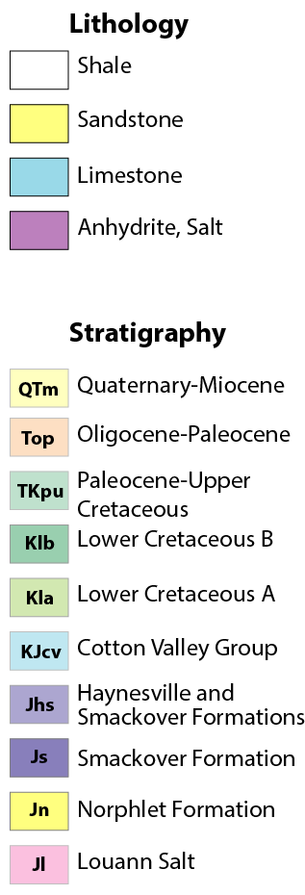
DeSoto Canyon Salt Basin - Lithologic Columns
Seal
Sink
Scale in feet
Notes:
Lithologic logs showing rock types and major mappable stratigraphic units in the DeSoto Canyon Salt Basin
Cretaceous sandstone targets would most likely be found in the Lower Cretaceous B and A and more commonly in the the Cotton Valley Group. Challenge with the CV Group is that generally they will be too deep (anything greater than 12,000 ft is over geo-pressure and would thus be impractical).
Multiple seals are present above these strata (Ferry Lake Anhydrite, the Marine Tuscaloosa Shale) Seismic profile showing the structural style of the northwestern DeSoto Canyon Salt Basin
DD160 – Hosston-Sligo sands (Kla); Paluxy sands (Klb) Sealed by overlying chalk and shale
VK 117 and MO 991 – lower Tuscaloosa sandstone (top Klb). Some Dantzler sand (upper Washita Group) may also be present. Seal is marine Tuscaloosa Shale - well developed and imaged seismically as a major downlap surface.

Slide 14
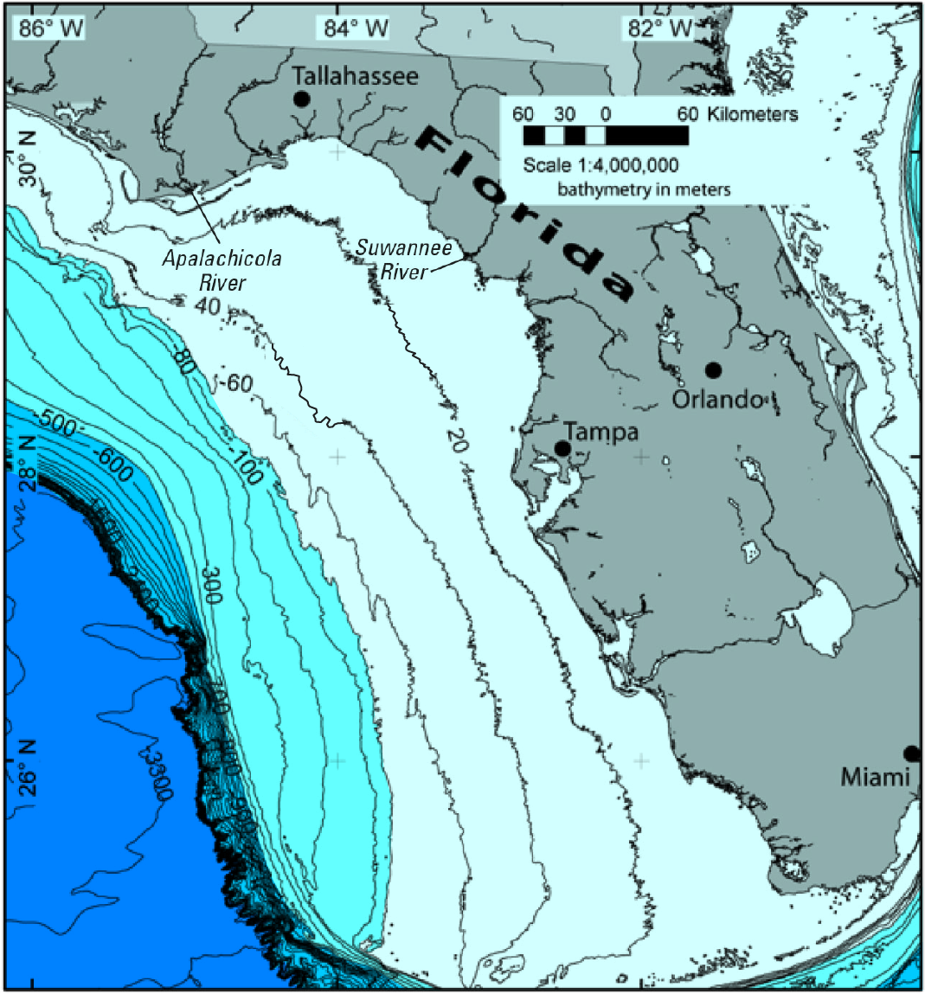
West Florida Shelf Bathymetry
Broad, shallow, region near shore (NE of 80 m contour).
Distally steepening outer shelf leading to West Florida Escarpment.
Distally
Shallow Shelf
West
Steepened
Florida
Shelf
Continental
Rise
Escarpment
Notes:
Bathymetric map of the West Florida Shelf (source: USGS). Note progressive steepening of the continental slope, culminating in the West Florida Escarpment.
Broad, shallow, region near shore (NE of 80 m contour).
Distally steepening outer shelf leading to West Florida Escarpment

Slide 15
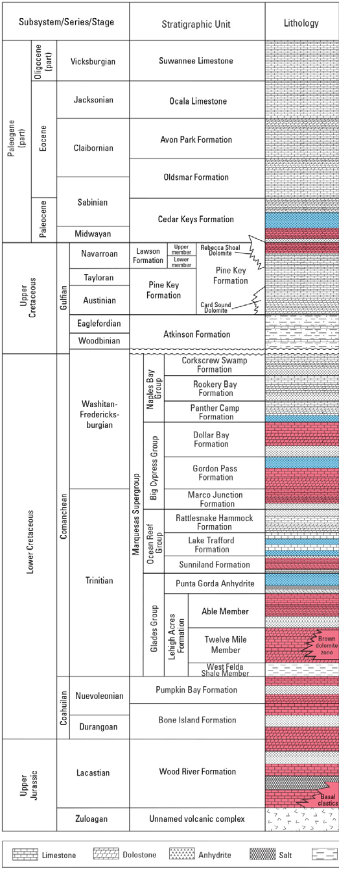
Florida – Lithologic Column
Seal
Sink
Roberts-Ashby et al. (2015)
Notes:
Stratigraphic column of the onshore South Florida Basin showing predominance of carbonate formations. Prospective CO2 sinks in red, evaporite seals in blue.
Stratigraphic column for the South Florida Basin study area. Storage assessment units consist of a reservoir (red) and regional seal (blue). Modified from Braunstein and others (1988), Pollastro and others (2001), and Faulkner and Applegate (1986).
Of particular interest (shallowest to deepest)
Cedar Keys/Lawson Fm SAU (seal middle Cedar Keys Fm, reservoir upper member of Lawson Fm and lower Cedar Keys Fm)
Dollar Bay Fm SAU (seal Panther Camp Formation; reservoir Dollar Bay Fm)
Gordon Pass/Marco Funciton Fm SAU (seal upper Gordo Pass Fm; reservoir Marco Junction and Gordon Pass Fm)
Sunniland Fm SAU (seal Lake Rafford Fm, reservoir Sunniland Fm)
Pre-Punta Gorda units SAU (seal Punta Forda Anhydrite, reservoir Wood River, Bone Island, Pumpkin Bay, and Lehigh Acres
Reference:
Roberts-Ashby, T.L., Brennan, S.T., Buursink, M.L., Covault, J.A., Craddock, W.H., Drake, R.M., II, Merrill, M.D., Slucher, E.R., Warwick, P.D., Blondes, M.S., Gosai, M.A., Freeman, P.A., Cahan, S.M., DeVera, C.A., and Lohr, C.D., 2014, Geologic framework for the national assessment of carbon dioxide storage resources—U.S. Gulf Coast, chap. H of Warwick, P.D., and Corum, M.D., eds., Geologic framework for the national assessment of carbon dioxide storage resources: U.S. Geological Survey Open-File Report 2012–1024–H, 77 p., http://dx.doi.org/10.3133/ofr20121024h.
or
Roberts-Ashby, T.L., Brennan, S.T., Merrill, M.D., Blondes, M.S., Freeman, P.A., Cahan, S.M., DeVera, C.A., and Lohr, C.D., 2015, Geologic framework for the national assessment of carbon dioxide storage resources—South Florida Basin, chap. L of Warwick, P.D., and Corum, M.D., eds., Geologic framework for the national assessment of carbon dioxide storage resources: U.S. Geological Survey Open-File Report 2012–1024–L, 22 p.,
http://dx.doi.org/10.3133/ofr20121024L.
Hydrogeological Units of Florida, compiled by SEGS Ad Hoc Committee, 1986, 8 p., 1 table

Slide 16
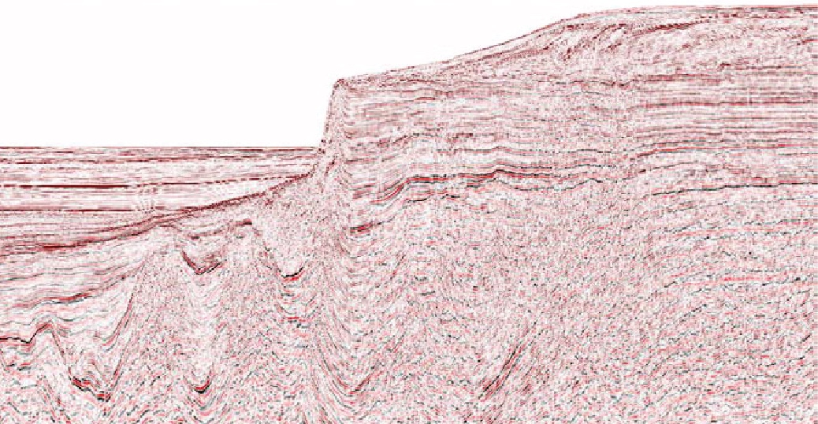
West Florida Shelf-Escarpment
Basin
Escarpment
Shelf
SL
QT
K
K
3 km
QT
J
J
6 km
K
J
Basement
9 km
J
VE ~4x
Roberts and Erickson (2009)
Notes:
Pre-stack, depth converted seismic profile showing geologic architecture along a transect from the West Florida Shelf to the continental rise (after Roberts and Erickson, 2009). Note major carbonate platform bounded by Cretaceous reef trend and overlain by prograded shelf. Structures southwest of platform include apparent Mesozoic minibasins below subhorizontal Cenozoic strata of the continental rise.
Thick Jurassic/Cretaceous section in the deepwater outboard of the escarpment showing all the plays associated with an autochthonous salt basin.
(Also evidence for an extension of the Norphlet SS along foot of escarpment)
Reference:
Roberts, G., and Erickson, J., The Norphlet Sandstone and other petroleum plays along and outboard of the Florida Escarpment, eastern Gulf of Mexico, Spectrum Geo Technical Paper Ref. 20563, 6 p. Available at: http://www.spectrumgeo.com/wp-content/uploads/GR_GoM_Technical_Poster_Full_Abstract1.pdf
[note, this was also presented at AAPG, and the abstract can be found here: http://www.searchanddiscovery.com/abstracts/html/2009/annual/abstracts/roberts.htm }

Slide 17
Observations and Further Questions
Large portfolio of potential sinks and seals in eastern Gulf of Mexico region.
Complex structural chronology, stratigraphic architecture in DeSoto Canyon Salt Basin.
Relatively simple Cretaceous carbonate platform and distally steepened Cenozoic shelf in West Florida.
Geopressure >12,000 ft; main storage prospects in Cretaceous-Miocene section.
Seismic and well data currently being compiled and analyzed to address questions:
Is sufficient porosity, permeability available in carbonate units to support commercial offshore storage?
Are robust reservoir seals developed above Miocene sand units?
Notes:
High-quality public 2D seismic data available.
Geophysical log coverage spotty above Jurassic.

