Slide 1
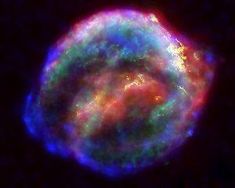
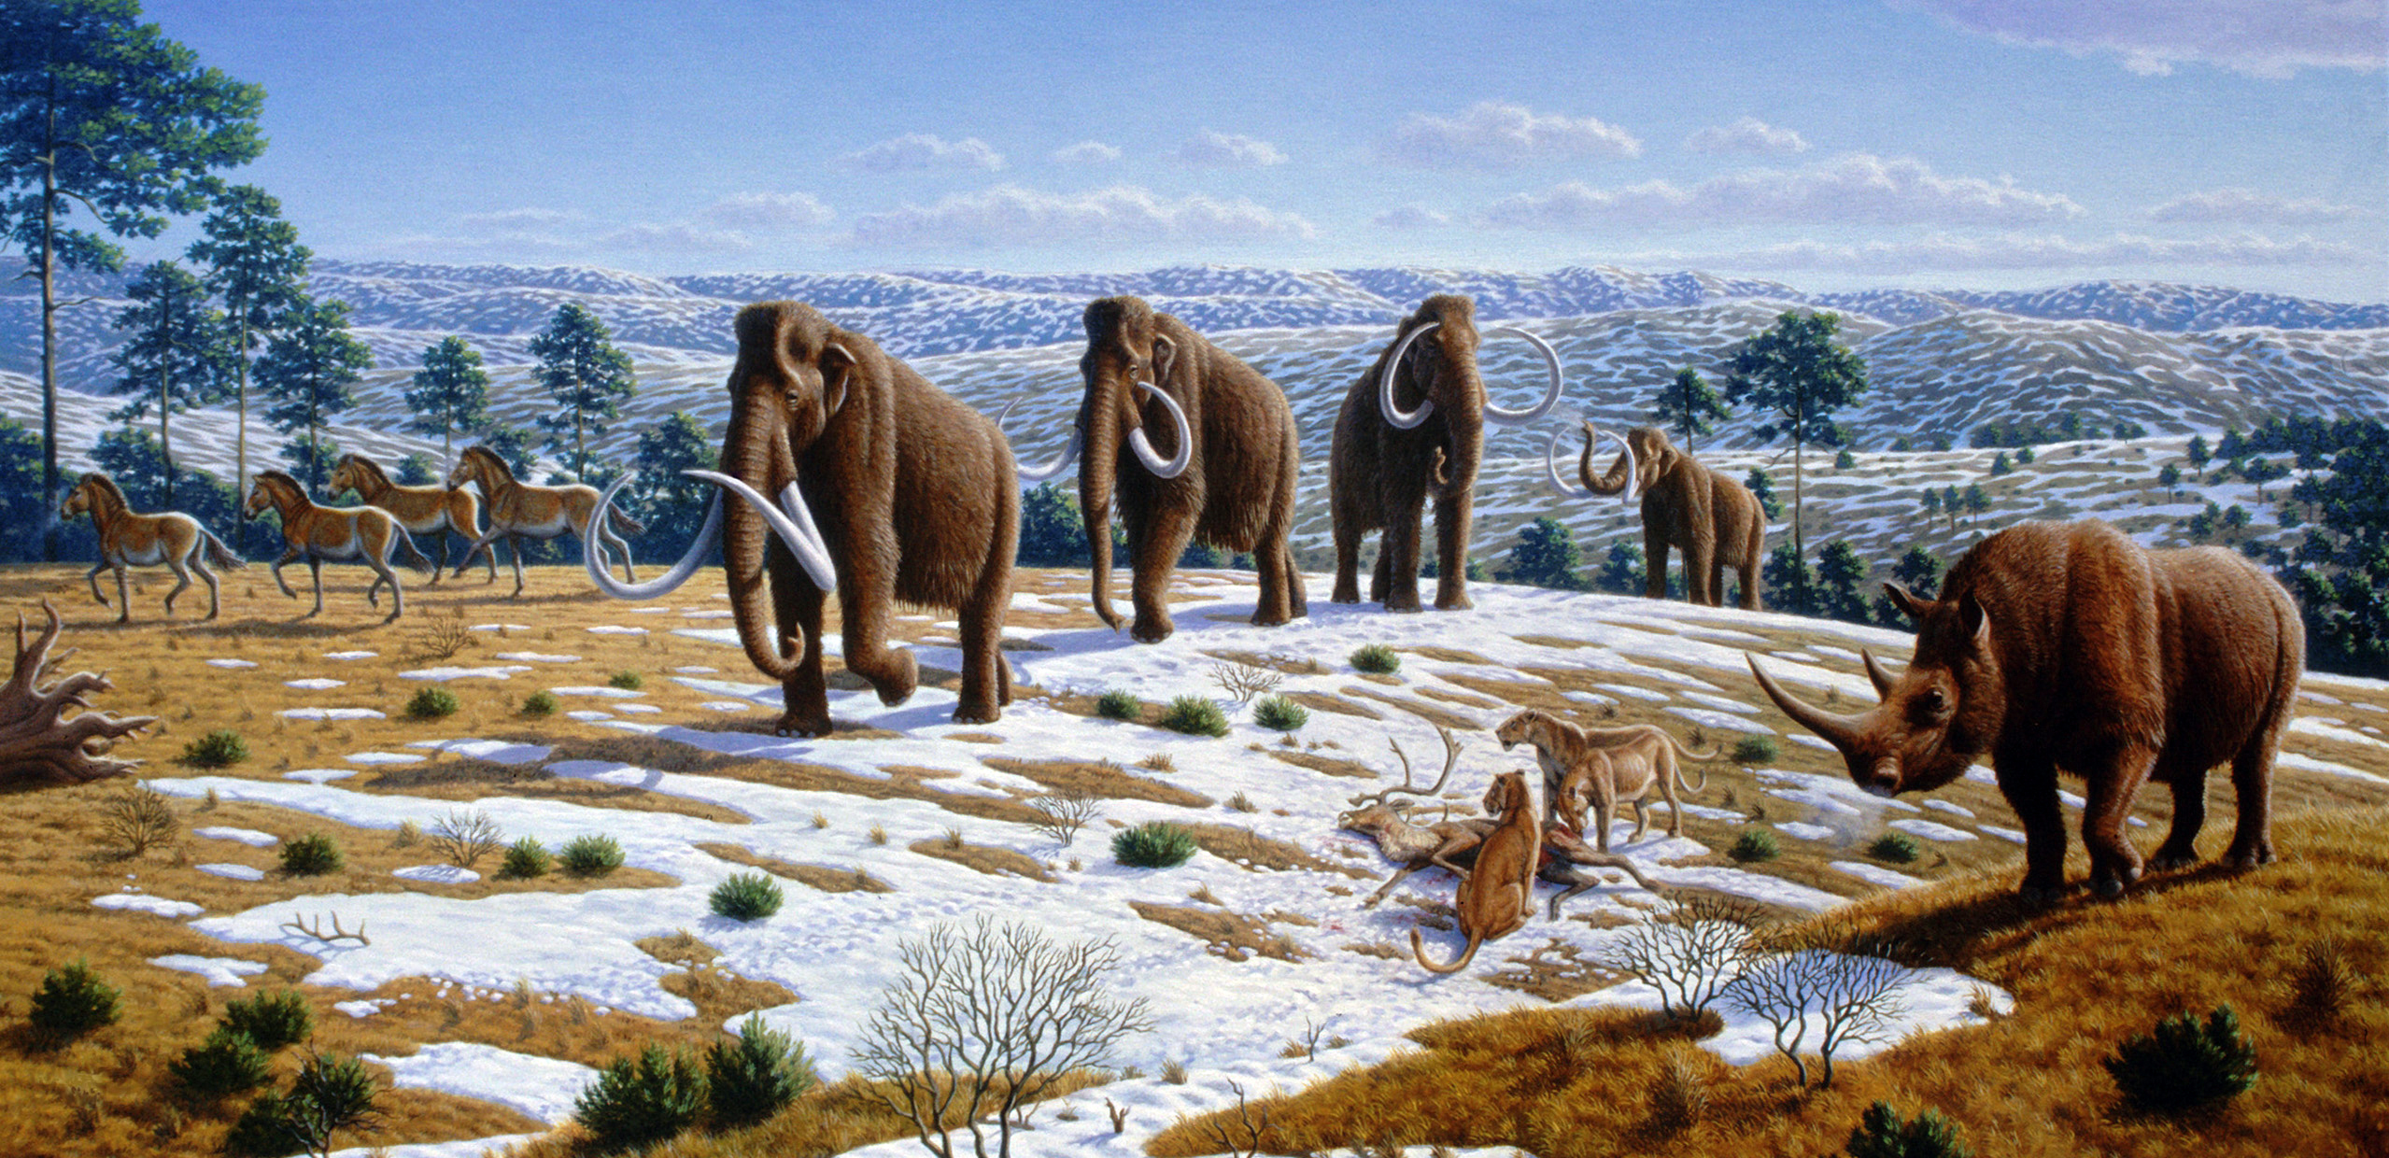


Terrestrial Effects of
Nearby Supernovae in the Early Pleistocene
Brian C. Thomas
Dept. of Physics and Astronomy
Washburn University
Collaborators
Adrian Melott (University of Kansas)
Andrew Overholt (MidAmerica Nazarene)
Michael Kachelrieß (Institutt for fysikk, NTNU, Trondheim, Norway)
Dimitry Semikov (Observatoire de Paris and Moscow Engineering Physics Institute)

Slide 2
Please Note:
This file is best viewed using the presentation view, since there are animations which obscure part of the text if viewed as a static slide.
Thanks for your interest in this work!

Slide 3
Supernova: Explosion of a High Mass Star
These explosions produce:
  Visible light
  High energy light: gamma-rays, X-rays, UV
    Photon emission lasts ~ months
  Ejecta blast wave
    Creates an expanding “remnant”
    Synthesizes heavy elements
    Including ⁶⁰Fe (half-life 2.6 Myr)
  Accelerated protons
    Cosmic rays
    Slow diffusion over thousands of years
~ few 10’s of ly
Every ~ 300 million years, occurs close enough (~ 30 ly) to cause serious damage to Earth.

Slide 4

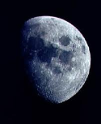
How can we detect a SN in Earth’s past?
Supernova ⁶⁰Fe flux arrives in upper atmosphere
  Atomic, molecular, fine grains
Go out and look for ⁶⁰Fe!
Mixes into atmosphere enters Earth’s Fe-cycle
SN ⁶⁰Fe (and stable Fe) oxidized
Forms nano-size oxide grains
Nano-oxides reach ocean
Rapidly dissolves and re-precipitates
Forms poorly crystalline ferric hydroxides (“rust”)
Settles into sediment
Ocean
Sediment
See also Fry, Fields & Ellis, “Radioactive Iron Rain”, Astrophys. J., 827, 48, 2016
Slide courtesy of Shawn Bishop (Tech. Univ. Munich)

Slide 5
Relevant time scales
Time for SN blast wave to reach Earth
  ~ 600 kyr
Time for blast wave to pass by (duration of depostion)
  ~ 100 kyr
Time for top-of-atmosphere to surface transport
  ~ 4-6 years
Residence time in ocean
  ~ 100 years (but, depends on Fe abundance; as short as days-months)
From Fry, Fields & Ellis, “Radioactive Iron Rain”, Astrophys. J., 827, 48, 2016

Slide 6
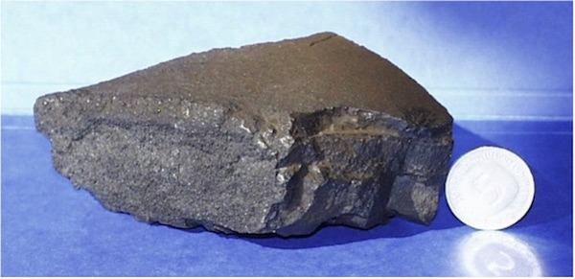
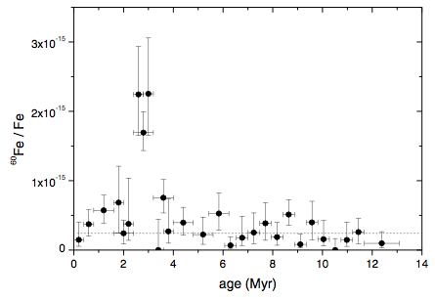
Supernova signal –
Multiple ⁶⁰Fe detections
Red stars: 1999, 2004 detections. Circles: Wallner et al. (2016, Nature).
Includes several different deep-sea archives, encompassing multiple sediment cores, along with iron-manganese crusts and iron-manganese nodules.
Knie et al. 2004
Wallner et al. 2016

Slide 7
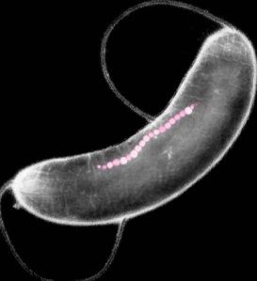
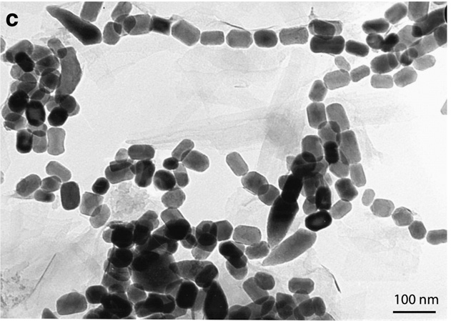
Supernova signal –
Multiple ⁶⁰Fe detections
Plus in 2016, detection in lunar crust samples (Fimani et al.), and direct detection in space (Binns et al.),
and in magnetotactic bacteria microfossils (Ludwig et al.)
Ludwig et al. 2016

Slide 8
Supernovae, “nearby”
Multiple signals showing one or several supernovae around 2.5 Ma
  Less clearly around 8 Ma
How far?
  Models of ⁶⁰Fe production, and reconstructions of stellar positions in the past indicate 150-300 light years away.
    Breitschwerdt et al., Nature, 532, 73, 2016

Slide 9
Is there a connection?
Are supernovae at 150-300 light years responsible for climate change and mass extinction around Pliocene-Pleistocene boundary?
We take:
  1) Observations of SN of same type expected to have made ⁶⁰Fe
  2) Models of how cosmic rays travel from explosion sites to Earth.
Investigate possible terrestrial effects.

Slide 10
Results:
Too little energy in light (gamma, x, uv) to have significant effect.
  Possibly some small effect from “light pollution.”
Cosmic ray flux is greatly increased for a few thousand years.
Two main effects, lasting ~ few thousand years:
  Triple normal radiation dose at the ground and under few 100 meters of water and rock, by muons
    “Everybody gets a CT scan each year.” Cancer, mutation rate up
  Greatly increased atmospheric ionization at low altitudes

Slide 11
Climate changes?
The effects of tropospheric ionization increases are not well-understood
  Speculation that ionization may be related to cloud formation.
  Likely to increase cloud-to-ground lightning due to higher electrical conductivity.
    Spark more grassland/woodland fires?
    Climate change?

Slide 12
Some interesting clues…
⁶⁰Fe signatures for SN(e) around 2.5 Ma and 8 Ma.
And, evidence of increased fires ~ same periods
Wallner et al. 2016
Bond 2015

Slide 13
Current and Future Work
Add to existing modeling
  Updated estimates for distance recently published
    We examined ~ 300 light year distance, may be more like 150 light years
  Cosmic ray propagation is non-trivial, currently waiting on numerical modeling for this case.
Investigate possible effect of greatly increased low-altitude ionization
  ionization-lightning-fires-climate connection?

Slide 14
Resources and Acknowledgements
Recent work by us:
  “Supernovae in the Neighbourhood”, A. L. Melott, Nature 532, 40-41, 2016.
  “Terrestrial Effects of Nearby Supernovae in the Early Pleistocene” B.C. Thomas, E. E. Engler, M. Kachelrieß, A. L. Melott, A. C. Overholt, and D.V. Semikoz, Astrophysical Journal Letters, 826, L3, 2016
These and other papers available at arXiv.org
  Or, email me: brian.thomas@washburn.edu
Thanks again to collaborators
Current work supported by NASA Exobiology grant No. NNX14AK22G

Slide 15
References
Bond, W.J. 2015, Front. Plant Sci., 5, 749
Binns, W. R. et al. 2016, Science 352, 677
Breitschwerdt et al., Nature, 532, 73, 2016
Fimiani, L. et al. 2016, Phys. Rev. Lett. 116
Fry, B.J. et al. 2015, Astrophysical J. 800, 71
Fry, B.J. et al. 2016, Astrophysical J. 827, 48
Knie, K. et al. 1999, Phys. Rev. Lett. 83, 18
Knie, K. et al. 2004, Phys. Rev. Lett. 93, 171103
Ludwig, P., et al. 2016, PNAS 113, 9232
Melott, A.L. 2016, Nature, 523, 40
Wallner, A. et al. 2016, Nature 532, 69
Thomas, B.C. et al. 2016, Astrophysical J. Lett. 826, L3

