Slide 1
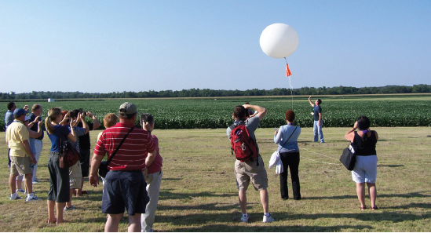
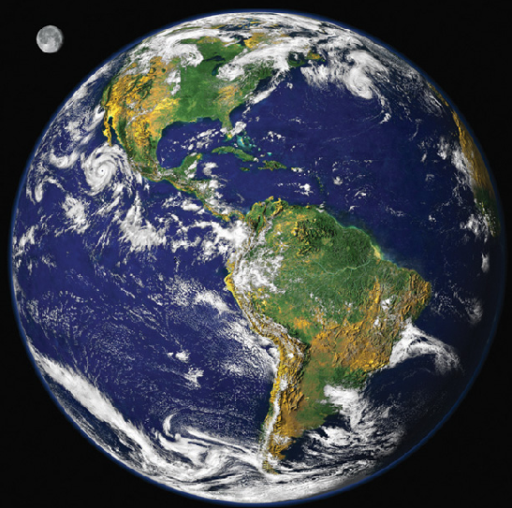
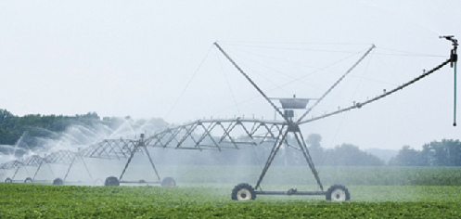
Creating an Environmentally Literate Public through the
AMS DataStreme Project
Dr. James Brey Wendy Abshire
Senior Science Consultant Director, Education Program
American Meteorological Society American Meteorological Society

Slide 2
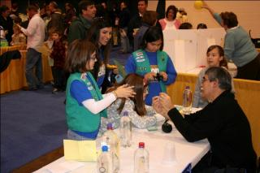
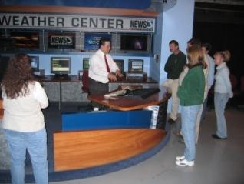
Our Mission
Foster scientific literacy in Earth system science for all

Slide 3

The DataStreme Project
Distance-learning semester-length courses for K-12 teachers
Scientific inquiry utilizing near real-time geoscience data
Local Implementation Teams (LITs) provide mentoring by scientists and practitioners
Free course materials (textbook, investigations manual, and website)
Three free graduate credits in Earth science from SUNY Brockport, upon completion of course and Plan of Action for peer-training
Teachers serve as resource agents in their schools, districts and communities
Supported by:

Slide 4
The DataStreme Project
AMS develops
materials
LITs mentor teachers
Teachers share
information

Slide 5


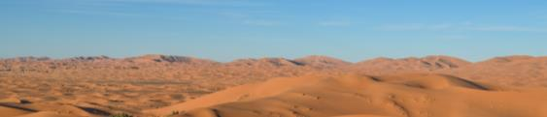
The DataStreme Project
Atmosphere
Ocean
Focuses on the study of the atmospheric environment through the use of near real-time weather data and other learning materials
Explores the ocean in the Earth system with special emphasis on flows of energy and water, and interactions between the ocean and other components of the Earth system
Earth’s Climate System
Systematic study of climate, climate variability, climate change and the human interaction with Earth’s climate

Slide 6
The DataStreme Project
More than 20,000 Teachers Directly Trained
Over 100,000
Teachers Peer Trained
Millions of Students Benefit!

Slide 7

A Framework for K-12 Science Education & NGSS
Basis of NGSS
Consists of 3 dimensions:
Dimension 1: Scientific & Engineering Principles
Dimension 2: Crosscutting Concepts that have common application across fields
Dimension 3: Core Ideas in 4 Disciplinary Areas
Physical Sciences
Life Sciences
Earth & Space Sciences
Engineering, Technology, & Applications of Science

Slide 8
How is DataStreme closely aligned?
Dimension 1: Scientific & Engineering Principles
DataStreme courses enable teachers to investigate scientific concepts as scientists do
Using models to understand concepts
Using real-world data to draw conclusions

Slide 9
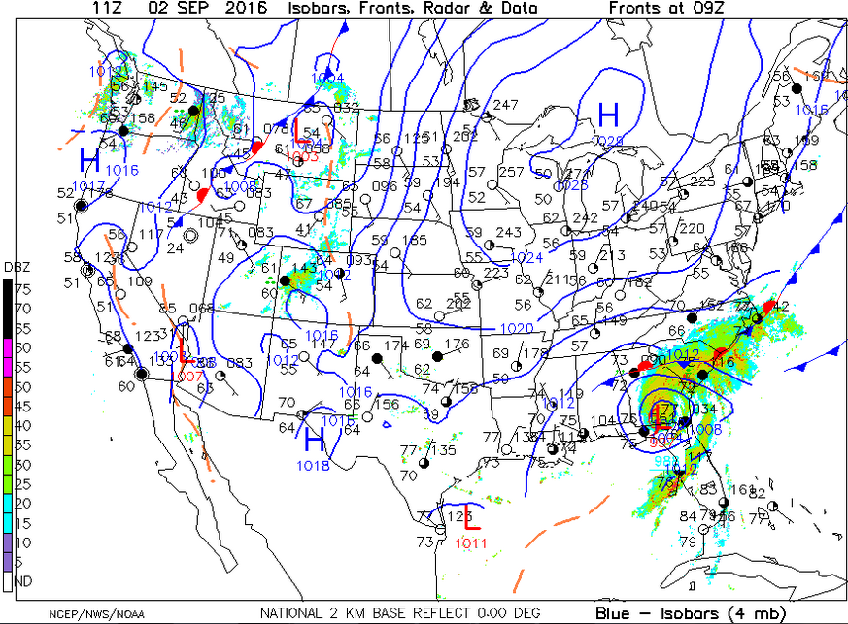
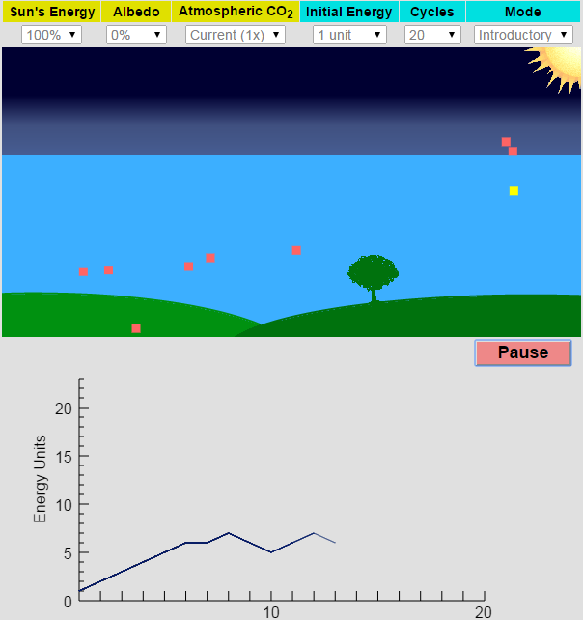
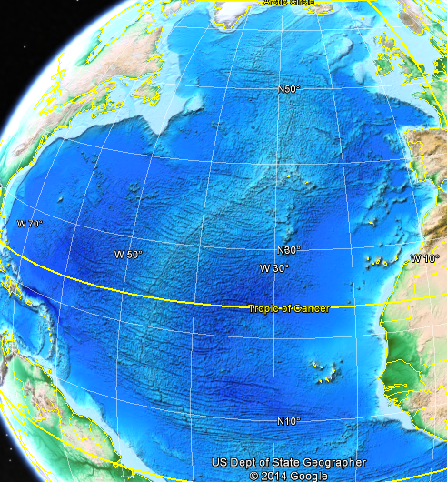
Using models to understand concepts
Customized weather maps from NCEP
AMS Conceptual Climate Energy Model
Google Earth investigation of plate tectonics

Slide 10
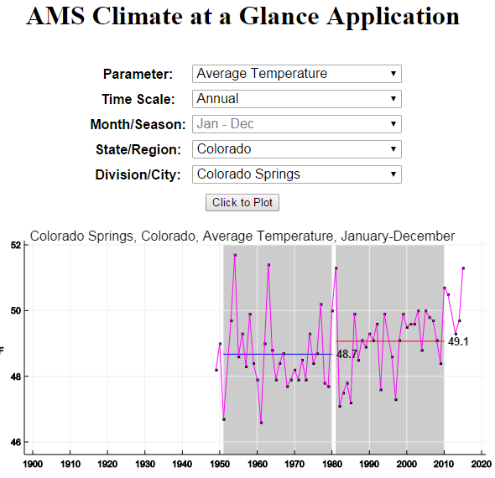
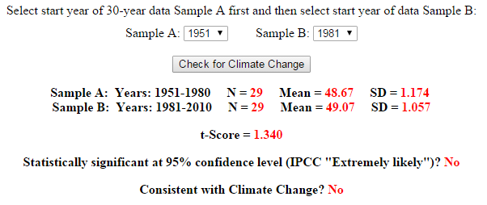
Brand new from AMS!

Slide 11
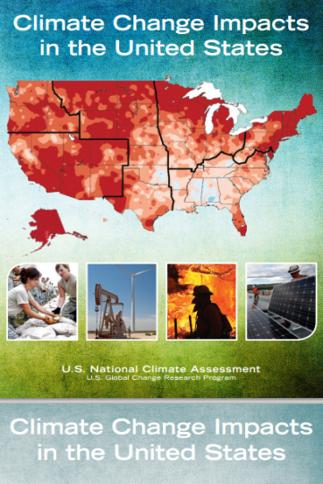
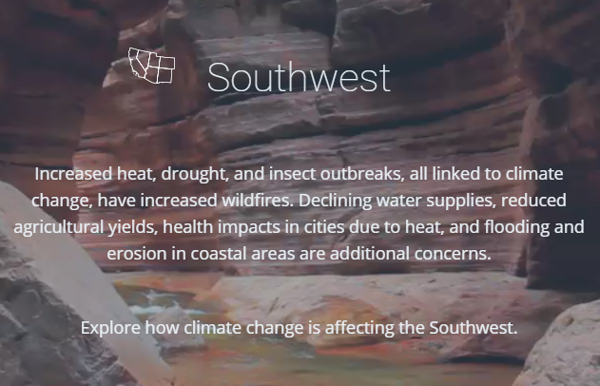
Using real-world data

Slide 12
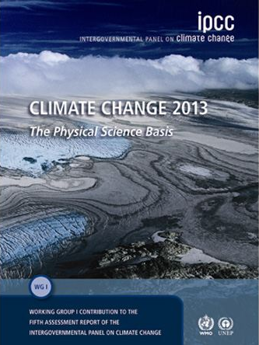
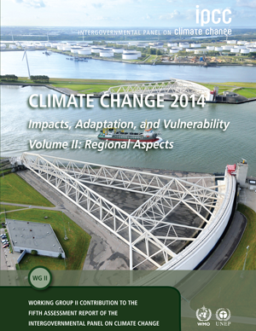
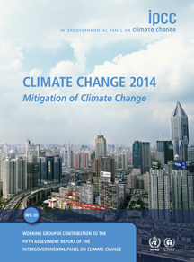
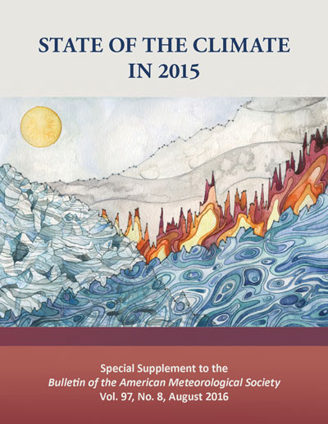
Using real-world data
IPCC, U.S. National Academies, NASA, NOAA, the most recent AMS/NOAA State of the Climate reports, the AMS Information Statement on Climate Change…

Slide 13
How is DataStreme closely aligned?
Dimension 2: Crosscutting Concepts that have common application across fields
Participants learn about the interconnectedness of Earth’s atmosphere, ocean and climate AND their impact on these systems.
NGSS and DataStreme stress the integration of content and application.
AMS believes that highly trained teachers are key to an environmental and geoscience literate public.
Cornerstone of
DataStreme

Slide 14
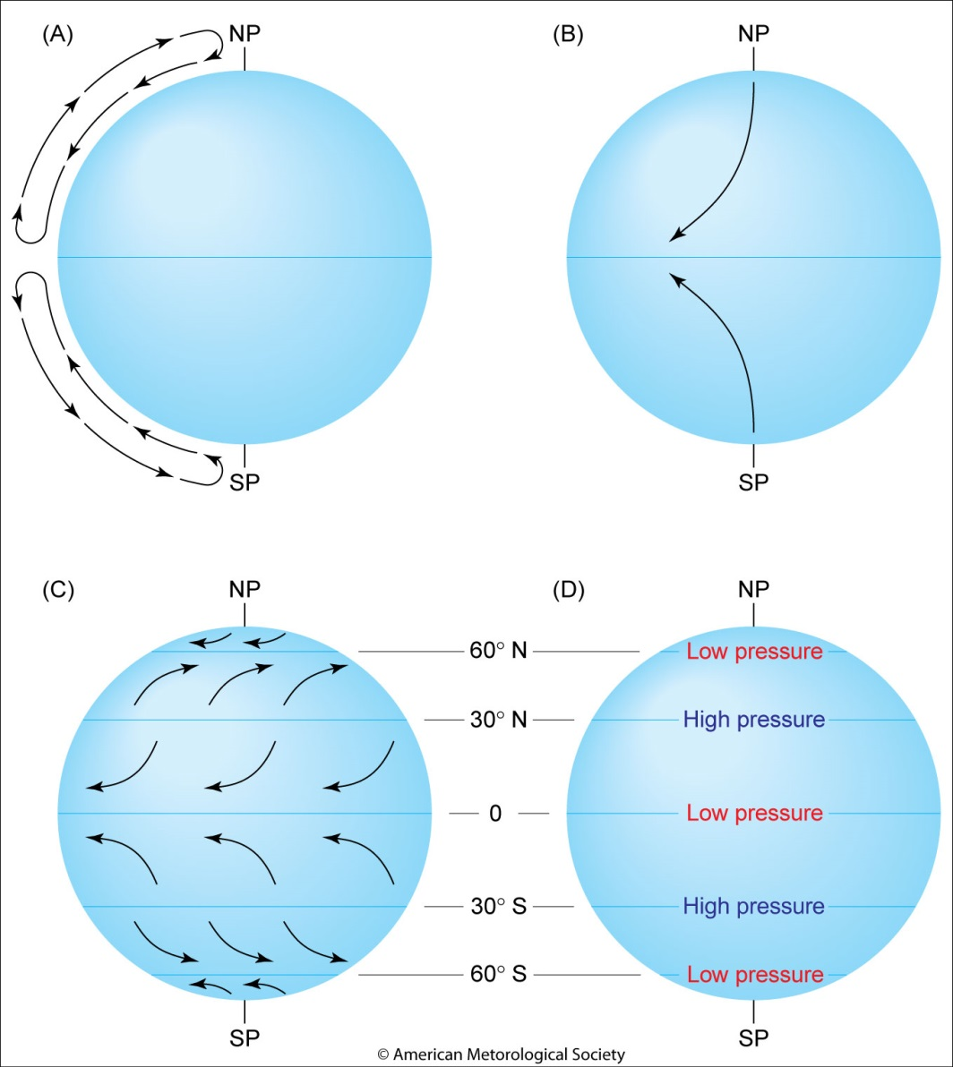
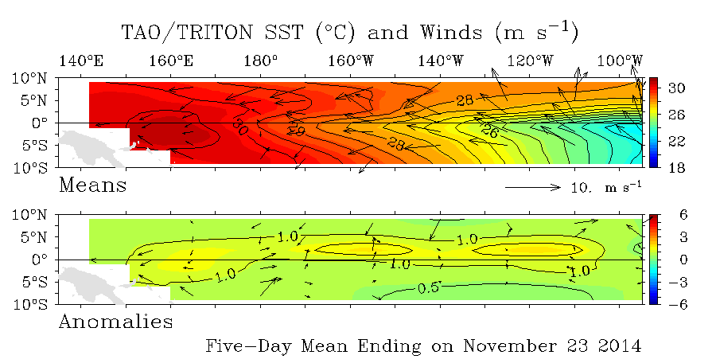
Using an Earth system-based approach
Examination of El Niño/La Niña
Causes of Earth’s planetary-scale atmospheric circulation

Slide 15
How is DataStreme closely aligned?
Dimension 3: Core Ideas in 4 Disciplinary areas
Physical Sciences
Life Sciences
Earth & Space Sciences
Engineering, Technology, & Applications of Science

Slide 16
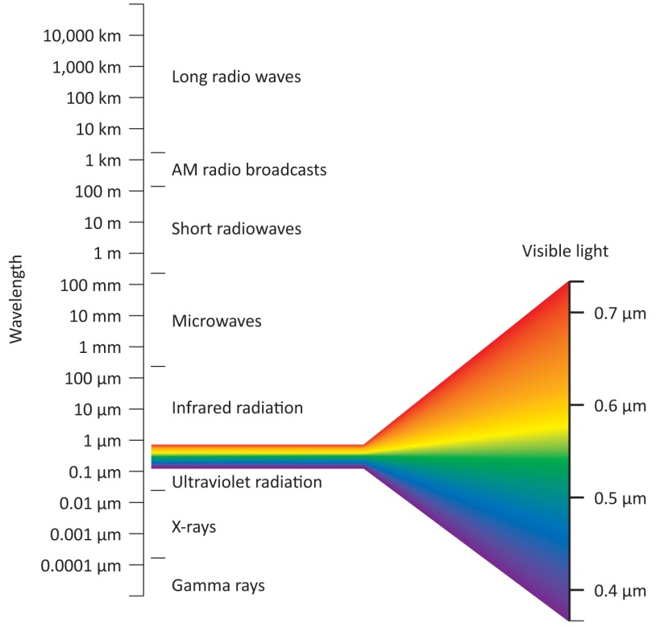
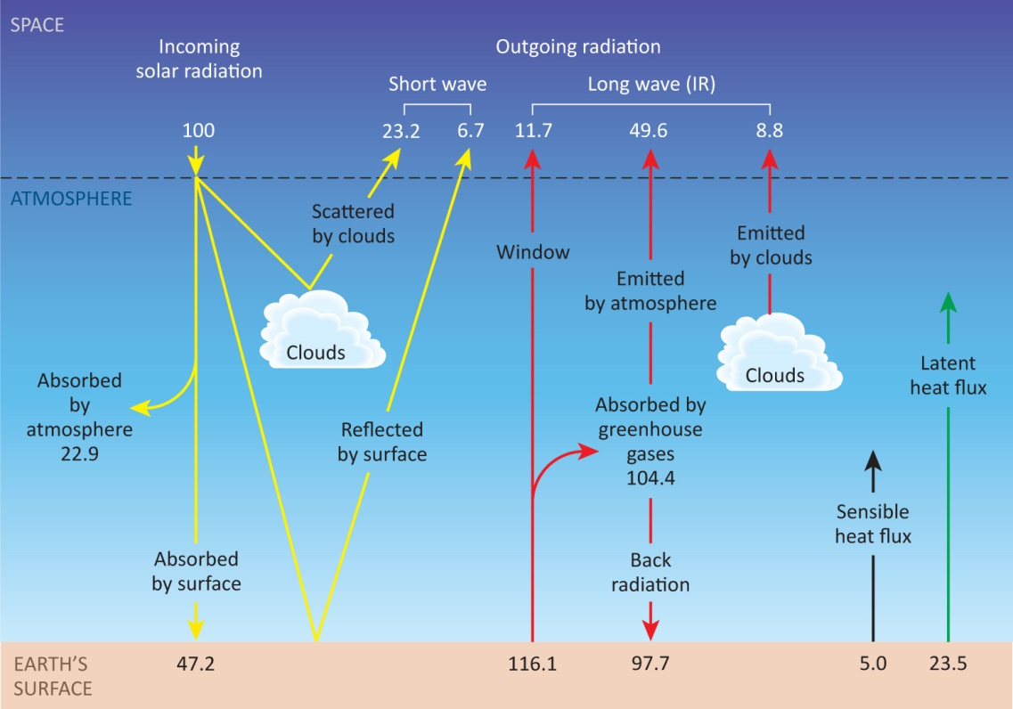
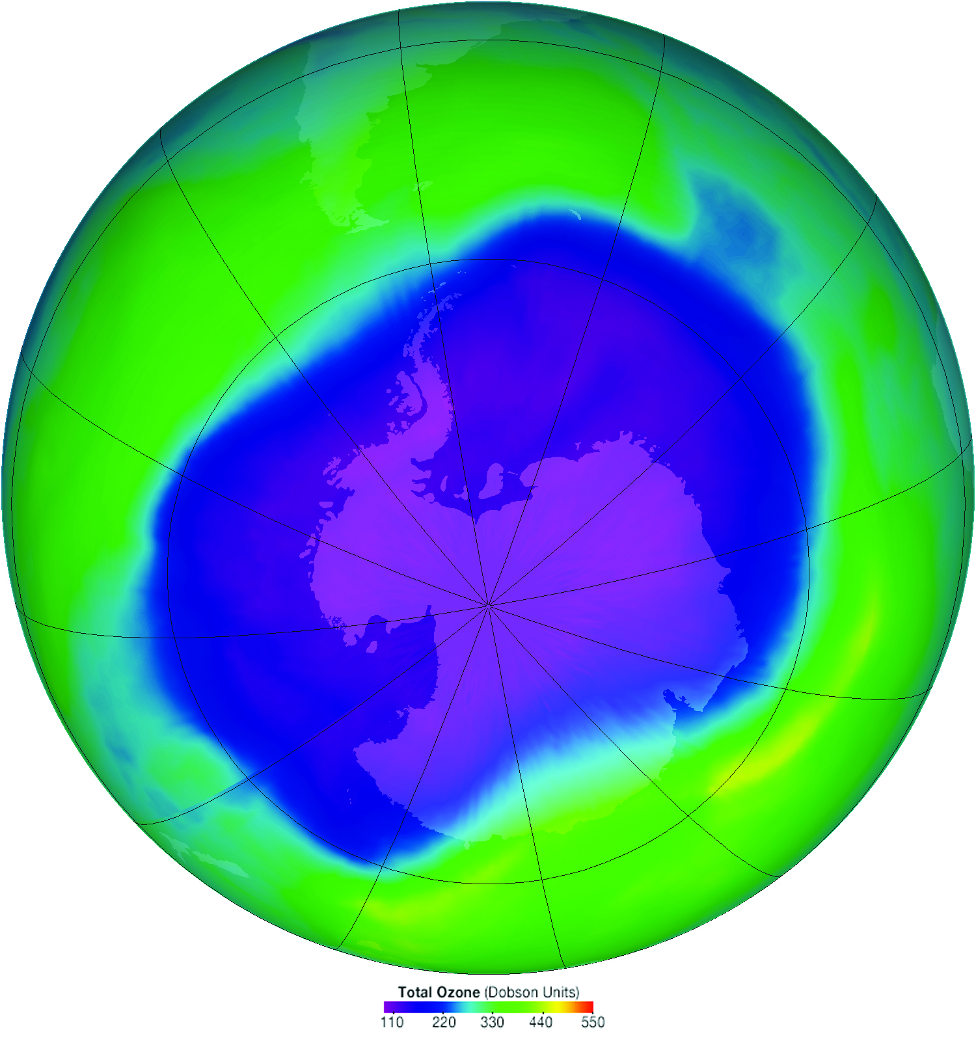
Physical Sciences
Electromagnetic radiation -> planetary energy budget -> stratospheric ozone shield -> global radiative equilibrium and climate change
Progressive
learning!

Slide 17
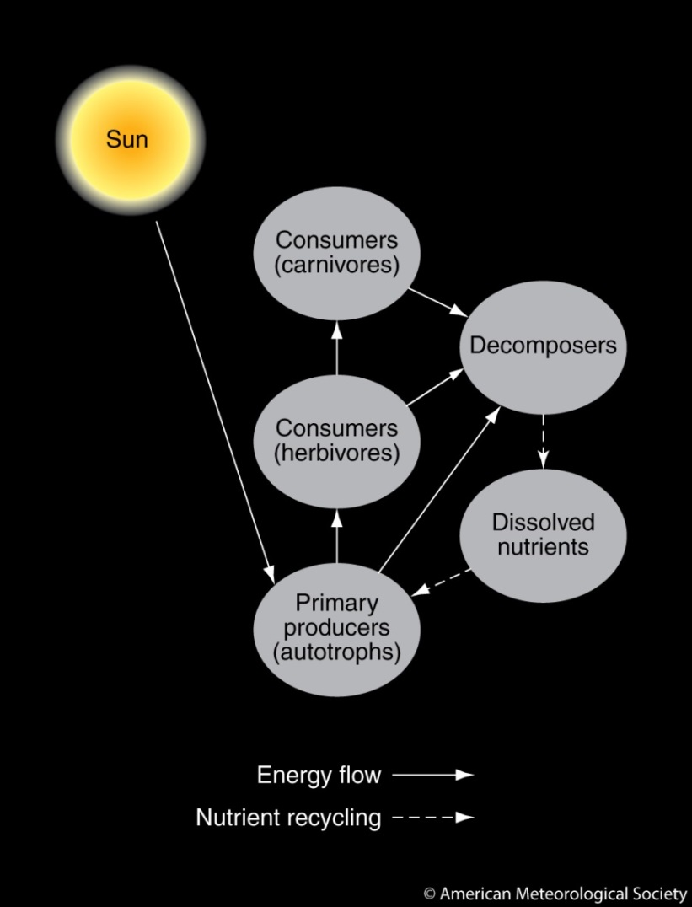
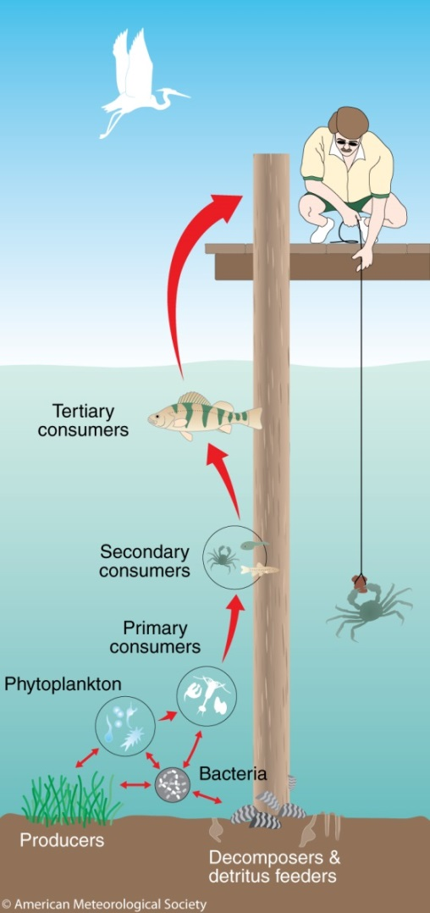
Life Sciences
Growth and development of marine organisms
Energy transfer within ecosystems

Slide 18
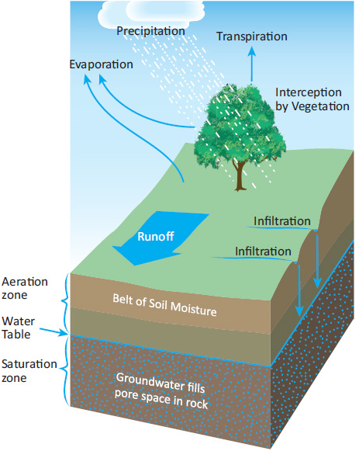
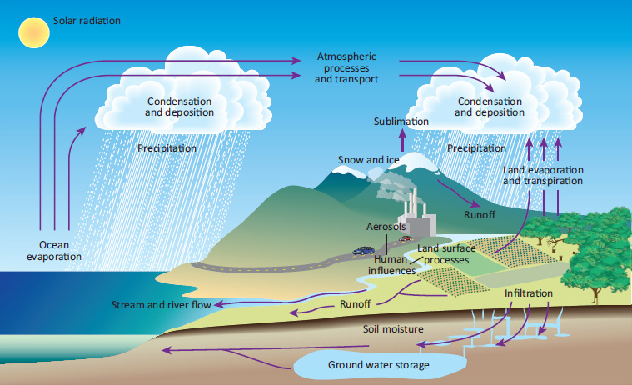
Earth & Space Sciences
Global water cycle and how it links the principal components of the Earth system

Slide 19
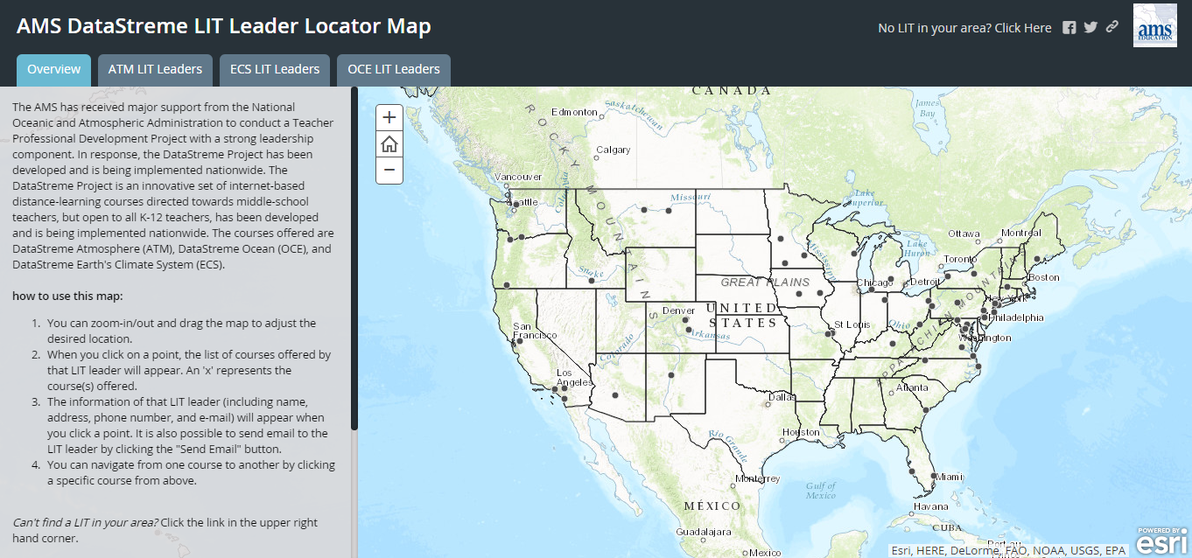
To Locate Your Nearest LIT
Visit www.ametsoc.org/amsedu
Click on your state or search the map.

Slide 20
Conclusions
Since 1996, more than 20,000 teachers have completed a DataStreme course, impacting thousands more teachers and millions of students.
The AMS believes that highly trained teachers are key to an environmental and geoscience literate public.
DataStreme courses are an excellent resource for teacher professional development.
Any opinions, findings, conclusions or recommendations expressed in this material are those of the author(s) and do not necessarily reflect the views of NOAA or the U.S. Department of Commerce.

Slide 21
@AMSeducation brey@ametsoc.org www.ametsoc.org/amsedu
?

