Slide 1
Policy and Communications on Resource Development in a Time of Public Uncertainty Stephen L. Wust, Ph.D. Chief Geologist New Mexico State Land Office

Slide 2
History of NM Trust Lands
1850: United States Congress passed the Organic Act, creating the Territory of New Mexico
Reserved sections 16 and 36 in every township to generate revenue for public schools, which was essential to settling the West
1910: The Enabling Act authorized the territory to organize for statehood and increased lands held in trust by granting sections 2 and 32 in every township
1912: Statehood

Slide 3
Land Ownership in NM (77,666,400 acres)
Private 43%
BLM 34%
Tribal 10%
Trust* 11%
State 2%
(Game and Fish, Department of Transportation, Energy and Minerals)
* 8.9 million acres of surface estate
13.3 million acres of mineral estate
The SLO owns land in every county of the state except Los Alamos

Slide 4
Role of the SLO
The Land Office seeks to optimize revenues while protecting the health of the land for future generations.

Slide 5









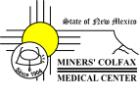



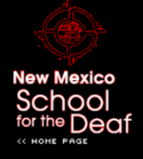

State Land Trust Beneficiaries
Public (Common) Schools
Carrie Tingley Hospital
New Mexico Boys' School
Las Vegas Behavioral Health Institute
New Mexico School for the Blind and Visually Impaired
Capital Buildings
Charitable Penal and Reform
Penitentiary of New Mexico
Rio Grande Improvements
Saline Lands, University of New Mexico

Slide 6
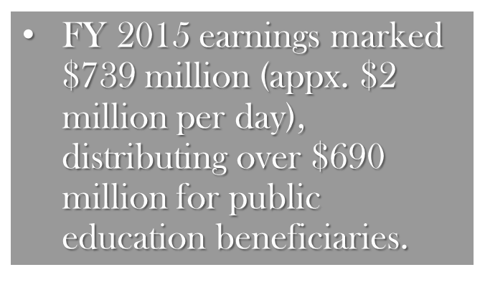
How Does State Trust Land Make Money?

Slide 7
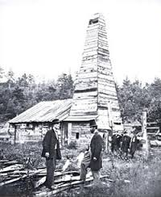
Benefits – Past & Present
How did petroleum discoveries help
Save The Whales?

Slide 8
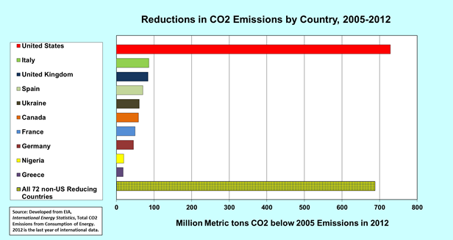
Benefits – Past & Present

Slide 9

Science and Resource Development
Technology to Mitigate
Analysis of Risk
Policy & Regulation for Compliance

Slide 10
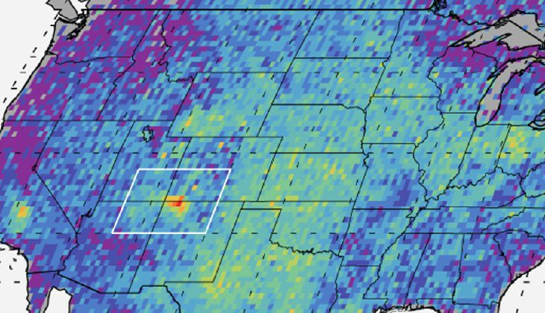
Methane Hot Spot

Slide 11
Science helps direct policy
Oklahoma orders wastewater disposal wells shut down after earthquake
From The Guardian

Slide 12
Stephen L. Wust, Ph.D. Chief Geologist New Mexico State Land Office swust@slo.state.nm.us

