Slide 1
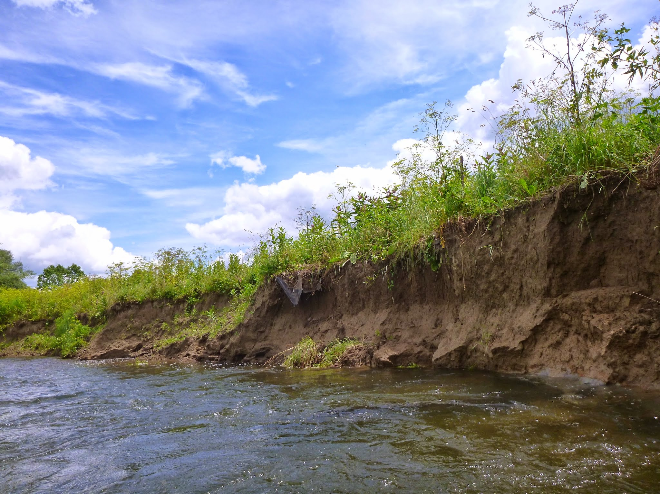

Virtually real: monitoring cutbank erosion mechanisms with SfM in Butternut Creek, New York
Les Hasbargen, Earth & Atmospheric Sciences, SUNY Oneonta
T58. Morphodynamics and Stratigraphy of Meandering Rivers
Convenors: Kory Konsoer, Jessica Ann Zinger, Douglas Edmonds
Presentation: Tuesday, 27 September 2016, in the Colorado Convention Center, Room 406, at 8:40 AM.
This session begins at 8:00 AM.

Slide 2
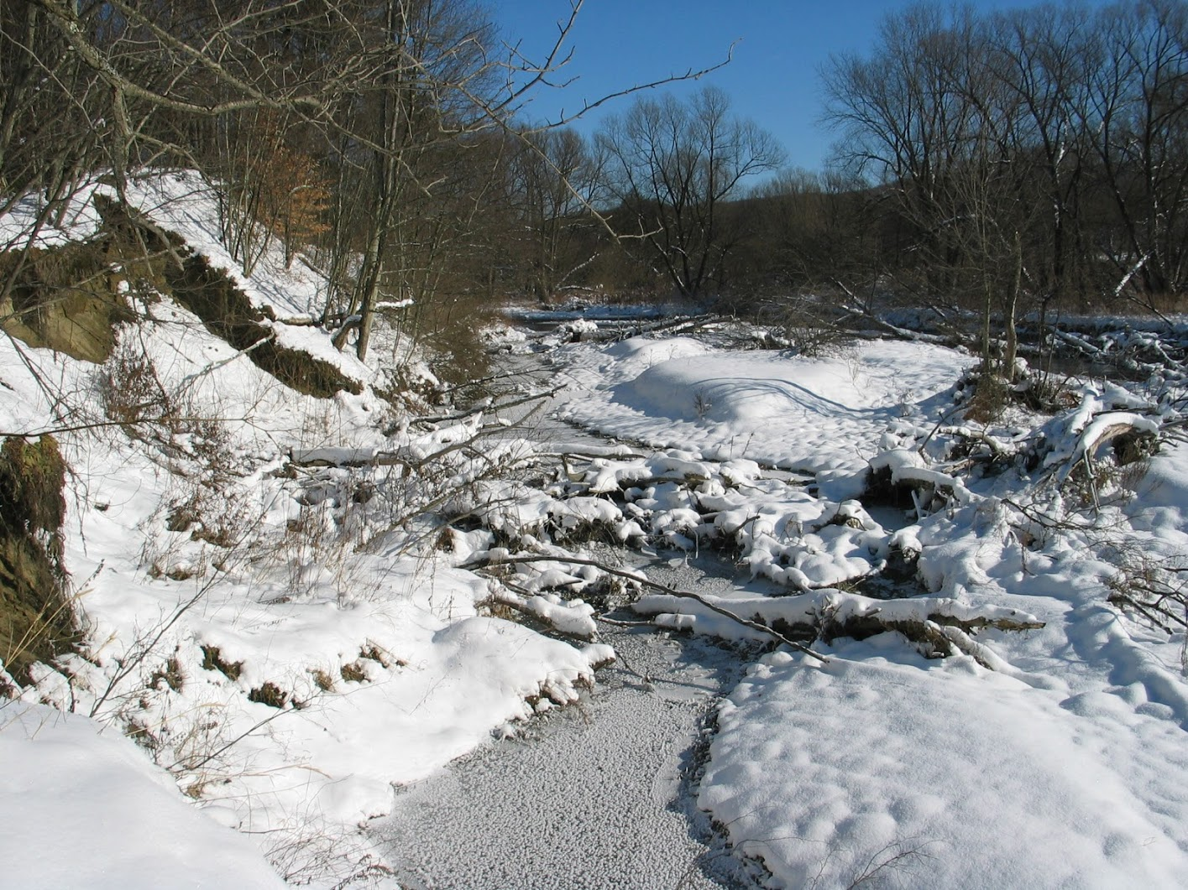
Acknowledgements
Research Assistants: Derek Walling, Pete Booth, David Busby Local landowners: Robert and Blevyn Wheeler, Morris Central School
The Research Foundation of SUNY for faculty research grant

Slide 3
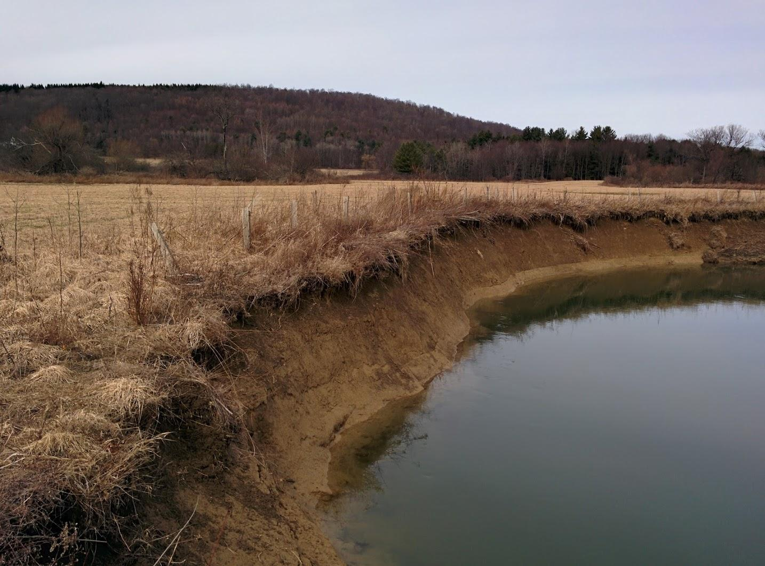
How will streams respond to climate change?
Climate models predict more stormy events for NE USA
Compare bank migration rates stream flow and climate records to test the following hypotheses
Larger flows erode more (bank shear stress)
Medium size flows erode more (undermine cutbanks→ bank collapse)
Freeze-thaw days erode more
Bank monitoring: Structure from motion

Slide 4
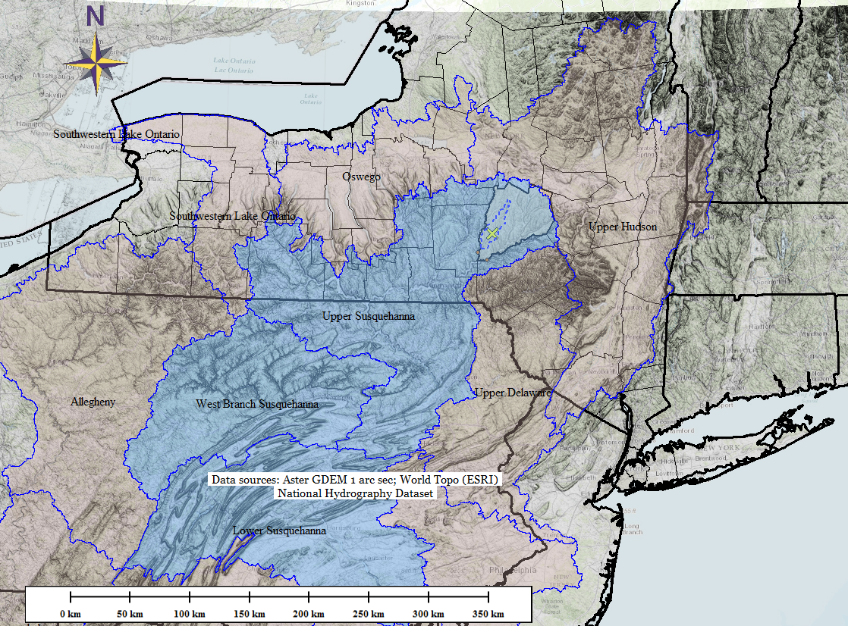
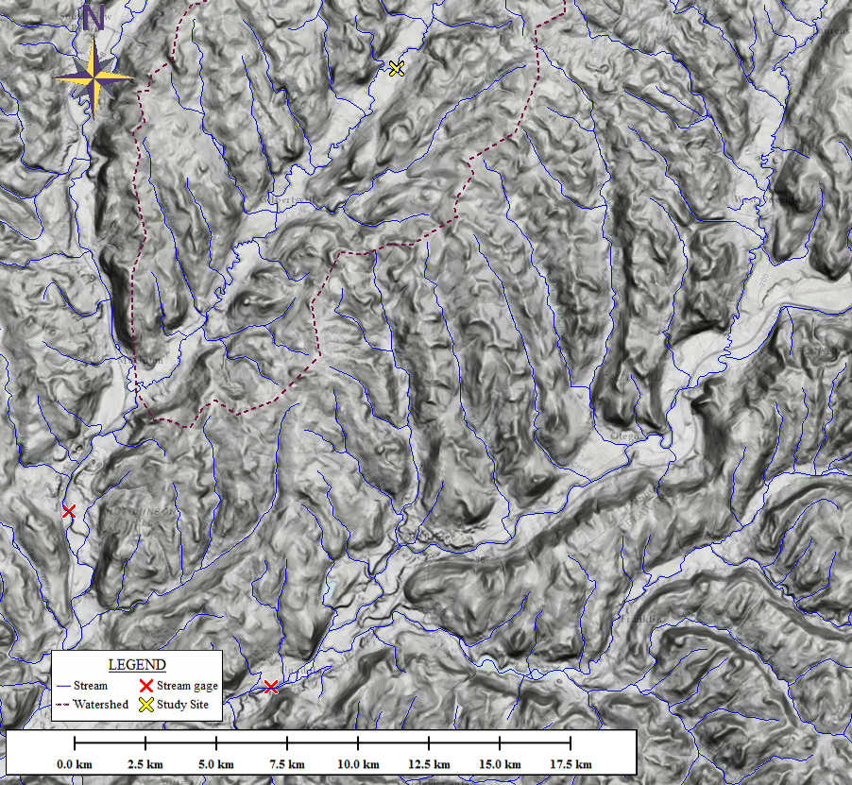
Field Sites:
Butternut Creek, a tributary to Susquehanna River
Study site
Climate data site

Slide 5
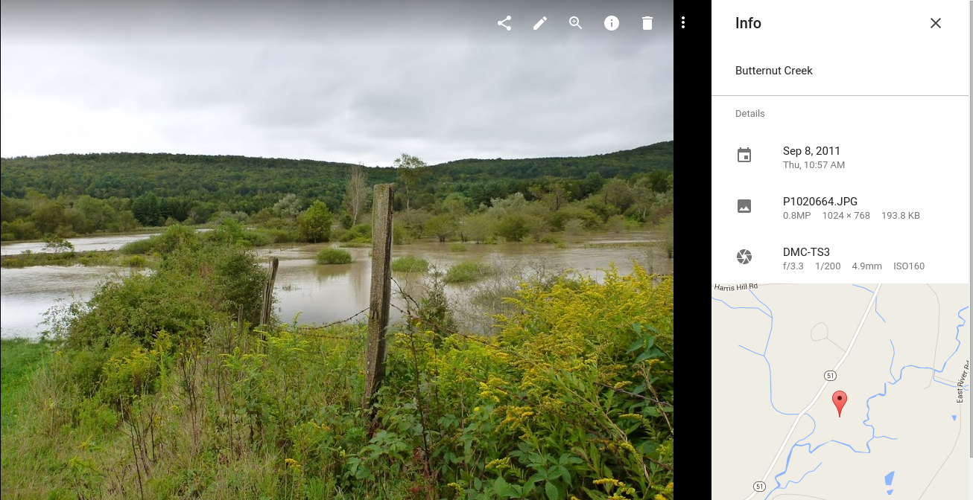
Hypothesis: Larger flows drive more migration
9/8/2011 (TS Lee), clearly overbank
> 99.99 percentile flow (flood of record since 1929)
What processes are active at the cutbank?
Does it matter once the river goes over the bank?

Slide 6
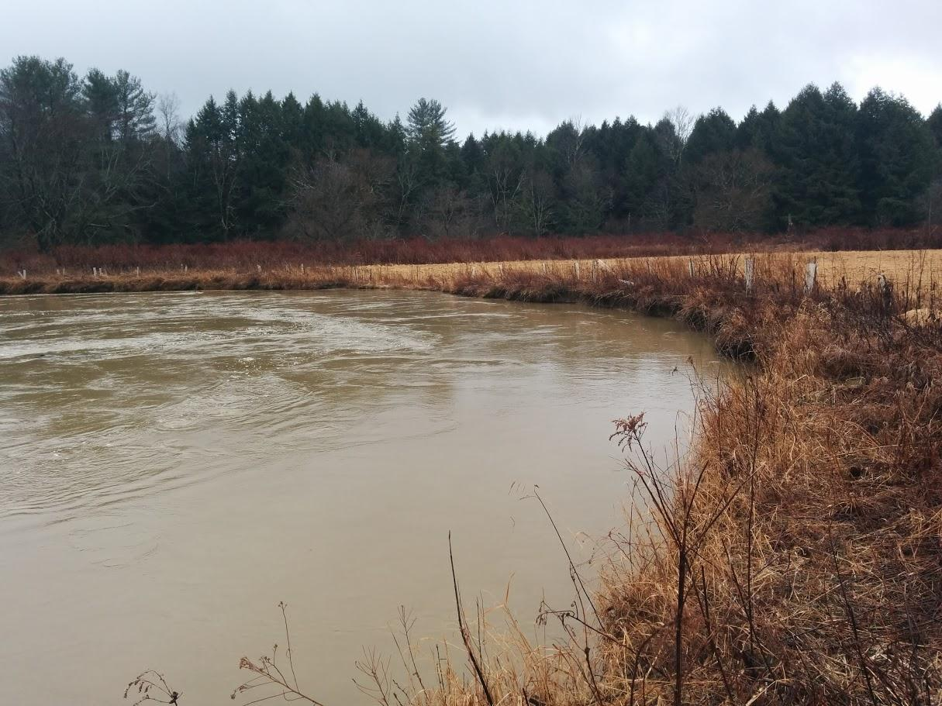
Near bankfull
~99th percentile flow day
2/25/2016

Slide 7
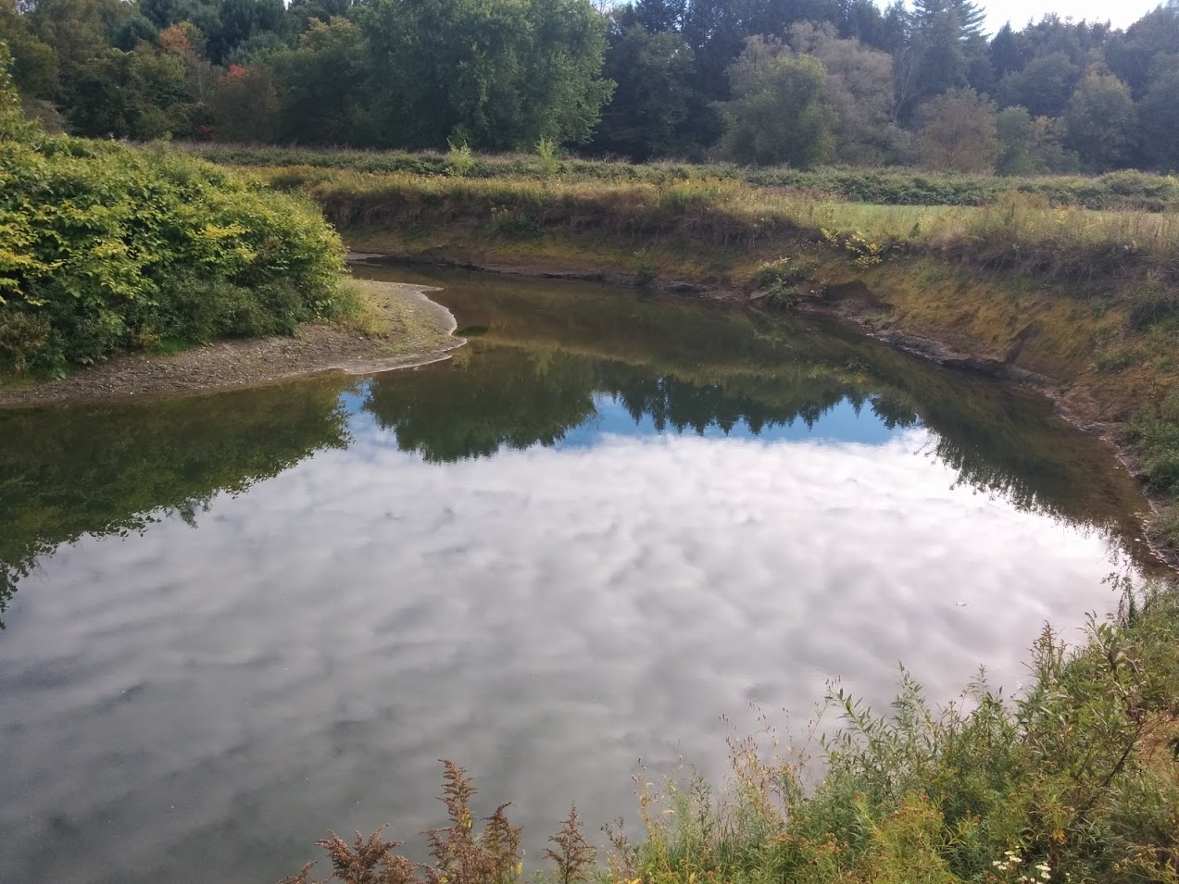
Visual significance of n-th percentile flow
99th percentile
59th percentile
93rd percentile
12th percentile

Slide 8
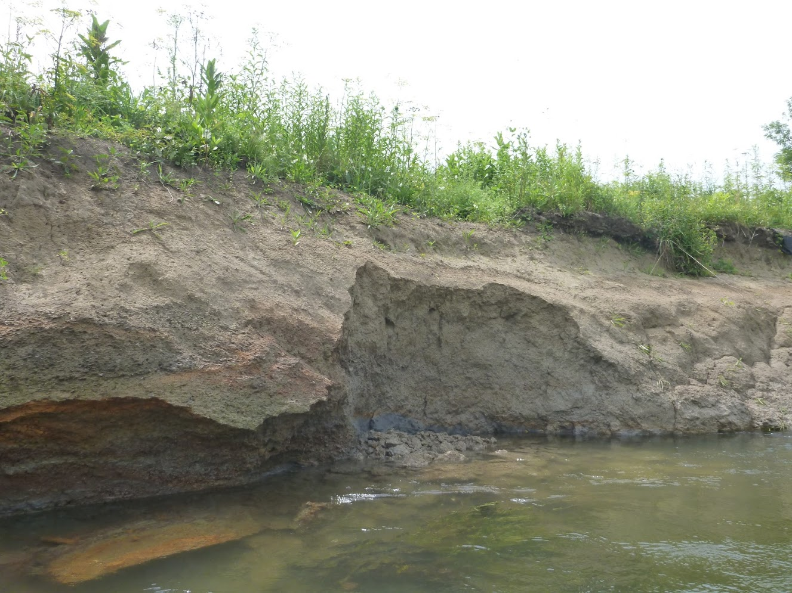
Undercut and collapse
Photo taken: 9/18/2011
Current water level =72 percentile
Next several slides reveal bank conditions and erosional processes, after a major flood
Smooth bank: eroded by fluid shear stress on the bank

Slide 9
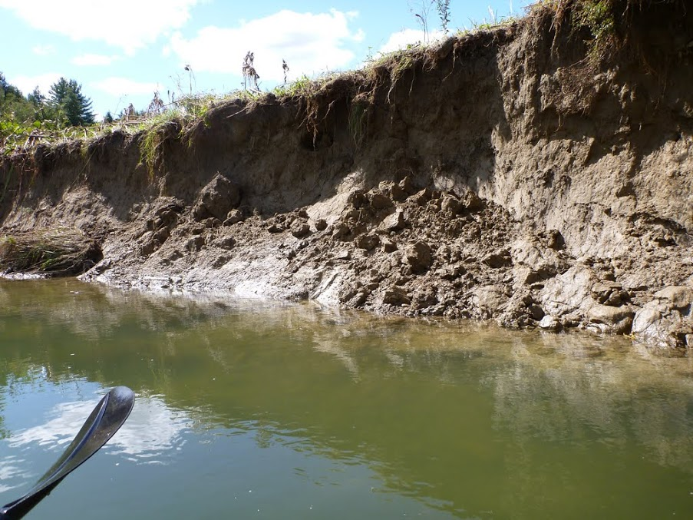
Note concavity of bank
Bank shear?
9/18/2011;
Current flow is 72 percentile
Zone of maximum erosion

Slide 10
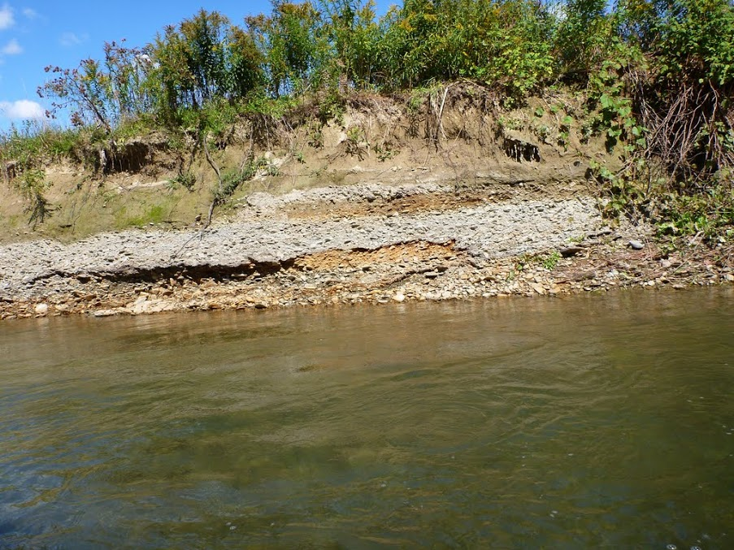
9/18/2011;
Current flow is 72 percentile
Bank materials vary
Old gravel bars

Slide 11
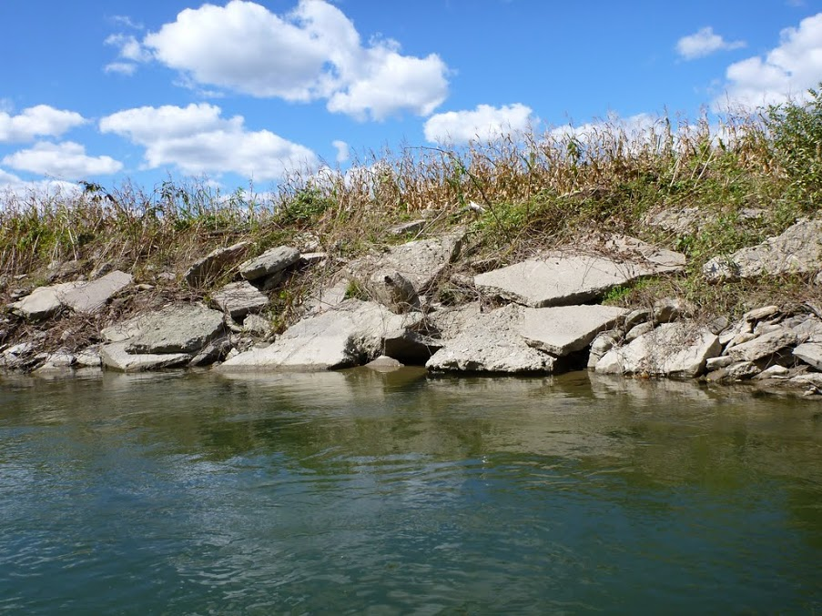
No erosion (has not moved since 1995 aerial image)
Current flow is 72 percentile
Bank Conditions:
armored outside bend

Slide 12
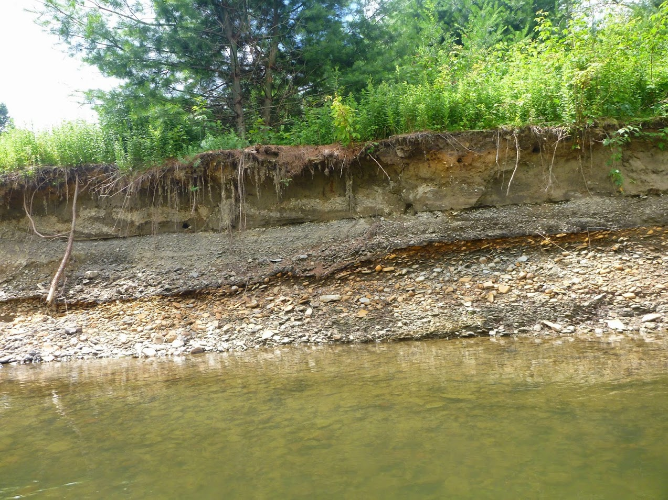
Variation in bank materials limits processes (threshold)
7/16/2014
~59th percentile flow day

Slide 13
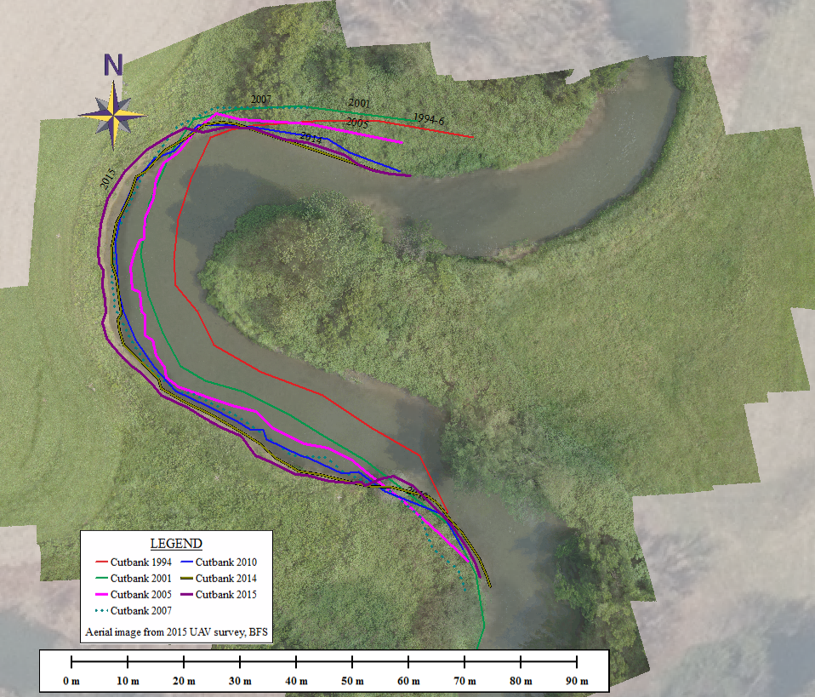
Meander migration rates,
6 active sites
(out of 10)
Rates vary from 0 to ~2 m/yr
Rates based on time series of orthoimagery from New York State GIS Clearinghouse, Lidar in 2007+UAV in 2015
Average migration distance = Area / Perimeter x 2
Green vegetated overlay is orthomosaic created by UAV

Slide 14
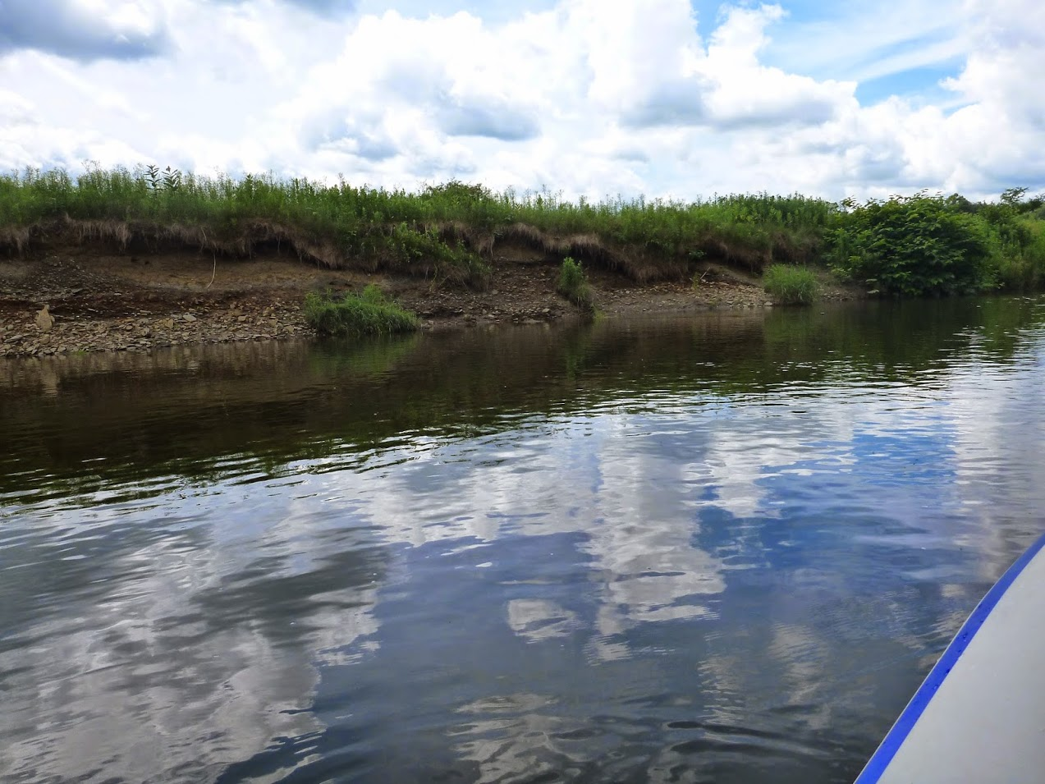
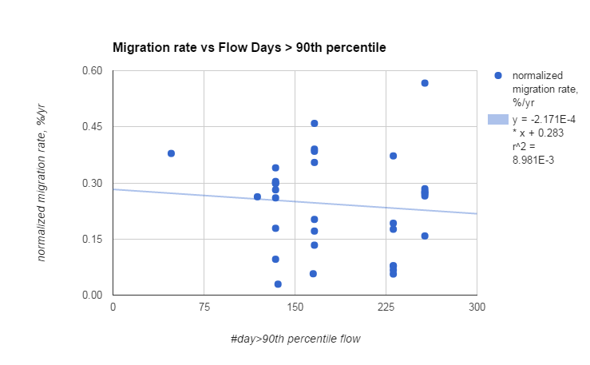
Migration rates vs # days > 90th percentile
No relationship between more flow days and migration rate
6 Cutbanks with measurable erosion on aerial imagery
Time periods: 1994-2001; 2001-2005; 2005-2010; 2010-2014
For each time period, the eroded distance is normalized to the total local eroded distance to allow cutbanks to be compared to each other

Slide 15
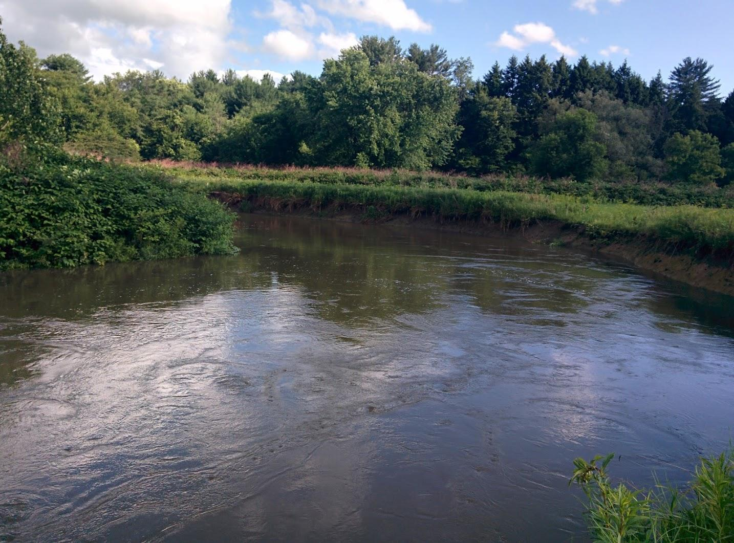
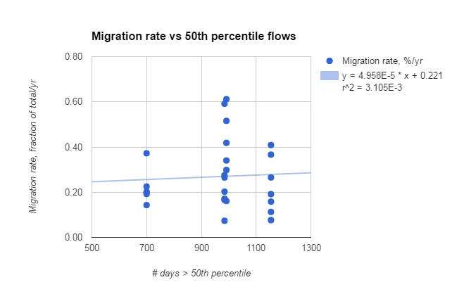
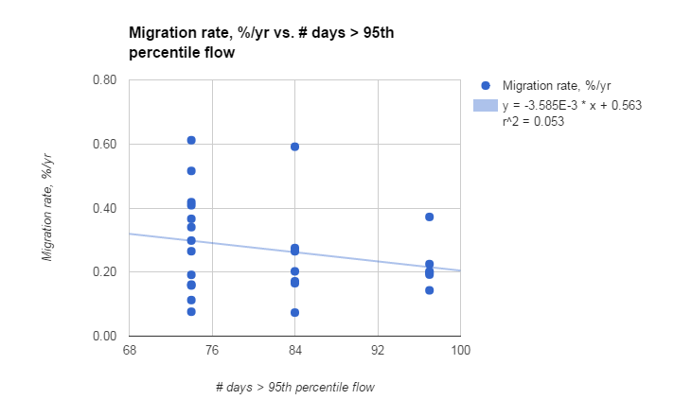
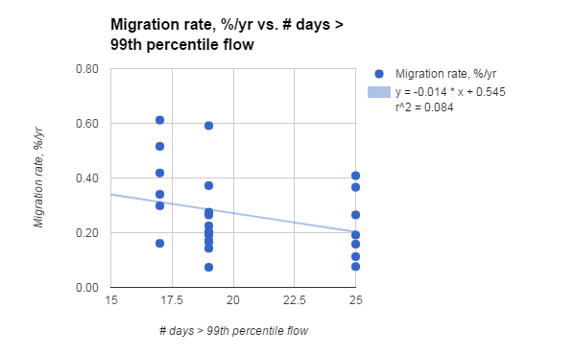
No relationship between very high or moderate flows and migration rate

Slide 16
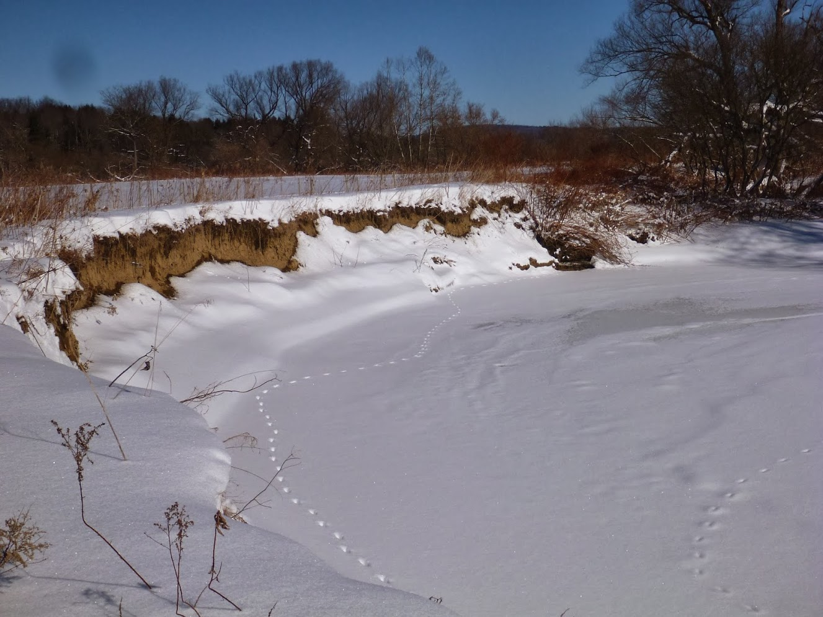
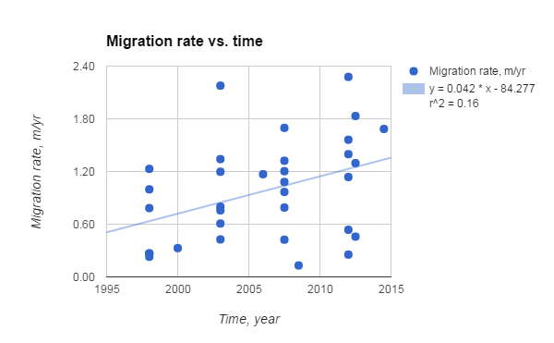
Migration rates since 1994
Very weak relationship between migration rate and time

Slide 17
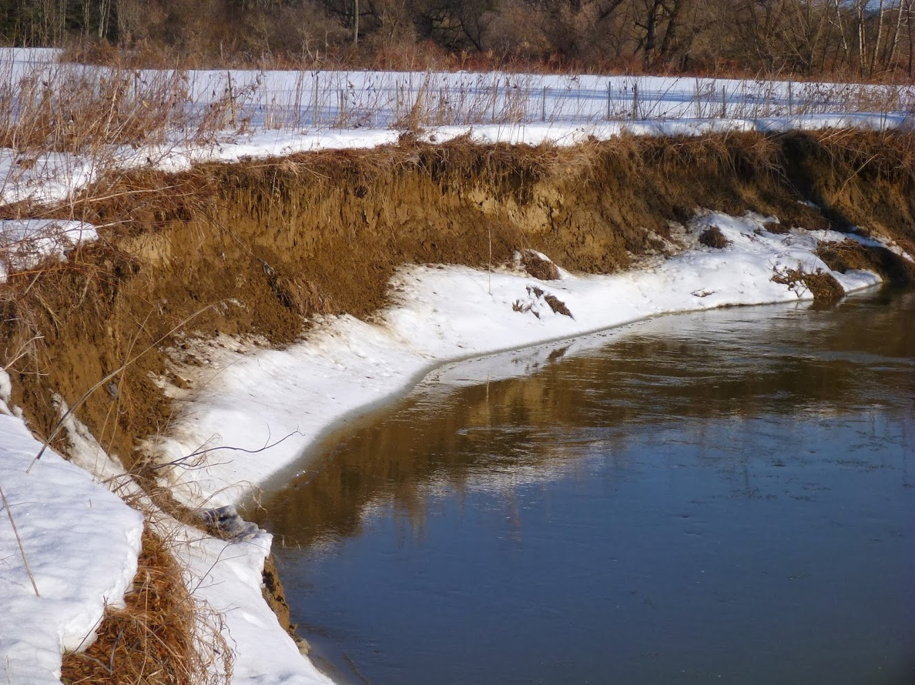
Freeze-thaw of cutbanks
Small grain flows/avalanches
Feb. 22, 2014: 77th Percentile flow

Slide 18
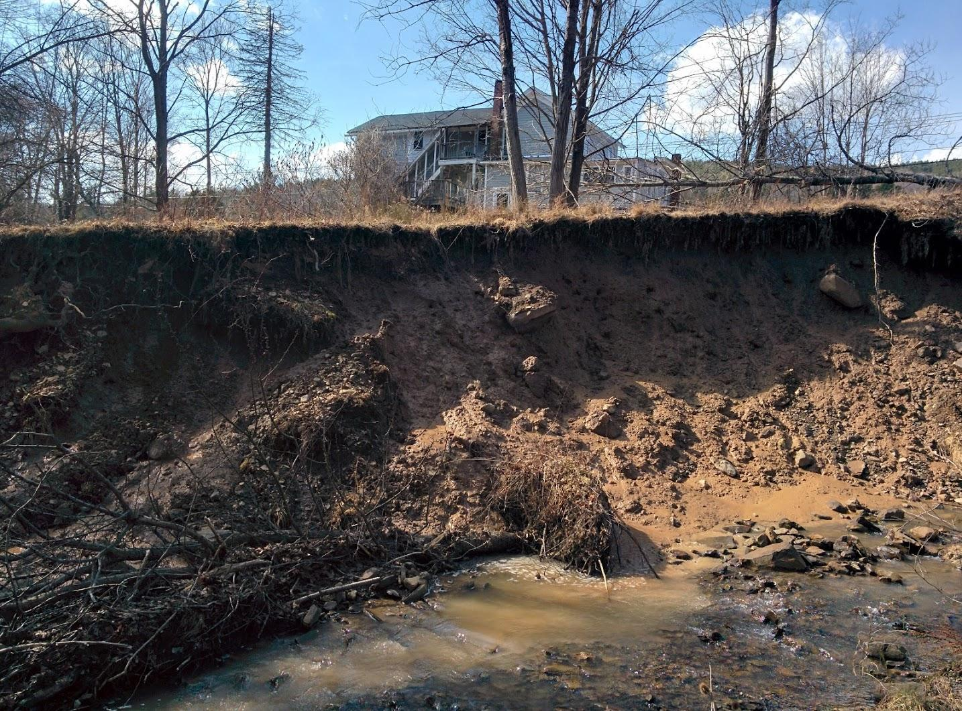
Freeze-thaw of cutbanks
can lead to
Debris flows, slumps, collapse
March 9, 2016, Oneonta
A single event can remove
1 to 20+ cm from a cutbank

Slide 19
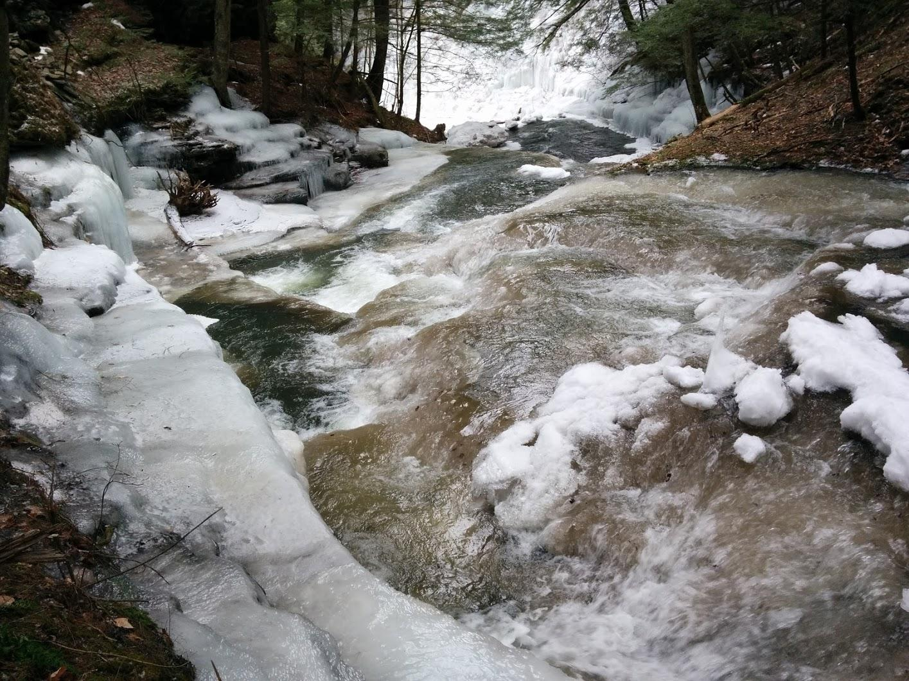
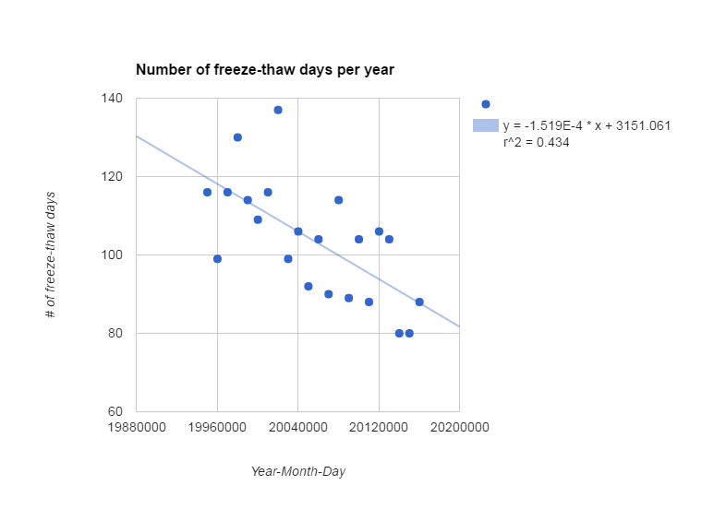
Freeze-thaw activated processes
80 to 120 f-t events per year
5 to 20 per yr for > 5C and < -5C
The number of freeze-thaw days appears to be declining

Slide 20
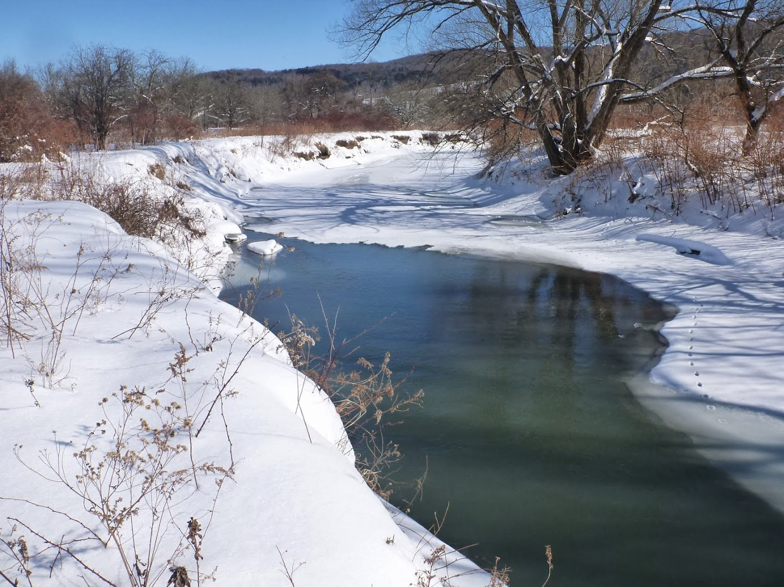
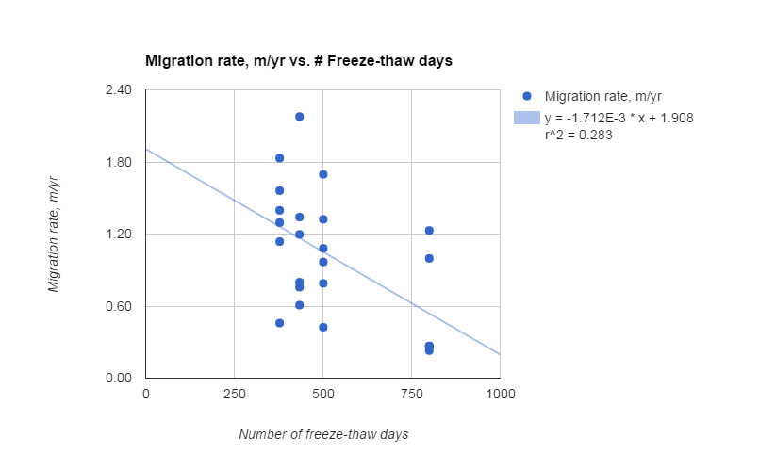
Migration rate vs freeze-thaw days
There is a weak inverse relation between the # of freeze-thaw events and migration rates!
This could be from the averaging interval effect...

Slide 21
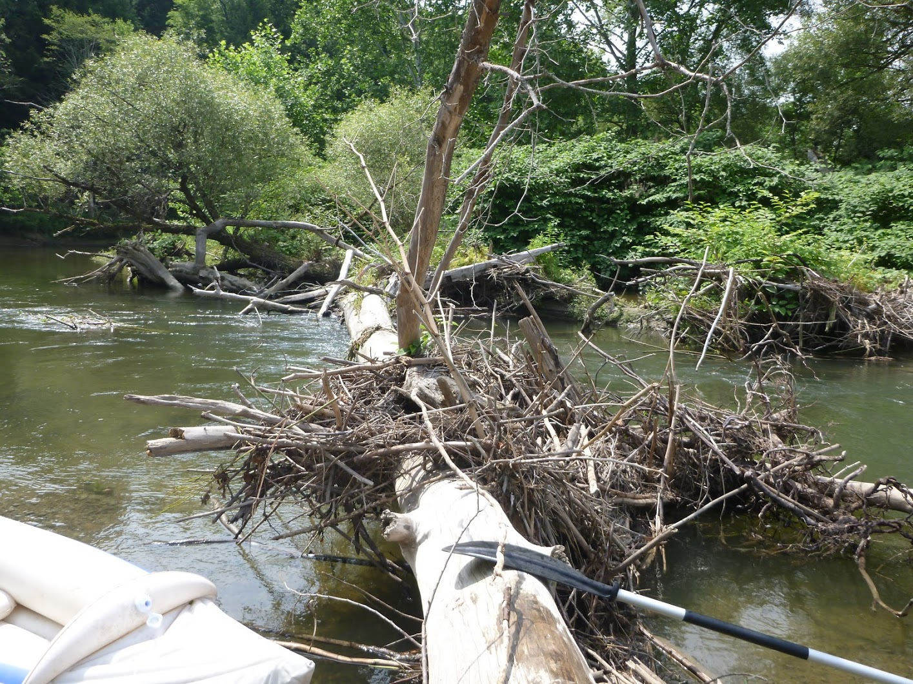
Conclusions
More floods = more migration doesn’t hold
More freeze-thaw = more migration is not obvious
Migration rate of cutbanks appears to be:
insensitive to mid-size and larger flows
Inversely related to freeze-thaw events
Rate interval may be too long to elucidate process control (shorter interval = higher rates or greater variability in rates?)
We need higher resolution measurements in time and space to get around this logjam! Enter structure from motion (SfM) photo surveys…

Slide 22
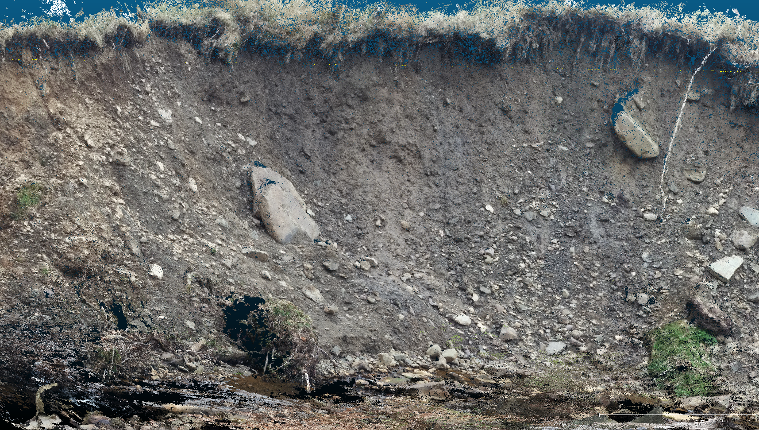
Point cloud rendition above of
cutbank at right (5 weeks apart)
cm scale features are detectable

Slide 23
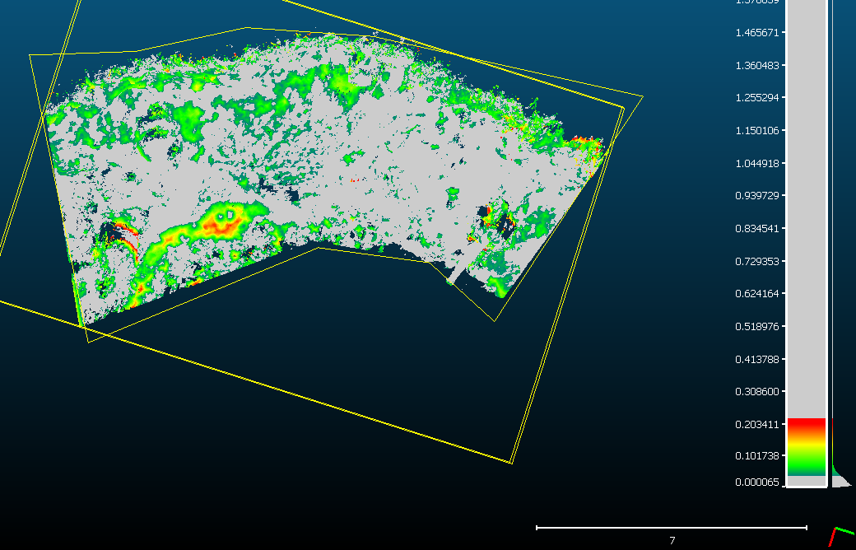
Point cloud registration and differencing can work
without ground control, if the two scenes are very similar
The differenced point clouds above measure movements from a freeze-thaw event on a 3 m high cutbank; largest differences are ~0.2 m

Slide 24
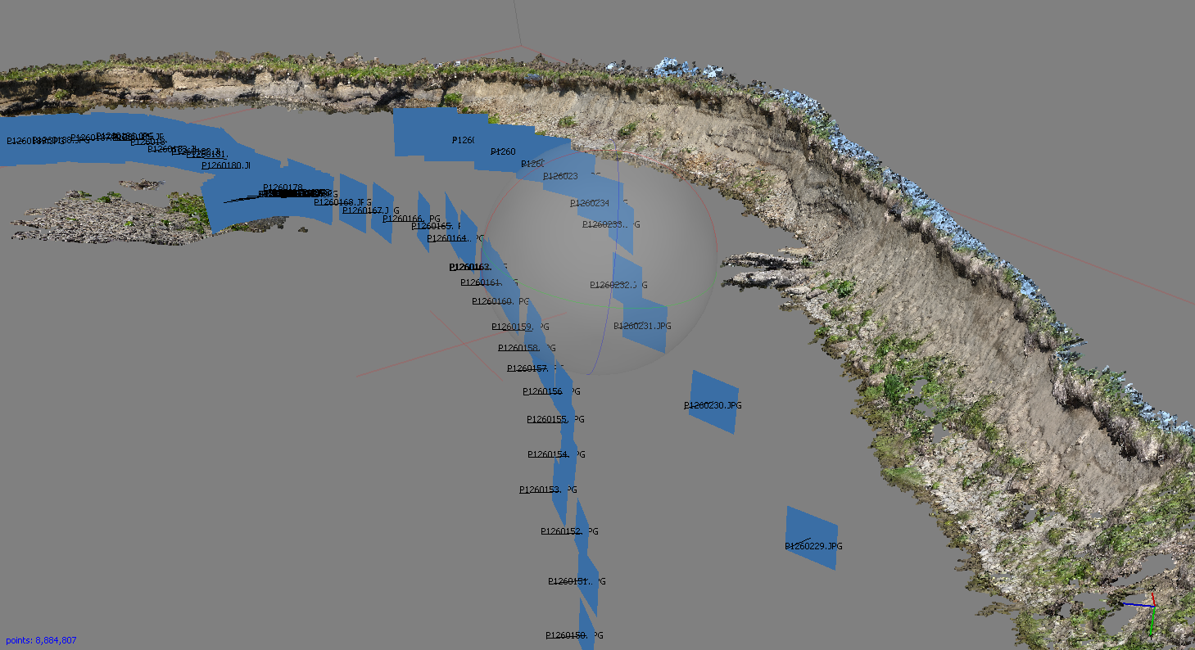
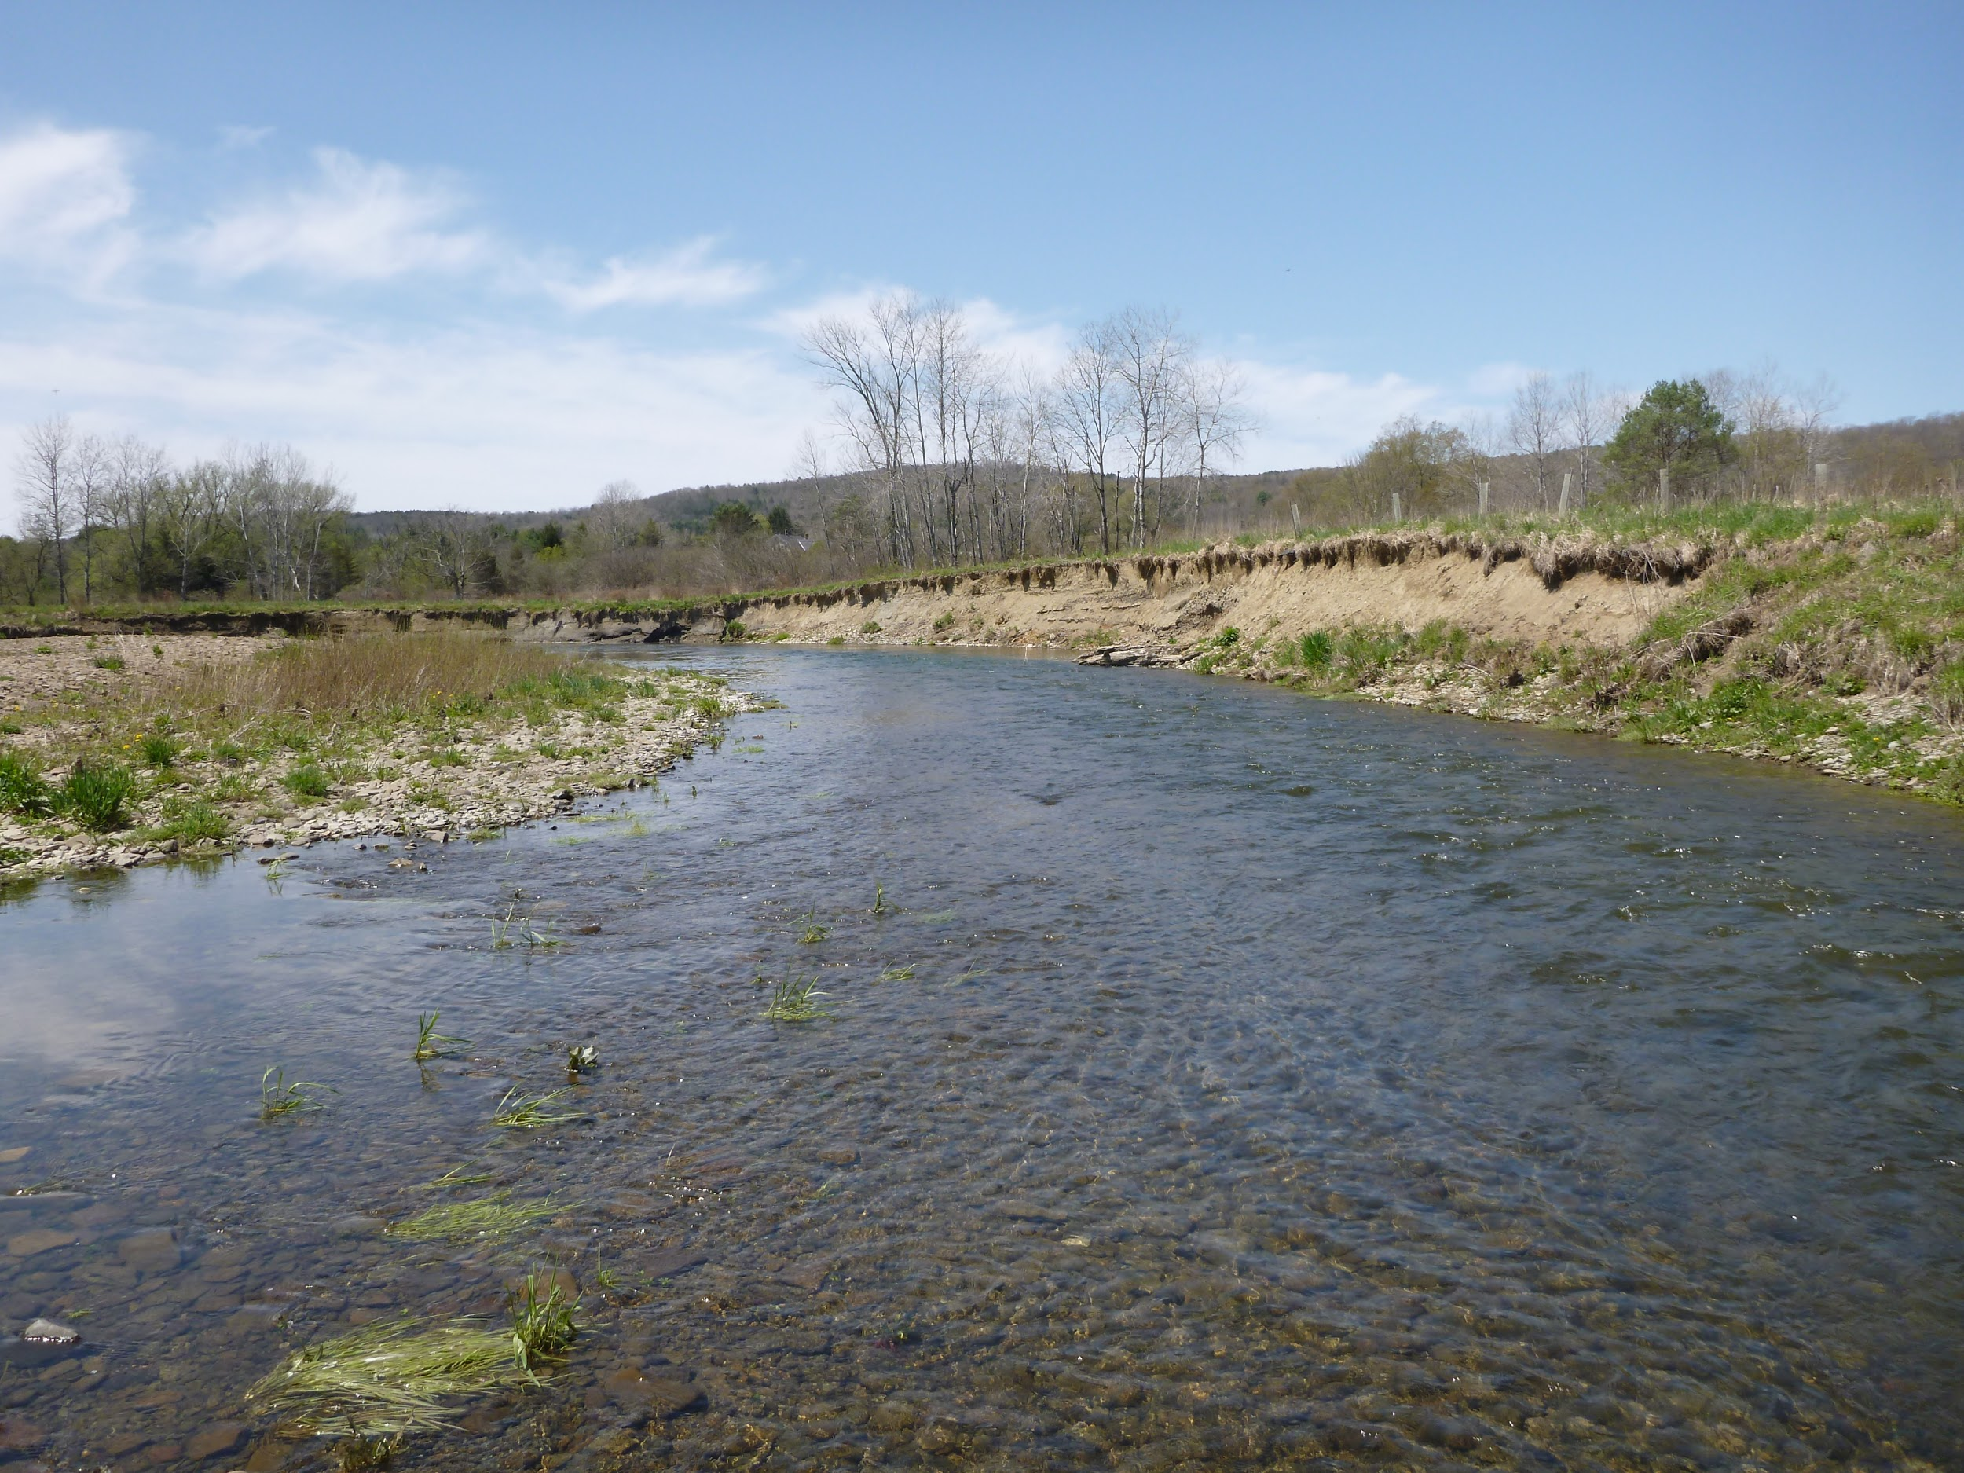
Structure from motion photo survey
Ground-based views from canoe and on foot
Camera is point-and-shoot Panasonic Lumix, 12 M pixels
57 photos yields ~ 8.8 M points
No ground control points

Slide 25
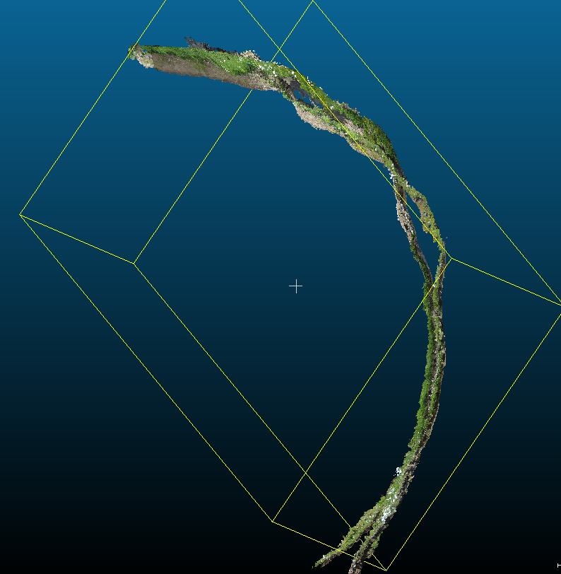
SfM as a measurement tool…
At left are two surveys of a cutbank with photos taken from a canoe a few years apart
No ground control points were used in reconstructing the scenes
CloudCompare registration process scales and aligns the point clouds, but…
Without ground control, one is left with uncertainties.
SfM can yield cm scale 3D pixels over an entire cutbank
Open source software (that is, CloudCompare) is available to compute differences
~100 m
top to bottom
2016
2014

Slide 26
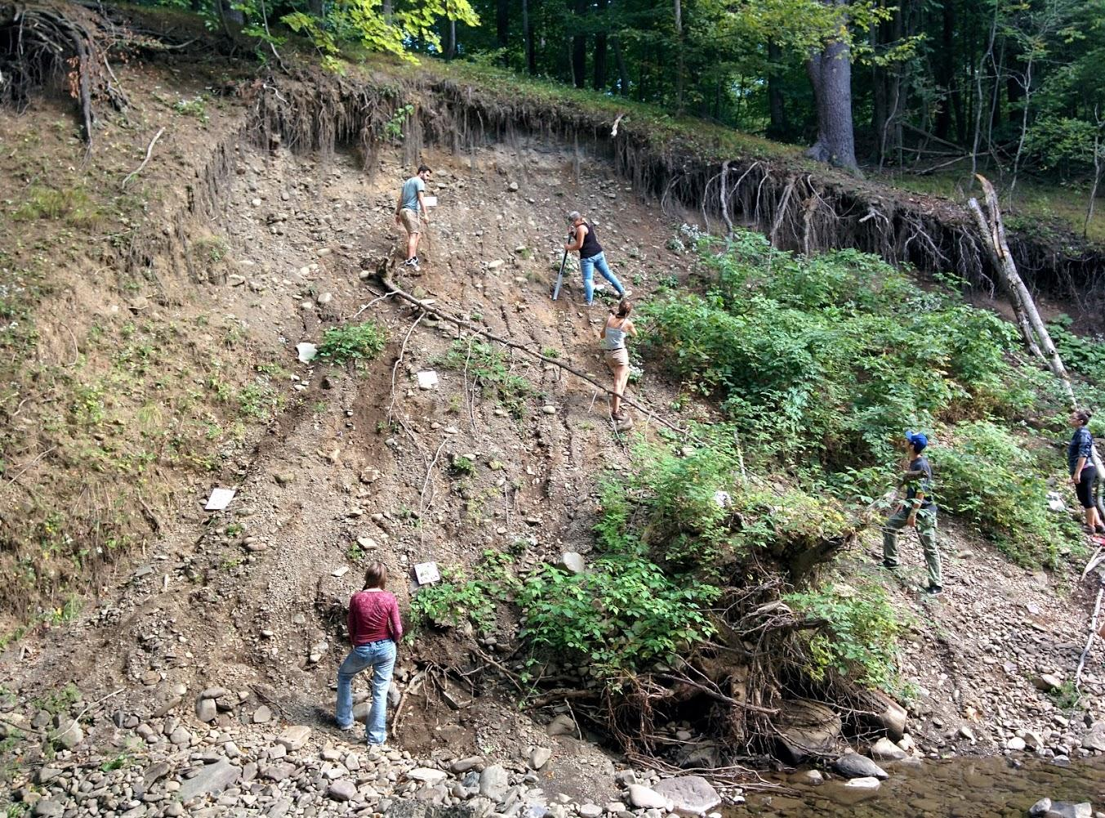
Conclusions
SfM from the ground works!
Need to fix a reference frame, or
Repeat surveys frequently
Processes are noisy at short time and space scales, at least on weak exposed regolith
I’ll take your questions!
Photo of SUNY Oneonta students placing ground control objects onto a landslide for SfM, Sept. 2016

Slide 27
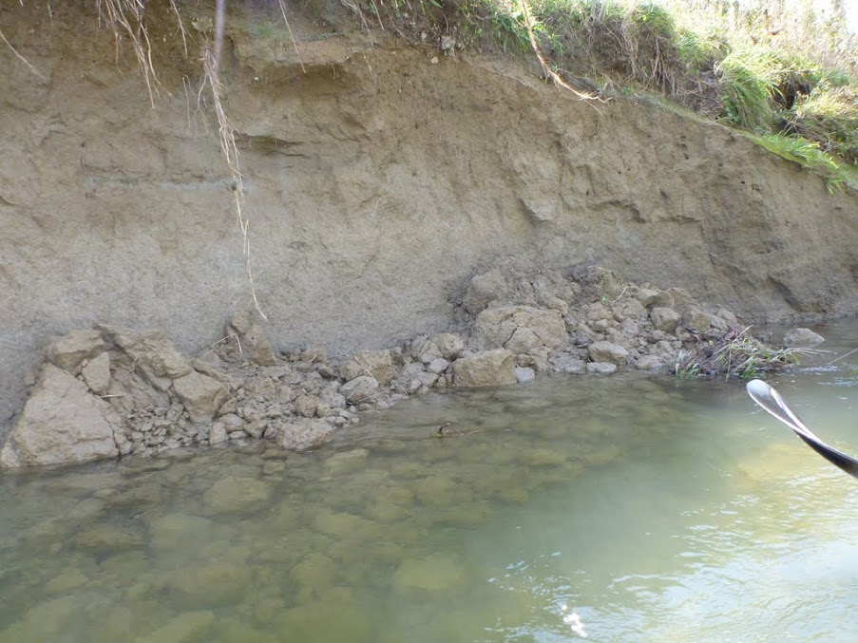
References to data sources
USGS stream data for Unadilla River and Susquehanna River
National Climatic Data Center for Otsego County climate 1994-2016, New York
Daily climate data, NOAA National Center for Environmental Information (site is GHCND:USC00305113)
New York State GIS for aerial imagery and lidar
Agisoft PhotoScan software for SfM Visual Structure from Motion (open source)

Slide 28
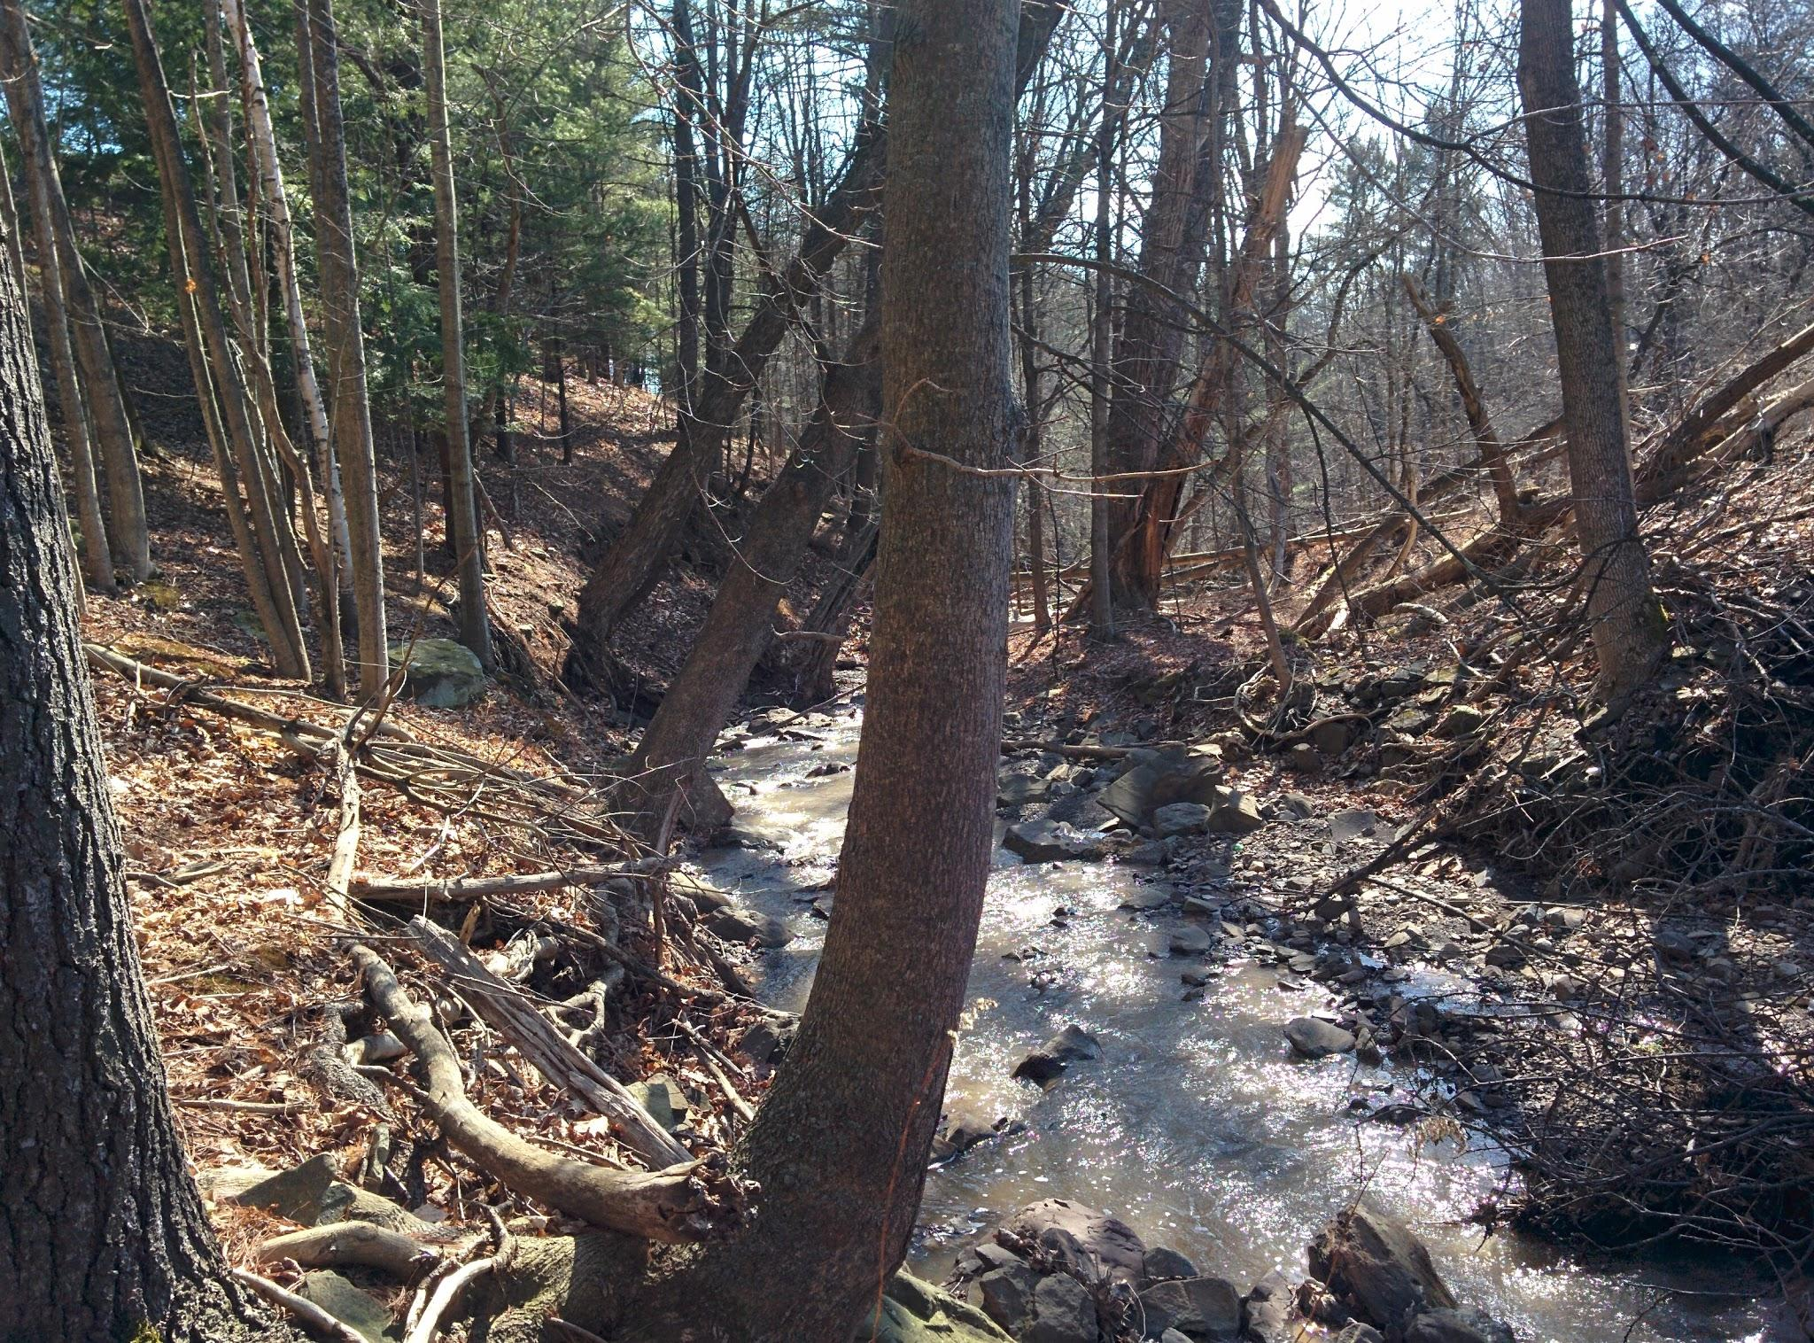
Abstract as submitted
July 2016
Several natural processes erode stream cutbanks including bank collapse, fluid bank shear stress during high flows, burrowing and bioturbation, and freeze-thaw events. Which of these contribute most to meander migration rate? Butternut Creek in upstate New York provides a case study for unraveling this question. Migration rates were determined for several meander bends based on aerial imagery. Cross correlation between migration rate and the number of exceedance days for discharge reveals a vaguely inverse relation, suggesting that higher flows stymie migration. One might hypothesize that higher flows enhance bank shear stress which removes a more uniform thickness from the bank, causing a reduction in bank collapse frequency, whereas lower flows may tend to undercut more effectively and enhance bank collapse. To identify and quantify the bank erosion mechanisms for Butternut Creek, air photos captured at low altitudes using a drone were collected. However, this view from above did not capture sufficient detail to elucidate cutbank erosion mechanisms. Surveys in three successive years with overlapping photographs of the stream banks were taken from a canoe and from the ground. PhotoScan, a structure-from-motion software by Agisoft, was used to construct three dimensional object models of the stream banks.Temporal changes were mapped by computing the distance between scaled, aligned point clouds using CloudCompare, an open source software designed to detect nonuniform changes in 3D object models. The processing steps and initial results will be presented, and the utility of highly detailed (0.005 to 0.010 m/pixel) process studies will be discussed.

Slide 29
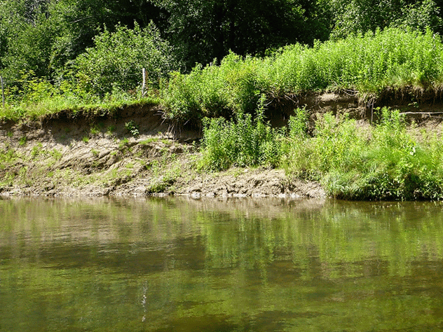
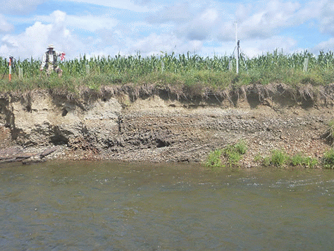
Measuring cutbanks with SfM: Take overlapping photos
The software (PhotoScan, by Agisoft):
Aligns photos
Finds common points in photos
Calculates 3D coordinates of each point
Colors the point
Rectifies the coordinates, if ground control points are known

Slide 30
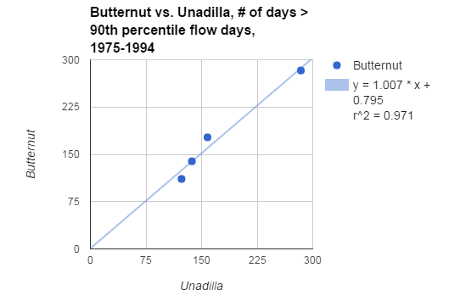
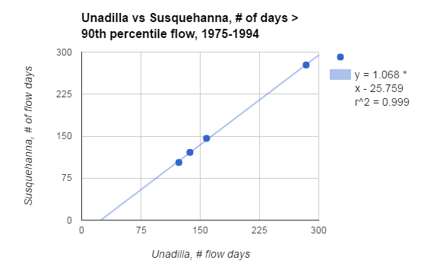
About those percentiles and proxies…
Butternut Creek was monitored by USGS until 1996
Two other gaging stations have overlapping data with the Butternut
I compared the number of flow days at a given percentile for the gages for overlapping time periods
Bottom line: the number of flow days on one stream can serve as a predictor of the number of flow days for a given time period on a nearby stream
I selected 4 periods of the same length, counted the #days exceeding 90th percentile, and the charts show the comparison between streams

Slide 31
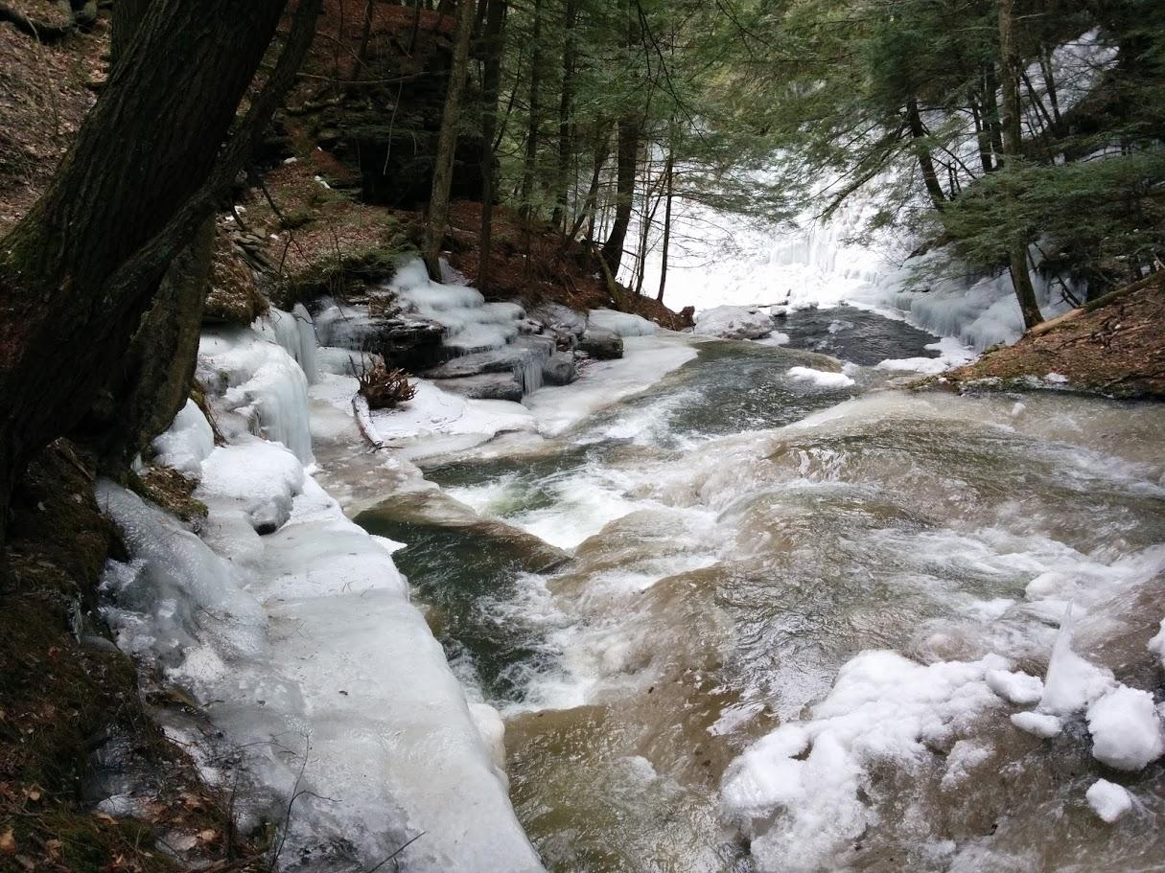
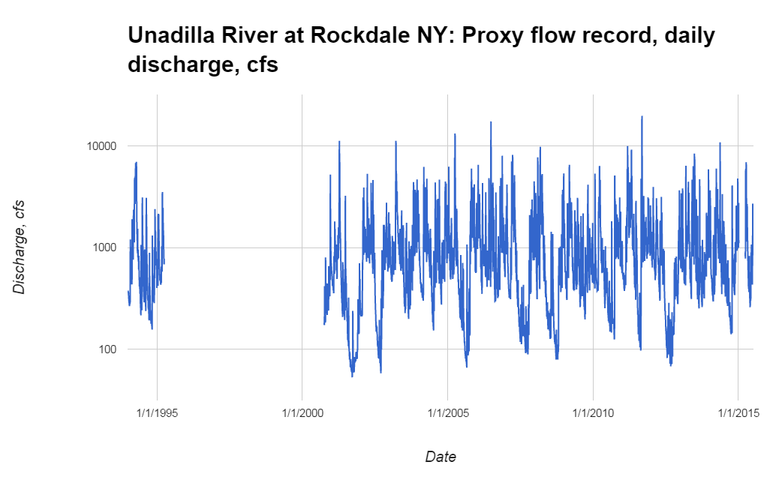
Flood of Record, Tropical Storm Lee
Threshold for erosional activity at 95th percentile?
Or (70th percentile)?
Gage not recording for this interval…
And there is aerial imagery for this time period

Slide 32
Freeze-thaw activates cutbanks

