Slide 1
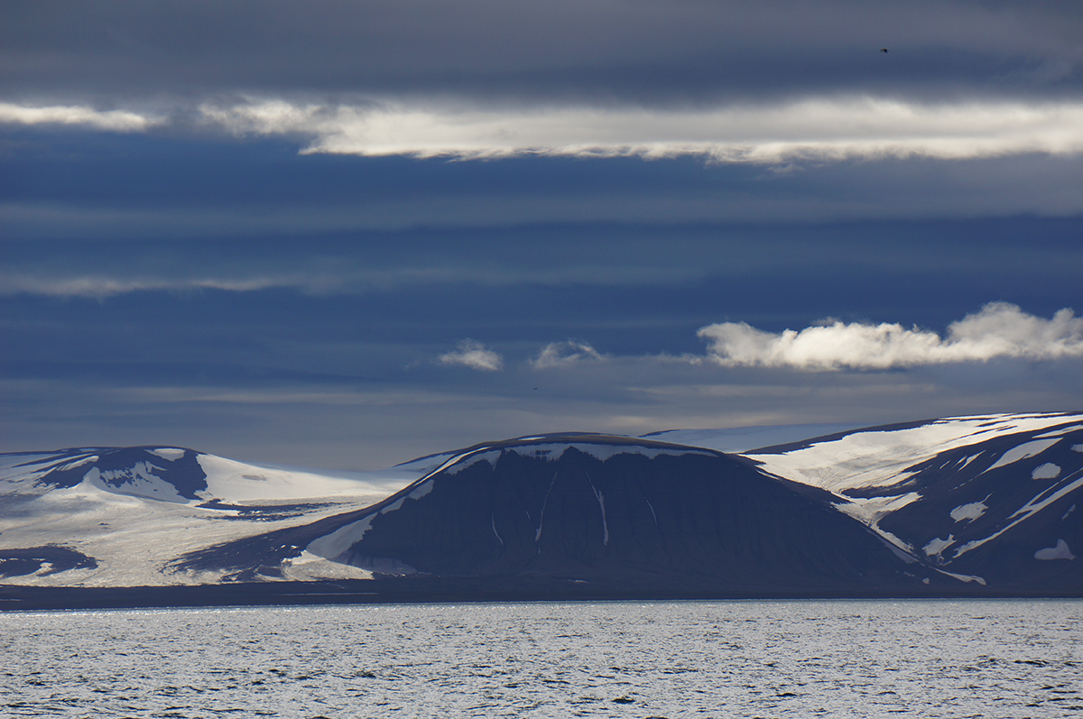











Mesozoic regional stress field evolution in Svalbard
Harmon Maher, Kim Senger, Kei Ogata, Alvar Braathen, Mark Mulrooney, Aleksandra Smyrak-Sikora, Per Terje Osmundsen
OUTLINE
- Geologic setting.
- Triassic Eastern Svalbard synsedimentary faulting & inferred stress field.
Cretaceous sill related cooling fractures & inferred stress field.
- Tensile fracture pattern in host Triassic strata
- Conclusions.
Notes:
This research is part of a consortium effort housed at the University of Oslo and that is taking a multifaceted look at the Triassic of the northern Barents Shelf. The consortium partners are identified here, and the sponsors below. After providing some context we will focus on Triassic synsedimentary faulting, and then on tensile fractures in Cretaceous sill and their host Triassic strata, before reaching some conclusions as to the regional stress field at this time.

Slide 2
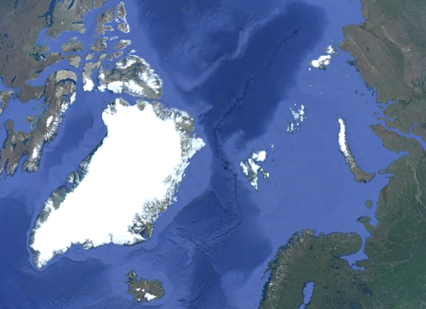
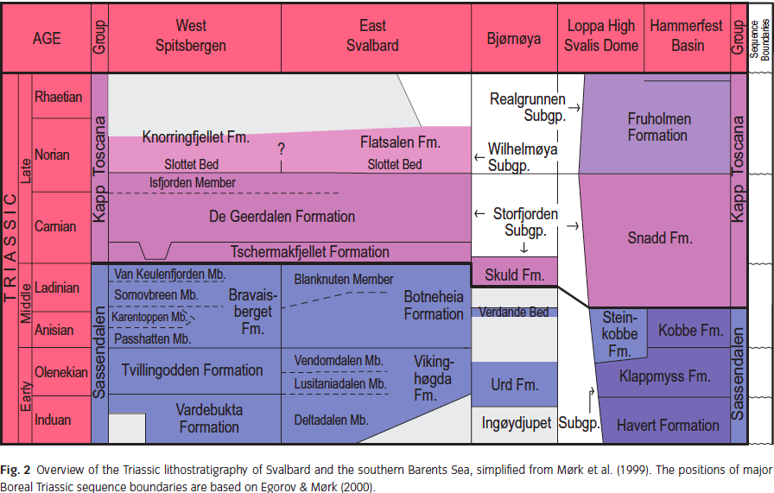
Major events:
transtension
^
West Spitsbergen fold-thrust belt development during transpression with thick foreland basin.
^
Cretaceous HALIP
^
Permian and Mesozoic platform sedimentation
^
Carboniferous intraplate rifting
^
Devonian tectonism
^
Caledonian orogeny
here
Notes:
For those unfamiliar with Svalbard it is located here. After earlier Paleozoic tectonic events that waned in intensity, there was a long period of relatively stable platform sedimentation from the Permian through the lower Cretaceous. Sedimentation was influenced by High Arctic Large Igneous Province during the Aptian, and brought to an end by Tertiary transpression and then transtension associated with the separation of the western Barents Shelf from northeast Greenland. Within the platform sediments will focus on the Middle to Late Triassic Botneheia, Tschermakfjellet and De Geerdalen formations.

Slide 3
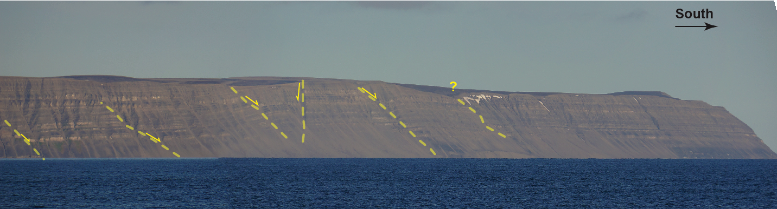
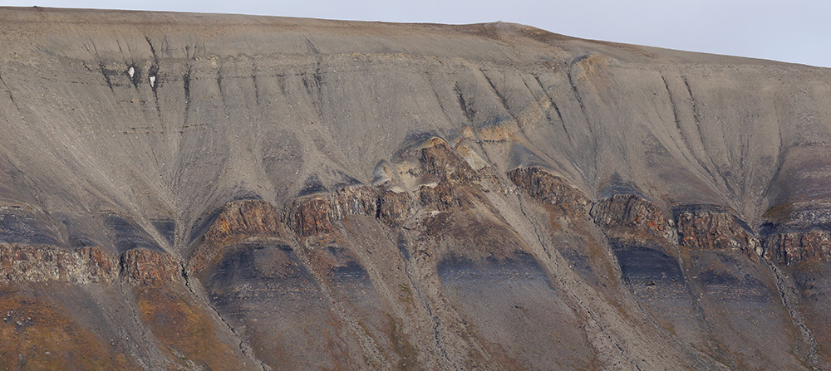
Two opportunities to constrain Mz stress fields during platform sedimentation:
Distributed minor syn-sedimentary Triassic faulting.
Cooling fractures in Cretaceous (Aptian) sills on Edgeøya associated with the High Arctic Large Igneous Province.
1)
De Geerdalen Fm.
Tschermakfjellet Fm.
Above: distributed normal faults in Triassic strata along SE tip of Edgeøya
Right: Cretaceous sill in Triassic age Botneheia and Tshermakfjellet Formation shales in western Edgeøya.
2)
sill
Notes:
This presentation explores the opportunity to constrain the regional stress field in the Svalbard area for two distinct periods within the Mesozoic. The first is provided by distributed synsedimentary Triassic faulting with offsets typically less than 100 meters. Second is a suite of diabase sills that formed on the margin of HALIP and often intruded the Triassic strata. Depicted below is the transition from Botneheia formation organic rich shales up into DeGeerdalan sandstone with one of the sills intruding.

Slide 4
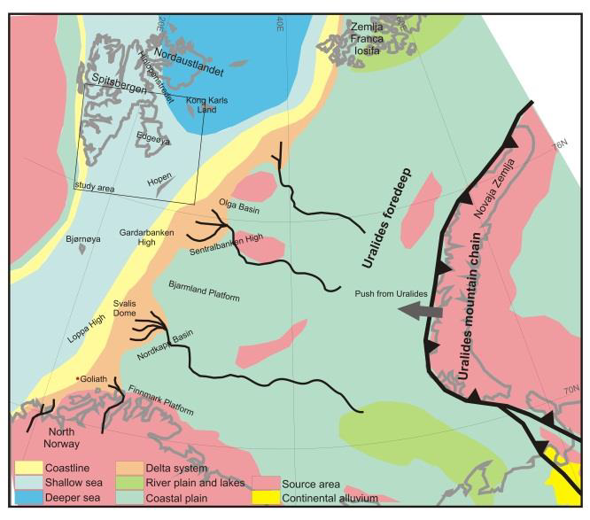
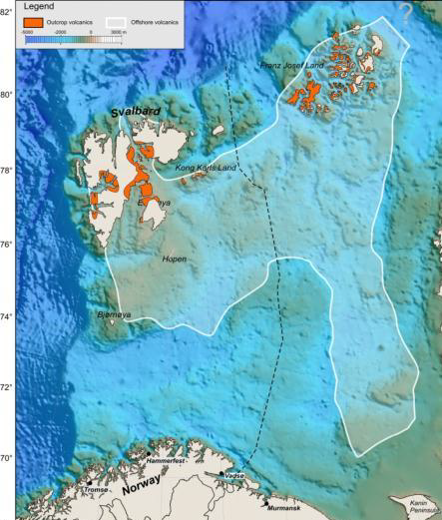
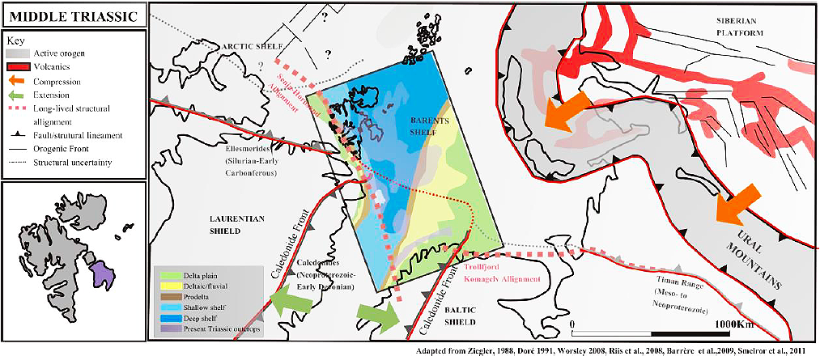
Based in – Riis et al. 2008, Smelror et al. 2009
Triassic - stable plate interior platform with active orogen to east feeding deltaic coastal plain.
Cretaceous (circa 120 Ma) - High Arctic Large Igneous Province.
Polteau et al. 2016
Edgeøya
From Anell et al. 2013
Notes:
A bit more context before the details. Atle Mørk and a host of collaborators have established that during the Triassic a deltaic and coastal plain system prograded from the Urals to the west, narrowing an interior sea way with time. This map from Polteau et al. shows where remnants of HALIP intrusive and extrusives occur on the Barents Shelf. Other HALIP components are found elsewhere in the Arctic. Note the position of Edgeøya, which we will now focus on, in this Triassic reconstruction.

Slide 5
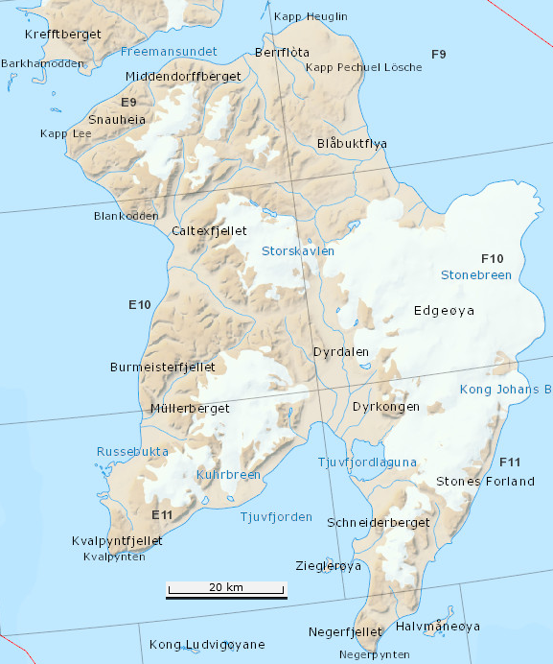
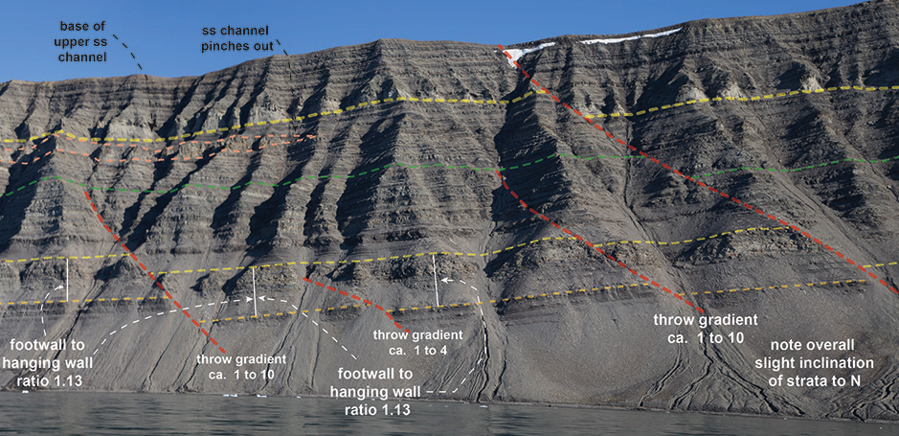
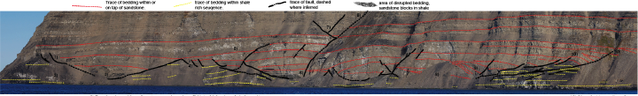
2 types of Triassic faulting:
thick skinned,
2) thin skinned with growth basins above detachments in Triassic shale rich horizons.
Both with significant footprint, and syn-sedimentary.
thick skinned
normal faulting
thin skinned
normal faulting
Notes:
There are 2 distinct types of Triassic faulting, thick skinned mostly without significant rotation (upper photo), and thin-skinned with distinct growth basins above detachments (lower photo). The relationship between the two is quite interesting, but we won’t have time to focus in on it today. This maps shows locations where these two types of faulting have been studied on Edgeøya.

Slide 6
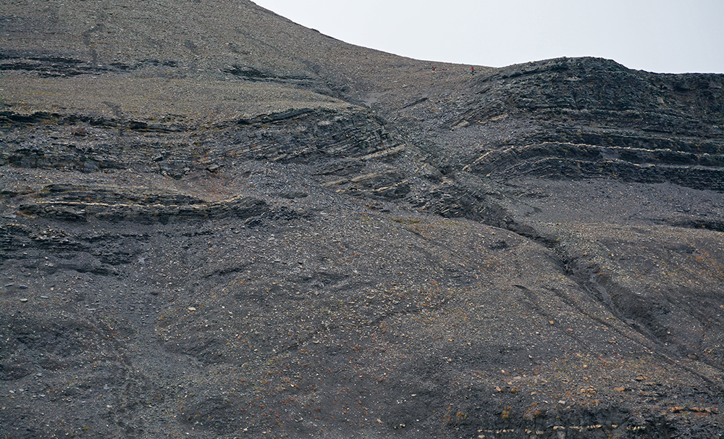
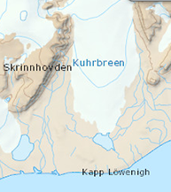
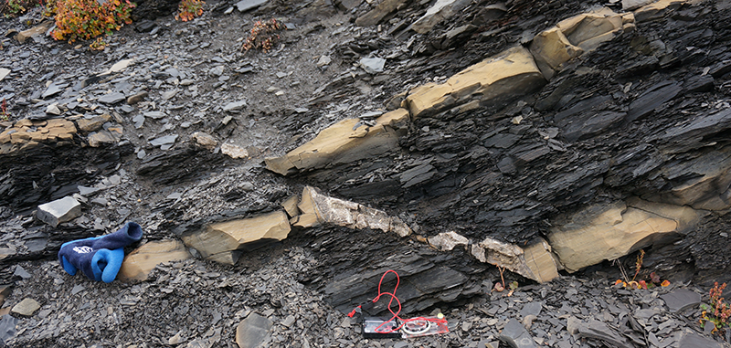
onlapping shales
person for scale
Tr _{T}
Tr _{B}
Tr _{B}
location
bedding
extensional faulting
bedding
normal fault growth monocline in Botneheia shales
Notes:
This is a normal fault monocline associated with one of the steep faults. The monocline composed of Botneheia Formation strata is onlapped by basal shales of the Tschermakfjellet formation, constraining its age.

Slide 7
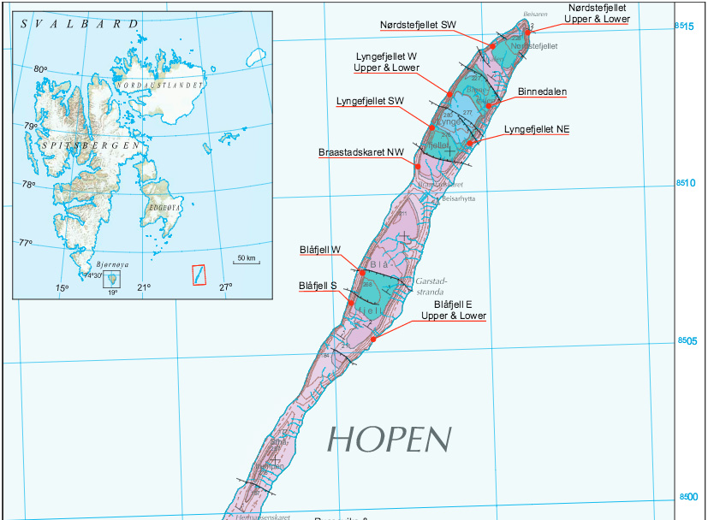
Steeply dipping faults on Hopen, significantly increases the footprint.
Edgeoya
Hopen
Map of northern Hopen from Lord et al. 2015.
Notes:
Moving from Edgeøya to Hopen – on Hopen there is a series of SSE-WNW trending normal fault, similar in orientation and character to those on Edgeøya, which helps to significantly increase the footprint of this faulting. Similar faults have also been recognized off shore.

Slide 8
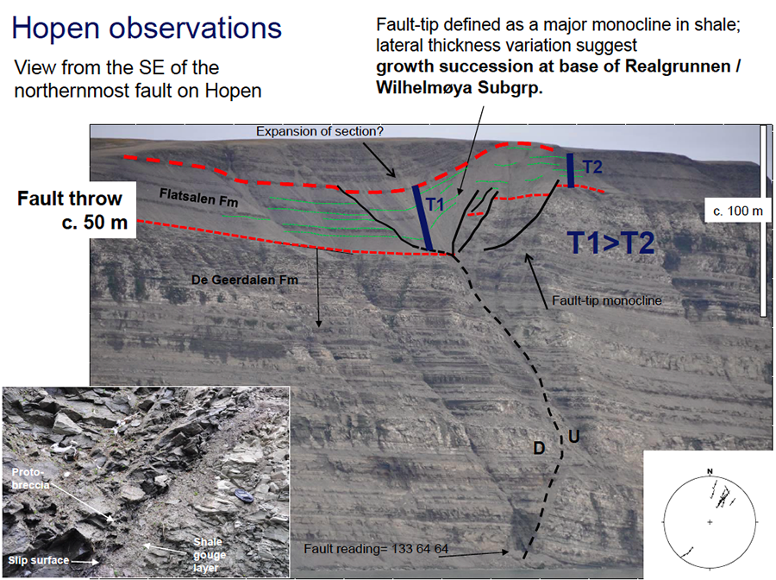
From Braathen, 2015, Tr N presentation
Notes:
On Hopen another monocline is associated with one of the faults, but this time with a growth section in sediments overlying the De Geerdalen Fm. This and abundant other similar observations on Edgeøya constrain synsedimentary faulting to have spanned the Carnian age Tschermakfjellet through DeGeerdalen section.

Slide 9
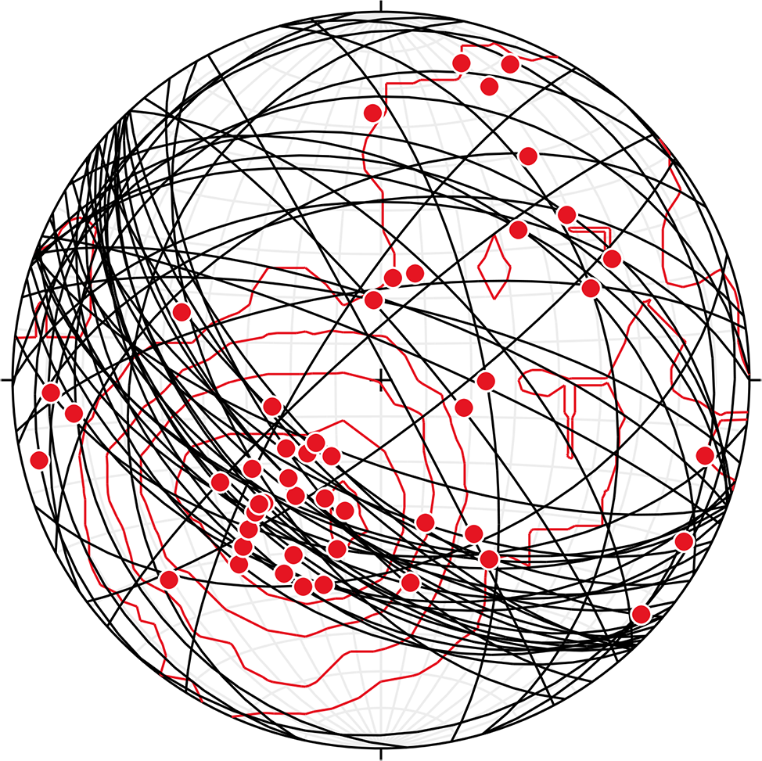
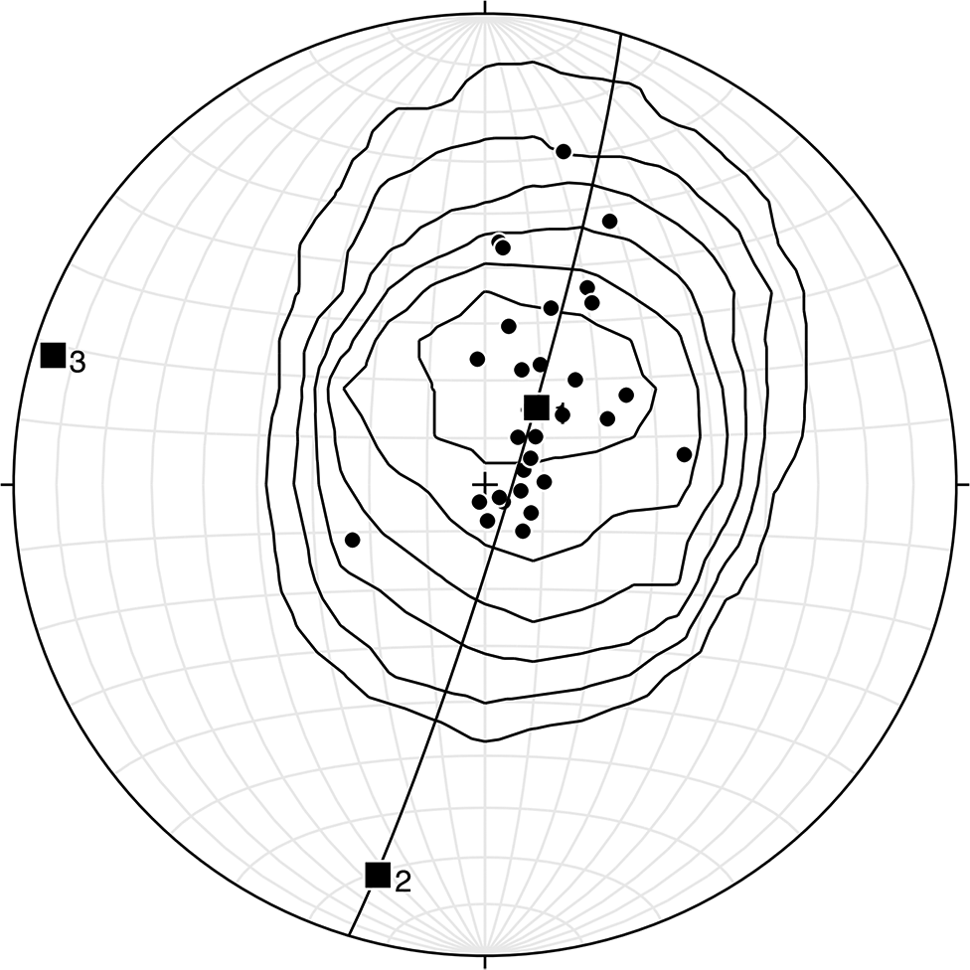
Fault planes (in black) & striae (red) w Kamb contour plot of striae from Triassic, Edgeøya and Hopen. n = 55 faults, 49 striae, c.i. = 2 sigma.
210-53
Kamp plot of poles to bedding planes from three monoclines associated with steep faults on Edgeoya. c.i. = 2 sigma.
girdle strike = 196
Notes:
Data on the steep faults from both Edgeøya and Hopen paints a noisy, but somewhat consistent picture of NE – SW extension, with south facing normal faults dominating. The girdle of poles to bedding in associated monoclines is roughly aligned with this direction.

Slide 10
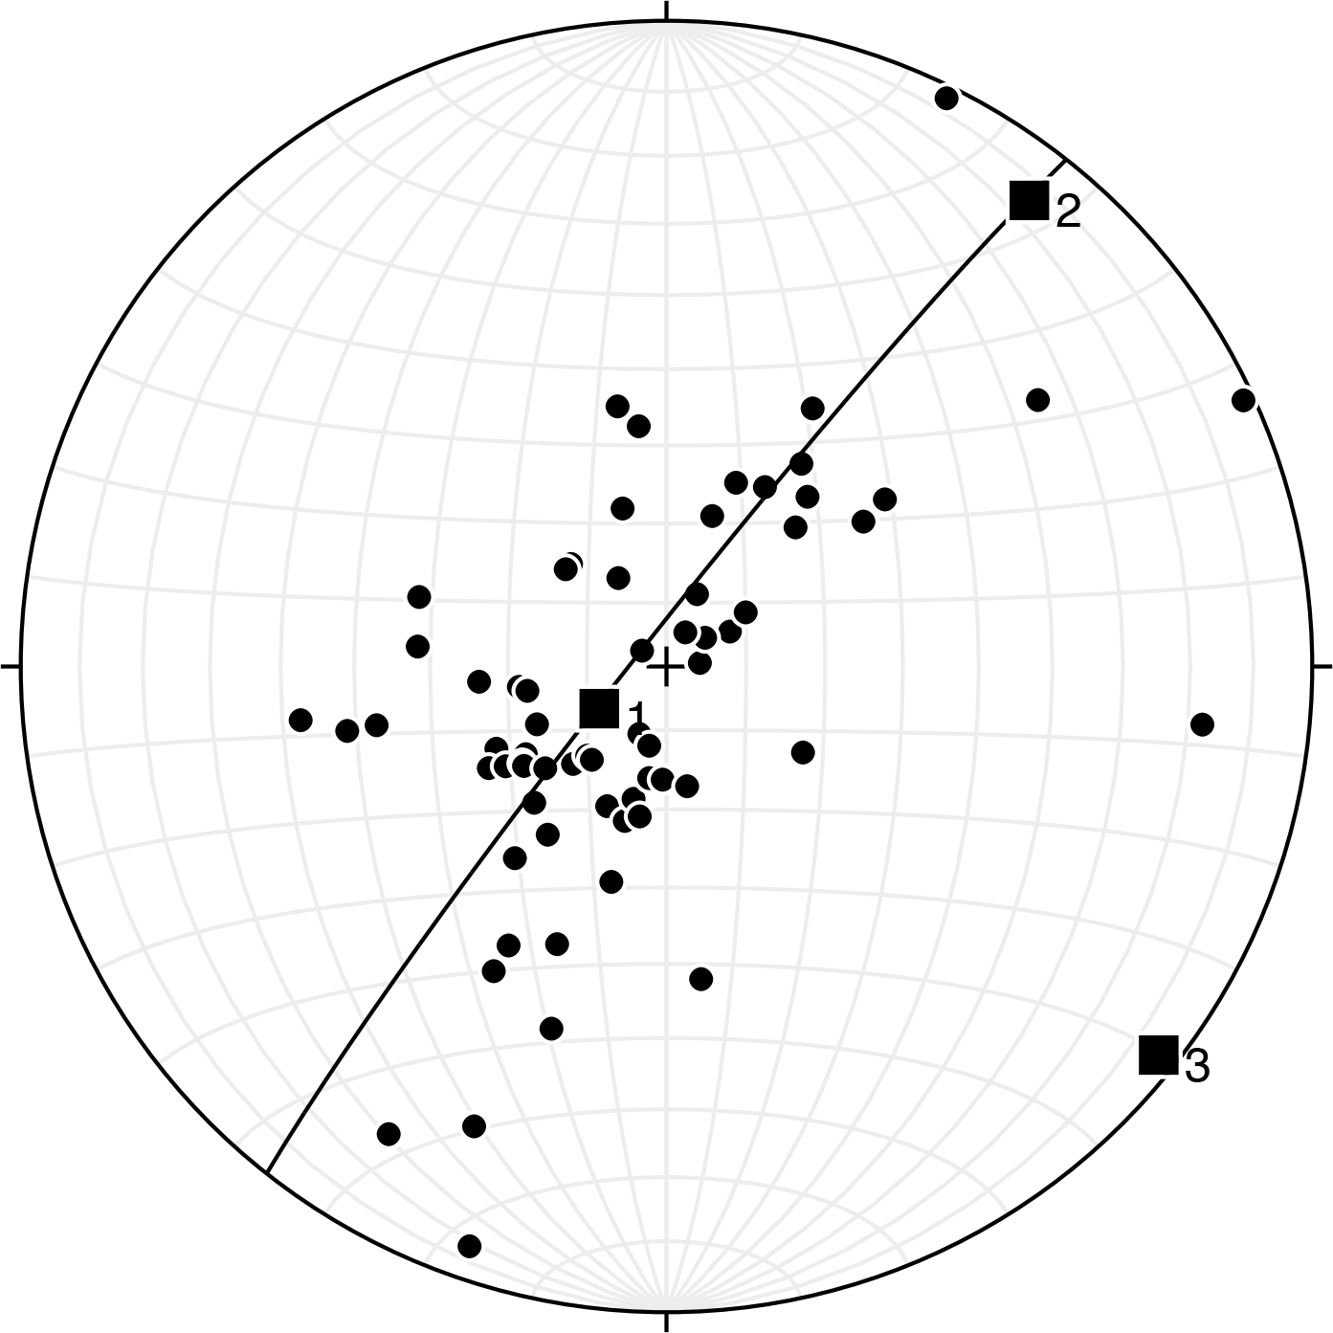
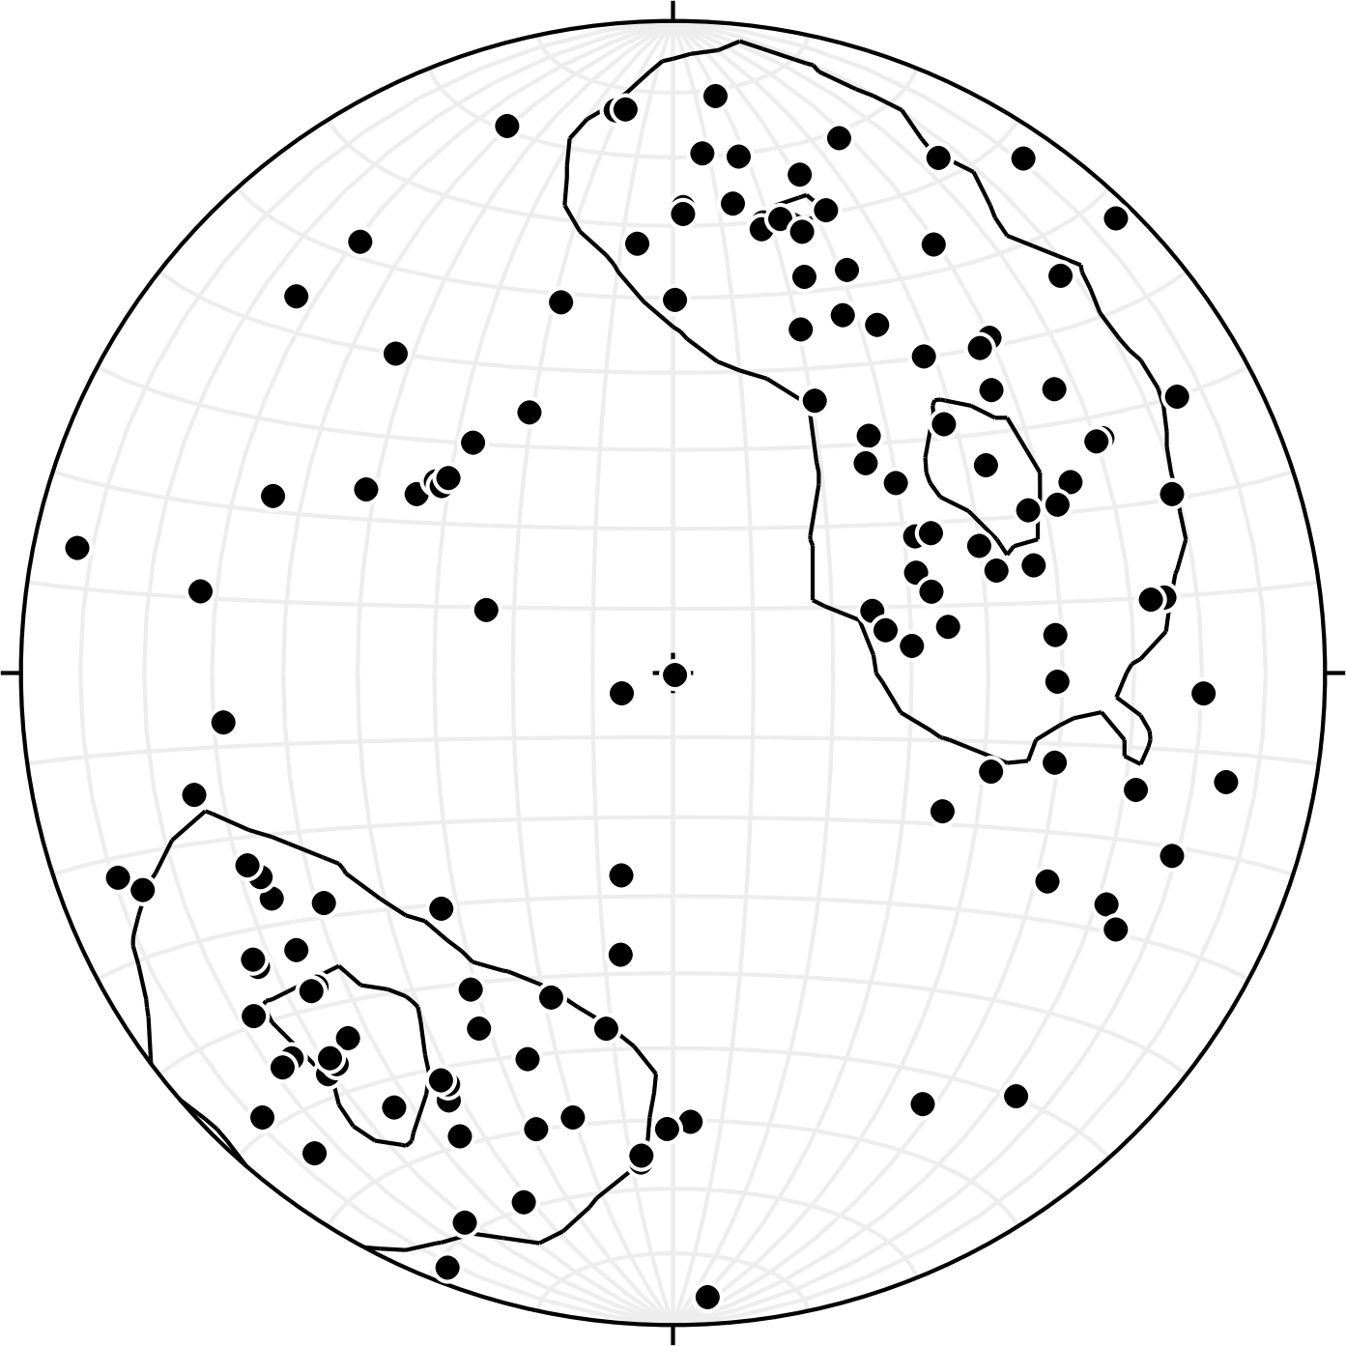
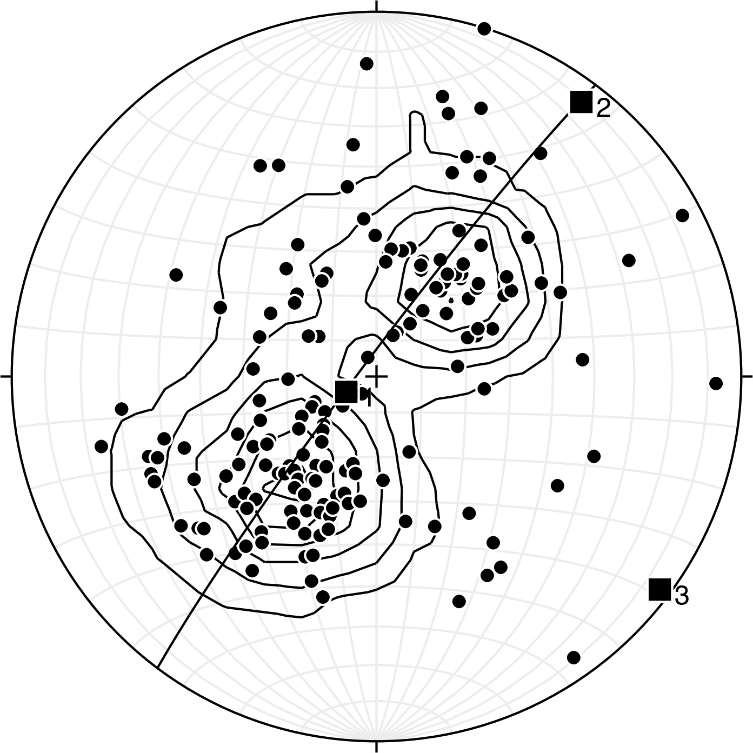
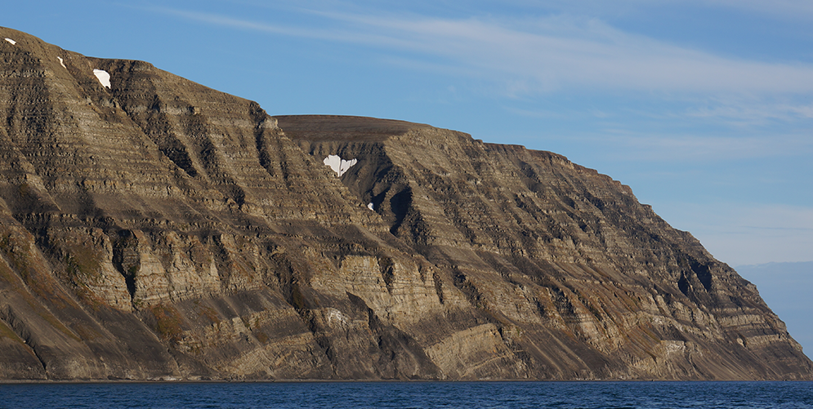
Kinematics of thin-skinned faulting
at Kvalpynten
14-27
219-16
Fault striae,
n = 151, Kamb plot with c.i. of 4.
56-42
Poles to rotated bedding,
girdle plane 218-86, n = 68
Poles to fault planes,
n = 175, girdle plane 217 -86. Kamb plot c.i. of 3.
Kvalpynten cliffs
S
Notes:
A focal site for studying the thin-skinned deformation where the Kvalpynten cliffs where 14 growth basins are exposed in a 7 km long section 400 to 500 meters high cliffs. Three of the growth basins are shown here. Plots of poles to rotated bedding, fault striae, and a suite of conjugate fault planes are all consistent with NE-SW extension. The upper basin portions are also dominantly down-to-the south.

Slide 11
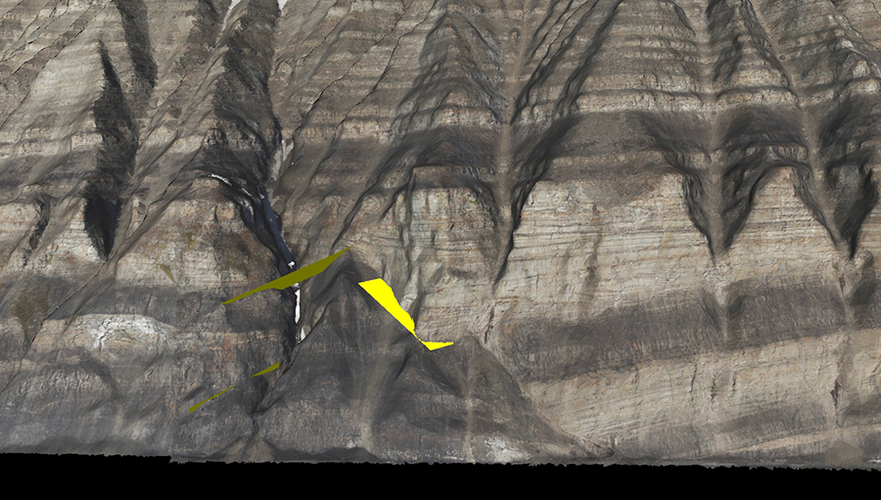
Georectified photogrammetric model of Kvalpynten cliffs viewed in Lime showing fault planes estimated by identifying three points on each
Poles to 35 fault planes measured in Lime with a common girdle striking 220.
Notes:
This is an image from a small portion of the the georectified photomosaic Lime model of the Kvalpynten cliffs. Lime software designed by Simon Buckley, allows strike and dip to be computed from 3 points chosen on the trace of on an assumed planar feature. Three such fault planes are shown here. The plot shows poles to 35 faults measured with Lime, and shows a pattern consistent with the field data, again indicating NE-SW extension.

Slide 12
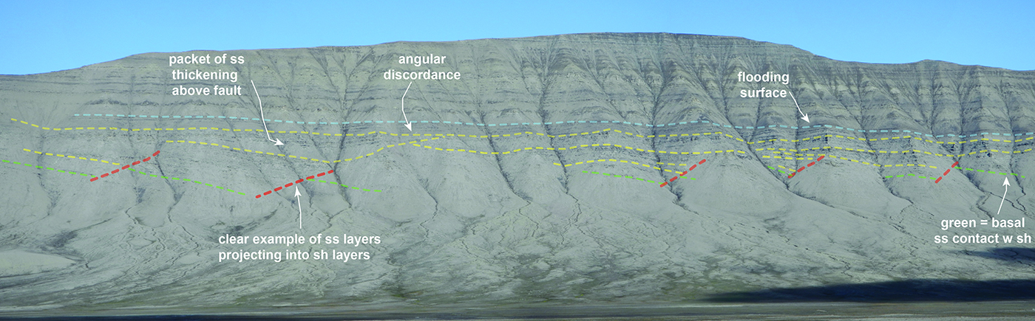
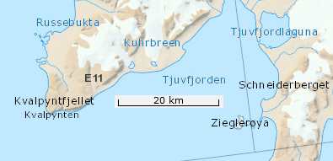
Data from Tjuvfjordskada
<- South
Tjuvfjordskada
Blue represents 19 poles to bedding, with a best-fit rotation axis of 126-1. Red are observed fault planes, green are the direction of oscillation ripple marks
Notes:
While the exposures are poorer and more limited data exists, south facing growth basins with similar kinematics were also seen at Tjuvjordskada to the east of Kvalpynten this last summer, and at the other localities.

Slide 13
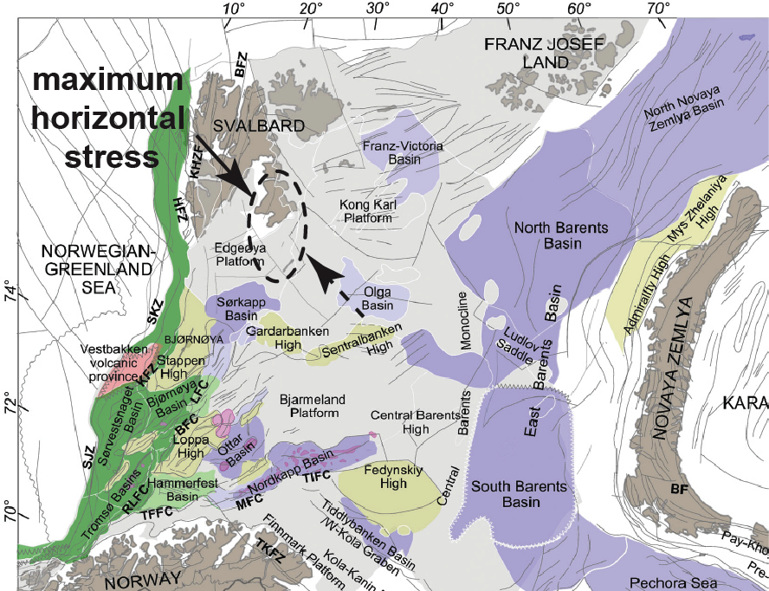
Syn-sedimentary Triassic fault summary
Primarily normal faults. Large footprint.
Faulting spans Tschermakfjellet through DeGeerdalen Fm. times.
Both thick and
thin-skinned have
south facing
synthetic set.
Kinematic data
suggests transport
directions for both
between 220 and 195.
This orientation
suggests a maximum
horizontal stress
highly oblique to
Novaya Zemyla.
Map from Marello et. al 2013
Notes:
Summarizing, the Triassic faults are primarily normal faults with a significant footprint and a consistent orientation that suggests a maximum horizontal stress in an orientation that is highly oblique to the ongoing Uralian orogenesis in the Novaya Zemyla area to the east. Syn-sedimentary faulting spans the Carnian

Slide 14
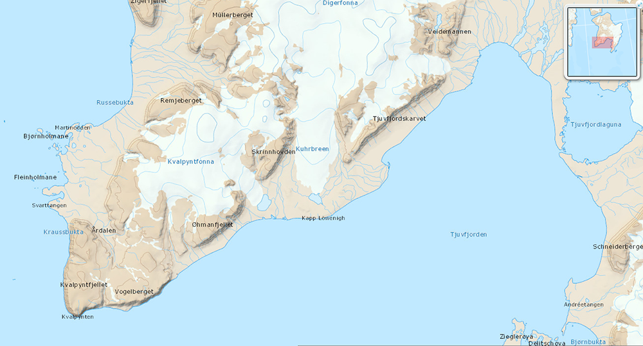
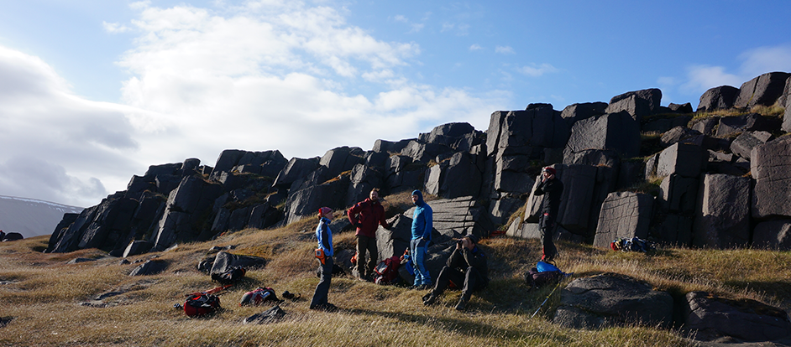
Interior 1
Interior 2
Andretangen
Walrus site
(Pongtongen)
Svartangen
Sill fracture study sites on Edgeøya.
Notes:
Now switching gears. These are the 5 study sites that data on fractures in the Cretaceous sills was obtained from on Edgeøya.

Slide 15
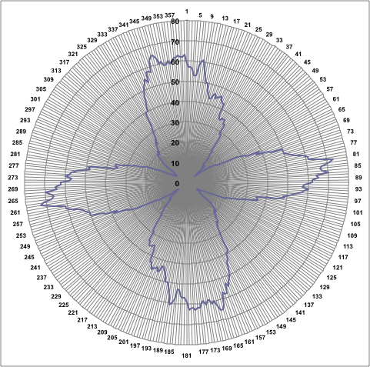
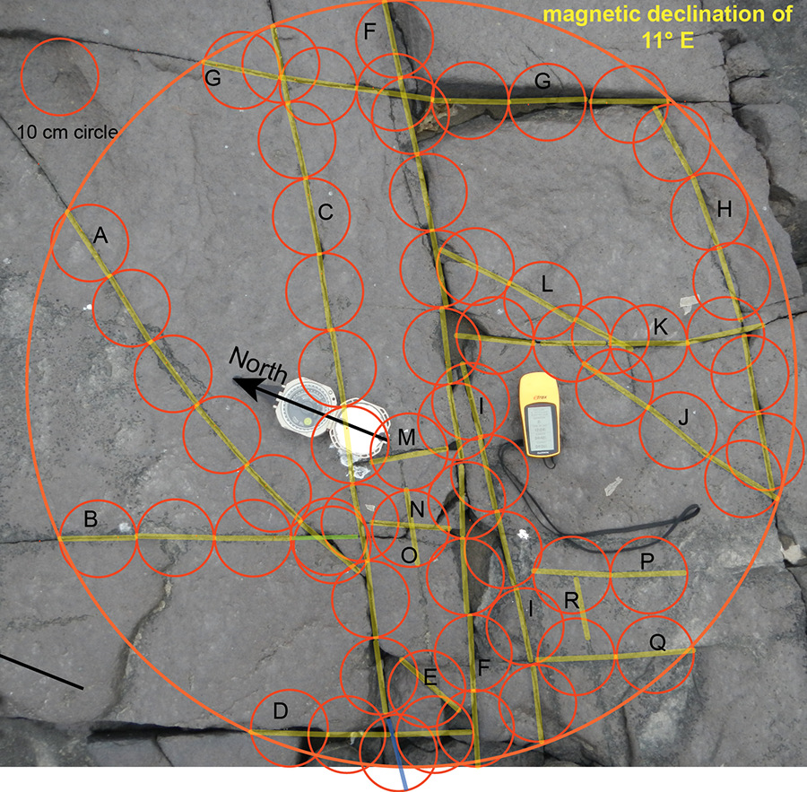
Composite plot for Svartangen diabase site: 6 photos, n = 412 line segments, 118 fractures, average fracture density of 6.9 m per m².
Interpretation: orthogonal joint set, both roughly equally developed, mutual truncation, hints of other fracture sets.
Notes:
In addition to fracture traverse data, vertical-axis, scaled and oriented photographs of sub-horizontal outcrops were taken. Fractures in the sills were predominantly vertical, and so most of the information is assumed to be in the strike distribution. 10 cm long line segment strikes were plotted as 20° sliding sector plots, a variant of a rose diagram. This length weighted approach avoids the strong directional bias inherent in traverse data. The plots is the aggregate result from 6 photos from the Svartangen study site. The data paints a fairly clear picture of two sub-orthogonal joint sets. Mutually truncating relationships such as seen in this photo can be interpreted as evidence for coeval formation of the 2 directions.

Slide 16
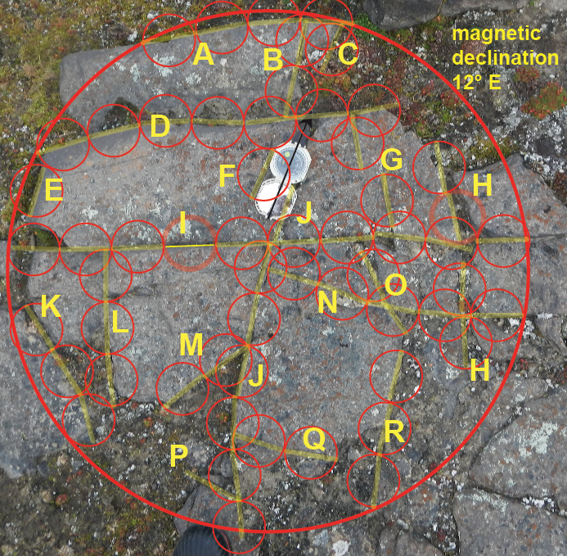
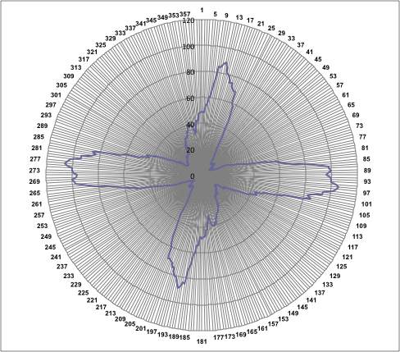
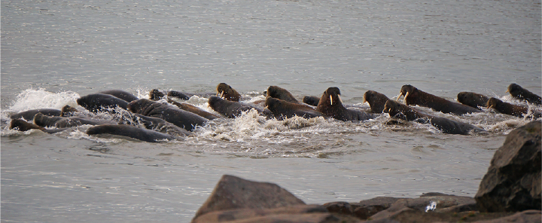
Walrus site: n = 355 segments, 102 fractures, average density = 7.5 m/m².
Interpretation: dominant orthogonal set w subordinate set.
Notes:
This is another example called the walrus site. Note the general similarity of the orientations. Field observations suggest that there are three preferred directions represented here.

Slide 17
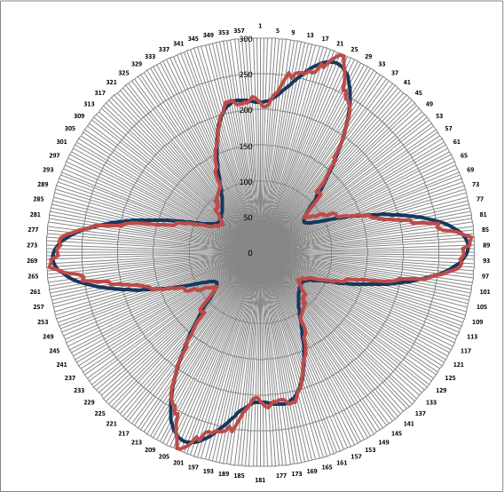
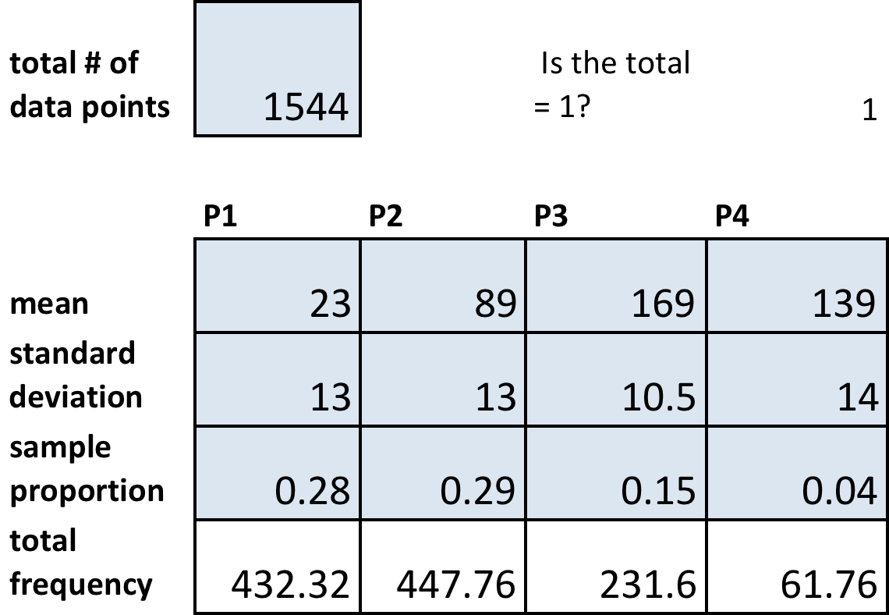
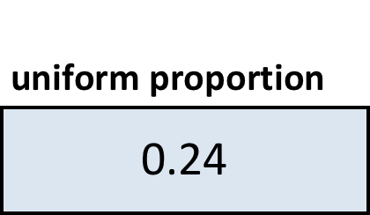
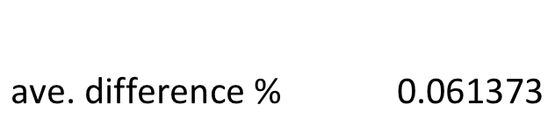
Statistical model of diabase sill strike distribution from 5 sites on southern Edgeøya: n = 1875 segments from 427 fractures.
Model: 4 normal distributions + uniform component, produced by a reiterative best fit.
Notes:
Aggregating all the sill data from the 5 sites on Edgeøya leads to this plot for the sill fracture strike distribution. It has been statistically modeled through reiterative best fits by eye as polymodal set of normal distributions. Note that the two sets in red are within one degree of being perpendicular, and are roughly evenly expressed. The green set at 23 degrees azimuth is also particular well developed and is interpreted on the basis of field relationships as a joint set that developed later (perhaps Tertiary in age).

Slide 18
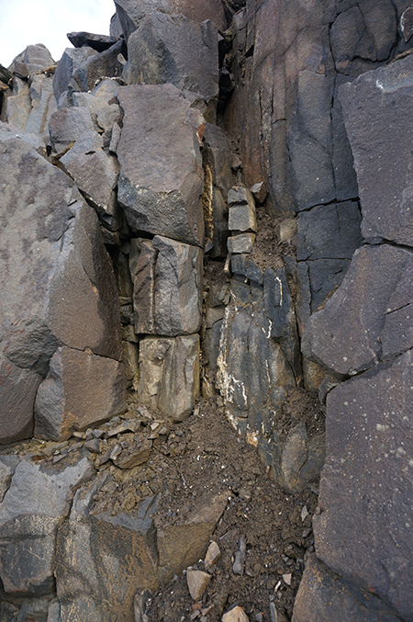
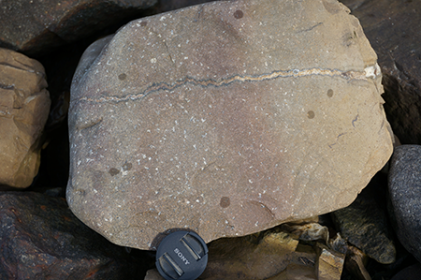
Photograph of veins in diabase at Andretangen, parallel to the two orthogonal directions.
These veins often taper into the sill interior, and are interpreted to be related to post-emplacement cooling.
Notes:
The contact with the Triassic host rock was exposed at the base of this sill along the shore, and one could clearly see veins ornamenting the orthogonal joint sets. The veins are most common at the margin and tapered into the sill, a geometry consistent with their being chill margin related veins and fractures.

Slide 19
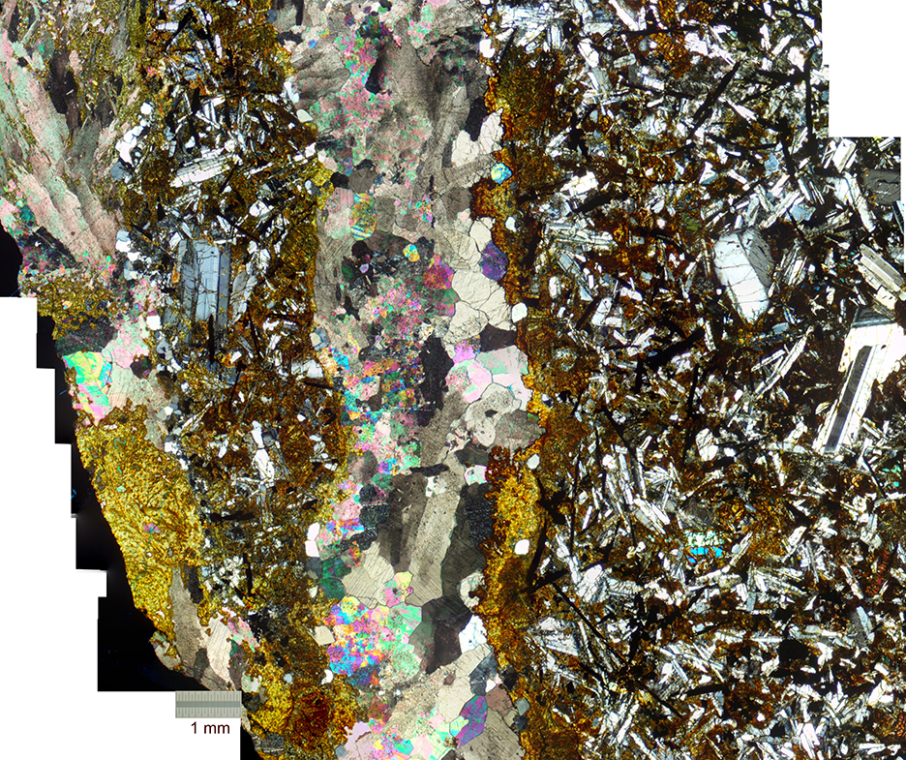
Notes:
This is a thin section mosaic under crossed polarizers of one of the calcite veins from Andretangen. In addition to calcite there is extensive alteration of the mafics to actinolite, chlorite and possibly iddingsite, an assemblage consistent with formation at higher temperatures during cooling.

Slide 20
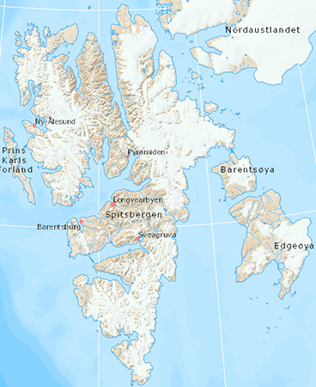
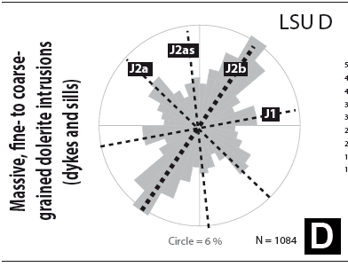
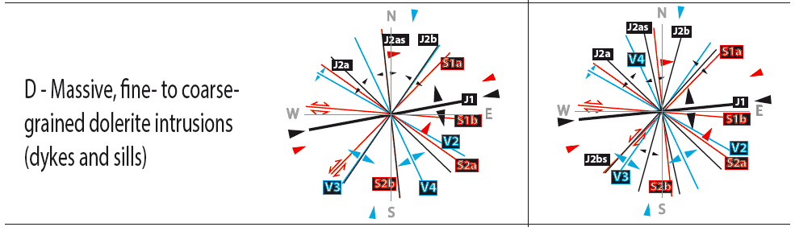
From Ogata et al. 2014, central Spitsbergen fracture study. J1 was identified as a “main fracture set” and possibly as related to cooling. Note also J2as in a orthogonal position.
Tertiary
fold-thrust
belt
Bed confined Through-going
Notes:
Now moving from the Edgeøya area to central Spitsbergen, extensive fracture studies have been done in relationship to a CO2 sequestration project. Fracture patterns are more complex than on Edgeøya, very likely due to the proximity to the Tertiary fold-thrust belt. Within the diabase sills an early set, designated here as J1 and J2as are of a common orientation to that found from Edgeøya, suggesting that this fracture set has an extensive footprint, and the authors suggest they are cooling related.

Slide 21
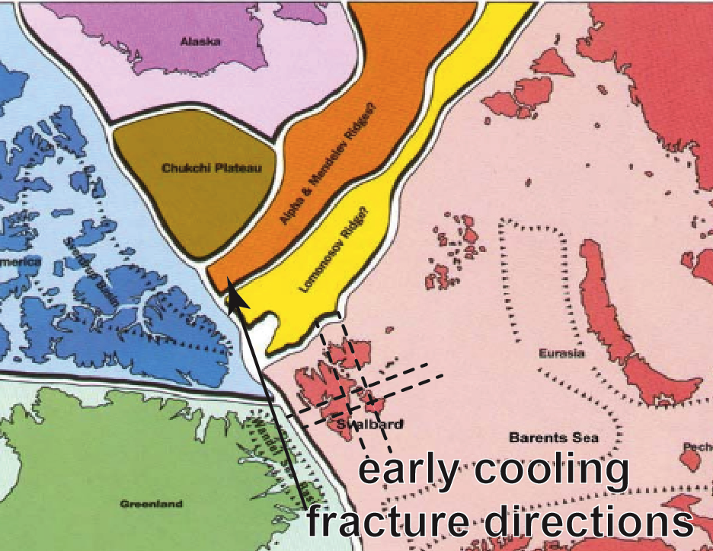
Sill fracture summary
Oldest joint sets in Edgeøya sill data - orthogonal just counterclockwise of E-W & N-S preferred orientations. Later set runs NNE-SSW.
Roughly equal development, consistent presence, and ornamentation by tapered
calcite veins at sill margins.
Interpreted as cooling
fractures oriented by the
regional stress field.
Sills in central Spitsbergen,
with more complicated
fracture distribution & history,
include same two
orientations.
Modified from Worsley 1986
Notes:
Now a quick summary of the sill fracture. On both Edgeøya and central Spitsbergen an orthogonal joint set that is roughly E-W and N-S oriented is interpreted to be sill cooling fractures oriented by the regional stress field. In both cases a later NE set is also evident.

Slide 22
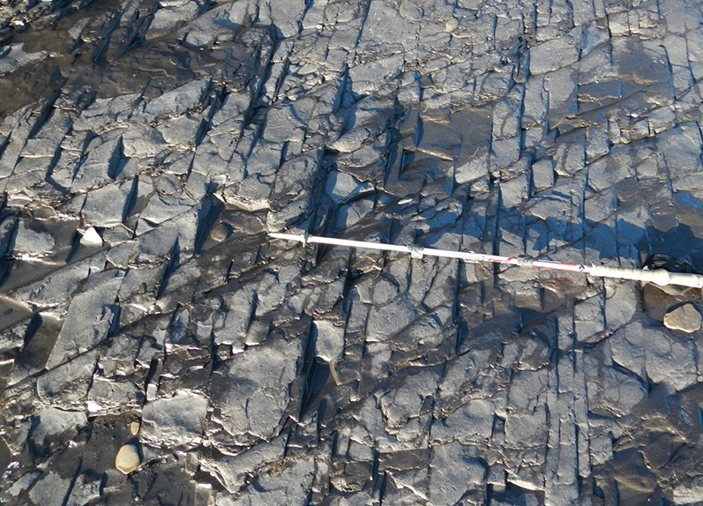
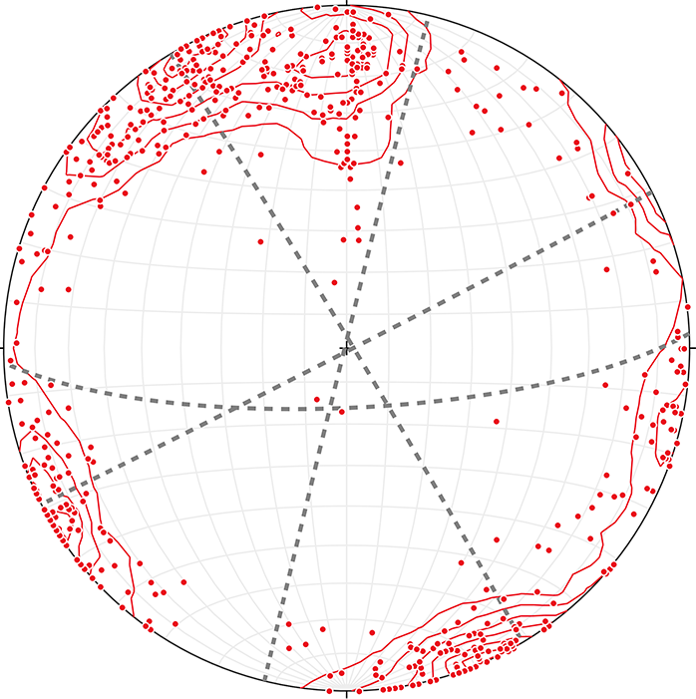
Tensile fractures in Triassic strata of Edgeøya, Central Spitsbergen, and Hopen
Kamb contour plot of poles to joints, n =565, with interpreted planes. Data from Lord and this study. Mostly traverse data and thus biased.
Example of ENE trending set of longitudinal joints (earlier). Outcrop from west most south facing cliffs on Edgeøya.
Notes:
Switching gears once again, we can now consider the joint patterns in the host Triassic strata. Pictured are two prominent joint sets in the Botnheia shales. On this composite contour plot of poles to joints with data both from the Master’s thesis of Gareth Lord, and from our work, the interpreted preferred orientations are marked. These two directions are similar to those seen in the sill, but all of this is traverse data, which is strongly prone to an orientation bias. Note the particular lack of a set aligned with the direction of Triassic fault established earlier.

Slide 23
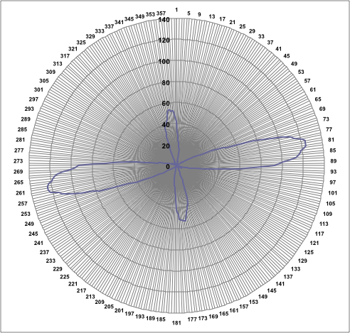
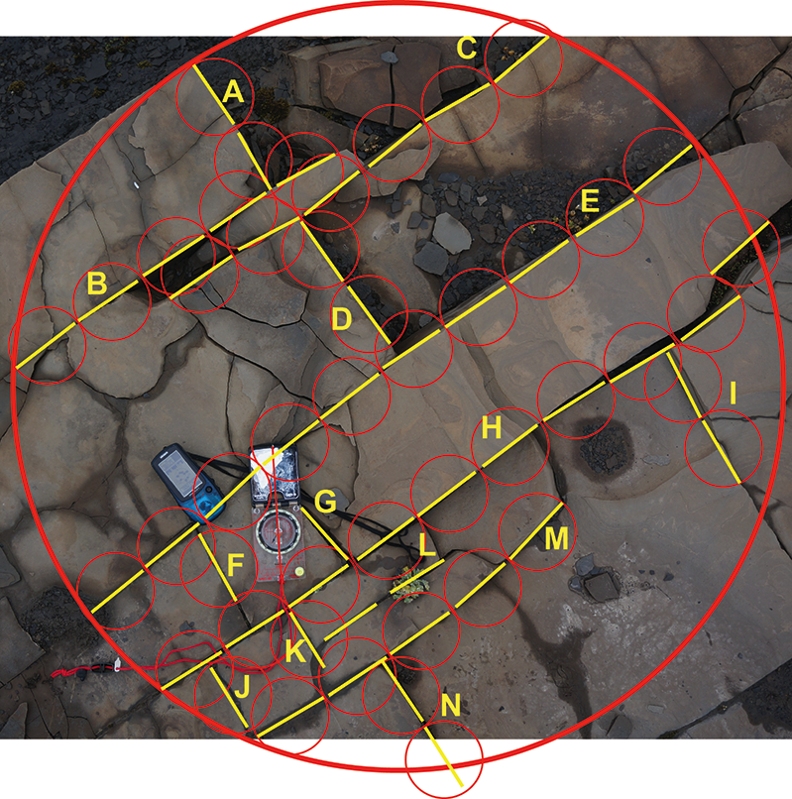
Sliding sector strike, plot one one study site, Edgeøya.
n = 212 line segments, 61 individual fractures
Fracture density = 6.2-6.3 m per m².
2 well developed orthogonal sets, with a longitudinal 70-80° with cross joints, similar to that in diabase .
Notes:
To avoid some of this bias, and allow for more direct comparison with some of the sill fracture data, length weighted fracture analysis was conducted at three sites in a manner similar to that done with the sills. This is an example of one of the photos and the plot results of all 4 photos analyzed from near the base of the Tschermakfjellet Formation in southern Edgeøya.. The ENE direction has a longitidunal geometry and ostensibly is the earlier set.

Slide 24
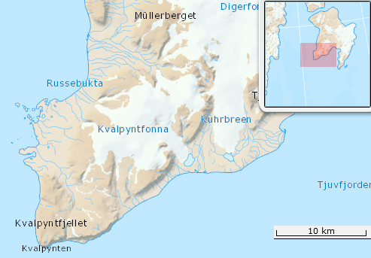
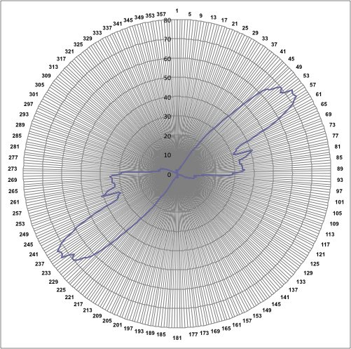

study site
Kvalpynten site: n = 148 line segments, from 65 fractures.
Interpretation: Two well developed ENE trending sets, at low angle to each other.
Notes:
These are some results from the Kvalpynten site. Note the two sets at a low angle.

Slide 25




Edgeøya Triassic strata fractures Edgeøya diabase sill fractures
n=250 fractures,
506 segments, 3 sites
n=427 fractures,
1875 segments
Both share similarly oriented orthogonal joint sets, more symmetrically developed in the diabase. Other sets differ.
Notes:
This shows the Edgeøya Triassic strata preferred orientations in a manner similar to done with the sill samples. Comparing the sill and host strata plots they share the orthogonal almost E-W and N-S pair, although the E-W set strongly dominates in the host Triassic strata. Again, the absence of the NNE set aligned with syn-sedimentary faulting in the host Triassic strata is notable.

Slide 26



Central Spitsbergen Triassic strata, fracture strike distribution (n=358), data from Lord (2013)
Modeled as 2 sub orthogonal sets, roughly 20 degrees from each other.
Traverse data – directional bias possible.
Notes:
Lord also collected a substantial dataset from Triassic strata in the Central Spitsbergen area, and statistically modeling this in a similar mode results in four directions that can be interpreted as 2 sub-orthogonal pairs about 20 to 25° from each other. However, this is a traverse data, and it should be remembered that the strength of the different modes may be influenced by directional bias.

Slide 27


Strike orientation data from Ogata et al. 2014, from the DeGeerdalen and Agardhfjellet Formations from the Central Spitsbergen area
Note the consistently well developed almost EW set J1, similar to the Lord data.
Notes:
Work in central Spitsbergen by Ogata et al. shows a somewhat similar pattern for roughly E-W directed joints in Triassic and Jurassic strata, but with the more N-S orthogonal fractures absent or much less well expressed.

Slide 28

Arguments that E-W trending regional joint set in Triassic strata is HALIP related:
sub-parallel to interpreted
sill cooling fractures.
similar calcite ornamentation
adjacent to sill.
appropriate loading paths :
> erosional unloading during differential HALIP uplift & formation of Upper K unconformity
> possible thermal effects (pore pressure increase, cooling contraction). Krajeski et al. document significant thermal effects of sills on Edgeøya.
Notes:
Focusing on the E-W trending regional joint set for the moment we would like to suggest that this set can be associated with HALIP. Not only is it aligned with cooling fractures in the sill, and the previously mentioned calcite veining on Edgeøya extends into the host sediment proximal to the sill, but a variety of possible loading paths can be inferred. These include possible thermal effects of the sill, including its influence on pore pressures in confining shales. Krajeski et al. document unusually high thermal maturity for the Edgeoya Triassic strata that they directly attribute to sill intrusions. In addition, there is evidence of Cretaceous differential erosion and uplift in the Svalbard, greater to the NW, that could have produced erosional unloading.

Slide 29


Conclusions
Syn-sedimentary Carnian normal faulting indicates a maximum horizontal stress traction oriented roughly SE-NW in eastern Svalbard.
A coeval regional joint set is absent in host Triassic strata.
An oblique extensional stress regime locally existed in the far foreland of Novaya Zemyla orogensis during the Triassic.
A regionally coherent orthogonal cooling joint set is expressed in the Aptian sills & adjacent Triassic strata, with an E-W dominant set in the strata.
HALIP may have induced a regional jointing episode in host Triassic strata.
The maximum horizontal regional stress direction shifted counterclockwise from the Triassic to the Cretaceous.
This Cretaceous direction is roughly aligned with the developing Amerasian basin margin.
Hancock et al. 1987
just about midnight
Notes:
The Carnian was characterized by minor distributed extension consistent with the maximum horizontal stress traction oriented SW-NW, distinctly oblique to the Uralian convergence to the east. The diagram in the corner is just to remind us of the substantial literature on foreland extensional stress regimes associated with convergent-collisional boundaries. Cooling fractures in Cretaceous sills suggest the maximum horizontal stress was more E-W, indicating a counter clockwise shift with time. HALIP related intrusion and uplift may also have induced a regional jointing episode in the platform cover strata. The Cretaceous direction is roughly aligned with the margin of developing Amerasian basin.
Thank you.

