Slide 1
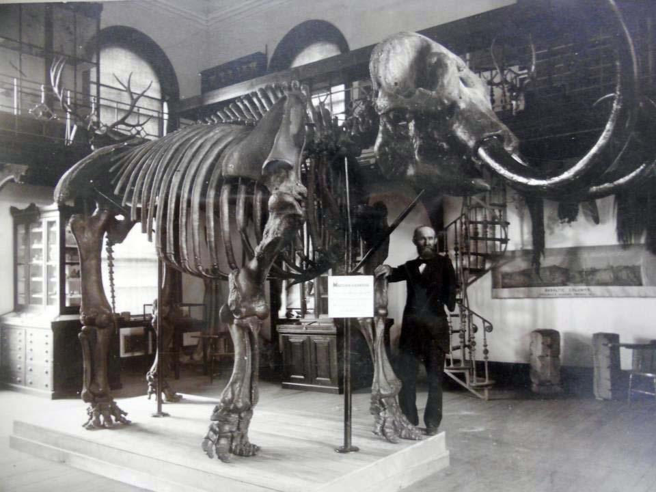
The Rutgers Geology Museum and its Role in the Evolution of the 19th and 20th Century Geoscience College Classroom
Rutgers University
Lauren Neitzke-Adamo- Rutgers Geology Museum
A.J. Blandford- Department of History
Ericka Gordor- Library Archives
Richard Olsson- Department of Earth and Planetary Sciences
Notes:
Thank you to my co-authors who have done the majority of the work putting the timeline and history together.
My role has been in consolidating the different resources and parts of the story which is still very much a work in progress.

Slide 2
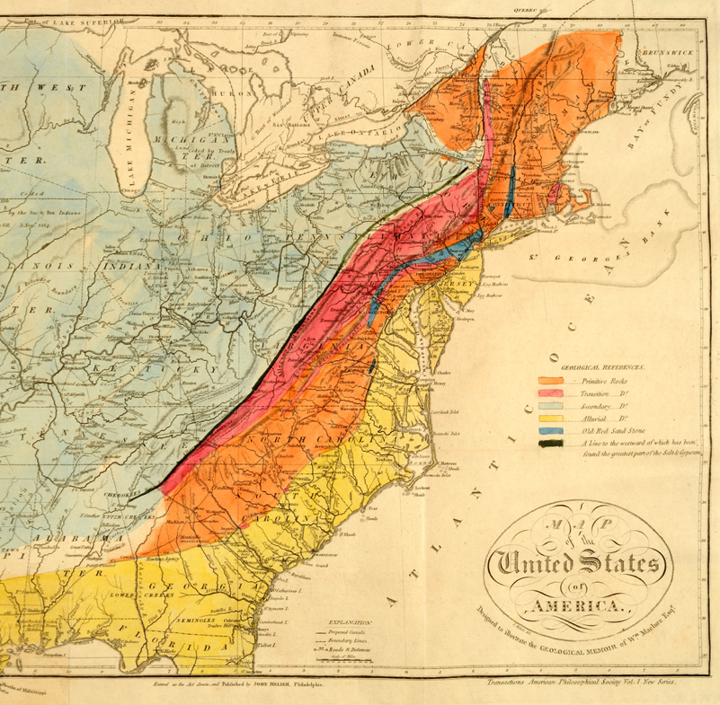
The Rise of Geology in the United States
1787- Samuel Latham Mitchill publishes “Geological Remarks on the maritime Parts of the State of New York”
1792- Mitchill teaches chemistry and natural history at Columbia
1809- William Maclure publishes geologic maps
1816- Parker Cleaveland publishes first geology text book.
1818- Geology articles begin appearing in the American Journal of Science
1830’s- MA, NY, and PA launch their own geological surveys
Geologic map published by Maclure and
included in Cleaveland’s geolgy text book.
Notes:
Brief overview and by no means is this a complete history but meant to provide a contextual framework for the importance of the work and events at RUGM.
Mitchill- publishes after returning from Edinburgh and was a member of the Natural History Society where James Hutton gave his first papers on Geology.
Mitchill starts teaching chemistry and natural history at Columbia College- probably first time anything close to geology was taught in US.
Mitchill founds American Mineralogical Society in 1798
Maclure not only called his map “geological” but his hand colored regions were based on first hand observations and collections of multiple samples. His colors were derived from Werner, the orange represent Primitive Rocks, the Pink Transition, the light blue Secondary, the yellow Alluvial, the dark blue is “The old Red Sandstone”, and the black line indicates the beginning of Slat and Gypsum regions.
Most of early texts and maps focused on the mineralogy and mining potential.
Cleaveland’s book was called “An Elementary Treatise on Mineralogy and Geology, used Maclure’s map
All of this is occurring at a time when the US is striving for financial independence from Europe, especially after the war of 1812.
Geology was popular because is was associated w/ personal and national financial improvement.
1st generation of professional geologists began to hold annual meetings which led to the 1st truly national scientific organization (American Association of Naturalists and Geologists)

Slide 3
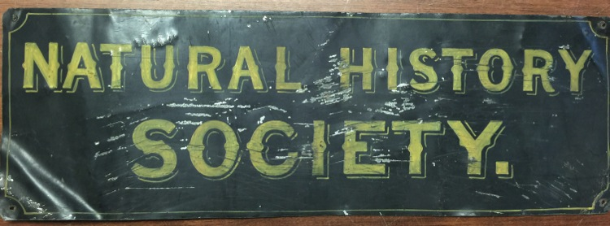
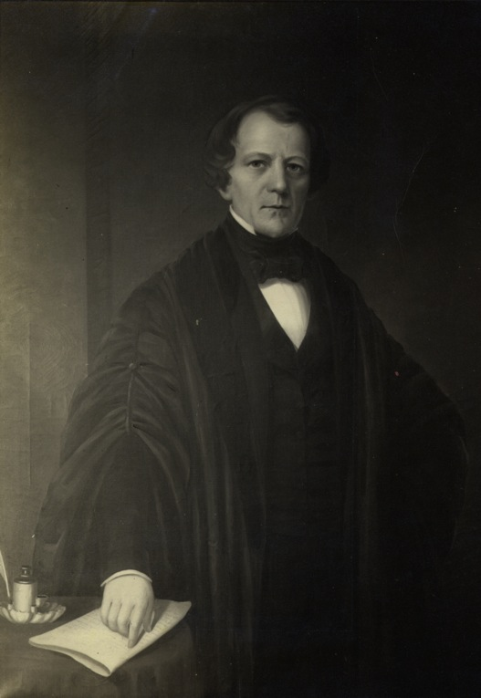
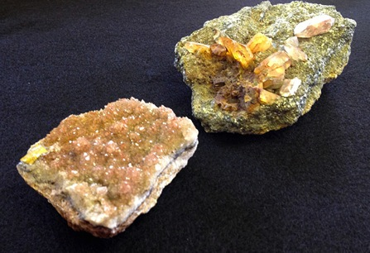
Geology at Rutgers University
1829- President was notified that John Finch was ready to teach a Geology course once a space and time were assigned.
1830- Student run Society for Natural History requests funds for a cabinet for the reception and preservation of specimens they collected.
1830- Lewis C. Beck starts teaching Geology and Mineralogy at Rutgers and greatly expands the mineral collections.
1853- George H. Cook appointed to succeed Beck. Became state geologist of NJ in 1864.
Beck
Collection
Lewis C. Beck
Notes:
Education was not confirmed to the classrooms.
Field trips common educational activity of the early 1800’s and students collected specimens and these became the basis for the University collections.
A demand arose that these collections be made available to everyone and created a market for jobs, texts, journals and public exhibitions.
1829- students petition president to create geology courses and a Mr. John Finch notifies university that he is ready to teach geology/mineralogy courses once space and time are available.
These lectures were open to the public and were attended by women as well.
Society for Natural History requests cabinet for the reception and preservation of the specimens collected by them. Showing that the collections pre-date museum and geology professors. Very small cabinet. Again unique because of student led initiative.
In 1830, Beck became the first Professor of Chemistry and Natural Science at Rutgers University. At the time he started teaching, only 11 academic institutions in the United States offered courses in geology, and Rutgers was the only one of these in New Jersey.
- From 1830- 1853
Beck was the head mineralogist for the New York Geological Survey, ultimately leading to his publication of a major volume of the Natural History of the State of New York
Beck’s notes support collections pre-date museum/geology courses.
By 1850’s most colleges possessed “cabinets” of specimen (mostly minerals but also fossils and artifacts). Collections were often augmented by collections of professors. Beck traveled extensively to add to growing cabinet. Still have this collection with many of the original labels.
Cook could be considered first curator of the “cabinet” but it was the bylaws of the Natural History Society that officially established the cabinet or the museum in 1857.
1864- Cook appointed State Geologist of NJ and head this position until his death in 1889

Slide 4
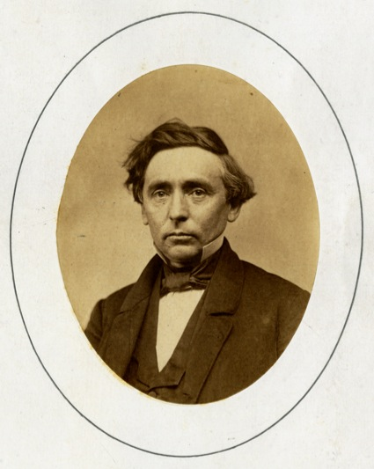
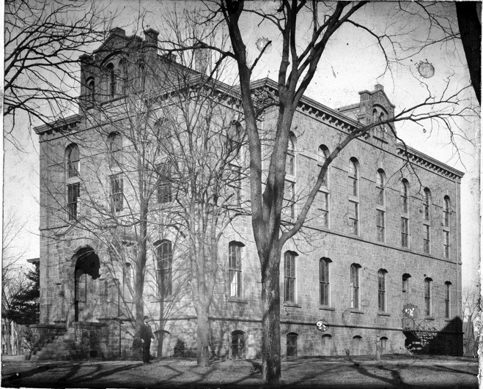
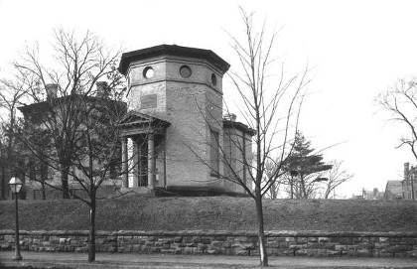
George Cook and the Morrill Act
1864- As VP of University Cook lobbied for funds after the passing of the Morrill Act under Lincoln.
  Faculty committee proposal for an observatory, astronomical apparatus and need for resources for scientific instruction, 1864 (first proposal for museum)
  Land Grant Status granted in April 1864
Schanck Observatory built in 1866
Geology Hall completed in 1872
  First structure devoted to scientific instruction and home to Geology, Physics, and Military Science
George H. Cook
Schanck Observatory
Geology Hall
Notes:
Cook is an extremely important figure in Rutgers History w/ an entire campus named after him.
Morrill Act of 1862
Museum proposed to accommodate the ever growing collection of which Cook added over 4,000 mineral and fossils
Rutgers designated the land grant college for New Jersey, April 1864
Rutgers Scientific School established 1864
Two courses of study—
Civil Engineering and Mechanics
Chemistry and Agriculture (geology falls under this group)
Building was built for the museum (still the museum on the 2nd and 3rd floors)
1st floor used for lectures and laboratory studies
Basement was an armory for studying military science.

Slide 5
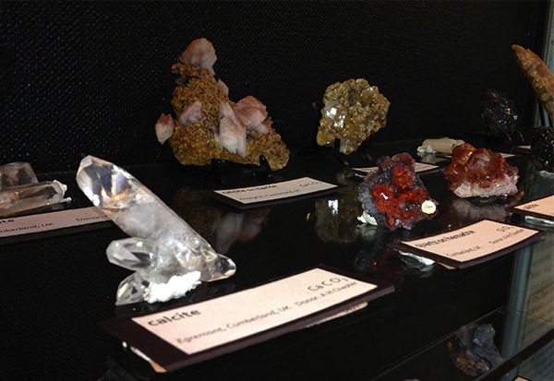
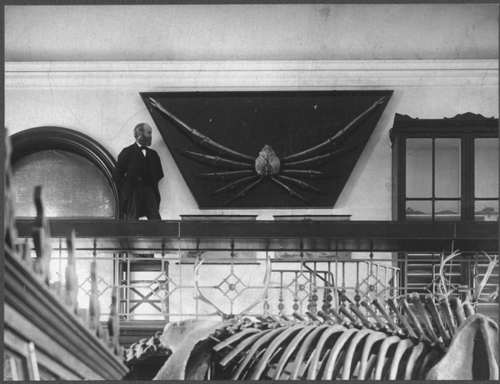
Early Years and Curators at the Museum
1892- A.H. Chester hired as first museum curator.
  Increased the museum collection by close to 5,000 specimen
1893- William S. Valiant hired as assistant curator.
  Responsible for reorganizing and labeling the almost 30,000 specimen in collections.
Chester
Collection
Notes:
Cook also purchased the Mannington Mastodon in 1870 for $300 but died before it was mounted in museum, has stood in museum since 1892.
Chester was professor of Mineralogy from 1893 to 1903
He worked with professors all over the world to grow the mineral collection to about 5,000 specimen.
Many were from type localities around the world (these in picture from Great Britain)
Wrote Dictionary of Mineral Names and their Etymalogies from studying the museum’s collections and was responsible for bringing mineralogy closer to the modern era
Valiant responsible for reorganzing entire museum and collections.
Starting in 1893, Valiant undertook a complete overhaul to arrange and describe the collection
Valiant was a self taught geologist and is often not credited w/ most of the work he did to organize the museum.
“The original condition of the museum was beyond description” and included a “conglomerate” if objects from an Egyptian mummy and skeletons to numismatic collection to botanic specimens, fossils, and minerals..”
“Here, there, and everywhere”
Strived to educate everyone who visited and encouraged questions.
Valiant become head curator when Chester retired (and was possibly doing much of the work before then), held that position until 1919
Collections assembled by cook, beck, chester, and valiant became teaching collections for paleontology and mineralogy classes.
Course held inside the museum and on the first floor in lecture hall.
All professors were responsible for teaching and helped with the development of the museum exhibits.

Slide 6
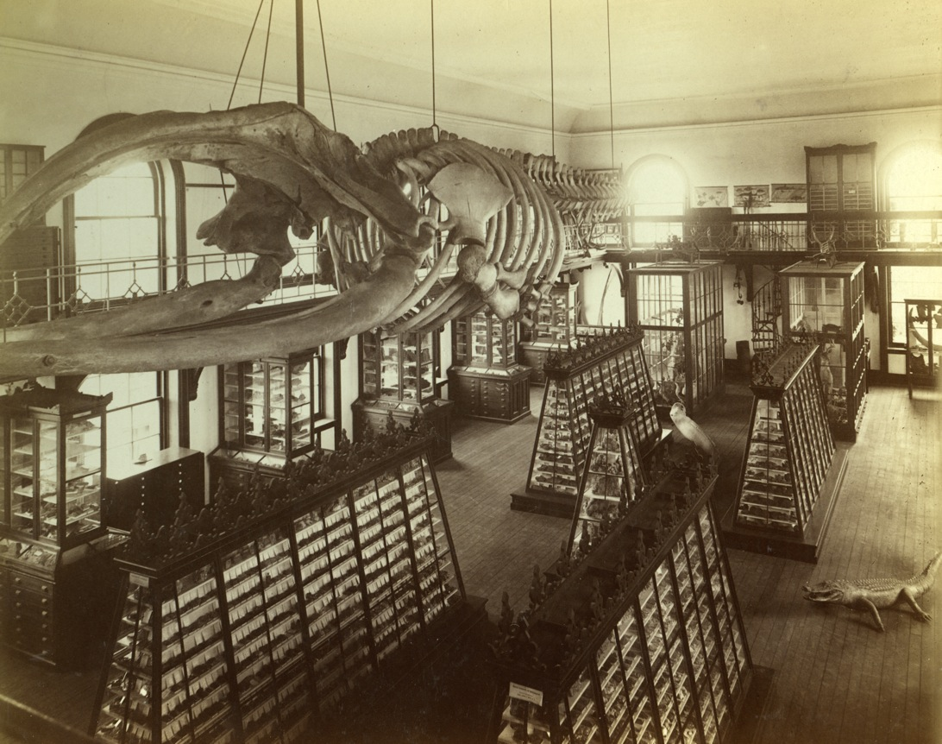
Geology Courses at the Geology Museum
Focus of early faculty was teaching and maintaining the exhibits in the museum.
Notes:
Classes held in museum and in lecture hall on first floor.
Other directors of note- Joseph Lewis until 1927.
Between 1926 and 1945 Geology courses were greatly expanded
Other major collections were acquired during this time
1940- Rowe collection of fluorescent minerals from Sterling Hill Zinc Mine
Minerals specific to NJ and no where else in the world.

Slide 7
How did students conduct research?
Visual scrutiny of objects
Notes:
Right whale hanging from the ceiling, no longer there (decayed)
Much of original victorian elements still there today. Original cases no longer there either.

Slide 9
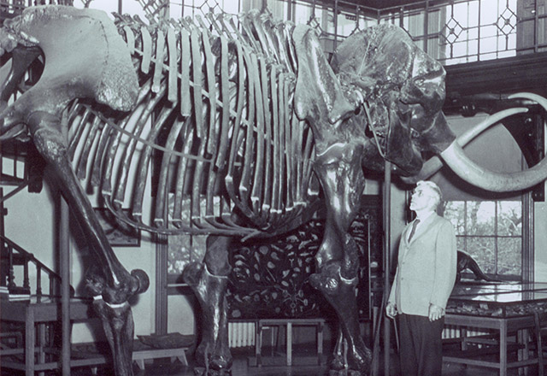
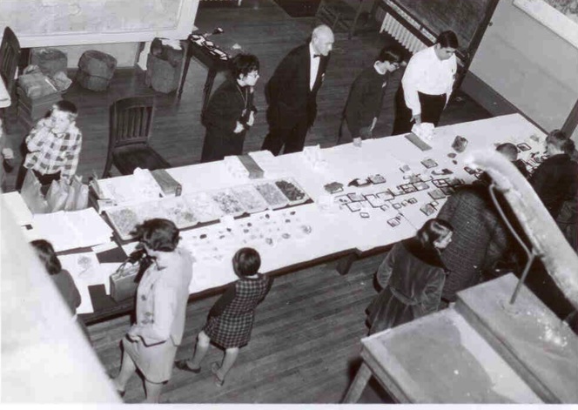
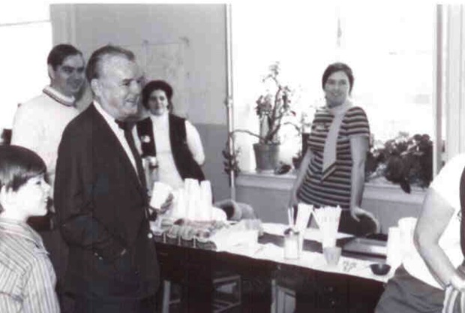
The Department of Geological Sciences
1931- Geology officially becomes a department
Albert Hayes responsible for expanding faculty and courses (1928-1945)
Focus of Department turned to research under tenure of Dick Olson.
Museum still open and faculty involved in exhibits.
First Open House in 1968
1977- Department moved to another campus
Albert Hayes
Notes:
Hayes responsible for transforming department into more of its modern form.
First BS in 1931
First MS in 1939
First PhD in 1938
Raymond Murray- Chairman of dept in 1967 started OH in 1968
Can see pictures from original OH house with mineral sale and all important coffee stand.
Prof. Steve Fox, who was a favorite amongst the students
This OH will be going into it’s 49th year.
Notable events at OH, Moon rock displayed in 1972, Ballard gave 1st public lecture on discovery of the Titanic in 1986
Department moved out of museum and to another campus in 1977
Faculty continues to expand in early 1980’s

Slide 10
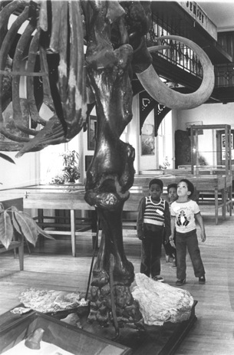
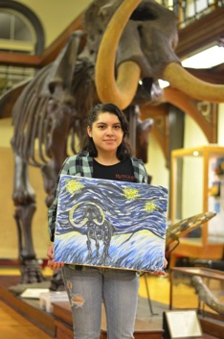
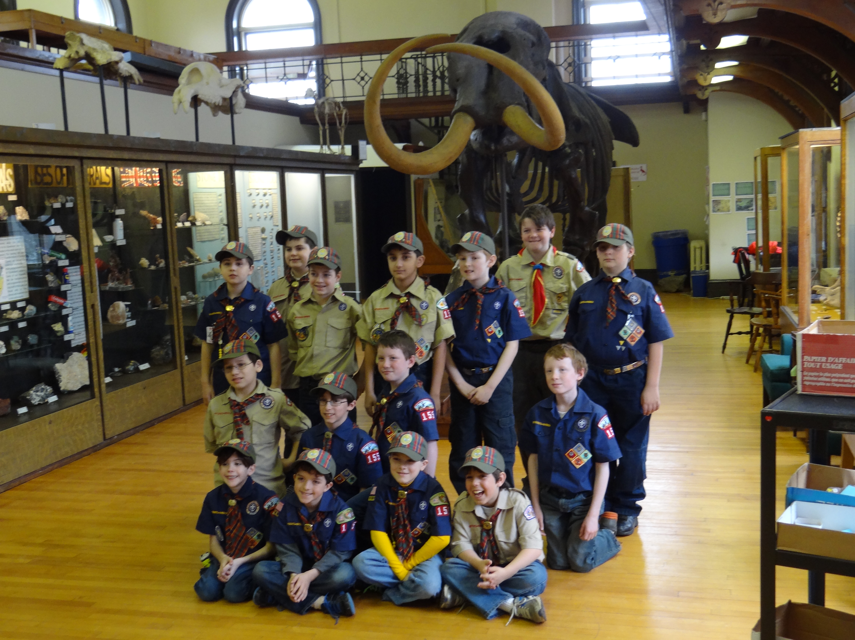
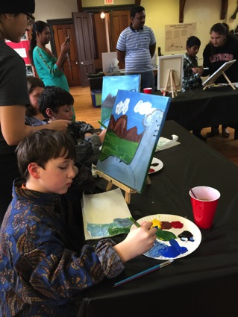
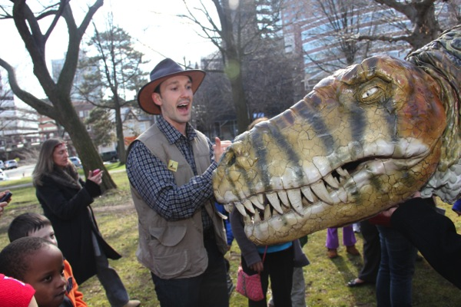
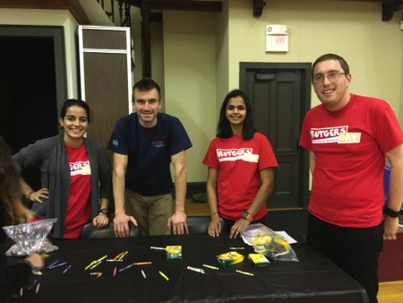

Museum as Outreach Center for Community
Outreach center for NJ and Rutgers Community
K-12 tours offered for first time in the 1970’s
Varity of tours, events, and field trips offered to all ages and special interest groups that cover Next Generation Science Standards.
Partner with centers and groups within and outside of Rutgers.
Provide professional development and training in science teaching for STEM Graduate Students.
Field Station Dinosaurs
Notes:
Outreach programs started in 1970’s when first offered tours to K-12 schools.
I started in 2009 and since that time have continued to the traditions while forging new relationships w/in and outside of RU
Other programs
4H
Undergrad internships- student presenting this afternoon from one of those internships
Graduate Students training
Boy scouts/ girl scouts
Field Station dinosaurs
Variety of college course (both ugrad and grad)
TEDx
Johnson and Johnson
Cake Boss TV event

Slide 11
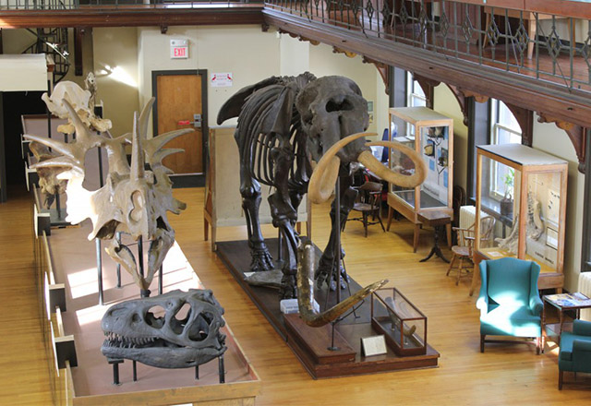
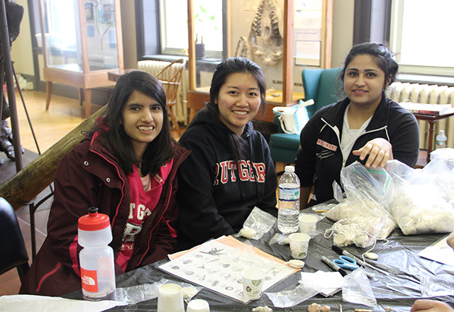
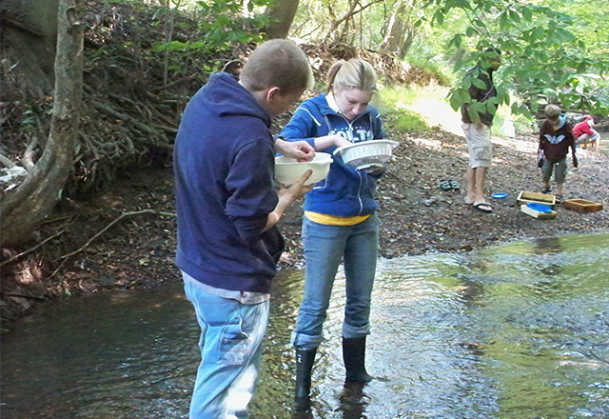
Conclusions
The Rutgers Geology Museum is not the oldest, but is one of the oldest geology museums in the country.
Unique that the original collections are still housed in the original space and the structural components are in tact.
The acquisition of the collections and the demand for geology courses was entirely student lead (Society for Natural History).
Mineral and Fossil collections remained the focal point of the faculty’s interest and courses for several decades.
Since the 1970’s the museum has remained an outreach center for the University and the NJ community.
Create awareness about global issues related to Earth Sciences and expand learning and understanding in the K-20 and older communities.

Slide 12
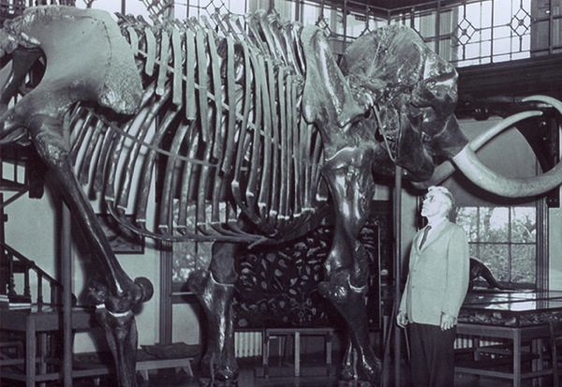

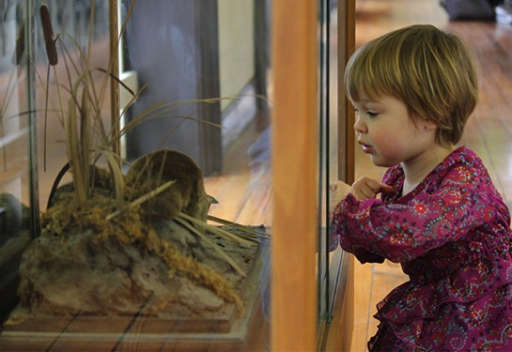
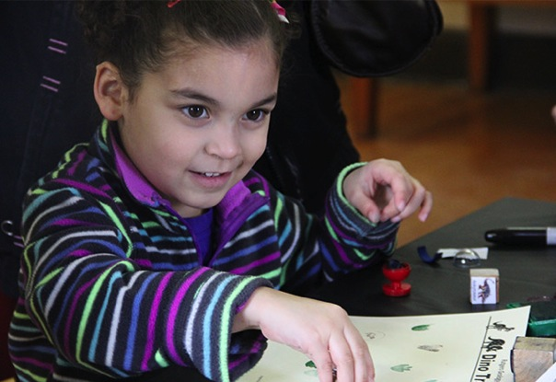
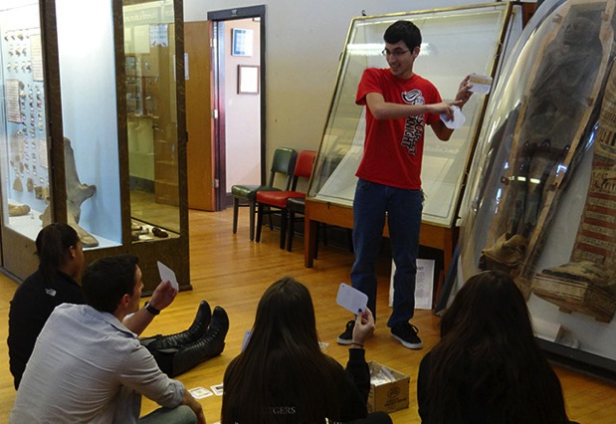
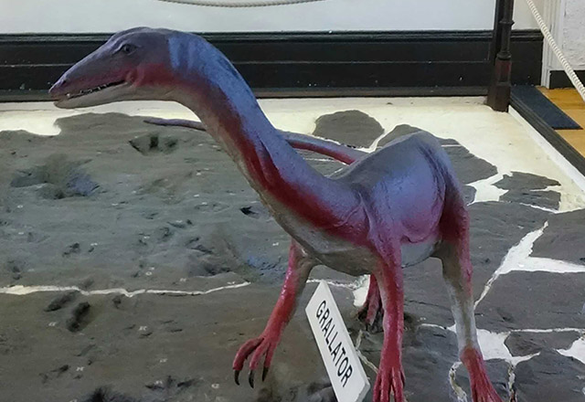
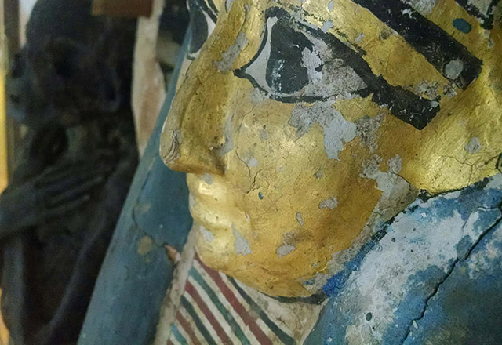
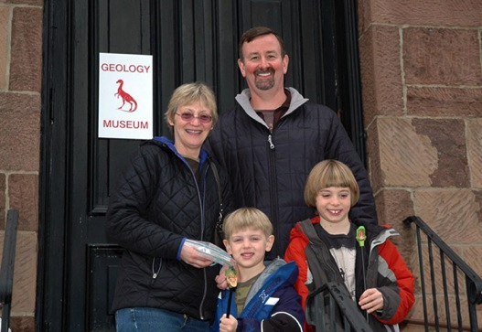
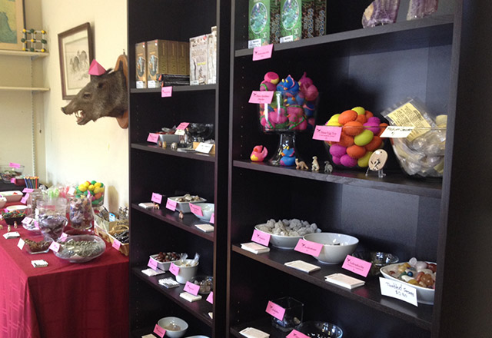
Thank you!
Email: Lauren.adamo@rutgers.edu
Web: geologymuseum.rutgers.edu

