Slide 1
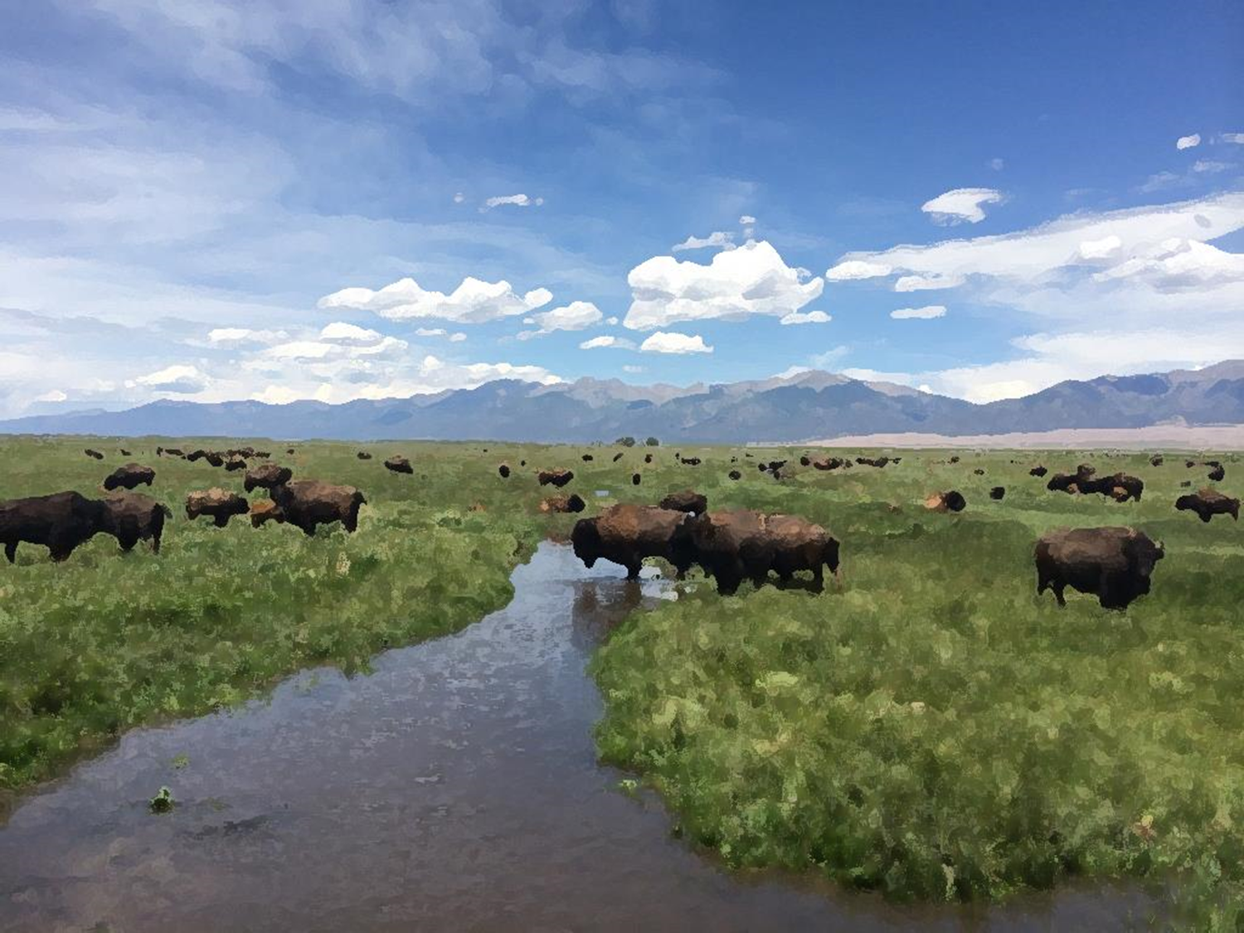

Using Lidar-Derived Digital Elevation Models to Determine Natural Stream Channels at Great Sand Dunes National Park & Preserve, Colorado
By Andrew Valdez
Geologist, Great Sand Dunes National Park & Preserve
Notes:
At Great Sand Dunes there is an inholding known as the Medano Ranch.
It’s owned by The Nature Conservancy and is an agricultural operation that raises Bison.
Ranching operations divert water out of stream for irrigation.
Once the purchase happens, the NPS will no longer irrigate and this could be an opportunity to reestablish streams in their natural channels.
140 years of agriculture and the flatness of the land have made traces of the former channel hard to find, so perhaps lidar data can useful.

Slide 2
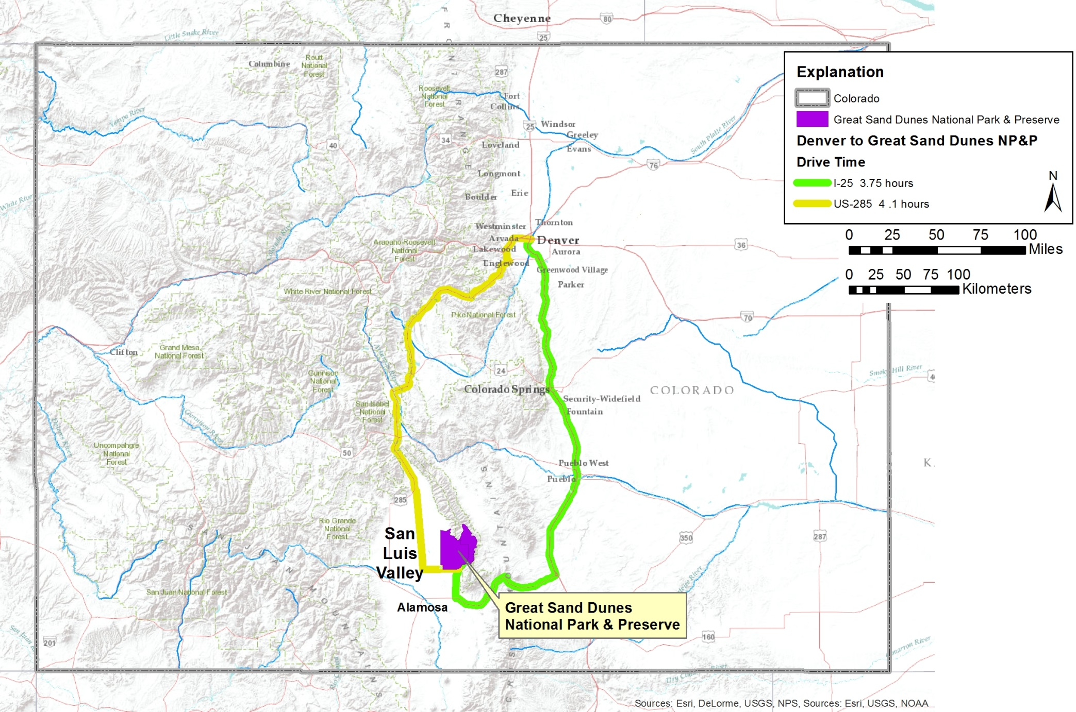
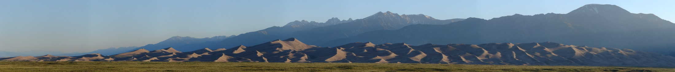
Location
US285
I-25
Photo by Molas (flickr)
Notes:
Great Sand Dunes National Park & Preserve is located in south-central CO in an area known as the San Luis Valley.
It’s 4 hours south of Denver and highlighted are a couple routes that will get you there.
This a view of Great Sand Dunes with the Sangre de Cristo Mountains behind them.

Slide 3
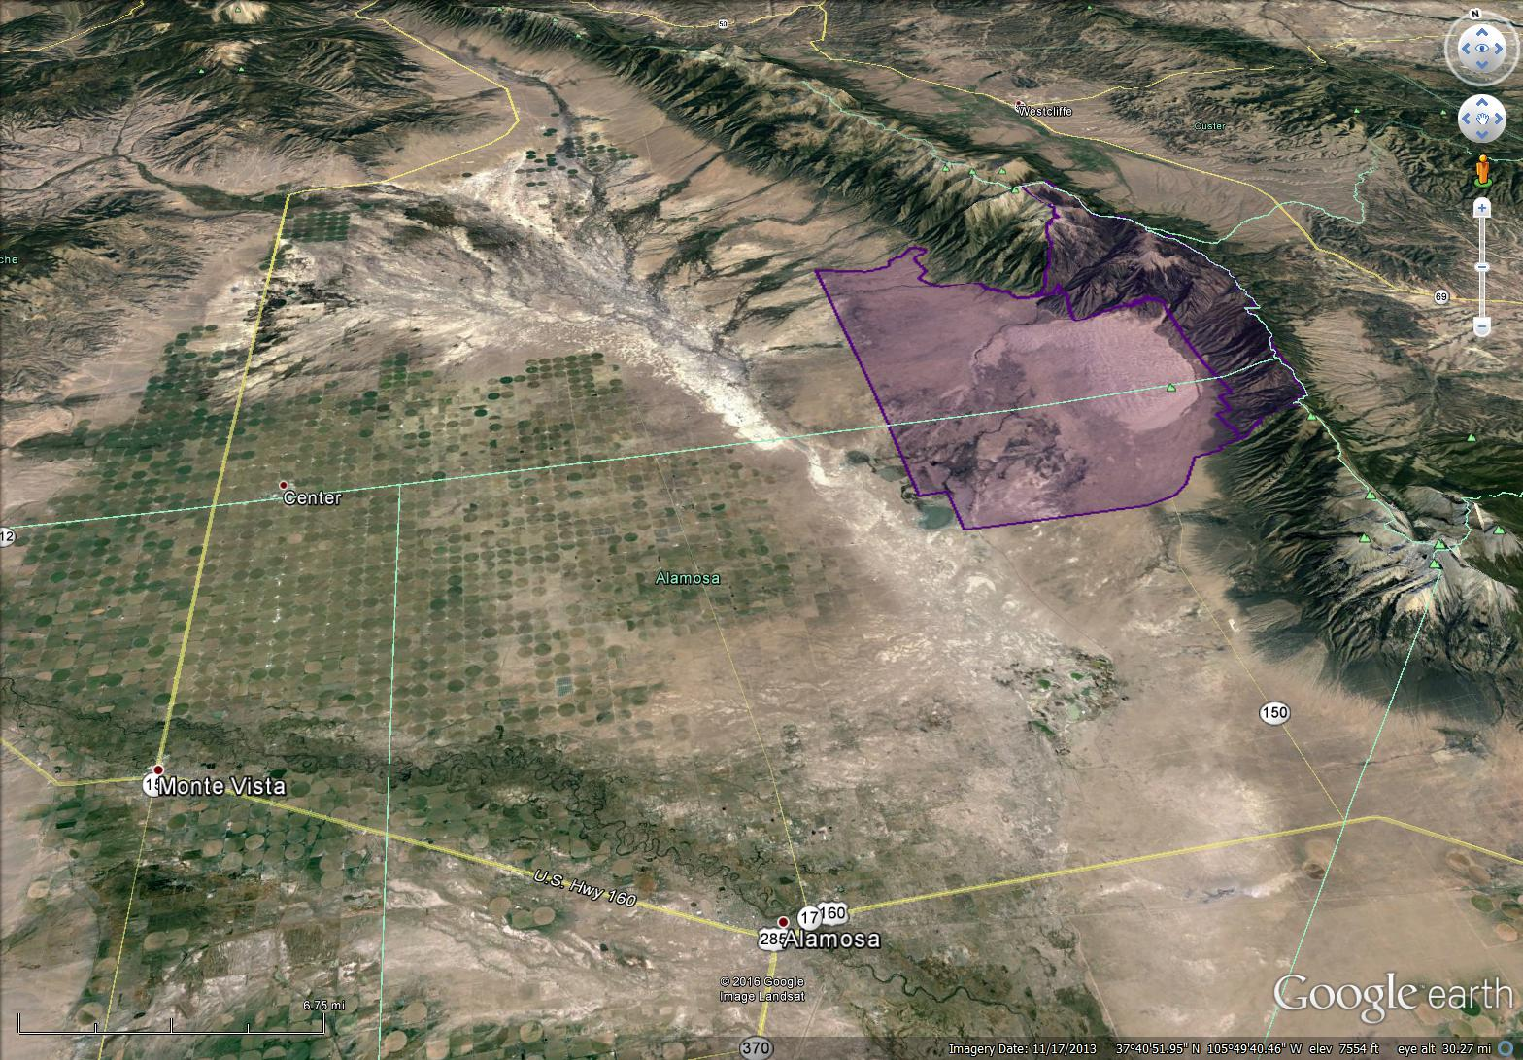
San Luis Valley Map
USGS lidar project:
Mapped at 1 return/square meter
September 2011
Sangre de Cristo Mountains
Great
Sand
Dunes
NP&P
San Luis Valley
Vertical exaggeration = 2
Notes:
Great Sand Dunes is located on the eastern side of the San Luis Valley.
The Dunes are there because streams carry sediment to the valley floor, deposit it, then wind transports it to the mountain front.
So the local hydrology is an important part of the Great Sand Dunes system.
We at the Park are fortunate to have lidar from a 2011 USGS lead San Luis Valley lidar survey.

Slide 4
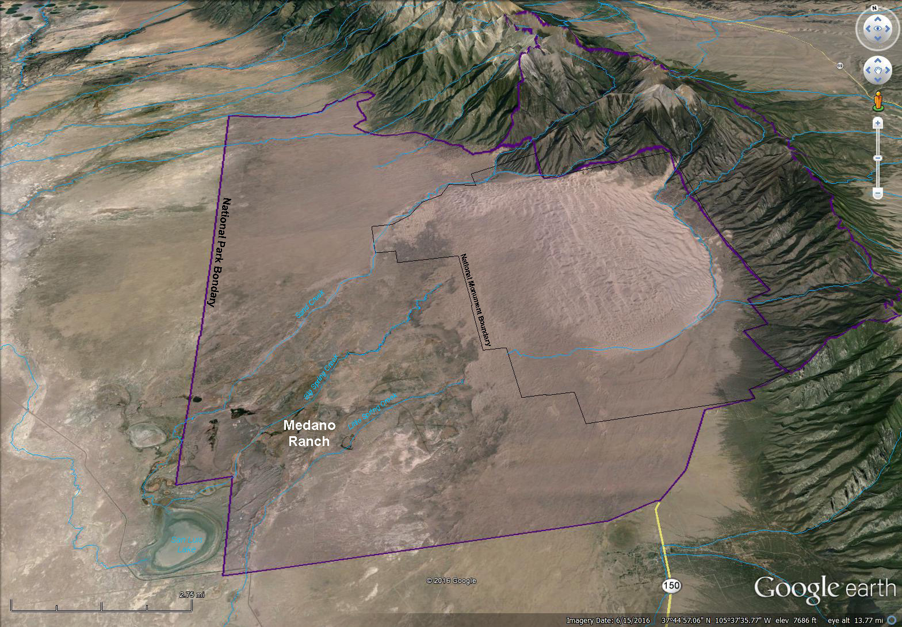
Park Map
Inland
Sabkha
Sand
Sheet
Dunefield
Vertical exaggeration = 2
Notes:
In 2000, Congress expanded the boundary of Great Sand.
The Monument boundary focused on the dunefield.
The new Park & Preserve boundary allows NPS management of other sandy areas including sand sheet and an inland sabkha.
There is also a hydrological system protected by the Park. Runoff is generated in the mountains and terminates at San Luis Lake.
Most streams completely infiltrate, filling the aquifer and that creates emergent zones where gaining streams form.
The Medano Ranch is in the southwest part of the Park and the streams of interest are Sand Creek and Big and Little Spring Creeks.

Slide 5
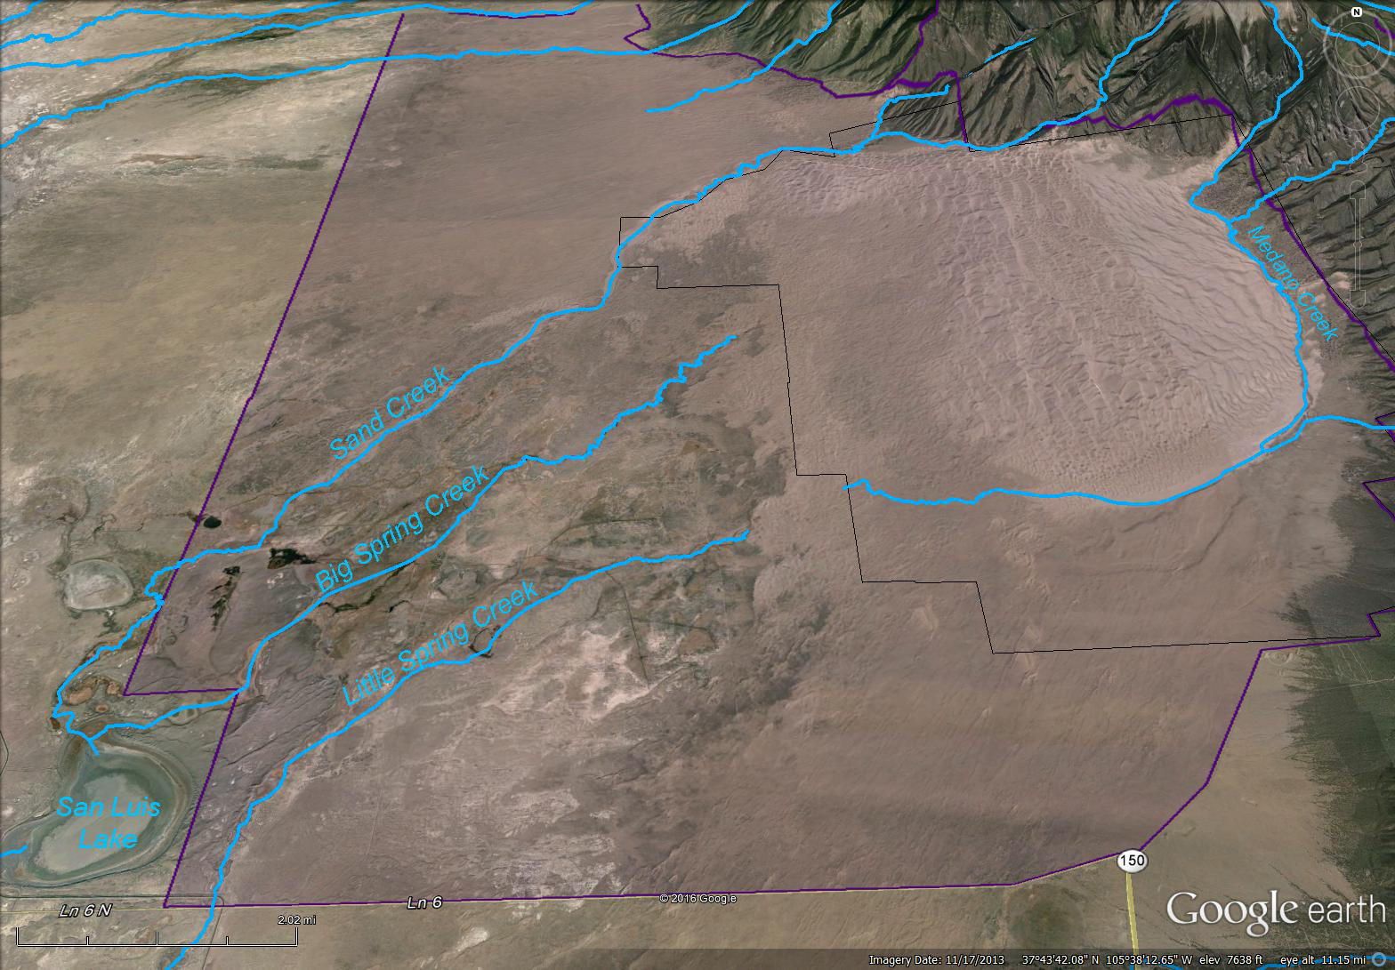
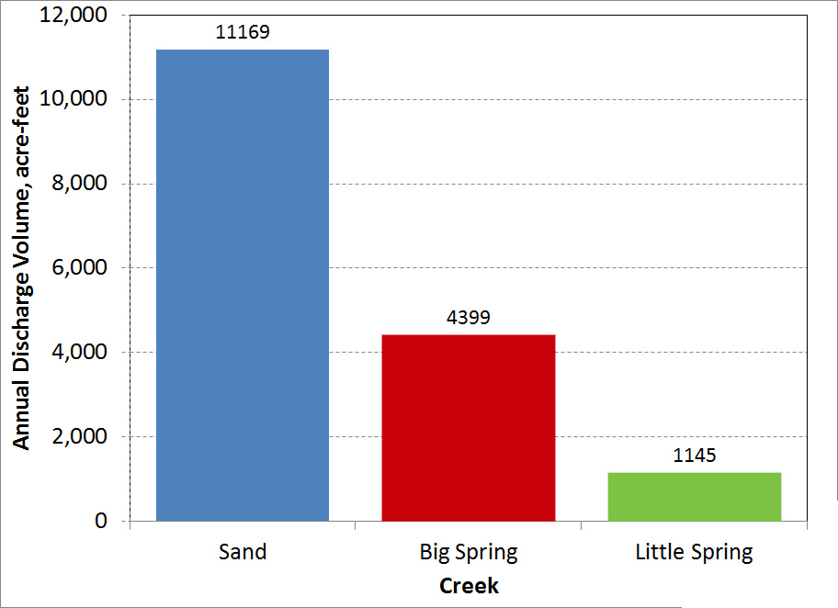
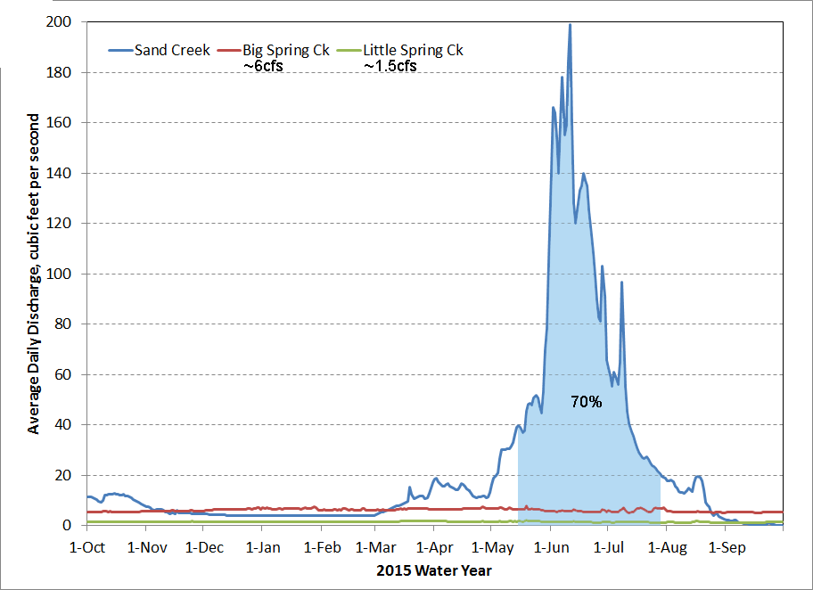
Streams
X
X
X
Notes:
Each stream is gauged at a Parshall flume and their location is shown by an X.
Sand Creek is the largest stream with an average annual flow volume of over 11,000 acre-feet.
Big Spring’s is around 4,400 acre-feet and Little Spring’s is close to 1,100 acre-feet.
Sand Creek shows a typical snow melt runoff pattern that peaks in early summer.
The time period when Sand Creek flows into the Medano Ranch is shown by the blue shaded area and in 2015 it would have been about 70% of the total flow.
Big and Little Spring Creeks are spring feed then their flow is near constant year round. Big Spring Creek’s flow is around 6 cfs and Little Spring’s is around 1.5 cfs.

Slide 6
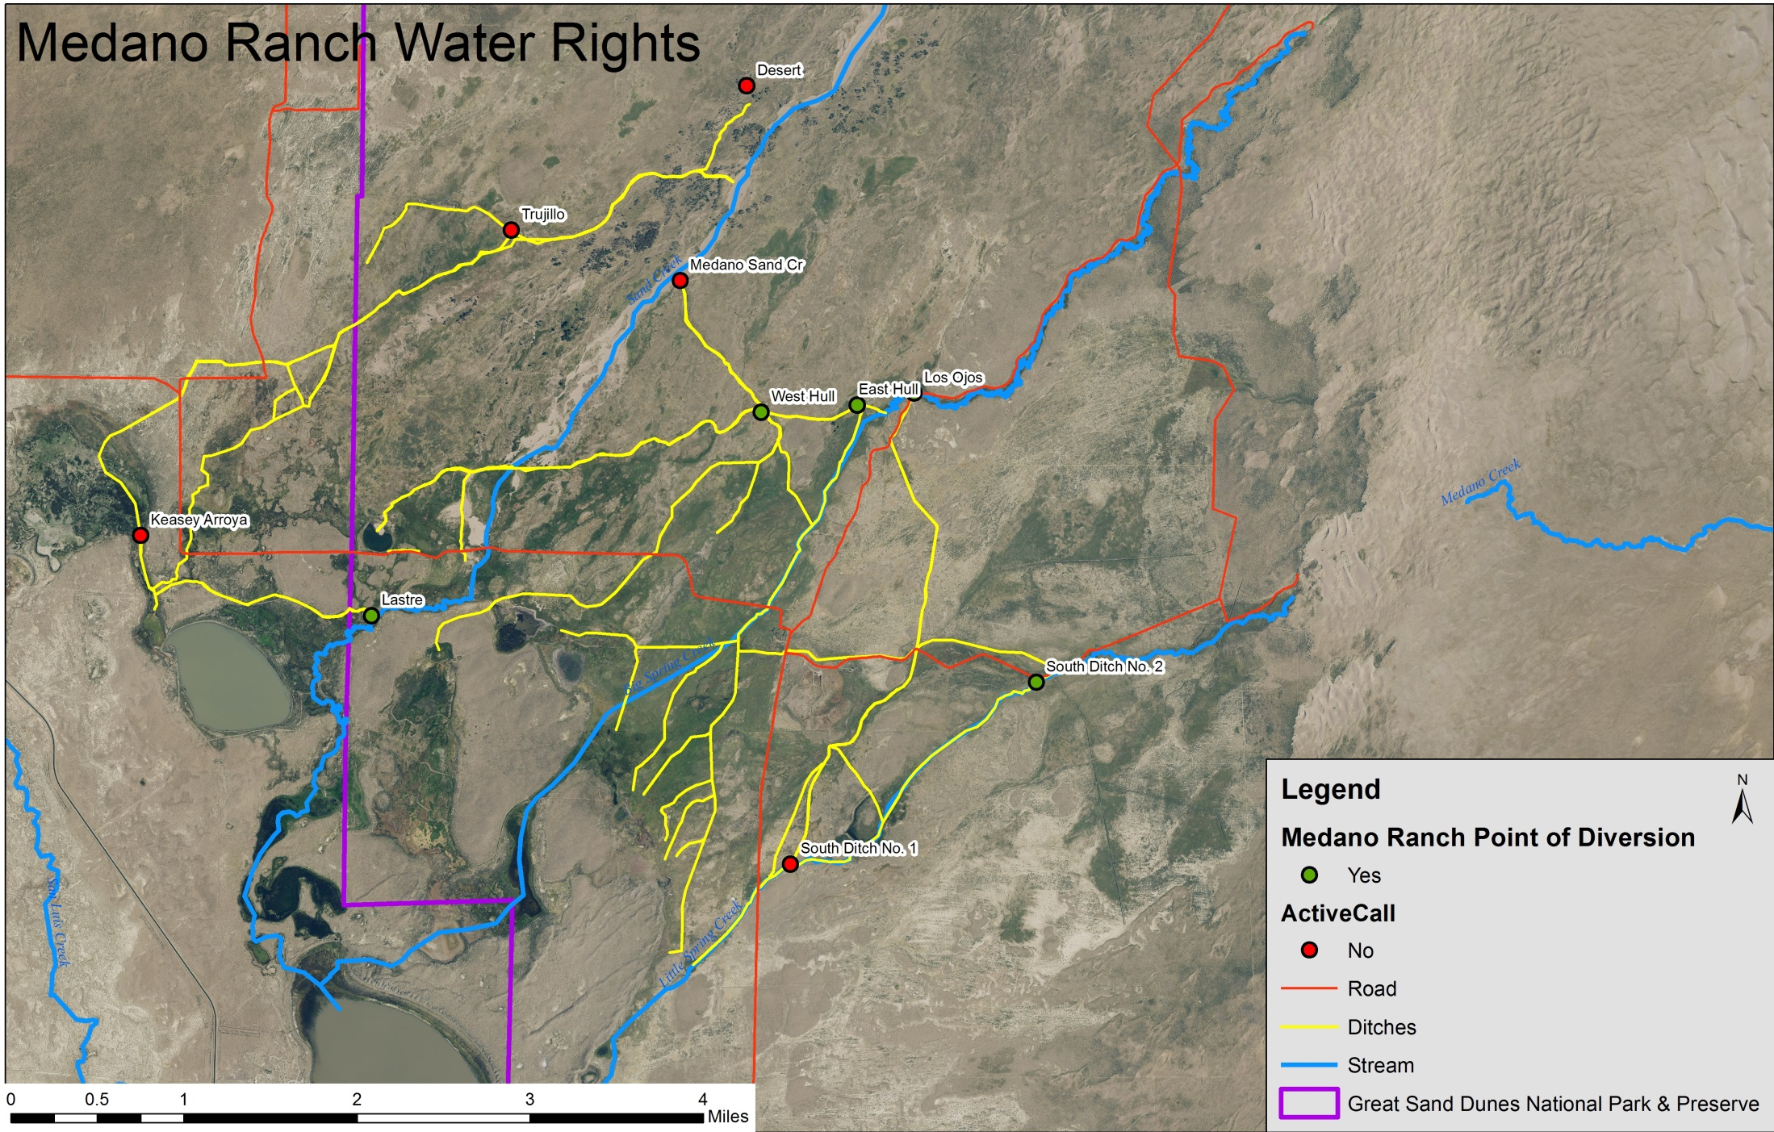
Medano Ranch
Notes:
This is the Medano Ranch irrigation system.
Diversion points are shown as dots.
Sand Creeks diversion’s are shown as red dots meaning there are inactive.
This stream has such a high sand load that attempts to divert it are overwhelmed and the water pretty much goes where it pleases.
The yellow lines are the distribution ditches.
Red lines are roads and they can impact water flow as well.
There are downstream water rights holders, so where the water flows is important to them.
For the rest of the talk I’ll focus and Sand and Big Spring Creek.

Slide 7
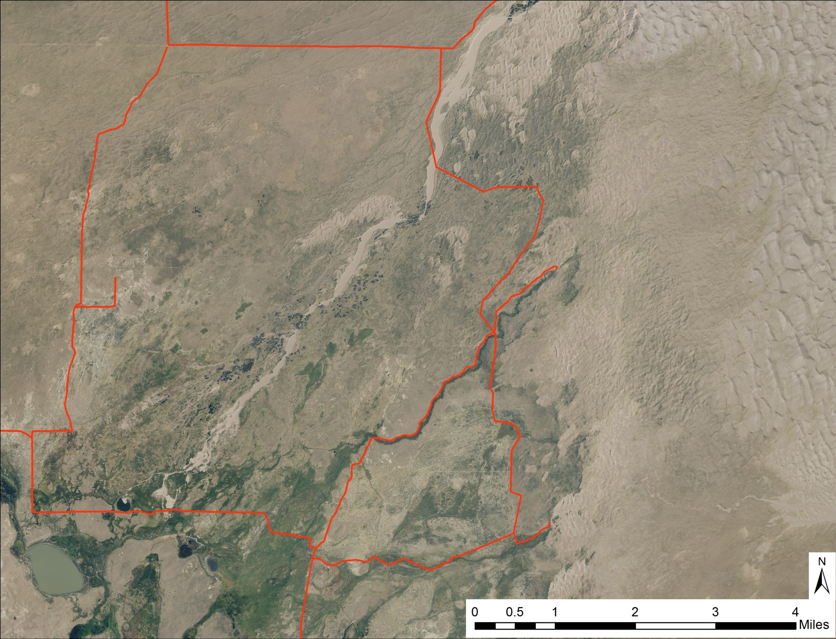
Sand Creek
Longitudinal Profile
Sand Creek
Road
Crossing
0.5%
<0.1%
VE=80
Notes:
Since Sand Creek isn’t diverted, it’s largely intact as a natural system.
Thanks to the lidar data we know that the gradient is half a percent as it flows through the sand sheet.
Once it leaves the sand sheet the gradient drops to less then one tenth of a percent and it drops most of it’s bedload.

Slide 8

Sand Creek
Perpendicular Profiles
VE=50
Current
Channel
4m
VE=110
Current
Channel
Sand Creek
1m
Current
Channel
VE=220
-1m
Notes:
Here are 3 topographic profiles across Sand Creek.
The upper profile shows 4m of entrenchment.
The middle has 1m.
At the lowermost profile, the channel is elevated 1 meter, so I think there’s potential for the stream to abandon that path.
Coppice dunes along the bank and parabolic dunes to the west act as natural levels to confine the main stream channel.

Slide 9
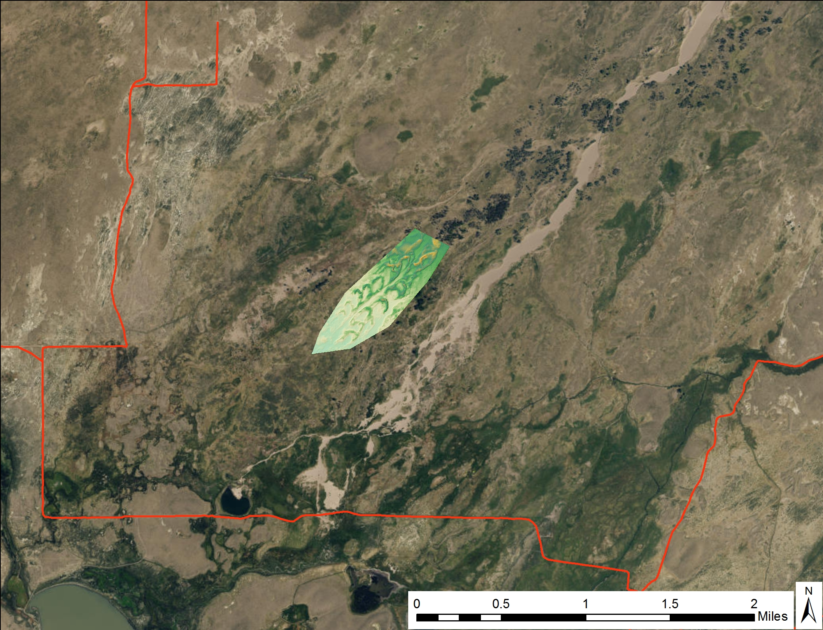
Sand Creek Conclusion:
Distributary System
Notes:
I think that the lower end of Sand Creek is a distributary system.
Water can flow anywhere in the land between the two blue lines.
I think the main channel has migrated in the recent past as there is an abandoned riparian zone and a dense parabolic dune train that shows up nicely in the digital elevation model.
The parts of the system that are impacted are where a ditch and road cross. They both direct water westward.

Slide 10
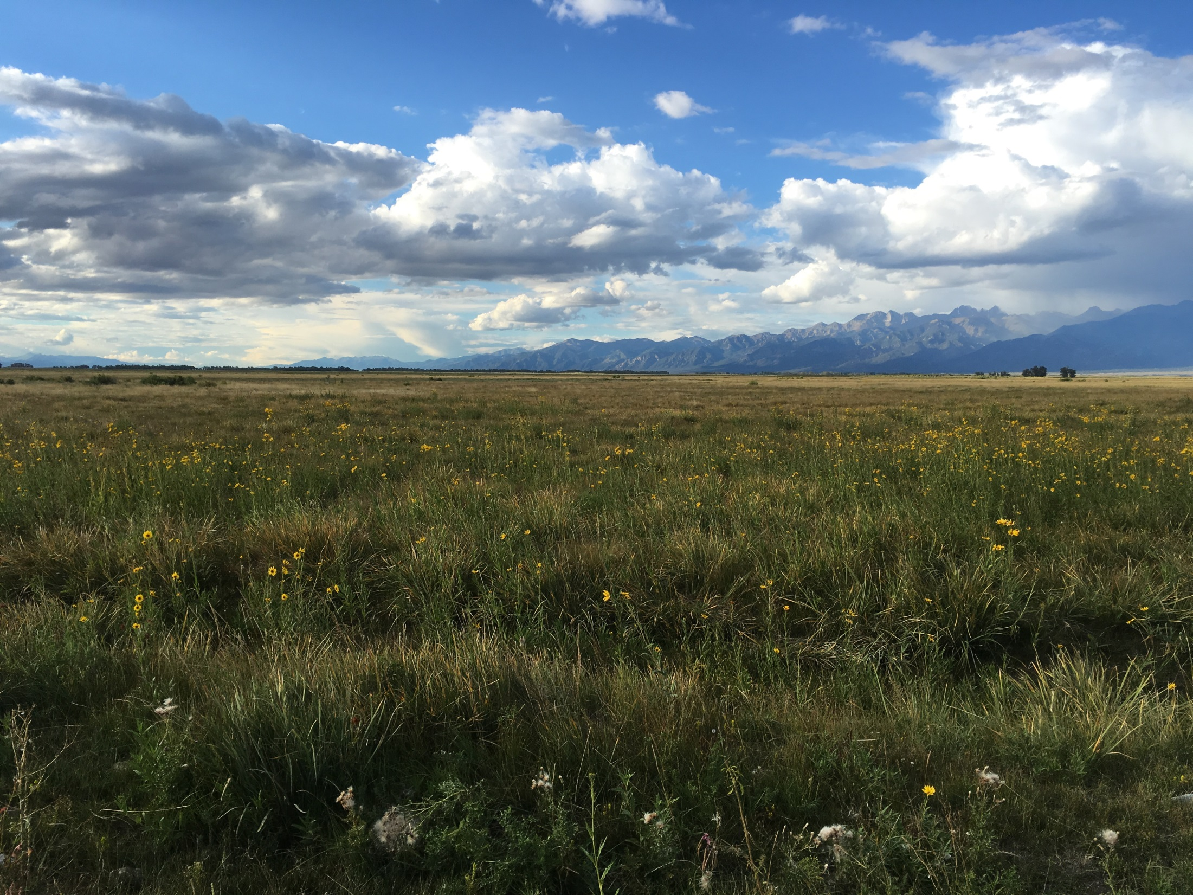
Big Spring Creek
Channel?
Notes:
Now on to Big Spring Creek.
This is the area it flows across meadows.
At ground level it looks planar so perhaps lidar can be useful to identify flow paths.

Slide 11
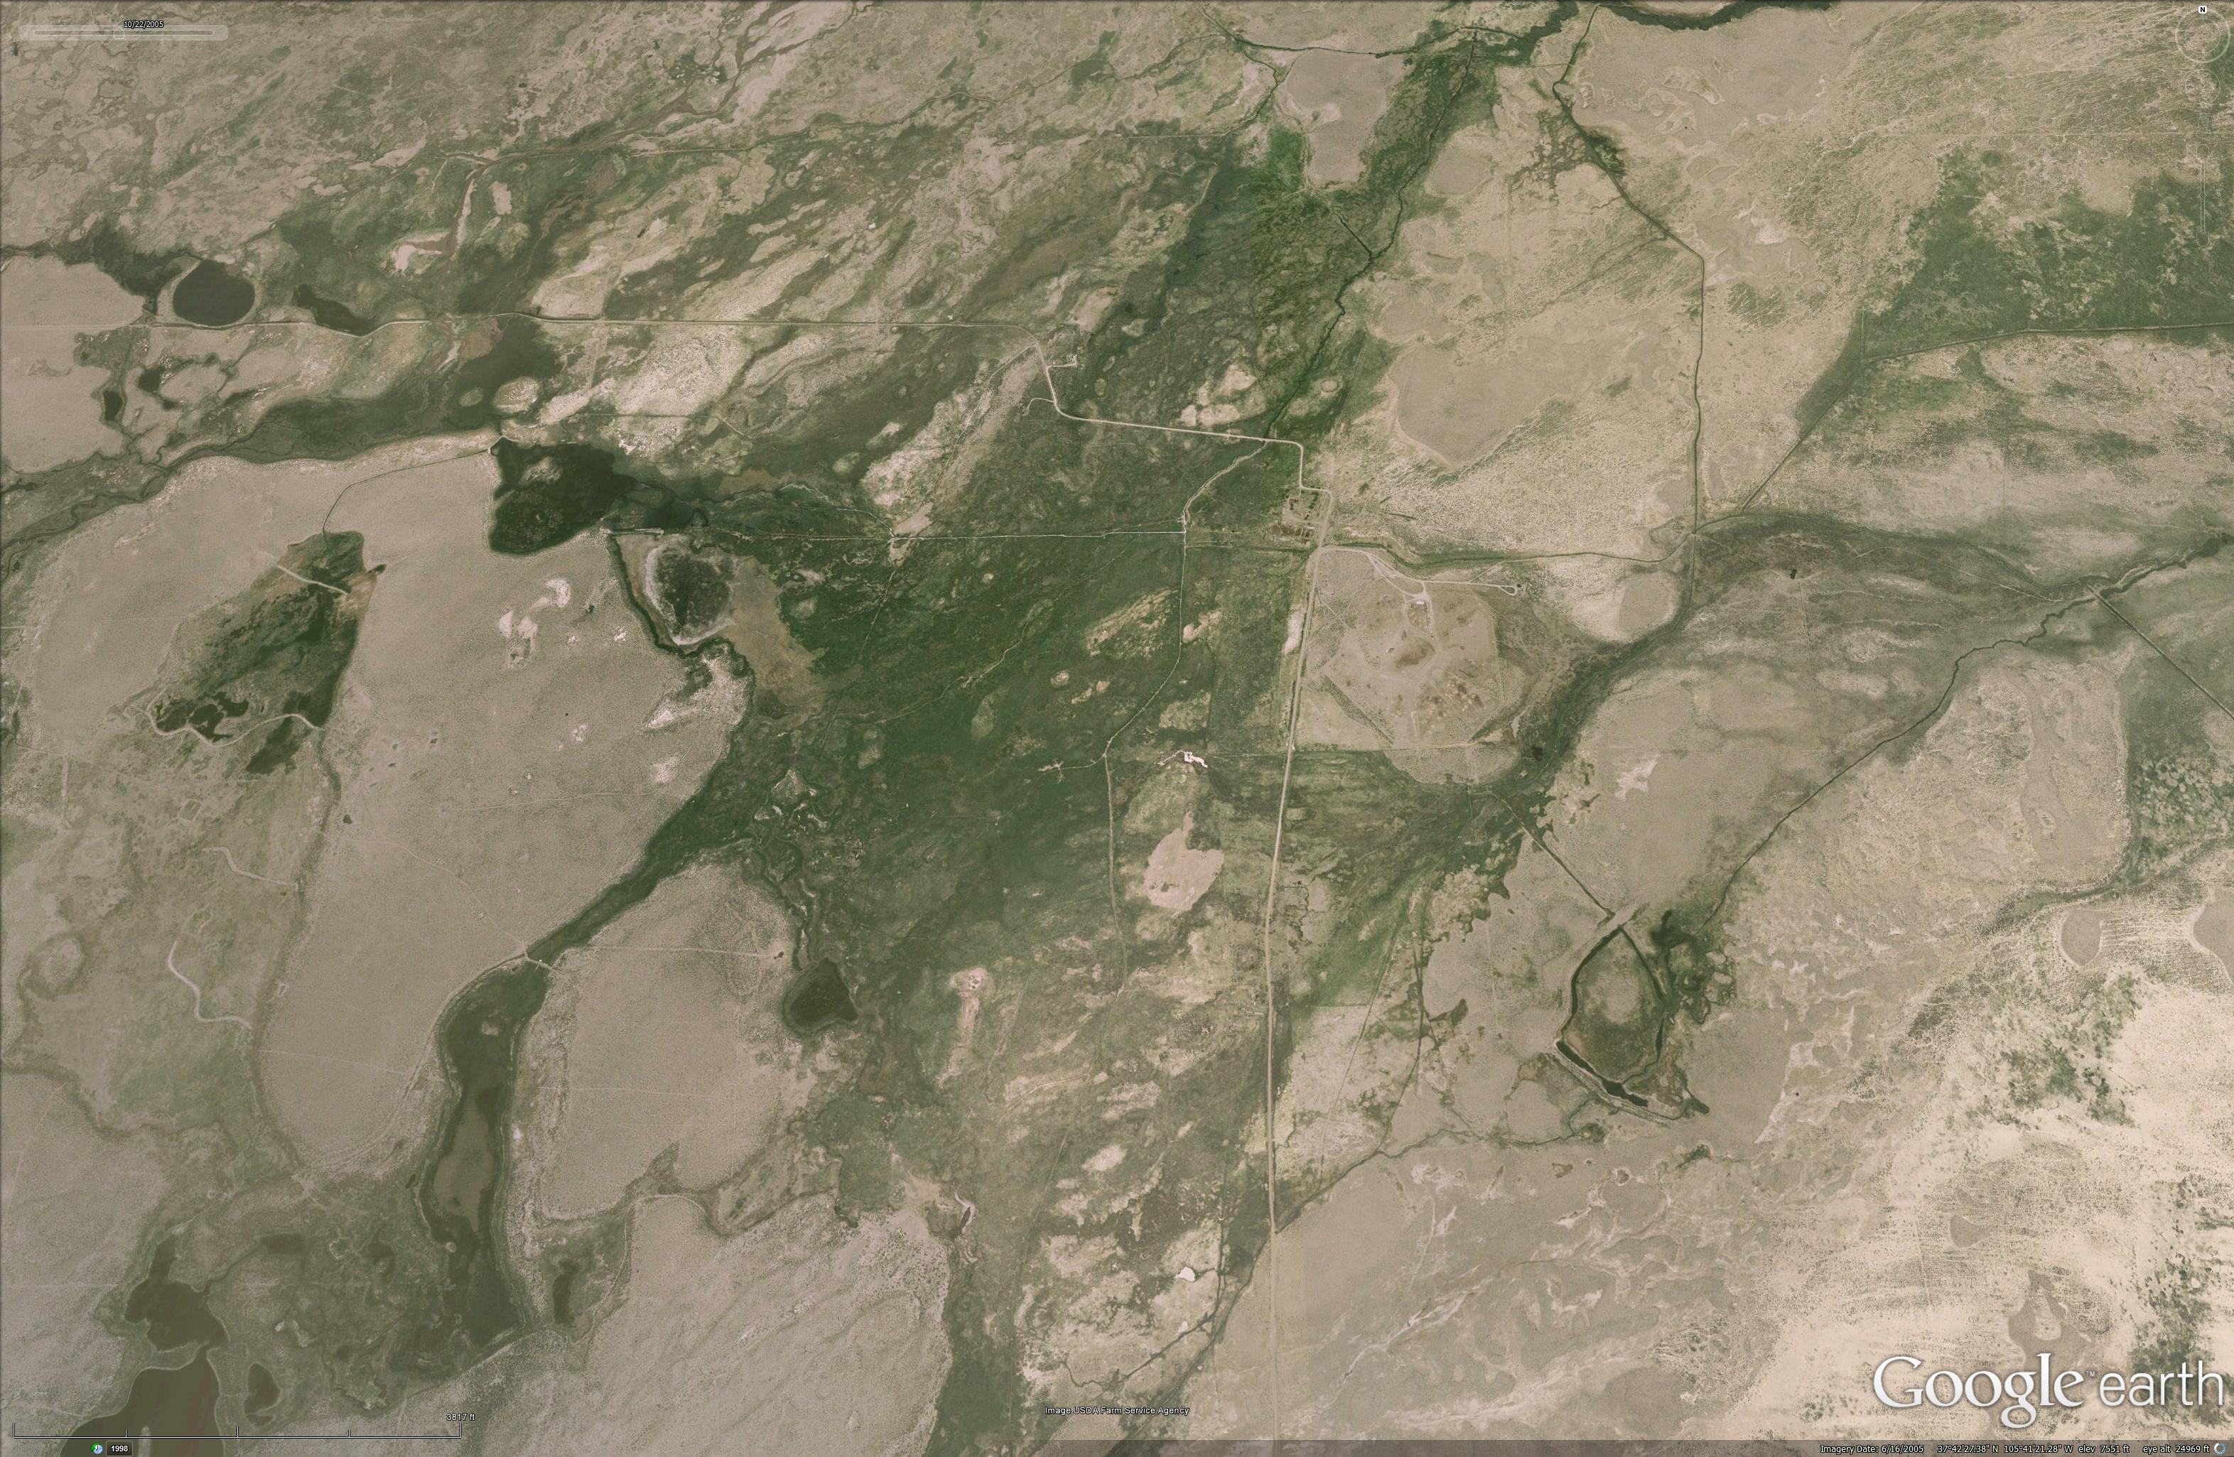
Big Spring Creek
Notes:
Here’s an aerial view.
Big Spring Creek leaves the sand sheet here, would flow over these meadows, then get impounded by this lunette.

Slide 12
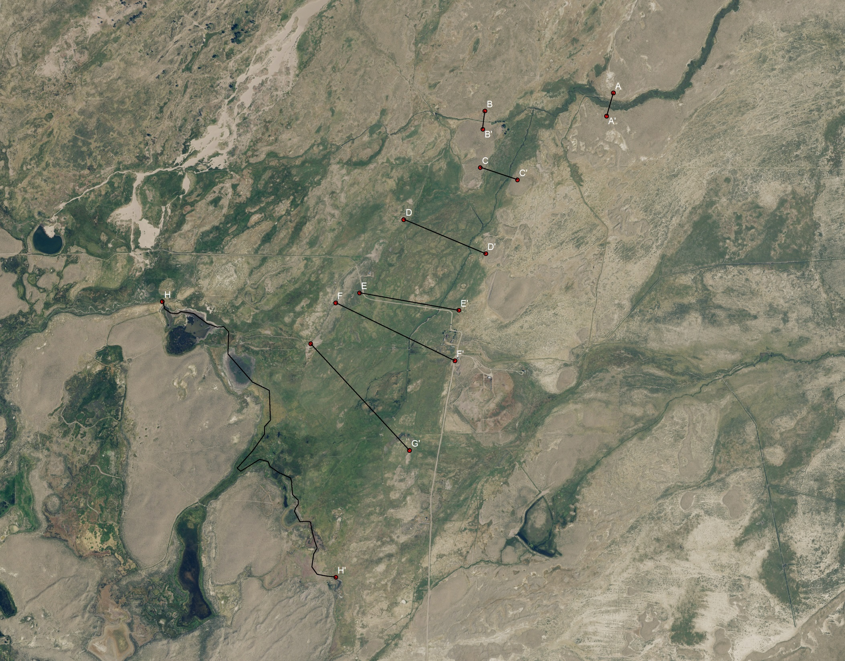
Big Spring Creek
Notes:
To determine where flow would likely occur, I created a series of profiles alone the stretch where it flows through the meadow.
Let’s look at the upper part first.

Slide 13
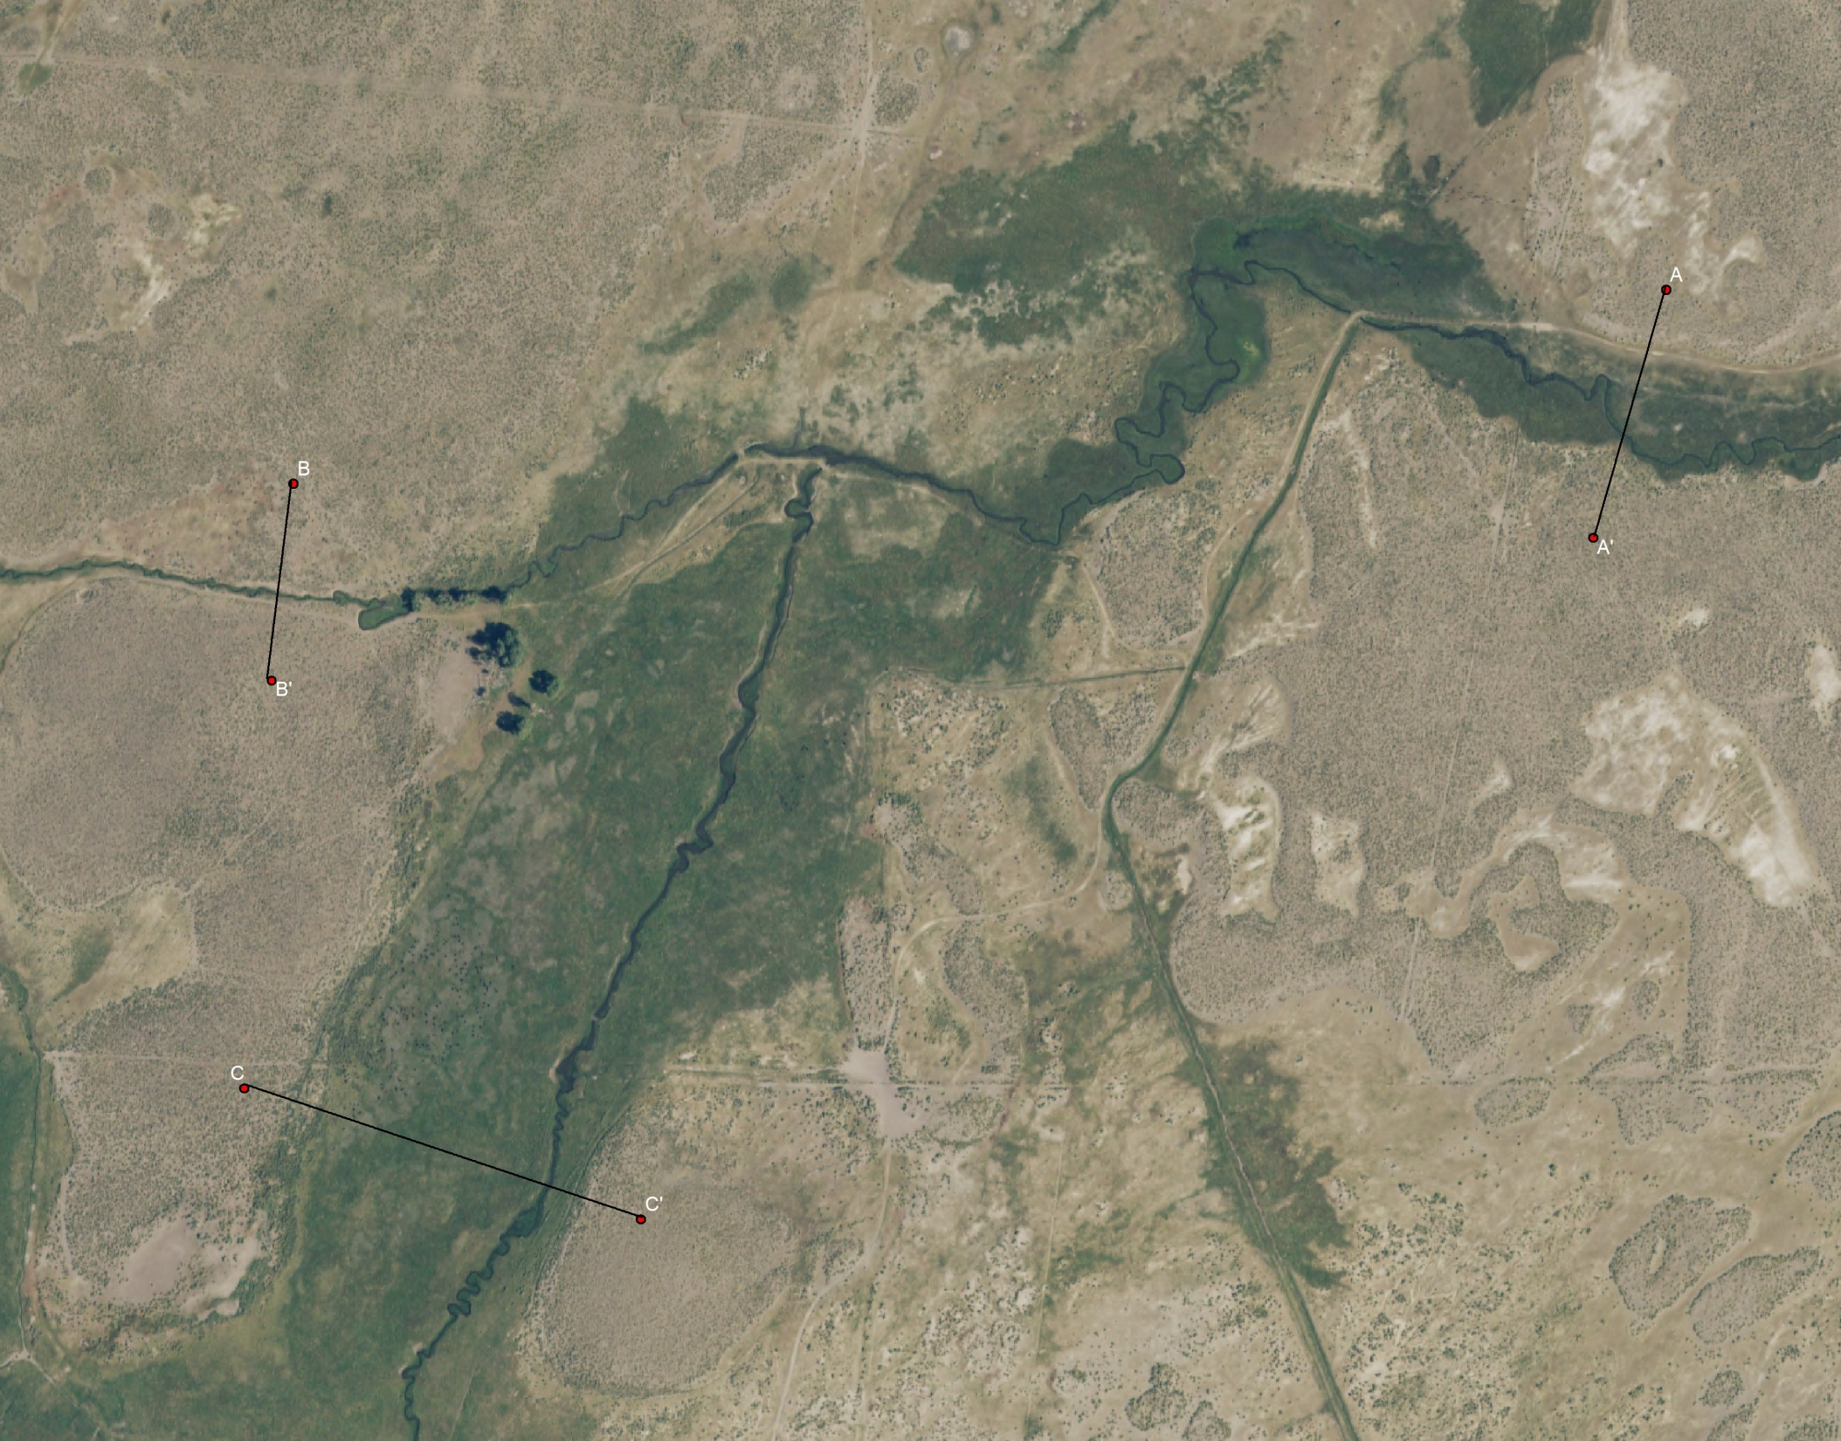
Big Spring Creek
Notes:
Profile A is where the stream is confined by the sand sheet.
B is on what I think is a ditch.
C is right before it flows into open meadow.

Slide 14
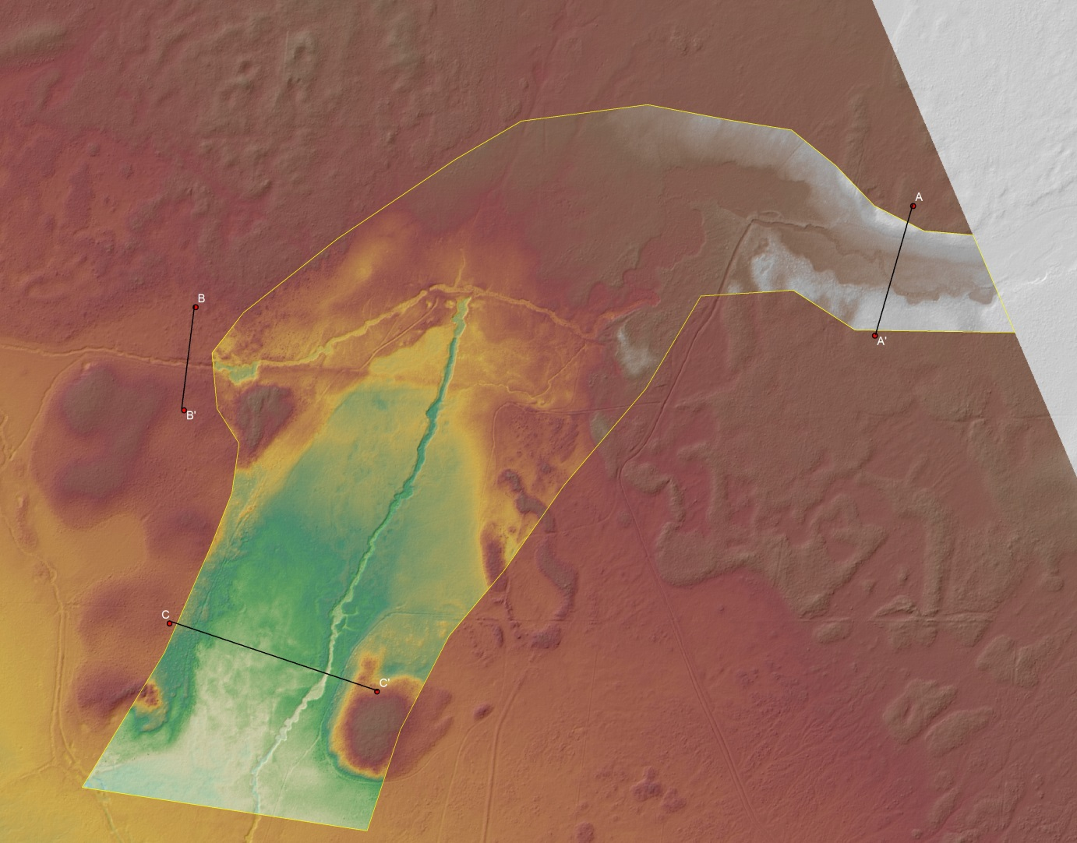
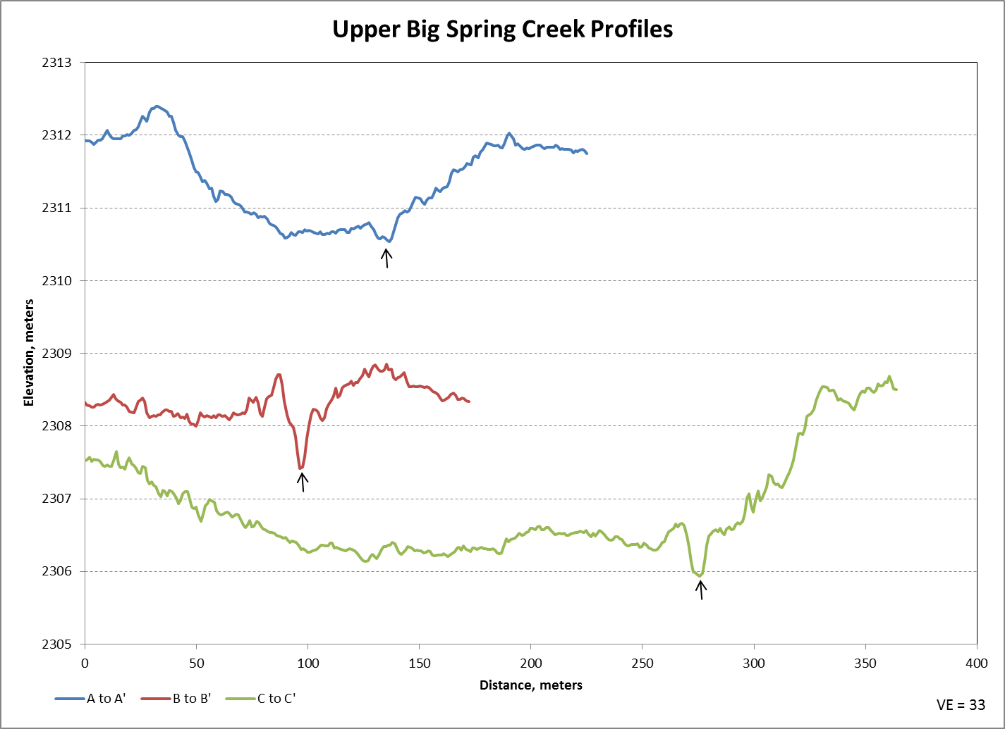
Big Spring Creek
Stream
Ditch
Ditch
Notes:
Here is the digital elevation model with a detailed insert.
Profile A shows a floodplain with the stream channel here.(point to arrow))
Profile B shows what I think is a ditch with a spoils pile here.
Profile C shows a wider floodplain with what I think is the ditch here.
The floodplain is somewhat level, but I think flow would concentrate here.

Slide 15
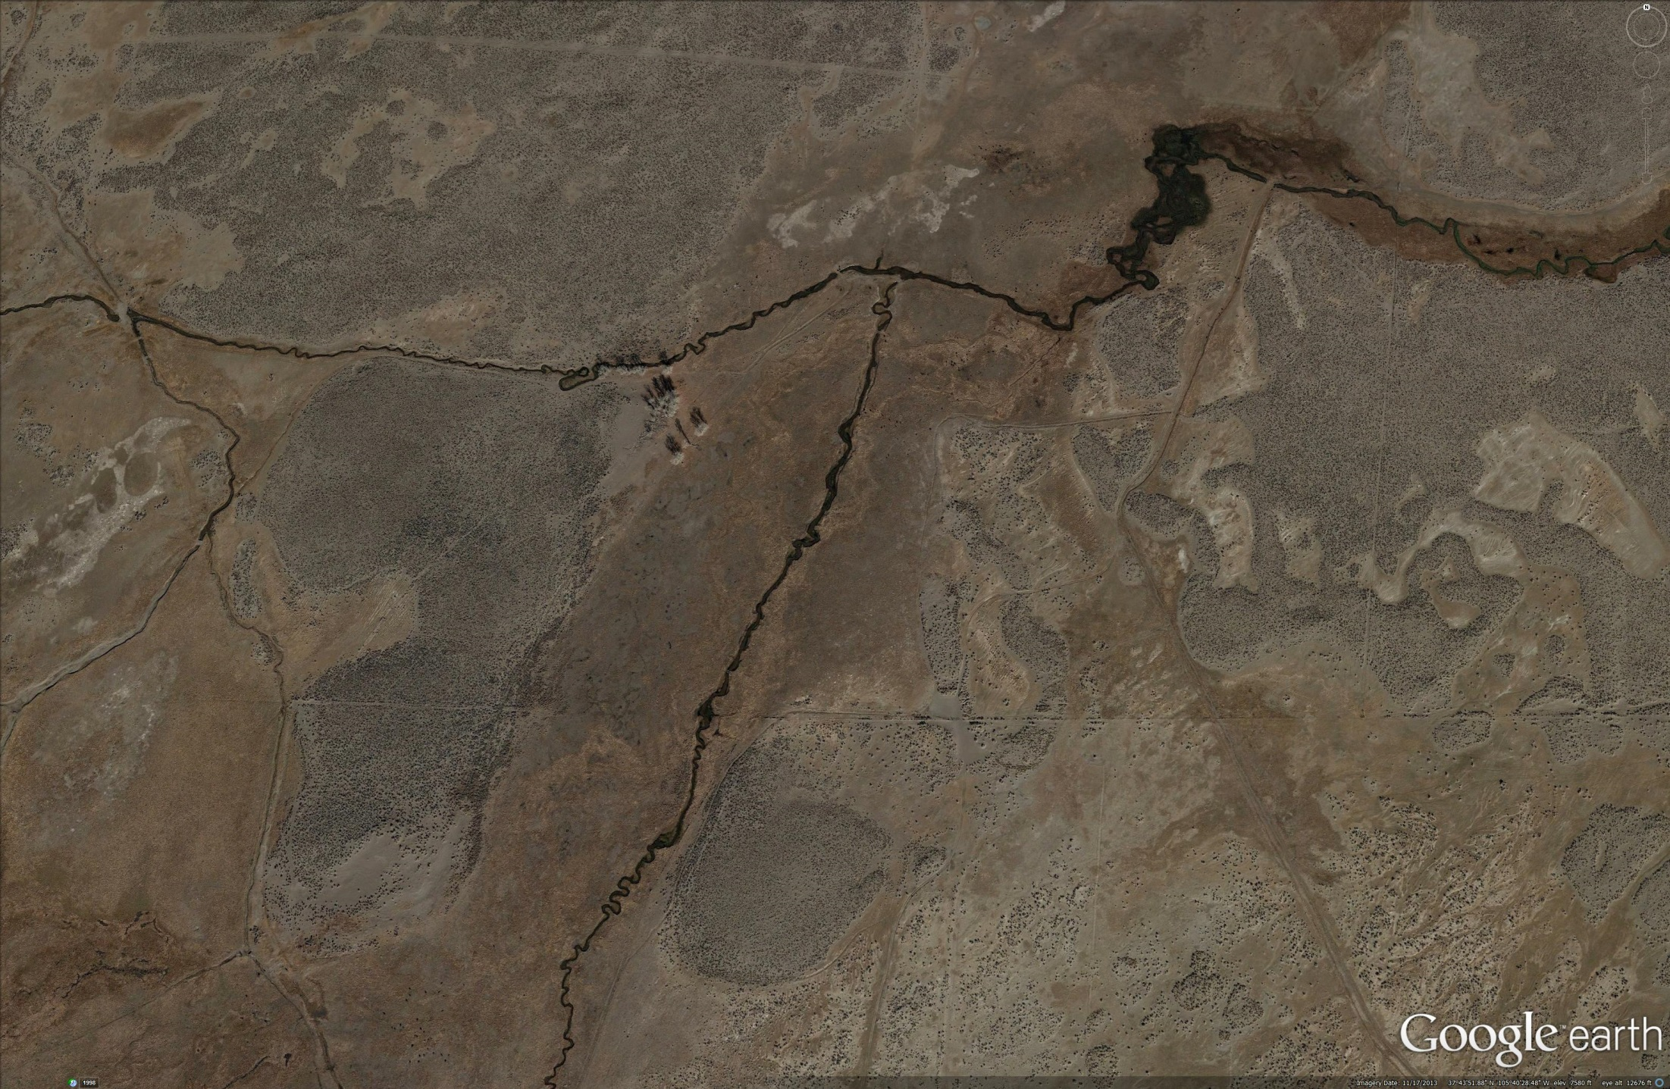
Big Spring Creek
Notes:
Relict channels can be identified on the ground. They are subtle, but are lower and have grass plus moss.
This area may show natural flow conditions as water is dispersed across the floodplain.
The vegetation contrast shows where the pre ditch channel.

Slide 16
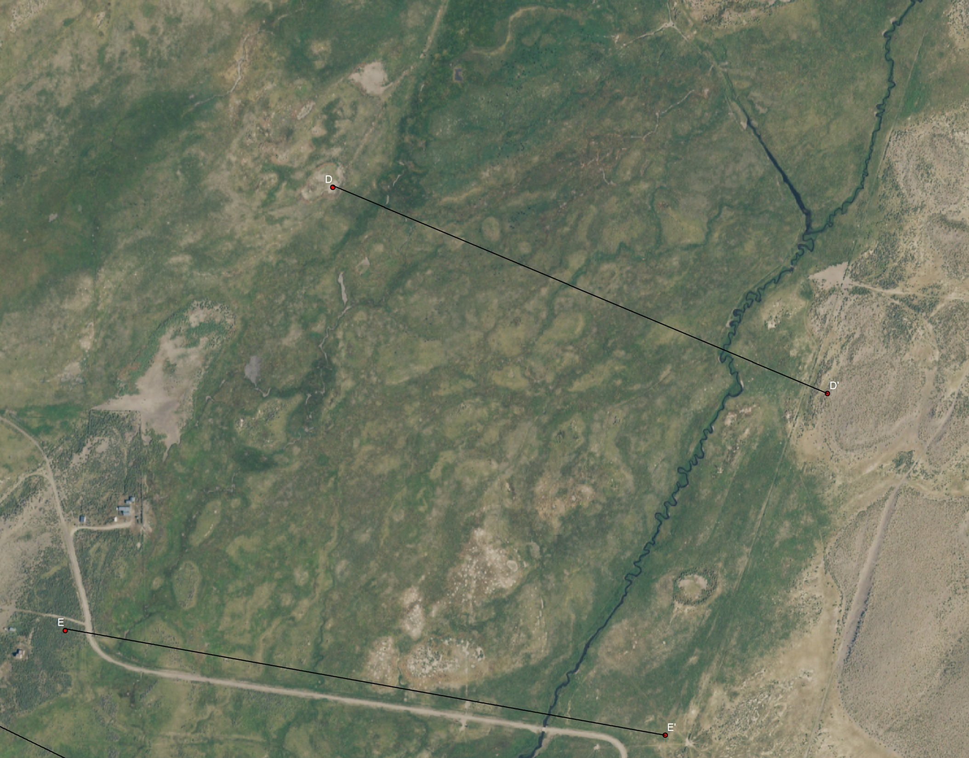
Big Spring Creek
Notes:
Here’s the middle meadow section with profiles D and E.
Here’s the ditch and you can channels throughout the meadow.

Slide 17
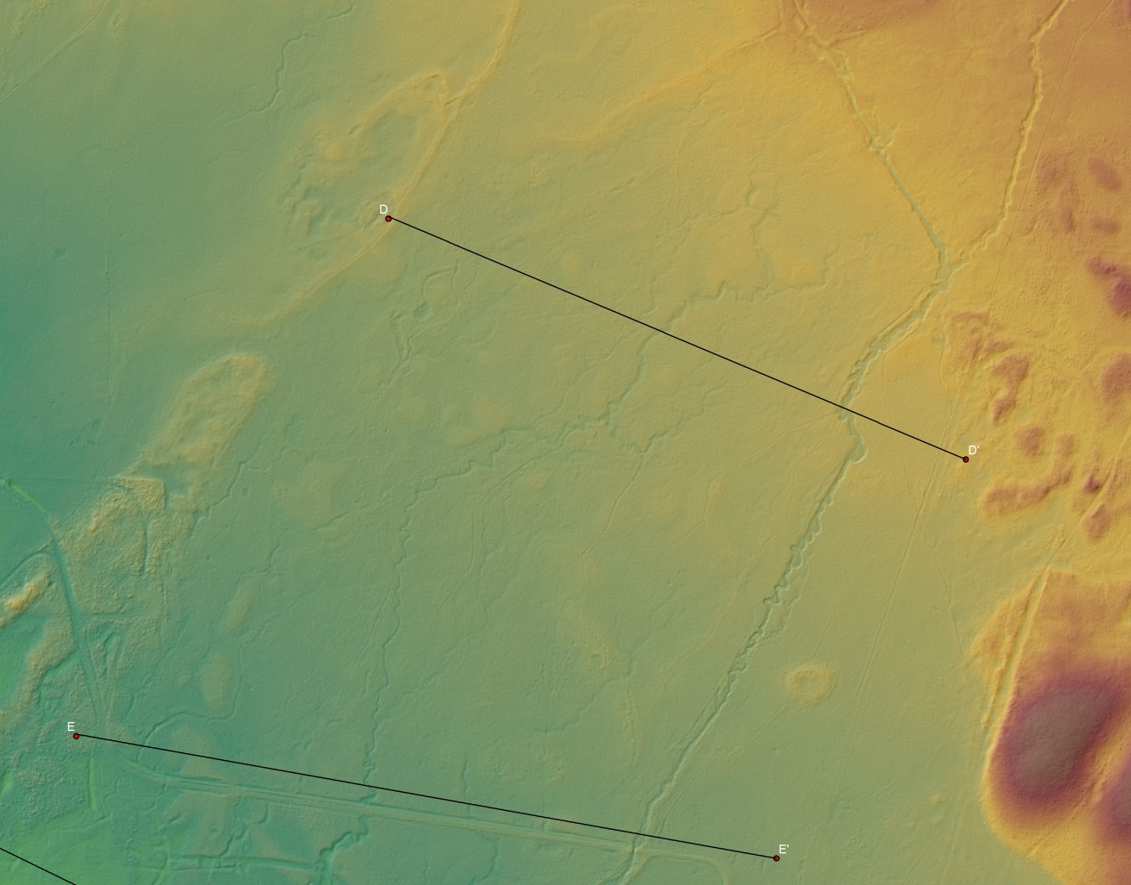
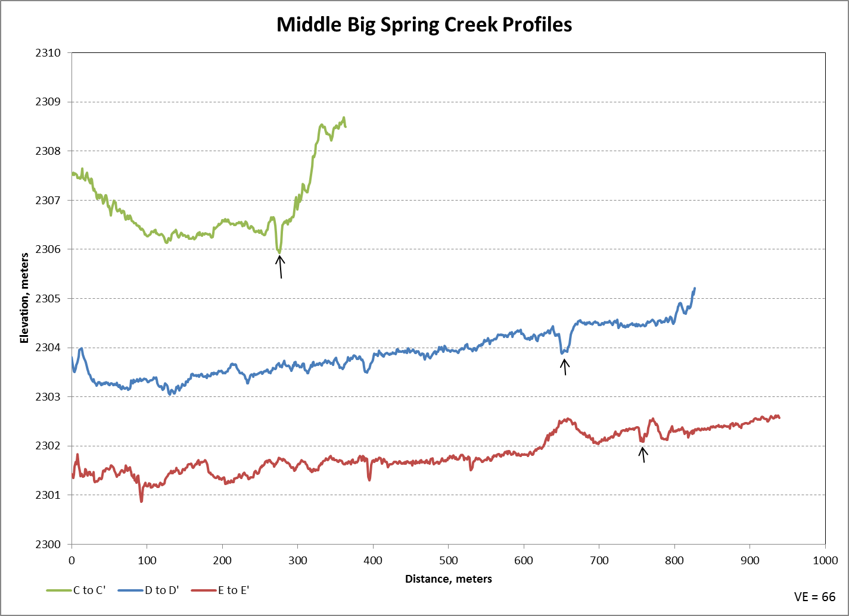
Big Spring Creek
Ditch
Ditch
Ditch
Notes:
This is the same area with a DEM basemap.
This is profile C form the previous section.
Profiles D and E show the meadow dipping toward the west, so I think natural flow would be in this direction and the ditches are trending away from it.
Here’s a slight interfluve that seems to have been built by parabolic dunes.
Here’s a gap where streamflow could enter the adjacent drainage.

Slide 18
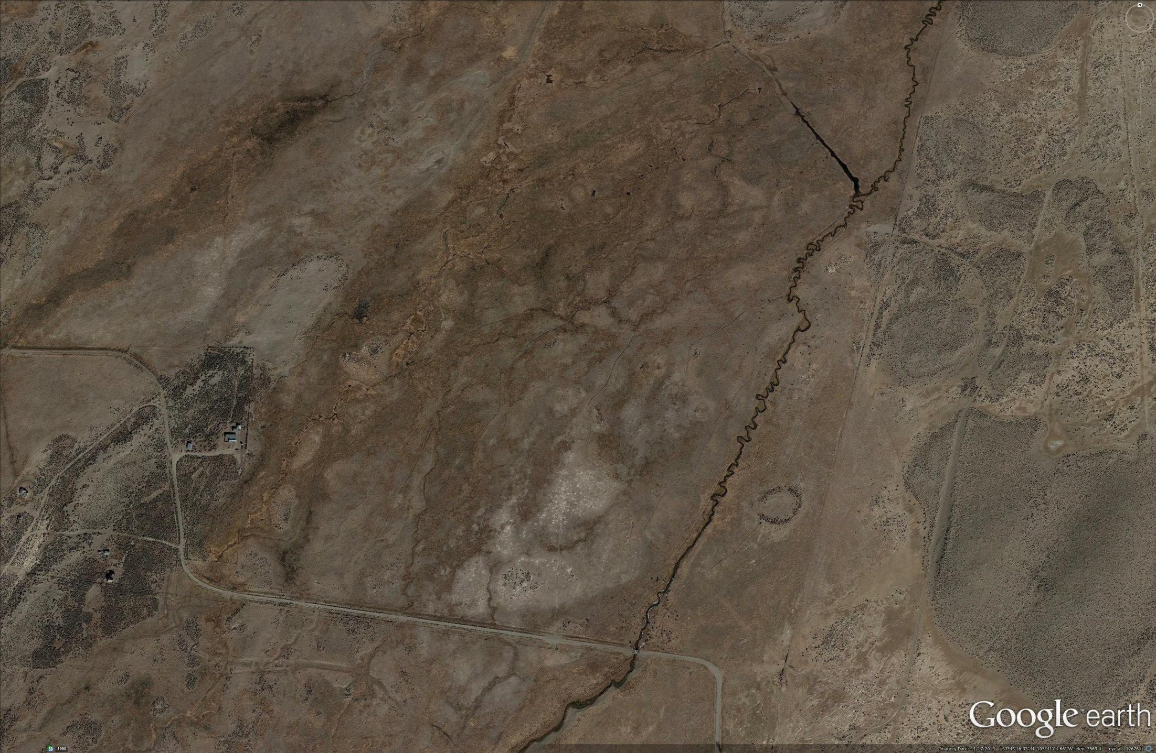
Big Spring Creek
Notes:
Vegetation indicates that the relict channel is here.

Slide 19
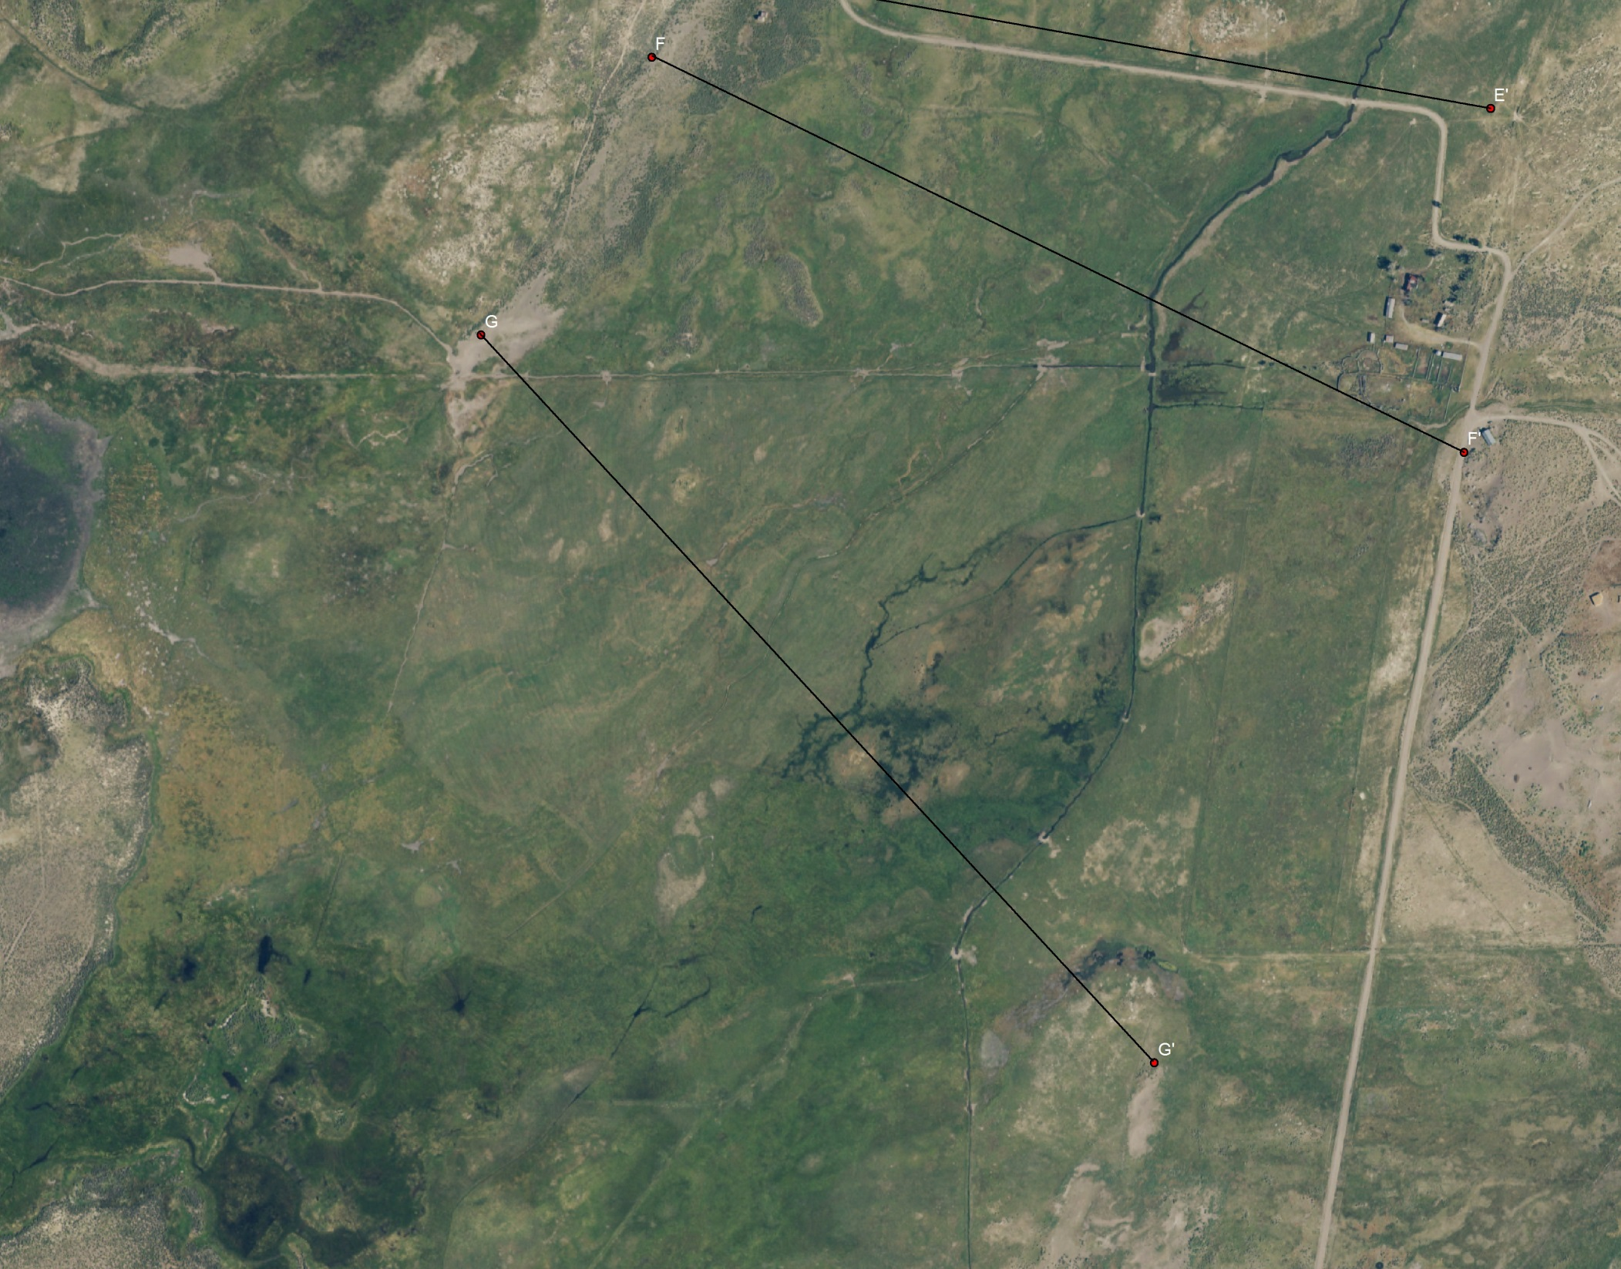
Big Spring Creek
Notes:
Here’s the lower meadow with profiles F and G.

Slide 20
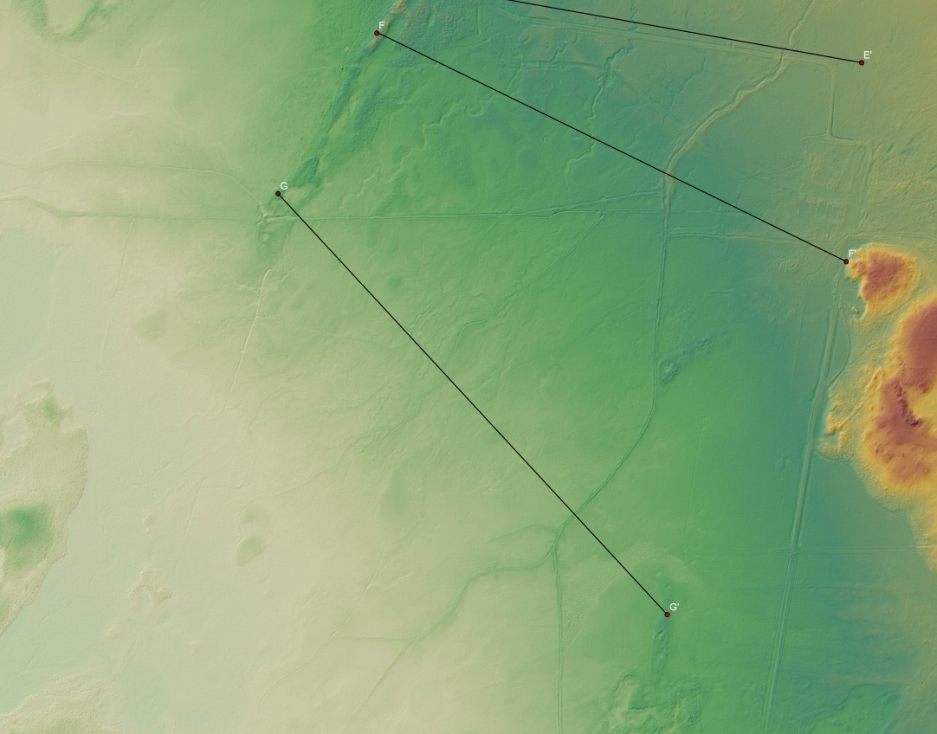
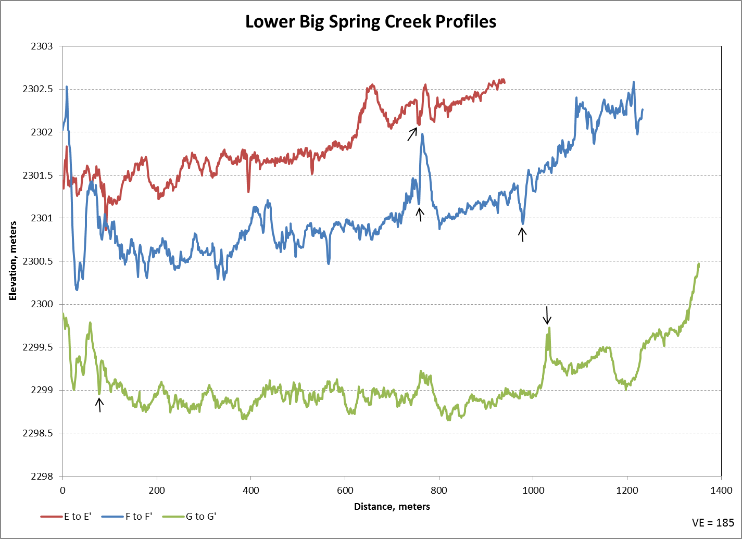
Big Spring Creek
Ditch
Ditch
Ditch
Notes:
Here’s a DEM view of it.
There is some rotation in the trend of the profiles and that flattens out the meadows.
At profile G it is flat enough that water can spread across it.
There is more relief on profile F.
The ditches are becoming elevated.

Slide 21
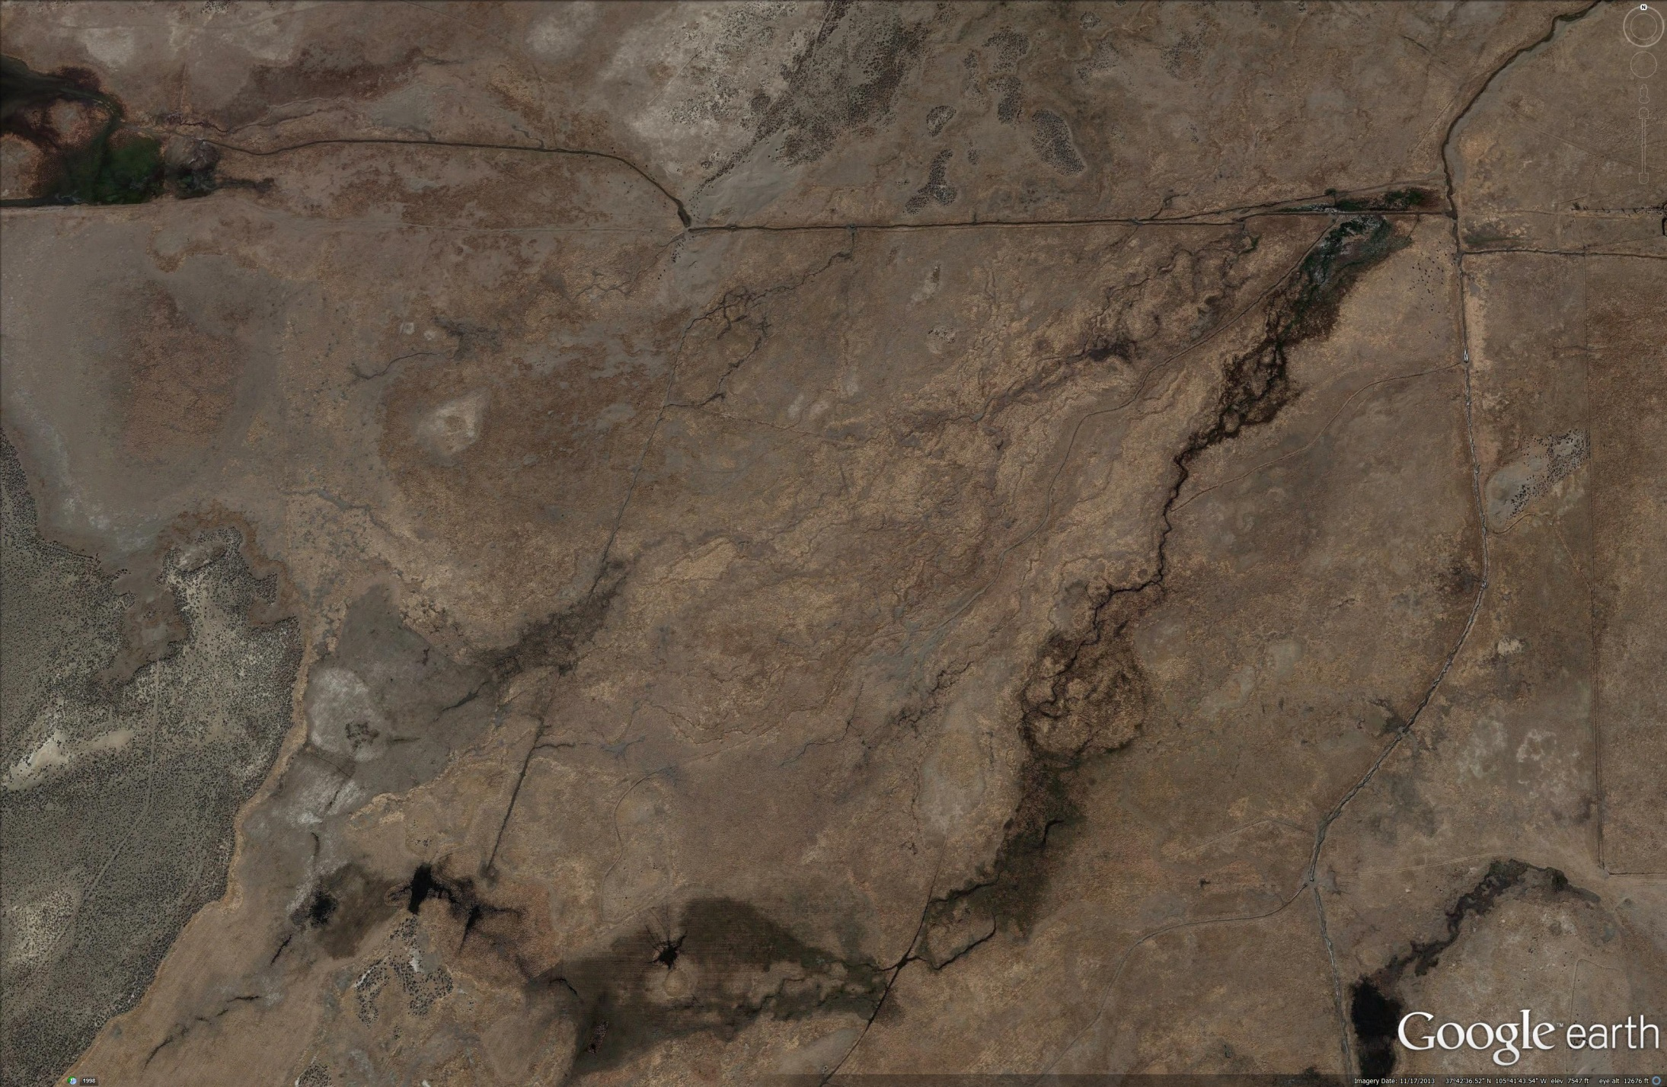
Big Spring Creek
Notes:
Vegetation shows that there are channels.
Water would enter here and flow along these paths to the lunette.

Slide 22
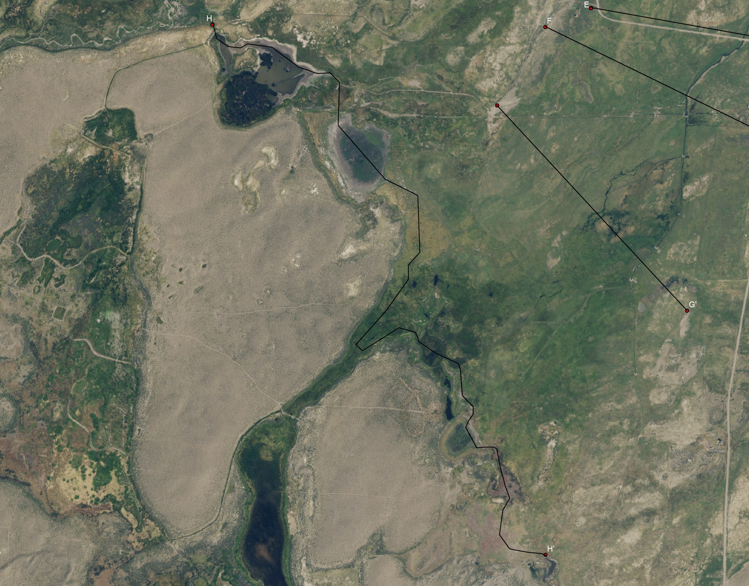
Big Spring Creek
Notes:
Once water gets to the lunette front, there are 3 possible outlets. One on the north, this one in the center, and one that takes water south.
To find the lowest outlet I measured a profile from H to H’.

Slide 23
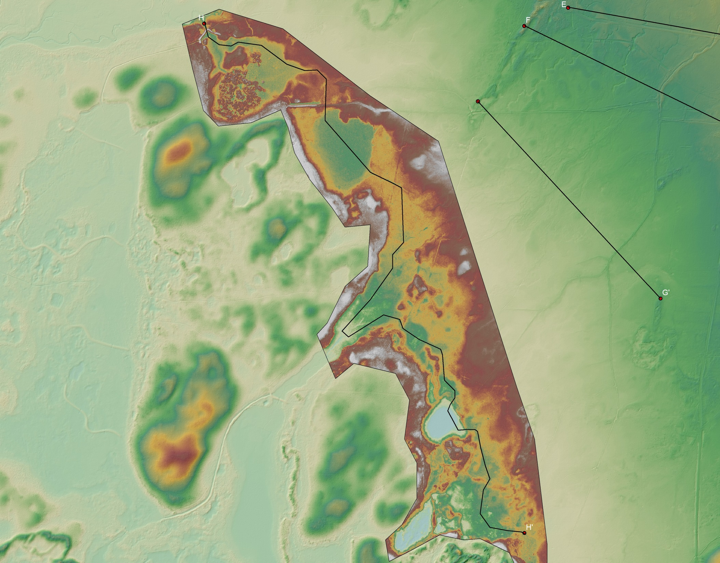
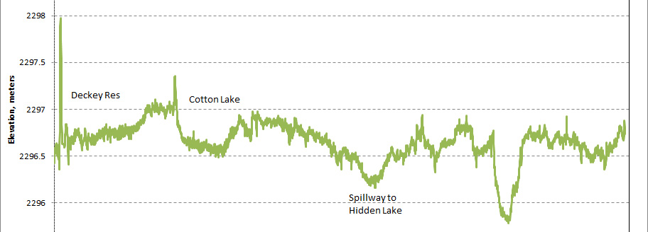
Big Spring Creek
Notes:
Here’s the DEM with a detailed insert.
The north spillway is at 2296.5m
The middle spillway is at that elevation, but there are some dikes and natural berms between the two.
When the dikes are removed, water the flows into Deckey reservoir should exit though the north spillway.
Water reaching Cotton lake or areas south should pass through the middle spillway.
The south spillway is almost half a meter higher.
So water reaching the lunette in this area, which is wehre I think Big Spring Creek would flow, should flow though the middle spillway.

Slide 24
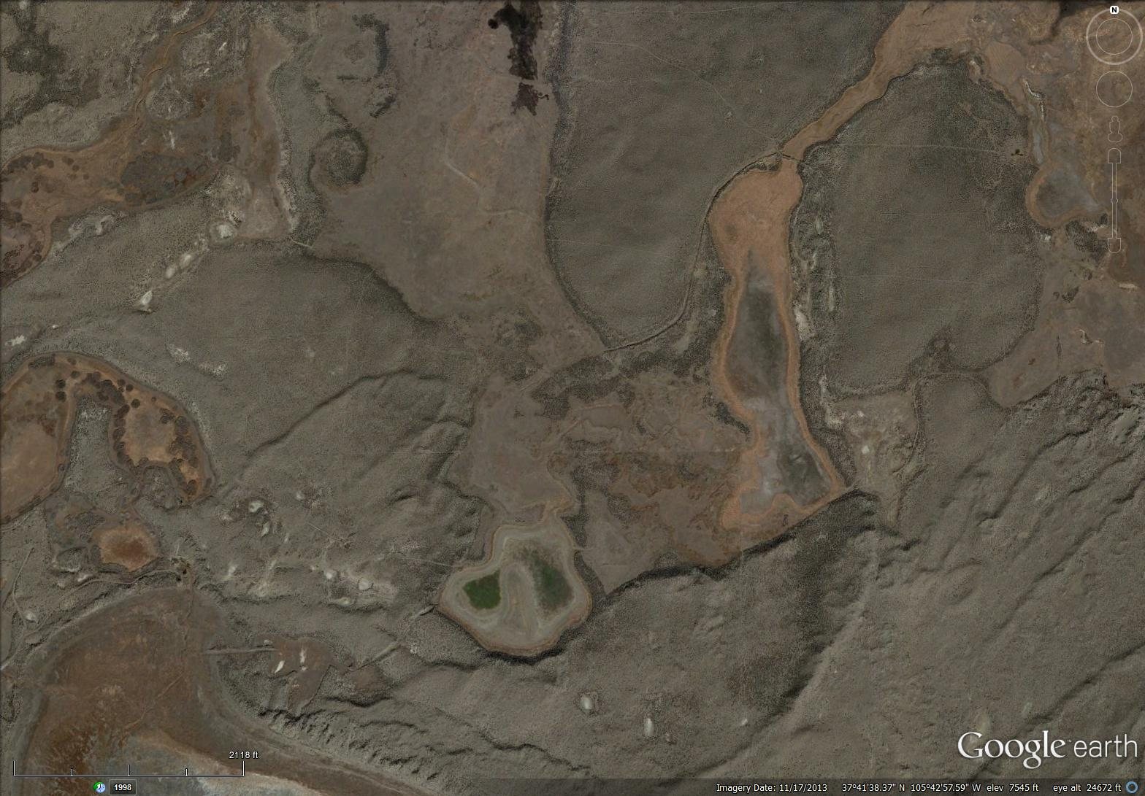
Big Spring Creek
Notes:
Here’s the middle spillway.
It leads to Hidden Lake.
Hidden lake overflows to this pond.
Then water leaves Great Sand Dunes and there are cuts though younger lunettes that would take the water to San Luis Lake.

Slide 25
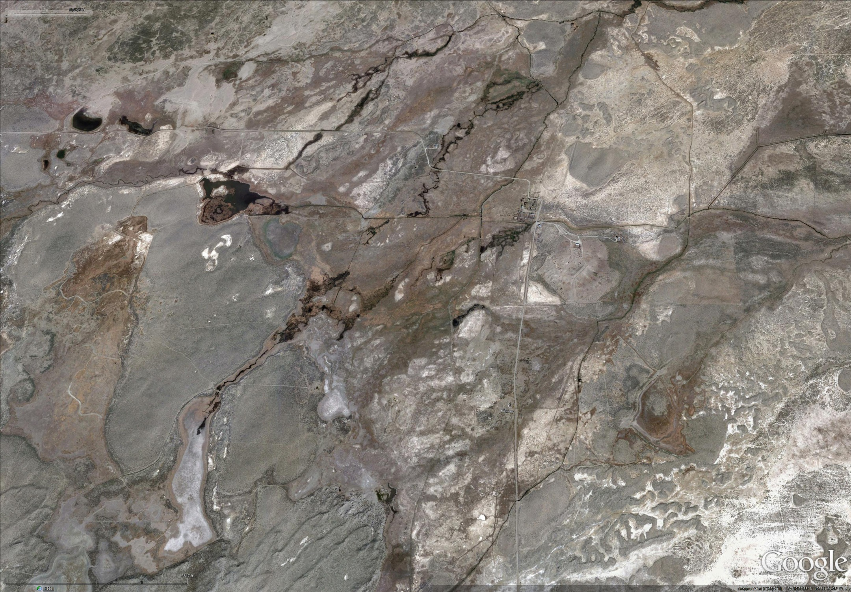
Big Spring Creek
Summary
Notes:
I think that once Big Spring Creek leaves the sand sheet it becomes an anastomosing stream that would initially flow along this path, but can migrate across the meadow.
Little Spring Creek would flow along this pathway, with a split in this area, from which it could flow west and join Big Spring Creek, or south and continue south of the previously mentioned south spillway.

Slide 26
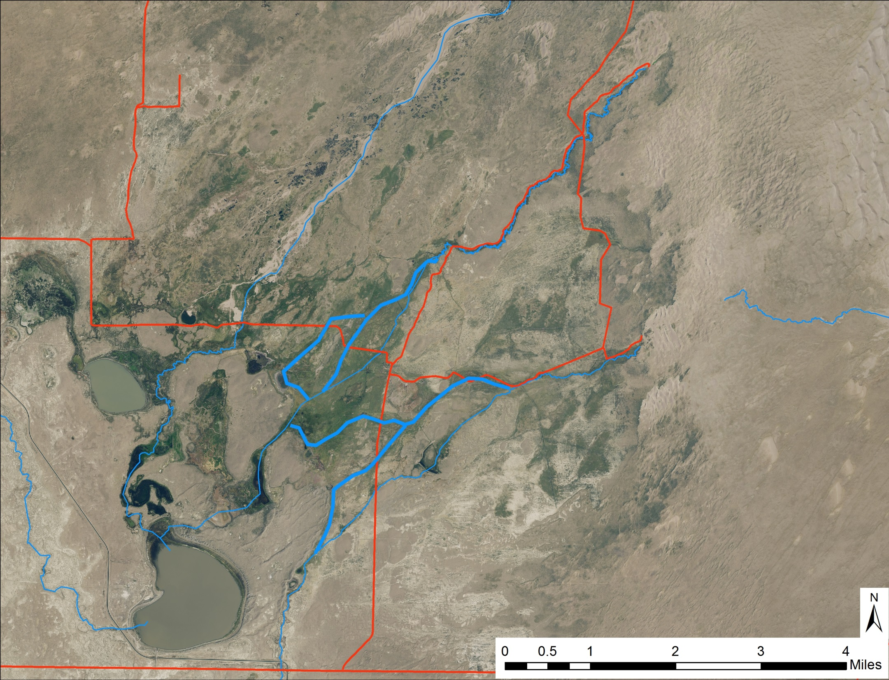
Summary
Notes:
In summary I think we’ve identified where water would flow if it wasn’t diverted into ditches as shown by the thick blue lines.
We’ve identiftied key sites to block ditches or breach dikes and roads to reestablish flow in natural channels.
We can address impacts to downstream water rights holders.
Separate projects are determining impacts to groundwater recharge and wetlands.

Slide 27
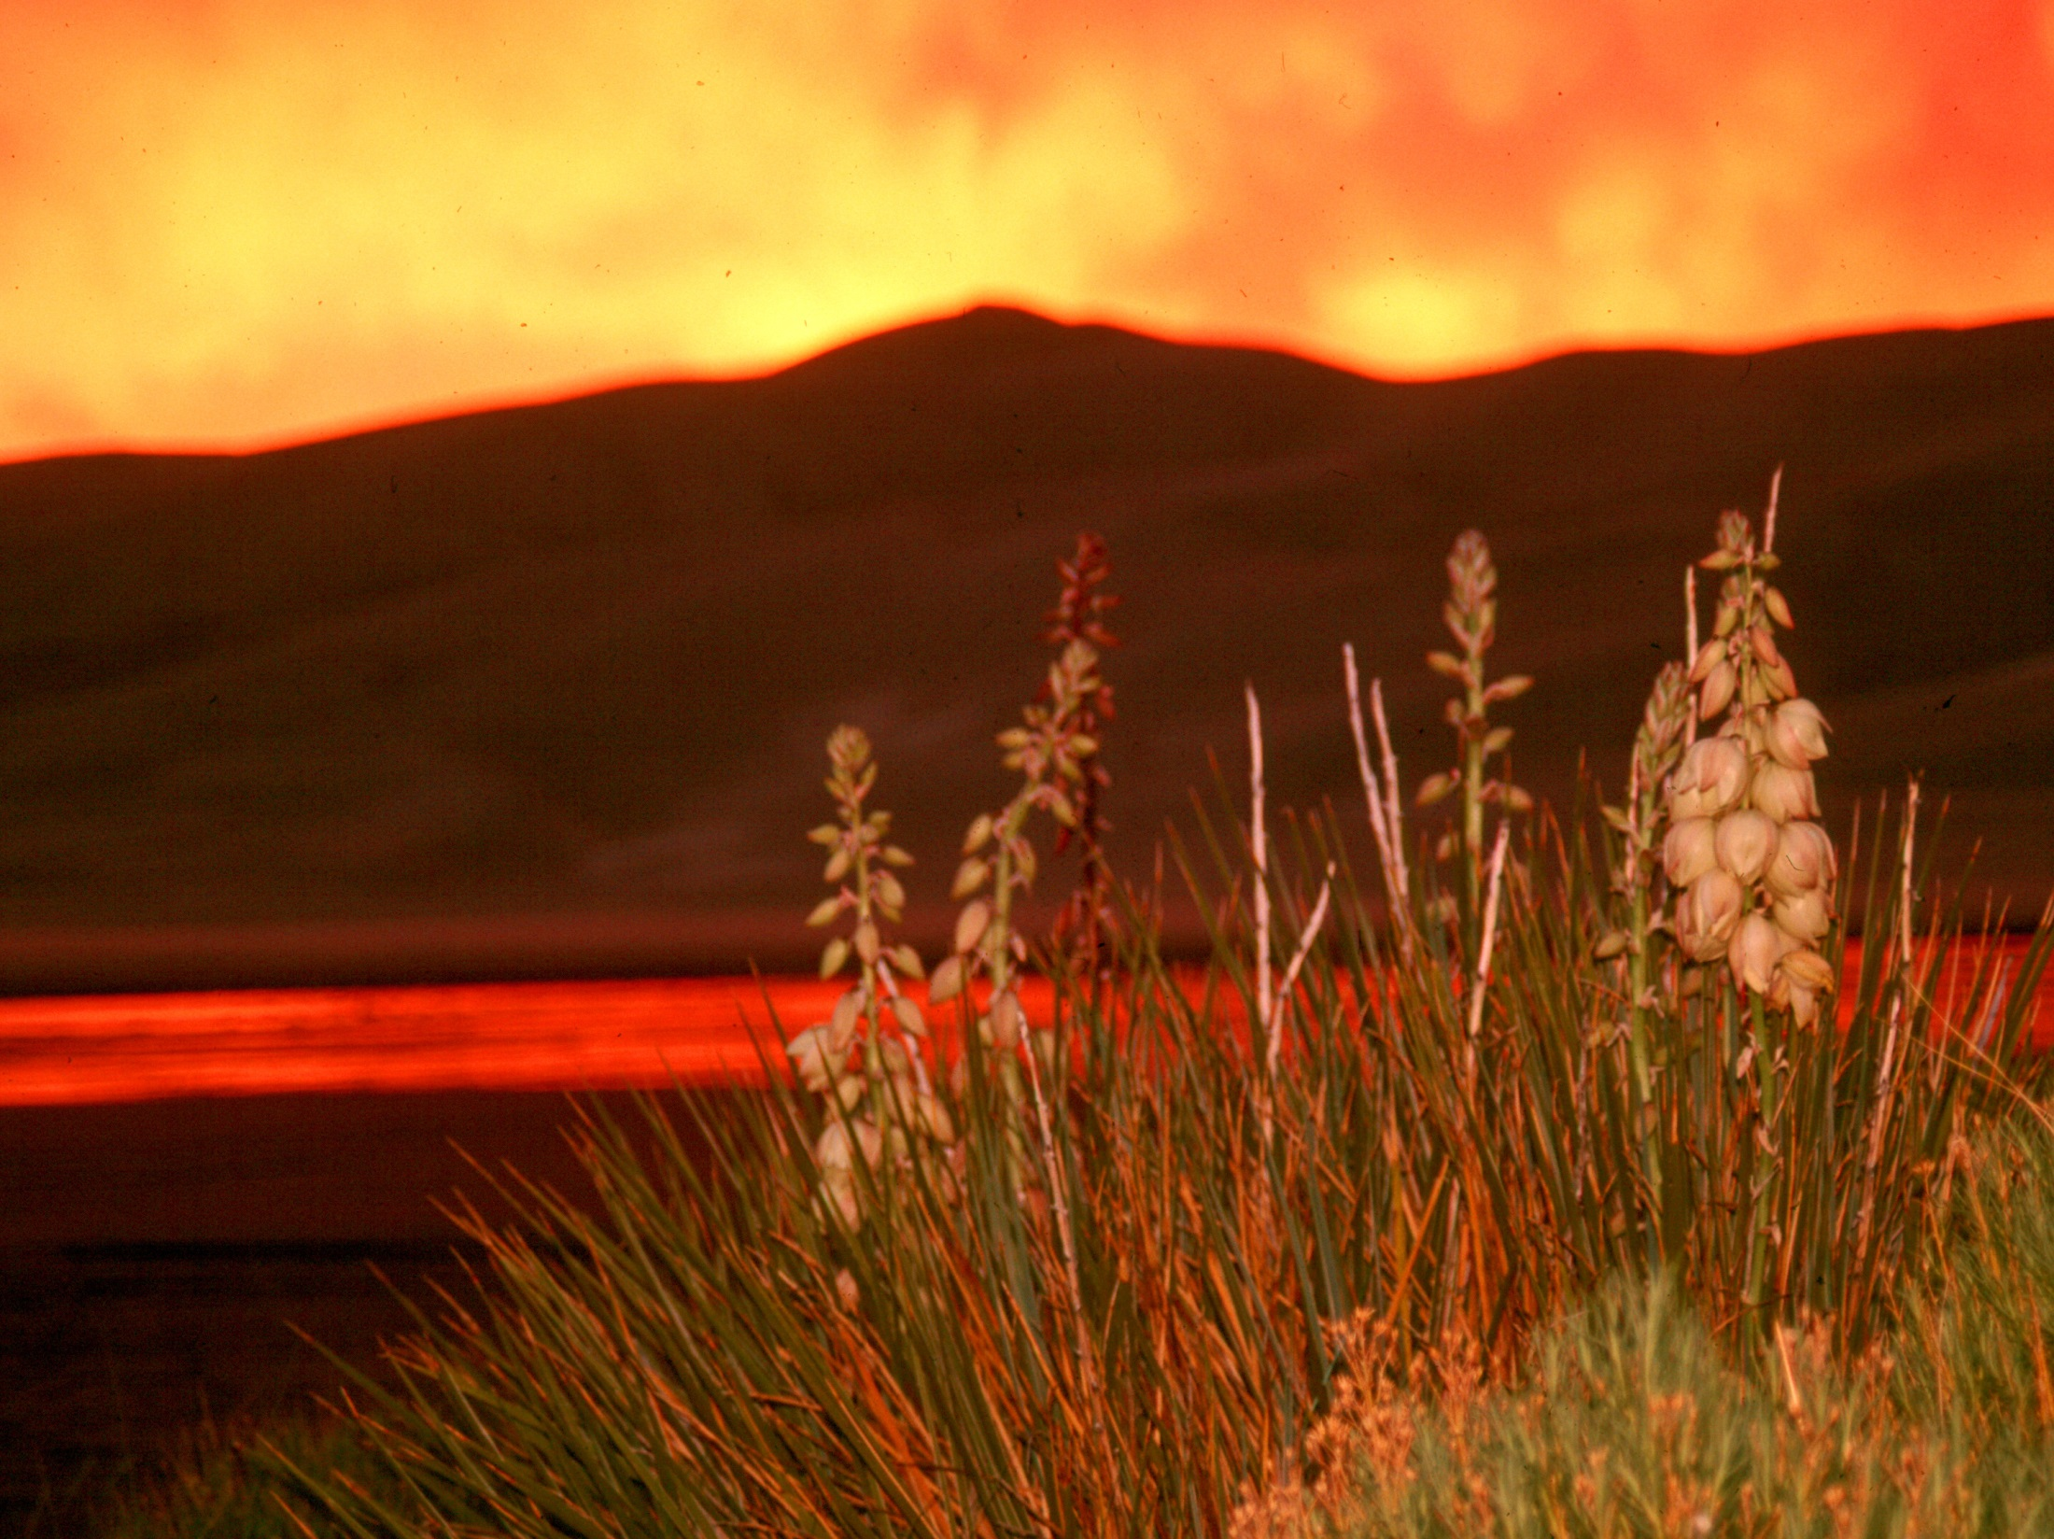

The End
andrew_valdez@nps.gov
Thanks:
USGS mapping program
NPS IMR-GIS

Slide 28
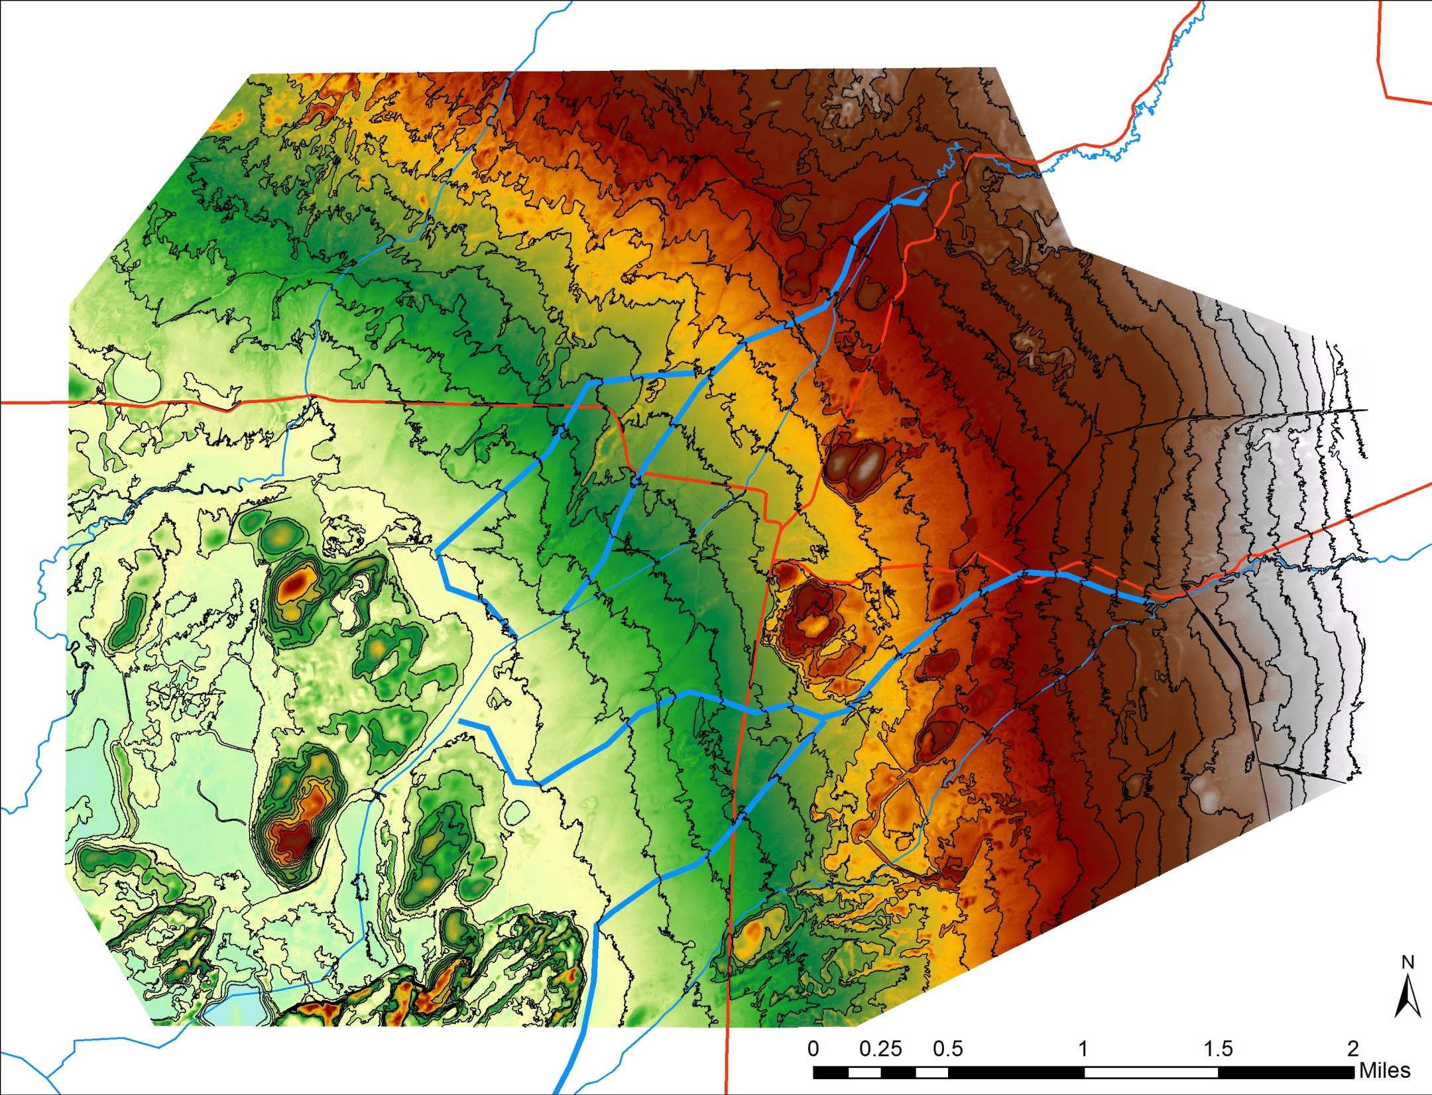
Summary

