Slide 1
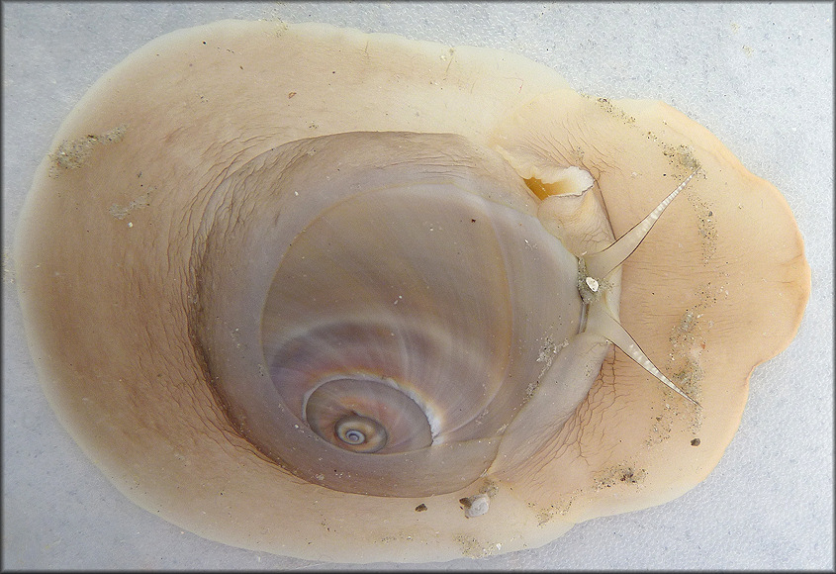
Stable isotopic analysis reveals omnivory in the naticid gastropod Neverita duplicata: Part 2, Modern food web analysis
Michelle M. Casey, Leigh M. Fall, Gregory P. Dietl

Slide 2
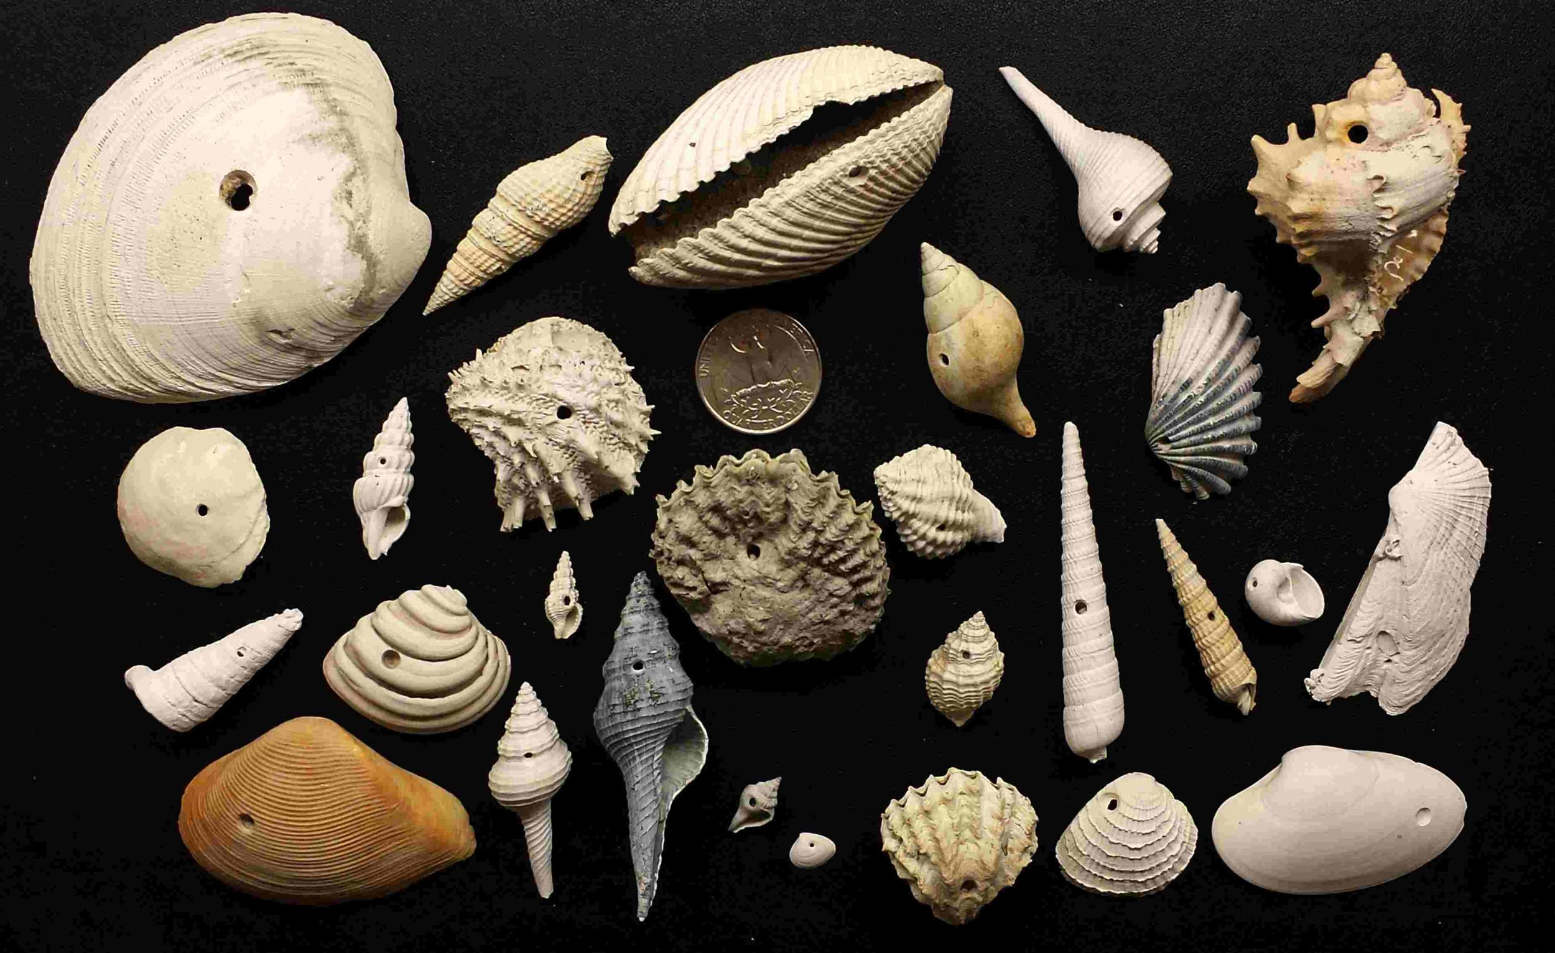

Slide 3
Nitrogen Fractionation in the Laboratory
Nitrogen signatures higher after eating clams for 1 year
Nitrogen fractionation factor = 3.58 ‰
Do our laboratory fractionation factors (Δ¹⁵N and Δ¹³C) change previously published trophic positions / dietary proportions?
What plants are Neverita duplicata eating?
Casey et al., in revision

Slide 4
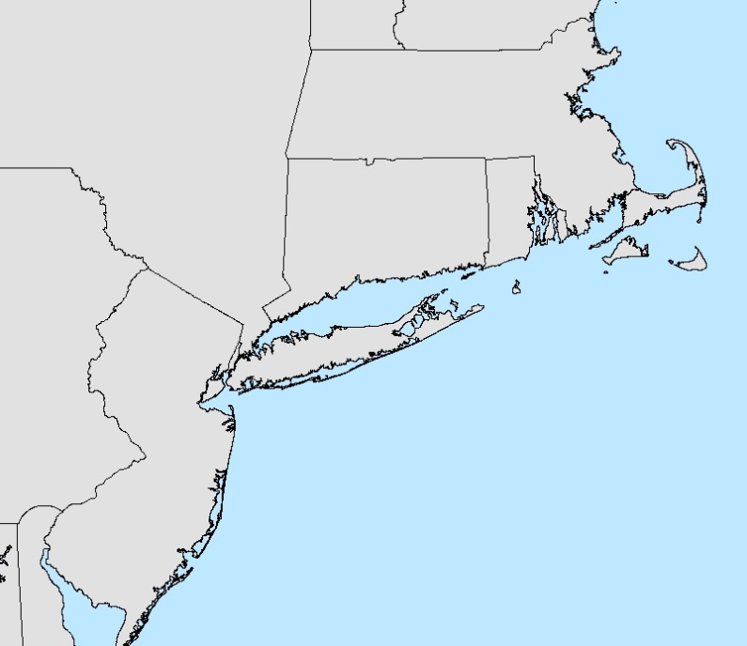
Food Web Sampling
Casey et al., in revision

Slide 5
Simplified Food Webs
Trophic Level
δ¹⁵N
Wolves
3
Raccoon
2.5
Goats
Sheep
2
Deer
C₃ Plants
C₄ Plants
1
-δ¹³C
Notes:
But in most cases, both in marine and lacustrine ecosystmes, we are dealing with food webs that have two or more isotopically distinct food sources. So in this example, the base of the pelagic part of the food chain is phytoplankton which will have a different carbon signature from the benthic epiphyton at the base of the littoral food chain. This difference will allow us to determine what proportion of an snail’s diet comes from the pelagic versus littoral food chain.

Slide 6
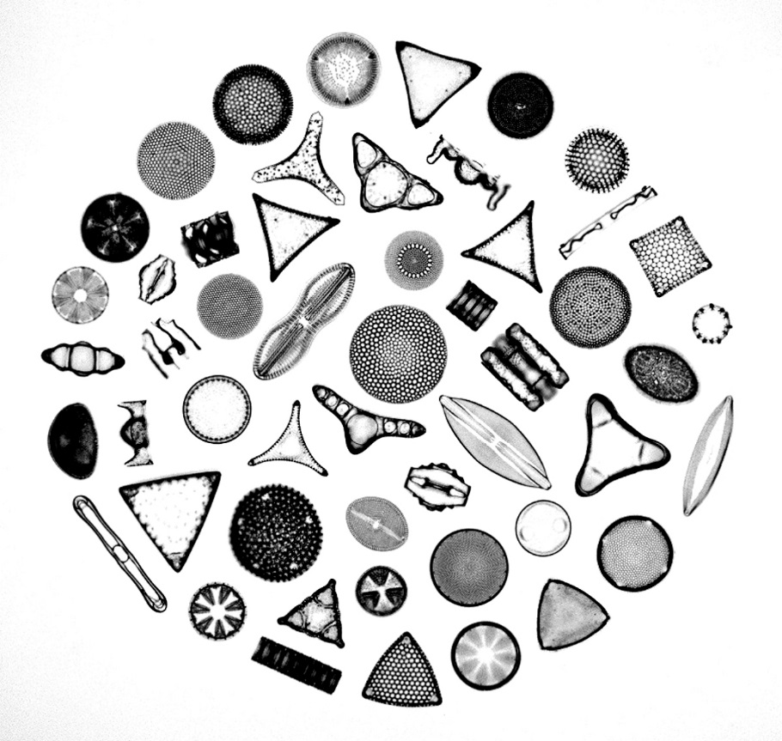
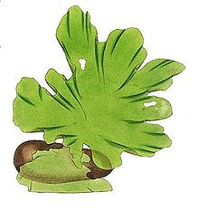

Marine Hypothetical Example
δ¹⁵N
3
Carnivorous Snails
?
2
Bivalves
Herbivorous Snails
2
?
1
Phytoplankton
Benthic Algae
1
-δ¹³C
Notes:
So if we graph this idealized food web in terms of each organisms delta C 13 values on the x-axis and it’s delta N 15 value on the y-axis.

Slide 7
Marine Hypothetical Example
δ¹⁵N
3
Carnivorous Snails
3
Herbivorous Snails
2
2
Bivalves
Benthic Algae
1
1
1
Phytoplankton
-δ¹³C
Notes:
We can come up with misleading results if we take the nitrogen signatures at face value as trophic position instead of looking at the number of trophic increase increments between our taxa and the base of the food web. So in this scenario, the carnivorous snail and herbivorous snail have the same delta N 15 value even though they do not have the same TP. So we need to measure the carbon and nitrogen signatures of the primary producers at the bottom of both food chains, or the isotopic baseline, in order to accurately calculate trophic position of the snails we’re interested in. We can do this by going out every two weeks over the growing season and directly measuring a time series of N and C values for the different primary producers, or we can do so my measuring proxy taxa, like herbivorous snails such as Littorina as a proxy for the benthic food chain, and blue mussles as a proxy for the pelagic food chain. I’ll show you examples of both methods from my research.

Slide 8




Accounting for Baseline
Whelk
Moon snail
Periwinkle
Mussel
α = [δ¹³C_{sc} - δ¹³C_{base2}] / (δ¹³C_{base2} - δ¹³C_{base1})
TP= λ+(δ¹⁵N_{sc}- [δ¹⁵N_{base1} x α + δ¹⁵N_{base2} x (1- α)])/3.4
Casey and Post, 2011
Notes:
Here is real data from my work in the Long Island Sound. The axes are the same as before with carbon and nitrogen. The points are an average value of 10 individuals of each taxa and the error bars show the minimum and maximum values. You can see the herbivorous snails the periwinkle, our littoral proxy, and the mussels, our pelagic proxy. The three taxa with an asterix are predatory. You can see that there is a difference in the carbon signature between the two proxies, but also about a 1.5 per mil difference in the nitrogen signature. That is about a half a trophic level worth of difference between periwinkles and mussels which are both tp 2. It’s also interesting to note that the food web doesn’t conform to my expectation. Busycon has a true predatory TP of 3 calculated from these values. But both drilling gastropods have a TP of around 2.5 to 2.7. This could reflect true omnivory in their diet or a large departure of their trophic level fractionation from average, in other words they have a fractionation of less than 3 per mil between source and consumer.

Slide 9
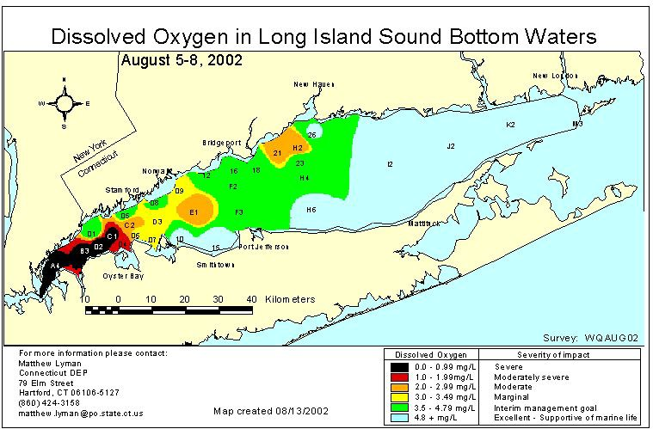
Littoral Proxy
Pelagic Proxy
δ¹⁵N (‰)
δ¹⁵N (‰)
Notes:
Another place we see nitrogen concentration affecting the isotopic signature of nitrogen is in eutrophied areas such as Long Island Sound. Here Nitrogen concentration is increased by anthropogenic input, especially in and around New York City, and leads to a whole host of symptoms, including summer hypoxia and anoxia. This is a map of Long Island Sound shows the amounts of dissolved oxygen in summer bottom waters. Yellow and darker are detrimental to shellfish health and anything red or black is potentially lethal. The red arrows represent my sampling localities.

Slide 10


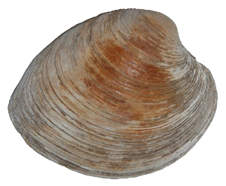
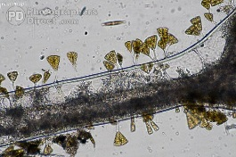
Milford, CT
TP = 3
Max TP=2.5
Notes:
To accurately calculate TP for this predatory whelk we need to know the proportion of it’s diet that is coming from each source and then calculate trophic level increase in nitrogen up from this point. But what else besides multiple food sources can affect the isotopic nitrogen signature of organisms.

Slide 11
Littoral Diet
α = [δ¹³C_{sc} - δ¹³C_{base2}] / (δ¹³C_{base2} - δ¹³C_{base1})
α = 0.0 means that the diet is 0% pelagic (or 100% littoral)
41%
Δ¹³C = 0.0 ‰
Δ¹³C = 1.9 ‰
Casey et al., in revision
Notes:
41% of snails still get more than 2/3 of their carbon from littoral sources (alpha= < 0.33)

Slide 12
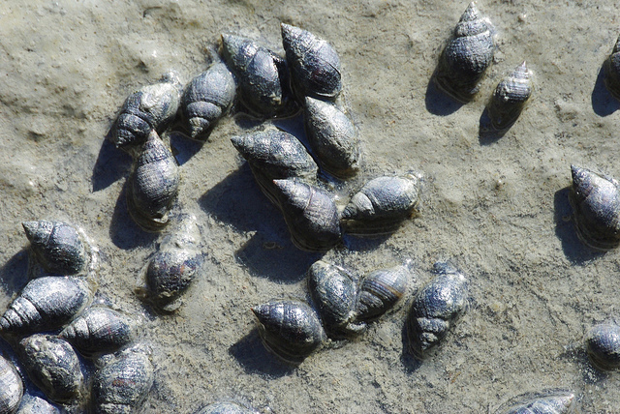
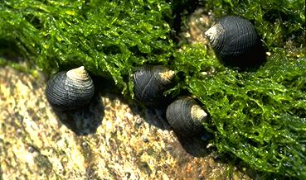
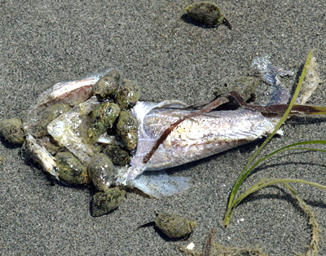
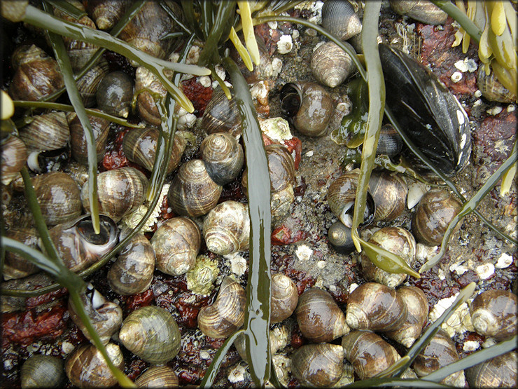
Mud snails
Periwinkles

Slide 13
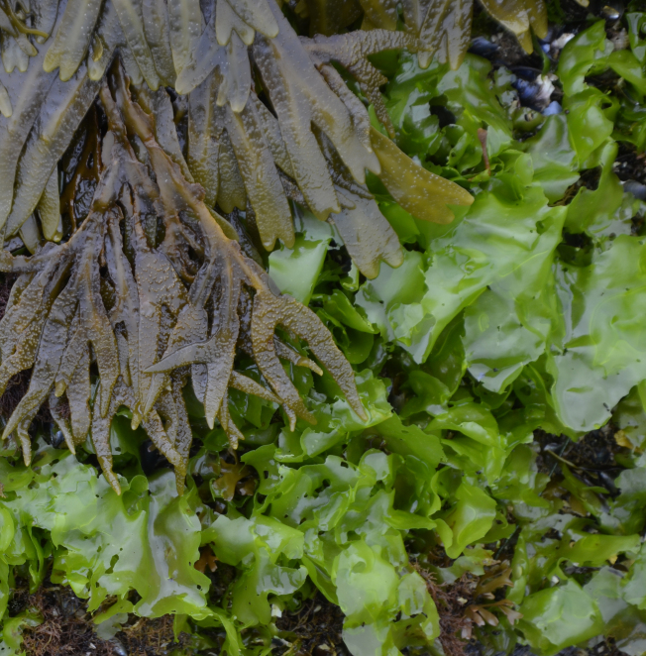
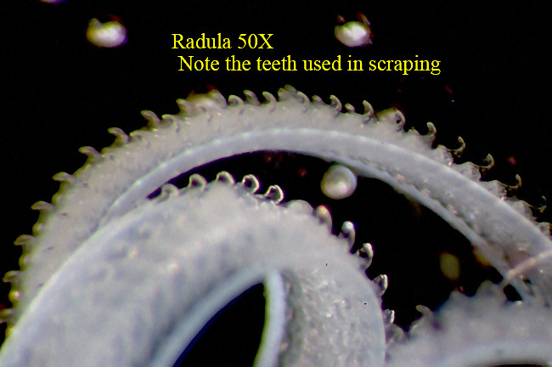
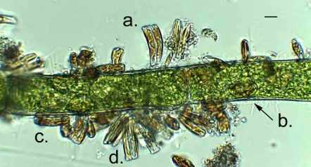
Conclusions
Photograph by Robert Zottoli
L. littorea
Neverita duplicata feeds as an omnivore in the wild!
Do our laboratory fractionation factors (Δ¹⁵N and Δ¹³C) change previously published trophic positions / dietary proportions?
Δ¹⁵N lowers TP estimates, but not significantly
Δ¹³C increases alpha (more pelagic), still relying on littoral carbon
What plants are Neverita duplicata eating?
N. duplicata likely feeds on benthic primary producers (e.g., macroalgae, epiphytic diatoms)
Must go beyond stable isotopic methods to determine exactly which plants N. duplicata is eating (e.g., isotopic labelling, DNA barcoding, immuno-assays)
Implications?
Photograph by Robert Zottoli
Photograph by Martyn Kelly

Slide 14
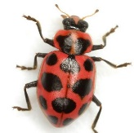

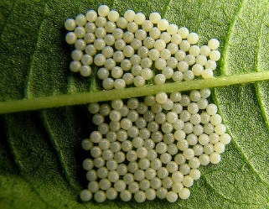
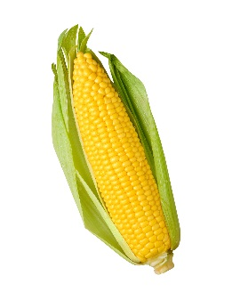

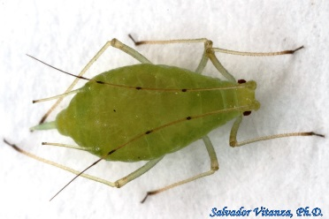
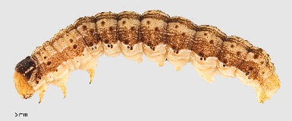
Implications
Will Neverita duplicata’s omnivory lead to increased drilling frequency?
We Don’t Know
Cottrell and Yeargan, 1998
Harmen et al., 2000
Notes:
Coleomegilla maculata = spotted ladybug beetle Coleomegilla maculata = spotted ladybug beetle
Helicoverpa zea eggs = corn earworm pea aphids
Zea mays pollen = sweet corn dandelions

Slide 15
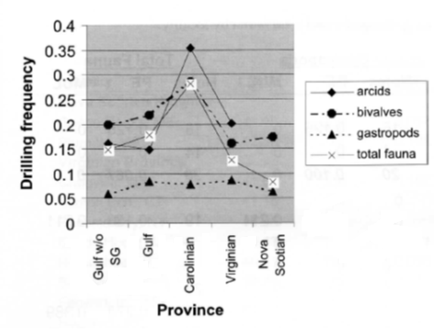
Implications
Copepods
Naticids
No more meat when it’s hot?
No more meat when it’s hot?
Boersma et al., 2015
Kelley and Hansen, 2007

Slide 16
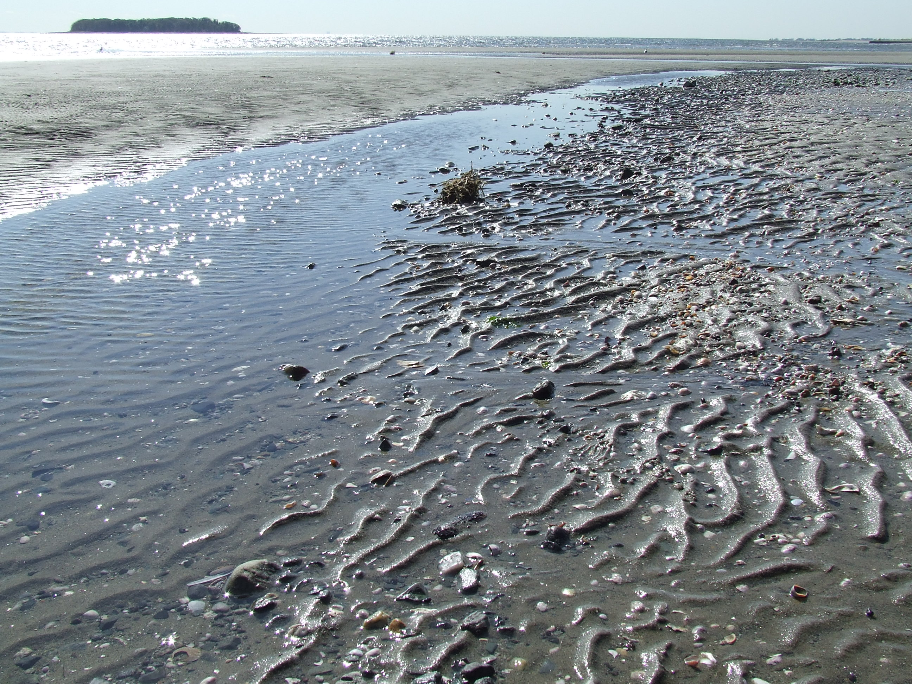




Acknowledgments
Tom Butler, Annalee Tweitmann and Steve Durham (Cornell) for help running laboratory experiments
Gerry Olack (Yale), Greg Cane (K-PESIL), and John Pollak (Cornell) for laboratory assistance
Gregg Rivara (Cornell Cooperative Extension) for supplying M. mercenaria prey
Daniel Casey, Emily Einstein, Úna Farrell, and Joanna Wolfe for help with field collections
SUNY Oneonta Faculty Research and Creative Activity Grant Programs and United University Professors Individual Development Award

