Slide 1

Using Content Analysis to Investigate the Treatment of Spatial and Temporal Scale in K-8 Science Standards and Textbooks
Kim A. Cheek and
Lauryn A. Stark

Slide 2
Content Analysis
Systematic coding and analysis of texts or visual material
Deductive Inductive

Slide 3
Are the spatial and temporal scales of ESS processes emphasized in K-8 science standards and textbooks ?
NGSS crosscutting concept: Scale, proportion, and quantity
CA, FL, and TX: ~ 30% of all school-aged students; textbook adoption states
Physical & Historical Geology
Astronomy
Weather and Climate

Slide 4
Coding: Scale as…
 | Magnitude¹ | Relationship between Objects or Events¹
Spatial | meter, km, global, synoptic, large, small | larger, smaller, scale factors in mapping (1:125,000)
Temporal | day, year, million years, Cretaceous, long, short, old | longer, shorter, older, younger
¹Terms defined in Cheek, K., LaDue, N., & Shipley, T. (in review)
based on cognitive science research reviewed in that paper.

Slide 5
Defining the coding unit
CA
PEs
DCIs
FL
Big Idea
(BI)
Benchmark (B)
TX
Strand
Essential Knowledge & Skills (EKS)
Clarification Statement (CS)

Slide 6
Geologic Time in MS Standards
 | CA (6th-8th) | FL (7th) | TX (6th, 7th, 8th)
Magnitude | 4.6 Ga, geologic time scale (PE & DCI) | geologic time (BI), radioactive dating to measure age (B) | ------
Relationship | Use of fossils & strata to est. relative age (CS) | Superposition to est. relative age (B) | ------

Slide 7
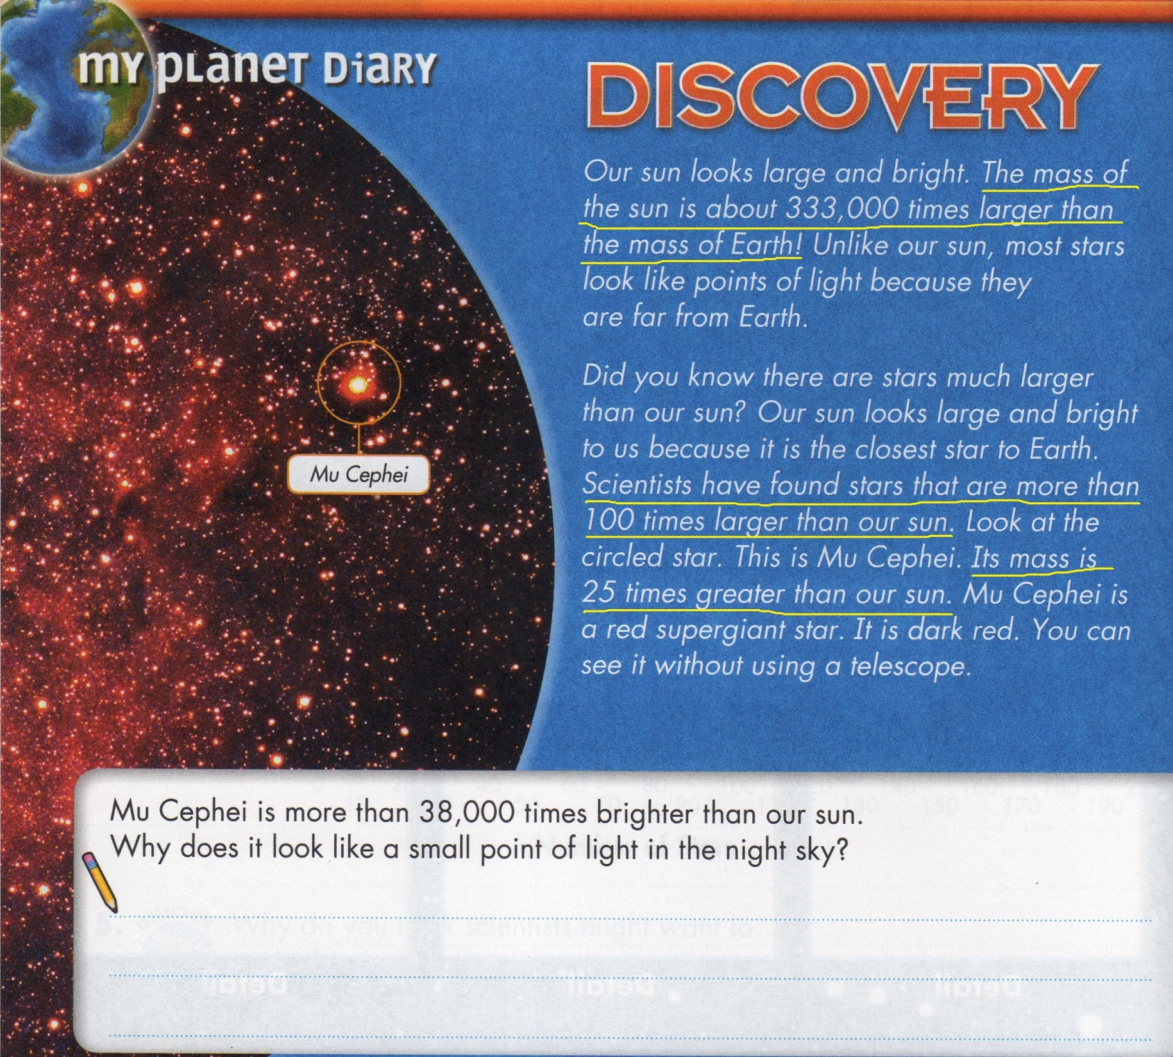

Slide 8
This research is funded by a University of North Florida Academic Affairs Scholarship grant.
Kim A. Cheek Lauryn A. Stark
k.cheek@unf.edu lauryn.stark@unf.edu

