Slide 1
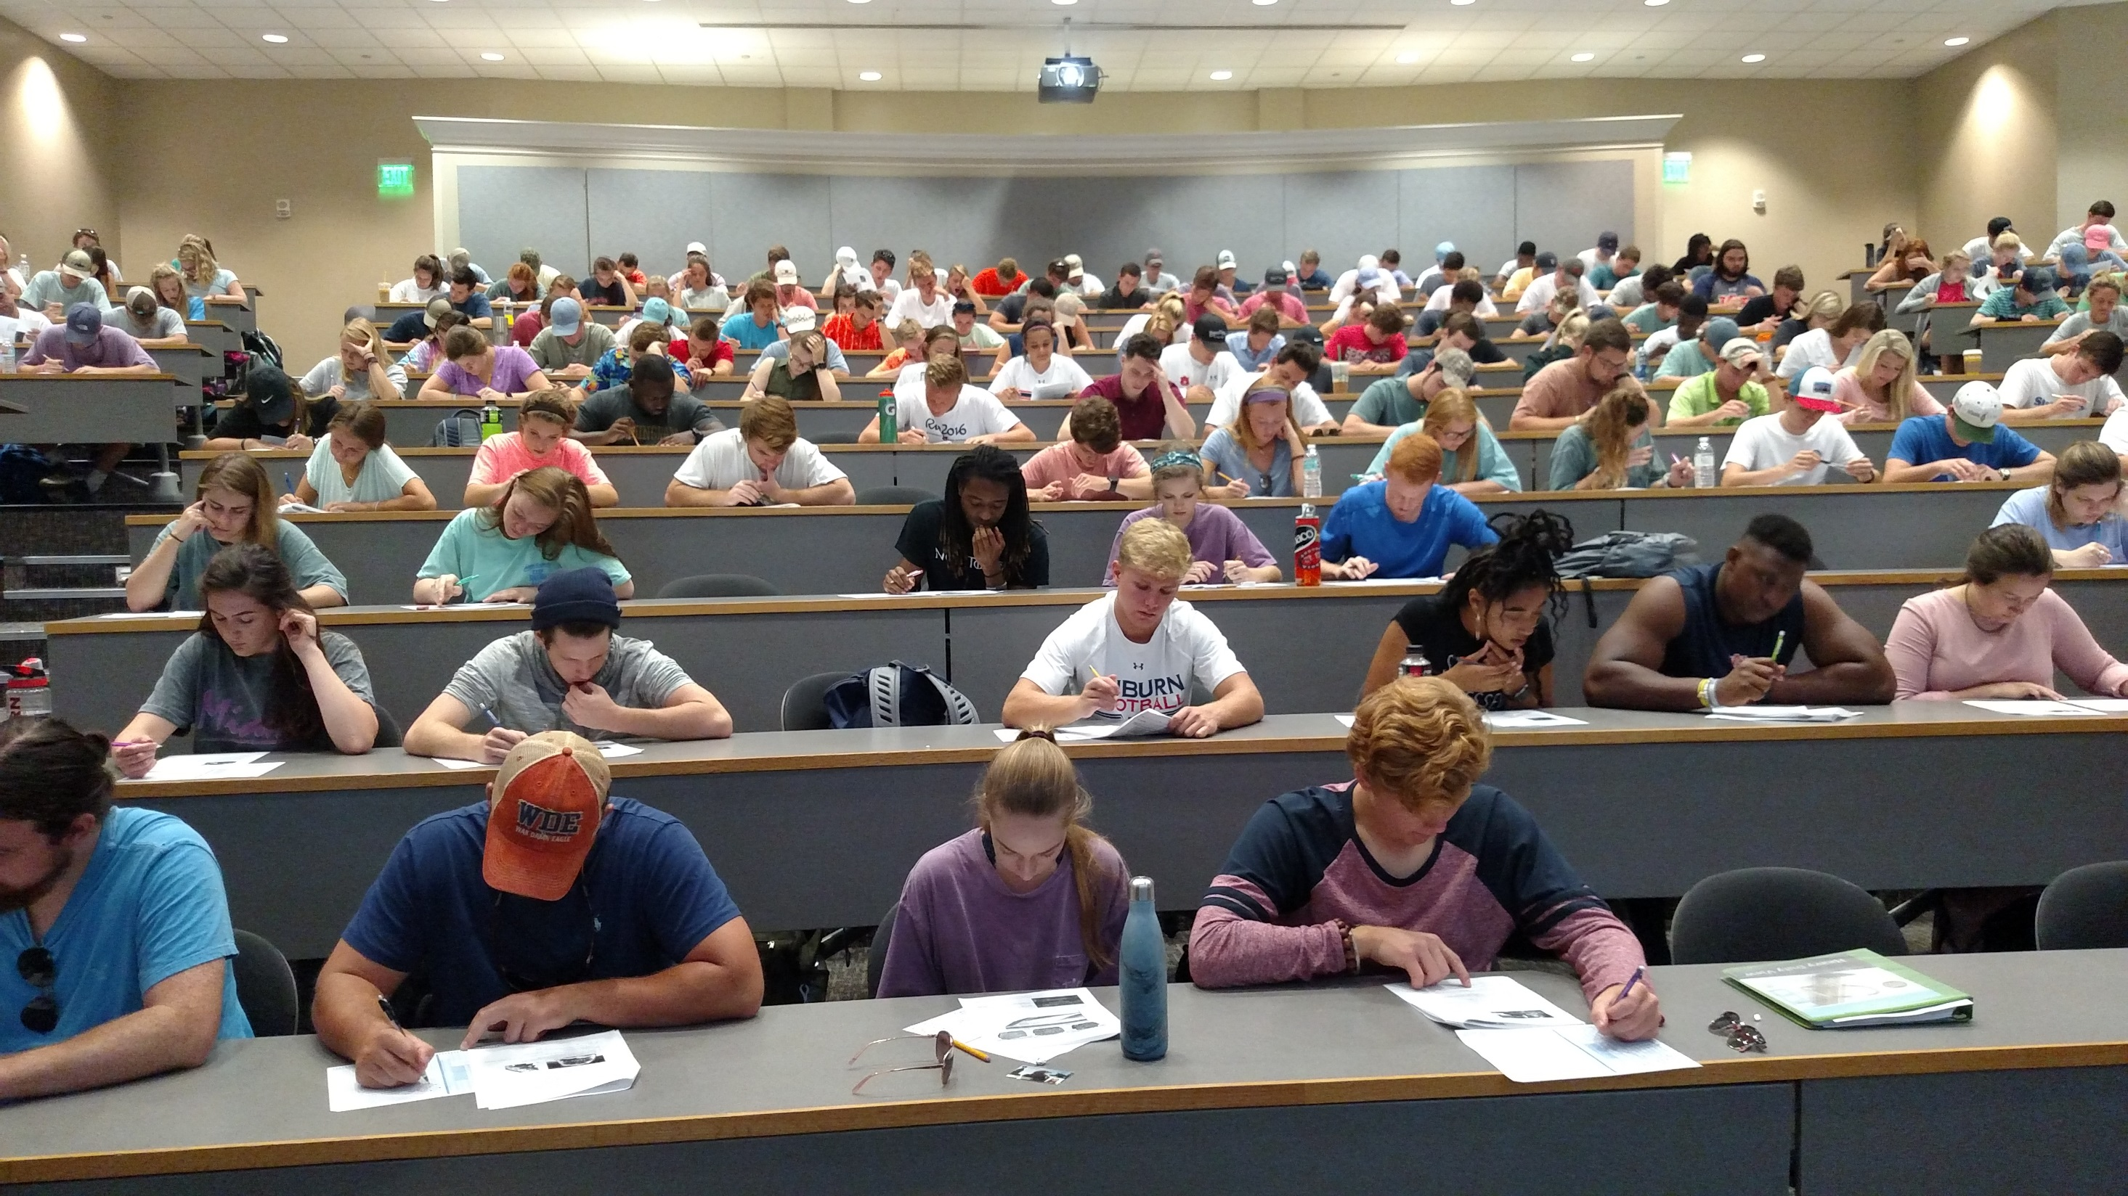

METHODS FOR BRINGING STUDENT BASED FIELD EXPERIENCES AND OBSERVATIONS INTO A PEER LEARNING COMMUNITY THAT IS DESIGNED FOR LARGE INTRODUCTORY GEOSCIENCES COURSES AND BEYOND
John Hawkins

Slide 2
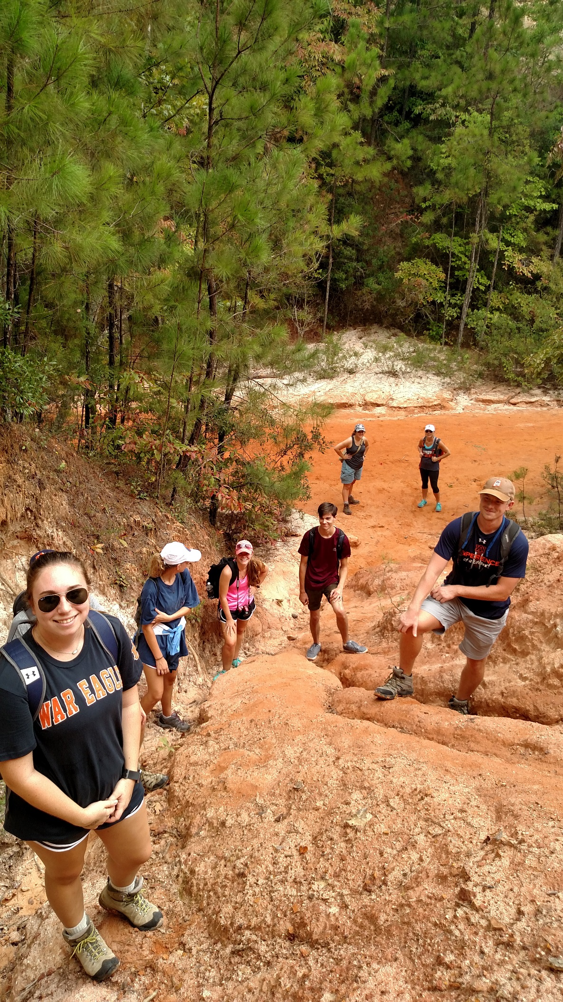
OUTSIDE
INSIDE

Slide 3



Slide 4
METHODS FOR BRINGING STUDENT BASED FIELD EXPERIENCES AND OBSERVATIONS INTO A PEER LEARNING COMMUNITY THAT IS DESIGNED FOR LARGE INTRODUCTORY GEOSCIENCES COURSES AND BEYOND
John Hawkins

Slide 5
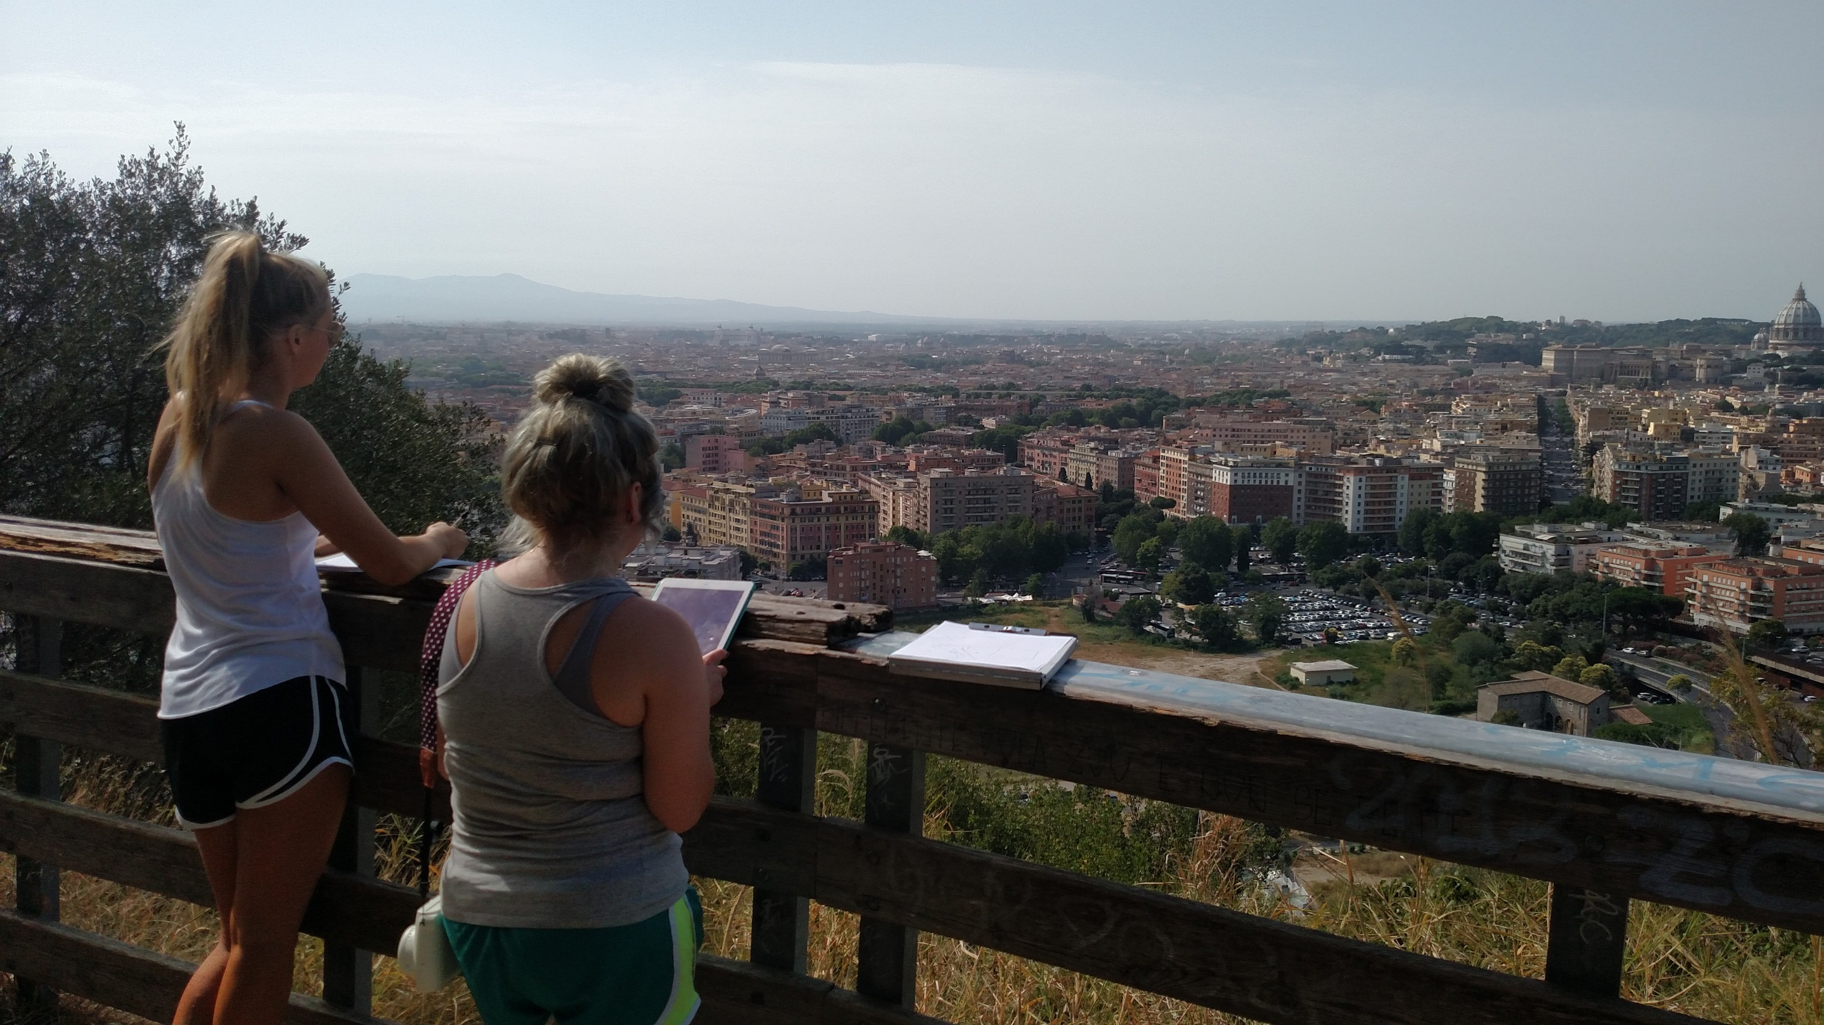

STUDENT BASED FIELD EXPERIENCES

Slide 6
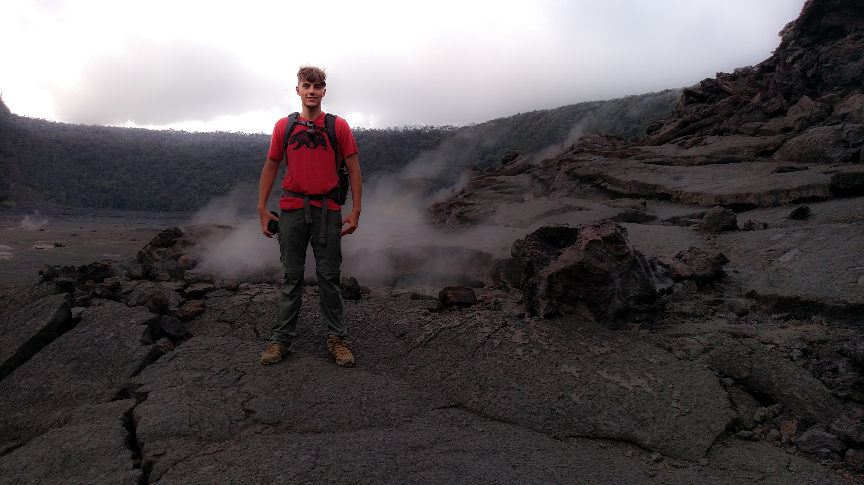
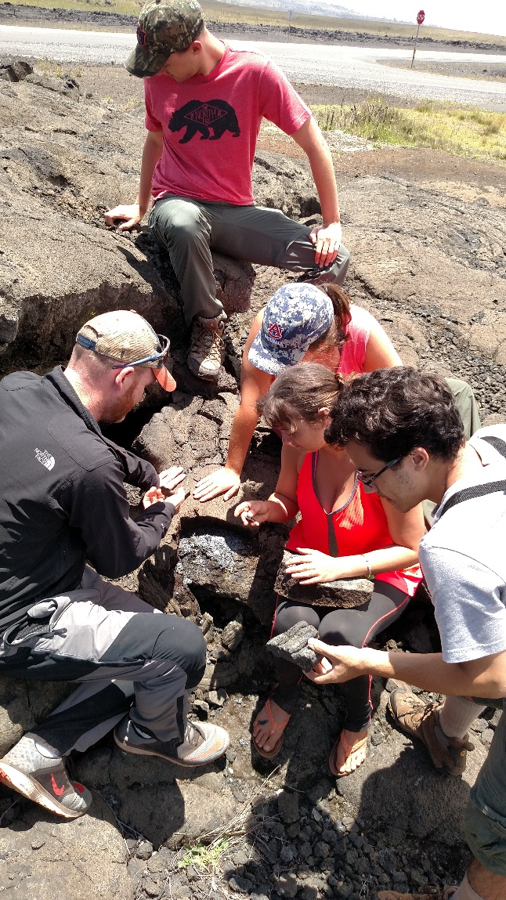
STUDENT BASED FIELD EXPERIENCES

Slide 7





Spark Post
Spark Page
Adobe Sketch
Spark Video

Slide 8

Spark Post

Slide 9
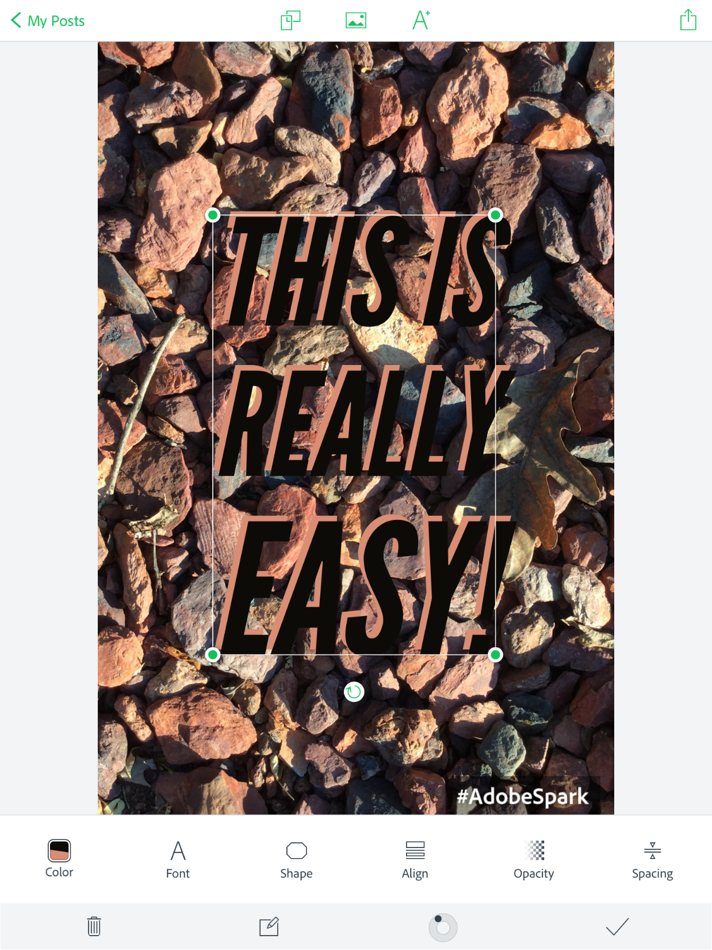
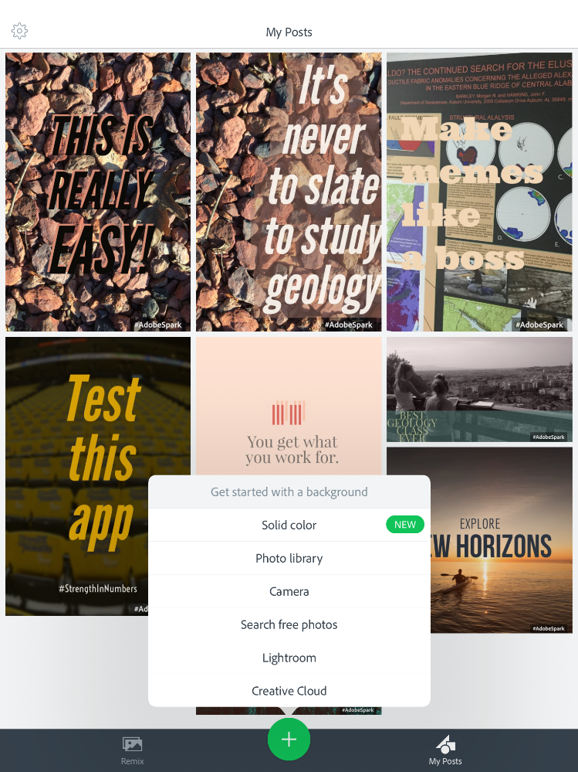
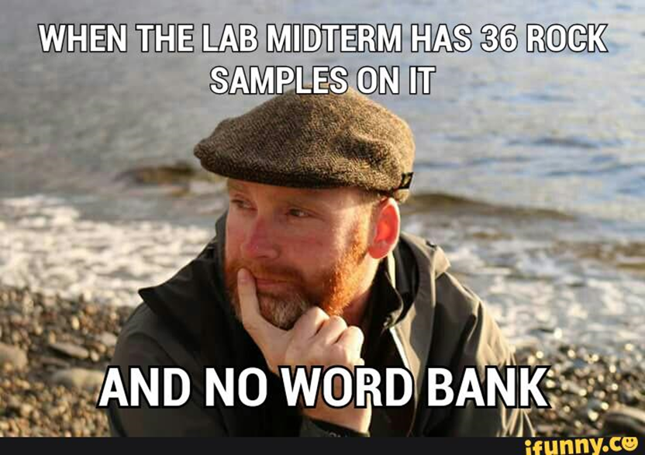
Spark Post

Slide 10

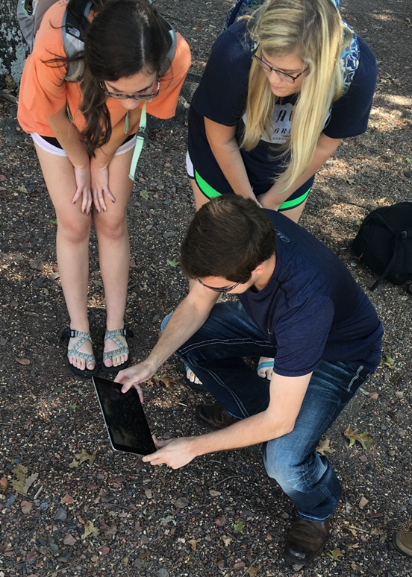
Spark Page

Slide 11
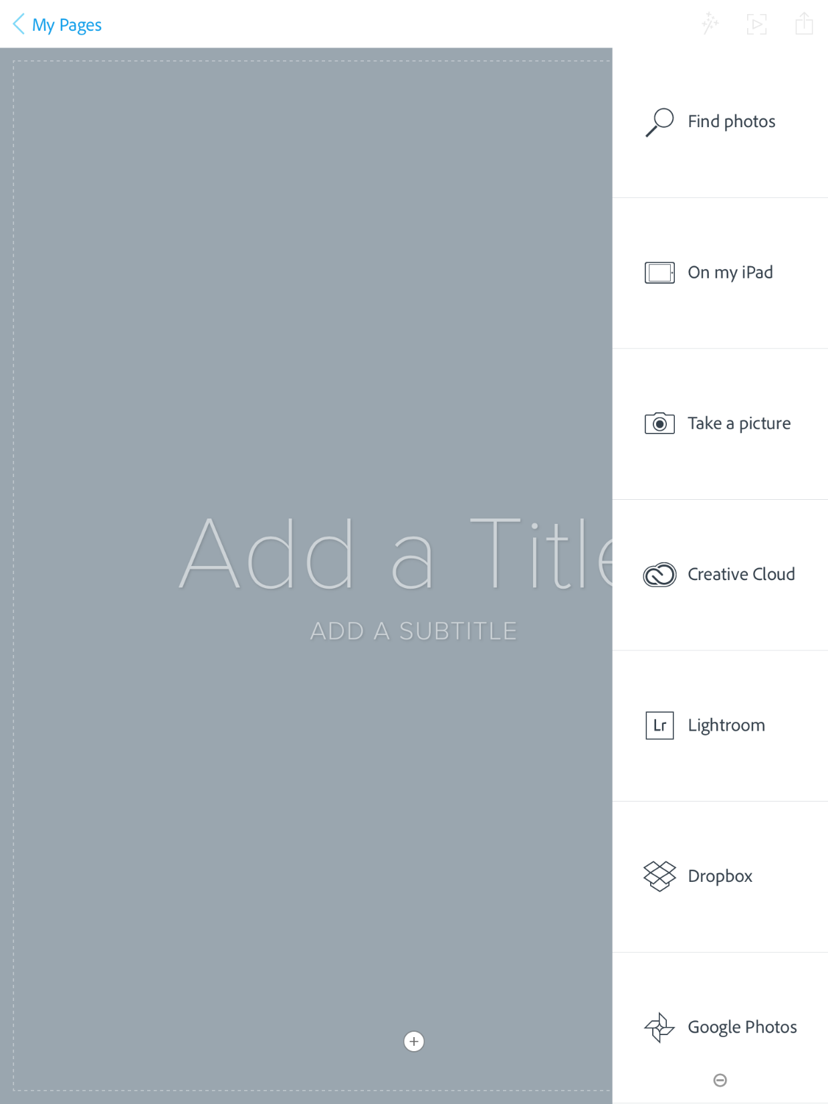
Spark Page

Slide 12
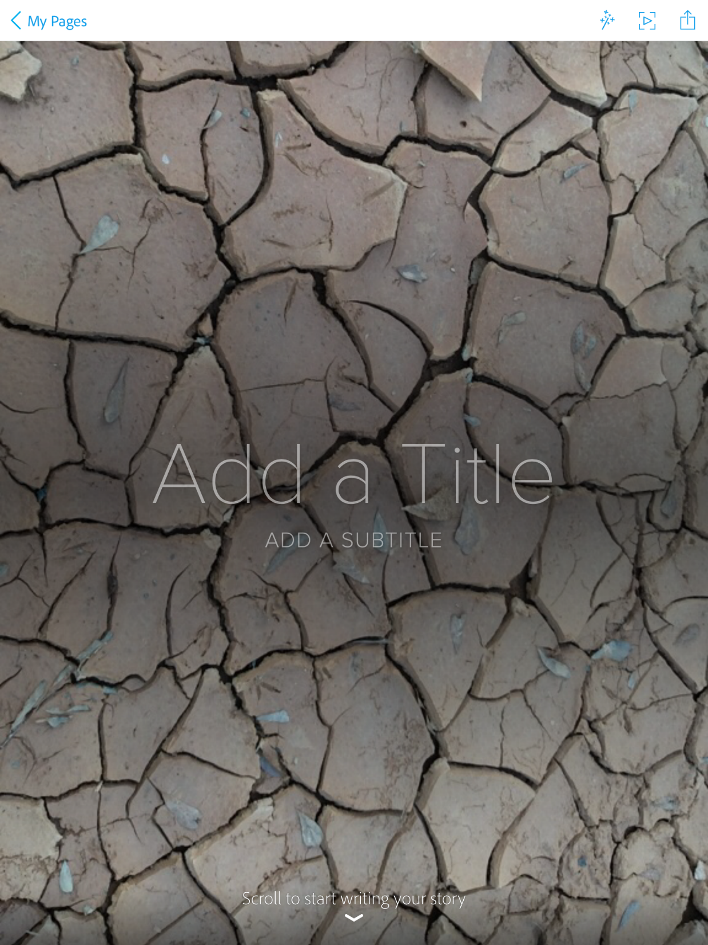
Spark Page

Slide 13
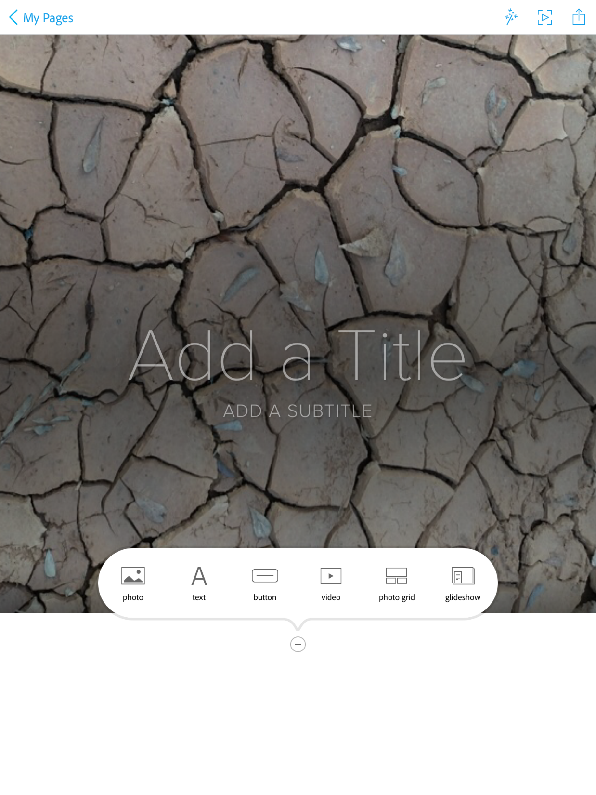
Spark Page

Slide 14


Slide 15
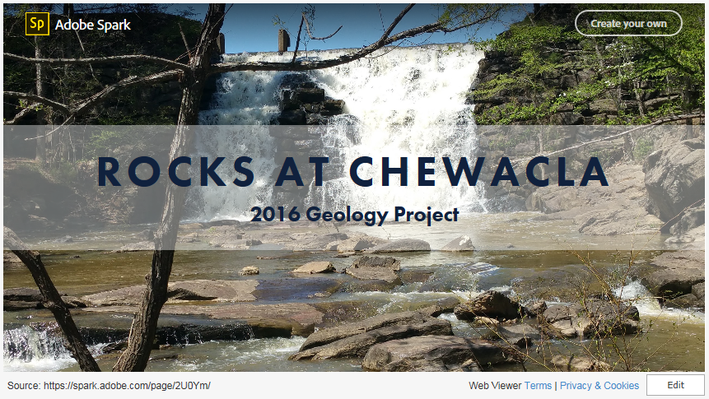

Slide 16
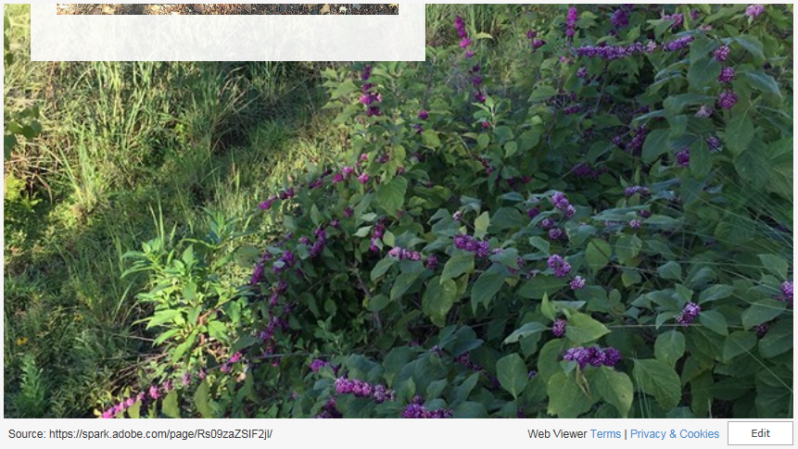

Slide 17
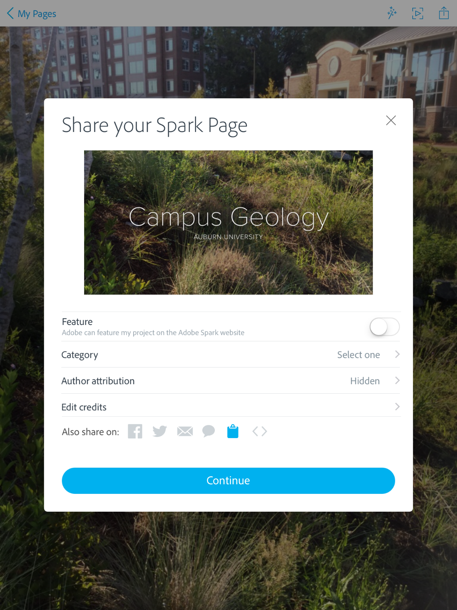
Spark Page

Slide 18
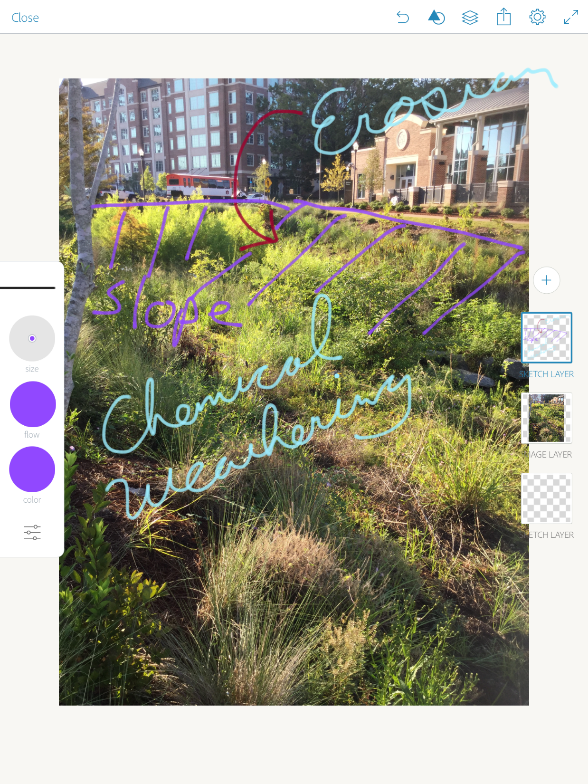
Adobe Sketch

Slide 19
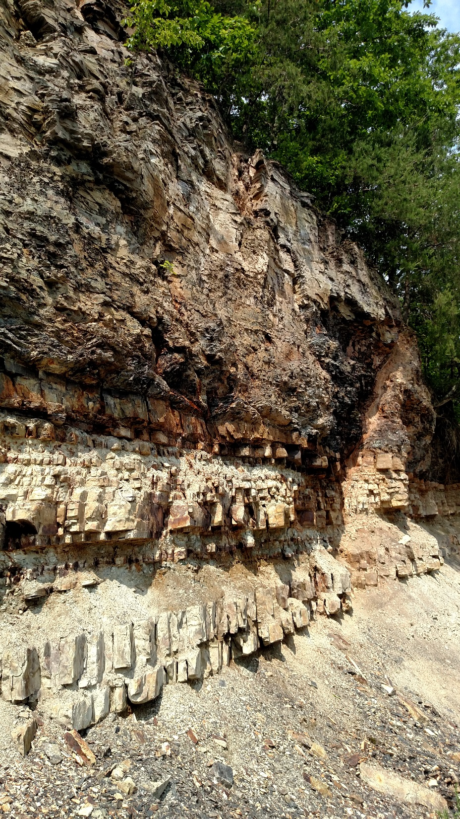
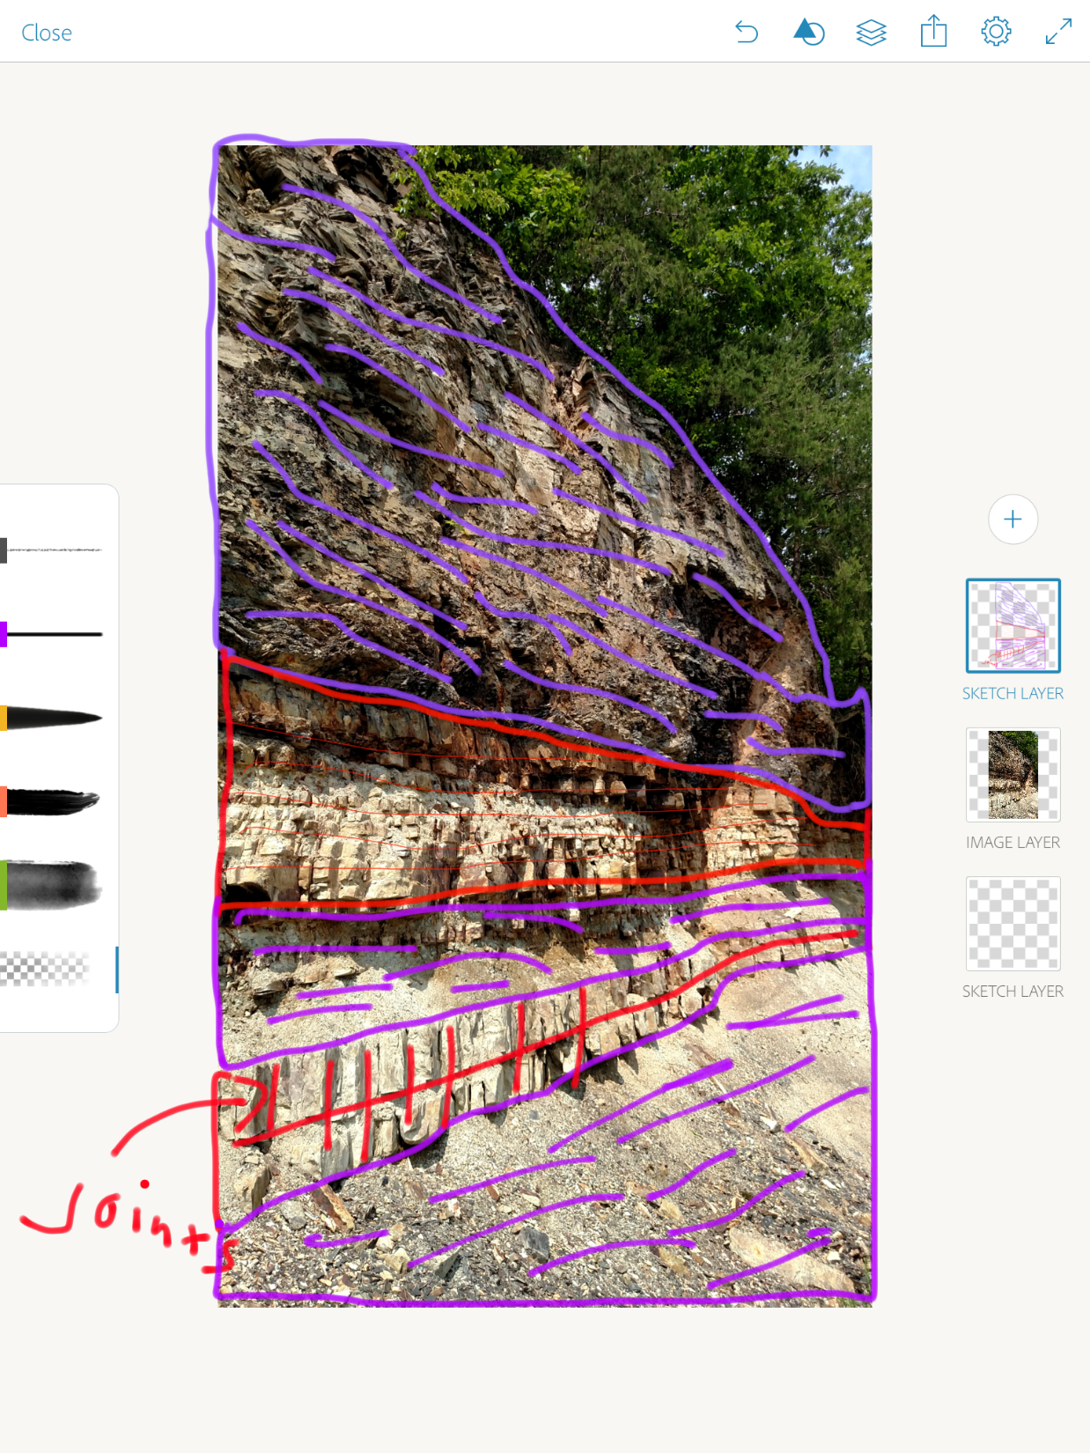
Adobe Sketch

Slide 20
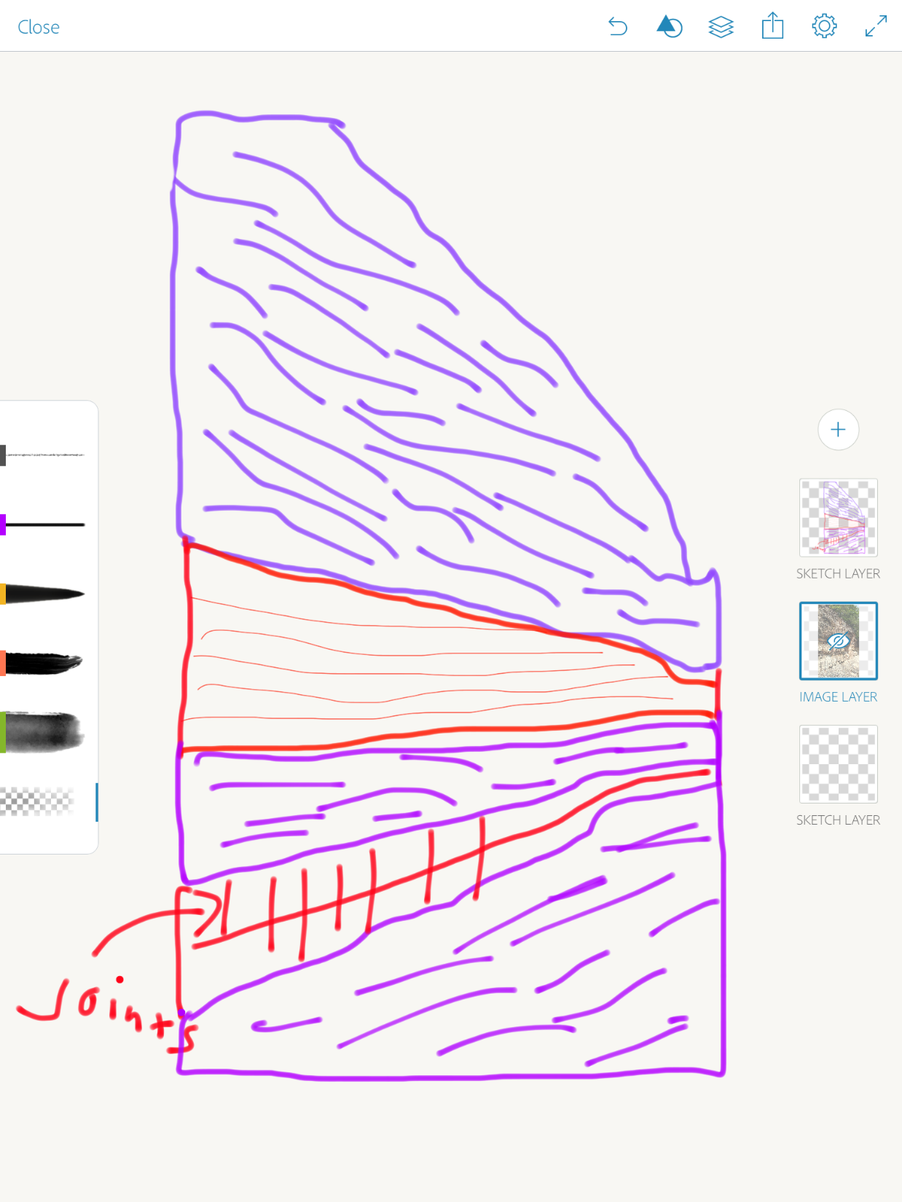

Adobe Sketch

Slide 21
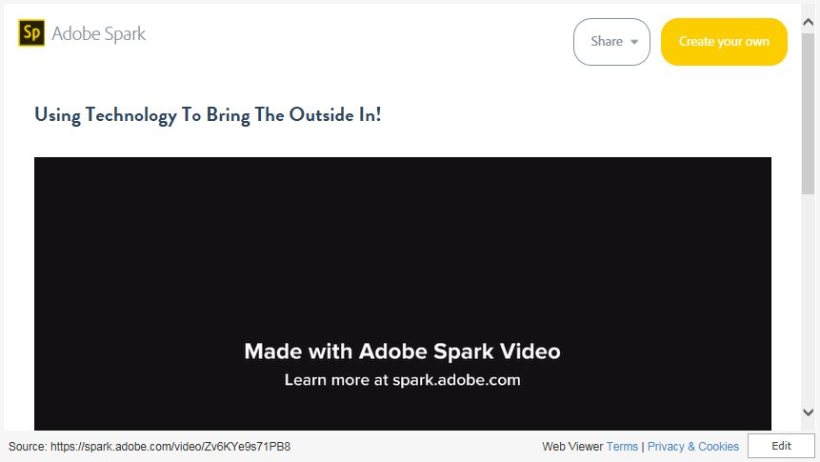
Spark Video

