Slide 1
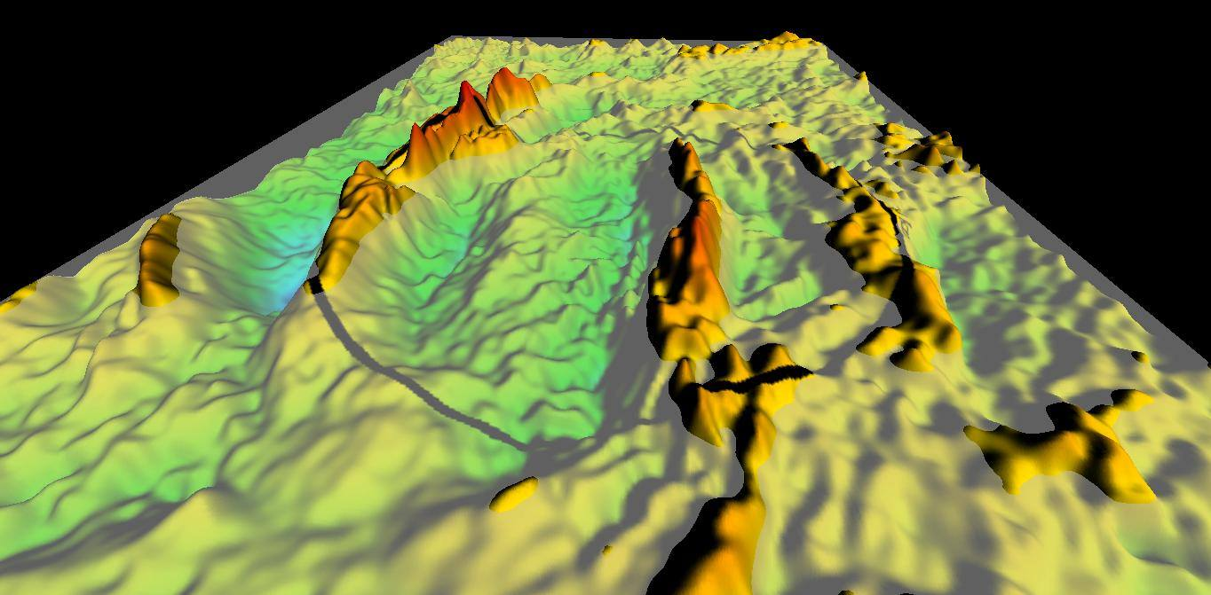

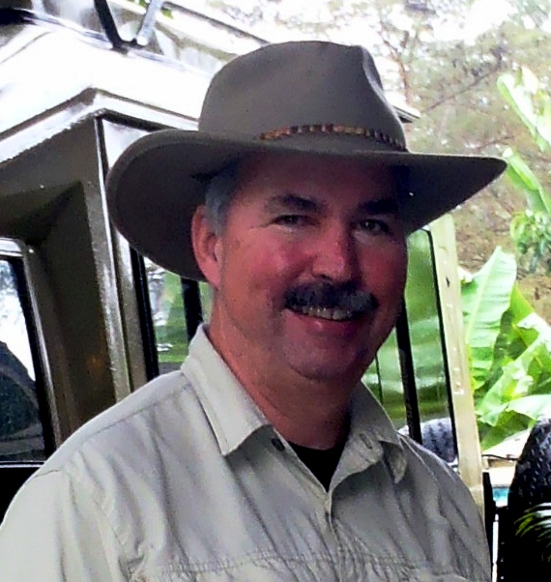
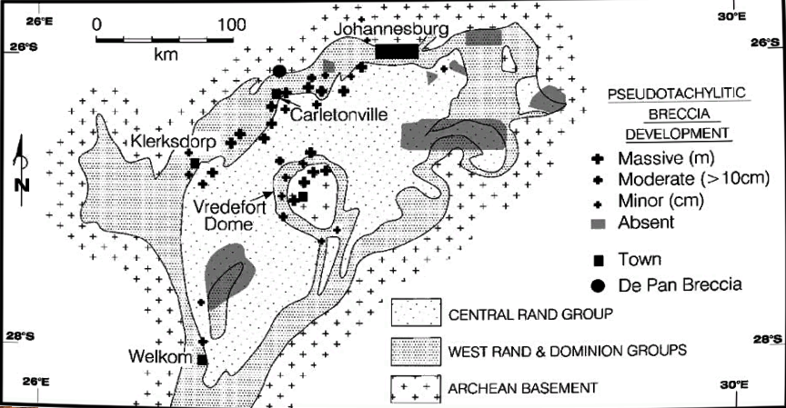
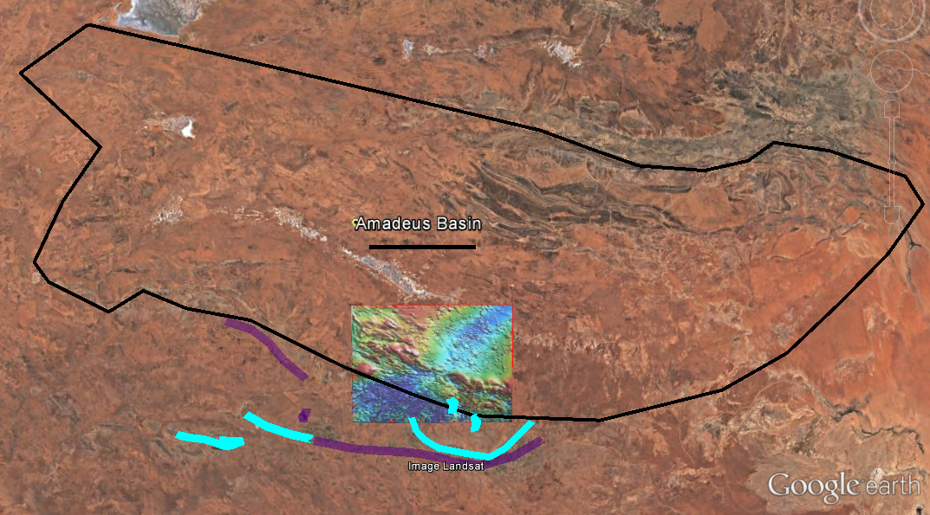
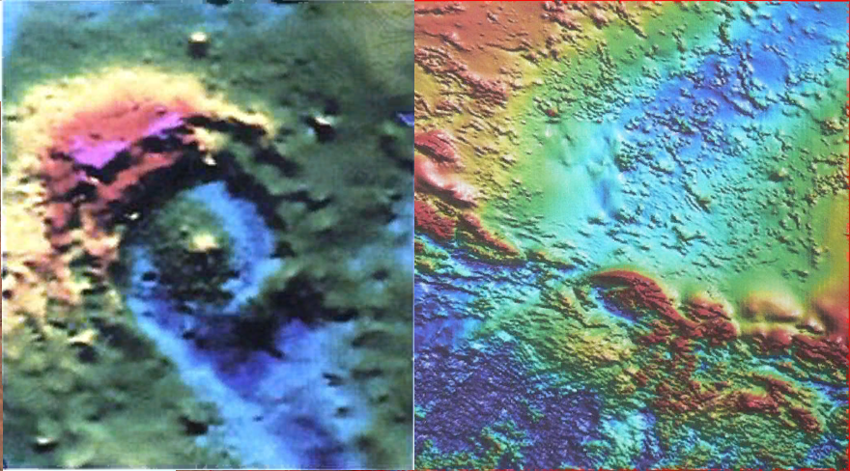
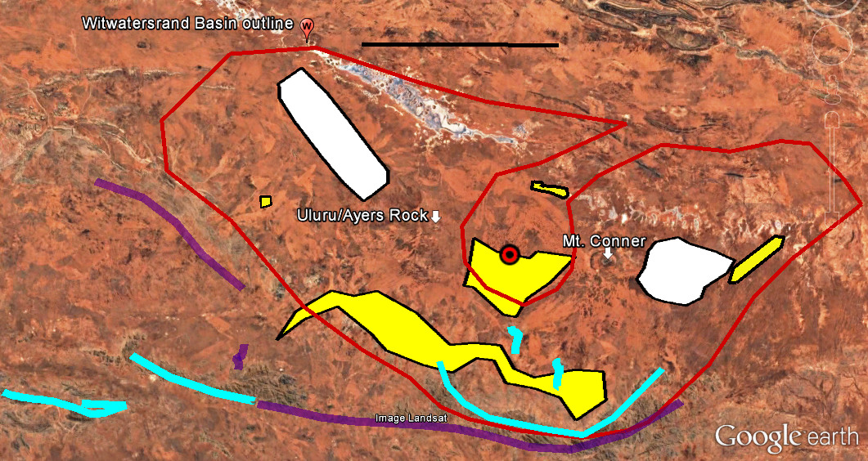
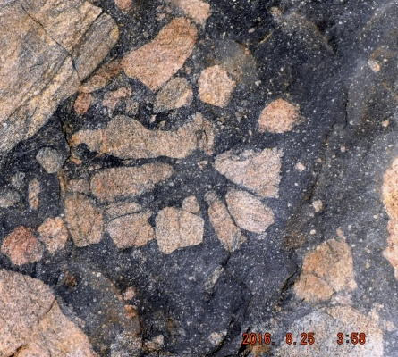
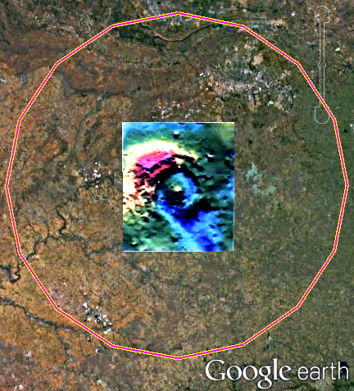
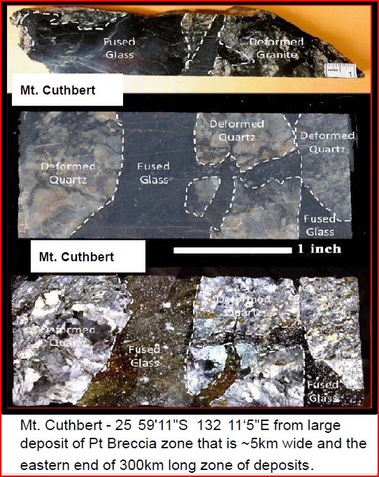
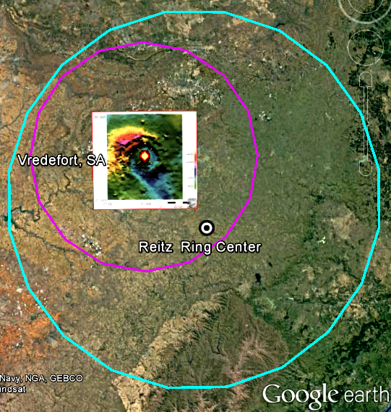
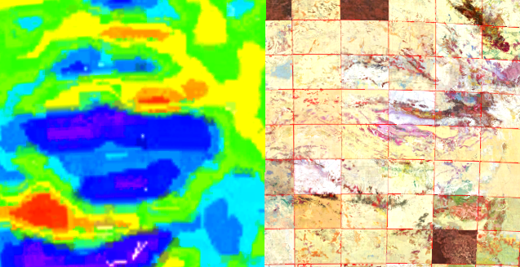
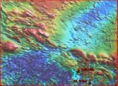
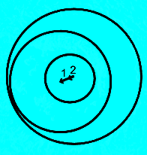

The Reitz Ring: A separate circular structure or an outer ring of the Vredefort Impact?
Daniel P. Connelly
MAPCIS Research
Abstract
Following the Trail
Discussion
The study of Vredefort Impact center as a model for MAPCIS (Massive Australian Precambrian/Cambrian Impact Structure) has been useful for understanding both impact sites. The similarities between the sizes of central structures suggest the missing outer ring of Vredefort should be much larger than predicted by the models. The Bouguer gravity image of Vredefort and the magnetic intensity image of MAPCIS show elongated paths suggesting both are the result of oblique impacts. The study of oblique impacts on Venus along with Chicxulub showed that offset central structures are more common than previously thought. The Consolidated Earth Impact Database shows the Vredefort Impact structure ~ 300 km diameter completely within the Reitz Ring ~500km diameter. The geographic center of the Reitz Ring is located approximated 120km from the center of Vredefort and falls within the elongated path presumably up range. Similarly, the geographic center of the ~600km diameter outer ring of MAPCIS also falls along its elongated path approximately 120km away from impact center and presumably up range. This combined set of clues allows one to paint a new picture of Vredefort ~2Ga and the Reitz Ring ~3Ga. The presumed older age of the Reitz Ring appears not to be relevant as the Vredefort Impact while producing this outer ring would not reset the age as it did at the impact center. The odds that two separate impacts of this size shared the same impact point are small to the extreme. As the missing outer ring of Vredefort was conservatively estimated from modelling and presumed concentricity, it is reasonable to conclude that the Reitz Ring ~500km diameter is the missing outer ring of the Vredefort Impact Structure.
First to a larger Vredefort based MAPCIS then to the Reitz Ring
In order to get to the point where the Reitz Ring becomes a viable candidate as an outer ring for the Vredefort Impact Structure separate lines study must converge. Studying the Reitz ring in isolation as a possible impact is not enough. Understanding the oblique impacts are more common as we see on Venus causing non concentric rings. Understanding that an outer ring for the Vredefort Impact structure can be larger than previously thought based on the commonalities with the main ring from MAPCIS
Understanding MAPCIS ( although officially a class 3 suspected impact) is still a useful model in this case.
Understanding the center of the Reitz Ring begins at the center of an elongated Vredefort Impact center making Vredefort the confirmatory evidence for the Reitz Ring.
Understanding that the dating of the Reitz Ring would not be reset to the date of the Vredefort Impact by the impact.
This is not the end of a discussion but a the beginning.
Side by side: Vredefort Bouguer gravity with MAPCIS magnetic intensity anomaly.
Witwatersrand intracratonic basin with Vredefort pseudotachylite and areas of lesser impact effect (Reimold &Gibson)
Amadeus intracratonic basin with pseudotachylite (pale blue)and areas of lesser impact affect (green)
I combine the two map elements in scale and Vredefort rotated to match MAPCIS. The centers of both approximate the red dot
100km
The red ring is an accepted maximum estimation based on modeling of the size of the original Vredefort impact structure 2.02 billion years ago, before erosion and other forces erased it.
100km
No PT
References
Vredefort pseudotachylite breccia
Bouguer gravity image (courtesy of South African Council for Geoscience) through Planetary and Space Science Centre, Canada
Camacho A., Vernon R.H., Fiztgerald J.D. Large Volume of Anhydrous pseudotachylite in the Woodroffe Thrust Musgrave Ranges, Australia, Journal of Structural Geology 1995
Carrasco, Tony-Grace Gravity Model 02, San Diego State University, Department of Geological Science, Google Earth overlays
Connelly D P., Connelly K., & Connelly D.- Pseudotachylite Breccias of Mount Cuthbert, Mount Fraser and the Kelly Hills, NT Australia, 34th IGC Brisbane 2012
Connelly D.P.- Vredefort Impact Structure: larger than previously thought? 35th IGC Cape Town, SA 2016
Connelly D.P., Presser,& Jaime L.B.- MAPCIS: New Imaging Reveals Deep Structure, GSA, Baltimore, USA 2015
Glikson A.Y. & Mernaugh T.P. 1990 Significance of pseudotachylite vein systems, Giles basic/ultrabasic complex, Tomkinson Ranges, western Musgrave Block, central Australia, Journal of Australian Geology &Geophysics 11,509-519
Hargraves R.B. and Fuller A.O. –The Reitz Ring: A Possible Circular Structure, 350-500 km in Diameter, in South Africa, Precambrian Research,14 (1981)99-106
Levesque S. -CEID v2015.02.13 Consolidated Earth Impact Database
Reimold Wolf Uwe, Gibson Roger L. 2002 “Pseudotachylites” In large Impact Structures
Reimold Wolf Uwe, Koeberl Christian,- Impact Structures in Africa: A Review, Journal of African Earth Sciences 93 (2014) 57-175
McDonald M.A., Melosh H.J., Gulick Sean P.S.- Oblique impacts and peak ring position: Venus and Chicxulub, Geophysical Research Letters , April 2008 Vol 35. Issue 7
Young DN, Duncan N, Camacho A, Ferenczi PA, and Madigan TLA -2002 Ayers Rock SG 52-8. 1:250,000 Geological Series NT surface geology and Total Magnetic Intensity image
Wenk H.R. & Weiss L.E. – 1982 Al-rich calcic pyroxene in pseudotachylite an indication of high pressure and high temperature. Tectonophysics, 84 329-341
No PT
MAPCIS
Pseudotachylite
breccia
Introduction
This hypothesis is based on the complementary geomorphology between the well researched Vredefort Impact Structure and the lesser known MAPCIS. Although the center of Vredefort is known, there has remained the problem of the missing main or outer ring. There is a basic assumption that the ring no longer exists due to the extreme age of Vredefort 2.02ba with all the intervening erosion and plate tectonics. This has left geologists with only an estimate of the original ring based on the central structure, currently accepted at 300km in diameter. MAPCIS has a well defined main ring ~600-650km that is seen in the surface geology as well as in the deep structures. The size, and orientation of the central impact along with the distance to proximal markers are remarkably similar between Vredefort and MAPCIS. This raised the question. Is the missing outer ring of Vredefort closer in size to MAPCIS and therefore much larger than previously estimated.
With that prediction of a larger outer ring in hand, I was fortunate to find a likely candidate. The Reitz Ring originally researched in 1981 had been mostly forgotten, an orphan if you will, with no new research. The Reitz ring had two problems as a candidate. First it is considered 3.1 Ba old, more than 1 billion years older than Vredefort. Second the center of the Reitz Ring is about 120 km southeast of the center of Vredefort. It can be shown that both these problems do not discount the connection between the Reitz Ring and Vredefort. The position of the Reitz Ring on the image to the immediate right shows it is too far the impact center to have the rock age reset to the younger age of Vredefort. The study of “Oblique Impacts and Peak Ring Position: Venus and Chicxulub” McDonald et.al. suggest this type of impact is not as rare as previously thought. In the map images below note the scale with each to cross reference the size
Comparison of the impact centers ( red dot)Vredefort South Africa vs. MAPCIS Australia with distances to scale.
Vredefort: (Red line)- Outline of Witwatersrand Basin rotated so the head of Vredefort orients to the southwest. (Yellow)- Areas of pseudotachylite breccias at Vredefort. (White)- bilateral areas with lesser impact effect that contain no pseudotachylite breccias.
MAPCIS: Pale blue- Areas massive pseudotachylite breccias in the Musgraves . Uluru and Mt. Conner (Green) mark bilateral areas of lesser impact effect of surviving target layers, no pseudotachylite.
300km
The estimated size of the Vredefort Ring based on the MAPCIS comparison should be 500km to 600km
Vredefort, with the Reitz Ring and MAPCIS both have and off center impact.
MAPCIS
Australia
600km
Based on M.A. McDonald et Al.
Contacts
500km
danielconnelly@comcast.net
CEID
Grace Gravity Model 02
GA Surface Geology 1:250,000 Mosaic Map D.P. Connelly 2011
Here finally we see the Reitz Ring at 500km diameter surrounding the estimated 300km diameter ring for Vredefort.
One thing that MAPCIS has well defined is the main ring of the impact structure in gravity images that reveal deep structure and the corresponding surface geology showing a diameter of approximately 650 kilometers.

