Slide 1
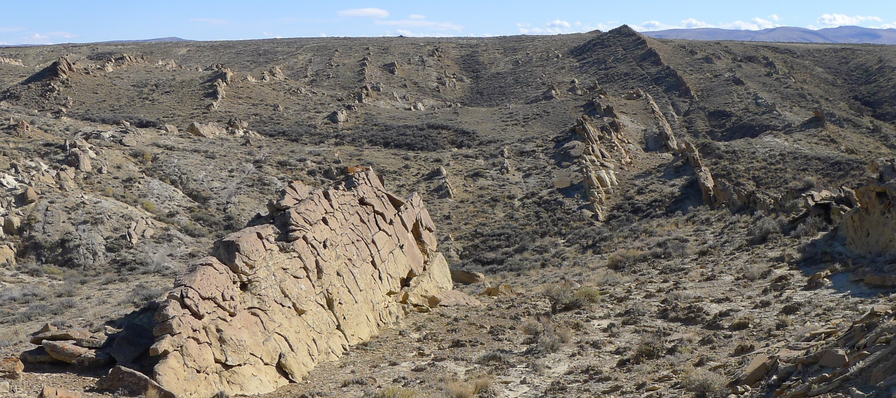


CONSTRAINING THE MAASTRICHTIAN THROUGH PALEOCENE DEVELOPMENT OF THE GREAT DIVIDE AND WASHAKIE BASINS, SOUTH-CENTRAL WYOMING
Ranie Lynds and Derek Lichtner

Slide 2
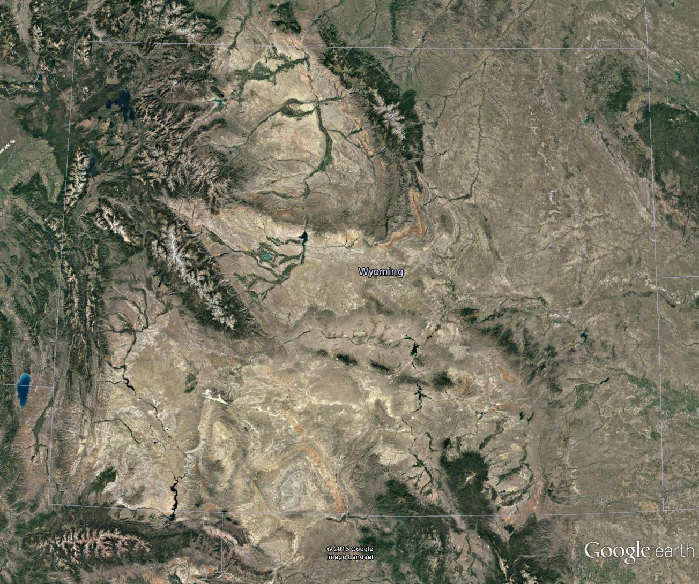
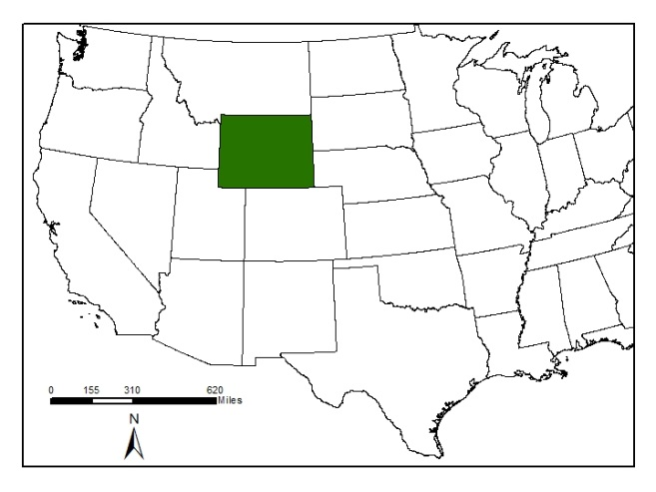
WYOMING
Wind Rivers
Granite Mtns
Overthrust Belt
Greater
Green
River
Basin
Sierra
Madre

Slide 3
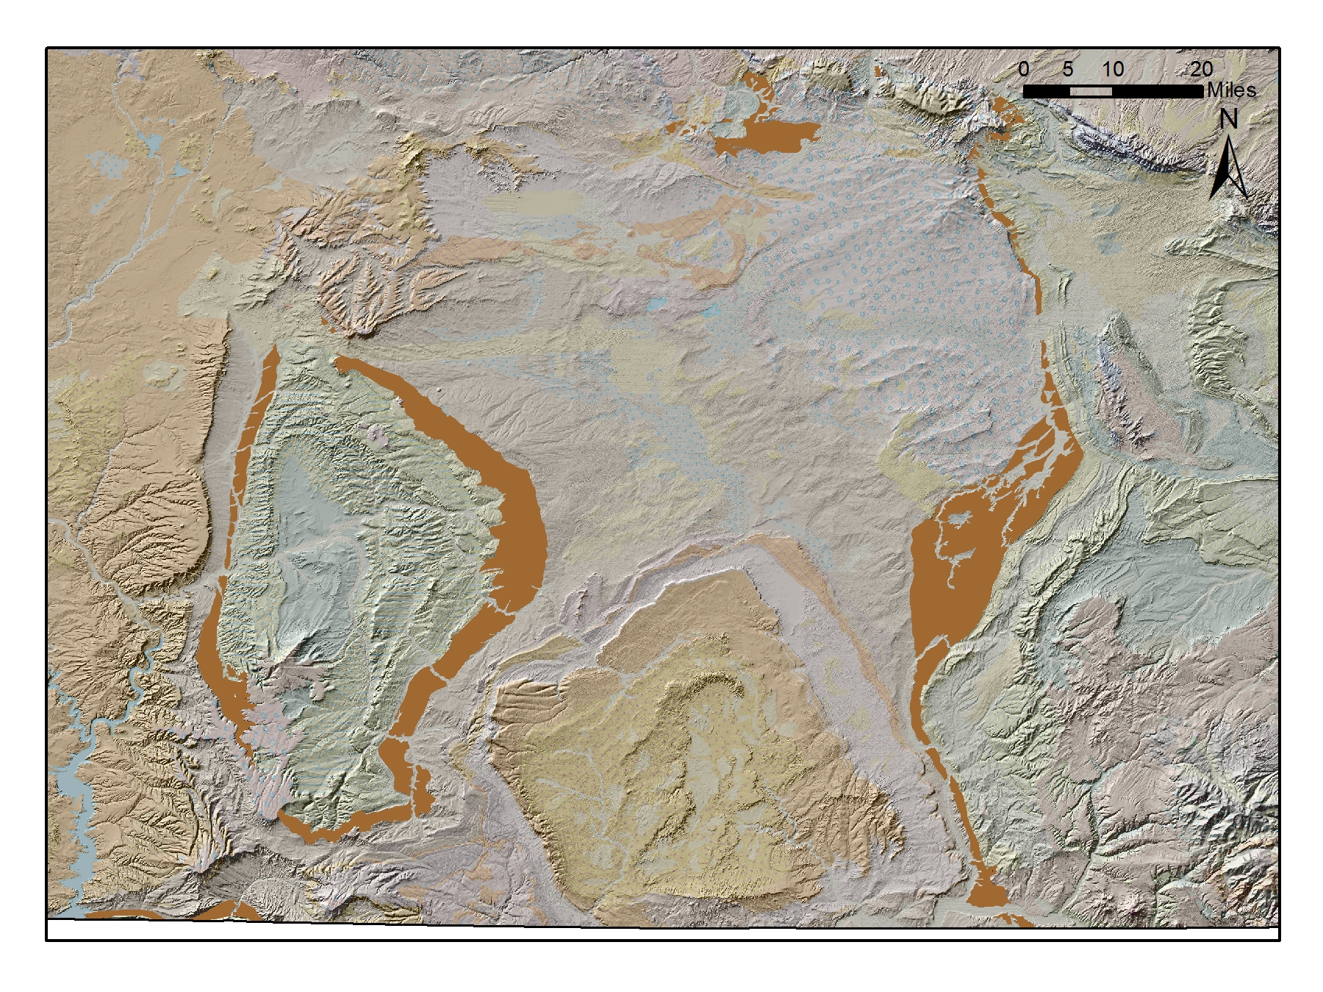
Eastern Greater Green River Basin
Fort Union Fm. outcrop
Great Divide
Basin
Rawlins
Uplift
Wamsutter Arch
Rock Springs
Uplift
Washakie
Basin
Sierra
Madre

Slide 4
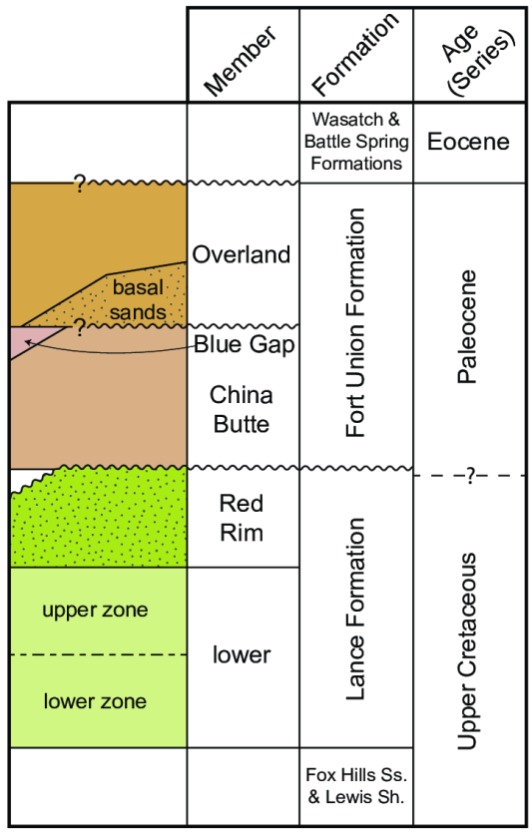
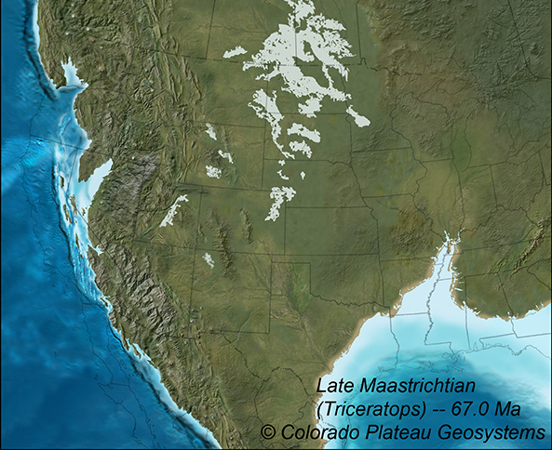
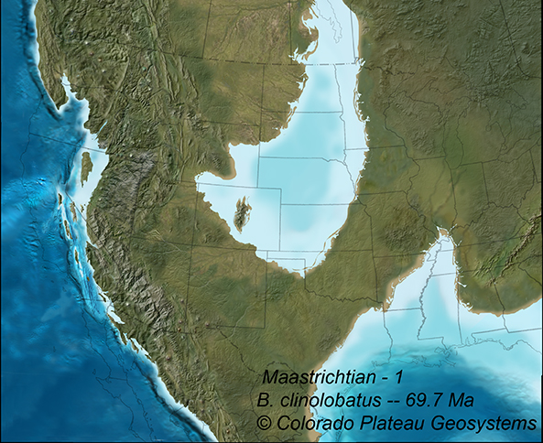
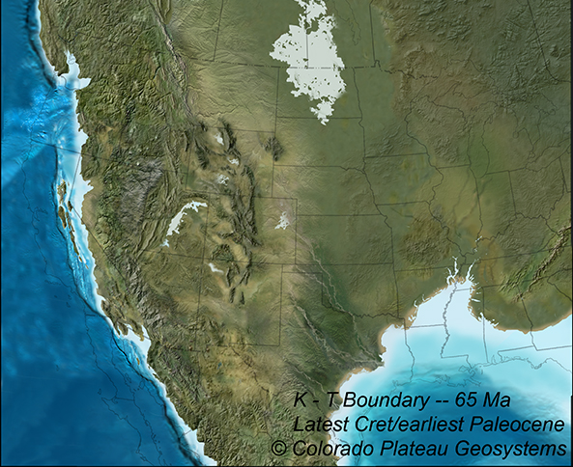
Background: Geologic Setting
K-T Boundary
Late Maastrichtian
Early Maastrichtian
used with permission from Ron Blakey
cpgeosystems.com/paleomaps.html
stratigraphy after Honey & Hettinger (2004)

Slide 5
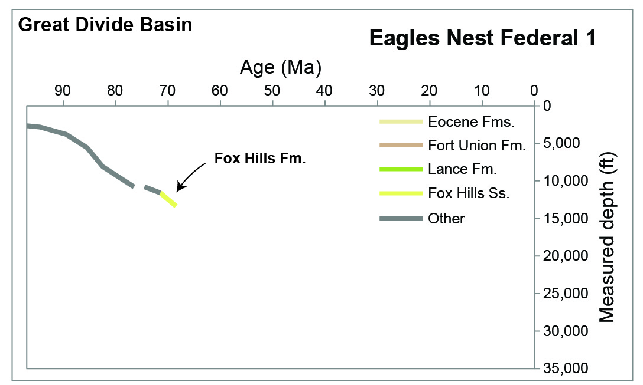
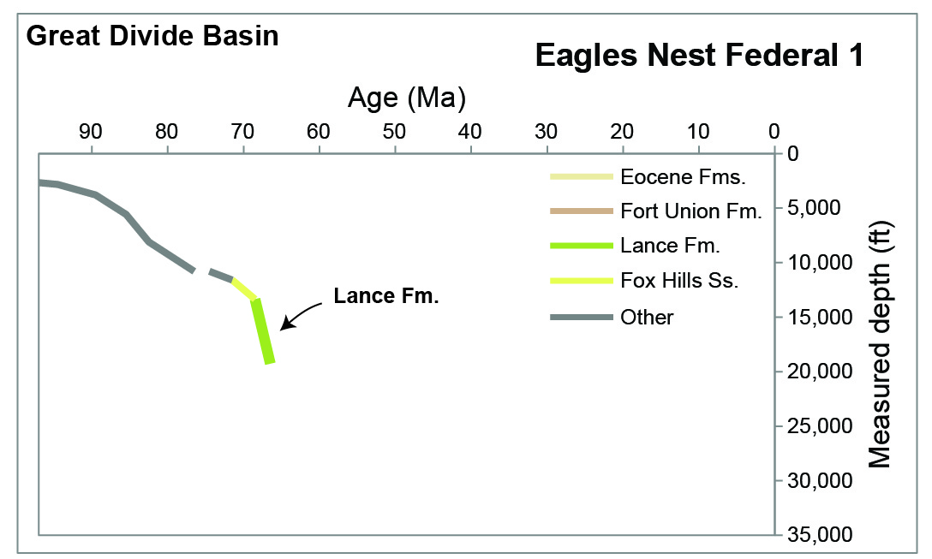
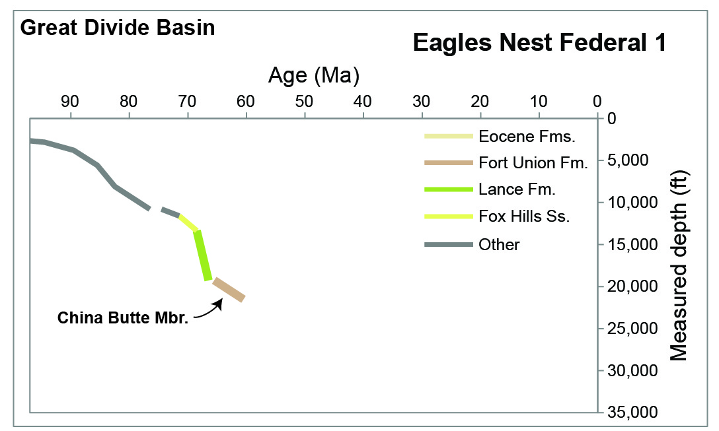
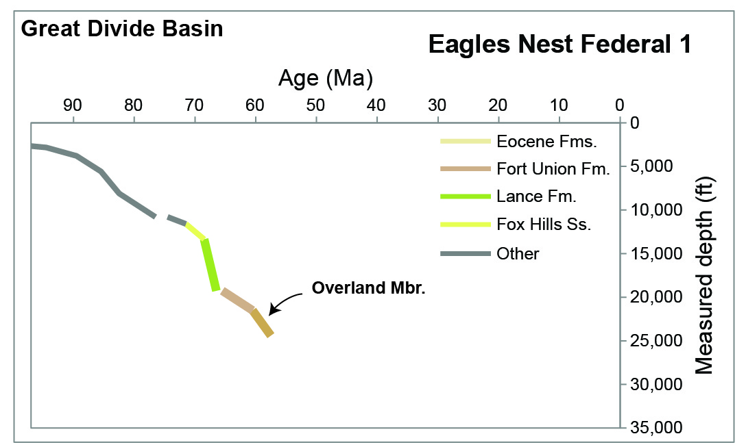
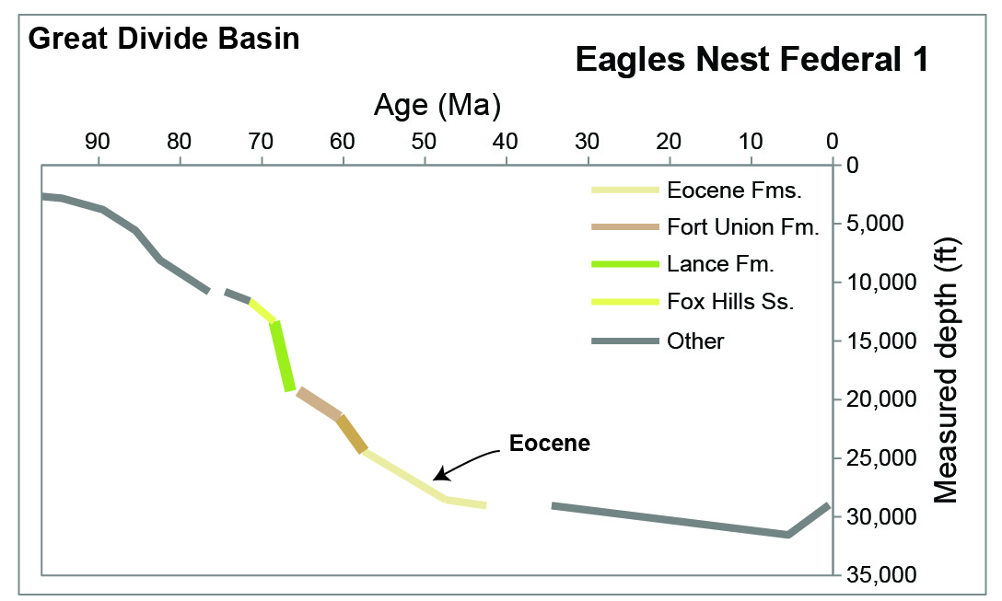
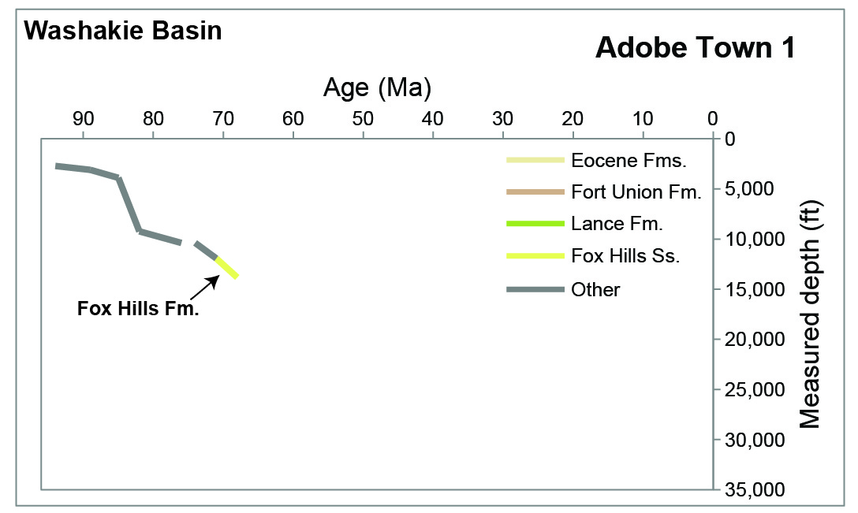
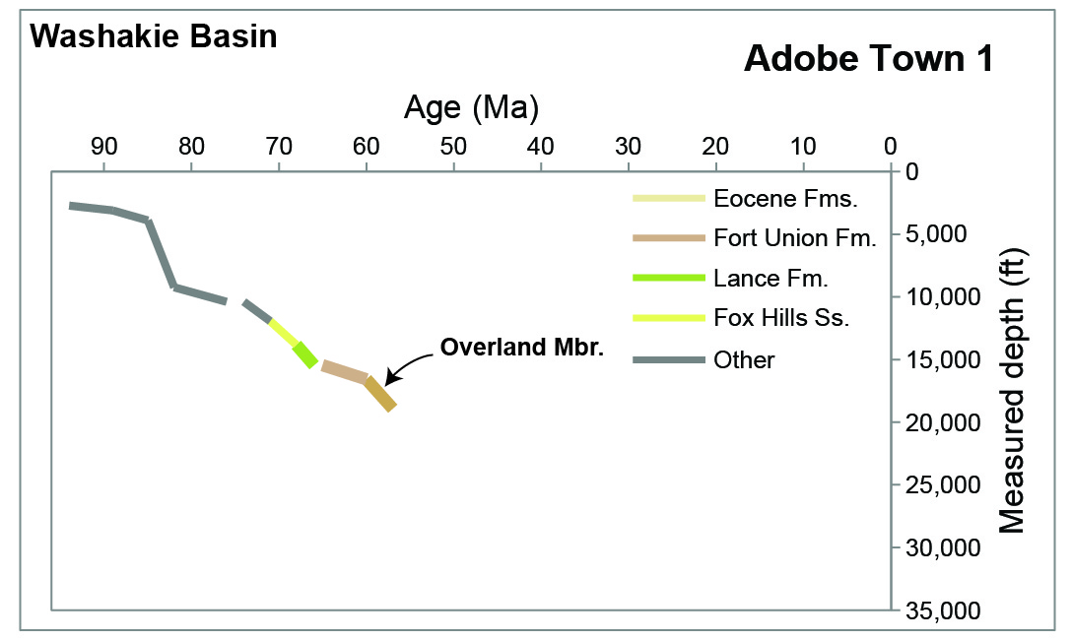
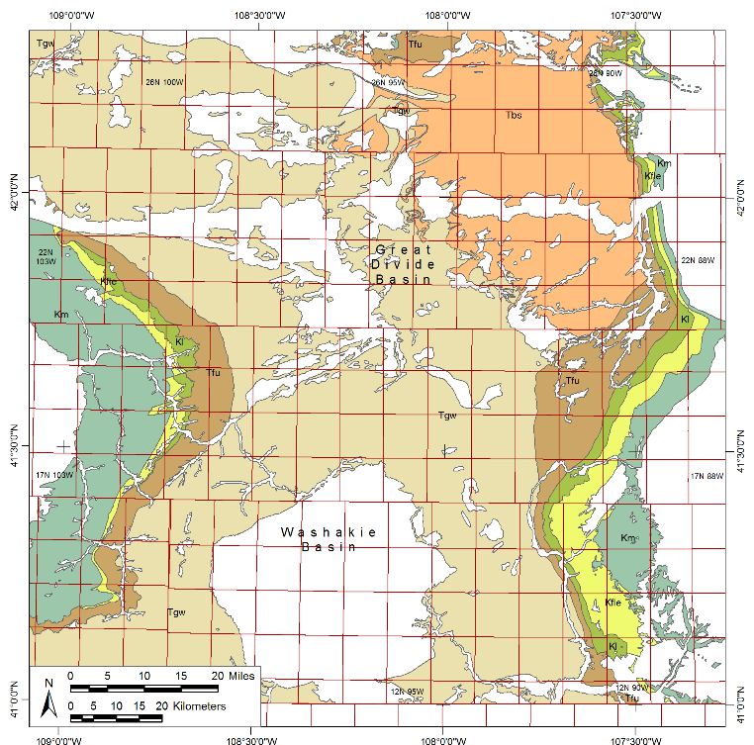
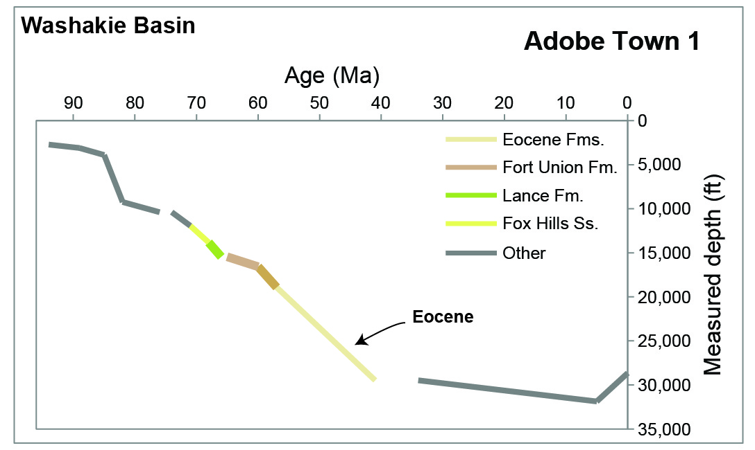
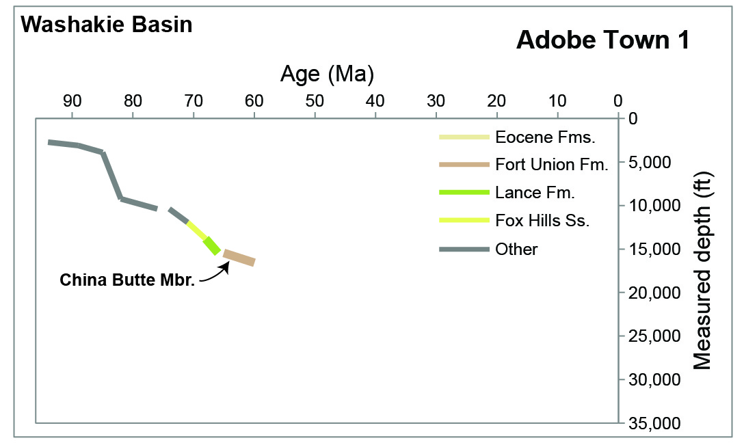
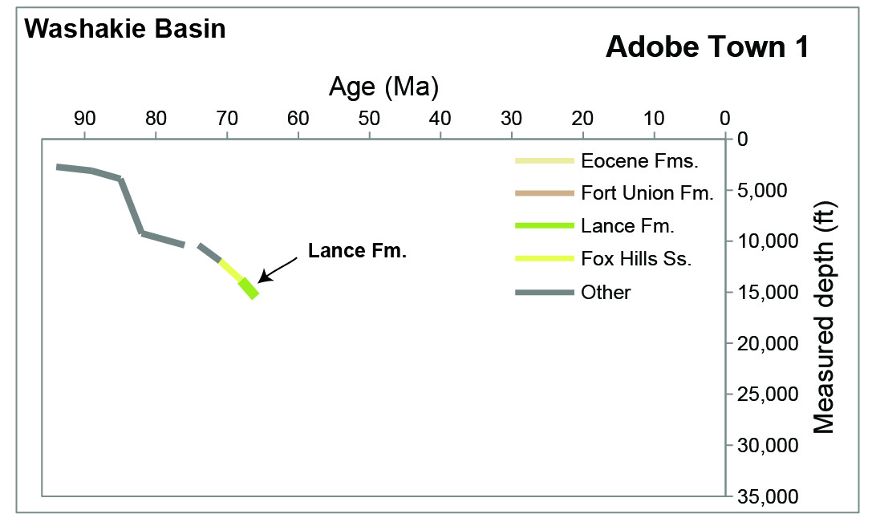
Burial history
data modified from Roberts, L., and others 2005, USGS DDS-69-D

Slide 6
Big questions…
What processes controlled Lance and Fort Union deposition?
Where are strata thickest and why?
And what is the timing on basin deformation and filling?
How did that create swamp-like conditions?
What was happening with the fluvial system?

Slide 7
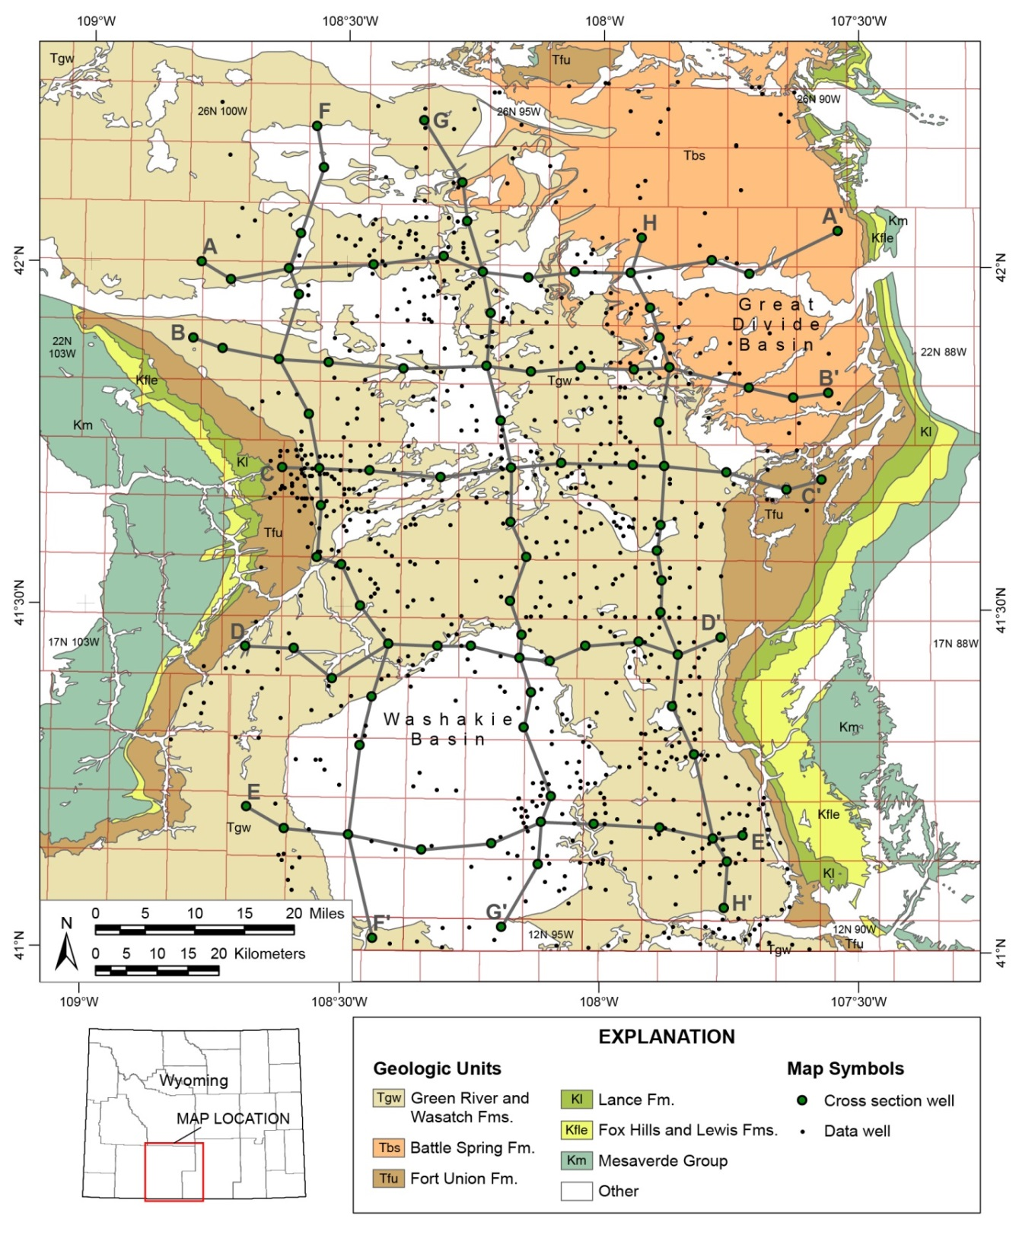
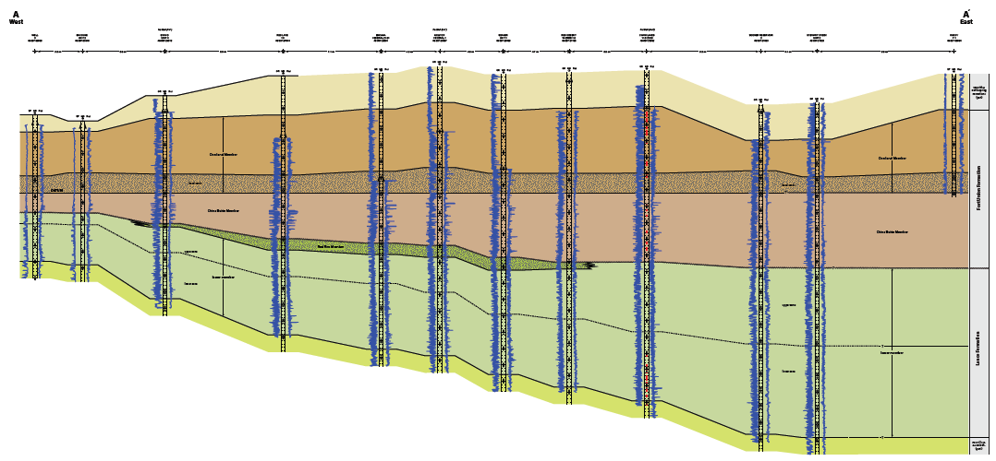
Data: wells
883 wells
8 cross sections

Slide 8
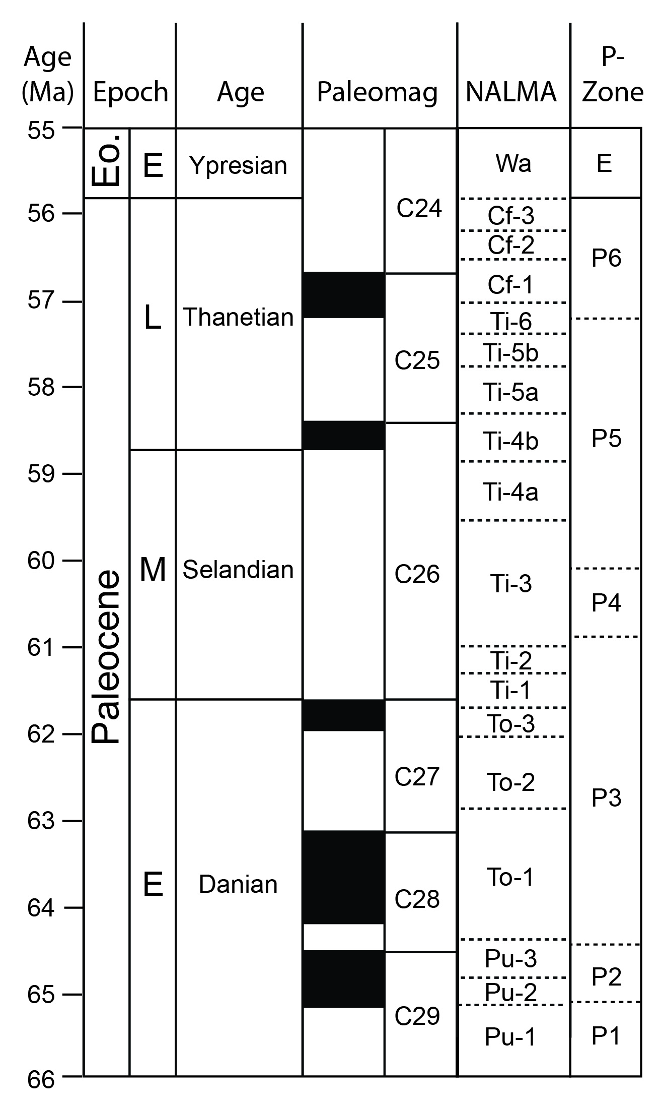
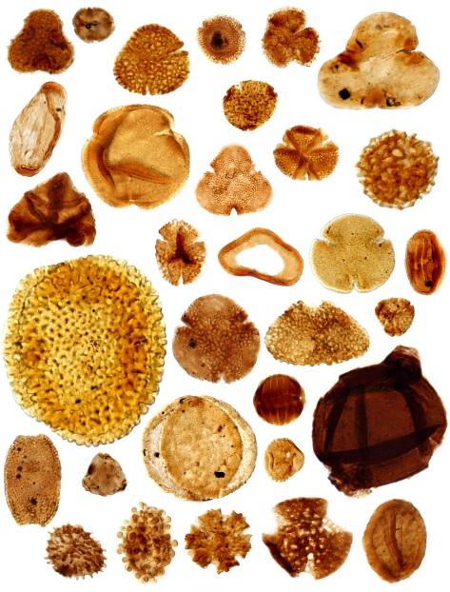
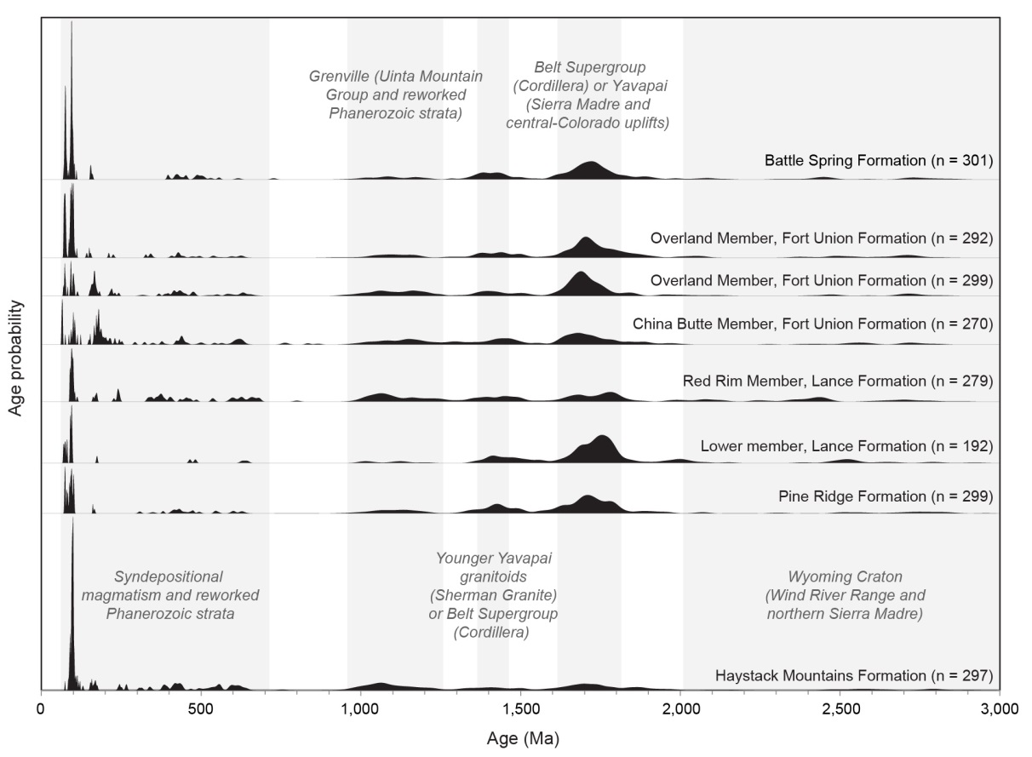
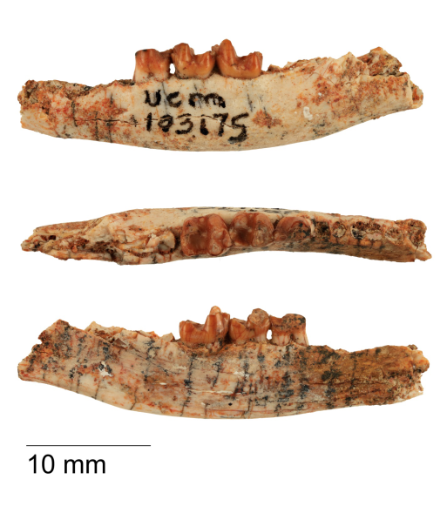
Data: biostratigraphic & dz compilation
Vargas, M.C., 2010, Microscopy of pollen and spore taxa from the Paleocene-Eocene Thermal Maximum
McComas, K., 2014, A new Puercan arctocyonid genus from the Great Divide Basin, Wyoming
All data at wsgs.wyo.gov
Modified from R.E. Dunn, written communication, 2015

Slide 9
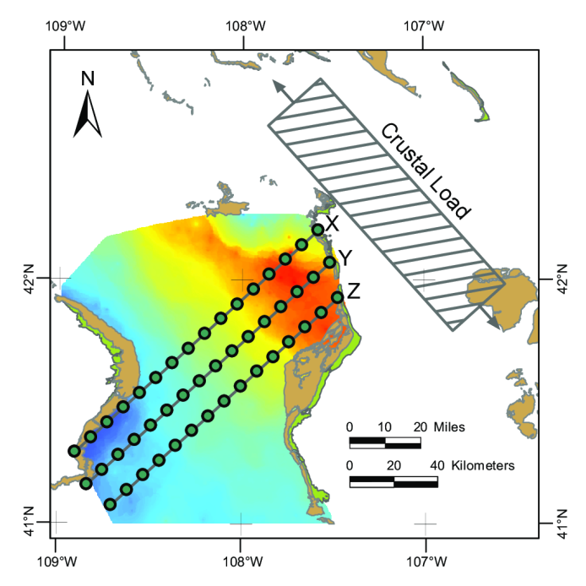
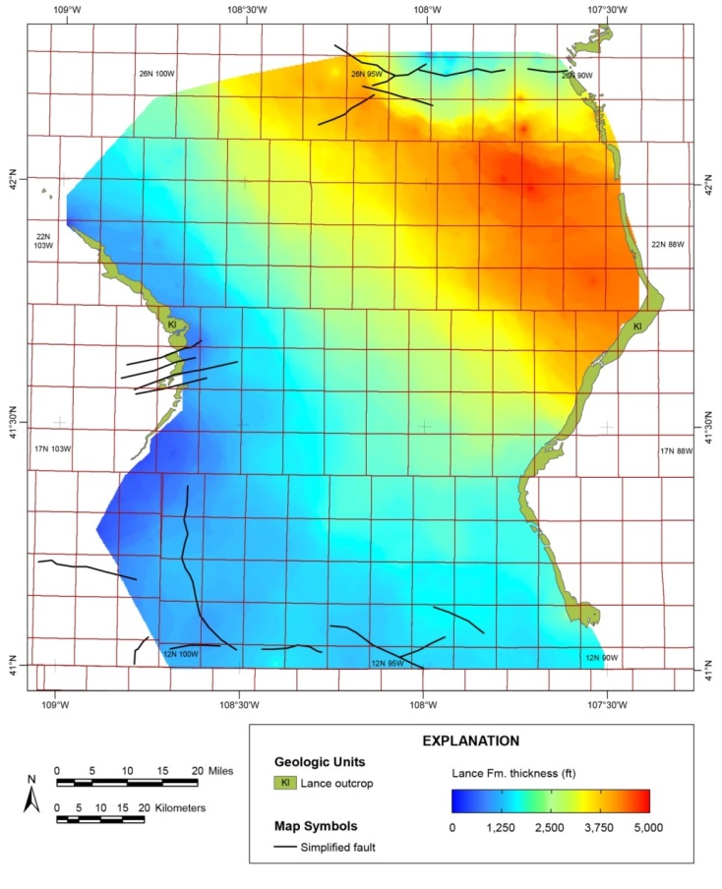
Fox Hills to Lance Fms. pre 69 Ma
Section | h_{L}, load height (m) | D, crustal rigidity (N-m)
X | 2,700 | 1.19×10²³
Y | 2,700 | 1.60×10²³
Z | 2,700 | 1.97×10²³
Lance Formation
Early Maastrichtian

Slide 10
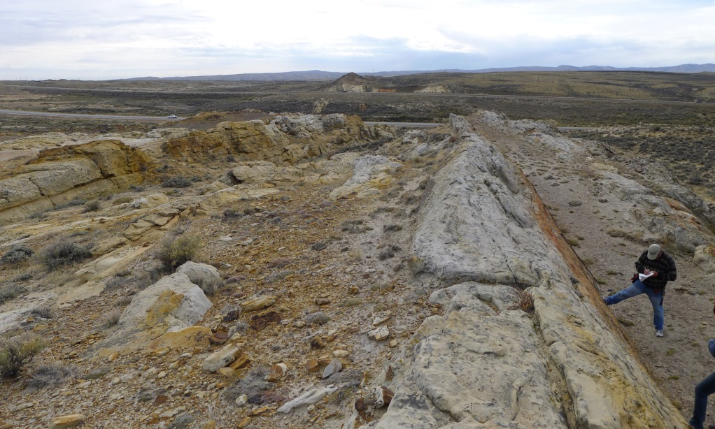
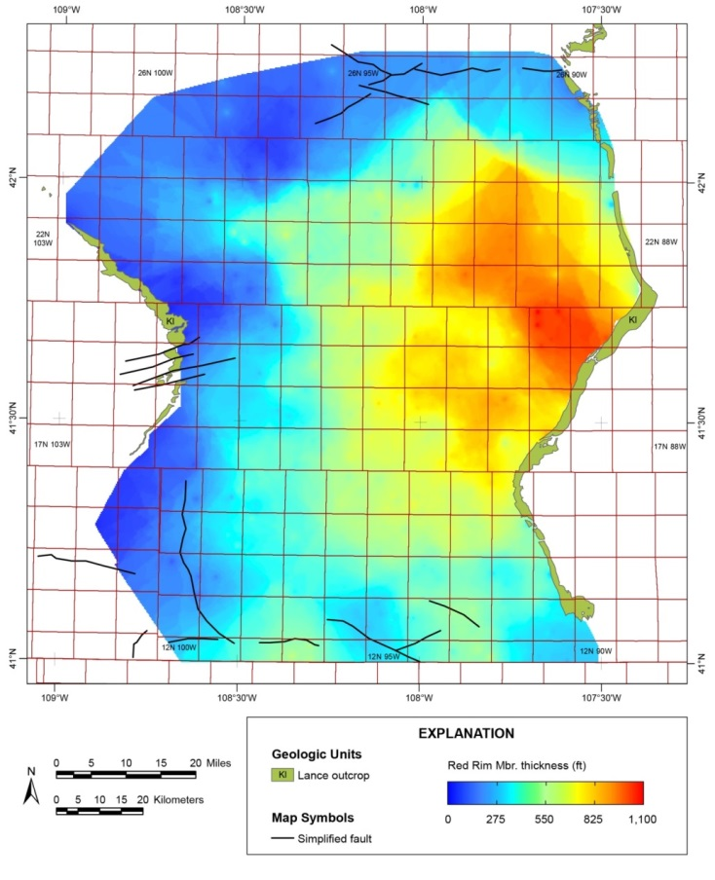
Red Rim Mbr. 69–66 Ma

Slide 11
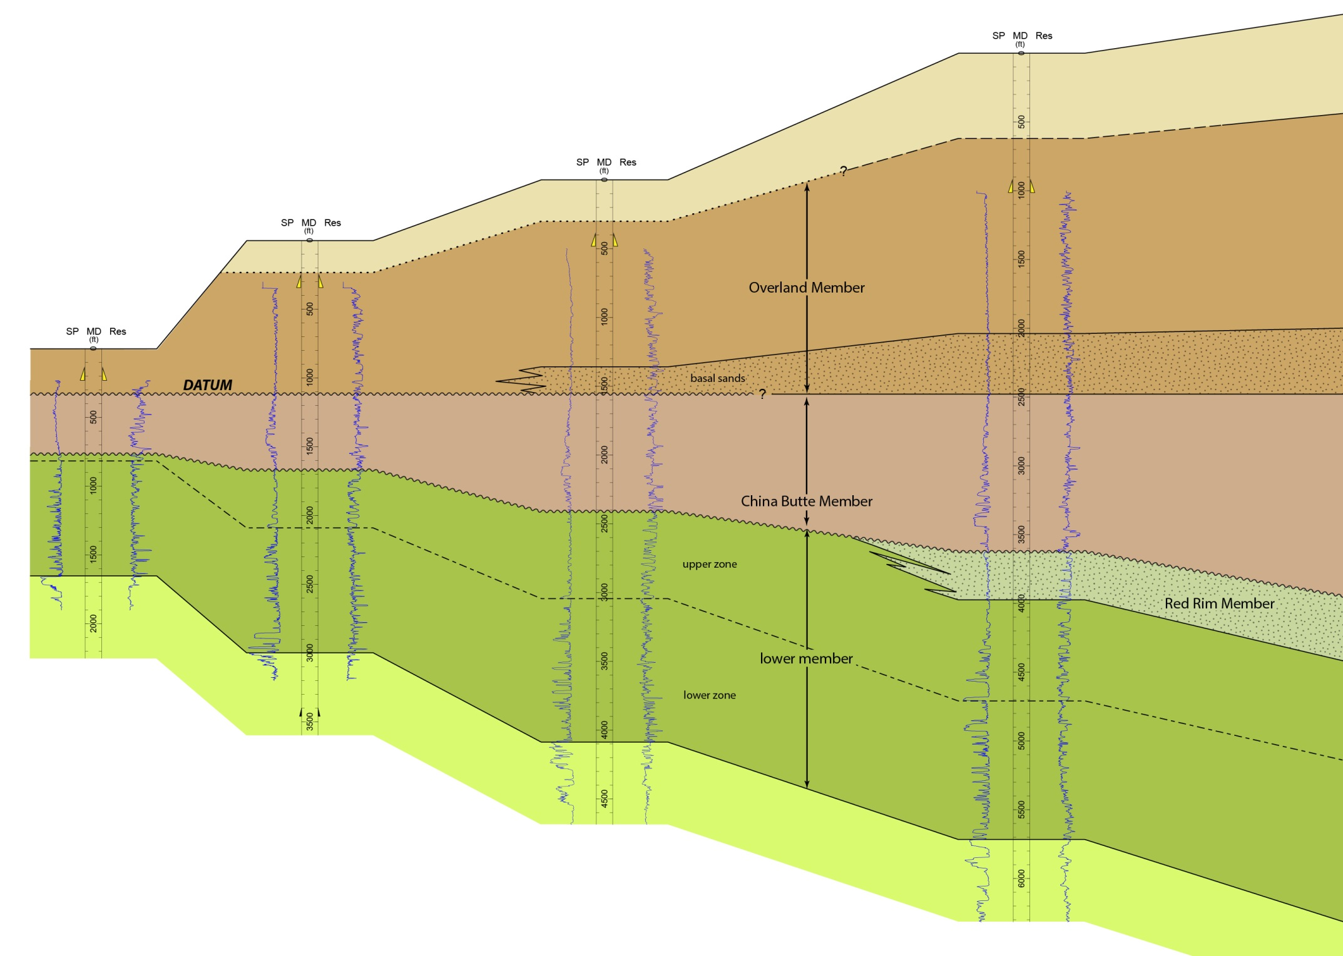
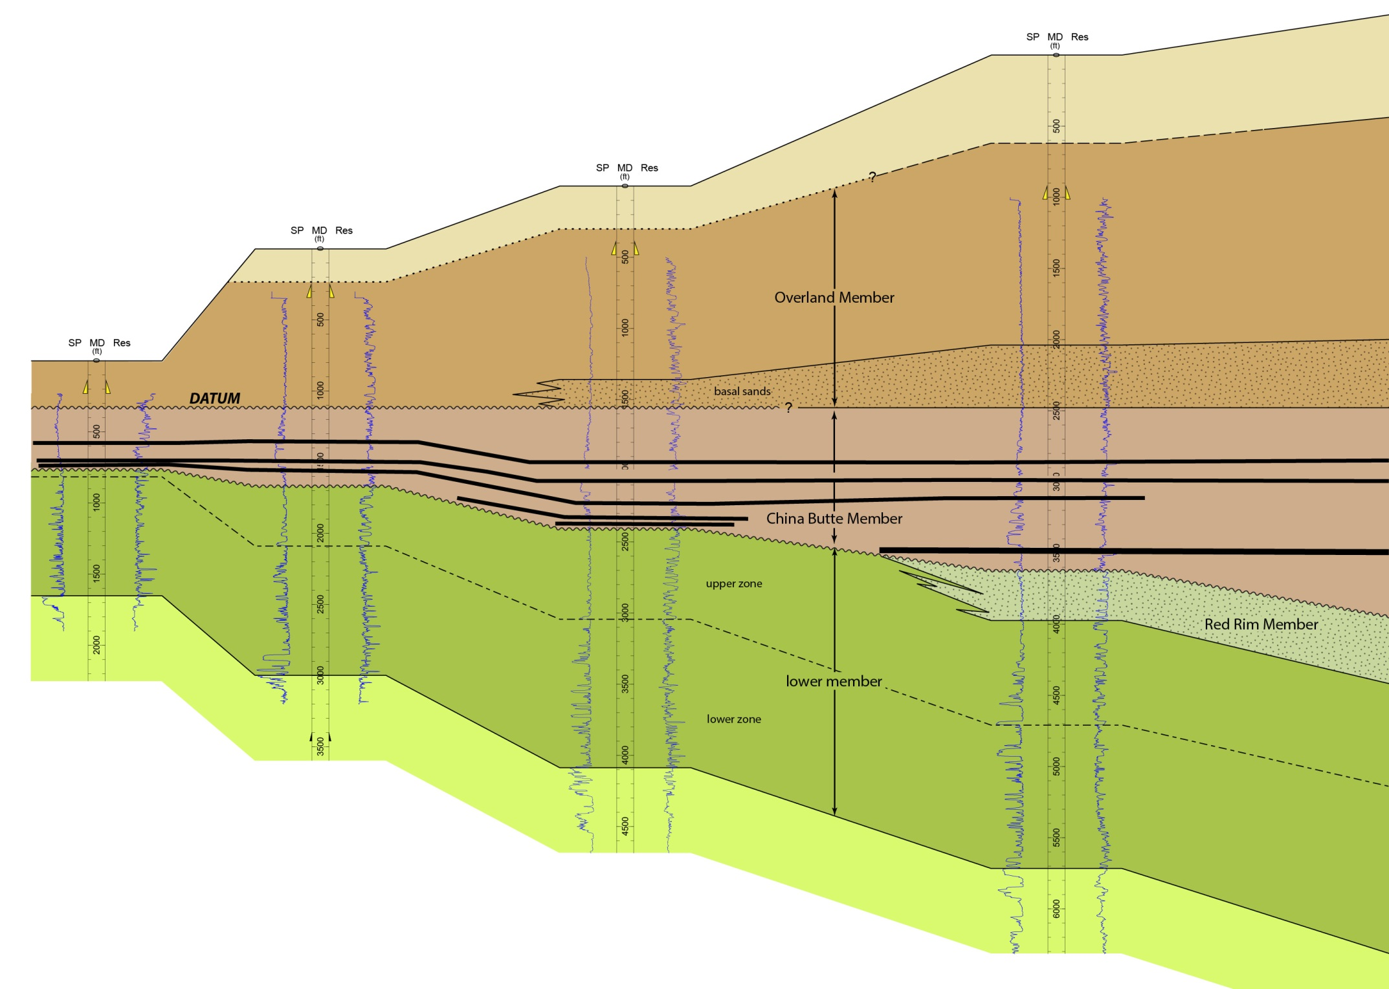
K-Pg boundary: Rock Spring uplift reinitiation
66–65.3 Ma
onlap

Slide 12
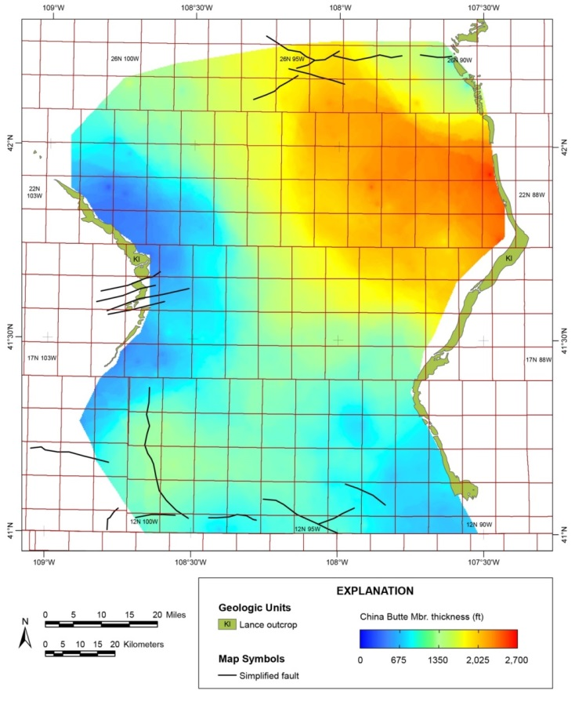
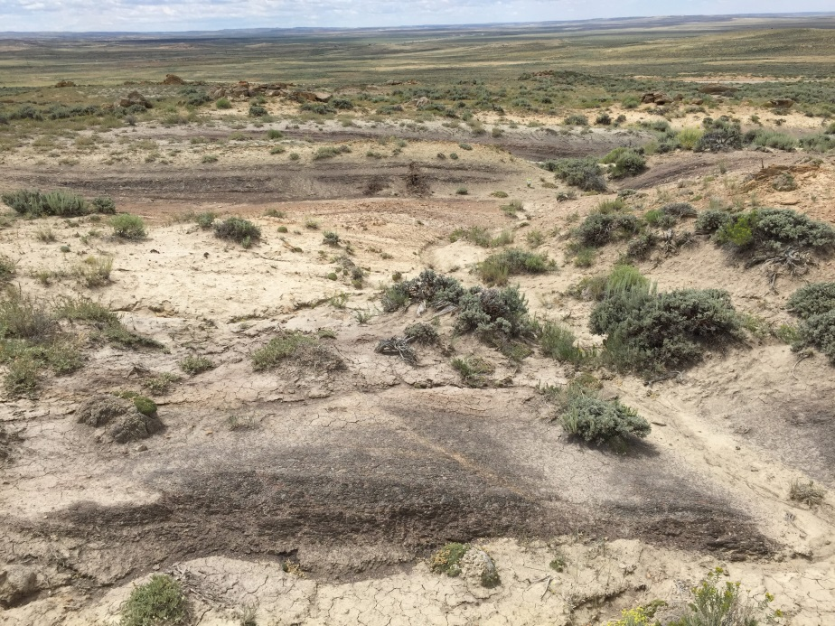
China Butte Mbr. 65.3–60.9 Ma

Slide 13
China Butte-Overland transition: Rock Spring uplift reinitiation #2
60.9–60.2 Ma
onlap

Slide 14
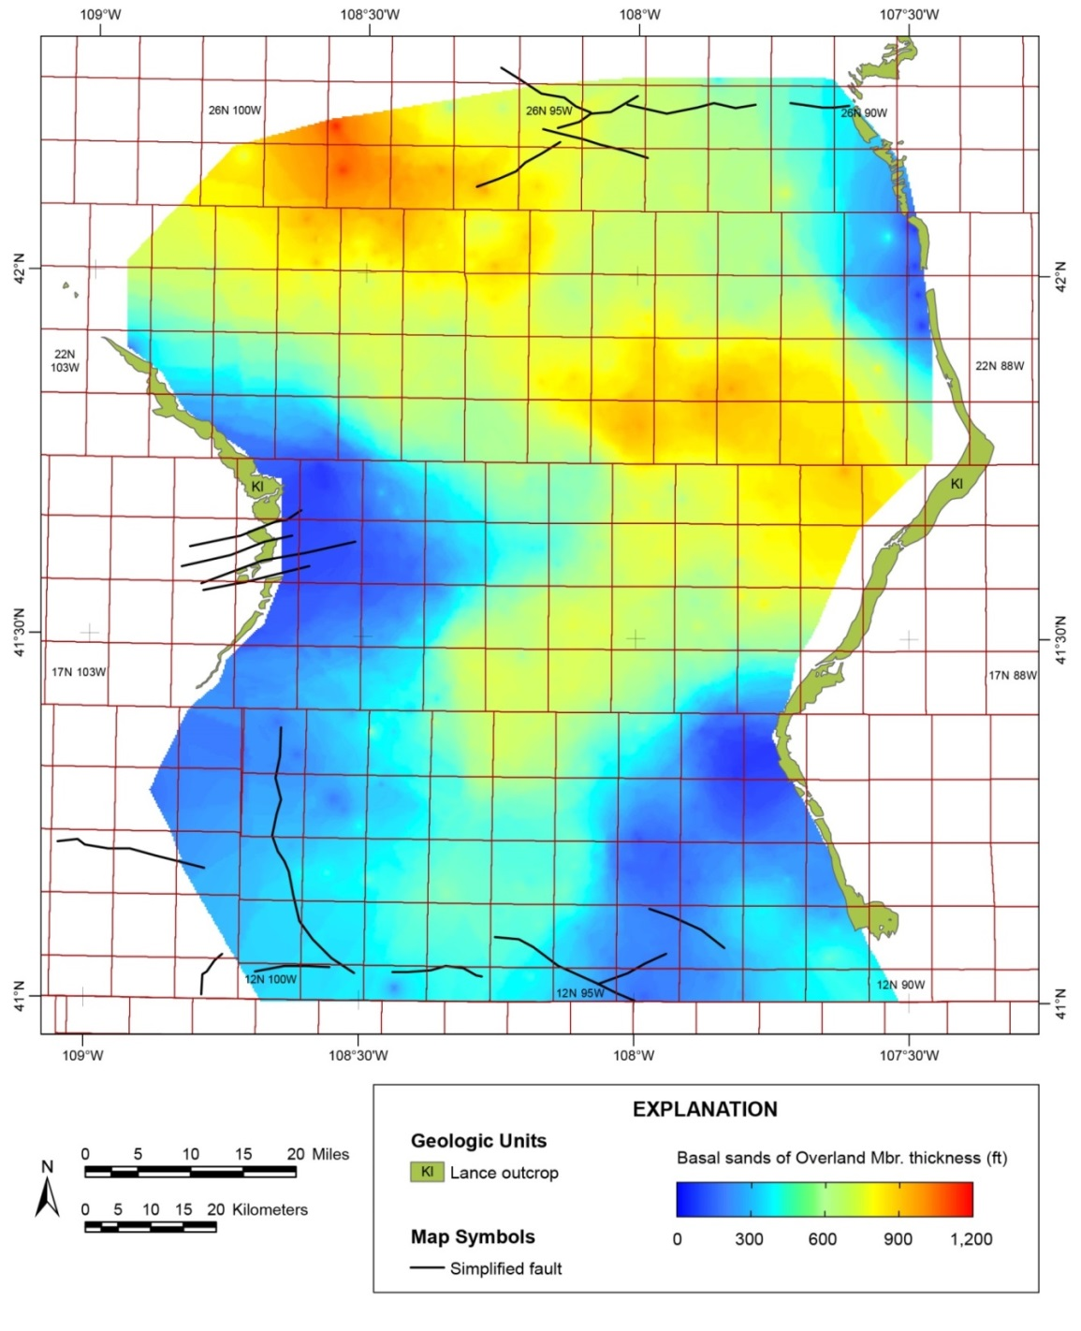
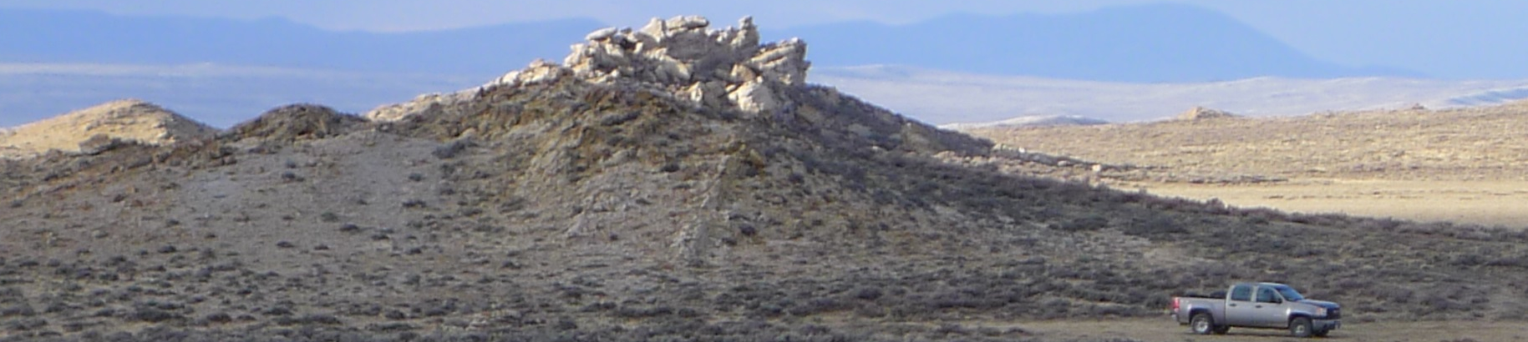
Overland Mbr., 60.2–55.8 Ma
Basal Sands,
Overland Mbr.
China Butte
coal section
Overland
basal sands

Slide 15
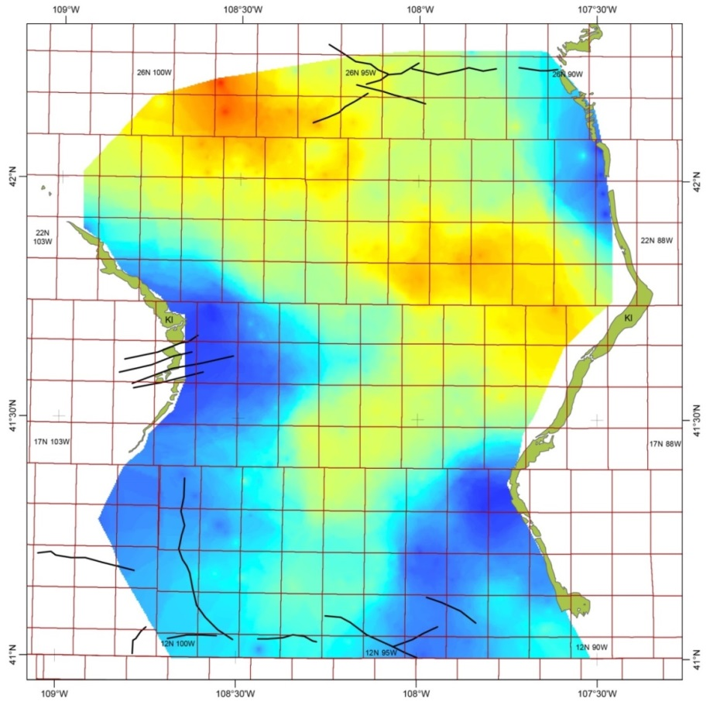


Conclusions
Timing is generally:
Pre-69 Ma: Lower Member of Lance Formation records interplay of retreat of Cretaceous Interior Seaway with Laramide subsidence loaded from the NE side of the Great Divide Basin.
69–66 Ma: Red Rim Member of Lance Formation records new load from east, possibly coincident with initial uplift of Sierra Madres, with primary sediment input from northwest.
66–65.3 Ma: Renewed uplift #1 of Rock Springs uplift, resulting in erosion of the Red Rim Member and part of the lower Lance Formation. Renewed uplift likely elsewhere as well.
65.3–60.9 Ma: Deposition of China Butte (Fort Union) coal zone during time of slower subsidence.
60.9–60.2 Ma: Renewed uplift #2 of Rock Springs uplift, minimal erosion of China Butte Member.
60.2–55.8 Ma: Basal sands of Overland Member deposited from mountain building event, followed by quiescence and swamp formation (Cherokee coal zone). Complex 3-D interaction of basin-margin uplifts. Separation of Great Divide and Washakie basins post Overland deposition. Wamsutter arch was a late (post-Paleocene) development.

Slide 16
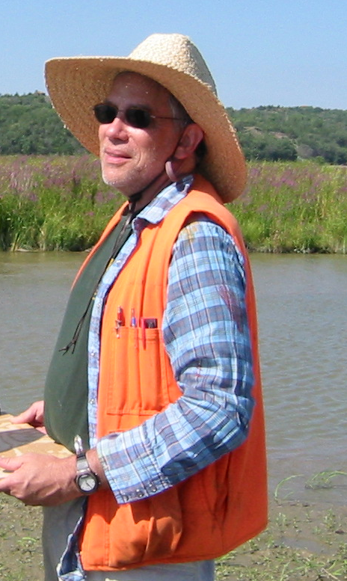
Dedicated to the memory of Paul Heller, mentor and friend, who would probably disagree (or at least argue) with all of this.
Special thanks to Chris Carroll and WSGS coal team, Jim Rodgers, and conversations with Mark Kirschbaum and Bob Hettinger.
Funding from WSGS and NCRDS.
Data available at www.wsgs.wyo.gov

