Slide 1
Data-rich societally-relevant undergraduate teaching resources for geoscience classrooms and field courses
Beth Pratt-Sitaula (UNAVCO)
Bruce Douglas (University of Indiana)
Becca Walker (Mt San Antonio College)
Benjamin Crosby (Idaho State University)
Donna Charlevoix (UNAVCO)
Chris Crosby (UNAVCO)
Katherine Shervais (UNAVCO)
Meghan Miller (UNAVCO)
Notes:
Today I am going to talk about a suite of resources that have been developed through NSF TUES and IUSE funding. As you can see, I am merely reporting on the efforts of a much larger team.

Slide 2
GETSI Project Overview
Mission: Develop and disseminate teaching and learning materials that feature geodesy data & quantitative skills applied to critical societal issues such as climate change, water resources, and natural hazards
Classroom oriented
NSF TUES (Transforming Undergraduate Education in STEM)
UNAVCO, Mt San Antonio College, and Indiana University
Field oriented
NSF IUSE (Improving Undergraduate STEM Education)
UNAVCO, Indiana University, Idaho State University
Partnership with SERC and NAGT
Developing seven modules (~2 weeks each)
Introductory & Majors-level

Slide 3

GETSI-InTeGrate partnership
Module development and assessment following model of SERC’s InTeGrate Project (NSF STEP)

Slide 4
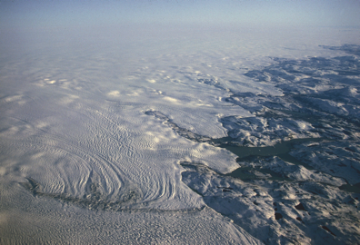
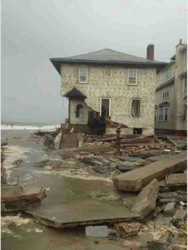
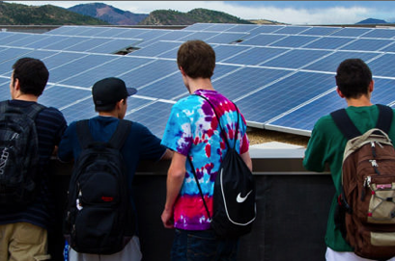
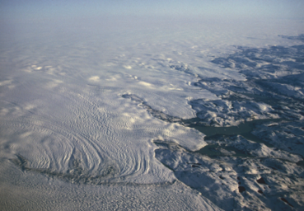
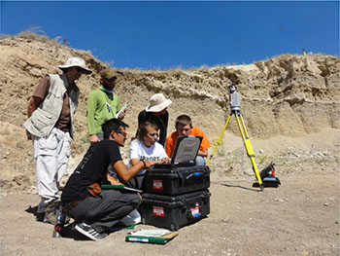
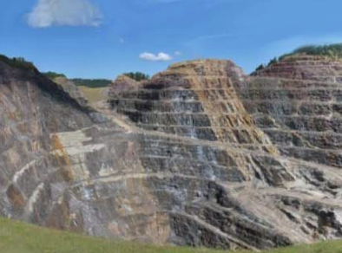
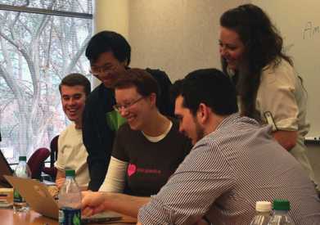

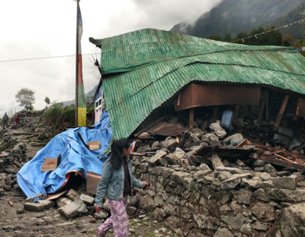
Solving societal challenges
Increasing student STEM engagement
Complementary paths to improvement
Notes:
Image sources: (all offered under a Creative Commons Attribution-NonCommercial-ShareAlike license)
(damaged house) https://commons.wikimedia.org/wiki/File:Damage_from_Hurricane_Sandy_to_house_in_Brooklyn,_NY.jpeg#/media/File:Damage_from_Hurricane_Sandy_to_house_in_Brooklyn,_NY.jpeg)
(Greenland ice) https://upload.wikimedia.org/wikipedia/commons/f/f9/Greenland-ice_sheet_hg.jpg
(students and solar panels) http://images.nrel.gov/viewphoto.php?&albumId=207379&imageId=6314201&...
(students at computer) https://commons.wikimedia.org/wiki/File:Wikipedians_in_Atlanta,_December_2012...
(student in the field) Bruce Douglas https://www.unavco.org/education/advancing-geodetic-skills/short-courses/2016/field-education/field-education.html
(mine) https://www.flickr.com/photos/baggis/5156621907/in/photostream/
(earthquake damage) By Sumita Roy Dutta - Own work, CC BY-SA 4.0, https://commons.wikimedia.org/w/index.php?curid=40998384
(water carrier) https://www.flickr.com/photos/danielbachhuber/3142801676

Slide 5
Societally-relevant STEM learning
Examples
National Research Council 2015. Reaching Students: What Research Says About Effective Instruction in Undergraduate Science and Engineering
PCAST. 2012. “Engage to Excel: Producing One Million Additional College Graduates with Degrees in Science, Technology, Engineering, and Mathematics.”
Project Kaleidoscope. 2006. “Transforming American’s Scientific and Technological Infrastructure Recommendations for Urgent Action: Report on Reports II.”
National Academy. 2010. Rising above the Gathering Storm, Revisited: Rapidly Approaching Category 5.
Bralower, Timothy J, P. Geoffrey Feiss, and Cathryn A. Manduca. 2008. “Preparing a New Generation of Citizens and Scientists to Face Earth’s Future.”
Notes:
www.globalchange.gov
www.earthscienceliteracy.org

Slide 6
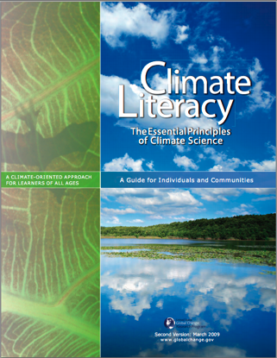

Why Geodesy for Students?
Topics align well with Earth Science and Climate Literacy Principles
Real world applications are shown to increase interest and learning
Discovery learning data analysis can increase critical thinking skills and quantitative skills
Measurement are on a human timescale
Earth science majors are often not learning about these critical research techniques

Slide 7
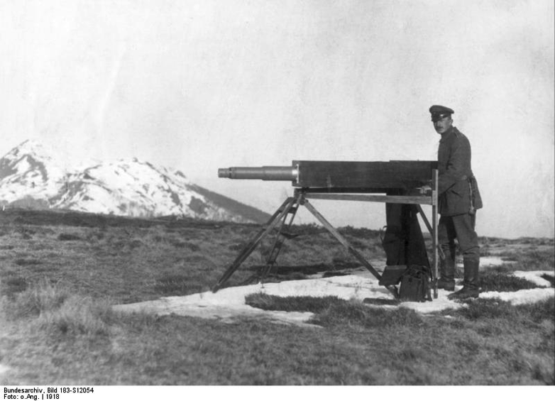
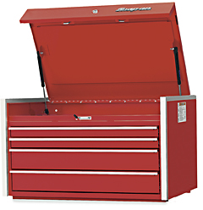
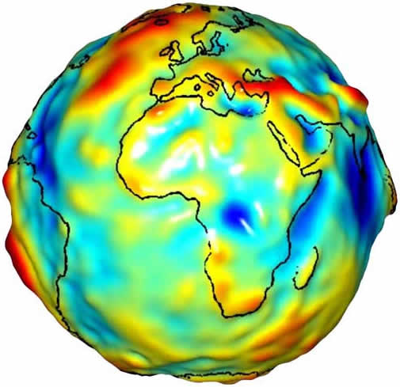
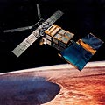
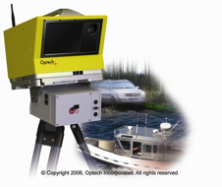

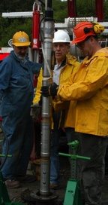
Geodesy is…
…the science of accurately measuring the Earth’s size, shape, orientation, mass distribution and the variations of these with time.
Traditional geodesy:
Precise positioning of points on the surface of the Earth
Modern geodesy:
A toolbox of techniques to better measure the Earth
wikipedia.org
JPL/NASA
7
Notes:
7
7
As we got better and better at measuring points on the Earth, it evolved into being able to determine how they change.
Think of geodesy as a toolbox of ways to better measure the Earth’s size, shape…etc

Slide 8
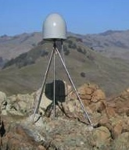
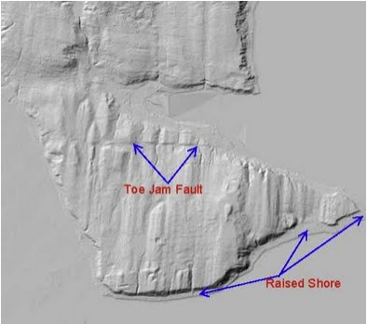
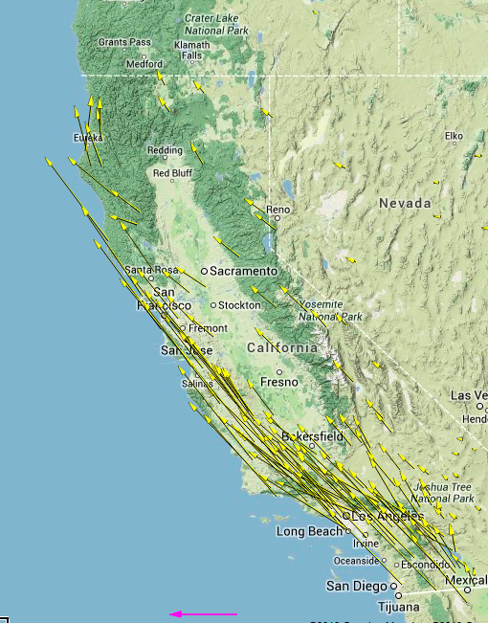
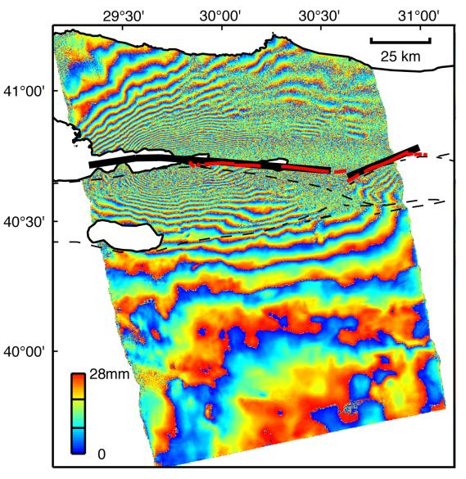
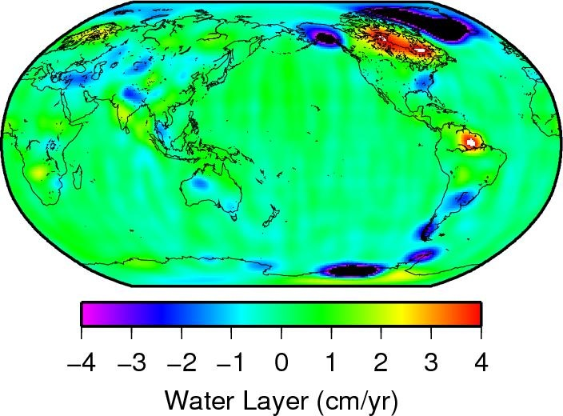
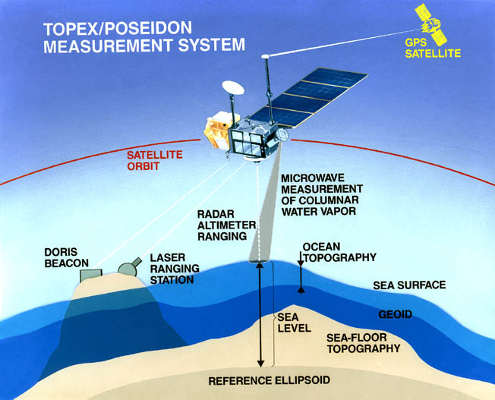
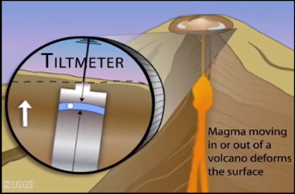
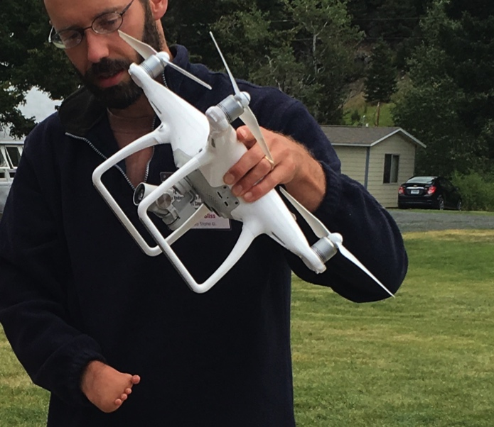
Unpacking the Geodesy Toolbox
GPS (Global Positioning System)
InSAR (Interferometric synthetic aperture radar)
LiDAR (Light detecting and ranging)
Structure from Motion
Strain meters, tiltmeters, creep meters
Gravity measurements
Sea level altimetry
GPS (Global Positioning System)
InSAR (Interferometric synthetic aperture radar)
LiDAR (Light detecting and ranging)
Structure from Motion
Strain meters, tiltmeters, creep meters
Gravity measurements
Sea level altimetry
usgs.gov
http://www.nasa.gov/topics/earth/features/graceImg20091214.html
www.jpl.nasa.gov
http://photojournal.jpl.nasa.gov/catalog/PIA00557
http://facility.unavco.org/data/maps/GPSVelocityViewer/GPSVelocityViewer.html
http://www.iris.edu/

Slide 9
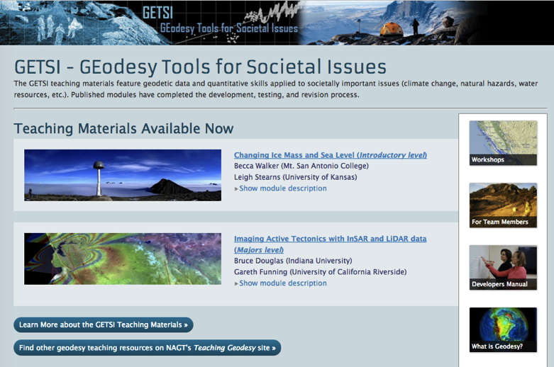
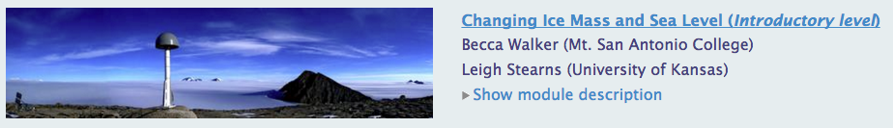
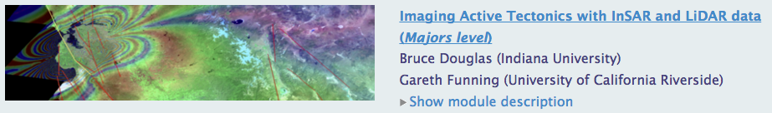
Published Modules
serc.carleton.edu/getsi
or search serc and getsi
Images: Michael Bevis & NASA/JPL/UCDAvis

Slide 10
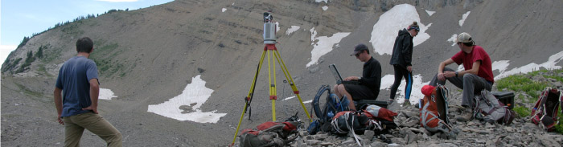
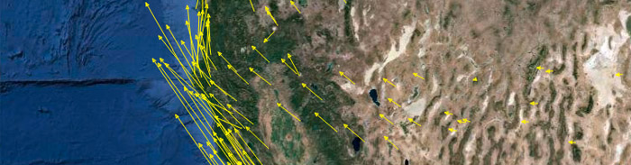
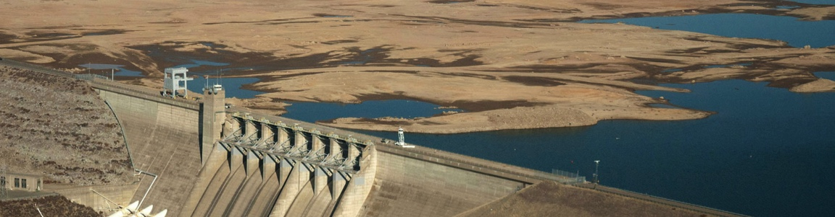
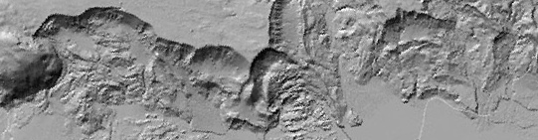
Upcoming Modules 2016
High Resolution Topography (Field)
Bruce Douglas (Indiana U)
Kate Shervais (UNAVCO) & others
GPS, Strain & Earthquakes (Majors)
Vince Cronin (Baylor)
Phil Resor (Wesleyan)
Measuring Water Resources (Majors)
Bruce Douglas (Indiana U)
Eric Small (U of Colorado)
Surface Process Hazards (Intro)
Becca Walker (Mt SAC)
Sarah Hall (College of Atlantic)
Images: N. Niemi, UNAVCO, CA Water Board, USGS

Slide 11

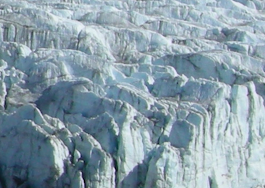
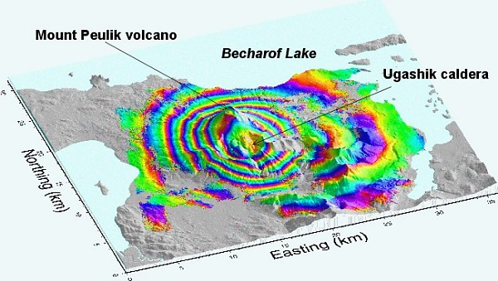
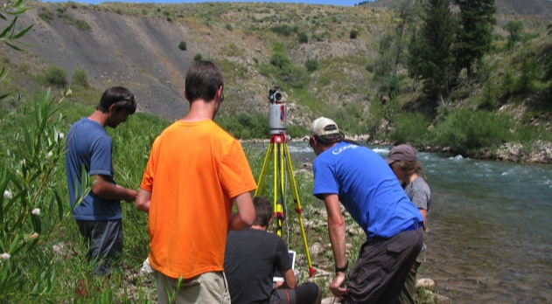
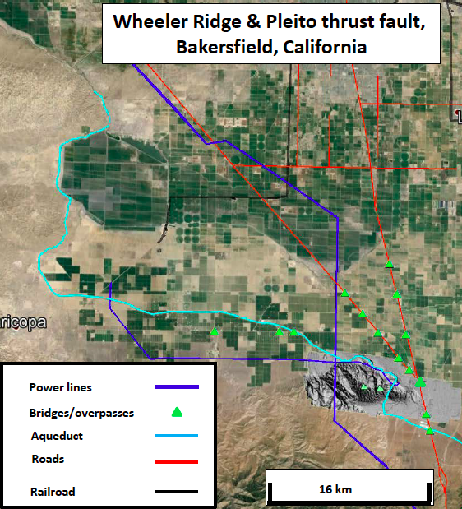
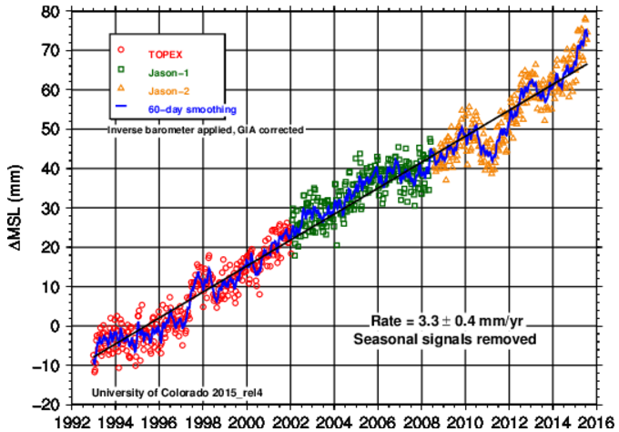
Module components & Development process
Guiding Principles
Address one or more geodesy-related grand challenges facing society
Make use of authentic and credible geodesy data
Improve student understanding of the nature and methods of geoscience
Develop student ability to address interdisciplinary problems and apply geoscience learning to social issues
Increase student capacity to apply quantitative skills to geoscience learning
Guiding Principles
Address one or more geodesy-related grand challenges facing society
Make use of authentic and credible geodesy data
Improve student understanding of the nature and methods of geoscience
Develop student ability to address interdisciplinary problems and apply geoscience learning to social issues
Increase student capacity to apply quantitative skills to geoscience learning
Images: B. Douglas, USGS, N. Niemi, GETSI, CU Sea level group

Slide 12
Module components & Development process
Module development criteria codified in “Materials Development Rubric”
Identify module learning goals
Identify unit learning outcomes
Determine assessment strategy
Design teaching materials to match assessment
Plan instruction strategies
Pilot Materials
Revise
serc.carleton.edu/integrate

Slide 13
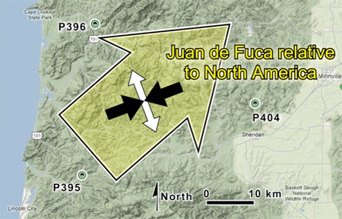
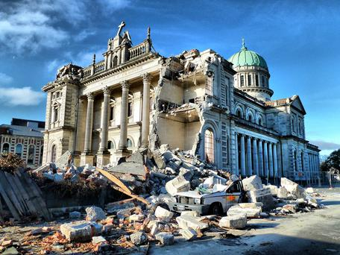
GPS, Strain & Earthquakes
Unit 1 Earthquake
Unit 2 Physical Models
Unit 3 Getting started with GPS data
Unit 4 GPS & strain analysis
Unit 5 South Napa Earthquake
Unit 6 Applying strain and earthquake hazard analyses to different regions
Student select own area of interest and analyze for strain and earthquake hazard
Images: V. Cronin, NOAA

Slide 14
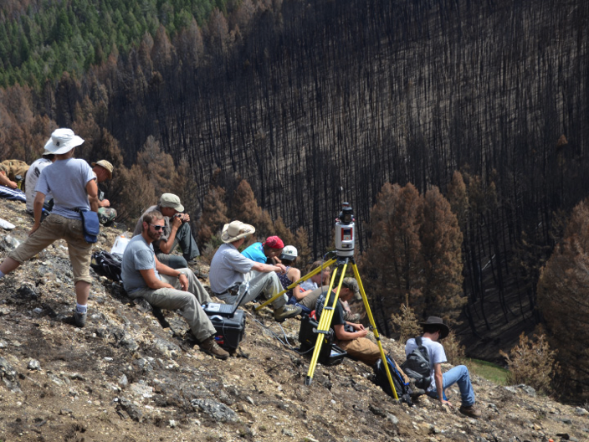
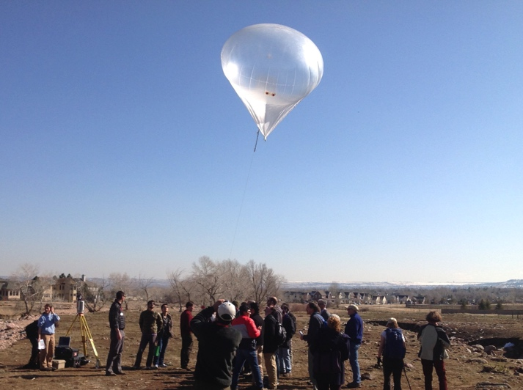
Analyzing High Resolution Topography with TLS and SfM
Unit 1 Intro to surveying
Unit 2 Stratigraphy application
Unit 3 Fault scarp application
Unit 4 Change detection
Unit 5 Summative Final Project
Students design and carry out own survey to address geoscience research question

Slide 15
Findings
Overall InTeGrate model works well
→Development Rubric pinpointed weaknesses in module components
→Student testing pinpointed gaps in alignment and student accomplishment
→Testers report higher student engagement
→Students accomplish the learning goals – including more discovery-based projects
Some challenges and solutions…

Slide 16
Data-rich Curriculum Developer’s Manual
Challenges & Solutions
Image reuse permission very time consuming →More author coaching and staff time
Team functionality varies →No single solution but structured communication about work styles, module progress, and work delegation helps
Design for future instructors’ ease of use →Non-author pilot testers to help pinpoint oversights

Slide 17
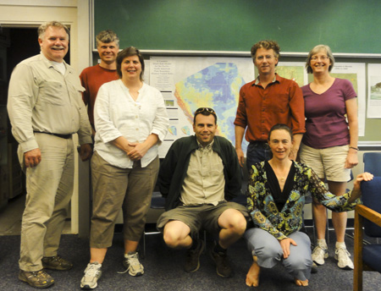
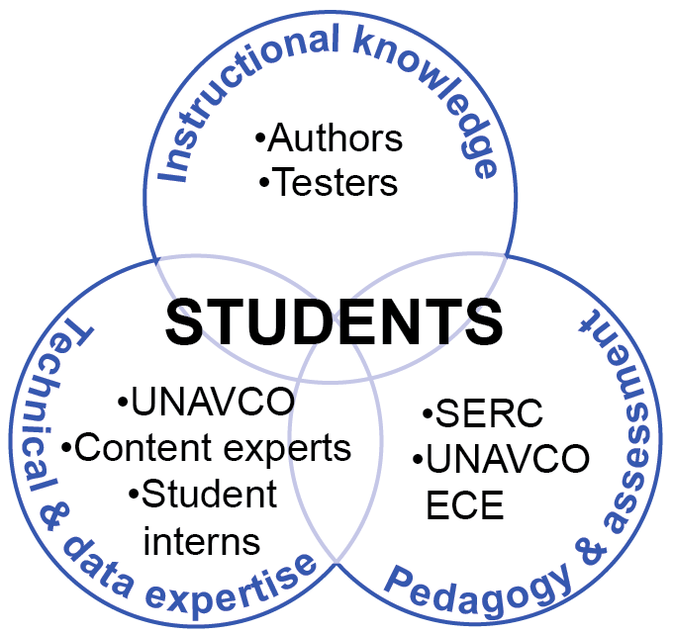
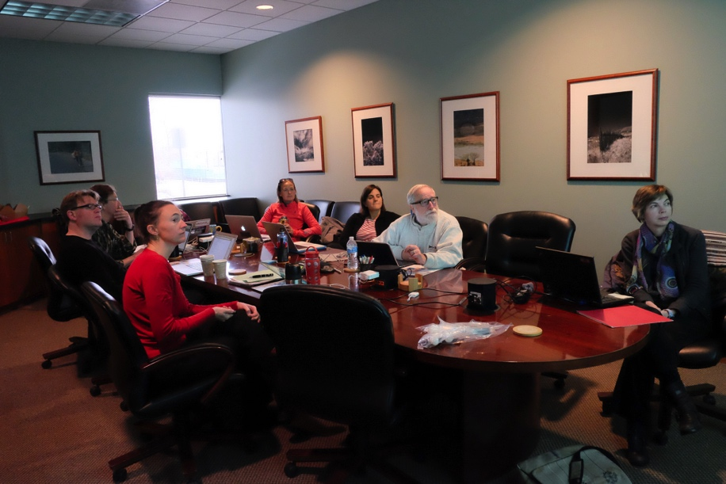
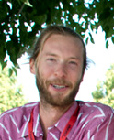
Data-rich Curriculum Developer’s Manual
Key element is three-fold expertise
Instructional
Pedagogy and assessment
Technical and data processing

Slide 18
Next Steps
Initial dissemination of GETSI Phase I materials via in-person and virtual venues
Research into module adaption/adoption →”meta” pilot-testers give feedback on actual use
GETSI Phase II
More classroom modules developed
Expand to include field education geodesy methods
Much more dissemination and continued research into adaption/adoption
Expand user base outside geoscience (civil engineering & environmental/bio science)

Slide 19
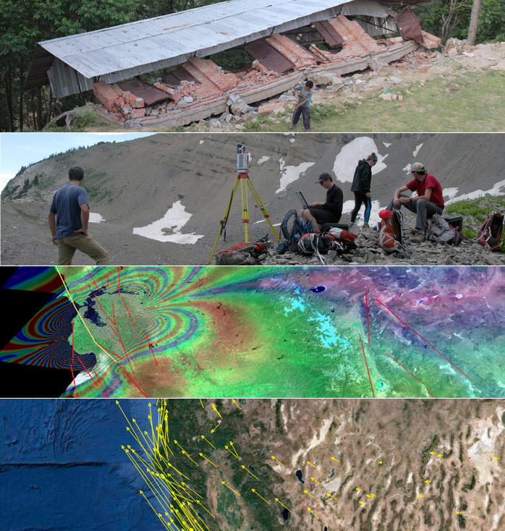
Short Course – AGU 2016
Sunday December 11
8 – 5 pm
San Francisco, CA
$300 stipend
bit.ly/agu16-unav
Deadline Nov 1, preference to applications received October 1
InSAR, GPS, Lidar, SfM

