Slide 1



VULNERABILITY ASSESSMENT OF GEOMEDIA AGAINST SPILLED ACIDS
HA, Seonjin
Yoon, Sukhwan
HYUN, Sung Pil*
Dept. of Groundwater
Korea Institute of Geoscience and Mineral
sha@kigam.re.kr
Notes:
Good morning, everyone
My name is Seonjin HA from KIGAM, Korea. Today I’m going to talk about the vulnerability assessment index of geomedia against spilled acids.

Slide 2
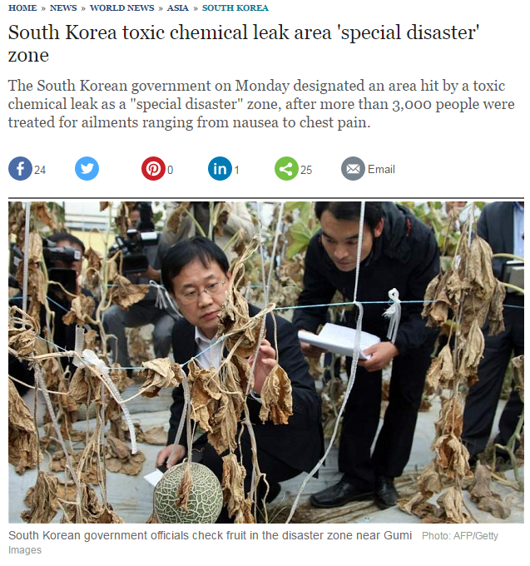
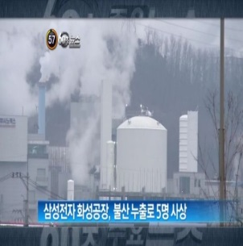
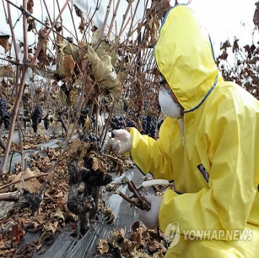
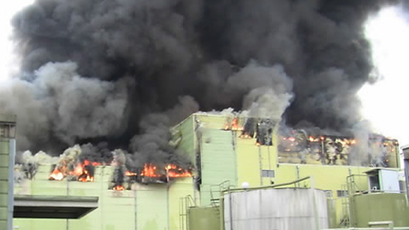
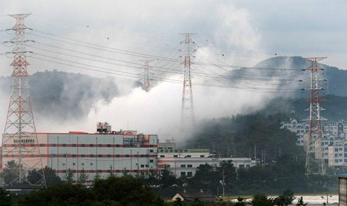

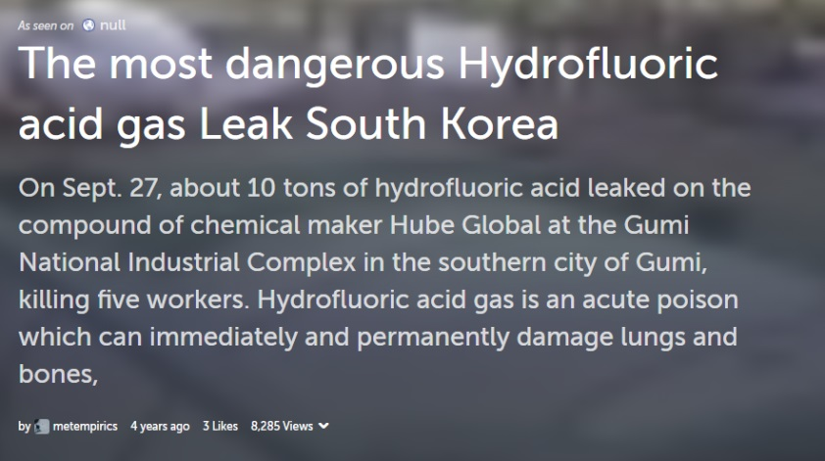
Introduction
Hydrofluoric Acid Leak in South Korea (2012)
Notes:
Recently, acid spill accidents are frequently occurring in Korea.
In 2012, at Gumi, Gyeong-buk province, hydrofluoric acid leak occured from one of the chemical-handling facilities.

Slide 3





Introduction
Scale of Damage (2012)
12
Tons of Hydrofluoric acid gas leak
5&18
Casualties& injured in the accident
3654
Livestock had been disposed
212
Hectare withered
Notes:
By that accident, about 12 tons of hydrofluoric acid gas leaked, 5 people died on the spot and 18 got injured.
This incident eventually caused the disposal of 3000 livestock and plants withered over 200 hectare.

Slide 4

Introduction
Domestic(Korea) and International Acid Spill Accident Cases
12
Tons of Hydrofluoric acid gas leak
5&18
Casualties& injured in the accident
3654
Livestocks had been disposed
212
Hectare withered
Date | Location | Chemical | Quantity | Accident type | Influence range
2015. 1. 21 | Tennessee, USA | Sulfuric acid | 48,000 gallons | Transportation Road Spill | travel 24 miles
2016. 1. 8 | NSW, Australia | Sulfuric acid | 6000 litres | Spill Environmental Release
1987. 10. 30 | Texas, USA | Hydrofluoric acid | 6,548 gallons | Refinery equipment breakdowns
2011. 2. 28 | Texas, USA | Hydrofluoric acid | 110,000 pounds | Refinery equipment breakdowns | travel 25 miles
2009. 3. 21 | Pennsylvania, USA | Hydrofluoric acid | 16 tons | Transportation Road Spill
2007. 2. 12 | Asan, Korera | Sulfuric acid | 1.8 tons | Leak
2012. 9. 27 | Gumi, Korea | Hydrofluoric acid | 20 tons | Transportation Road Spill
2013. 1. 28 | Sangju, Korea | Hydrochloric acid | 100 tons | Crack
2014. 11. 5 | Bonghwa, Korea | Sulfuric acid | 2 tons | Transportation Road Spill
Notes:
This slide summarizes that acid spill accidents are happening not only in Korea but globally including the U.S. and Australia.
Breakdown of container during handling or road spills during transport are major acid release mechanisms to the environment.
The spilled acid can travel up to 10s of miles depending the geography & geology of the spill accident location.

Slide 5

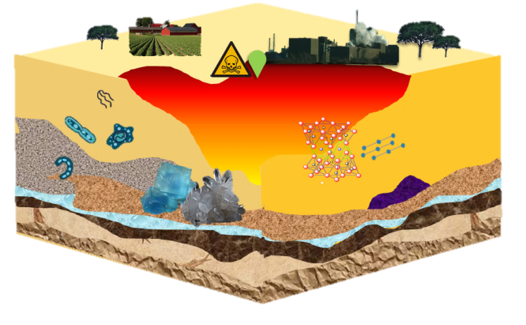
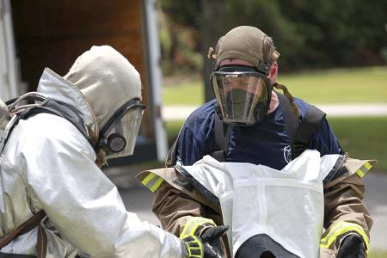

Problem Posing
Conventional Accident Response System
< Occurrence of Event >
< Effective Countermeasures >
Safety rules
Location of acid leak
Quantity of spilled acid
Casualties …
Hazard level ?
Dosage of counteragent ?
Recovery period ?
Expense ?
Lack of understanding of the behavior of spilled acid into soil
& The necessity of an accident rating scale for remediation and expense
Notes:
Once that kinds of acid release accident occurs, we normally identify the location of acid leak and quantity of spilled acid or count casualties.
Then accident response team might sprays counteractive and restrict the access for a while.
However, though behaviors of spilled acid will be different depending on the type of soil, there are no researches that evaluate the tolerance of geomedia against acid spill.
If hazard level is established, it obviously help estimate the dosage of counteragent, recovery period and expenses against accident.
So my project group focused on the lack of understanding and began to give scores for preparing remediation and deciding expense based on understanding reaction between acid and geomedia.

Slide 6
Research Objectives
To develop a geomedia’s vulnerability assessment system against spilled acid by marking index.
To get vulnerability indices over a demonstration area using the assessment system at the Geum river basin and industrial complexes.
Spilled acid into soil environment is estimated to be spread and reacted with geomedia then ultimately neutralized.
But affected spatial/time range on neutralization is determined by features of the geological media.
By establishing a vulnerability assessment index for acid spills, country specific geomedia will be evaluated against acid spill.
The resulting vulnerability assessment index will be used as basic data on the scale of damage, spatial extent, damage cost estimates by acid leak accident.
Furthermore, It will be used as indicators derived in response by determining the end of the restoration process and expected to be utilized for site selection of industry/acid storage facilities.
Notes:
The objective of my presentation is to introduce geomedia’s vulnerability assessment system against spilled acid and show you some demos using the assessment system.

Slide 7
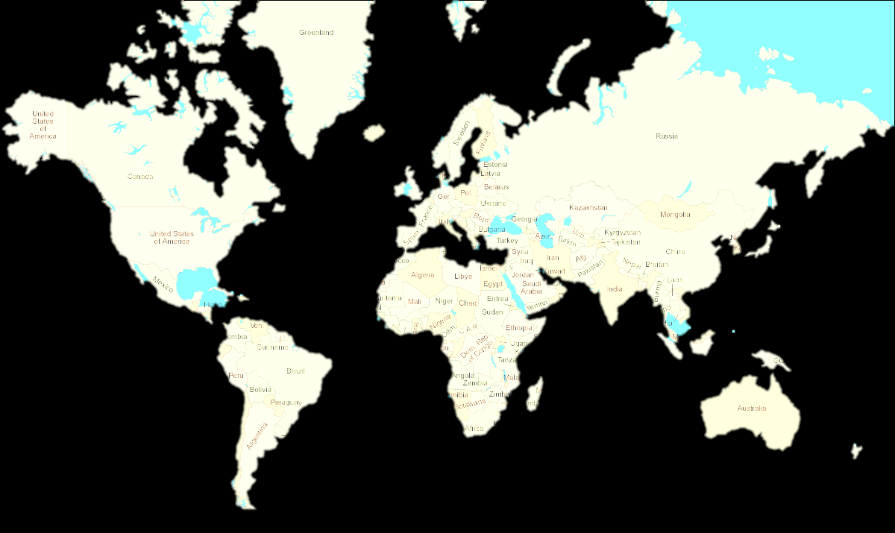



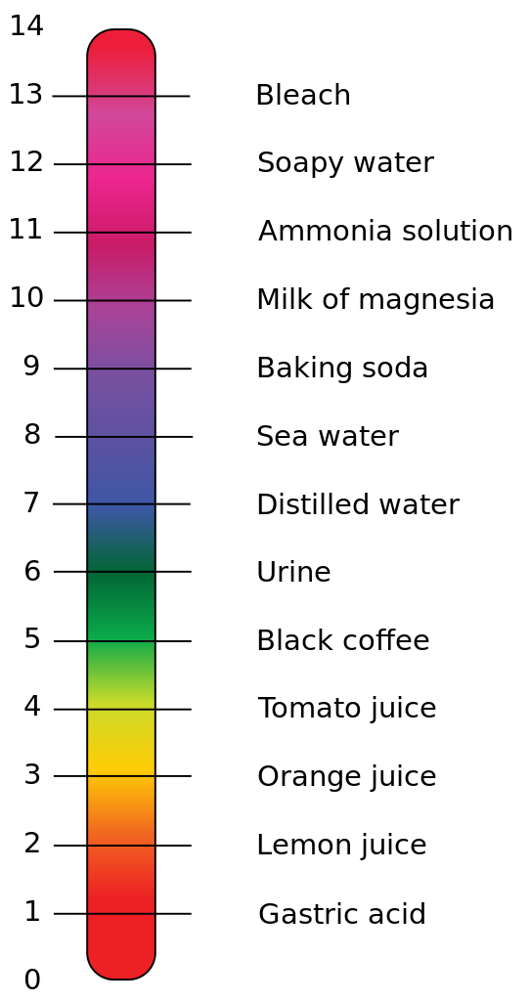





Scenario Examples
10m
10m
Unsaturated
zone
sand
bedrock
Unsaturated
zone
Saturated
zone
Geomedia A
Geomedia B
The environmental impact depends on geomedia’s reactivity & transport property.
Notes:
To help understanding the concept of vulnerability assessment, I prepared 2 scenarios.
On the left, geomedia A that has bedrock and consist of unsaturated zone.
On the right, geomedia B that has thick saturated zone underneath sand media.
If there are same amount of the acid spills, how the acid bloom move and how affected volume varies in geomedia A and B?

Slide 8
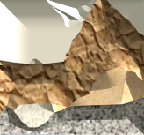


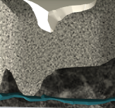
Sceniaro Examples
Meaning of Vulnerability Index
Geomedia A
-1
-0.5
0
0.5
1
1.5
2.
2.5
3
-1
-0.5
0
0.5
1
1.5
2.
2.5
3
Geomedia B
pH
Point of Acid Spill, T=t0
T=t
Affected spatial/time range on neutralization are determined by features of the geological media
pH
Notes:
As you might imagine, the initial acid will be dispersed by gravity as function of time.
Affected spatial and time range until neutralization will be determined by features of the geological media.
If the acid front meet the impermeable bedrock and unsaturated zone like geomedia A, the affected domain will be limited.
In case of geomedia B, the dilution and dispersion will be fast once it meet the saturated zone.

Slide 9
Research Features
Meaning of Vulnerability Index
Geomedia A
Example index : 1,2,3…
Low VAI
V
2V
4V
8V
Small Volume Large
Less Resistant More
Geomedia B
Example index : 8,9,10…
Less Vulnerable More
Point of Acid Spill, T=t0
T=t
T = 48 hr
High VAI
“ Vulnerability Assessment Index “
(a proportional volume of) geomedia that reaches pH 2 after 48 hours from the acid spill event
(a level of ) reciprocal of geomedia’s acid neutralization capacity against the moving acid front
Notes:
Ultimately, the vulnerability assessment index reflects the affected volume of the geomedia connecting pH 2 points after 48 hrs.
Larger pH 2 boundary geomedia volume will marked as higher index and that means more vulnerable to acid and less resistant to damage.
But making acid spill accident deliberately and measuring the affected volume in field are realistically impossible.
So we had approaches to make algorithms by adding factors affecting outcome together to estimate the affected volume.

Slide 10
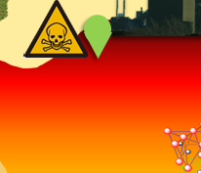
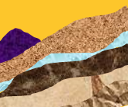
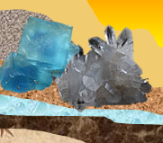
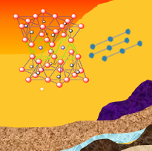
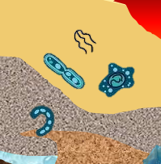
Factor selection
Physicochemical properties of Acid
Amount of acid
Concentration of acid
Type of acid (density, volatility…)
Phase of acid …
Physicochemical Properties of Geomedia
Particle size / Surface area
Porosity / Permeability
Hydraulic conductivity
Ratio of top soil and clay soil …
Kaolinite + 6H⁺ ↔ 2Al³⁺ + 2SiO_{2(aq)} + 5H₂O
Goethite + 3H⁺ ↔ Fe³⁺ + 2H₂O
Gibbsite + 3H⁺ ↔ Al³⁺ + 3H₂O
Calcite + H⁺ ↔ Ca²⁺ + HCO₃⁻
Soil Composition
Sample | Initial pH | Specific surface area (m²/kg) | Hydrogen ion consumption (µmol/m²)
Crushed sandstone | 7.74 | 3910.1 | 34.63
Crushed granite | 7.04 | 3790.5 | 32.18
Crushed schist | 6.67 | 4146.3 | 25.80
Crushed basalt | 7.40 | 21290.0 | 8.99
Granite soil (industrial area) | 7.04 | 6224.3 | 20.48
Granite soil (control) | 5.18 | 12549.7 | 8.96
Schist soil (industrial area) | 4.71 | 19287.5 | 5.14
Kaolinite | 4.71 | 19392.1 | 4.53
Montmorillonite | 8.16 | 58415.0 | 3.92
Soil Biology
Community of soil organism
Effect of bioremediation …
Notes:
This slide shows factors that reflect geomedia’s reaction and transport properties.
In reaction between geomedia and acid, there are quite a lot of factors would be involved.
For the physicochemcial properties, amount, concentration, type and phase of acid would be considered.
Regarding geomedia, particle size, surface area, porosity, permeability, hydraulic conductivity, ratio of top soil and clay soil would be considered.
For the soil composition, different soil minerals and rock have different hydrogen consumption so that should be also taken into account.
And furthermore, microorganic community in soil might behave differently once attacked by acid spill.

Slide 11

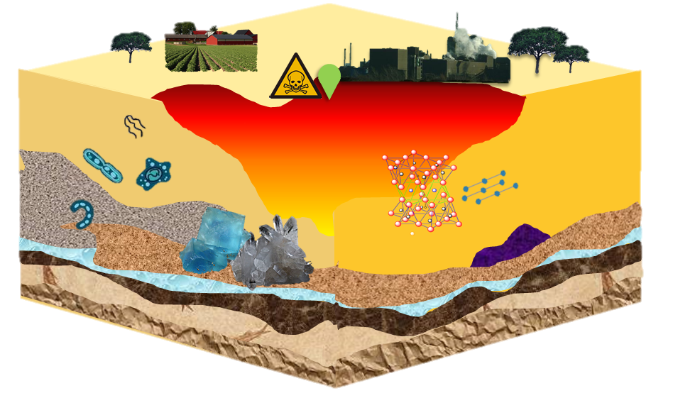


Factor selection - Problem
Physicochemical properties of Acid
Amount of acid
Concentration of acid
Type of acid
Phase of acid …
Geomedia A
Vulnerability Assessment
Index
5
Physicochemical Properties of Geomedia
Particle size
Porosity / Permeability
Hydraulic conductivity
Ratio of top soil and clay soil …
Geomedia B
Vulnerability Assessment
Index
10
Soil Composition
Particle size
Porosity
Ratio of top soil and clay soil …
T = 48 hr
Soil Biology
Community of soil organism …
But geomedia are really complex and factors are interdependent!
Notes:
But geomedia is really complex to estimate and some factors are interdependent to be evaluated.
For example, quartz content has low potential to neutralize the acid but porosity is high so move widely.
The clay hinders the movement of acid but consuming hydrogen ion well.
And particle size, surface area, porosity, permeability, hydraulic conductivity is defined as function of each other.
So in this study, factors that can represent the other factors are selected along with publicly available data.

Slide 12
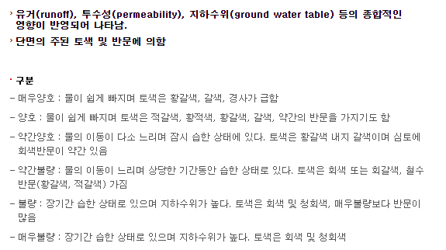
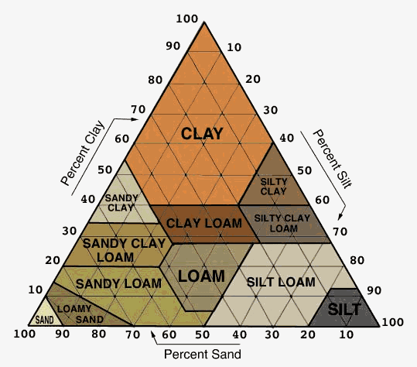
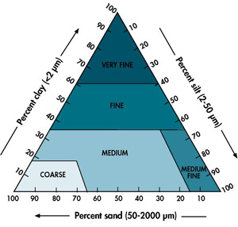
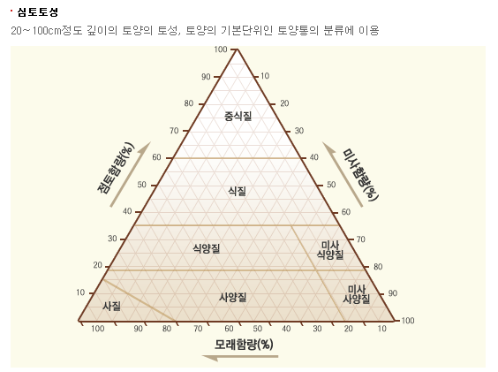
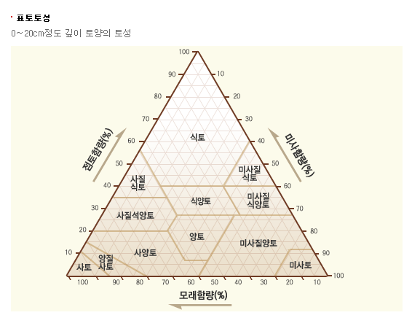
Factor selection – Main physical factor
Physical parameter is given more weighted score than geochemistry parameter as differences in permeability have a progressively larger impact on migration of acid spill (Bea, 2013).
Valuation basis
  Soil drainage classification ( 5 levels)
  Topsoil : 5 % Clay(clay + clay loam + silty clay + silty clay loam)
  Subsoil : 5 % Fine soil(very fine + fine)
 | Condition | Mottle | Water migration | Groundwater level | Color | Slope
Very good | Well drainage | N/A | Fast | Low | Light brown, brown | Steep
Good | Well drainage | Low | Rather slow | Low | Reddish brown, yellowish brown | -
Rather poor | Wet short period | Low | Slow | High | grayish brown | -
Poor | Wet long period | High | Slow | High | Gray, slate | -
Very poor | Wet long period | Low | Very slow | High | Gray, slate | -
Notes:
The main physical factor that I chose is soil drainage.
By bea’s group in earth science group at LBNL, permeability has larger impact on migration of acid spill than other geochemcial factors.
So 5 categorized soil drainage, from very good to very poor, is given more weighted score than any other parameter.
For the top soil content and subsoil content, the score decided based on the clay and fine soil content.
But practically, pure clay and pure fine soil doesn’t exist in korea territory classified by triangle table.
So we defined clay by accumulating region on clay, clay loam, silty clay and silty clay loam together and fine soil as very fine and fine soil together.

Slide 13
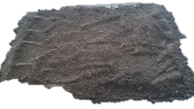
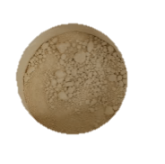
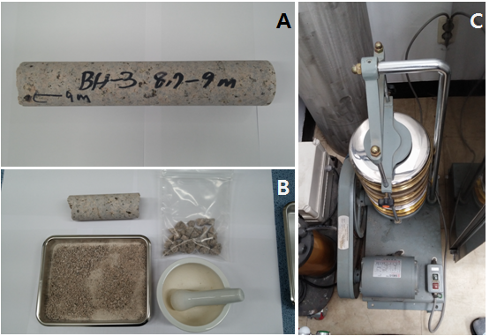
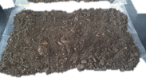
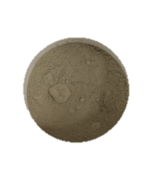
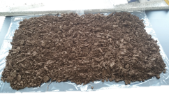
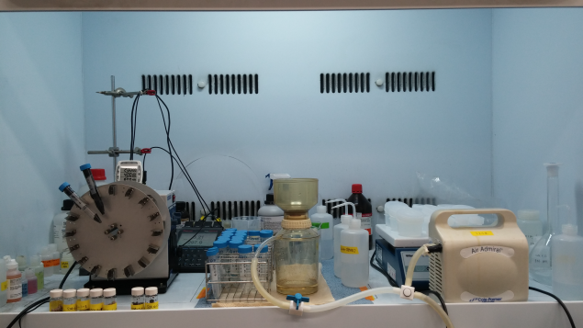
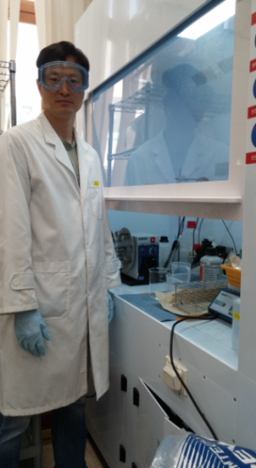
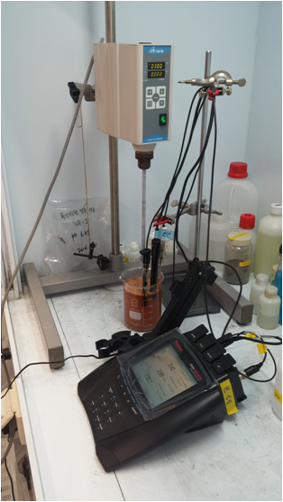
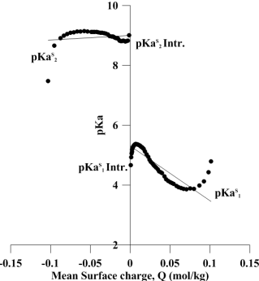
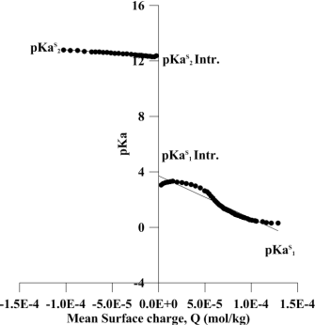
Factor selection – Main geochemical factor
Experimental hydrogen ion consumption capacity :
Sandstone > Granite > Schist > Basalt
Hydrogen ion consumption is not simply depending on specific surface area but surface functional groups according to the difference of the configuration minerals.
Sample | Initial pH | Specific surface area (m²/kg) | Hydrogen ion consumption (µmol/m²)
Crushed sandstone | 7.74 | 3910.1 | 34.63
Crushed granite | 7.04 | 3790.5 | 32.18
Crushed schist | 6.67 | 4146.3 | 25.80
Crushed basalt | 7.40 | 21290.0 | 8.99
Granite soil (industrial area) | 7.04 | 6224.3 | 20.48
Granite soil (control) | 5.18 | 12549.7 | 8.96
Schist soil (industrial area) | 4.71 | 19287.5 | 5.14
Kaolinite | 4.71 | 19392.1 | 4.53
Montmorillonite | 8.16 | 58415.0 | 3.92
Kaolinite + 6H⁺ ↔ 2Al³⁺ + 2SiO_{2(aq)} + 5H₂O
Goethite + 3H⁺ ↔ Fe³⁺ + 2H₂O
Gibbsite + 3H⁺ ↔ Al³⁺ + 3H₂O
Calcite + H⁺ ↔ Ca²⁺ + HCO₃⁻
Notes:
Main geochemical factor is hydrogen ion consumption capacity.
Since 2014, we have conducted experiments using diluted and original sulfuric acid to 10 geomedia samples collected from the Geum river basin.
As results, hydrogen ion consumption is not simply depending on specific surface area but surface functional groups according to the difference of the configuration minerals.
So if geomedia contains more sandstone, granite and kaolinite than other contents, that willl be evaluated to be less vulnerable.

Slide 14
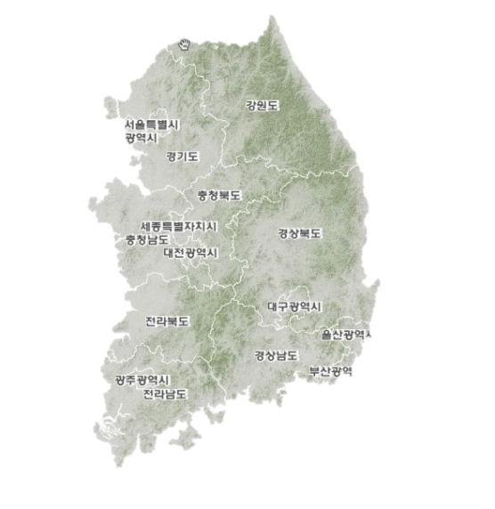
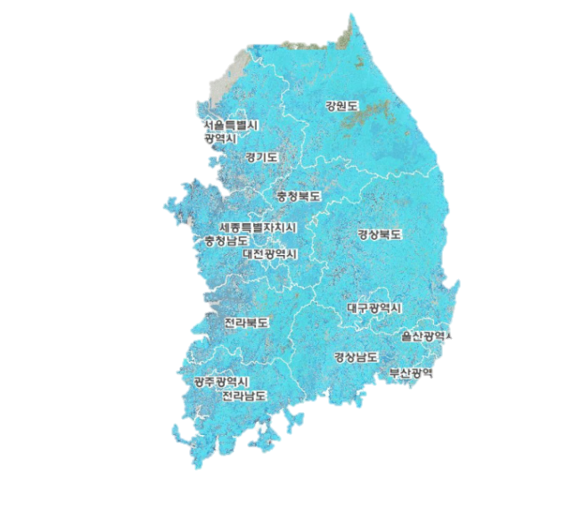
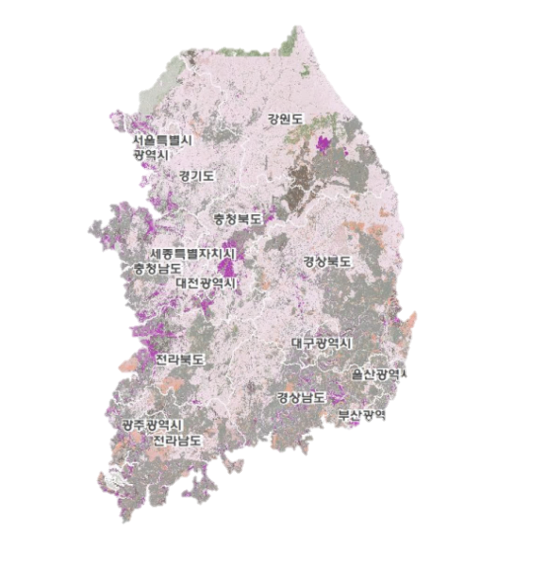
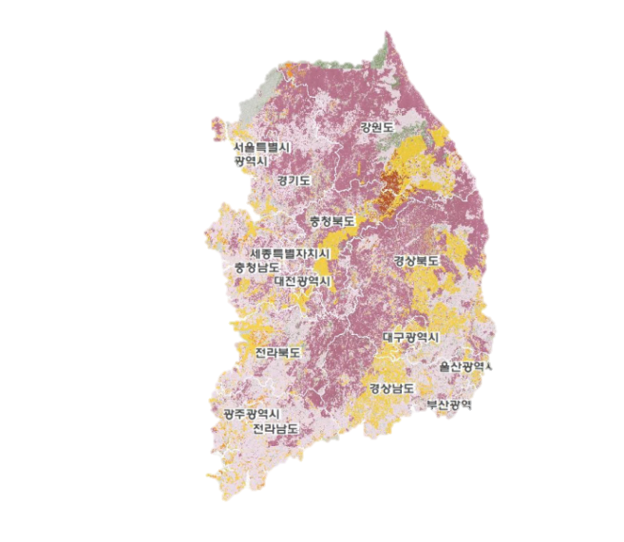
Factor selection – weighting
Characteristic of Korea Terrain
  Overall, the drainage level is high due to terrain slope (① ,②).
  Along the coastal border of the peninsula, clay content ratio increases (③).
  Top soil and subsoil shows the difference between southeastern and northern region (③,④).
The region is distinguished by given weight at each factor and determined by summation of each category
5 representative area were pre-tested and adjusted the weight to evaluate the entire area evenly.
전문가 설문조사를 바탕으로 의견을 수렴하여 설정
전문가 전공 영역 : ---
설문 내용 : ---
① Slope ② Drainage ③ Topsoil ④ Subsoil distribution
<<<< More weighted Less weighted >>>>
Notes:
The most tricky part that I’m struggling on is how to weigh on each parameter while make distinction.
Overall, drainage level of korea is high due to the slope and clay content ratio increases along the coastal border.
And top soil and sub soil shows the difference between southeastern and northern region.
So 5 representative areas were pre-tested and adjusted the weight to evaluate the entire area evenly.

Slide 15
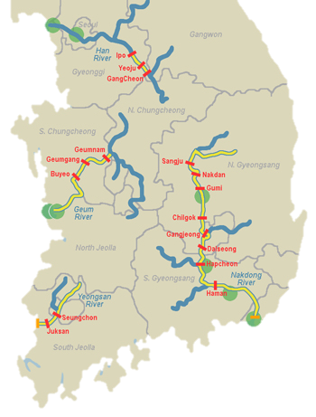

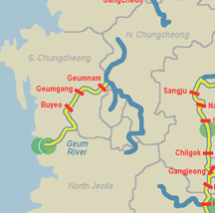



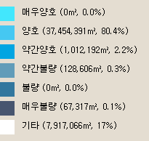
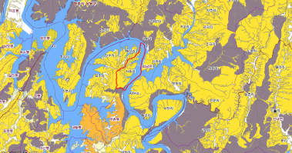

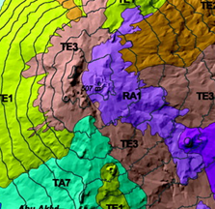
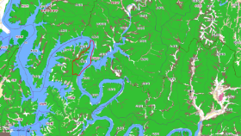
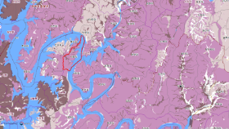
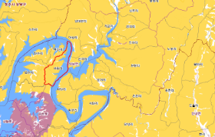
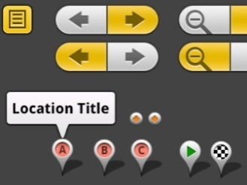

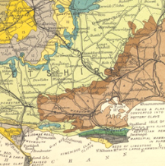
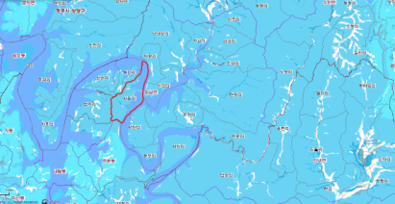
Prototype
Target area
  The Geum river basin ①
  Siwha ② /Onsan ③ /Yeosu ④ industrial complexes
Minimum factor method
Physical factor : permeability of geomedia
Chemical factor : contents of reactive primary & secondary minerals
Weighted score for each factor to get the final vulnerability indices.
②
  ①
③
④
Location in
Index out
Data from geologic map + Algorithm + GUI
Address or Coordinate
Index & color
Notes:
Through that kind of algorithm, now we do develop a prototype having a goal for service to users who are interested in.
The system asks users the region of interest and call the database from geologic map.
Then calculated score and alphabetical index based the algorithm will be pop up to users.

Slide 16
Method - Soil Classification Algorithm
Permeability
Topsoil (~20cm)
Soil textural classes
Subsoil(20 ~100cm)
Soil textural family
Content of kaolinite
Vulnerability Index
Kaolinite > 50%
Score : 0
16
17
18
18
19
20
(-10)=
Fine >5%
Clay > 5%
Score : 3
Kaolinite ≤ 50%
Score : 1
Fine ≤ 5%
Score : 2
Very good
Score : 13
Fine > 5%
Kaolinite > 50%
Clay ≤ 5%
Score : 5
Kaolinite ≤ 50%
Fine ≤ 5 %e
Kaolinite > 50%
15
16
17
17
18
19
Fine >5%
Clay > 5%
Score : 2
Kaolinite ≤ 50%
Fine ≤ 5%
Score : 3
Good
Score : 12
Fine > 5%
Kaolinite > 50% 0.
Clay ≤ 5%
Score : 4
Kaolinite ≤ 50%r : 1
Fine ≤ 5%S : 3
Notes:
You geologists might be quite familiar with this type of decision tree.
Yes, we brought USGS soil classification algorithm to classify geomedia
So if one region has very good permeability, more than 5 % clay at top soil, more than 5 % of fine soil at subsoil and more than 50% of kaolinite,
That will be marked 6.

Slide 17
Method - Soil Classification Algorithm
Fine > 5 %
Kaolinite > 50%
Score : 0
13
14
15
15
16
17
Kaolinite ≤ 50%
Score : 1
Clay > 5%
Score : 3
Fine ≤ 5%
Score : 2
Kaolinite > 50%
Rather poor
Score : 10
Fine > 5%
Kaolinite ≤ 50%
Clay ≤ 5%
Score : 5
Fine ≤ 5%
Fine > 5%
Kaolinite > 50%
11
12
13
13
14
15
Clay > 5%
Kaolinite ≤ 50%
Fine ≤ 5% 3
Poor
Score : 8
Kaolinite > 50%
Fine > 5%
Kaolinite ≤ 50%
Clay ≤ 5%
Fine ≤ 5%
Kaolinite > 50%
10
11
12
12
13
14
Clay > 5%
Fine > 5%
Kaolinite ≤ 50%
Very poor
Score : 7
Fine ≤ 5%
Fine > 5%
Kaolinite > 50%
Clay ≤ 5%
Kaolinite ≤ 50%
Fine ≤ 5%

Slide 18
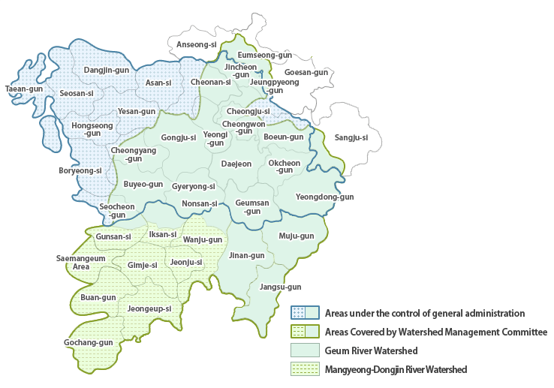

Case study 1 - The Geum River basin
  ① the Geum river basin
7
Through vulnerability assessment system, the Geum river basin was evaluated as quite vulnerable area showing more red index than green index.
Industrial complexes gravitate towards northern part of the Geum river basin.
The site of industiral complexes are not matching with the acid-resistance geomedia.
Notes:
Here is point of interest, the geum river basin and here is southern korea peninsula.
Through vulnerability assessment system, the Geum river basin was evaluated as quite vulnerable area showing more red index than green index.
Right side picture shows that Industrial complexes gravitate towards northern part of the Geum river basin.
So as result, the companies near here need cares to treat to prevent acid release.

Slide 19




Case study 2 – National industrial complexes
② Sihwa industrial complex
③ Onsan industrial complex
④ Yeosu industrial complexes
Notes:
Next case study points were sihwa, Onsan and yeosu industrial complex that located in northern, eastern, and southern part of the korea peninsula.
These region are national industrial complexes that many companies gravitate in.
Through the assessment, we examined that these areas were quite resistant against acid spill showing the greenish colors.
It might be a coincidence but the results may come from coastal boarder that has high clay contents in spite of high drainage.

Slide 20
Summary and Conclusion
Development of vulnerability assessment system
  Factors : drainage, topsoil, subsoil and contents of kaolinite
Demonstration sites
  the Geum river basin : Vulnerable
  the Siwha/Onsan/Yeosu industrial complexes : Less vulnerable
Notes:
I ‘d like to sum up the main points now
We began development of vulnerability assessment system by selecting fators and weighting.
And according to application into the Geum River basin area and 3 industrial complex sites, index were evenly distributed and demo site were evaluated by index from 1 to 10 with colors.
So if we develop it reasonably, it can contribute to decide the appropriate site and remediation sphere by serving ancillary data.

Slide 21
Future work
  Expert survey ( ~ Sep 2016)
  GUI development ( ~ Dec 2016)
  Evaluation of performance of vulnerability index
  Improvement by adding factors
  Application
Notes:
In the future work, the weight will be corrected through opinions from expert survey. And GUI will be produced soon.

Slide 22
Acknowledgement
  This research was financially supported by KIGAM’s Basic Research Project (GP2015-023) and KAIST’s IWT project (N01160456) funded by the Ministry of Science, ICT, and Future Planning.
Notes:
This research is supported from KIGAM and KAIST funded by Korea government.

Slide 23

VULNERABILITY ASSESSMENT INDEX OF GEOMEDIA AGAINST SPILLED ACIDS
Thank You
HA, Seonjin,
Yoon, Sukhwan
HYUN, Sung Pil*
Dept. of Groundwater
Korea Institute of Geoscience and Mineral
sha@kigam.re.kr
Notes:
Thank you very much for your attention. If you have any questions, I shall do my best to answer them. Thank you.

Slide 24


















Slide 25
Soil Classification for vulnerability Assessment
Permeability
Topsoil (~20cm)
Soil textural classes
Subsoil(20 ~100cm)
Soil textural family
Content of kaolinite
Vulnerability Score
Kaolinite > 5%
Score : 0
9
B
Clayey soil >10%
Clay > 5%
Score : 2
Kaolinite ≤ 5%
Score : 1
10
C
Clayey soil ≤ 10%
Score : 3
12
Very good
Score : 7
C
Clayey soil > 10%
Kaolinite > 5%
11
C
Clay ≤ 5%
Score : 4
Kaolinite ≤ 5%
12
C
Clayey soil ≤ 10 %e
14
D
Kaolinite > 5%
8
B
Clayey soil >10%
Clay > 5%
Score : 2
Kaolinite ≤ 5%
9
B
Clayey soil ≤ 10%
Score : 3
11
C
Good
Score : 6
Clayey soil > 10%
Kaolinite > 5% 0.5
10
C
Clay ≤ 5%
Score : 4
Kaolinite ≤ 5%r : 1
11
C
Clayey soil ≤ 10%S : 3
13
D
A (less vulnerable): under 6
B: 7 - 9
C: 10 - 12
D (vulnerable): over 13

Slide 26
Kaolinite > 5%
Score : 0
6
Clayey soil > 10%
A
Kaolinite ≤ 5%
Score : 1
7
B
Clay > 5%
Score : 2
Clayey soil ≤ 10%
Score : 3
9
B
Kaolinite > 5%
8
B
Rather poor
Score : 4
Clayey soil > 10%
Kaolinite ≤ 5%
9
B
Clay ≤ 5%
Score : 4
Clayey soil ≤ 10%
11
C
Kaolinite > 5%
4
A
Clayey soil > 10%
Clay > 5%
Kaolinite ≤ 5%
5
A
Clayey soil ≤ 10% 3
7
B
Poor
Score : 2
Kaolinite > 5%
6
B
Clayey soil > 10%
Kaolinite ≤ 5%
7
B
Clay ≤ 5%
Clayey soil ≤ 10%
9
B
Kaolinite > 5%
3
A
Clay > 5%
Clayey soil > 10%
Kaolinite ≤ 5%
4
A
Clayey soil ≤ 10%
6
A
Very poor
Score : 1
Clayey soil > 10%
Kaolinite > 5%
5
A
Clay ≤ 5%
Kaolinite ≤ 5%
6
A
Clayey soil ≤ 10%
8
D

