Slide 1


GSA Annual Conference
September 2016
Professional Science Master’s
Wiess School of Natural Sciences

Slide 2

Professional Master’s Programs Graduate Level
Professional Development Training
SUBSURFACE GEOSCIENCE
@ RICE UNIVERSITY

Slide 3
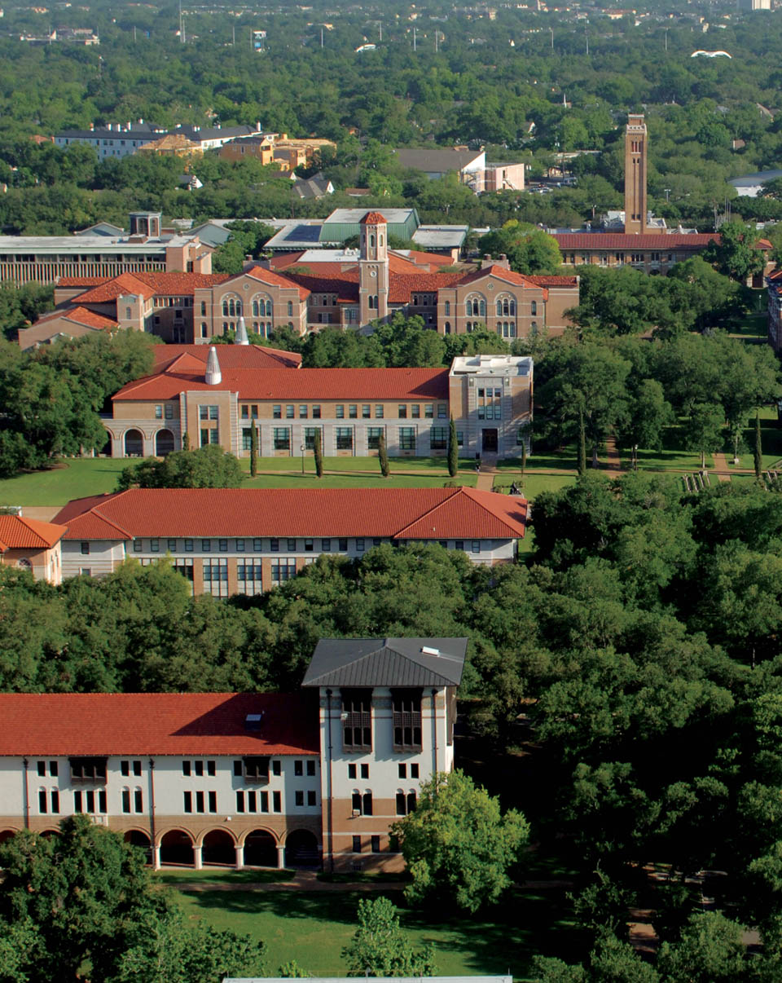

Slide 4
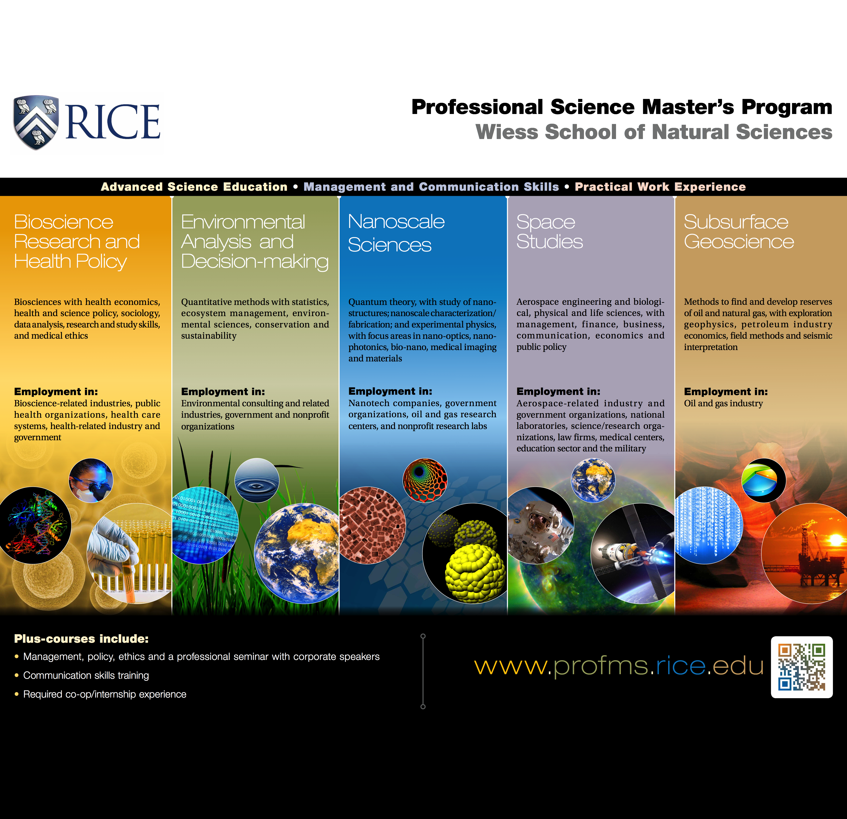

Slide 5


Brief History of the PSM
Established by Sloan Foundation in 1997
Industry Feedback: more people needed with scientific background and business knowledge
Program needed to encourage students to continue in science
Sloan funded start-up programs at U.S. Universities offering curricula merging science with business and communication
PSMs supported by Council of Graduate Schools/PSM Affiliation Office and NPSMA

Slide 6
Key Features of SG Degree
Advanced geology/geophysics course work
Set of tailor-made courses taught by adjunct faculty from
industry
Enrichment via “plus components”, such as business,
management and communication skills training
Professional Development workshops
Networking Opportunities
A required practical Work Experience
Close Collaboration with Industry via an industry advisory
board guiding curricula design, workforce needs, etc
Notes:
We are working hard to enrich the students experience – following the original outline

Slide 7
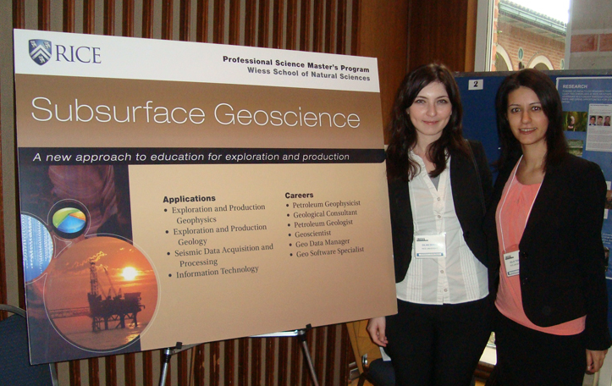
Subsurface Geoscience Degree
Focus Areas:
Geology
Geophysics
Required courses include:
Exploration Geophysics I & II
Petroleum Geology
Sequence Stratigraphy
Seismic Reflection Data Interpretation
Petroleum Industry Economics and Management
Modern Industrial Exploration Techniques
Total of 40 credit hours required

Slide 8
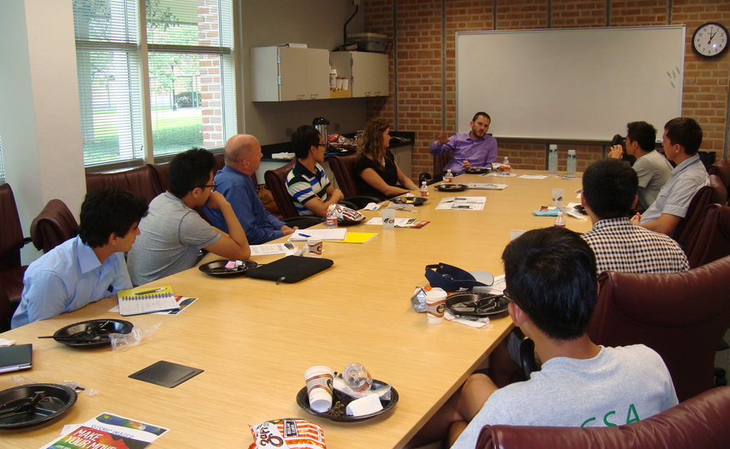
SG Cohort Courses or “Plus Courses”
Management for Science and Engineering
Basic business concepts
Access to MBA courses at Jones School of Business
Science Policy and Ethics
The policy, politics, ethics, and legal issues that relate to science and technology
Master’s Seminar (2)
Communication training
Corporate guest speakers
Master’s Project
Internship results
Notes:
PLUS CONTENT IS DELIVERED VIA A SET OF DEDICATED COURSES, Integration of content into existing graduate level STEM classes,
Cooperation across campus with Centers,

Slide 9

Management For Scientists and Engineers
Team Taught
Leadership
Understanding Accounting
Marketing in High Technology Organizations
Project Management:
Strategy in High Technology Organizations
Intellectual Property
Effective High Technology Organizations
Entrepreneurship

Slide 10
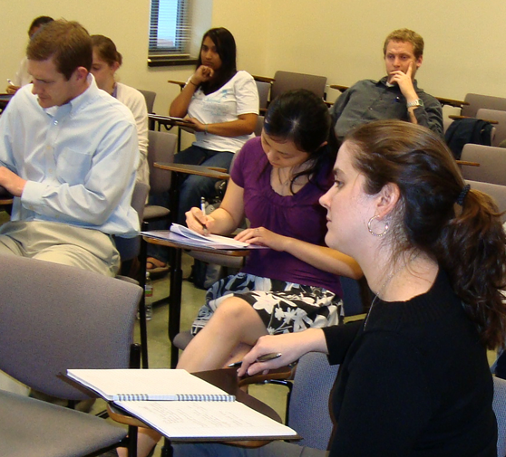
Science Policy and Ethics
Science Policy & Ethics
Lecturers: Kirstin Matthews and
Barbara Carlin
Fellow at Baker Institute for Public Policy
Role of science in policy formation and vice versa
Business Ethics
Impact of ethics, religion and politics on science and
policy creation.
Development of critical thinking, writing and
communication skills.

Slide 11
Communication Coaching
Development of individual learning plans by dedicated communication faculty
Individual counseling and feedback on written and oral assignments
Individual presentation practice sessions
Access to writing/communication workshops and courses
Seminar topics designed based on students’ needs
Integration of communication instruction into existing
courses

Slide 12
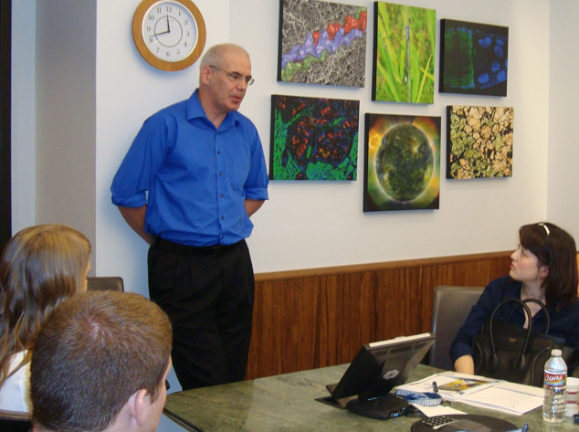
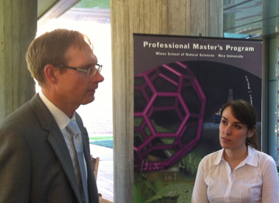
Professional Development Master’s Seminars
With topics requested by industry:
Entrepreneurship
Project Management
Networking
Leadership
Team Building
Communication
Presentation Skills
Career Development
Notes:
Cooperation with Employers (adjunct instructors, seminar presentations, host sites for experiential learning, mentors)

Slide 13
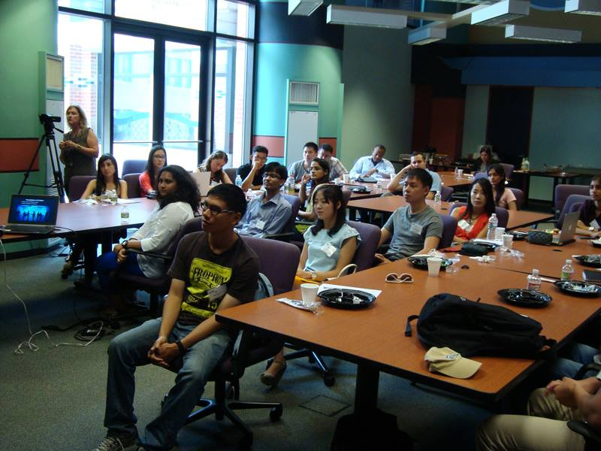
Intensive Preparation for
International Students
Cultural Workshop for all incoming international professional master’s students:
Cultural Foundations & U.S. Culture
Social Interactions & Networking
Interviewing Skills & Mock Interviews
PLUS: Academic Conversation Skills Workshop AND Grammar in Writing Workshop

Slide 14
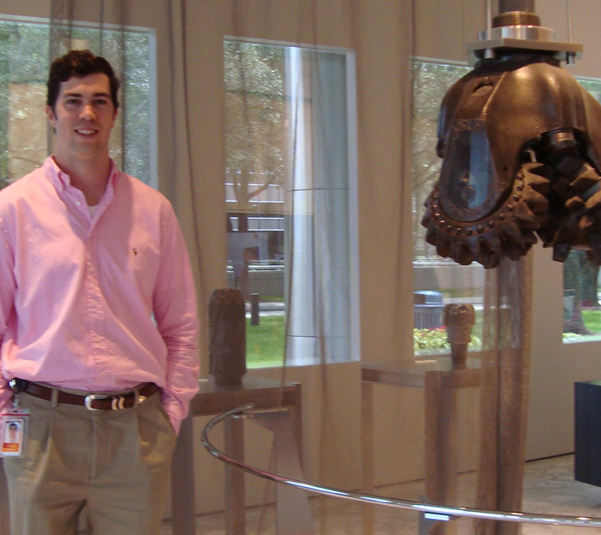
Internship/ Co-op/ Project Work
Three to six month period
Directly related to area of study
Normally salaried positions
Assistance through Program Director and
Rice’s Center of Career Development
Oral and written reports i.e. mini-thesis

Slide 15
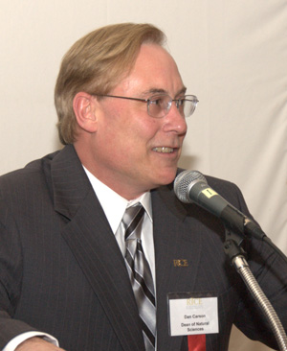
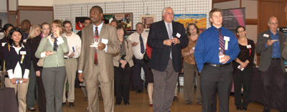
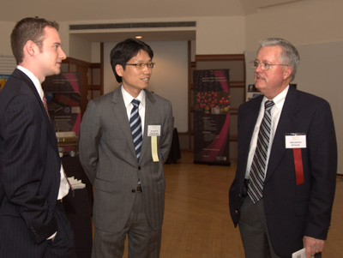
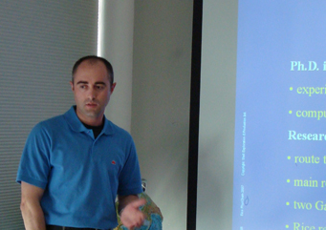
Corporate Relationship Building
Industry Board of Affiliates
Seminar Speakers
Annual Corporate Reception
Corporate Luncheons
Fieldtrips to corporations
Career Fairs
Networking Opportunities

Slide 16
Other Program Options
Other Program Options
5th Year Master’s Degree
Advanced Rice students in good standing apply during their junior year
Take courses during their senior year.
A plan of study based on their particular focus area will need to be approved
With good planning, students can finish their BA/BS and their MS degrees within 5 years

Slide 17
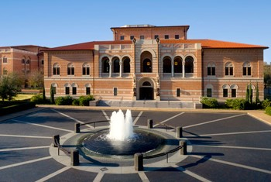
Coordinated MBA/PSM
Collaboration with the Jesse H. Jones Graduate School of Business (JGS)
Meet growing demand for managers with the technical expertise.
The coordinated program trains students to apply management strategies that meet the needs of high-technology companies.

Slide 18
COMPARISON between PLUS and Scientific Training
Comparison
Traditional Science Training
PLUS Professional Development
Academic curriculum
More of a “self-contained, single focus” experience
Long-term commitment to area of investigation
Presentations/abstracts/papers/ grant applications for specialized audiences that share expertise
Thesis with supervision by academic faculty
Interdisciplinary curriculum
Working as part of a team of diverse members
Comfort with changing/ short-term projects and goals
Speaking/writing for a heterogeneous team that will include non-scientists
Experiential learning with direct employer involvement

Slide 19
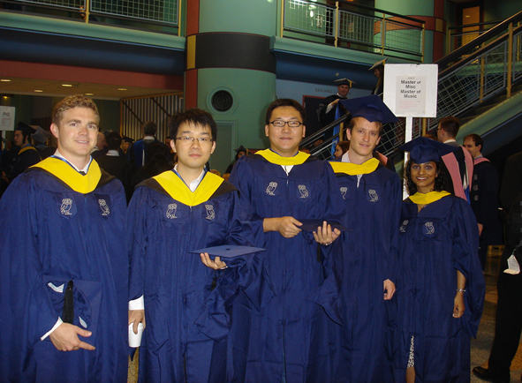

What can Energy Companies
expect from Graduates?
What can Companies expect from Graduates?
Productive, well-rounded, technically adept professional employees on day one
Cross-disciplinary education
Science, Math, Computation, and Business
Project Management
Team Building
Flexibility to changing industry demands
Career advancement for existing workforce
Technically trained cadre of workers for local
and regional industry

Slide 20
Subsurface Geoscience
Applications
Geological research and exploration
Reservoir development and production
Sequence Stratigraphy
Seismic Acquisition and Processing
Software development and support
Careers
Petroleum Geologist
Geological Consultant
Petrophysical Analyst
Financial Advisor
Project Manager
Geophysicist/Geologist
Internship providers, Employers and Program Supporters include:
Advanced Geophysical, Anadarko, Apache, Baker Hughes, BHP Billiton, CGG Veritas, Chevron, ConocoPhillips, Denbury Resources, ExxonMobil, Fairfield/Nodal, Halliburton/Landmark, HESS Corp, Hart Energy, Hilcorp, ION Geophysical, INEXS, In-Depth Geo, Kerogen Explorations, Schlumberger, Lynn Inc., Marathon Oil, MicroSeismic, Inc., Oasis Petroleum, Occidental Petroleum, PGS, Repsol, Shell, Schlumberger, Roxanna Oil, Southwestern Energy, Taos Resources, Task Geosciences, Total E&P, and others …
Notes:
Over 85 students are now employed in the industry

Slide 21

PSM = Win, Win, Win
PROFESSIONAL MASTER’S = WIN, WIN, WIN
Win for the employers
- have a technically trained cadre of workers
Win for the university
- provide students with another career option
and help solve community workforce needs
Win for the student
- alternative way to remain in science
without getting a PhD

Slide 22
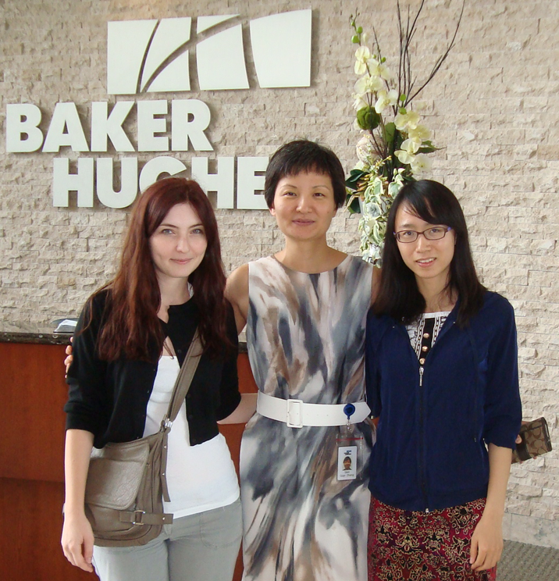
Why Students enroll in the SG Program
Impart scientific/technical skills
Not interested in research, but in business perspective of technical/scientific problems
Fulfill personal interest
Increase opportunity for advancement/pay
Employment in preferred field
Notes:
CONCEPT HAS PROVEN TO BE SUCCESSFUL:

Slide 23
Some Statistics
SG Retention:
97% of our students completed the program,
3% moved into thesis programs after or during completion of our program
SG Employment:
97% of graduates are employed in industry as of Spring 2016
Diversity:
30% Asian students, 5% Hispanic, 4% African-American, and 4% Middle Eastern.
Gender:
43% female, high percentage in a male dominated industry
Notes:
CONCEPT HAS PROVEN TO BE SUCCESSFUL:

Slide 24
www.profms.rice.edu
www.epmp.rice.edu
Dagmar K. Beck
Director
Professional Master’s in Science and Engineering
dkbeck@rice.edu
(713) 348-3188
and
Lindsey Hodge Agustina Fernandez-Moya
Program Administrator Program Coordinator
lh29@rice.edu af15@rice.edu

Slide 25
Recognition of PLUS Training
“the PSM has answered the call for change in graduate education”
Joan Ferrini-Mundi, Assistant Director, Education and Human Resources, National Science Foundation
“the gold standard and shining model for professional skills and development in graduate education”
Daniel D. Denecke, Vice President, Best Practices and Strategic Initiatives, Council of Graduate Schools

