Slide 1
Studying an Ophiolite in its Natural Environment: IODP Leg 352 Drilling in the Izu-Bonin-Mariana (IBM) Forearc
R. J. Stern (U TX Dallas)
Mark Reagan (U Iowa)
Julian Pearce (Cardiff U)
and the IODP Exp. 352 Shipboard Science Party*
*Renat Almeev, Aaron J. Avery, Claire Carvallo, Timothy Chapman, Gail L. Christeson, Eric C. Ferré, Marguerite Godard, Daniel E. Heaton, Maria Kirchenbaur, Walter Kurz, Steffen Kutterolf, Hongyan Li, Yibing Li, Katsuyoshi Michibayashi, Sally Morgan, Wendy R. Nelson, Julie Prytulak, Marie Python, Alastair H.F. Robertson, Jeffrey G. Ryan, William W. Sager, Tetsuya Sakuyama, John W. Shervais, Kenji Shimizu, Scott A. Whattam
T209 Wed. 3:20 pm

Slide 2
Subduction Initiation Hypothesis
Drilling Target: volcanic stratigraphy to record subduction initiation
Hypothesis of Stern and Bloomer (1992) with modifications, such as Reagan et al. (2010) and Ishizuka et al. (2006)

Slide 3
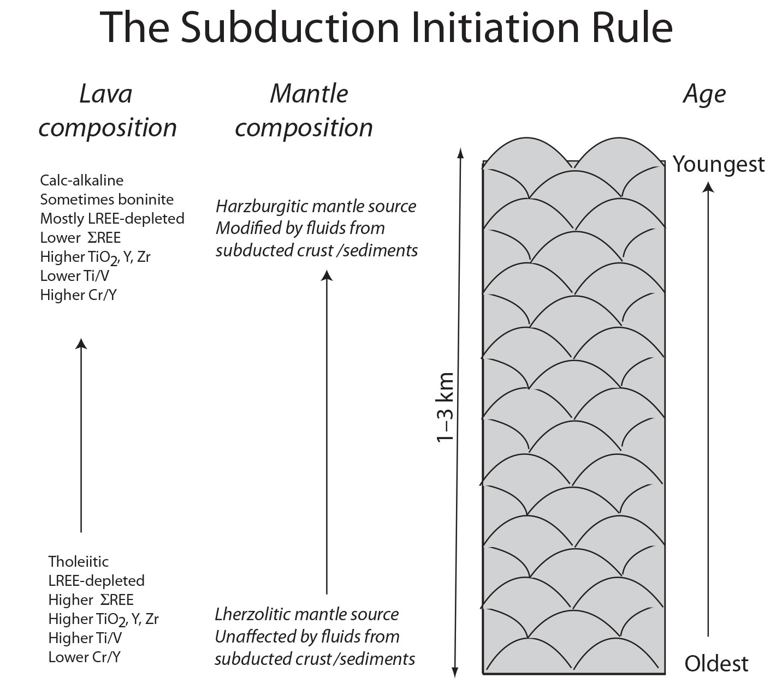
We want to test
Ophiolites that show this chemotemporal evolution probably reflect formation in a proto-forearc during subduction initiation
Whattam and Stern 2011 CMP

Slide 4

Lithosphere 4, 469–483

Slide 5
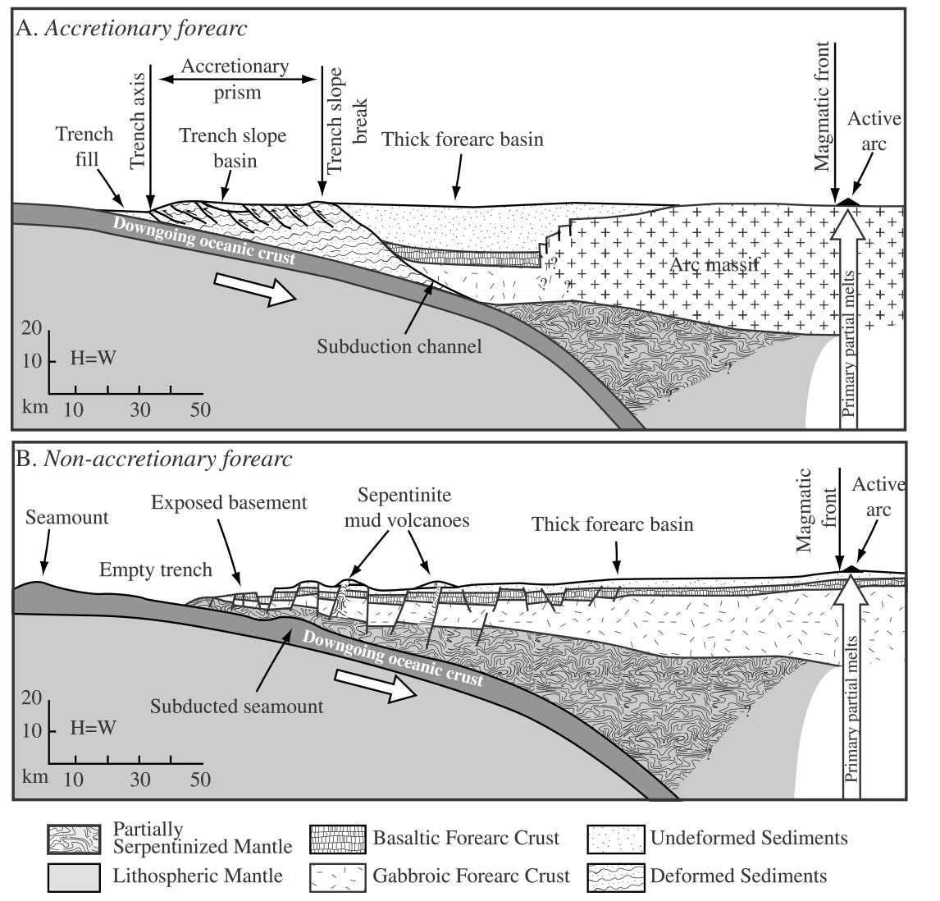
Target Naked Forearcs, where crust is easily reached by drilling
Forearc crust buried
Sedimented forearc
(near continent) Forearc in region of high sediment supply (near continent):
Forearc crust is buried.
Forearc crust exposed
Naked forearc
(distant from continent) Forearc in region of low sediment supply (intra-oceanic arc):
Forearc crust is exposed on seafloor.

Slide 6
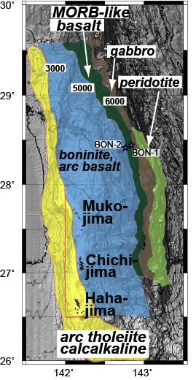
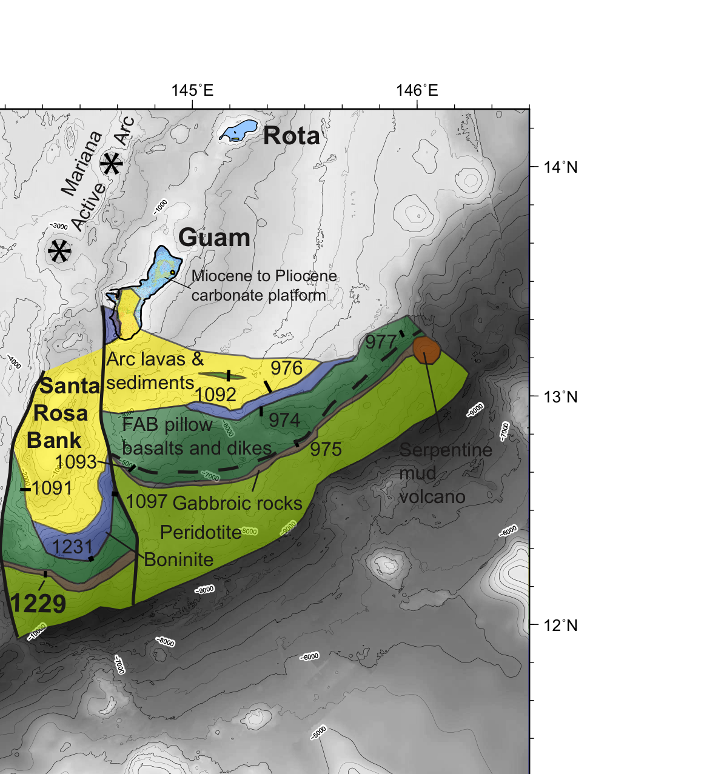
IBM Forearc is naked; lithospheric section exposed
They drilled this one
Reagan et al. (2010, 2013)
after Ishizuka et al. (2011)

Slide 7

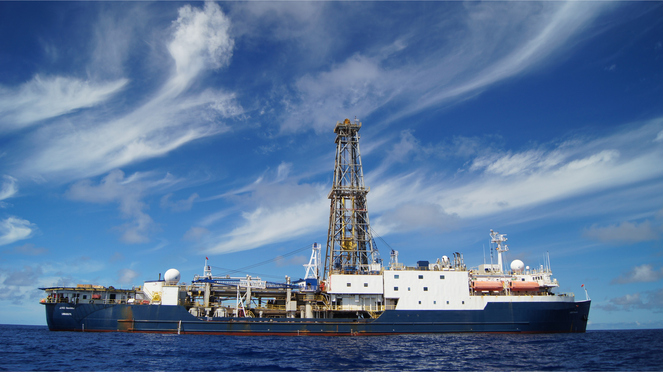
IODP Expedition 352 (July 30 – September 29, 2014)
Drillship JOIDES Resolution
Photo courtesy Amy West

Slide 8
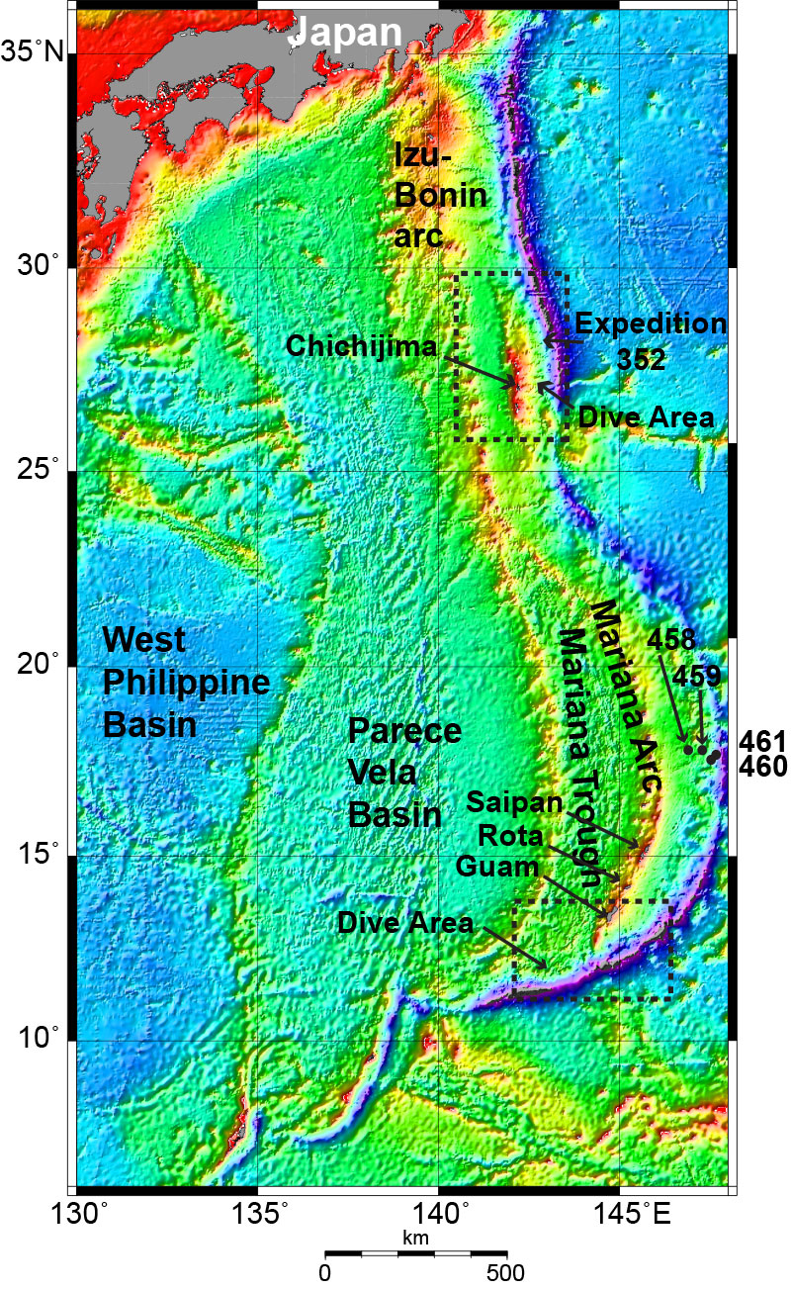
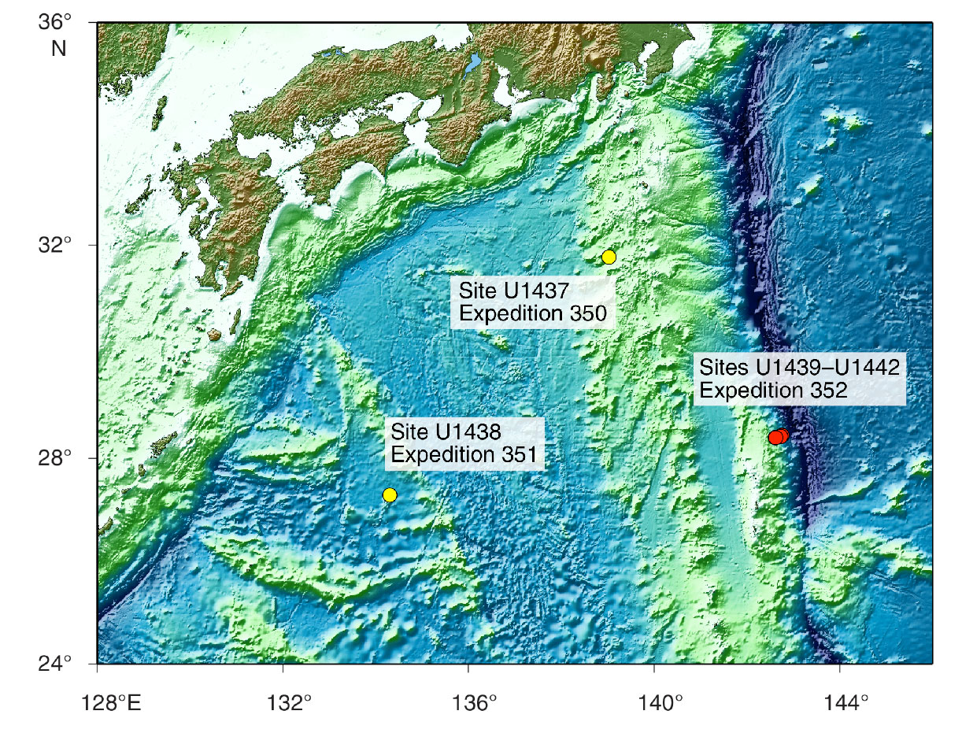
Expedition 352: drilling the Izu forearc

Slide 9

Expedition 352: Participants

Slide 10
Objectives
Obtain a high-fidelity record of magmatic evolution during subduction initiation by coring volcanic rocks down to underlying intrusive rocks, including radiometric and biostratigraphic ages.
Use these results to test the hypothesis that fore-arc basalt lies beneath boninites and to understand chemical gradients within these units and across their transitions.
3. Use drilling results to understand how mantle melting processes evolve during and after subduction initiation.
4. Test the hypothesis that the fore-arc lithosphere created during subduction initiation is the birthplace of supra-subduction zone ophiolites.

Slide 11
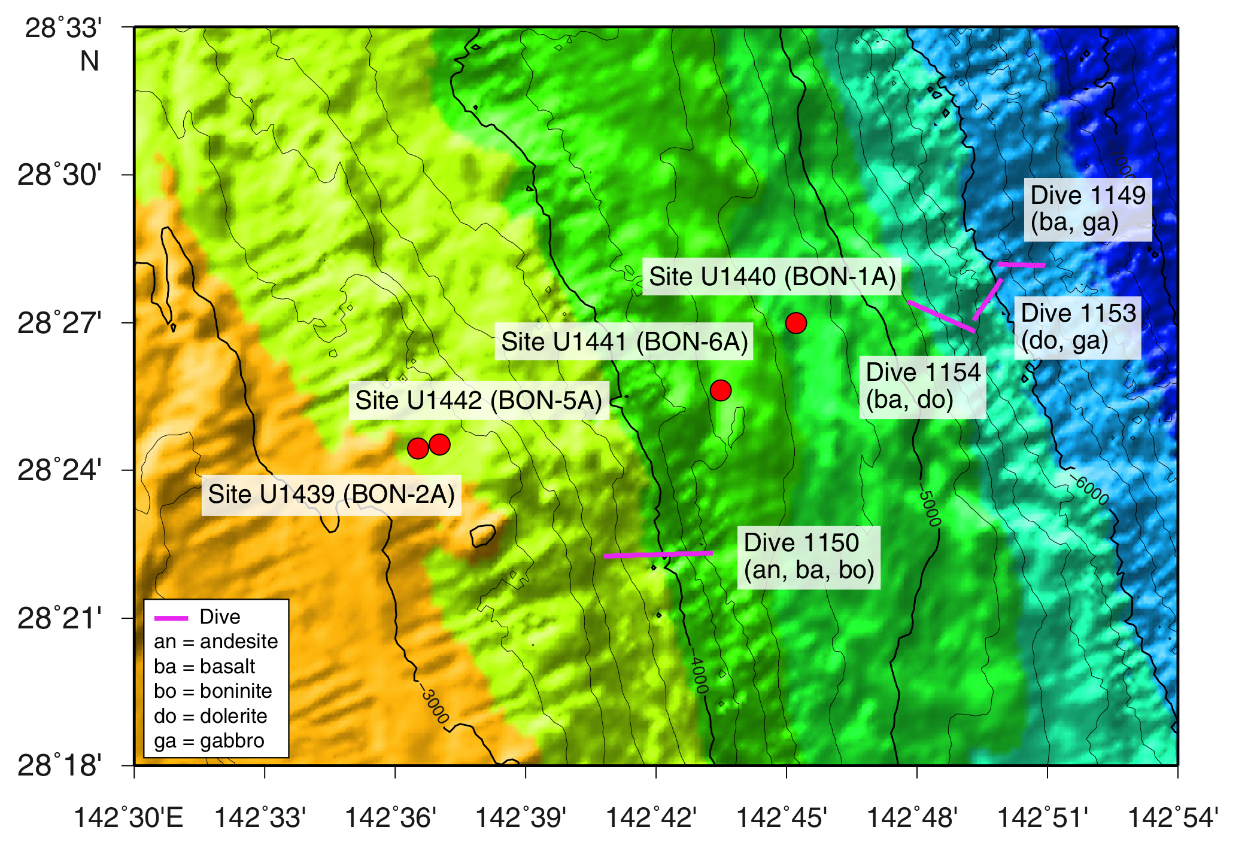
Expedition 352: Location
Note locations of Shinkai 6500 manned submersible dives.
Ga = gabbro
Ba = forearc basalt
Do = dolerite
Bo = boninite
(Ishizuka et al., 2011)
4 drillsites sampled ~20 km across the forearc

Slide 12
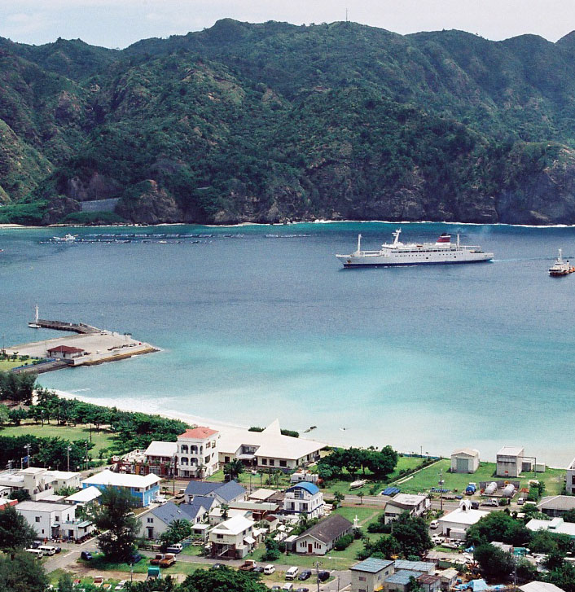
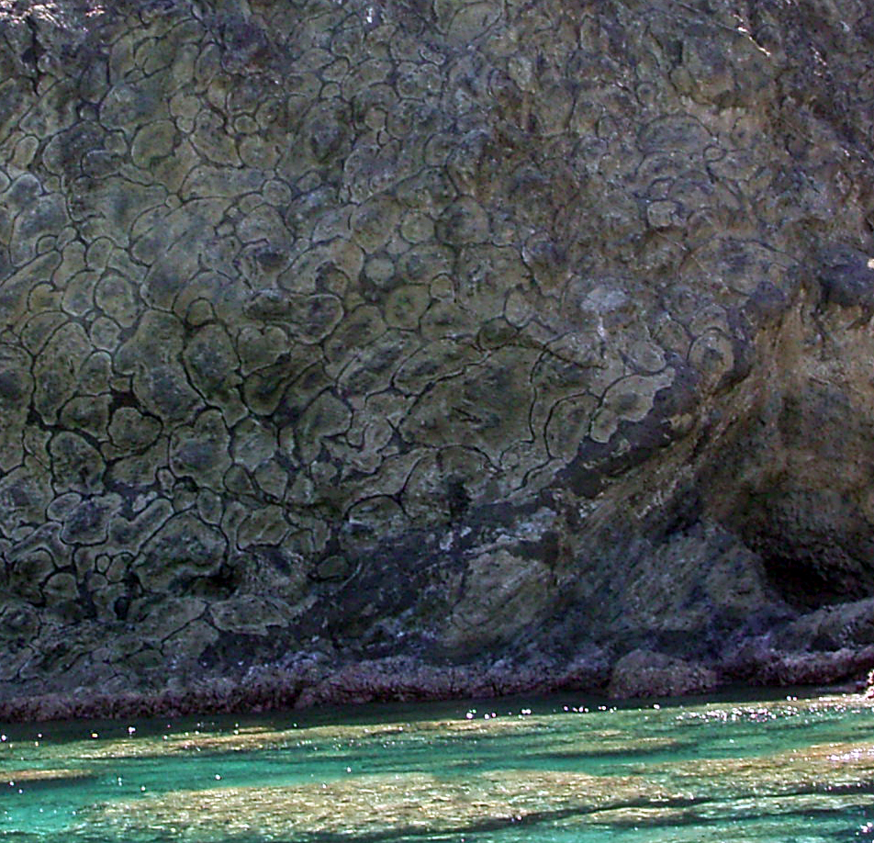
Just to the west of the 352 drilling transect is Chichijima,
type locality of boninite
Futani harbor, Chichijima
Boninite pilows on seacliff

Slide 13
Two pairs of sites recovered >1200m of basement:
U1440, U1441 (Deeper, nearer the trench) recovered fore-arc basalts (FAB)
U1439, U1442, (Shallower, closer to trench) recovered boninites

Slide 14
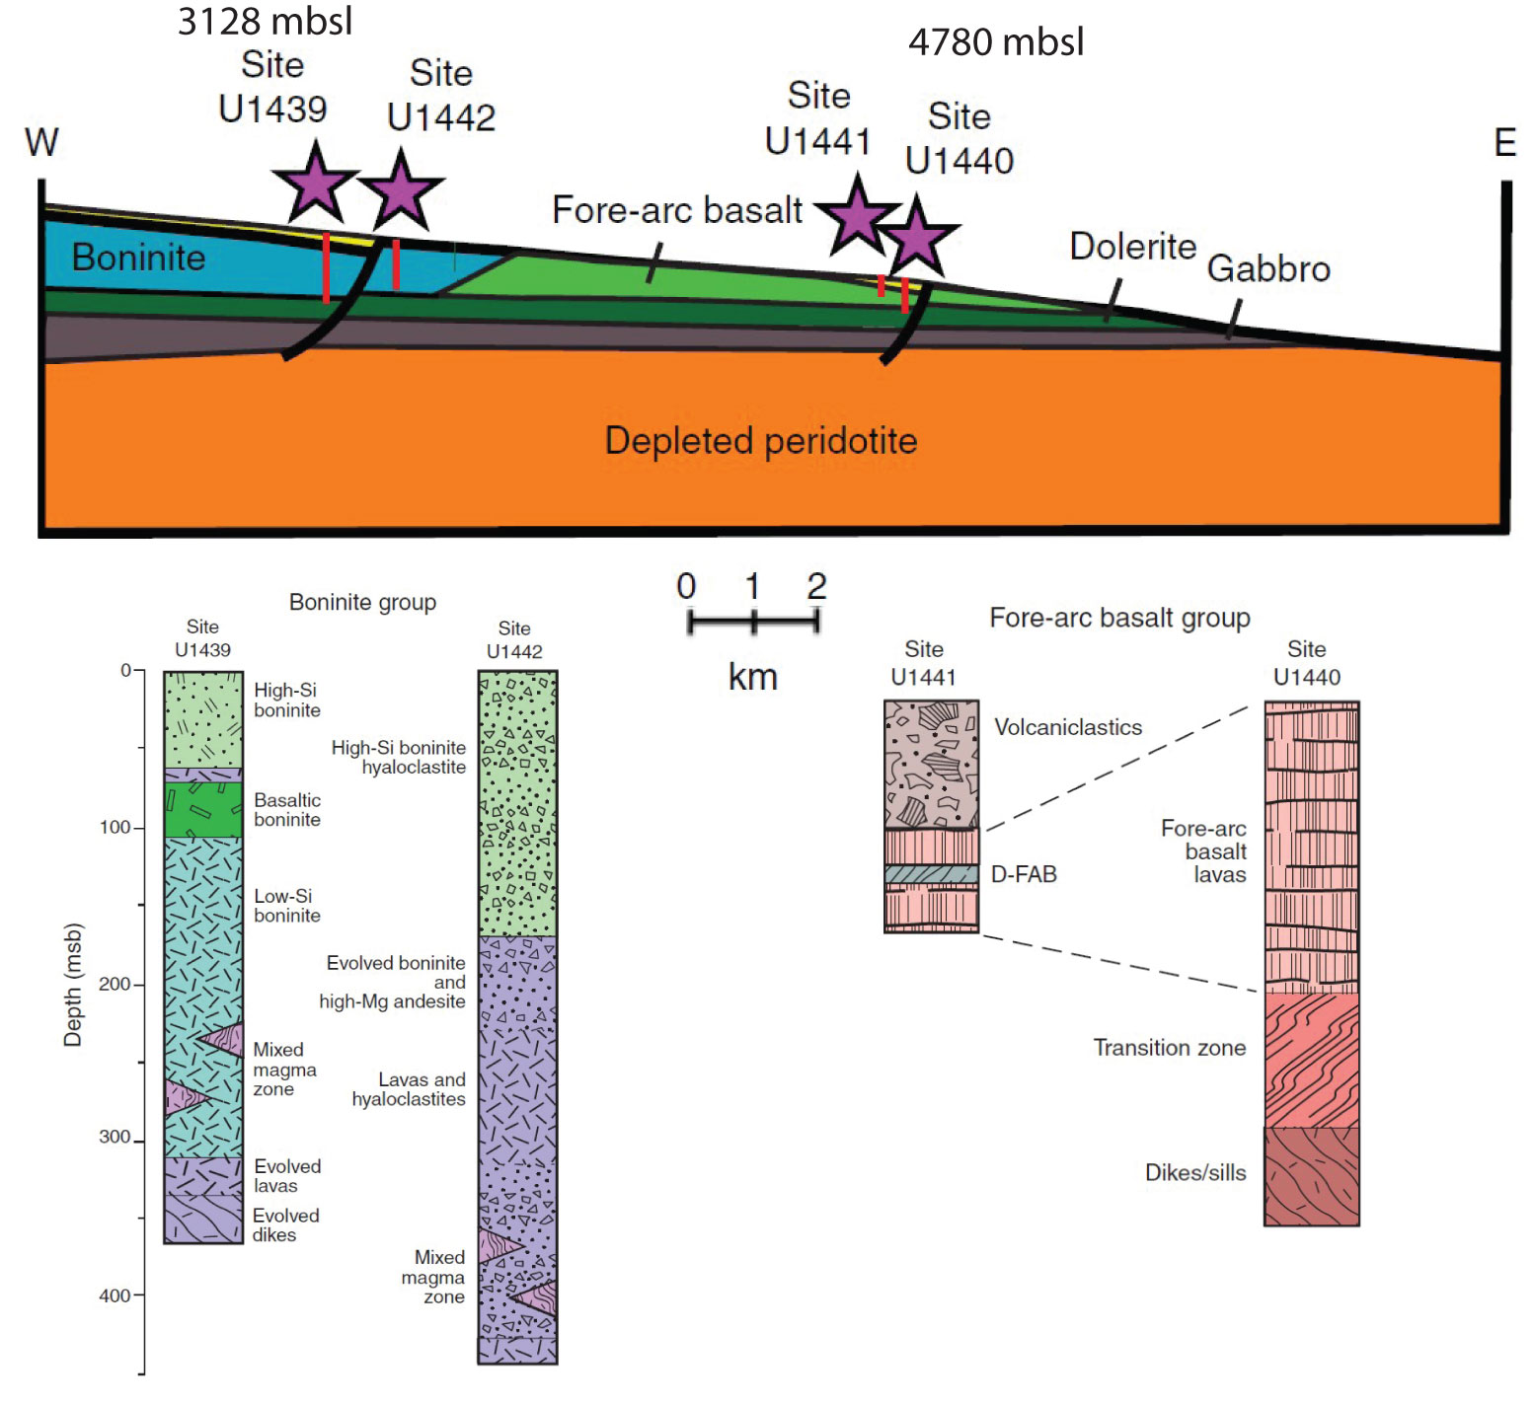

Slide 15
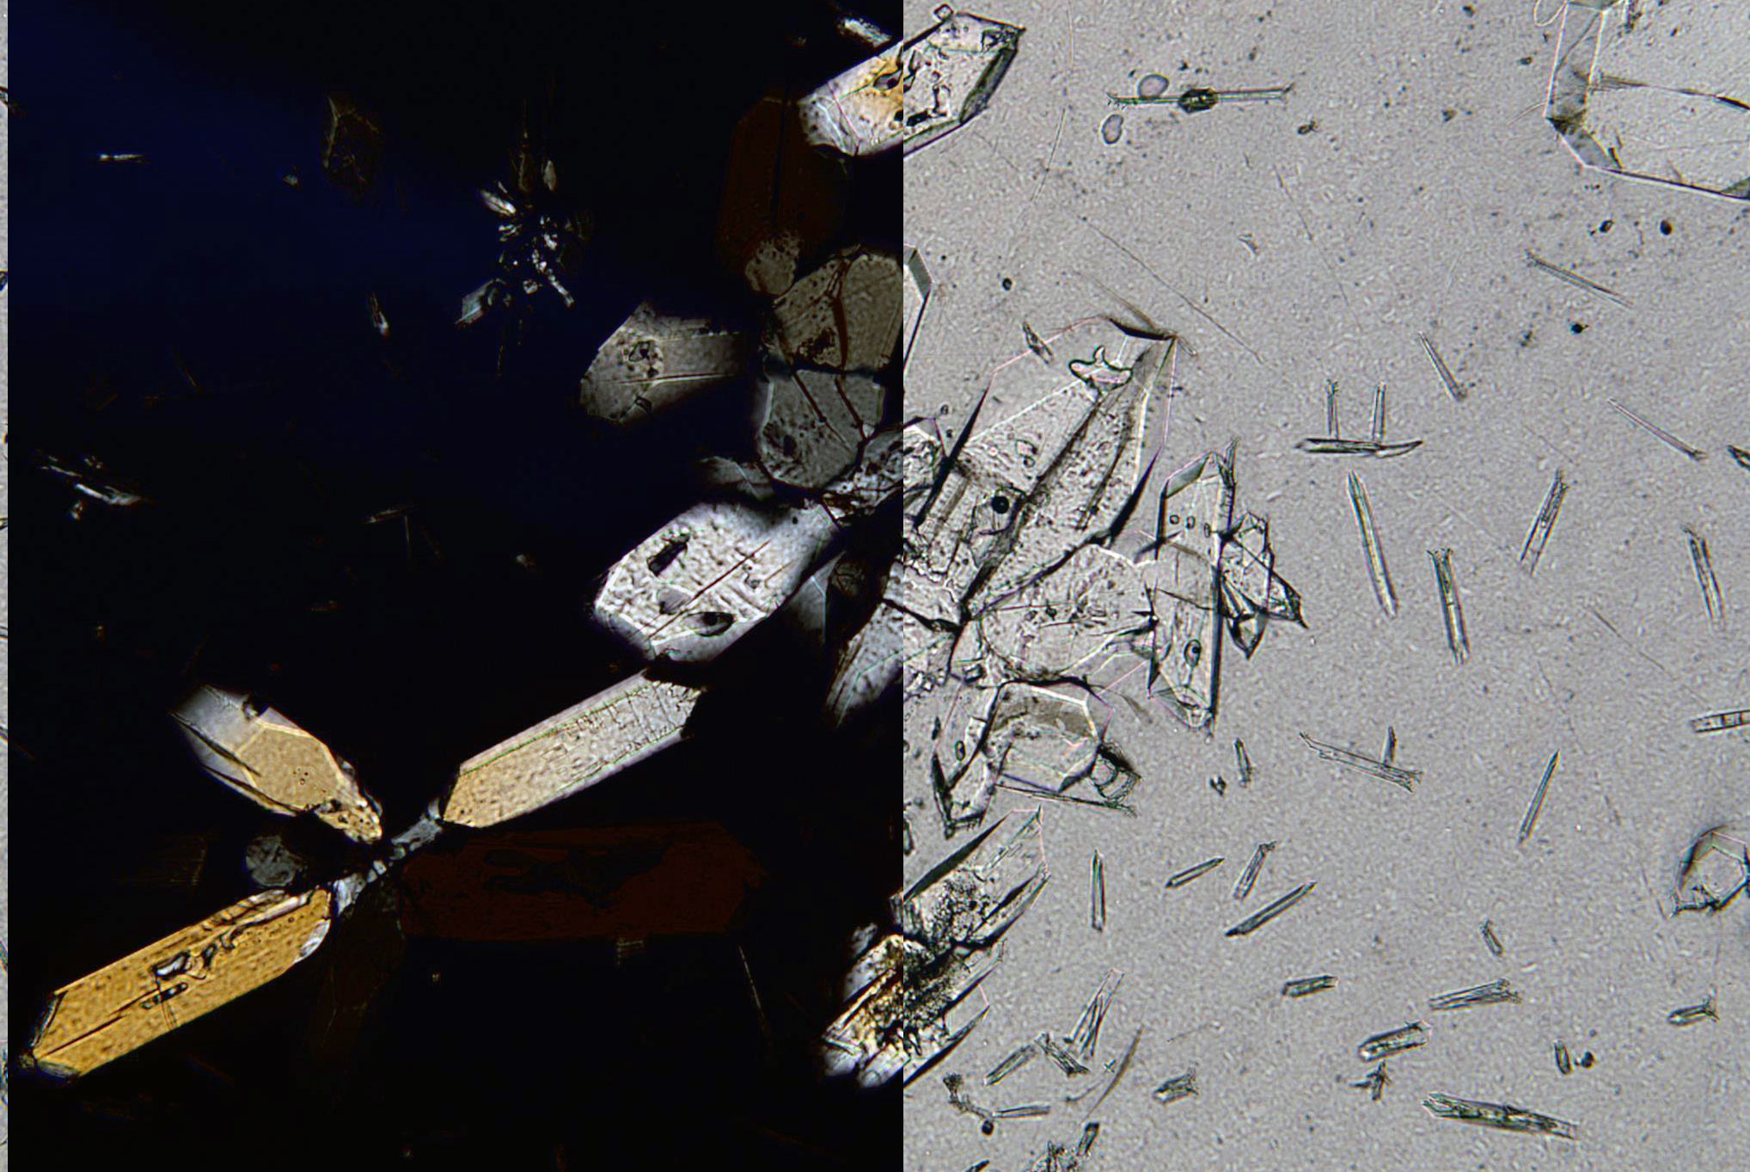
Boninite
xpl
ppl
0.25mm
U1439A_21X: SiO₂=56 wt %; MgO=16.65 wt. %, TiO₂ = 0.17 wt %
OPX phenocrysts and microlites in glass

Slide 16
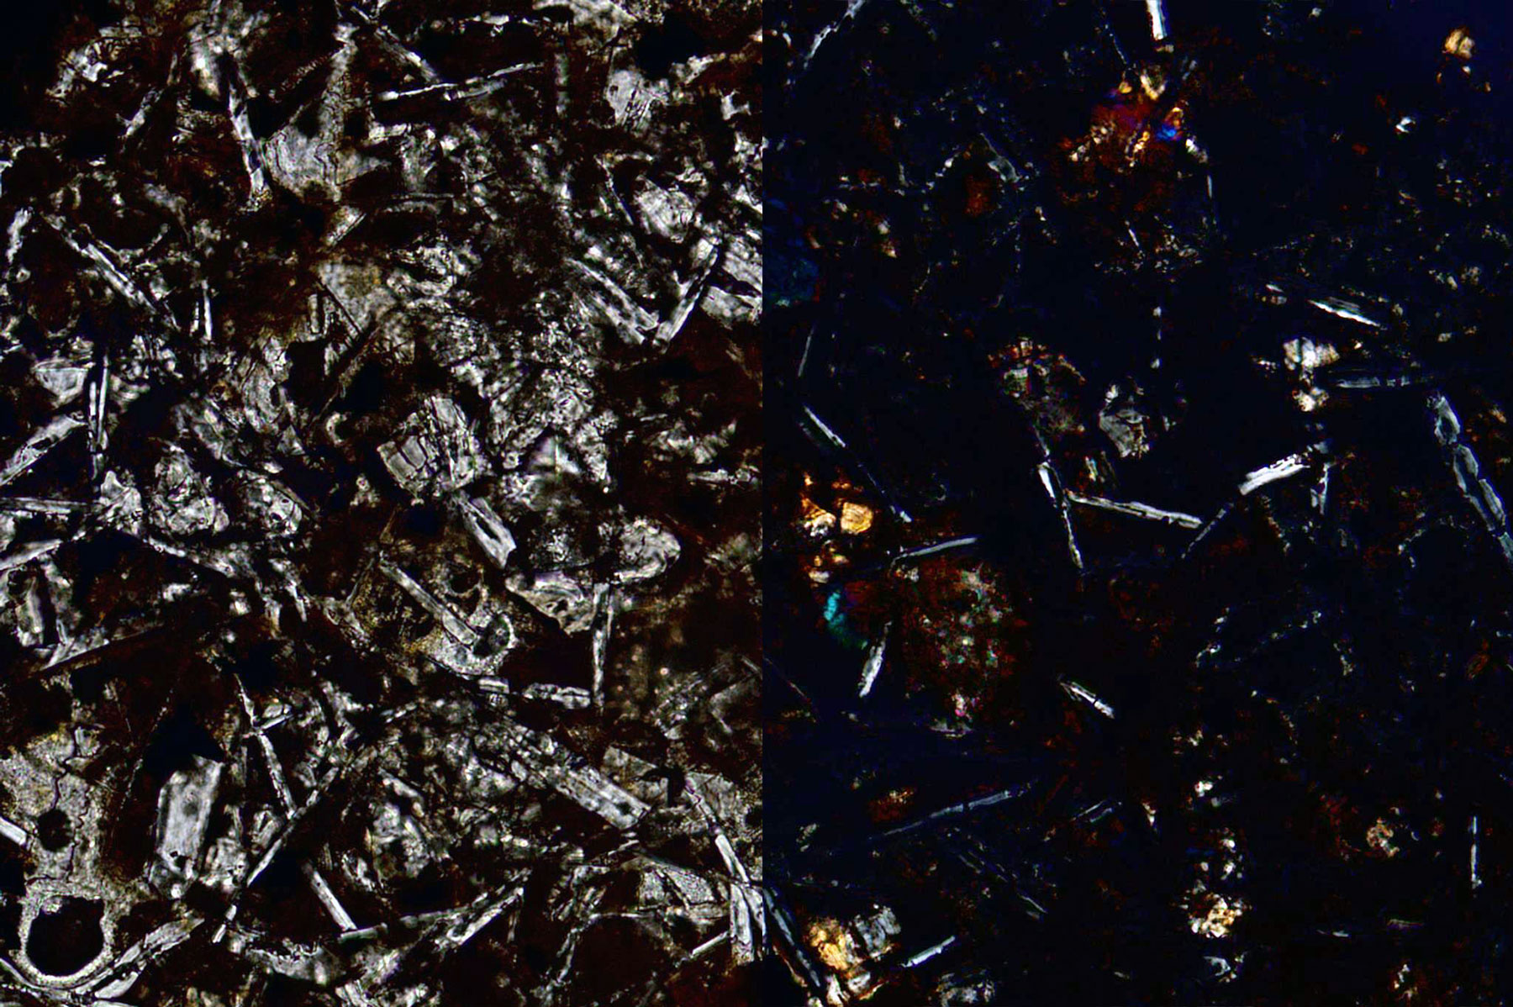
Forearc basalt (tholeiite)
0.1 mm
ppl
xpl
U1440A_13X etc. is an aphyric basalt. SiO2=49.5 wt. %, MgO = 6.8 wt %, TiO2=0.99 wt %. It is a FAB consisting entirely of plagioclase, augite, magnetite, and altered glass.

Slide 17
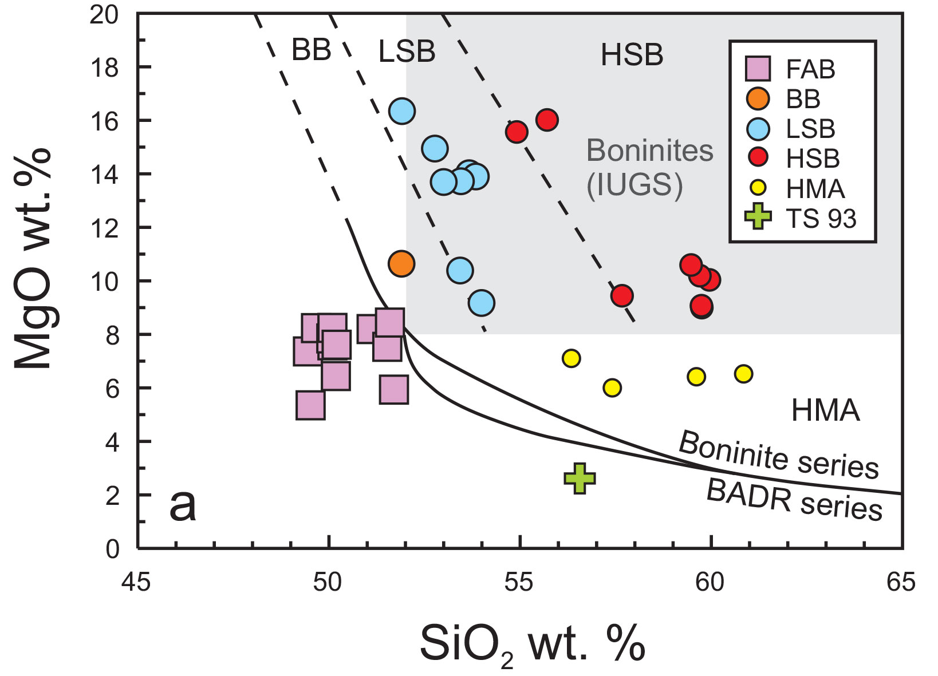
Whole-rock geochemistry of Expedition 352 samples
FAB

Slide 18
Drilling Summary: Boninite Sites
Wide range of boninite types:
High-Si boninites (H)
Low-Si boninites (L)
Basaltic boninites (B)
Evolved boninites (HMA)

Slide 19
Drilling Summary: FAB Sites
Petrographcally similar to MORB
Depleted Fore-arc Basalt (D-FAB)
Depleted in incompatible trace elements (<20ppm Zr)
.
Less fractionated; a few cpx-plag microphenocrysts
At least five separate doleritic intrusions with no lavas over that interval.
Interpreted as a sheeted dyke complex by analogy with ophiolite and ocean drilling upper crustal sections.
FAB

Slide 20
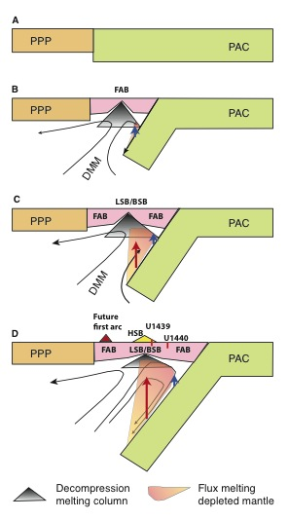
Interpretation: Initiation and Evolution of the Subduction Zone
>51 Ma
50-51 Ma
Results demonstrate a build-up of subduction component and depleted mantle as subduction proceeds
~45 Ma
PPP= Proto-Philippine Sea Plate
PAC= Pacific Plate
Pink = New oceanic crust

Slide 21
Preliminary conclusions
Obtain a high-fidelity record of magmatic evolution during subduction initiation by coring volcanic rocks down to underlying intrusive rocks, including radiometric and biostratigraphic ages.
Use the results of Objective 1 to test the hypothesis that fore-arc basalt lies beneath boninites and to understand chemical gradients within these units and across their transitions.
Use drilling results to understand how mantle melting processes evolve during and after subduction initiation.
Test the hypothesis that the fore-arc lithosphere created during subduction initiation is the birthplace of supra-subduction zone ophiolites.
Detailed record through lavas into likely sheeted dykes
Partially confirmed: two different systems (basalt and boninite) existed
Increase in mantle depletion and subduction component with time
Yes, forearcs are potential sites of ophiolite formation

Slide 22

Ongoing studies of Expedition 352 samples:
Submitted: Manuscripts on the phase chemistry, pXRF methods, and physical properties.
In the future: manuscripts reporting all aspects of core composition including glass chemistry (matrix and inclusion), isotopes of all varieties (radiogenic, stable, and non-traditional stable), experimental petrology, detailed whole-rock chemistry, sulfur speciation, Fe speciation, and trace elements in mineral phases. Magnetic properties,paleomag., and structural geology studies also are in the works.

