Slide 1


The Changing Landscape of Open Access Publishing in the Geosciences
2016 GSA Conference Denver, CO
Amanda Bielskas, Columbia University Shaun Hardy, Carnegie Institution for Science

Slide 2
Introduction: Global Open Access Trends
⅔ of the world’s journals offer an immediate OA option of some kind.
Just under ½ of all journals across the world have adopted the hybrid model.
Journals with an immediate Gold OA model accounted for just under 17% of global articles in 2014.
A total of 19% of global papers published in subscription-based journals in the past two years (2013-2014) usually become freely accessible within 12 months - mainly via subject repositories like PubMedCentral.
When we take Gold, Green and Delayed OA together about 18% of articles published in the last 2 years (2013-2014) were freely accessible upon publication.
From: Universities, U. K. (2015). Open access factsheet series: monitoring the transition to open access [Internet]. London: Universities UK.

Slide 3
Introduction: Open Access Definitions
{
Gold OA | All content immediate free to read (authors usually pay APC)
Hybrid OA | Authors pay to make individual articles in subscription journals free to read
Delayed OA | All content becomes free to read after some period of time (6-48 months)
Green OA | Self-archiving/posting in open repositories
Immediate OA

Slide 4
Introduction: Defining “Geosciences”
Web of Science & JCR | Scopus | GeoRef | DOAJ
Geology Geochemistry & Geophysics Geosciences, Multidisplinary Mineralogy Crystallography Paleontology Environmental sciences Soil science Engineering,geological Oceanography Meteorology & Atmospheric Sciences | Earth and Planetary Sciences | OA Source List: “Geological journals/series” “Related disciplines” Excluded “General science” | Geology (includes Mineralogy & Paleontology) Geophysics Geomagnetism Crystallography Environmental Sciences Oceanography Meteorology, Climatology

Slide 5
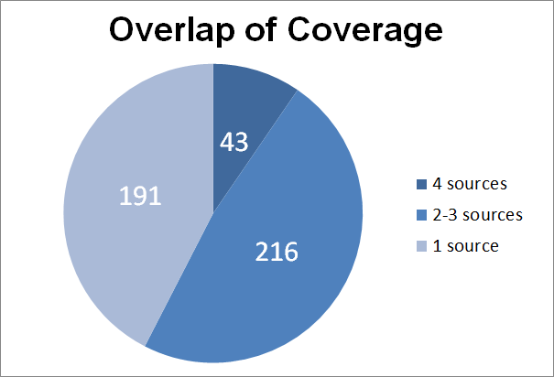
Introduction: Defining “Geosciences”
450 OA “geoscience” journals
(listed in one or more sources)
 | Titles included | Unique titles
WoS | 142 | 0
GeoRef | 187 | 51
Scopus | 259 | 21
DOAJ | 305 | 119

Slide 6
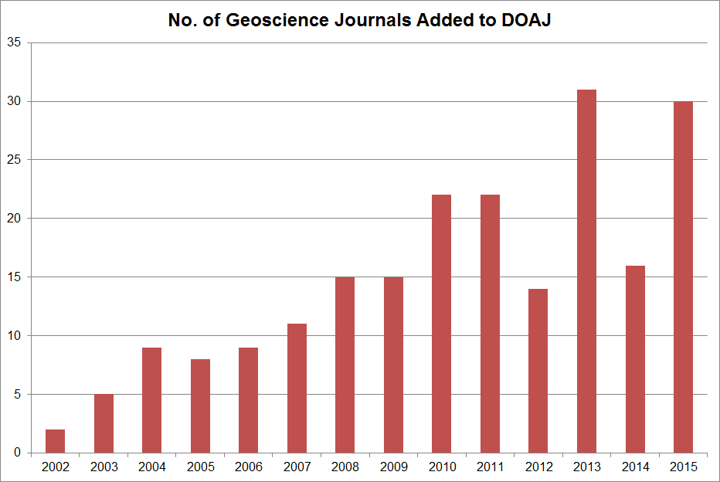
Trends, 2000-2015: OA geoscience journals
DOAJ launched
DOAJ relaunched with tighter inclusion policies

Slide 7
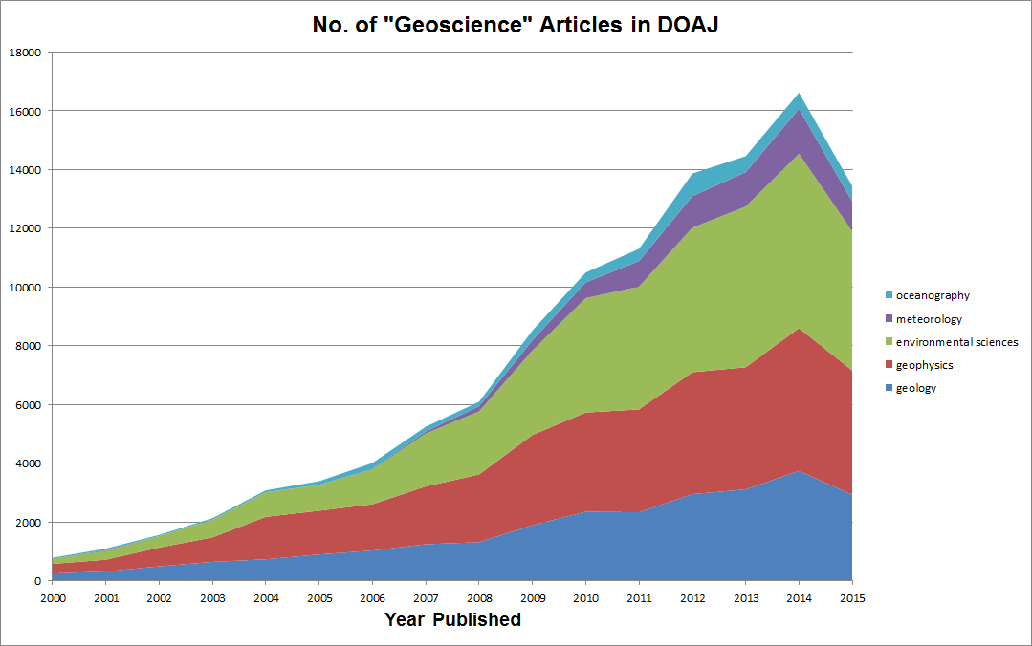
Trends, 2000-2015: OA Geoscience Articles
*not cumulative - articles may appear in more than one category
DOAJ relaunched with tighter inclusion policies

Slide 8
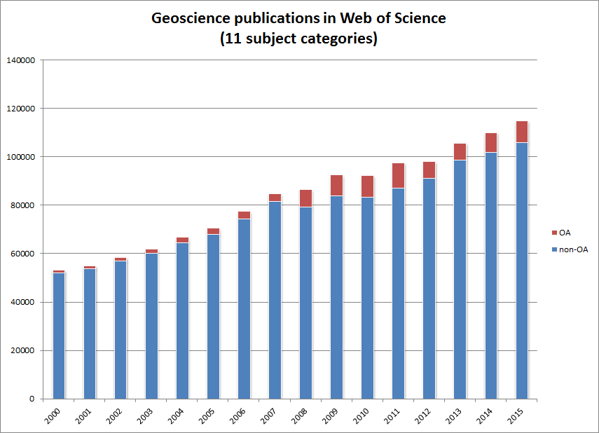
Trends, 2000-2015: OA Geoscience Articles

Slide 9
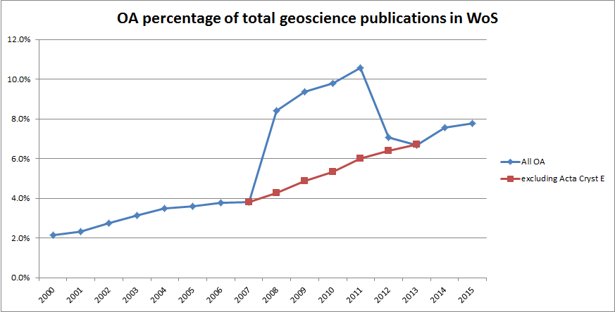
Trends, 2000-2015: OA Geoscience Articles

Slide 10
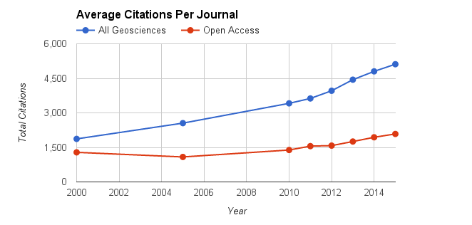
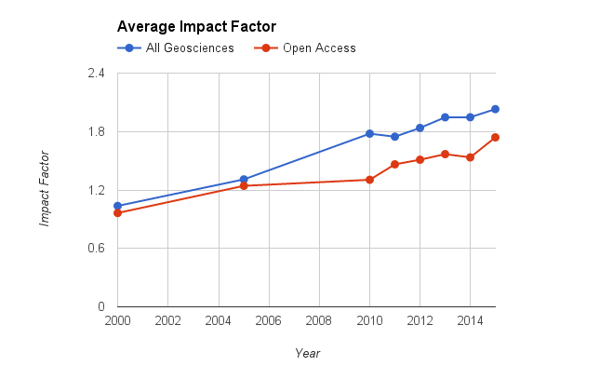
Trends, 2000-2015: Assessing Impact

Slide 11
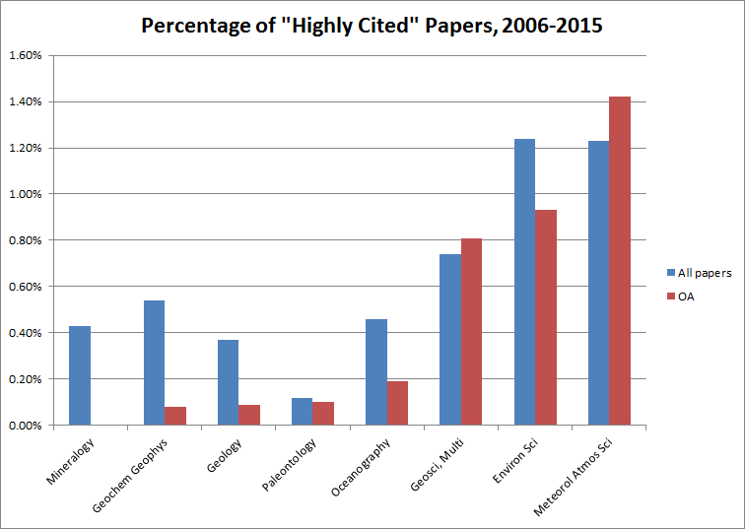
Trends, 2000-2015: Assessing Impact

Slide 12
Case Studies: Columbia & Carnegie: Profiles
Geosciences at Columbia University | Geosciences at Carnegie Institution for Science
Department of Earth & Environmental Sciences Earth Institute Lamont-Doherty Earth Observatory 200 Ph.D. level researchers & 80-90 graduate students Center for International Earth Science Information Network (CIESIN) International Research Institute for Climate and Society (IRI) A number of other affiliated institutes, centers, and research areas such as Earth and Environmental Engineering, Climate Center, Water Center, many Sustainability programs and Institutes | Department of Terrestrial Magnetism Geophysical Laboratory 60 staff/research scientists 40-50 postdocs & research associates Geosciences Astronomy & Astrophysics Physics & Materials Science

Slide 13
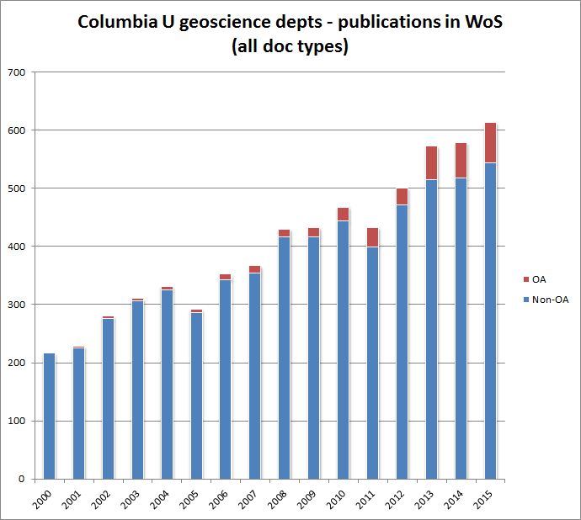
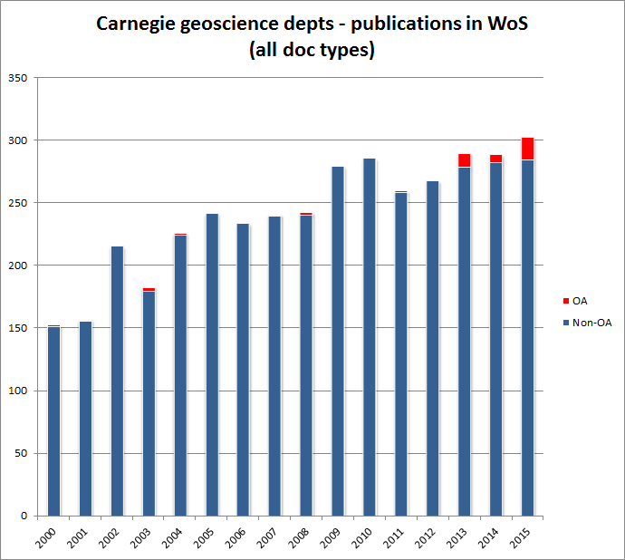
Case Studies: Columbia & Carnegie

Slide 14
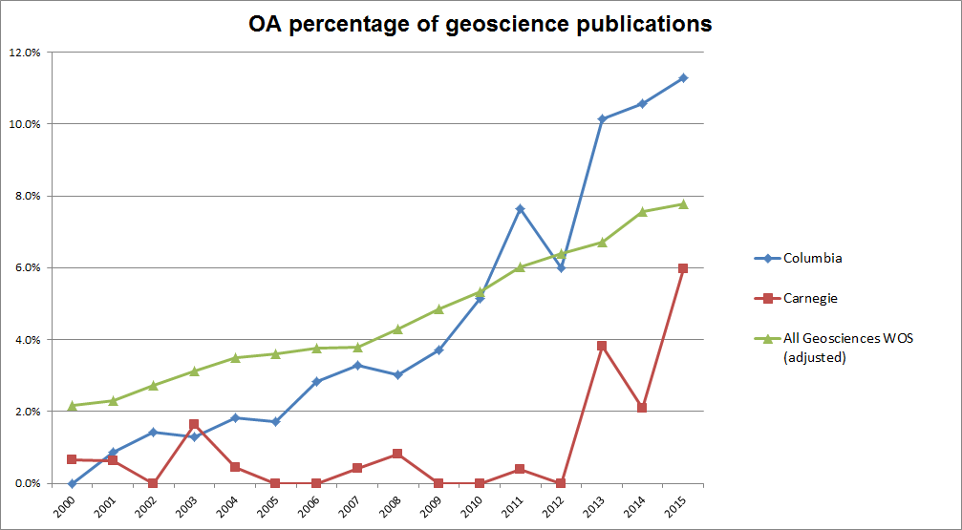
Case Studies: Columbia & Carnegie compared to OA geosciences overall

Slide 15
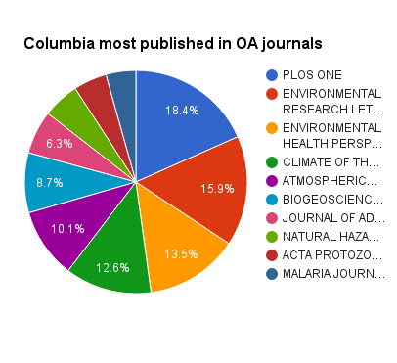
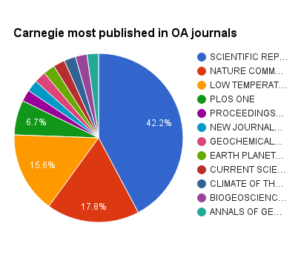
Case Studies: Columbia & Carnegie: OA journals, 2000-2015

Slide 16
Case Studies: Columbia & Carnegie
Factors influencing author uptake of OA
Cost:
Gold OA APCs: Free—$3,000
Hybrid Journal OA APCs: $250/page—$5,000
Funding:
Publication funds from institutions
The ability to pay APCs with grant funds
Impact/Familiarity:
Hybrid OA uptake

Slide 17
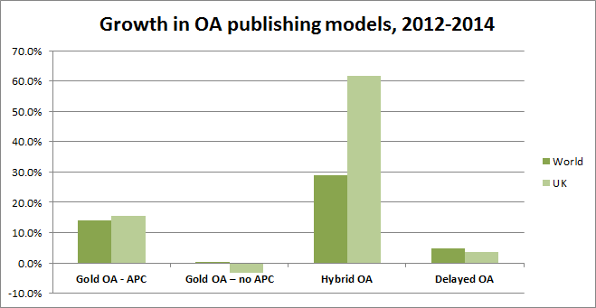
Hybrid Journal Uptake: All Fields
Hybrid OA: 6.5%
Gold OA: 11.4%
}
% of all 2014 journal articles by UK authors
“Of the immediate OA models, uptake of the Gold-Hybrid option grew the fastest globally and in the UK [from 2012 to 2014]”
“UK authors tend to choose more highly-cited journals for their articles compared to the world average. This may in part explain the higher take-up in the UK compared to the world average for hybrid journals.”
Source: Universities UK, Monitoring the Transition to Open Access (August 2015)

Slide 18
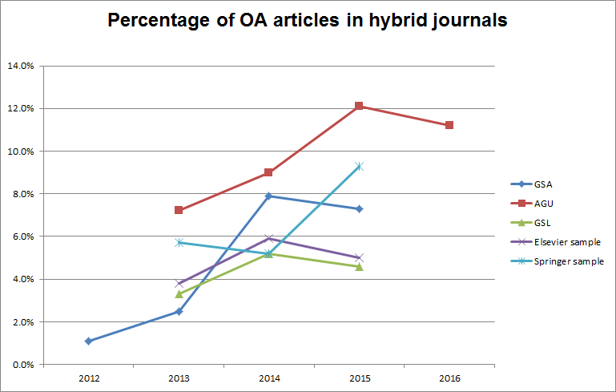
Hybrid Journal Uptake: Geosciences
Publisher-provided data (GSA, AGU, GSL); our 10-journal sample (Elsevier, Springer)

Slide 19
Conclusions:
No single bibliographic source identifies all OA publications
The number of OA geoscience journals is increasing (new journals and journals converting to OA)
The % of OA journal articles in the geosciences is increasing
No significant differences in impact factors between OA and geoscience journal overall is evident
Adoption of Gold OA by Columbia and Carnegie authors is increasing, but still accounts for a small % of overall output
Geoscience publishers are seeing growing uptake of Hybrid OA option
Hybrid OA is the fastest growing OA publishing mode globally

Slide 20
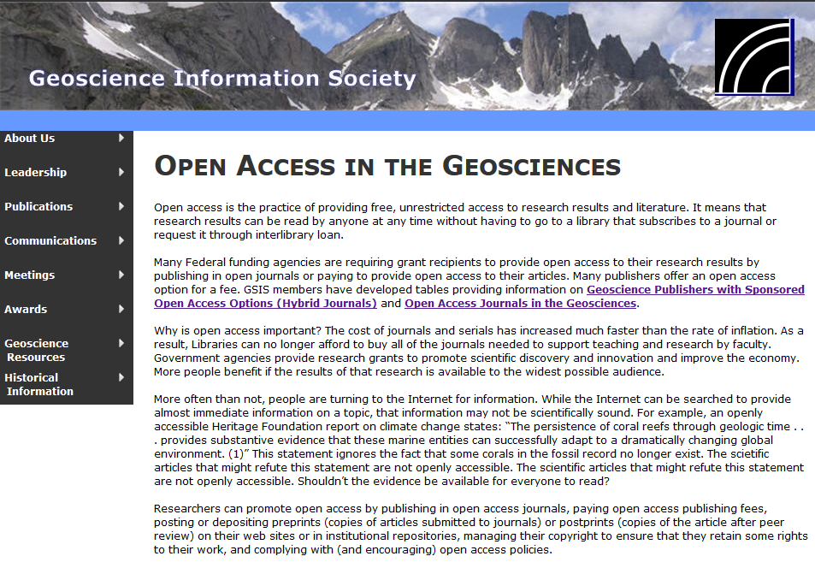
www.geoinfo.org/openaccess.html
Amanda Bielskas: asb2154@columbia.edu
Shaun Hardy: shardy@carnegiescience.edu

