Slide 1
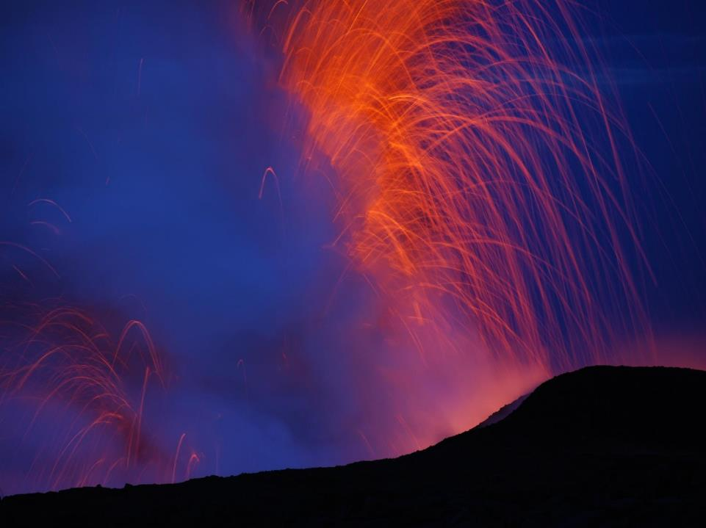

Magma supply to Kīlauea Volcano, Hawaiʻi:
Building on the foundation established by Don Swanson
Michael Poland (U.S. Geological Survey – Cascades Volcano Observatory)
Kyle Anderson (U.S. Geological Survey – California Volcano Observatory)
U.S. Department of the Interior
U.S. Geological Survey
Notes:
Good afternoon, everyone, and thank you for being here today. Perhaps the most fundamental control on a volcano’s eruptive activity is the rate of magma supply to that volcano. Of course, this parameter is exceedingly difficult to determine, as it may be continuous at some volcanoes and episodic at others, and it can only be inferred indirectly. In a general sense, magma supply can be determined by dividing a volcano’s volume by its age, but this provides little information on current conditions. The first estimate of contemporary magma supply to any volcano was made by Don Swanson at Kilauea, in 1972. Since that time, many others have built upon the foundation Don established, and we now have a picture of how magma supply to Kilauea varies over time and relates to eruptive activity. Don has continued to develop the story as well, weaving the concept into his newfound understanding of cycles of effusive and eruptive activity at Kilauea, and possibly even relating supply variations at Kilauea to the eruptive patterns of Mauna Loa.

Slide 2
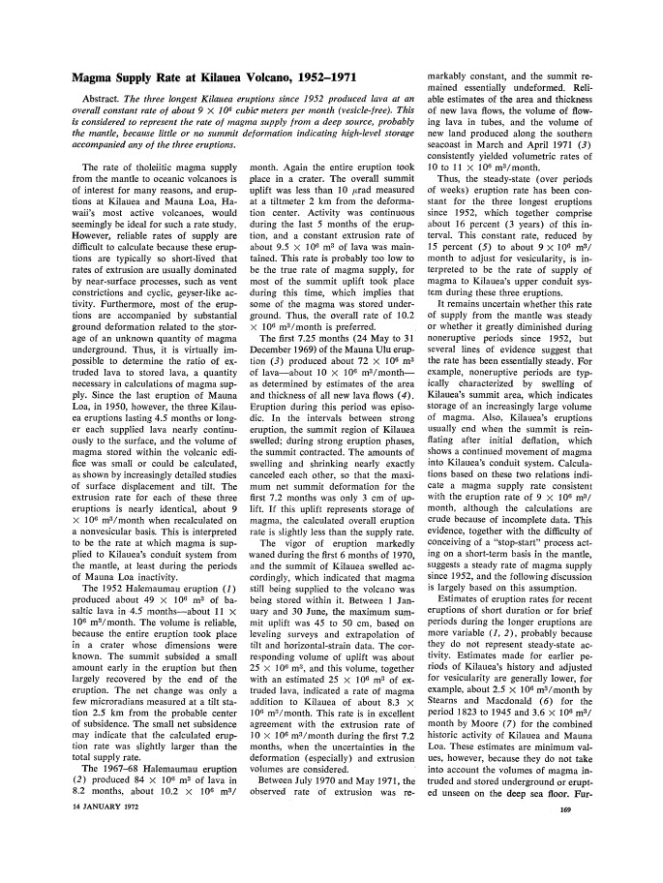

Steady magma supply, 1950s–2002
Swanson, D. A. (1972), Magma supply rate at Kilauea volcano, 1952-1971, Science, 175(4018), 169-170.
First estimate of rate of magma supply from the mantle to Kīlauea
0.11 km³/yr
GSA Annual Meeting, September 25, 2016
2/13
Notes:
This is the article that started exploration into Kilauea’s magma supply, which Don published in Science in 1972. It followed Don’s first stint at the Hawaiian Volcano Observatory, were he observed both summit and rift eruptive activity at Kilauea and used a number of different datasets to estimate a supply rate of 0.11 km3/yr from the mantle to the volcano.

Slide 3
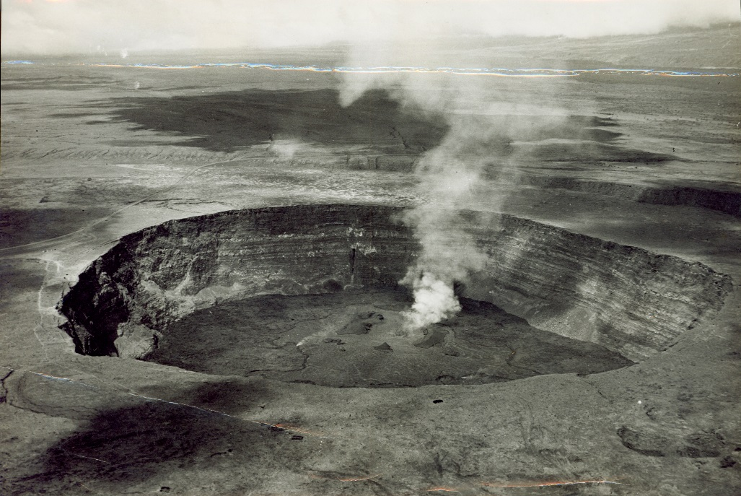
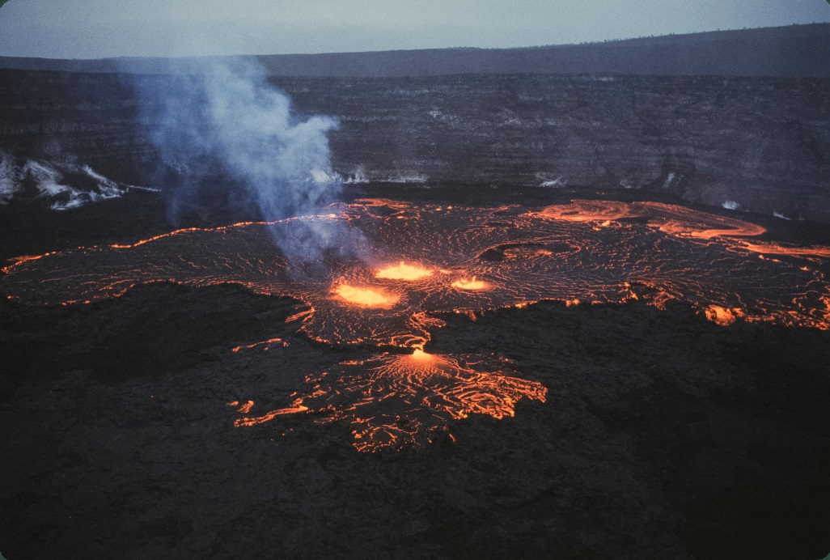
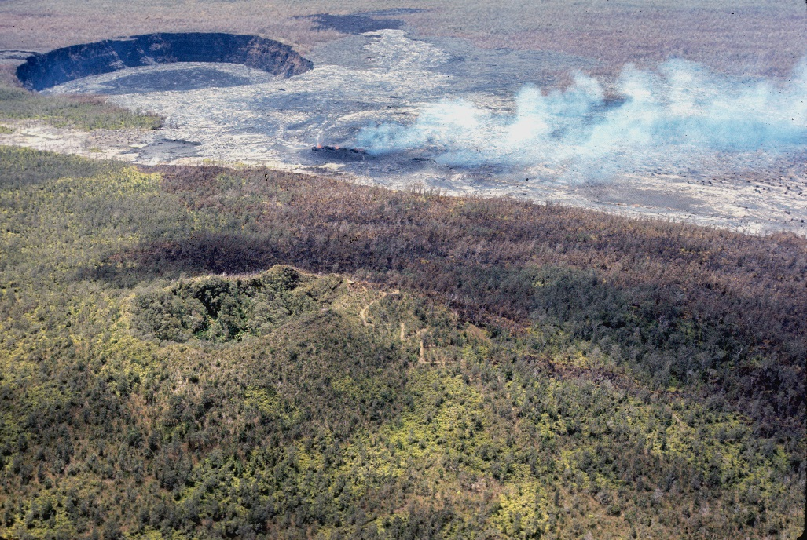
Steady magma supply, 1950s–2002
1952 summit eruption
Photographer unknown
1967–68 summit eruption
Photo by Dick Fiske
1969 ERZ eruption
Photo by Don Swanson
GSA Annual Meeting, September 25, 2016
3/13
Notes:
Don’s method was simple but powerful. He looked at three long-term (4.5 months or longer) eruptions at Kilauea, in 1952, 1967-68, and 1969, and suggested that, because there was no summit deformation, the magma supply rate balanced the eruption rate. All three eruptions had about the same rate of lava extrusion, leading Don to suggest the magma supply rate to be 0.11 km3.

Slide 4
Steady magma supply, 1950s–2002
Time period | Supply (km³/yr) | Method | Reference
1918–1979 | 0.08 | Ratio between repose times and erupted volumes | Klein, 1982
1919–1990 | 0.09 | Effusion rate of several sustained eruptions | Dvorak and Dzurisin, 1993
1952–1971 | 0.11 | Effusion rate of three sustained eruptions | Swanson, 1972
1956–1983 | 0.09 | Average summit and rift deformation and eruption volumes | Dzurisin et al., 1984
1959–1990 | 0.06 | Average based on deformation and eruption volumes | Dvorak and Dzurisin, 1993
1960–1967 | 0.02–0.18 | Deformation-inferred refilling of summit reservoir | Dvorak and Dzurisin, 1993
1966–1970 | 0.07 | Deformation and eruption volumes | Dvorak et al., 1983
1967-1975 | 0.05–0.18 | Deformation and eruption volumes | Wright and Klein, 2008
1971–1972 | 0.08 | Deformation and erupted volumes | Duffield et al., 1982
1975–1977 | 0.07–0.16 | Microgravity and deformation | Dzurisin et al., 1980
1975-1982 | 0.08 | Deformation and erupted volumes | Johnson, 1995
1983–1984 | 0.12 | First 20 episodes of Pu`u `O`o eruption | Wolfe et al., 1987
1983–2002 | 0.12 | Pu`u `O`o eruption volumes | Heliker and Mattox, 2003
1983–2002 | 0.13 | SO₂ emissions from ERZ | Sutton et al,, 2003
1991 | 0.08 | Deformation and effusion rates | Denlinger, 1997
GSA Annual Meeting, September 25, 2016
4/13
Notes:
Since Don’s work, many other authors have attempted to constrain the magma supply rate to Kilauea using various means, usually following Don’s example of combining deformation and extrusion rate data. Don’s work is highlighted in red, and you can see that all subsequent estimates cluster around Don’s estimate. The magma supply to Kilauea would therefore appear to have been more or less constant between 1952 (and maybe even earlier) and 2002, although some short-term fluctuations might have occurred.

Slide 5
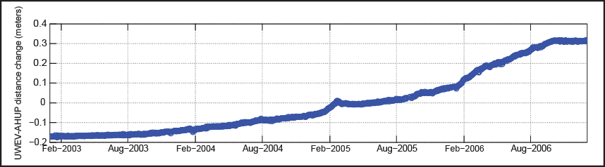
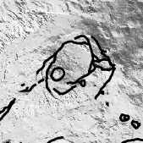
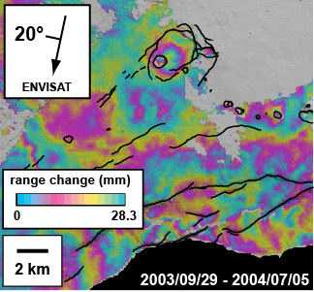
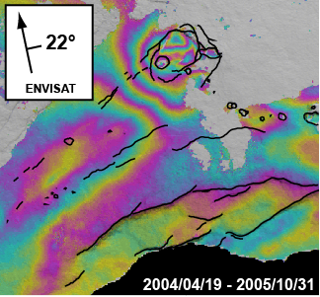
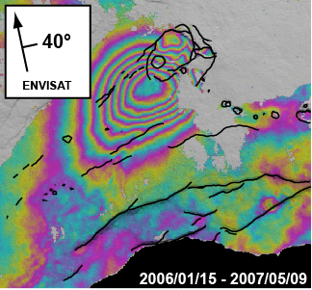
Surge in magma supply, 2003–2007
GSA Annual Meeting, September 25, 2016
5/13
Notes:
The situation changed in 2003, when a period of long-term inflation began at the summit of Kilauea, even while eruptive activity from the east rift zone continued. The rate and locus of summit deformation changed over time, with the highest rate of uplift – over 25 cm/yr – occurring in 2006. The inflation was captured by a variety of methods, including both InSAR and GPS. The inflation implies that the rate of supply exceeded the rate of extrusion. But does that mean that supply increased? Or did extrusion decrease?

Slide 6
Surge in magma supply, 2003–2007
SO₂ emissions
1900 t/d
(0.18 km³/yr)
1100 t/d
(0.11 km³/yr)
CO₂ emissions
18500 t/d
7700 t/d
GSA Annual Meeting, September 25, 2016
6/13
Notes:
The rate of lava extrusion can be inferred from measurements of east rift zone SO2 emissions. Over 2000-2004, SO2 emission rates were relatively steady. After a small “burp” associated with an extrusive event in 2005, the SO2 emissions settled on a new average that was higher than before, indicating an increase in the extrusion rate. This was consistent with heightened lava flow activity in 2005-2007, including three simultaneous ocean entries at one point. Inflation and increased lava extrusion suggested a near doubling in magma supply to the volcano. This was corroborated by CO2 emission rates, which, since CO2 degasses at great depths, should correlate with magma supply. Over 1995-2004, CO2 emission rates were relatively constant. In 2004, however, the emission rates more than doubled, consistent with an increase in magma flux to the volcano.

Slide 7
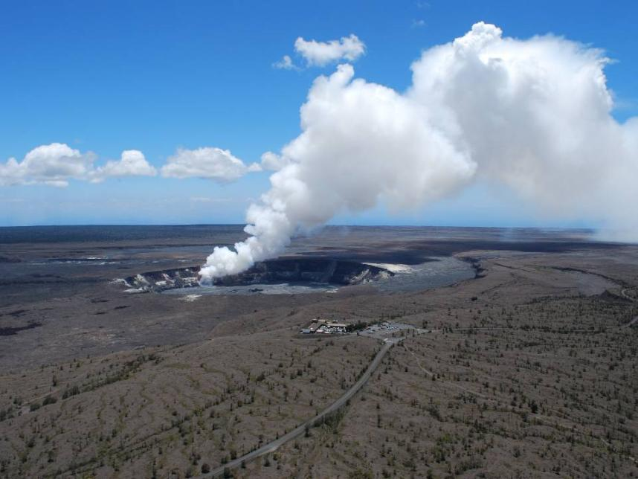
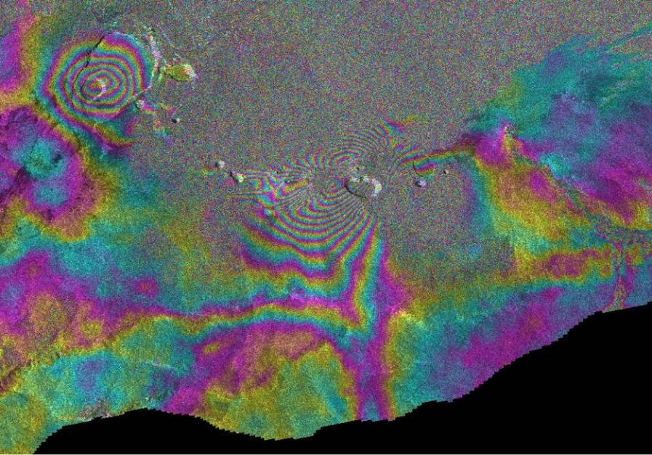
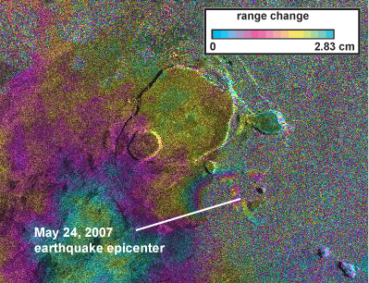
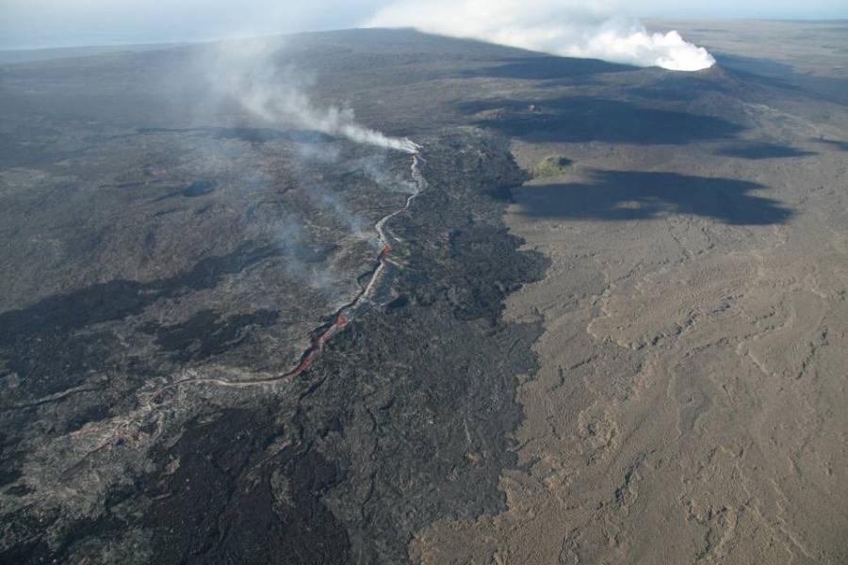
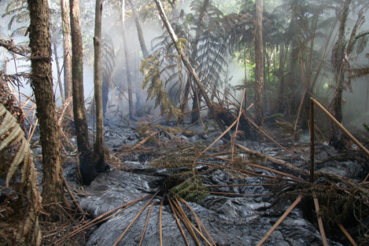
Surge in magma supply, 2003–2007
June 17, 2007, 7:30 AM
June 17, 2007, 8:00 AM
June 17, 2007, 2:00 AM
March 19, 2008
July 21, 2007
May 24, 2007
April 12 – June 21, 2007
range change
0
2.83 cm
5 km
GSA Annual Meeting, September 25, 2016
7/13
Notes:
The increased supply to Kilauea had an important impact on eruptive activity that began to manifest in 2007. The high rate of inflation stressed faults around the caldera, leading to a pair of M4 earthquakes in May 2007 (see interferogram). A month later, the summit magma reservoir ruptured, and a dike intruded the east rift zone. As the intrusion seemed to be losing steam, 6 hours after its onset, the flank started to move in a slow earthquake. The east rift zone opening that this motion promoted reinvigorated the intrusion, and a new dike segment was emplaced and eventually erupted. In July 2007, a fissure eruption occurred on the east rift zone, eventually localizing on a vent that became the new locus of lava effusion until 2011, and the summit eruption of Kilauea, which started in March 2008, might also have been caused by the large influx into Kilauea’s magmatic system. The increase in magma supply clearly had a profound impact on Kilauea’s eruptive activity.

Slide 8
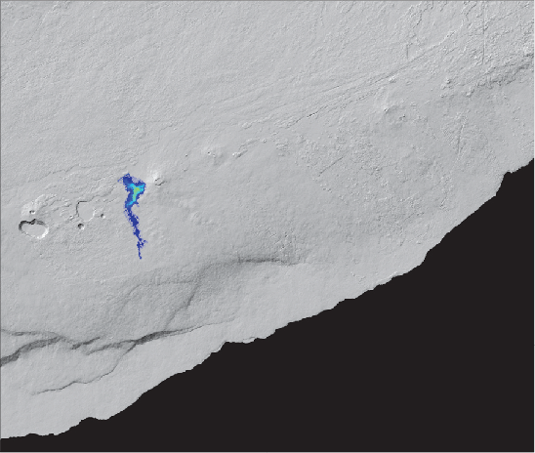

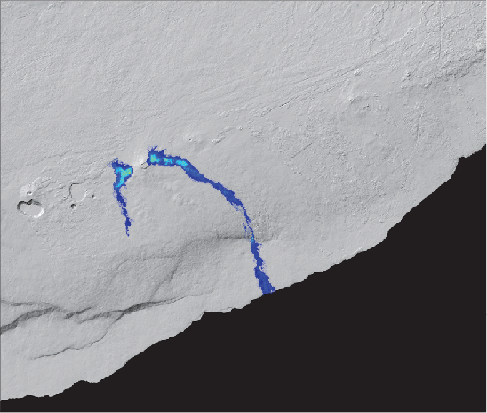

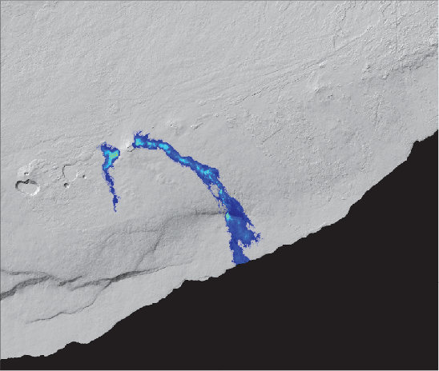







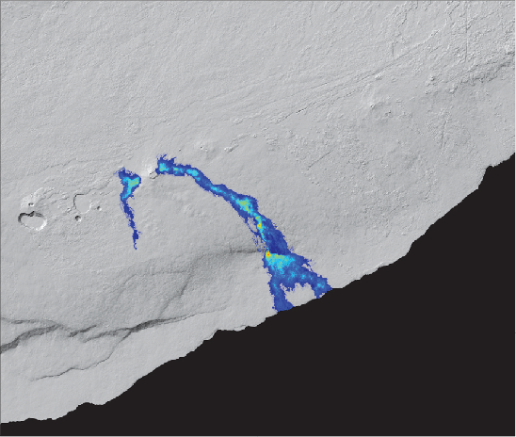
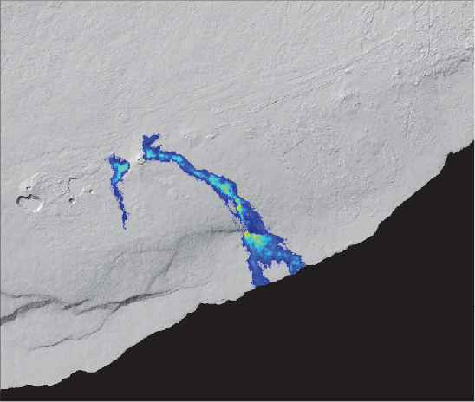
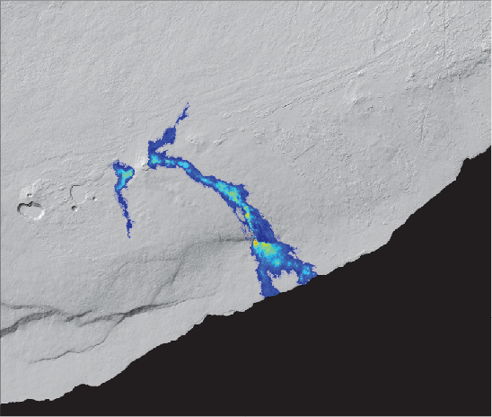

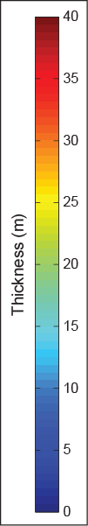
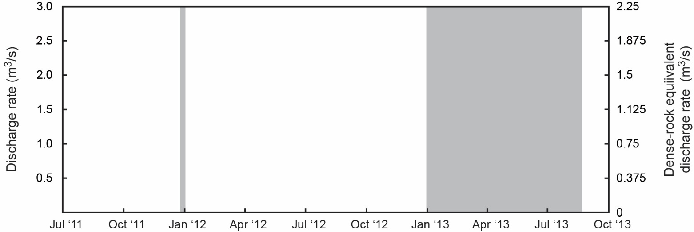
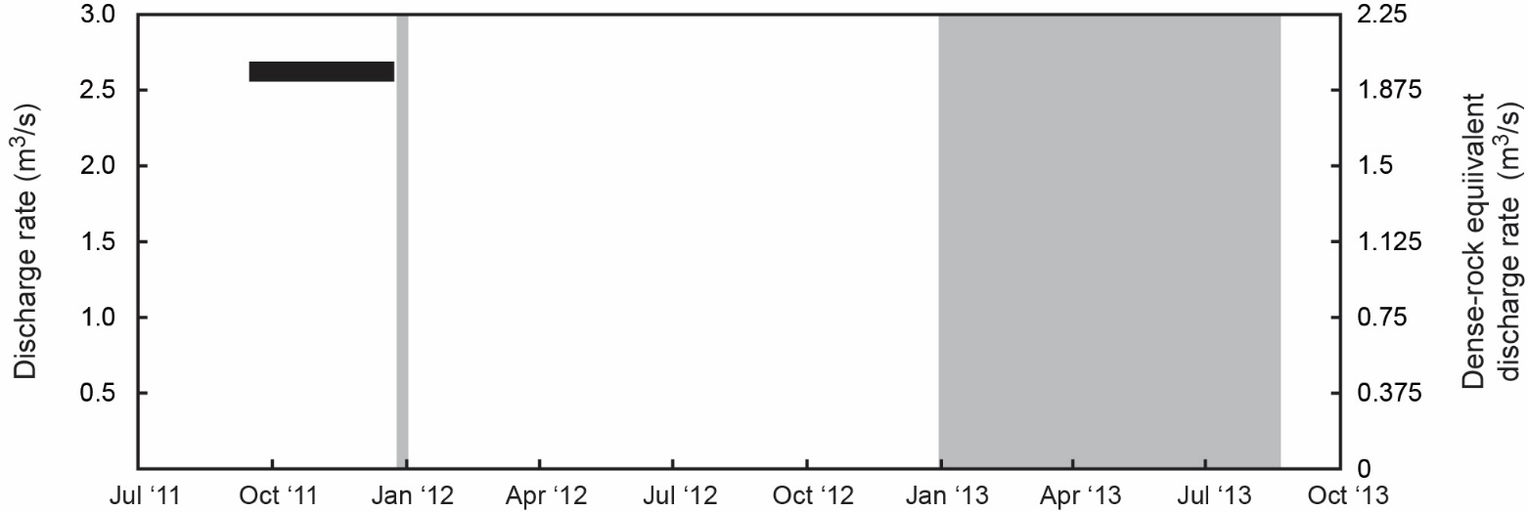
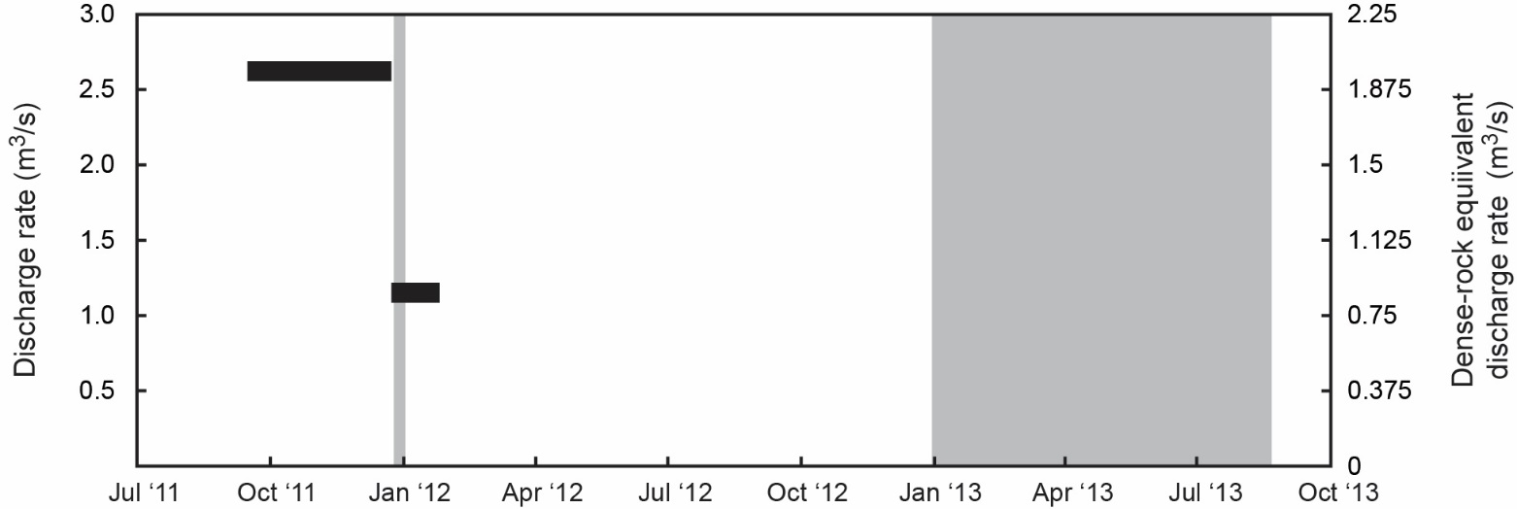
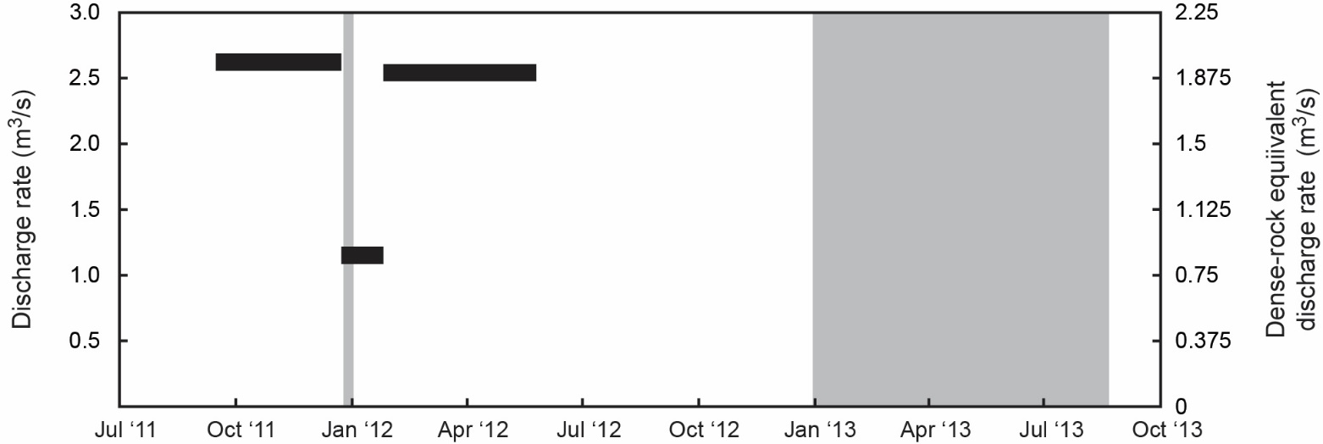
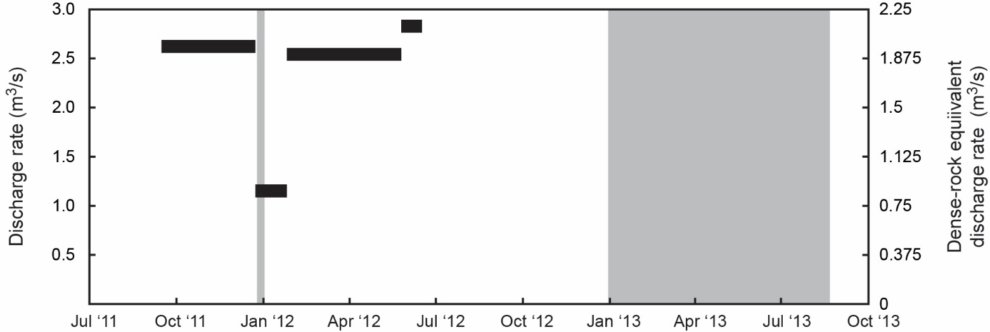
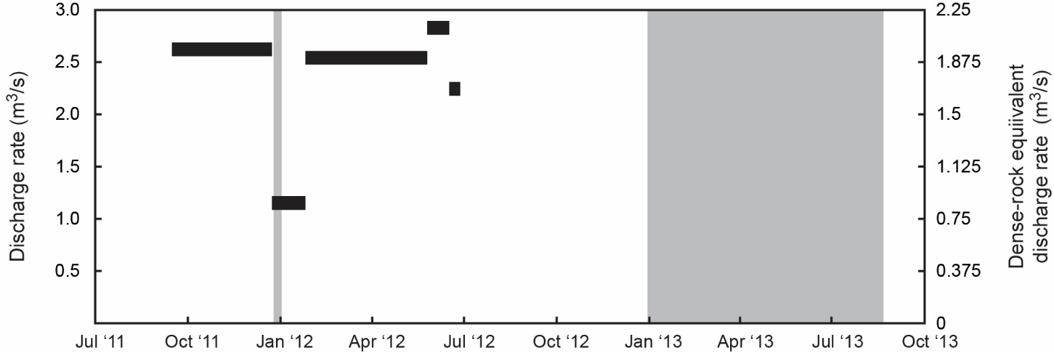
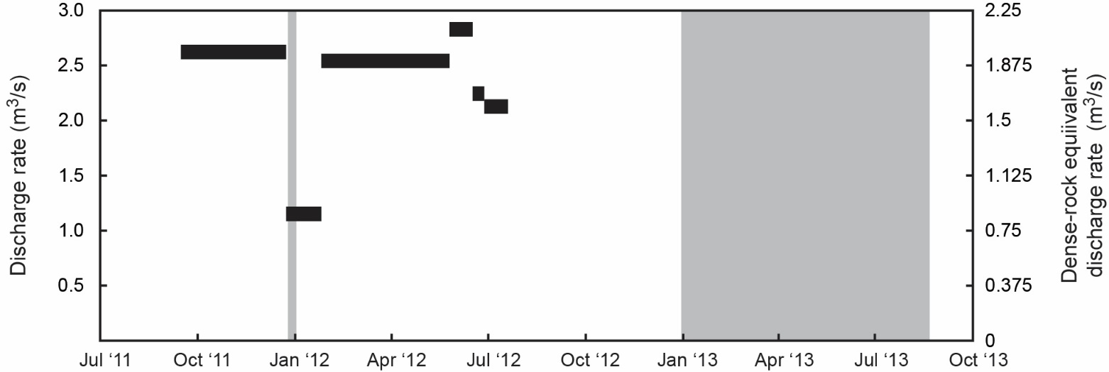

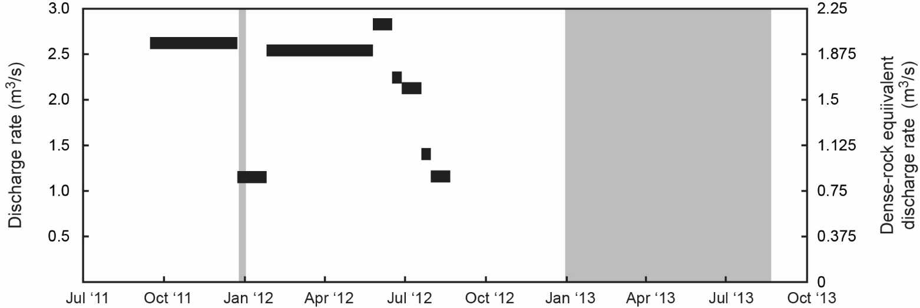

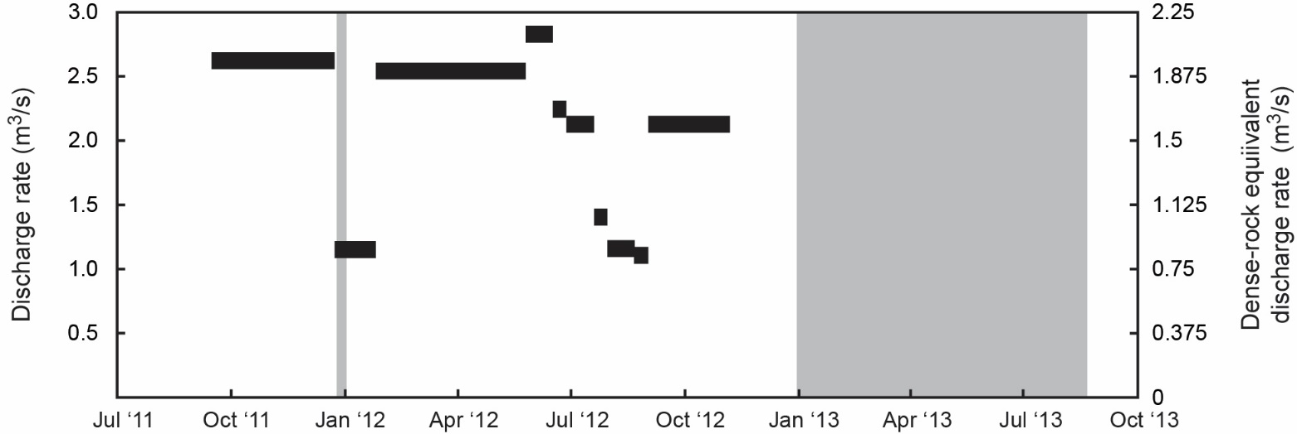
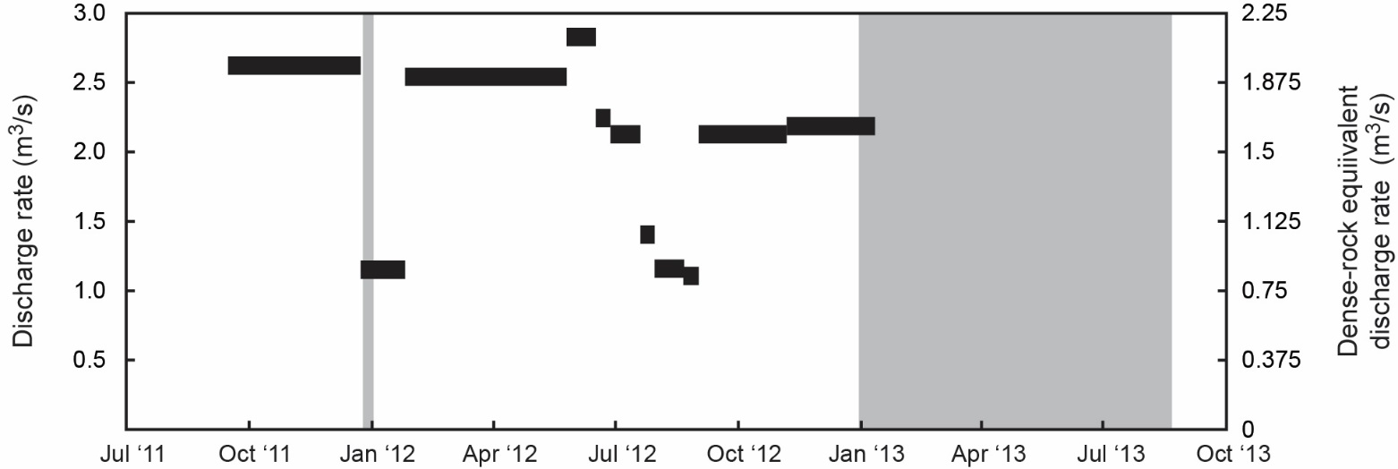
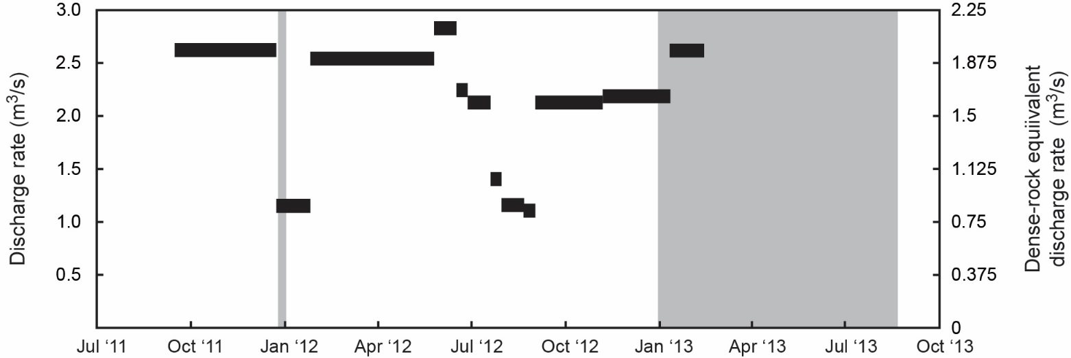

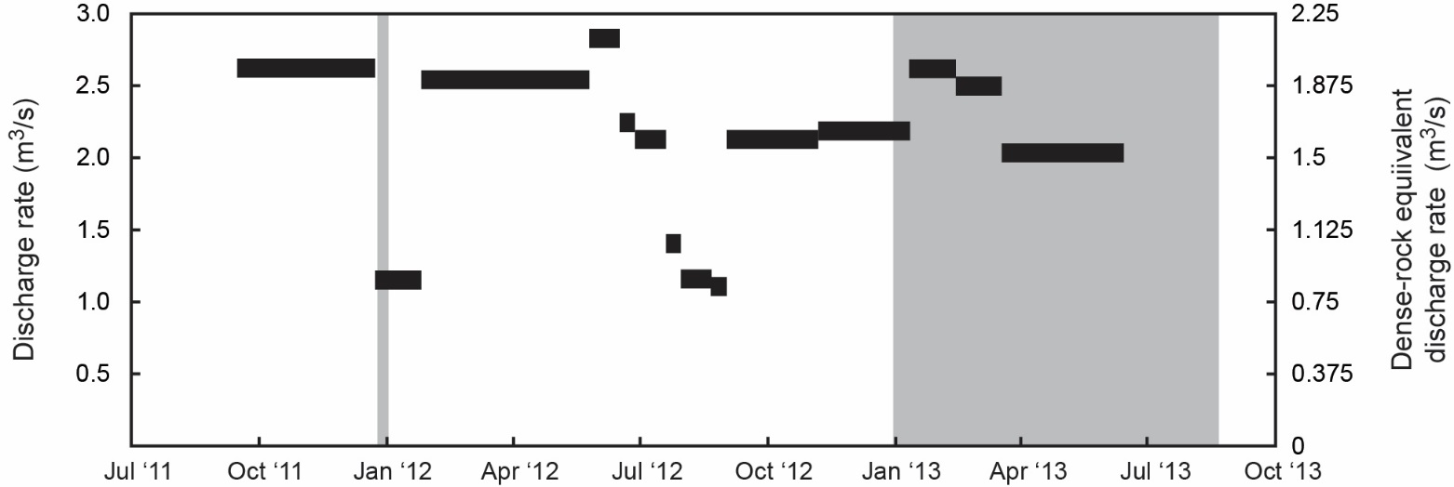

Lull in magma supply, 2011–2016
Active ocean
entry
Active ocean
entry
GSA Annual Meeting, September 25, 2016
8/13
Notes:
Activity seems to have returned to “normal” following the formation of new eruptive vents in 2007-2008, but the effusion rate was clearly waning from it’s 2005-2007 high, interrupted only by a fissure eruption in 2011. Following that eruption, summit deformation was minimal, implying little magma storage. At the same time, lava extrusion rates from the east rift zone, as revealed by satellite topography measurements, were noticeably lower than average. Normal extrusion rate is 3-4 m3/s, TDX reveals 1-2 m3/s in 2012. Using Don’s original principles of summit deformation + extrusion rate, the magma supply rate may have been half the long-term average. Thus, by 2011, we seem to have entered into a lull in magma supply.

Slide 9
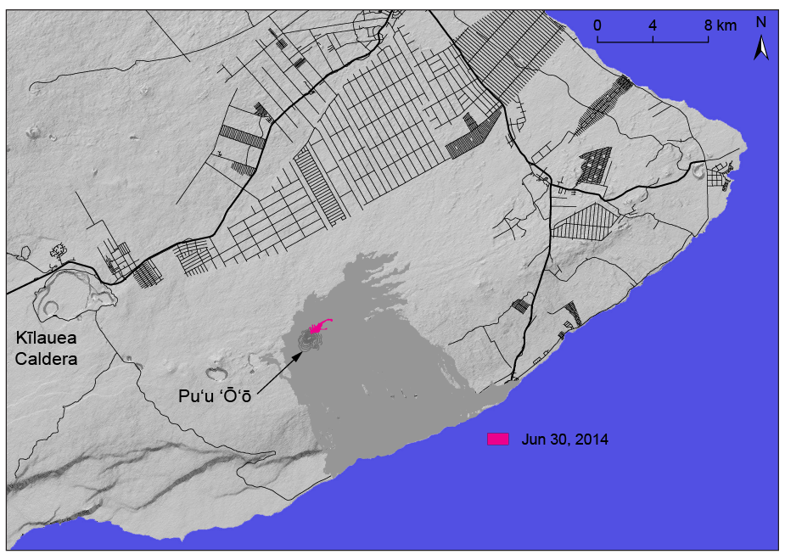






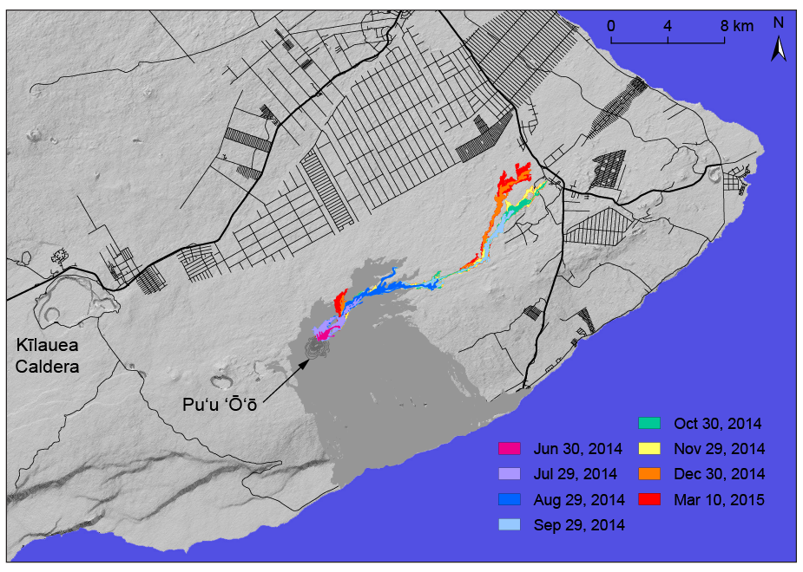


Lull in magma supply, 2011–2016
NAS Volcanology Workshop, August 17–19, 2016
GSA Annual Meeting, September 25, 2016
19/29
9/13
Notes:
Again, the lower supply rate had important implications for eruptive activity. The Pahoa lava flow crisis of 2014-2015 was initiated by the formation of a new eruptive vent on the east rift zone that sent lava flows to the northeast. But these flows stalled repeatedly 20 km from the vent. Is it possible that the lower supply rate, and corresponding lower extrusion rate, meant that these flows did not have enough “oomph” to go father, where they would have caused more of a disruption to the island’s Puna district?

Slide 10

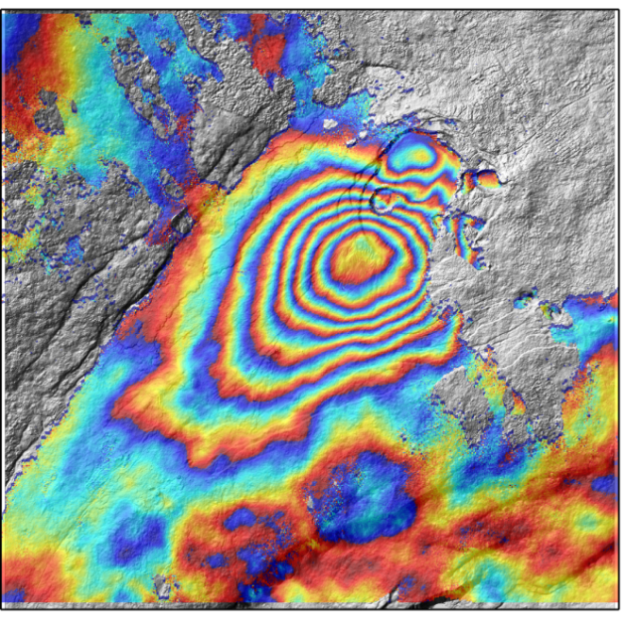

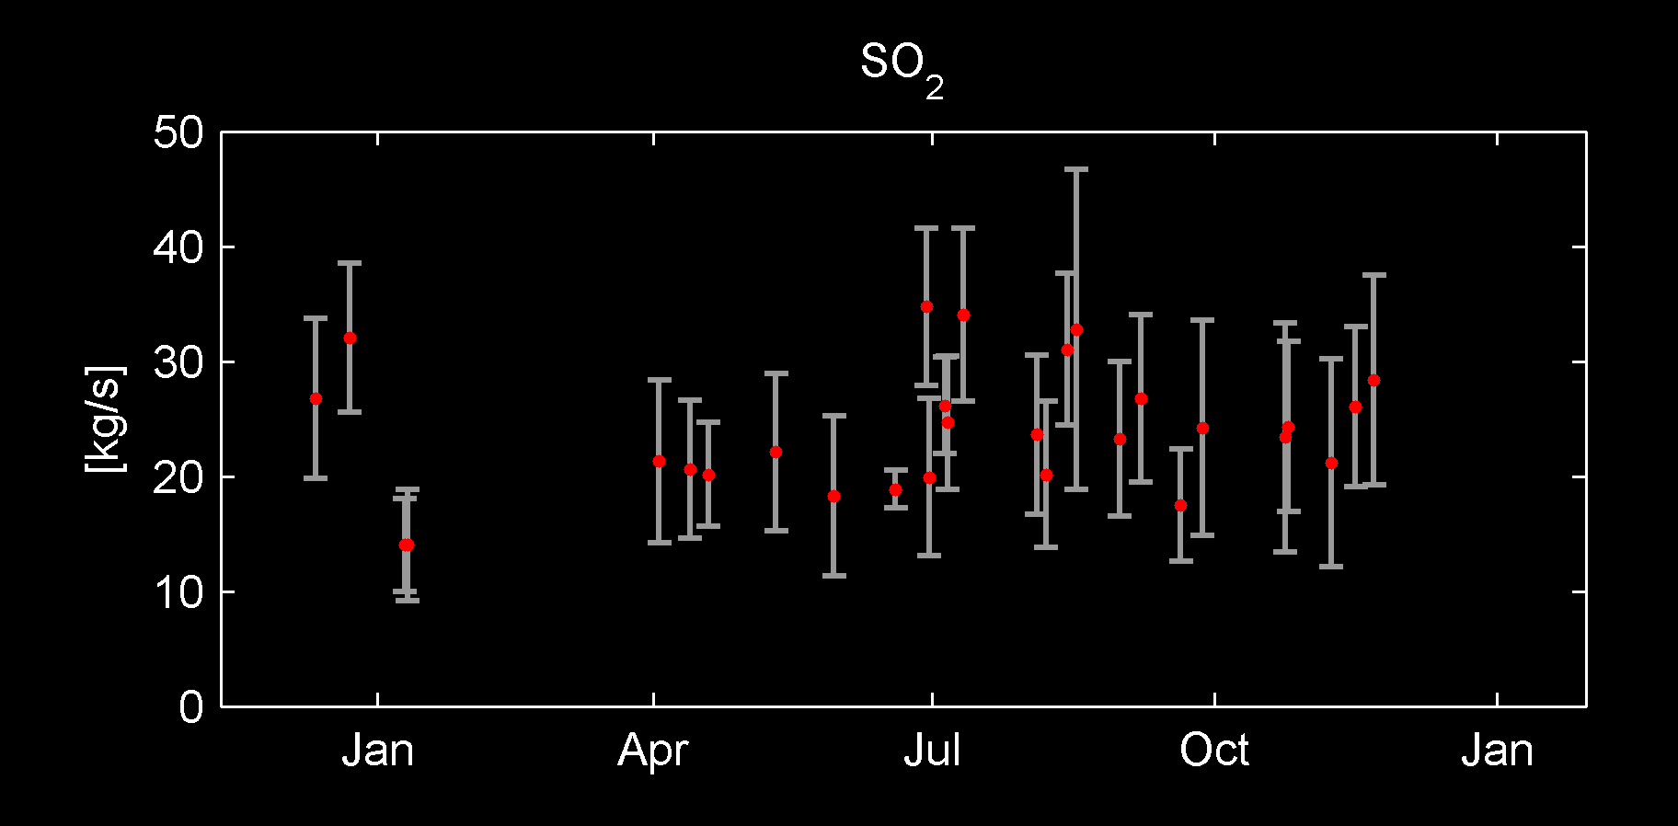
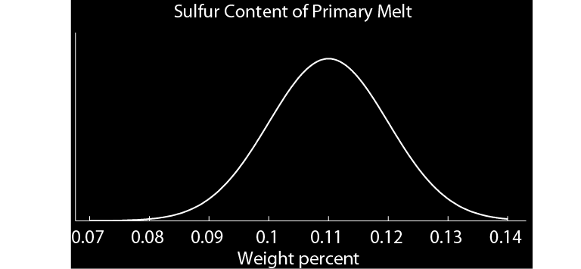

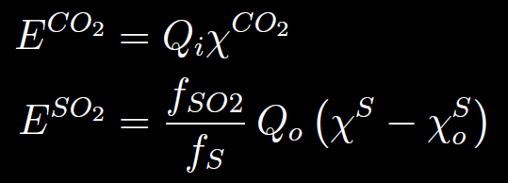

Modeling magma supply rate to Kīlauea Volcano, 2000–2016
SO₂ flux (E^{SO2E})
CO₂ , SO₂ fluxes (E^{CO2}, E^{SO2S})
Pu`u `Ō`ō
Summit
Lava effusion rate
Ground deformation rate u’
Lava effusion rate (Q_{o}), residual sulfur in lava (χ_{O}^{S})
Reservoir location (x,y,z), magma storage rate (Q_{s})
South flank deformation rate
Magma storage rate in deep rift (Q_{r})
0.10 wt%; Clague et al. [1995]
0.11 wt%; Fornari et al. [1979]
0.11 wt%; Garcia et al. [1989]
Magma density (ρ), compressibility (β)
Volume change rate of summit reservoir
0.09 wt%; Greenland et al. [1985]
0.09 wt%; Dixon et al. [1991]
0.12 wt%; Anderson and Brown [1983]
Summit
deformation
MSR
(Q_{i})
Primary S (χ^{S}),
primary CO₂ (χ^{CO2})
0.08 wt%; Moore and Fabbi [1971]
0.13 wt%; Harris and Anderson [1983]
Conservation of mass
Gas emissions
GSA Annual Meeting, September 25, 2016
10/13
Notes:
The increase and subsequent decrease in magma supply over the past 15 years are also supported by detailed physics-based modeling of Kilauea’s magmatic system. These models start with a physical law, like conservation of mass, and a conceptual model of the volcano to relate a variety of data types (like gas emissions and deformation) to prior information (like the sulfur content of the magma) to estimate the supply rate.

Slide 11
Modeling magma supply rate to Kīlauea Volcano, 2000–2016
GSA Annual Meeting, September 25, 2016
11/13
Notes:
This modeling allows us to estimate magma supply over time to Kilauea. Our results agree with Don’s original estimate that the supply rate in the early 2000s was a little over 0.1 km3.yr. The rate appears to have increased to over 0.2 km3/yr by 2006, but then decreased to less than 0.1 km3/yr by 2012. Uncertainties in these estimates overlap somewhat, but it seems clear that there was certainly a decrease in supply rate from 2006 to 2012.

Slide 12

Looking forward
0.3
0.2
Magma Supply Rate (km³/yr)
0.1
?
?
?
0.0
2000
2005
2010
2015
GSA Annual Meeting, September 25, 2016
12/13
Notes:
So the supply rate over the last several years appears to have risen relative to the long-term average that Don established, then subsequently decreased to below that average. A logical next question to ask is “what will happen next?” Well, quite obviously the supply rate might increase, stay the same, or decrease. An increase might mean a heightening in eruptive activity (due to an increase in extrusion rates), whereas a steady supply rate probably means a continuation of what we are seeing now. A decrease in eruption rate might mean the end of the east rift zone eruption. But where would the supply go? Mauna Loa, perhaps?

Slide 13
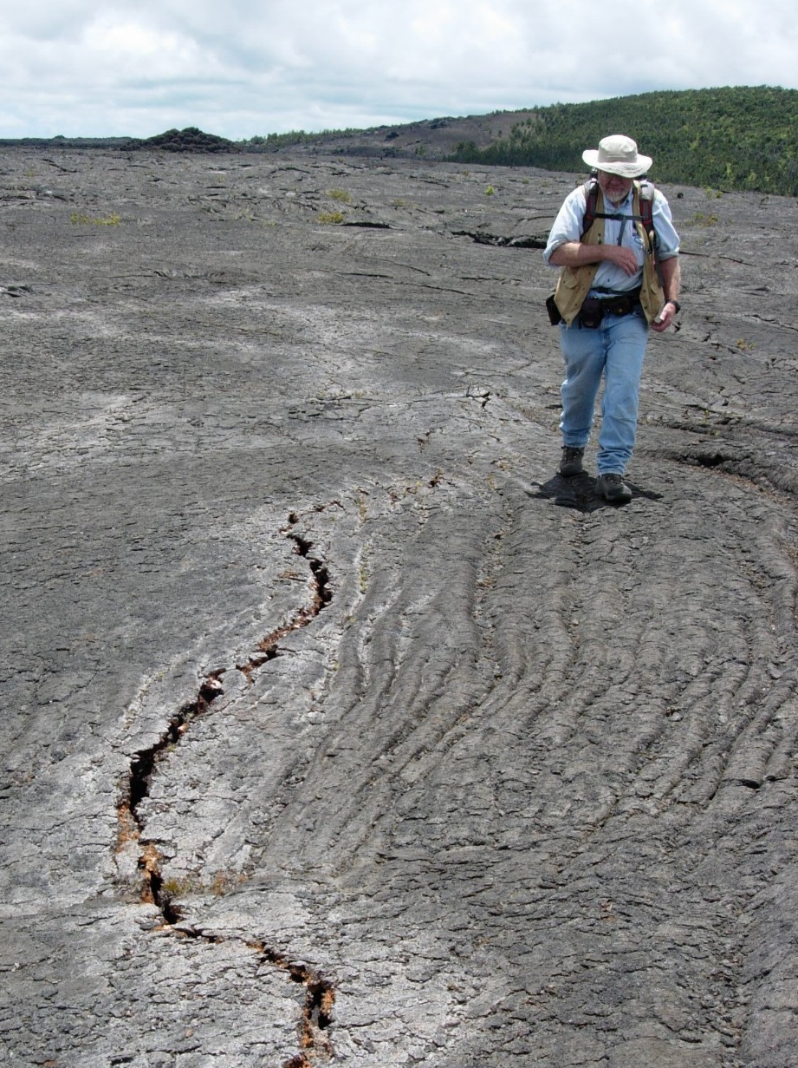
Looking back
Swanson et al., 2014
GSA Annual Meeting, September 25, 2016
13/13
Notes:
The view presented here is very limited in its temporal scope, and it is worth noting that Don has already evolved beyond this perspective, and he is looking at the past several centuries at Kilauea. He has found that Kilauea experiences cycles of effusive and explosive activity, and that the volumes erupted during explosive cycles are much less than during effusive cycles. So perhaps these cycles are in some way controlled by major fluctuations in magma supply? Preliminary work in collaboration with Frank Trusdell further suggests that Mauna Loa might be more active during these Kilauea explosive phases, so perhaps magma supply is shared by the two volcanoes, and flickers between them. I think we know more about magma supply to Kilauea than any other volcano on Earth, and it is based on a foundation that Don Swanson not only established, but that he also continues to push back himself. Thank you.

Slide 15
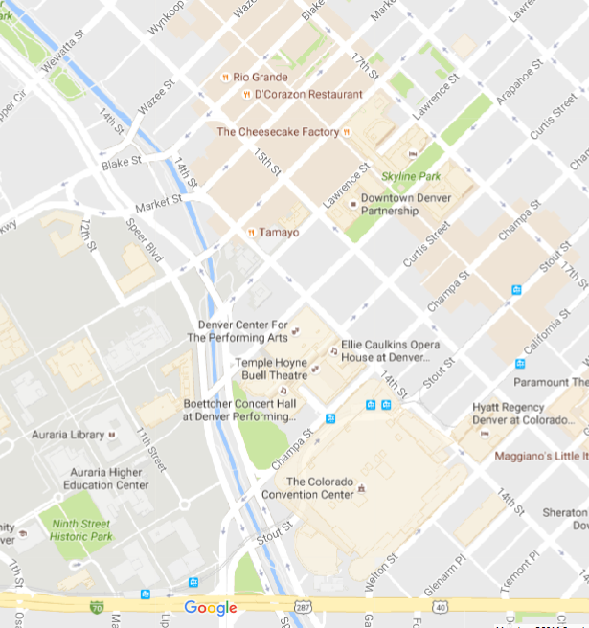
Post-session reception
Rio Grande Restaurant
1525 Blake Street
between 15th and 16th
Drinks starting at 6:30 PM
Dinner at ~7:30 PM

Slide 16
POSTER SESSION – MONDAY
THE LIFECYCLE OF THE EOCENE-OLIGOCENE SCHOOLHOUSE MOUNTAIN CALDERA, MOGOLLON-DATIL VOLCANIC FIELD, SOUTHWEST NEW MEXICO (SWENTON, Vanessa M.)
THE COONEY TUFF: ASH FALL IN A CALK-ALKALINE SUBDUCTION RELATED VOLCANIC FIELD, SOUTHERN NEW MEXICO (RENTZ, Shannon P.)
OXYGEN ISOTOPE AND GEOCHEMICAL ANALYSIS OF VOLCANIC ROCKS FROM SOUTH-CENTRAL NEW MEXICO: INSIGHT ON CRUSTAL CONTAMINATION AND MAGMATIC EVOLUTION (HOFFMAN, Max L.)
CHANGING ERUPTION STYLES DURING THE ~1085 CE SUNSET CRATER ERUPTION, NORTHERN ARIZONA (ORT, Michael H.)
THE TIETON ANDESITE LAVA FLOWS – OF GREAT LENGTH, BUT WHERE DID THEY COME FROM? (GUSEY, Daryl L.)
FACTORS CONTROLLING THE EMPLACEMENT OF THE 80-KM-LONG TIETON ANDESITE LAVA FLOW FIELD, SOUTH-CENTRAL WASHINGTON (AYERS, Samantha K.)
GOAT ROCKS VOLCANO: A LONG-LIVED ANDESITE CENTER IN THE SOUTHERN WASHINGTON CASCADES (WALL, Kellie T.)
GEOCHEMISTRY OF KEANAKĀKO‘I TEPHRA FROM KĪLAUEA VOLCANO, HAWAI‘I (GARCIA, Michael O.)
AN ISOTOPIC PERSPECTIVE INTO THE MAGMATIC ARCHITECTURE AND EVOLUTION OF THE RIFT ZONES OF KĪLAUEA VOLCANO (PIETRUSZKA, Aaron J.)
PETROLOGIC EVOLUTION OF MAGMA ERUPTED AT PU'U O'O, KILAUEA VOLCANO: ARE DECADAL CHANGES IN MAGMA COMPOSITION PRIMARILY DRIVEN BY SHALLOW OR DEEP PETROGENETIC PHENOMENA? (BOHRSON, Wendy A.)
BEM MODELING OF FEBRUARY 1993 INTRUSION SEEN BY JERS-1 SATELLITE, KīLAUEA VOLCANO, HAWAII (MOORE, Sarah C.)
THE SHUMAKER CREEK MEMBER AND BASALT OF POWATKA: TWO HIGH-BA WANAPUM BASALT FLOWS, COLUMBIA RIVER BASALT GROUP (MARTIN, Bart S.)
PETROLOGY AND GEOCHEMISTRY OF THE LAZUFRE VOLCANIC COMPLEX: EVIDENCE FOR DIVERSE PETROGENETIC PROCESSES AND SOURCES IN THE ANDEAN CENTRAL VOLCANIC ZONE (WILDER, Alicia)
PHYSICAL CHARACTERISTICS OF GLACIOVOLCANIC PILLOW LAVAS FROM UNDIRHLIDAR, SW ICELAND (THOMPSON, Anna C.)
GEOCHEMICAL CONSTRAINTS ON THE MAGMATIC SYSTEM AND ERUPTIVE ENVIRONMENT OF A GLACIOVOLCANIC TINDAR RIDGE FROM UNDIRHLíðAR, SW ICELAND (WALLACE, Chloe)
NEW INSIGHTS ON THE FORMATION OF GLACIOVOLCANIC TINDAR RIDGES FROM DETAILED MAPPING OF UNDIRHLIDAR RIDGE, SW ICELAND (HEINEMAN, Rachel)
3-D MAPPING OF QUARRY WALLS TO CONSTRAIN THE INTERNAL STRUCTURE OF A GLACIOVOLCANIC TINDAR, SW ICELAND (EDWARDS, Benjamin R.)
CYCLICITY OF EXPLOSIVE BASALTIC ERUPTIONS AT AN INTRAPLATE VOLCANO, AKAROA VOLCANIC COMPLEX, NEW ZEALAND (SHANKLE, Madison G.)
GRAVITY AND GEOCHEMICAL CONSTRAINTS ON THE EVOLUTION OF THE EL VALLE VOLCANO, PANAMA (MUNSEY, Keith R.)

