Slide 1

The Role of Monazite Weathering on Phosphorus Budgets of the Loch Vale Watershed, Rocky Mountain National Park, Colorado, USA
Jason R. Priceª, Joel Moore^{b}, & Dalton Keransª
ª Environmental Studies Program, Illinois College, Jacksonville, IL ^{b} Department of Physics, Astronomy, and Geoscience, Towson University, Towson, MD

Slide 2
Chemical Weathering in Glaciated Watersheds
Why study phosphate mineral weathering in glaciated watersheds?
  High mechanical weathering through comminution of bedrock to rock flour
    Yields increased chemical weathering rates of accessory (<2%) phosphate minerals (e.g., Hodson et al., 2004)
      Phosphorus is a lithogenic macronutrient
        Often limits biological productivity downstream
        Involved in algal blooms in eutrophic lakes
  Glaciated alpine watersheds are very sensitive to anthropogenic disturbance

Slide 3
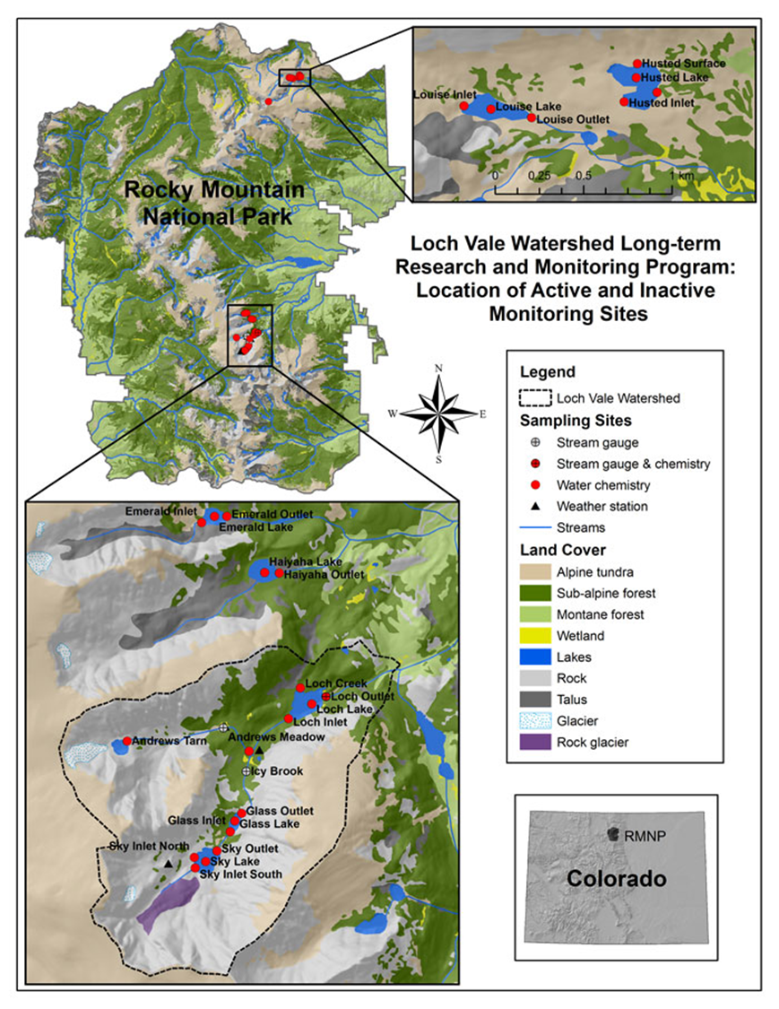
Loch Vale Watershed
http://www.nrel.colostate.edu/projects/lvws/site_description.html

Slide 4
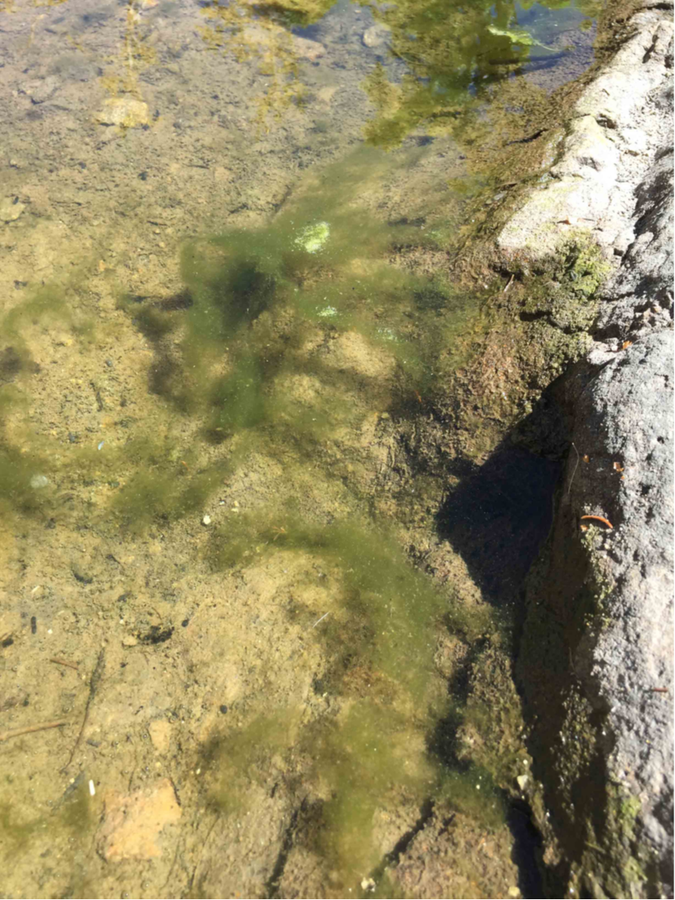
Algal blooms in The Loch
Photo courtesy of Bella Oleksy

Slide 5
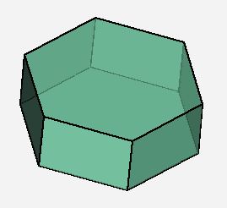
Phosphate Minerals in the Loch Vale Watershed
Apatite → Ca₅(PO₄)₃(Cl,F,OH)
  Dissolution voids in detrital stream sediment grains
  0.1% of bedrock by volume (Cole, 1977)
http://www.minerals.net/Smorf/CrystalDetail.aspx?sort=2&MineralId=22&MineralName=Apatite

Slide 6
Phosphate Minerals in the Loch Vale Watershed (cont’d)
Monazite → (REE)PO₄
  0.1% of bedrock by volume (Cole, 1977)

Slide 7
Phosphate Minerals in the Loch Vale Watershed (cont’d)
Monazite (cont’d)
  EMPA and LA-ICP-MS analyses yield:
(La_{0.192}Ce_{0.406}Nd_{0.166}Pr_{0.0540}Gd_{0.0449}Sm_{0.0397}Ca_{0.0668}Th_{0.0690})Si_{0.0172}P_{0.935}O₄
  Shiller (2010) reported dissolved REE concentrations at the Loch Vale watershed outlet for 1998-2002

Slide 8
Phosphate Minerals in the Loch Vale Watershed (cont’d)
Plug-flow column reactor
  Unweathered crushed 150-600 µm (30-100 mesh) granitic bedrock from Loch Vale watershed
    Provided courtesy of M. Schulz, USGS, Menlo Park, CA
      Slightly finer subset of that used in similar experiments by White et al. (1999a,b)
  Influent pH = 3 HNO₃
  Average flow rate of 8.4 ± 0.9 mL hour⁻¹
    Controlled by hosecock
  Operating temperature 20.2 ± 2.9°C
  Sampled until effluent chemistry reached steady-state
    Last sample collected at day 71

Slide 9
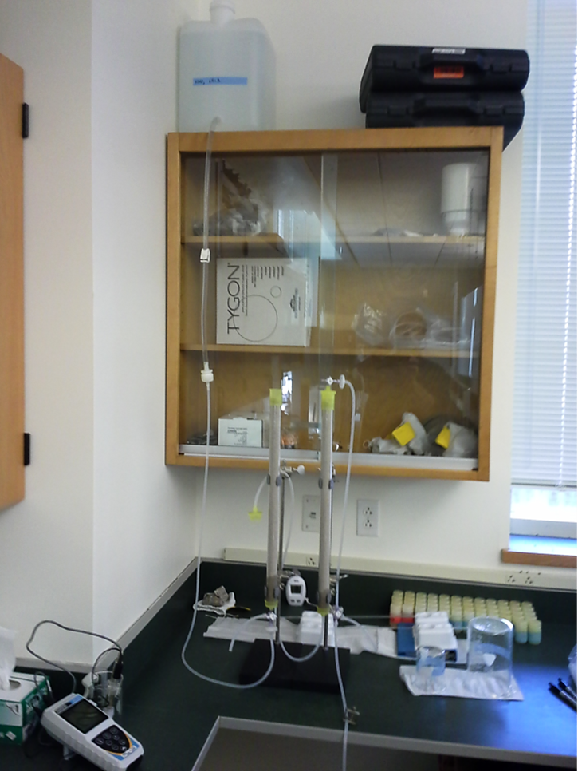
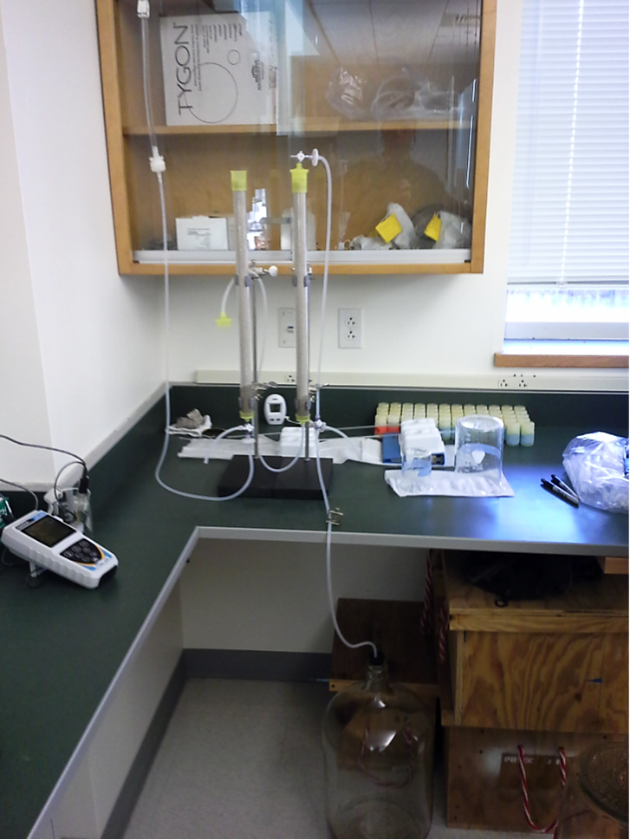
Phosphate Minerals in the Loch Vale Watershed (cont’d)
Plug-flow column reactor (cont’d)

Slide 10
Phosphate Minerals in the Loch Vale Watershed (cont’d)
Plug-flow column reactor (cont’d)
  May use mass-balance calculations to determine the relative contributions of P⁵⁺ to effluent from each mineral (C_{EP})
    Assuming that sources of REEs other than monazite are negligible,
    S_{MP}
    C_{EP} = C_{EREE} • ─────
    S_{MREE}
    C_{EREE} = REE concentration in effluent
    S_{mp} = Monazite P⁵⁺ stoichiometry
    S_{MREE} = Monazite REE stoichiometry
After C_{EP} is calculated for monazite, difference with total P⁵⁺ concentration is that for apatite

Slide 11
Phosphate Minerals in the Loch Vale Watershed (cont’d)
Plug-flow column reactor (cont’d)
  May use mass-balance calculations to determine the relative contributions of P⁵⁺ to effluent from each mineral (C_{EP}) (cont’d)
    Integrating the area under curve for each mineral (A_{MP}) for 71 days (d_{e}) of experiment:
    d_{e}
A_{MP} = ∫ C_{EP}(t) dt d_{o}
    Normalizing areas to 100%:
      Apatite 99.9%
      Monazite 0.1%

Slide 12
Phosphate Minerals in the Loch Vale Watershed (cont’d)
Plug-flow column reactor (cont’d)
  P⁵⁺ released from apatite dissolution at watershed scale for 1984 – 2008 is (Price et al., 2013):
13 – 47 mol ha⁻¹ yr⁻¹
    Range of values reflects weathering by different proportions of H₂CO₃ and H₂SO₄
    From reactor monazite releases 0.1% of P⁵⁺ to reacting solutions, or
0.013 – 0.047 mol ha⁻¹ yr⁻¹
      Divide these by the P⁵⁺ stoichiometry in monazite of 0.935 yields weathering rate of
0.014 – 0.050 mol ha⁻¹ yr⁻¹

Slide 13
Phosphate Minerals in the Loch Vale Watershed (cont’d)
Watershed-scale monazite weathering rate (α_{M}) from REEs (Shiller, 2010),
  α_{M} = Δm_{REE} / β_{REE}
      Where,
      Δm_{REE} = watershed REE flux (mol ha⁻¹ yr⁻¹)
      β = stoichiometry of REE in monazite
      Assumes REE inputs from precipitation are negligible

Slide 14
Phosphate Minerals in the Loch Vale Watershed (cont’d)
Watershed-scale monazite weathering rate (cont’d)
  Recall, from column reactor monazite weathering rate of:
0.014 – 0.050 mol ha⁻¹ yr⁻¹
 | La³⁺ | Pr³⁺ | Nd³⁺
Monazite Stoichiometry (moles) (n = 6) | 0.192 | 0.0540 | 0.166
Stream Flux (mol ha⁻¹ yr⁻¹) (Shiller, 2010) | 0.0036 | 0.0012 | 0.0049
Monazite Weathering Rate (mol ha⁻¹ yr⁻¹) | 0.019 | 0.023 | 0.030

Slide 15
Summary and Conclusions
Apatite and monazite present in the Loch Vale watershed bedrock in the same modal abundance of 0.1% (Cole, 1977)
  P⁵⁺ contribution to streams from watershed-scale weathering rates:
    Apatite → 13 – 47 mol ha⁻¹ yr⁻¹
    Monazite → 0.018 – 0.028 mol ha⁻¹ yr⁻¹
      Consistent with column reactor experiments
        Thus, in the Loch Vale watershed of Rocky Mountain National Park monazite contribution of P⁵⁺ to surface waters is negligible compared to apatite
With increasing interest in P⁵⁺ budgets of surface waters it is important to quantify natural primary mineralogical sources including apatite and monazite

Slide 16

Thank You!

