Slide 1
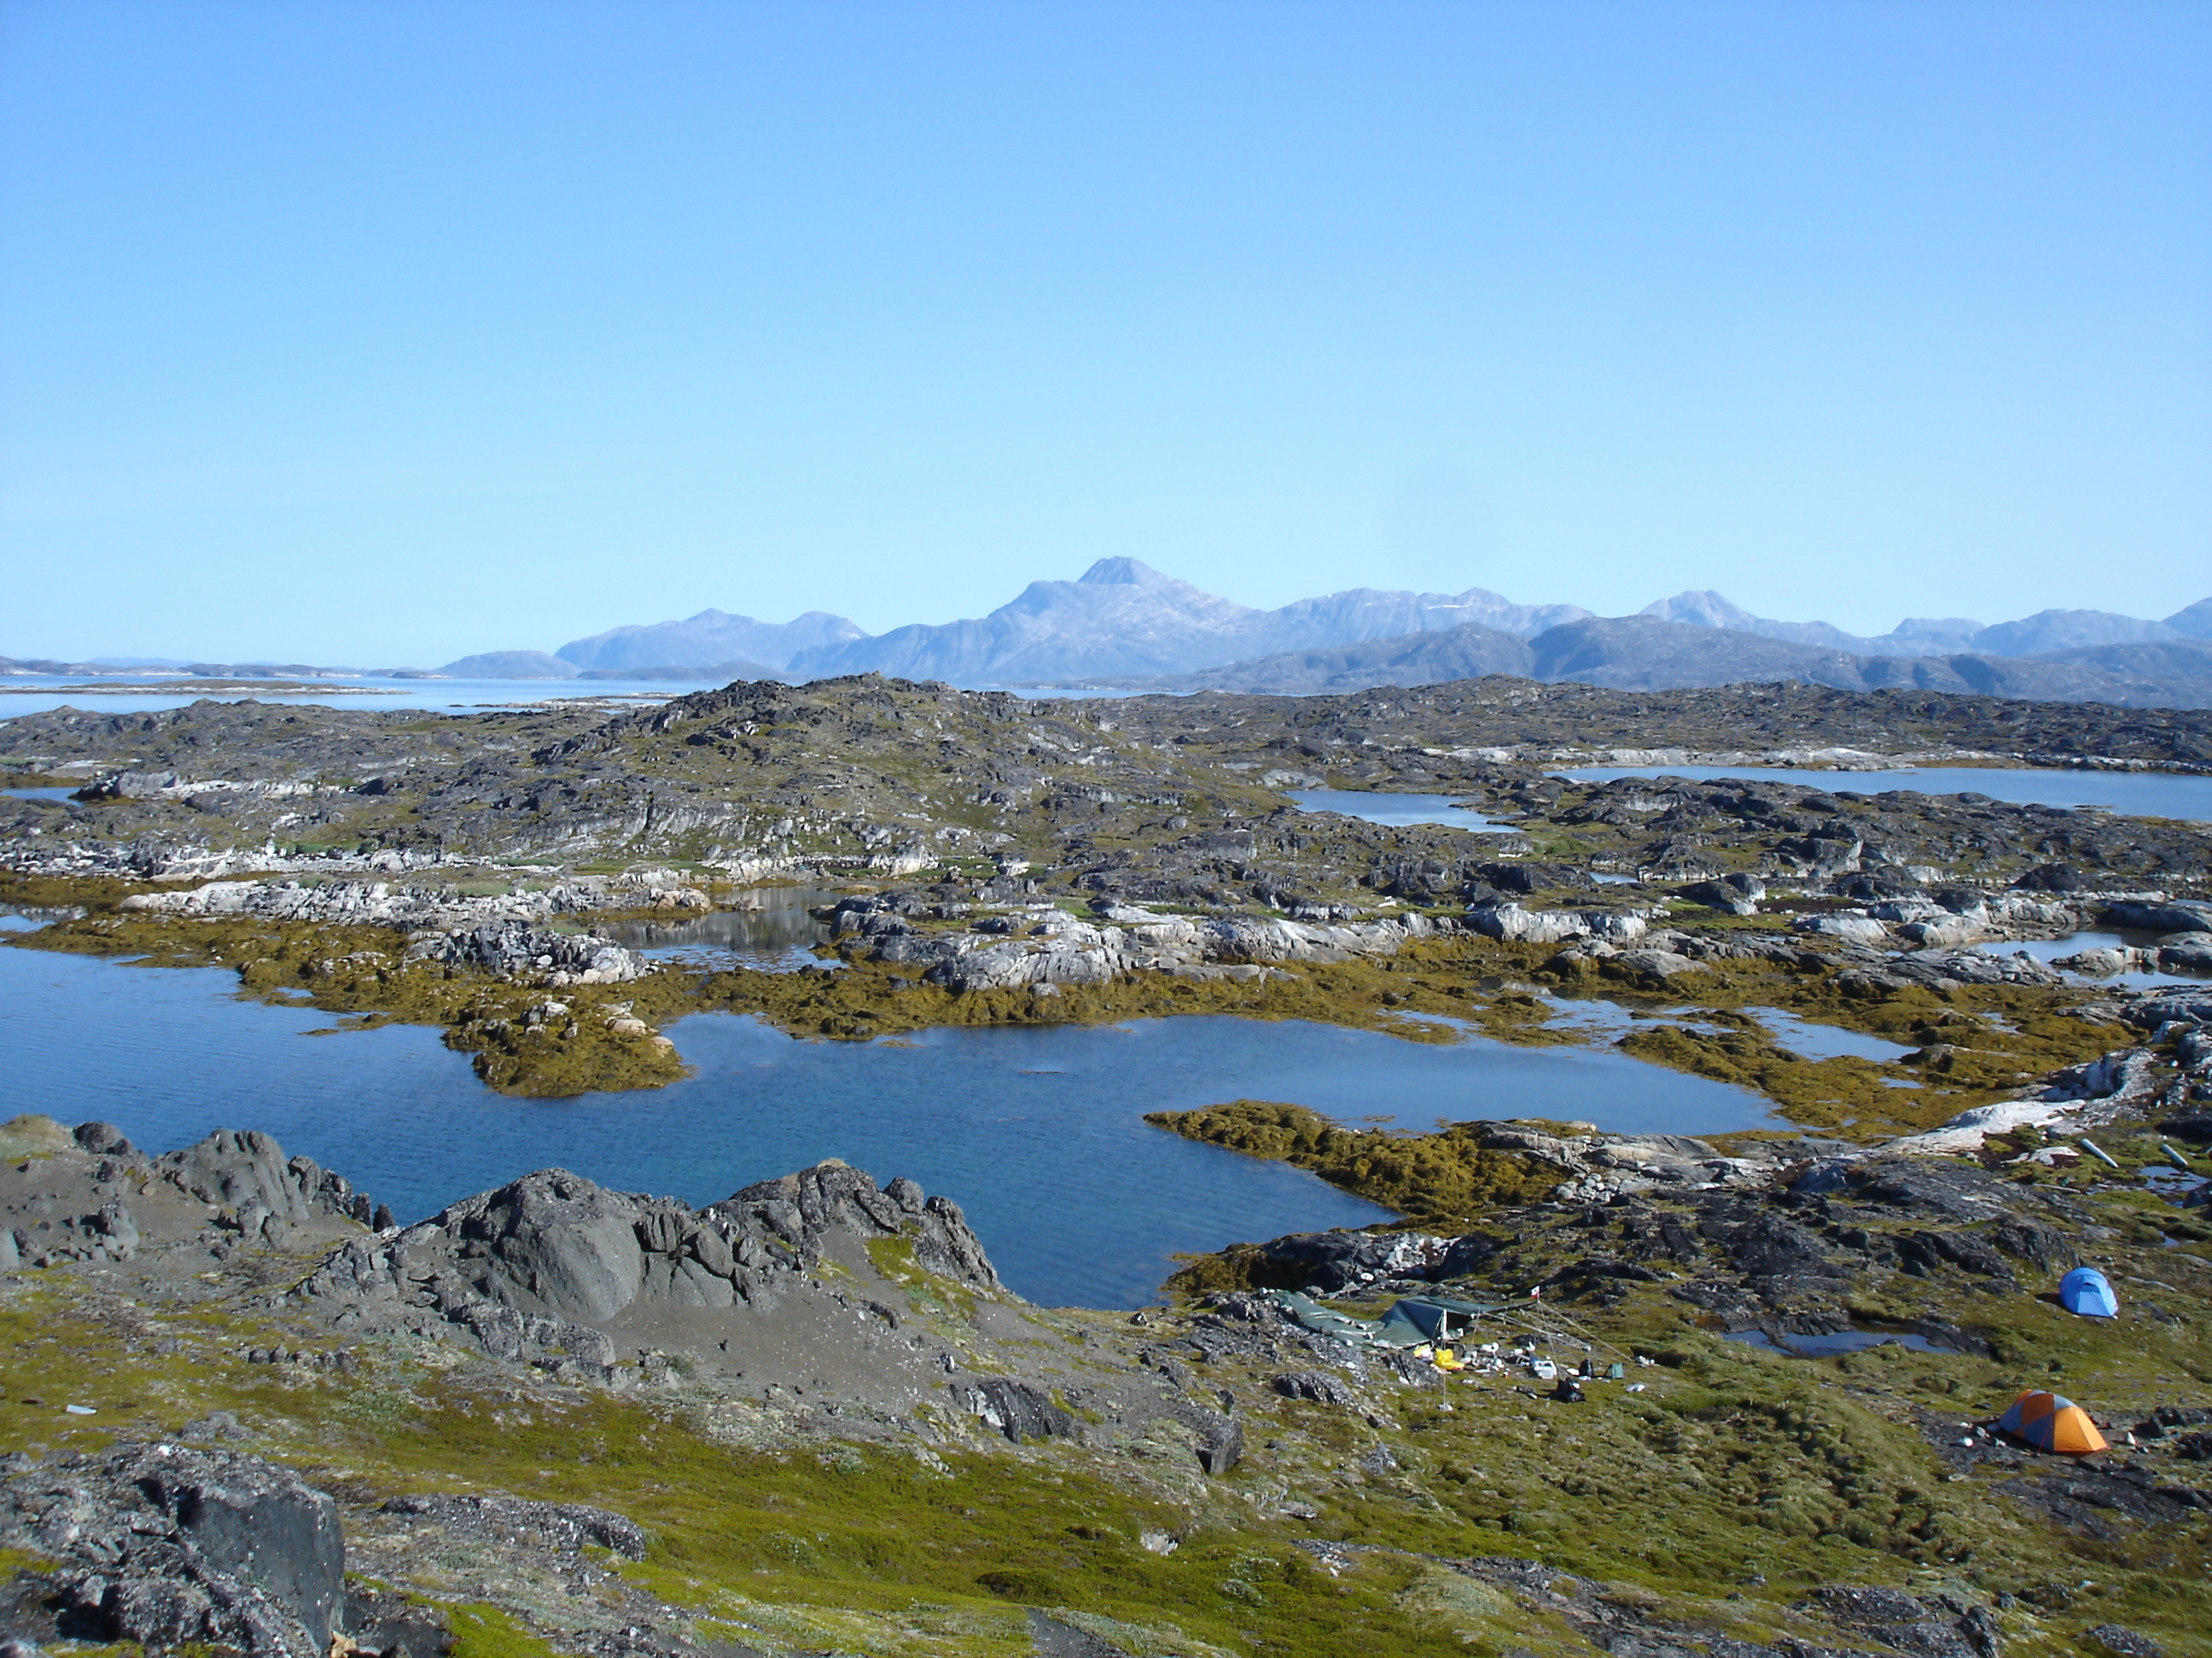



Origin of > 3.65 Ga Quartz-Amphibole-Pyroxene Rocks from Akilia, SW Greenland: An Integrated Field and Mineral Composition Investigation
Melissa Hage¹, Tomohiro Usui², Chris Fedo³, and Martin Whitehouse⁴
¹Dept. of Geography-Geology, Univ. of Wisconsin-Baraboo/Sauk Co., Baraboo
²Earth Life Science Institute, Tokyo Institute of Technology, Tokyo
³ Dept of Earth and Planetary Sciences, Univ. of Tennessee, Knoxville
⁴ LIG, Swedish Museum of Natural History, Stockholm

Slide 2
Introduction
Archean sedimentary rocks may reveal conditions of early Earth
Sedimentary units, including BIF, have potential to host evidence of early life
Effects of dynamic Earth
Primary characteristics may be overprinted by metamorphic events
Results in ambiguities in protolith interpretation
Quartz-amphibole-pyroxene (QAP) unit on Akilia, SW Greenland
Protolith age and identification controversial
Notes:
Sedimentary rocks have the potential to reveal conditions of the paleoenviromental settings in which they were deposited. Banded iron formation (BIF), a lithology that many consider a marine chemical precipitate, is among the oldest sedimentary rocks on Earth and have been linked to Earth’s early biosphere. Due to tectonic recycling, many primary physical and chemical characteristics of Archean supracrustal rocks, of which BIF is a common component, have been hydrothermally and metamorphically overprinted. Any such, overprinting may result in changes in mineralogy and geochemistry, which in turn may lead to ambiguities in protolith interpretation
Eoarchean rocks whose protolith identification has been particularly controversial occur on Akilia, an island in SW Greenland. Rocks on Akilia have experienced granulite-facies metamorphism and intense deformation
Within this succession, there is an up to ~5 m-thick banded lithology comprised mostly of quartz, amphibole, and pyroxene (QAP) interleaved between amphibolite and ultramafic rocks that has been interpreted by some as BIF. Others have interpreted the same rocks to be mafic and ultramafic igneous rocks that have experienced repeated metasomatism, thus only superficially resembling BIF

Slide 3
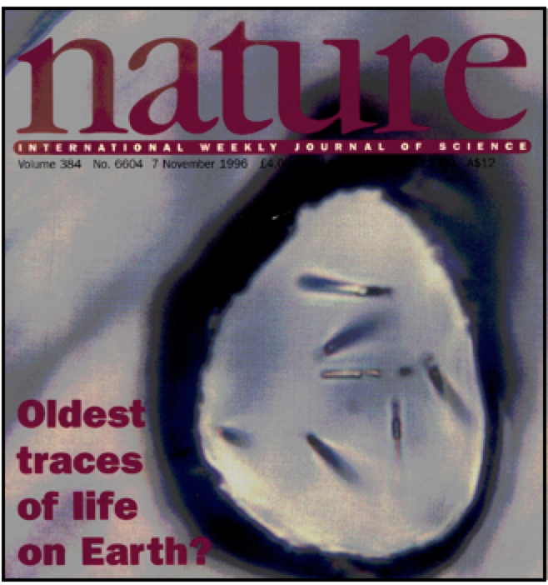
Importance of Protolith Age and Identification
Apatite with ¹³C-depleted graphite inclusions
Protolith must be BIF to use C isotope signature as described for evidence of life
How old are the rocks?
Difficult to determine given the polyphase high-grade metamorphism that has reset zircon ages
Crosscutting relationships have been used to establish its antiquity
Mojzsis, S.J., et al. 1996. Evidence for life on Earth before 3800 million years ago. Nature, 384: 55-59.
Notes:
The correct identification of these rocks is of the utmost importance because they are reported to contain grains of apatite with 13C-depleted graphite inclusions that have been claimed as evidence for the oldest life on Earth. In order for the carbon isotope signature to be used evidence for life, it is necessary for the banded Qap rocks to be sedimentary, as this would establish an appropriate host lithology that formed in the presence of a liquid hydrosphere. So, there are two main issues that need to be addressed. First, is the protolith of these rocks really sedimentary, thus making them appropriate for hosting evidence of early life. Second, are the rocks really as old as they are claimed to be? The age of the rocks are difficult to determine given the polyphase high-grade metamorphism that has reset zircon ages, resulting in cross-cutting relationships being used to establish the antiquity of the rocks. However, there is debate over if the critical contact used for is tectonic or igneous in nature.

Slide 4
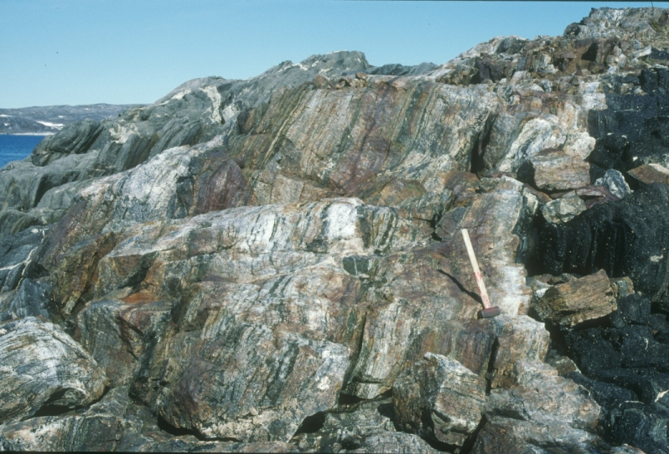
Research Purpose
Integration of field observations and mineral compositional data along the critical geologic contacts and lithologies to address issues regarding
age and origin of QAP unit
Notes:
In this study, we integrate field observations and mineral compositional data along the critical geologic contacts and lithologies to address issues regarding the age and origin of the QAP unit. Structural data were collected to determine the geologic nature (tectonic or igneous) of the critical contact that has been used to date the QAP lithology. Whole-rock geochemistry from a number of novel specimens relative to the protolith discussion sets the framework for determining mafic mineral composition by electron microprobe.

Slide 5
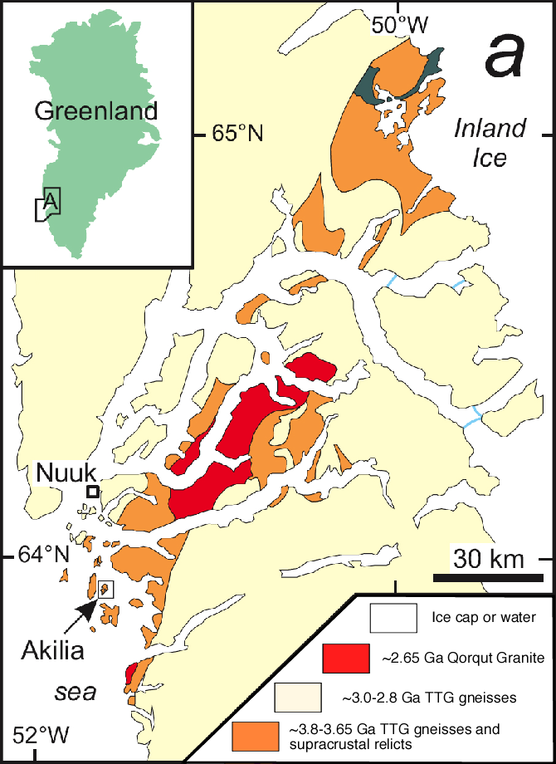
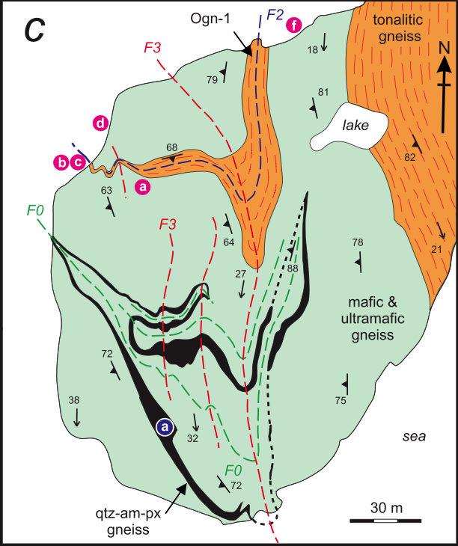
• 3.65 - 3.85 Ga TTG Amîtsoq gneisses
> 3.7 Ga Akilia Association
Mafics and ultramafics
BIF
QAP rocks
Granulite-facies metamorphism
Geologic Setting
Isua Greenstone Belt
Whitehouse et al. (2009)
Modified from Nutman et al. (1996)
Notes:
Akilia is comprised of two main lithologic assemblages, where the most abundant is the ~3.65-3.85 Ga tonalitic Amitsoq gneisses. The second assemblage is predominantly comprised of coarse-grained mafic and ultramafic supracrustal rocks, termed the Akilia association, which are generally assumed to be older. Regionally, both BIF and volcanic rocks are present within this older group of rocks; and it is the banded QAP lithology in this assemblage on Akilia that has been interpreted as BIF. After their assembly, the rocks in this area underwent multiple episodes of regional metamorphism, including a granulite facies event at ~3.6 Ga and an upper-amphibolite-facies event at ~2.7 Ga.

Slide 6
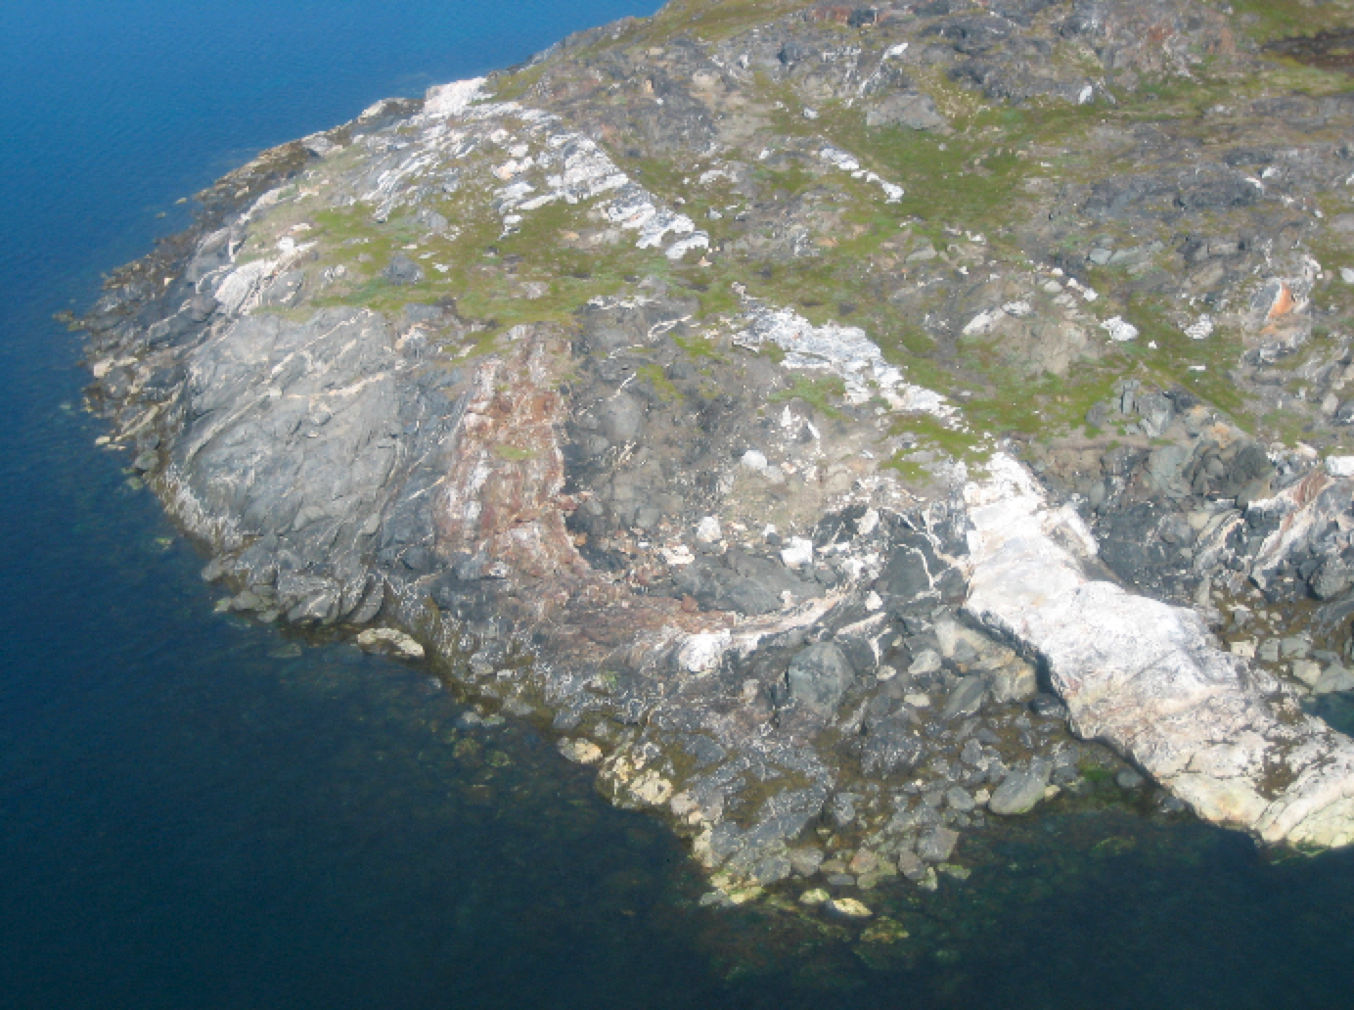
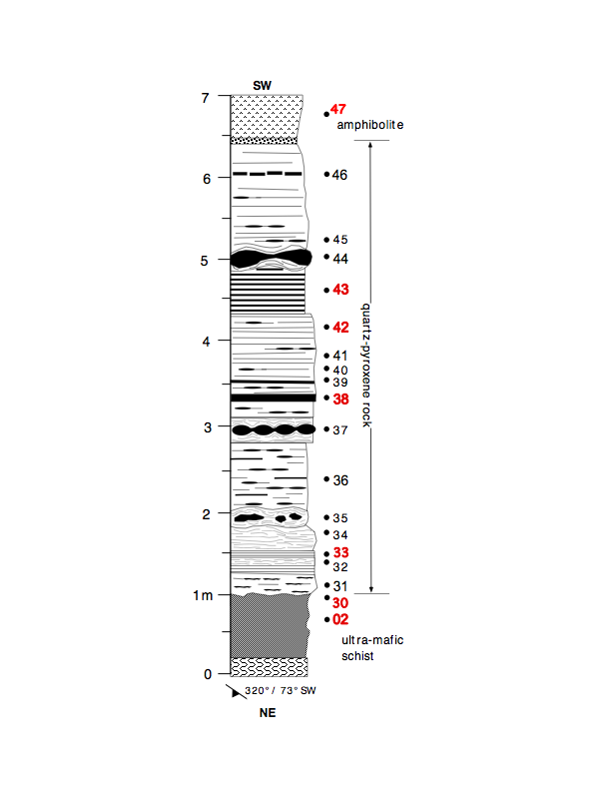
Qorqut granite
quartz-amphibole-pyroxene rock
amphibolite
QAP
ultra-mafic
05
02

Slide 7
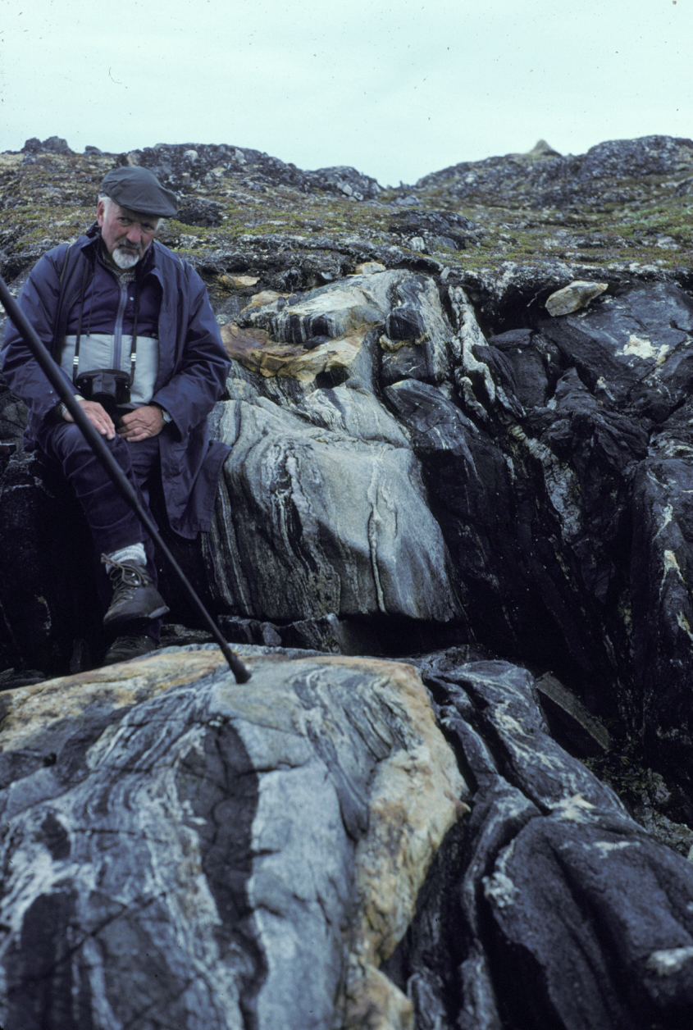
Amîtsoq gneiss
Akilia Assn.
Minimum age of Akilia amphibolite based on
cross-cutting by younger Amîsoq tonalitic gneiss?
Is this relationship cross-cutting or tectonic?
Discordance?
Nutman et al. (1997, GCA)
Notes:
An assumption used in earlier attempts to date these rocks was that the QAP unit was an integral part of a volcano-sedimentary succession with adjacent mafic and ultramafic rocks, whose minimum age could be determined from the age of cross-cutting tonalitic Amitsoq gneiss. Subsequent studies have questioned this assumption, instead concluding that the relationship between the QAP unit and the tonalititc gneiss is tectonic
In the field, we observed intense foliation involving the key contact between tonalitic Amîtsoq Gneiss and mafic and ultramafic rocks of the Akilia Association used to establish the age of the QAP unit.

Slide 8
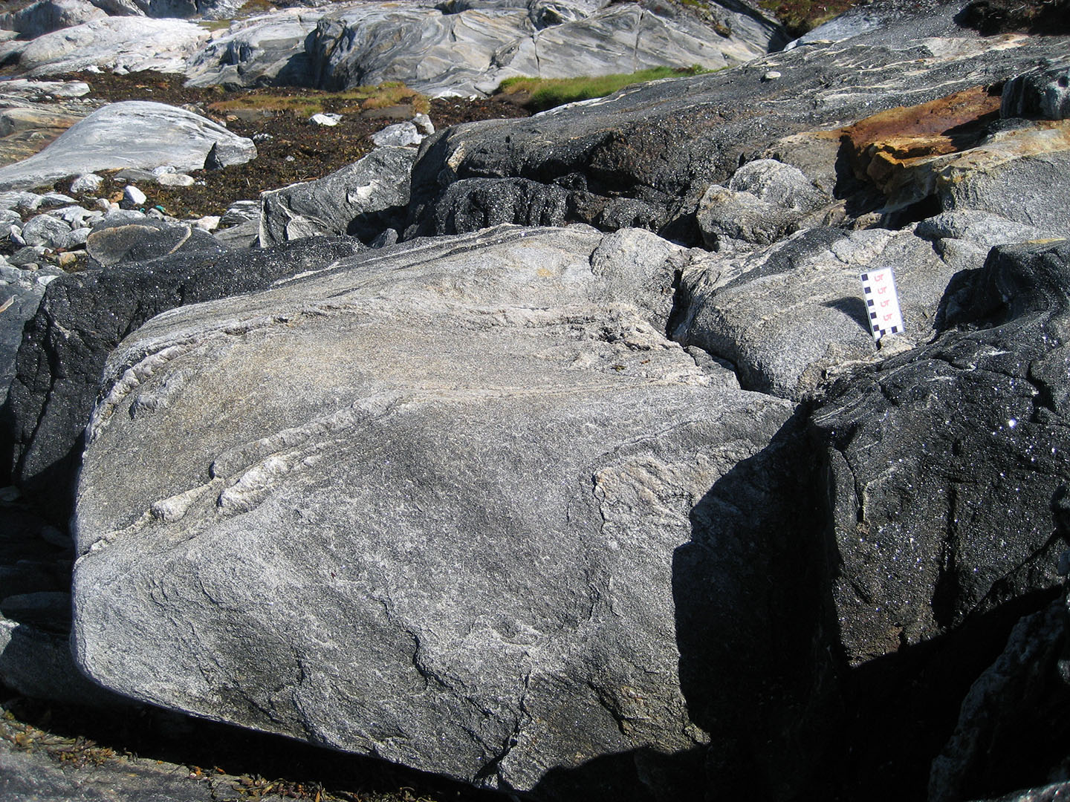
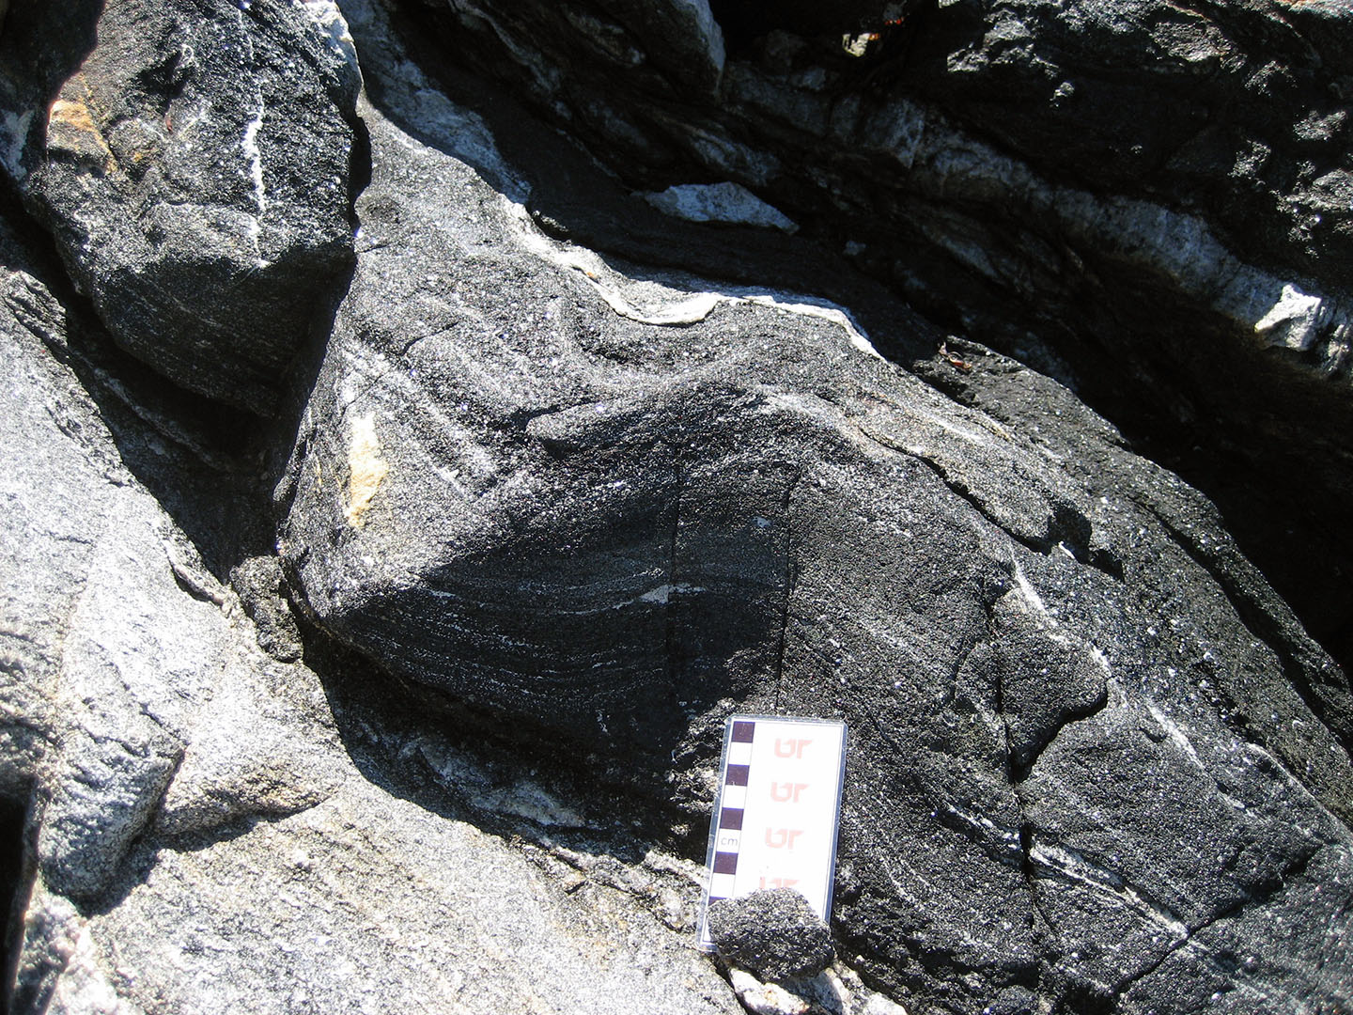
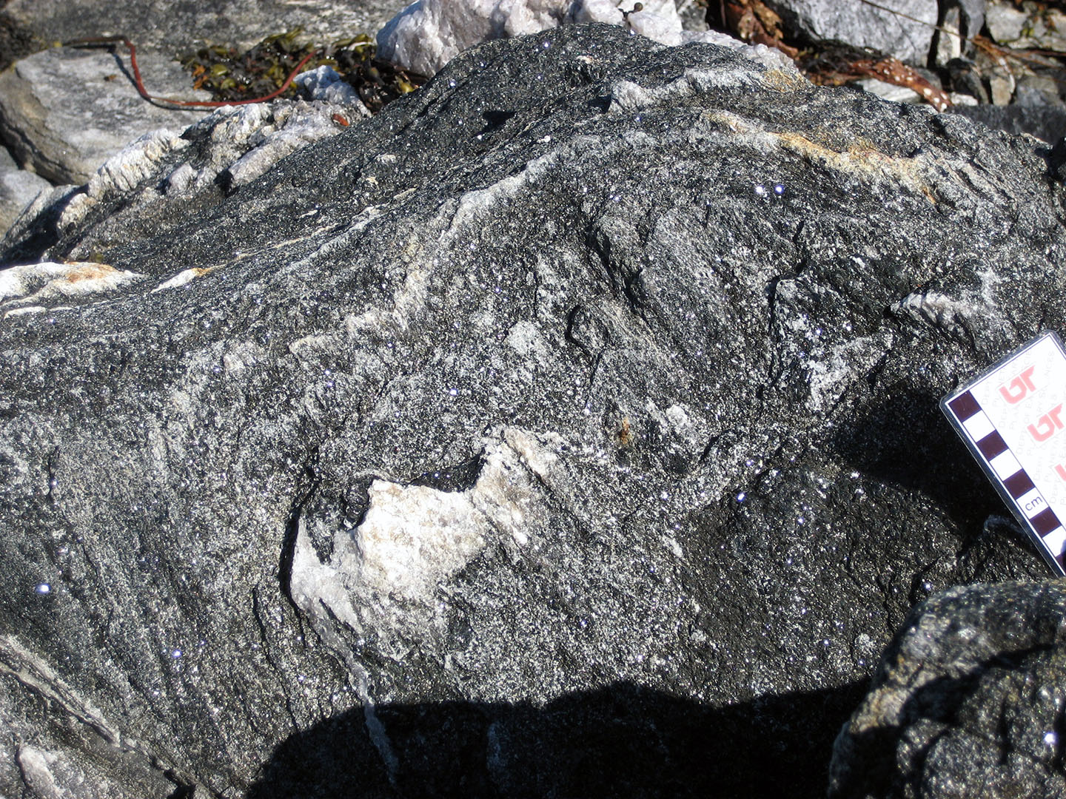
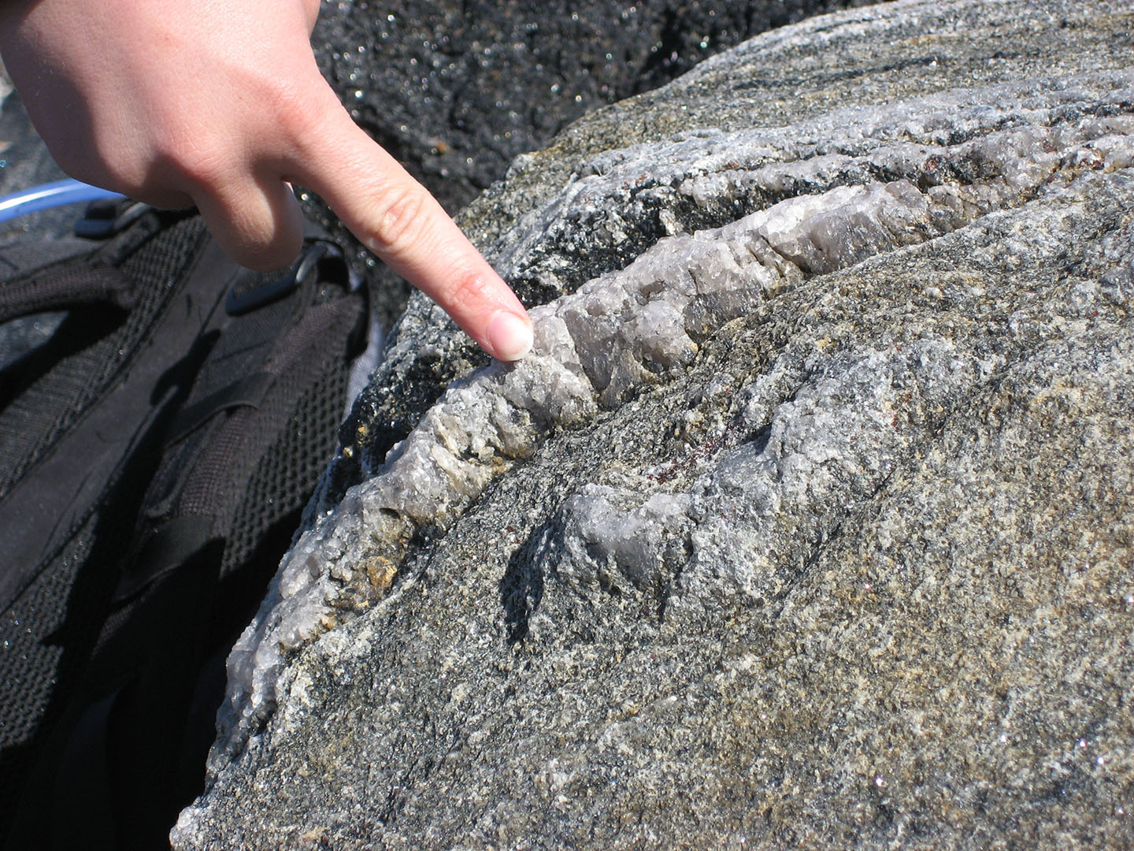
A
B
Akilia Assn.
Akilia Assn.
Amîtsoq gneiss
Akilia Assn.
Amîtsoq gneiss
C
D
Akilia Assn.
Akilia Assn.
Notes:
Field photographs of the key relationships between the two units. (A) Tectonic interleaving of Akilia Association and the Amîtsoq Gneiss. (B) Close up of the key contact, where the deformed, tectonically folded nature of the contact can be seen. (C) Foliation surfaces and folded quartz in in the Akilia Association. (D) Close up of quartz stretching lineations in the Akilia Association. Finger in orientation of stretching lineations.

Slide 9
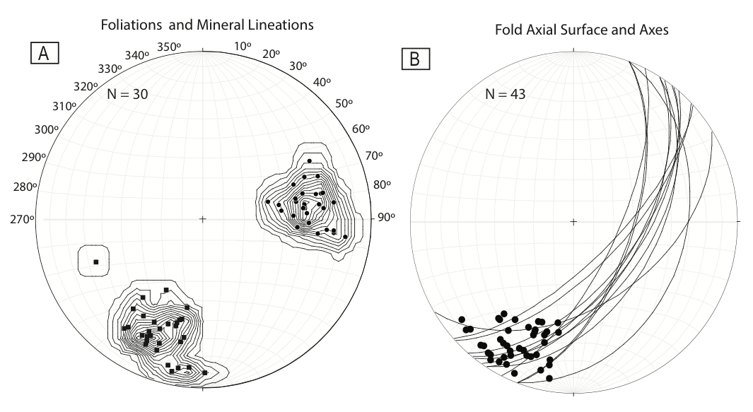
Field Relationships Between Amîtsoq Gneiss and Akilia Association
Axial surfaces
Foliations
Fold axes
Mineral lineations
Notes:
Structural data for both the Amîtsoq Gneiss and Akilia Association on both sides of the key contact show the same orientations.
Foliation planes in both units consistently strike N and dip towards the W.
Axial-surface data of cm-scale folds in both units strike NE and dip SE . Fold axes in both units plunge gently to the SW .
Mineral lineations in both units trend SW and plunge gently to moderately towards the SSW, which is the same direction as the fold axes (towards the SSW).
The lineations correspond directly with the fold axes data, which implies that either the mineral lineations are linked to the same deformation event that created the folding or that the two formed during different events and then rotated towards parallel during a later event. The uniformity of all structural measurements between the Amîtsoq Gneiss and Akilia Association indicates that the relationship seen today between the two units is tectonic, with any prior relationships having been erased during high-temperature and high-pressure deformation and metamorphism. Primary relationships between the two units cannot be determined.

Slide 10
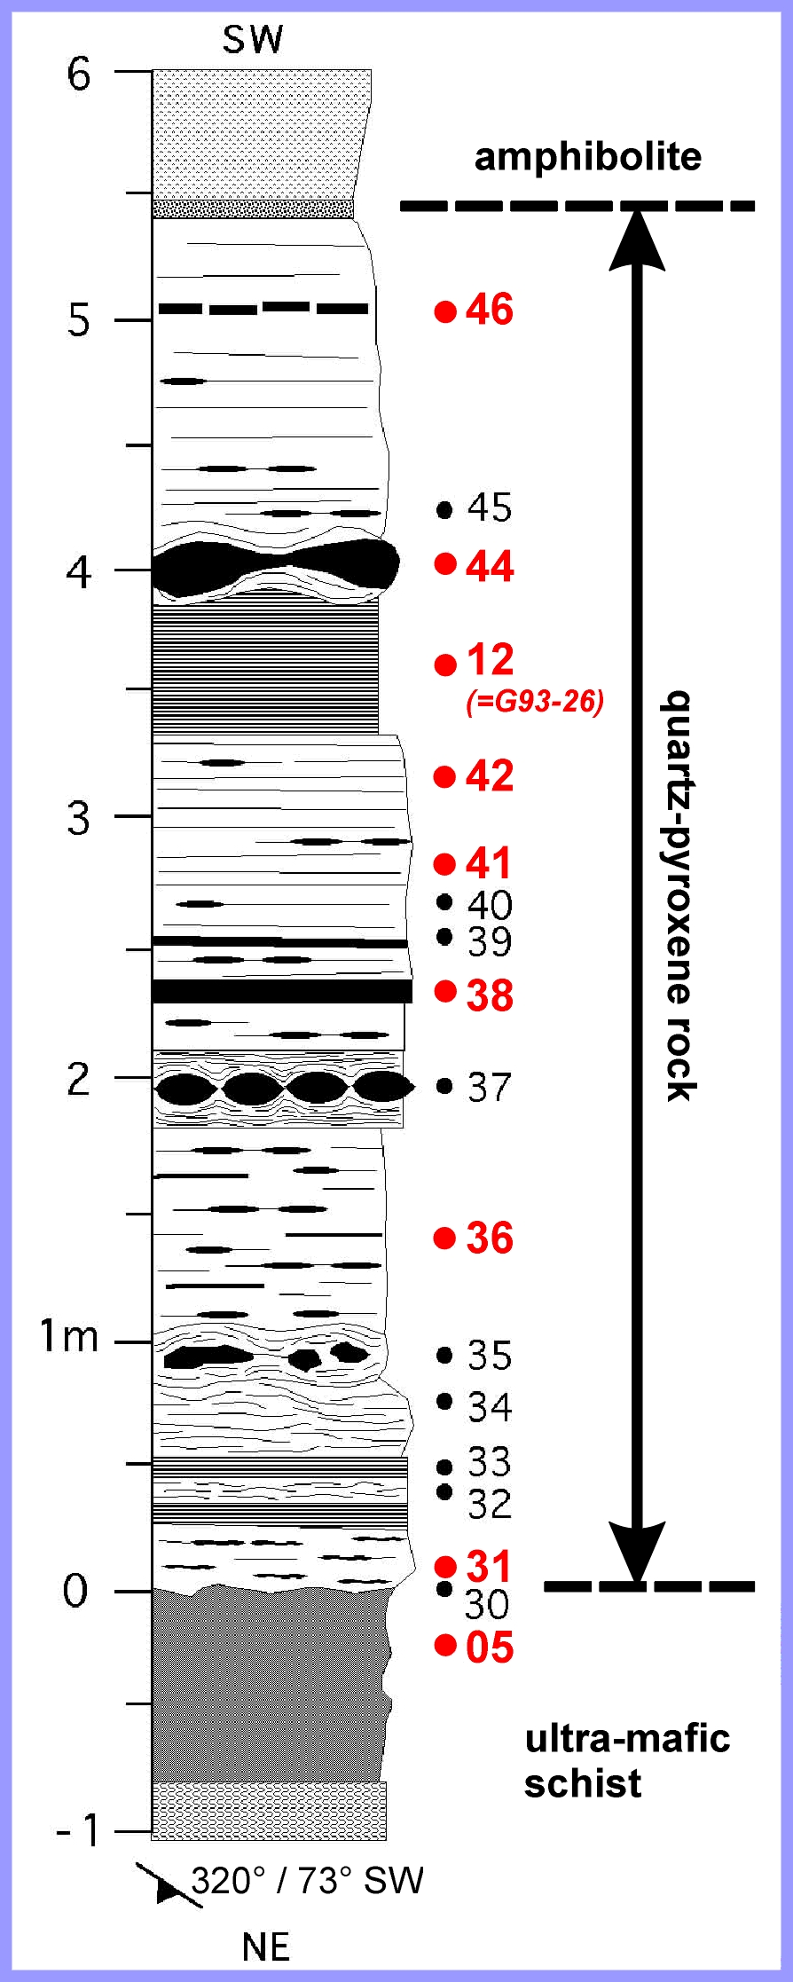
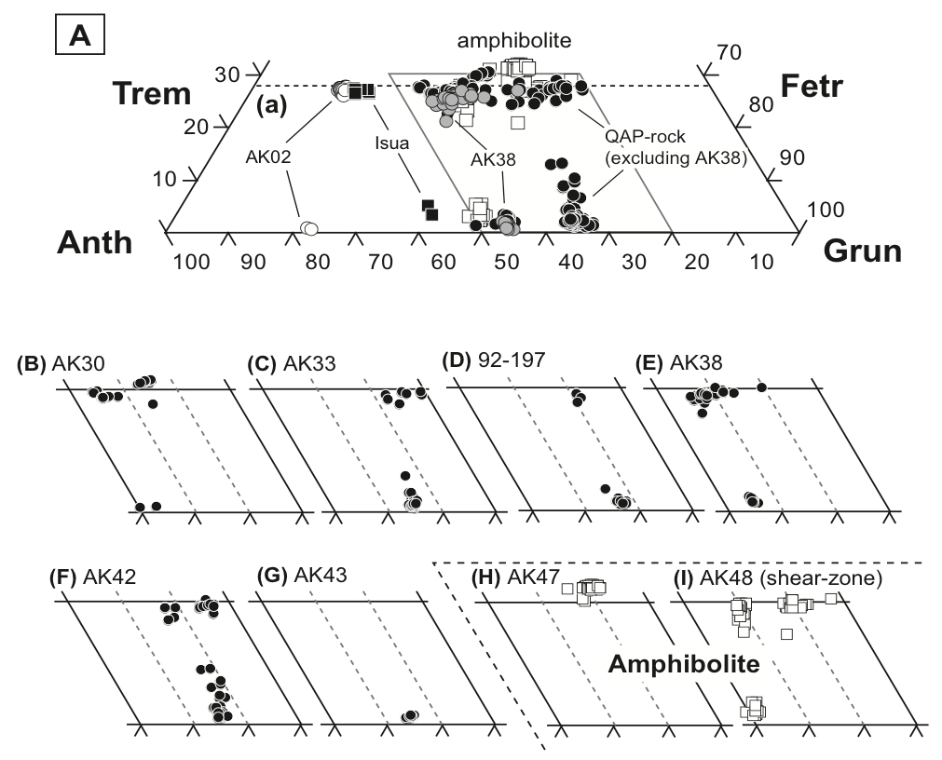
Amphibole Chemistry
•47
•43
•42
quartz-amphibole-pyroxene rock
•38
•33
•30
•02
Notes:
Within QAP, amphibole consists dominantly of actinolite, hornblende and cummingtonite
Outside QAP, mafic phases are dominated by anthophyllite, and hornblende, and possess whole-rock trace-element signatures indicative of an igneous origin (i.e., Th/Sc and Cr/Th ratios and abundances of Cr, Y, TiO₂.,P₂O₅.).

Slide 11
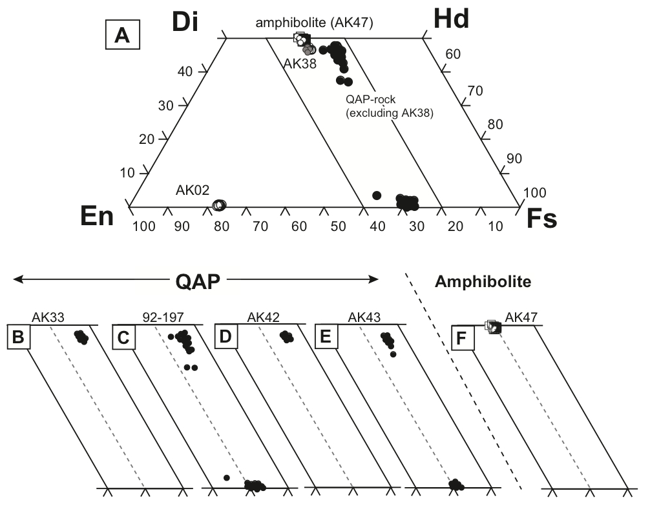
Pyroxene Chemistry
•47
•43
•42
quartz-amphibole-pyroxene rock
•38
•33
•30
•02
Notes:
Within QAP, pyroxene is dominantly diopside, hedenbergite and augite, which point to an original Mg-rich protolith.
Outside QAP, mafic phases are dominated by enstatite.

Slide 12
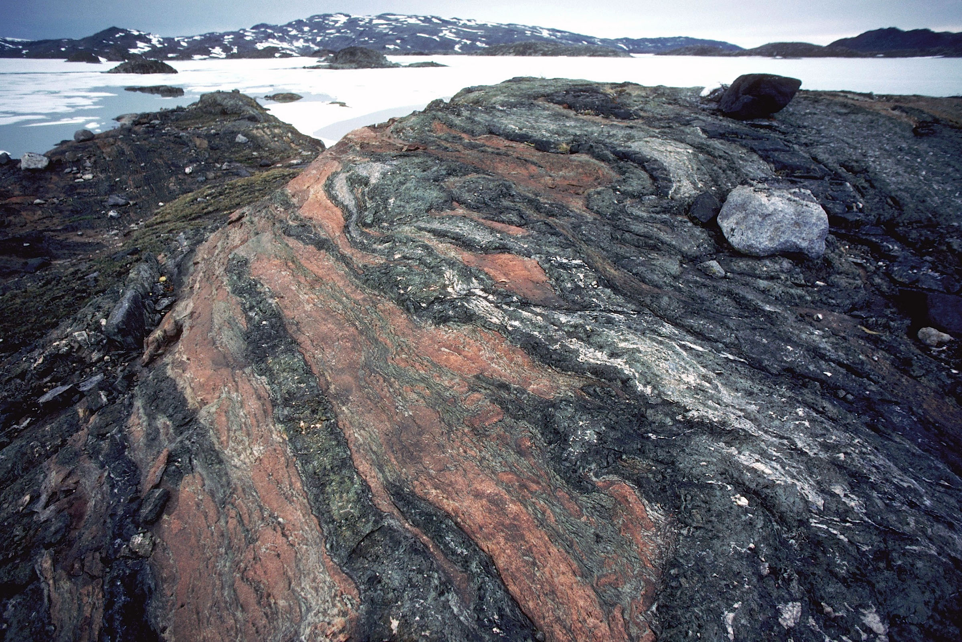
Possible Protolith for QAP
Two different intercalated protoliths exposed to granulite facies metamorphism
Ultra-mafic rocks with disseminated carbonate
Fe-rich carbonate band
Image copyright: James L Amos/corbis

Slide 13
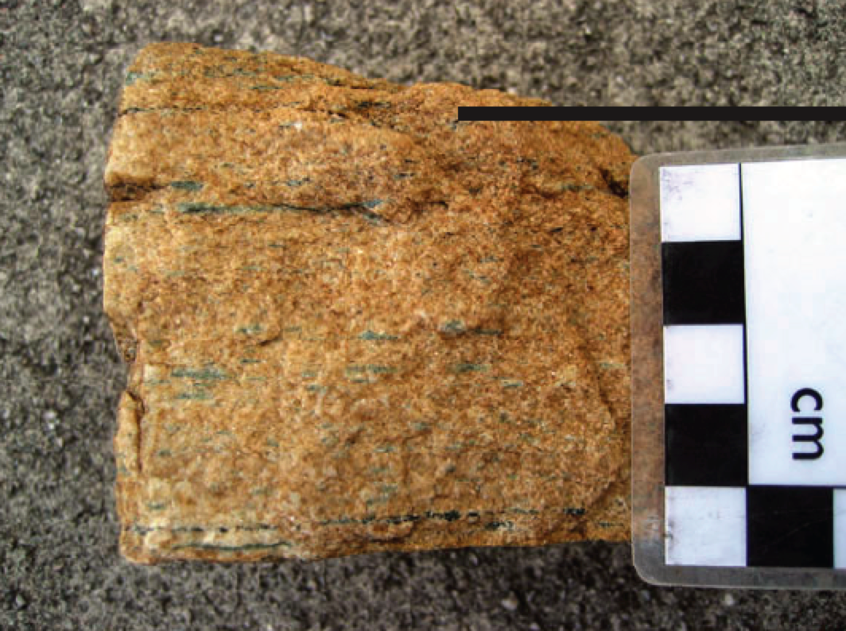
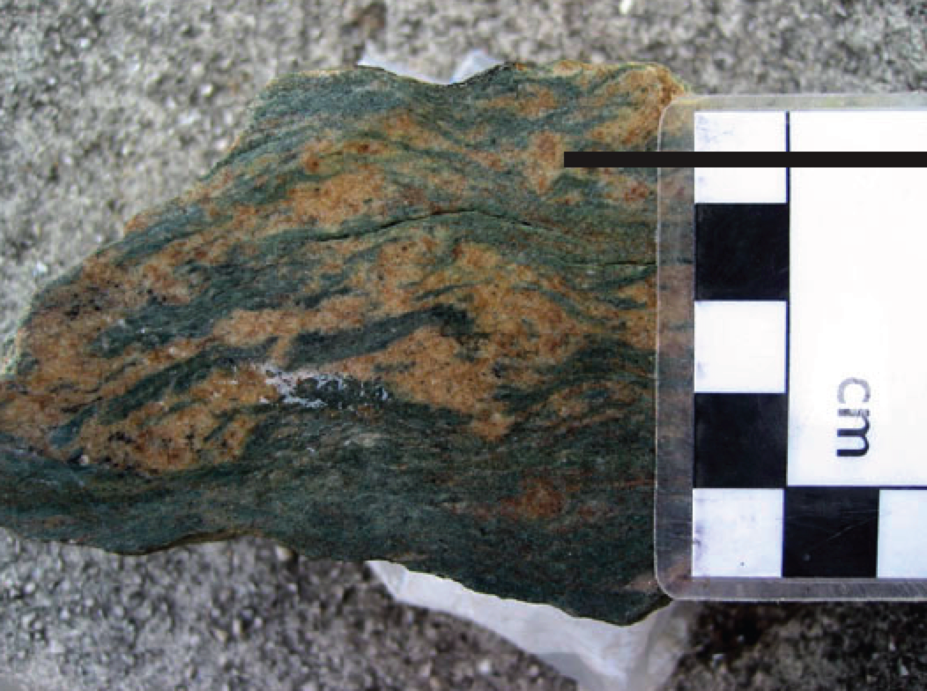
Ferroan dolomite (90%), with minor amounts of high-Ca amphibole (10%), quartz, and plagioclase feldspar
High and low Ca amphibole (50%) mixed with disseminated ferroan dolomite (45%), and lesser amounts of quartz, plagioclase feldspar, and micas
Carbonate metasomatized mafic samples from Isua that no longer exhibit a mafic geochemical signature
Metasomatic fluids may have removed all compatible elements
Geochemically more similar to Akilia QAP than Akilia ultramafic
Notes:
Have undisputed mafic protolith, but are geochemically more similar to Akilia QAP unit than to Akilia ultramafic unit (AK02)

Slide 14
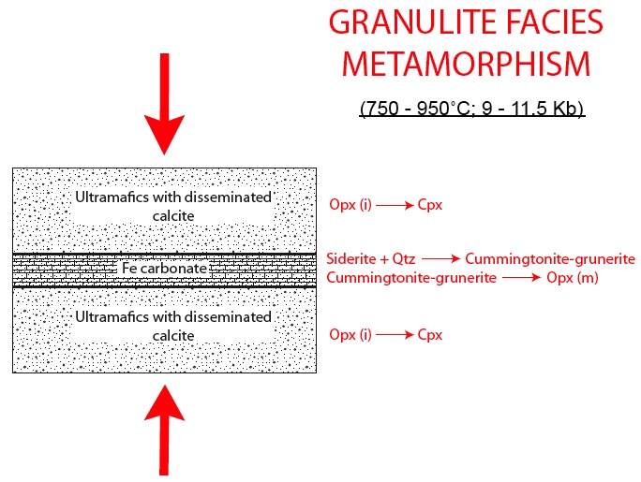
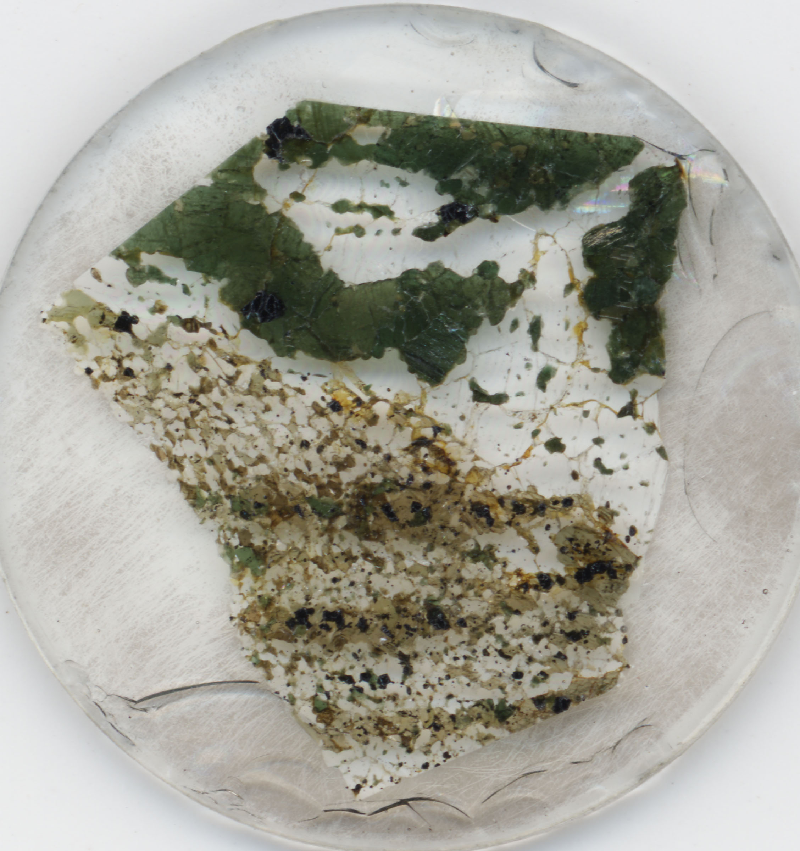
Proposed Model
Incident light
Mt
Cpx
Mg-rich ultramafic protolith with disseminated secondary carbonate ➔ Ca-rich pyroxenes
Fe-rich metasomatic carbonate band located within ultramafic protolith ➔ Low Ca pyroxenes and amphiboles
Opx
Amph
0.5 mm
Sample 92-197 (original “life rock”)
Notes:
The upper half of the thin section is coarsely crystalline, magnetite poor, and dominated by clinopyroxene and quartz. The lower half is finer grained, magnetite is present, and contains dominantly orthopyroxene, quartz, and amphiboles.

Slide 15
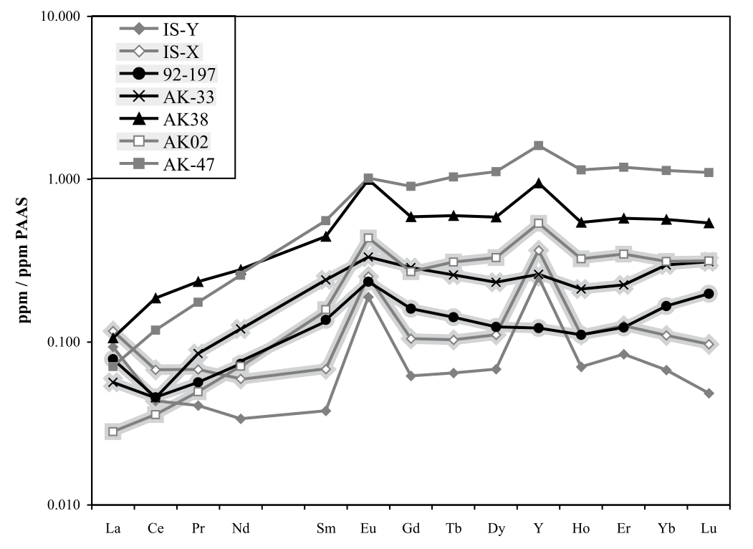
AK38 missing link between ultramafic rocks and rest of QAP unit
Most structurally intact layer; no boudinage, pinch-and-swell structures, or qtz infiltration
Geochemically like ultramafic rocks (AK02) + abundant Fe
•47
•43
•42
quartz-amphibole-pyroxene rock
•38
•33
•30
•02
Notes:
Sample AK 38 appears to be the critical sample that links a possible ultramafic protolith to the rest of the QAP rocks. The layer from which this sample was collected is the thickest, most structurally intact layer of the QAP outcrop, and lacks evidence for boudinage, pinch-and-swell structures, or quartz infiltration. Sample AK 38 has a geochemical fingerprint that is more similar an ultramafic rock than any other subunit of the QAP outcrop. Samples AK 02 and AK 38 possess nearly identical REY patterns. When compatible element (Cr, Sc, Sr, Co, V, and Zn) concentrations are compared, AK 38 is more similar to AK 02 than other QAP subunits .

Slide 16
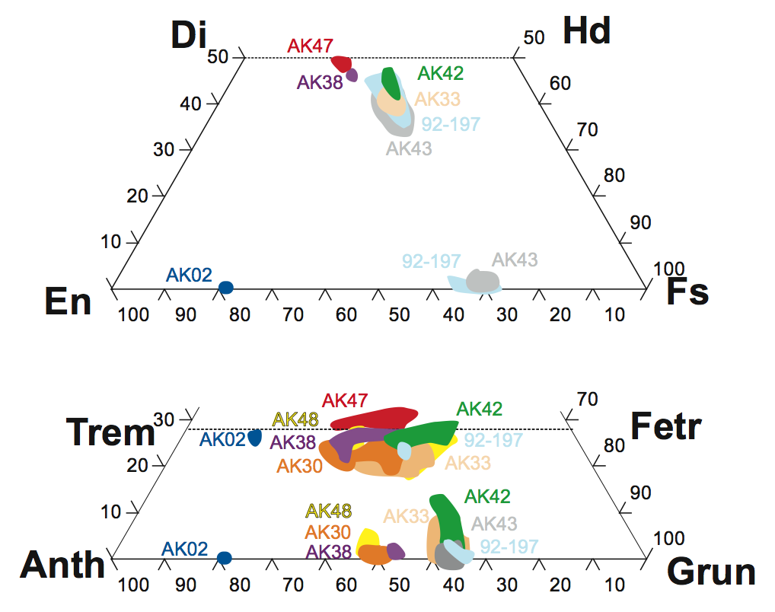
•47
Ca addition
•43
•42
Fe addition
quartz-amphibole-pyroxene rock
•38
Ca addition
•33
Fe addition
•30
•02

Slide 17
Conclusions
Uniformity of all structural measurements between the Amîtsoq Gneiss and Akilia Association → relationship tectonic, not igneous
Any prior relationships erased during high-T and high-P deformation and metamorphism.
Provides no age constraints on depositional age of the QAP unit
Amphibole: actinolite, hornblende and cummingtonite
Pyroxene: diopside, hedenbergite and augite
Carbonate- and silica-metasomatized ultramafic rocks represents a plausible explanation for the compositions of most of the QAP lithology and is based on known, highly relevant geology.
Ultramafic rocks with disseminated carbonate and Fe-rich carbonate bands occur in the amphibolite-facies metamorphosed Isua Greenstone Belt
BIF protolith unnecessary

Slide 18
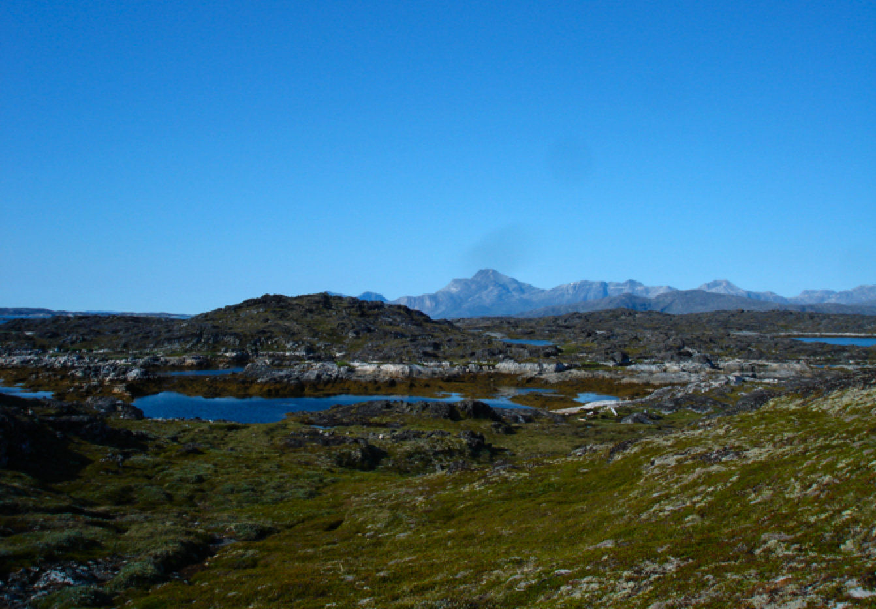
Acknowledgments
NASA grant EXOB08-0063 (CMF)
American Philosophical Society and NASA Astrobiology Institute’s Lewis and Clark Fund for Exploration and Field Research in Astrobiology
GSA Student Research Grant
Precambrian Institute Center Student Grant
Mayo Educational Foundation Scholarship.

Slide 19
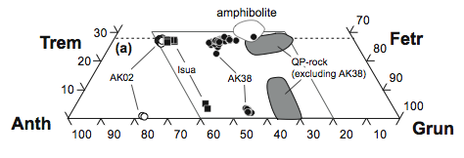
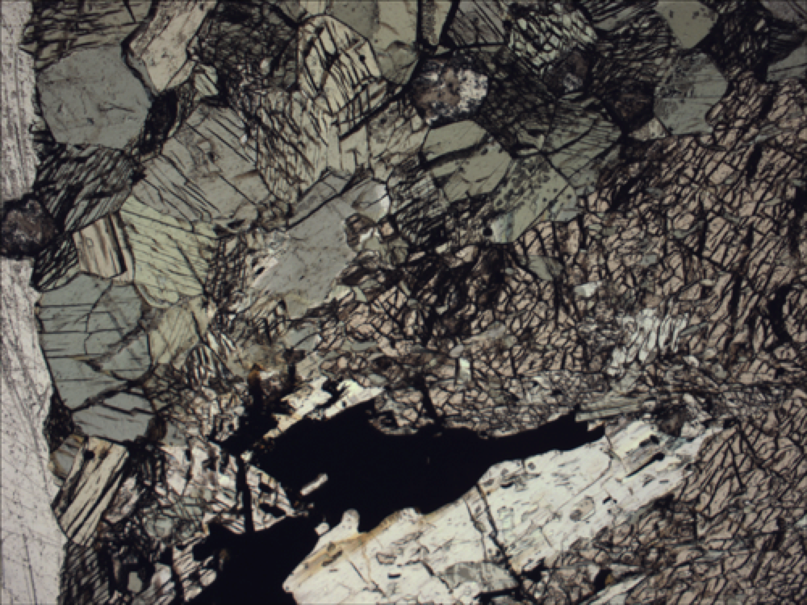
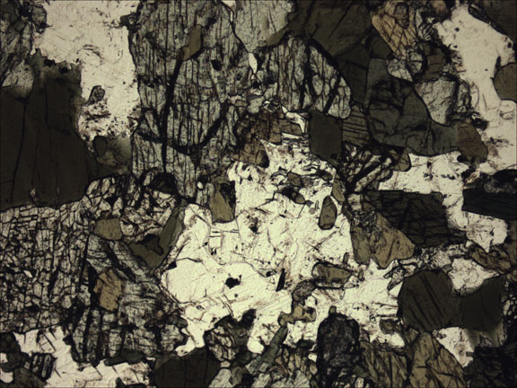
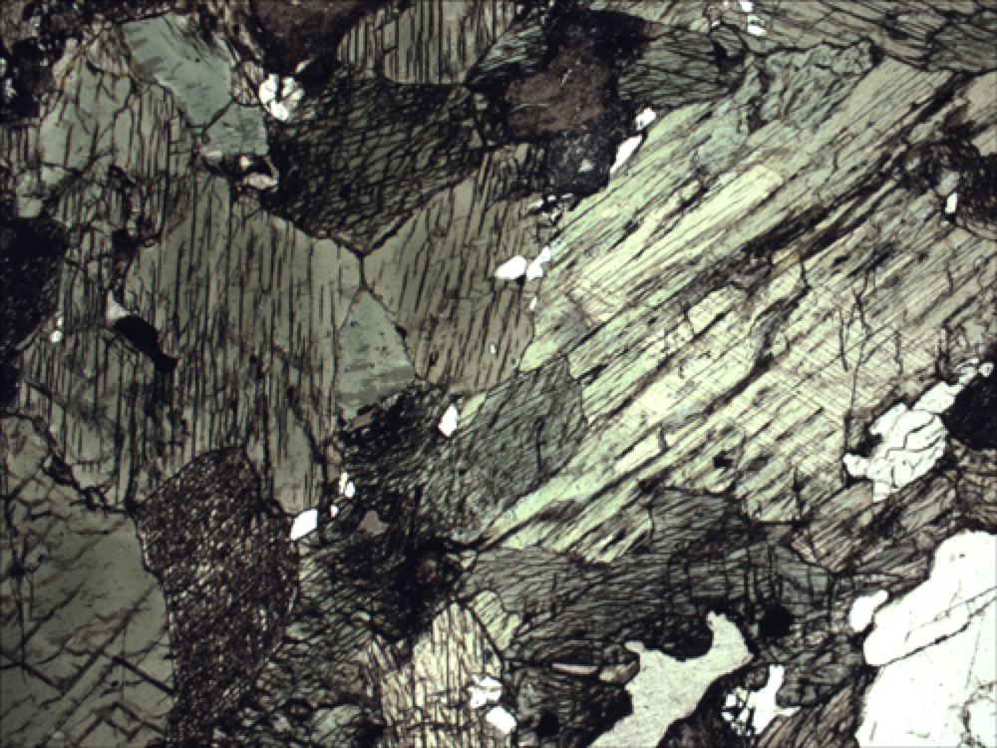
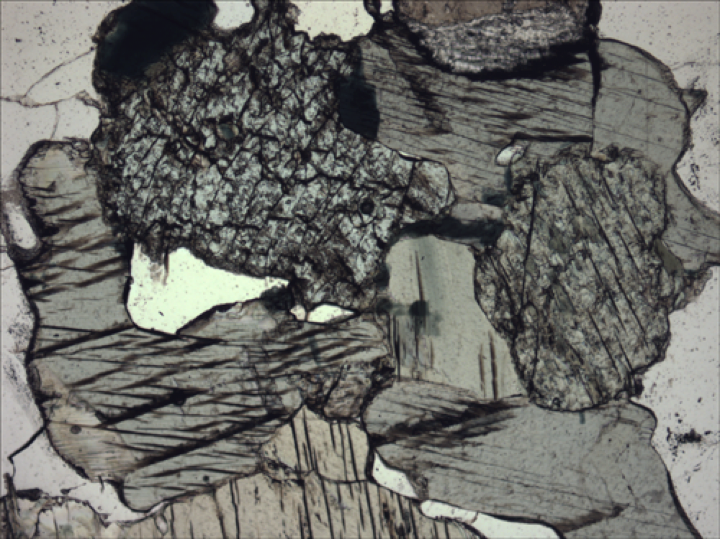
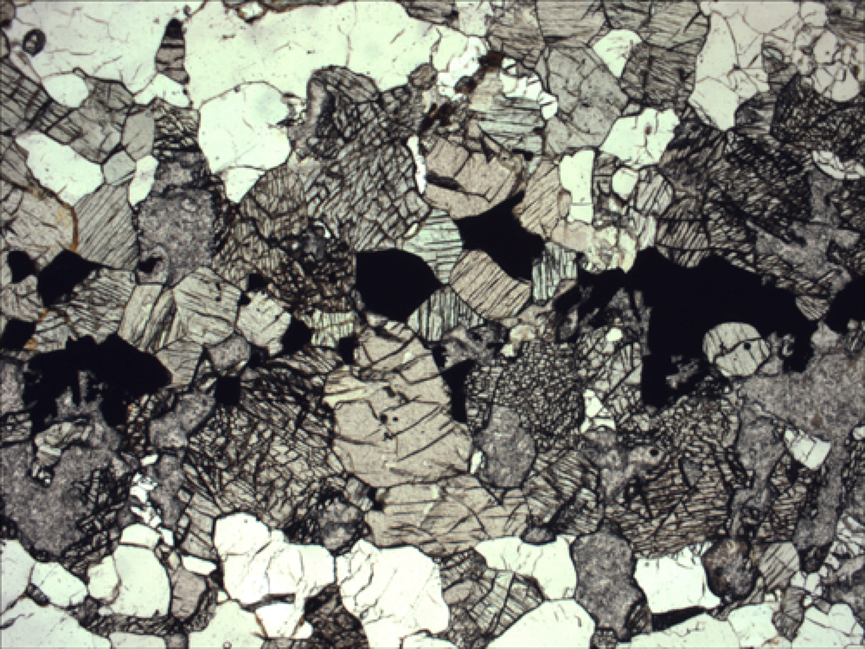
Amphibole Chemistry
•47
amphibolite
Trem
Fer
QAP (excluding AK38
•43
•42
Anth
Grun
quartz-amphibole-pyroxene rock
•38
•33
•30
•02
F.O.V. is 2.5 mm

Slide 20
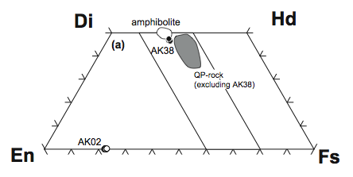
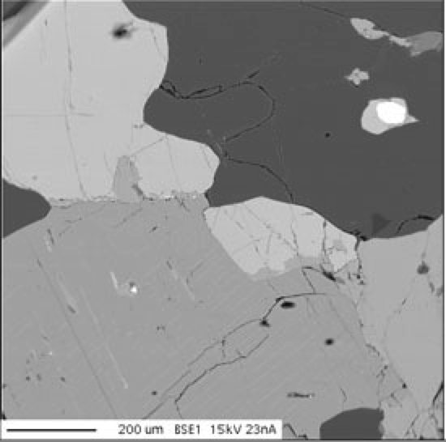
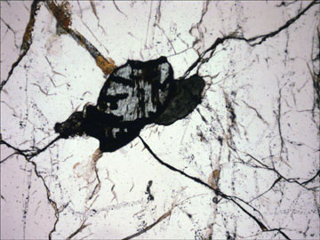
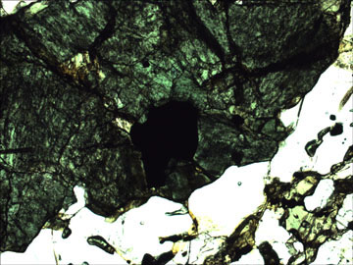
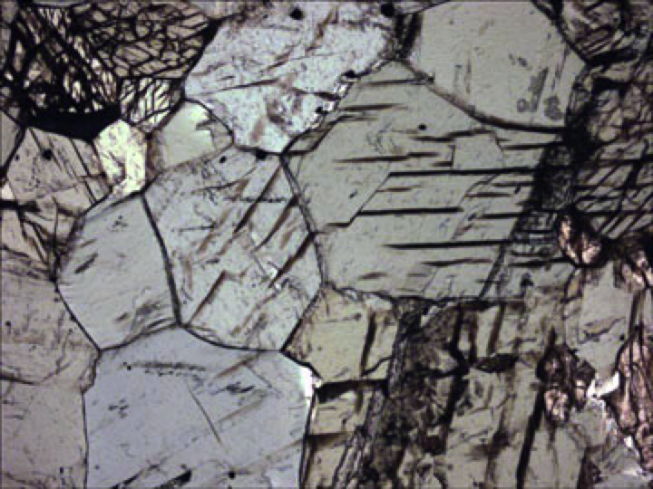
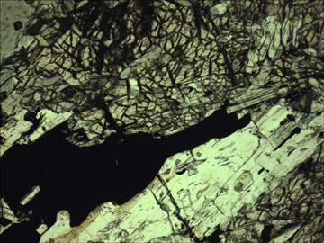
Pyroxene Chemistry
•47
Di
Hd
•43
•42
quartz-amphibole-pyroxene rock
•38
En
Fs
opx
•33
cpx
•02

Slide 21
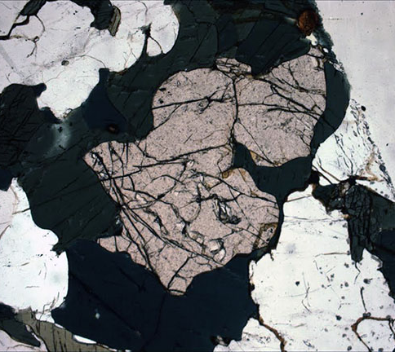
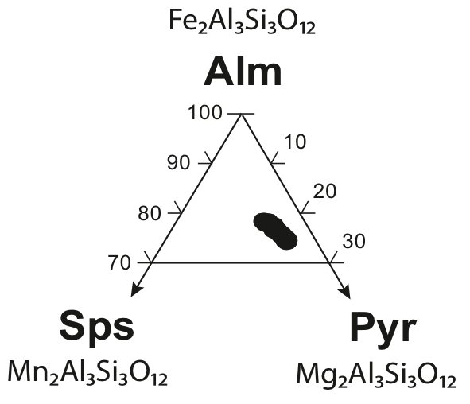
Evidence for Post-Depositional Fe Enrichment
and Mobility: Fe-Rich Garnets
Sample AK33
Notes:
Additional evidence for Fe enrichment comes from the chemistry of garnets found in sample AK 33 and AK 48 from the QAP unit indicates a consistent and homogenous almandine composition, comprised predominantly of FeO (30 wt. %) and Al₂O₃ (21 wt. %), with lesser amounts of CaO (8 wt. %) and MgO (2 wt. %). Data points for each sample overlaps each other.

