Slide 1

What Can the Study of Modern Seismicity Tell Us About Past and Future Large Shocks?
Martin Chapman, Qimin Wu, Anna Hardy and Jacob Beale
2016 Annual Meeting
Geological Society of America
September 27, 2016
Denver, Colorado

Slide 2
OUTLINE
Review of Source Rupture Process for the 2011 Mineral, VA earthquake
Review of Results from the Analysis of the August 25, 2011 - January 12, 2012
Mineral Aftershocks
Results from a 1-year Temporary Network Deployment in Summerville, SC
Comparison of the Mineral Aftershocks with Current Seismicity in and around
Summerville
Hot off the Press View of the Correlation of Lidar Lineaments with shallow
Mineral, VA aftershocks (time permitting).

Slide 3
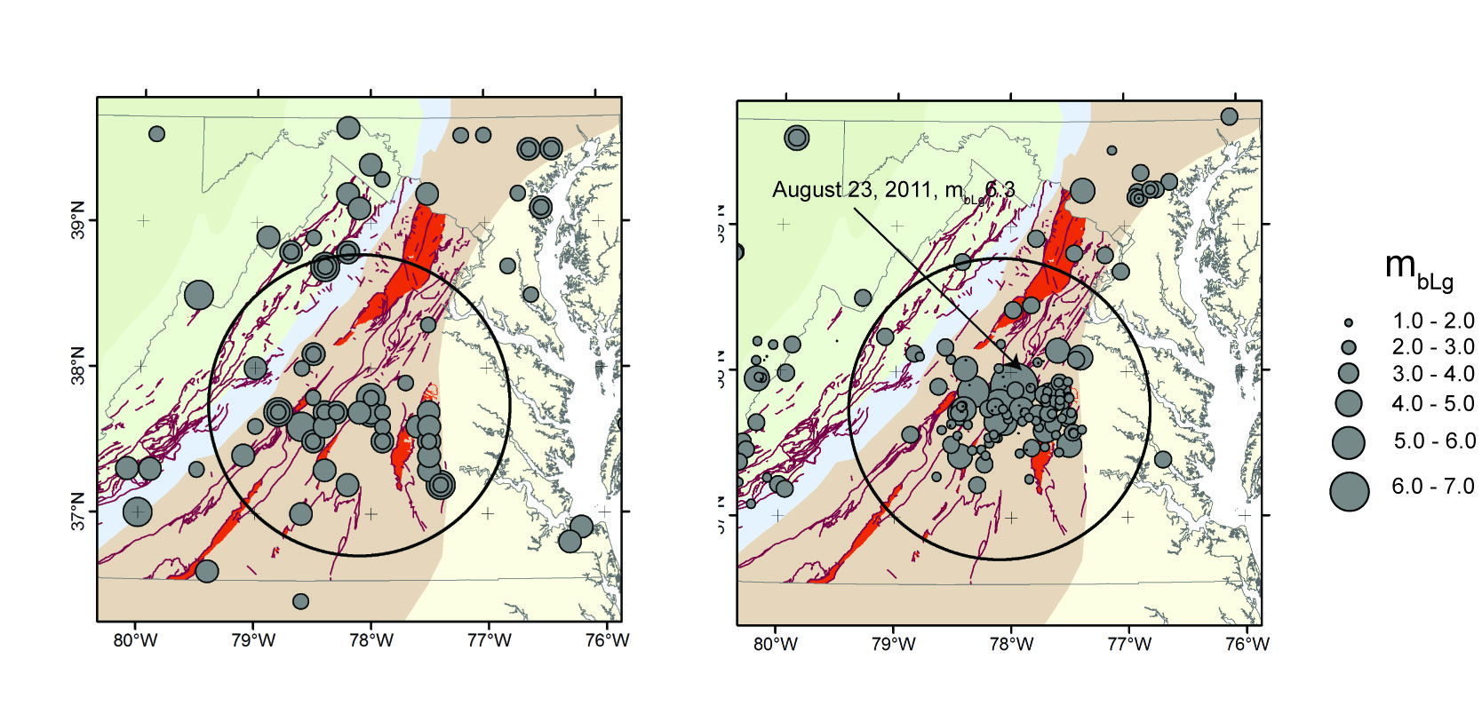
Central Virginia Seismic Zone
Historical (pre-instrumental)
Instrumentally located

Slide 4
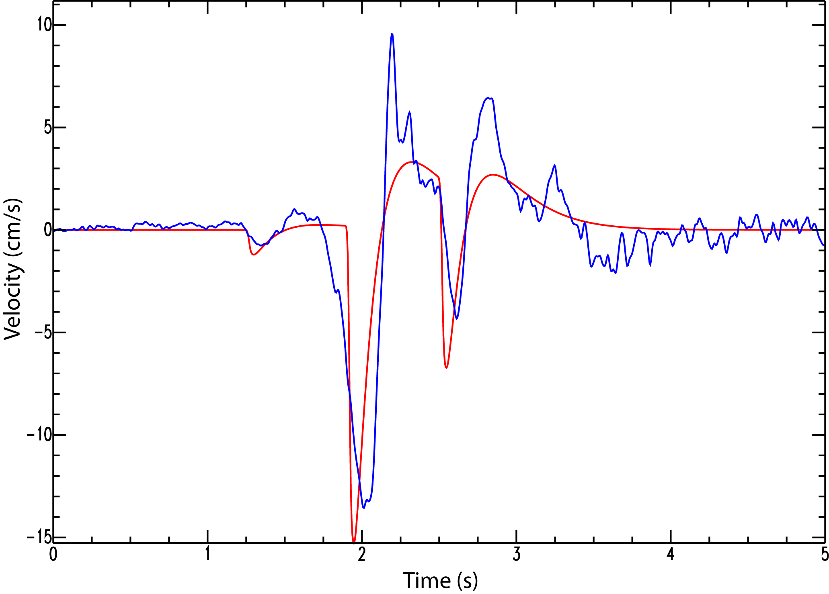
Transverse Component of Ground Velocity, North Anna Nuclear Power Station, 23 km from Epicenter
Observed data
(transverse)
additional pulses ?
0.25 x 10²⁴ dyne-cm
50 bars: M_{w} 4.9
synthetic velocity record
comprised of 3 subevents
2.25 x 10²⁴ dyne-cm
300 bars: M_{w} 5.5
1.22 x 10²⁴ dyne-cm
300 bars: M_{w} 5.4
The mainshock started out as mediocre M_{w} 4.9 event. But that initial subevent
was followed by two much larger subevents that accounted for most of the
moment release.
From: Chapman, M.C., (2013). On the Rupture Process of the 23 August 2011 Virginia Earthquake, Bulletin of the Seismological Society of America, 103, 613-628.

Slide 5
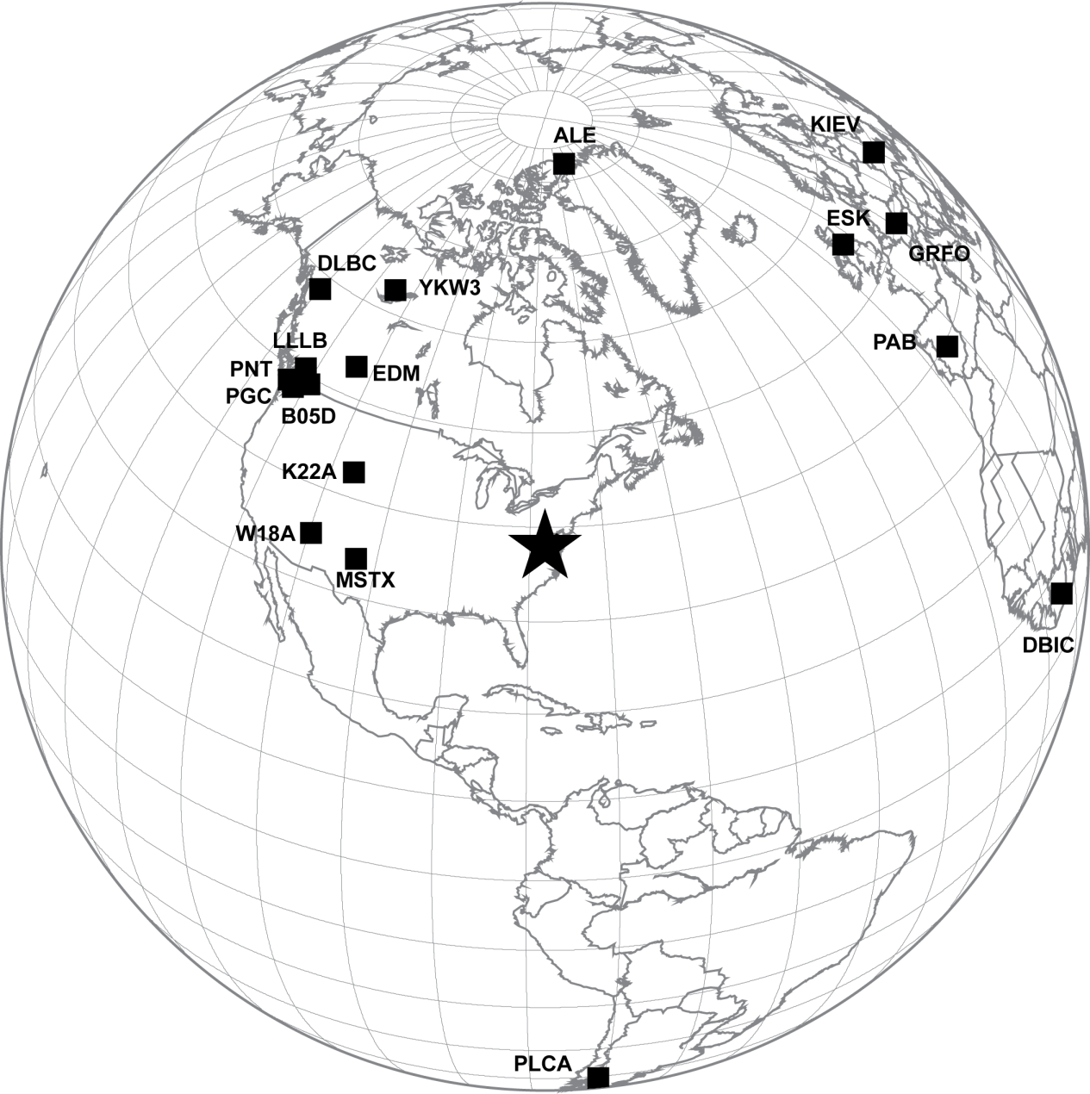
Fortunately, 17 teleseismic stations at distances beyond 20 degrees showed clear
sub-event arrivals
From: Chapman, M.C., (2013). On the Rupture Process of the 23 August 2011 Virginia Earthquake, Bulletin of the Seismological Society of America, 103, 613-628.

Slide 6
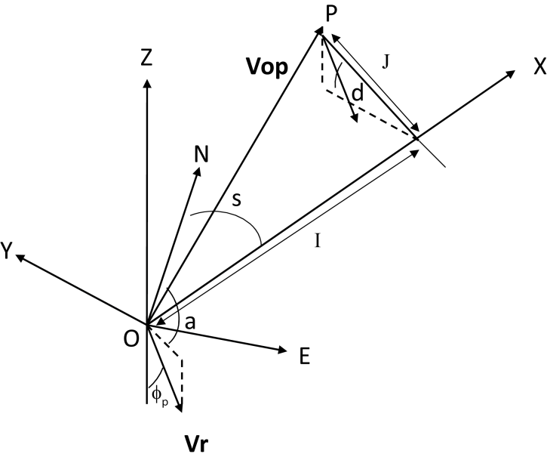
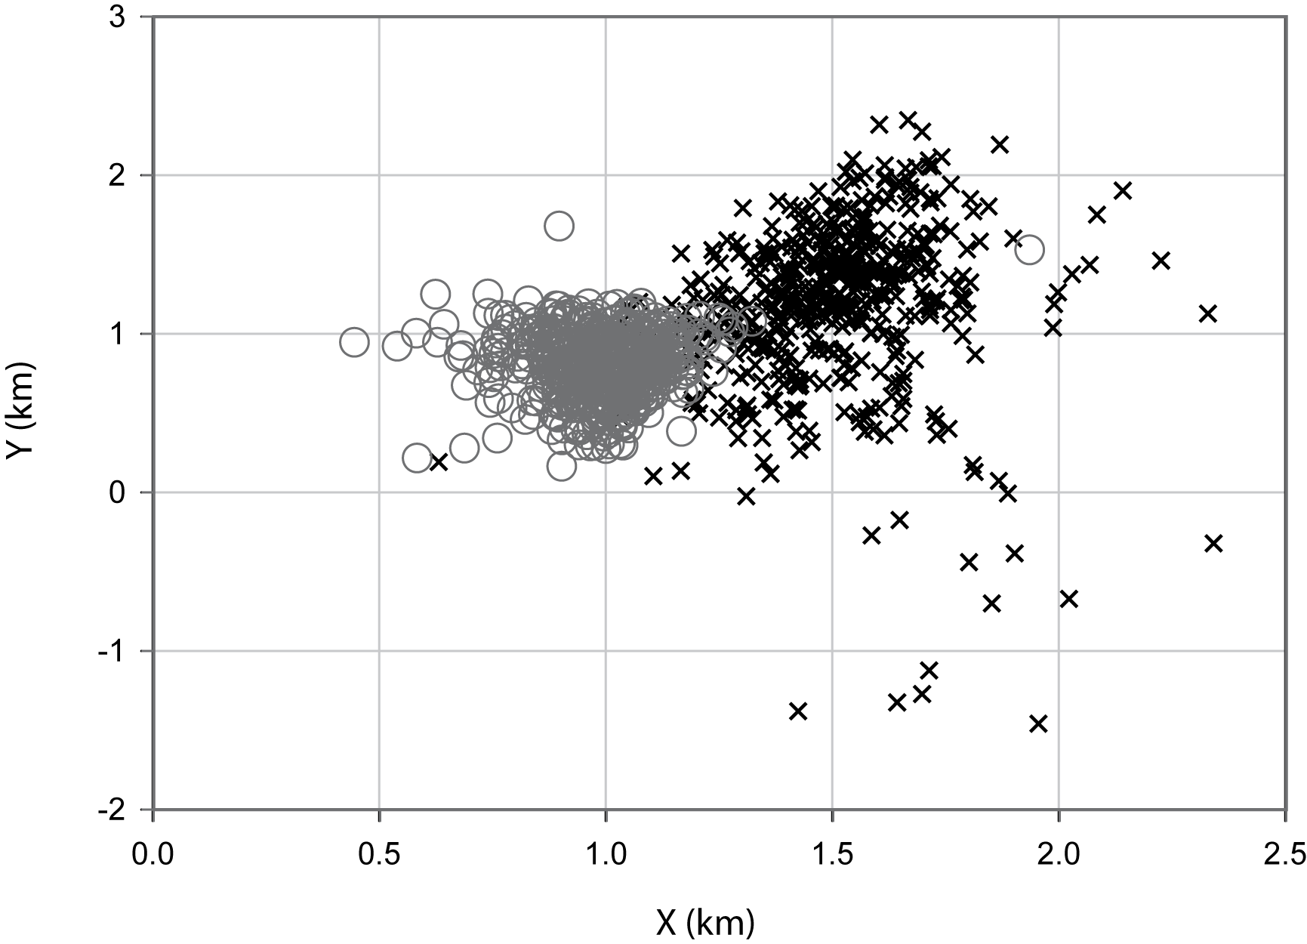
The arrival times of the subevents at local, regional
and teleseismic stations
were used to determine the relative locations.
Fault Plane
3rd subevent
2nd subevent
Location of initial
subevent
From: Chapman, M.C., (2013). On the Rupture Process of the 23 August 2011 Virginia Earthquake, Bulletin of the Seismological Society of America, 103, 613-628.

Slide 7
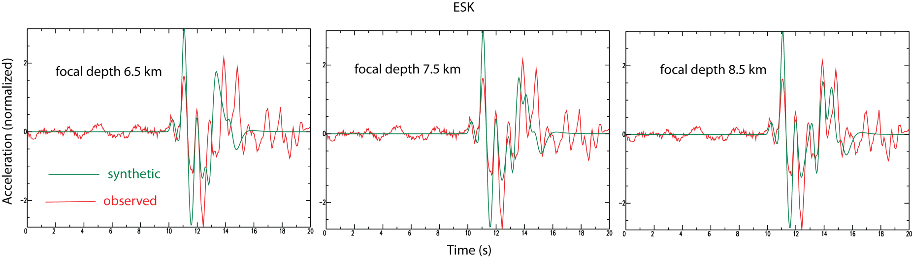
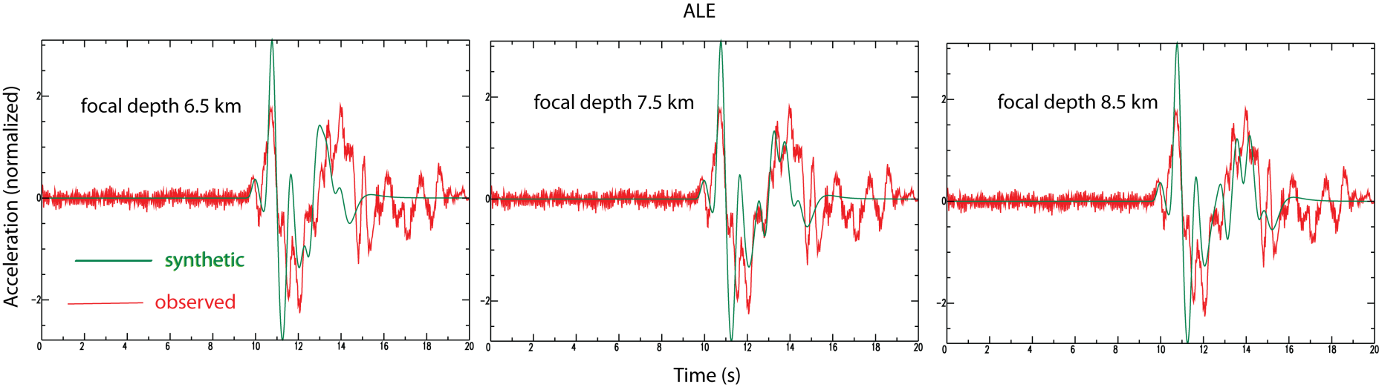
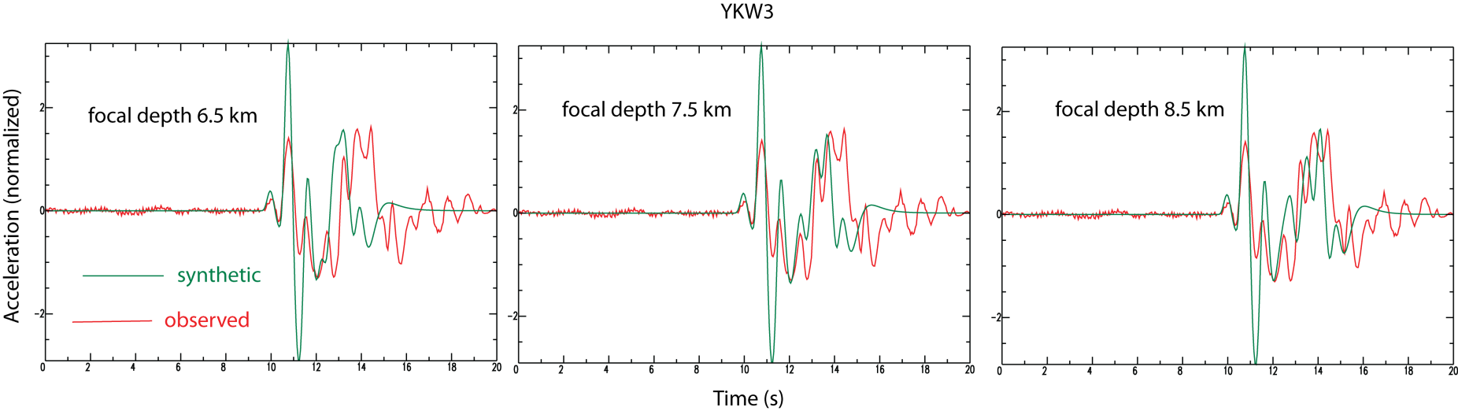
Focal depth (8.0 km) was determined from teleseismic waveform matching
From: Chapman, M.C., (2013). On the Rupture Process of the 23 August 2011 Virginia Earthquake, Bulletin of the Seismological Society of America, 103, 613-628.

Slide 8
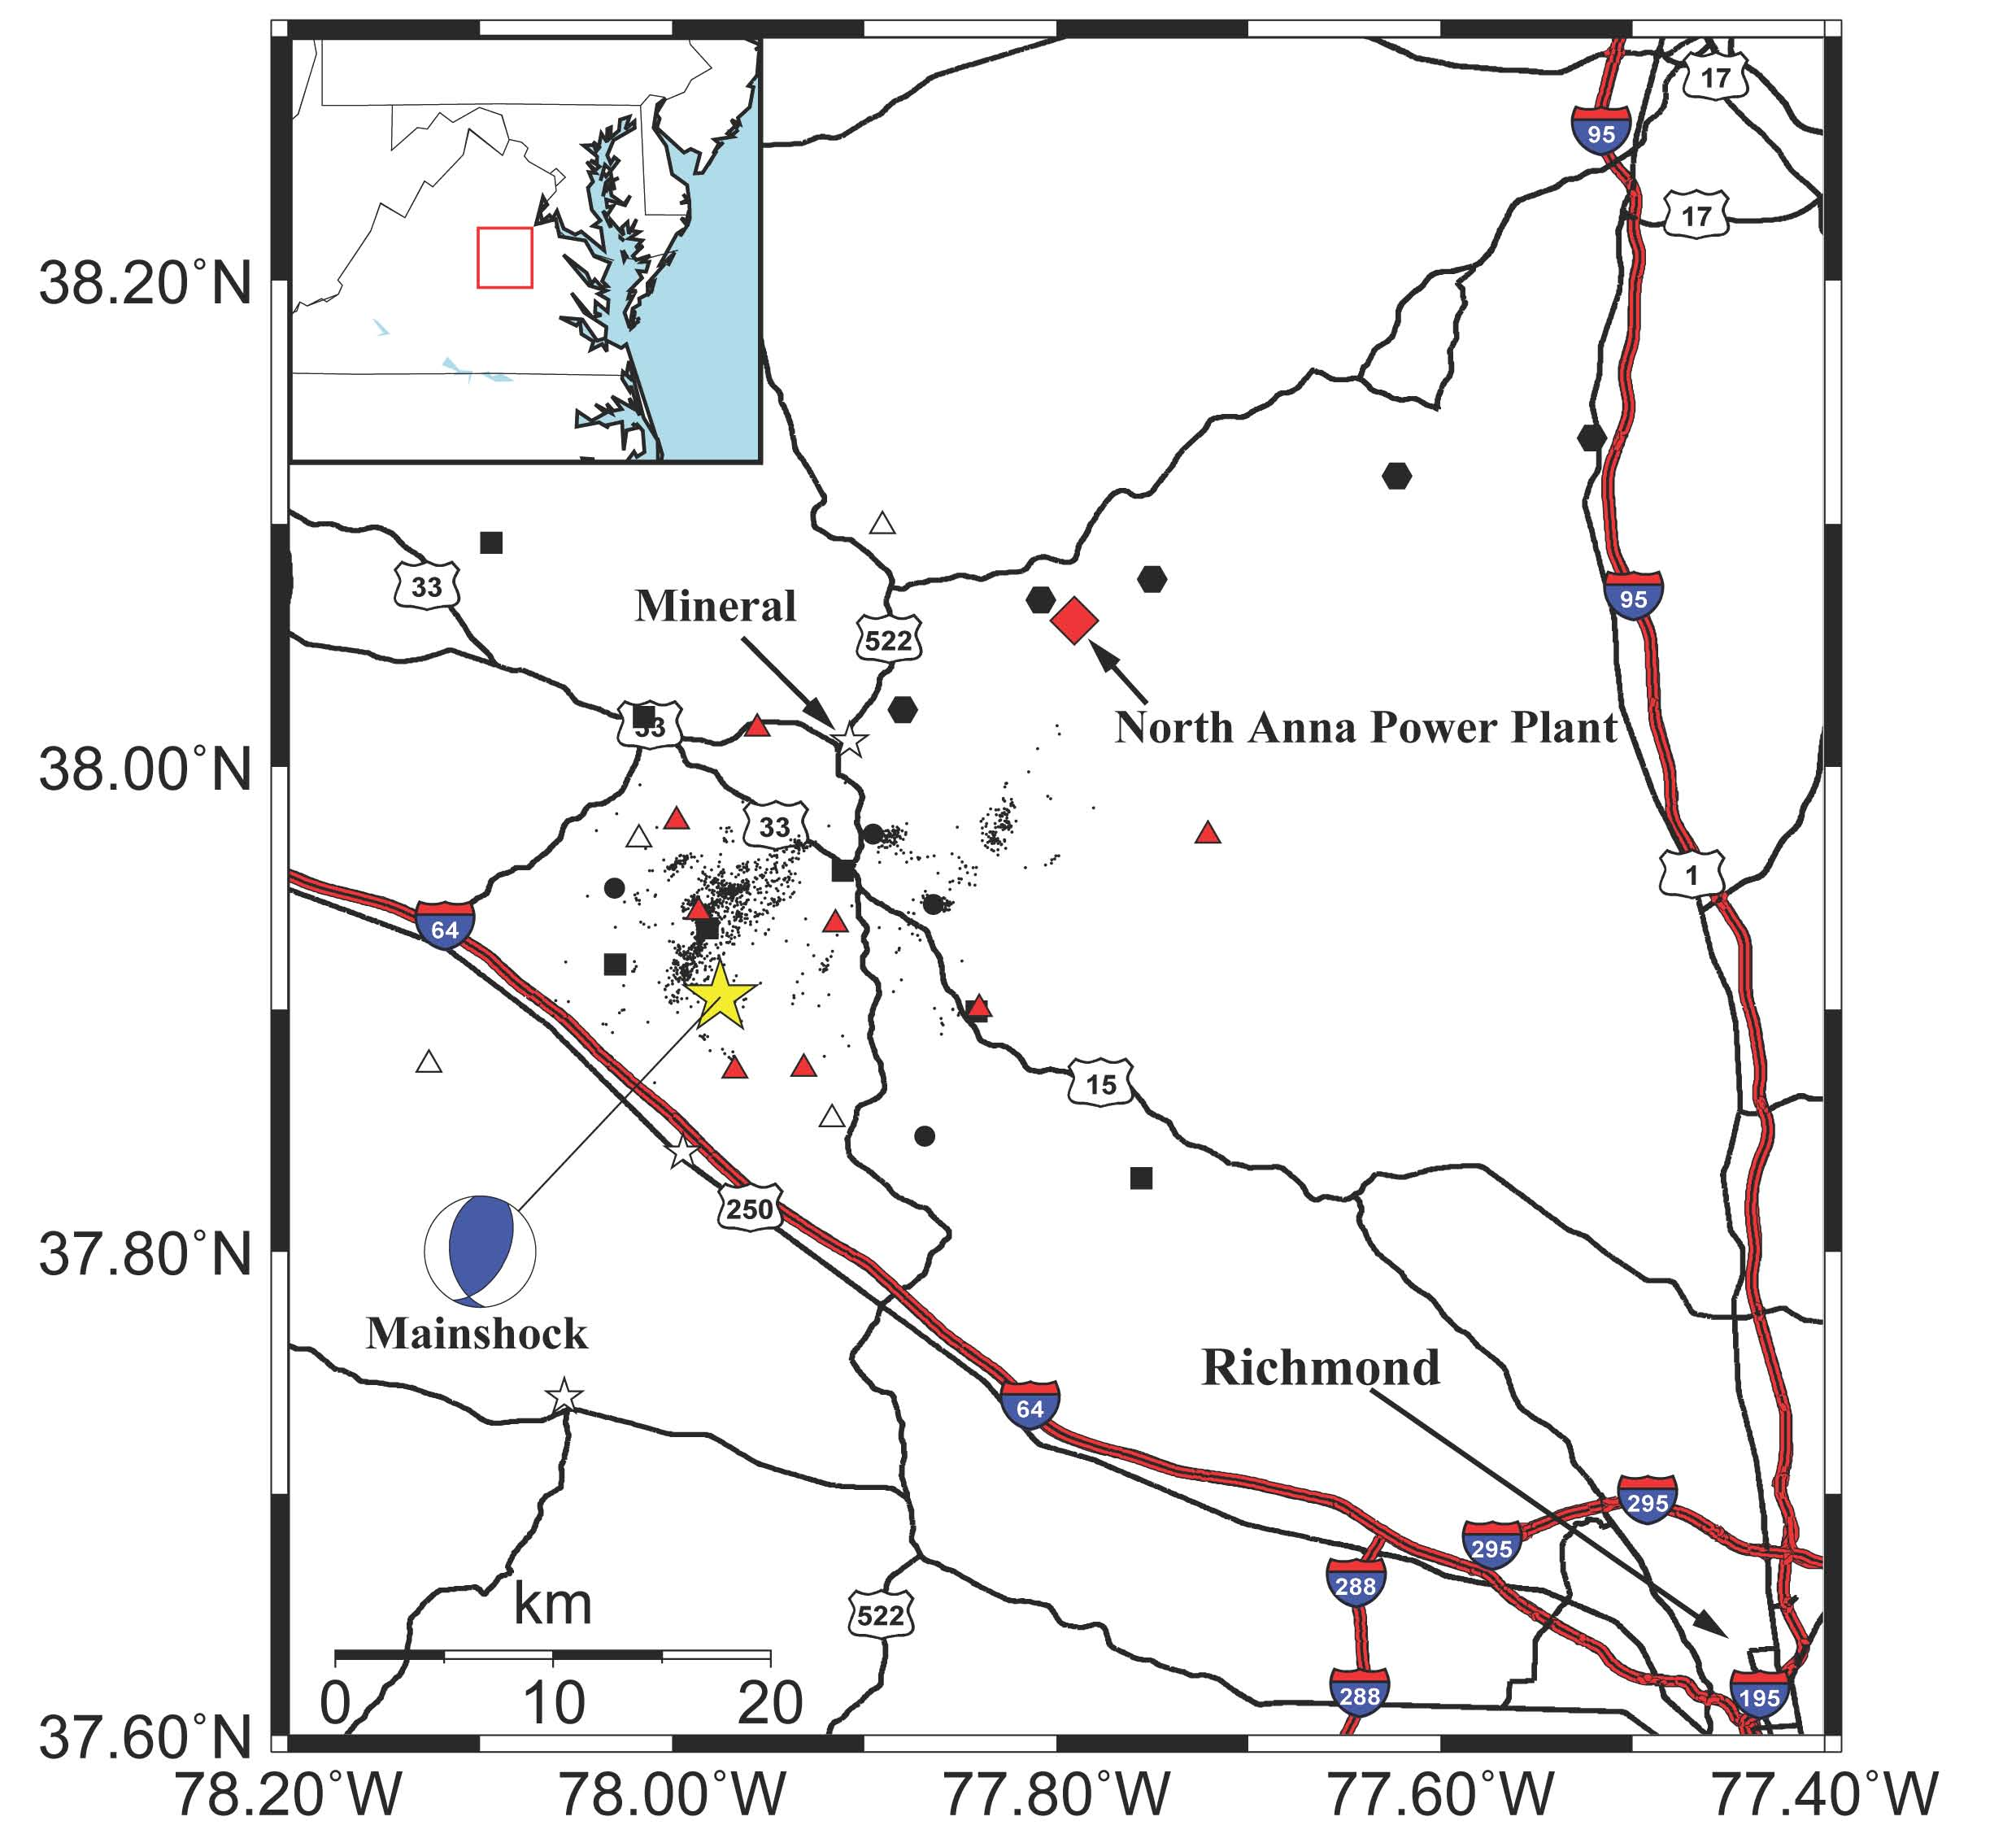
The mainshock was poorly recorded, but the aftershock sequence was one of the
Best ever recorded in the eastern U.S
Temporary seismic
stations operating
from August 23, 2011
until early January, 2012.
Contributors: Virginia Tech, University of Memphis, Lehigh University, IRIS, USGS.
From: Wu, Qimin, M.C. Chapman and J.N. Beale, 2015, The Aftershock Sequence of the 2011 Mineral, Virginia,
Earthquake: Temporal and Spatial Distribution, Focal Mechanisms, Regional Stress and the Role of Coulomb Stress Transfer, Bulletin of the Seismological Society of America, v. 105, no. 5, p. 2521-2537, doi. 10.1785/0120150032.

Slide 9
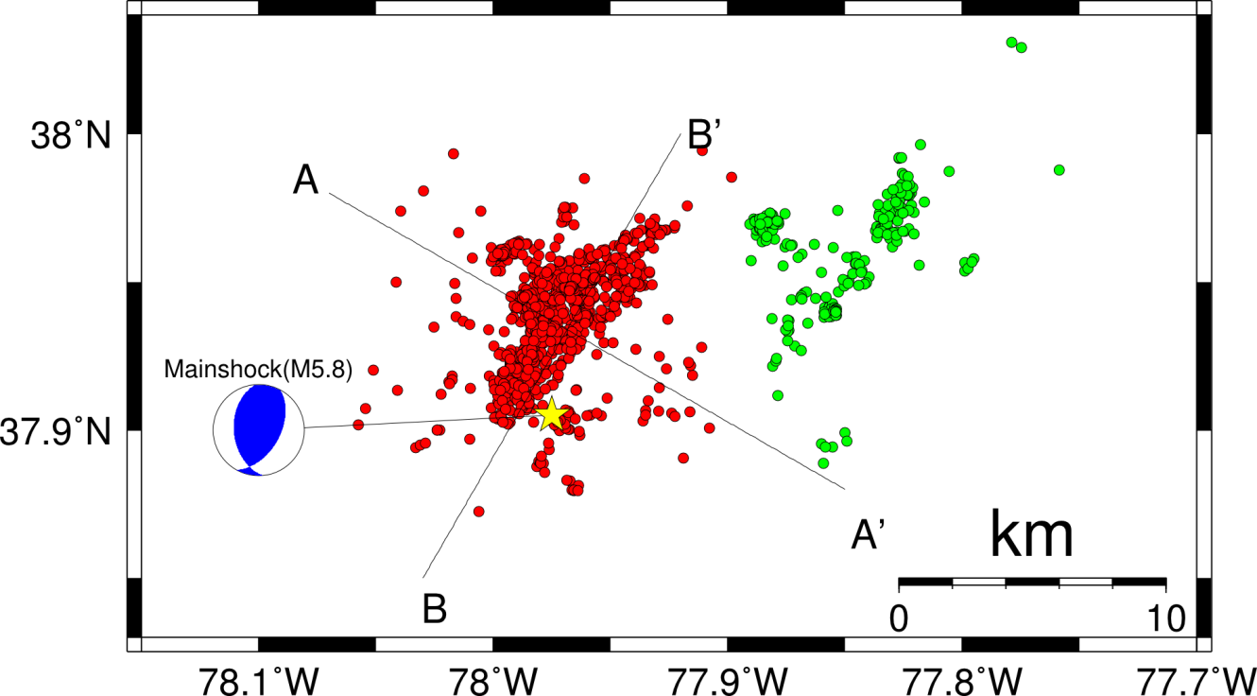
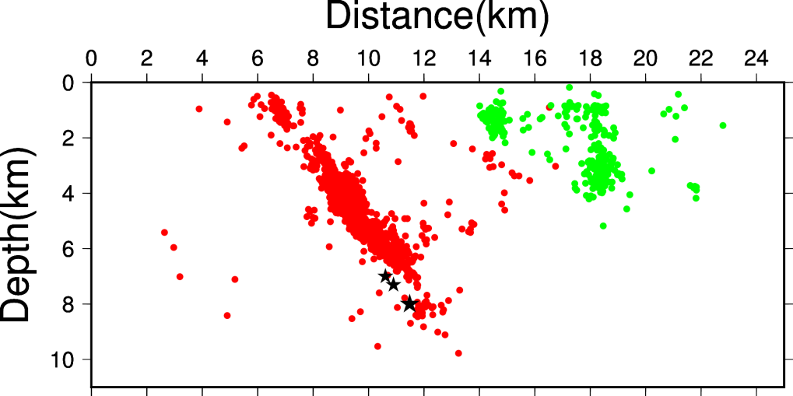
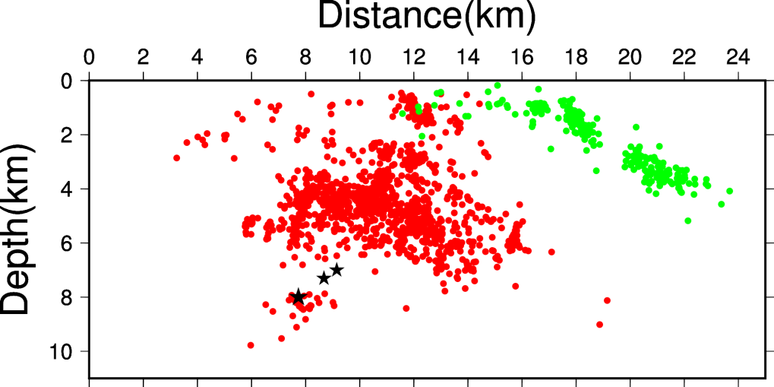
Double-Difference Aftershock Relocation (1,712 events)
Wu et al. (2015)
A
A’
B
B’
Black stars: 3 subevents of the mainshock (Chapman, 2013)
From: Wu, Qimin, M.C. Chapman and J.N. Beale, 2015, The Aftershock Sequence of the 2011 Mineral, Virginia,
Earthquake: Temporal and Spatial Distribution, Focal Mechanisms, Regional Stress and the Role of Coulomb Stress Transfer, Bulletin of the Seismological Society of America, v. 105, no. 5, p. 2521-2537, doi. 10.1785/0120150032.

Slide 10
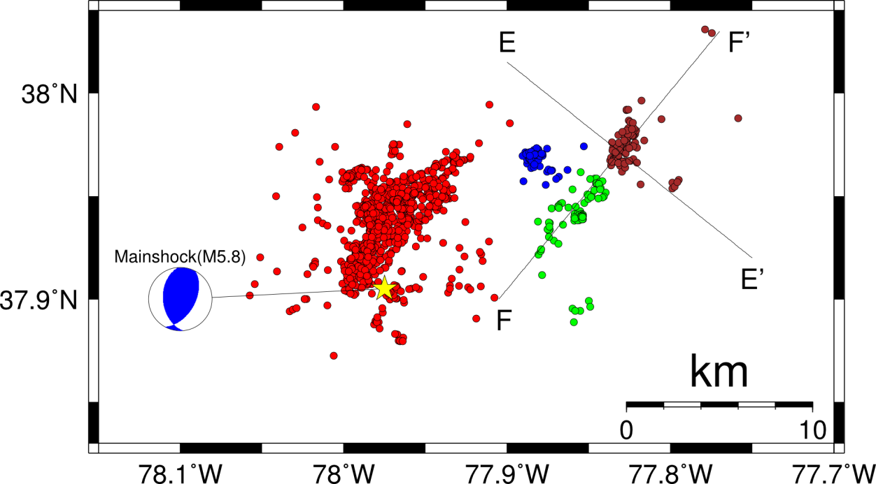
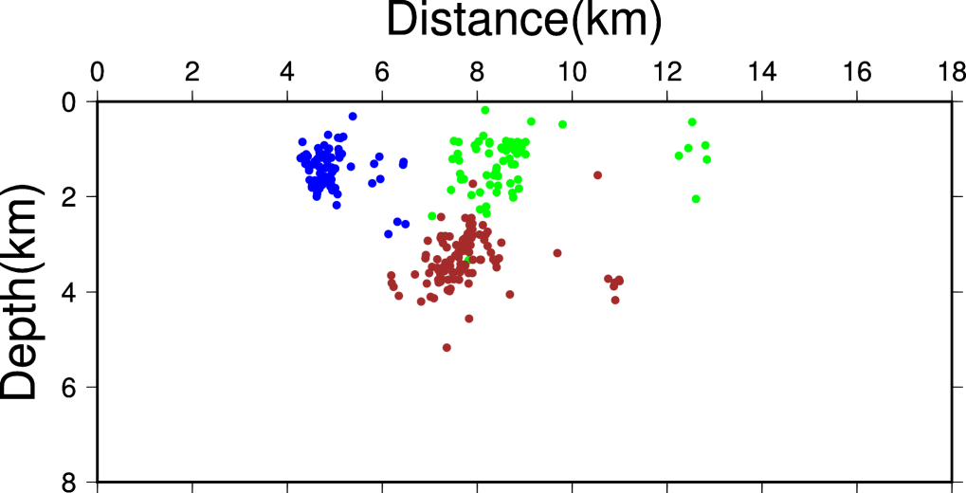
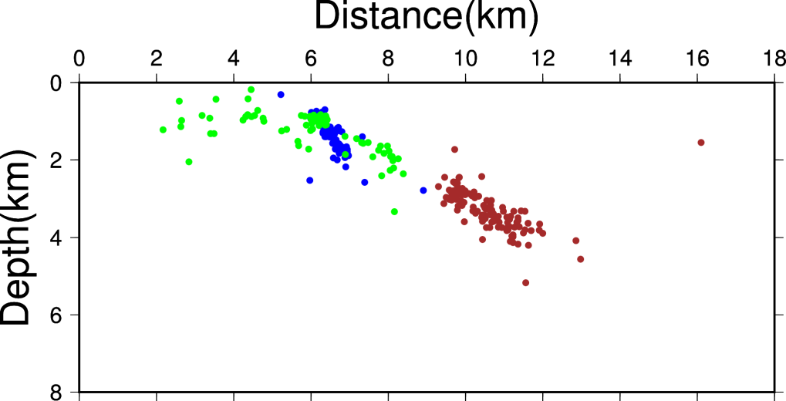
Northeastern aftershocks
E
E’
F
F’
From: Wu, Qimin, M.C. Chapman and J.N. Beale, 2015, The Aftershock Sequence of the 2011 Mineral, Virginia,
Earthquake: Temporal and Spatial Distribution, Focal Mechanisms, Regional Stress and the Role of Coulomb Stress Transfer, Bulletin of the Seismological Society of America, v. 105, no. 5, p. 2521-2537, doi. 10.1785/0120150032.

Slide 11
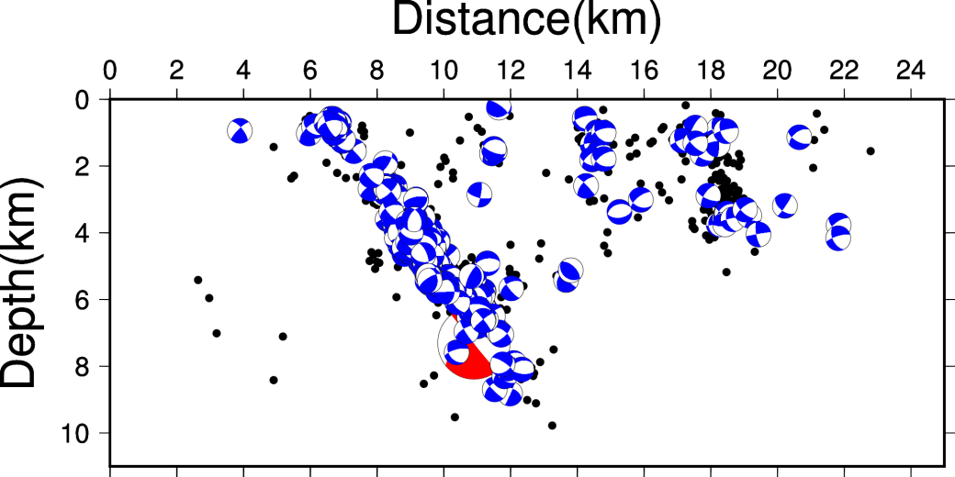
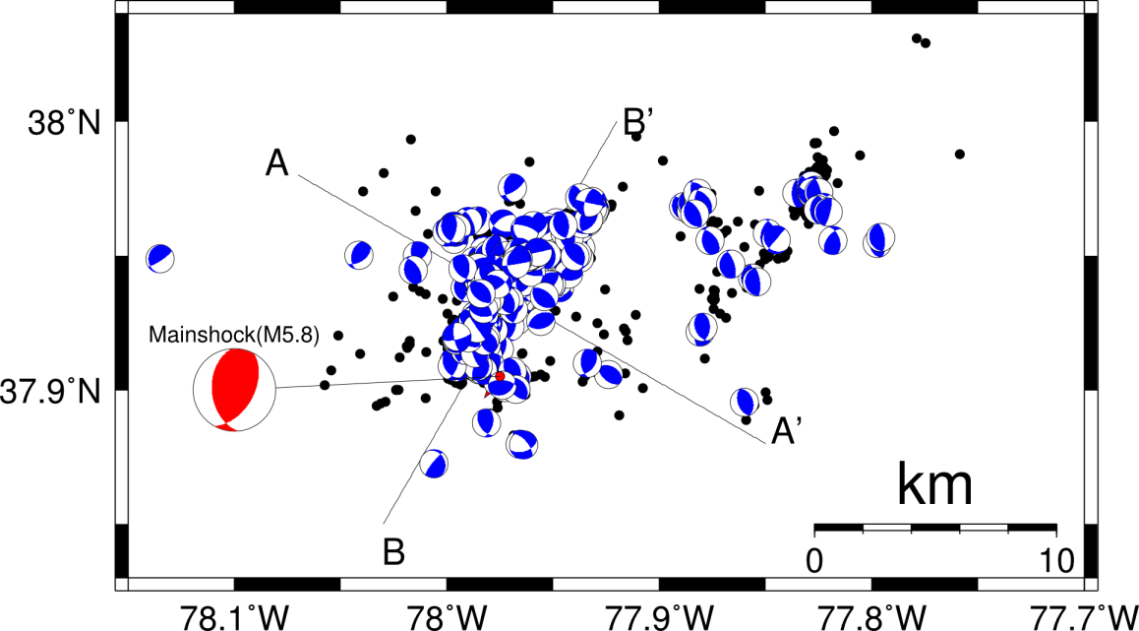
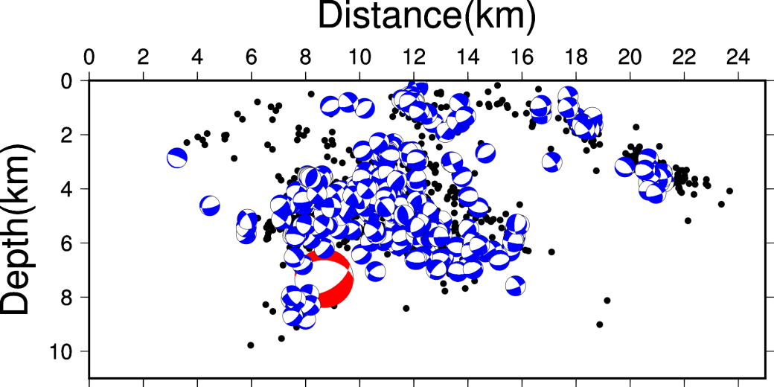
Focal mechanism solutions (393 events)
Wu et al. (2015)
A
A’
B
B’
From: Wu, Qimin, M.C. Chapman and J.N. Beale, 2015, The Aftershock Sequence of the 2011 Mineral, Virginia,
Earthquake: Temporal and Spatial Distribution, Focal Mechanisms, Regional Stress and the Role of Coulomb Stress Transfer, Bulletin of the Seismological Society of America, v. 105, no. 5, p. 2521-2537, doi. 10.1785/0120150032.

Slide 12
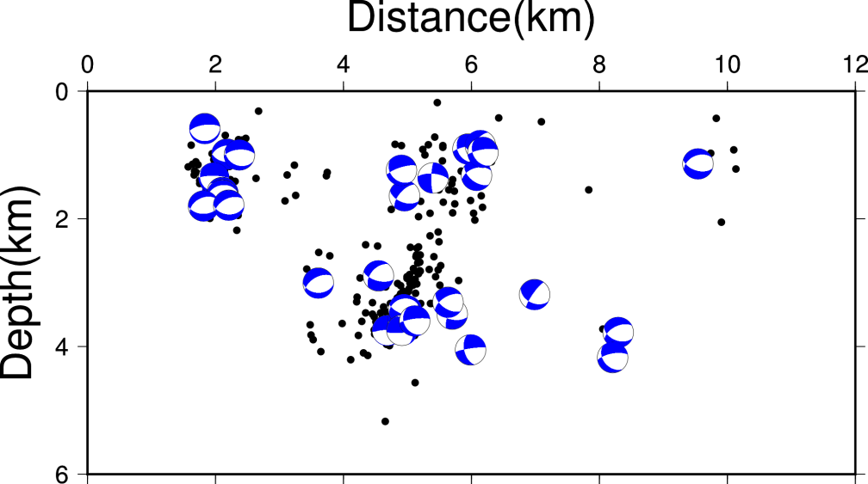

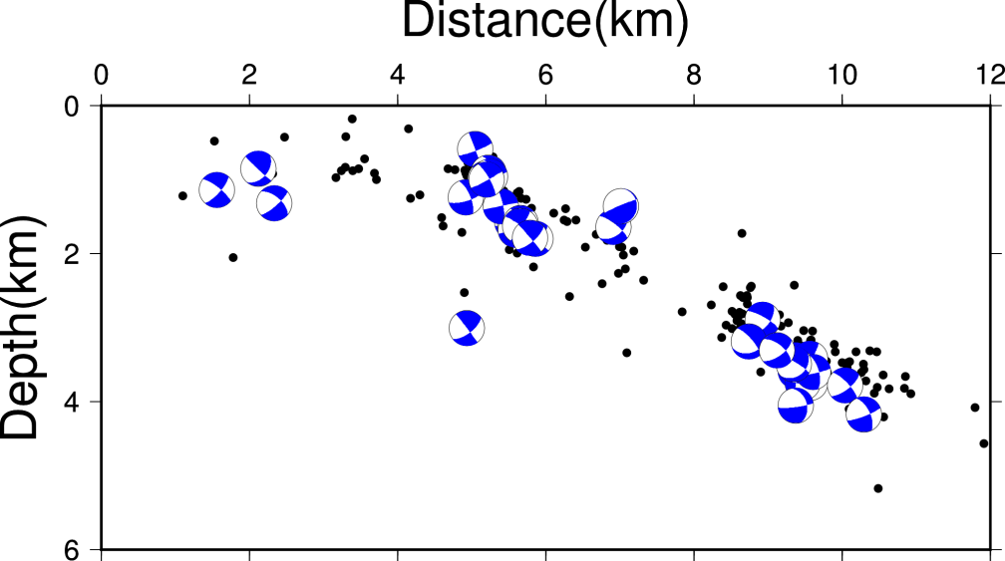
Northeastern aftershocks
E
E’
F
F’
From: Wu, Qimin, M.C. Chapman and J.N. Beale, 2015, The Aftershock Sequence of the 2011 Mineral, Virginia,
Earthquake: Temporal and Spatial Distribution, Focal Mechanisms, Regional Stress and the Role of Coulomb Stress Transfer, Bulletin of the Seismological Society of America, v. 105, no. 5, p. 2521-2537, doi. 10.1785/0120150032.

Slide 13
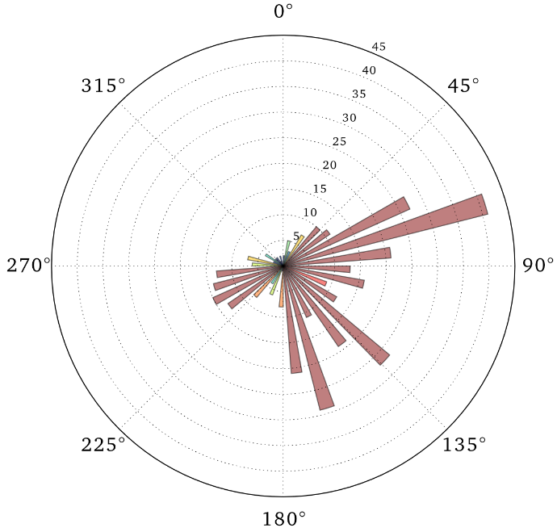
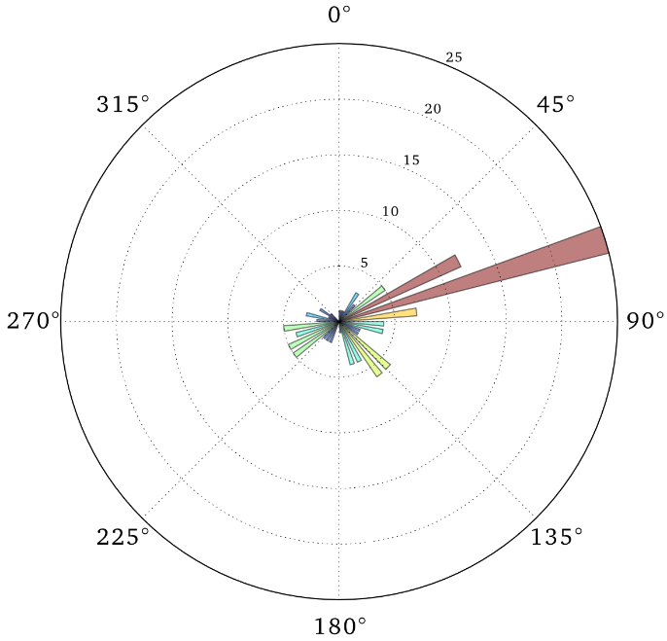
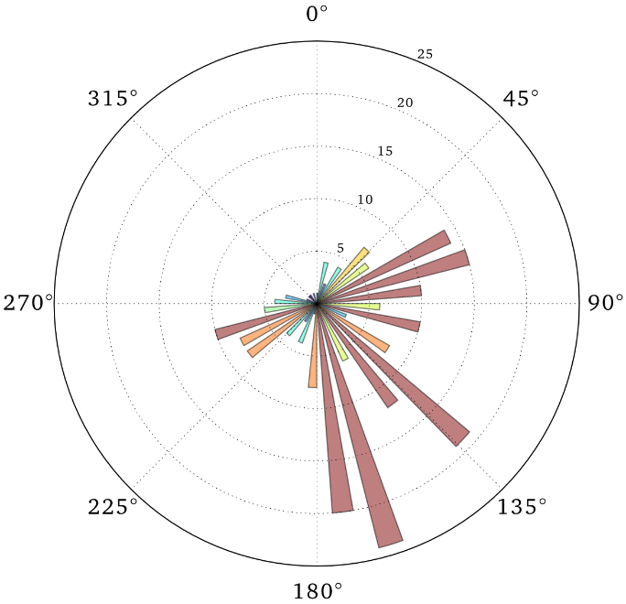
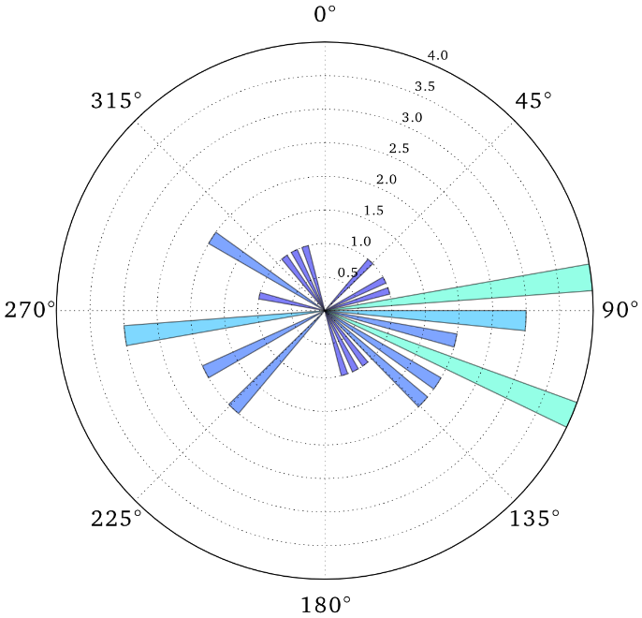
Focal Mechanism P-axis Trends
depth 0 - 4 km
(126 events)
all 393 events
mainshock P axis N103°E
depth 4 - 6 km (231 events)
depth > 6 km
(36 events)
From: Wu, Qimin, M.C. Chapman and J.N. Beale, 2015, The Aftershock Sequence of the 2011 Mineral, Virginia,
Earthquake: Temporal and Spatial Distribution, Focal Mechanisms, Regional Stress and the Role of Coulomb Stress Transfer, Bulletin of the Seismological Society of America, v. 105, no. 5, p. 2521-2537, doi. 10.1785/0120150032.

Slide 14
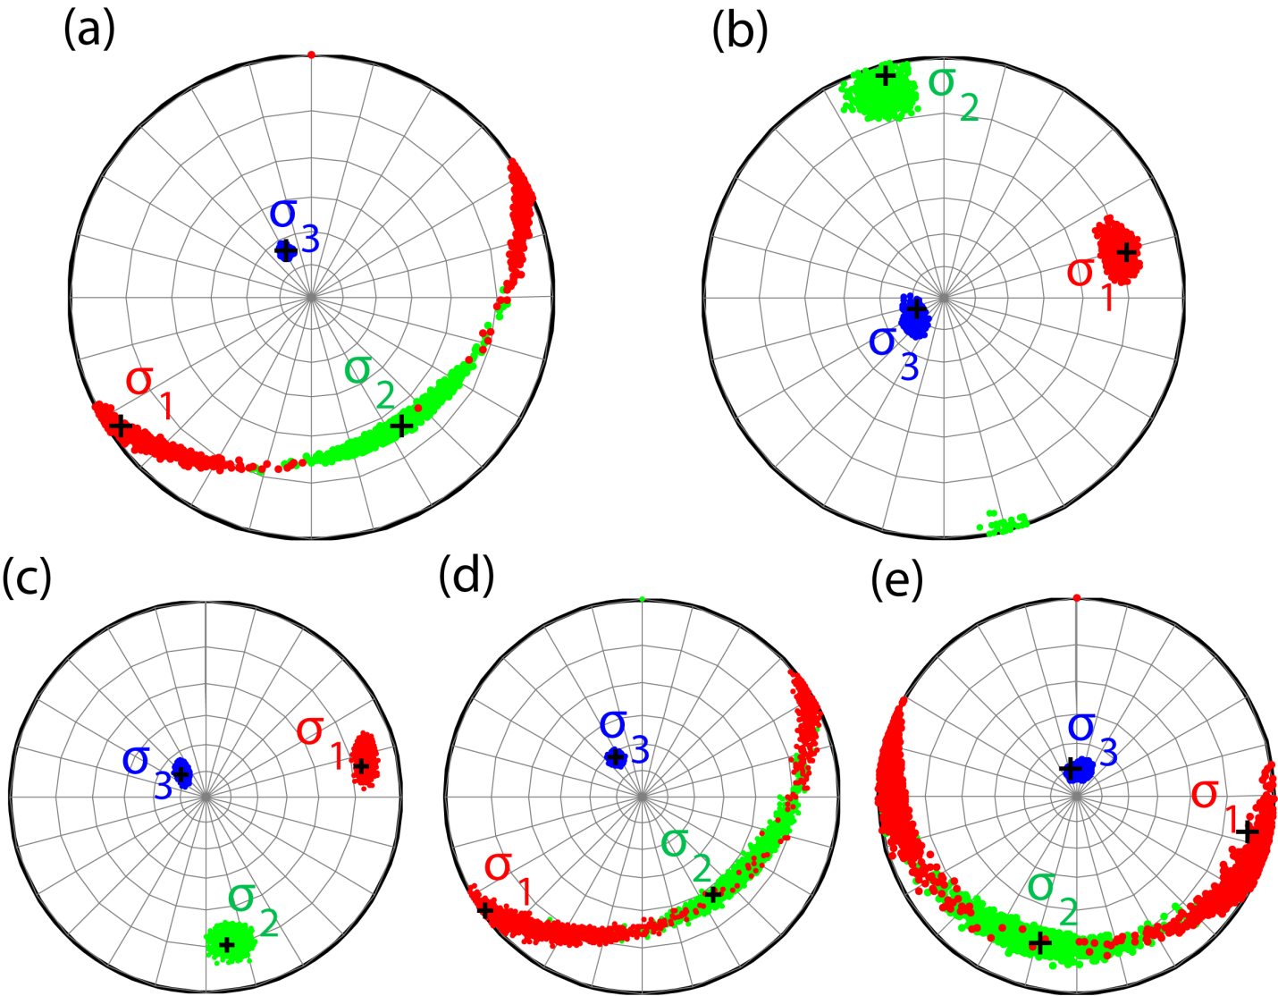
Stress inversion using focal mechanisms
Northeastern aftershocks
Main cluster
In main cluster
Depth 0 – 4 km
Depth 4 – 6 km
Depth > 6 km
From: Wu, Qimin, M.C. Chapman and J.N. Beale, 2015, The Aftershock Sequence of the 2011 Mineral, Virginia,
Earthquake: Temporal and Spatial Distribution, Focal Mechanisms, Regional Stress and the Role of Coulomb Stress Transfer, Bulletin of the Seismological Society of America, v. 105, no. 5, p. 2521-2537, doi. 10.1785/0120150032.

Slide 15
Coulomb Stress Transfer
The Coulomb stress change :
- the shear stress change (positive in the direction of slip )
- the normal stress change (positive in the direction of unclamping )
- the effective coefficient of friction (0 ~ 0.8)
Program Coulomb 3.3 (Toda et al., 2011)

Slide 16
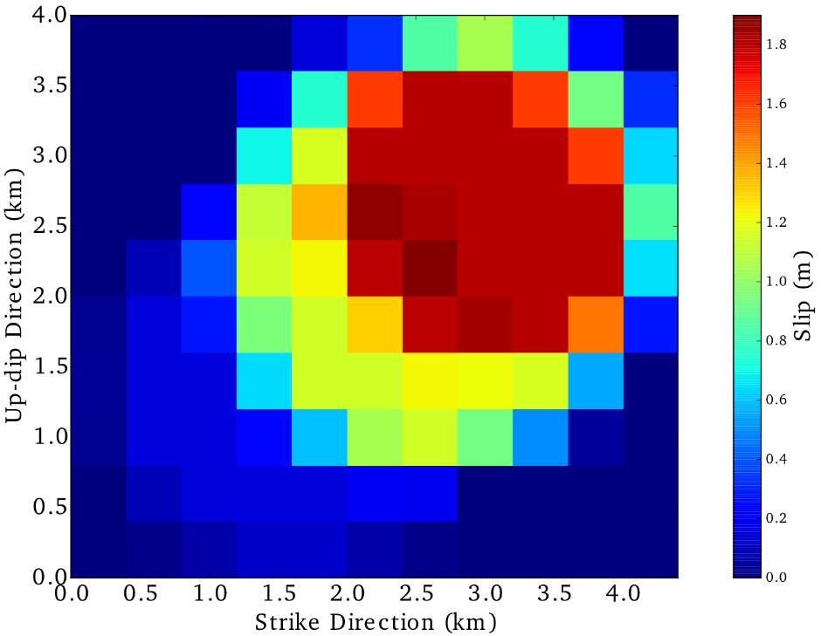
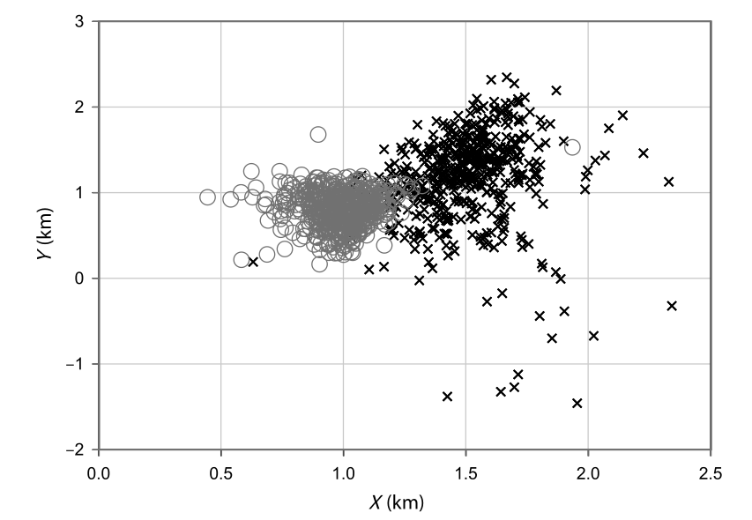
Source fault
Fault size: 4km x 4km
Slip concentrated on 3 sub-events
initial subevent
subevent 2
subevent 3
(Chapman, 2013)
From: Wu, Qimin, M.C. Chapman and J.N. Beale, 2015, The Aftershock Sequence of the 2011 Mineral, Virginia,
Earthquake: Temporal and Spatial Distribution, Focal Mechanisms, Regional Stress and the Role of Coulomb Stress Transfer, Bulletin of the Seismological Society of America, v. 105, no. 5, p. 2521-2537, doi. 10.1785/0120150032.

Slide 17
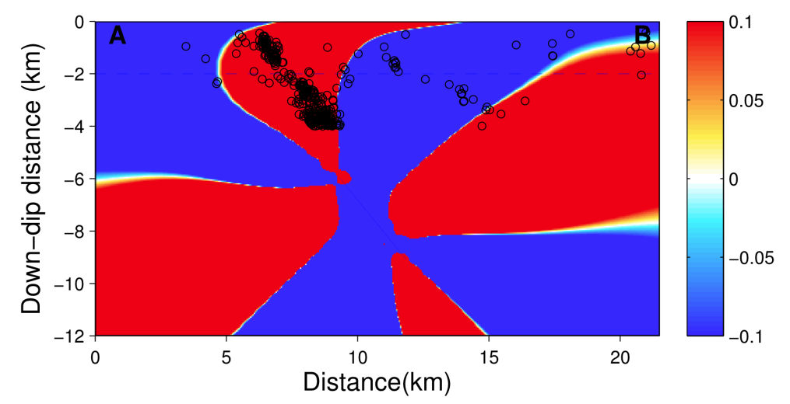
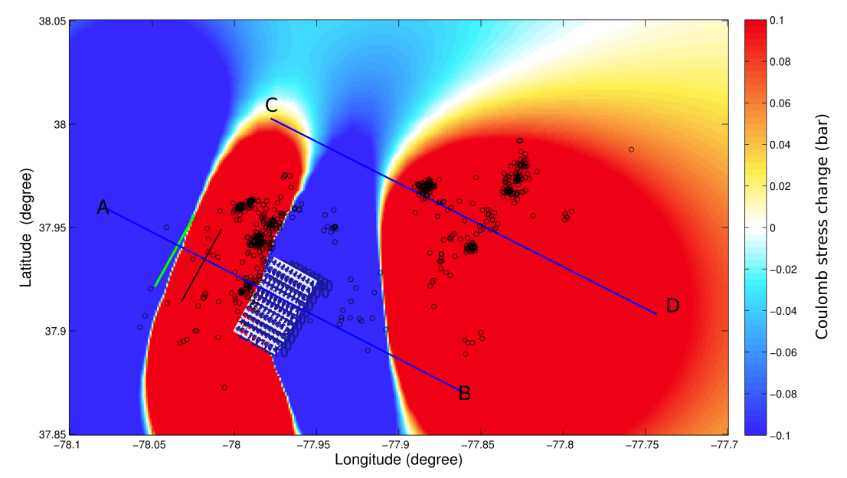
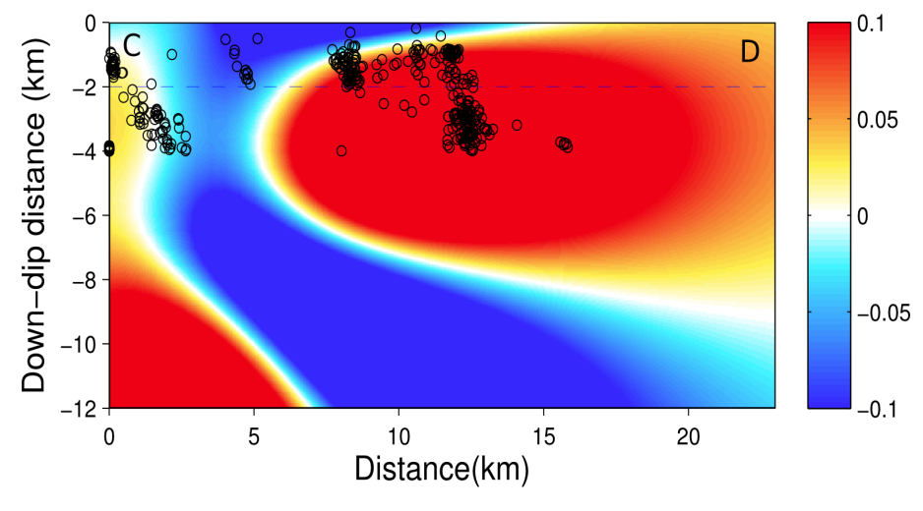
Coulomb stress change on receiver fault type 1 for
shallow events
Strike: 340°, Dip: 60°, Rake: 90°
(with earthquakes at depth 0 – 4 km)
Cross sections
A
B
Map view at depth 2 km
Bars
C
D
Bars
From: Wu, Qimin, M.C. Chapman and J.N. Beale, 2015, The Aftershock Sequence of the 2011 Mineral, Virginia,
Earthquake: Temporal and Spatial Distribution, Focal Mechanisms, Regional Stress and the Role of Coulomb Stress Transfer, Bulletin of the Seismological Society of America, v. 105, no. 5, p. 2521-2537, doi. 10.1785/0120150032.

Slide 18
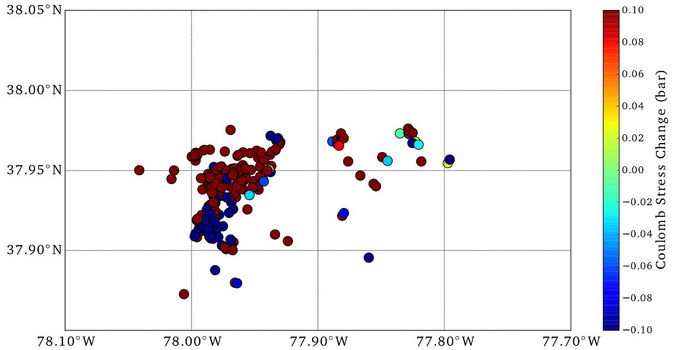

Coulomb stress change on focal mechanism nodal planes
Stress change on randomly selected nodal planes
Positive stress change rate:
308/393 = 78.4％
Maximum stress change on both nodal planes
Positive stress change rate:
343/393 = 87.3％
From: Wu, Qimin, M.C. Chapman and J.N. Beale, 2015, The Aftershock Sequence of the 2011 Mineral, Virginia,
Earthquake: Temporal and Spatial Distribution, Focal Mechanisms, Regional Stress and the Role of Coulomb Stress Transfer, Bulletin of the Seismological Society of America, v. 105, no. 5, p. 2521-2537, doi. 10.1785/0120150032.

Slide 19
The mainshock triggered shallow aftershocks with very consistent focal mechanisms different from that of the mainshock to distances of at least 30 km.
This occurred in response to Coulomb stress changes on the order of 0.1 bar. It indicates:
Reverse faults trending N-NW, rather than NE as the mainshock, are optimally oriented in the shallow stress field.
The stress field at the depth of mainshock rupture initiation and moment release may be slightly rotated with respect to the shallow stress field.

Slide 20
The concentration of aftershocks at depths of 4-6 km in the main aftershock
cluster features a wide range of fault plane strikes. No single fault plane is responsible.
The zone of major mainshock moment release lies in a conspicuous gap in aftershock activity.
The aftershocks formed a halo of activity up-dip and to the north-northeast of the
mainshock rupture, in the direction of mainshock rupture propagation.
The aftershocks outline the shallow perimeter of mainshock rupture, which coincides with
the zone of maximum positive Coulomb stress transfer from the mainshock.
SW
NE
mainshock subevents

Slide 21
An 8-station temporary seismic network was operated in the Summerville, SC area for 1 year
(August 7, 2011 through August 30, 2012)
Purpose:
Determine accurate hypocenters and focal mechanisms using targeted station locations.
Results:
134 earthquakes detected and located (duration magnitudes -1.8 to 2.6).
48 focal mechanisms with sufficient constraint to be considered reliable.
Interpretation of Results:
The modern seismicity near Summerville, SC is occurring in a South-striking, West-
dipping tabular zone within which the majority of earthquakes exhibit reverse motion
on either N-NW or S-SE striking fault planes. The S-SE striking planes are consistent with
the orientation of the seismic zone.

Slide 22
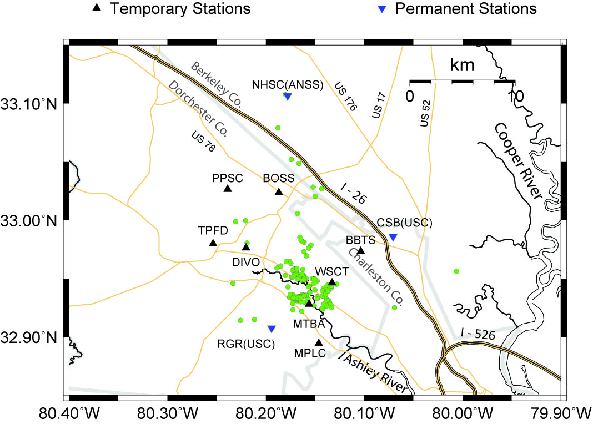
from: Chapman, M.C., J.N. Beale, A.C. Hardy and Q. Wu (2016) Modern seismicity and the fault responsible for the 1886 Charleston,
South Carolina Earthquake, Bull. Seism. Soc. Am., 106, 364-372.

Slide 23
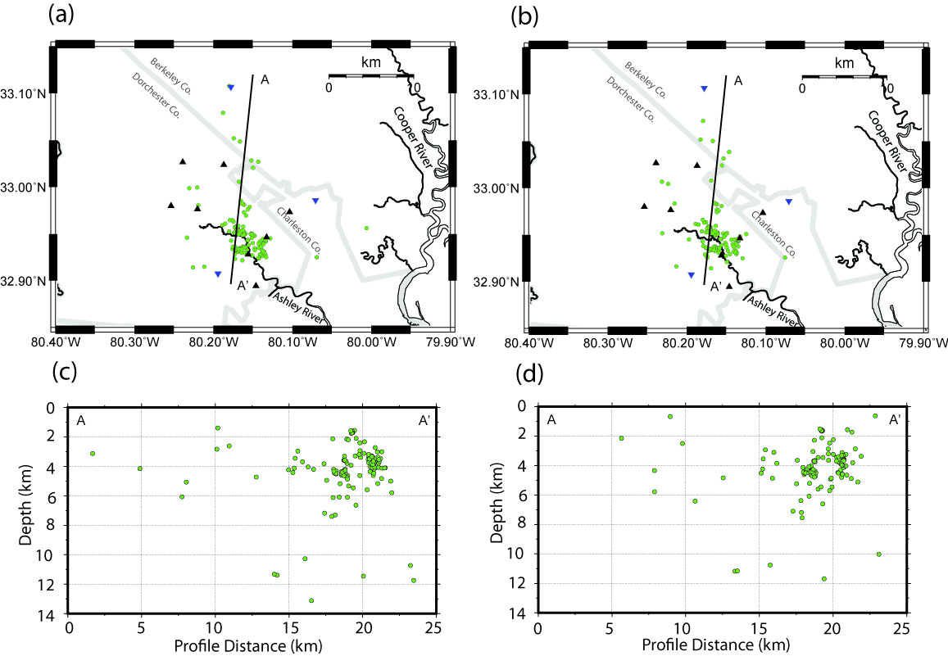
Single-event locations (Hypoellipse)
Double-difference locations (HypoDD)
from: Chapman, M.C., J.N. Beale, A.C. Hardy and Q. Wu (2016) Modern seismicity and the fault responsible for the 1886 Charleston,
South Carolina Earthquake, Bull. Seism. Soc. Am., 106, 364-372.

Slide 24
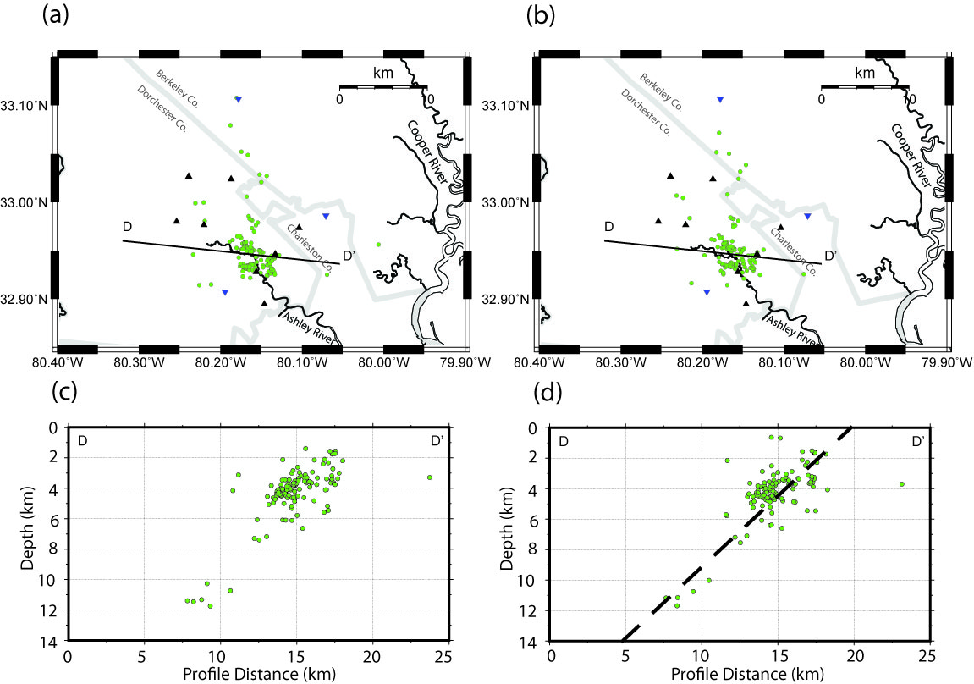
Single-event locations (Hypoellipse)
Double-difference locations (HypoDD)
from: Chapman, M.C., J.N. Beale, A.C. Hardy and Q. Wu (2016) Modern seismicity and the fault responsible for the 1886 Charleston,
South Carolina Earthquake, Bull. Seism. Soc. Am., 106, 364-372.

Slide 25
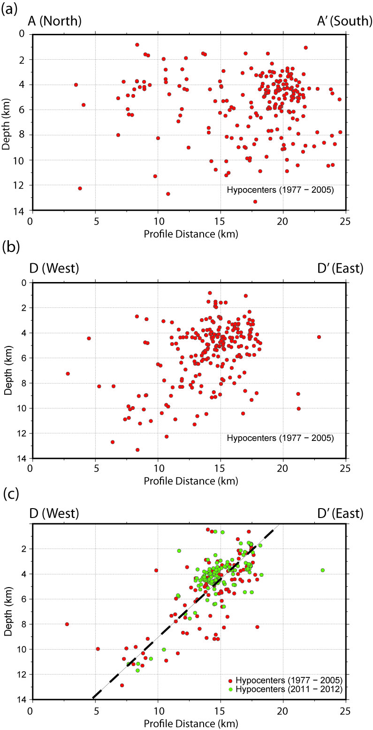
1977-2005 events re-located using archived
phase arrival time data (single event locations, Hypoellipse)
from: Chapman, M.C., J.N. Beale, A.C. Hardy and Q. Wu (2016) Modern seismicity and the fault responsible for the 1886 Charleston,
South Carolina Earthquake, Bull. Seism. Soc. Am., 106, 364-372.

Slide 26
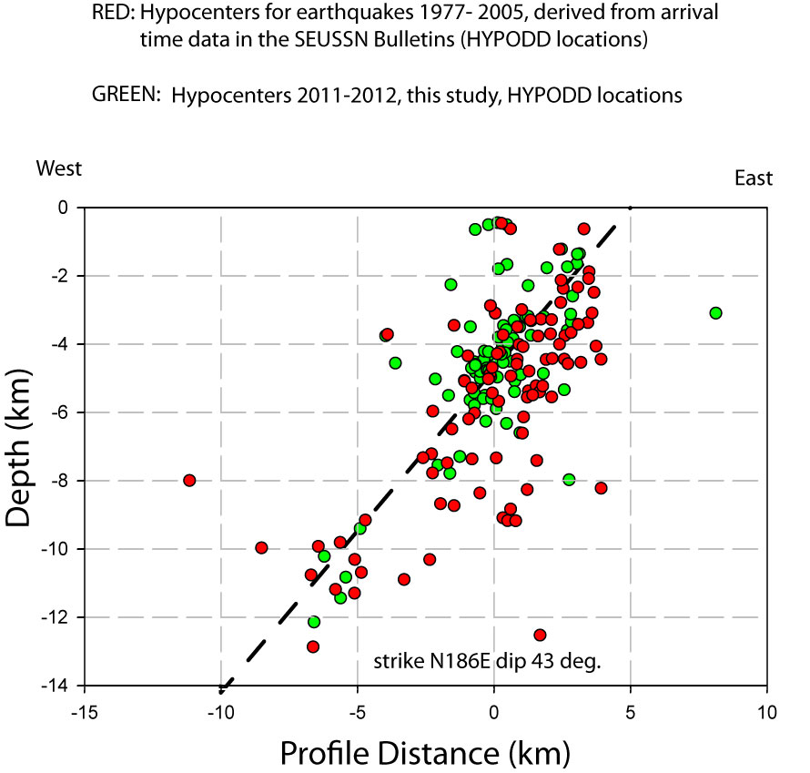

Slide 27
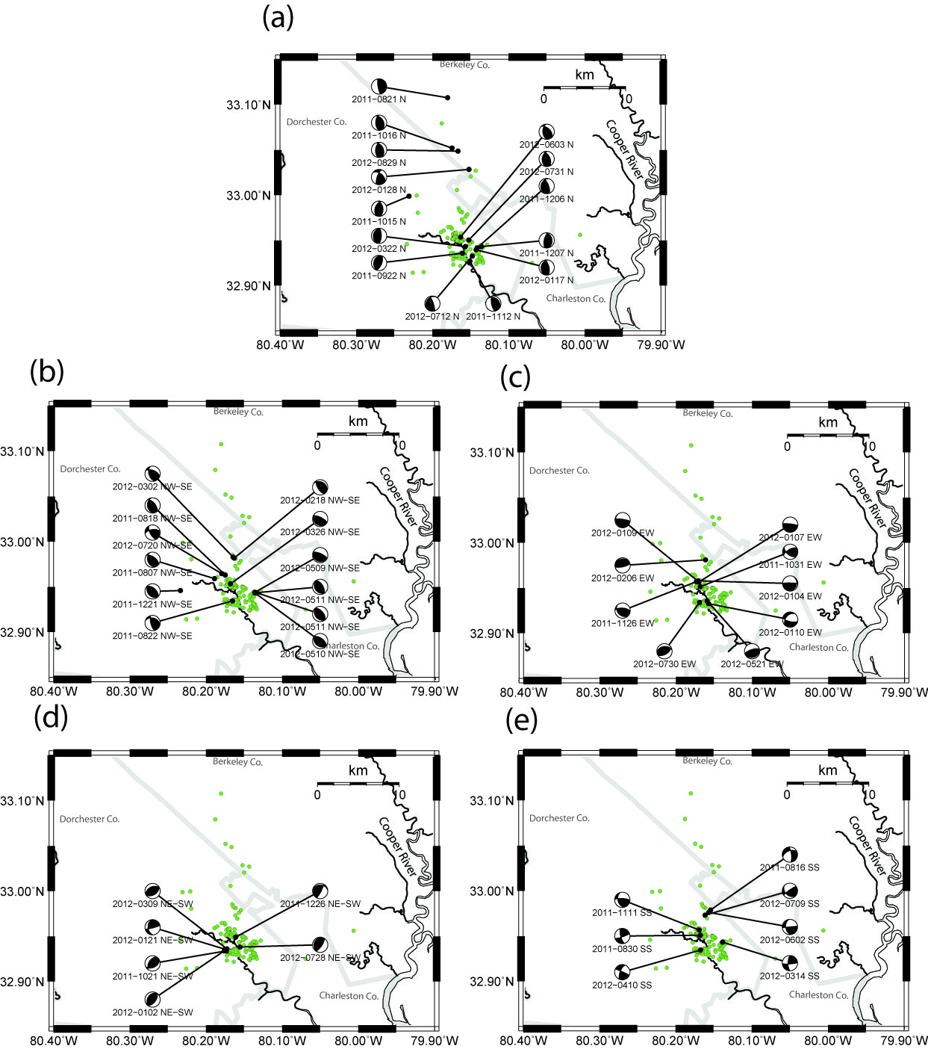
N - S: 14/48, 29%
NW-SE: 12/48, 25%
E-W: 9/48 19%
NE - SW: 6/48 13%
Strike slip: 7/48 15%
from: Chapman, M.C., J.N. Beale, A.C. Hardy and Q. Wu (2016) Modern seismicity and the fault responsible for the 1886 Charleston,
South Carolina Earthquake, Bull. Seism. Soc. Am., 106, 364-372.

Slide 28
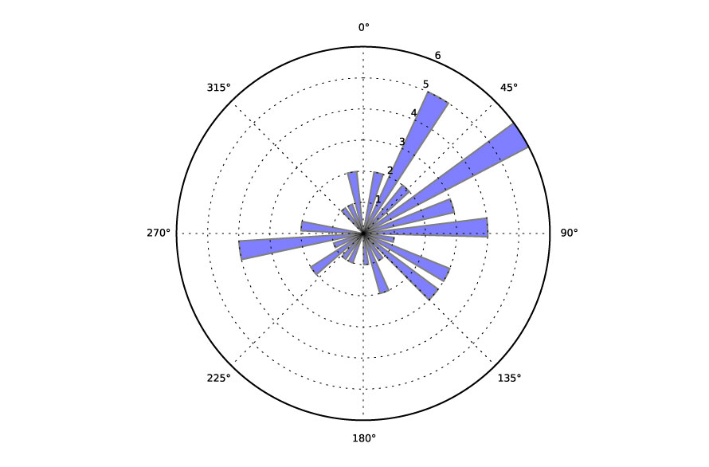
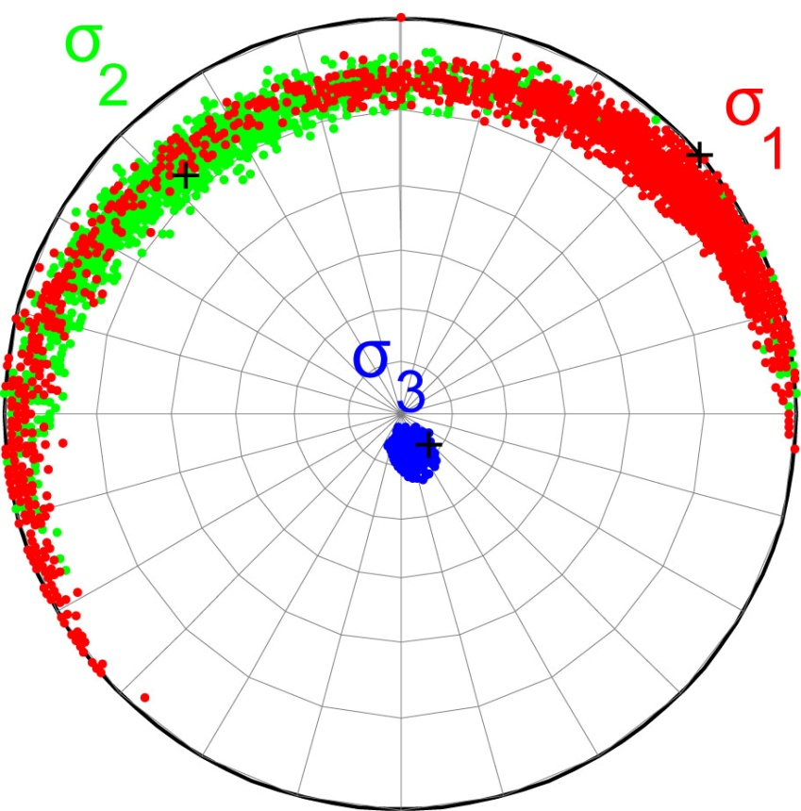
Stress Inversion results from focal
mechanisms. Colors indicate approximate
95% confidence regions of principle stress directions
Focal Mechanism P-axis trend
MSATSI (Martínez-Garzón et al., 2014)
from: Chapman, M.C., J.N. Beale, A.C. Hardy and Q. Wu (2016) Modern seismicity and the fault responsible for the 1886 Charleston,
South Carolina Earthquake, Bull. Seism. Soc. Am., 106, 364-372.

Slide 29
The distribution of hypocenters and focal mechanisms in Summerville is
reminiscent of the aftershock sequence of the 2011 Mineral, Virginia Earthquake.
In both cases we see:
A tabular zone of aftershocks as expected for a reverse mechanism
The majority of events are at shallow depth
Considerable variability in focal mechanism
Features of the Mineral aftershocks that may have relevance in regard to Summerville:
1) Mineral aftershocks define a tabular zone that has the strike and dip
of the mainshock focal mechanism, but the majority of the aftershocks have different
focal mechanisms. The aftershock hypocenters appear to outline the zone of
mainshock rupture termination, in the direction of rupture propagation
2) The aftershocks are largely controlled by the perturbation of the stress field
caused by the mainshock. The spatial geometry of this perturbation is reflected by
the aftershock hypocenter locations.

Slide 30
HYPOTHESIS REGARDING THE 1886 CHARLESTON EARTHQUAKE
We think that modern seismicity in Summerville is completely analogous to the
aftershock sequence of the 2011 Mineral, Virginia earthquake.
Our hypothesis is that shocks near Summerville are mapping the zone of stress
perturbation (positive Coulomb stress change) caused by the 1886 shock, which was
predominantly reverse faulting on a South-striking, west-dipping plane.
If the analogy with the Mineral shock is accurate, then the Summerville hypocenter
distribution will have the same general orientation (strike, dip) of the mainshock
rupture plane, but the hypocenters will tend to cluster near the termination
of rupture, preferentially in the direction of rupture propagation. Focal mechanisms
in this cluster will be variable. This is consistent with data we have
collected recently.
This suggests the following hypothetical model for the 1886 shock:

Slide 31
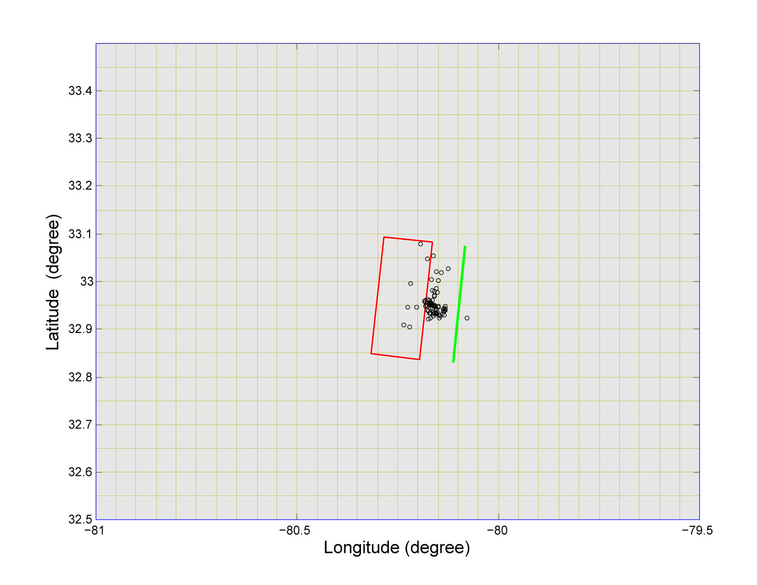
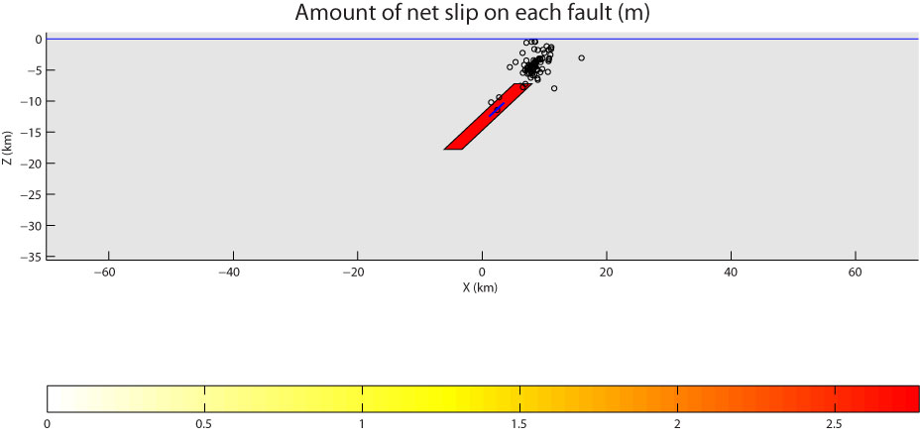
surface trace of fault plane
Dutton's Woodstock "epicentrum"
*
*
Dutton's Rantowles "epicentrum"

Slide 32
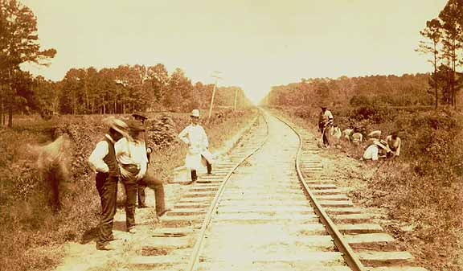
Dutton, C.E. (1889) The Charleston earthquake of August 31, 1886,
in Ninth Annual report of the U.S. Geological Survey, 203-528
Surface projection of plane fit to hypocenters
Looking N70E along Charleston and Savannah
railroad, just west of Rantowles, SC
Plate XXVI, Dutton (1889)

Slide 33
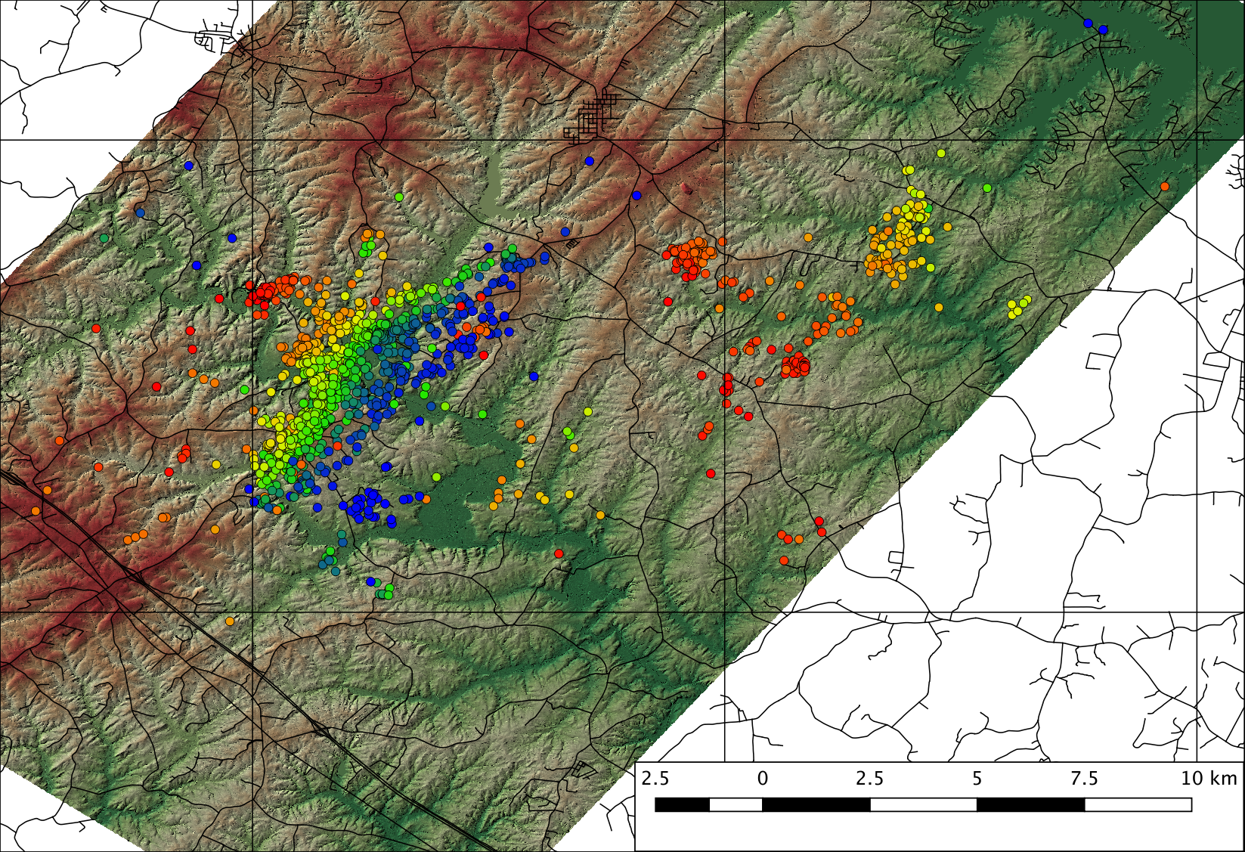
DEM generated from USGS LIDAR data
Lake Anna

Slide 34
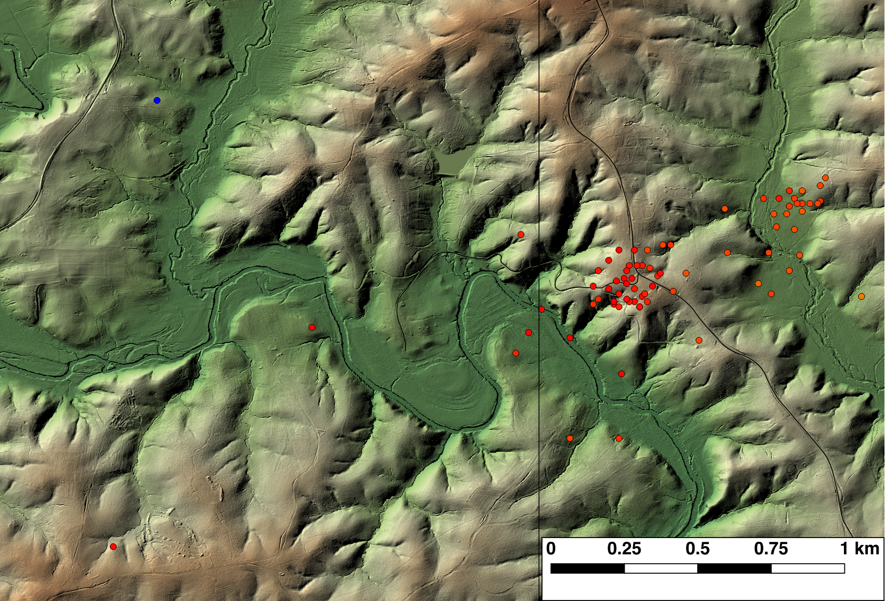
LIDAR image with low sun-angle processing
Bend of River Ln.
South Anna River
Yanceyville Rd.

Slide 35
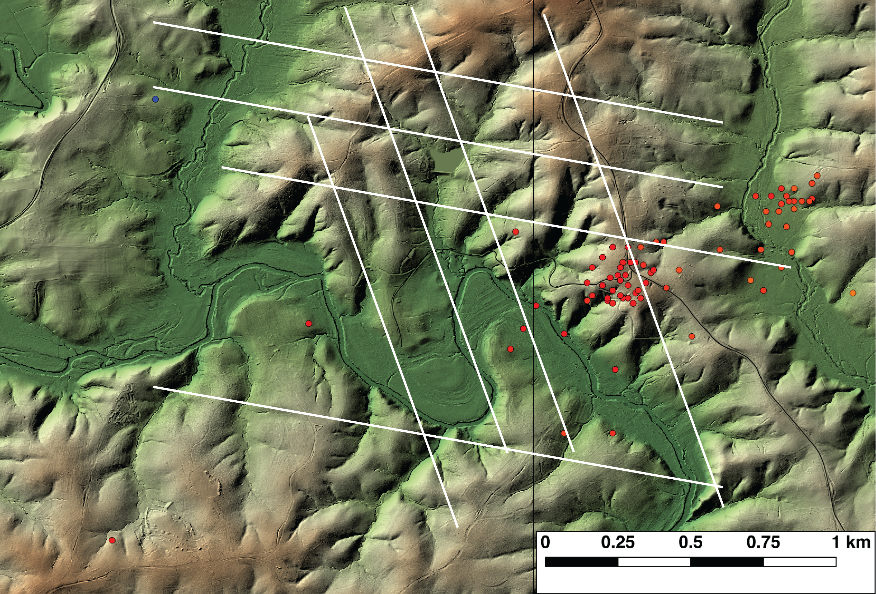

LIDAR image with low sun-angle processing
N20W
N100E

Slide 36
Lake Anna

Slide 37
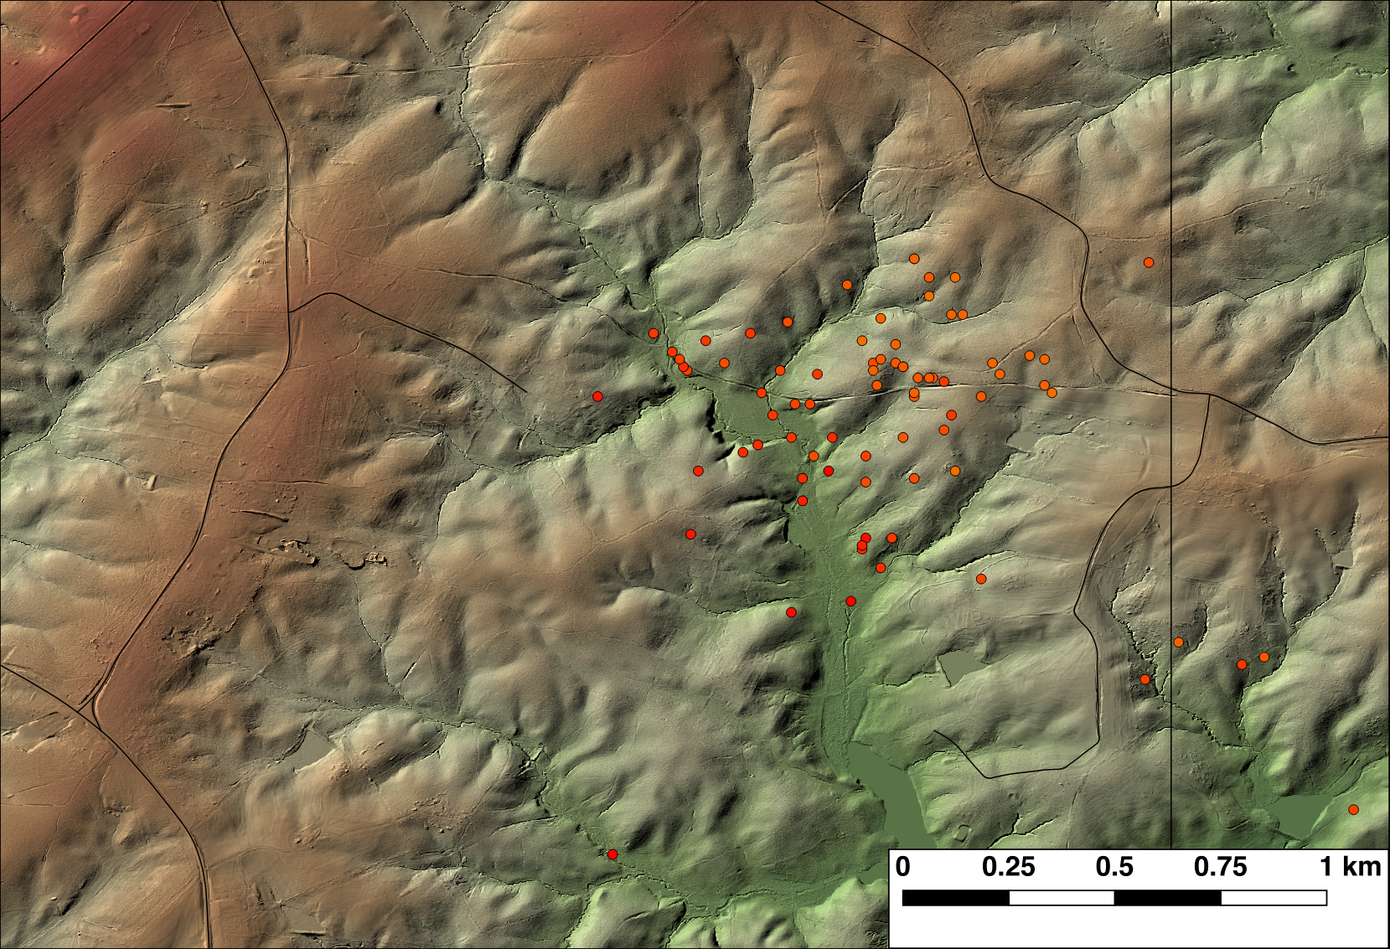
Ebenezer Rd.
Moorefield Rd.
Rt. 522 Pendleton Rd
Breezy Point. Rd.

Slide 38
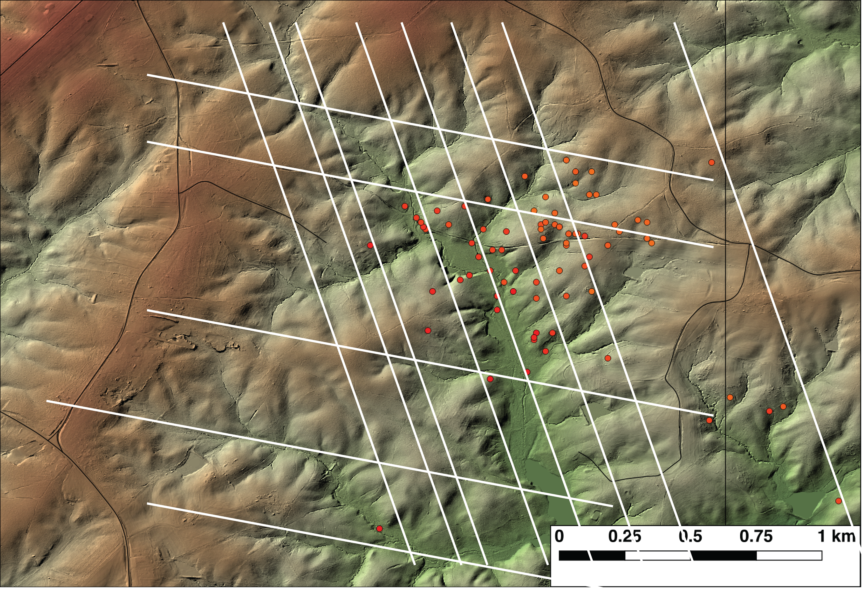
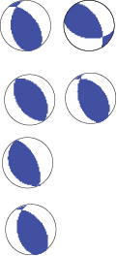
N20W
N100E

Slide 39
Lake Anna

Slide 40
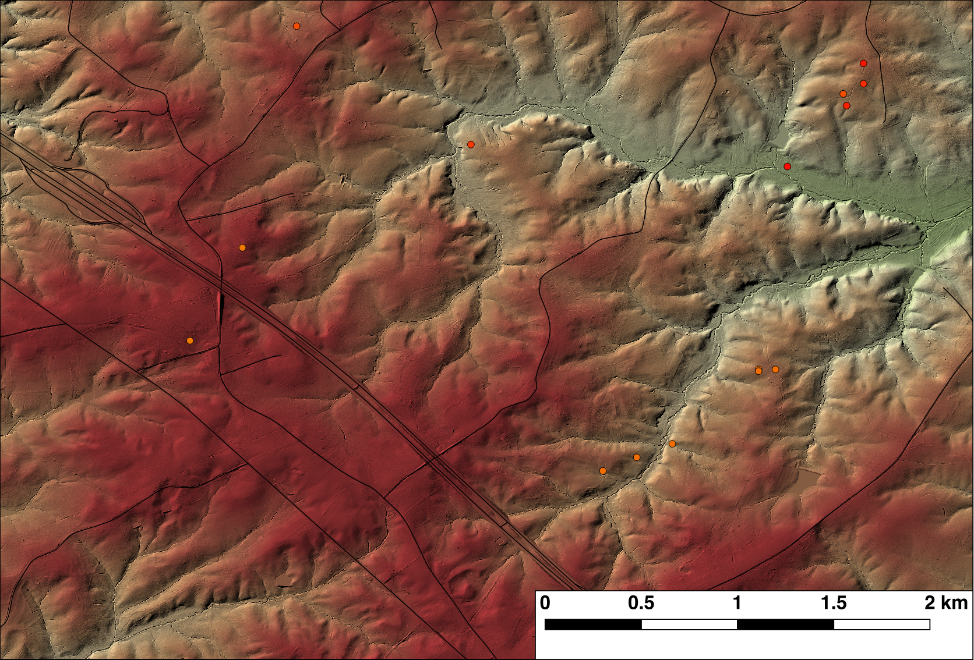
Rt. 604 Roundabout Rd.
I-64
Rt. 250
Rt. 683 Parrish Rd.
Rt. 605 Shannon Hill Rd.

Slide 41
