Slide 1

Enhancement of astrobiological detection potential by fracture-sourced fluids near Mars’ dichotomy boundary
Rebecca J. THOMAS & Brian M. HYNEK
Laboratory for Atmospheric and Space Physics, University of Colorado, boulder, co

Slide 2
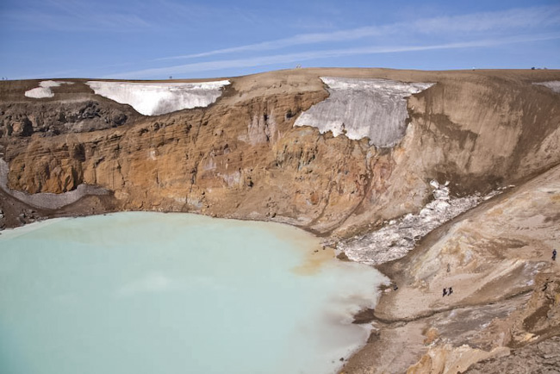
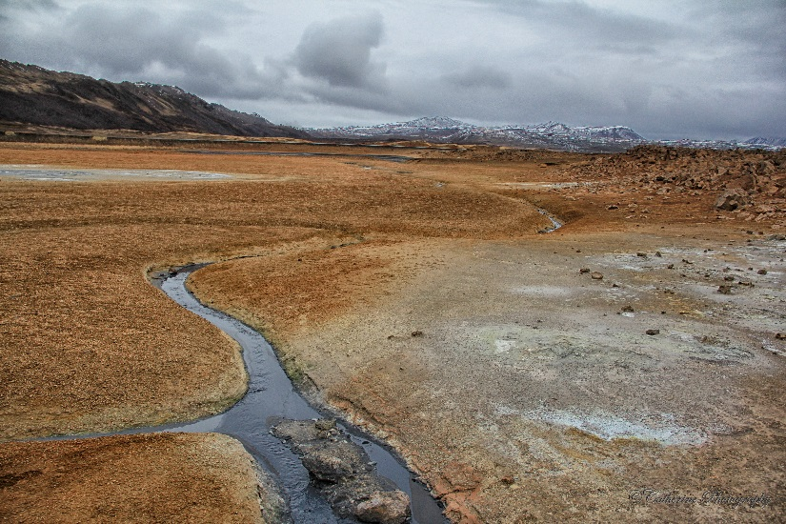
If there was life on early Mars, where would it be?
Surface aqueous environments
Evidence that these existed
Widespread exposures of hydrated-minerals within Noachian sediments across Mars’ southern highlands
Geomorphological evidence for fluvial, deltaic, lacustrine environments
Challenges to detection:
Late burial of early sediments
Long-term degradation of exposed early sediments

Slide 3
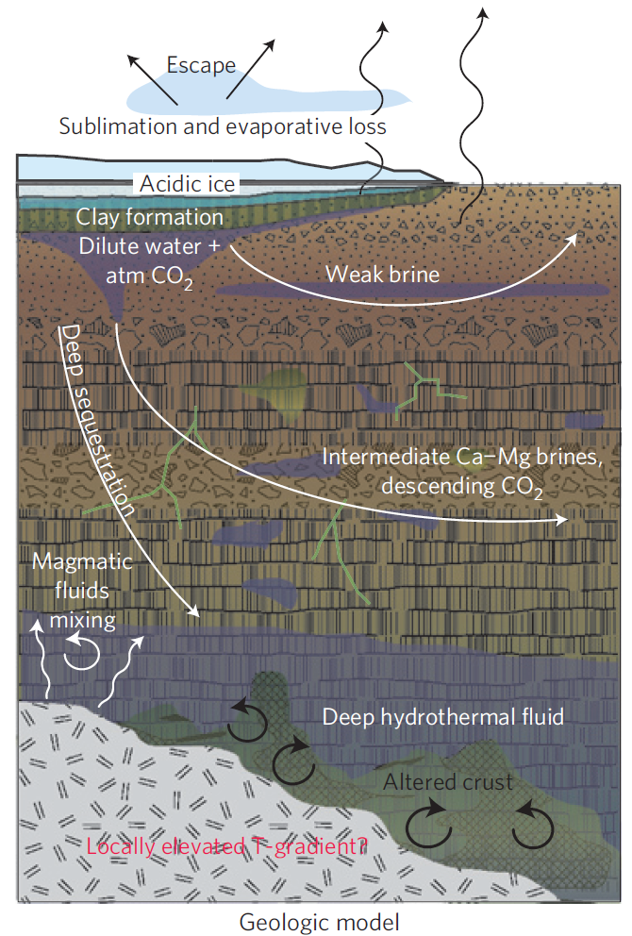
And on later Mars?
Evidence for a change after the Early Hesperian (~ 3.5 Ga)
Lack of widespread hydrated sediments
Lack of fluvial landforms
→ Subsurface
Challenges to detection:
Inaccessibility
Michalski et al., Nat. Geosci., 2013

Slide 4
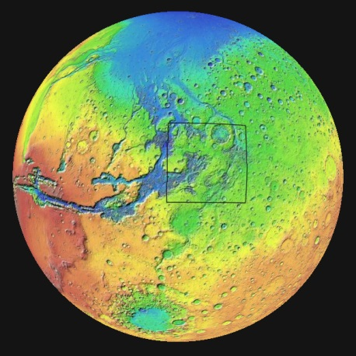
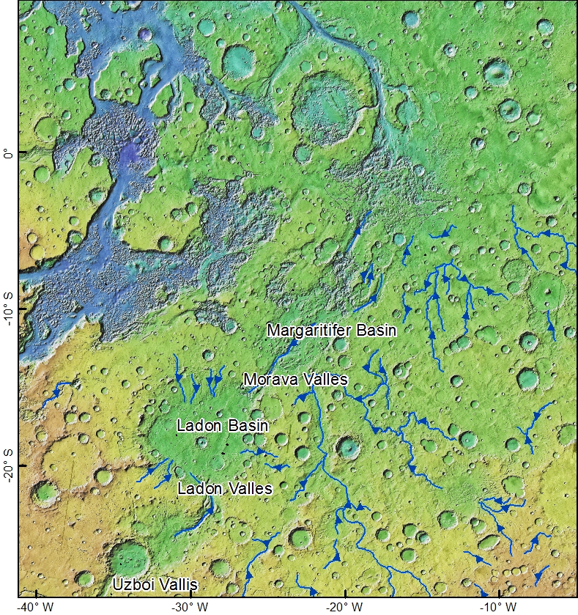
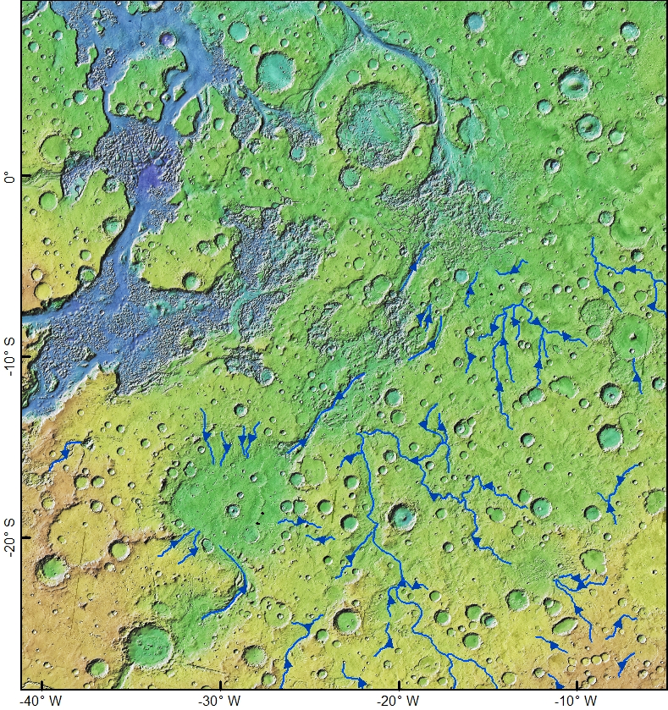
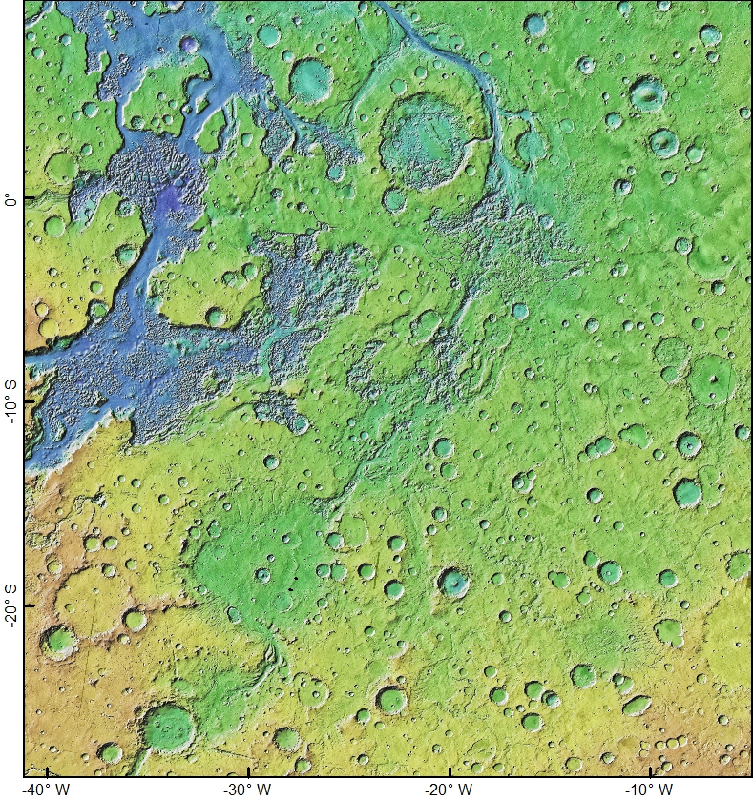
Margaritifer Terra: Astrobiological potential through time
Noachian-Early Hesperian fluvial

Slide 5
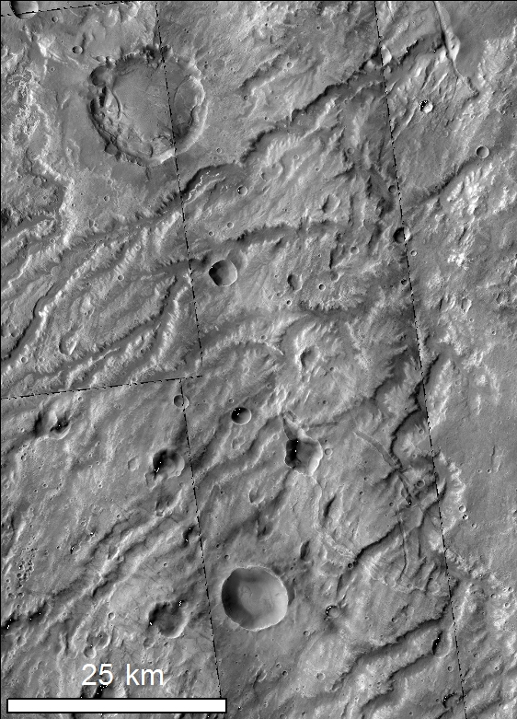
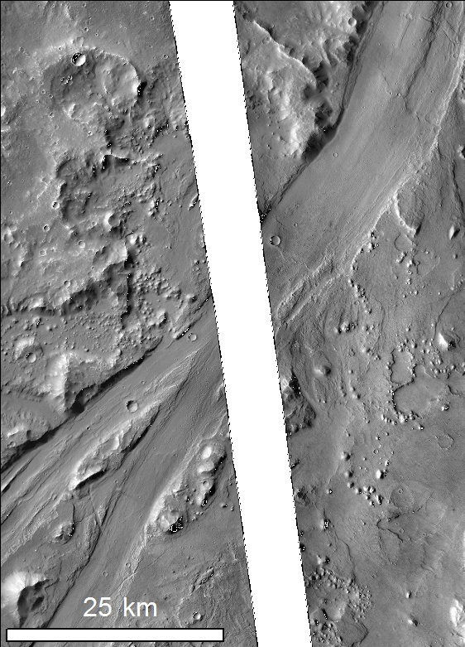
Margaritifer: Noachian-Early Hesperian fluvial

Slide 6
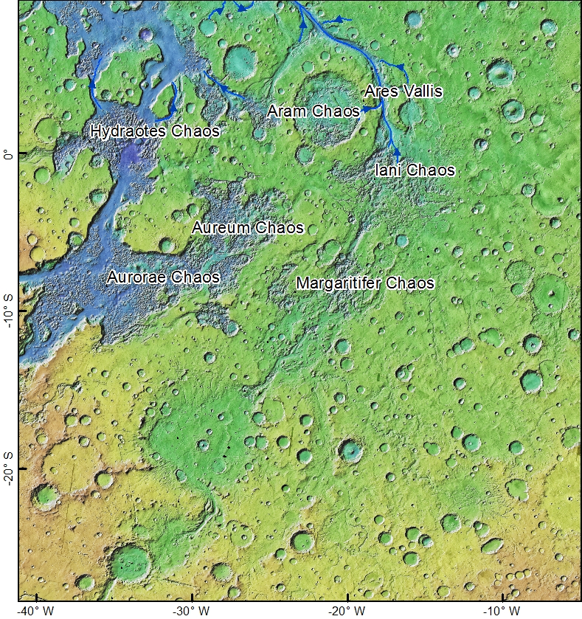
Margaritifer Terra: Astrobiological potential through time
Noachian-Early Hesperian fluvial
Hesperian-Amazonian chaos-formation and outflow
Notes:
The central channel is missing

Slide 7
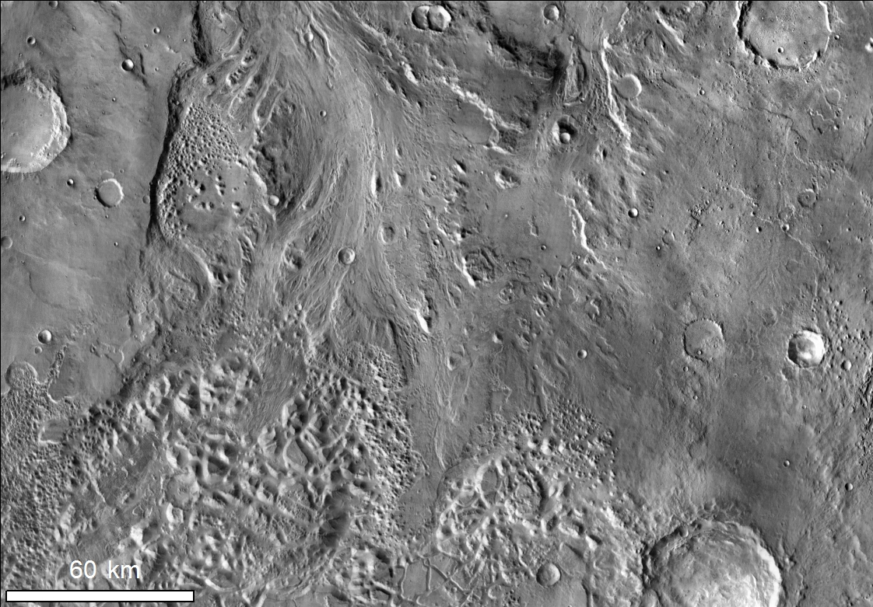
Margaritifer: Hesperian-Amazonian chaos outflow

Slide 8
Investigating astrobiological potential
Look for:
Hydrated minerals and lithologies
Morphologies indicating
Noachian-Early Hesperian fluid flow (channels)
Hesperian-Amazonian fracturing (graben) and fluid flow (channels, erosion)
Deposition from Hesperian-Amazonian fluid
Methodology
Spectral analysis – targeted CRISM, THEMIS DCS
Grid mapping (Ramsdale et al., 2015 for more details)
Observations, regional and local mapping on CTX, HiRISE images

Slide 9
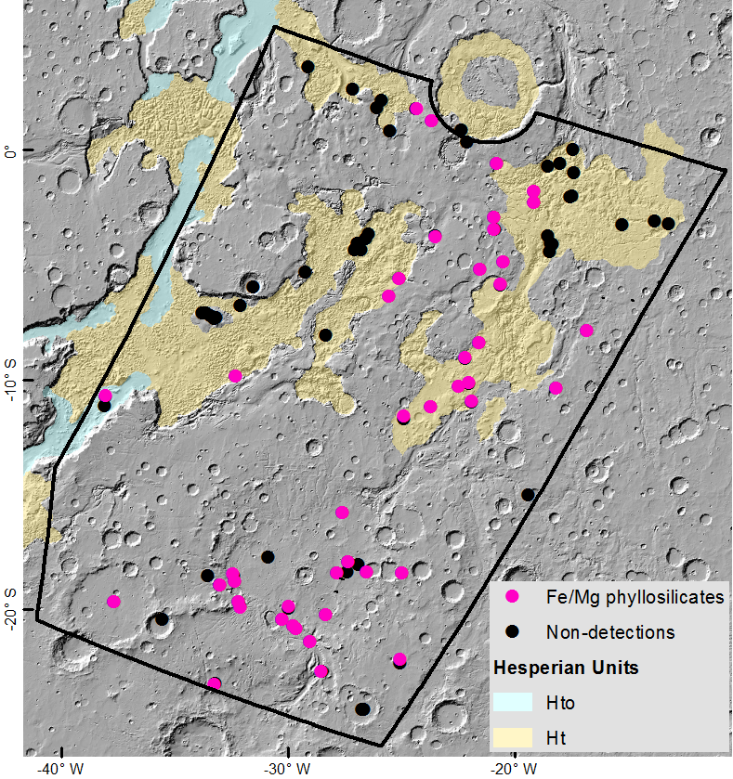
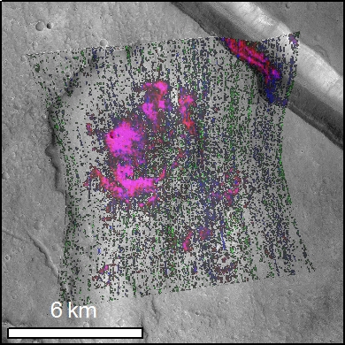
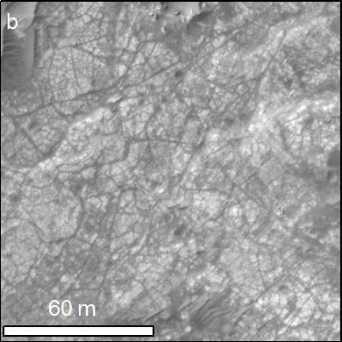
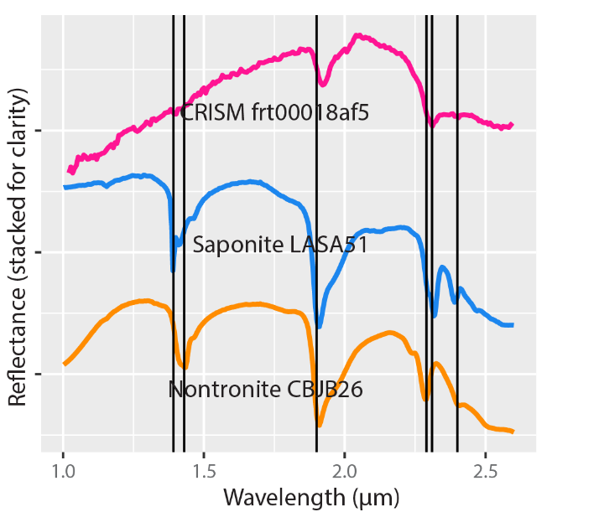
Evidence for clays

Slide 10
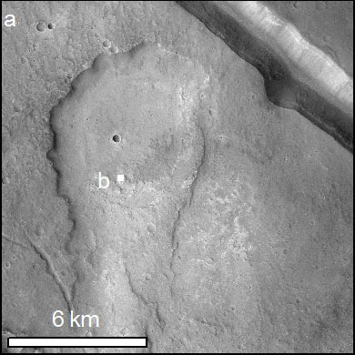
Clay-bearing lithology

Slide 11
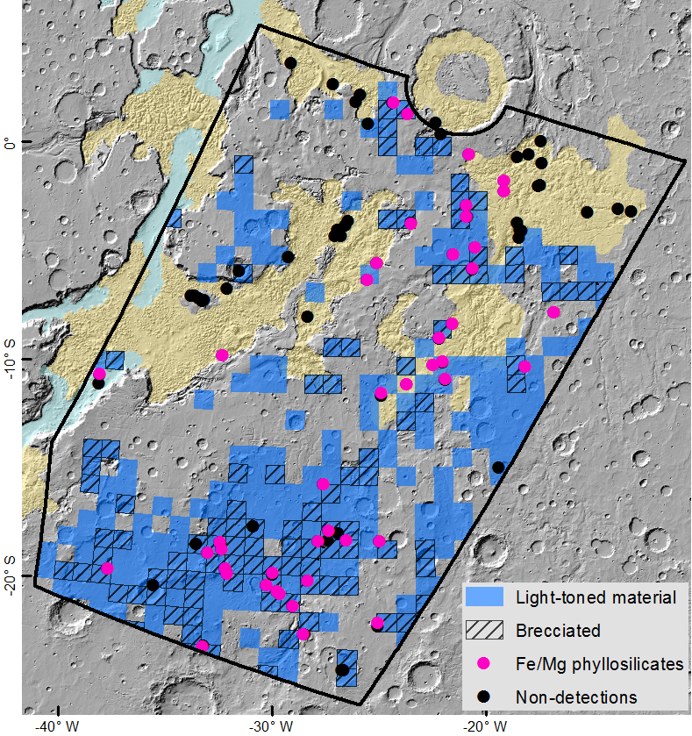

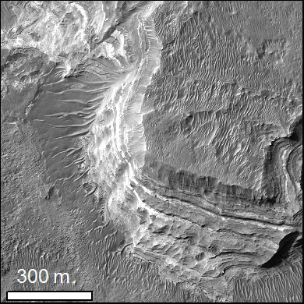
Extent of early hydrated lithologies

Slide 12
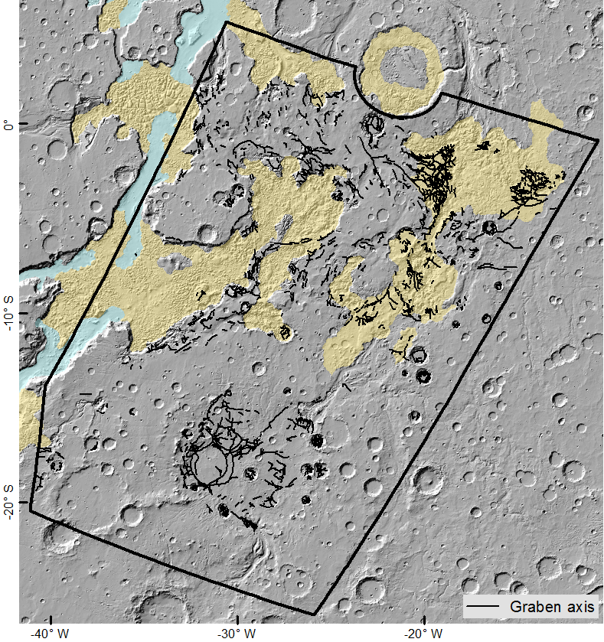
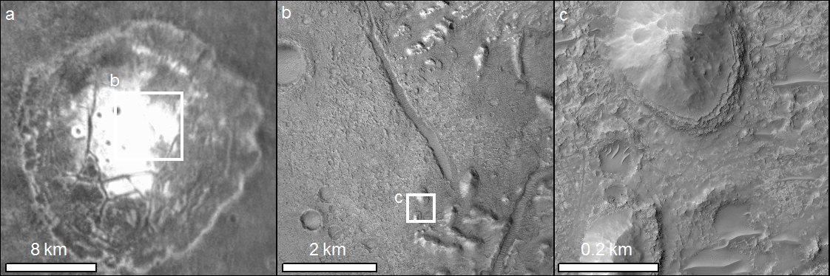
Why is there such extensive exposure of early sediments?

Slide 13
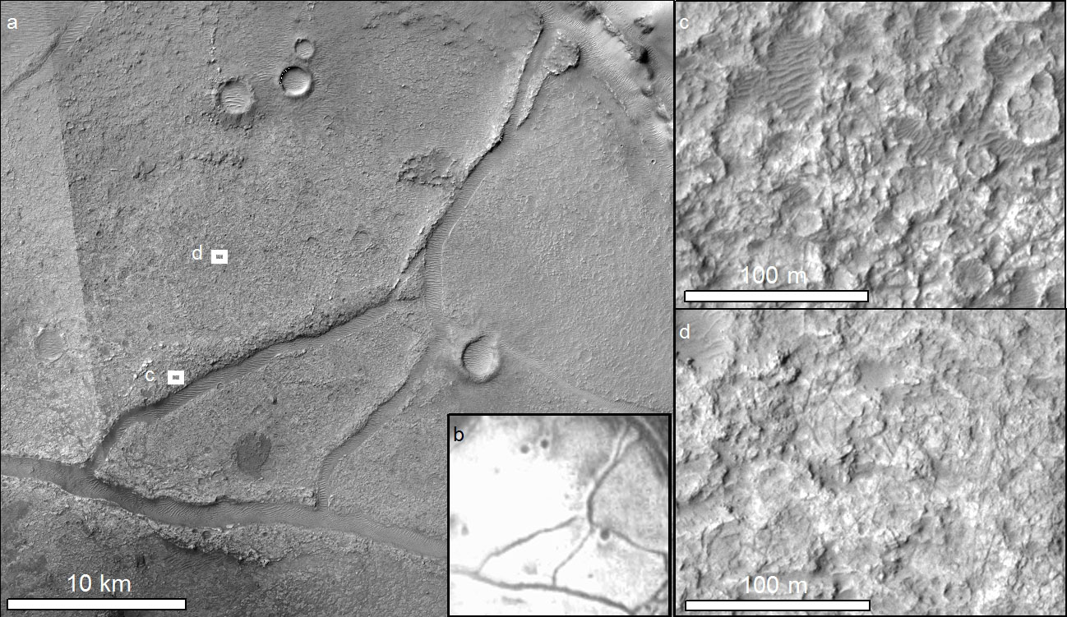
Evidence for later deposition from fluid

Slide 14
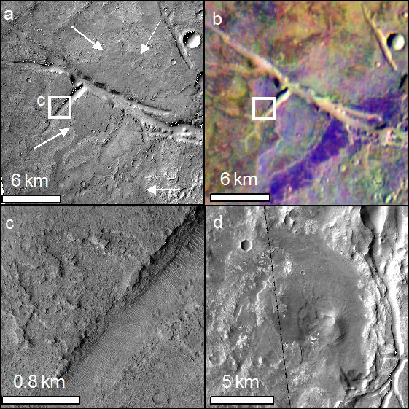
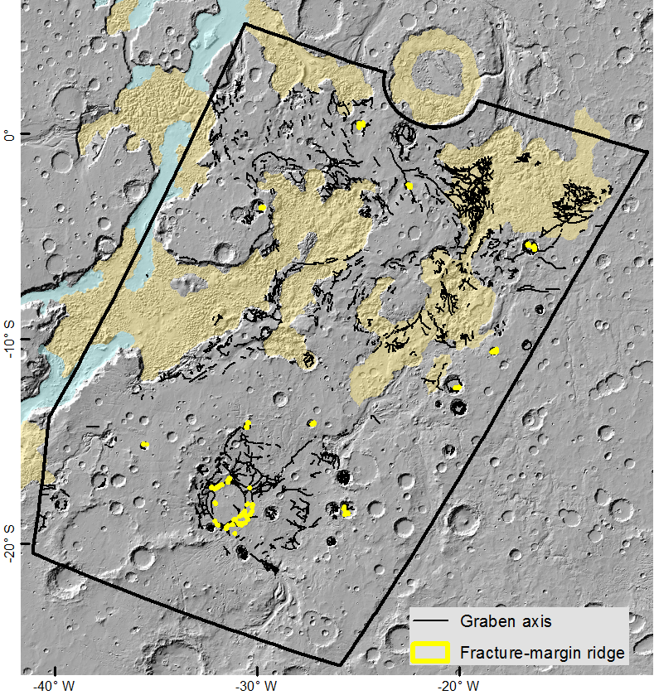
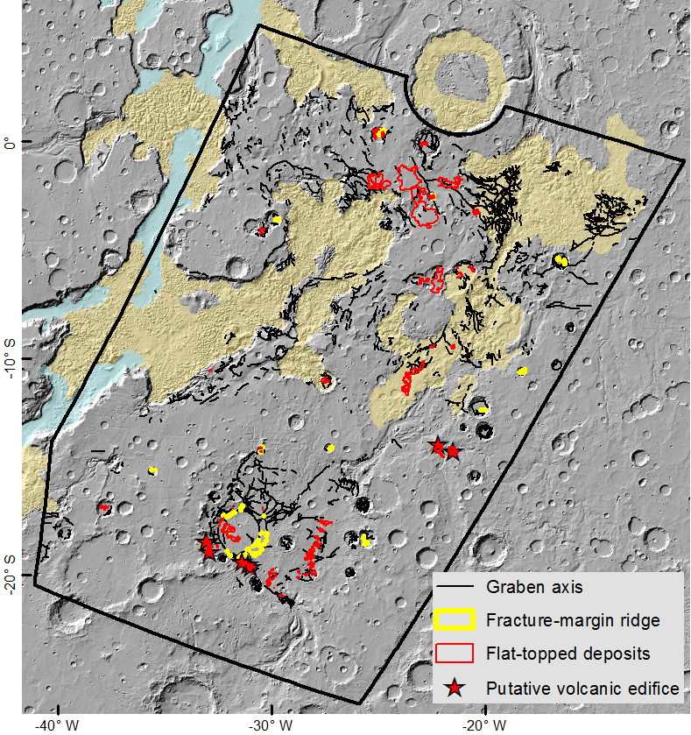
Evidence for volcanic deposition

Slide 15

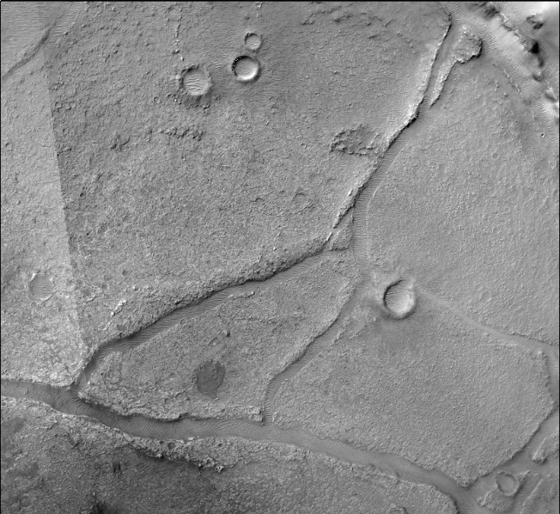
Astrobiological detection potential in Margaritifer
Early:
Presence of clay-bearing substrate over a very large area
Clays indicate a good environment for life
A multiplicity of exposures over a large region
⎫
Late:
Deposition of cements from this fluid
Potential hydrothermal activity
Good potential for preservation/detection of biosignatures from a subsurface biosphere
⎫

Slide 16
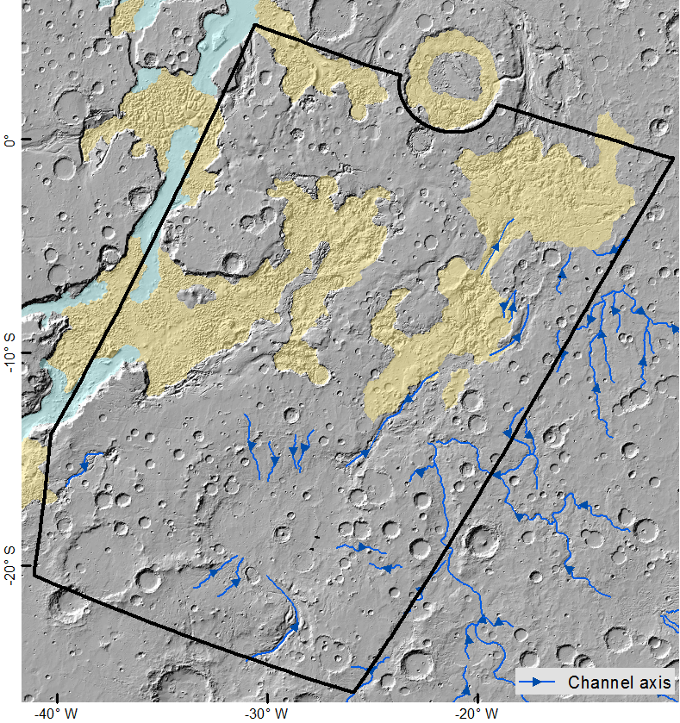
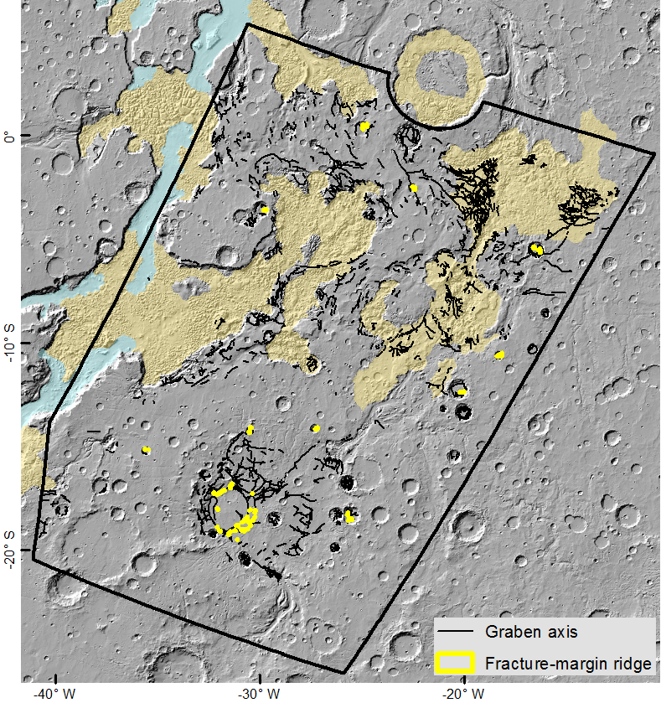
A unique geological history → exceptional potential

Slide 17
Thank you – questions?
rebecca.thomas@lasp.colorado.edu

