Slide 1
Utilizing image recognition technology for foraminiferal assemblage analyses
Christian H Gfatter

Slide 2
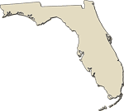
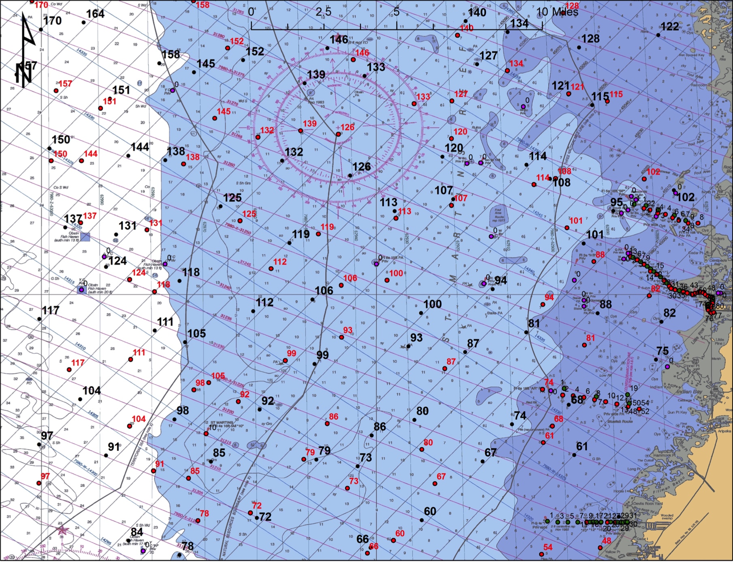
Florida Springs Coast

Slide 3
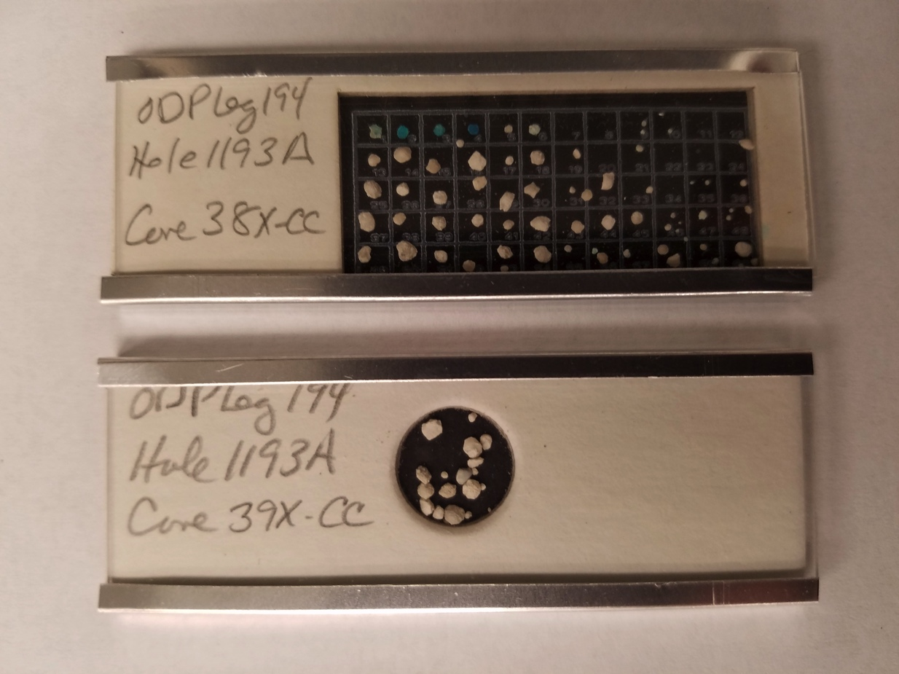
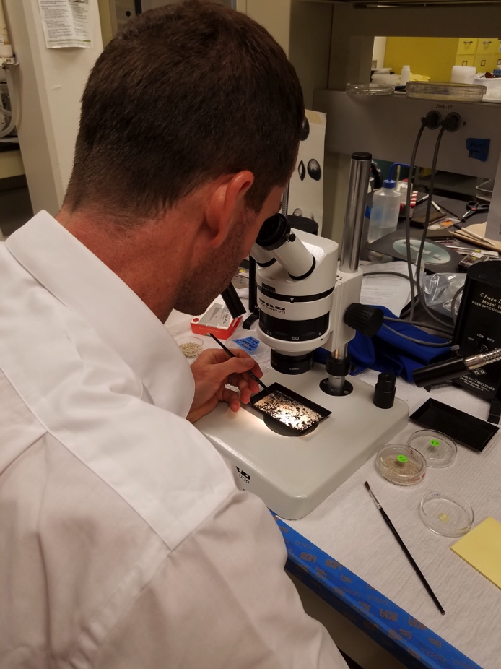
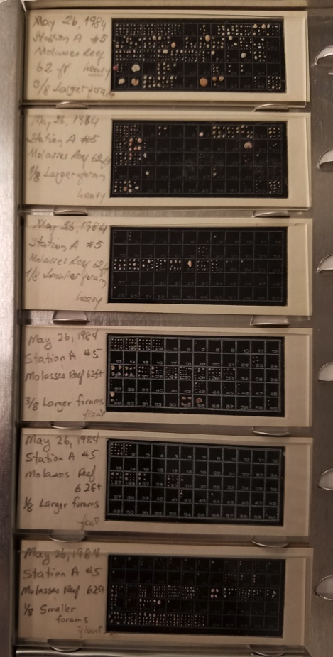
Traditional picking
Pick
Arrange
Store

Slide 4
Identification
Requires skill developed over years
Novice
Expert
familiar with > 100 genera or species
Identified | using pictures | using electronic dichotomous key | using available resources
Genera | 57 of 60 | 56 of 60 | 60 of 60
species | 7 of 57 | 14 of 56 | 30 of 60
time | 2 hours | 3 hours | 1.5 hours
estimated correct | TBD | TBD | > 95%
Notes:
Broken & tiny forams might not be identifiable or only identifiable to a certain level
Still subjective, like balls & strikes being called by a minor league umpire vs. a major league umpire. i.e., Called to the best of their ability, but that strike could have been a ball.

Slide 5
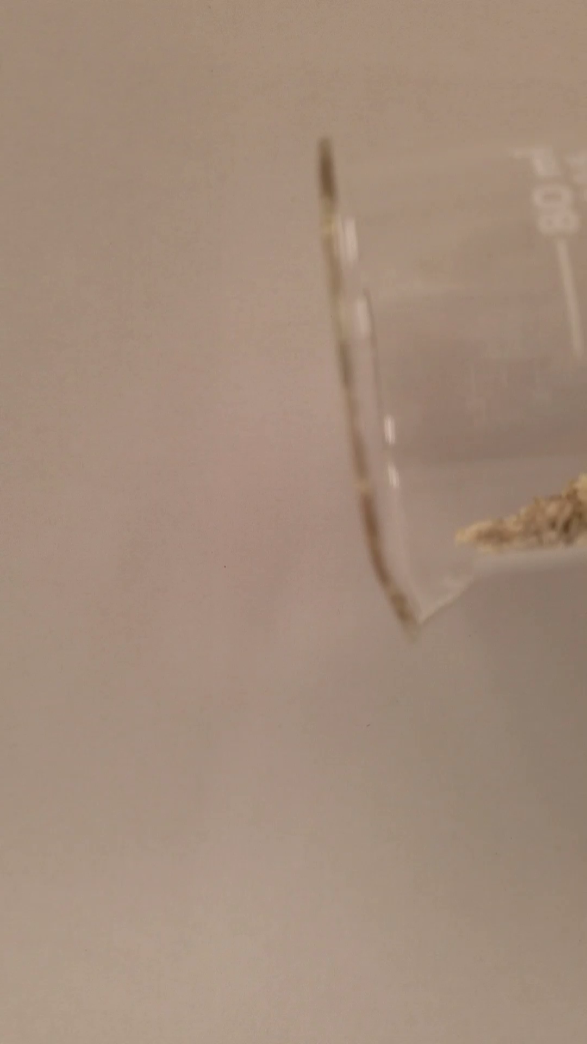
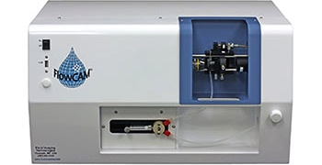


The Big Idea
Add sediment containing foraminifera
Machine sorts & processes particles
Software generates data which allows writing detailed Thesis
Software generates Thesis

Slide 6
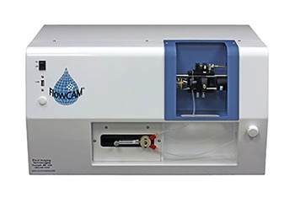
Imaging Instruments
FlowCam® VS Series
(2 µm to 2 mm particles)
Output from sediment sample
Images selected as forams

Slide 7
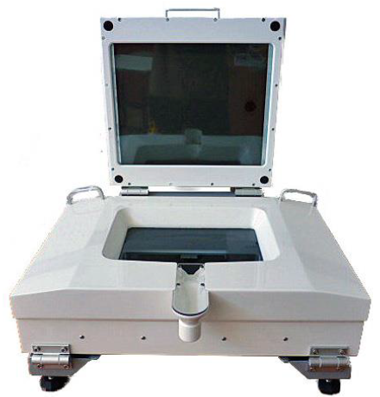
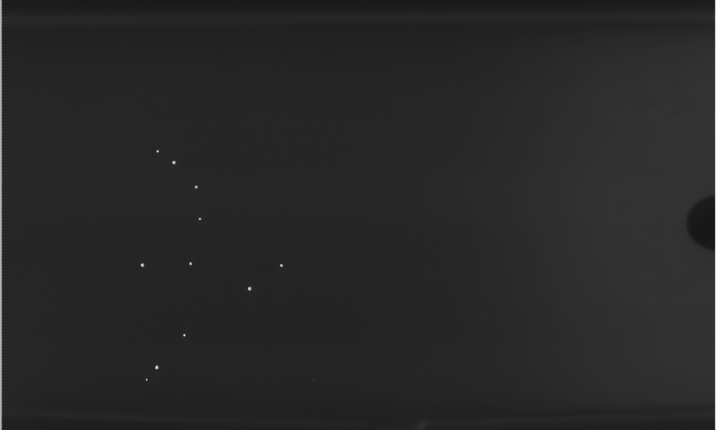
Imaging Instruments
ZooSCAN
(liquid zooplankton)
Images of 11 forams
using the lower light

Slide 8

Imaging Instruments
ZooSCAN
(liquid zooplankton)
Images of 11 forams
using the upper light

Slide 9
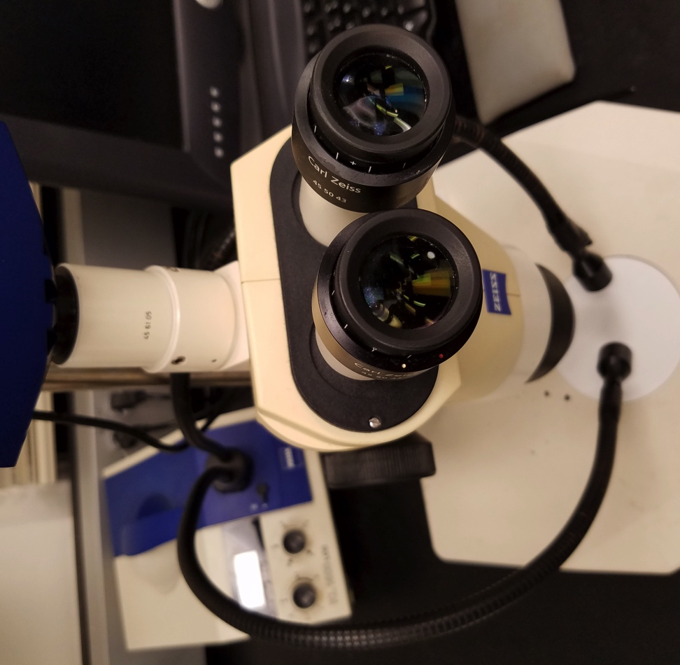
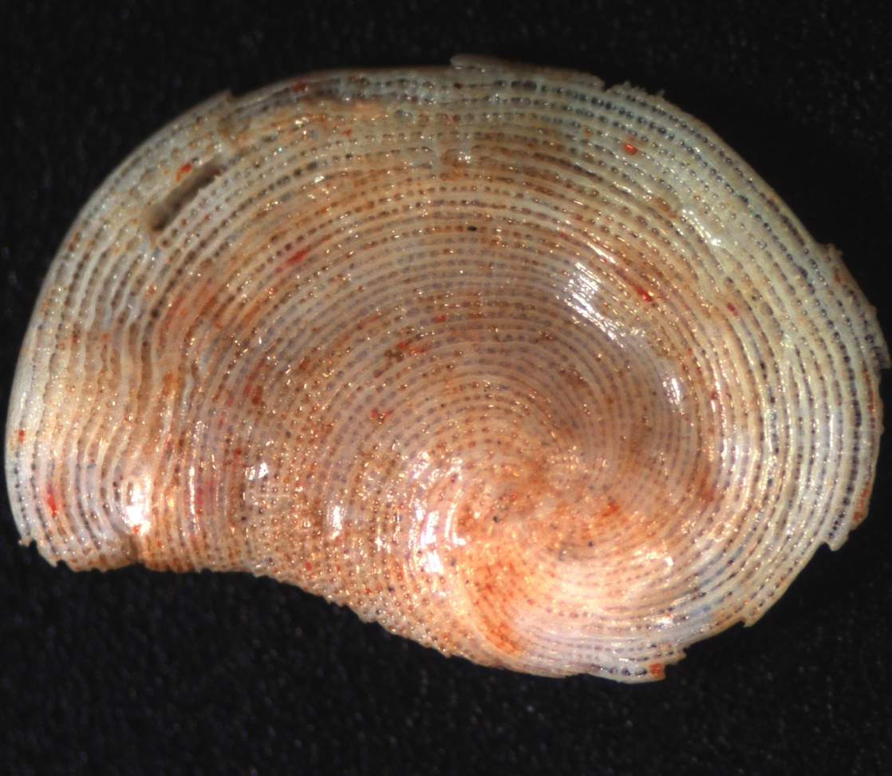
Imaging Instruments
Zeiss AxioCam MRc5
(5 megapixel digital microscope camera)
Archaias angulatus

Slide 10
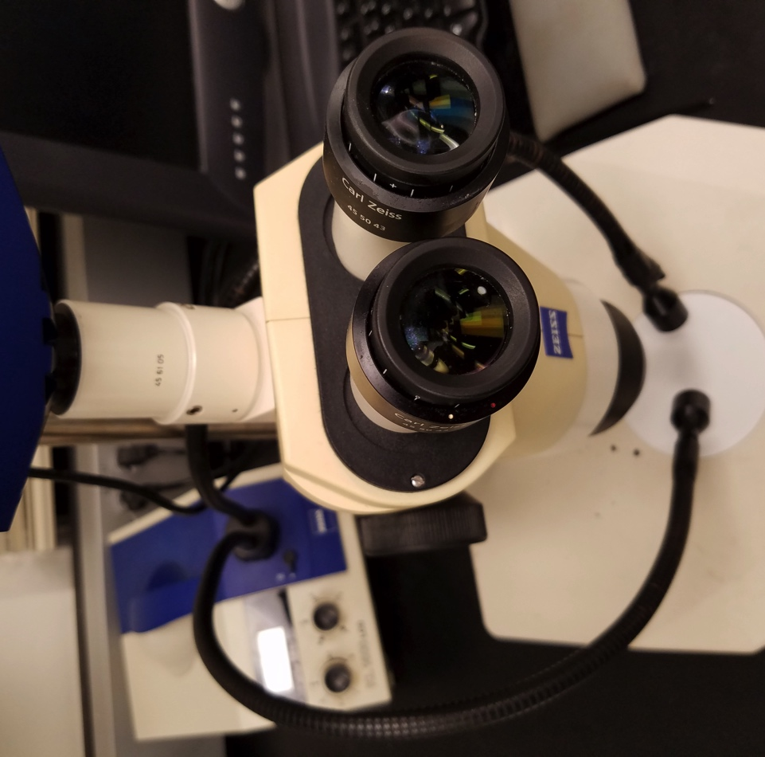
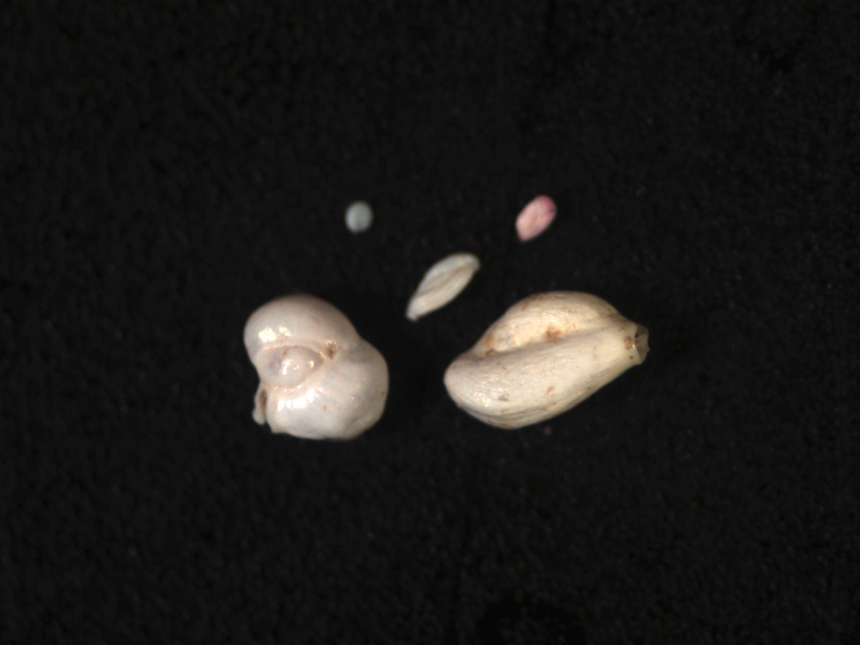
Imaging Instruments
Zeiss AxioCam MRc5
(5 megapixel digital microscope camera)
Magnification
20 x
focused on largest foram

Slide 11
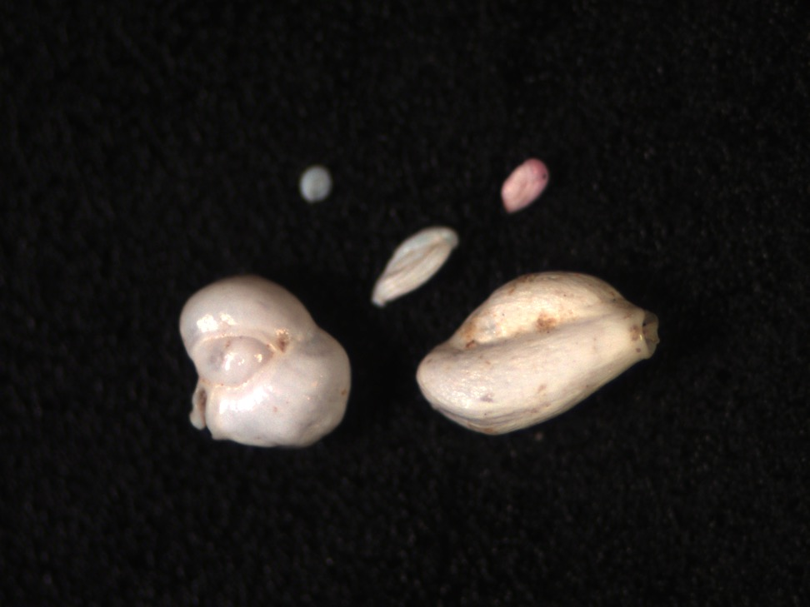
Imaging Instruments
Zeiss AxioCam MRc5
(5 megapixel digital microscope camera)
Magnification
25 x
focused on largest foram

Slide 12
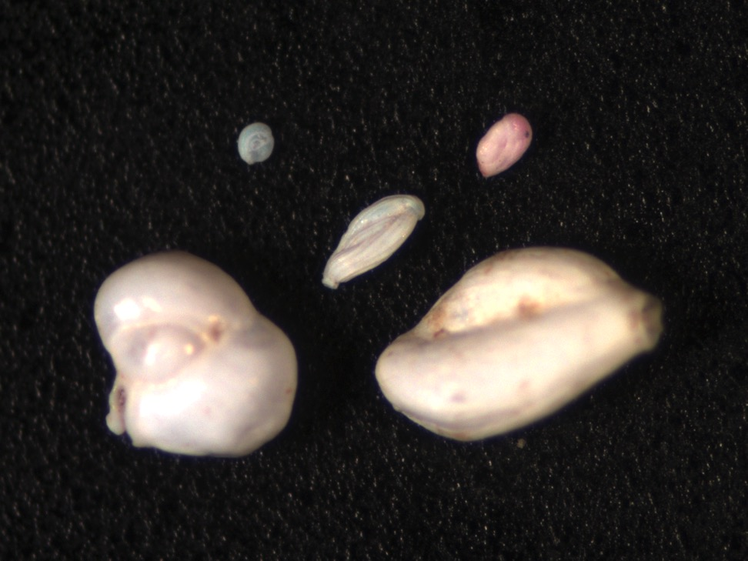
Imaging Instruments
Zeiss AxioCam MRc5
(5 megapixel digital microscope camera)
Magnification
32 x
focused on mid-sized foram

Slide 13
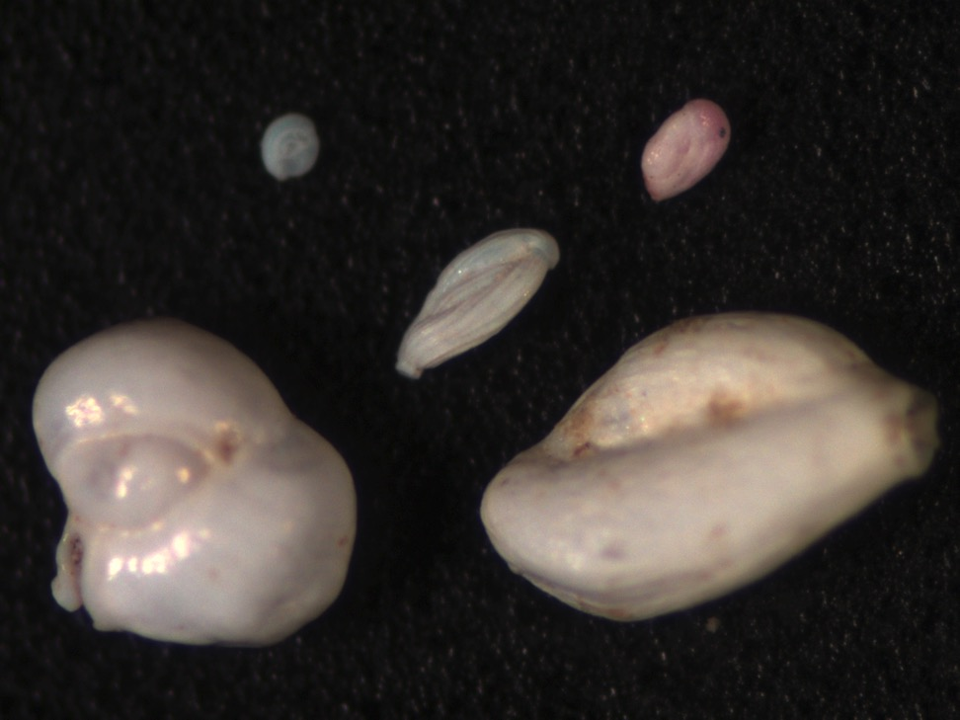
Imaging Instruments
Zeiss AxioCam MRc5
(5 megapixel digital microscope camera)
Magnification
40 x
focused on mid-sized foram

Slide 14
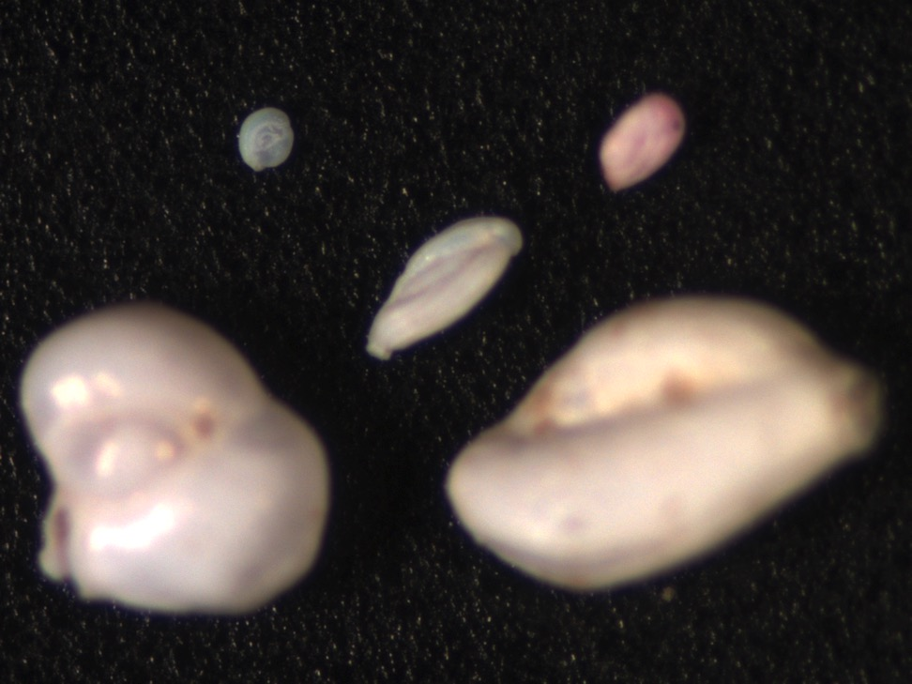
Imaging Instruments
Zeiss AxioCam MRc5
(5 megapixel digital microscope camera)
Magnification
40 x
focused on smallest foram

Slide 15
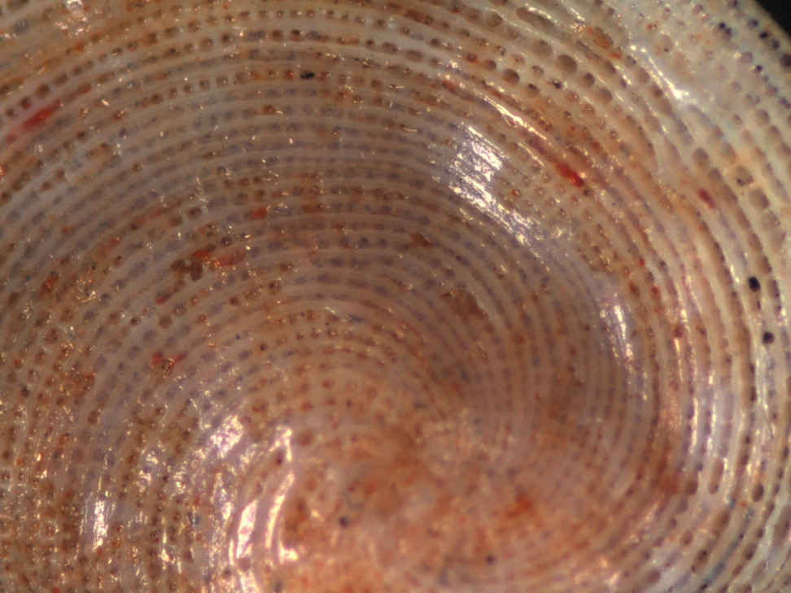
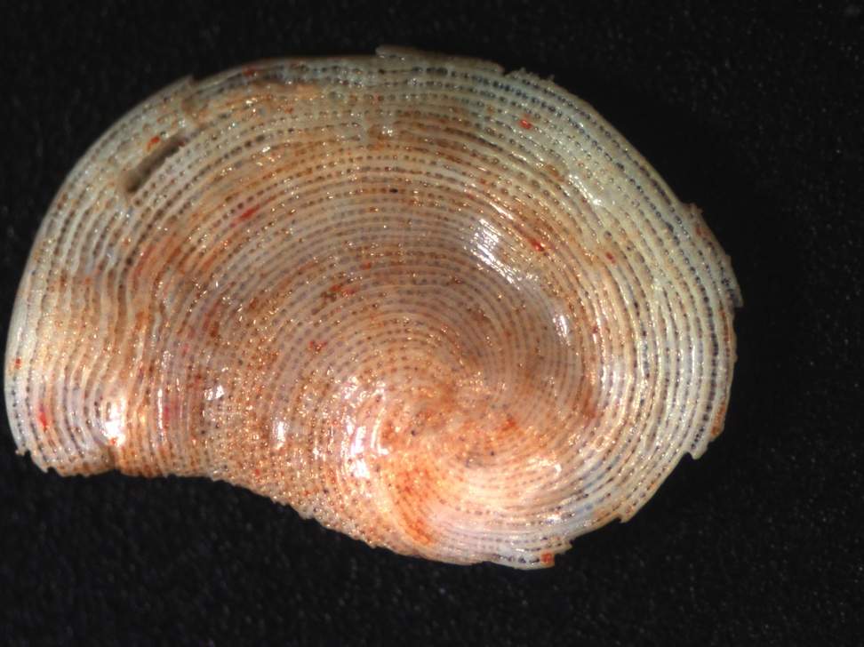
Imaging Instruments
Zeiss AxioCam MRc5
(5 megapixel digital microscope camera)
Additional set of images taken for larger specimens
Magnification
40 x
Archaias angulatus
20 x
Archaias angulatus

Slide 16
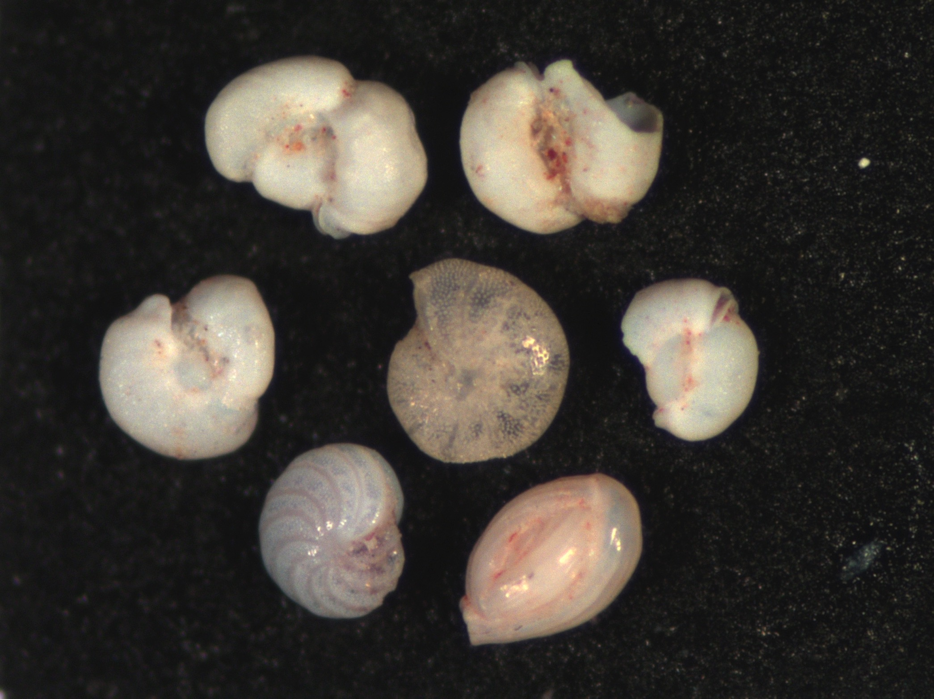
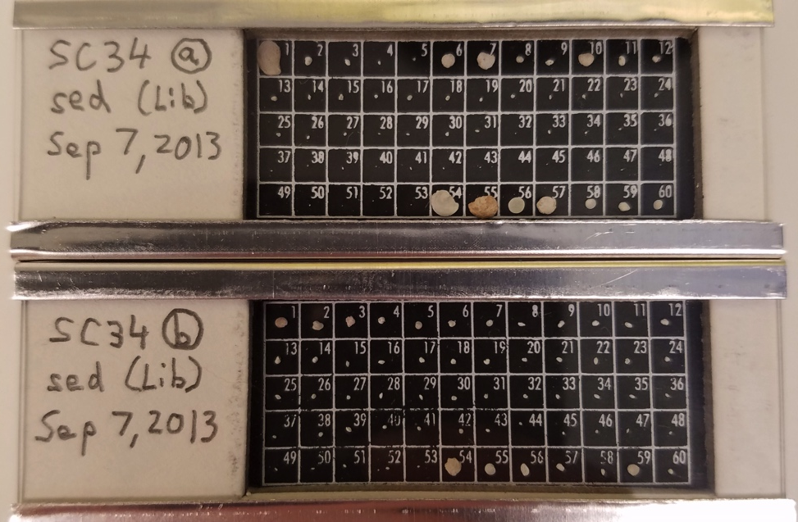
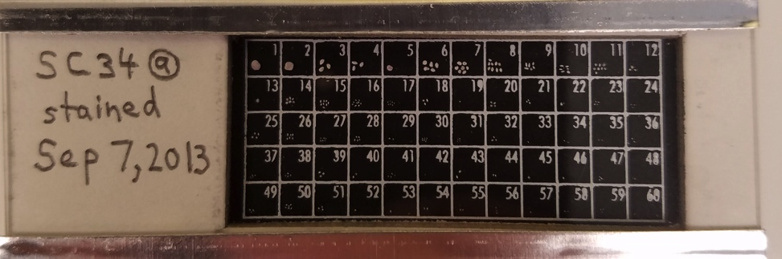
Micropaleoslide arrangement
Library images from sites
Sampling site images
1+ slides per site
1 foraminifera per grid
Several views photographed
1 slide per site
1+ forams per grid
1/4 of grid utilized with
forams grouped by size

Slide 17
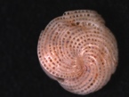
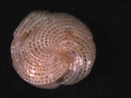
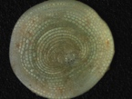
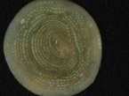
Combining AxioCam pictures with
FlowCam image processing software
images
VisualSpreadsheet
AVI animation

Slide 18

Video used by FlowCam software (VisualSpreadsheet)
For this demo, 48 images at 6 frames per second

Slide 19
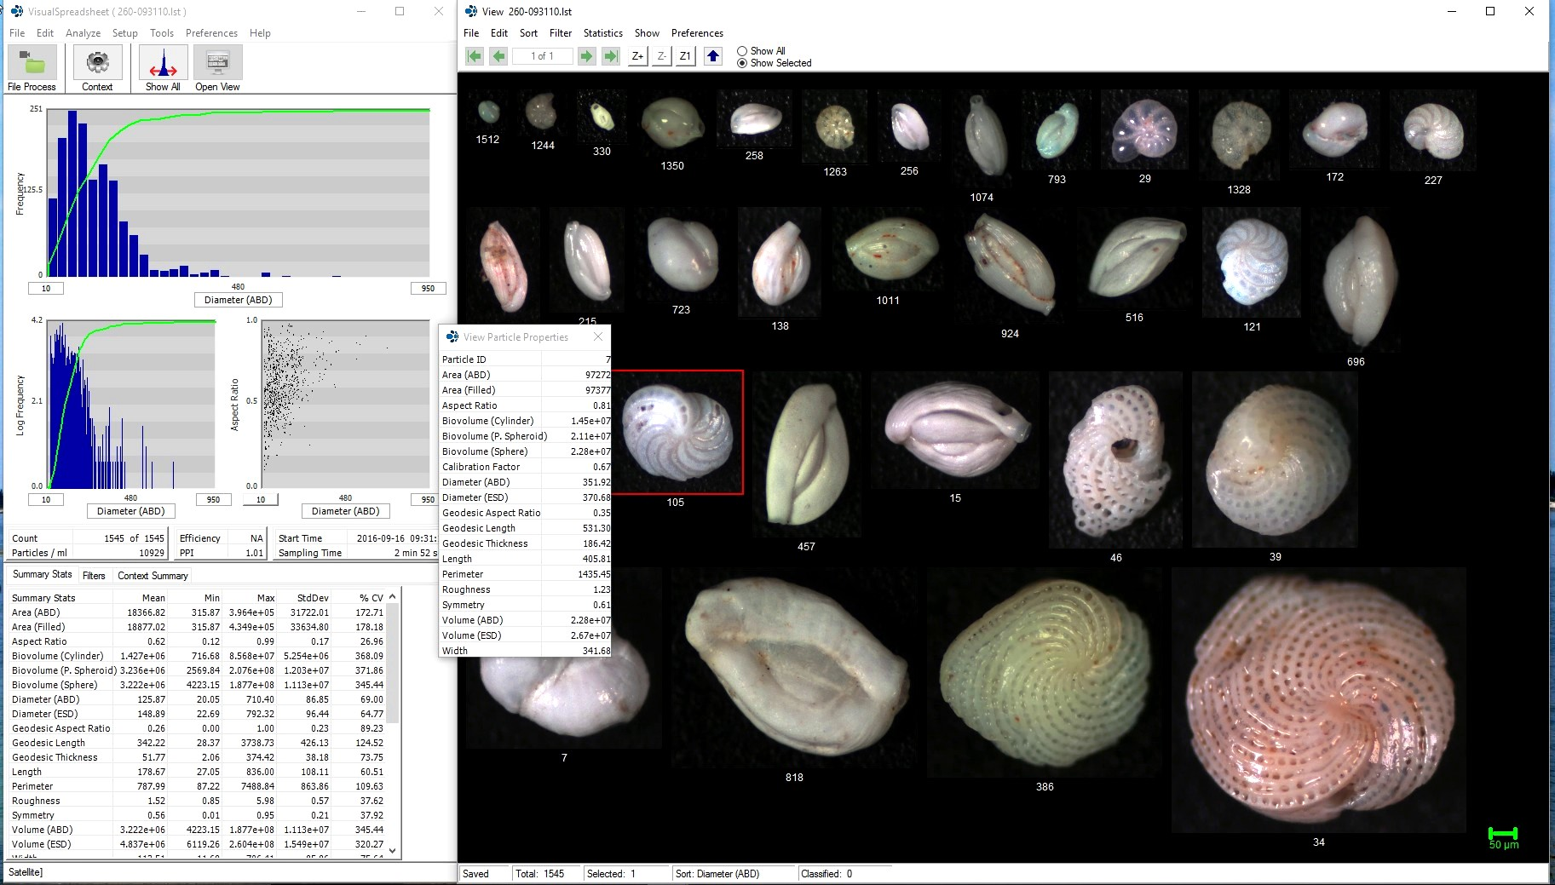
VisualSpreadsheet output

Slide 20
Refinement
Initial classification and measurements systematically made by software
Manual post-processing: image rejection, identification overrides, etc.
Library grows, helping improve processing of subsequent foraminiferal samples
Digital data (images & records) can be shared and backed-up (physical specimens archived)
Notes:
Automatic IDs may not be exact, but it should aid manual work
Software gets better and better

Slide 21
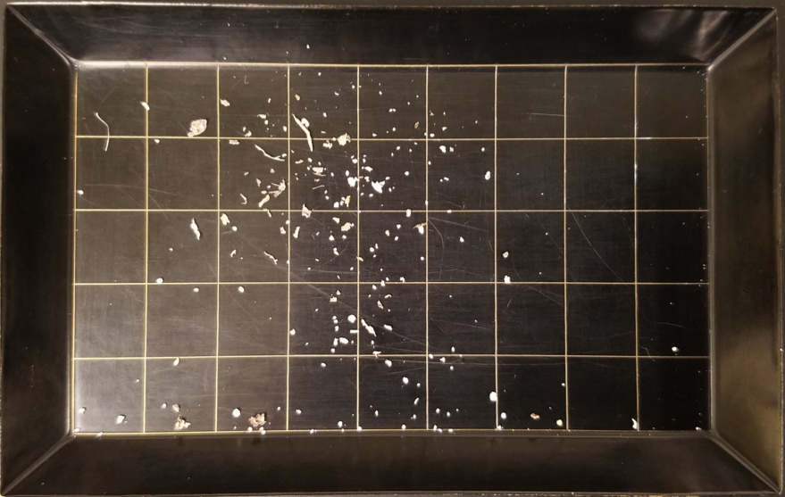
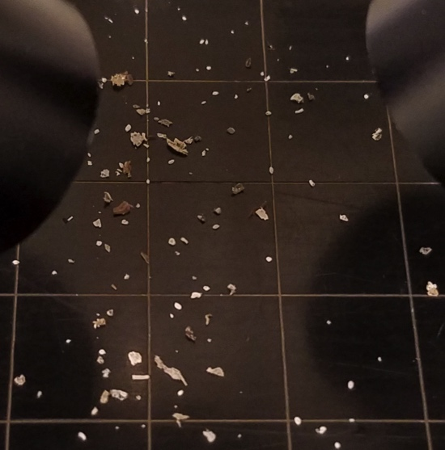
Potential Applications & Considerations
WHAT: heavy mineral sands (e.g., in ancient beach sands), diatoms, ostracods, & other opaque organisms
HOW: using trichloroethylene (TCE) separation technique to provide foraminiferal samples for bulk processing
SOFTWARE: other programs (e.g. SIPPER) may make finer determinations, provide different data, etc.
Notes:
• TCE might speed up the number of images taken, or be utilized to create aliquots of forams to be processed by machine (automated, but currently black & white images)
• There is better (as well as other) software & technology available, but these were within our area and budget to explore

Slide 22

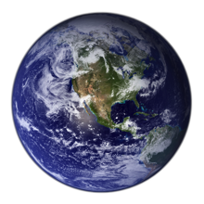
Summary
Identification efficiency
    Consistency
    Error reduction
Broeckina orbitolitoides
Additional data
    Standardized characterization
    (e.g. length)
Digitization
    Accessibility
    Global sharing

Slide 23

Acknowledgements & Credits
Cushman Foundation for Foraminiferal Research
Dr. Pamela Hallock Muller
Kyle Amergian
Harry Nelson, VP – Aquatic Markets, Fluid Imaging Technologies
Ian W Bishop, University of Colorado
Kate Dubickas
Dr Paul Carlson, Florida Fish and Wildlife Research Institute
Images:
www.fluidimaging.com/products/flowcam-vs
www.hydroptic.com/zooscan.html
commons.wikimedia.org
cliparts.co
Maps:
Florida Center for Instructional Technology, University of South Florida

Slide 24

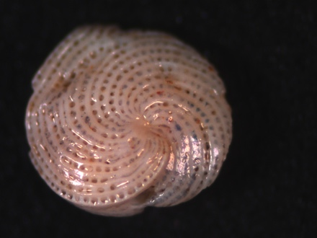


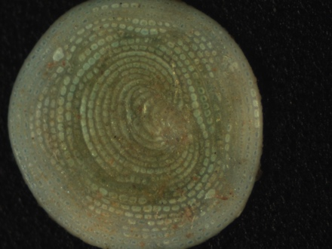
Questions

Slide 25
Thank you!
Christian H Gfatter
+1 (312) 321-1777
cgfatter@mail.usf.edu

