Slide 1

VOLCANOTECTONIC PROCESSES NEAR MARS’ DICHOTOMY BOUNDARY
Rebecca J. THOMAS & Brian M. Hynek
Laboratory for Atmospheric and Space Physics, University Of Colorado, Boulder, CO

Slide 2
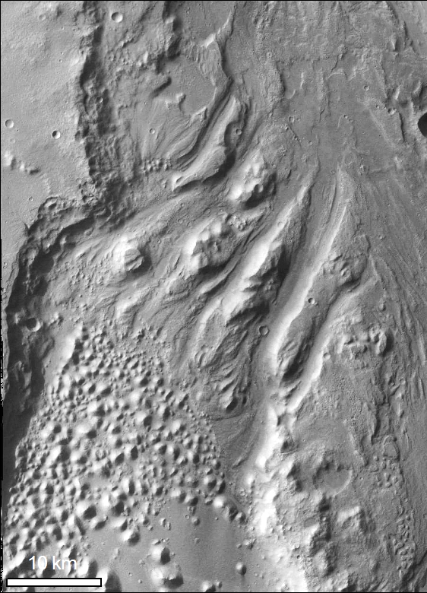
Magmatism involved with water outflow on Mars?
3.5 Ga onwards on Mars, hypothesized connection between surface fracturing, water outflow and magmatic intrusion.
BUT There is a lack of surface evidence for the magmatic component.
We present new evidence for surface volcanism, intimately connected to the surface fracturing and fluid outflow.

Slide 3
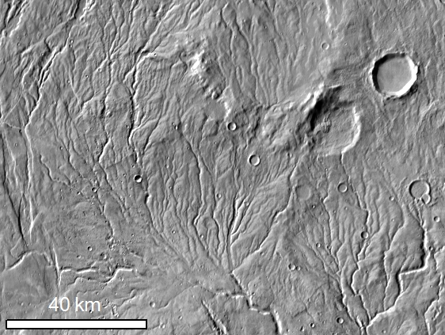
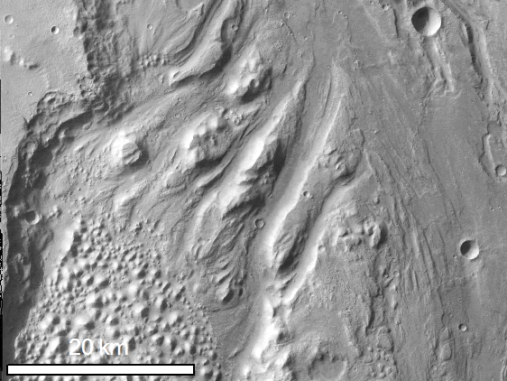
Importance of Hesperian-Amazonian outflows
After Early Hesperian (3.5 Ga), cooler, drier climate → lack of precipitation + thick cryosphere
Fluvial networks no longer form
Chaos and outflow channels form when water is released catastrophically from the subsurface
Chaos-sourced outflows = major geomorphological agent during this period
Southern highlands fluvial network
Iani Chaos → Ares Vallis

Slide 4
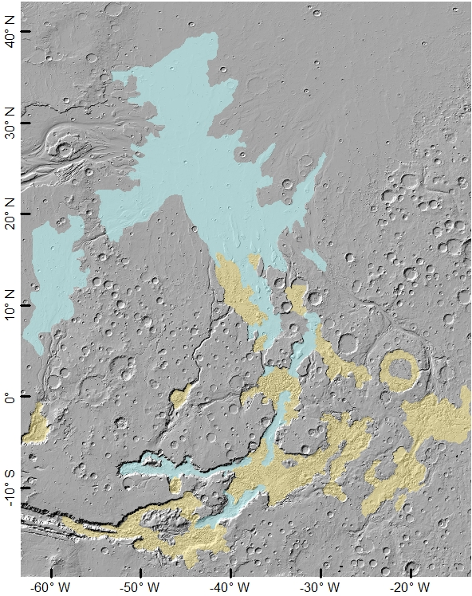
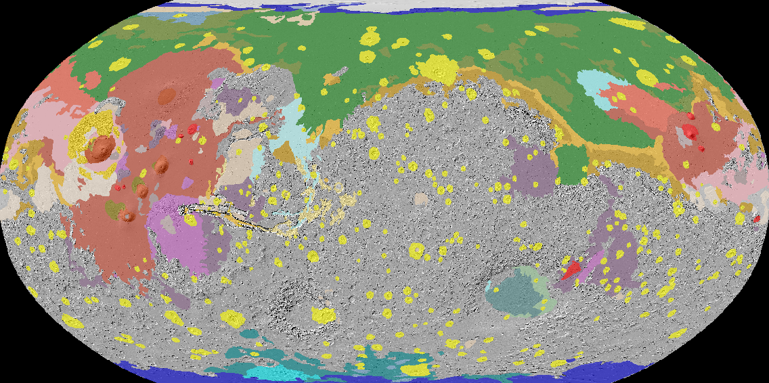
Importance of Hesperian-Amazonian outflows
Hesperian-Amazonian Units ( Tanaka et al., 2014)

Slide 5
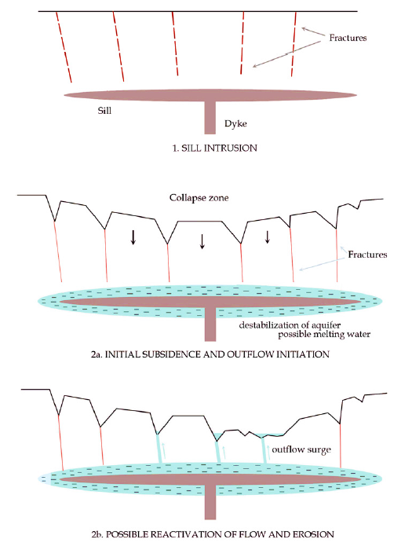
Groundwater outflow – but why?
Many hypotheses for the trigger for chaos & outflow:
  Cryospheric melting by igneous intrusion (Cabrol et al., 1997; Chapman and Tanaka, 2002; Meresse et al., 2008)
  Release from deep aquifers through disruption of the cryosphere (Carr, 1979; Coleman, 2005; Rodriguez et al., 2005)
  Destabilization of hydrous clathrates (Hoffman, 2000; Max and Clifford, 2001)
Many require heating by magmatic intrusion
Meresse et al. (2008)

Slide 6
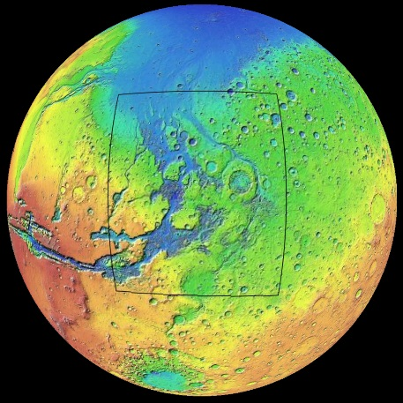
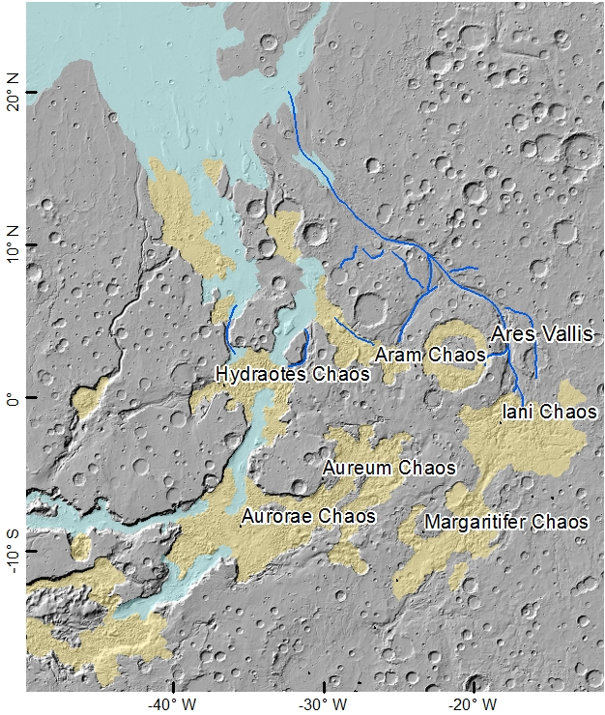
Problem: very limited evidence of volcanic activity
Chaos regions particularly cluster SE of the Chryse basin

Slide 7
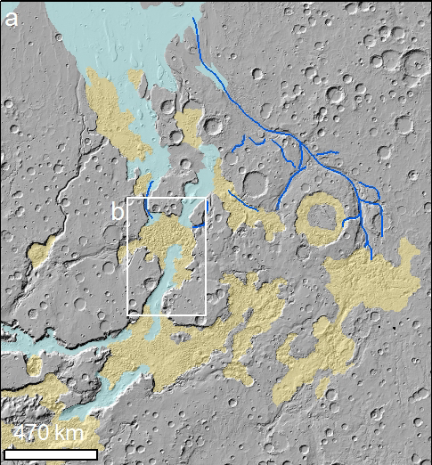
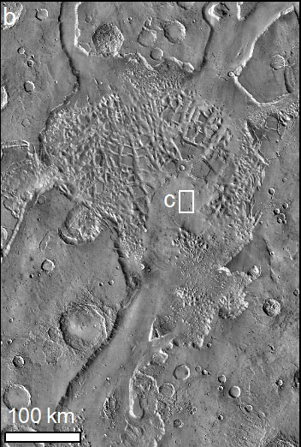
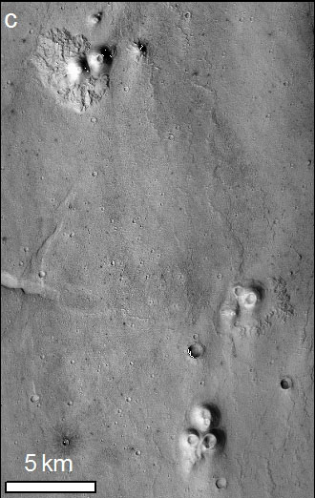
Only volcanic examples: Hydraotes cones
See Meresse et al. (2008)

Slide 8
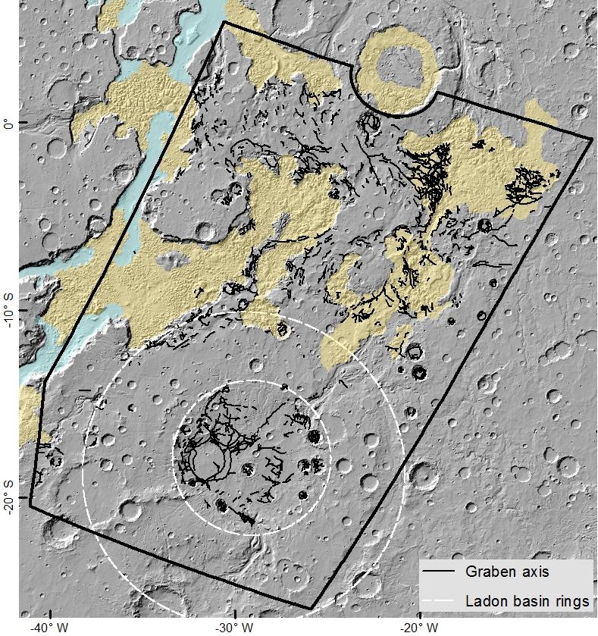
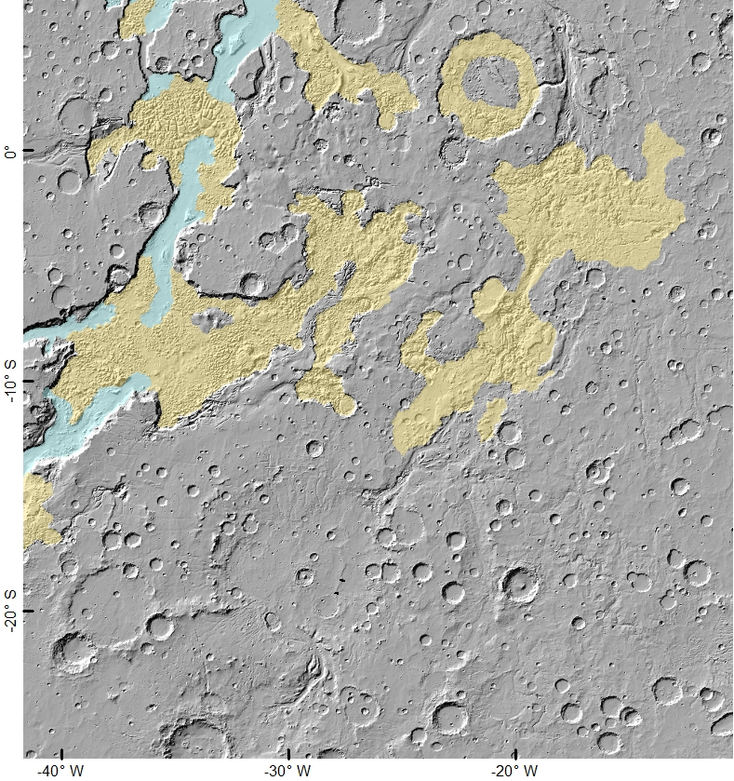
New evidence: Margaritifer Terra
East of Tharsis volcanic province
Surrounding and south of chaos
Extensively fractured during period of chaos-formation

Slide 9
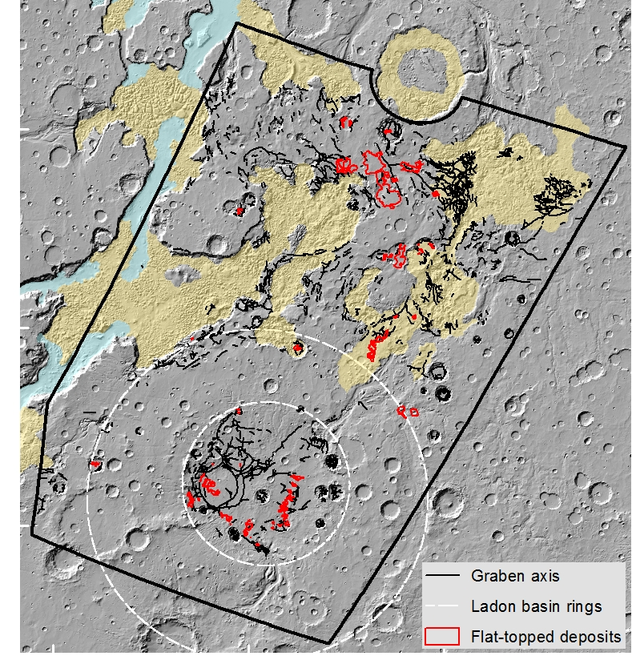
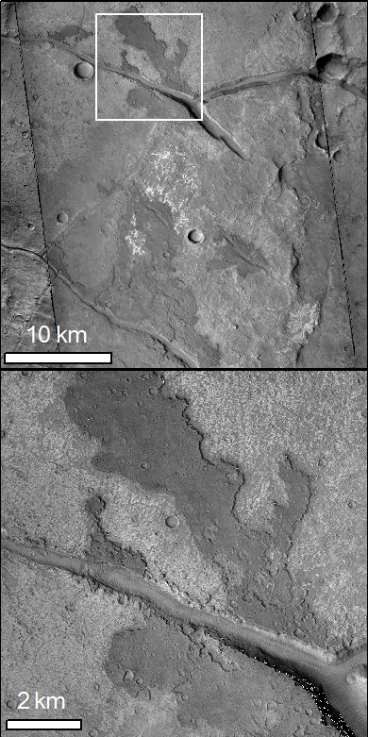
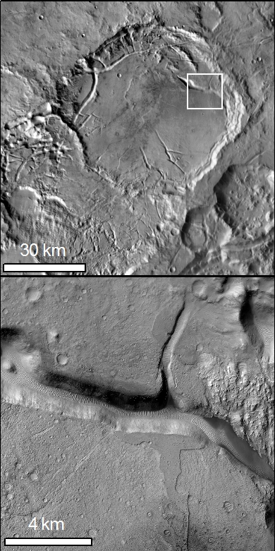
Fracture-side deposits

Slide 10
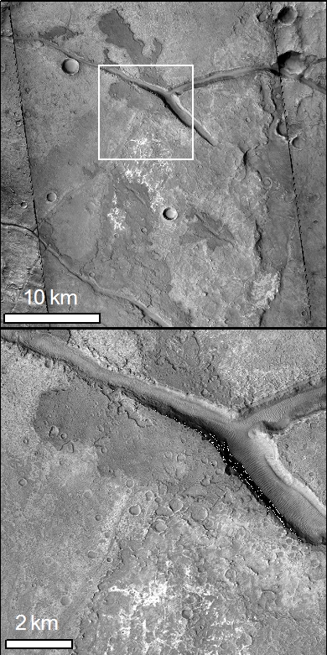
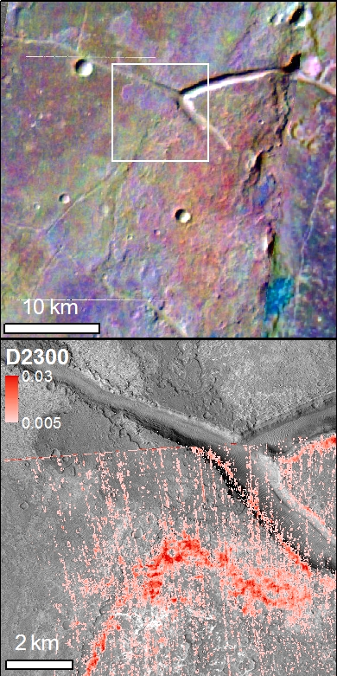
Non-clay-bearing, basaltic spectral signature

Slide 11
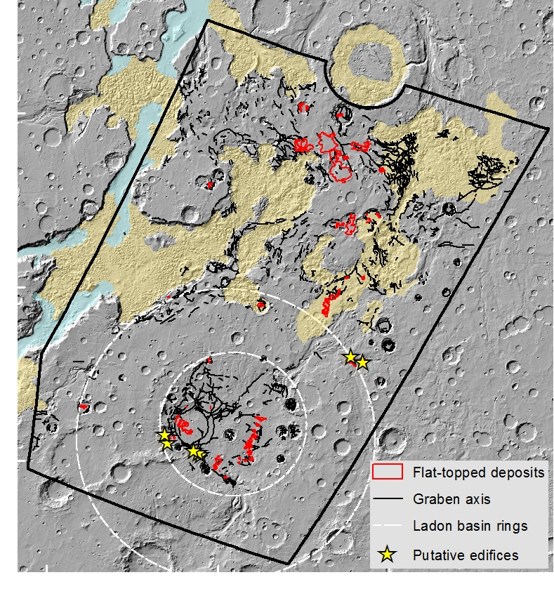
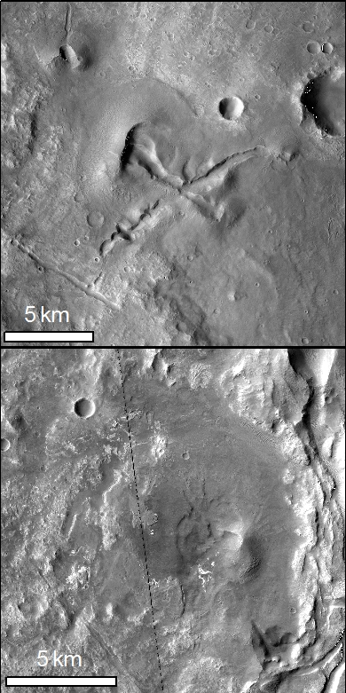
Putative volcanic edifices

Slide 12
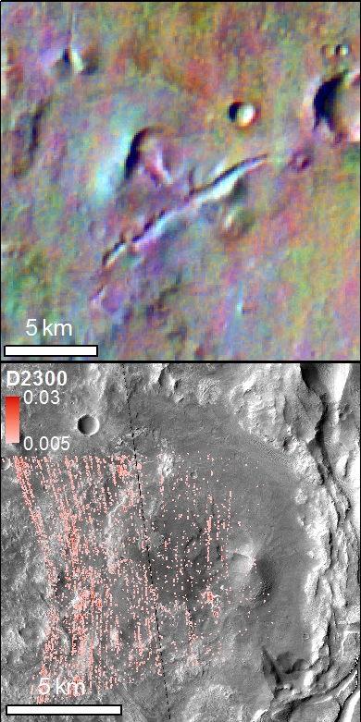
Non-clay-bearing, basaltic spectral signature

Slide 13
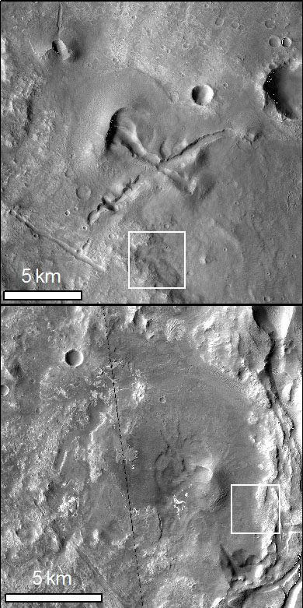
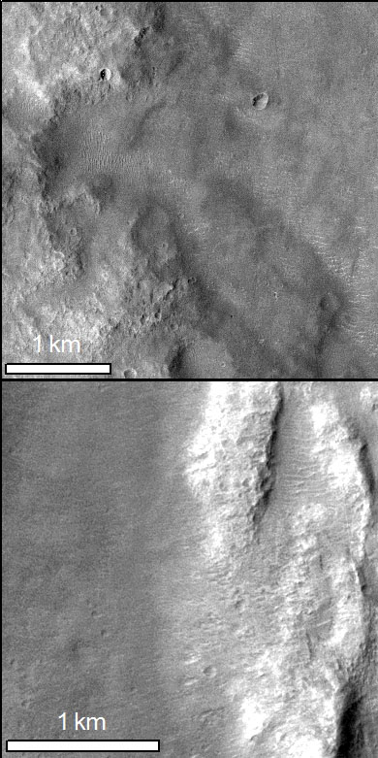
Edifices – pyroclastic?

Slide 14
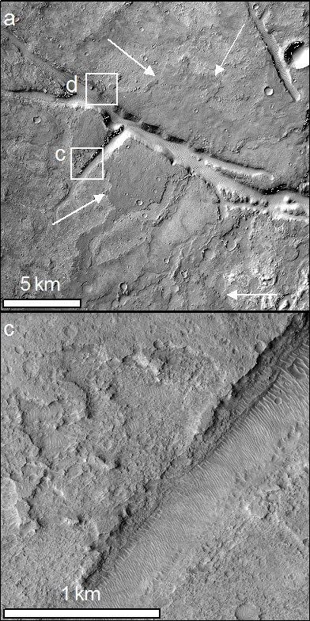
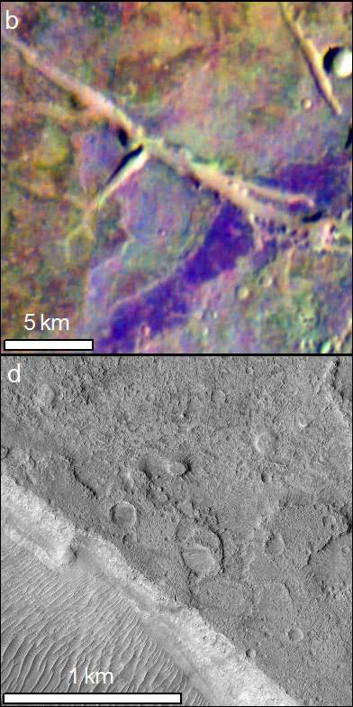
Correlation of volcanism with fluid outflow

Slide 15
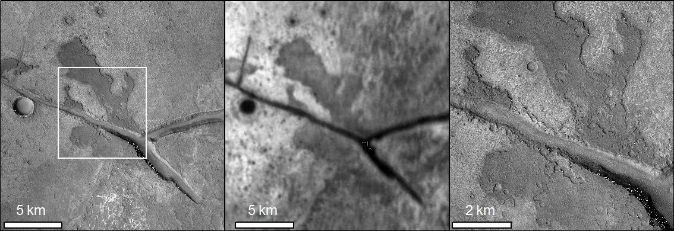
Correlation of volcanism with fluid outflow 2

Slide 16
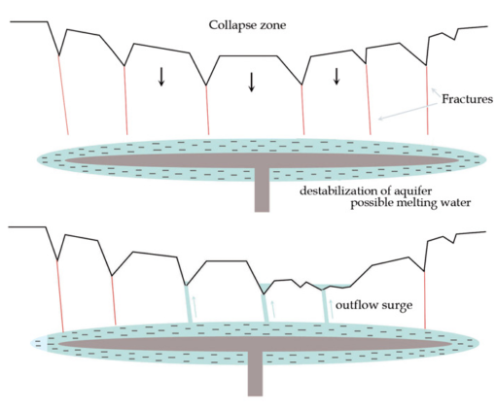
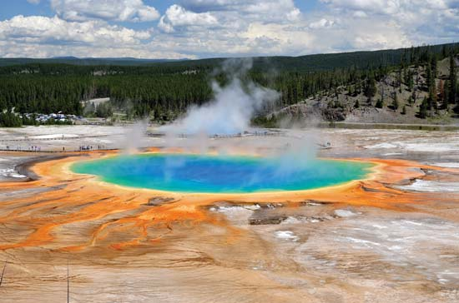
Implications of water/volcanism co-occurrence
Magmatism was intimately connected with the water outflow
Hydrothermal environments
  Favorable to life
  Excellent biosignature preservation potential

Slide 17
Conclusion: Volcanic deposits in Margaritifer ✓
At Mars’ dichotomy boundary in the Hesperian-Amazonian:
Fracture-formation
+
Water outflow
+
Effusive volcanism
(lava + ?pyroclastic?)
Strengthens hypotheses that chaos and associated catastrophic outflows resulted from magmatic intrusion.
Raises possibility of hydrothermal deposits → astrobiological implications

