Slide 1



Mi-STAR Teacher Professional Development for Implementation of NGSS-Aligned
Three-Dimensional Curriculum and Assessments
J.E. Huntoon, B. Bergman, E.E. Gochis, S. Tubman,
M.L. Hoover and E.C. Robeck

Slide 2
Mi-STAR is…
Michigan Science Teaching and Assessment Reform
  Middle school curriculum development (3-year, integrated science)
  Teacher PD
  Teacher preparation
  Supported by the Herbert H. and Grace A. Dow Foundation
Partners
  Eleven (+) school districts in Michigan
  Scientists and engineers from seven universities in Michigan
Staff
  Education experts and researchers from Michigan, Illinois, Virginia
Connections/Advisers
  Michigan Department of Education
  Michigan Math / Science Centers
  Professional societies representatives

Slide 3
Purpose of Teacher PD – Address Needs
Before It’s Too Late (2000) – Report to the Nation from the National Commission on Mathematics and Science Teaching for the 21st Century, John Glenn, Chair (p. 21)
  “If the core of mathematics and science is about inquiry, then too many of today's mathematics and science classrooms come up short.
  Students are crippled by content limited to the "What?"
  They get only a little bit about the "How?" (or "How else?") and not nearly enough about the "Why?" Missing entirely is "Why should I care?"
Notes:
In the late 20th century (and even today) many teachers focus on teaching content, that is, factual knowledge, and spend less time engaging students in using science as a tool to develop their own understanding of the world around them and the problems facing society.

Slide 4
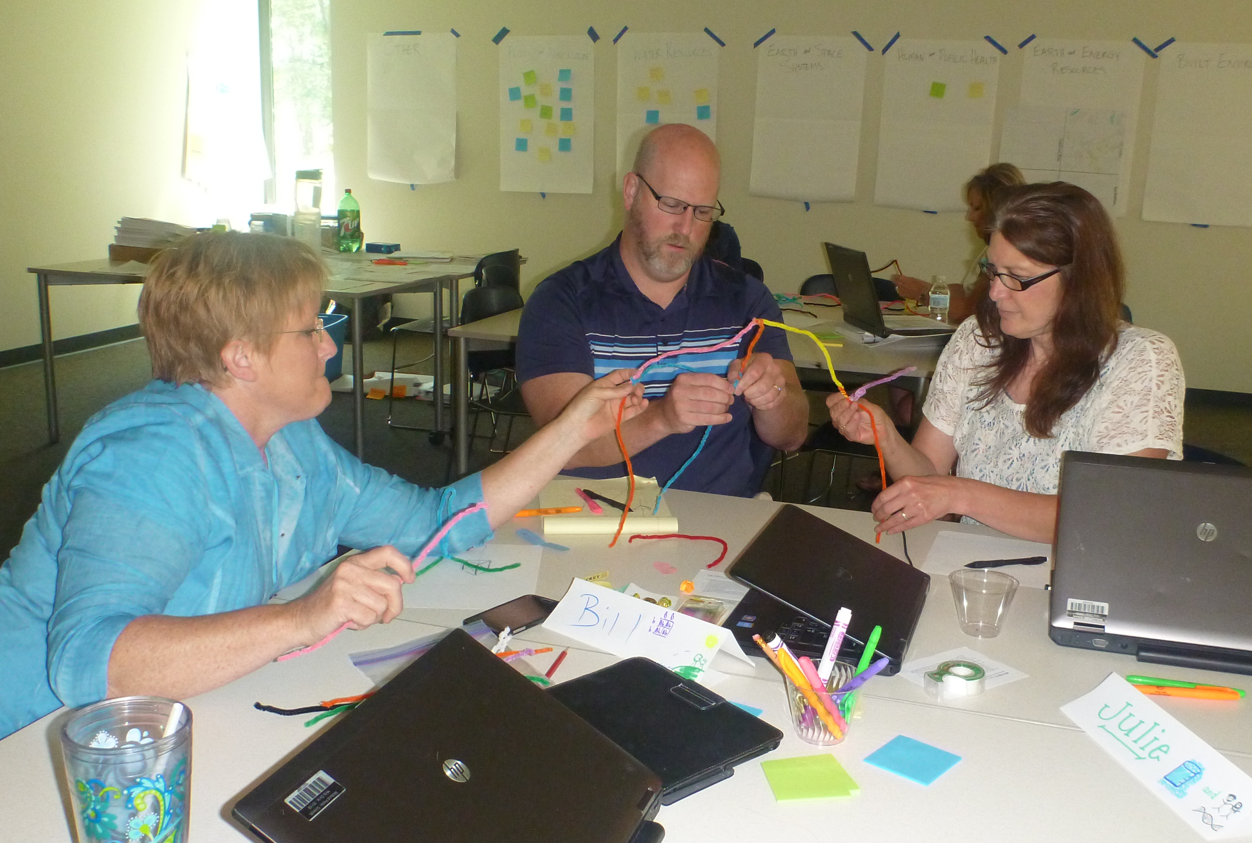
NGSS Designed to Promote Change
Disciplinary Core Ideas
  Physical Science
  Life Science
  Earth and Space Sciences
  Engineering, Technology and Applications of Science
Science and Engineering Practices
Crosscutting Concepts
Teacher PD Must Address All Three Dimensions
Notes:
The familiar aspects of educational standards - disciplinary knowledge (the facts upon which future knowledge is built) - continue to be included in the NGSS.
But the NGSS also includes Science and Engineering Practices. The practices are the things that real scientists and engineers do when they go to work everyday. NGSS also includes the Crosscutting Concepts, which describe the things scientists and engineers look for when they try to understand phenomena or develop solutions to problems.
Many, perhaps even most, current teachers have a good background in the disciplinary core ideas. Almost none of the current teacher workforce has had specific training in how to engage students in using the science and engineering practices and the crosscutting concepts however.
So, this is where PD really needs to concentrate right now.

Slide 5
DCIs by Topical Area (Middle School)
Earth and Space Science
  Space Systems
  History of Earth
  Earth’s Systems
  Weather and Climate
  Human Impacts
Physical Science
  Structure and Properties of Matter
  Chemical Reactions
  Forces and Interactions
  Energy
  Waves and Electromagnetic Radiation
Engineering, Technology, and Applications of Science
  Engineering Design
Life Science
  Structure, Function, and Information Processing
  Matter and Energy in Organisms and Ecosystems
  Interdependent Relationships in Ecosystems
  Growth, Development and Reproduction of Organisms
  Natural Selection and Adaptions

Slide 6
SEPs and CCCs
Science and Engineering Practices
  Asking questions and defining problems
  Developing and using models
  Planning and carrying out investigations
  Analyzing and interpreting data
  Using mathematics and computational thinking
  Constructing explanations an designing solutions
  Engaging in argument from evidence
  Obtaining, evaluating, and communicating information
Crosscutting Concepts
  Patterns
  Cause and effect
  Scale, proportion, and quantity
  Systems and system models
  Energy and matter
  Structure and function
  Stability and change
  Interdependence of science, engineering, and technology
  Influence of engineering, technology, and science on society and the natural world

Slide 7
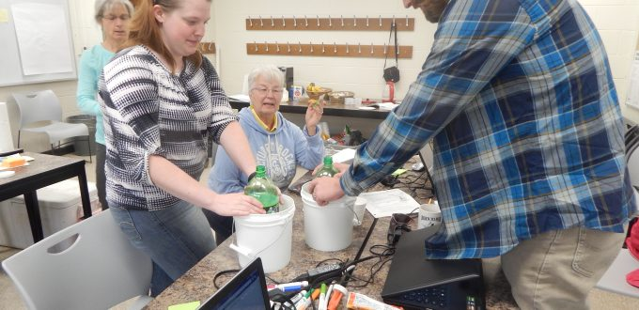
Goals of PD
Help teachers be as effective as possible
  The vision:
    Engage their students in using all three dimensions simultaneously
    Facilitate students’ investigations of phenomena
    Guide students’ development of solutions to problems
    Provide students with extended opportunities to develop, test and refine their own understanding
  The reality:
    Prepare students to do well on high-stakes tests
Notes:
The ultimate goal of PD is to improve students’ learning outcomes.
The vision underlying most PD is that it is designed to help teachers be better prepared in content pedagogy
However, what most teachers want, and we all need to be sensitive to, is that teachers need to ensure that their students do as well as possible on high-stakes tests. Funding for schools and continued employment for teachers in some cases depends on the outcome of these tests.
One of the best things that we have found is that by using NGSS-aligned materials and methods, students do better on standardized tests AND are more engaged overall. Win-win.

Slide 8
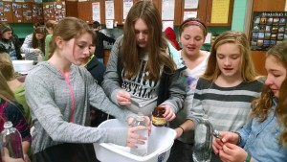
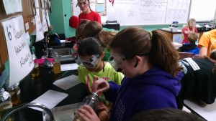
Performance Expectations
Three-dimensional
Specify what students must be able to do
For example: Construct an argument supported by evidence for how increases in human population and per-capita consumption of natural resources impact Earth’s systems.
  Science and Engineering Practice: Argument from evidence
  Disciplinary Core Idea: Human impacts on earth systems
  Crosscutting Concept: Cause and effect
Notes:
The actual standards (of NGSS fame) are articulated as performance expectations. Each includes at least one SEP, DCI, and CCC. These specify what students must be able to do at the conclusion of instruction. Note that this is “what they must be able to do” not what they must “know.” The emphasis here is important for assessment as well as teaching. The goal of teaching now is to get students to “do the learning.”
There are many: ESS (15); ETS (4); LS (21); PS (19)

Slide 9
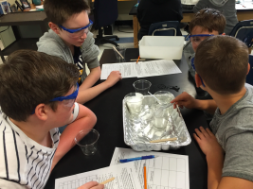
Keeping It Real (Why Should I Care?)
Mi-STAR’s approach
  Unit Challenges
    Real-world phenomena and problems
    Local and/or regional relevance
    Ongoing interaction/ongoing formative assessment
  Emphasis on the disciplinary “Three E’s”
    Earth
    Environment
    Engineering
Insulation Inspiration

Slide 10
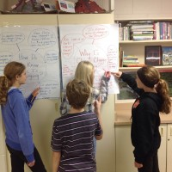
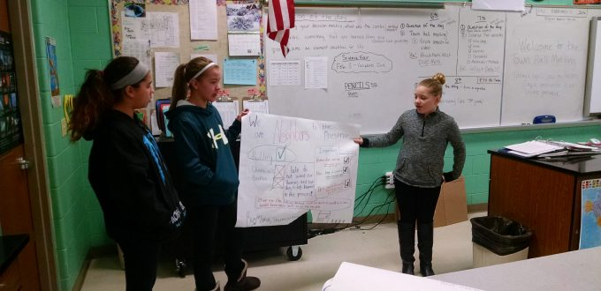
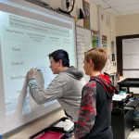
Performance-Based Assessment
Engage in argument (discussion) using evidence
  Identify scientific evidence
  Evaluate and critique evidence
  Reason and synthesize
  Support a claim with evidence
Notes:
Assessments can be based on the NGSS evidence statements. All require students to DO SOMETHING.
The emphasis is clearly on critical thinking rather than memorization.
I know this will be one of the hardest parts because even in the University, we struggle in some cases to do more than give multiple choice exams that emphasize memorization.
The importance of focusing on assessment is clear – if classroom-based assessments become performance-based assessments, then classroom learning must become student centered – the focus has to be on what the students are learning to do.

Slide 11
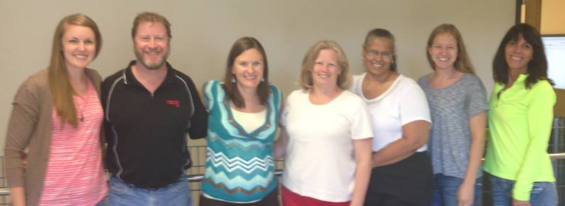
PD Needed
NGSS – introduction + practice
Unpacking PEs into component SEPs, DCIs, CCCs – examples + practice
Conceiving of real-world and relevant scenarios that allow for three-dimensional classroom-based assessment – examples + practice
Developing and using rubrics to grade performance-based tasks – examples + practice
Creating mini lessons/units – practice + collaborative review
Identifying connections between “primary” PEs and “supporting” PEs – practice + collaborative review
Critiquing existing materials’ three-dimensionality – practice + collaborative review
Establishing personal networks to support ongoing learning – technology enabled
Notes:
Based on our experiences, teachers need PD that starts with the basics and proceeds all the way to where they are implementing NGSS-aligned curricula in their classrooms.
Almost all the teachers we have worked with describe themselves, at the start, as being familiar (to varying degrees) with NGSS. After only a short time with us they indicate that now they know how little they know.
Most of the teachers also say that they think that student-centered classrooms are best in promoting student learning – but they indicate that in many cases they are doing a lot of the teaching.
Based on our experiences, the best way to help teachers to learn how to engage their students in performing the practices and using the crosscutting concepts is to model three-dimensional teaching as part of PD so that teachers experience – as learners – what they hope to support in their own classrooms with their own students later on.

Slide 12
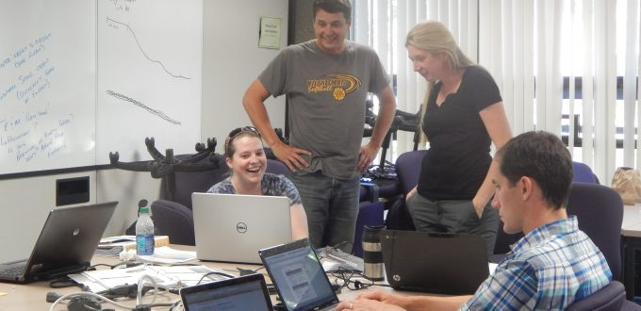
Mi-STAR’s Approach
Online Mi-STAR Academy
  Basic training for all Mi-STAR participants
Summer PD sessions with certified facilitators
  Train-the-trainer model allows for growth of network
Customized real-time support by scientists and engineers for pilot-testing teachers
  Teachers’ needs and requests inform development of next generation of PD
Major learnings:
NGSS-cataloged materials are not necessarily NGSS-aligned
Three-dimensional teaching and assessment is challenging to develop and implement
Student learning outcomes resulting from three-dimensional teaching are promising
Notes:
The online academy is the basic training needed to continue further.
Most of the teachers also say that they think that student-centered classrooms are best in promoting student learning – but they indicate that in many cases they are doing a lot of the teaching.
Ongoing, customized support is critical.
It is probably not possible to simply revise existing materials in order to make them fully three dimensional.

Slide 13
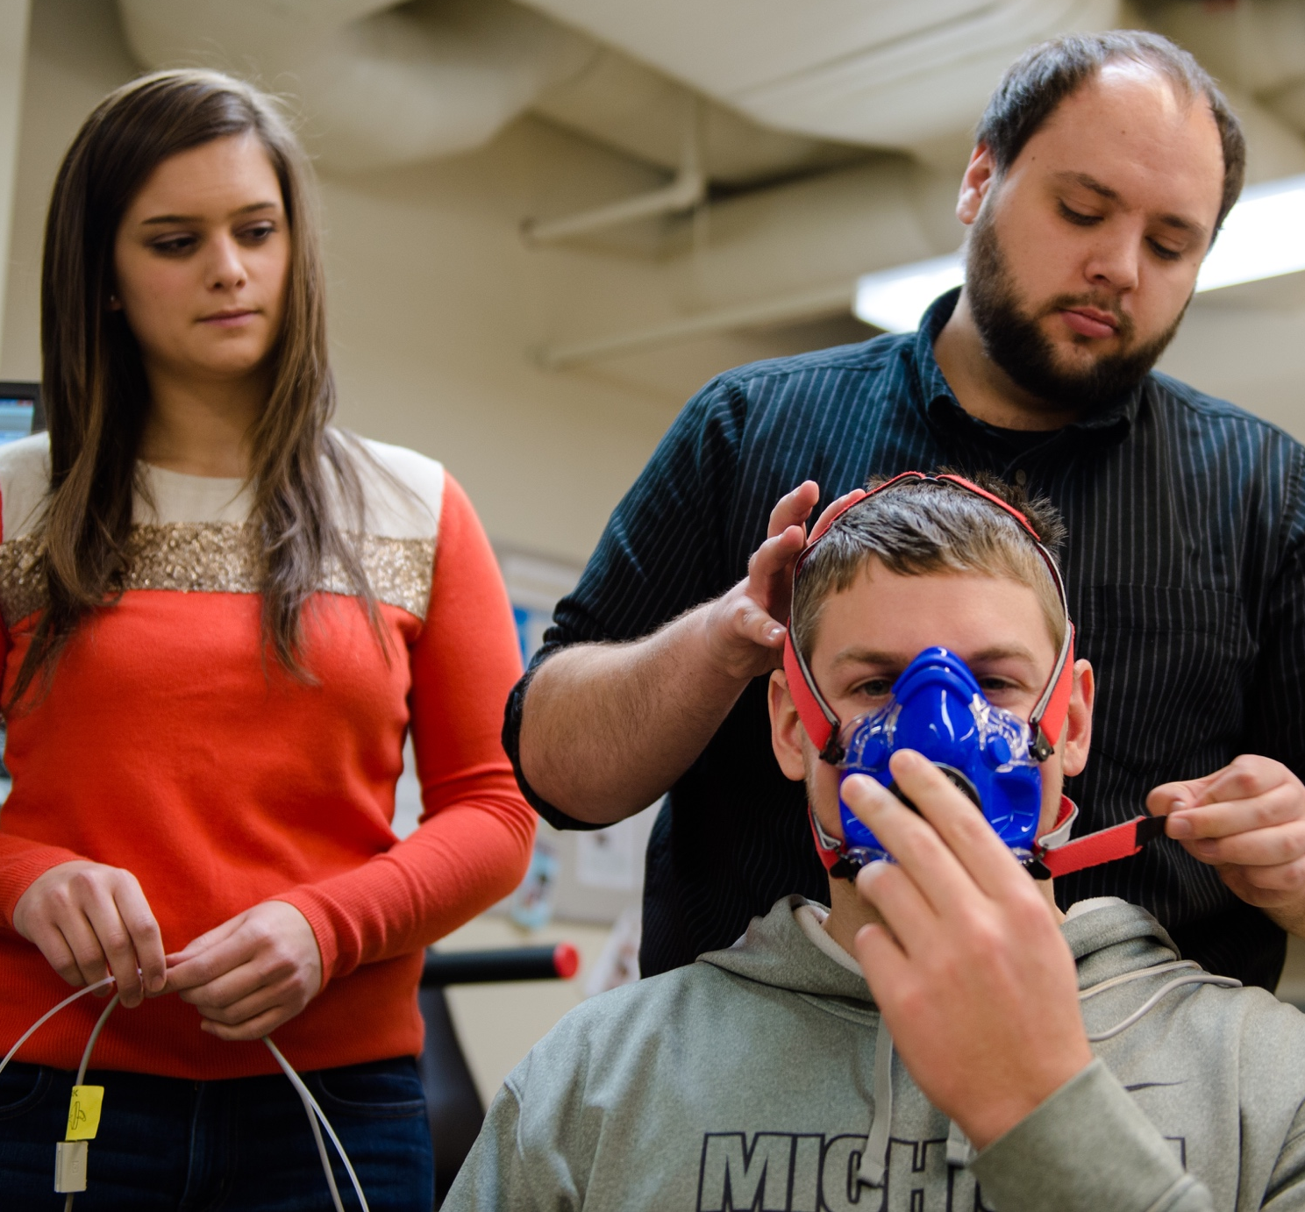
Our Community’s Role…
      We have an opportunity to position ESS as central to science via NGSS
      ESS examples can demonstrate the real-world applications of all the sciences and engineering
      The K-12 students of today are our future university students, industry and government employees and professional colleagues
Thank You!
http://mi-star.mtu.edu/

