Slide 1






Evolution of Giant Salt Pillows, Eastern Gulf of Mexico:
Implications for Exploration and CO₂ Storage
Jack C. Pashin and Jenny Meng, Oklahoma State University
Guohai Jin and Denise J. Hills Geological Survey of Alabama
This material is based upon work supported by the U.S. Department of Energy National Energy Technology Laboratory. Cost share and research support are provided by the Project Partners and an Advisory Committee.
GSA Annual Meeting, Denver CO, September 2016
Notes:
Be sure to acknowledge our sponsors and partners.

Slide 2
Opening Points
  Giant salt pillows associated with major oil and gas accumulations.
  Pillows in the DeSoto Canyon Salt Basin of the MAFLA shelf underexplored.
  Literature extremely limited.
  Onshore structures host major CO₂ storage and EOR projects. (Cranfield, Citronelle, SECARB III Anthropogenic).
  Offshore potential of structures in SE USA being assessed.

Slide 3
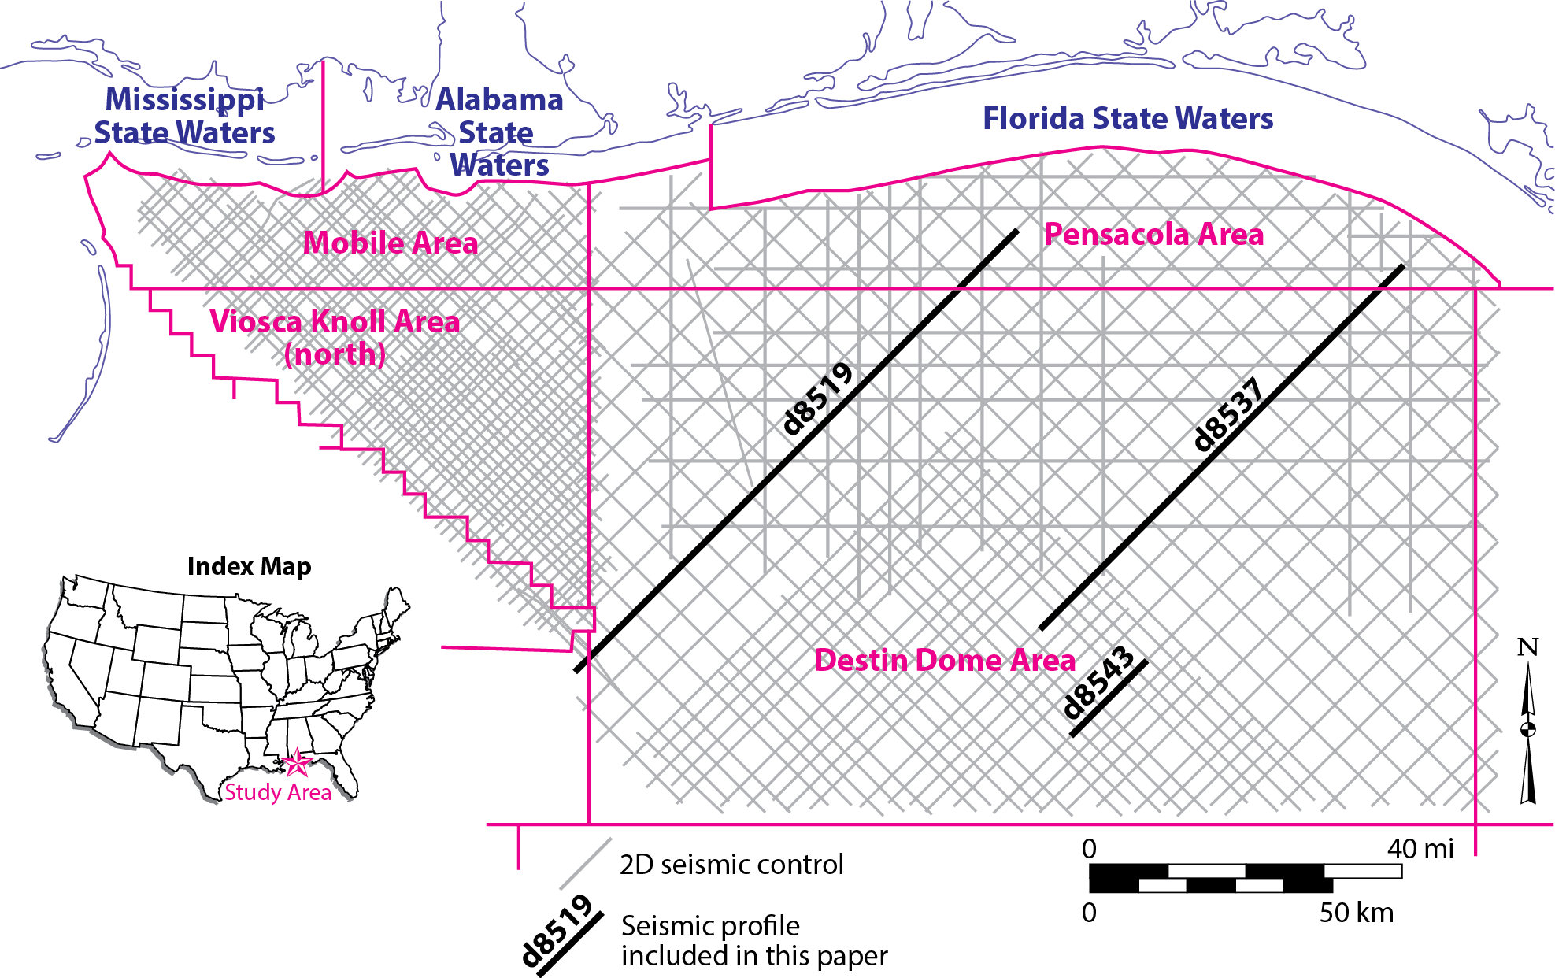
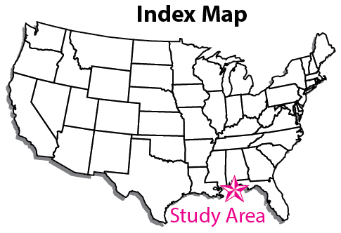
Study Area
DeSoto Canyon Salt Basin
Notes:
Map showing etent of study area and density of publically released 2D seismic control used in our study.

Slide 4
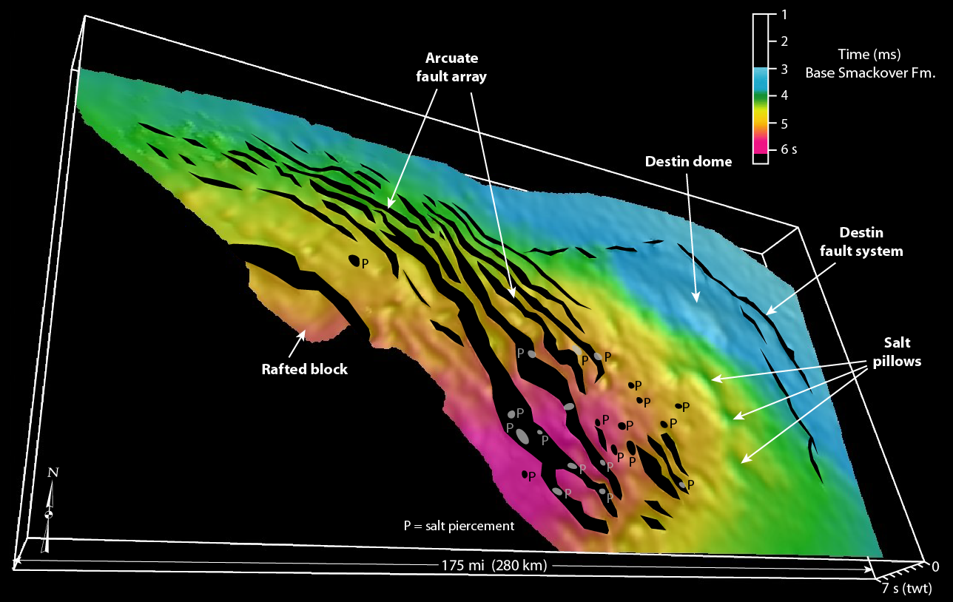
Base Smackover Limestone
Notes:
Point out arcuate fault array (rolller province), peripheral faults of Destin fault system, and intervening region with giant salt pillows, including Destin Dome.

Slide 5
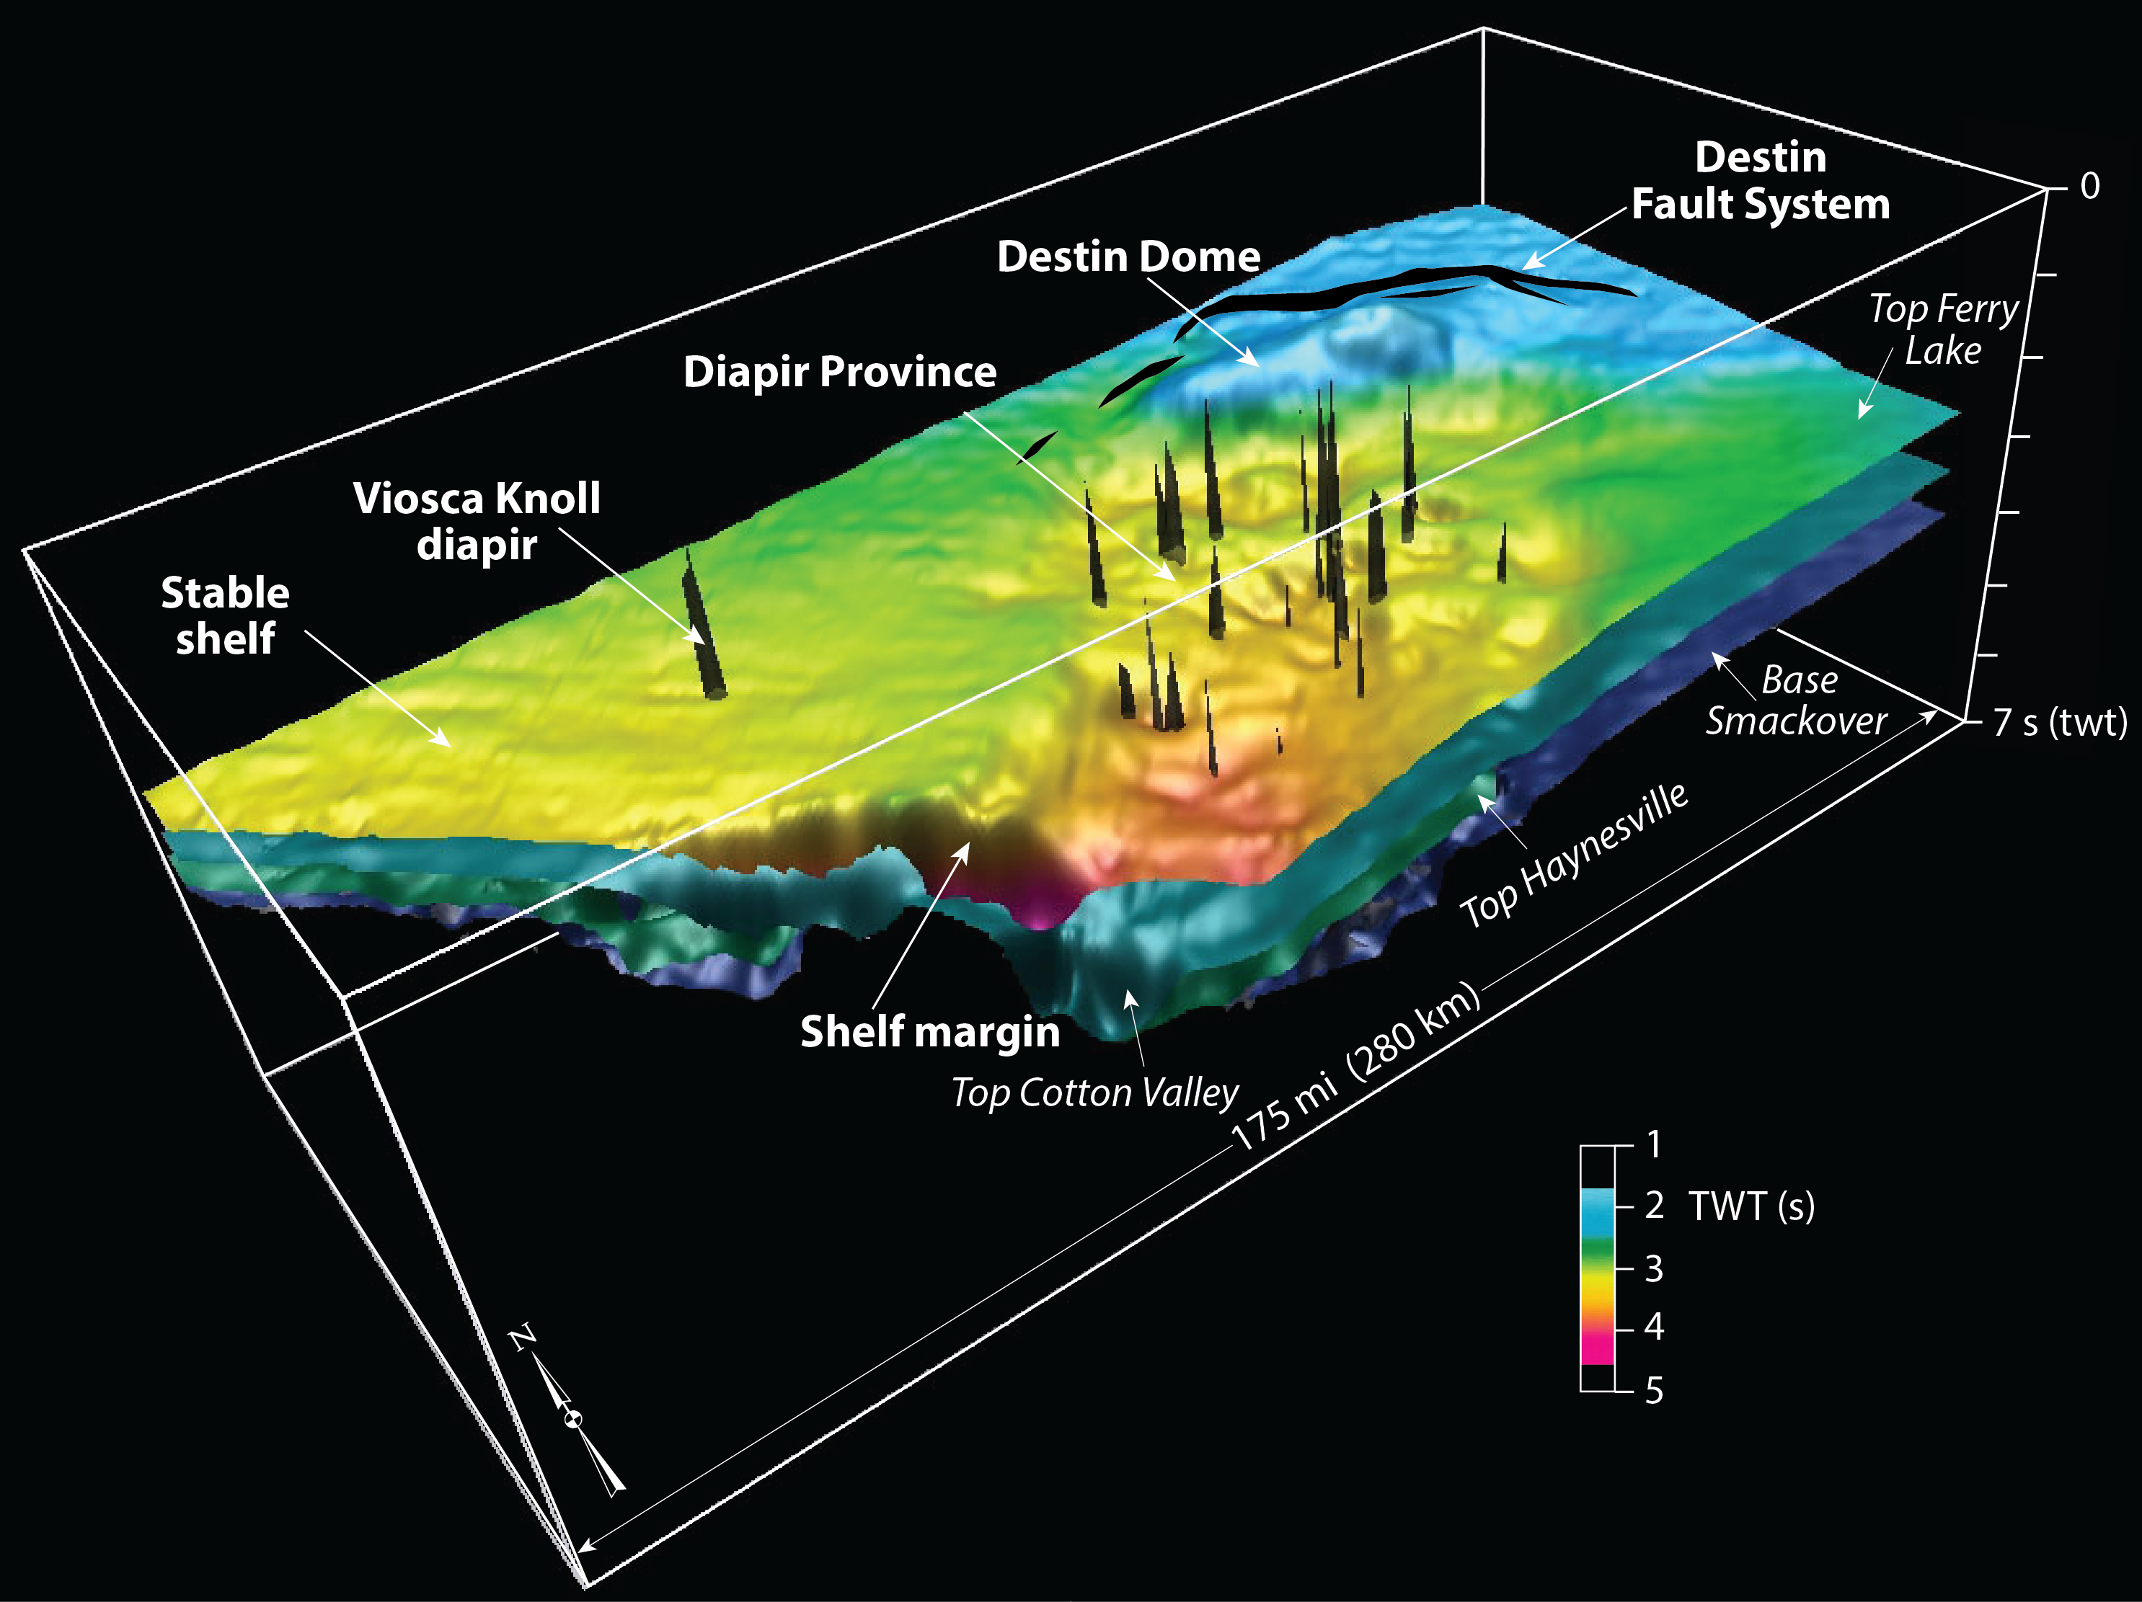
Top Ferry Lake Anhydrite
Top Ferry Lake Anhydrite
Notes:
Point out differences in structural geometry in Lower K section. Arcuate fault array absent, salt pillows between peripheral faults in updip region and salt diapirs in deep part of salt basin.

Slide 6
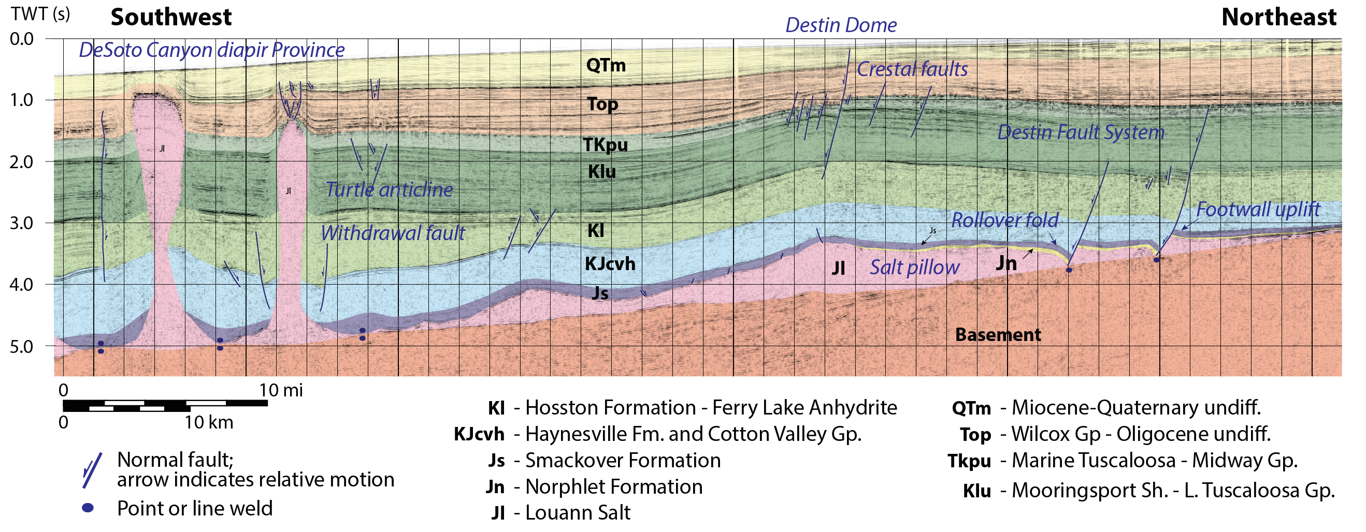
Destin Dome
Notes:
Point out location of pillows between diapirs and peripheral faults. Note that Destin Dome deforms younger strata than small pillow in downdip area.

Slide 7
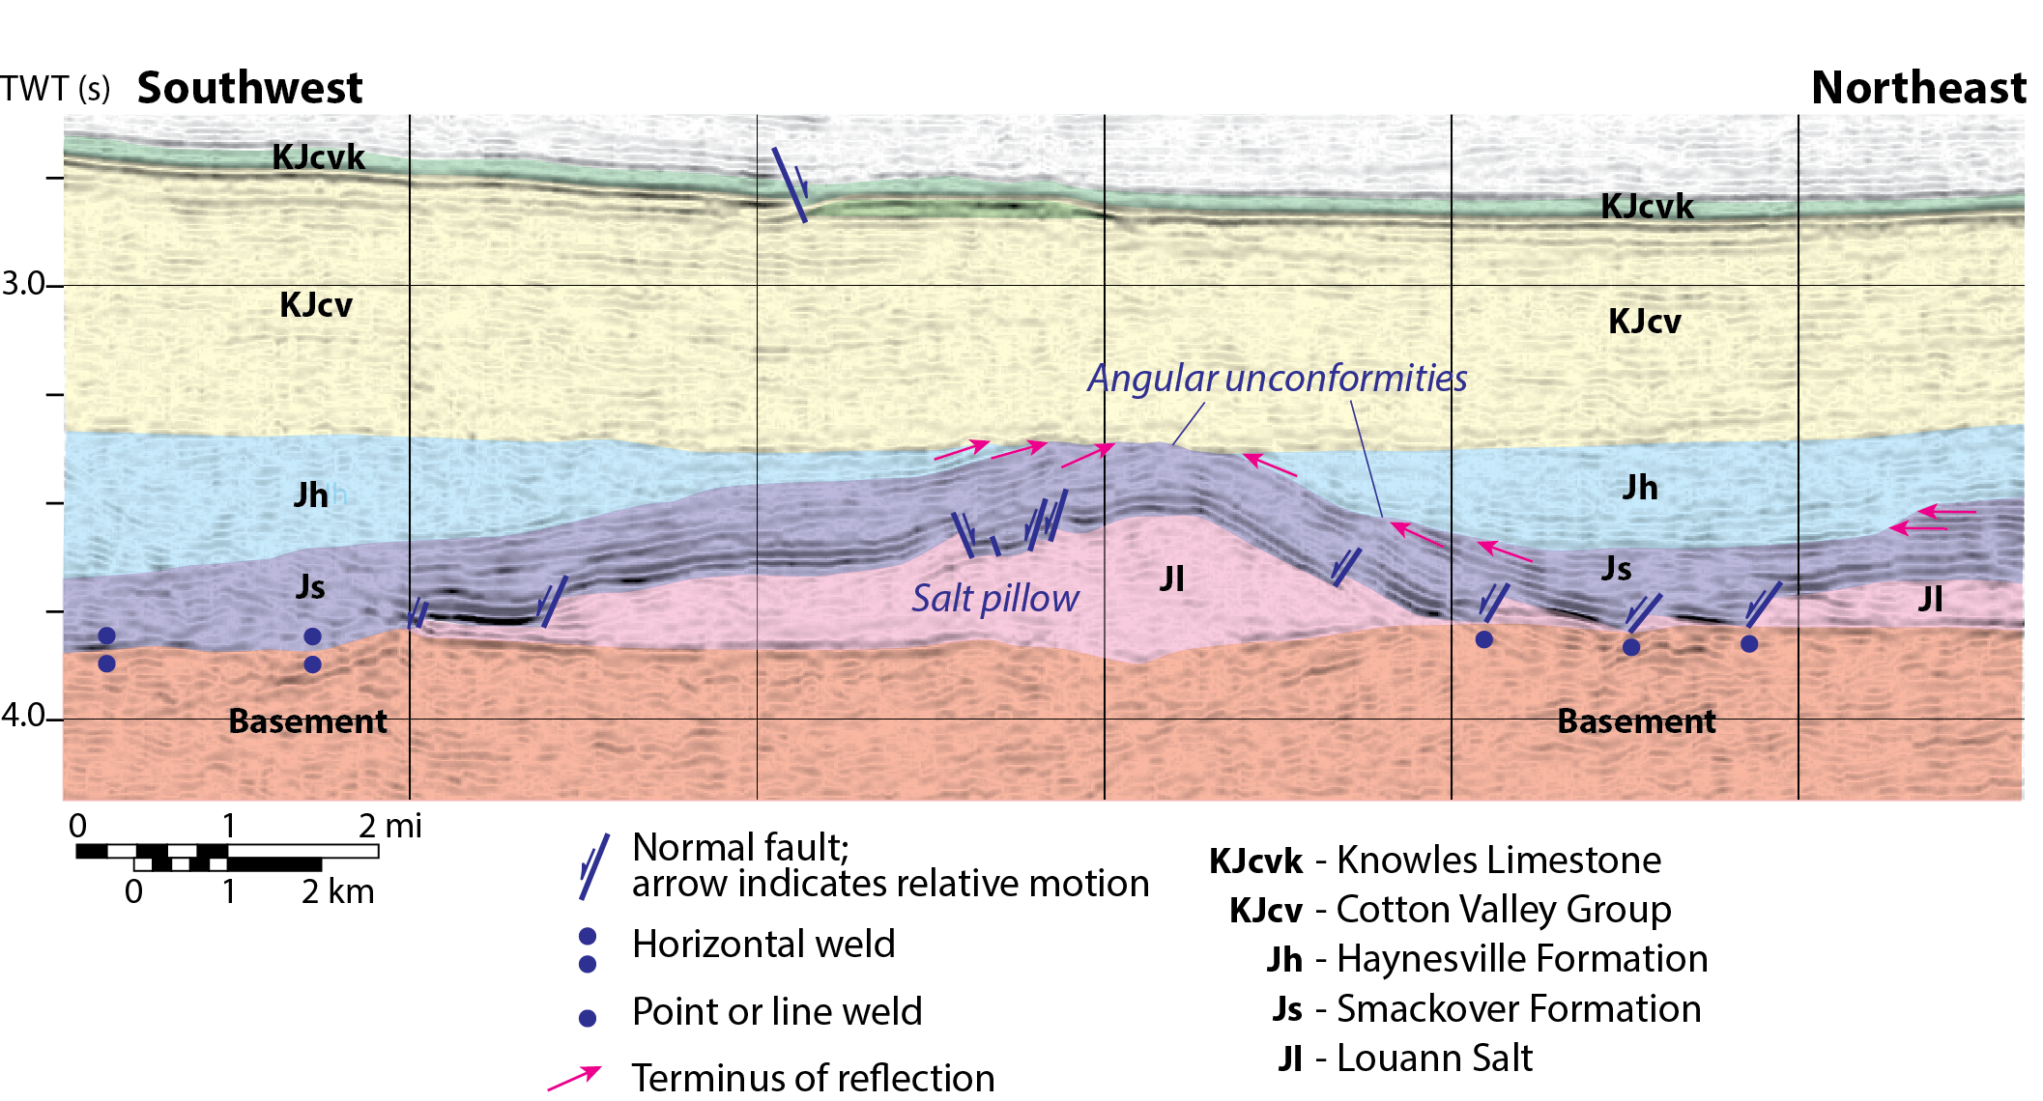
Early Salt Pillow
Notes:
Evidence for early pillow formation. Note prominent angular unconformity truncating anticline at base of Cotton Valley section.

Slide 8
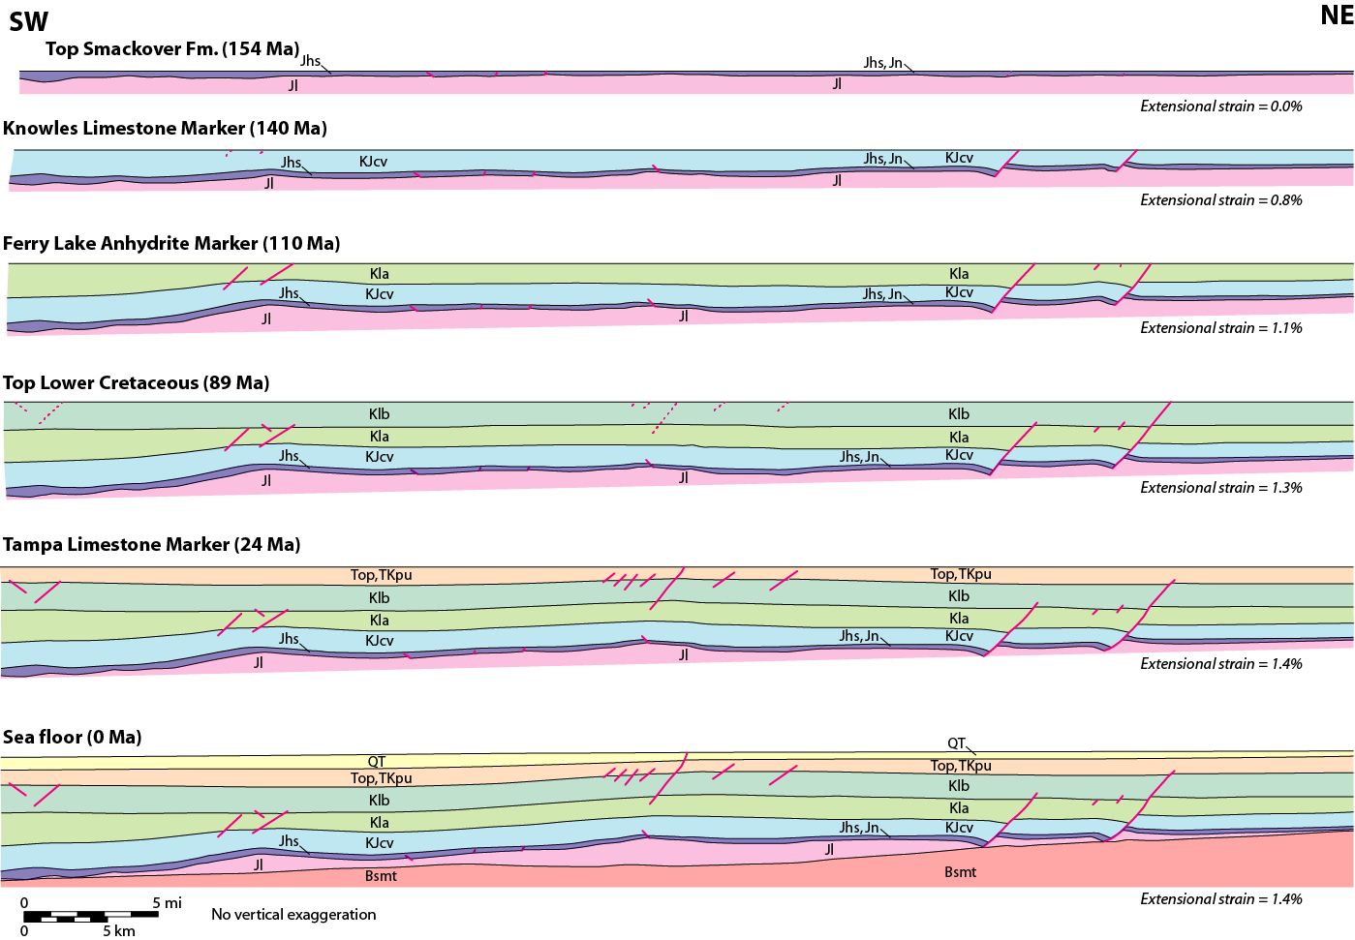
Balanced Restoration
Notes:
Balanced restoration of depth-converted seismic profile shows early development of downdip pillow. Small perturbation at crest of Destin Dome formed early, bot larger structure largely Tertiary age – postp-dates peripheral faults and diapirs.

Slide 9
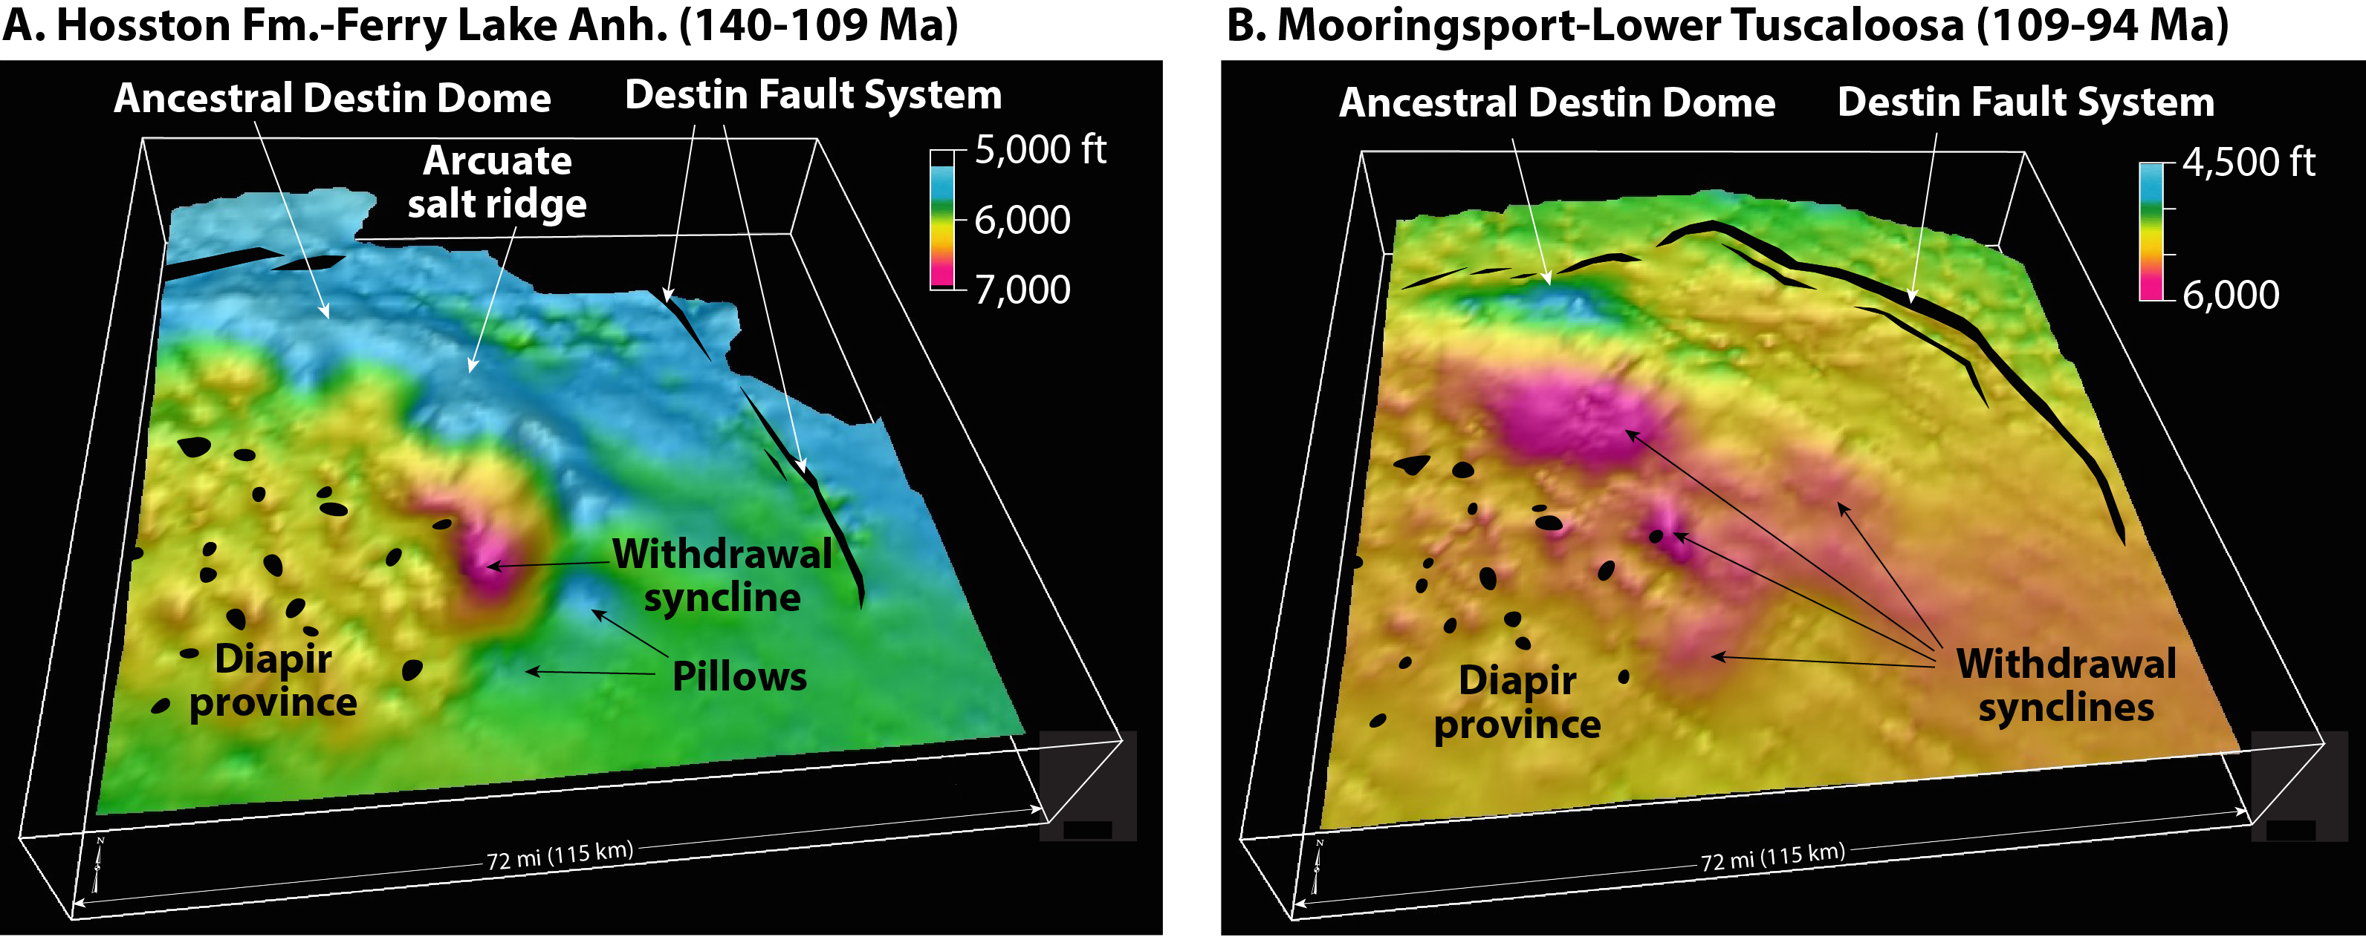
Pillow Evolution
(Total Effective Subsidence)
Notes:
A. Point out arcuate salt ridge developed updip of large salt withdrawal basin in diapir province. B. Point out major pillow in ancestral Destin Dome and how far removed pillow formation is from peripheral faults.

Slide 10
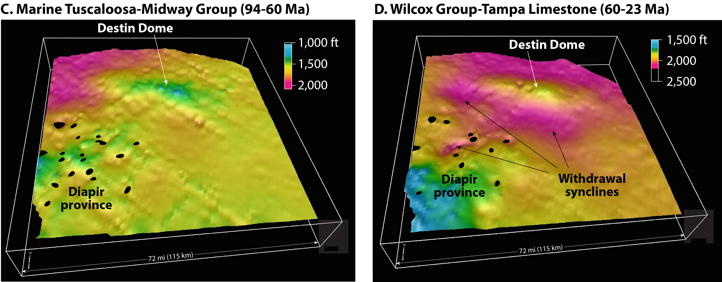
Pillow Evolution
(Total Effective Subsidence)
Notes:
C. Note development of main Destin Dome pillow largely post-dates perhipheral faults, salt withdrawl in diapir province limited. D. Continued flow of salt into Destin Dome sourced from withdrawal complex at margins of pillow.

Slide 11
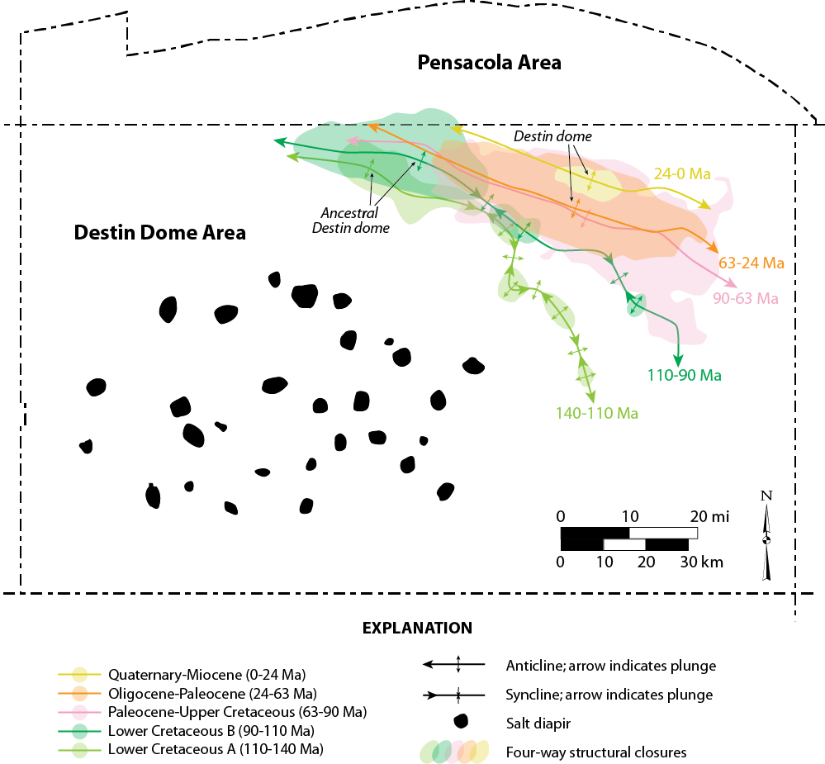
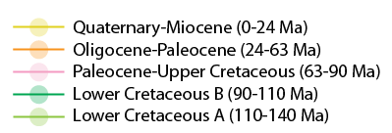
Growth History
10 mi
Notes:
This shows how pillow formation migrated NE and E through time. Point out relationships among small pillows, Ancestral Destin Dome, and main Destin Dome structure. Early structures 140-90 Ma. Destin Dome < 90 Ma. Flow of salt in to the dome decreased greatly and ultimately died out in Miocene.

Slide 12
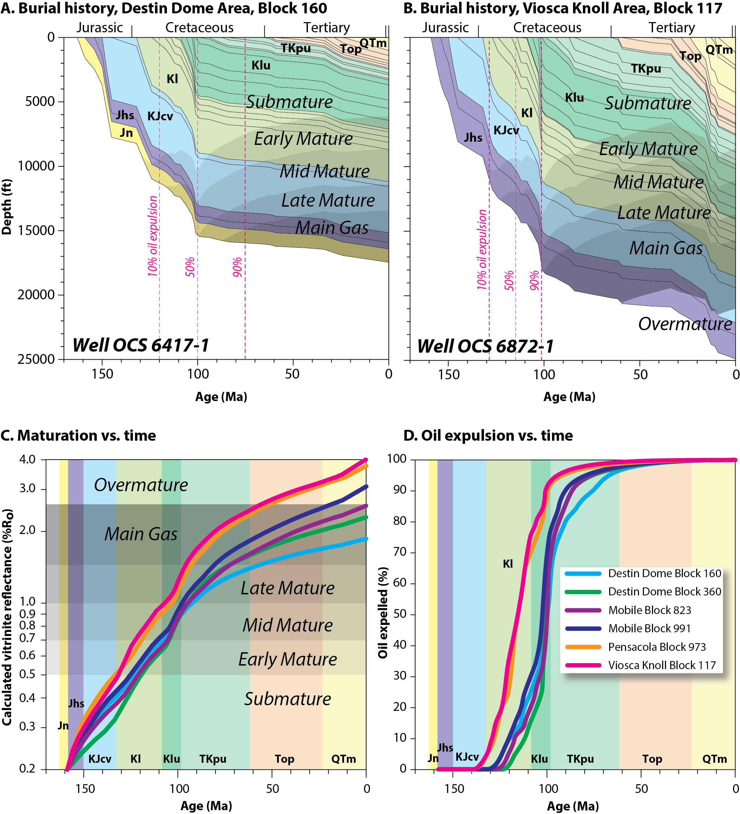
Burial History
Notes:
Burial history curves show that subsidence history different in (A) Destin Dome than (B) other parts of the salt basin (curve on right is typical). Subsidence of Norphlet effectively stopped as salt flowed into Destin Dome after 90 Ma.
All curves show net decelerating subsidence rate expected in passive margin successions. Note entire region in main gas window to overmature.

Slide 13
Maturation and Expulsion
Notes:
C. Thermal maturation vs. time in DeSoto Canyon salt basin. Maturation decelerated near end of Cretaceous.
D. Major expulsion of hydrocarbons was rapid – prior to Late Cretaceous. Thus expulsion largely contemporaneous or post-dates formation of small pillows and Ancestral Destin Dome. Expulsion prior to formation of main Destin Dome structure.

Slide 14
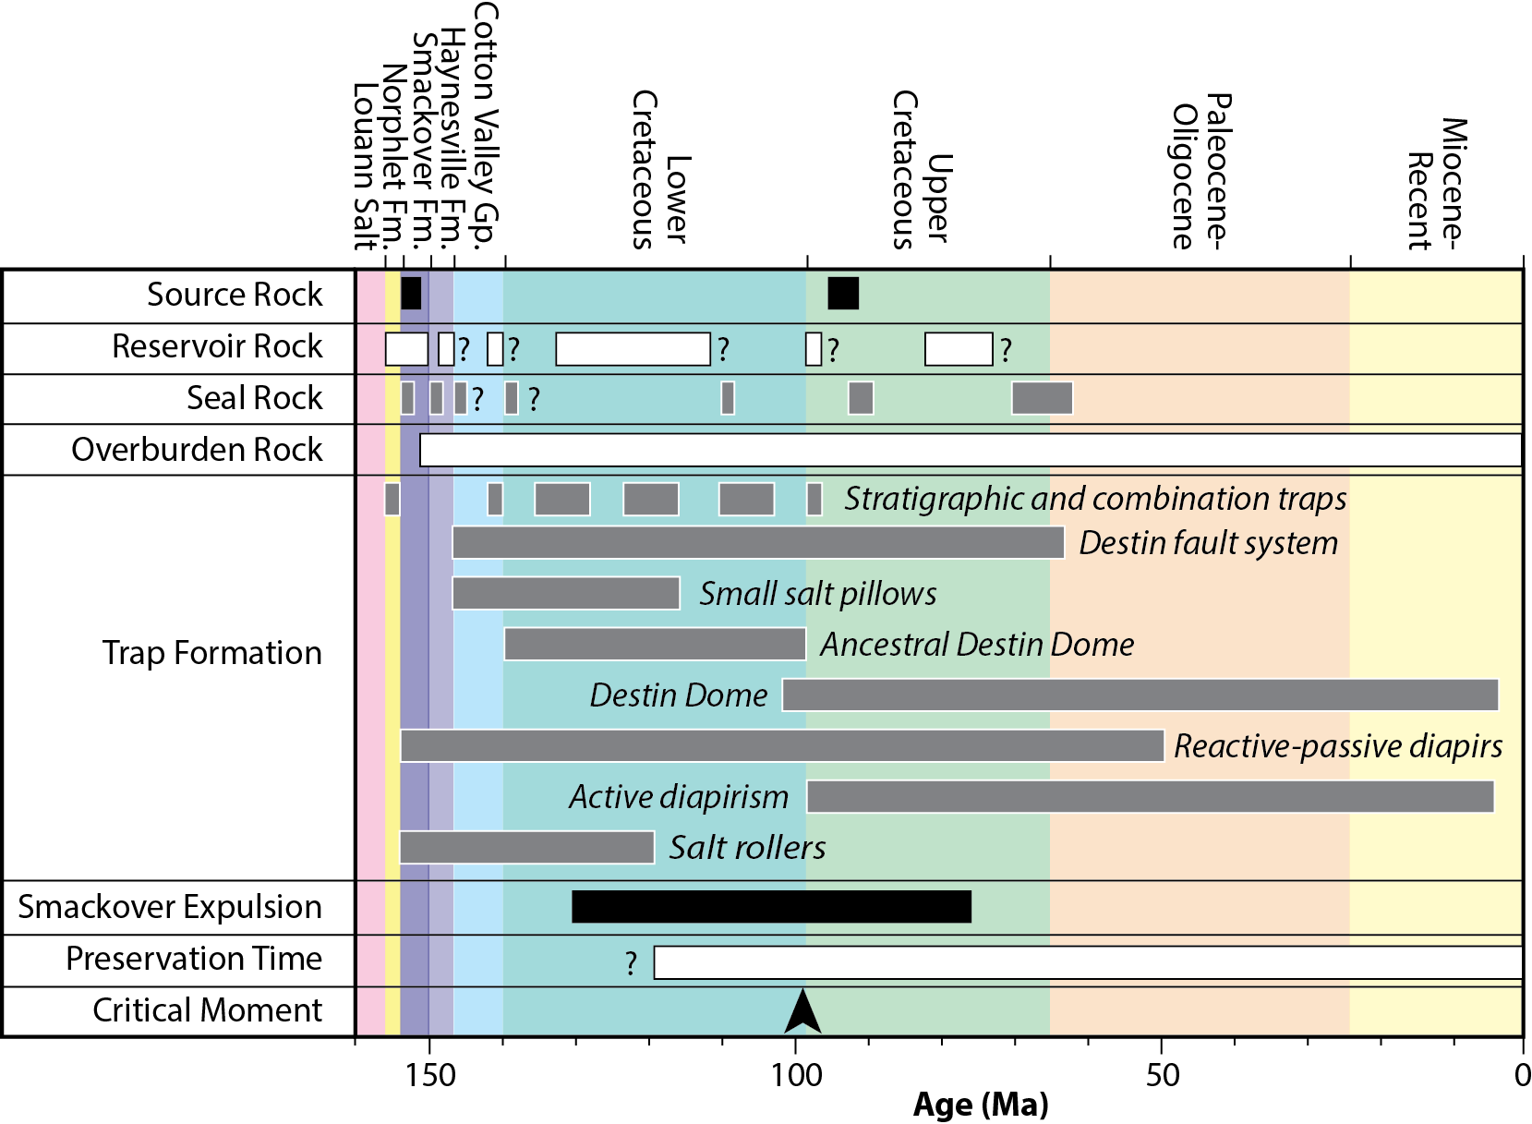
Petroleum Systems Chart
Notes:
Petroleum systems chart showing elements of petroleum system. Most structures early relative to Smackover expulsion. Destin Dome late, however; Known hydrocarbons in Norphlet stratigraphic traps charged prior to major development of structure.

Slide 15
Concluding Thoughts
  Salt pillows associated with large 4-way closures.
  Complex structural chronology.
  Jurassic reservoirs in dry gas window.
  Early anticlines have favorable timing of closure relative to Smackover oil expulsion.
  Norphlet stratigraphic traps in late structures.
  Massive potential for Gt-scale CO₂ storage in pillow-cored folds.
  Main geological risk posed by crestal faulting.
Notes:
Thanks!

