Slide 1
Spatial and temporal variability in rock dome exfoliation & weathering
Faye Moser
MS Candidate in Earth Science
University of North Carolina Charlotte
fvisco@uncc.edu
September 2016 [GSA]
Dr. Martha Cary Eppes Univ. of N. Carolina Charlotte
Dr. Brian Collins USGS, Menlo Park, California
Dr. Greg M. Stock National Park Service, Yosemite National Park

Slide 2
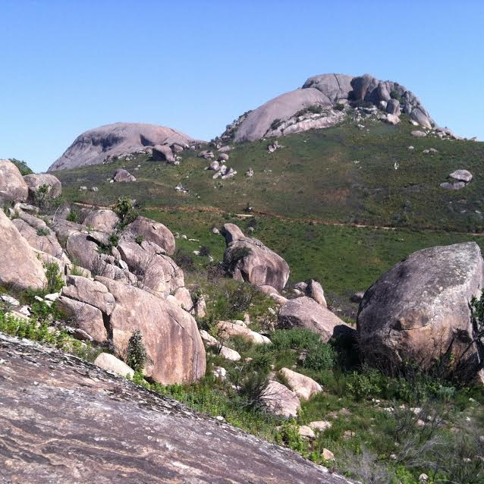
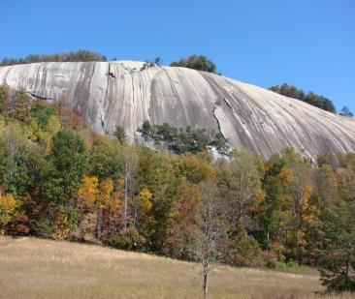
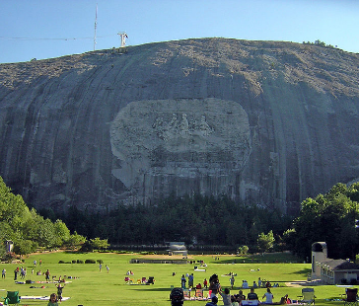

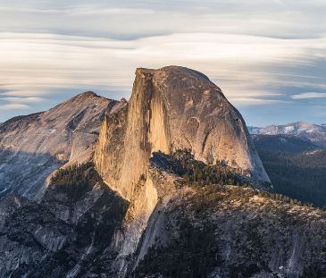
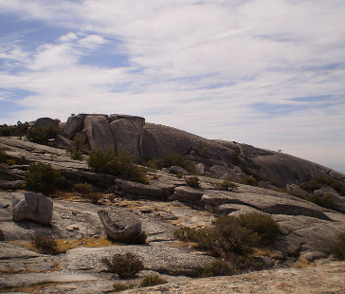
Agenda
Background & Significance
Study site
Research Questions
Methodology
Data & Results
Stone Mountain, NC
Stone Mountain, GA
Half Dome, CA
Bald Rock Dome, CA
Diamond Rock and Paarl Rock, South Africa
Corcovado Mountain, Brazil
Notes:
Exfoliation domes (such as you see here) and their associated surface parallel sheet joints manifest all over the world and strongly influence landscape evolution, hydrology, and hazard mitigation. But, we know surprisingly little about their formation processes.

Slide 3
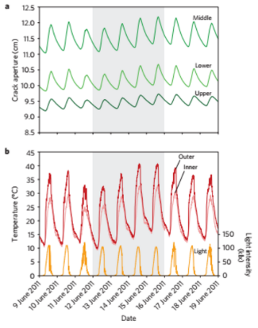
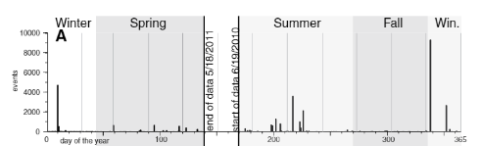
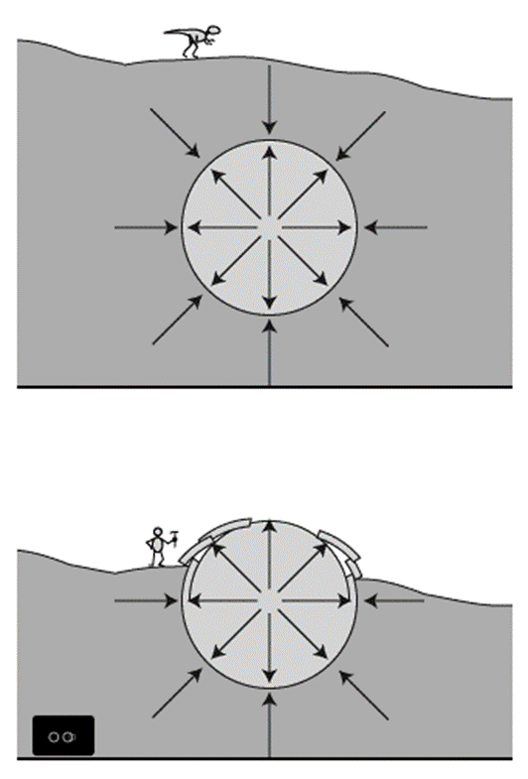
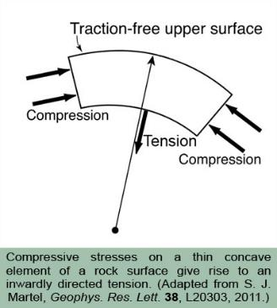
The formation of exfoliation joints is influenced by…
Overburden Removal?
From Collins and Stock [2016]
From Eppes et al. 2016
Leith et al. [2014]
Surface Morphology?
Martel [2006, 2011]
Climate?
From J. Merck lecture, University of Maryland 2010
Notes:
Their formation mechanisms are typically attributed to unloading as in Leith et al. , wherein previously-confined rock is exposed via uplift or overburden removal, causing pressure to release and the rock to expand. However, the literature suggests that we are not really sure if unloading is the primary mechanism of dome exfoliation.
CLICK
For example, Martel’s studies suggest that sheet jointing can occur as a result of surface curvature, wherein if the surface-parallel compression stresses exceed tension stresses, fractures can occur.
CLICK
Further, Collins and Stock and Eppes et al. attributed fracture propagation to be coincident with annual and daily thermal cycling, with the most rock deformation events correlating with temperature peaks, such as mid-day and sunset. Here, you can see daily crack deformation in centimeters with temperature cycles.
CLICK
We also see similar activity in annual thermal cycling. In this graph, we have number of cracks and day of the year, with increased activity in summer and winter.
Overall very little data exists regarding the morphology and temporal evolution of exfoliation sheeting. So, before we can address these competing hypotheses, we need more data, for which the unique opportunity to collect became available via the following event.

Slide 4
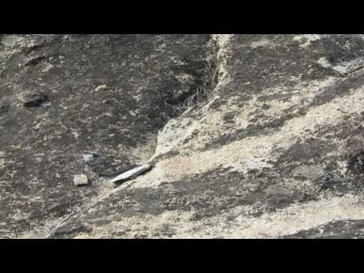
https://www.youtube.com/user/dotysan
https://www.youtube.com/watch?v=MWhmoW1PzwU
Notes:
In 2014, in Twain Harte, California, a rare, highly rapid major exfoliation cracking event was filmed, from which I will now play a clip for you.
SHOW VIDEO

Slide 5
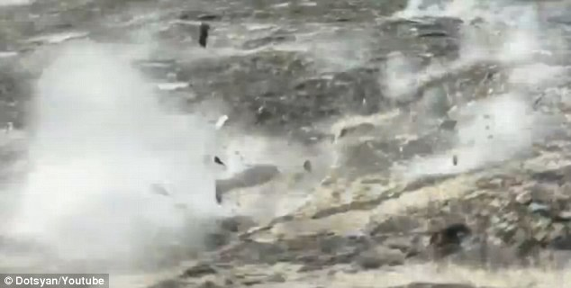
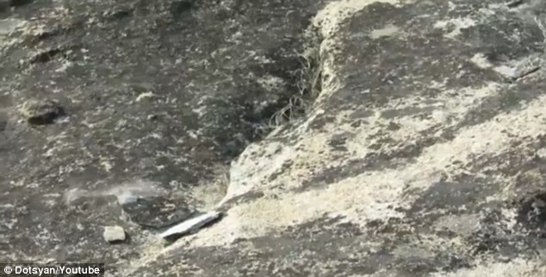
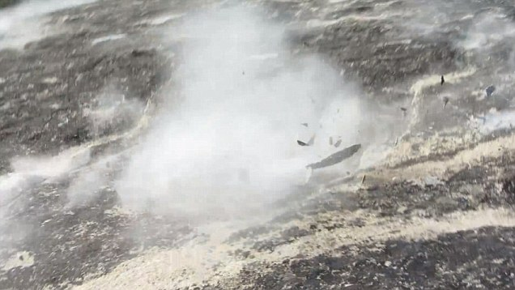
https://www.youtube.com/user/dotysan

Slide 6
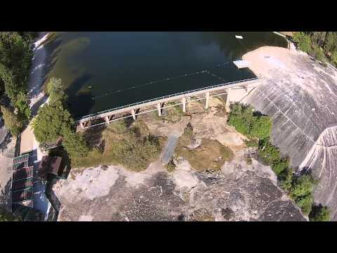
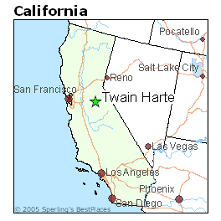
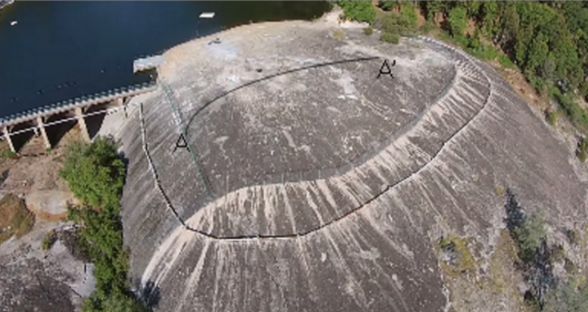
Study area:
Twain Harte, CA
Notes:
This video is just one of four exfoliation events that occurred there in 2014. The opportunity here is to collect a representative data set from an exfoliation dome whose cracking timeline and characteristics are known and well documented.
CLICK
Twain Harte is located in the western foothills of the Sierra Nevada mountain range.
CLICK
The granite dome from the video is locally known as “The Rock” and is a focal point of the town, with a recreational lake behind an built-in 99 meter multi-arch dam.

Slide 7
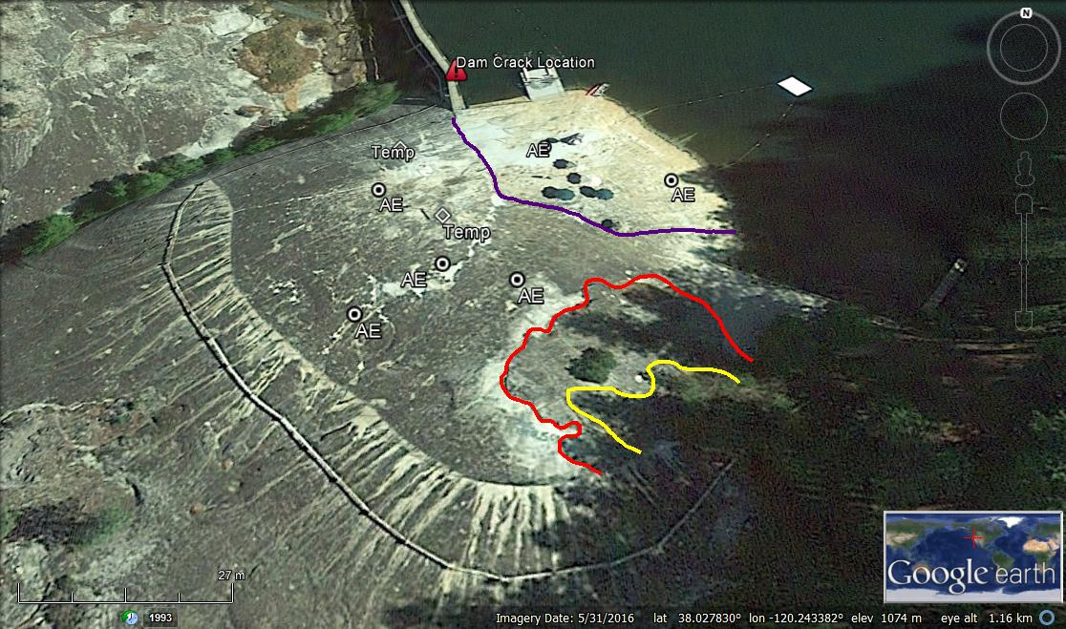

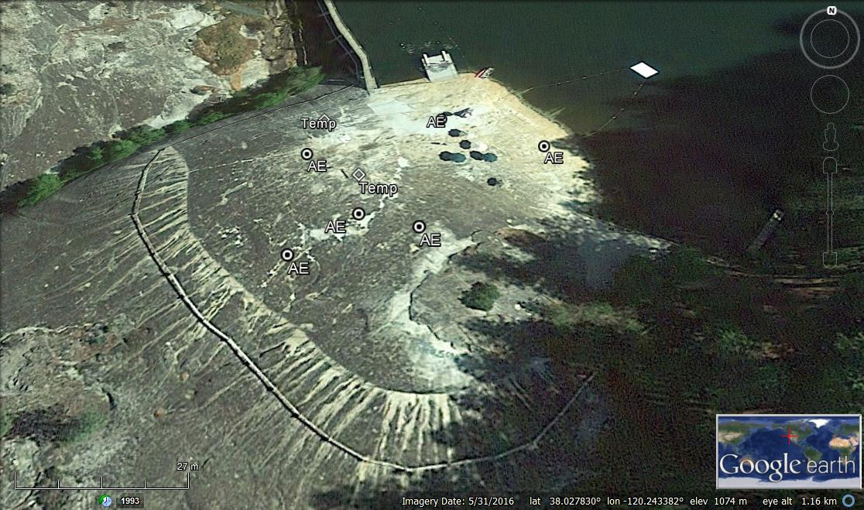
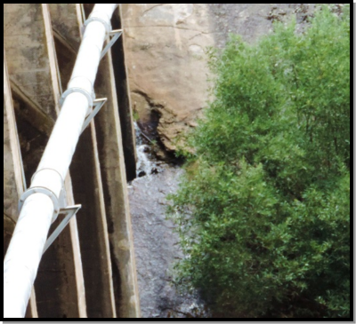
Preliminary recon results
Previous generations of exfoliation
Fresh exfoliation surface
1 m
Notes:
My co-authors were contacted after the Twain Harte exfoliation to deploy 6 acoustic emission and temperature sensors to monitor rock surface activity, the locations of which can be seen here. These sensors recorded conditional data for 7 months. <REMOVE “EXFOLIATION SLABS” and colored lines FROM MAP and add temp sensors locations>
Further, when doing a preliminary assessment of the Rock’s surface, it became apparent that there were multiple generations of these cracking events.
CLICK
These manifested as stratigraphically differentiated slabs, shown here, of which we were very interested in exploring the characteristics of these slabs.
CLICK
The final significant point I would like to make about this image is here,
where the exfoliation events that occurred on the rock actually cracked the dam.
Twain Harte was seriously affected by this dam fissure, which resulted in draining of this reservoir, the loss of revenue from it being closed, and the expense of repairing the dam. Thus, understanding the cause of this cracking event was imperative, especially since there are many other dome-adjacent dams across California.

Slide 8
Research questions
How is cracking changing through time and space?
  Short term evolution (10⁻¹ yr)
  Long term evolution (10⁵ yr)
Are similar exfoliation events occurring regionally?
  Domes
  Slabs
Notes:
The existence of the generational slabs brings us to recognize that this is ongoing at this dome for quite some time.
CLICK
So we asked ourselves how is cracking changing through time and space.
We can address this in short time scales via the Twain Harte exfoliation event.
As well as in long time scales via the exfoliation slabbing and the assumption that exfoliation is occurring at specific time intervals.
CLICK
Also, are similar exfoliation events occurring regionally?
If so, are the characteristics of domes consistent in other domes in the area?
We applied the same question to slab characteristics.

Slide 9
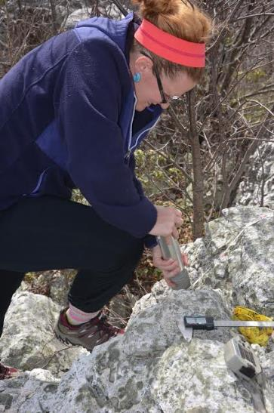
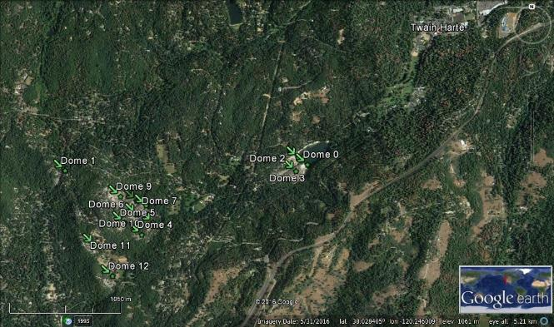
Field Methods
Mapped 15 granodiorite domes and their associated slabs
  Cracking – stratified random sampling scheme by slab
  Schmidt hammer
Acoustic emission (AE) sensors
Temperature sensors
Subsurface crack meters
Extensometer
1050 m
Notes:
To address these questions, we have:
CLICK
conducted detailed mapping and characterization of exfoliation slabs at Twain Harte and 15 other nearby domes using transects. Along these transects we collected data pertaining to surface morphology and characteristics of every linear void > 2 centimeters in length.
CLICK
We also collected about 5000 Schmidt hammer R-values from the exfoliation slabs. This tool measures the compressive strength of a surface and we used these rebound values as a proxy for weathering. The field mapping was my focus for this project, while my coauthors.
CLICK
2) monitored cracking events, near-surface temperatures, and light intensities for 7 months following the 2014 event using six acoustic emission (or AE) sensors and temperature sensors. The AE sensors serve as mini-seismographs monitoring cracking.
CLICK
3) We also monitored post-event deformation using a deployment of crack meters and subsurface extensometer instrumentation installed under the fresh slab.

Slide 10
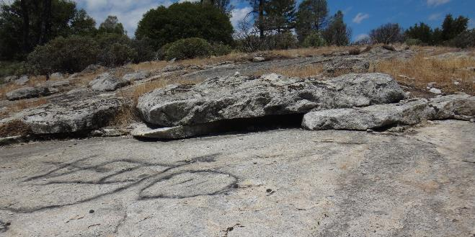
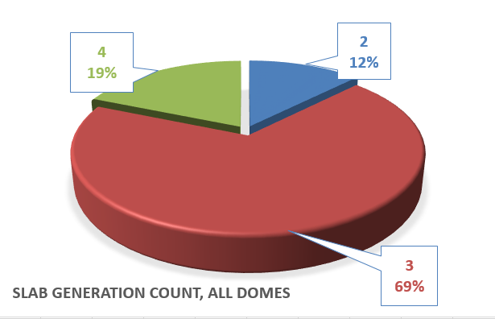
Slab identification
3
2
1
Notes:
Mapping revealed 2-4 generations of exfoliation sheets at all sites. The preliminary identification of these generational slabs was evident via stratigraphic contact.
CLICK
As a convention, we assigned numbers to slabs observed in the field – 1 being the freshest and 4 being the oldest.
It was clear that these demarcated exfoliation events that had occurred and broken away part of the “shell” of the dome. These stacked slabs display distinctly different weathering characteristics.
CLICK
Although Twain Harte and it’s adjacent sites (in the green) had 4 generations due to the presence of fresh cracking, about 70% of the other domes (in the red) had 3.

Slide 11
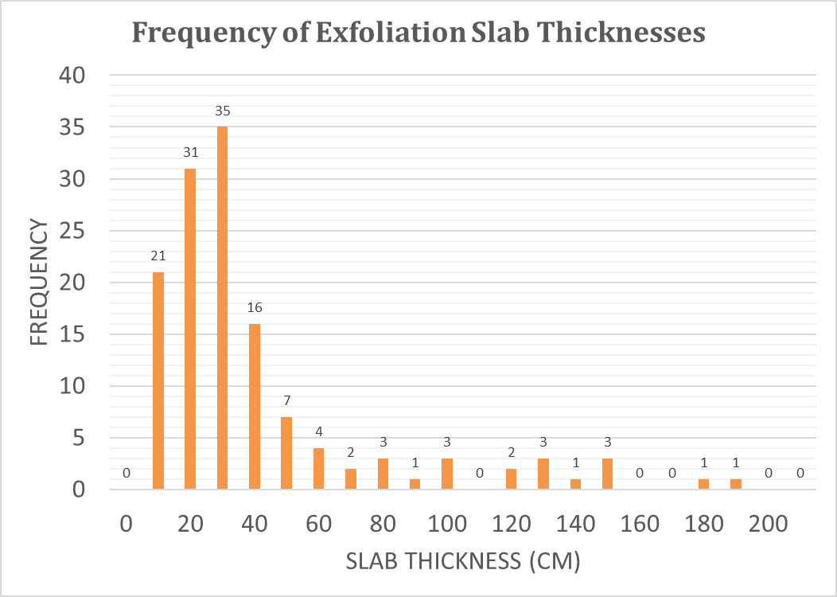
Slab characteristics
Notes:
In macroscale, all slabs at all sites exhibited a characteristic thickness of ~ 20 – 35 cm,
CLICK
Which is shown here. We have slab thickness in centimeters and frequency.

Slide 12
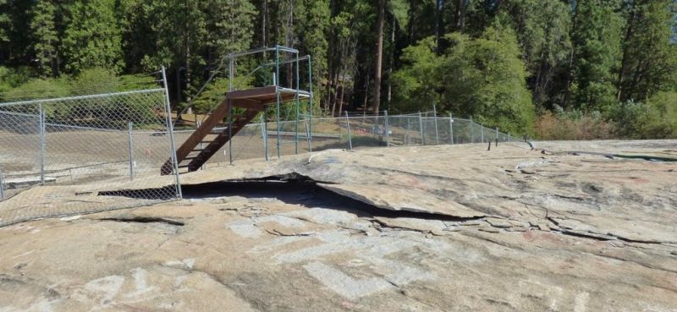
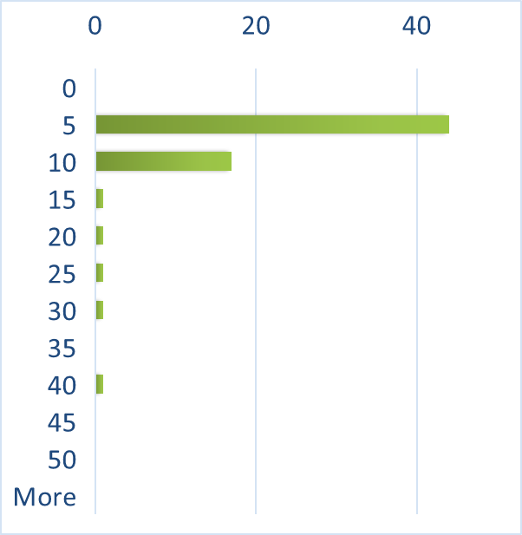
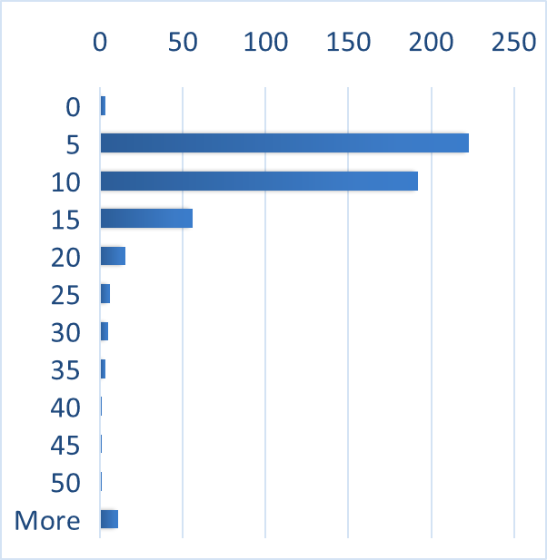
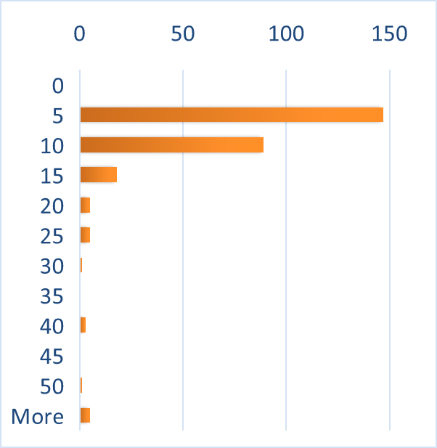
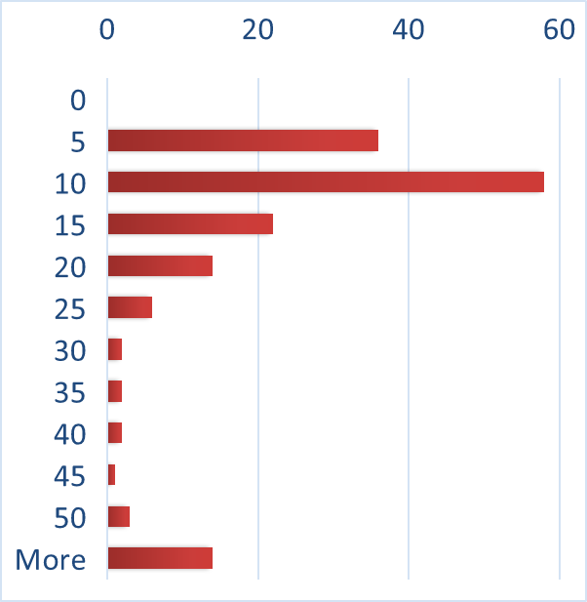
Slab characteristics cont.
Frequency
Spall height (mm)
Slab 1
Slab 2
Slab 3
Slab 4
Slab exfoliation processes are consistent.
Notes:
We also found this same consistency in the microscale sheeting,
CLICK
with characteristic spalling heights on each slab being 5 – 10 mm.
You can see that here with spalling height in millimeters and their frequencies.
CLICK
So, based on the macro and microscale crack height consistency, we are able to deduce that exfoliation processes are temporally and spatially consistent in this region.

Slide 13
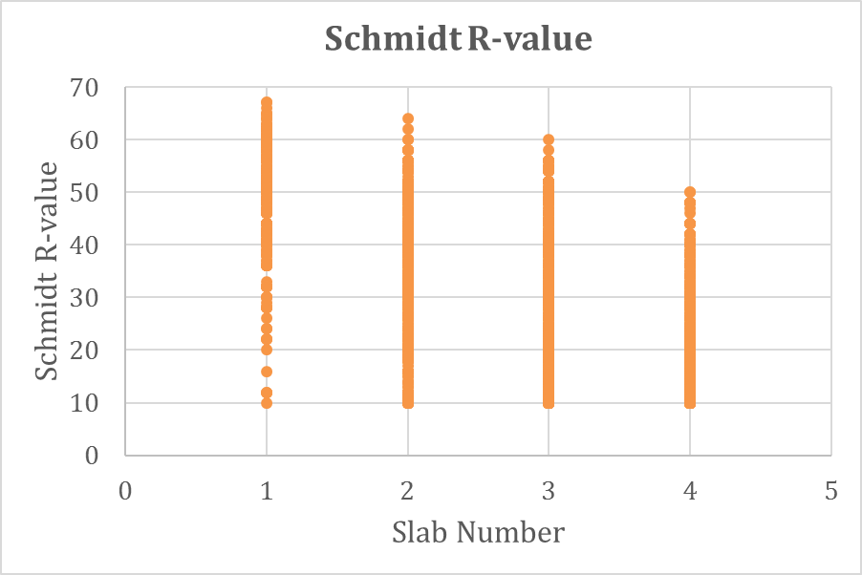
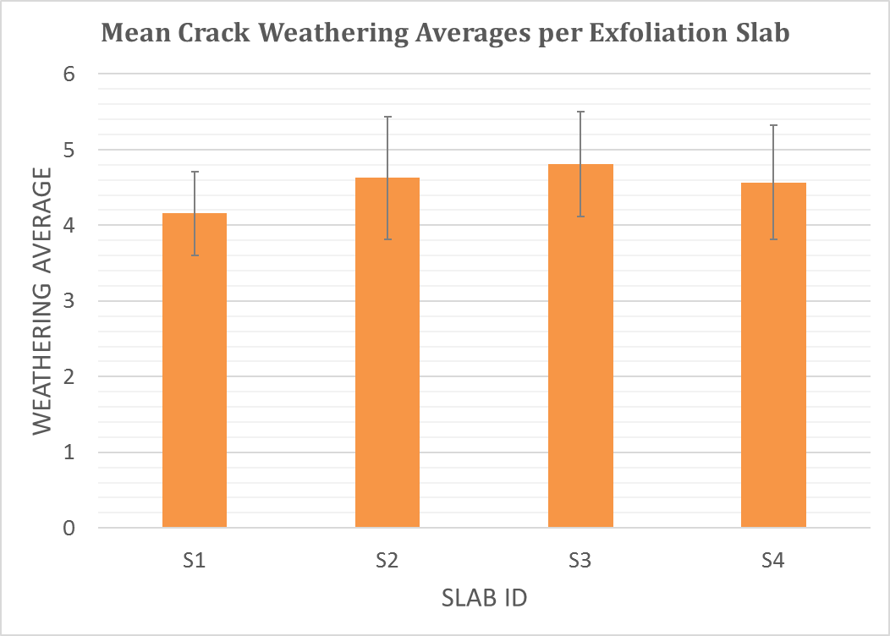
Exfoliation slab age proxies
0 = fresh crack → 6 = most weathered
Notes:
To better understand relative ages between these slabs, we utilized Schmidt hammer r-values as an age proxy. In this case, the r-value reading is known to decrease with weathering. As you can see here, we found a strong negative correlation confirming that rock weathering is increasing with slab age.
CLICK
Also, we assigned a weathering index to each of the transect cracks, 0 being the freshest and 6 being the most weathered. Generally, observed crack weathering increased with slab age, and levelled off with the oldest slab.

Slide 14
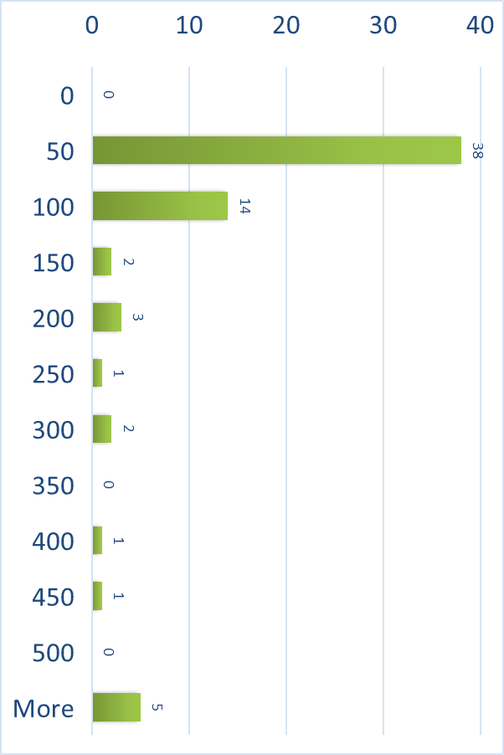
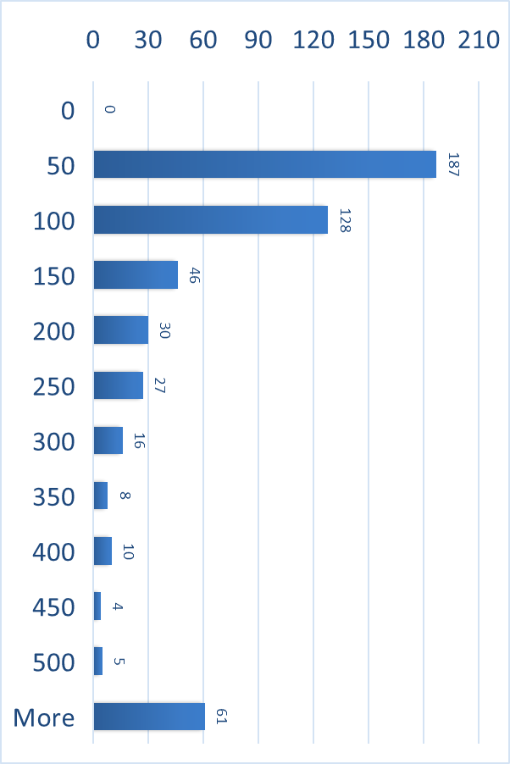
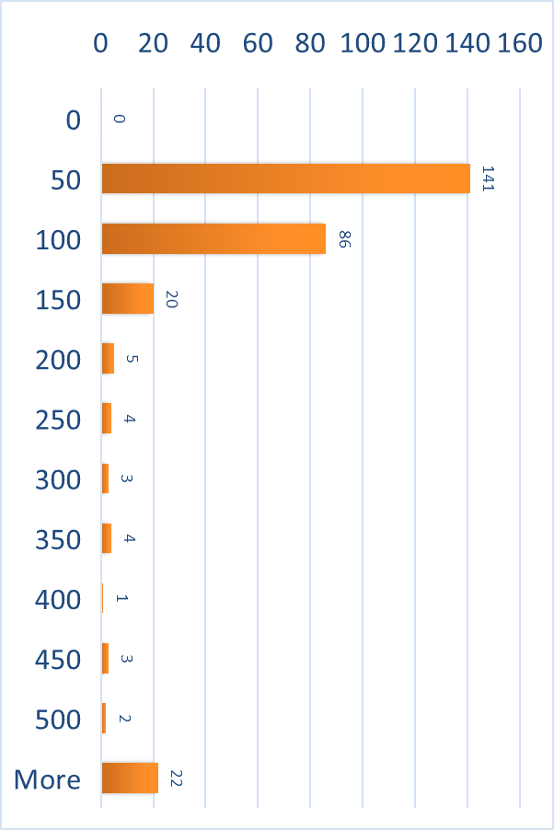
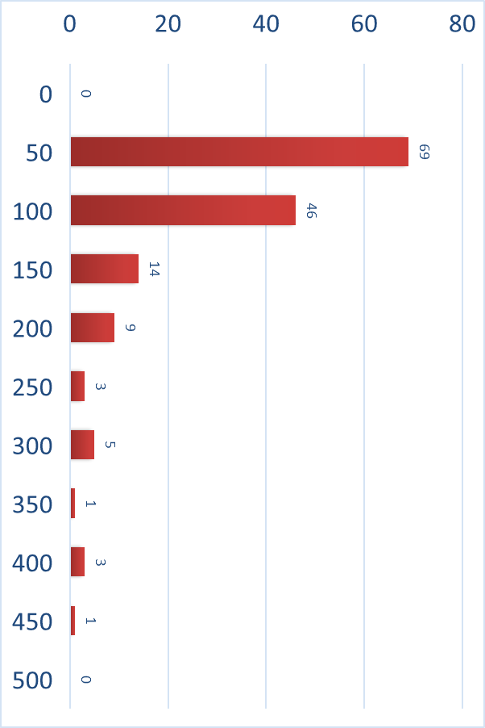
Slab age proxies cont.
Frequency
Crack length (mm)
MEAN: 200 mm
MEAN: 261 mm
MEAN: 270 mm
MEAN: 226 mm
Slab 1
Slab 2
Slab 3
Slab 4
Slab weathering increases with age.
Notes:
We observed similar trends in crack length values. With Student’s t-test values all above 0.05, the slab’s crack length populations are not statistically different.
CLICK
However, it is apparent that length is generally increasing with slab age and leveling off with slab 4, just like the crack weathering.
CLICK
Therefore, slab weathering increases with age.
Based on all of these data, we can see that these exfoliation events are happening distinctly through time. This is supporting evidence that the exfoliation process hasn’t changed. However, if you recall from earlier, we aren’t exactly sure what that process is.

Slide 15
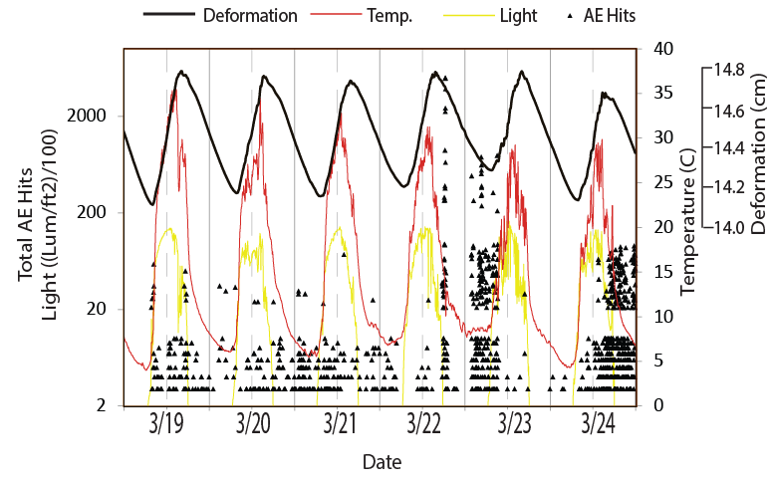
Thermal influences
Notes:
One possible explanation could lie in the influence of temperature. So, does our AE data support the influence of the sun on Twain Harte rock at short time scales?
CLICK
Here, we have the crack meter represented by the solid bold line. You can clearly see that crack deformation is occurring with temperature change peaks in red.
Acoustic emission hits, represented by the points, primarily show that times of peak cracking are occurring at mid-day and sunset, if we ignore the linear background noise at the bottom.
Importantly, both mid-day and sunset have been suggested in other studies, those mentioned earlier and others, to be times of peak stresses associated with solar thermal cycling.

Slide 16
Summary points for “The Rock” Exfoliation
Exfoliation processes are consistent through TIME and SPACE, long-term (10⁵).
  Short term (10⁻¹ yr) cracking is triggered by thermal cycling.
Further questions
Reconcile observed short-term triggers with long-term exfoliation drivers
  Curvature?
  Unloading?
Notes:
We have concluded that long-term exfoliation processes ARE consistent through time and space in the western Sierra Nevada foothills region.
At least at short time scales, major episodes of cracking appear to be triggered by incoming solar radiation cycles.
CLICK
Future work with this data set would be useful in reconciling the influence of other competing hypotheses of long-term exfoliation drivers, such as curvature and unloading. For instance, if we think in terms of classical unloading theory, why would “The Rock” be rapidly exfoliating now if no recent exhumation has occurred?
There is definitely still a great deal our data set has to offer in regard to understanding rock exfoliation mechanics.
CLICK
Thank you all for your time and attention. I’ll take questions if there’s time left.

Slide 17
Thank you!
Acknowledgments:
Co-authors Dr. Martha Cary Eppes, Dr. Brian Collins, Dr. Greg Stock
GSA Graduate Research Grant Fund (2015, 2016)
GSA On to the Future Scholarship (2016)
Ephrum Laubhann & Suzanne Ching
Twain Harte Lake Association
Condor Earth Technologies, Inc.
Sugar Pine RV Park

