Slide 1
Life on a Sterile Planet – Results From a Pilot Study on Misconceptions of Mass Extinctions
Kyle Gray & Alexa Sedlacek
Department of Earth and Environmental Sciences
University of Northern Iowa
Notes:
This study grew out of observations made by Dr. Sedlacek regarding answers that students were giving in her Earth History (Historical Geology) course.

Slide 2
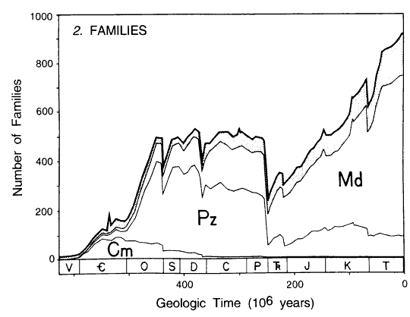
Mass Extinctions - Scientific Definition
Marine biodiversity
Three Faunal Groups
Big 5 Mass Extinctions
Sepkoski, 1997
Notes:
Background on the Scientific Consensus of What Is a mass Extinction
In the early 1980s David Raup and Jack Sepkoski took on the challenge of quantifying marine biodiversity in the Phanerozoic. In 1981, Sepkoski publishes what we term the Sepkoski Curve. Through statistical analysis, he determines that there are three groupings of marine families that account for over 90% of the data. These are the faunal groups. The Cambrian faunal group, dominated by trilobites, inarticulate brachiopods, the Paleozoic fauna, brachiopods, bryozoans, crinoids among others, and the Modern, dominated by bivalves and other molluscan fauna. The dominant faunal group has changed over time. In addition, this figure shows three significant drops in biodiversity. The Ordovician, Devonian, Late Permian, Triassic, and end – Cretaceous.

Slide 3
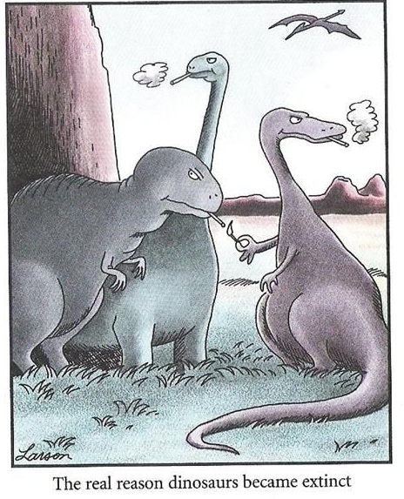
Mass Extinction – Contributing Factors
Climate Change
Cooling and warming
LIPS volcanism
Siberian Traps
Deccan Traps
CAMP Volcanism
Bolide Impacts
Notes:
Scientific Consensus – Causes
Climate change: cooling in the Ordovician and Devonian, warming during the Late Permian, bolide impact associated only with the Cretaceous extinction event. Large Igneous Provinces are associated with the Permian extinction, Triassic, and Cretaceous. Many mass extinctions have multiple contributing factors

Slide 4
Pilot Study
Open-Ended Survey
Define a ME.
When did you first learn about MEs?
How many MEs have there been?
What causes MEs?
If you travel back in time, what would it look like?
Notes:
Study Methods
Developed a questionnaire with nine, open-ended questions regarding what students think about mass extinctions. Administered at the beginning of each term in Sedlacek’s Earth History (EH) course.

Slide 5
Pilot Study
Administered to Earth History (18 – 30 students/semester)
Earth & Environmental Sci Majors
Biology
Science Teaching (about 30% of students)
Notes:
This earth History course is required by the Earth Science majors. Biology majors have the option of taking a year of geology or a year of physics. About half choose geology. Course are required for students who wat to teach Earth Science.

Slide 6
Demographics
68 students F14, Sp15, Sp16
Female = 27, Male = 40
Notes:
Results presented form three sections of EH. Many of the biology majors are juniors or seniors who held off taking the course until late in their program. Many of the Earth & Environmental Science majors are freshmen and sophomores just starting their program.

Slide 7
First Learn – Age and Context
When did you first learn about MEs?
No Response = 1
Notes:
Most students stated that they first learned about mass extinctions (MEs) in elementary school =- though the process is probably iterative with students first learning about the topic in elementary school but not learning the formal definition until High school or college. The one student in the “Other” category stated ‘Young”.

Slide 8

First Learn – Age and Context
How did you first learn about MEs?
Media
History Channel
Discovery Channel
Science Documentary
Other
Field Museum
Ice Age, Mammoth, Dodo
The apocalypse of 2011
No Response = 18
Notes:
Not surprising that dinosaurs was the most common context for learning about MEs. Those in the media category show the utility of science documentaries on TV, and the other category showed a wide range of contexts.

Slide 9
Causes
Either an ice age, meteor, volcano eruption, just some big, lethal event that takes place that kills organisms.
Some sort of mass climate change event changing the global temperature or atmosphere composition
Disease, natural disaster, famine, starvation, poaching, meteor, bad environment, etc.
Notes:
When asked what causes a ME, many students stated a volcano, meteor, or ice age. Other responses included climate change, and others gave responses that focused on species-level extinctions that may be regional in nature. This last group stems from the upper-level Biology majors who have learned about extinction from a biological (rather than geological) perspective.

Slide 10
Causes
Notes:
When tabulated, metoers, climate change,a nd generic natural disasters were most frequently given.

Slide 11
How Many Mass Extinctions?
There have been five mass extinctions. I watch Cosmos.
7 - Complete guess
42- the answer is always 42
I would guess in the ten-thousands. The term "mass extinction" seems kind of vague… there have been many different types of mass.
Notes:
When asked how many extinctions, the answers varied from 10,000s to 1.

Slide 12
How Many Mass Extinctions?
4.98
9.05
100s
10,000s
Notes:
If all of the responses with a certain number are included, the mean number of extinctions is 9.05, but if we remove all responses higher than 12, the mean drops to just under 5.

Slide 13
What would you see afterwards?
n = 98 codes
Notes:
One question we asked was what would you see if you went back in time to just after a ME. The majority of students gave a description that included few organisms being present. This category and the Ecosystem category are further subdivided below.

Slide 14
What would you see afterwards?
Barren Land
(aka The Desolation of Chicxulub)
N =17
No vegetation. No animal life on hand or marine life
Lots of barren wasteland
A whole lot of nothing. A lot of volcanic ash maybe, some flooding, or even massive glaciers
Little to no life with some life such as bacteria
Notes:
17 students described a setting with barren land devoid of any animals or plants (i.e. a desolate landscape).

Slide 15
What would you see afterwards?
Carnage
Few Organisms
n =14
n =11
A lot of dead animals and empty habitats. It’d probably be very eerie.
Very few if any living organism, be it animal or plant life
A lot of carnage. Many bodies of organisms that perished.
Only a few animals left on the planet, so I imagine it would be hard to find animals.
Lots of dead animals laying on the ground with forests of dead vegetation.
Notes:
14 students described a setting where one would see dead animals or plants lying across the landscape (i.e. carnage). Perhaps driven by popular images of what a ME would look like?
11 students described a setting with few organisms but were not specific in their descriptions.

Slide 16
What would you see afterwards?
Wrecked Ecosystems
Normal Ecosystems
n =7
n =4
Lots of decomposition. Unbalanced ecosystems. Decrease in plant life
Nothing extremely different than what is normal. Just less animals who weren't able to make it through the event.
There would be problems in the food chain. If they were herbivores there would be more vegetation
Notes:
For the ecosystems category, seven students mentioned ecosystems that were not healthy or improperly functioning. However, four students mentioned that one would see normally functioning ecosystems.

Slide 17
Biological View Of Extinction
Depending on the mass extinction the view would vary. One of the first mass extinctions occurred when oxygen was produced in large enough quantities to be toxic to anaerobes. I would expect to see large amounts of species filling new niches. The more famous mass extinction occurred when an asteroid struck the Earth. I would expect to see more mammalian type creatures filling new niches.
Alex – Senior Biology
Notes:
As noted above, many of the responses seemed to describe extinctions that take place on a local or regional level for just a few species. In fact, some students seemed to suggest that a mass extinction did not need to kill off every member of a species – just every member in a given region or continent. This quote illustrates this biological perspective. Besides a correct view of MEs, note the use of biologic terms such as niches, organisms, mammalian, etc. (Name is a pseudonym)

Slide 18
Conclusions
Many students think MEs nearly “sterilize” the planet.
Concept initiated at an early age
Dinosaurs are a “gateway” topic
Few students understand how MEs can look “normal”
Sample biased by upper-level biology students
(37% of participants)
Notes:
The results indicate that a fair number of students taking an undergraduate Earth History course think that every mass extinction sterilizes the planet to the point where only bacteria are left to once again repopulate the planet. Similarly, few students realize that mass extinctions happen so slowly that one could visit a ME and not notice anything unusual happening (Other than bolide impact). In addition, this concept is started at an early age through the introduction of dinosaurs and may be a way to introduce a correct view of MEs.

Slide 19
Implications
K-6 teachers need to understand MEs
Emphasis in our El Ed content courses?
Dinosaurs are a “gateway” topic
Emphasize survivors when talking about MEs
Notes:
Given that people begin to learn about MEs at an early age, those of use who teach preservice elementary education majors may consider including MEs in our curriculum.

Slide 20
Next Steps
Broaden Sample to Non-Science Majors
Participant Interviews
Expand to Other Locations/Populations
Best Teaching Practices
Media/Film Studies
Notes:
We are looking to expand this project and would be interested in finding collaborators in other institutions.

Slide 21
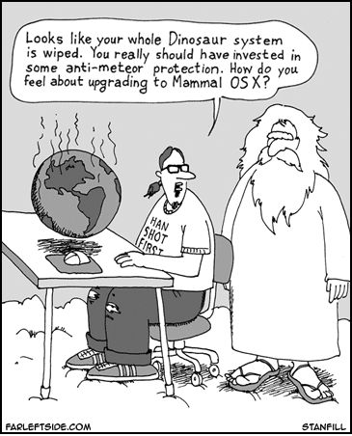
Questions??
Interested in collaborating?
Contact Kyle Gray
kyle.gray@uni.edu

