Slide 1
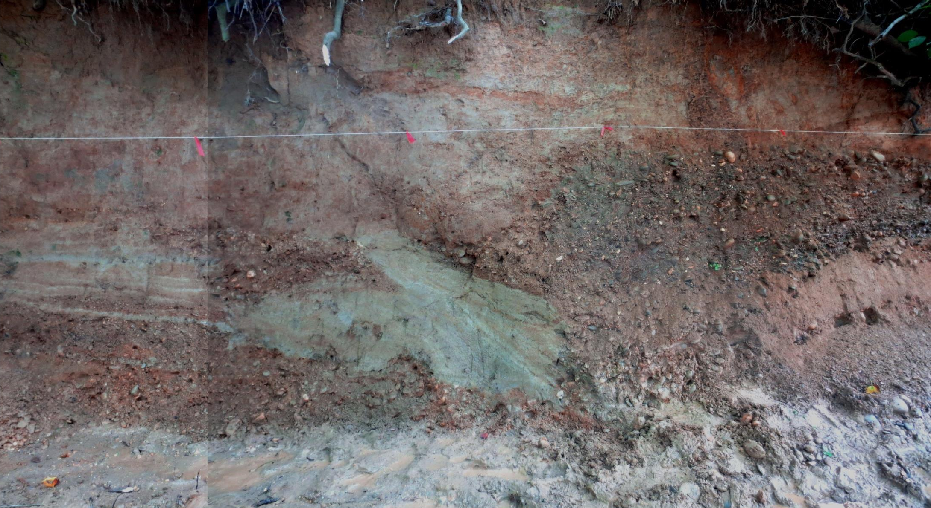


FIELD EVIDENCE OF LATE QUATERNARY FAULTING IN THE EASTERN TENNESSEE SEISMIC ZONE NEAR KNOXVILLE AND IMPLICATIONS FOR SEISMIC HAZARD
Randel Tom Cox
Eric Gamble
Robert D. Hatcher, Jr.
Jacob C. Glasbrenner

Slide 2

Funding provided by

Slide 3
OUTLINE:
Regional setting

Slide 4
OUTLINE:
Regional setting
Instrumental/historic seismicity

Slide 5
OUTLINE:
Regional setting
Instrumental/historic seismicity
Risk

Slide 6
OUTLINE:
Regional setting
Instrumental/historic seismicity
Risk
Seismicity alignments

Slide 7
OUTLINE:
Regional setting
Instrumental/historic seismicity
Risk
Seismicity alignments
Quaternary faulting

Slide 8
OUTLINE:
Regional setting
Instrumental/historic seismicity
Risk
Seismicity alignments
Quaternary faulting
Paleoseismic chronology

Slide 9
OUTLINE:
Regional setting
Instrumental/historic seismicity
Risk
Seismicity alignments
Quaternary faulting
Paleoseismic chronology
Summary

Slide 10
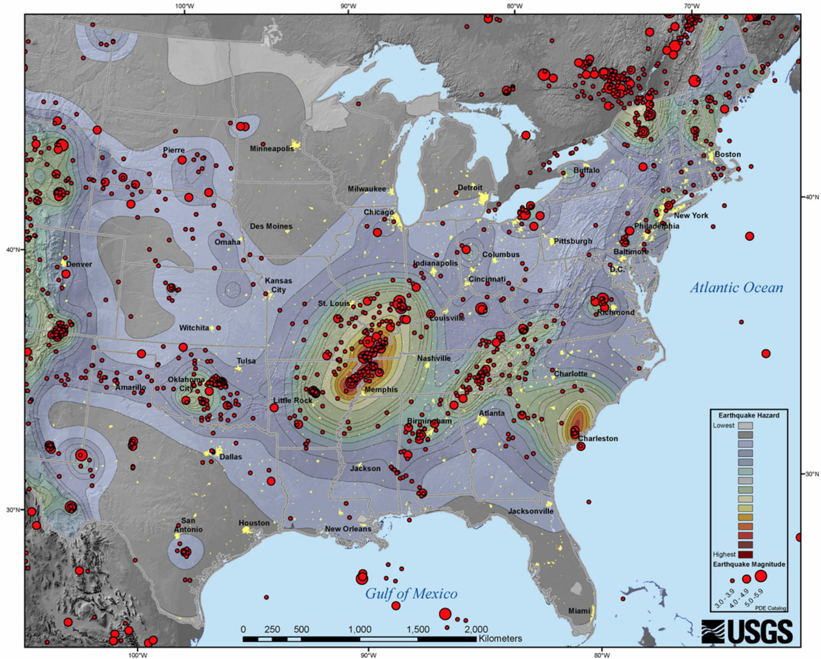
C-EUS (& S Canada) Earthquakes

Slide 11
C-EUS (& S Canada) Earthquakes
EASTERN
TENNESSEE
SEISMIC
ZONE

Slide 12
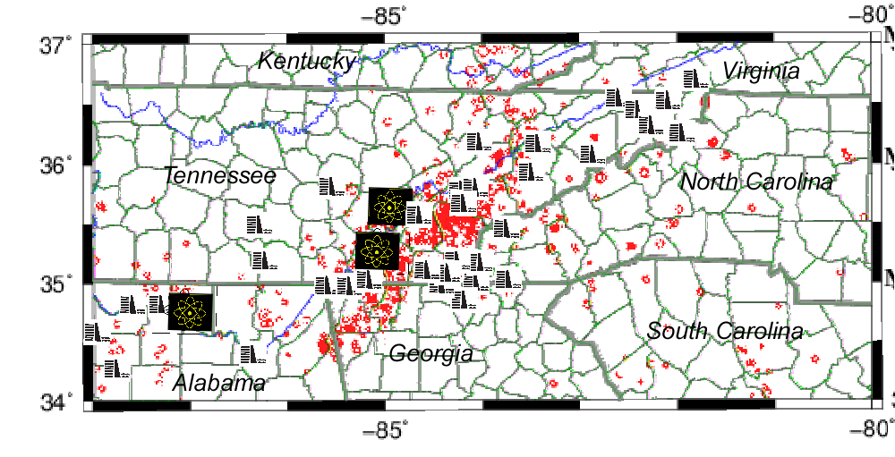
DAMS, REACTORS, and EARTHQUAKES
REACTORS and DAM map?

Slide 13
DAMS, REACTORS, and EARTHQUAKES
REACTORS and DAM map?
DAMS

Slide 14
DAMS, REACTORS, and EARTHQUAKES
REACTORS and DAM map?
REACTORS
DAMS

Slide 15
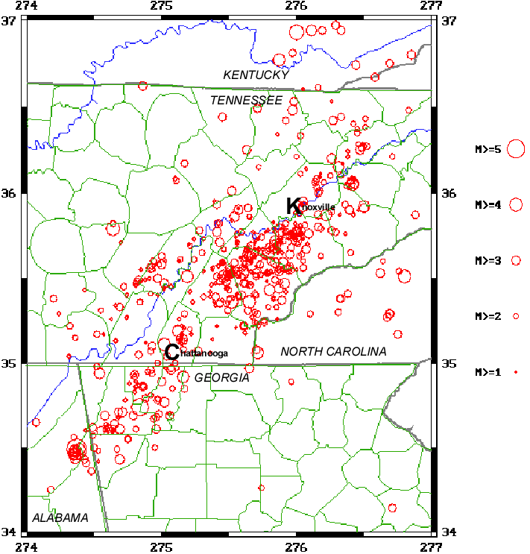

Slide 16


Slide 17
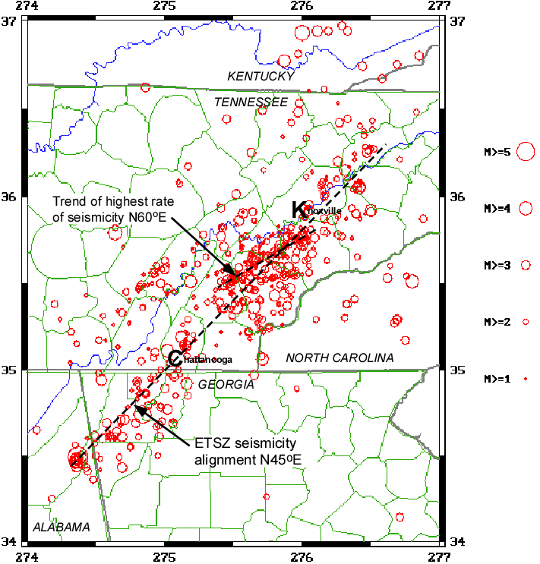

Slide 18
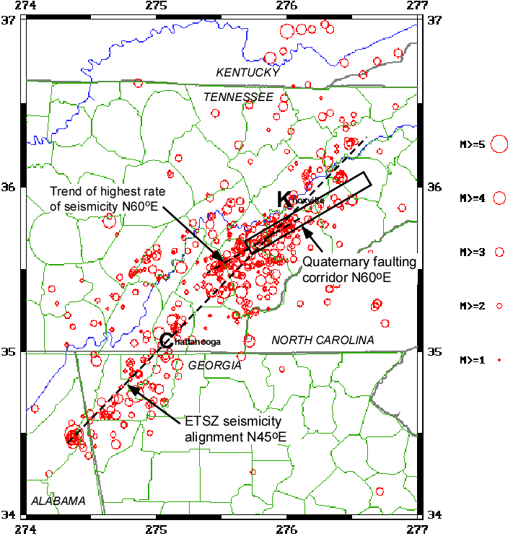

Slide 19
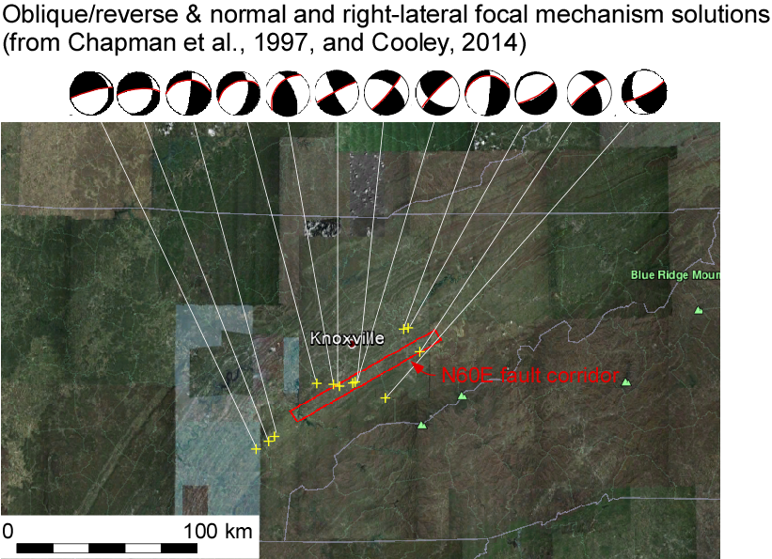

Slide 20
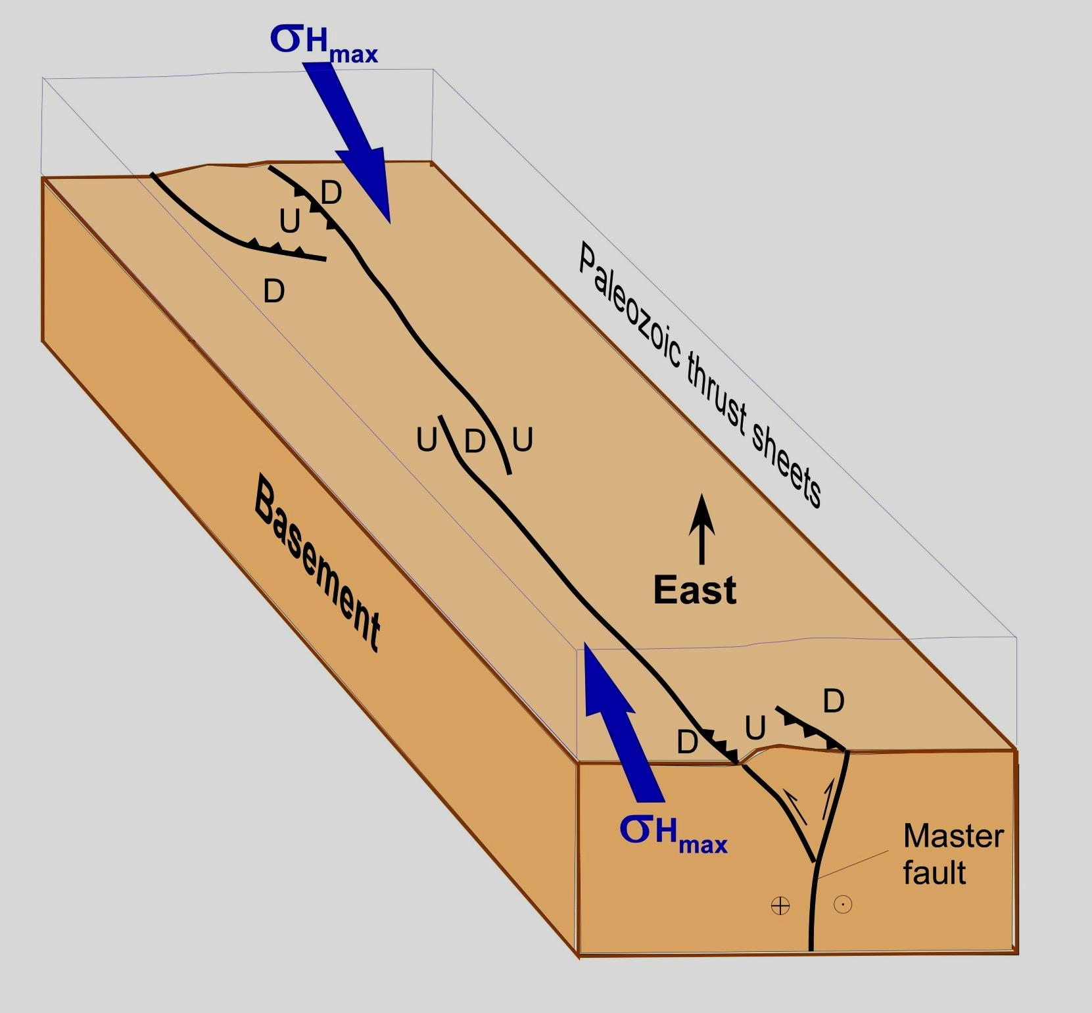
Speculative Model

Slide 21
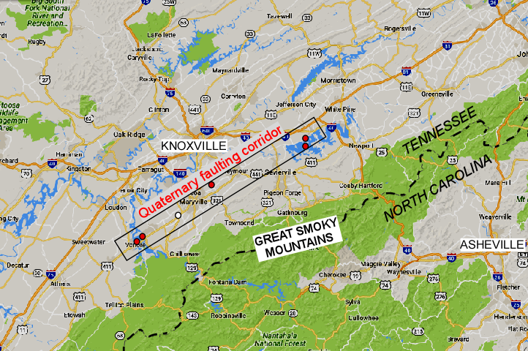
Map of corridor showing field sites labeled
0 100 km

Slide 22
Douglas Lake
North & South
Map of corridor showing field sites labeled
0 100 km

Slide 23
Map of corridor showing field sites labeled
Brakebill Island
0 100 km

Slide 24
Map of corridor showing field sites labeled
Maryville
0 100 km

Slide 25
Map of corridor showing field sites labeled
Vonore
North & South
0 100 km

Slide 26
Douglas Lake
North & South
Map of corridor showing field sites labeled
0 100 km

Slide 27
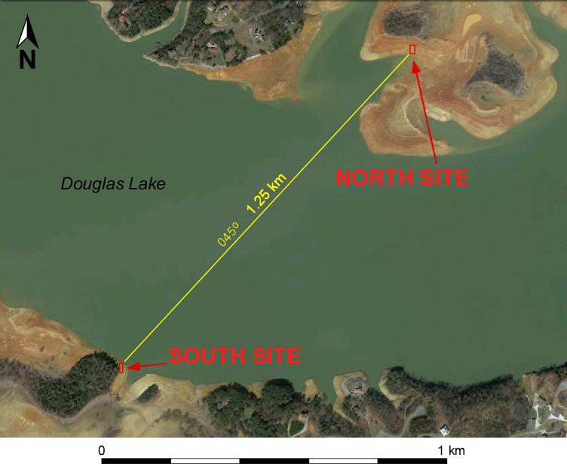
DL-6 & 9 map

Slide 28
thrust
DL-6 & 9 map

Slide 29
fissure
DL-6 & 9 map

Slide 30
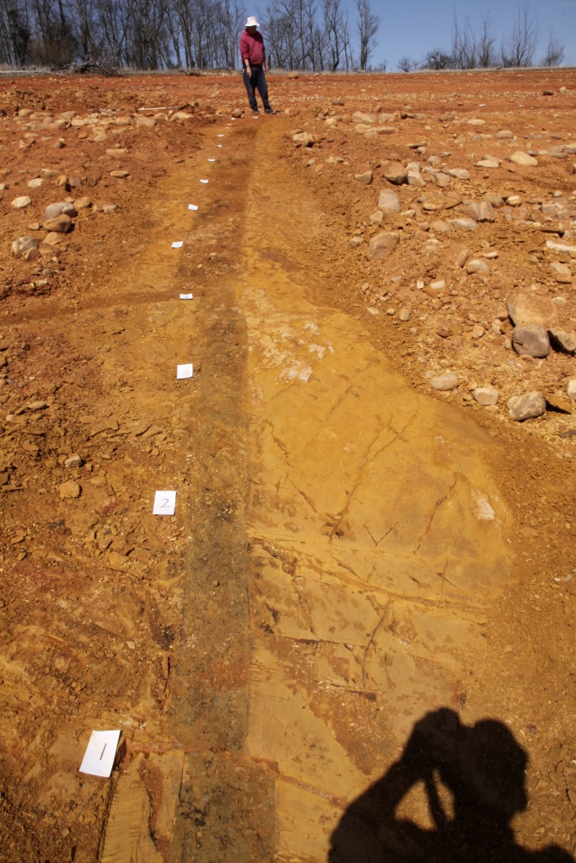
DOUGLAS LAKE,
NORTH SHORE
ALLUVIUM-FILLED
FISSURE
DL-6 fissure
Looking NE

Slide 31
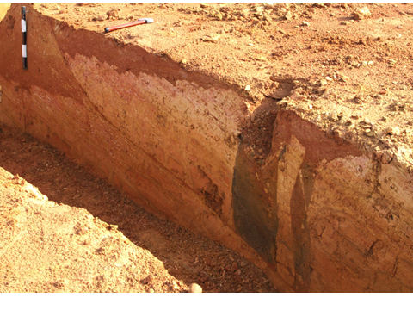
WEST
DOUGLAS LAKE, NORTH SHORE
THRUST
EAST
ALLUVIUM
ALLUVIUM-FILLED FISSURES
PLEISTOCENE
ORDOVICIAN SHALE
SAPROLITE

Slide 32
WEST
DOUGLAS LAKE, NORTH SHORE
THRUST
EAST
ALLUVIUM
ALLUVIUM-FILLED FISSURES
PLEISTOCENE
ORDOVICIAN SHALE
SAPROLITE

Slide 33
DL-6 & 9 map

Slide 34
DL-6 & 9 map
fissures

Slide 35
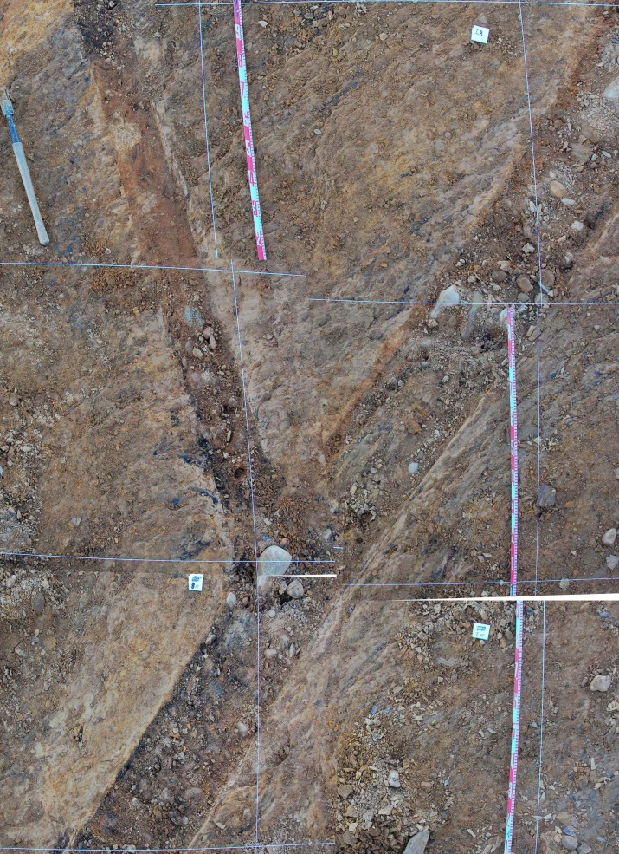
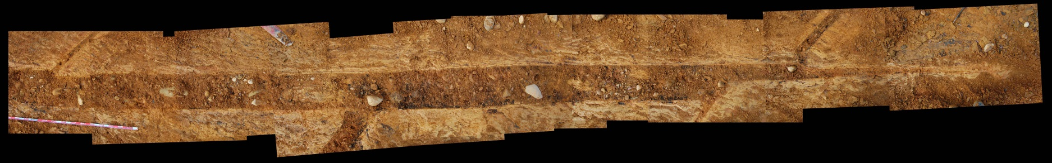
DOUGLAS LAKE,
SOUTH SHORE
ALLUVIUM-FILLED
FISSURE
NORTH
1 m
0

Slide 36
Map of corridor showing field sites labeled
Brakebill Island

Slide 37
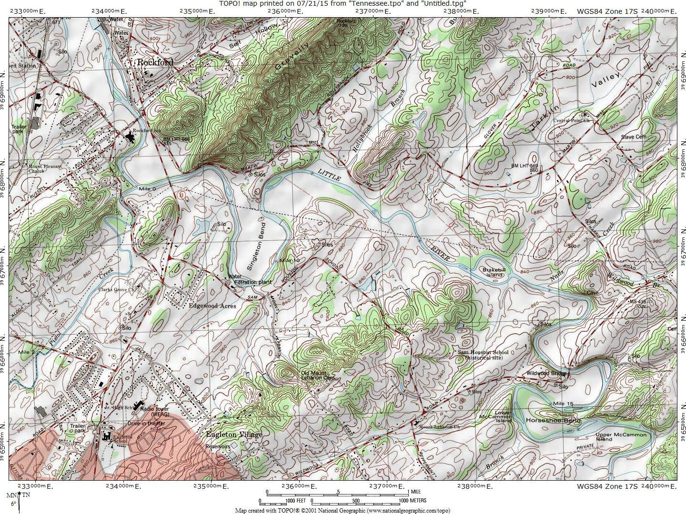

Slide 38
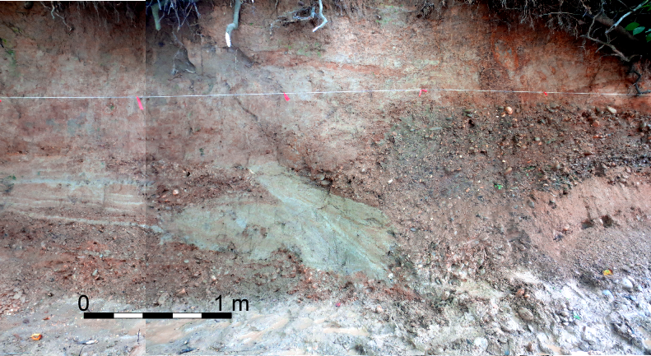
WEST
EAST

Slide 39
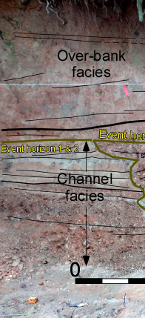
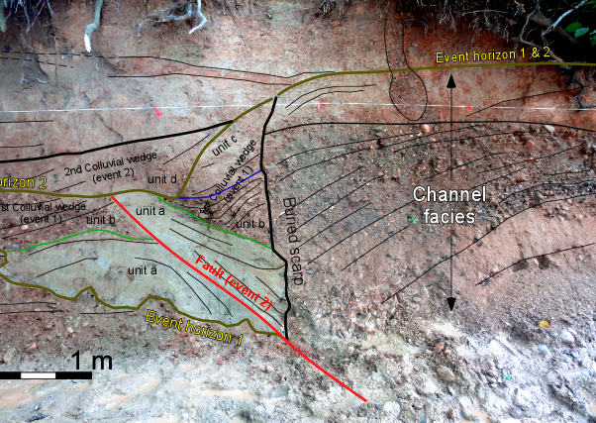
WEST
EAST

Slide 40
Map of corridor showing field sites labeled
Maryville

Slide 41
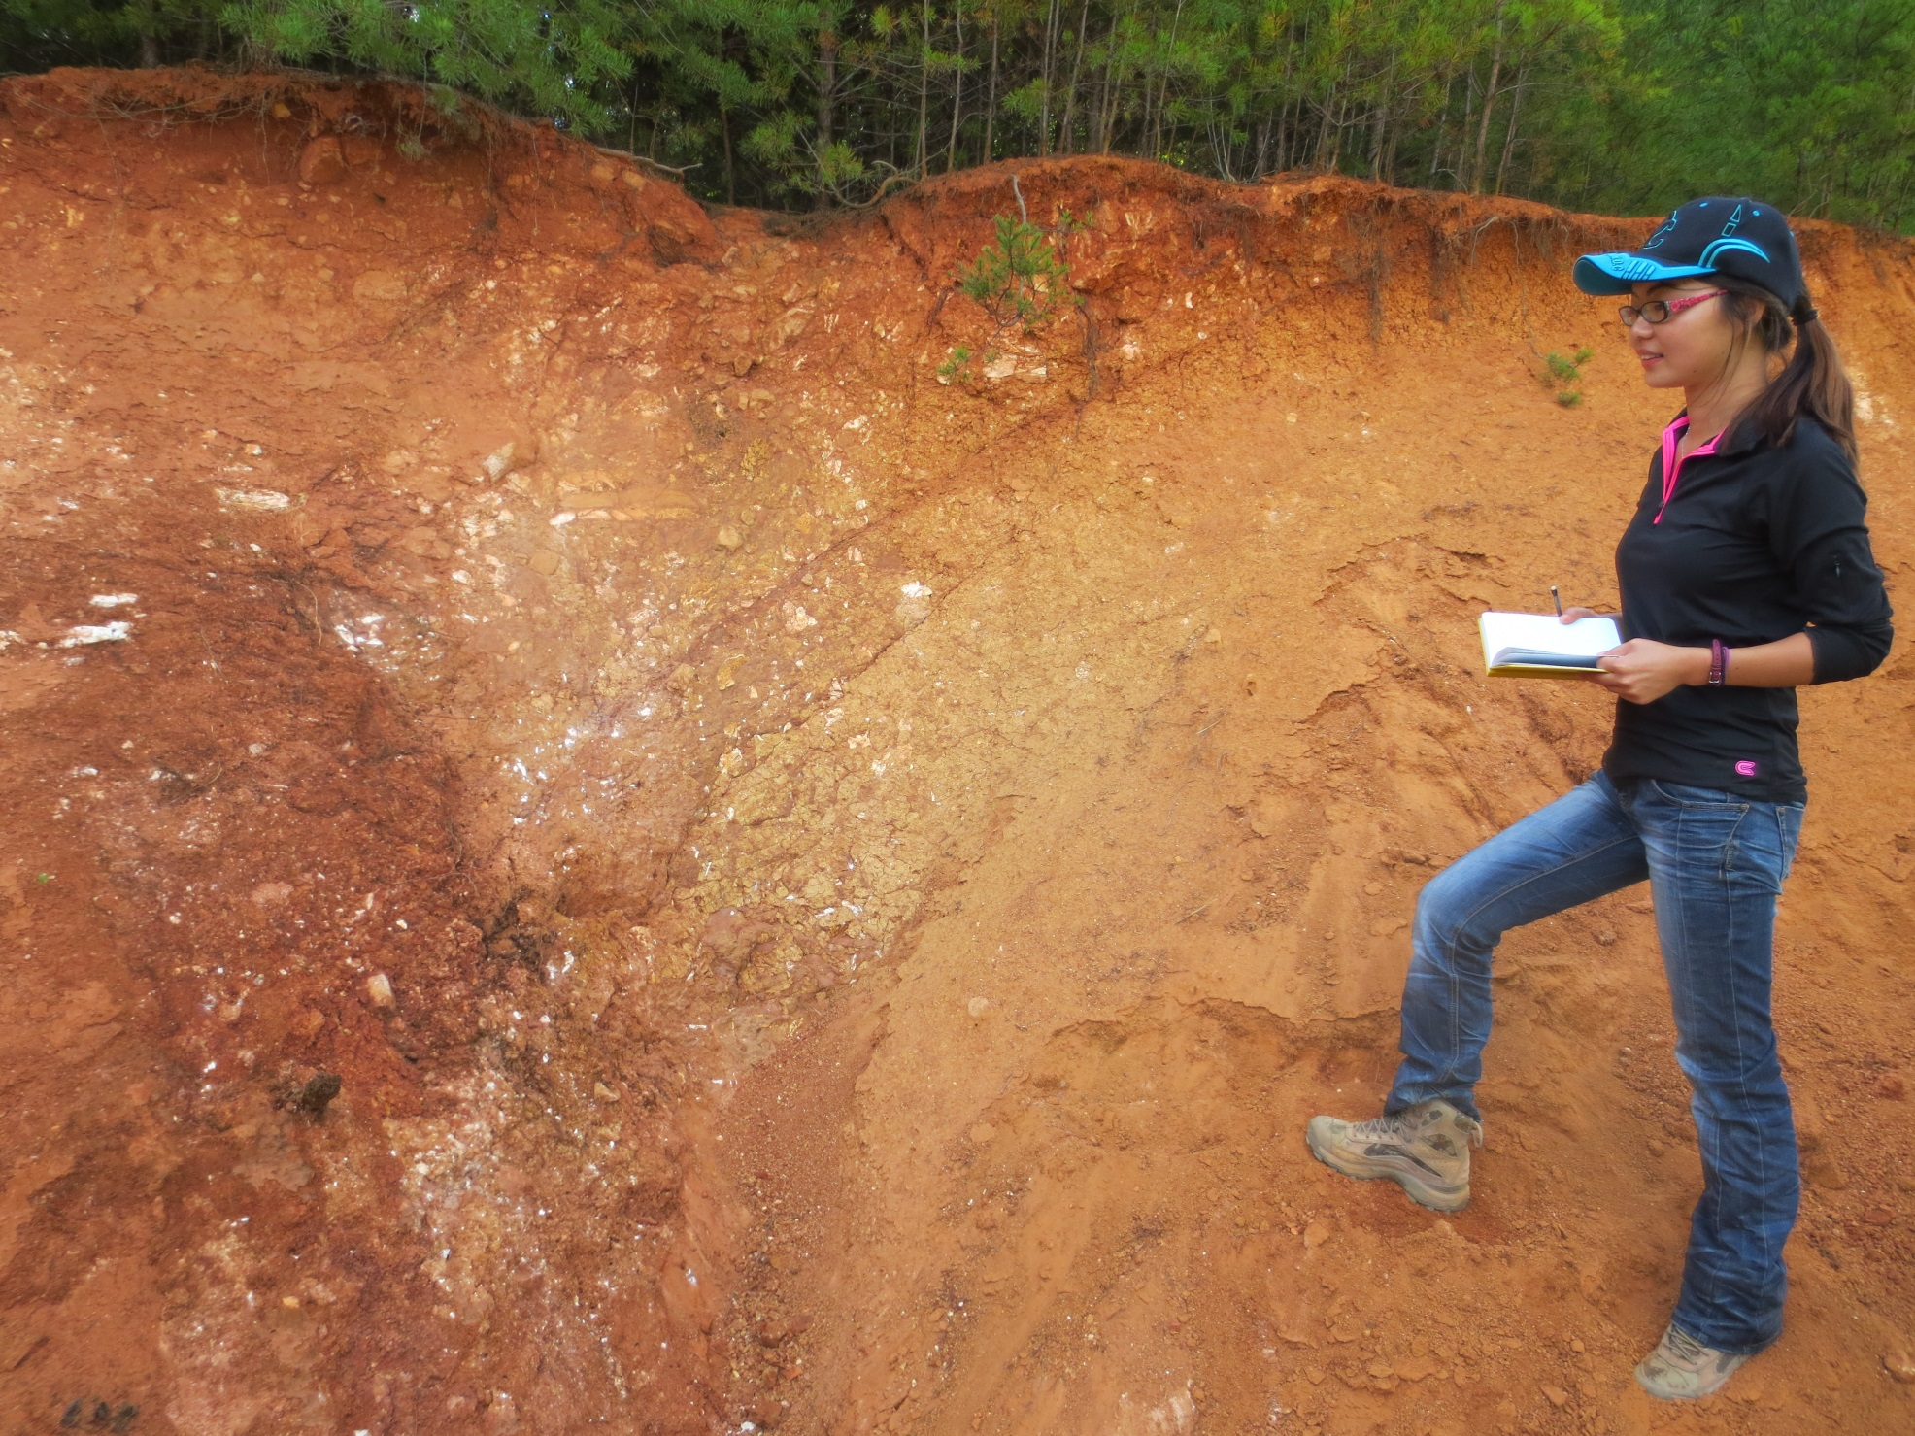
EAST
POSSIBLE FAULT AT MARYVILLE
WEST
Maryville pit fault photo?

Slide 42
EAST
POSSIBLE FAULT AT MARYVILLE
WEST
CHERT-POOR
RESIDUUM
CHERT-RICH
RESIDUUM
CHERT-POOR
RESIDUUM
Maryville pit fault photo?
CHERT-RICH
RESIDUUM
COLLUVIUM
COLLUVIUM

Slide 43
Map of corridor showing field sites labeled
Vonore
North & South

Slide 44
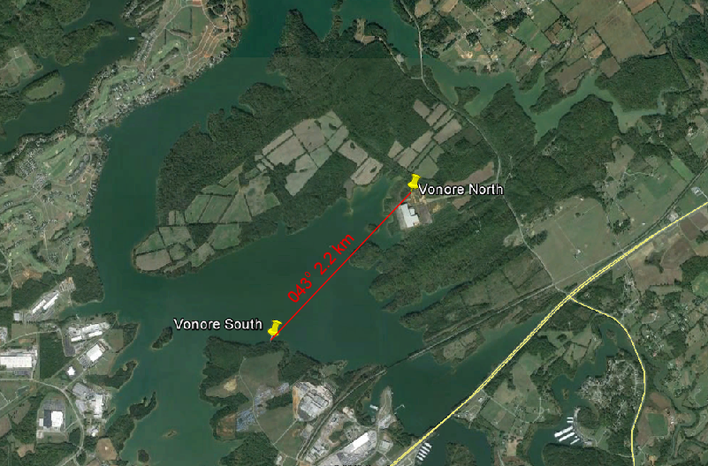
Vonore map

Slide 45
Vonore map
Normal fault

Slide 46
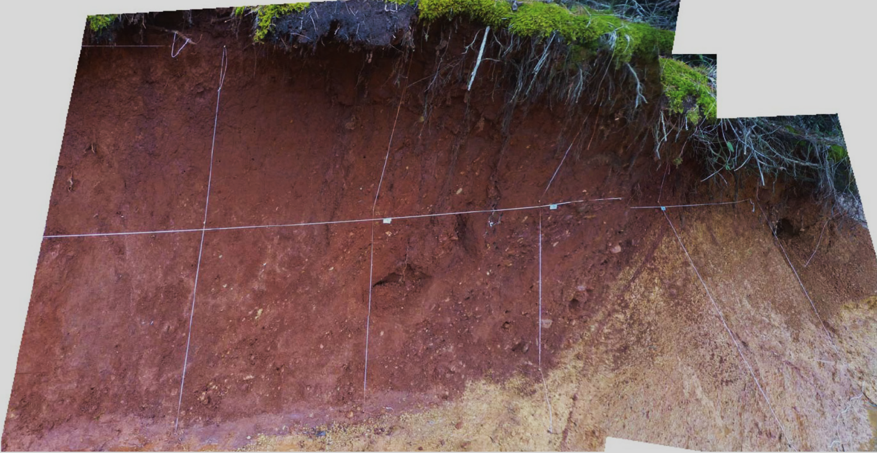
EAST
NORMAL FAULT AT VONORE SOUTH
WEST
Pleistocene alluvium
Cambrian shale
saprolite

Slide 47
EAST
NORMAL FAULT AT VONORE SOUTH
WEST
Pleistocene alluvium
Cambrian shale
saprolite
Cambrian shale saprolite

Slide 48
Vonore map

Slide 49
Tranpressional? fault
Vonore map

Slide 50
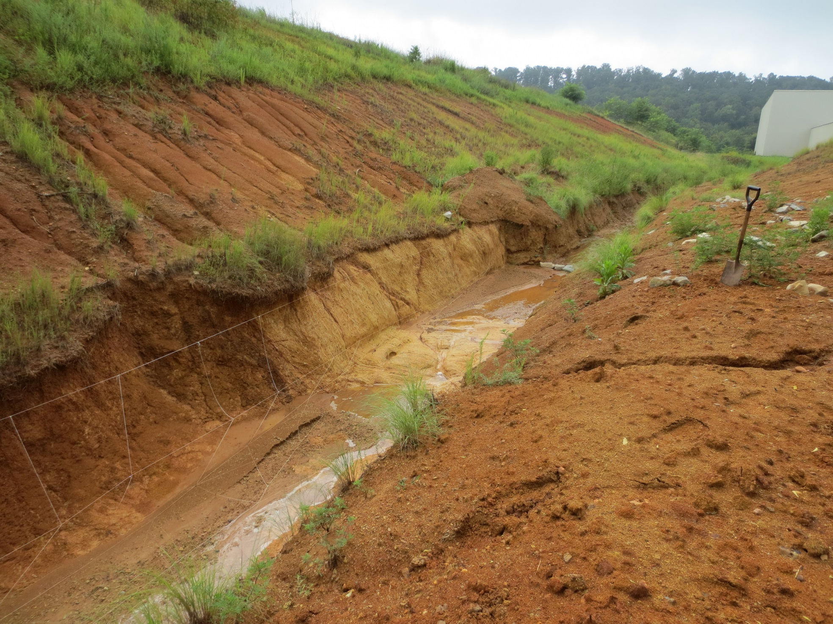
Looking east
TRANSPRESSIONAL? FAULT AT VONORE NORTH
CAMBRIAN SHALE
SAPROLITE
PLEISTOCENE? COLLUVIUM

Slide 51
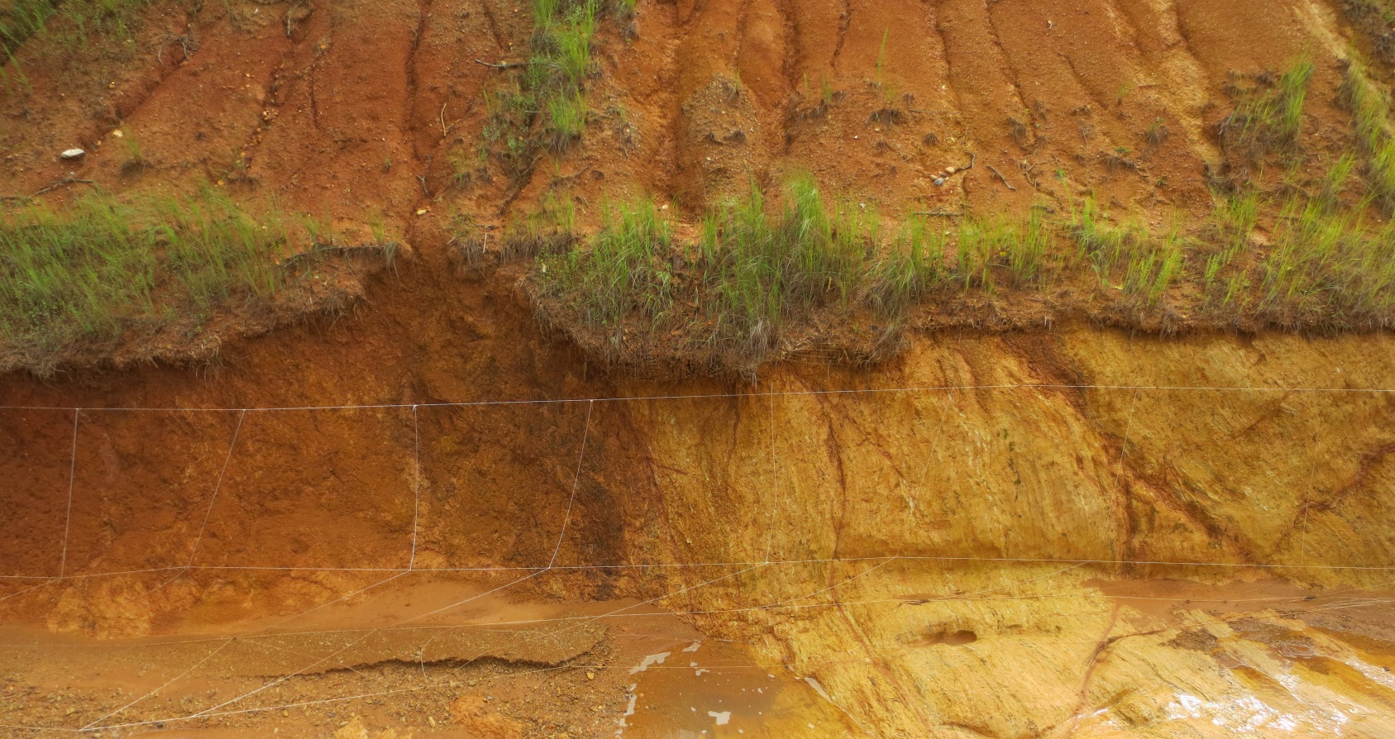
EAST
TRANSPRESSIONAL? FAULT AT VONORE NORTH
WEST
PLEISTOCENE? COLLUVIUM
CAMBRIAN SHALE
SAPROLITE

Slide 52
EAST
WEST
PLEISTOCENE? COLLUVIUM
CAMBRIAN SHALE
SAPROLITE

Slide 53
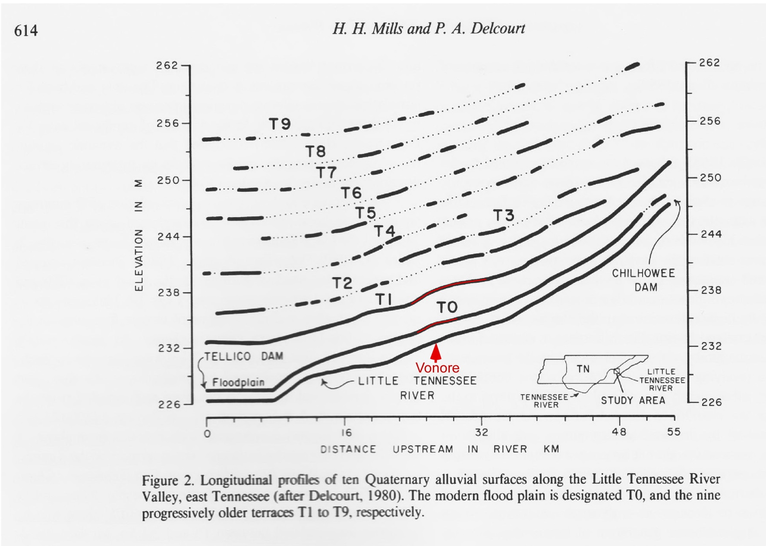
(1991)

Slide 54
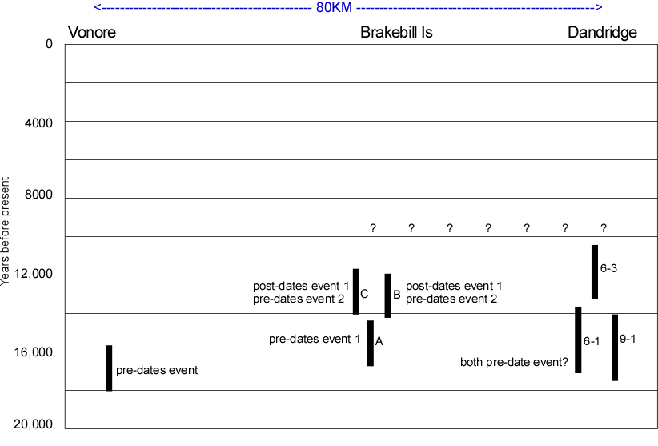
TIMING
TIMING/locality chart

Slide 55
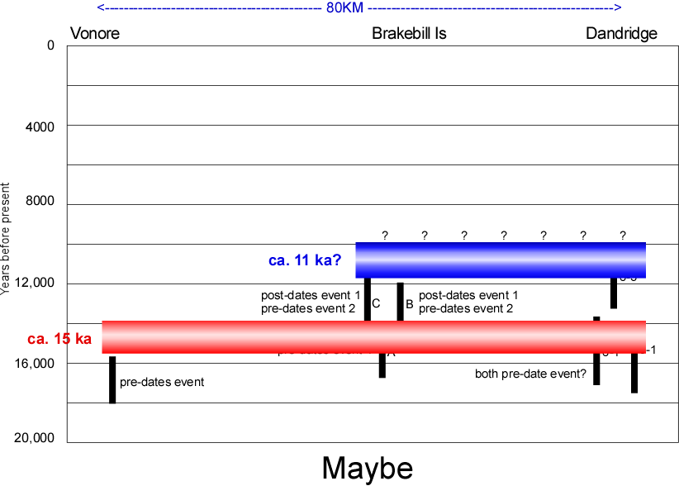
TIMING

Slide 56
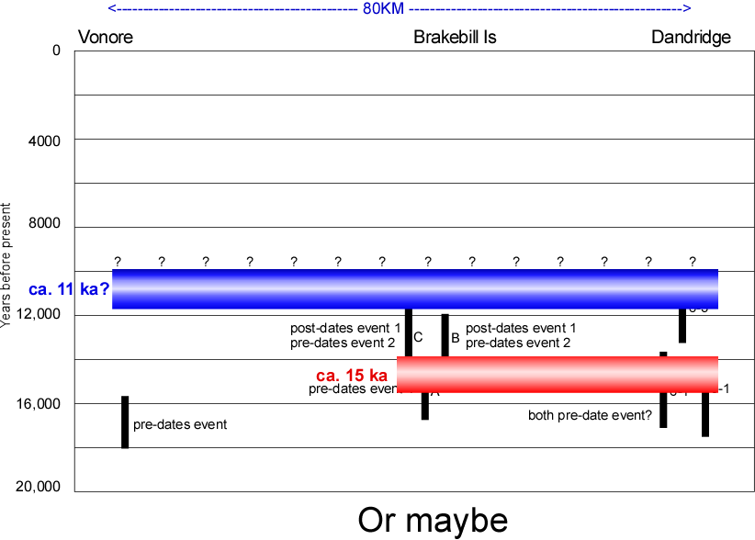
TIMING

Slide 57
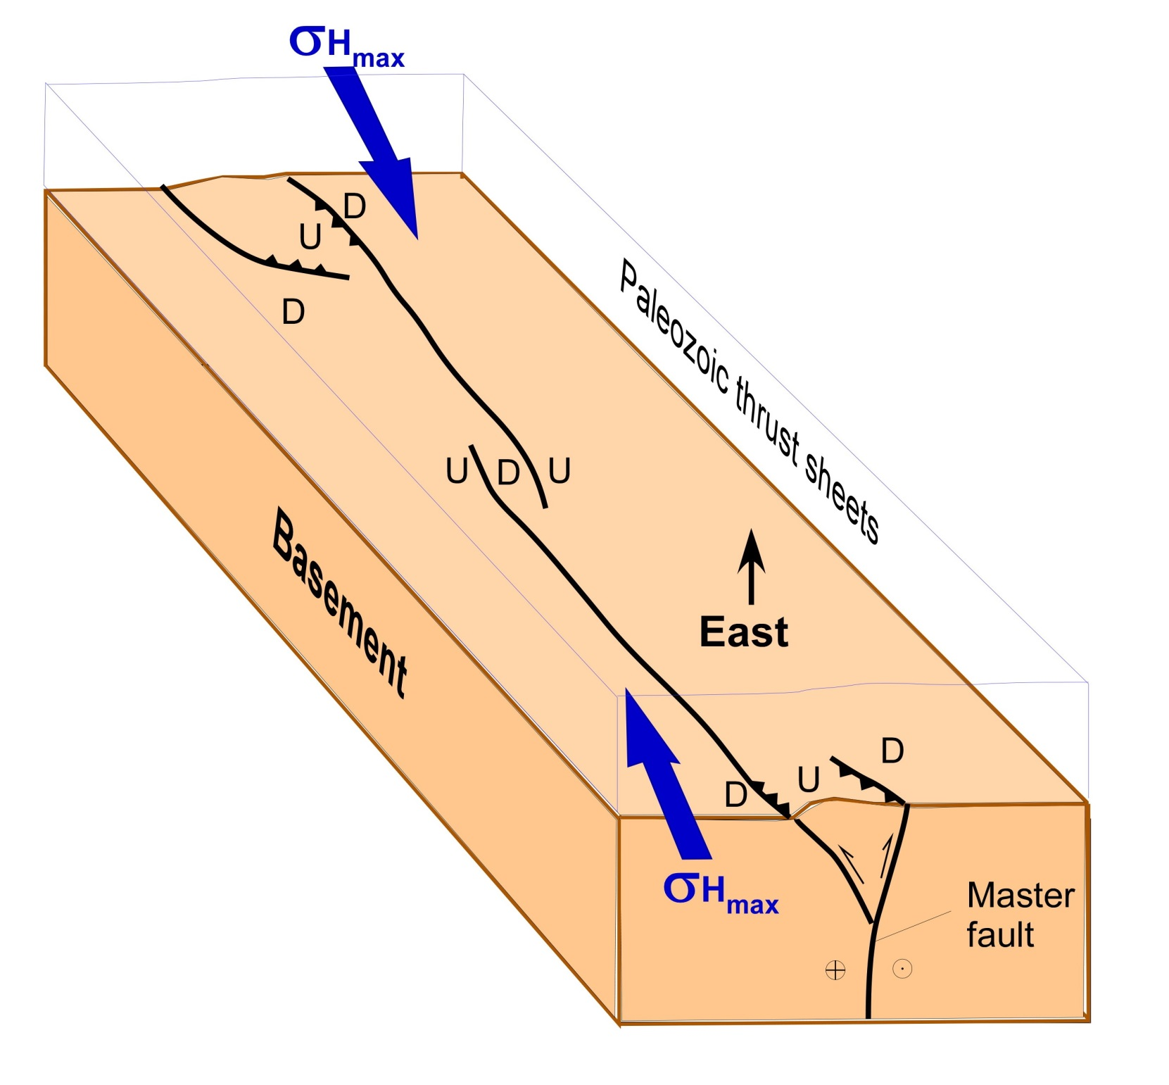

Slide 58
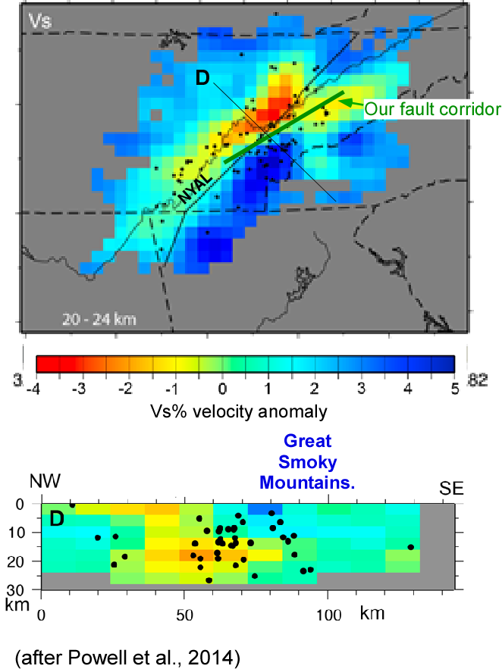

Slide 59
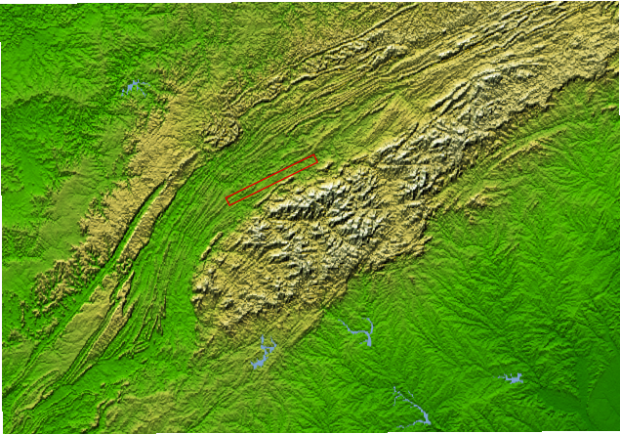
QUATERNARY FAULTING CORRIDOR
SMOKY MOUNTAINS

Slide 60
APPALACHIAN REJUVENATION?
QUATERNARY FAULTING CORRIDOR
SMOKY MOUNTAINS

Slide 61
Summary:

Slide 62
Summary:
An 80 km-long, 060º corridor of Quaternary faulting is collinear with an alignment of concentrated seismicity.

Slide 63
Summary:
An 80 km-long, 060º corridor of Quaternary faulting is collinear with an alignment of concentrated seismicity.
Together this seismicity alignment and faulting corridor are >100 km long.

Slide 64
Summary:
An 80 km-long, 060º corridor of Quaternary faulting is collinear with an alignment of concentrated seismicity.
Together this seismicity alignment and faulting corridor are >100 km long.
A 100 km-long rupture on a possible master fault at depth could generate a M7+ earthquake.

Slide 65
Summary:
An 80 km-long, 060º corridor of Quaternary faulting is collinear with an alignment of concentrated seismicity.
Together this seismicity alignment and faulting corridor are >100 km long.
A 100 km-long rupture on a possible master fault at depth could generate a M7+ earthquake.
The ETSZ Quaternary faulting corridor may be an important element in rejuvenation of the southern Appalachians.

Slide 66

?’s

