Slide 1
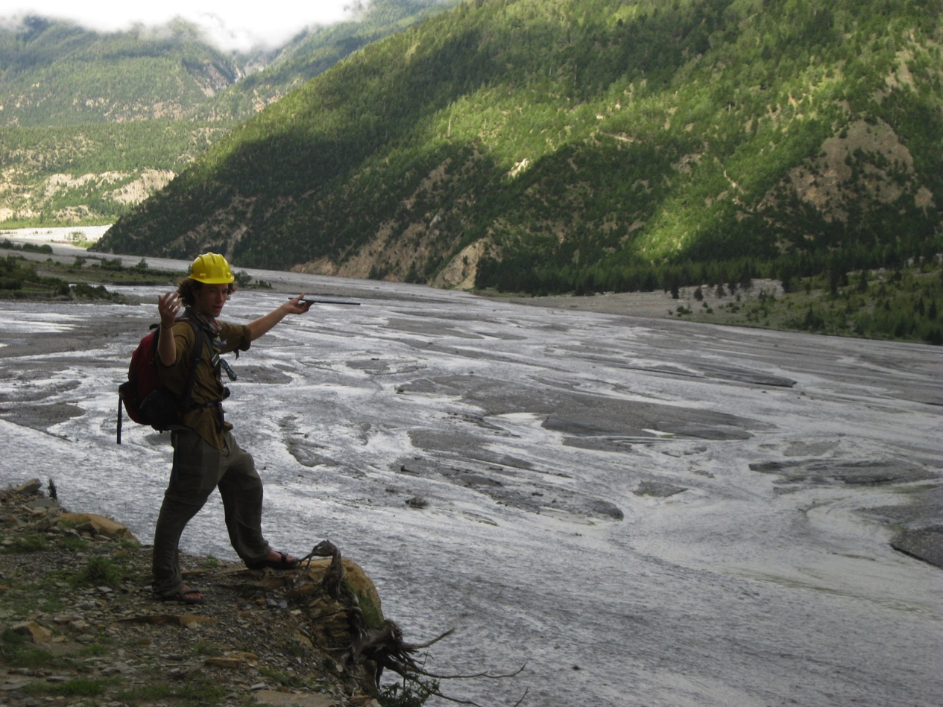
Discovery-based research in a study abroad experience
“Nepal: Geoscience in the Himalaya”
Beth Pratt-Sitaula
Bishal N Upreti
Ananta Gajurel
Notes:
Thank you for giving me the chance to talk today – about the geoscience field program for which I am the academic director in Nepal.
It is called “Nepal: Geoscience in the Himalaya”
My name is Beth Pratt-Sitaula and I have worked on geology and education projects in Nepal since 2000.
The program includes a significant independent research project and minor ones – so I wanted to describe this example of Discovery learning.
Image: Beth Pratt-Sitaula

Slide 2
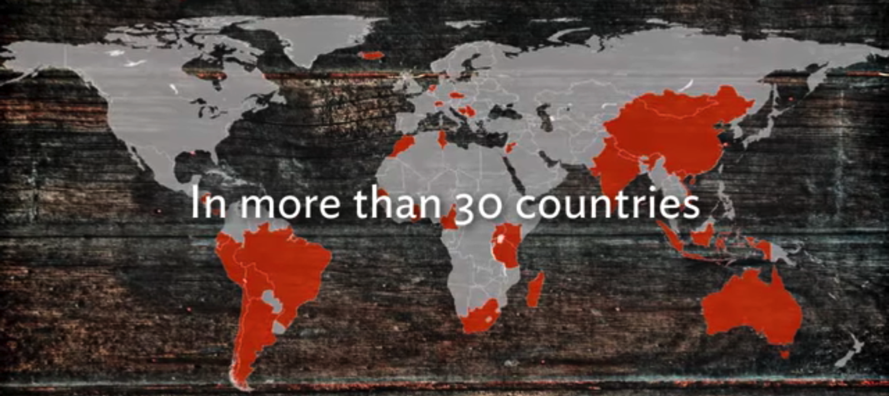
The SIT Study Abroad Experience
Mission: SIT prepares students to be interculturally effective leaders, professionals, and citizens.
Experiential, field-based approach
Focus on critical global issues
Non-traditional locations
Undergraduate research
Local networks

Slide 3
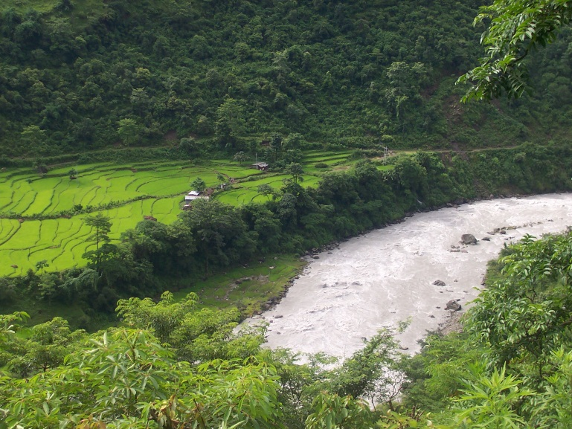
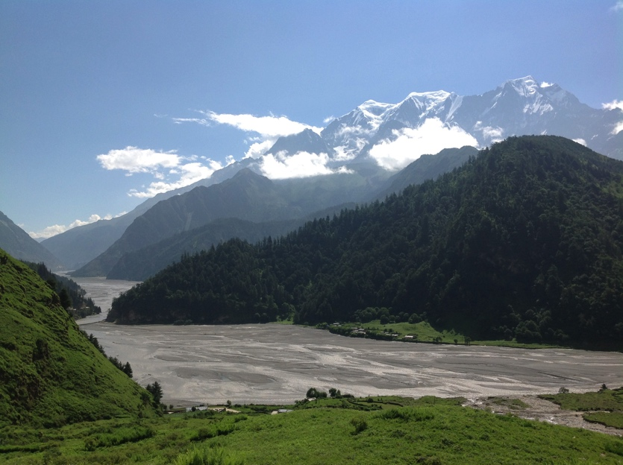
Nepal: Geoscience in the Himalaya
Earth science knowledge underpins (or should) many societal decisions
Developing countries particularly vulnerable to geohazards
Himalaya have
phenomenal geology
Research is invaluable
Notes:
Images: Beth Pratt-Sitaula

Slide 4
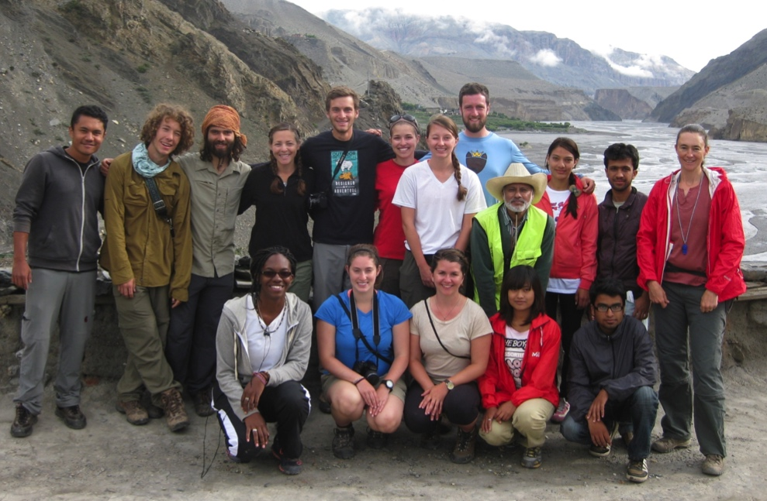
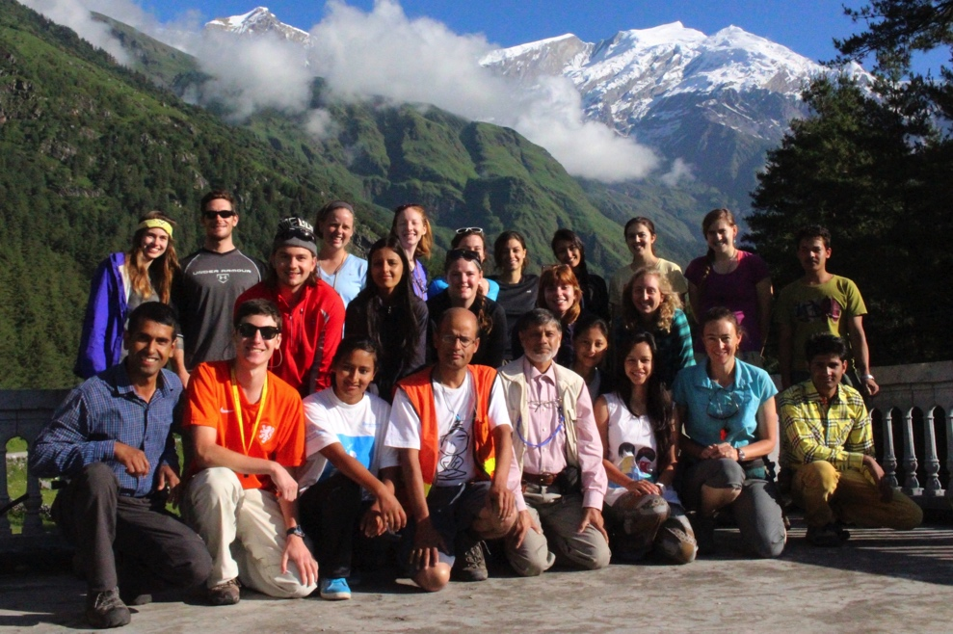
Nepal: Geoscience in the Himalaya
Started summer 2013
7 weeks (mid-June – early August)
9 credits
3 courses including…
2-week independent study project
Notes:
Images: Bhairab Sitaula

Slide 5
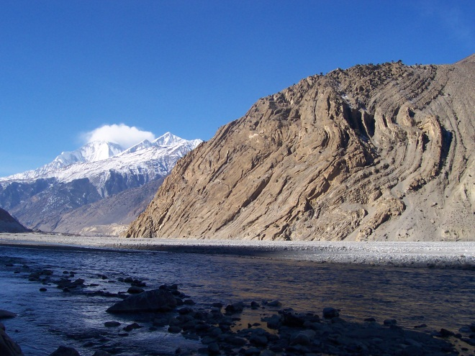
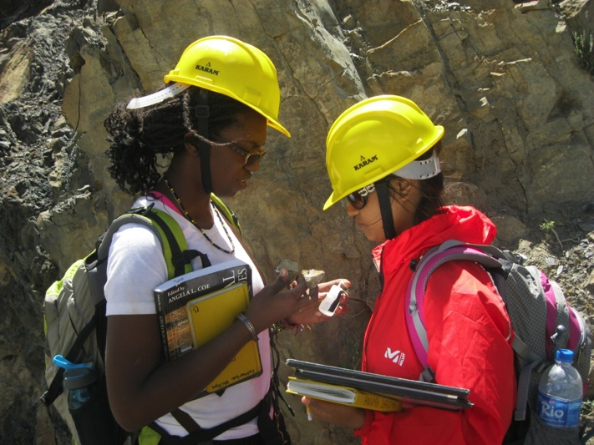
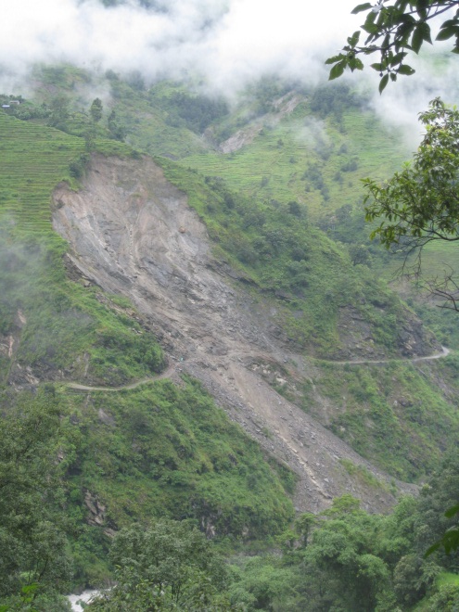
Nepal: Geoscience in the Himalaya
Earth Science Field Methods (3 credits)
Geohazards in the Himalaya (3 credits)
Field Study Project (3 credits)
Scaffold to discovery learning
Notes:
Images from left to right:
Beth Pratt-Sitaula
Lisa Ely
Bhairab Sitaula

Slide 6
Discovery Learning Convocation Recommendations
Students should know that they are engaged in a real scientific problem.
Students should know that the work they are doing matters to the scientific community
Students should know how their discoveries are contributing to the field
and society!

Slide 7
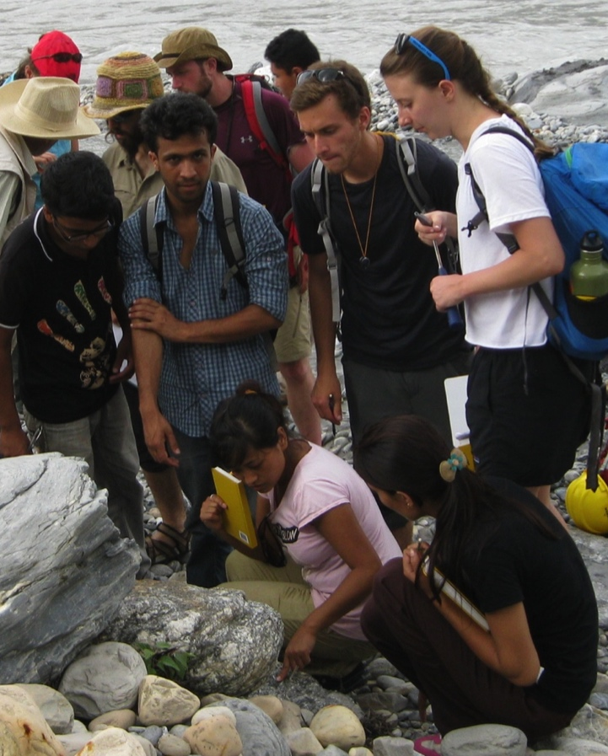
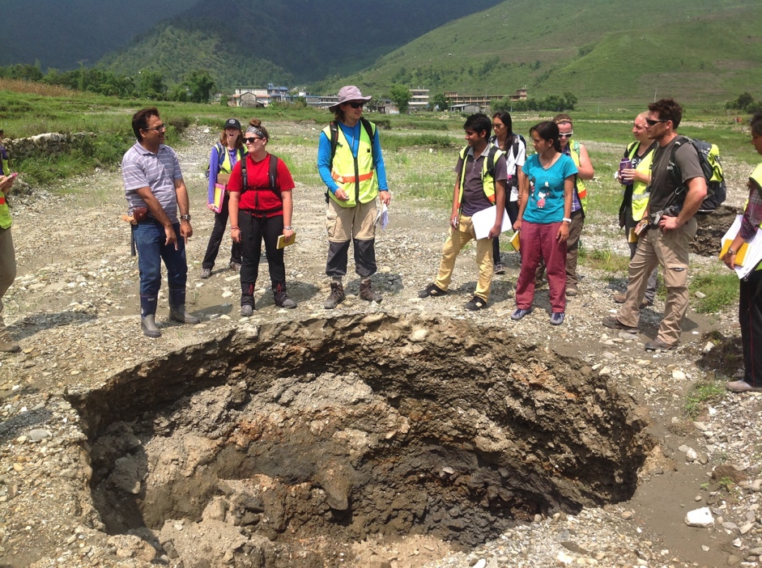
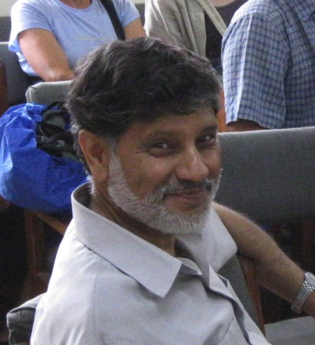
Nepali co-designers & instructors
Expert Himalayan geologists as co-designers and co-instructors
Integral to effective, locally-relevant science
Integral to local advisor network
Integral to safety and security
Notes:
Images from left to right:
Beth Pratt-Sitaula
Bhairab Sitaula
Beth Pratt-Sitaula

Slide 8
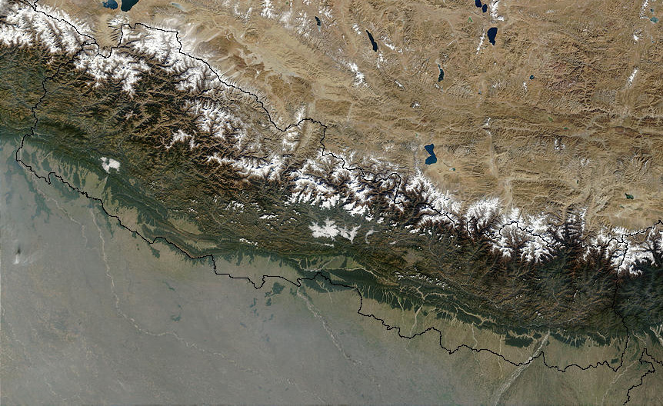
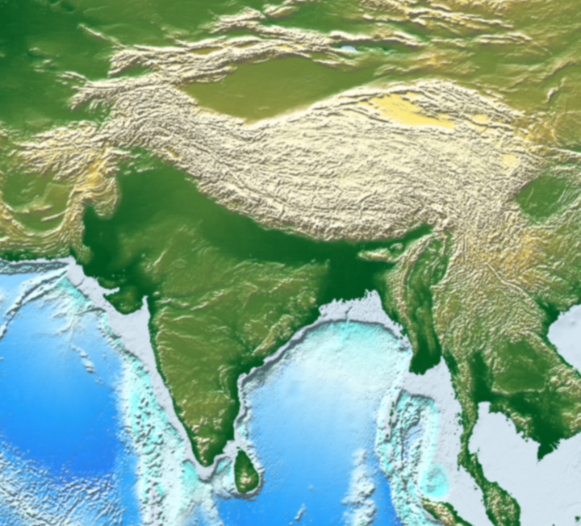
Nepal: Geoscience in the Himalaya Mid June – early Aug
Dhaulagiri
Annapurna
Everest
Pokhara
Kathmandu
~100 km
Notes:
Go into some detail about amazing Himalayan geology, contracts, and human-earth system interactions

Slide 9
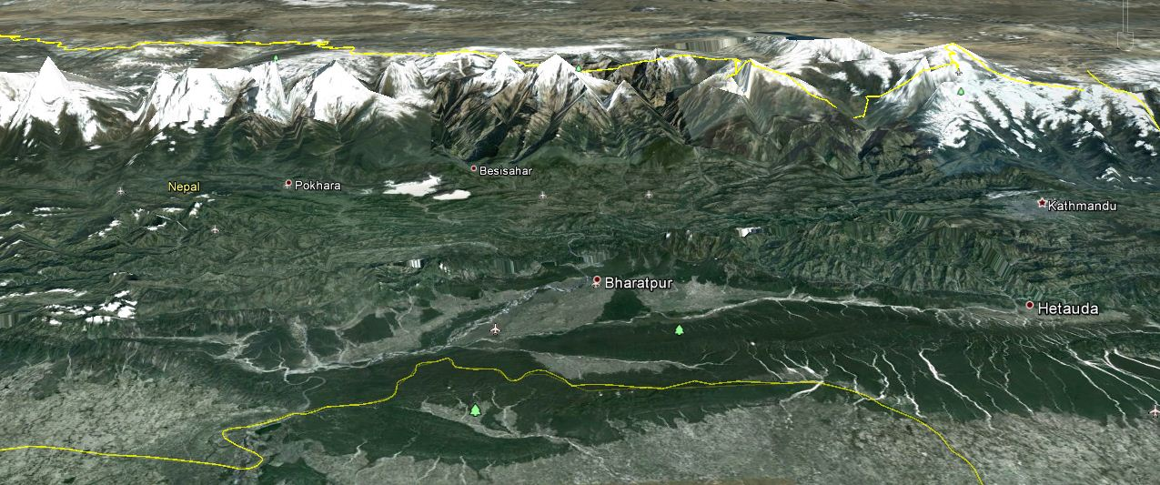
Nepal: Geoscience in the Himalaya
Pokhara
Kathmandu
N
~50 km

Slide 10
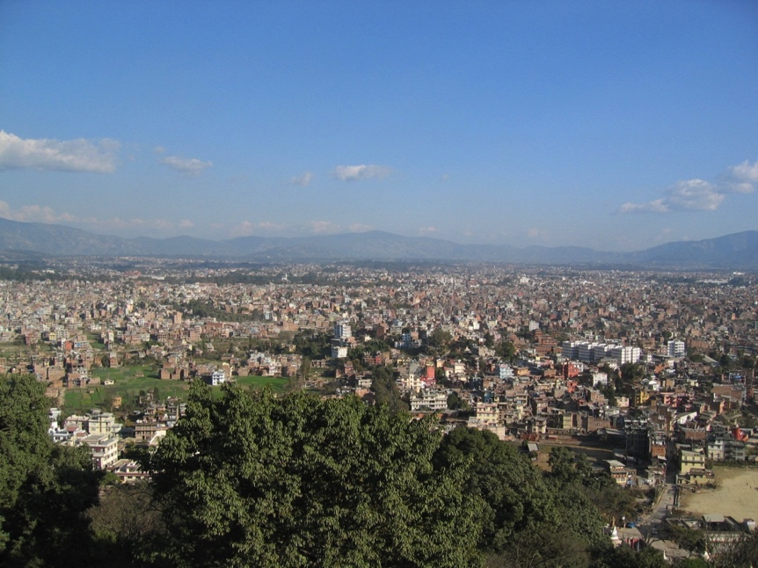
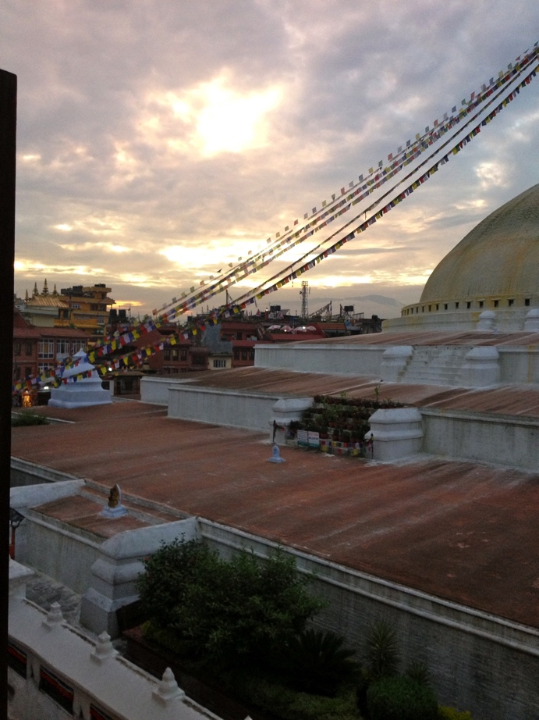
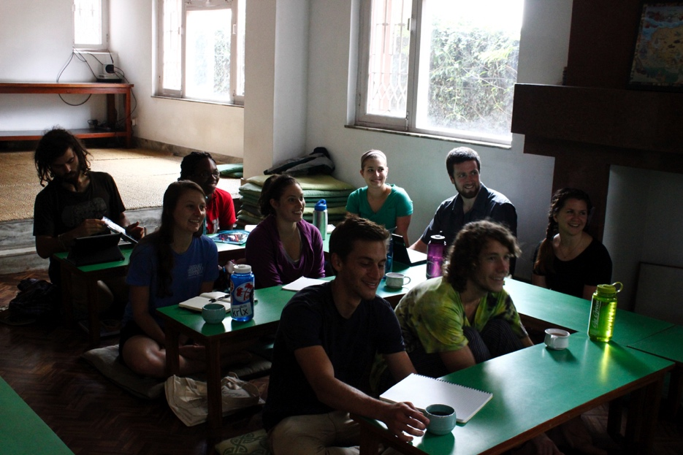
Orientation in Kathmandu
Geology, environment, language, culture, partner organizations.
Notes:
Images from left to right:
Beth Pratt-Sitaula
Tenzin Choezom
Mary Reagan Harvey

Slide 11
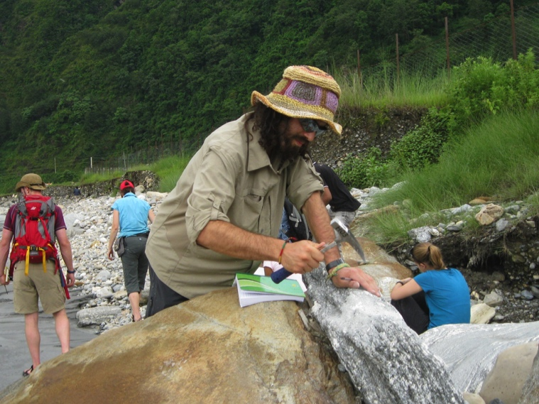
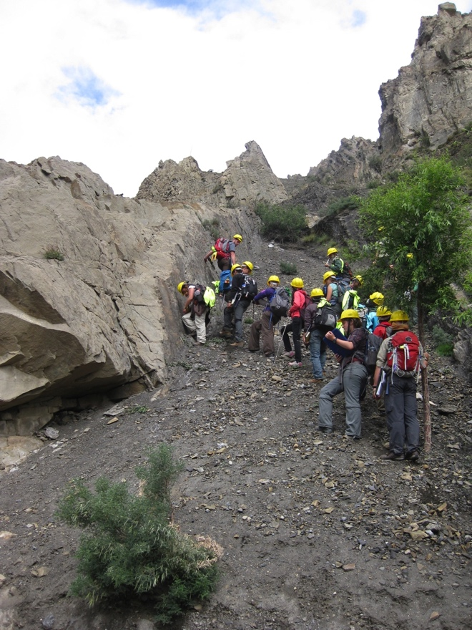
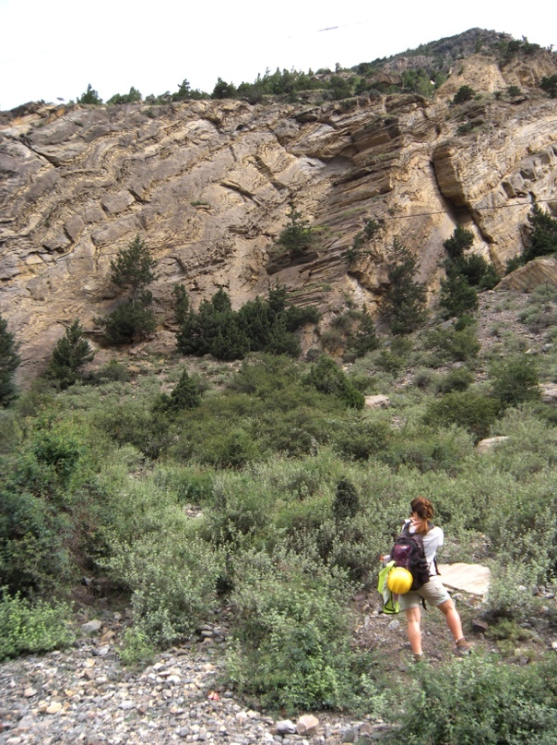
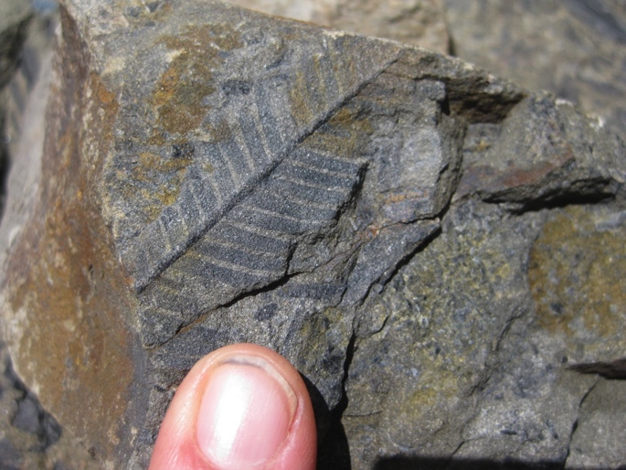
Earth Science Field Skills
Learning to “read” the rocks to understand past environments and past-and-present geologic processes. Make maps and cross-sections based on field and remote sensing observations.
Notes:
Images from left to right:
Mary Reagan Harvey
Bhairab Sitaula (3)

Slide 12
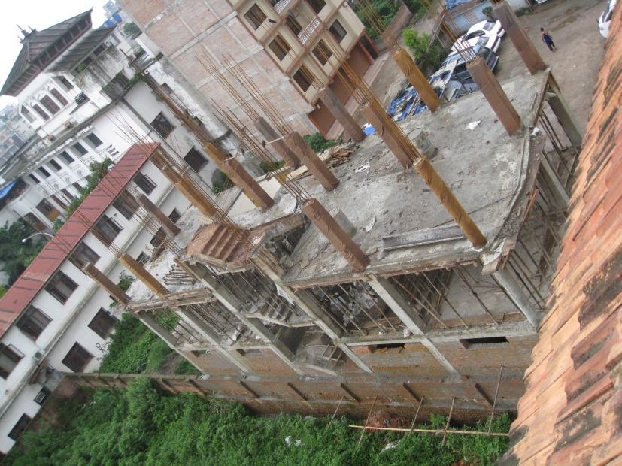
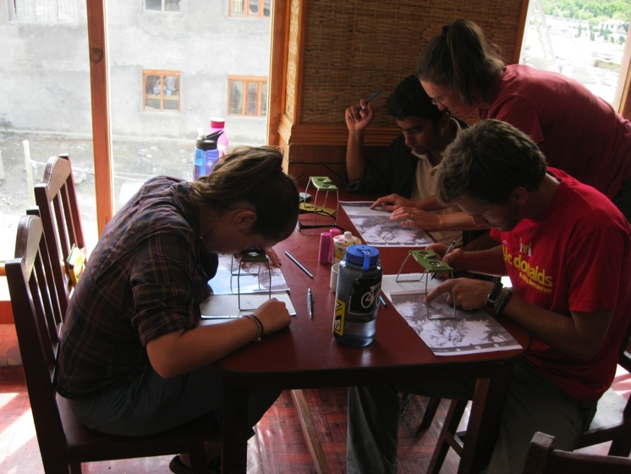
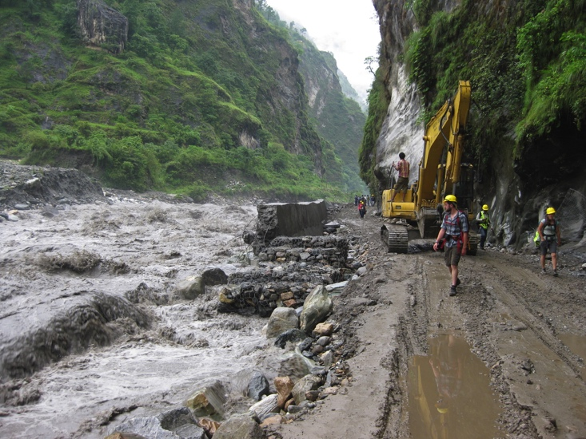
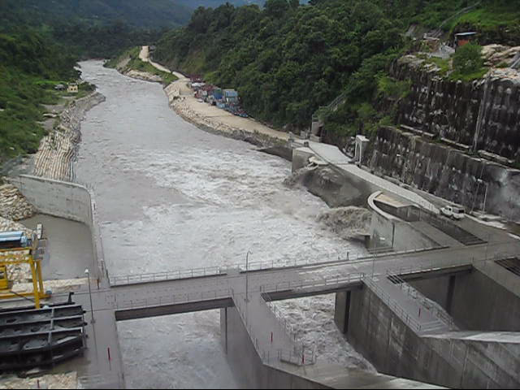
Geohazards & Human-Earth System Interconnections
Example topics: Landslides, flooding (drought), earthquake hazard, agriculture/soils, climate change, hydropower development, engineering geology, geomorphology
INITIAL GROUP RESEARCH PROJECT
Notes:
Images from left to right:
Beth Pratt-Sitaula
Bhairab Sitaula
Caitlin Orem
Beth Pratt-Sitaula

Slide 13
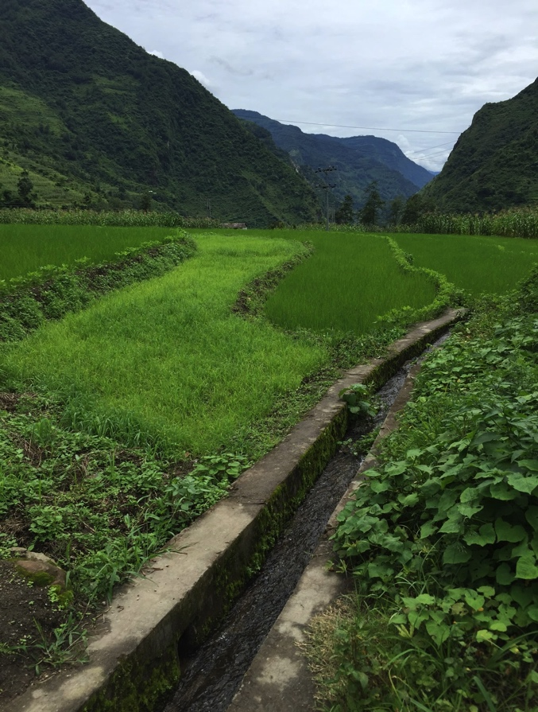
Scaffolding Research Projects
Geohazards & Human-Earth System Interconnections
General Topic
  “Agriculture and water”
More specific research question
  “How are agricultural water sources
  vulnerable to geohazards?”
Related questions
  “How do the agricultural water
  sources change with elevation?”
  “What mitigation measures do/might
  use protect water sources?”

Slide 14
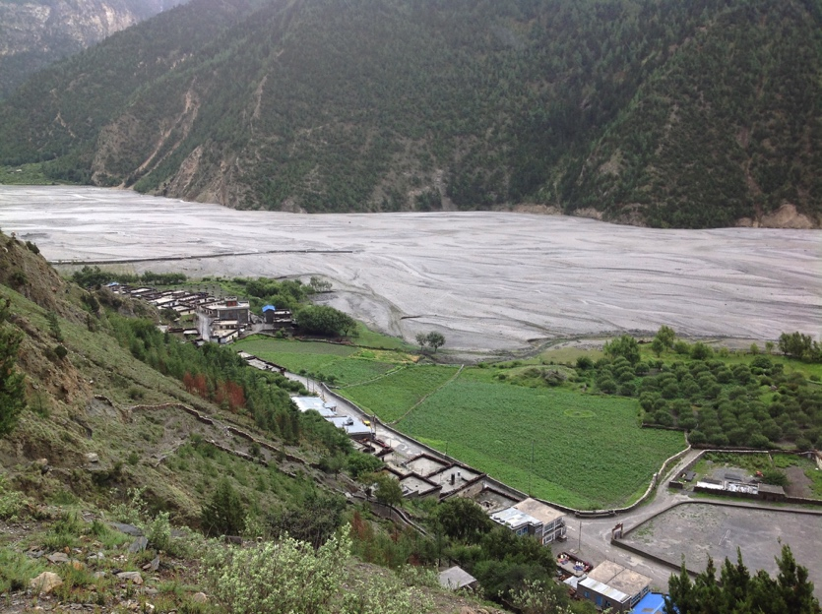
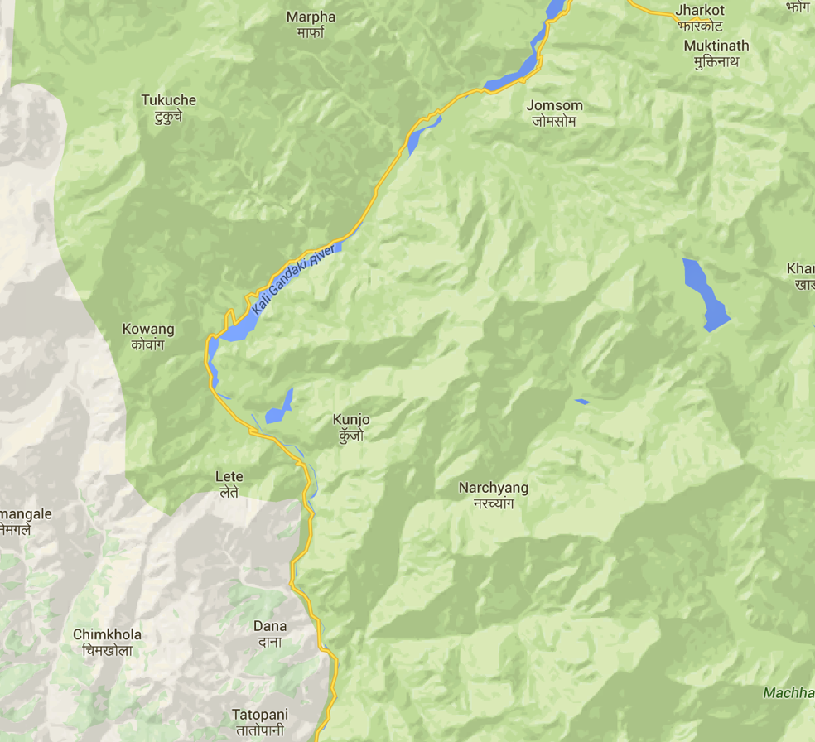
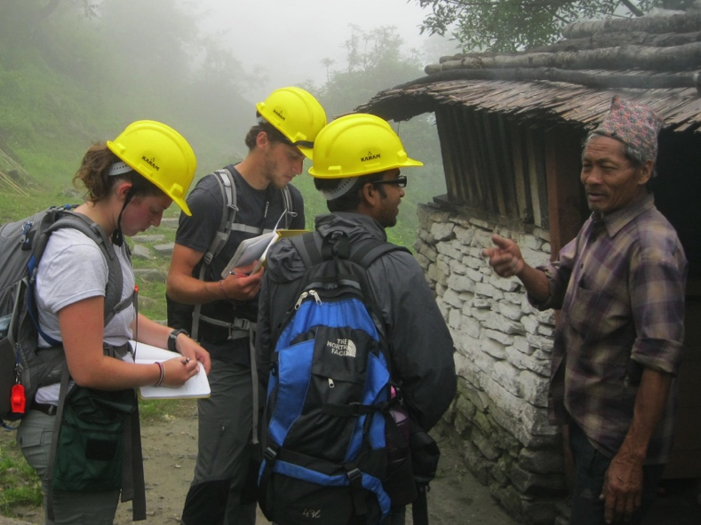
Groups at work
Drought
Sediment
Accumulation
Landslide

Slide 15
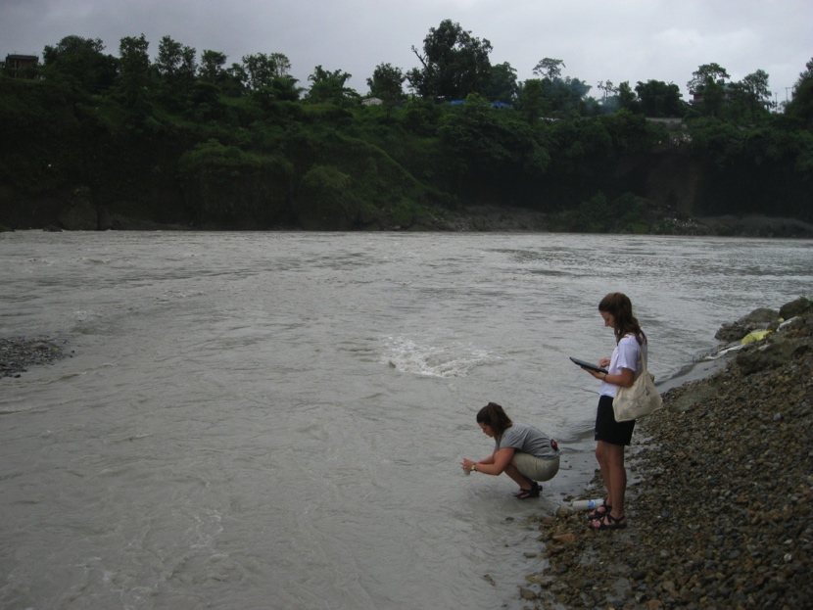
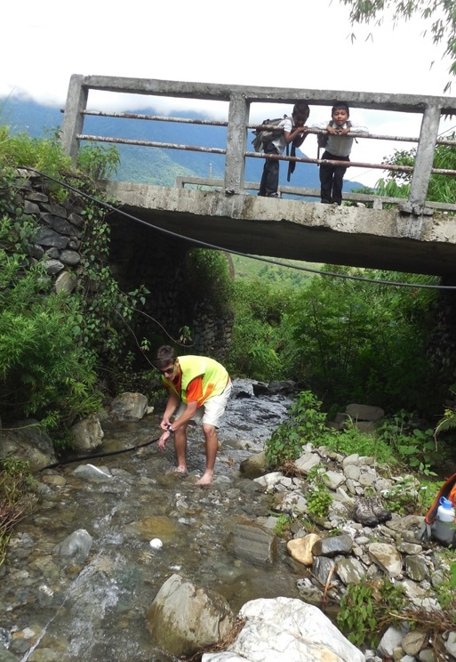
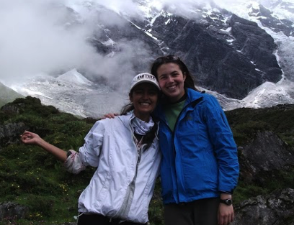
Field Study Project (FSP)
In pairs or individually, students design and conduct their own research project and present the results.
Notes:
Images from left to right:
Bir Bahadur Tamang
Bhairab Sitaula
Jonathon White

Slide 16
Research Steps
Brainstorm interests/ideas
Hone in on research question
Identify needs (advisor, background knowledge)
Design and propose project
Execute project
Communicate findings (written and oral)

Slide 17
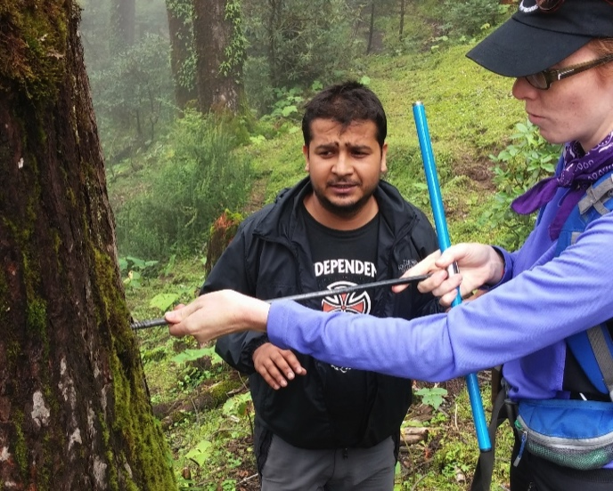
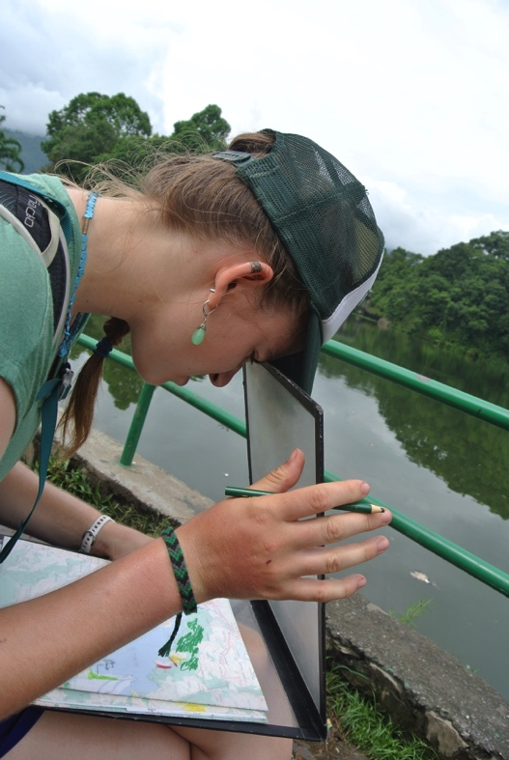
Example Research Projects
Post-earthquake spring changes
Post-earthquake damage analysis
Arsenic water testing
Soil fertility chemistry
Geologic fault mapping
Sink hole & landslide hazard mapping
Igneous petrology analysis
Water quality chemistry
Lake sedimentation & land-use change
Tree ring analysis & climate
Climate change perception interviews
Notes:
Images from top to bottom:
Natasha Romito
Blake Warner

Slide 18
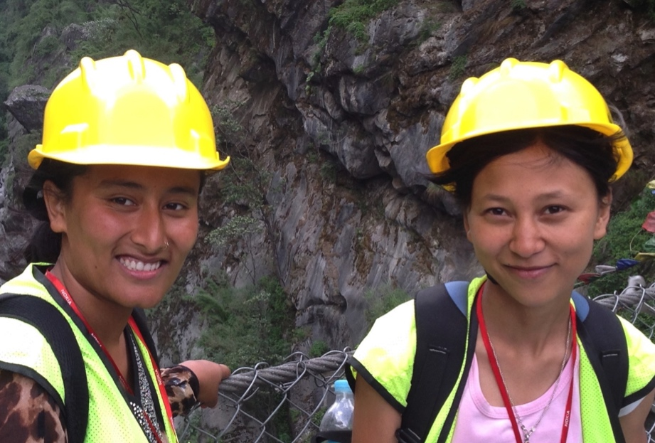
Nepali student profiles
Never/seldom have met or talked to foreigner
Educated in English from at least high school but never spoken with native English speaker
From hierarchical educational system where instructors are not questioned or challenged
Most have never been “trekking”
or to High Himalaya
Very excited/intrigued
/intimidated to study with
USA students

Slide 19
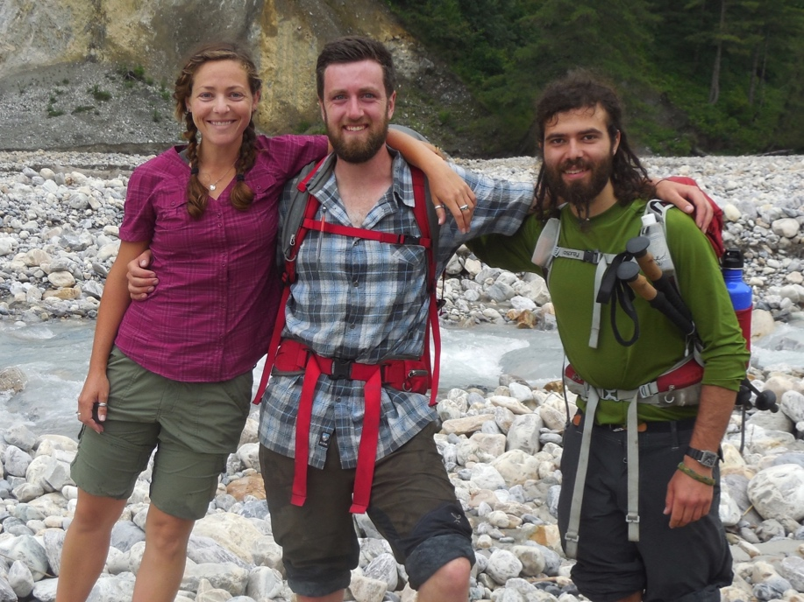
USA student profiles
Have met range of non-Americans
More than half have never been to developing country and some have not left USA
From range of private and state schools
From interactive educational system where students are expected to question
Avid campers (mostly)
Very excited/intrigued
/intimidated to study in Nepal

Slide 20
Solutions in mixed group
Nepali students need cultural/historical/logistical orientation too
Nepali student application includes motivation for wanting to study with USA students
USA students need experience as minority
Mixed academic project groups
Participation grade includes
  USA students speaking Nepali at meals
  Nepali students expected to help them
  Rotation of helping to serve meals

Slide 21
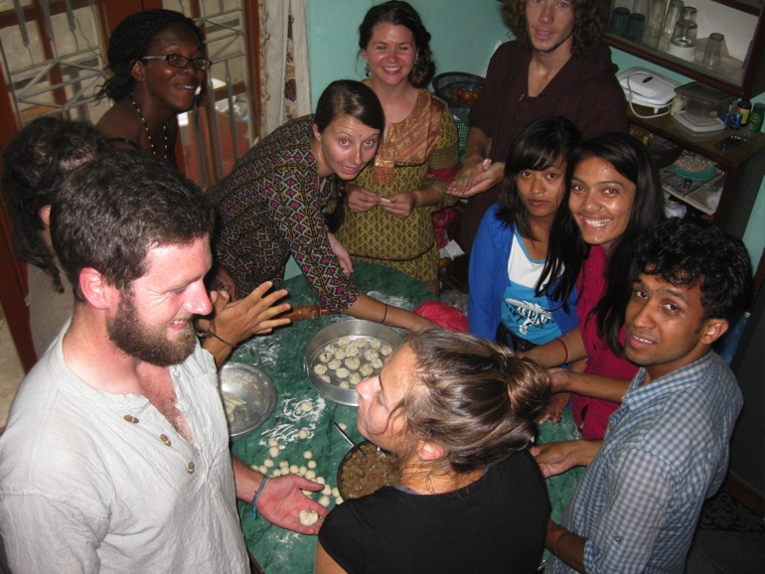
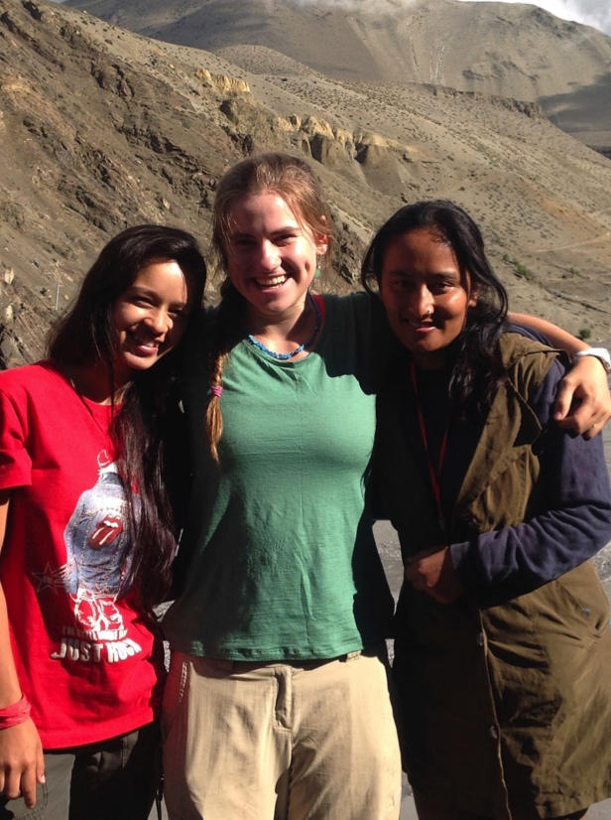
Outcomes for mixed group
Tears and challenges but…
Nearly every student in debrief and course evaluations mentions the value of having both USA and Nepali students
Notes:
Images: Beth Pratt-Sitaula

Slide 22
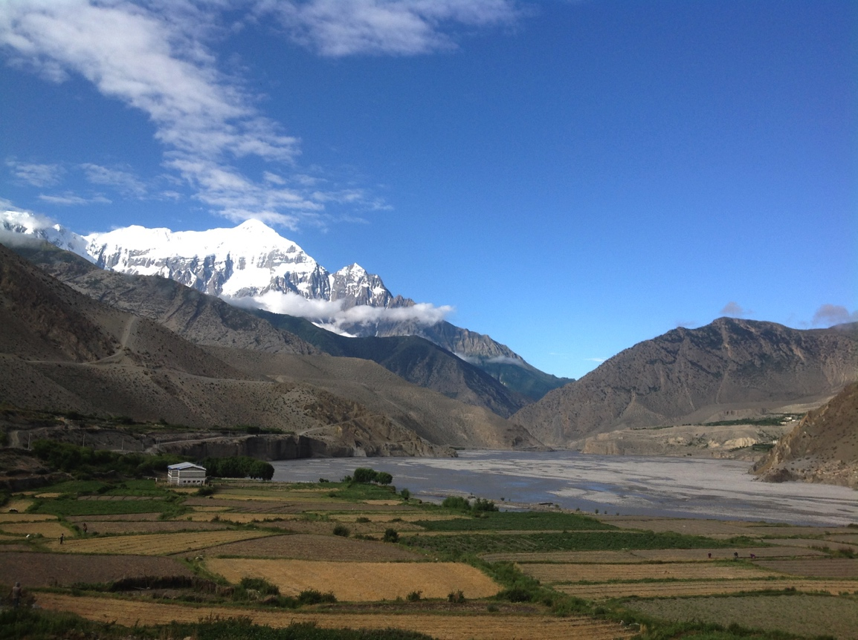
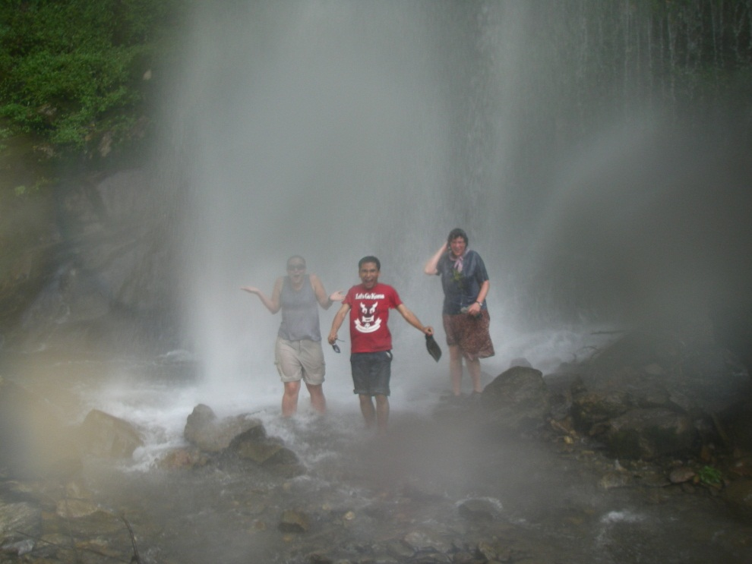
Questions?
www.sit.edu/npg
Notes:
Image: Mary Harvey

