Slide 1
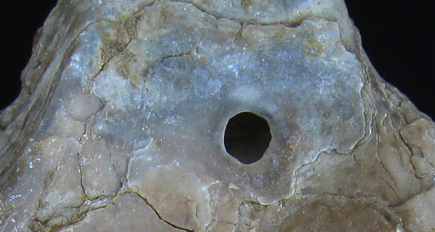
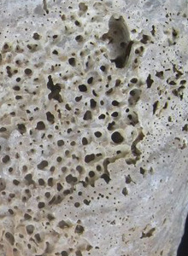
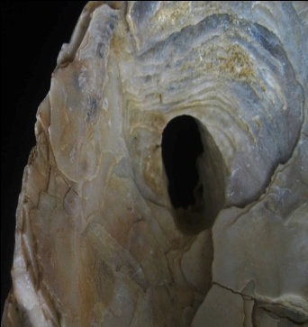

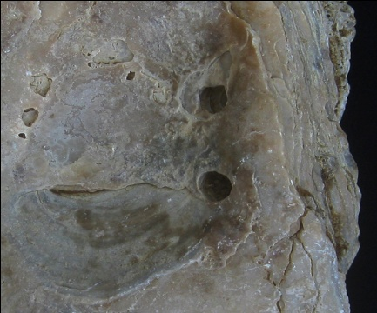
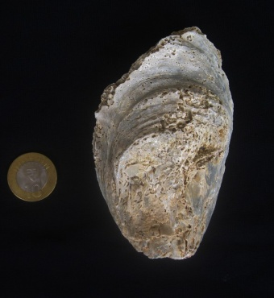
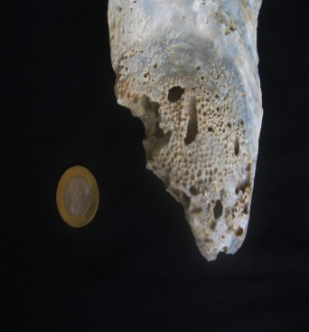

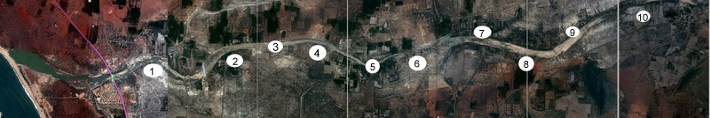


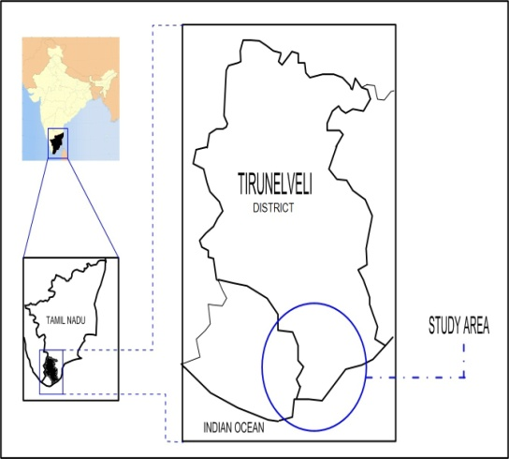
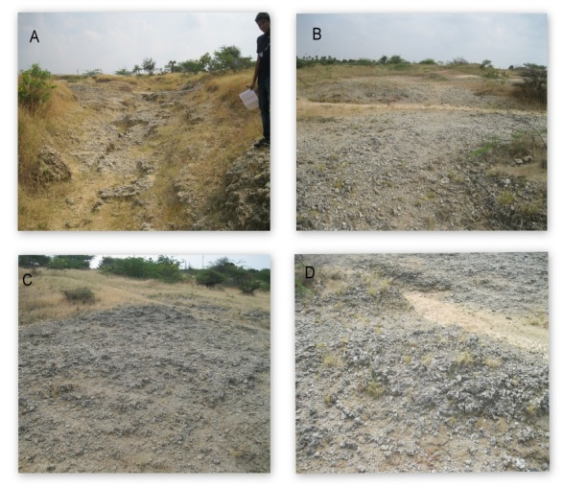
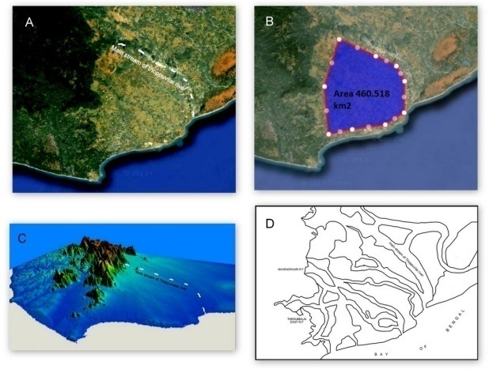


An Analysis On Predatory Signatures on Miocene Oysters of Crassostrea Sp. From East Coast of Southern India Riffin T Sajeev* Department of Geology, Periyar University, Salem,INDIA .*riffin@rediffmail.com
ABSTRACT
The eastern coast lines of southern India are rarely used to study its paleontological importance. Living oysters of Crassostrea Sp. are found throughout these coastal margins. Recent reports indicate the existence of a paleo-estuary dated to the mio-pliocene age, along the valleys of the southern end of Western Ghats. About 70 specimen of Crassostrea Sp. have been sampled from this area of which, almost 80 percent are disarticulated and observed as subjected to the predatory action of ichnotaxa. All oysters seem to have adapted extremely thick layered calcite shells, which is a remarkable morphological feature. Bore holes and biodegradation are seen in an extreme magnitude. A previous work of the author describes the existence of a giant Paleo-estuary which existed along the eastern coastlines of India during the mio-pliocene age, based on the morphological and taxonomical features of Crassostrea Sp. from the same area. The proposed work is a detailed analysis of the Predatory signatures on shell fragments by ichospecies in the proposed paleo-estuary during the mio-pliocene age.
In this study, the author analyzes the nature of the ichnospecies that thrived among these oysters, their threat to the life of oysters and their contribution towards the necessity for an adaptation of a thick layered shell on these oysters. The study proposes to identify each ichnotaxa by analyzing their predatory pattern and the style of biodegradation on the host shells. The study also proposes to explain the paleo-climate and paleo-topography and further insight to the nature of sediments in the estuary during the mio-pliocene, based on the features on the samples of Crassostrea Sp.
Conclusion
The study area which was an estuary during Mio-pliocene age have shallow water environment and the fluvial sedimentation from western ghat (mahendragiri area) and alluvial sedimentation from sea had created low energy environment and allowed the oysters to disarticulate before burial. The whole paleo estuary had ceased may due to the uplift happened in that area due to neo tectonic activities . An evidence in the form of slip fault found by the author during field study.
References:
Presence of Miocene Oysters: Rise and Fall of a Paleo-Estuary in the East Coast of India .Riffin T Sajeev, International Journal of Advanced Earth Science and Engineering 2014, Volume 3, Issue 1, pp. 129-142, Article ID Sci-198 ISSN: 2320 – 3609
Occurrence of Arctostrea: Existence of high energy Paleoenvironment in Cauvery Basin, India during Late Cretaceous.Riffin T Sajeev, International Journal of Scientific and Engineering Research 4(12):1319-1327.December 2013, DOI: 10.14299/ijser.2013.12.002
Citation: Geological Society of America Abstracts with Programs. Vol. 48, No. 7 : DOI: 10.1130/abs/2016AM-285113

