Slide 1
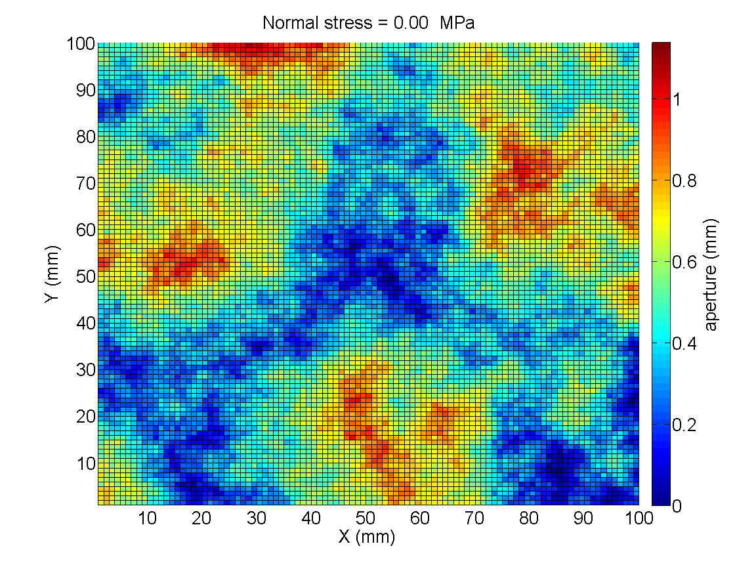
Development of an empirical model relating permeability and specific stiffness for rough fractures
Lichun Wang and Bayani M. Cardenas
Department of Geological Sciences
The University of Texas at Austin
GSA 2016 Lichun Wang (wanglichun@utexas.edu) 9-25-2016

Slide 2
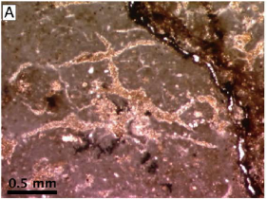
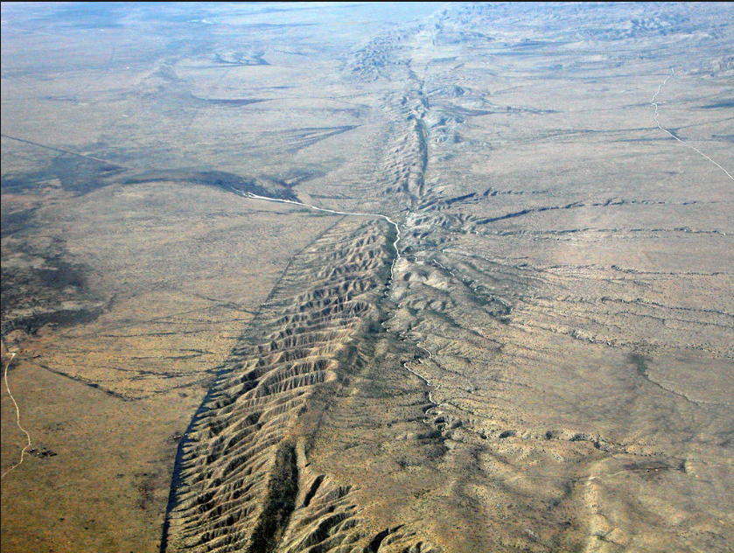
Fractures are present everywhere…
Increasing scales
Calcite-cemented cracks
San Andreas fault
Fractures are Complex, highly Heterogeneous, and Anisotropic

Slide 3
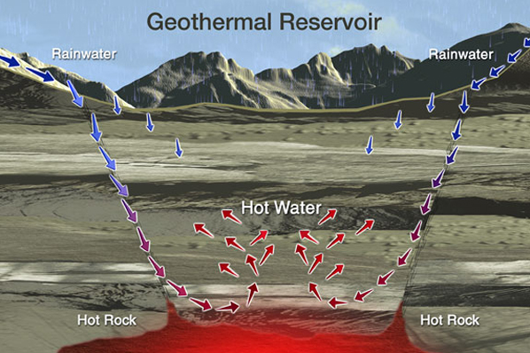
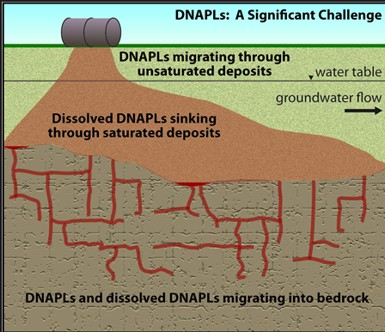
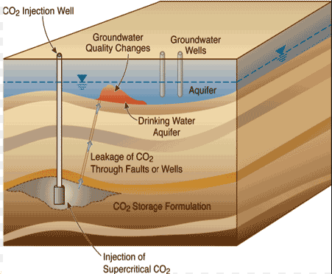
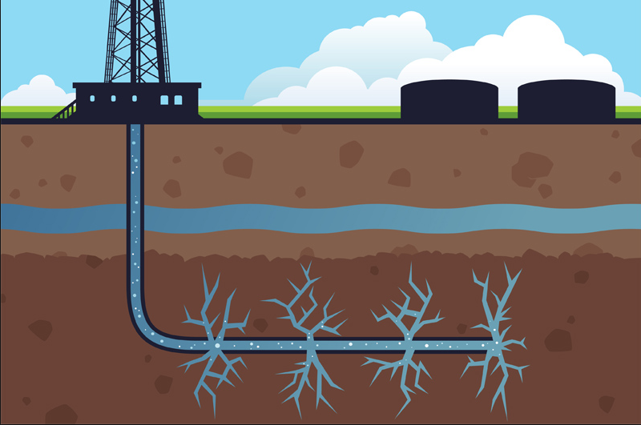
Fractures are flow pathways
Heat transport
Mass transport
Contamination
CO₂ leakage
Shale gas migration
How do we obtain a precise hydraulic property (Permeability, k) of fractures?

Slide 4
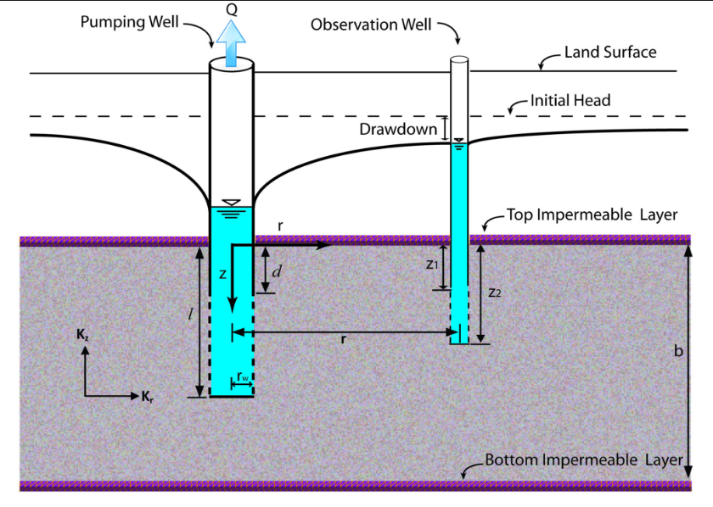
Direct method: Hydraulic testing
Permeability: k
Pros: Provides “real” permeability (k)
Cons: Expensive and difficult
Permeability: A hydraulic property of geological formations

Slide 5
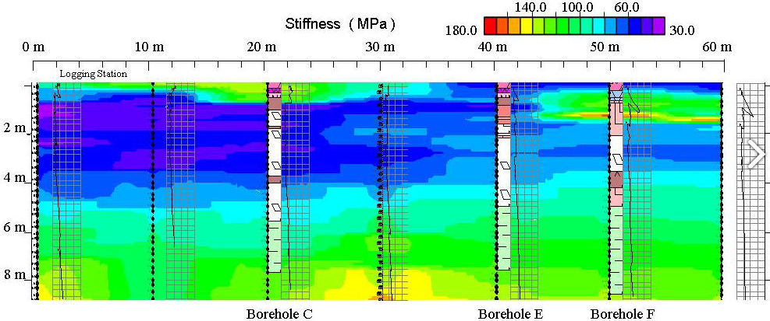

Indirect method: Geophysical tools
Electrical, electromagnetic, magnetic, seismic and gravity
British Geological Survey
Mechanical property (specific stiffness, s)
Hydraulic property (Permeability, k)

Slide 6
Intrinsic relationship between s and k
Permeability
Fluid Flow
Contact area
Aperture field
Stiffness
Can we establish the relationship between s and k?

Slide 7
The target of this presentation
Relating hydraulic property (Permeability, k) to mechanical property (Specific stiffness, s) of rough fractures
Approaches used in this presentation
Numerical modeling

Slide 8
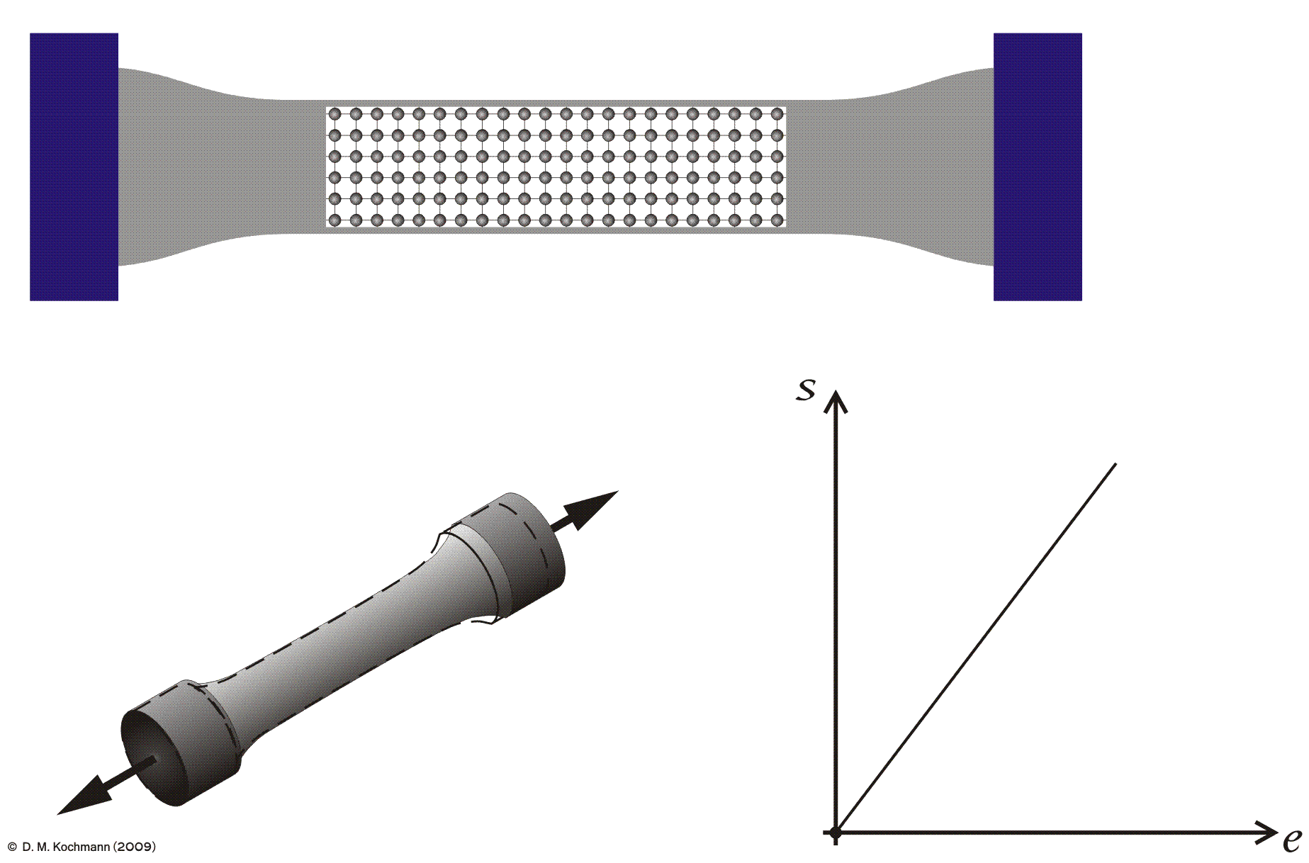
Elastic deformation behavior
Stress
D. M. Kochmann (2009)
Strain
S.D. Lee, J.P. Harrison (2001)

Slide 9
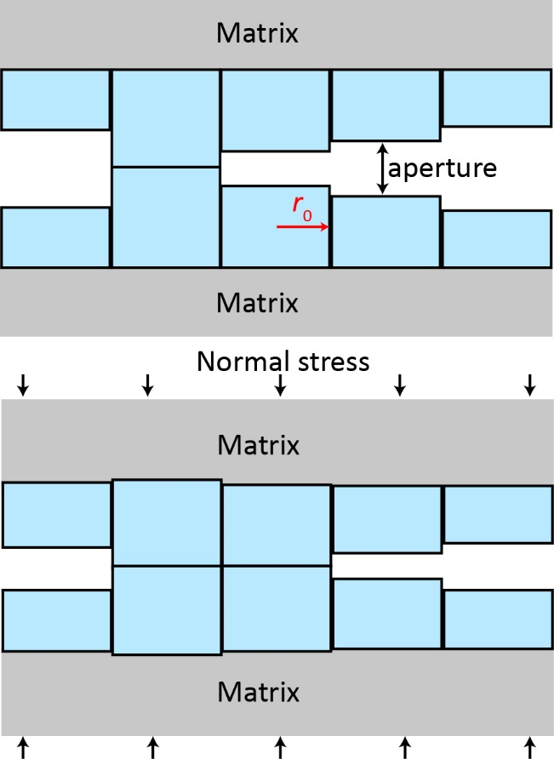
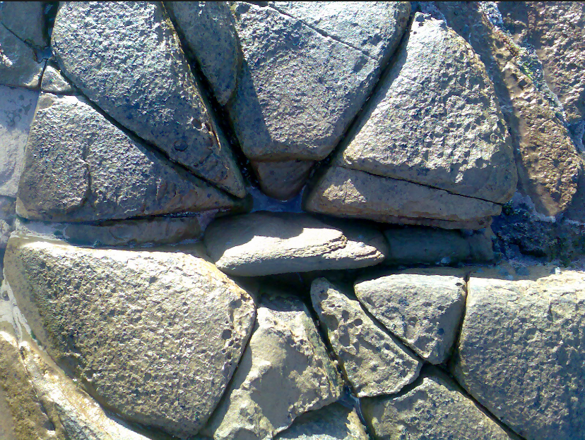
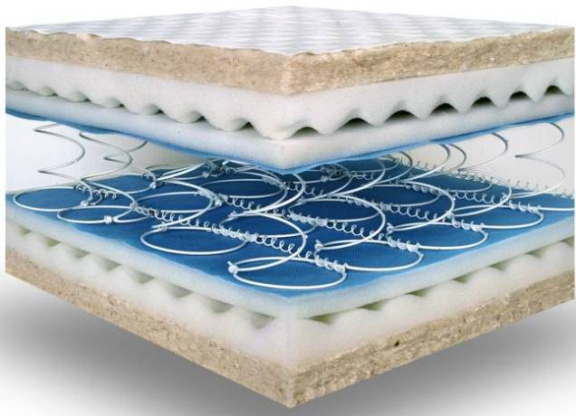
Fracture deformation model
Cylinder
Cylinder
Cylinder
Wang and Cardenas (2016)

Slide 10
Effect of fracture heterogeneity
Increasing roughness
Typical Rocks:
Granite, Limestone, Shale, Sandstone, Basalt, Marble
7 * 6 = 42
Increasing correlation length of fracture
7 * 6 *6= 252
Wang and Cardenas, J. Geophy. Res.: Sol. Ea., 2016

Slide 11
Results: Fracture deformation model
Wang and Cardenas, J. Geophy. Res.: Sol. Ea., 2016

Slide 12
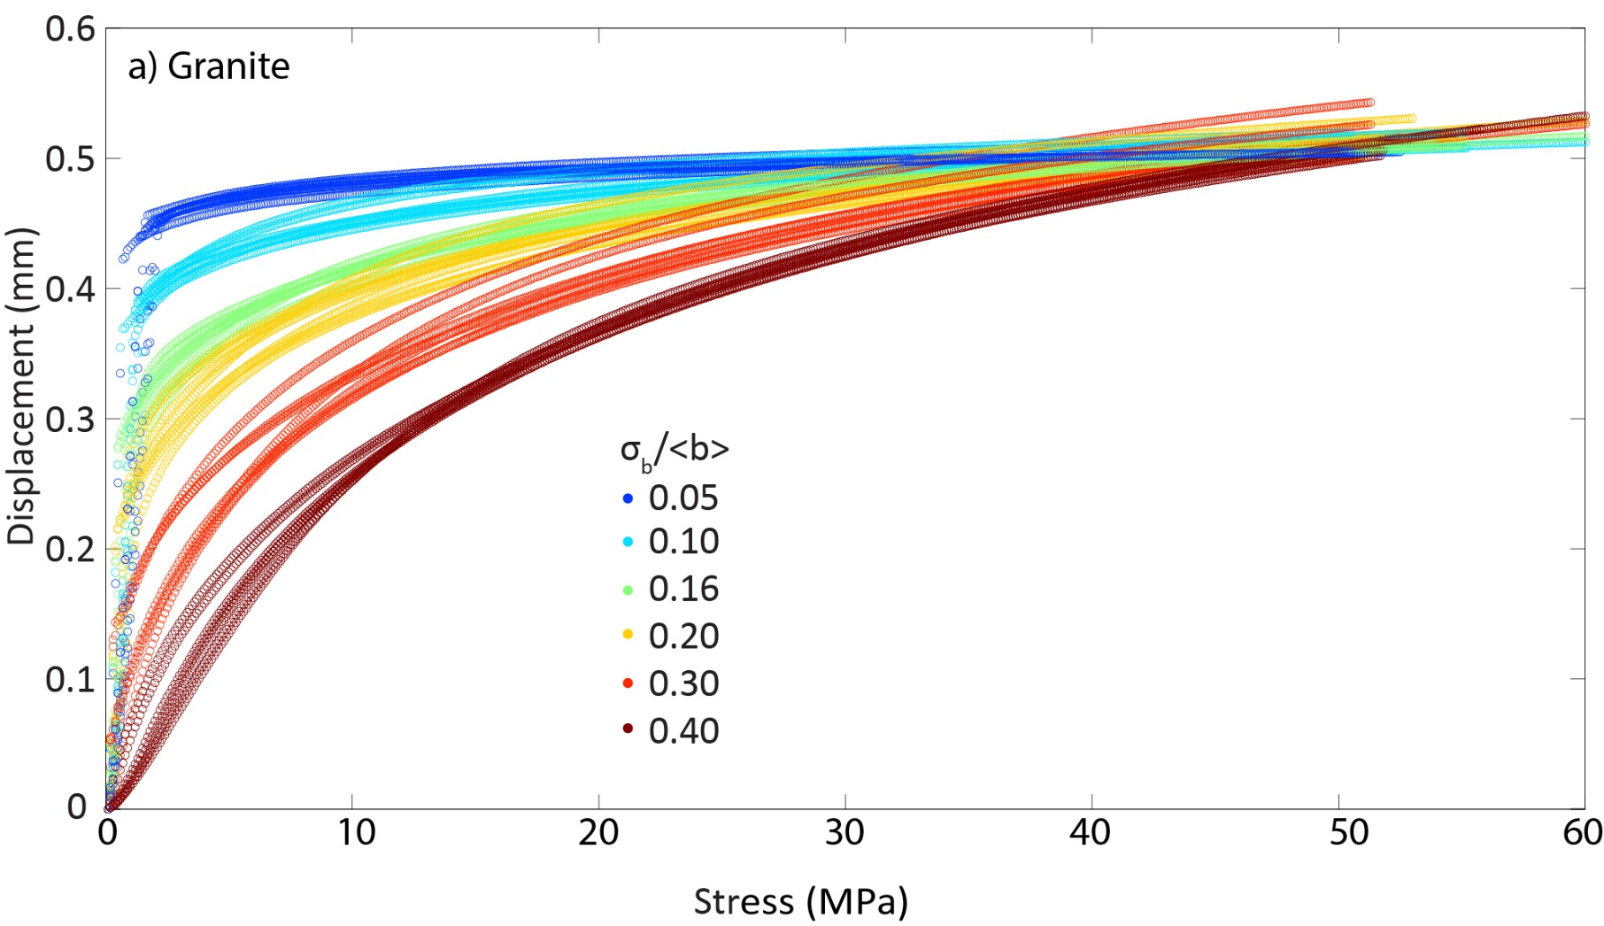

Results: Non-linear displacement ~ stress
(strain)
Roughness
$$Stiffness=\frac{Change in stress}{Change in strain}$$

Slide 13
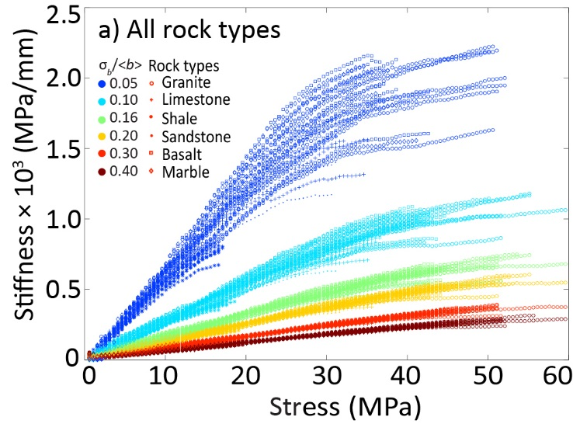
Results: Stiffness ~ stress
Roughness: σ_{b}/<b>

Slide 14
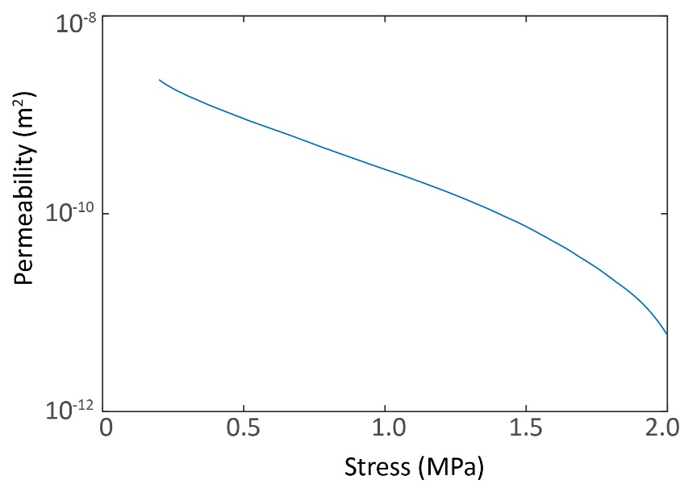
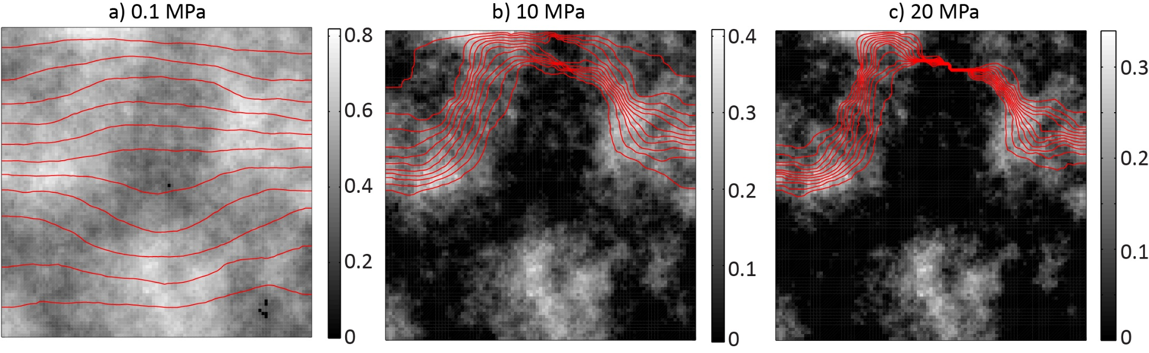
Fluid flow model: Modified Local Cubic Law (MLCL)
$$∇∙\left[\frac{T_{x}}{C}\frac{∂p}{∂x}\cos\left(∅_{x}\right)\vec{i}+\frac{T_{y}}{C}\frac{∂p}{∂y}\cos\left(∅_{y}\right)\vec{j}\right]=0$$
MLCL:
Wang et al., Water Resour. Res., 2015
Increasing stress
×10
Dispersive flow
Sheet-like flow

Slide 15
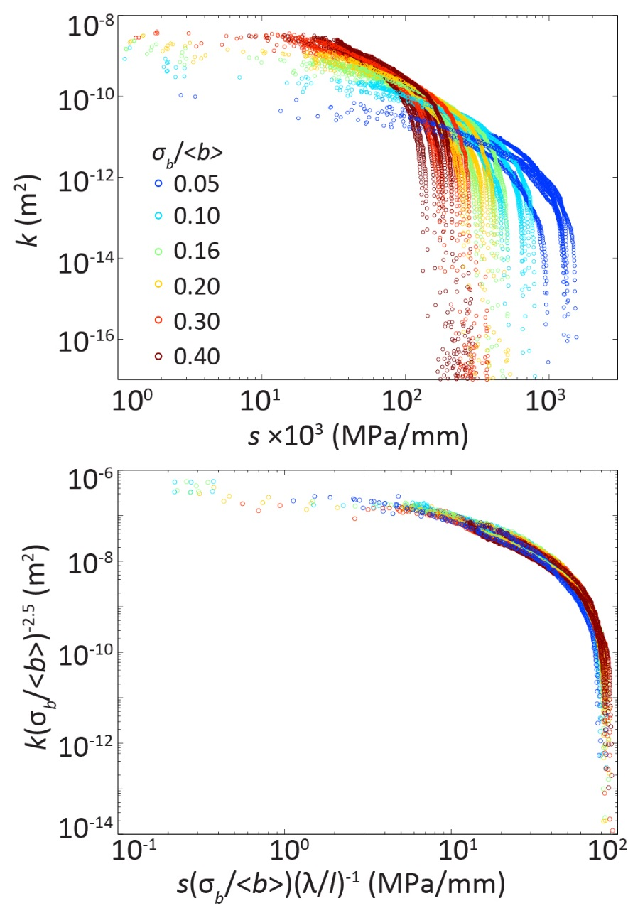
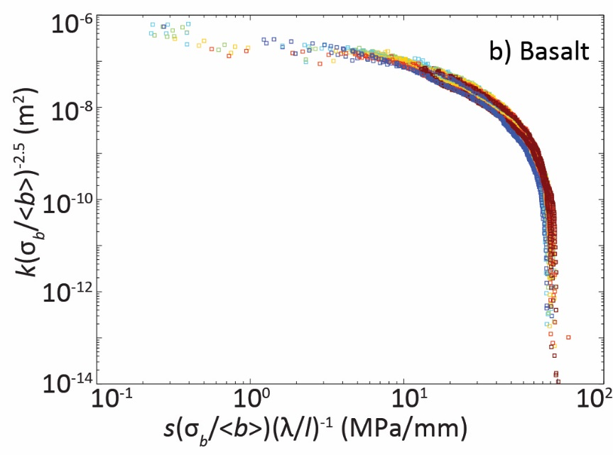
Results: Stiffness (s) ~ Permeability (k)
a) Granite
Roughness: σ_{b}/<b>
Dimensionless correlation length: λ/l
a) Granite

Slide 16
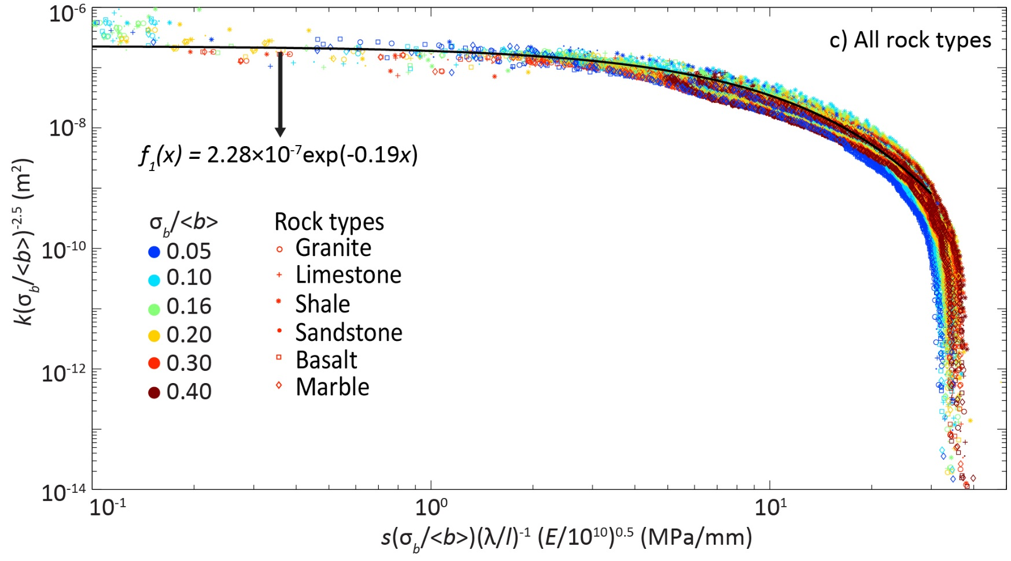
Results: Stiffness (s) ~ Permeability (k)
Roughness
Wang and Cardenas, J. Geophy. Res.: Sol. Ea., 2016

Slide 17
Take-home message
Non-linearity between normal stress and displacement
Fracture permeability is related to the specific stiffness via an exponential function
The scaling coefficients are dependent on fracture roughness and correlation length

Slide 18




Acknowledgments

