Slide 1
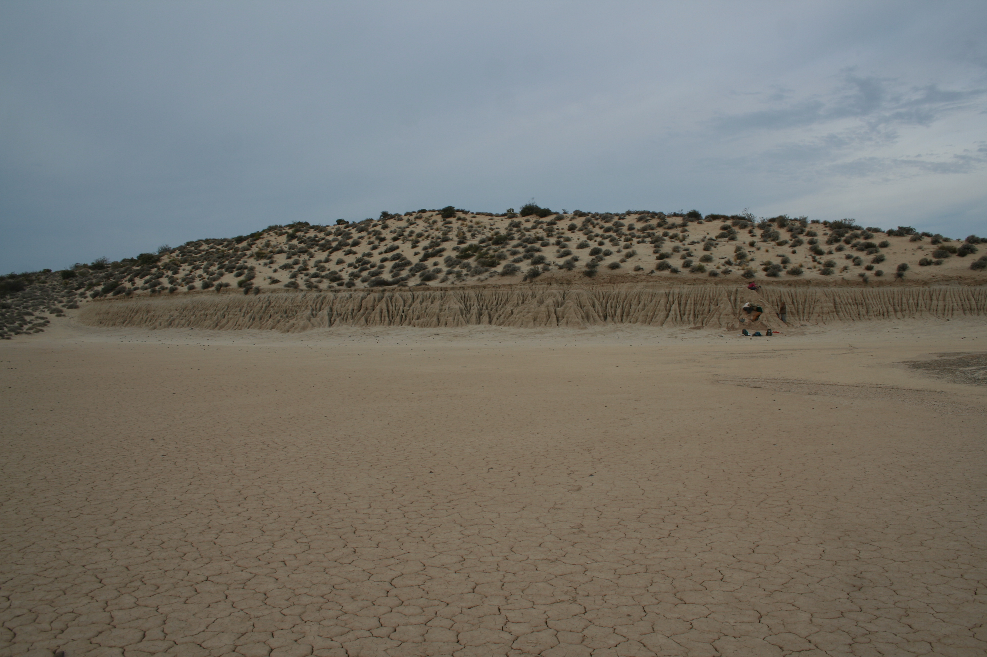

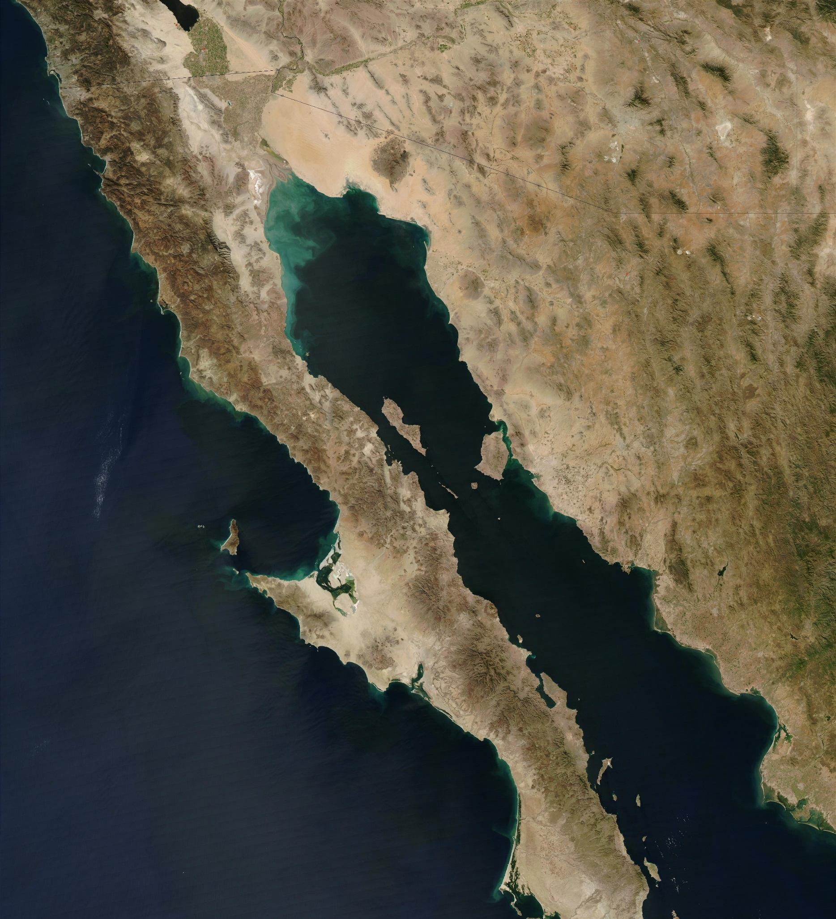
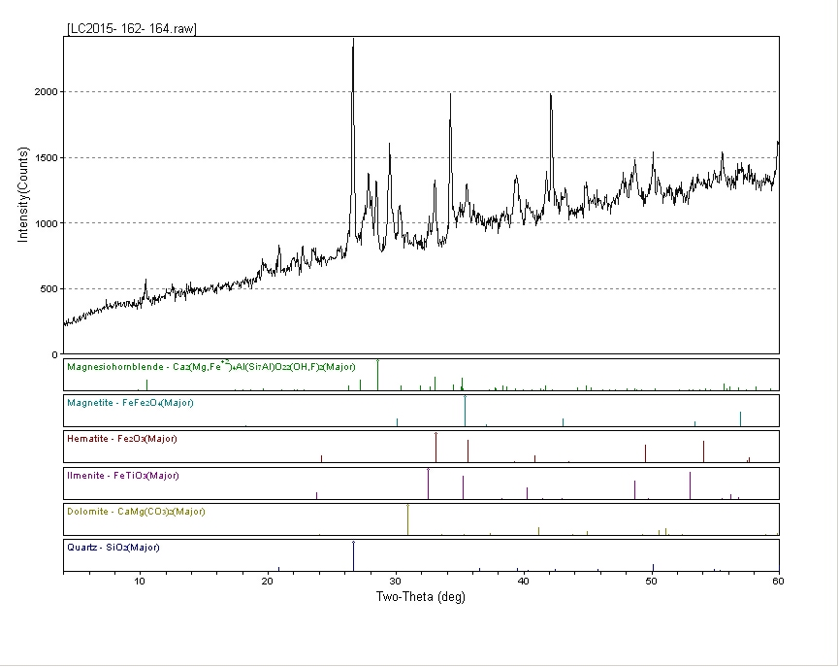
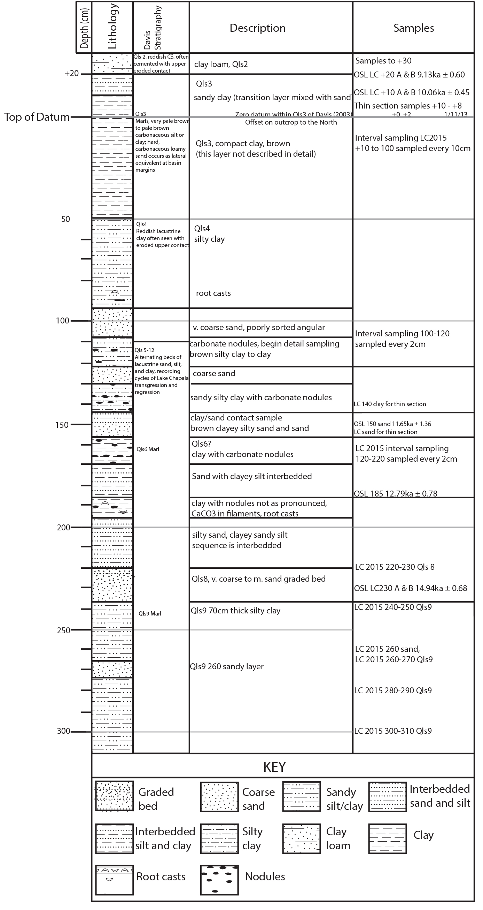
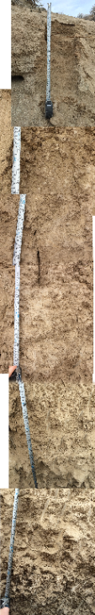
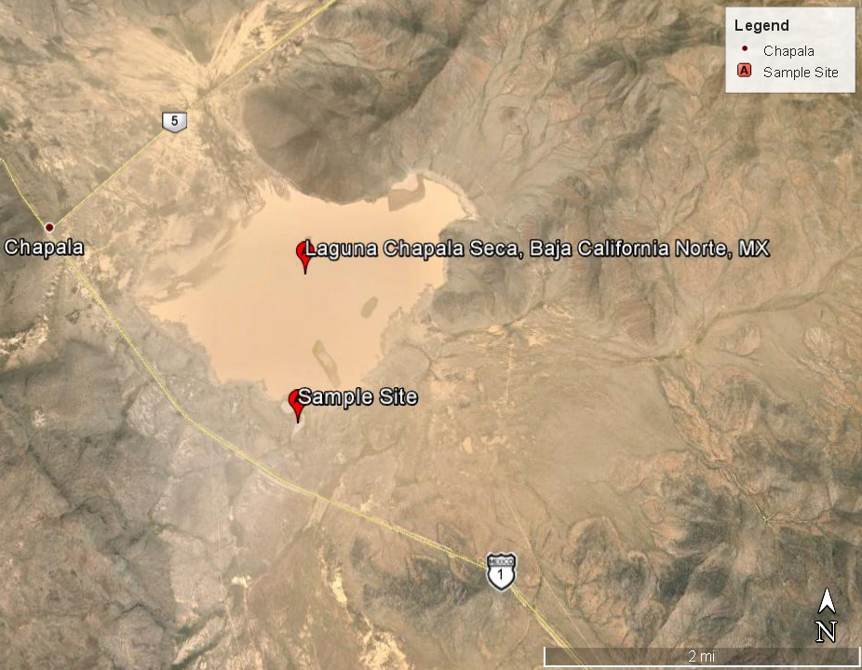
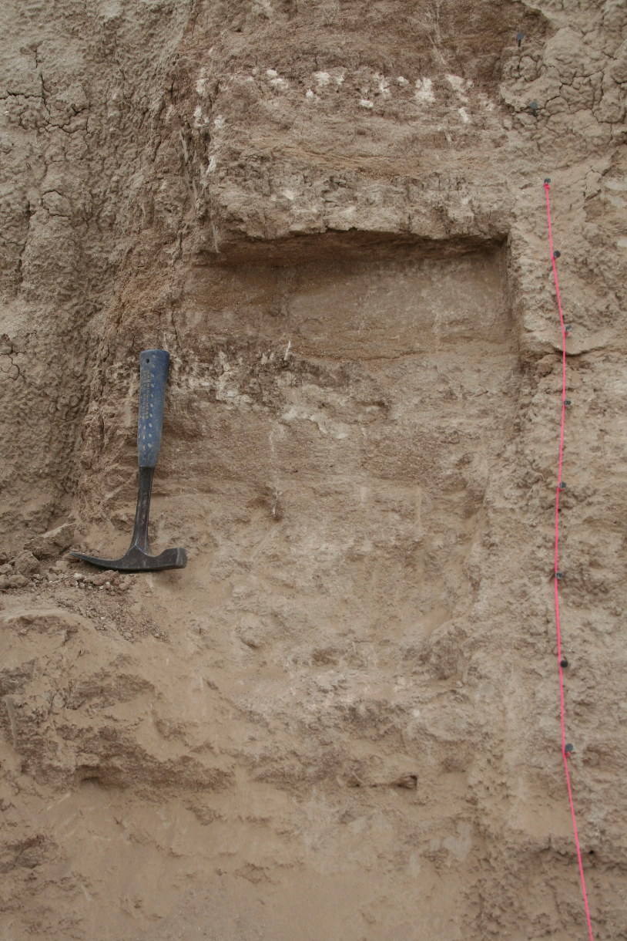
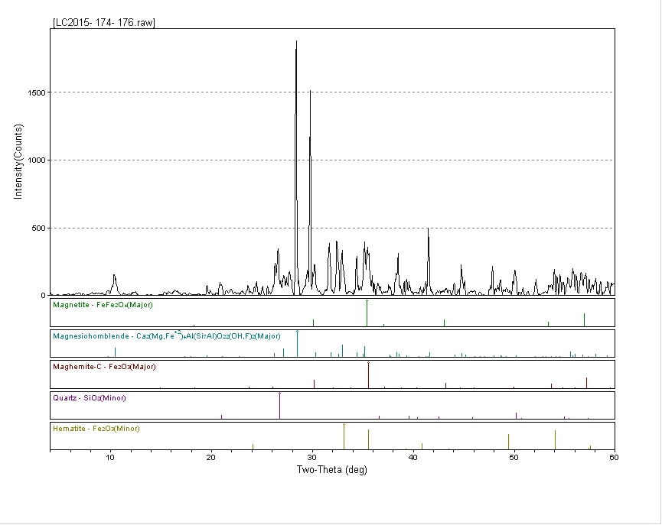
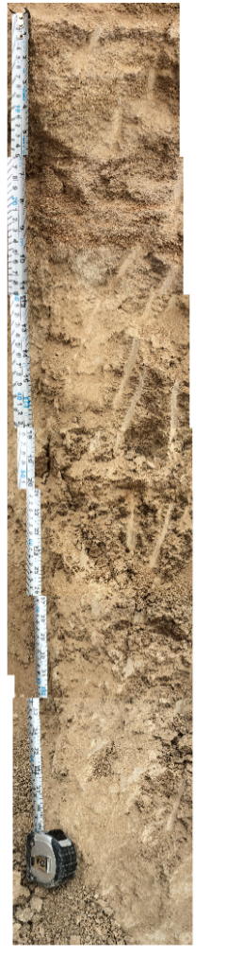
Testing the Younger Dryas Impact Hypothesis Using Elemental and Magnetic Spherule Analysis of 12.9ka Lake Sediment From Laguna Chapala, BC, Mexico
THOMAS, Kaylee A. and MUROWCHICK, James B.
University of Missouri – Kansas City
Abstract
Results
Lacustrine sediments deposited in Laguna Seca Chapala, located in central Baja California, Mexico, span the Younger Dryas stadial. The Younger Dryas was an abrupt change in climate that occurred approximately 12.9 ka and is hypothesized to have been triggered by a cometary airburst or impact. Evidence of the impact has been found by others at nearly 40 localities in North America. In North America, the YDB is coincident with the extinction of more than 40 species of megafauna and the demise of the Clovis paleoIndian culture.
This research examines the elemental composition and magnetic fraction of the lacustrine sediments for indicators of an impact fallout horizon in the sedimentary sequence. We collected 49 samples (spanning 2 cm each) across two distinct grain-size boundaries that were bracketed by optically stimulated luminescence (OSL) and radiocarbon dating reported by Davis (2003) to be between 15 ka and 8 ka. X-ray diffraction analysis shows the sediment contains dominantly quartz, sodic plagioclase, a small amount of microcline, and minor calcite. The samples were homogenized and leached using double-distilled nitric acid and microwave digestion. After digestion, the leachates were diluted with 18MΩ water and analyzed by ICPMS for Ir, Fe, Ni, Co, Mn and Ti.
Results show that the samples have high concentrations of Fe, likely due to detrital magnetite. All samples contained <0.1ppb of Ir with no apparent spikes in concentration. Mn, Co, and Ni do show spikes in concentration at two sample intervals (162-164 and 174-176cm below the base of the overlying modern dune sands). The cause of those spikes is not known, but they do not appear to be related to a possible fallout layer. Both of the spikes fall above a layer dated at 12.79±0.78ka by OSL dating. Results indicate that Laguna Chapala sediments do not preserve evidence of meteoric impact.
Study Area
Lake Chapala is in the Laguna Seca Chapala basin located in the central region of the Baja Peninsula of Mexico. Lake Chapala is accessed by driving northeast on Highway México 1 from Bahia de los Angeles.
X-Ray Diffraction Patterns for Magnetic Samples
ICPMS data for Ti, Cr, Fe, Ni, Co, and Mn concentrations vs. depth
Conclusions
Stratigraphy
X-ray diffraction analysis shows the bulk sediment contains dominantly quartz, sodic plagioclase, a small amount of microcline, and minor calcite. XRD results of the magnetic samples provide the composition of maghemite, magnesiohornblende, some ilmenite as lamellae in magnetite, minor hematite and dolomite. Quartz was also found in the XRD analysis due to the grains sticking to the magnetic grains. The magnetic fractions of the sediment are high in Ti.
Results of ICMPS analysis show Co and Mn appear to have parallel patterns. Cr, Ni, and Fe also share similar patterns, with some resemblance to the Co and Mn curves. The samples have high concentrations of Fe, likely due to detrital magnetite. All samples contained <0.1ppb of Ir with no apparent spikes in concentration. Mn, Co, and Ni do show spikes in concentration at two sample intervals (162-164 and 174-176cm below the base of the overlying modern dune sands). The cause of those spikes is not known, but they do not appear to be related to a possible fallout layer. Both of the spikes fall above a layer dated at 12.79±0.78ka by OSL dating. Results indicate that Laguna Chapala sediments do not preserve evidence of meteoric impact. The likely cause of this is prevailing wind patterns preventing the fallout from traveling as far southwest as Baja California, Mexico, assuming proposed impact in Great Lakes region.
United States of America
Left: Location of Laguna Seca Chapala in
Baja California, Mexico (Google Earth images)
Below: Laguna Seca Chapala (Google Earth images)
+20
m
Mexico
50
Methods
XRD results for sample 162-164
150
OSL dating of 5 samples collected in 2013 from Qls1, Qls 2, Qls5, Qls6, and Qls9 horizons concluded dates of 10.06+/-0.45 ka; 9.13+/-0.60 ka; 11.65+/-1.36 ka 12.79+/-0.78 ka; and 14.94+/-0.68 ka respectively.
Based on the OSL data correlated with radio carbon data from Davis (2003) we extracted sediment samples every 2cm from 120-220cm which likely crosses the Younger Dryas Boundary.
Samples were prepared for ICPMS (inductively coupled mass spectrometry) analysis of platinum group elements in the ICPMS lab at University of Missouri- Kansas City. 49 samples were homogenized and leached with 2.00mL of double distilled nitric acid and digested in XP1500 Teflon vessels in the CEM Mars microwave. After digestion, the samples were diluted to 100g with 18MΩ water.
The CEM Mars microwave parameters used were ramp to temperature, 600W at 100% for 8 minutes, 800PSI max, 180°C max, hold for 12 minutes. The system then shuts off and cools down.
The samples were sent to Dave Wronkewicz’s lab at University of Missouri- Rolla for ICPMS analysis. Bismuth was used as an internal standard for Ir and indium as an internal standard for Ni, Cr, Fe, Co, Mn, and Ti analysis.
Two samples were processed for magnetic analysis. The magnetic fraction of the sediment was extracted using a 52-grade neodymium magnet in a wet slurry. The magnetic particles collected were washed and recollected magnetically 4 times.
The bulk sample and the magnetic fraction of the 2 samples were analyzed using powder X-Ray Diffraction (XRD) at University of Missouri- Kansas City.
200
250
300
Acknowledgements
This research was supported by the Summer Undergraduate Research Program at University of Missouri- Kansas City.
Stratigraphic Section (Niemi 2013; Thomas & Niemi 2015) with highlighted area of where YDB would be recorded.
XRD results for sample 174-176

