Slide 1
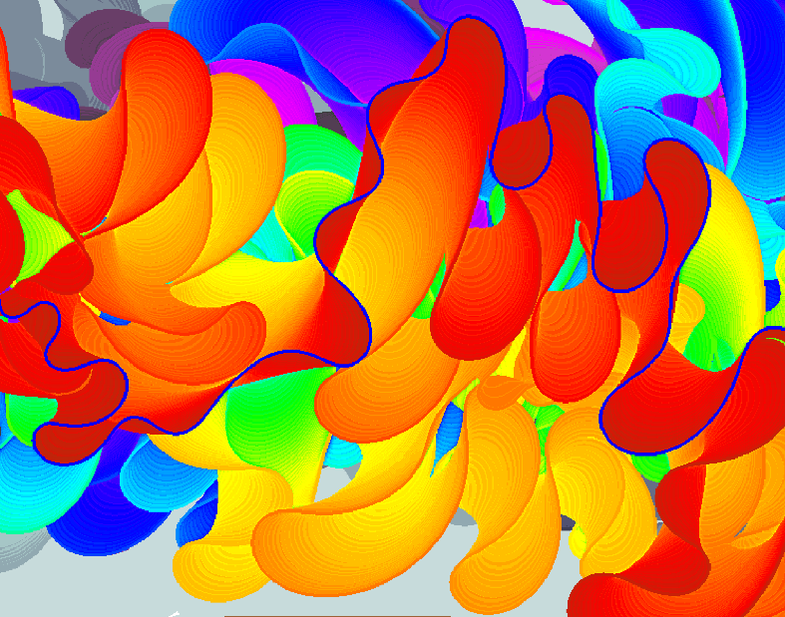
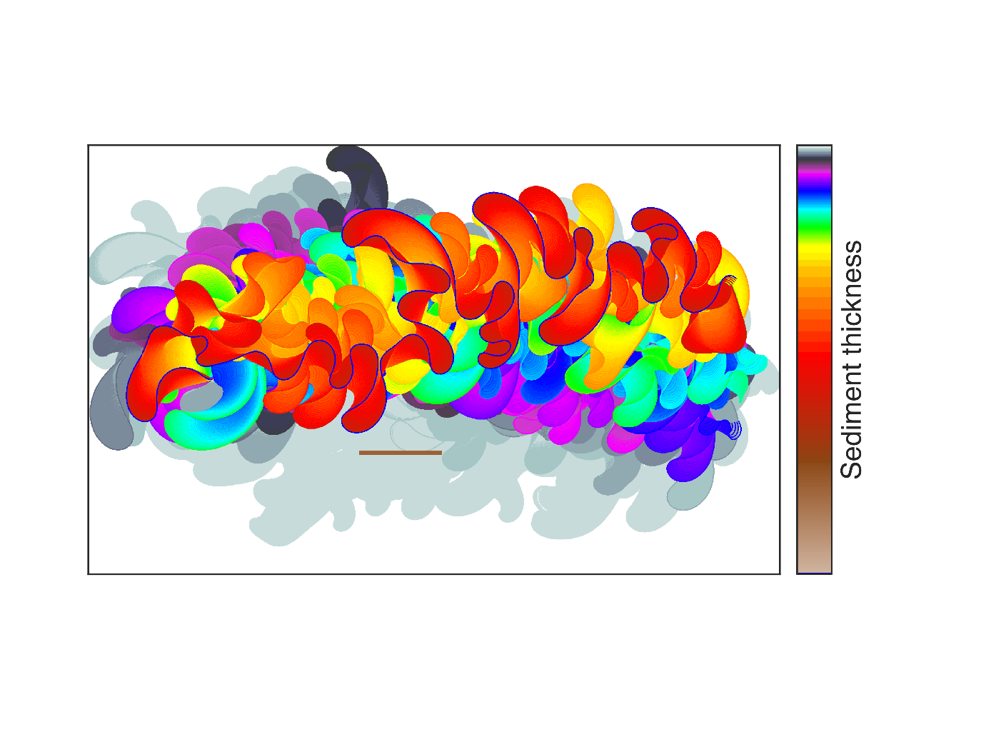





SEDIMENT STORAGE TIME IN A SIMULATED MEANDERING RIVER’S FLOODPLAIN: COMPARISONS OF POINT BAR AND OVERBANK DEPOSITS
Sediment thickness
Tobias Ackerman | Jim Pizzuto | University of Delaware | GSA | 2016
tobiack@udel.edu
NSF EPSCoR 11A-1301765

Slide 2
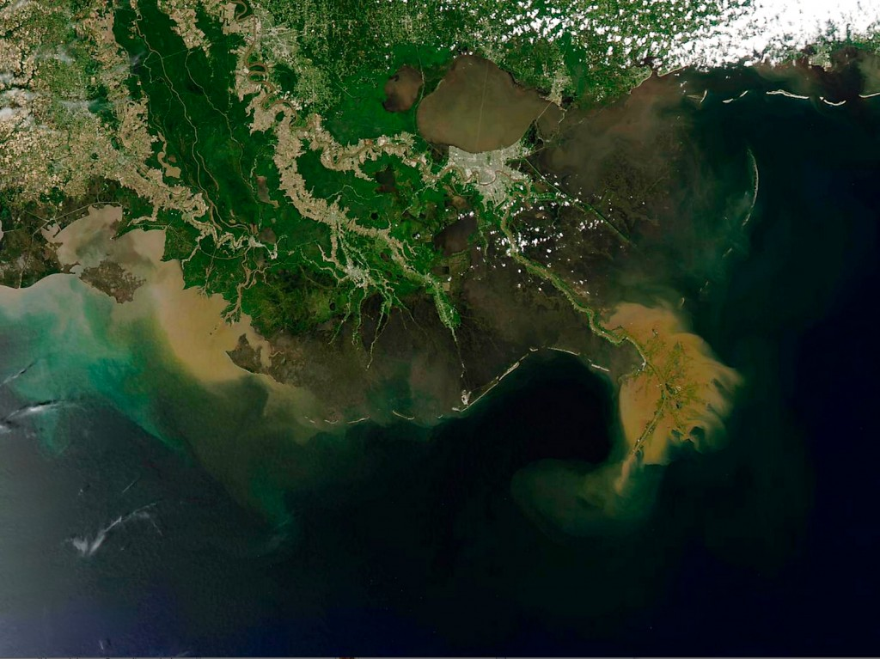
Why Sediment?
~ Its how the mountains travel to the sea
Geology
Earth history is recorded in sedimentary rocks
Environment
Sediment plays an outsized role in aquatic environments
May 6, 2013

Slide 3
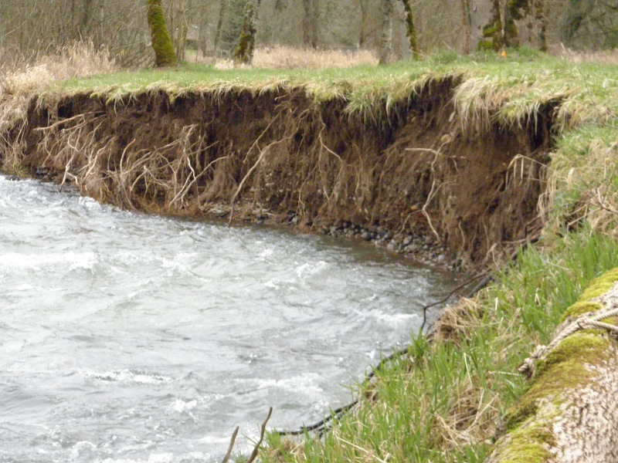
Why Floodplain Storage?
~ Its about time
Geology
Source to sink signal lag
Environment
Direct sediment & pollutant supply to waterway
Re-emission of trapped ‘contaminants’

Slide 4
Modeling effort
Simulate a meandering river
Deposit ‘sediment’ in 2 facies
Point bar deposits
Overbank (vertical accretion) deposits
Caveats
No channel incision or aggradation
No valley walls, or processes shorter than 30 years
Uniform erodibility, and hydrograph
Track the age of sediment when its eroded
Research findings
Overbank storage has a heavier distirbution than point bar storage.
Distributions become light tailed
Less valley confinement leads to heavier tails

Slide 5
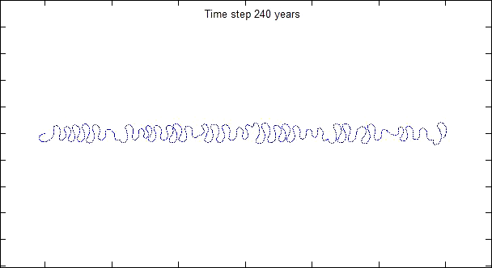
Channel centerline simulation (4ky)
Migration = f(Substrate erodibility, curvature, flow)
10 km
Schwenk et.al. 2015 (Ikeda et.al. 1981)
Floodplain dimensions ±25 by ±33 km
Node spacing 0.28 to 1.9 W (20 to 133m)
Annual migration rate ≈ 5% channel width
Channel width = W = 70 m
Δt = 0.17 years
Erodibility (Eo) = 3.7 x 10⁻⁸
Flow Q = 325 cms
Flow Depth = 3 m
Valley Slope = 6.7 x 10⁻⁴

Slide 6
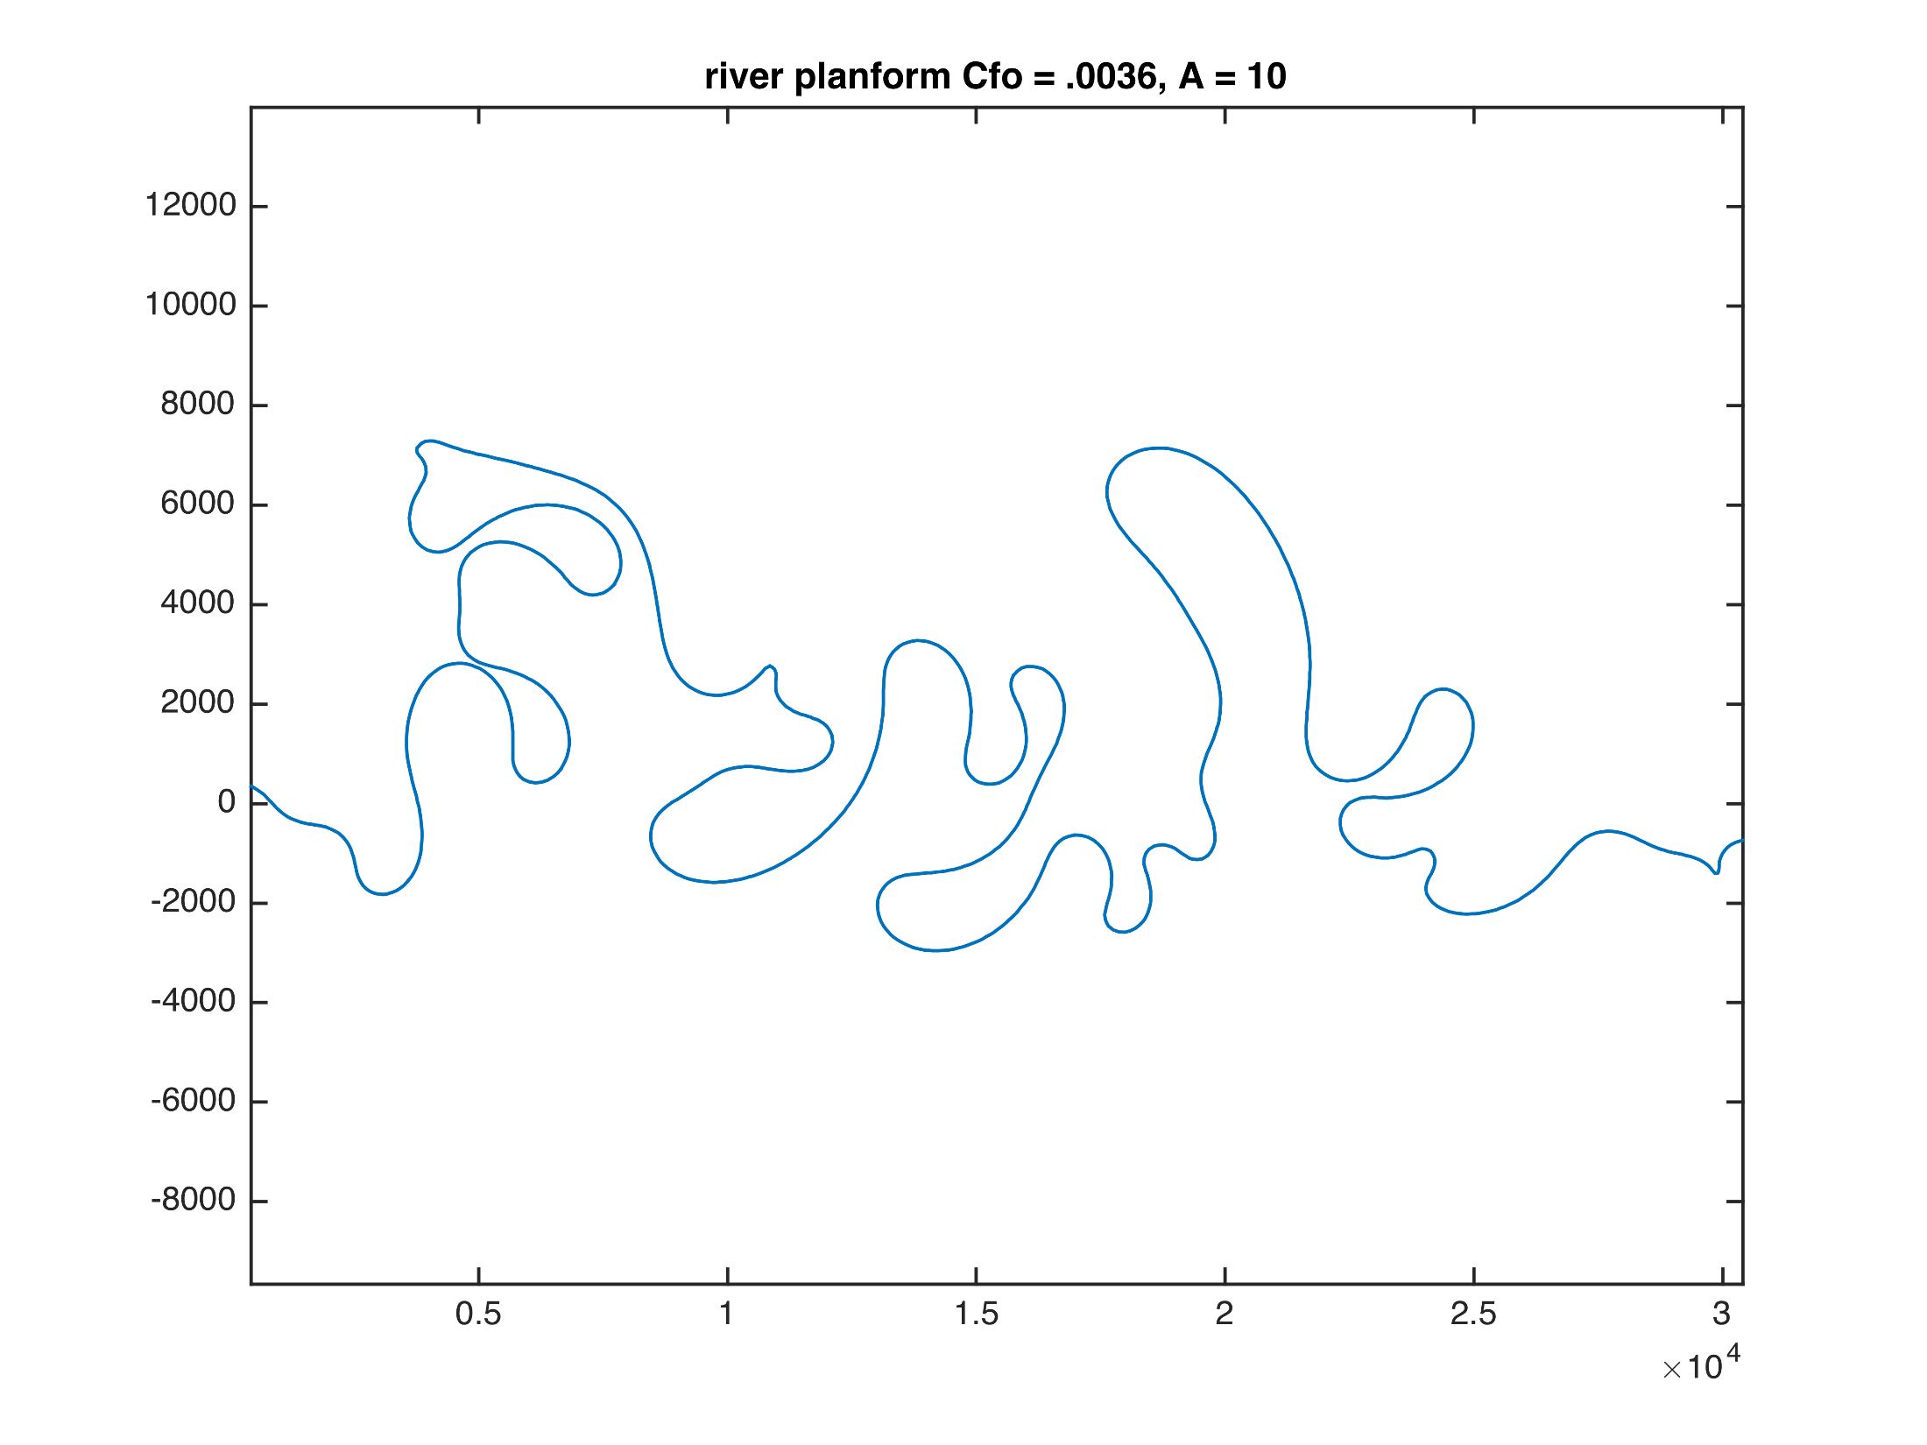
Planform Scale
27 w
4
Meander wavelength
Sinuosity (tortuosity)
Way too high:
Leopold & Wolman 1957,
Schumm 1963
10 km

Slide 7
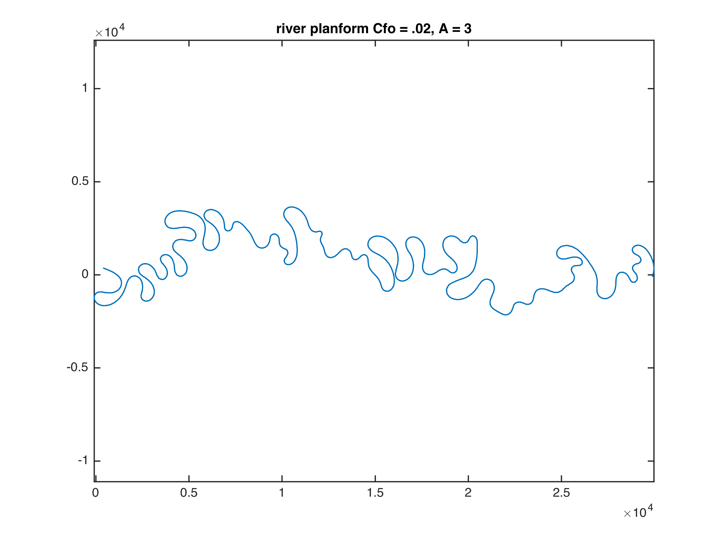
Planform Scale
27 w
4
Meander wavelength
Sinuosity (tortuosity)
Way too high:
Leopold & Wolman 1957,
Schumm 1963
Adjust
Friction factor
Cross slope factor
Erodibility constant
Violates hydrodynamics
12 w
3.2
10 km
10 km

Slide 8
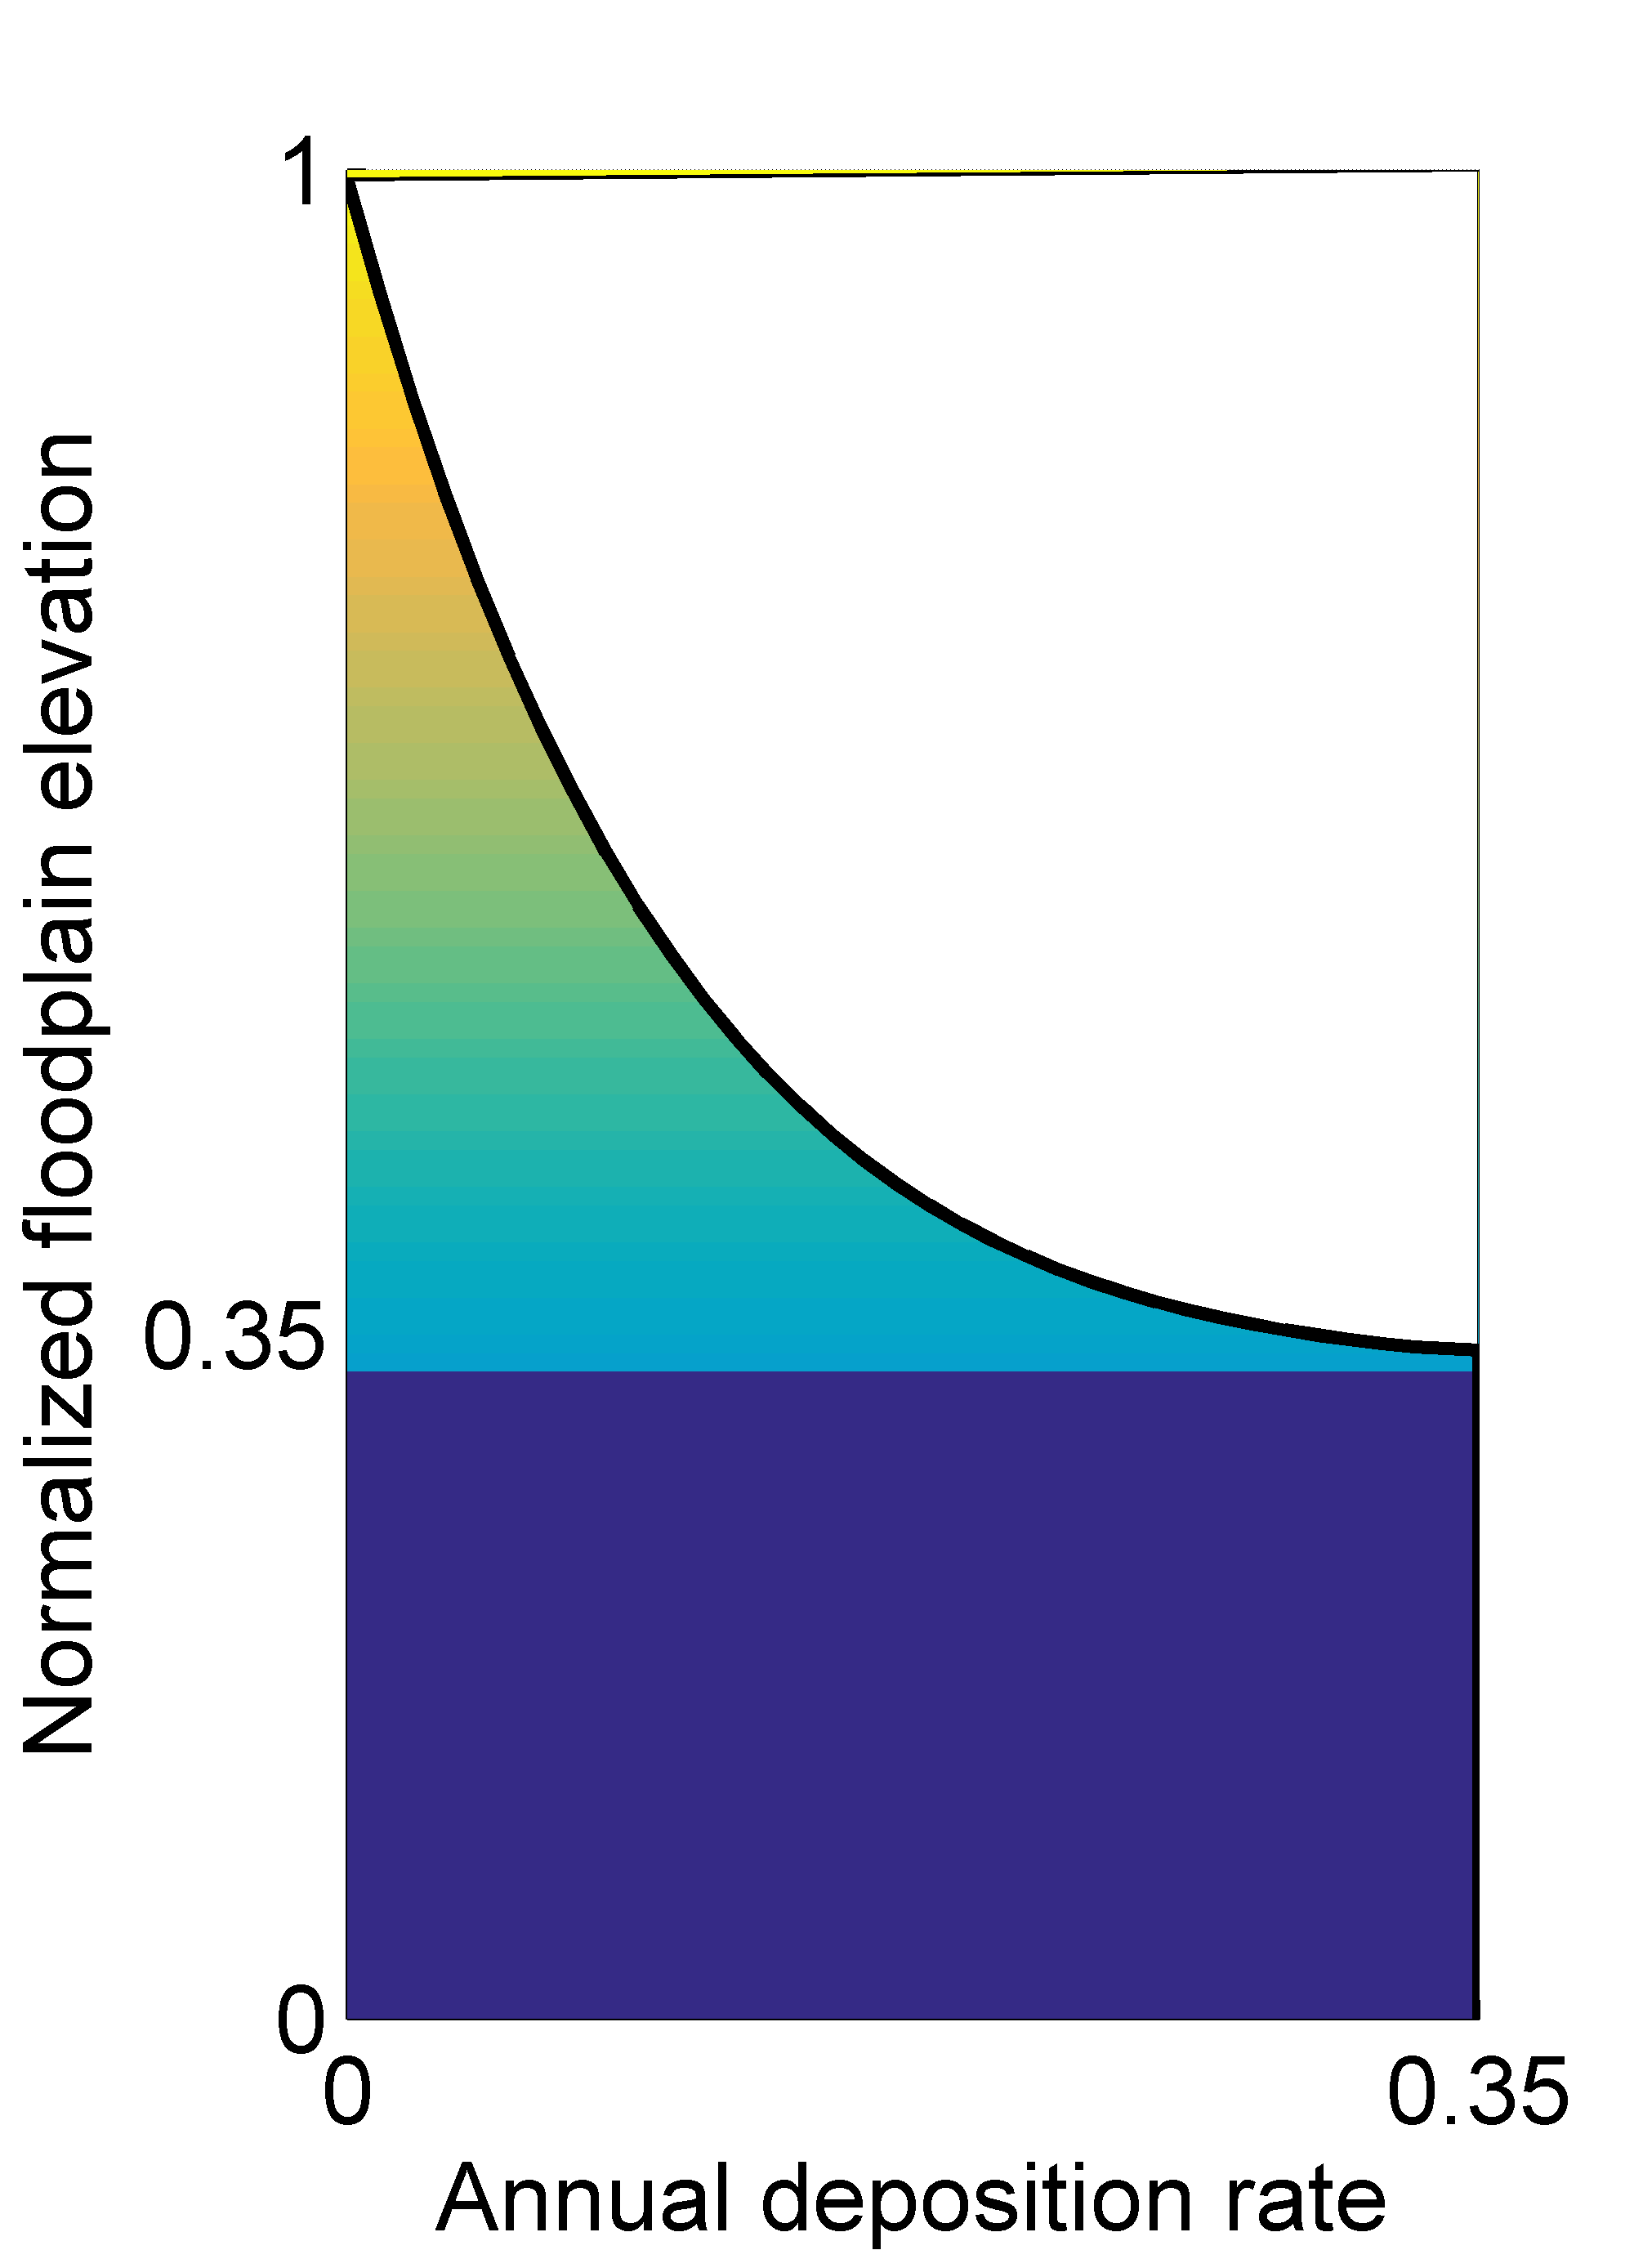
Stratigraphic Column
Floodplain deposition rates
probably decrease with elevation
and distance from channel
Point bar deposition is abrupt
Δh = (h_{max} – h_{act}) [ν + μ e^{(-D/λ)}]
(after Howard, 1992)
Δh = Change in elevation
h = Elevation max & actual
D = Distance to channel
ν = ‘Pelagic’ fine sedimentation rate
μ = ‘Diffusive’ coarse sedimentation rate
λ = Diffusive length scale

Slide 9
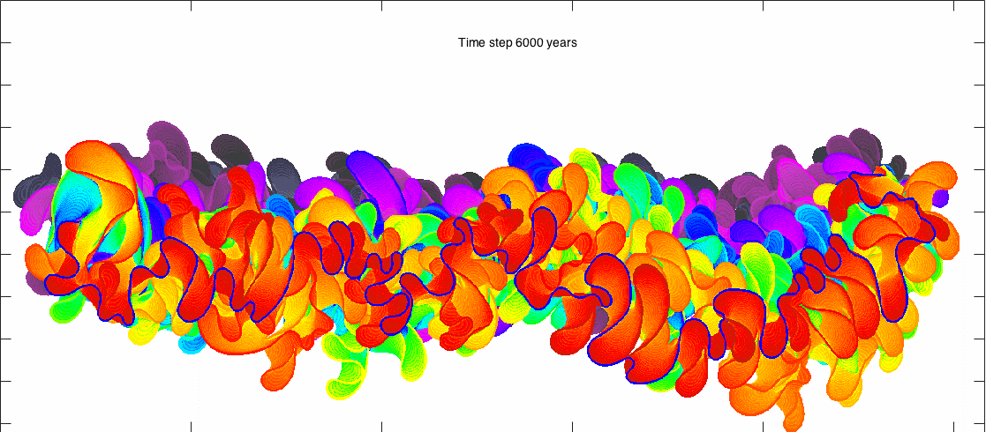

Floodplain elevation simulation 6–9 ky
Sediment thickness
10 km
Cool colors are older and higher elevation
Channel margin is mostly warmer colors
Channel width = W = 70 m | Pixel size = W/5 = 14 m | Δt = 30 years

Slide 10
Flow

Slide 11
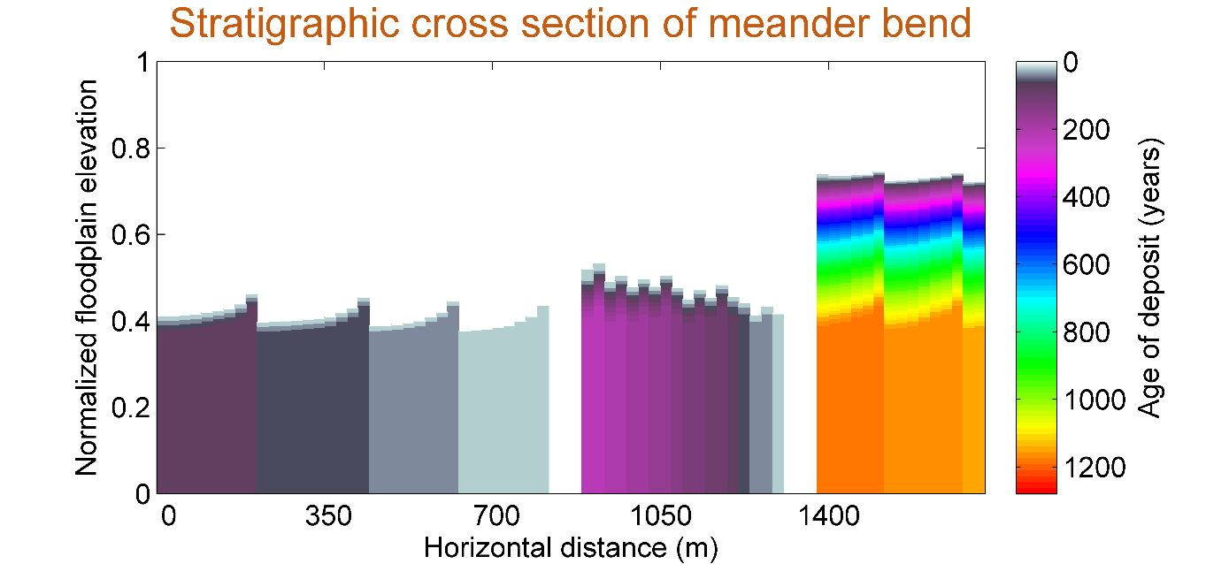
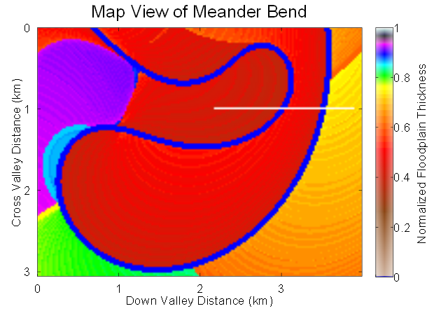
Stratigraphic cross-section of sediment age
Migration direction
channel
channel
Younger deposits
Thick blocks of basal point bar deposits
Thin layers of younger overbank deposits
Scroll bars? (arrows)
Floodplain becomes smoother with time

Slide 12
Stratigraphic cross-section of sediment age
channel
channel
Overbank deposition rate
with elevation
with distance from channel
Δh = (h_{max} – h_{act}) [ν + μ e^{(-D/λ)}]
(after Howard, 1992)
H = max floodplain height | μ = 0.0025∗Η | ν = 0.008∗Η | λ = 0.5∗W

Slide 13
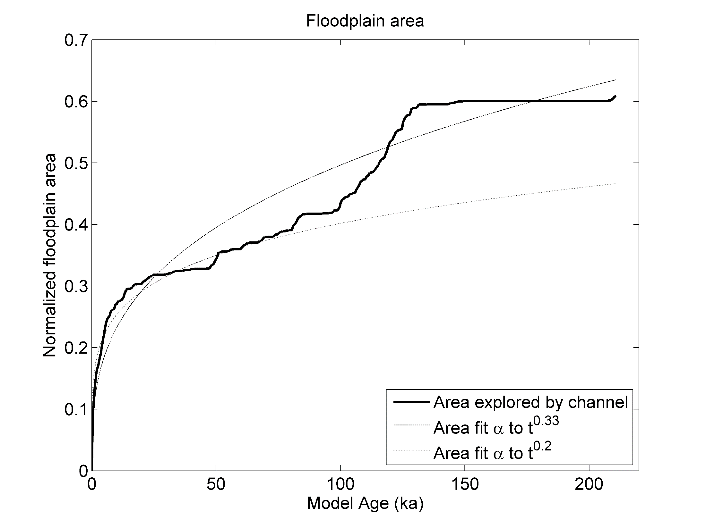
Storage time results
(ky)

Slide 14
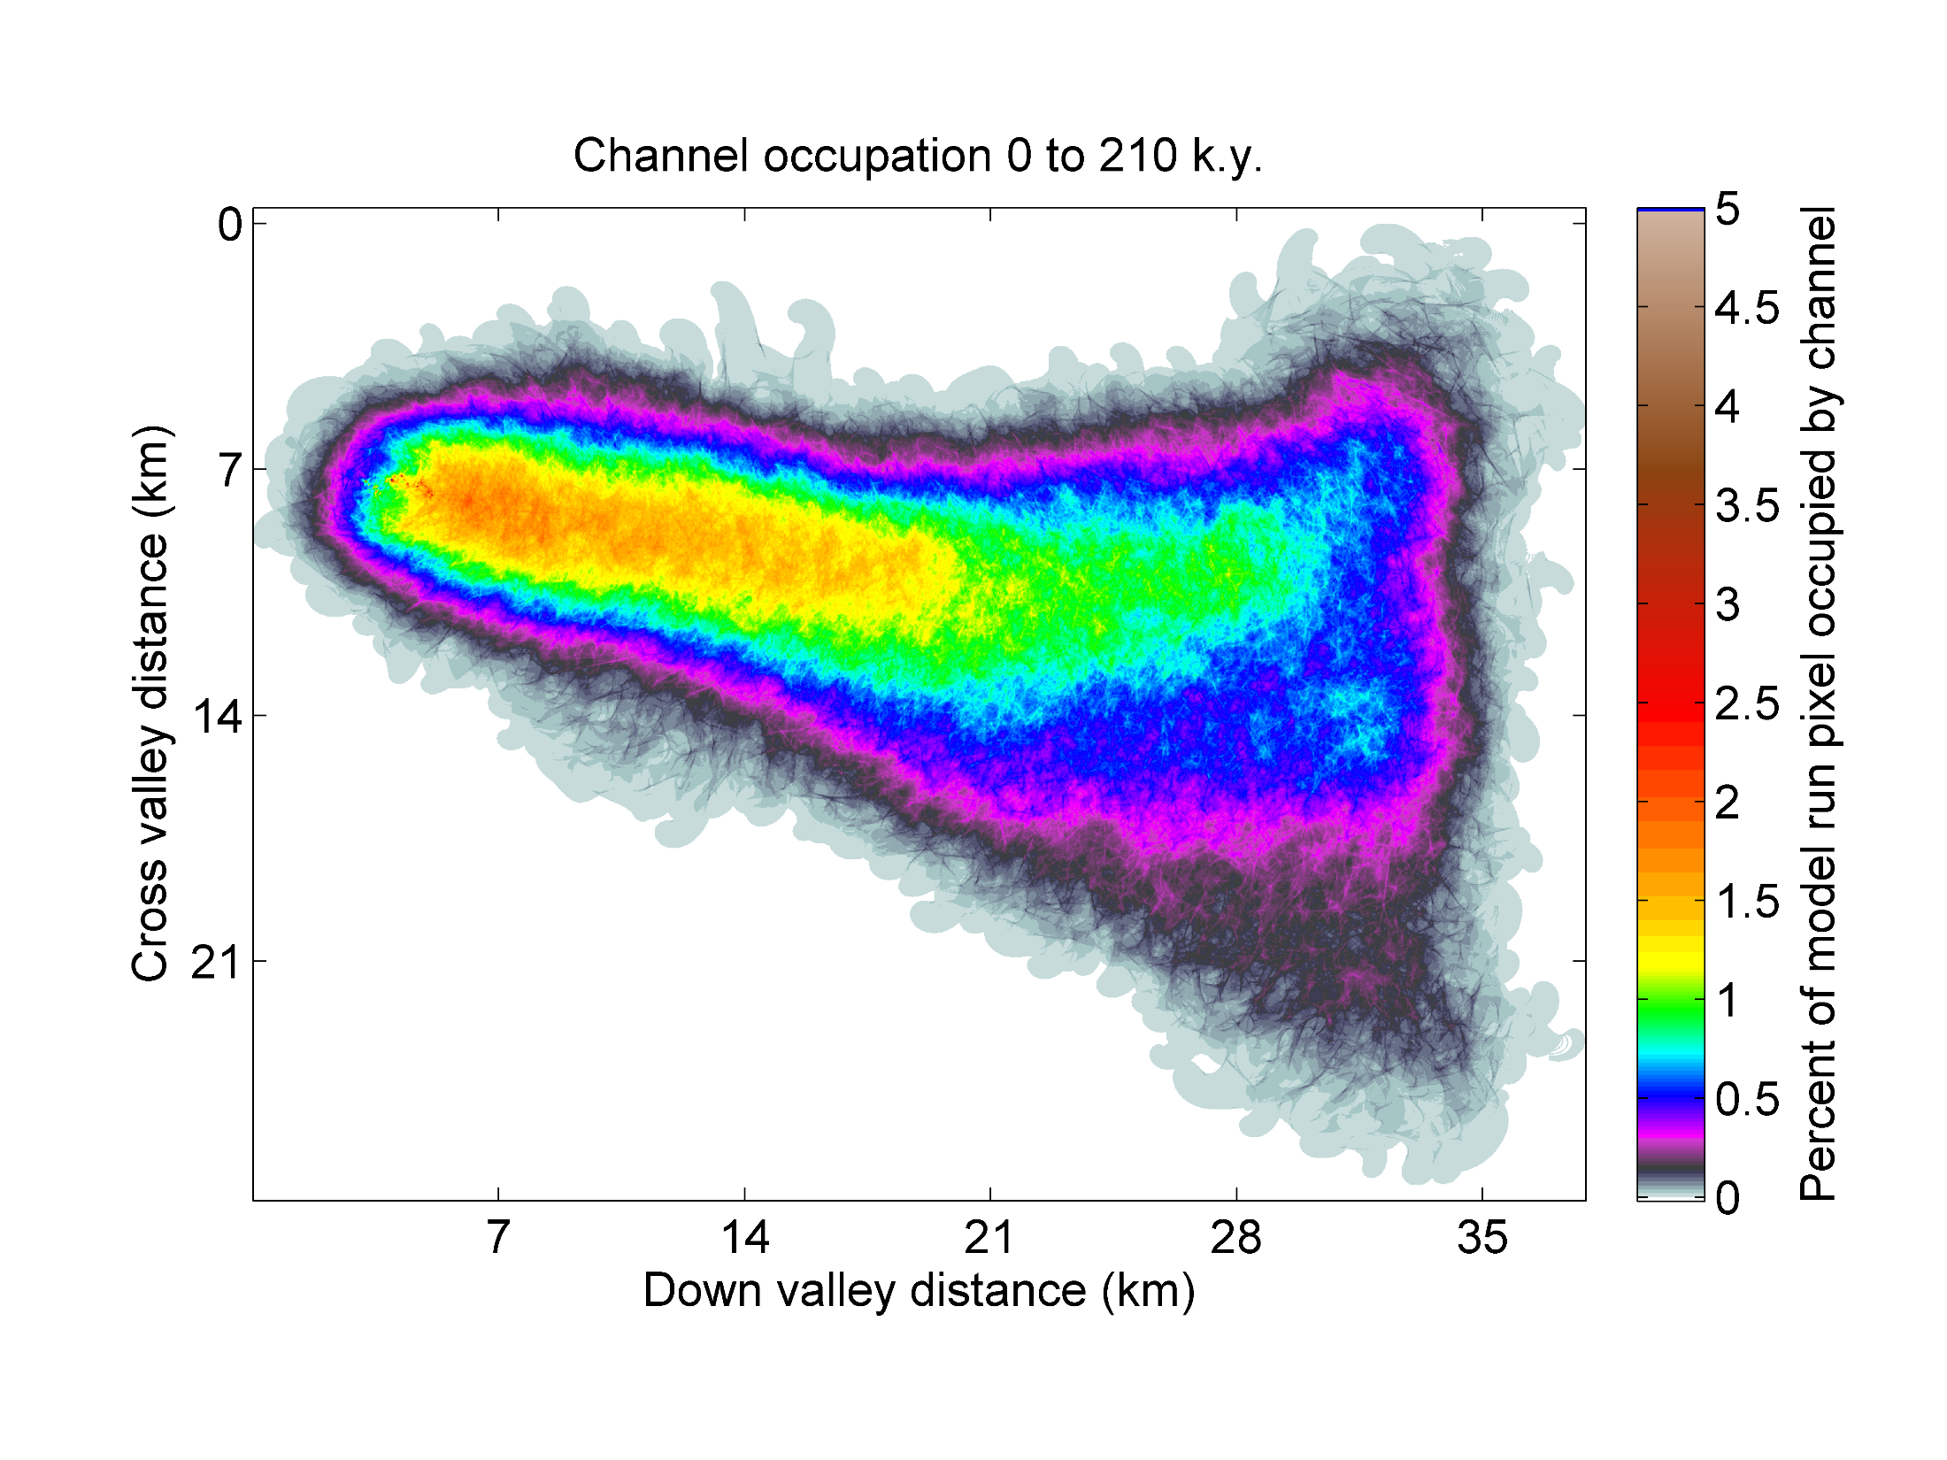
Channel frequents center of floodplain
Upstream
Downstream

Slide 15
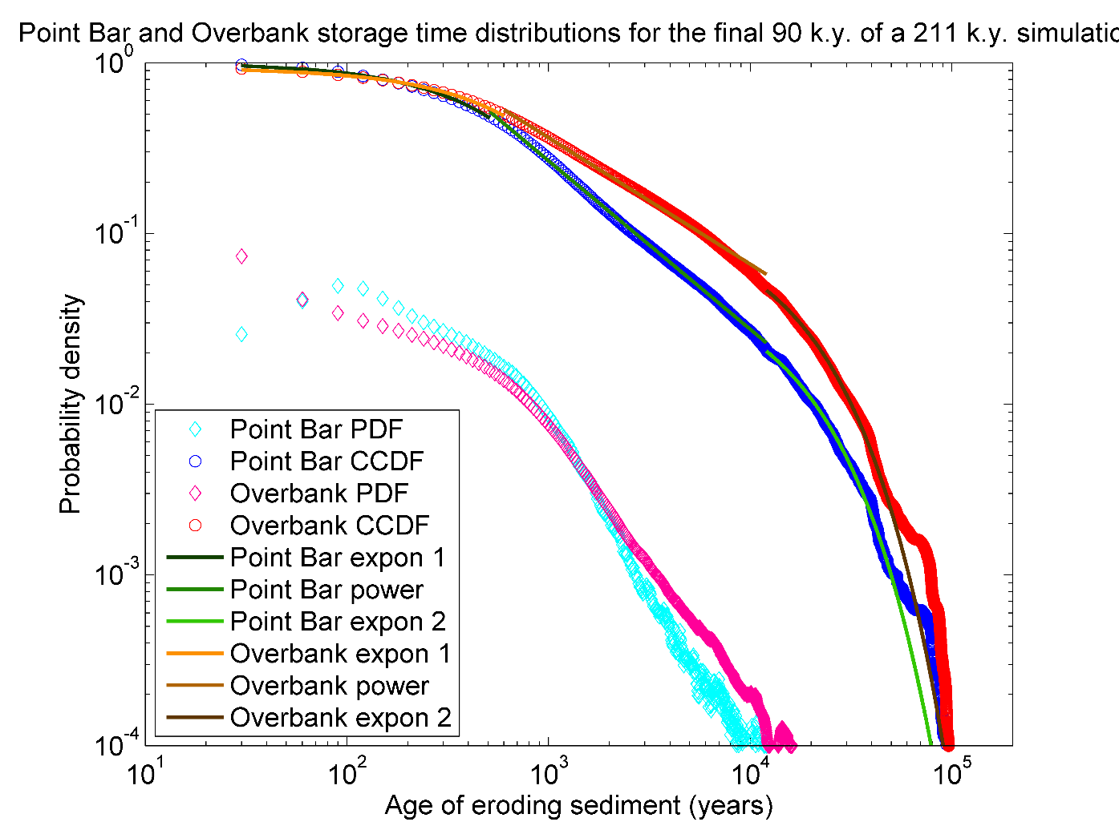
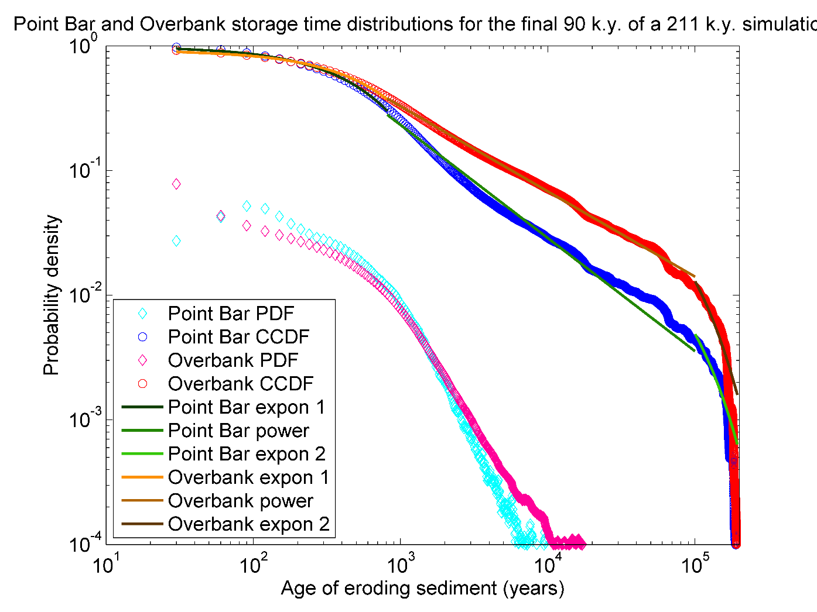
Upstream Point Bar and Overbank storage time distributions
Median

Slide 16
Upstream Point Bar and Overbank storage time distributions
Overbank storage has
heavier distribution
Point bar
peak erosion
-0.75
-1
Exponential tailing beyond 10 ky indicates equal probability of erosion !

Slide 17
Point Bar and Overbank storage time distributions
-0.75
-1

Slide 18
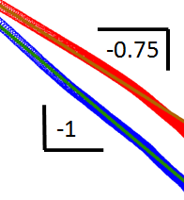
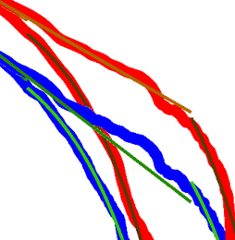
Conclusions
Check planform geometry
Point bars may have a peak contribution
similar to the time to migrate 5-6 W
Overbank storage has a
heavier distribution
Valley confinement influences light tail
Thank you

