Slide 1


Reconstruction of Historic Water Quality in the Tidal Christina River from Pre-European Settlement through the Present
Meg Christie ª, Don Charles^{b}, Ron Martin ª, Pete McLaughlin^{C}, Jim Pizzuto ª
ª Department of Geological Sciences, University of Delaware
^{b} Academy of Natural Sciences of Drexel University
^{c} Delaware Geological Survey

Slide 2
Introduction
Determine how water quality varied over the last 1000 years in a tidal river through analysis of sediment cores and diatoms
Increase understanding of changes in water quality before European settlement
Determine continuing impacts of land-use changes on water quality

Slide 3
Hypotheses
Post-settlement water quality will degrade due to land-use changes, which increase sediments and nutrient loads
20th century perturbations to water quality include input of heavy metals and further inputs of nutrients and sediments

Slide 4
Background
European settlement in the Mid-Atlantic US began in the late 1600s
Impacts include: increased sedimentation, vegetation changes, increased nutrient levels, changes in carbon storage, and increased heavy metals (Boesch et al., 2001; Bratton et al., 2003; Cooper & Brush, 1991)
Christina River is also influenced by “natural” processes
This research is significant because tidal river systems are:
  Lacking research on historical changes
  Likely impacted by sea level change

Slide 5
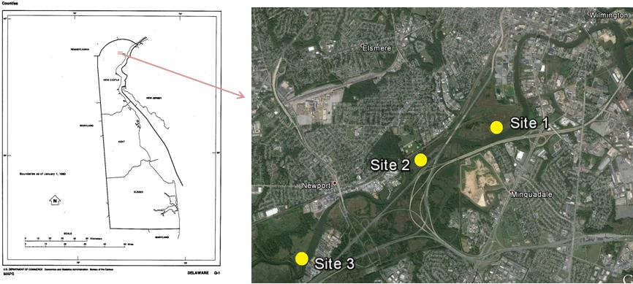
Study Sites
Three sites selected in marshes surrounding Christina River near Wilmington, DE
Marshes are tidally inundated 2x per day, oligohaline
Watershed contains a variety of land-uses (agriculture, urban, forest, industry); Sites impacted by multiple Brownfields and a Superfund site

Slide 6
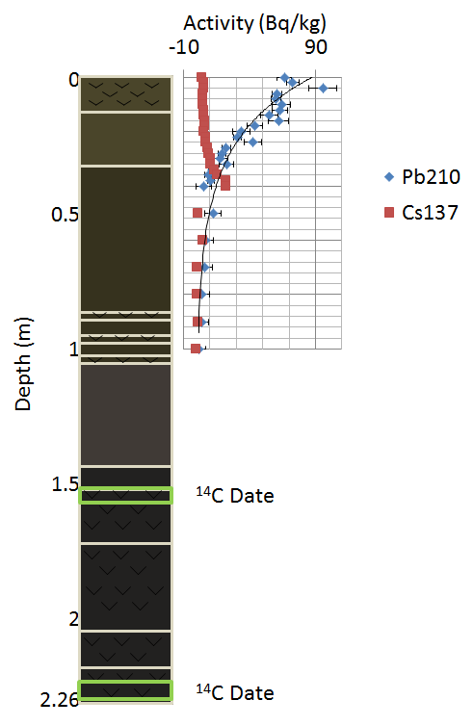
Methods
    Two 2-2.5 m cores from each site
      Brown-grey clay/mud throughout the core. Organics were variable.
Chronology
  Gamma counting (Pb-210, Cs-137): every 2 cm in top meter of core
  Pollen analysis: every 5-10 cm between 1 and 1.5 m
    Used % Ambrosia and Quercus:Ambrosia to identify settlement horizons
  Radiocarbon dating:2-3 samples taken below 1.5 m
Pollen Analysis
Pollen Settlement Horizon Samples
¹⁴C Date
¹⁴C Date
Notes:
Dates based on Hilgartner & Brush (2005), Matlack (1997)
Q:A ≤ 1 is ~1780
Q:A ≤ 5 is ~1730
%A ≤ 1 is ~1660

Slide 7
Methods
Diatoms
  Samples taken every 10 cm
  >500 valves identified and counted at 1000x
  Stratigraphically constrained cluster analysis and two trophic indices were used to analyze the diatom data
Chemistry
  Sediment chemistry analyses were performed by Plant and Soil Sciences at the University of Delaware

Slide 8
Age-Depth Model
Focus on Site 1, other sites similar
Error based on methods and depth intervals (light blue)
Flat area at 150 m corresponds to both a change in dating methods and sediment type
Notes:
Focus on core 1 due to time. Other cores generally follow the same patterns.
Dates at the top 100 cm of the core based on Cs-137 (1963) and Pb-210 (constant sedimentation method).
Pollen dates from 100-150 cm. Based on Hilgartner and Brush, Matlack. Dates based on abundance of Quercus (oak) and Ambrosia (ragweed)
Dates below 150 cm are from radiocarbon dating.
The flat area of the curve is present in two of the sites. In the third site, it looks as though it may be present due to the shape of the curve but there is no radiocarbon date at the same area. There is a change in sediment color near here, so it may be due to a hiatus/erosion, or it may simply be due to the change in dating methods.

Slide 9
Sediment Chemistry Results:
Metals
Zinc from National Vulcanized Fiber Co. (~1900-1990s) and DuPont Pigment Plant (closed in 1950s)
Pb from gasoline, 1920s-1970s
Other metals from other industries along river
Zn
Notes:
All metals were fairly consistent up to about 250 ybp. After this time, they rose sharply. Zinc is related to industrial activity (National Vulcanized Fiber Company in Yorklyn on the Red Clay Creek, http://www.dnrec.delaware.gov/swc/wa/Documents/TMDL_TechnicalAnalysisDocuments/23a_Amended%20RCC%20Zn%20TMDL%20Background%20and%20Basis%20Document.pdf). This company opened in the early 1900s, and prior to 1970s was dumping Zn directly into the river. This peak may be shifted somewhat downward, based on those dates.
Pb was in fuel from about 1920 to about 1970, when it was phased out
Other metals likely related to the various industries installed along the Christina River, and rivers that flow into it.

Slide 10
Sediment Chemistry Results: Phosphorus
Phosphorus is generally variable in Christina River
After 200 YBP, consistently high
  Agricultural and phosphorus detergents
Notes:
Phosphorous generally increases after 250 ybp, but has always been fairly variable. Particularly, the phosphorous in more recent samples is likely related to increases in agriculture.

Slide 11
Sediment Chemistry Results: Nitrogen
Similar pattern to Phosphorus
Recent increases partially due to agriculture? Overall not as clearly responding to anthropogenic activity

Slide 12
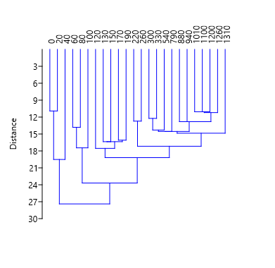
Cluster Analysis of Diatom Data
Runoff? Changes to pollution laws?
Post Enviro movement?
Continuing nutrients?
Major industrial increases
Green revolution
Post-deforestation, early industrialization
Increasing inputs of nutrients
Time (ybp)
Mid-settlement: Deforestation Starts
Pre-European Settlement to
Early Settlement:
Low nutrients
Forested
Cophen. Corr.
0.844
Notes:
Classical, Paired Group (UPGMA) with Euclidean similarity index.
Clustering is stratagraphically constrained and is based on relative percent abundance data. Cluster analysis was performed using PAST.
Clustering based on diatom assemblages, i.e. how similar an assemblage is to its neighbors.
Cluster are constrained by time so that the ages must go in order
Clusters correspond to known timing of land-use changes

Slide 13
Trophic Index (Porter, 2008; vanDam et al., 1994)
Percent abundance of species preferring high nutrient conditions increases over past 200yrs, particularly past 100yrs
Species preferring moderate nutrient conditions decrease over the same period
Species preferring low nutrient conditions low to absent throughout
(medium nutrient concentrations)
(high nutrient concentrations)
Notes:
vanDam (1999) assigns a category to diatoms based on their sensitivity to nutrients. This scale goes from 1 (oligotraphenic) to 7 (hypereutraphenic). The percent of valves in each category is calculated. In this chart, we are looking at category 3 (mesotraphenic) which is common to systems like this vs. category 6 (eutraphenic), which is indicative of high nutrients. As you can see, the mesotraphenic species become less common after about 300 ybp, while the eutraphenic species increase from about 10-15% before 300 ybp, to 15-30% between 300 and 100 ypb, finally reaching 30-50% in the last 50-100 years. This indicates that nutrients increased somewhat following settlement, but have increased even further in more recent years, likely due to increasing use of industrial fertilizers. The rise between 100 ybp and now is consistent with other research from this river (Valinski et al 2010)

Slide 14
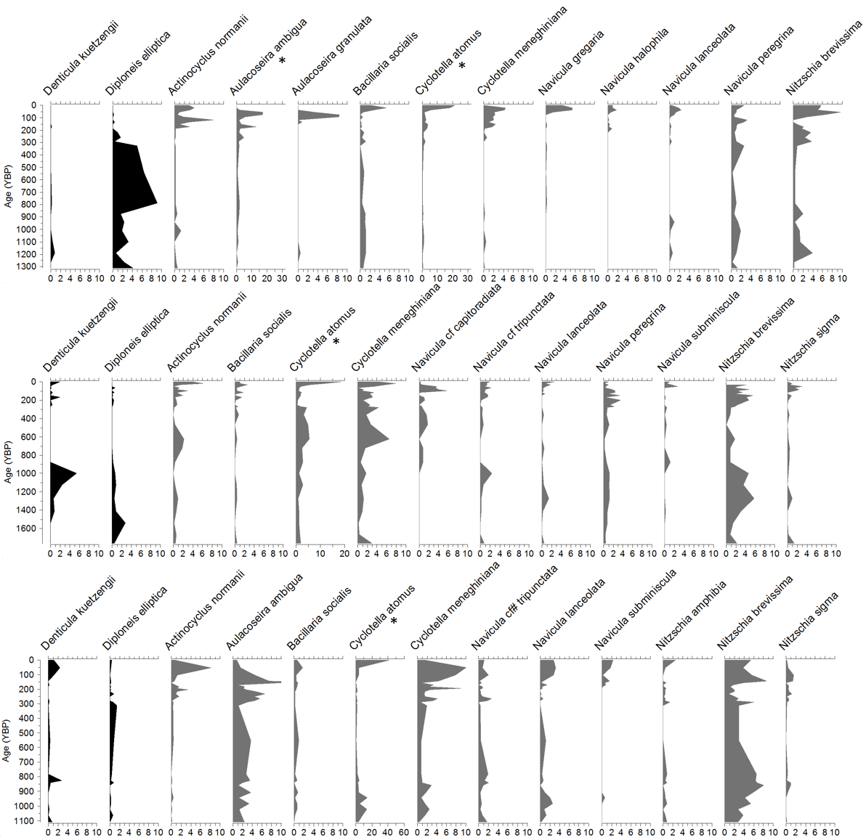
Diatom Species Analysis
% abundance
Black: Mesotraphenic; Grey: Eutraphenic, as grouped by Porter (2008) and van Dam (1994)
Species track trophic levels through time

Slide 15
Trophic Index Results vs. Sediment Chemistry
Notes:
In order to identify how similar the trophic indices were, I compared them to nutrient data from my sediment chemistry, specifically P. While the sediment P is not necessarily directly relatable to aqueous P, I can get a good idea of the trends. As you can see, in both cases, the index shows higher nutrients when sediment P is higher, but vanDam seems to fit better.
**Nitrogen is from Site 3, using species index results from site 3.
I have similar data for site 3 using nitrogen, and can provide it later if someone would like to discuss it. N did not fit as well as P.

Slide 16

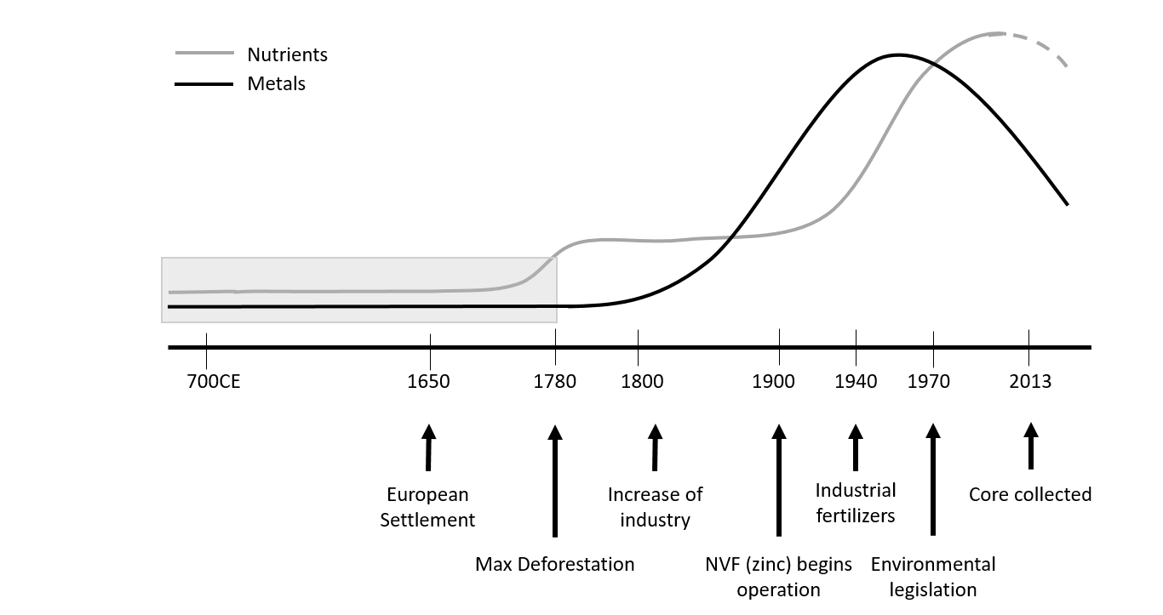
Conceptual Model: Regional Water Quality History
Nutrients
Metals
700 CE 1650 1780 1800 1900 1940 1970 2013
European Settlement
Increase of Industry
Industrial Fertilizers
Core Collected
Maximum Deforestation
DuPont, NVF open (ZN)
Enviro. Legislation

Slide 17
Conclusions
Diatoms were used to identify nutrient-related changes caused by land-use shifts in a transitional environment
  This allowed the influences of different land-use strategies to be better understood
  In particular, van Dam’s Trophic Index seems to track phosphorous in this site
  While sediment P remains high in recent samples, the diatom trophic index shows a decrease/variation in recent samples
Metals were important pollutants in the Christina River following the industrial revolution and have declined since the 1970s, likely due to improved environmental laws

Slide 18
Ongoing Work
Transfer Function
  Currently, I am working with a dataset of modern samples from DE to try to create a working transfer function which would allow me to predict what the TP levels were in my samples through time. (Just Finished!)
Environmental Analysis
  Compile habitat types for diatom species and use them to track the changing environment through time (Just Finished!)

Slide 19
Acknowledgements
Funding for this project was partially provided by NSF-EAR1331856, GSA Graduate Student Grant, and an SEPM Foundation Grant.
Thanks also to Tobi Ackerman, Corey Hovanec, Dale Lambert, Mike Orefice, Adam Pearson, and Matt Pinson for help in the field and to Chris Sommerfield for advice and guidance.

Slide 20

Questions?

