Slide 1
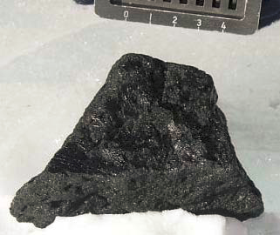
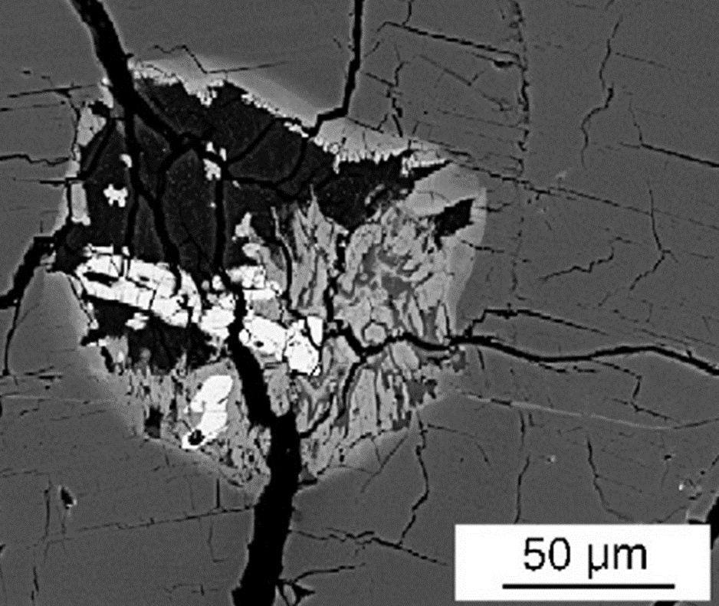



Role of chlorine in the petrogenesis of the nakhlites
Paul Giesting, Justin Filiberto, and Allan Patchen
University of Tennessee, Knoxville
Southern Illinois University, Carbondale

Slide 2
Nakhlites: Martian clinopyroxenite
Nakhlites
MIL/5790 amph
Crys Chem
Terrestrial
Synthetics
Hot & Salty
Name | Abbreviation | Year | Location
Nakhla |  | 1911 | Al Buhayrah, Egypt
Lafayette (stone) |  | 1931 | Indiana, USA
Governador Valadares |  | 1958 | Minas Gerais, Brazil
Yamato 000593 | Y-000593 | 2000 | Antarctica
Yamato 000802 | Y-000802 | 2000 | Antarctica
Yamato 000749 | Y-000749 | 2000 | Antarctica
Northwest Africa 817 | NWA 817 | 2000 | Morocco
Northwest Africa 998 | NWA 998 | 2001 | (Northwest Africa)
Miller Range 03346 | MIL 03346 | 2003 | Antarctica
Miller Range 090136 | MIL 090136 | 2009 | Antarctica
Miller Range 090032 | MIL 090032 | 2009 | Antarctica
Northwest Africa 5790 | NWA 5790 | 2009 | (Northwest Africa)
Northwest Africa 6148 | NWA 6148 | 2009 | (Northwest Africa)
Miller Range 090030 | MIL 090030 | 2009 | Antarctica
Northwest Africa 10153 | NWA 10153 | 2014 | (Northwest Africa)
Clockwise from top left: Lafayette, Nakhla, Y-000593, MIL 03346. Field of view 2.2 mm wide for Lafayette and Nakhla.
Via the Mars Meteorite Compendium
Meteoritical Bulletin Database

Slide 3
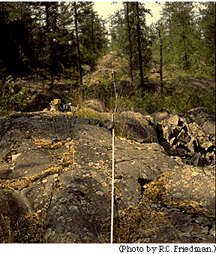
Nakhlite stratigraphy
Nakhlites
MIL/5790 amph
Crys Chem
Terrestrial
Synthetics
Hot & Salty
McCubbin et al. 2013

Slide 4
Nakhlites/chassignites at depth
Nakhlites
MIL/5790 amph
Crys Chem
Terrestrial
Synthetics
Hot & Salty
http://courses.washington.edu/ess439
Giesting et al. 2015

Slide 5
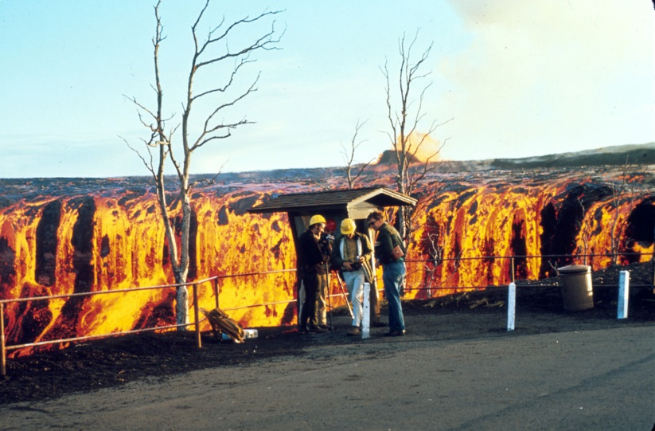
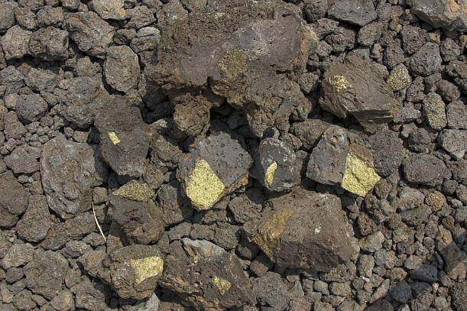
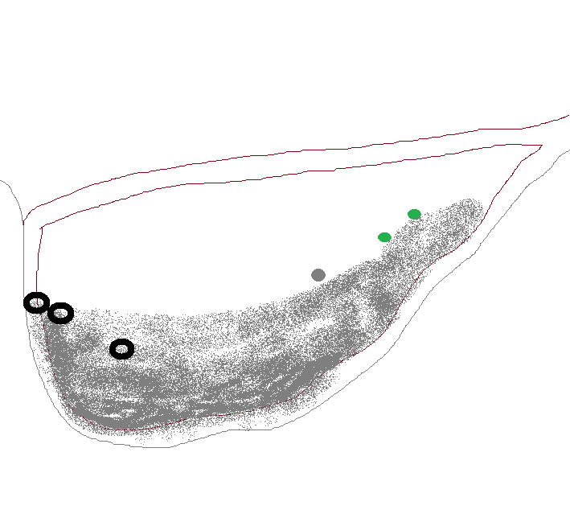
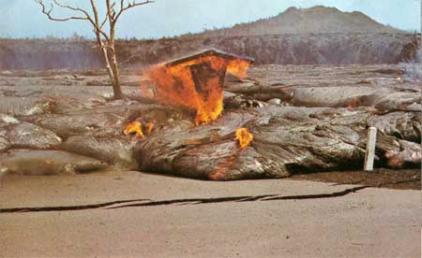
Nakhlites/chassignites at surface
Nakhlites
MIL/5790 amph
Crys Chem
Terrestrial
Synthetics
Hot & Salty
Dunite xenoliths in 1800-01 lava of Hualalai
Quenched margin
NWA 5790
MIL 03346
Nakhla
Rip-up clasts /
“xenoliths”
(chassignites,
NWA 998?)
Cumulus augite
Maunua Ulu lava ponding in Aloi Crater
NPS photos, 1969

Slide 6
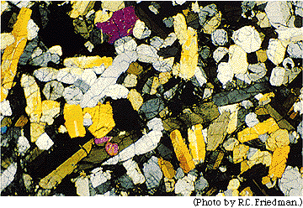
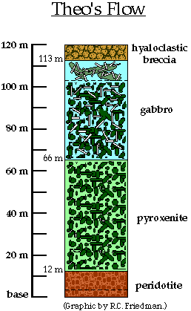
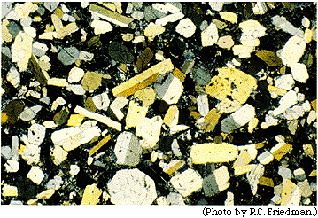
Nakhlites/chassignites at surface
Nakhlites
MIL/5790 amph
Crys Chem
Terrestrial
Synthetics
Hot & Salty
Nakhla
Theo’s Flow
McCubbin et al. 2013
Friedman Lentz et al. 1999
Field of view ~5 mm

Slide 7
MIL & NWA 5790 intercumulus
& melt inclusions
Nakhlites
MIL/5790 amph
Crys Chem
Terrestrial
Synthetics
Hot & Salty
Left: Intercumulus area of MIL 03346; Day et al. 2006
Right: Melt inclusions in MIL 03346; Sautter et al. 2006

Slide 8
MIL & NWA 5790 amphibole
Nakhlites
MIL/5790 amph
Crys Chem
Terrestrial
Synthetics
Hot & Salty
Sautter et al. 2006
McCubbin et al. 2013

Slide 9
MIL & NWA 5790 amphibole
Nakhlites
MIL/5790 amph
Crys Chem
Terrestrial
Synthetics
Hot & Salty

Slide 10
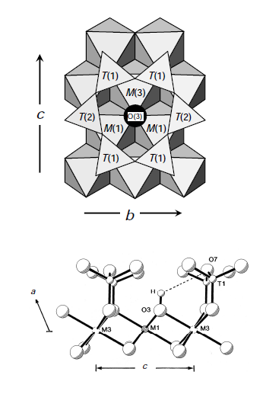
Amphibole – crystal chemistry & Cl
Nakhlites
MIL/5790 amph
Crys Chem
Terrestrial
Synthetics
Hot & Salty
AB₂M₅T₈O₂₂X₂ M = M(1,2,3)
A = A T = T(1,2)
B = M(4) X = O(3)
Hawthorne & Oberti 2007

Slide 11
Volume - Cl
Nakhlites
MIL/5790 amph
Crys Chem
Terrestrial
Synthetics
Hot & Salty

Slide 12
Terrestrial localities
Nakhlites
MIL/5790 amph
Crys Chem
Terrestrial
Synthetics
Hot & Salty

Slide 13
Terrestrial localities
Nakhlites
MIL/5790 amph
Crys Chem
Terrestrial
Synthetics
Hot & Salty

Slide 14
Experiments
Nakhlites
MIL/5790 amph
Crys Chem
Terrestrial
Synthetics
Hot & Salty
potassic-chloro-hastingsite
kaersutite
Jenkins et al. 2015 (GSA abstract)
Chan et al. 2016, in press

Slide 15
Experiments
Nakhlites
MIL/5790 amph
Crys Chem
Terrestrial
Synthetics
Hot & Salty
potassic-chloro-hastingsite
kaersutite
Jenkins et al. 2015 (GSA abstract)
Chan et al. 2016, in press

Slide 16

Nakhlite amphibole: setup
Nakhlites
MIL/5790 amph
Crys Chem
Terrestrial
Synthetics
Hot & Salty
Fractionated Melt
Lower f(O₂)
KCl
FeCl₂
Cumulus
McCubbin et al. 2013

Slide 17
Nakhlite amphibole: hot & salty
Nakhlites
MIL/5790 amph
Crys Chem
Terrestrial
Synthetics
Hot & Salty
Fluid Unmixing
Chloride
Aqueous
KCl
FeCl₂
Cumulus
McCubbin et al. 2013

Slide 18
Nakhlite amphibole: melt inclusions
Nakhlites
MIL/5790 amph
Crys Chem
Terrestrial
Synthetics
Hot & Salty
Chloride
Aqueous
Fluid Escape
Aqueous
Chloride
Chloride Fluid Trapped
in Melt Inclusions
Cumulus

Slide 19
Next questions
Nakhlites
MIL/5790 amph
Crys Chem
Terrestrial
Synthetics
Hot & Salty
What was the melt and fluid composition (OH/F/Cl) at every stage of the evolution of the NC magma chamber and flow?
Can we deduce the timing of fluid addition?
What about the K & Fe that were needed to create extreme amphibole at the end of the process?
  Did these evolve internally or were they supplied by external fluid, magma, etc.?
  Were they really coordinated with Cl?
  Can we track Fe in melt & fluid along with olivine & augite composition?

Slide 20
Nakhlite stratigraphy and volatile content
Nakhlites
MIL/5790 amph
Crys Chem
Terrestrial
Synthetics
Hot & Salty
Melt inclusions at least partly shield melt and minerals from exsolution and loss (“degassing”) of volatile components
Melt inclusion phases are available for NWA 2737, Chassigny, MIL nakhlites, and NWA 5790
What about spots between?
McCubbin et al. 2013

Slide 21
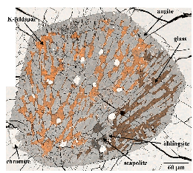
Nakhla and scapolite
Nakhlites
MIL/5790 amph
Crys Chem
Terrestrial
Synthetics
Hot & Salty
Marialitic (Cl-dominant) scapolite in Nakhla melt inclusion
High Cl, but lacking Ca, K, Fe to make potassic-hastingsite, so Cl finds another silicate home
Justin’s talk
Filiberto et al. 2014

Slide 22
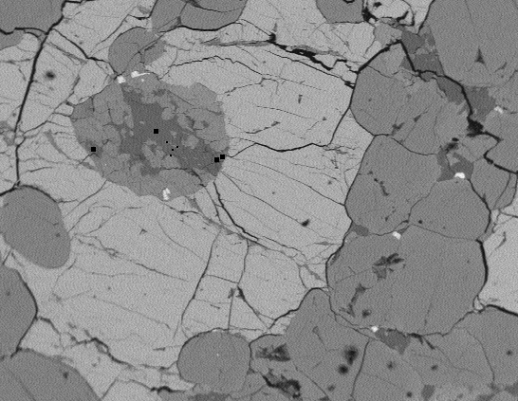
Lafayette apatite
Nakhlites
MIL/5790 amph
Crys Chem
Terrestrial
Synthetics
Hot & Salty

Slide 23
Chassignite amphibole & Lafayette apatite
Nakhlites
MIL/5790 amph
Crys Chem
Terrestrial
Synthetics
Hot & Salty
Giesting et al. 2015 measured amphibole & glass Cl in a melt inclusion and modeled melt OH content
  NWA 2737: 0.3 wt% Cl, 0.7 wt% H2O
  Chassigny: 0.3 wt% Cl, 0.4 wt% H2O
Lafayette melt inclusion apatite has 0.3 apfu F, 0.5 apfu Cl, and presumably 0.2 apfu OH
  Using the K values in McCubbin et al. 2015, and measured values of 0.02 wt% F and 0.3 wt% Cl in glass, apatite model gives 0.5 wt% H2O in melt, with good agreement between F-OH & Cl-OH values
These few olivine melt inclusions in Lafayette & Chassigny record similar OH & Cl content.
Perhaps we are not missing a lengthy stretch of pile between Chassigny & Lafayette?

Slide 24
Lafayette & Nakhla glass and low temperature phases
Nakhlites
MIL/5790 amph
Crys Chem
Terrestrial
Synthetics
Hot & Salty

Slide 25
Lafayette & Nakhla glass
Nakhlites
MIL/5790 amph
Crys Chem
Terrestrial
Synthetics
Hot & Salty

Slide 26
Lafayette & Nakhla glass
Nakhlites
MIL/5790 amph
Crys Chem
Terrestrial
Synthetics
Hot & Salty

Slide 27
Acknowledgments
Nakhlites
MIL/5790 amph
Crys Chem
Terrestrial
Synthetics
Hot & Salty
David Jenkins, Albert Chan, Bailey Mueller
Hap McSween
Francis McCubbin, Frank Mazdab, Kevin Righter
Questions?

