Slide 1
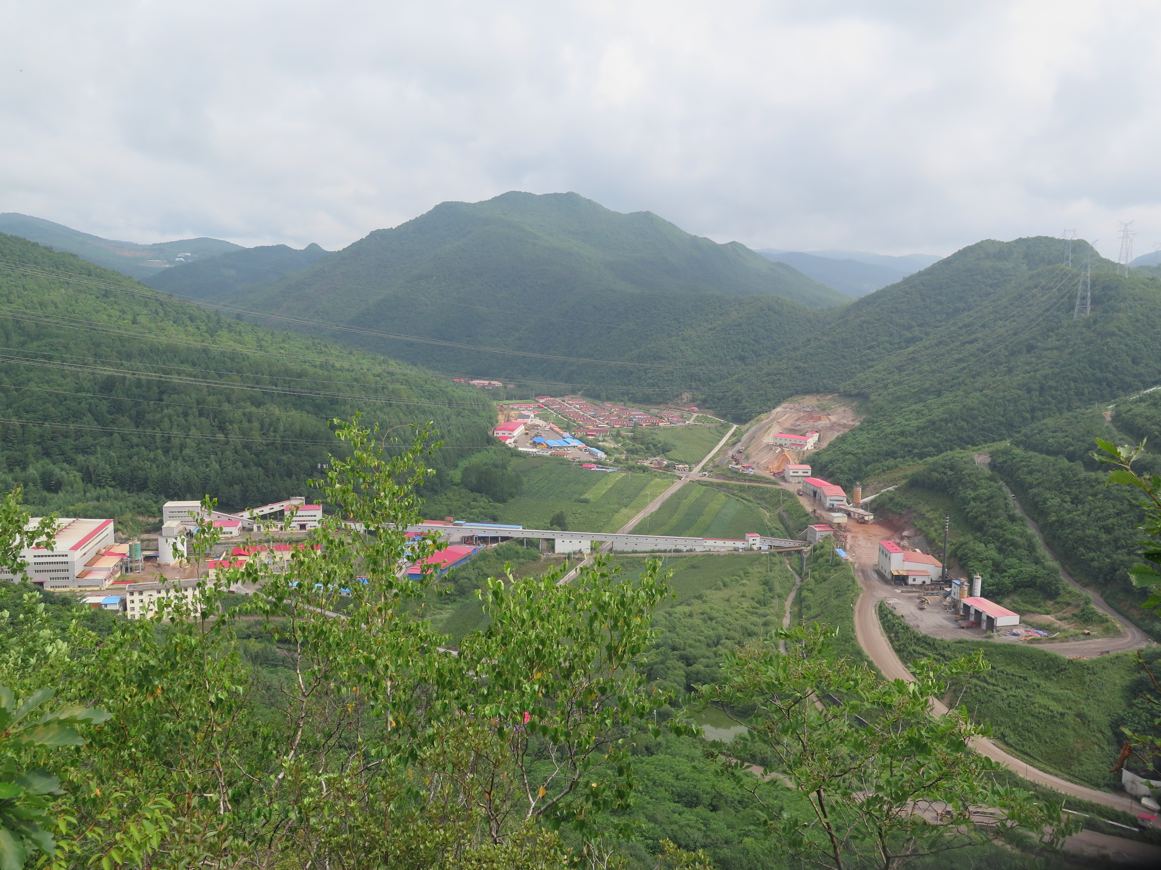


Magmatic-Hydrothermal Deposits of the Hunjiang Basin, Jilin Province, NE China, with a Focus on the White Mountain Breccia-Hosted Gold Deposit
Halley A. Keevil, Thomas Monecke, Richard Goldfarb, Greg Collins, Tao Feng, Tim Baker, Nigel Kelly, and Andreas Möller
GSA 2016, Denver CO September 25th

Slide 2
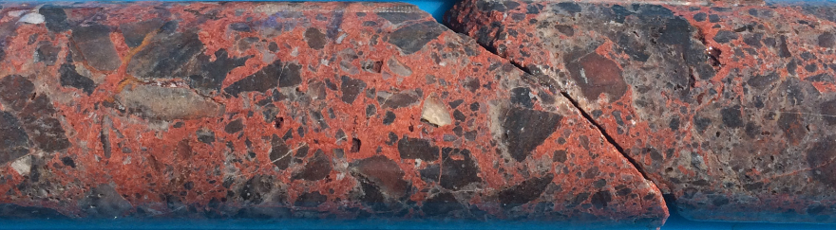

Intro
Geologic Setting
Deposit Stratigraphy
Ore and Alteration Patterns
Regional Deposits
Geochronology
Conclusions
Introduction & Framework
White Mountain is a sediment-hosted gold deposit with enigmatic characteristics
Minimal academic work has been published in peer-reviewed journals on a) the deposit and b) the Hunjiang basin in which it is located
This talk will discuss the results of a basin-wide deposit study and geochronology work conducted to constrain the regional framework for White Mountain
Polymictic matrix-supported breccia at White Mountain. Grade 35.1 g/t Au.

Slide 3
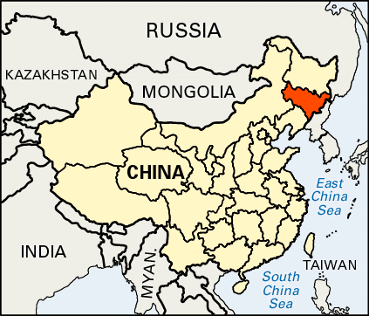
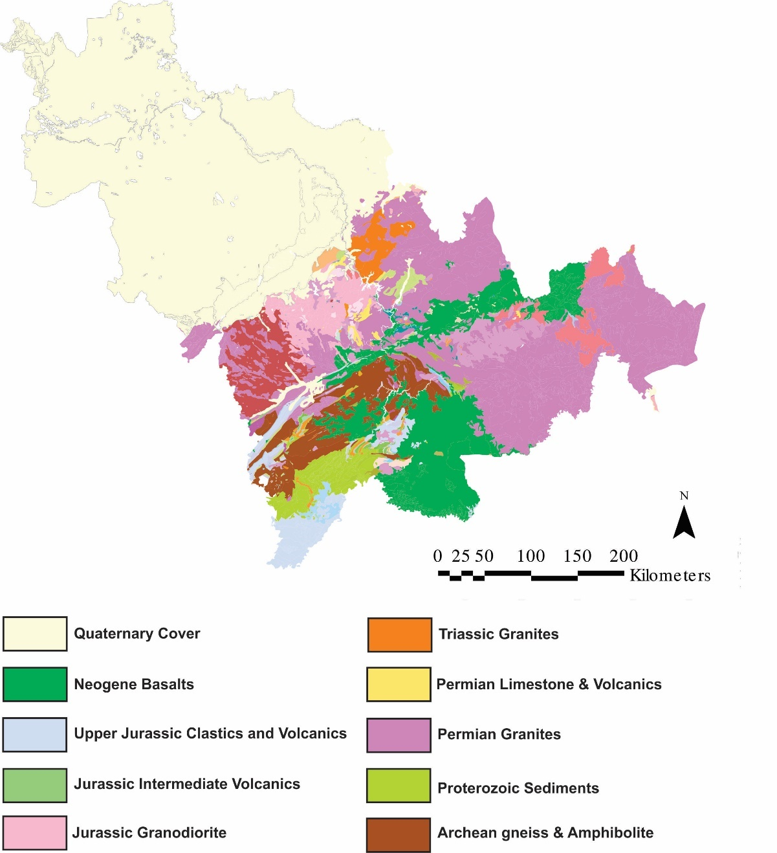
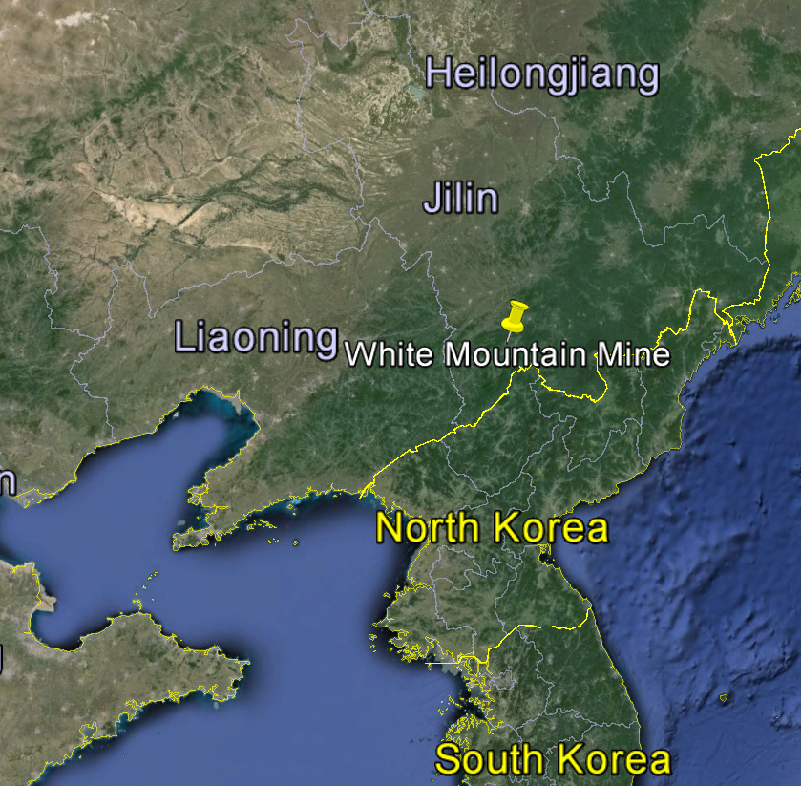
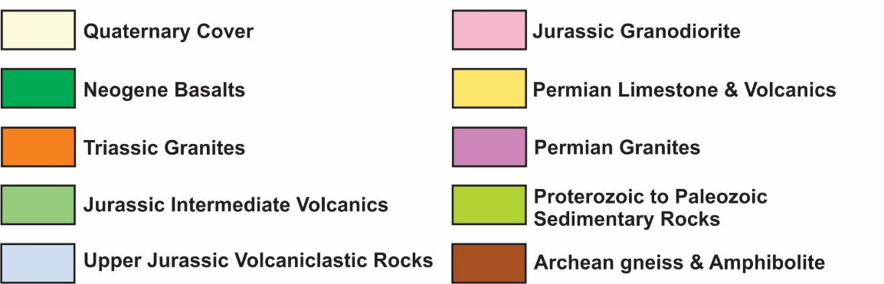
Intro
Geologic Setting
Deposit Stratigraphy
Ore and Alteration Patterns
Regional Deposits
Geochronology
Conclusions
Regional Geologic Setting:
Changchun
(capital)
Baishan
N
Quaternary cover in NW
Igneous and sedimentary rocks in SE

Slide 4
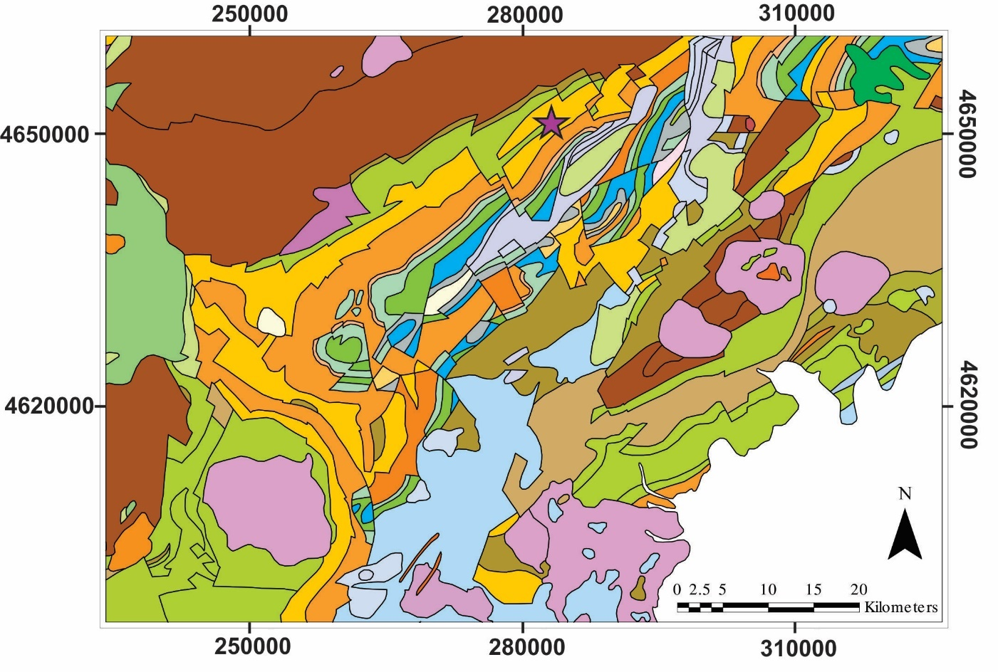
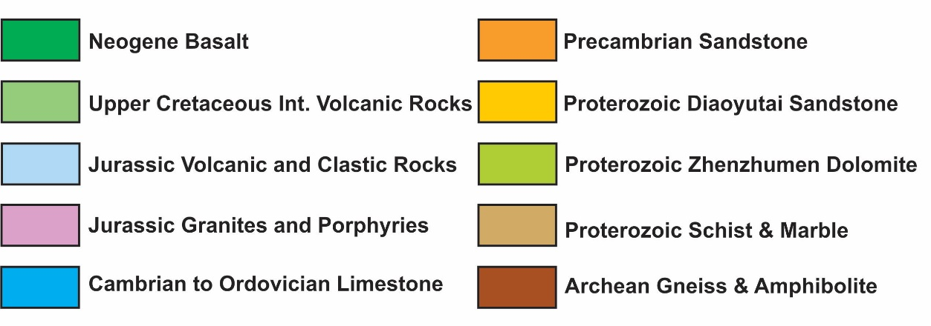
Intro
Geologic Setting
Deposit Stratigraphy
Ore and Alteration Patterns
Regional Deposits
Geochronology
Conclusions
Regional Geologic Setting:
Hunjiang Basin, SE Jilin
Well endowed with various mineral deposits
White Mountain located in Proterozoic sedimentary succession

Slide 5
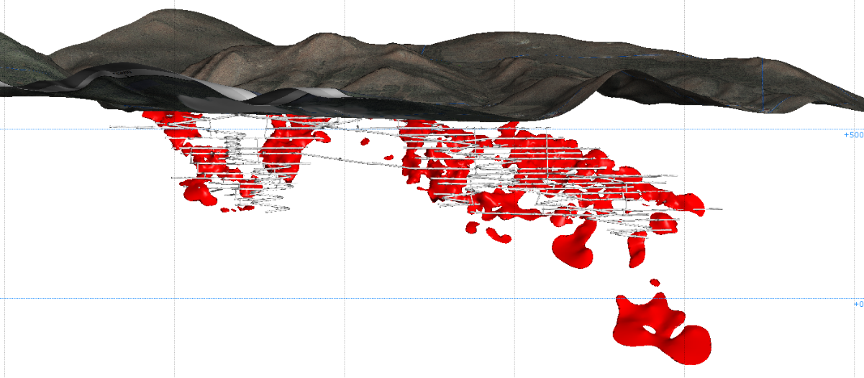
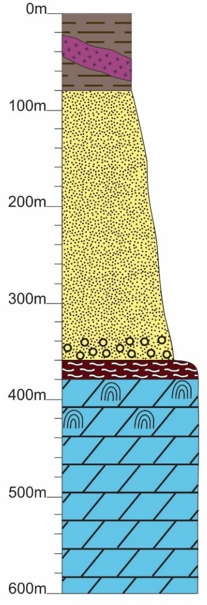
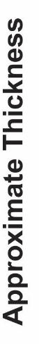

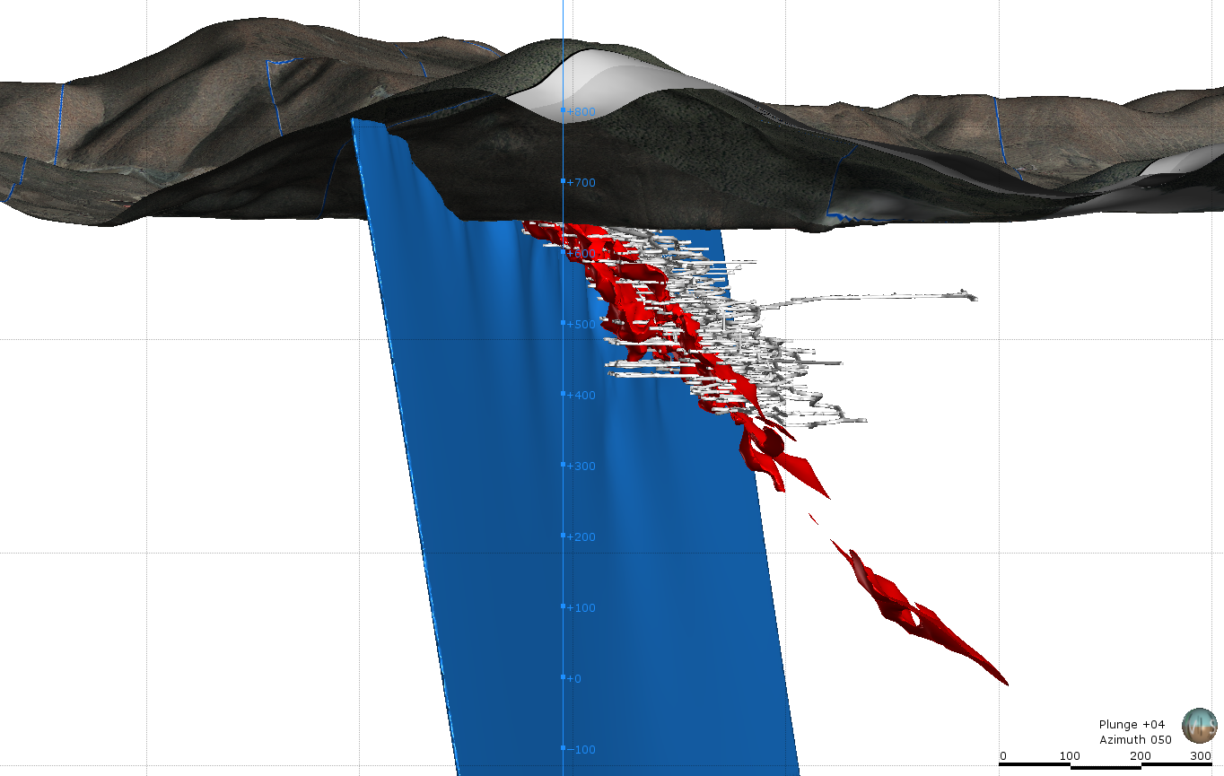

Intro
Geologic Setting
Deposit Stratigraphy
Ore and Alteration Patterns
Regional Deposits
Geochronology
Conclusions
Mine-scale Stratigraphy
>1.0g/t Au, facing NW
>1.0g/t Au, facing NE

Slide 6
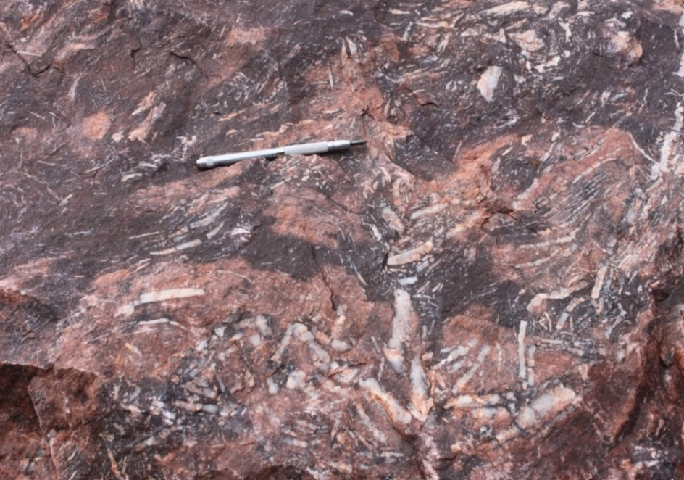
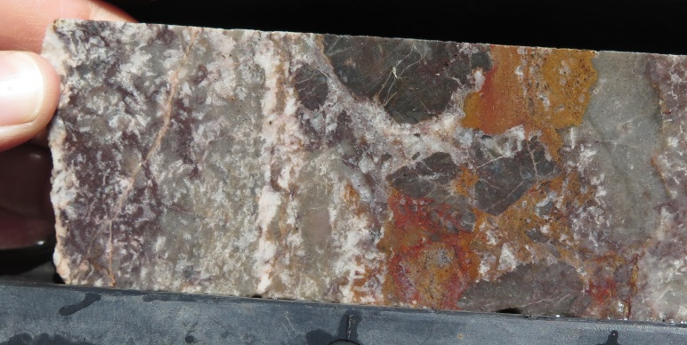

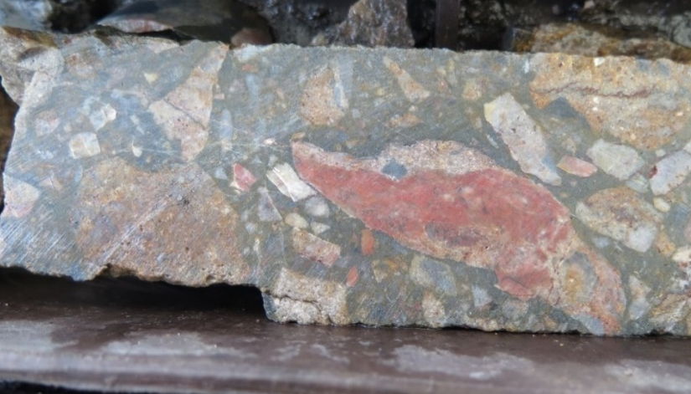
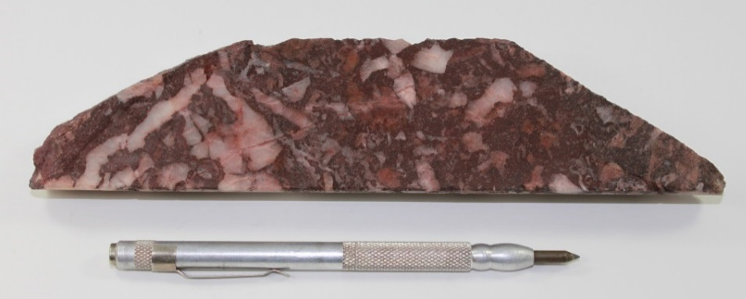
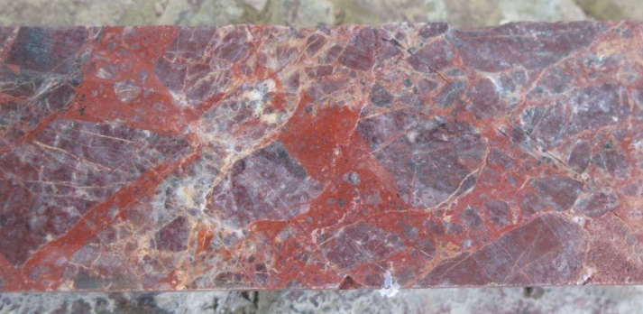
Intro
Geologic Setting
Deposit Stratigraphy
Ore and Alteration Patterns
Regional Deposits
Geochronology
Conclusions
Mine-scale Stratigraphy
Scalloped Quartz Breccia (Favorable Interval):
Ore Breccias:
Scalloped Qz breccia is a regional feature in the basin
The ore breccia at White Mountain exploits this unit

Slide 7
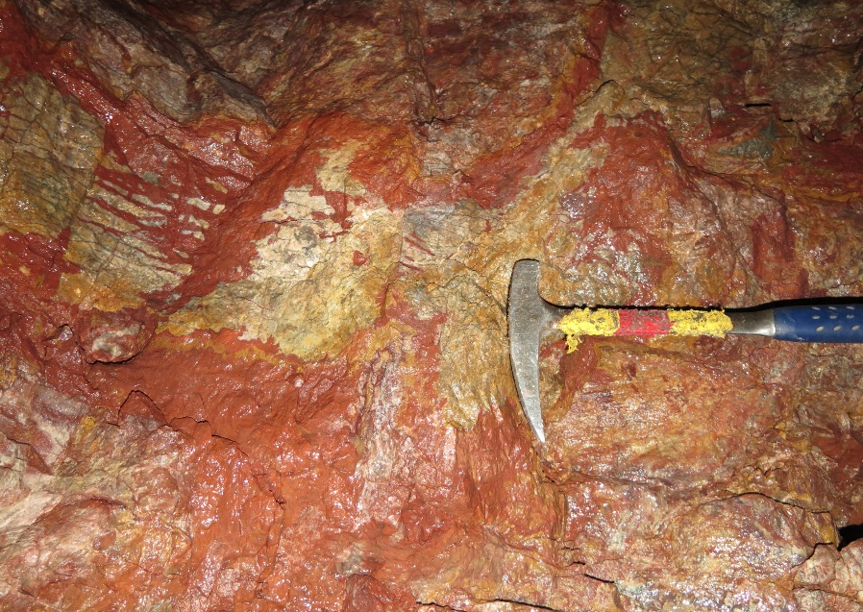
Intro
Geologic Setting
Deposit Stratigraphy
Ore and Alteration Patterns
Regional Deposits
Geochronology
Conclusions
Ore & Alteration Patterns at White Mountain
Mineralization
20μm
30μm
Mineralization (top) consists of native gold/electrum within fractures in quartz, barite, and iron oxides
Alteration (right) consists dominantly of hematite and clays (kaolinite, dickite, illite)
Shows characteristics of multiple deposit types
Alteration

Slide 8

Intro
Geologic Setting
Deposit Stratigraphy
Ore and Alteration Patterns
Regional Deposits
Geochronology
Conclusions
What about the regional framework?
Research Question: Are there other related deposits within the Hunjiang basin? If so, how are these related to White Mountain, and how does White Mountain fit within the regional tectonic framework?
 | Carlin-type gold | High sulfidation (HS) | Distal disseminated
Metal association | Gold-only (associated sulfides = pyrite, marcasite) with gold in arsenian pyrite rims | Au + Ag, Cu, pyrite, associated arsenic sulfides, eg. enargite, luzonite, tennantite, tetrahedrite | Au + Ag, electrum, argentite, tetrahedrite, tennantite
Geochemical anomalies | Ag, As, Sb, Tl, Hg | Au, Ag, As, Cu, Sb, Bi, Hg, Te, Sn, Pb, Mo, Te/Se | Ag, As, Sb, Tl, Hg, Ba, F
Alteration Minerals | Pyrite, marcasite, quartz (silicification), orpiment, realgar, stibnite, kaolinite, dickite, illite, decalcification | Alunite, kaolinite, dickite, pyrophyllite, diaspore, late barite | Quartz (silicification), decalcification, sericite, variable clays
Ore Fluids | Low salinity, CO₂ and H₂S-bearing fluid | Acidic, low salinity, low temperature fluid | Hypogene magmatic fluid derived from distal porphyry system
Structural Control | Spatial association w/ pre-existing crustal faults | Can be associated with local fault structures but not necessary | Can be related to axial planes in folded rocks, can have stockwork veins, often disseminated
Geodynamic setting | Continental back-arc extension environments | Related to subduction zones | Distal to porphyry systems (related to subduction zones)
?
?
Cline et al. (2005); Kerrich et al. (2000); Sillitoe and Bonham (1990);
Sillitoe (2008); Simmons et al. (2005);

Slide 9
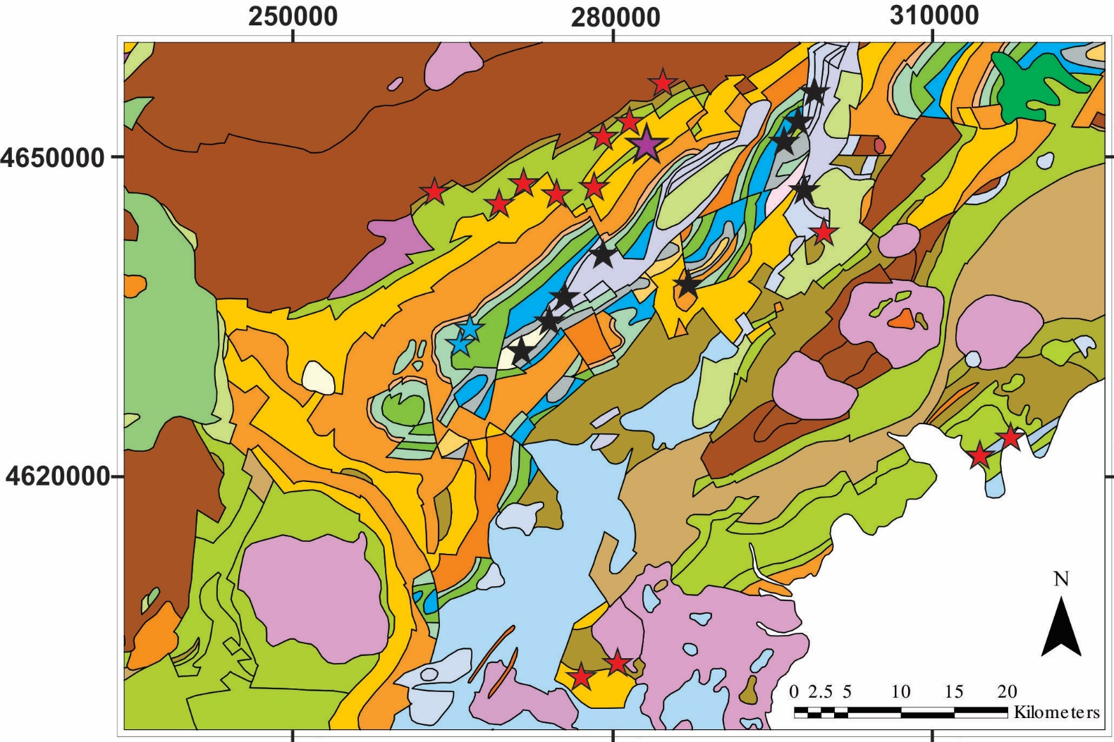
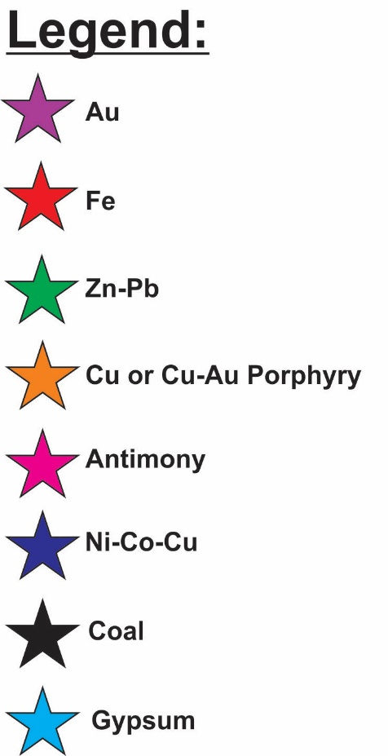
Intro
Geologic Setting
Deposit Stratigraphy
Ore and Alteration Patterns
Regional Deposits
Geochronology
Conclusions
Iron Deposits

Slide 10
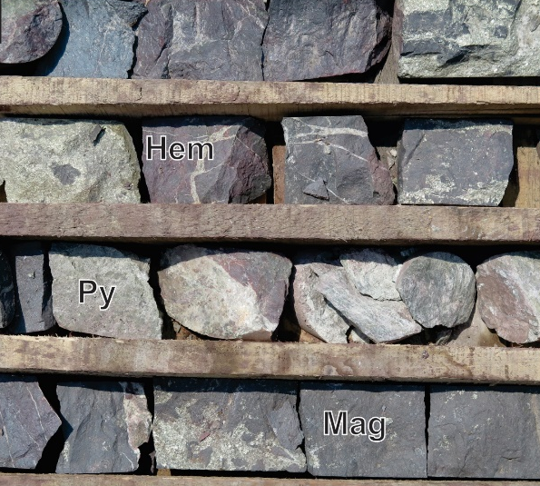


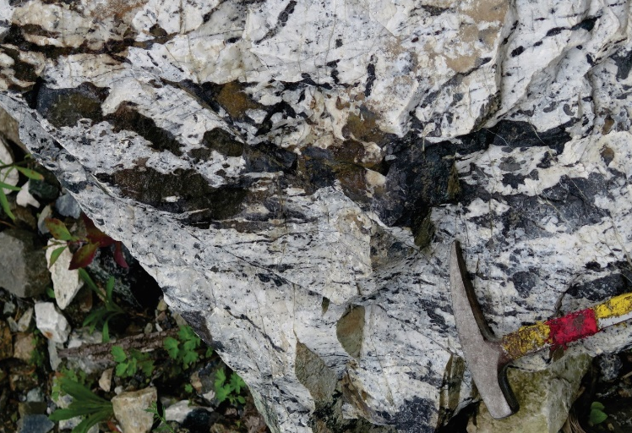
Intro
Geologic Setting
Deposit Stratigraphy
Ore and Alteration Patterns
Regional Deposits
Geochronology
Conclusions
Iron Deposits
The iron deposits within the northern part of the basin are dominantly hematite-bearing breccias (the favorable unit at the White Mountain deposit)
Iron deposits to the south appear to be skarns
Massive replacement of marble with hematite, pyrite, magnetite

Slide 11
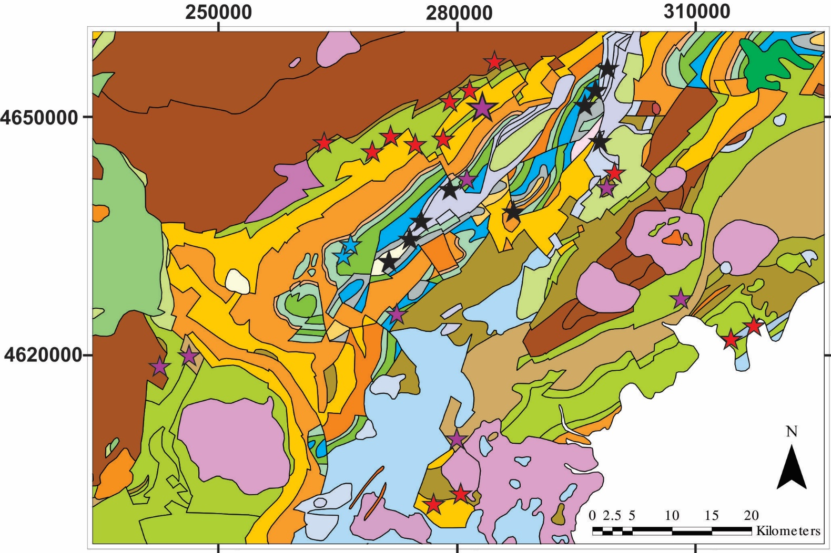
Intro
Geologic Setting
Deposit Stratigraphy
Ore and Alteration Patterns
Regional Deposits
Geochronology
Conclusions
Gold Deposits

Slide 12
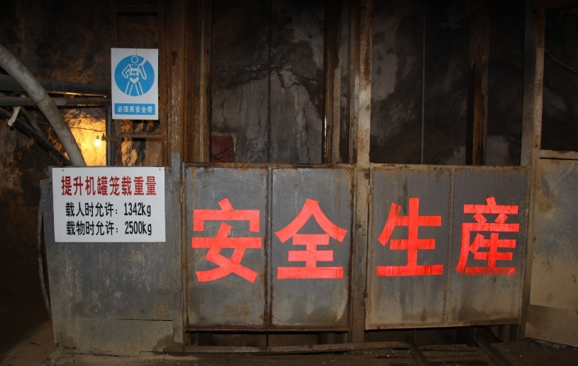
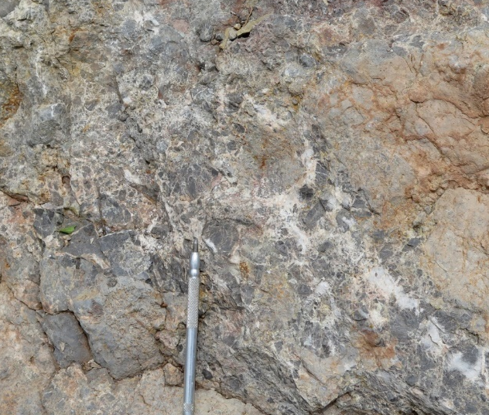

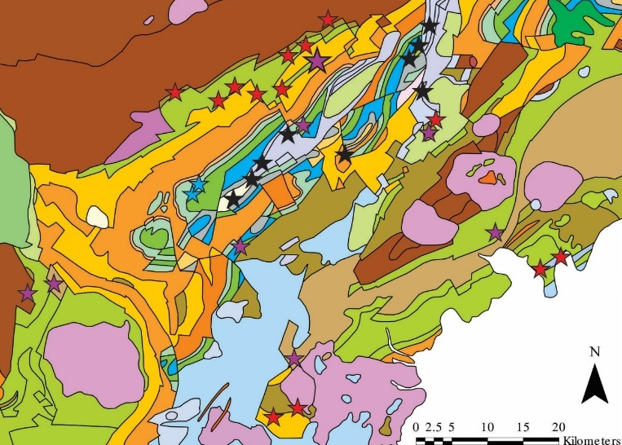
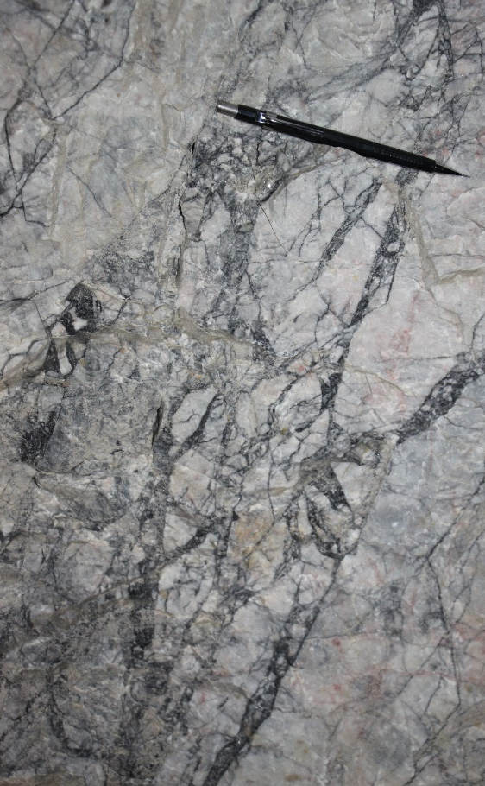
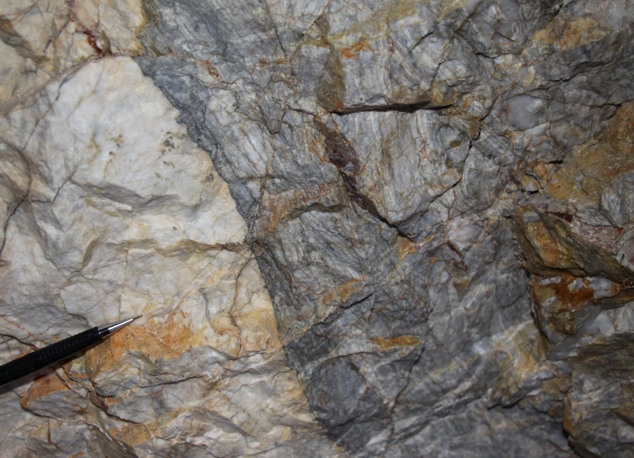
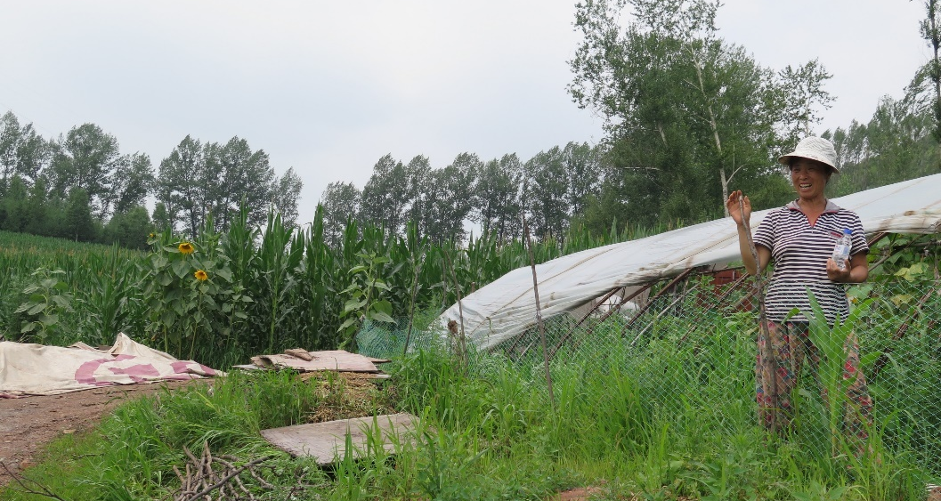
Intro
Geologic Setting
Deposit Stratigraphy
Ore and Alteration Patterns
Regional Deposits
Geochronology
Conclusions
Gold Deposits
Huanggoushan gold deposit
Sulfide breccias and banded veins in marble
Langdonggou gold deposit
Sulfide veins and breccias within rhyolite host

Slide 13

Intro
Geologic Setting
Deposit Stratigraphy
Ore and Alteration Patterns
Regional Deposits
Geochronology
Conclusions
Porphyry Deposits – They Do Exist in the Basin!

Slide 14
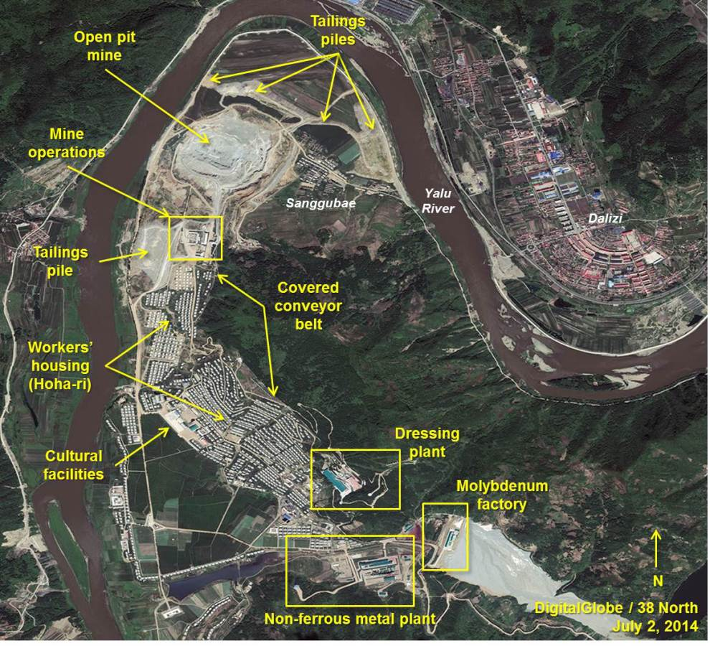
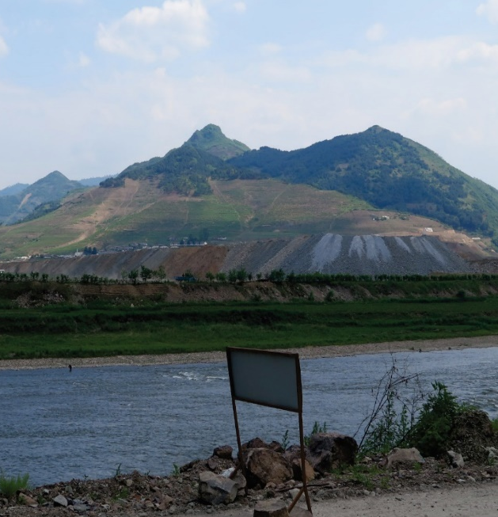
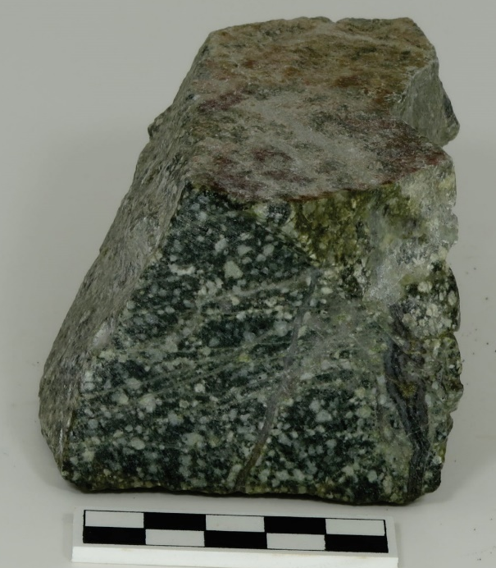


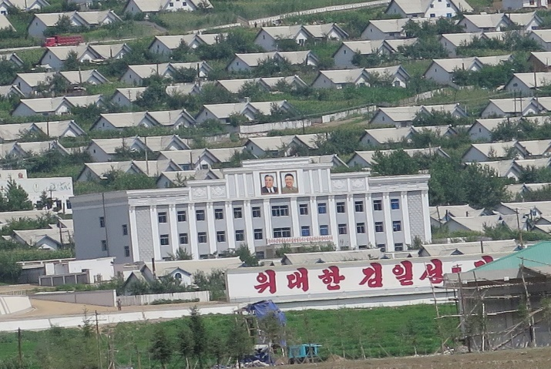
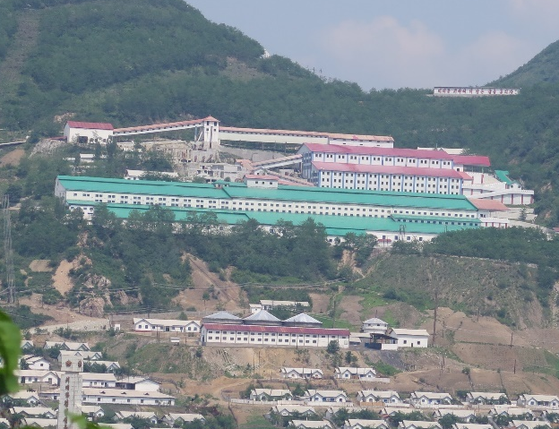
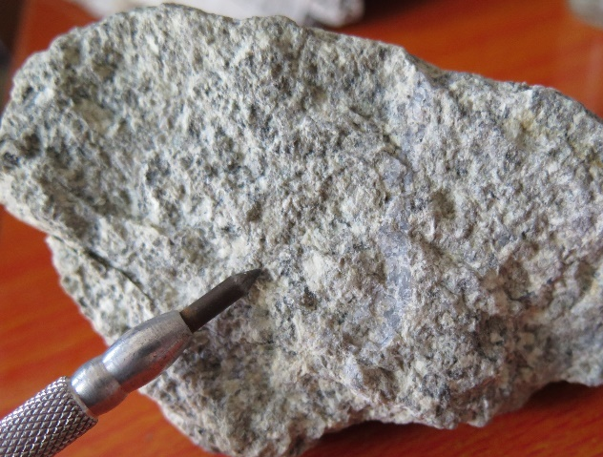
Intro
Geologic Setting
Deposit Stratigraphy
Ore and Alteration Patterns
Regional Deposits
Geochronology
Conclusions
Porphyry Deposits
March 5 Youth Porphryry, North Korea
Cu ± Mo(?) deposit – substantial operation on China-Korea border
Liudaojiang Cu-Au porphyry deposit
Stockwork veins of chalcopyrite + pyrite, skarn mineralization in country rock
Stockwork veining
Qz Vein
Skarn mineralization

Slide 15
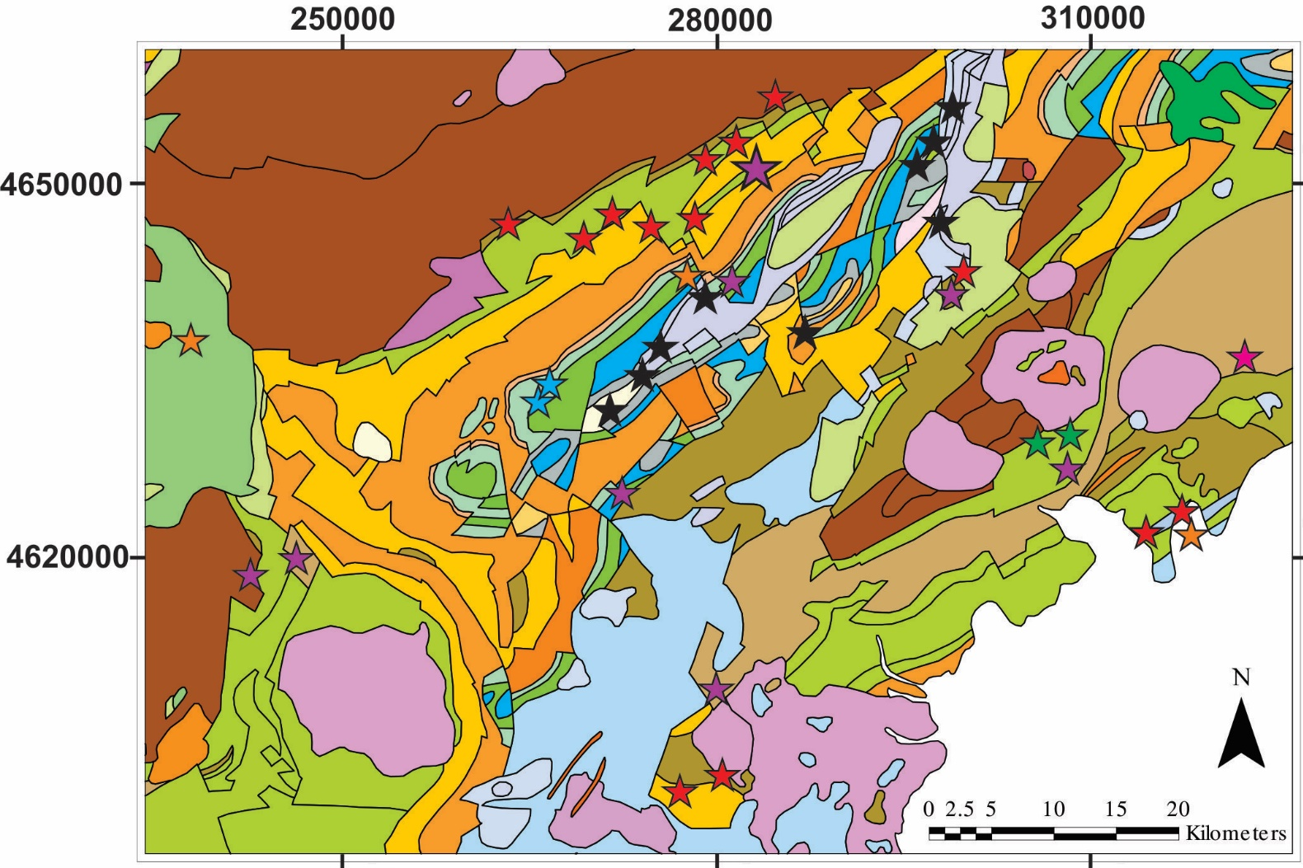
Intro
Geologic Setting
Deposit Stratigraphy
Ore and Alteration Patterns
Regional Deposits
Geochronology
Conclusions
Zn-Pb and Antimony Deposits

Slide 16
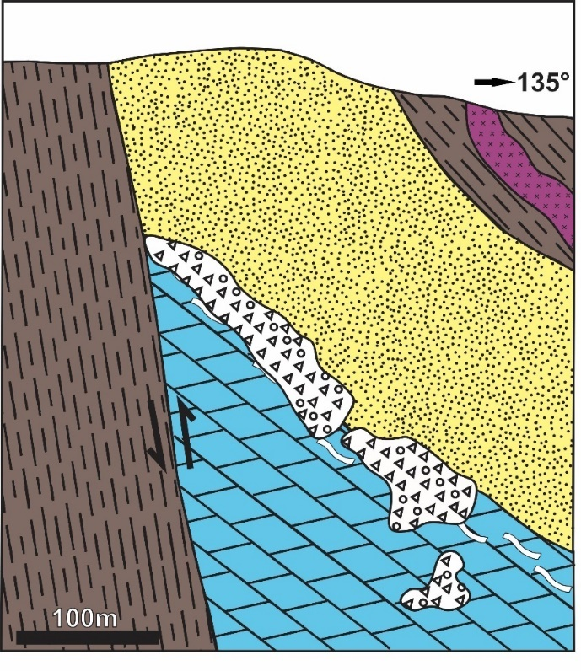
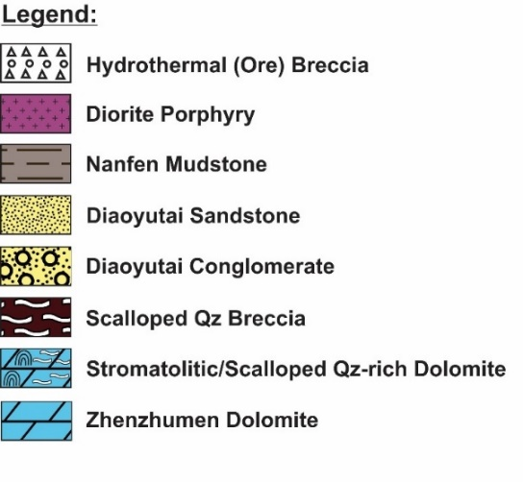
Intro
Geologic Setting
Deposit Stratigraphy
Ore and Alteration Patterns
Regional Deposits
Geochronology
Conclusions
Geochronological Constraints
Hanging-Wall Sandstone, White Mountain
²⁰⁷Pb/²⁰⁶Pb
²³⁸U/²⁰⁶Pb
Detrital zircons in the hanging wall sandstone yielded concordant Proterozoic ages and Archean ages

Slide 17
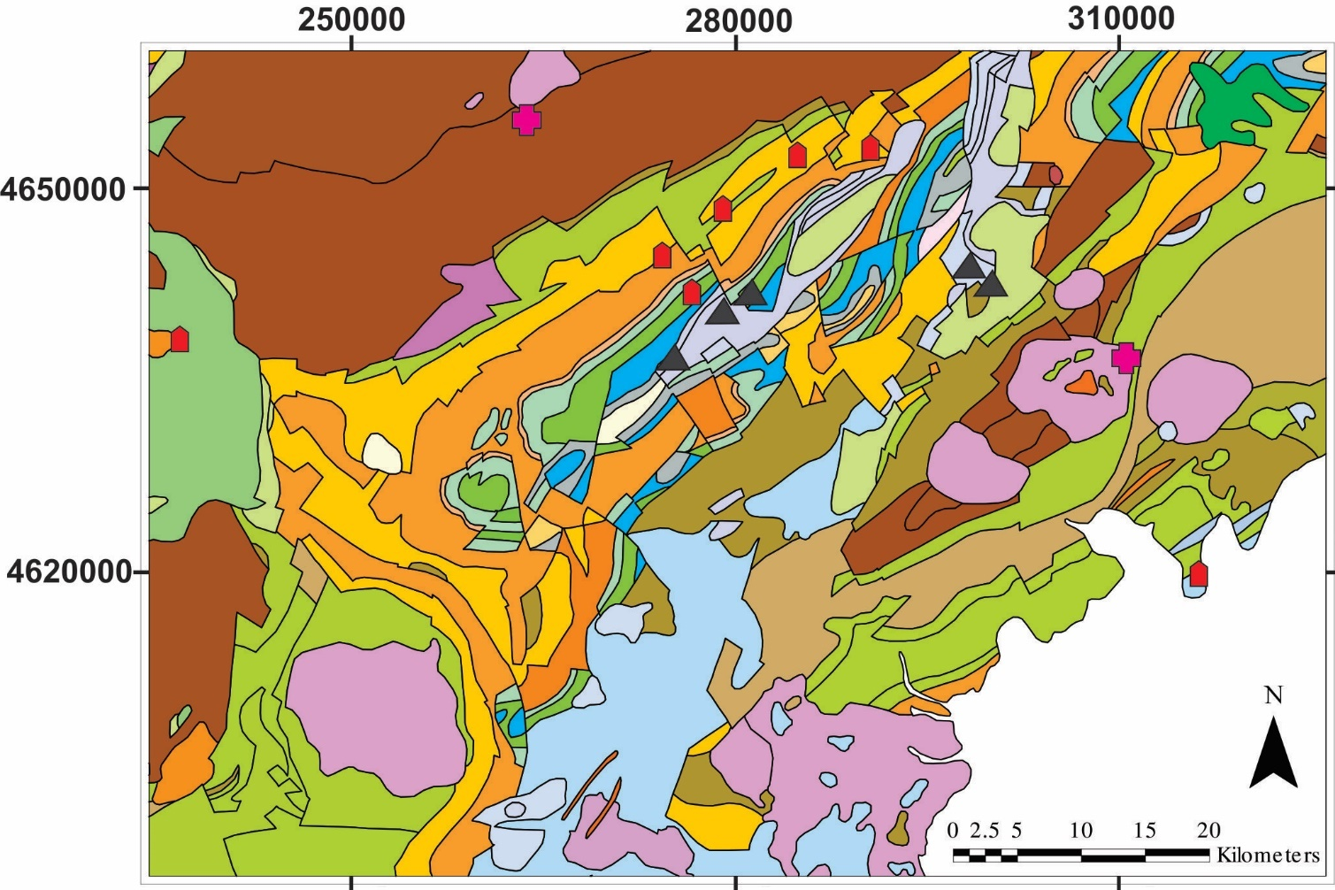

Intro
Geologic Setting
Deposit Stratigraphy
Ore and Alteration Patterns
Regional Deposits
Geochronology
Conclusions
Geochronological Constraints
Early Cretaceous
Middle Jurassic

Slide 18
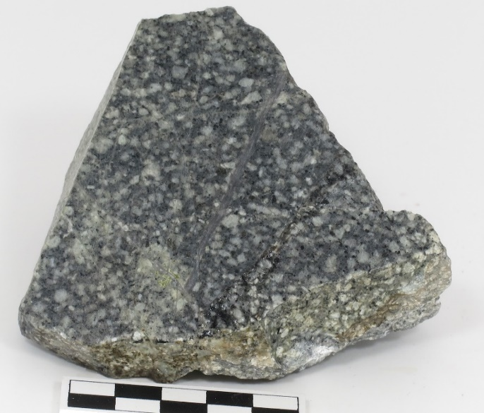

Intro
Geologic Setting
Deposit Stratigraphy
Ore and Alteration Patterns
Regional Deposits
Geochronology
Conclusions
Geochronological Constraints
Mineralized Liudaojiang Porphyry:
²⁰⁷Pb/²⁰⁶Pb
²³⁸U/²⁰⁶Pb
Magmatic zircon rims yield Middle Jurassic ages
Concordia Age = 166.0 ±0.8 Ma (2σ, decay-const. errs included) n = 10 MSWD (of conc.&equiv.) = 1.4, Probability (of conc.&equiv.) = 0.11

Slide 19
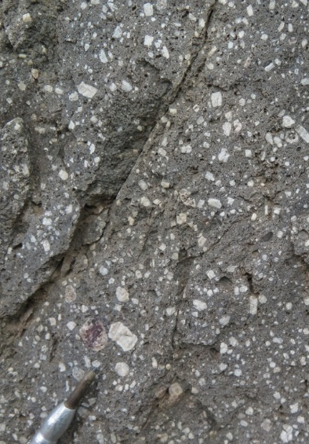
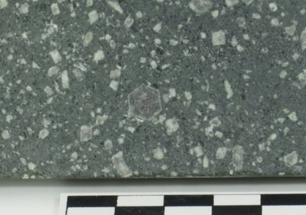
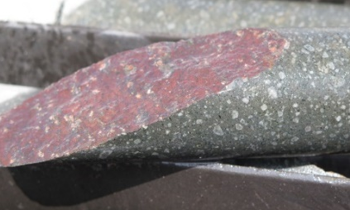
Intro
Geologic Setting
Deposit Stratigraphy
Ore and Alteration Patterns
Regional Deposits
Geochronology
Conclusions
Geochronological Constraints
Unmineralized White Mountain Porphyry:
²⁰⁷Pb/²⁰⁶Pb
²³⁸U/²⁰⁶Pb
Concordia Age = 130.2 ±0.9 Ma (95% confidence, decay-const. errs included)
n = 14 MSWD (of conc.&equiv.) = 2.0, Probability (of conc.&equiv.) = 0.005
The White Mountain porphyry yields Early Cretaceous ages

Slide 20
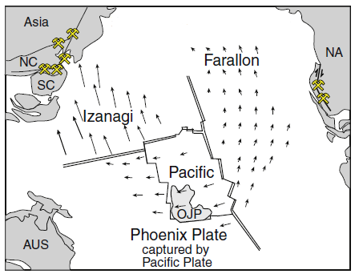
Intro
Geologic Setting
Deposit Stratigraphy
Ore and Alteration Patterns
Regional Deposits
Geochronology
Conclusions
Interpretations and Conclusions
Research Question: Are there other related deposits within the Hunjiang basin? If so, how are these related to White Mountain, and how does White Mountain fit within the regional tectonic framework?
The Pacific Plate “captured” the Phoenix plate in the Lower Cretaceous, resulting in a shift to northerly subduction of the Izanagi and Farallon plates.
Diagram from Sillitoe (2008)

Slide 21
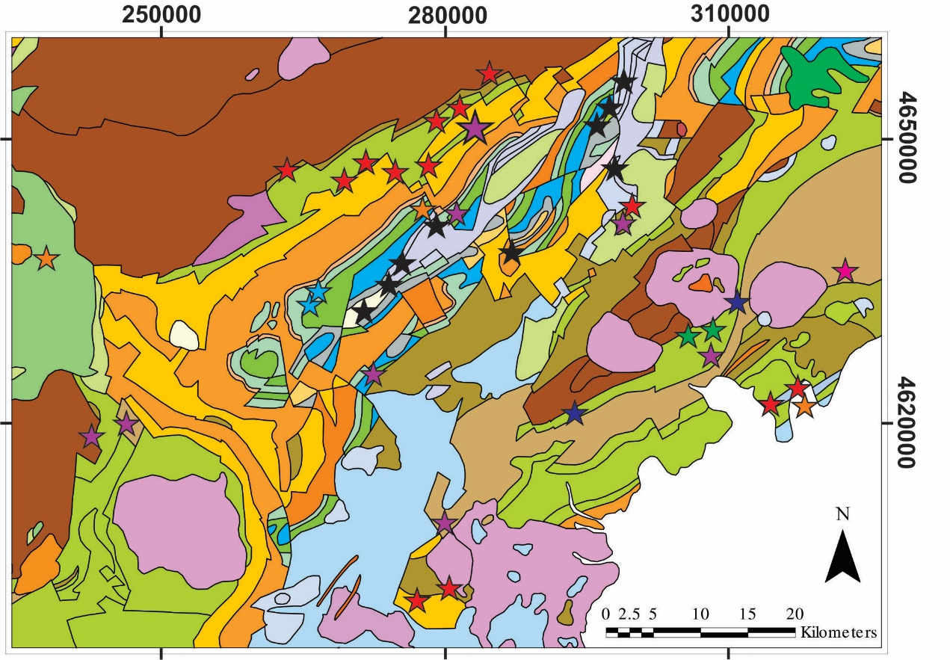
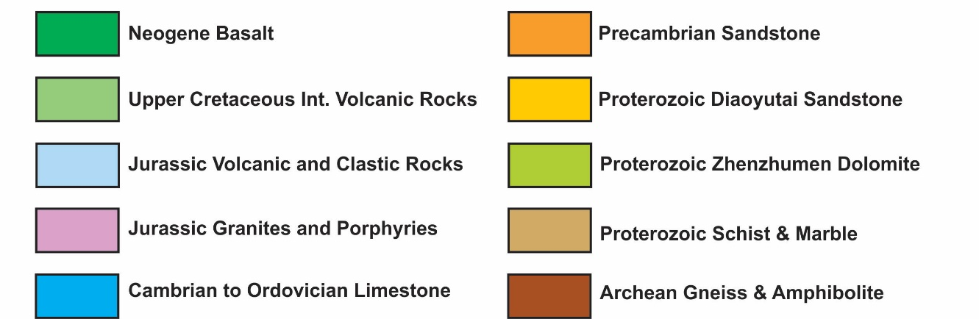

Intro
Geologic Setting
Deposit Stratigraphy
Ore and Alteration Patterns
Regional Deposits
Geochronology
Conclusions
Interpretations and Conclusions
Results Summary:
Sedimentary rocks in the Hunjiang basin range from Proterozoic to at least Permian
Hematite alteration occurred before most structural activity
Compression predated Mesozoic extension
Structural activity largely finished by the Early Cretaceous (volcaniclastic rocks unconformably overlying dipping sedimentary rocks)
Geochronology suggests mineralization occurred during the Early Cretaceous or later
Mesozoic extension and magmatic-hydrothermal activity are the likely drivers of mineralization within the basin

Slide 22
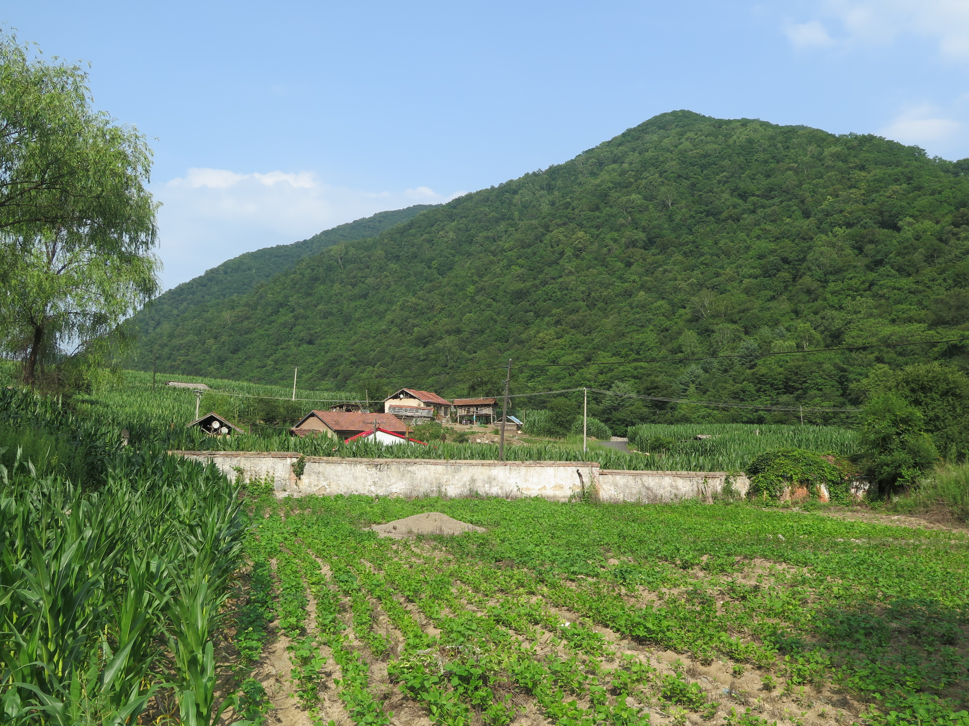


Acknowledgements:
Eldorado Gold Corp.: Feng Tao, Greg Collins, Tim Baker, Peter Lewis, Sun Peng, Liu Hongfu
The Society of Economic Geologists for grants and fellowships
The Geological Society of America for conference opportunities

Slide 23
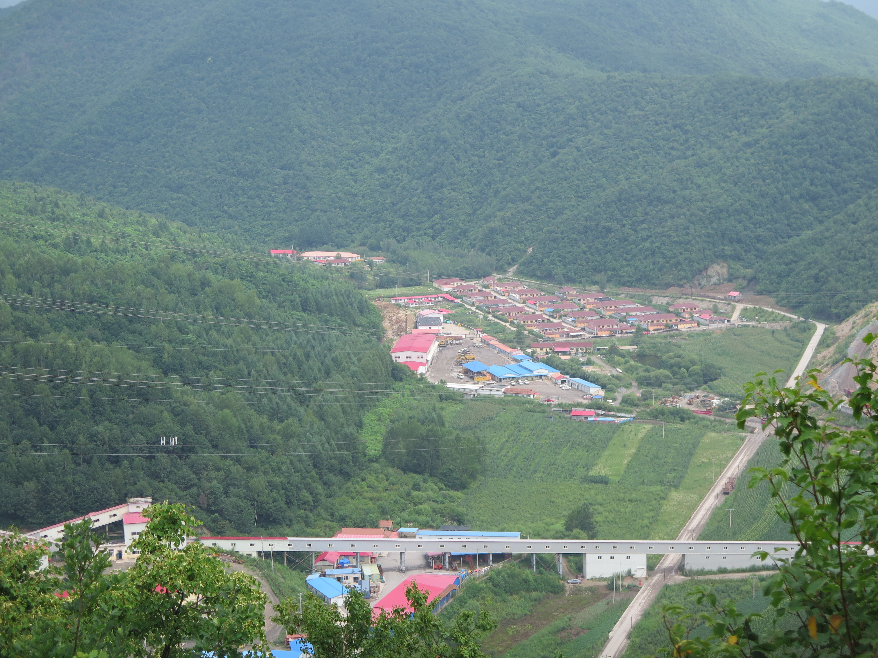
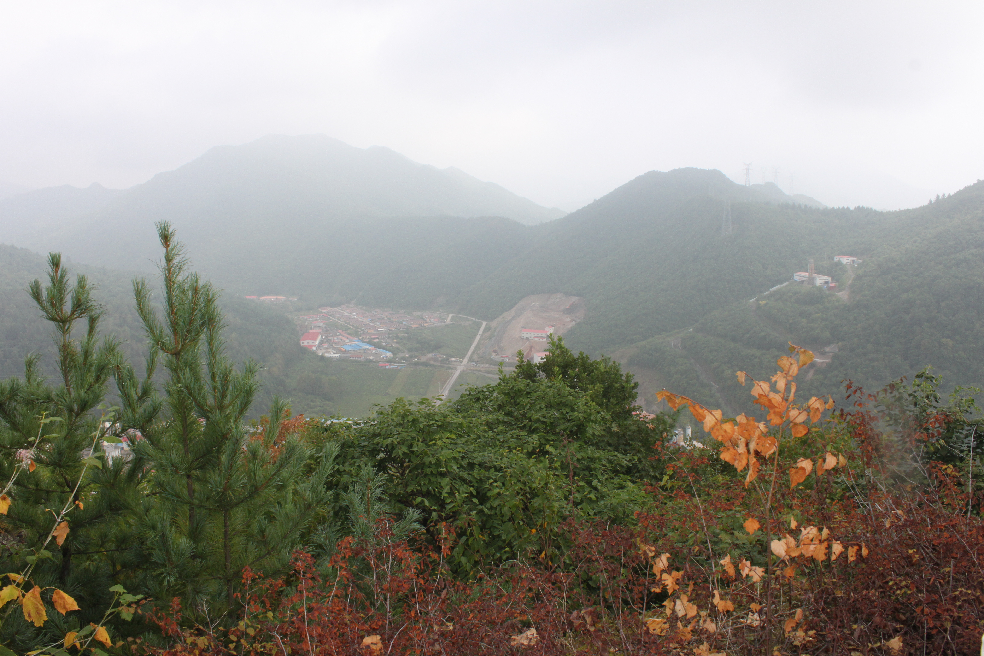
References:
Chapman, J., Kosacz, R., Sun, Y., and Warren, M., 2007. White Mountain Project, Jilin Province, China. Report prepared for SinoGold Mining Limited: SRK Consulting, 22 p.
Cline, J.S., Hofstra, A.H., Muntean, J.L., Tosdal, R.M., and Hickey, K.A., 2005. Carlin-Type Gold Deposits in Nevada: Critical Geologic Characteristics and Viable Models: Economic Geology 100th Anniversary Volume, p. 451-484.
Giggenbach, W.F., 1992. Magma degassing and mineral deposition in hydrothermal systems along convergent plate boundaries: Economic Geology, v. 87, p. 1927-1944.
Goldfarb, R.J., Taylor, R.D., Collins, G.S., Goryachev, N.A., and Orlandini, O.F., 2014. Phanerozoic continental growth and gold metallogy of Asia: Gondwana Research, v. 25, p. 48-102.
Hart, C.J.R., Goldfarb, R.J., Qiu, Y., Snee, L., Miller, L.D., and Miller, M.L., 2002. Gold deposits of the northern margin of the North China Craton: multiple late Paleozoic-Mesozoic mineralizing events: Mineralium Deposita, v. 37, p. 326-351.
Ross, K., and Rhys, D., 2012. Petrographic study of samples from the White Mountain gold deposit, Jilin Province, China. Report prepared for Eldorado Gold Corp., by Panterra Geoservices Inc.
Sillitoe, R.H., and Bonham, H.F., 1990. Sediment-hosted gold deposits: Distal products of magmatic-hydrothermal systems: Geology, v. 18, p. 157-161.
Sillitoe, R.H., 2008. Major Gold Deposits and Belts of the North and South American Cordillera: Distribution, Tectonomagmatic Settings, and Metallogenic Consideration: Economic Geology, v. 103, p. 663-687.
Simmons, S.F., White, N.C., and John, D.A., 2005. Geological Characteristics of Epithermal Precious and Base Metal Deposits: Economic Geology 100th Anniversary Volume, p. 485-522.
Zhao, G., and Cawood, P.A., 2012. Precambrian geology of China: Precambrian Research, v. 222, p. 13-54.
Thank You!

