Slide 1
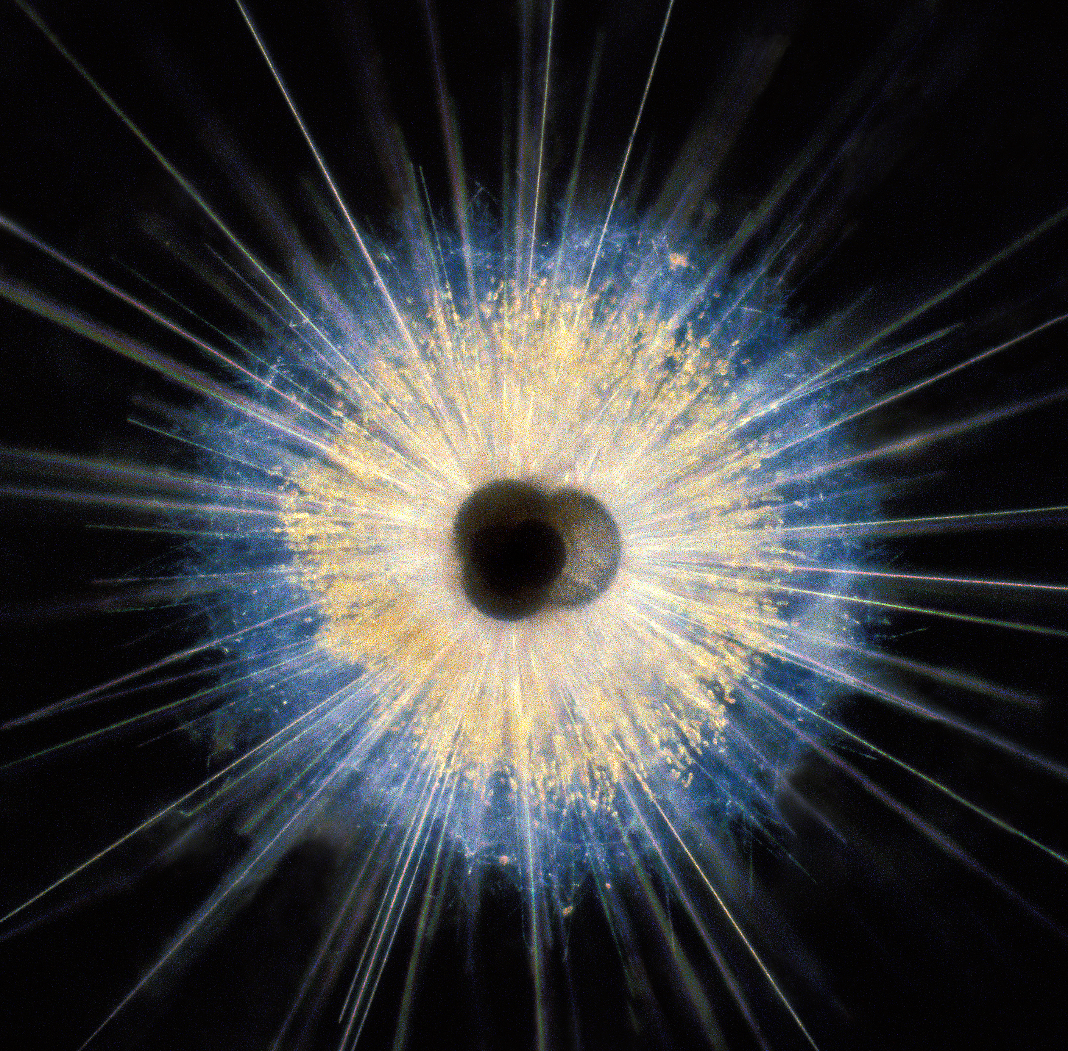


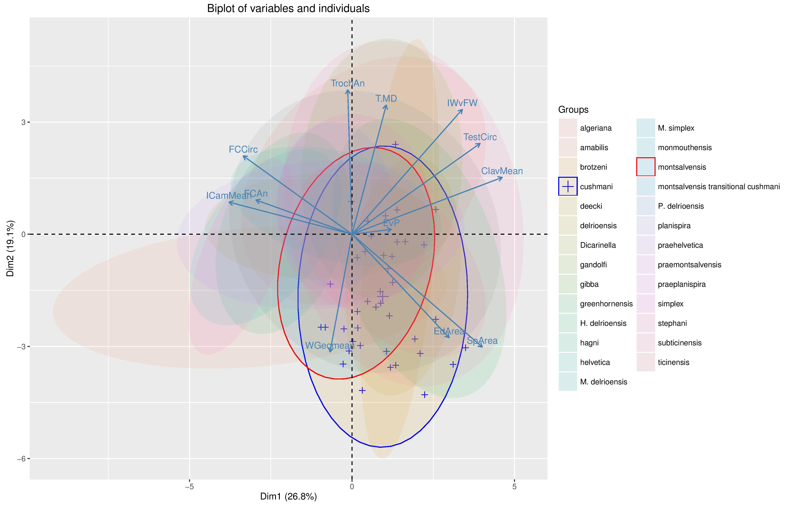
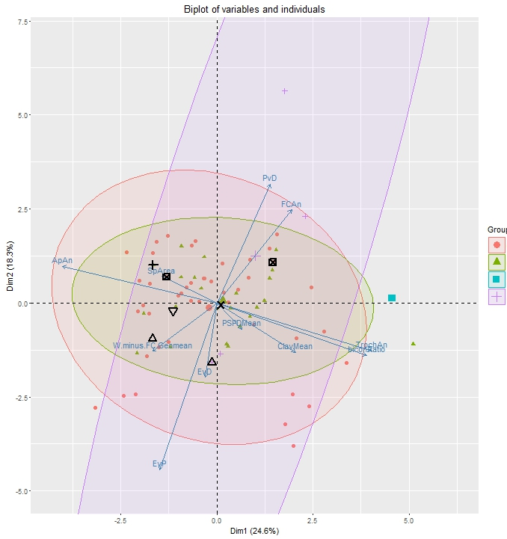
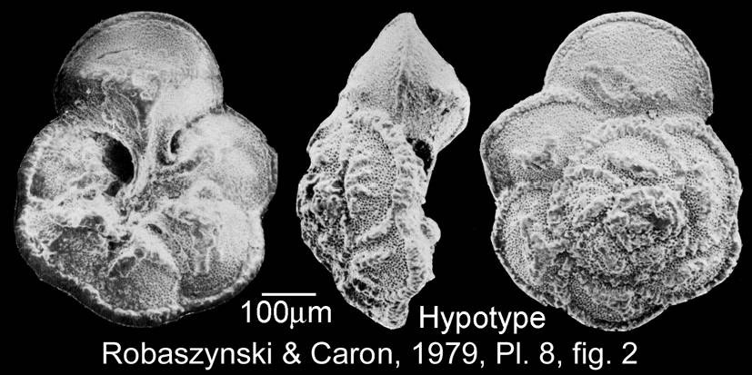
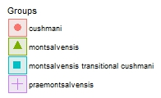
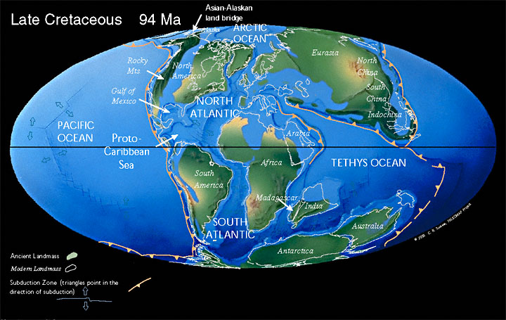
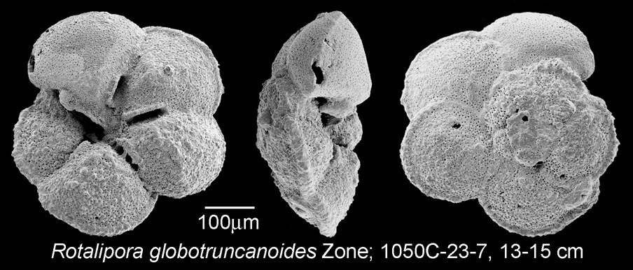
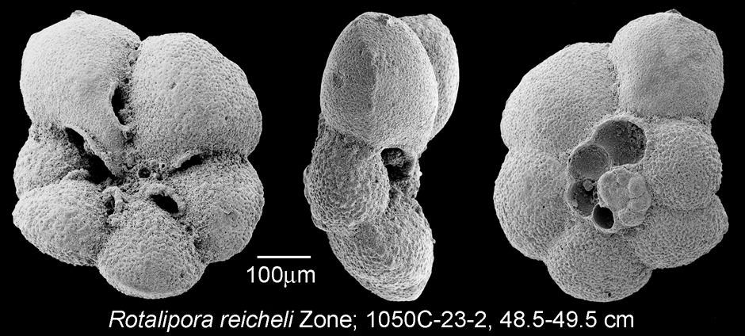
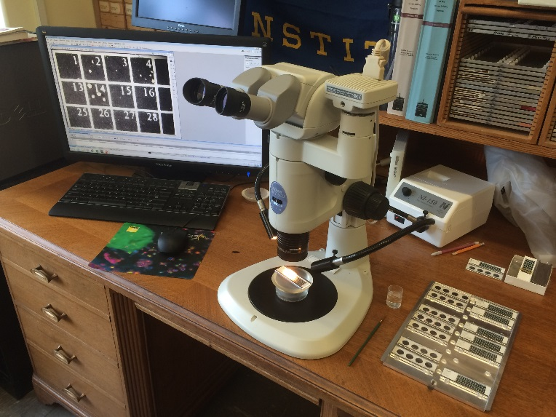
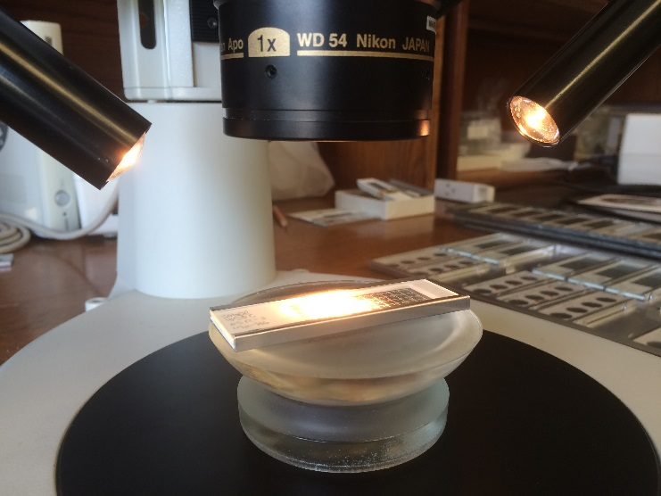
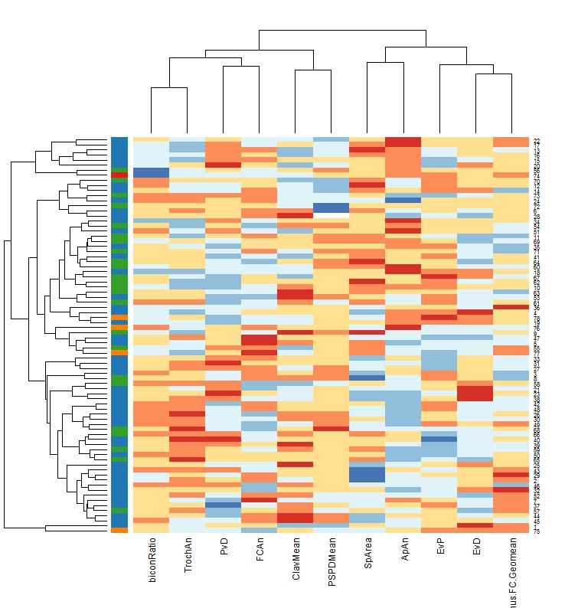
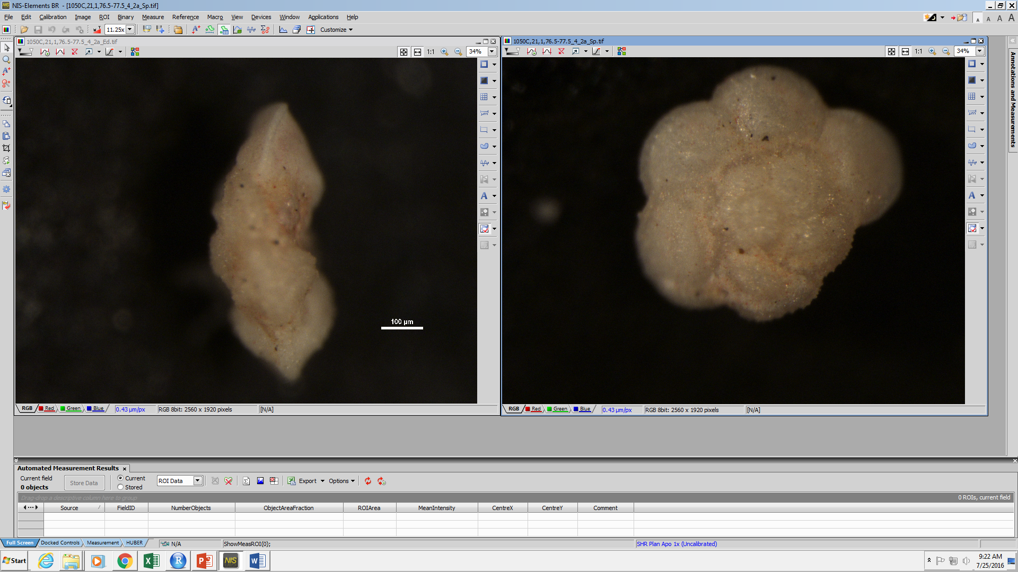

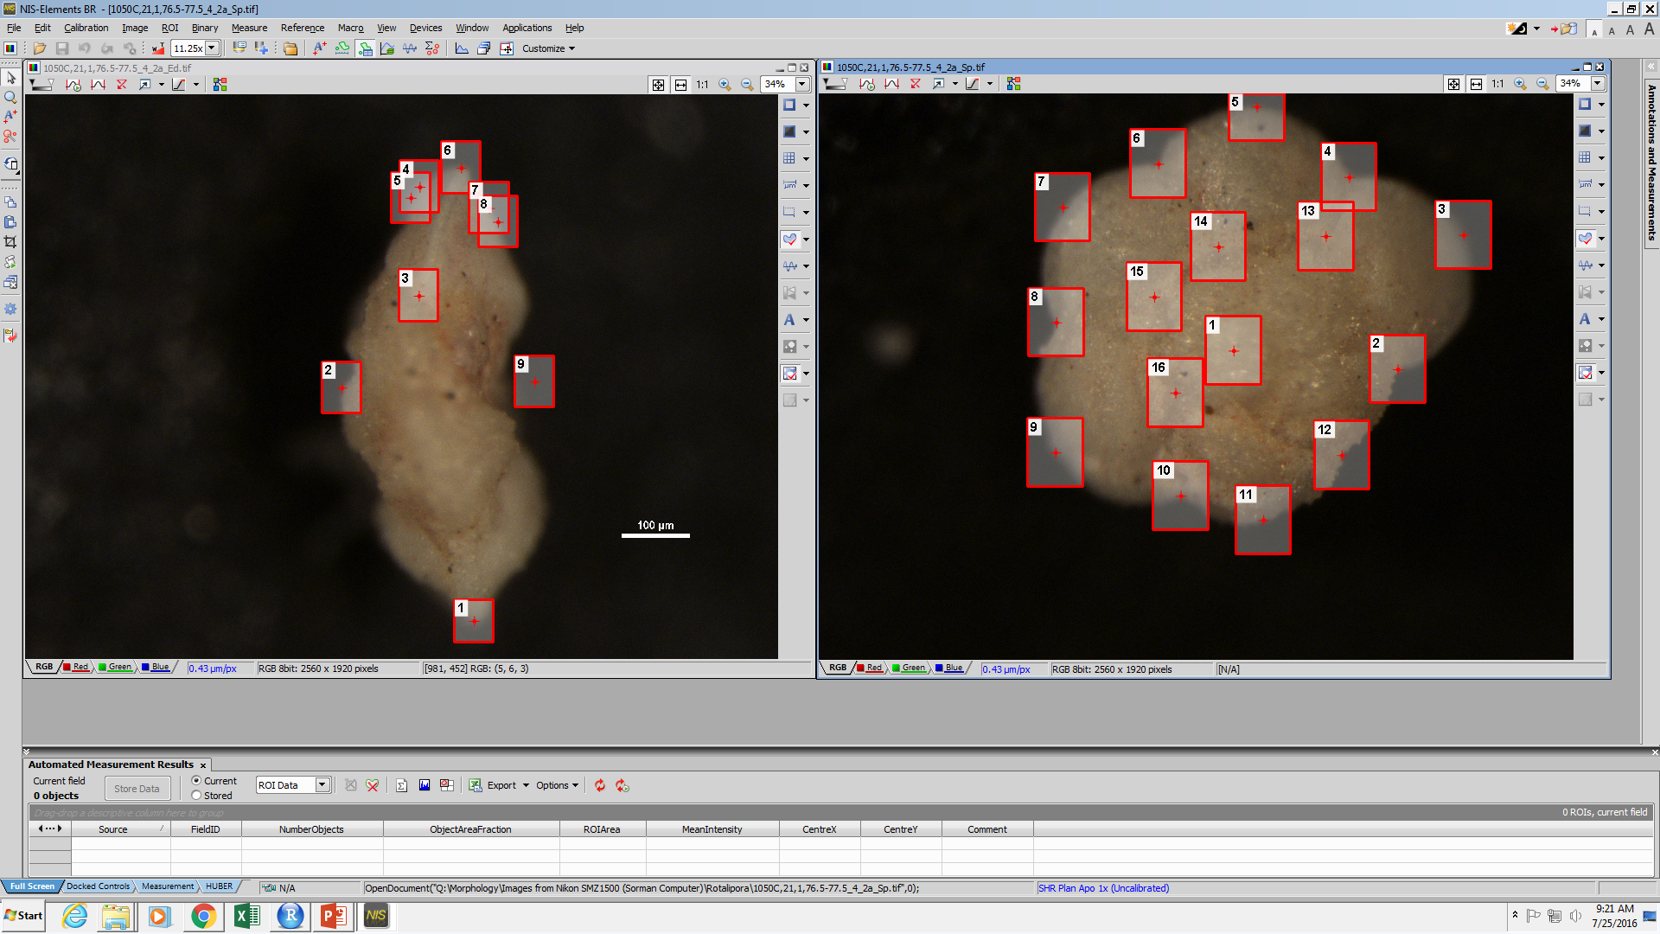
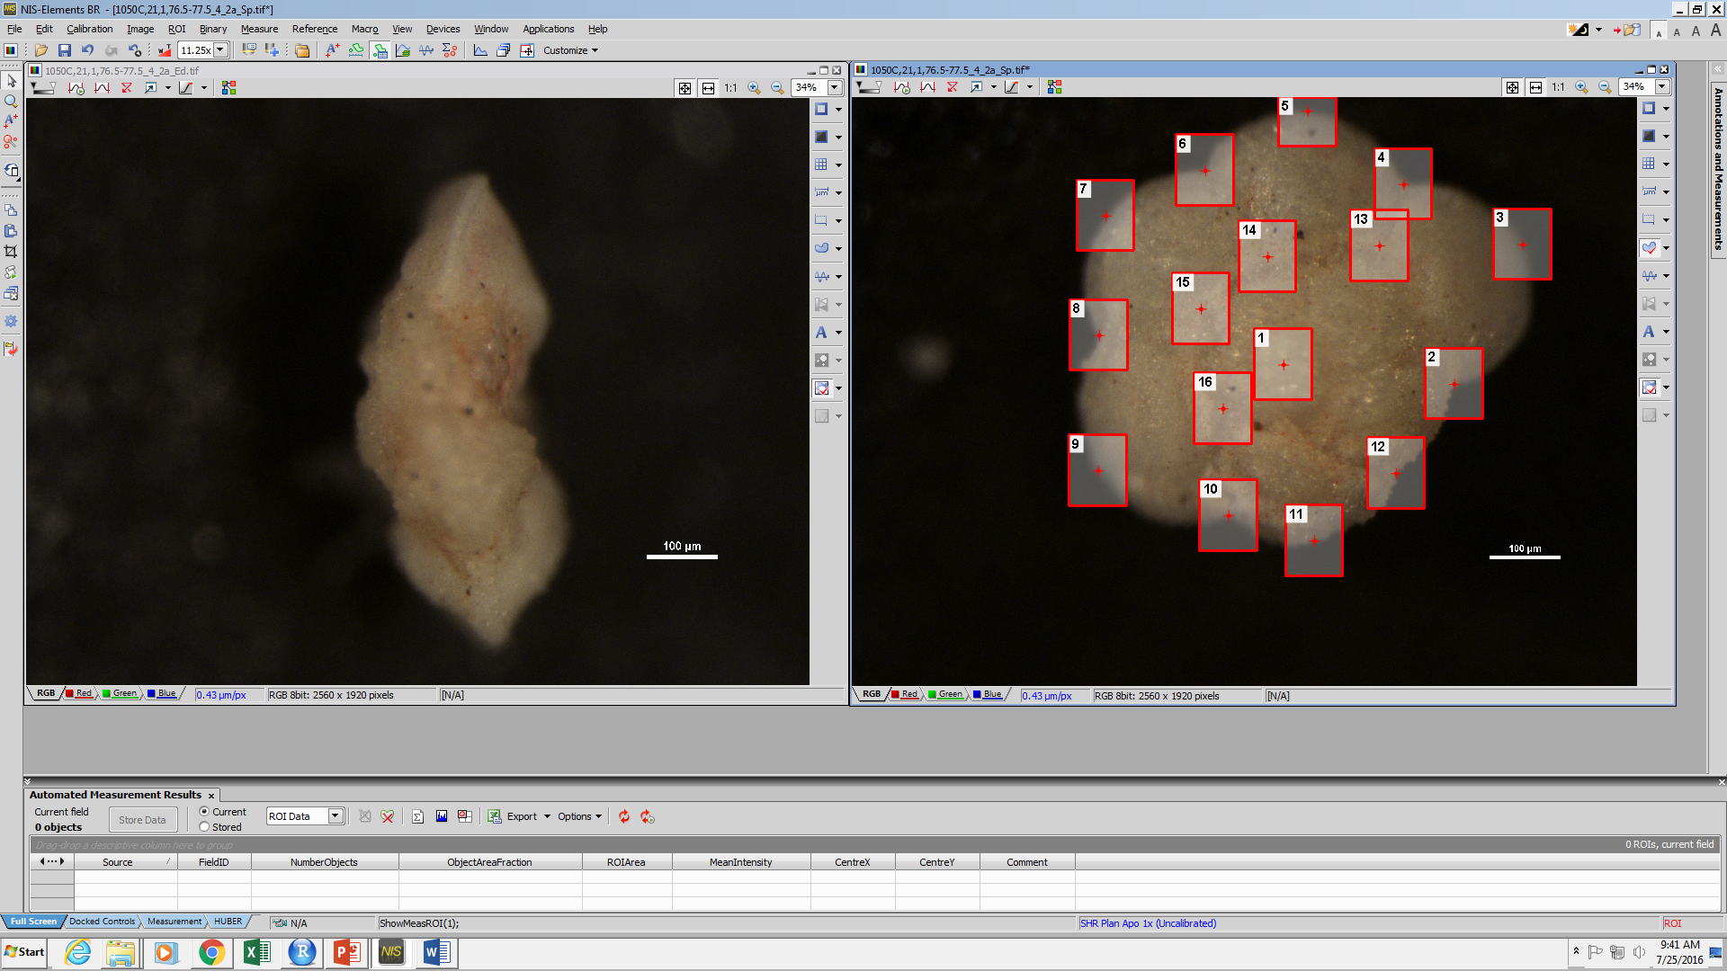
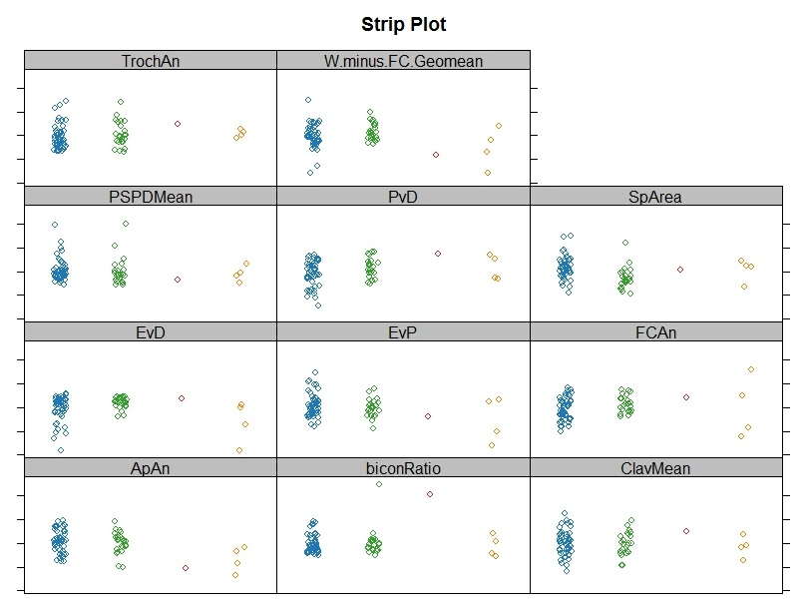

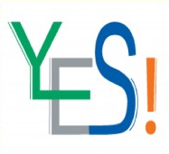
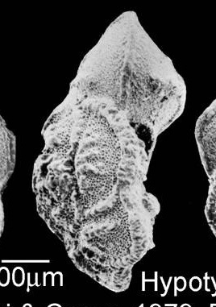
Morphometric study of the Rotalipora lineage (planktic foraminifera) during the Middle and Late Cenomanian
Melanie G. Sorman¹, Andrew J. Fraass², and Brian T. Huber²
¹University of Wisconsin-Whitewater, Department of Geography, Geology, & Environmental Science
²Smithsonian Institution, Department of Paleobiology
Introduction
The Cenomanian (Late Cretaceous, ~94-100 Ma) time period can be used to determine planktic foraminiferal evolutionary history and interpret Earth’s climatology. Planktic foraminifera are microorganisms that are abundant in the fossil record, making them a valuable group to study. This project examines the evolution of the genus Rotalipora (focusing on R. cushmani, R. montsalvensis, and R. praemontsalvensis) and their morphologic variability and relation to one another with the goal to better define the Rotalipora phylogenetic tree.
Results
Morphometrics
Species
Rotalipora cushmani (n=49)
Ridges on spiral side
“Y-shape” surface texture on umbilical side
Moderately biconvex
Well-defined keel
Smithsonian
Rotalipora montsalvensis (n=24)
Inflated chambers
Biconvex
Well-defined keel
Collection Site
These biplots use individual species as points and the 11 characteristics as vectors. The horizontal axis is the first principal component and the vertical axis is the second. The black symbols in the right figure represent the type material.
R. cushmani has a wider distribution than R. montsalvensis, as shown in the blue and red outlined ovals. The two species show similar characteristics, but differ mostly in Edge/Spiral Area, meaning R. cushmani has a relatively larger test size.
R. cushmani has two groups within the described oval – one near the center and another to the bottom right. R. montsalvensis is generally found in the center of the plot, and R. praemontsalvensis has one outlier that causes its oval to be much wider.
Scotese, PaleoMap
Rotalipora praemontsalvensis (n=4)
Inflated, globular chambers
Biconvex
Chamber surface smooth
Present but not well-defined keel
Samples were collected from Blake Nose Plateau, ~280 miles east of Daytona Beach, Florida
Methods
Imaging
Using a Nikon SMZ1500 Microscope, spiral and edge view orientations of the species are imaged
Universal stage helps with easier and faster imaging
Species
Heat Map
R. cushmani
R. montsalvensis
R. montsalvensis transitional R. cushmani
R. praemontsalvensis
High values
Conclusions
Low values
A heat map was constructed with 11 variables, showing a phylogenetic tree of the three species. Variables were removed to either reduce apparent noise within the dataset, or due to redundancy with other measures.
The heat map shows a grouping of R. montsalvensis, R. praemontsalvensis, and high variability of R. cushmani.
Taking Measurements
11 qualitative descriptive terms (e.g. accessory aperture position and types of sutures)
14 quantitative parameters constructed by ~40 measurements
Considering how little data have been collected on R. praemontsalvensis (due to its rarity in samples), comparison with the other species is premature, but it is noteworthy that three of the four individuals clustered well together. The morphology of R. cushmani is highly variable compared to the other species, which is most apparent on the strip plot. Given these results, these three species can be more easily distinguished by qualitative data rather than quantitative (e.g. the ridge and “y-shape” surface ornament on R. cushmani).
Future study will examine the Rotalipora lineage with a more stratophenetic approach so as to give the most accurate understanding of its phylogeny. The collected data will continue to be examined quantitatively to see if there are other methods that can better define the species. These data will also be used in a subsequent study of Cenomanian planktic foraminiferal morphospace, with comparisons of the variability within species and higher-level taxonomic units.
W.minus.FC.Geomean
Manual Measurements
Term | Meaning
TrochAn | Trochospiral Angle
W.minus.FC.Geomean | Geometric mean of the Expansion Rate excluding Final Chamber (FC)
PSPDMean | Previous Suture Point Distance Mean
PvD | FC Perpendicular vs. FC Circle Diameter
SpArea | Spiral Area
EvD | FC Equator vs. FC Circle Diameter
EvP | FC Equator vs. FC Perpendicular
FCAn | Final Chamber Angle
ApAn | Apical Angle
biconRatio | Biconvexity Ratio
ClavMean | Clavateness Mean
Species
R. cushmani
R. montsalvensis
Acknowledgements/References
R. montsalvensis transitional R. cushmani
Huber, Brian T., R. Mark Leckie, Richard D. Norris, Timothy J. Bralower, and Emily CoBabe. "Foraminiferal Assemblage and Stable Isotopic Change Across the Cenomanian-Turonian Boundary in the Subtropical North Atlantic." Journal of Foraminiferal Research 4th ser. 29 (1999): 392-417. Print.
Adrian A. Dragulescu (2014). xlsx: Read, write, format Excel 2007 and Excel 97/2000/XP/2003 files. R package version 0.5.7. https://CRAN.R-project.org/package=xlsx
Simon Urbanek (2016). rJava: Low-Level R to Java Interface. R package version 0.9-8. https://CRAN.R-project.org/package=rJava
Jari Oksanen, F. Guillaume Blanchet, Michael Friendly, Roeland Kindt, Pierre Legendre, Dan McGlinn, Peter R. Minchin, R. B. O'Hara, Gavin L. Simpson, Peter Solymos, M. Henry H. Stevens, Eduard Szoecs and Helene Wagner (2016). vegan: Community Ecology Package. R package version 2.4-0. https://CRAN.R-project.org/package=vegan
Alboukadel Kassambara and Fabian Mundt (2016). factoextra: Extract and Visualize the Results of Multivariate Data Analyses. R package version 1.0.3. https://CRAN.R-project.org/package=factoextra
Erich Neuwirth (2014). RColorBrewer: ColorBrewer Palettes. R package version 1.1-2. https://CRAN.R-project.org/package=RColorBrewer
Max Kuhn. Contributions from Jed Wing, Steve Weston, Andre Williams, Chris Keefer, Allan Engelhardt, Tony Cooper, Zachary Mayer, Brenton Kenkel, the R Core Team, Michael Benesty, Reynald Lescarbeau, Andrew Ziem, Luca Scrucca, Yuan Tang and Can Candan. (2016). caret: Classification and Regression Training. R package version 6.0-70. https://CRAN.R-project.org/package=caret
Automated Measurements
R. praemontsalvensis
Clavateness & Expansion Rate
I would like to thank the NHRE program, NSF, Elizabeth Cottrell, Gene Hunt, and Virginia Power for giving me the opportunity to conduct this research. Additional thanks to the Youth Engagement through Science (YES!) program for providing this project with two wonderful high schoolers, as well as thanks to Jonathan Wingerath for creating the universal stages.
Final Chamber Angle
Trochospiral Angle
Apical Angle
Chamber Length
Suture Length
A strip plot was constructed using variables from the heat map. In each variable, R. cushmani consistently shows higher variability than R. montsalvensis. R. cushmani has a greater number of individuals than R. montsalvensis, which could account for R. cushmani appearing to have higher variability. However, for PvD and EvD, the R. cushmani grouping clearly deviates from R. montsalvensis.

