Slide 1
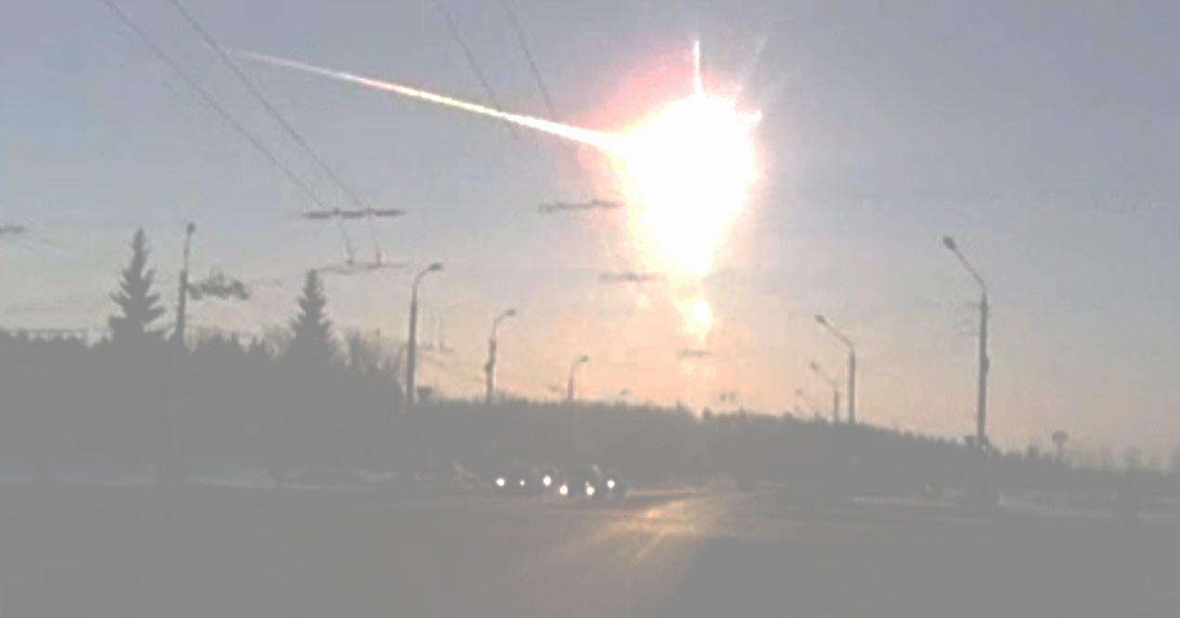

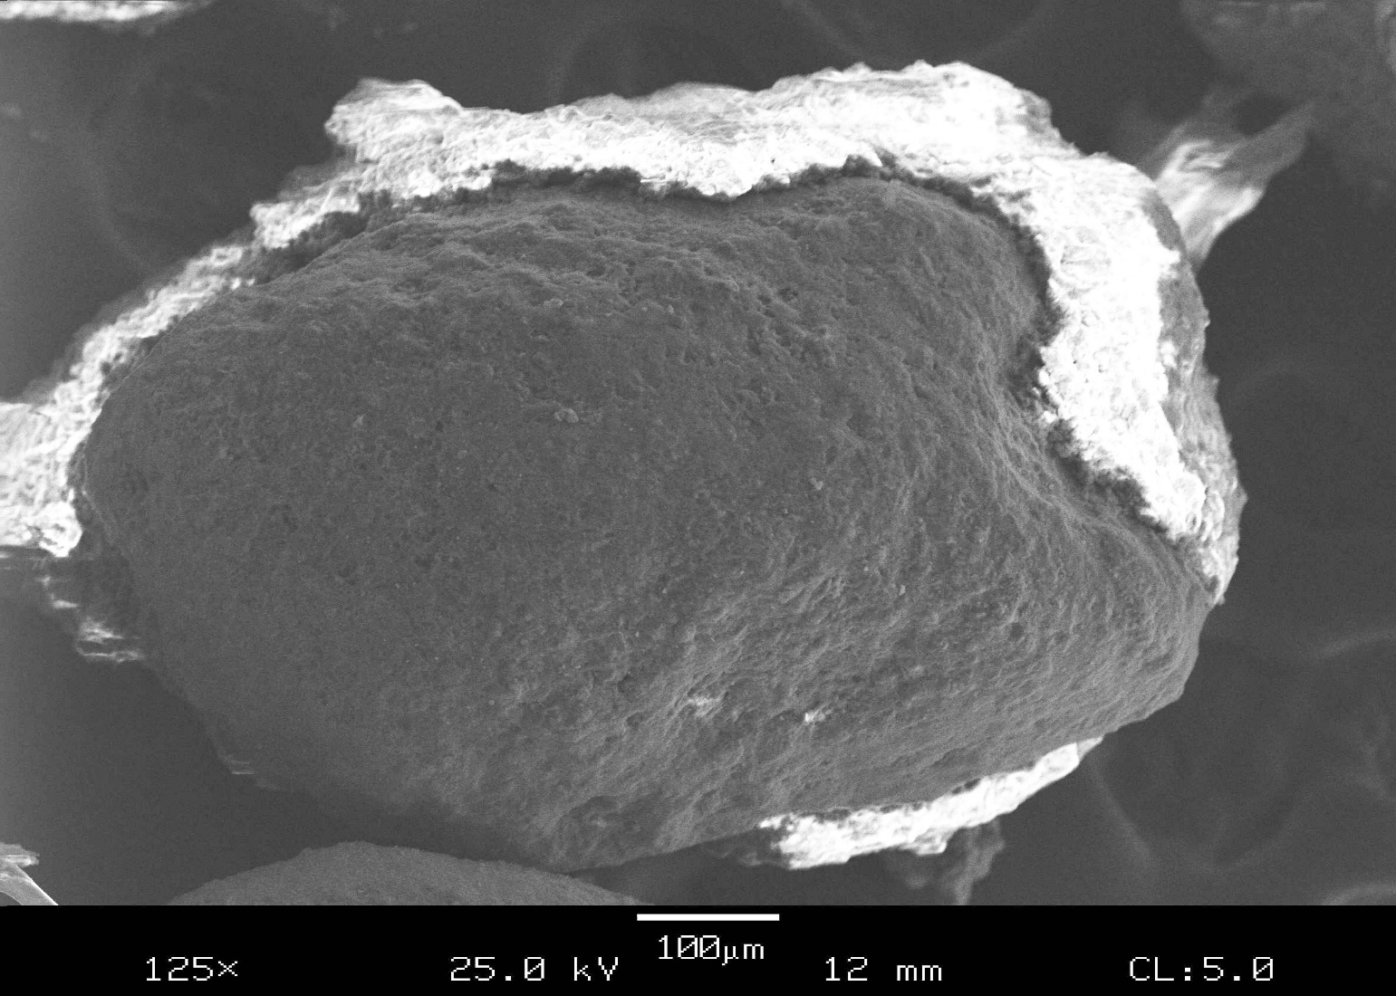
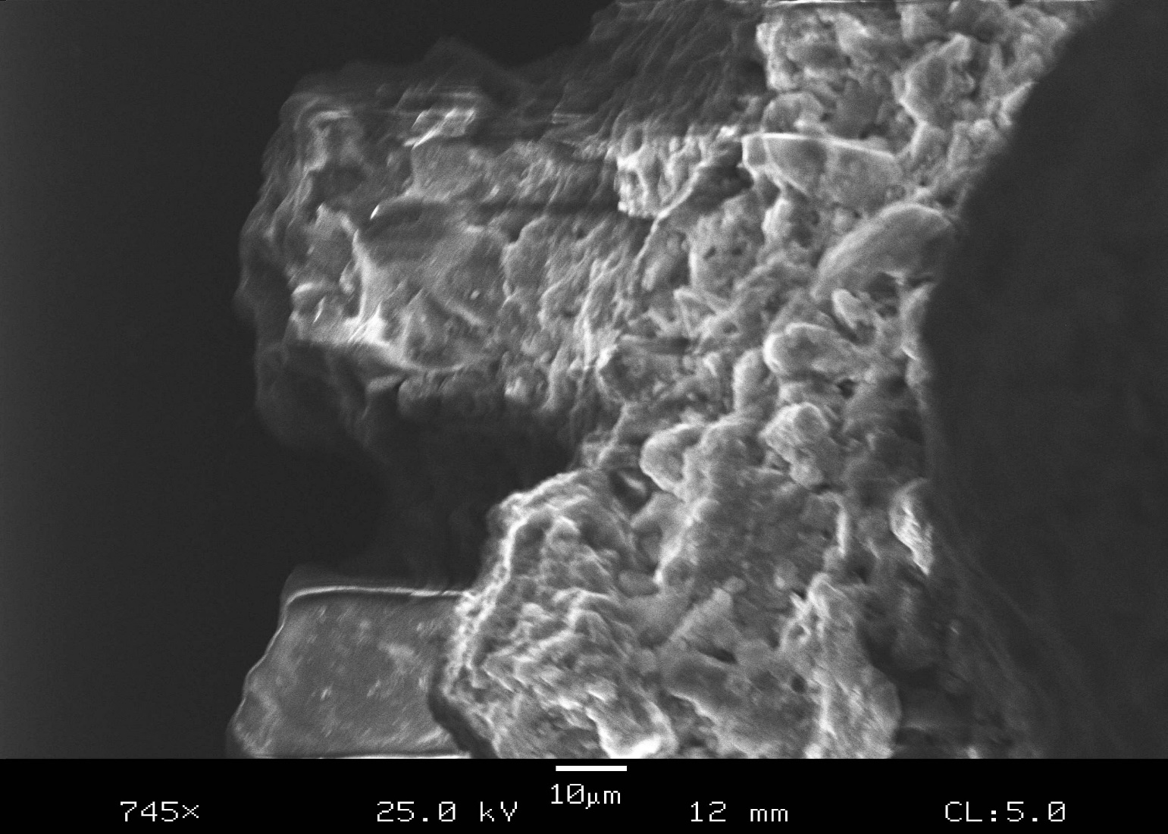
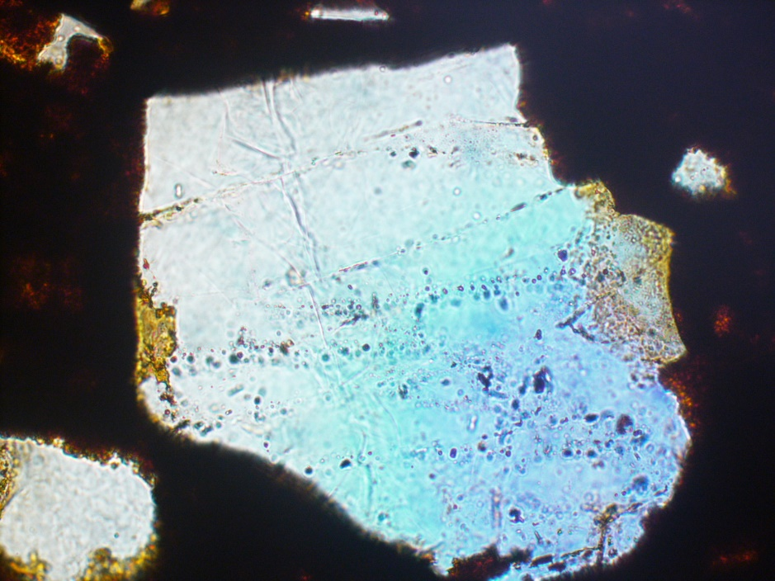
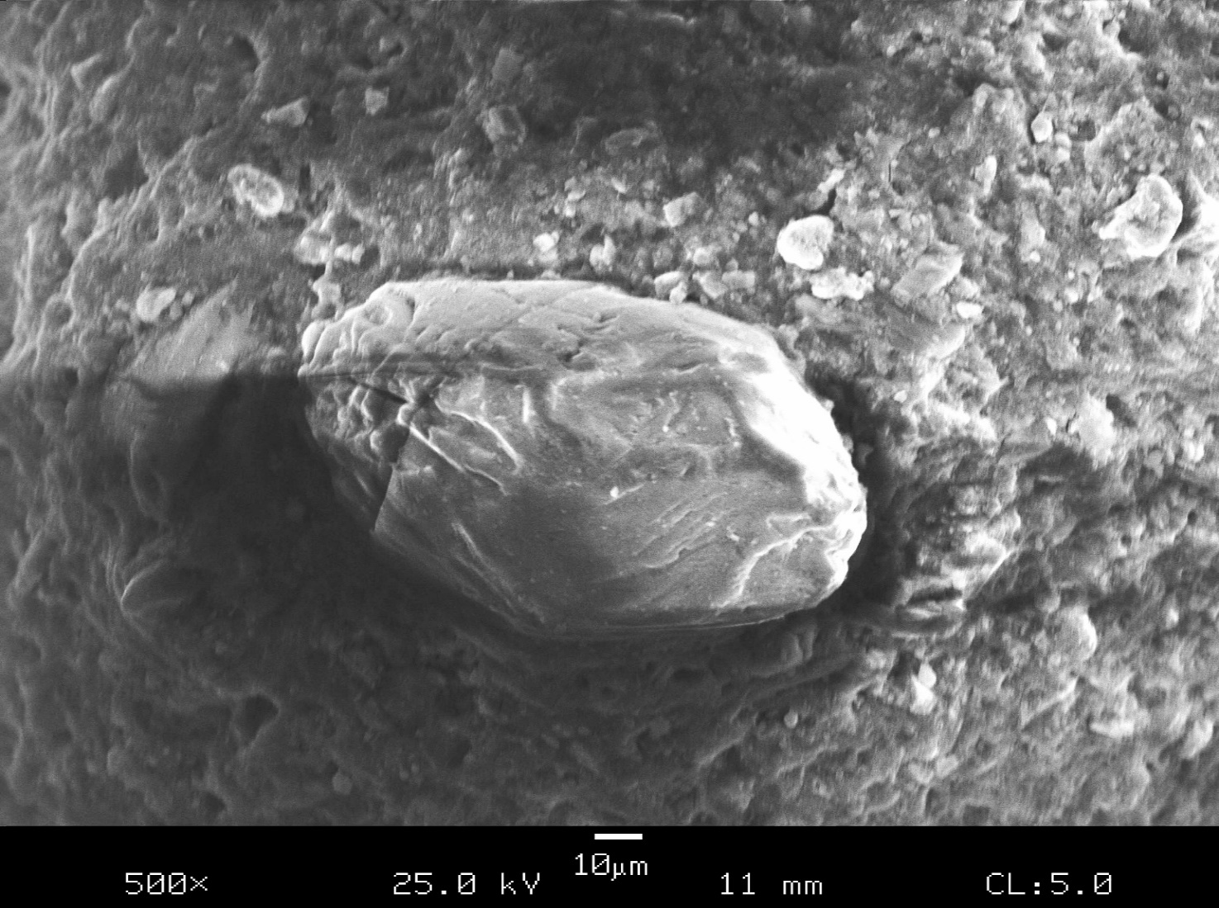
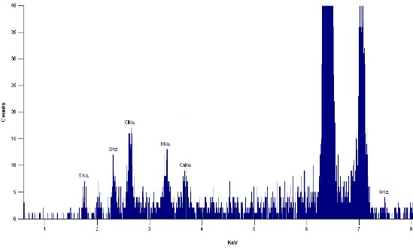
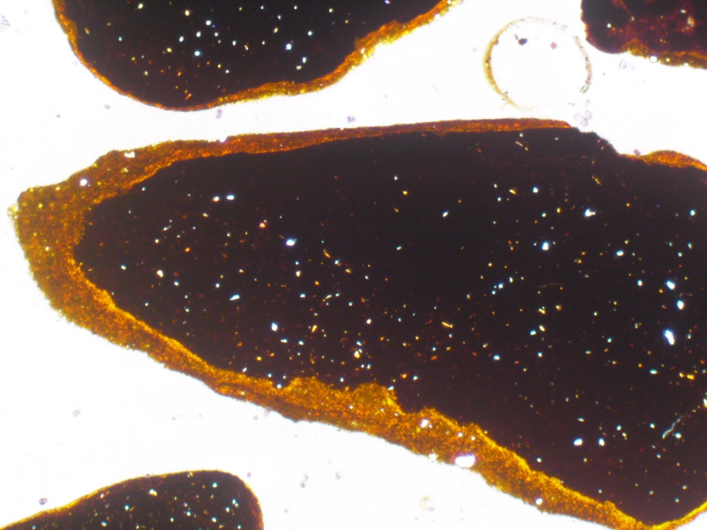
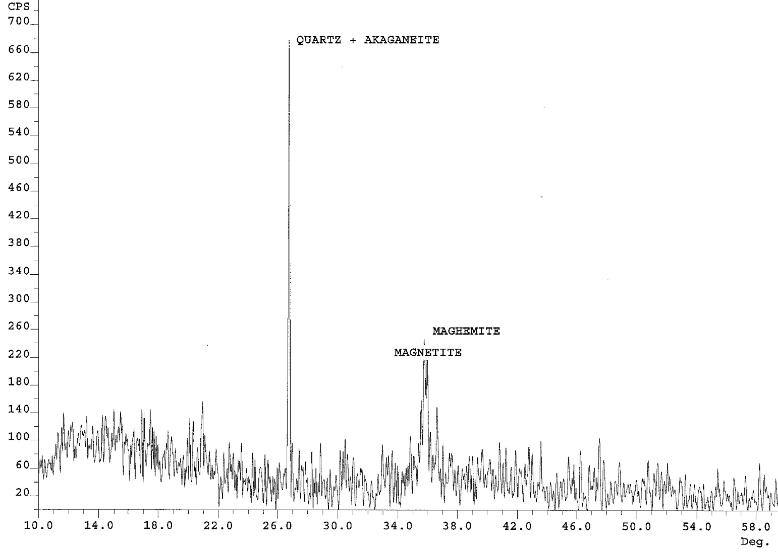
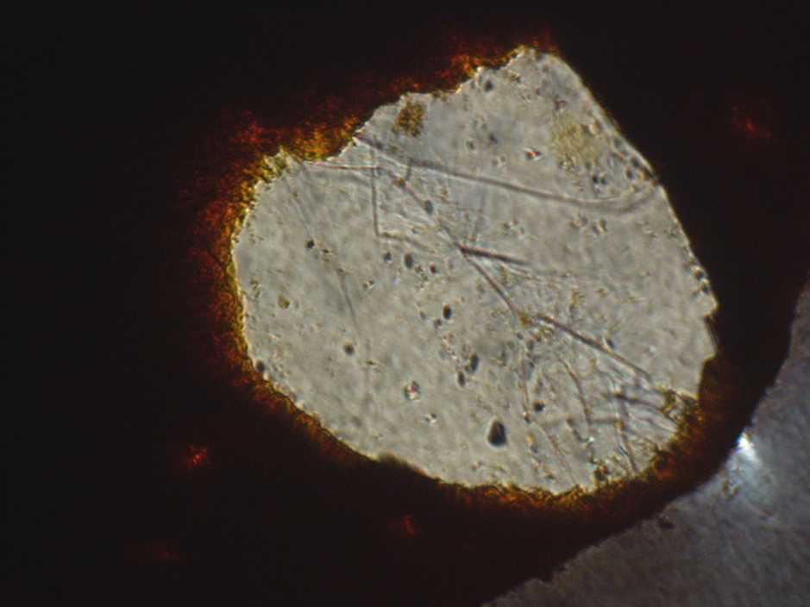
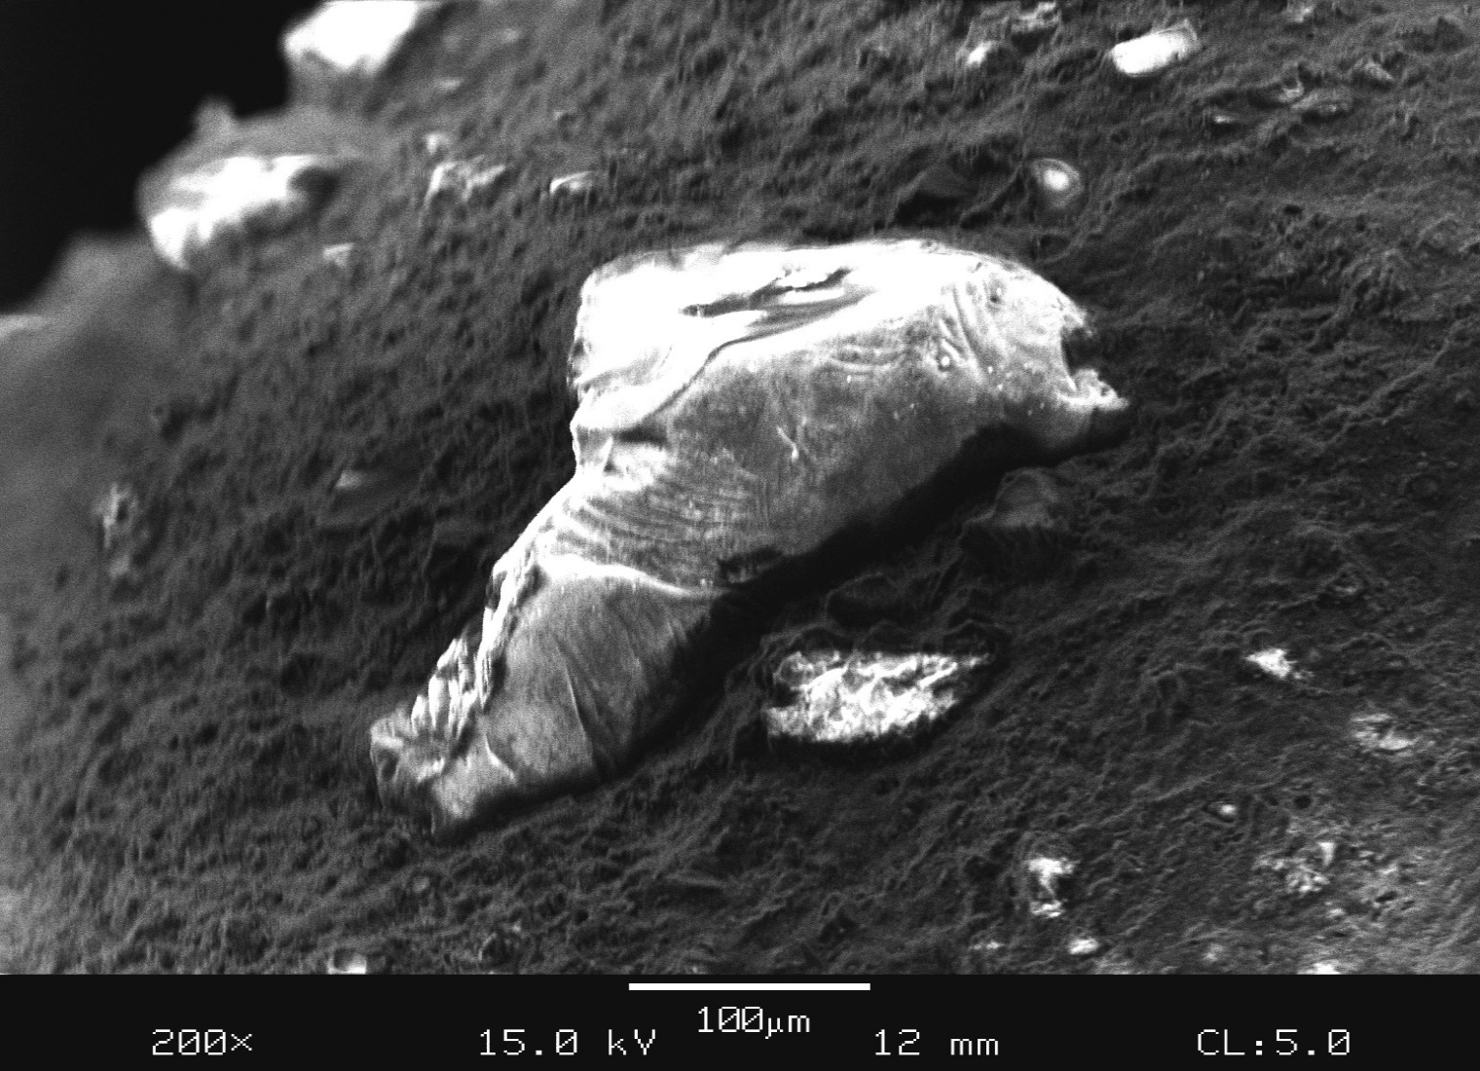
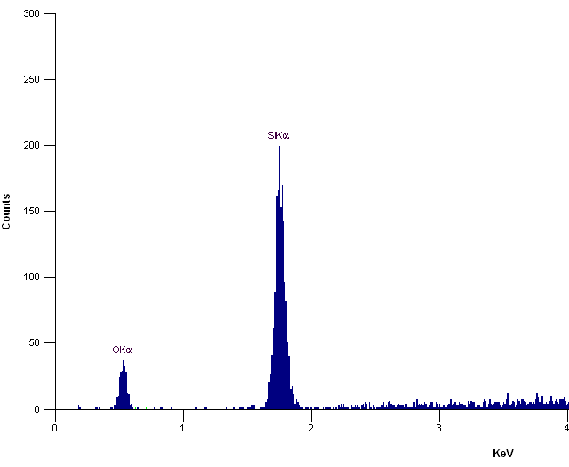
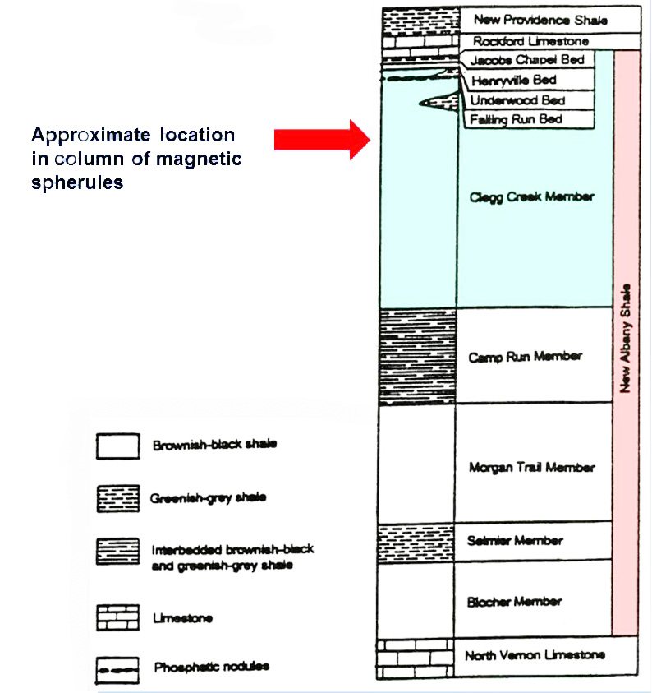
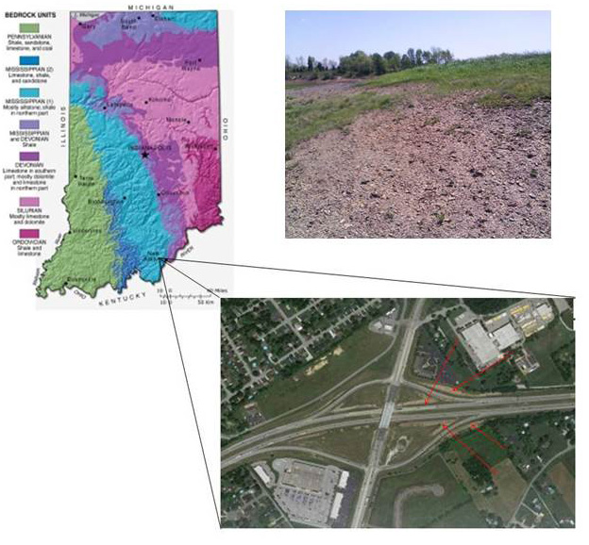
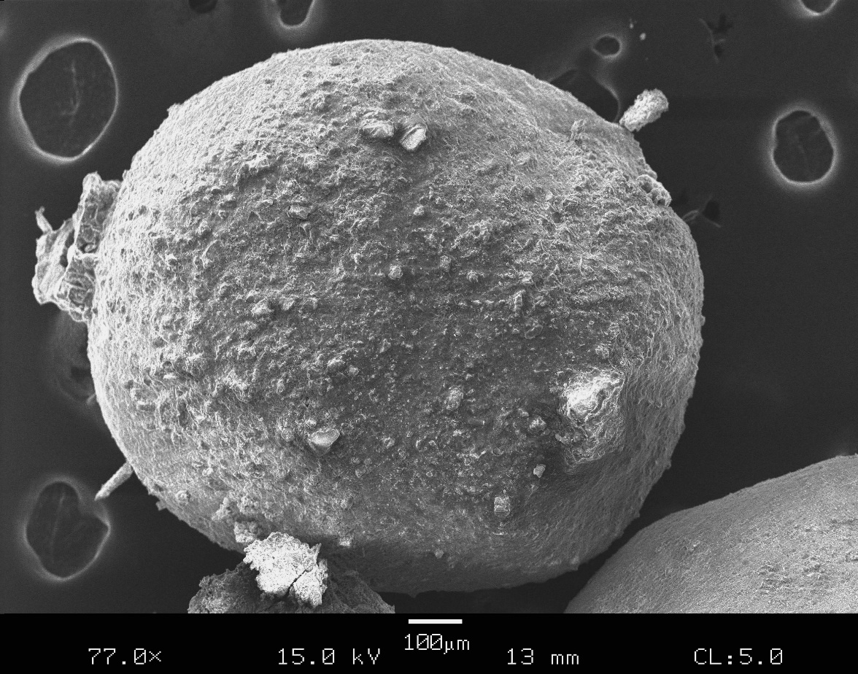
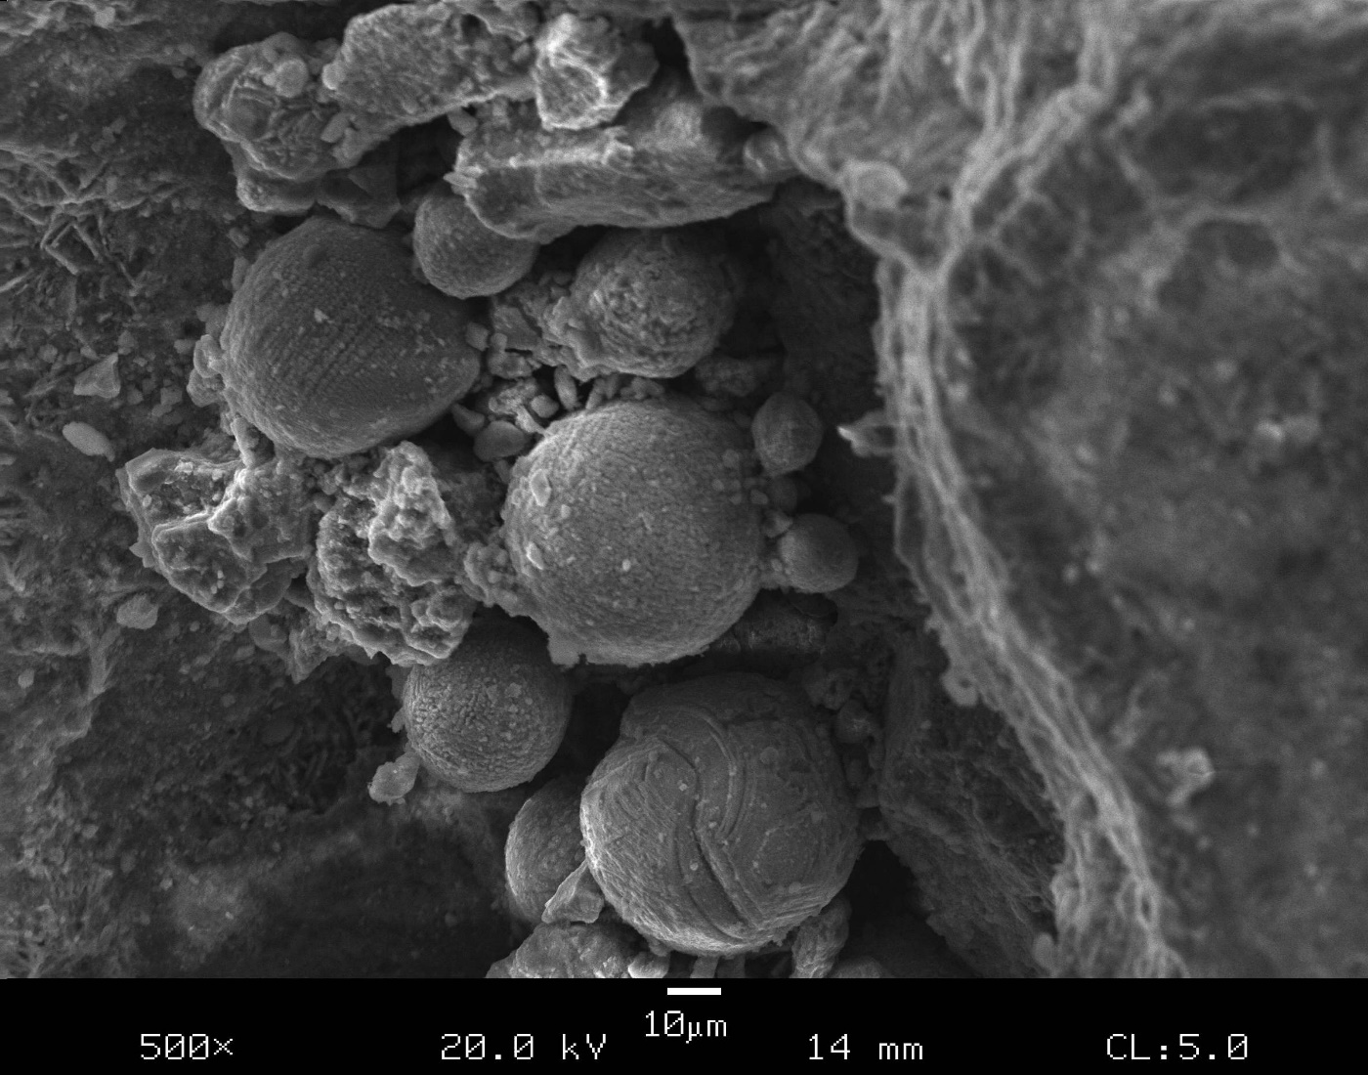
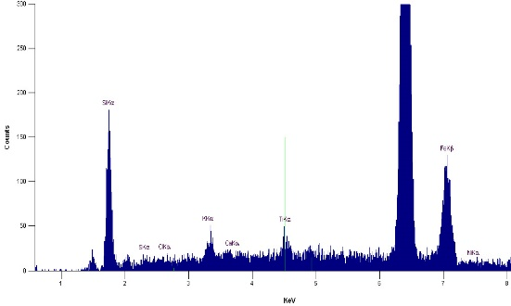
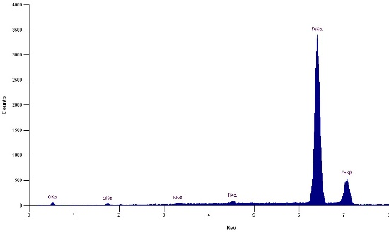
EVIDENCE FOR AN EXTRATERRESTRIAL IMPACT IN THE LATE DEVONIAN NEW ALBANY SHALE, FLOYD COUNTY, INDIANA
Glenn M. Mason and Deanne D. Caffee-Cooper
Department of Geosciences
Indiana University Southeast
New Albany, Indiana 47150
gmason@ius.edu
Abstract
Five great mass extinction events are recognized in the past 500 million years. Although the extinction events are agreed upon, only the Cretaceous (K-T) event has produced enough positive evidence that suggests a bolide impact. Although impacts have been suggested for other extinction events, volcanism, climate change, changes in CO₂ levels, and evolutionary diversity have also remained viable triggers for consideration. The lack of evidence remains the primary reason for the dismissal of an impact causation triggering other mass extinction events, including the Kellwasser Event that occurred in the Late Devonian. Iron-bearing microtektite-like glassy spherules were identified in the Late Devonian Clegg Creek Member of the New Albany Shale in a zone which corresponds to the Frasnian-Famennian boundary. These microtektite-like glassy spherules are: (1) too large and dense to have been transported at the time of shale deposition; (2) of a composition and morphology that does not represent material that would have formed in situ by groundwater; and (3) are in areas free of overburden that might have contaminated the shale. It must be considered that the source of these microspheroids originated from above the shale then fell into the sediments before lithification. An extraterrestrial source seems the most viable. Scanning Electron Microscopy/Energy Dispersive X-ray (SEM/EDX) analyses of the microspheroids indicates a roughly spherical shape with a glassy composition, magnetic and iron-rich, in a vitrified to semivitrified matrix. This suggests that these microtektite-like Fe spherules are in fact ballistic impact ejecta and originated from an event during this time.
Impact Evidence
Detailed examination of the magnetic particles proceeded systematically by particle size fraction. After examination of several hundred randomly selected grains from different size fractions at random, some general observations were made: (1) All grains were highly magnetic, irrespective of the particle size; (2) most grains were well-rounded and had a high degree of sphericity, again irrespective of particle size; (3) many grains had a glassy-like surface, but this was often obscured by an oxidation “rind”; (4) some grains appeared to be an amalgamation of materials, with smaller grains adhering to or stuck into the mass of the larger grains; (5) there was observed a second distinct class of very small (<100 microns) perfectly spheroidal particles in all size fractions; (6) although differing in size, the different size fractions completely resembled one another with regard to particle shape, magnetic qualities, surface characteristics, mineralogy, and chemistry; (7) elemental analysis by EDX displayed a relatively uniform chemistry, predominately Fe, Si, and O. Additionally, Al, Cl, K, Ni, Ca, P, S, and Ti were detected. Nickel, although never detected in abundance was never the less distinct (<0.5 – 2.0%) serving together with the morphology, was the first indicator of meteoric origin.
Impact quartz, i.e. fractured quartz, although not as distinct as has been reported in modern astroblems, was observed and widespread in all size fractions. Figure 3 in an optical microscopic photograph (crossed polarizers, 600x) of fractured quartz from the 1.4 mm fraction. Figure 4 is an electron microscope photograph of a (presumed) quartz grain from the 500μ separation. In addition to fractured quartz grains (anisotropic under OM), diaplectic (altered by shock waves) glass (isotropic under OM) was also commonly observed. Figure 5 is an optical microscopic photograph of diaplectic glass from the 500μ separation. Figure 6 is an electron microscope photograph of a diaplectic glass fragment (with concoidal fractures) grain from the 500μ separation.
Of note was the tentative identification of akaganeite a [Fe³⁺,Ni²⁺)₈(OH,O)₁₆Cl_{1.25} · nH₂O] as reported by Buckwald (1989) and refined by Scheck et al., (2015) as a weathering product of meteoritic material. It was observed that in most samples, a major XRD peak occurred at ~26.6º, yet the 20.8º of quartz was disproportionately small. This served as an indication that the peak was being shared by another mineral. Upon examination of samples, it was observed that oxidation rim contained a significant amount of the element chlorine. Thus XRD plus EDX data and observation of the morphology of the oxidation rim led to the conclusion that akaganeite was present. This might be an expected mineral formation when iron-rich meteoric fragments fall into a marine environment. Figure 9 is an SEM photograph of a magnetic particle with the clearly visible (charging, the Fe metal does not charge at the same rate) oxidation rim. Figure 10 is a higher magnification view of the reaction rim with X-ray diffractogram of a a magnetic particle in which, quartz would remain unaltered but the original Fe-meteorite material would be altered to magnetite, maghemite, and akaganeite as proposed by previous authors including Bland et al. (2006).
Introduction and Geologic Background
Five great mass extinction events are known to have occurred in the past 500 million years of the earth’s history. These five great events collectively are sometimes referred to by geologists as the five fingers of death as large percentages of the earth biota became extinct at each. Although the extinction events themselves are agreed upon, only the Cretaceous (K-T) event has produced enough positive evidence that suggests a bolide impact may have been the cause. Although impacts have been suggested as mechanisms for other extinction events, volcanism, global climate change, changes in CO₂ concentrations, and evolutionary diversity changes have also remained viable triggers for consideration.
There exists no clear agreement for these events that delimits cause, duration, and intensity (was it geologically instantaneous or did it occur over millions of years). To answer these questions about the extinction events would provide geologists valuable clues to understand the potential of future events.
One of the five great extinction events occurred in the late Devonian, called the Kellwasser Event, occurred at the boundary that marks the beginning of the last phase of the Devonian period at about 374 - 360 Ma. Overall, 19% of all families and 50% of all genera went extinct during this event. Regressive/transgressive cycles and related anoxic conditions have been blamed for the extinctions. One popular idea for the Kellwasser event is the possibility of a single or multiple asteroid impacts. Although many theories have been offered, none are assumed to be solely responsible. Many believe the extinction was caused by a combination of factors culminating in the loss of worldwide biota.
The New Albany Shale was deposited during the Late Devonian Period and considered to straddle the Devonian-Mississippian boundary. It is composed of brownish-black carbon-rich shale, greenish-gray shale, and minor amounts of dolomite and dolomitic quartz sandstone. The formation consists of five members in southeastern Indiana. In ascending order: (1) the Blocher Member; (2) the Selmier Member; (3) the Morgan Trail Member; (4) the Camp Run Member; and (5) the Clegg Creek Member. The Clegg Creek Member is characterized by brownish-black to black, finely laminated pyritic shale rich in organic matter. The Clegg Creek contains the highest concentrations of organic material in the New Albany (Hasenmueller, 1982). Deposition took place in an anoxic marine environment yielding siliceous carbonaceous brownish-black shale. Fossils are a rarity in New Albany Shale, but when found, they can yield spectacular finds of fossil wood and vertebrate fossils including shark’s teeth and fish bones. Figure 1 shows the stratigraphy of the New Albany Shale in Southern Indiana.
Figure 9. SEM photograph of a magnetic particle with clearly visible (charging) oxidation rim from the 500 m fraction. - 500 m. (125x)
Figure 10. SEM photograph of a magnetic particle with oxidation rim magnified to show detail, from the 500 m fraction. EDX clearly shows presence of chlorine. (745x)
Figure 3. OM photograph of fractured quartz grain from magnetic separation. crossed polars. (600x)
Figure 4. SEM photograph of fractured quartz (?) from 500μ separation. (500x)
Sample Source and Experimental Methods
This study began with IUS an undergraduate geology student, John Wilson in 2013, as an attempt to recovered micrometeorites from shale. It became far more complex. Samples for the current study were collected at a roadside exposure created by the construction of Interstate 265. (Lee Hamilton Freeway). Here, the New Albany Shale is exposed with the soil overburden removed, forming a clean surface, but relatively uncontaminated by soils and human materials. Approximately 20 feet of the Camp Run Member of the New Albany Shale is exposed at this location. To collect samples, an industrial magnet was used and grid pattern was established, dragging the retrieval magnet so that it dug into the loose weathered shale retrieving magnetic particles. At this location, the Clegg Creek member is weathered yielding a greater surface area exposed for retrieval. Samples were returned to the laboratory where they were scrutinized with a binocular microscope and all obvious man-made contaminants were discarded. Samples were washed with distilled water. Once the fragments were cleaned, they were passed through nonmagnetic sieves, separating the particles into six fractions: U.S. Standard Sieve #8 (>2.36 mm), U.S. Standard Sieve #10 (2.00 – 2.36 mm), U.S. Standard Sieve #14 (1.40 – 2.00 mm), U.S. Standard Sieve #20 (850 m - 1.40 mm), U.S. Standard Sieve #35 (500 m - 850 m), U.S. Standard Sieve #50 (300 m - 500 m). Particles <300 m were also collected and retained for analysis. Nearly half (46.97%) of the recovered sample material fell into the largest particle size (>2.36 mm). In these samples, the magnetic material was often still embedded in the shale matrix.
There were, however, numerous large particles (up to marble size) that were free of the shale matrix and extremely magnetic. U.S. Standard Sieve #10 (2.00 – 2.36 mm), U.S. Standard Sieve #14 (1.40 – 2.00 mm), U.S. Standard Sieve #20 (850 m - 1.40 mm) were the most common particle sizes recovered with 9.21%, 18.29%, and 13.81% respectively. The smaller particle sizes, U.S. Standard Sieve #35 (500 m - 850 m), U.S. Standard Sieve #50 (300 m - 500 m), particles <300 m yielded decreasing amounts of magnetic particles with 7.5%, 2.23%, and 1.97% respectively. Approximately 40% (39.6%) were particles in, what might be termed, the medium range. It was upon particles in the medium range that most time was spent observing.
Following separation of particles, individual grains were investigated with an Amray model 1810 Scanning Electron microscope (SEM) equipped with and Energy Dispersive X-ray elemental analyzer (EDX). Thin sections of each particle range were studied by optical microscopy (OM). Individual particles and each size distribution were analyzed by X-ray diffraction using a Scintag XDS 2000 automated diffractometer using Cu Kα radiation operating at 45 kV and 40 mA with a Peltier solid state detector. Figure 2 illustrates the location where the samples were collected.
Figure 11. OM photograph of magnetic particle with reaction rim clearly visible. (uncrossed polars, 400x)
Figure 12. X-ray diffractograph of magnetic particle with quartz, akaganeitie, magnetite, and maghemite identified.
Conclusions
Evidence to support an extraterrestrial source for these magnetic particles can be summarized in five ways: (1) micro/spheroids are too large and dense to have been transported at the time of shale deposition and they are a composition that does not represent material that would have formed in situ by groundwater; (2) fractured quartz and diaplectic glass are found in the particles; (3) the Fe–rich nature of the material is consistent with meteoric fragments; (4) the identification of weathering products magnetite, maghemite, and akangaeite are consistent with the weathering of meteorite fragments that have fallen into a marine environment; and lastly (5) Ni, albeit in relatively low abundance, is still identifiable in virtually all fragments.
These micro/spheroidal particles display chemistry, mineralogy, morphology, that are consistent with an extraterrestrial origin. Omnipresent Ni in the samples seems to preclude a terrestrial origin and favor an extraterrestrial association. It seems most probable that these fragments are related to impact and are the “fallout” or ejecta associated with a major Late Devonian event. These particles lend strength to the idea that at least a major impact occurred around this time in the Earth’s geologic history and it does appear to match up stratigraphically to known Extinction Level Events (ELE). Whether or not the impact was the cause or the “trigger” of the Devonian Mass Extinction remains a mystery. However, one would have to ponder the effect of what might have been millions of tons of finely disseminated spheroidal Fe being dumped into the Devonian seas. A large quantity of Fe might have an adverse effect upon the oxygen balance in the oceans, which might have in turn affected life or produced climate changing consequences.
Figure 5. OM photograph of diaplectic glass with possible coesite inclusions from 500μ separation. (600x)
Figure 6. SEM photograph of diaplectic glass (?) from 500μ separation with EDX of composition (200x)
Two distinct grouping of spheroids were identified. The larger group appeared to be a conglomeration of material, mostly Fe, but also composed of a large amount of Si and O. All are highly magnetic. Figure 7 (60.5x) is an SEM photomicrographs of the typical examples of the larger particles that were observed., from the size fraction 1.40 mm. The high degree of rounding and high sphericity typical of these particles can be observed. Individual grains often are coated by a thick weathering “rind” of Fe-oxide.
The second group is composed of very small 50 - 100μ, with most <50μ; a few of these spheroids are as small as the 10μ or in the realm of bacteria. These small microspheroids that were composed Fe and O with traces of Ni and Ti. No sulfur was detected in association with these microspheroids (eliminating the possibility of being frambiodal pyrite). Many of the small spheroids exhibited a crenulated surface. Figures 9 – 10 are SEM photomicrographs of small spheroids identified in association with the larger particles. From comparison with literature these appear to be similar to Onoue et al., 2011)
References
Bland, P. A., Zolensky, M. E., Benedix, G. K., and Sephton, M. A., 2006, Weathering of chondritic meteorites. Meteorites and the early solar system II, 853-867.
Buchwald, V.F. and Clarke, R.S., Jr., 1989, Corrosion of Fe-Ni alloys by Cl-containing akaganéite (β-FeOOH): the Antarctic meteorite case. American Mineralogist: 74: 656-667
Claeys, P., Casier, J.G., and Margolis, S.V., 1992, Microtektites and mass extinctions- Evidence for a late Devonian asteroid impact. Science 257 (5073), 1102-1104.
Hasenmueller, N. R., and Bassett, J. L., 1981, Stratigraphy, in Hasenmueller, N. R., and Woodard, G. S., eds., Studies of the New Albany Shale (Devonian and Mississippian) and equivalent strata in Indiana: Bloomington, Indiana Geol. Survey, p. 5-32.
Chelyabinsk meteor, Feb. 15, 2013 Background photo, Retrieved September 2016 from, from Facebook: following the nerd
Indiana Geological Survey. Retrieved August 2016 http://igs.indiana.edu/geology
Lineback, J. A., 1970, Stratigraphy of the New Albany Shale in Indiana: Indiana Geol. Survey Bull. 44, 73 p.
Onoue, T., Nakamura, T. , Haranosono, T., and Yasuda, C., 2011, T. Composition and accretion rate of fossil micrometeorites recovered in Middle Triassic deep-sea deposits, Geology, June 2011, v.39; no.6, pp 567-570.
Scheck, J., Lemke, T., Gebauer, D., 2015, The role of chloride ions during the formation of akaganéite revisited, Minerals: 5(4): 778-787.
New Albany Shale outcrop along Interstate 265. (Photo by J. Wilson.)
Figure 1. Stratigraphy of the New Albany Shale in Southern Indiana. (modified from Hasenmuller and Bassett, 1981)
Figure 2. Geologic Map of Indiana with sampling locality indicated. (Indiana Geologic Survey and Google Earth, 2013)
Figure 7. SEM photograph of larger microspheroids 1.4 mm separation with overall chemistry Fe, Si, and Ti especially noted. (60.5x)
Figure 8. Microspheroids from the 1.40 mm fraction with EDX showing Fe composition.
Acknowledgement
I would like to acknowledge John T. Wilson IV, who did the early legwork for this research. Additionally, I am especially grateful to my research assistant Deanne Caffee-Cooper, whose long hours of diligent work made this work possible. She will be sorely missed as she progresses forward with her career.
Background photograph modified from Chelyabinsk meteor, 15 February 2013

