Slide 1

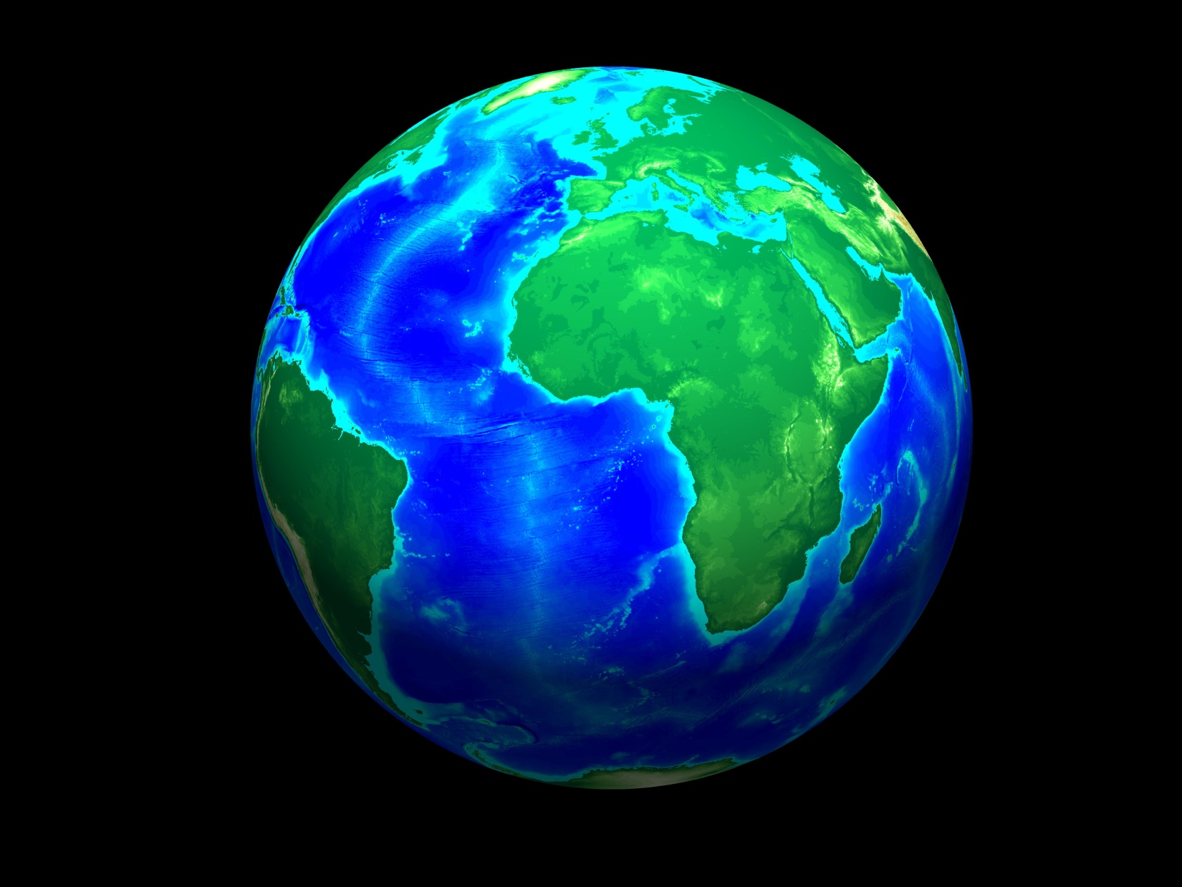
An ancient slab visible from the transition zone to the deep mantle beneath the southern Indian Ocean
Lawrence Livermore National Laboratory
Nathan A. Simmons, Steve C. Myers, Eric Matzel, Gardar Johannesson
Lawrence Livermore National Laboratory, Livermore, California, USA
Steve Grand
University of Texas at Austin, Texas, USA
This work performed under the auspices of the U.S. Department of Energy by Lawrence Livermore National Laboratory under Contract DE-AC52-07NA27344. LLNL-PRES-680102

Slide 2
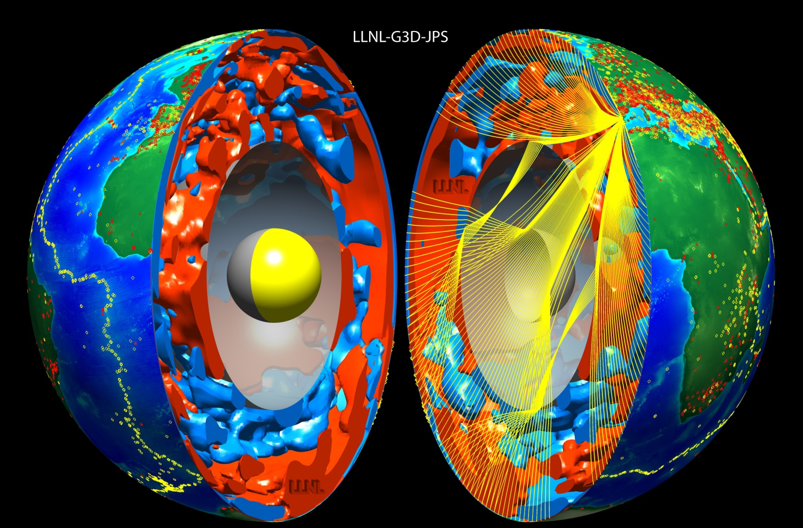
Global-scale body wave travel time models LLNL-G3D Series, Simmons et al. 2011, 2012, 2015
LLNL-G3D-JPS (Simmons et al. 2015, GRL)
Joint model of P- and S-wave velocity structure, ~3 million crustal-regional-teleseismic data (P, Pg, Pb, Pn, pP, pwP, PcP, S, Sn, SS, ScS, SKS, SKKS)

Slide 3
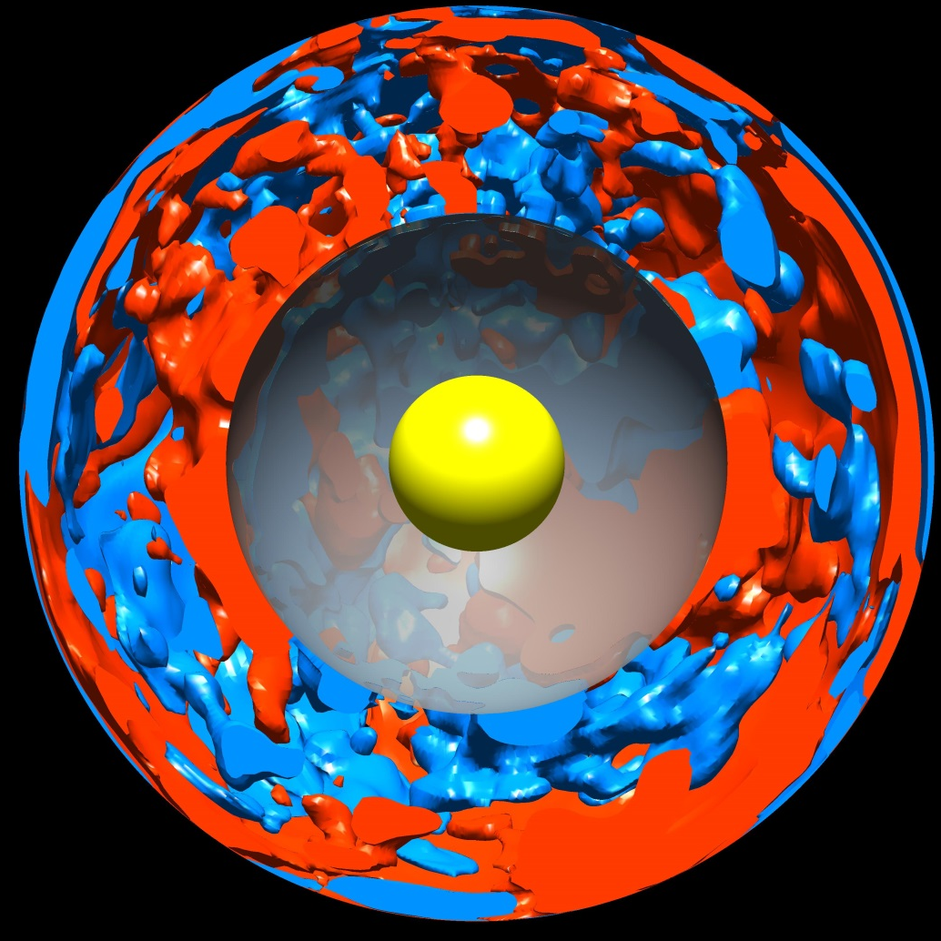
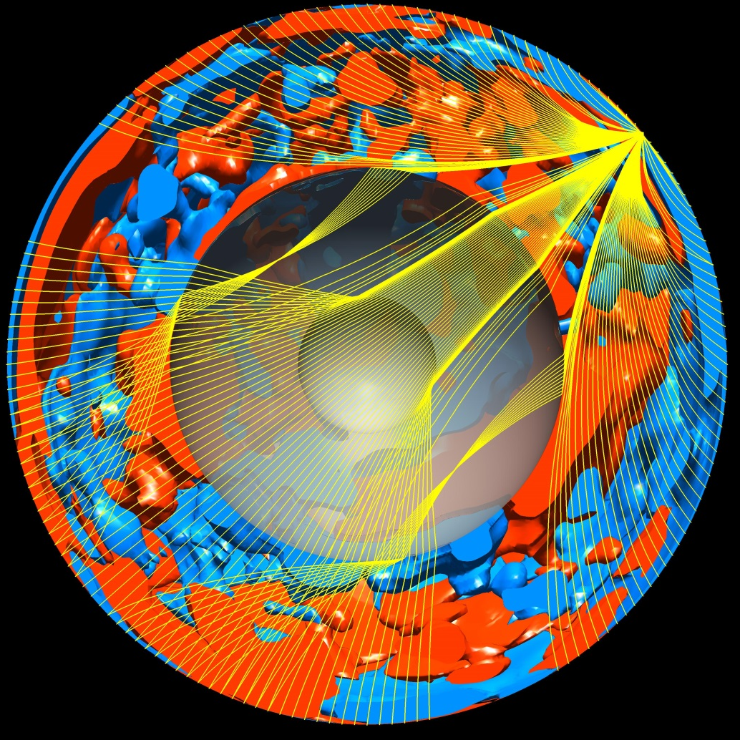
Developed for seismic event monitoring, supported by the NNSA office of Nuclear Detonation Detection
Unique techniques developed at LLNL:
Bayesian multiple-event location (Bayesloc – Myers et al. 2007, 2009, 2011)
Multiresolution imaging with hierarchical spherical tessellations (PMTI)
Multi-phase 3-D ray tracing with multi-pathing (Simmons et al. 2011, 2012)

Slide 4
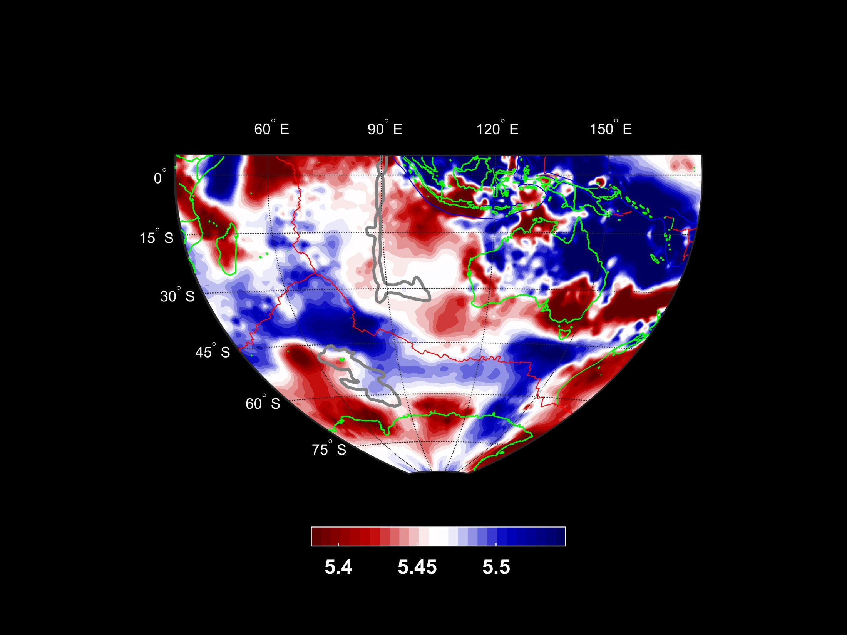
Observations: Prominent fast transition zone anomalies near Kerguelen and Tasmania
S-wave velocity, Depth = 623 km
Ninety East Ridge
Broken Ridge
SEIR
?
Kerguelen Plateau
?
SEIR = SouthEast Indian Ridge
δVs
-1.5%
+1.5%

Slide 5
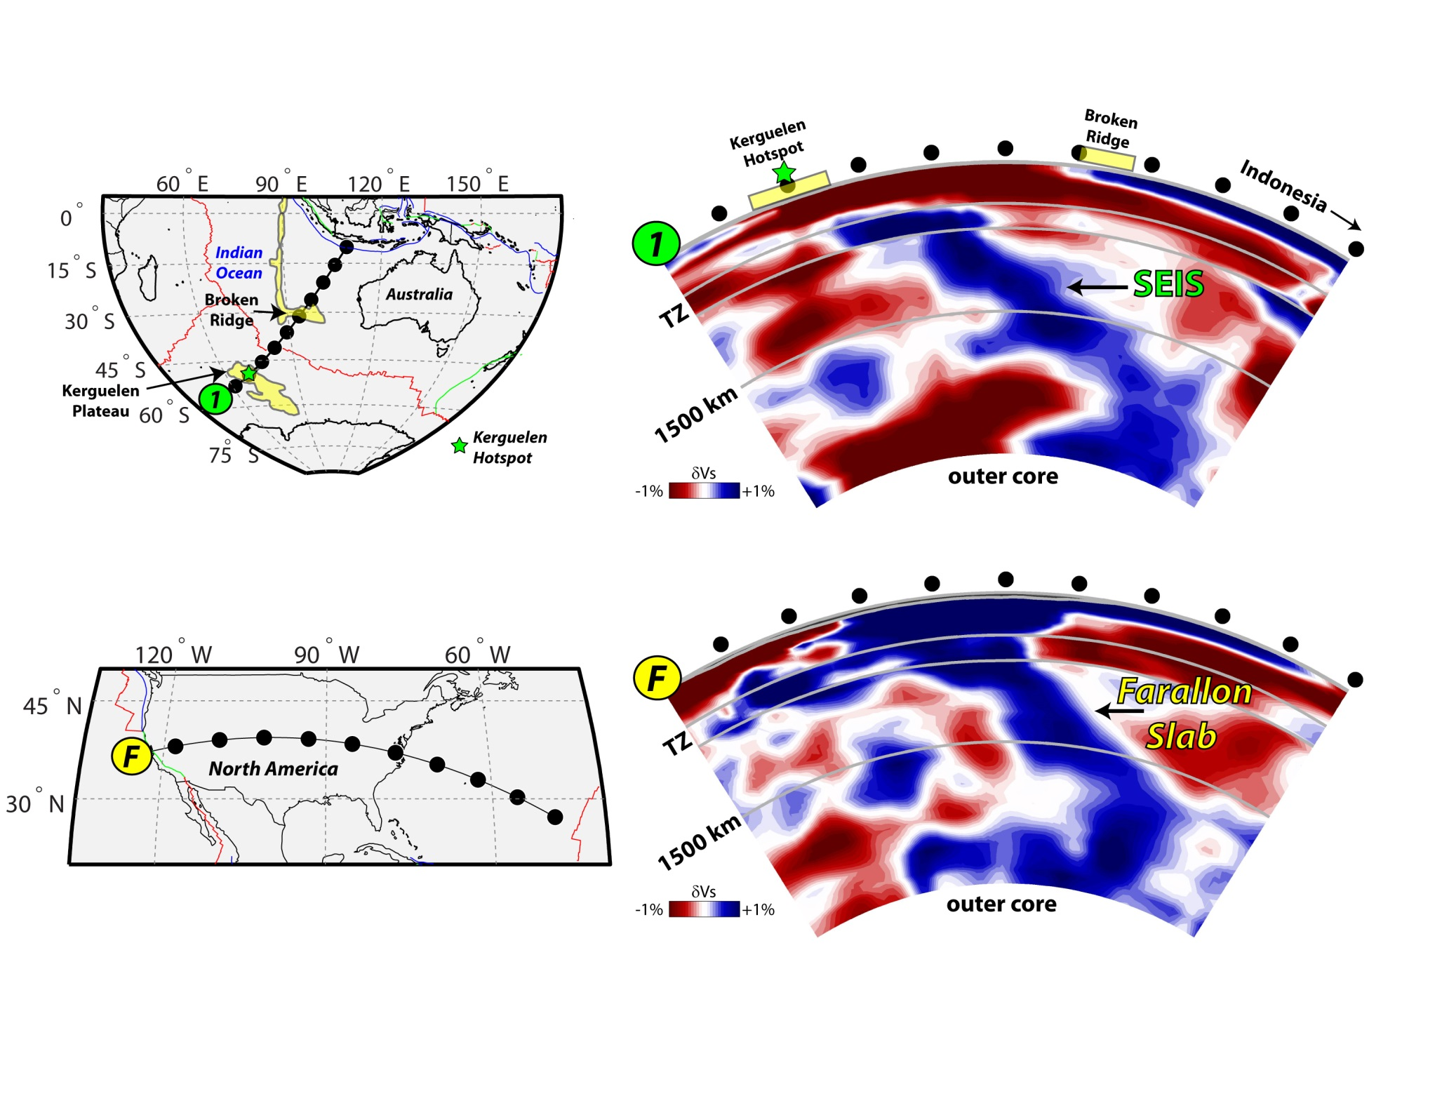
Observations: Fast material extends into the deep mantle SEIS = SouthEast Indian Slab
SEIR
SEIR

Slide 6
Observations: Comparable to the Farallon slab SEIS = SouthEast Indian Slab
SEIR
SEIR

Slide 7
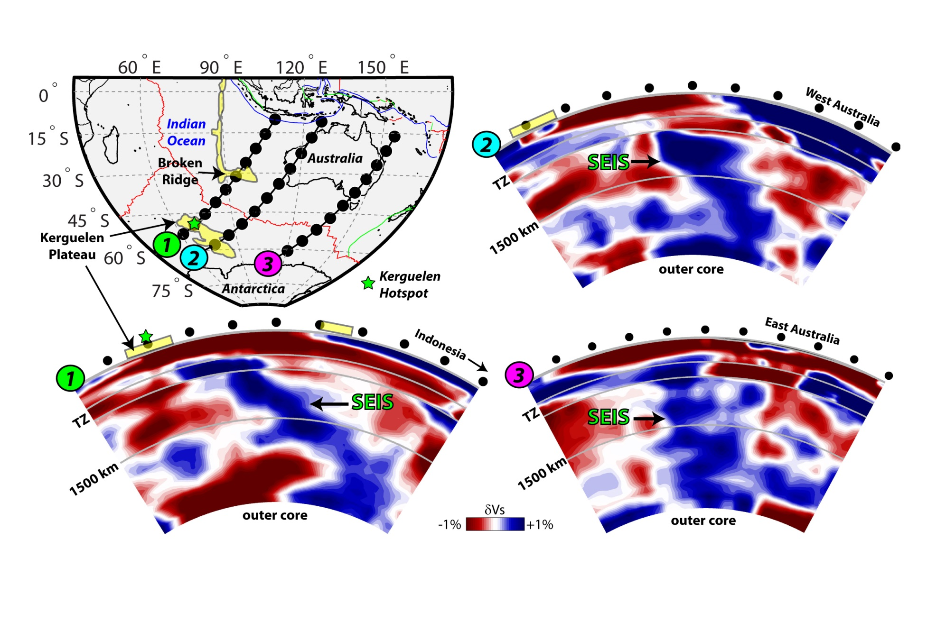
Observations: Visible along multiple cross sections SEIS = SouthEast Indian Slab

Slide 8
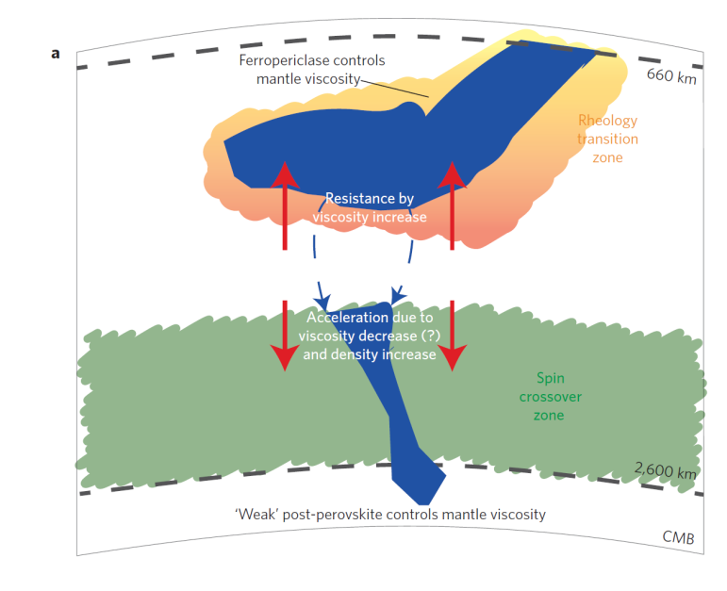
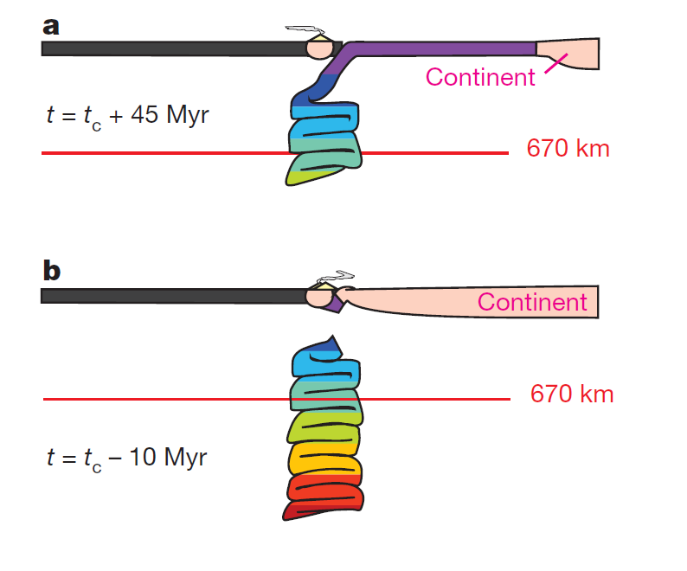
Observations: Visible along multiple cross sections SEIS = SouthEast Indian Slab
Marquardt & Miyagi (2015, Nature Geo.)
Sigloch & Mihalynuk (2013, Nature)

Slide 9
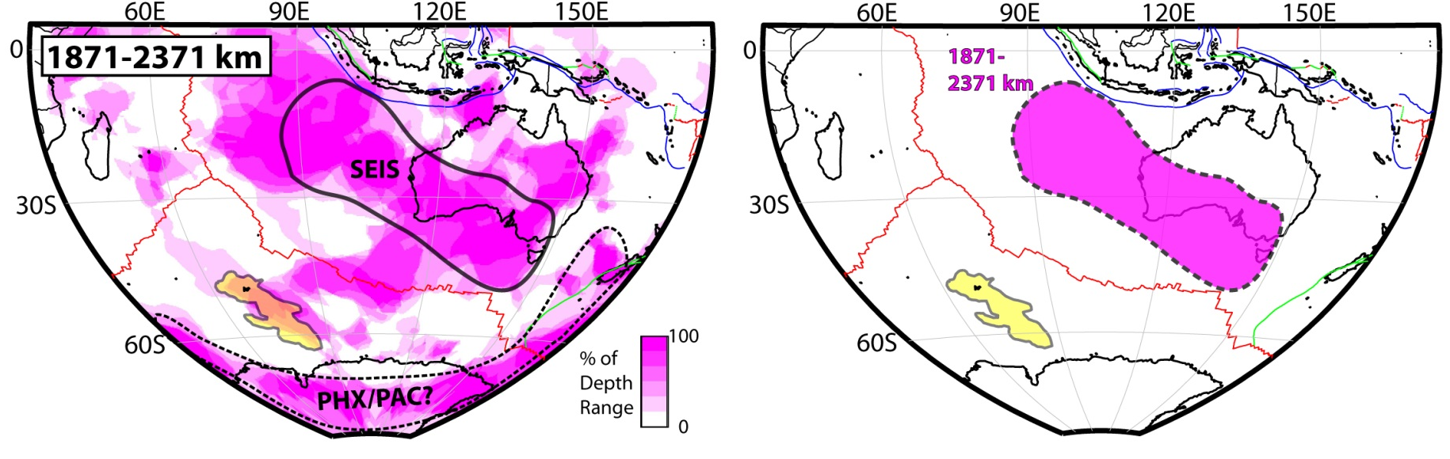
Observations: Areal extent of fast material
Actual Location of Fast Material
(Deep Lower Mantle)
Generalization
Outline around slab-like anomalies seen in cross sections
Possible remnants of Phoenix/Pacific subduction beneath East Gondwana

Slide 10
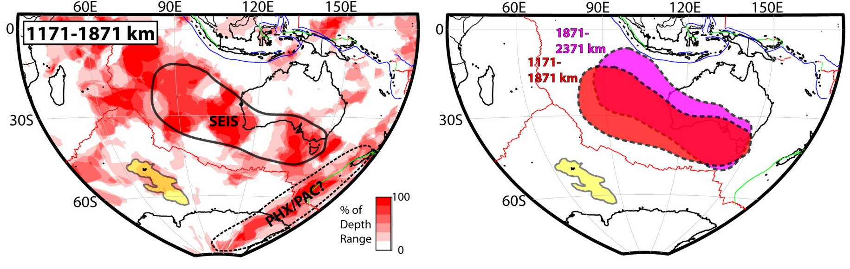
Observations: Areal extent of fast material
Actual Location of Fast Material
(Middle Lower Mantle)
Generalization
Outline around slab-like anomalies seen in cross sections
Possible remnants of Phoenix/Pacific subduction beneath East Gondwana

Slide 11
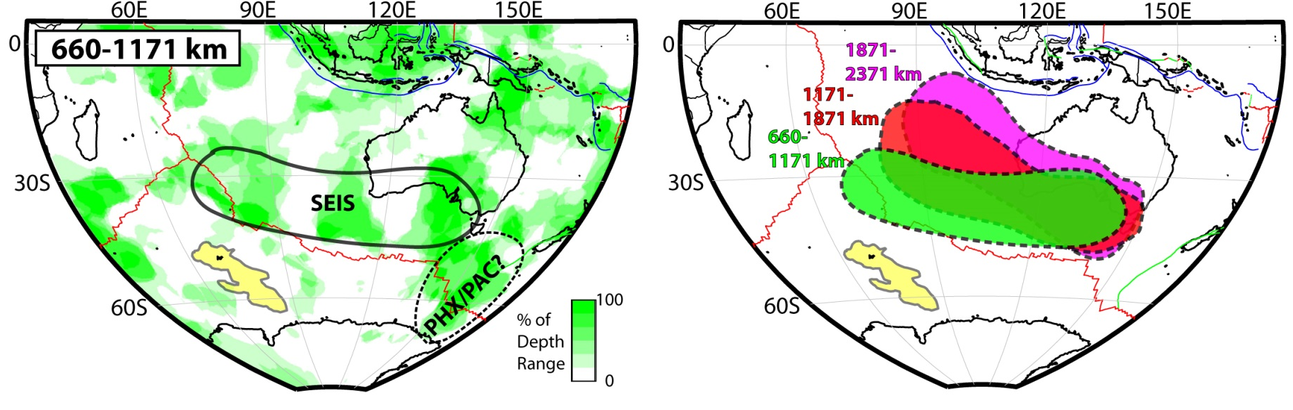
Observations: Areal extent of fast material
Actual Location of Fast Material
(Shallow Lower Mantle)
Generalization
Outline around slab-like anomalies seen in cross sections
Possible remnants of Phoenix/Pacific subduction beneath East Gondwana

Slide 12
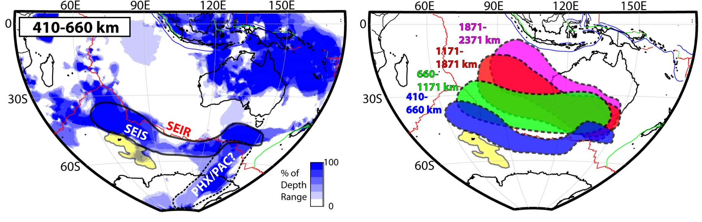
Observations: Areal extent of fast material
Actual Location of Fast Material
(Upper Mantle Transition Zone)
Generalization
Outline around slab-like anomalies seen in cross sections
Possible remnants of Phoenix/Pacific subduction beneath East Gondwana

Slide 13
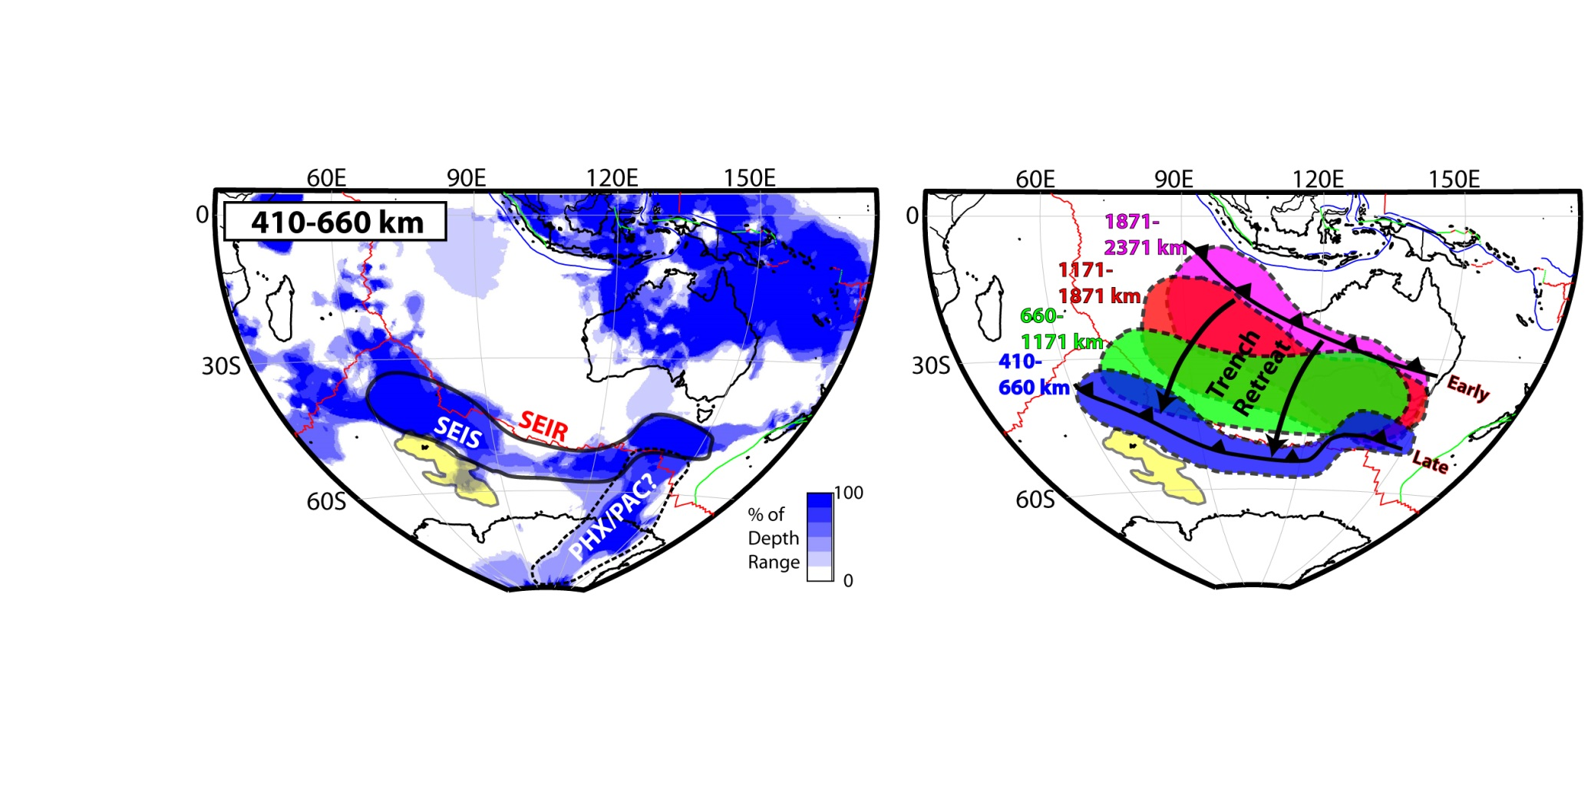
Interpretation: Retreating subduction zone, but when?
Actual Location of Fast Material
(Upper Mantle Transition Zone)
Generalization
Outline around slab-like anomalies seen in cross sections
Possible remnants of Phoenix/Pacific subduction beneath East Gondwana

Slide 14
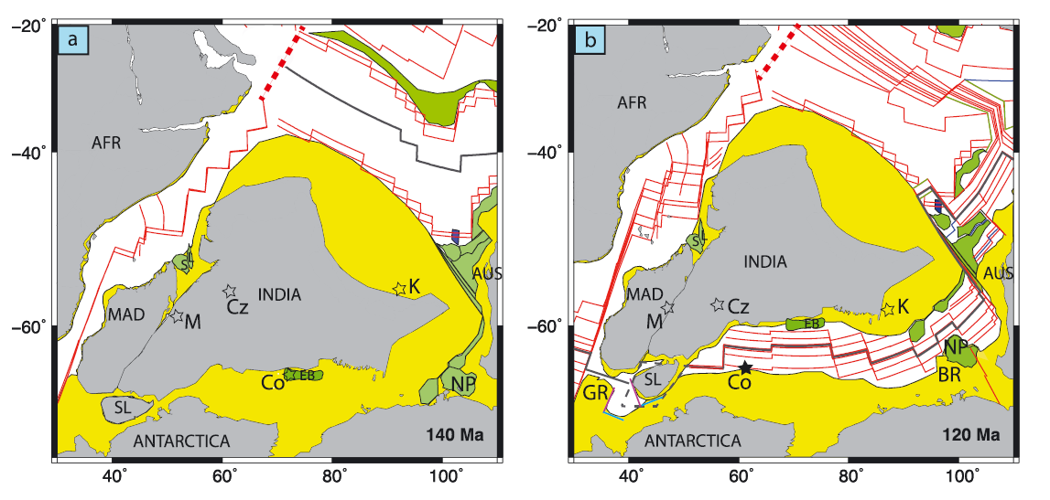
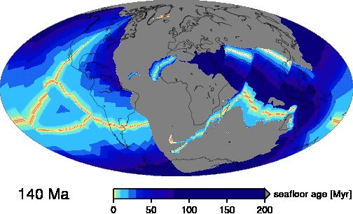
Interpretation: Incompatible with recent tectonics
140 Ma
120 Ma
East Gondwana
Gibbons, Whittaker, Müller (2013)
East Gondwana
Müller et al. (2008)
Animatrion from: geodynamics.usc.edu/~becker

Slide 15
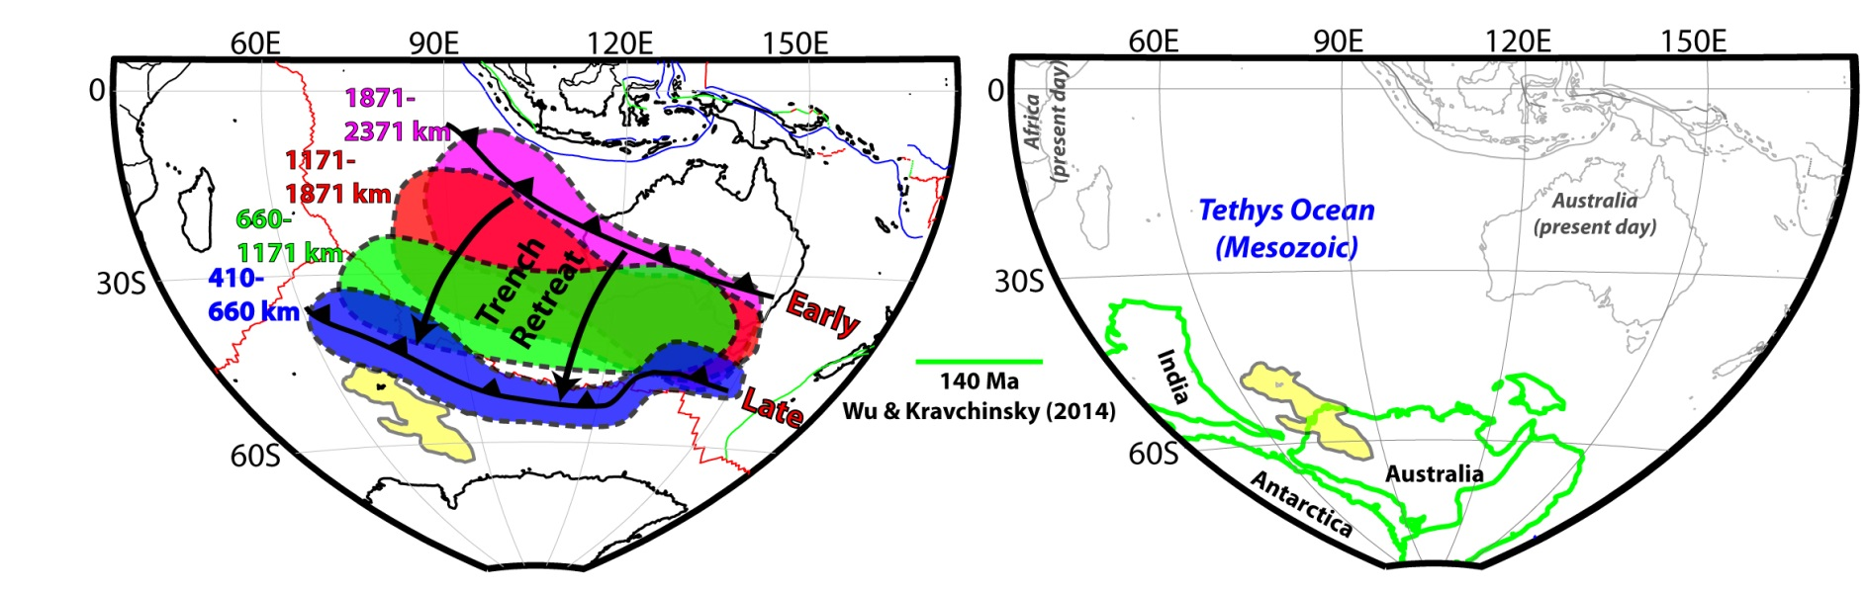
Interpretation: The subduction must have ended in the Early Cretaceous (~130-140 Ma)
Wu and Kravchinsky (2014)
Reconstruction of East Gondwana at 140 Ma
Geometric parametrization of apparent polar wonder path (APWP) tracks

Slide 16
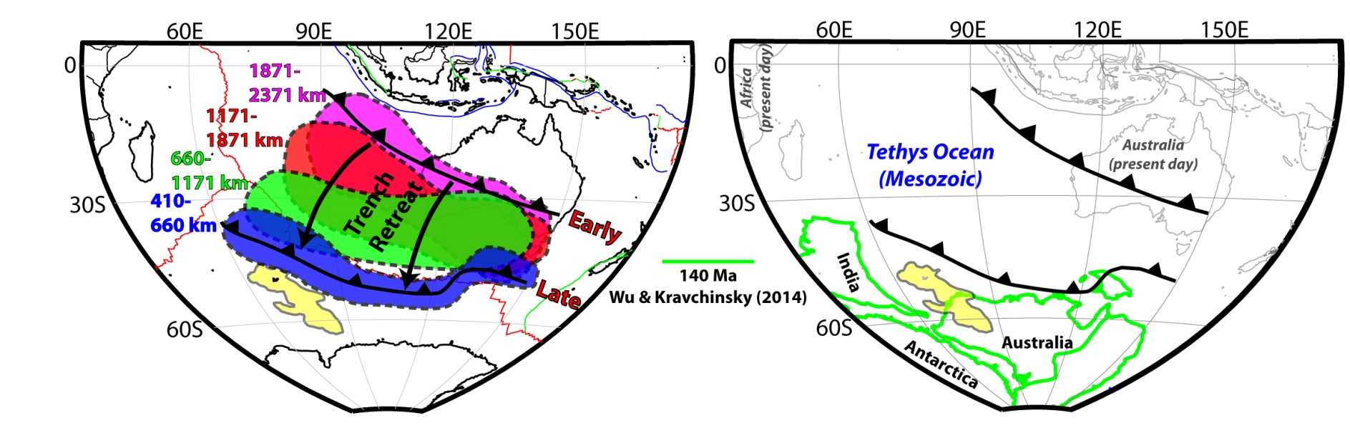
Interpretation: The subduction must have ended in the Early Cretaceous (~130-140 Ma)
Wu and Kravchinsky (2014)
Reconstruction of East Gondwana at 140 Ma
Geometric parametrization of apparent polar wonder path (APWP) tracks

Slide 17
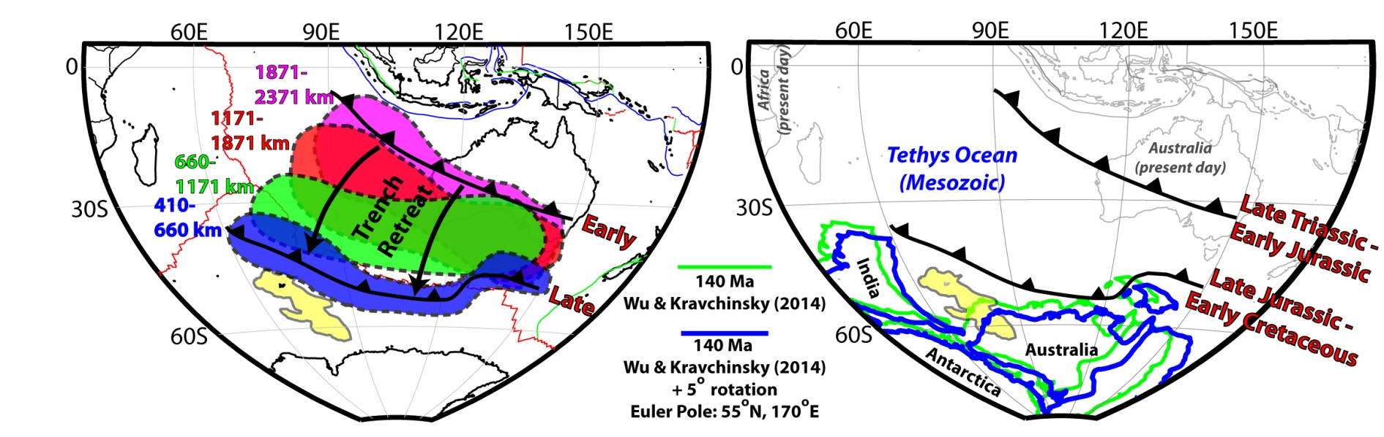
Interpretation: Mostly Jurassic-age intra-oceanic subduction zone sweeping across the Tethys Ocean
Wu and Kravchinsky (2014)
Reconstruction of East Gondwana at 140 Ma
Geometric parametrization of apparent polar wonder path (APWP) tracks

Slide 18
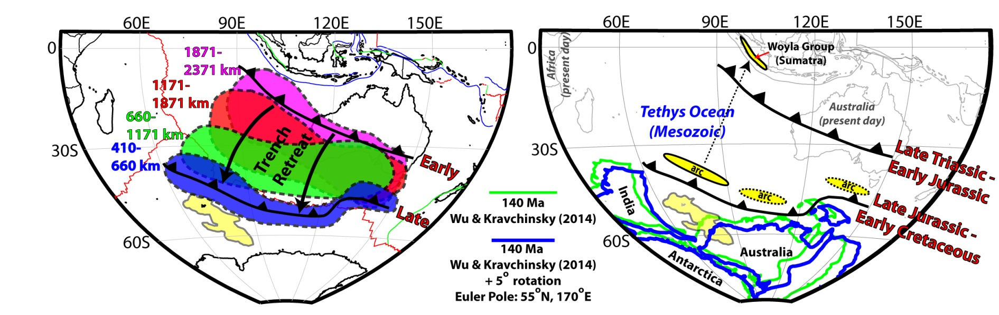
External evidence: The Woyla intra-oceanic arc terrane in Sumatra
Barber and Crow (2003)
Woyla Group (Sumatra)
Jurassic-Early Cretaceous intra-oceanic volcanic arc
Unknown origin

Slide 19
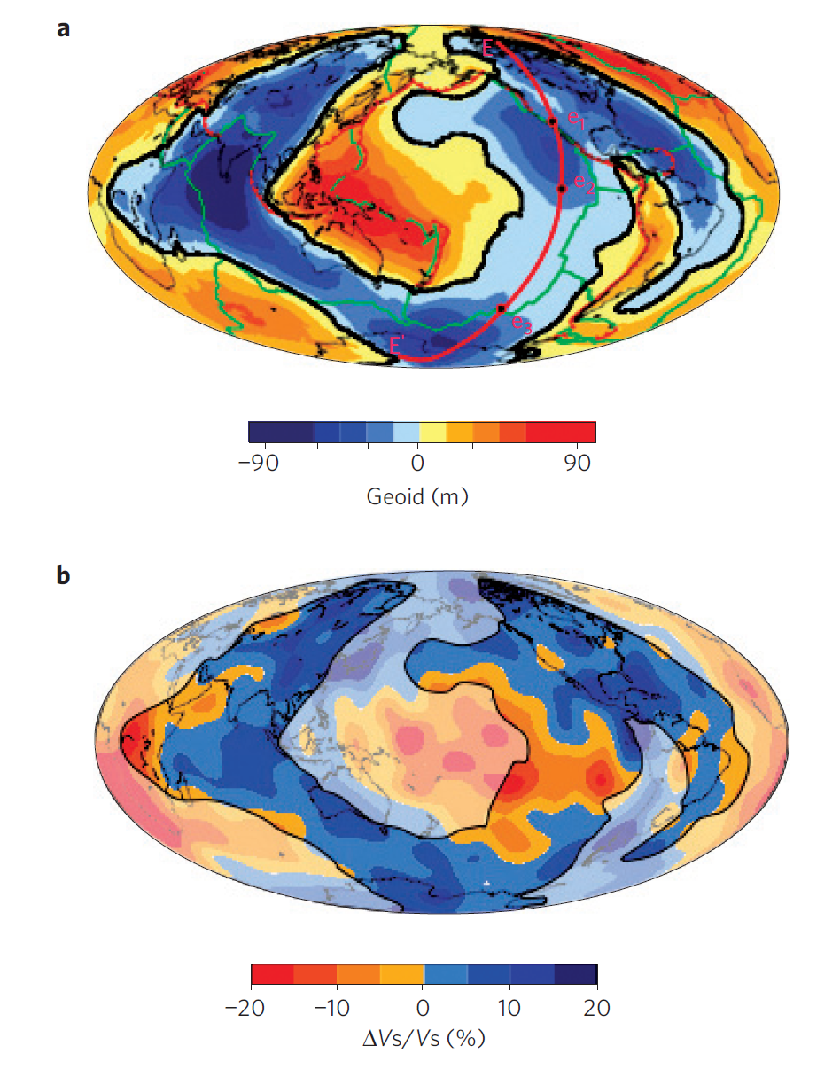
External evidence: Geoid suggests deep slab material
Observed Geoid
Integrated S20RTS over 2000-2890 km
Spasojevic, Gurnis, Sutherland (2010)

Slide 20
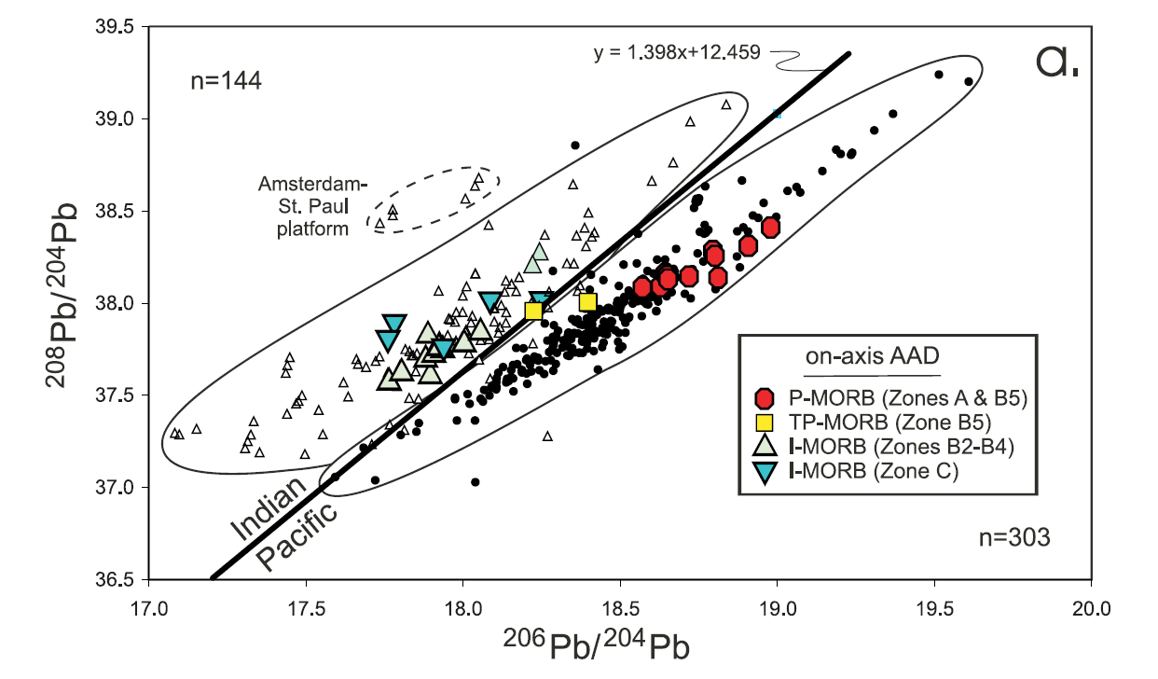
External evidence: Indian Ocean MORB composition is distinct
Indian MORB
Pacific MORB
Kempton et al. (2002)
“…the data can be explained by a model in which Indian mantle includes a significant proportion of material that was processed in the mantle wedge above a subduction zone…”

Slide 21
External evidence: Indian Ocean MORB composition is distinct
The SEIR possibly samples the altered mantle generated by SEIS subduction.
Indian MORB
Pacific MORB
Kempton et al. (2002)
“…the data can be explained by a model in which Indian mantle includes a significant proportion of material that was processed in the mantle wedge above a subduction zone…”

Slide 22
External evidence: Indian Ocean MORB composition is distinct
The SEIR possibly samples the altered mantle generated by SEIS subduction.
Indian MORB
Pacific MORB
Kempton et al. (2002)
“…the data can be explained by a model in which Indian mantle includes a significant proportion of material that was processed in the mantle wedge above a subduction zone…”
TOMORROW:
“Supra-subduction zone (SSZ) history of the southern Indian Ocean: Implications for ophiolites”
Eldridge Moores & Nathan Simmons
8:45am, Room 203

Slide 23
Implication: Longevity of slabs in the shallow mantle
Estimated global average slab sinking rates:
1.2 ± 0.3 cm/yr (van der Meer et al., 2010)
1.3 ± 0.3 cm/yr (Butterworth et al., 2014)
If subducted @ 130-140 Ma → Sinking rate is <0.5 cm/yr!

Slide 24
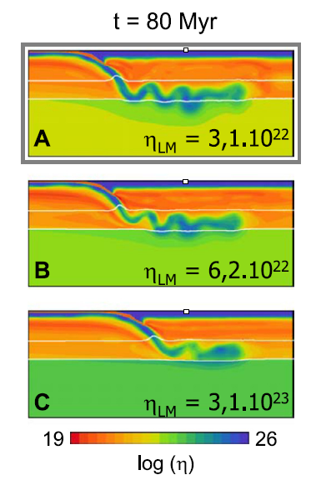
Implication: Stall time in the transition zone could exceed 100 Myr
Basic causes for stagnation:
Phase transitions and metastability
Viscosity contrast from UM to LM
A perfect mixture for SEIS?
Extensive trench retreat (rollback)
Old downgoing slab
Thin/young overriding plate
Undisrupted by subsequent subduction
???
Číẑková and Bina (2013)

Slide 25
The End
For more details, see:
Simmons et al. (2015, GRL)
Our webpage:
https://www-gs.llnl.gov/about/nuclear-threat-reduction/nuclear-explosion-monitoring/global-3d-seismic-tomography
-OR-
Google: LLNL global tomography
Email:
Simmons27@LLNL.gov

Slide 26
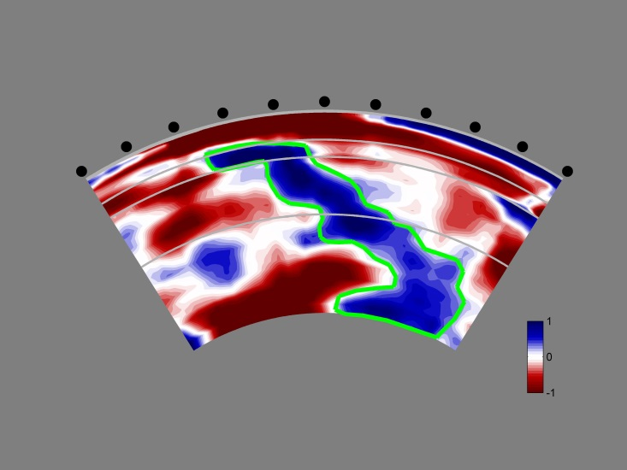
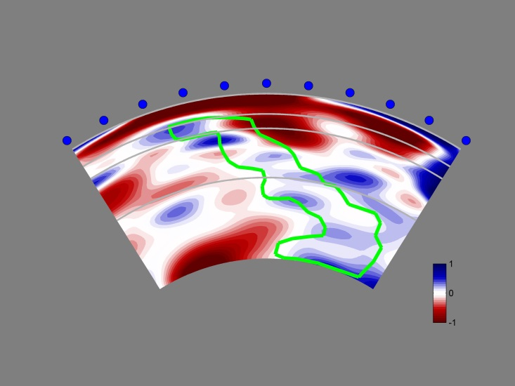
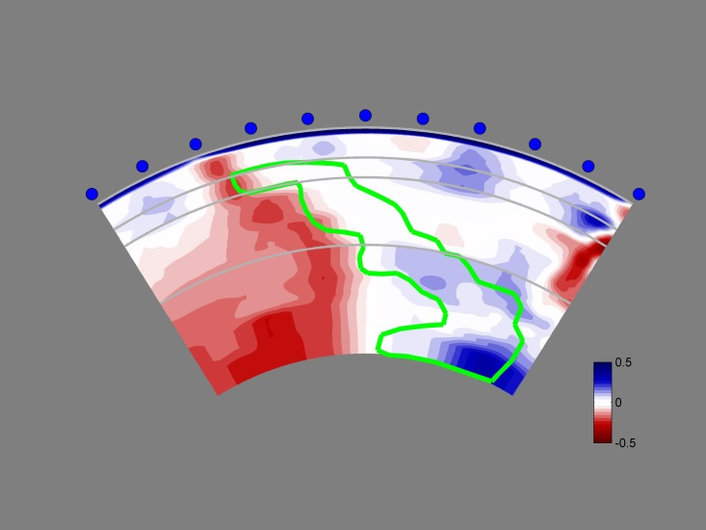
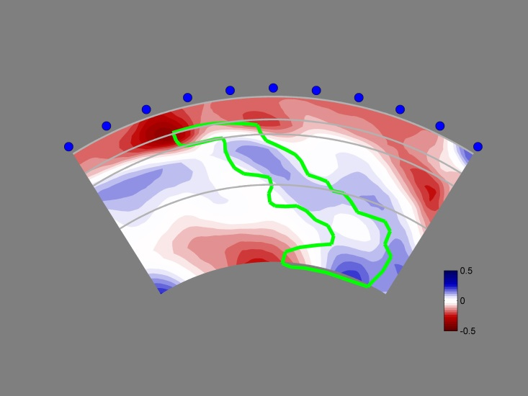
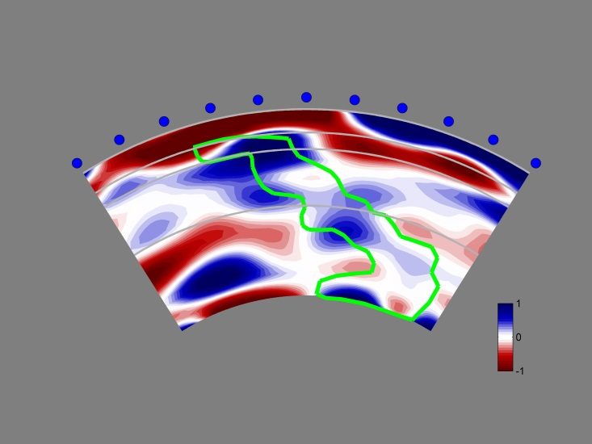
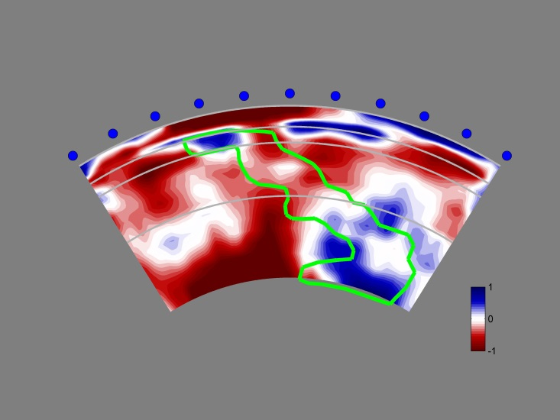
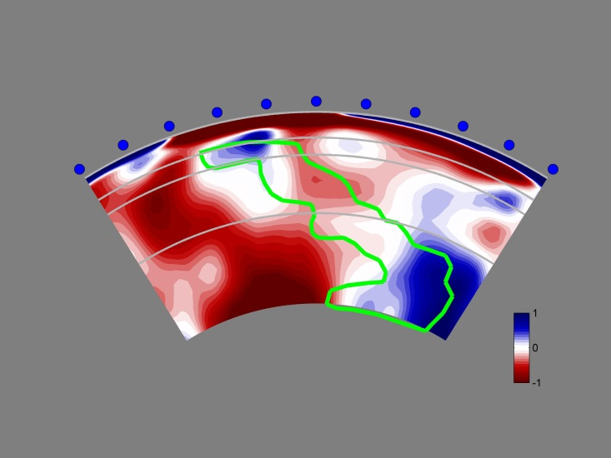
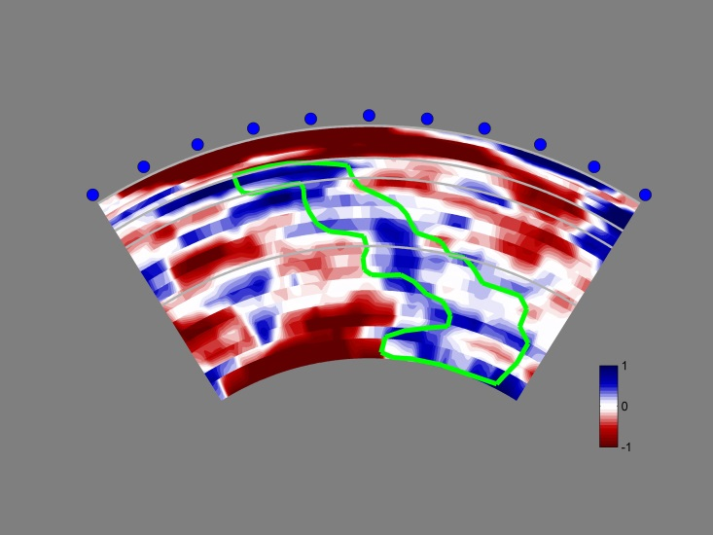
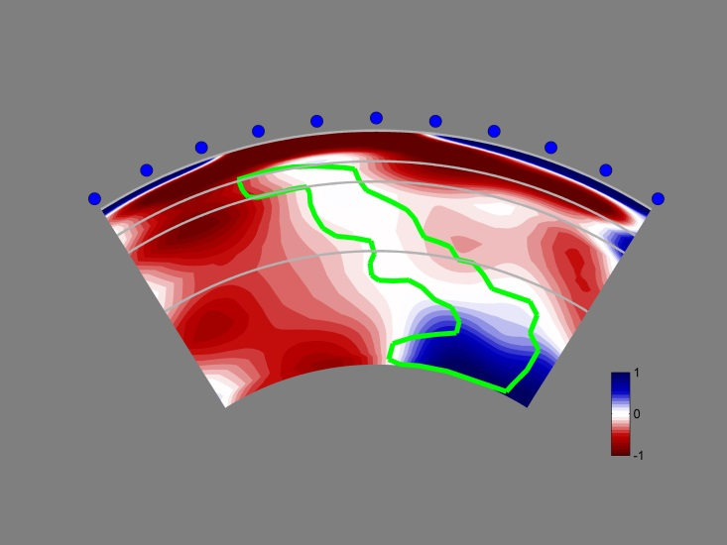
LLNL-G3D-JPS (global P/S model)
LLNL-G3D-JPS
δVs
(%)
S20RTS (Caltech)
δVs
(%)
MITP08 (MIT)
δVp
(%)
Zhao2013 (Tohoku)
δVp
(%)
SAW24b16 (Berkeley)
δVs
(%)
HMSL (Scripps)
δVs
(%)
Savani (ETH-Zurich)
δVs
(%)
Grand2014 (Texas)
δVs
(%)
S362WMANI (Harvard)
δVs
(%)

Slide 27
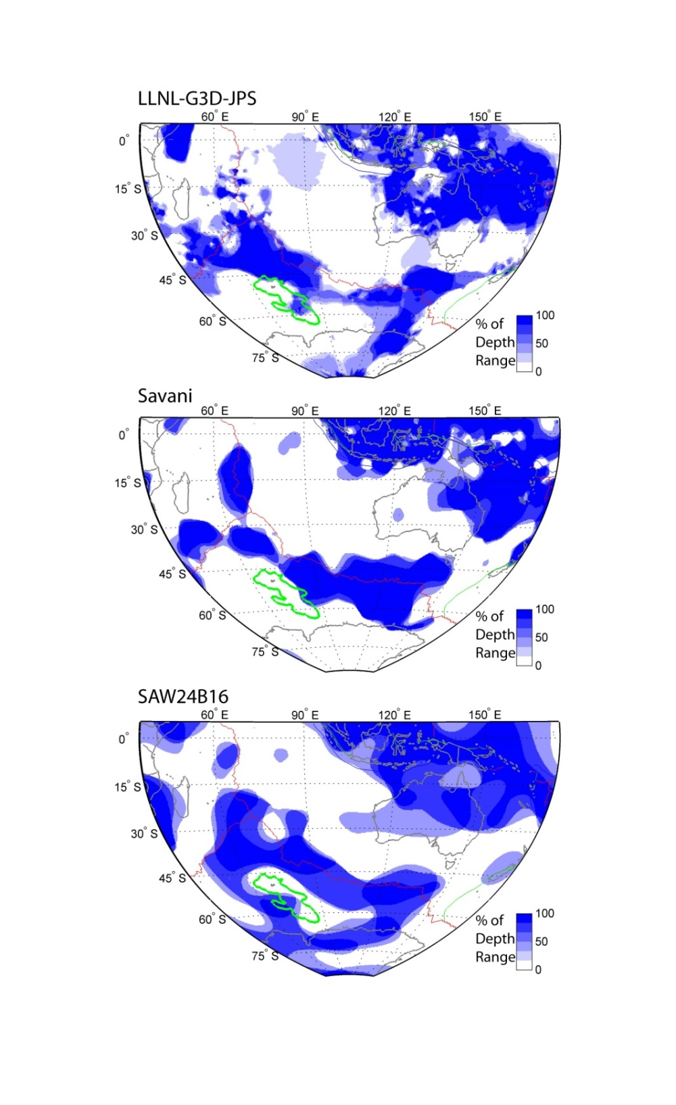
External evidence: Some hints from past tomographic models?
Areal extent of fast material in the transition zone can be seen in other models
Simmons et al. (2015)
Auer et al. (2014)
Mégnin and Romanowicz (2000)

Slide 28
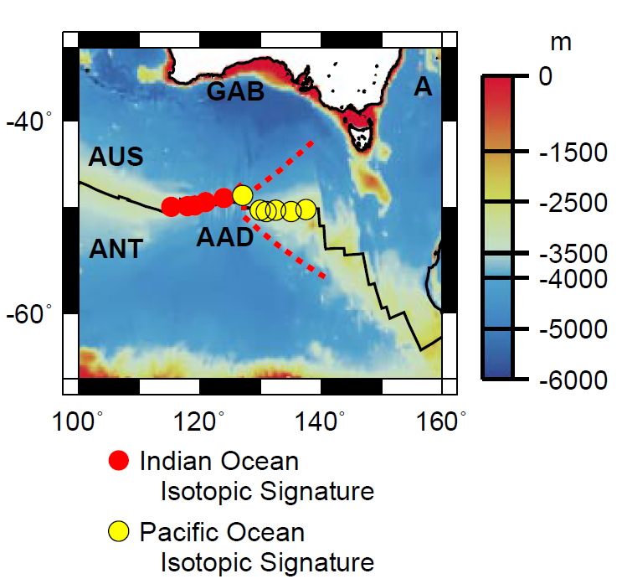
External evidence: Indian Ocean MORB composition is distinct
The SEIR possibly samples the altered mantle generated by SEIS subduction.
Indian MORB
Pacific MORB
Indian←→ Pacific
Kempton et al. (2002)
Australian-Antarctic Discordance
“…the data can be explained by a model in which Indian mantle includes a significant proportion of material that was processed in the mantle wedge above a subduction zone…”
Gurnis, Müller, Moresi (1998)

