Slide 1
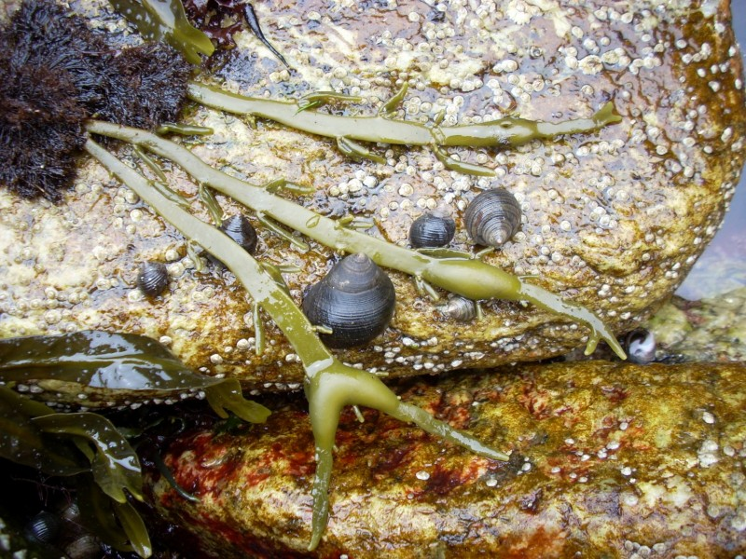


Information loss in the rocky intertidal
Laura Schachter
Vassar College
Mary Kosloski
University of Iowa

Slide 2
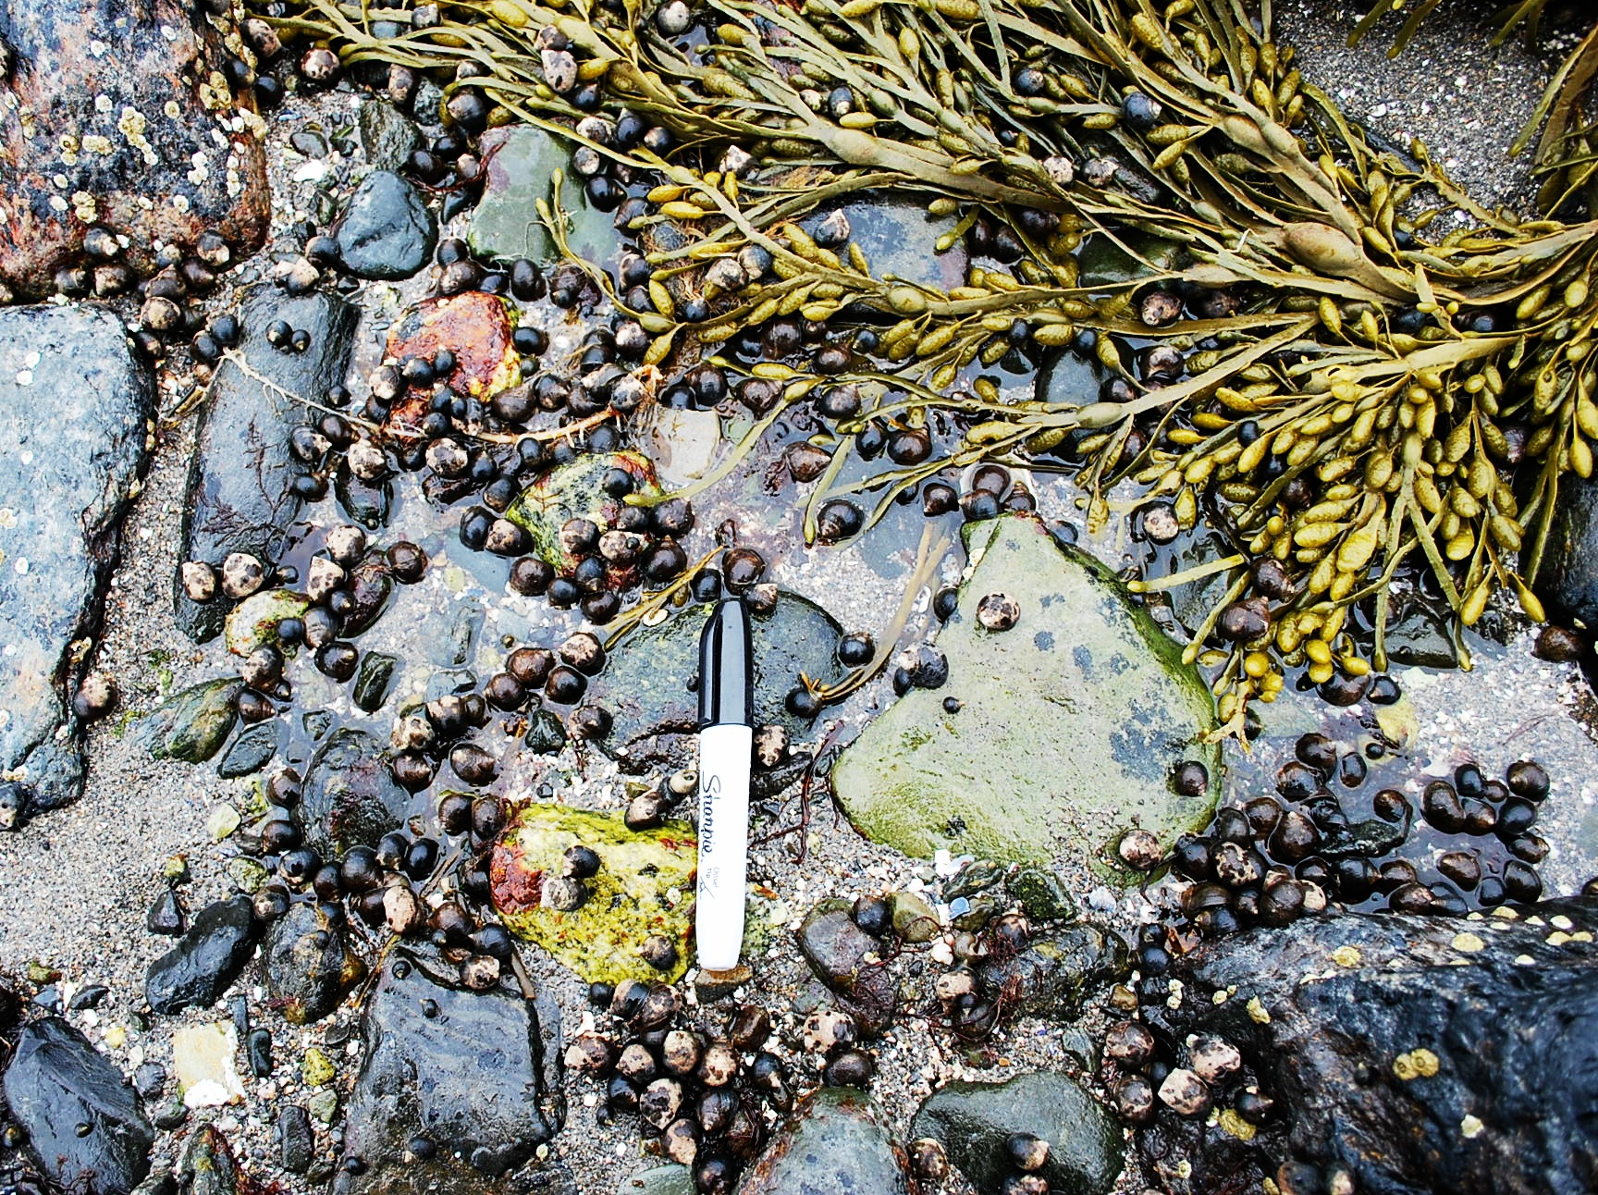
Background
Taphonomic processes involve the loss of information.
Living community
Dead
Preserved
Collected
Notes:
our general thesis: taphonomy is always losing information, but how much?
Taphonomic processes, or the things that happen to an organism between death and a paleontologist viewing it, can provide information about the burial environment, but heavily involve loss of different types of information, but we never knew quite how much

Slide 3
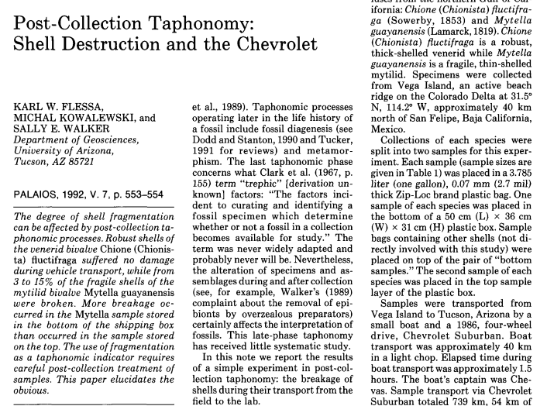
Background
“Post-collection taphonomy: shell destruction and the Chevrolet” -Flessa et al., 1992
Takeaway: We all know this happens, but how much of a problem is it?
Notes:
There’s this paper: taphonomy in the back of a ‘57 chevy...what they did WAS
Quantifying an obvious problem
Who thought you could publish a paper where the findings were: “if you don’t take care when packing up your samples, they will break in the back of a pickup truck and you will lose information”?
Here we didn’t get the exciting experience of driving our snails around in an antique car, but instead got to throw them in a rock tumbler and acid baths.
Mary’s research on repair scars depends on her ability to be able to identify the repair scars as best as she can on each individual. We were curious if other taphonomic properties were hindering her ability to do this, so we set to work classifying lots of snails

Slide 4
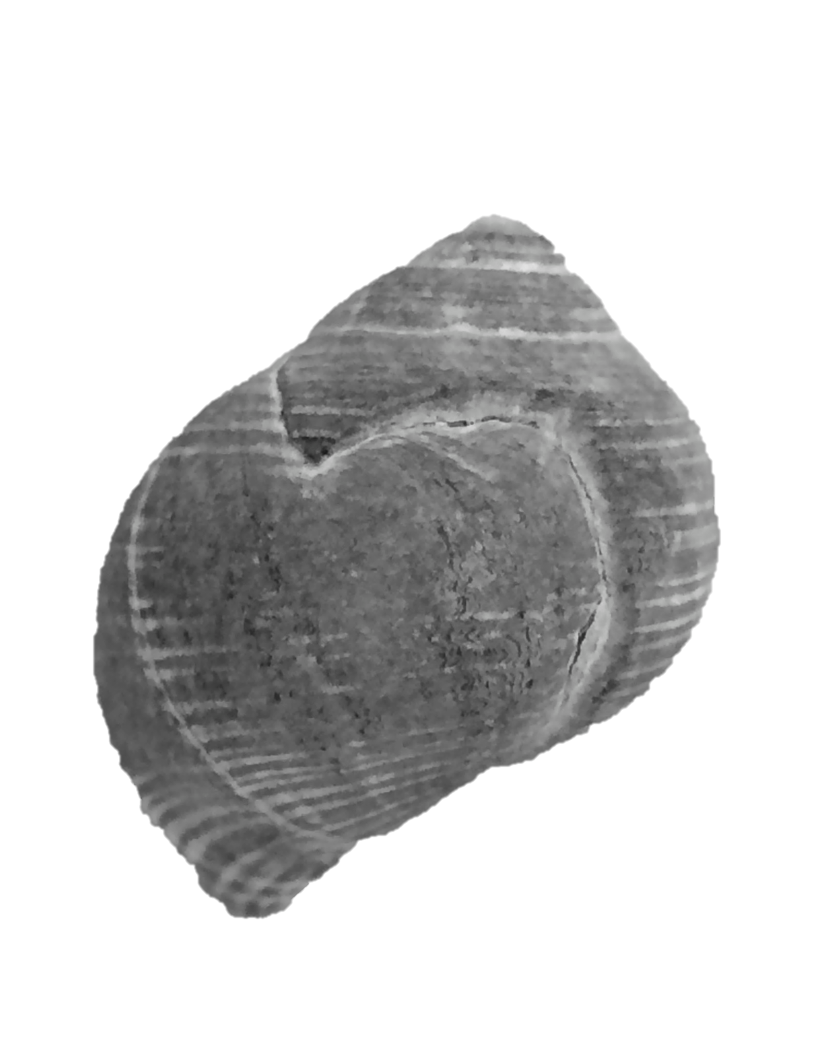
Interpreting Repair Scars
Factors influencing repair frequency
Prey body size
Prey growth rate
Prey shell shape
Microstructure
Predator Abundance
Sample size
Taxonomic scale
Taphonomy
Modified from Dietl & Kosloski 2013, Palaios
Notes:
What is a repair scar: evidence of failed predation on the shell of an organism. The predator got a bite out of the shell (or try to crush), but didn’t actually kill then organism, and thus the organism continued to grow, leaving a noticeable “scar” on the shell
Repair scars help us estimate selective pressure
Notice the last row- “taphonomy” is included in possible factors affecting repair frequency. It is a known problem, but we don’t know how bad it is
Kim Cook
Bridget Kelley
Patricia Kelley
Also looking into this problem

Slide 5
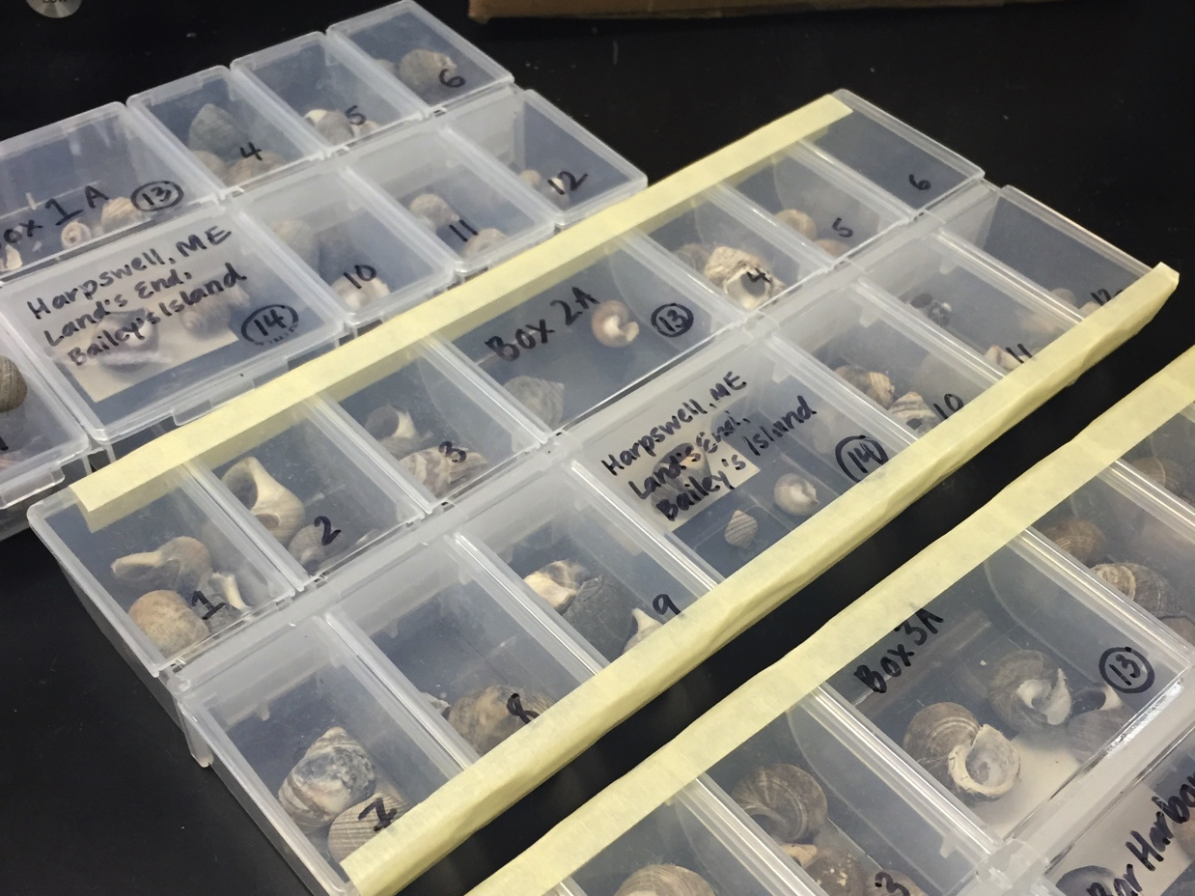
Littorina littorea
Rocky intertidal marine gastropod
Harsh environment
Vulnerable to climate change
Notes:
These (invasive) snails were collected from new jersey up to newfoundland, and they live in the harsh rocky intertidal zone.
This zone is subject to lots of wave drag, desiccation, and abrasion from sediment and material in the water column

Slide 6
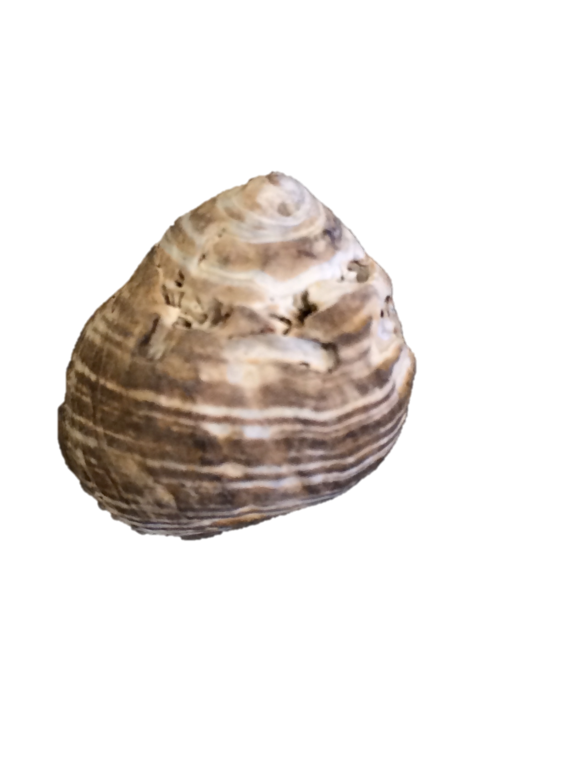
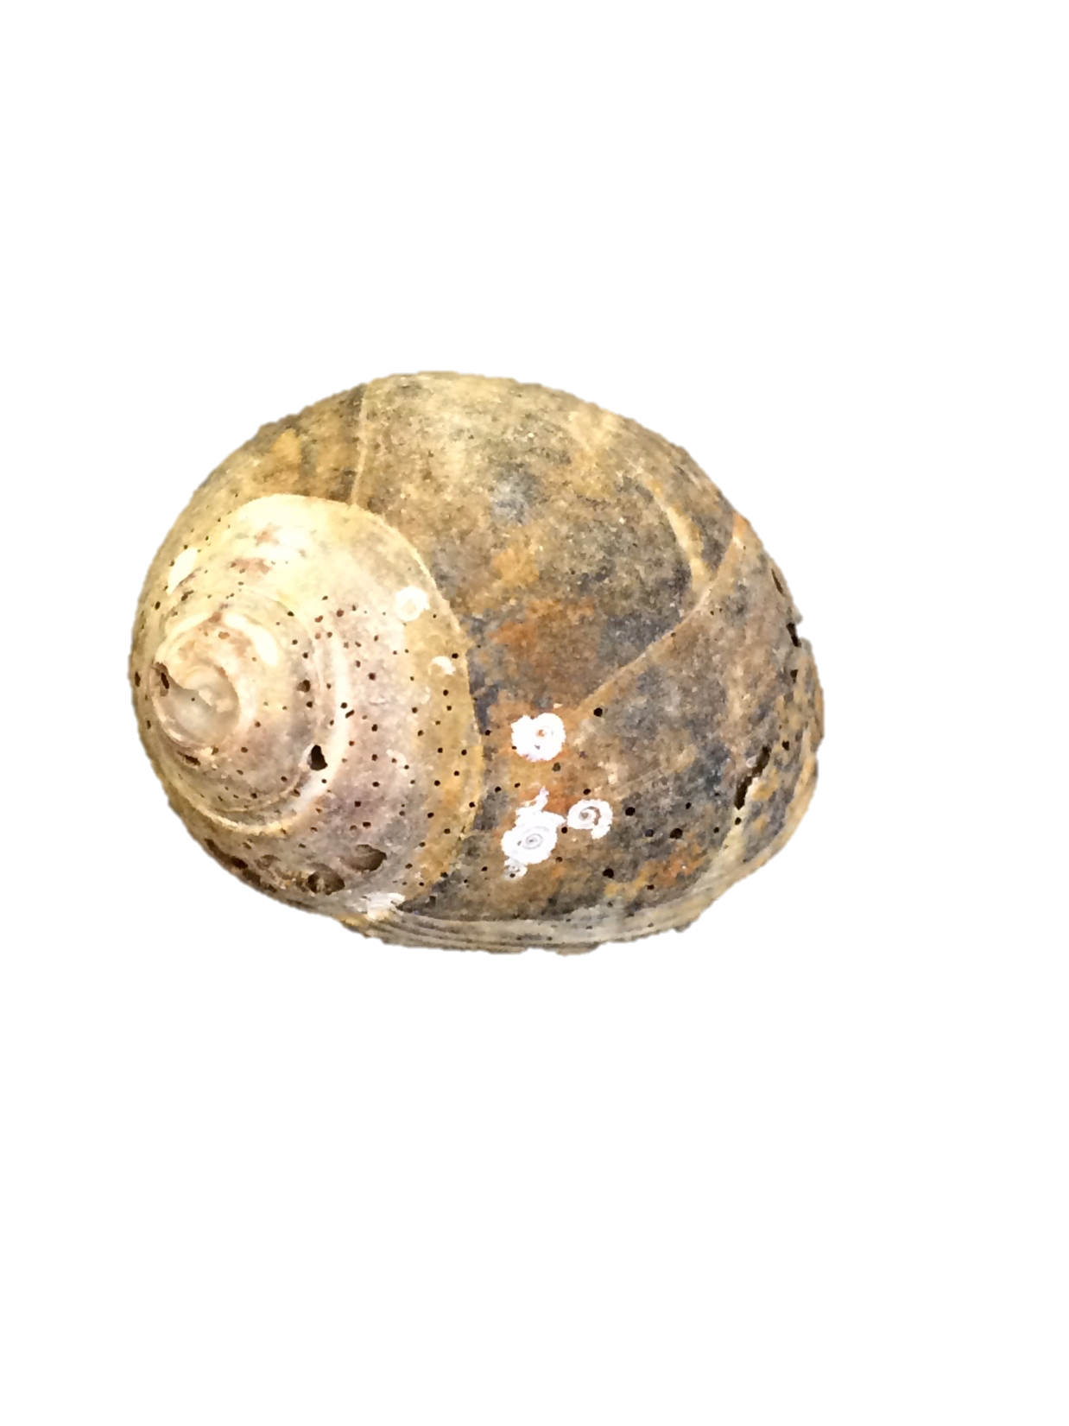
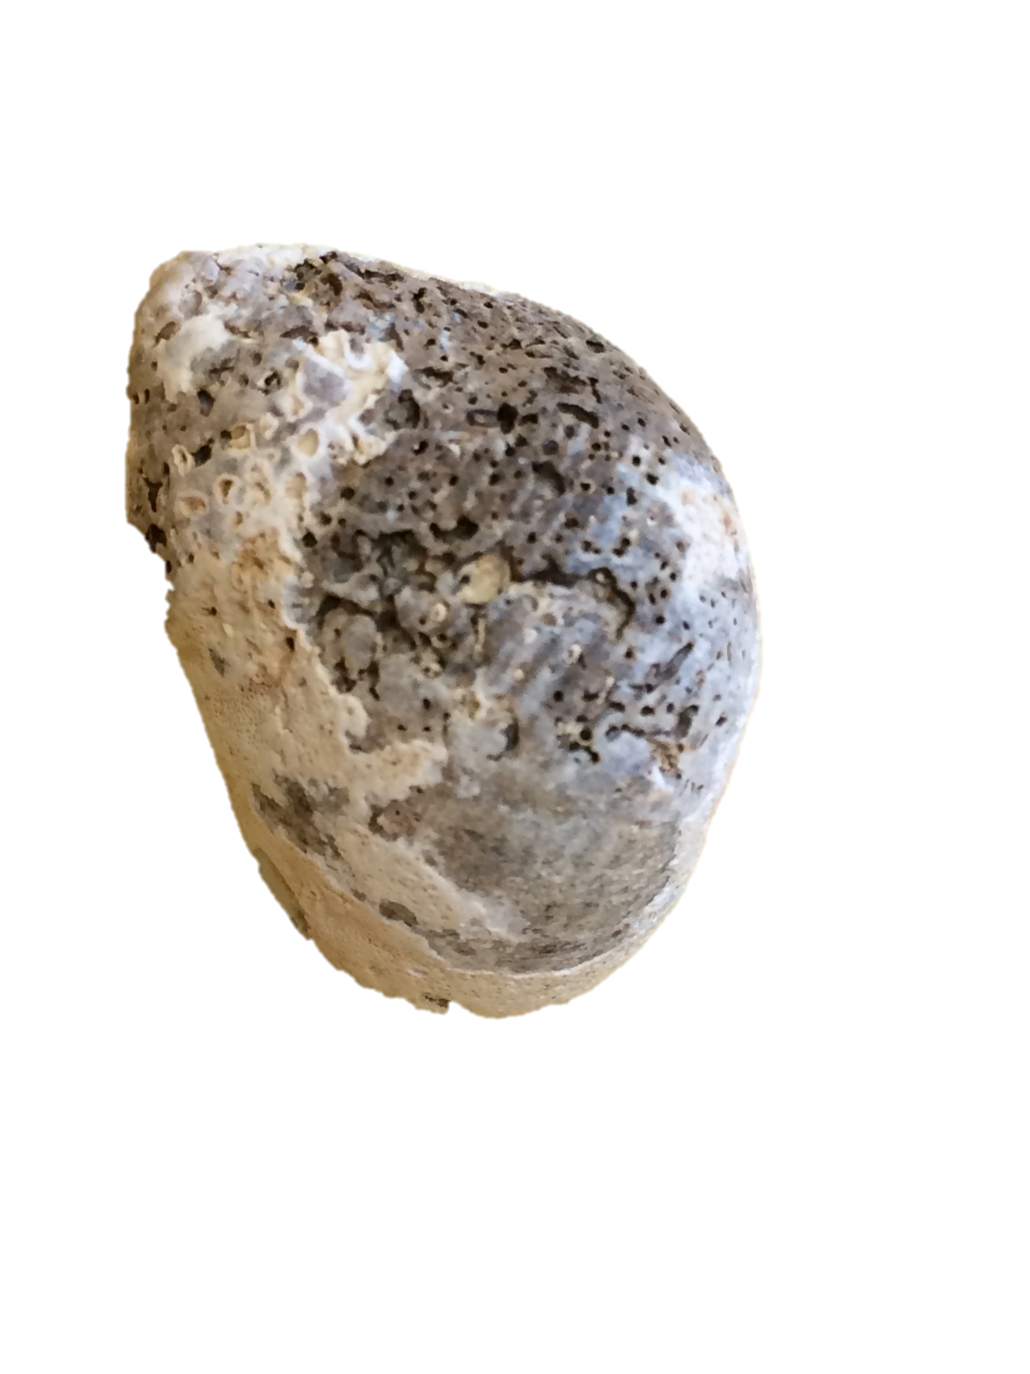
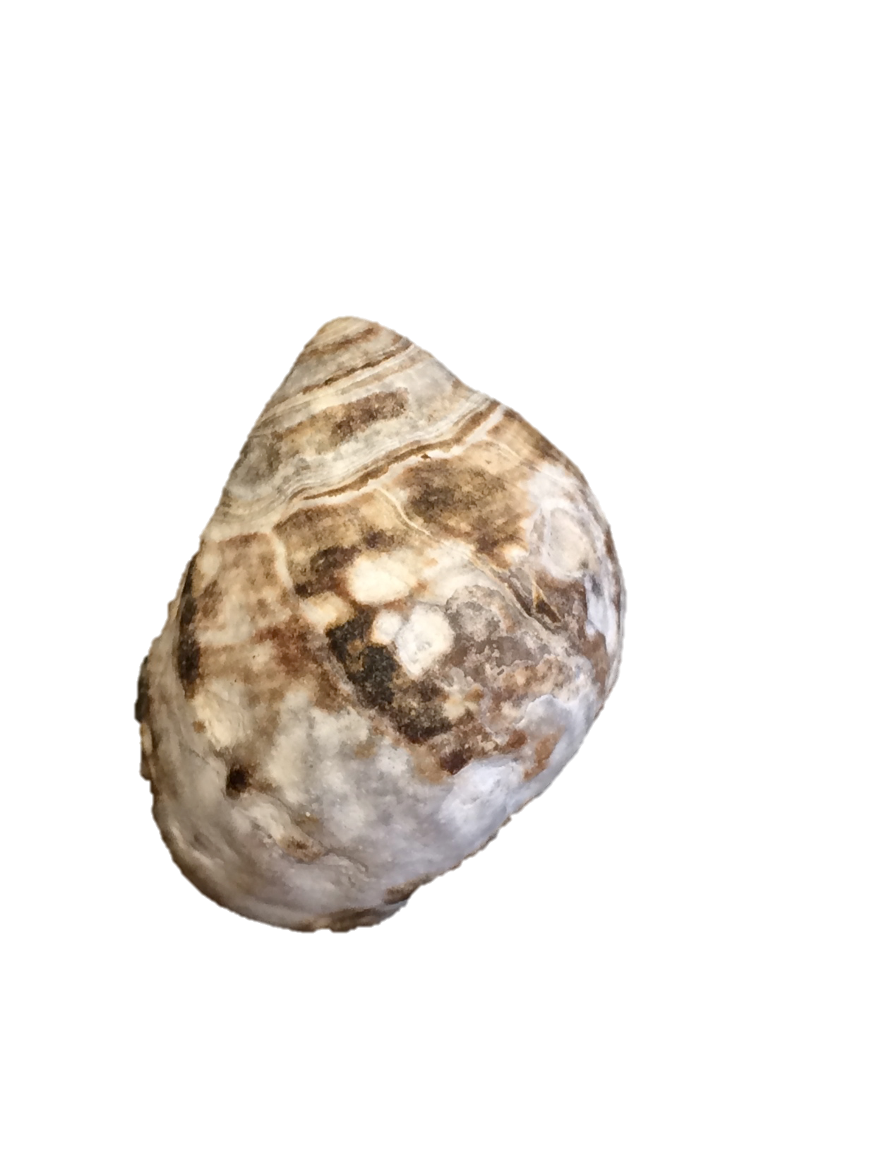
Methods
Bioerosion
Encrustation
Chalkiness
0= no evidence
1= <20% coverage (slightly altered)
2= >20% coverage (chalky)
Notes:
So, on my end of the research, I started by classifying three different taphonomic markers we found on our samples.
I used microscope and repeated batches until numbers converged
Bioerosion: is the erosion of shell surfaces by living organisms (i.e., evidence of boring, such as that produced by Clione)
Encrustation: is the presence of overlaying material that adhered to the shell surface (I am going to get a picture of a shell with a big pile of encrustation since it isn’t totally obvious in this picture)
Surface alteration: (or chalkiness) is degradation of the original luster of the shell
0, 1, 2 scale to quantify

Slide 7
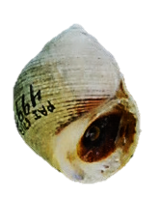
Methods Continued
shell width
Repair scars
Linear measurements
shell length
shell thickness
Notes:
On Mary’s end, she did her usual thing identifying major repair scars on each individual as well as taking linear measurements
Major=siginificantly embayed

Slide 8
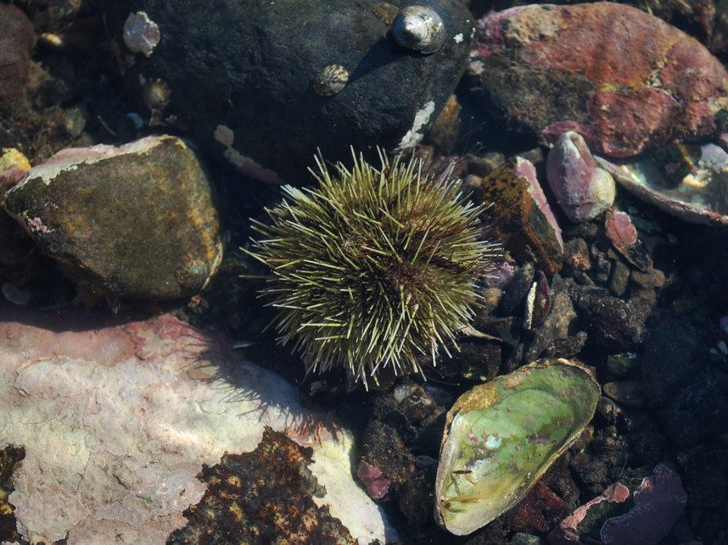
Museum Collections
Locality | Number of Specimens
Holyrood, Newfoundland, Canada | 23
Cape May, New Jersey, United States | 19
Rockport, Maine, United States | 17
Bar Harbor, Maine, United States #1 | 17
Bar Harbor, Maine, United States #2 | 42
Provincetown, Massachusetts, United States | 31
Bar Harbor, Maine, United States #3 | 42
Bar Harbor, Maine, United States #4 | 31
Notes:
Non experimental groups
These were the groups we examined for taphonomic markers and repair scars and linear measurements, but didn’t run any experiments on

Slide 9
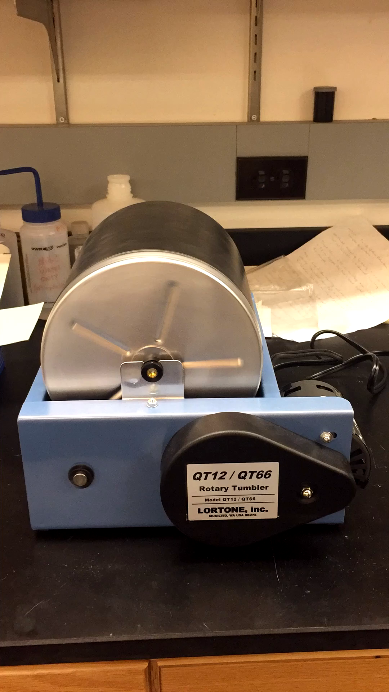
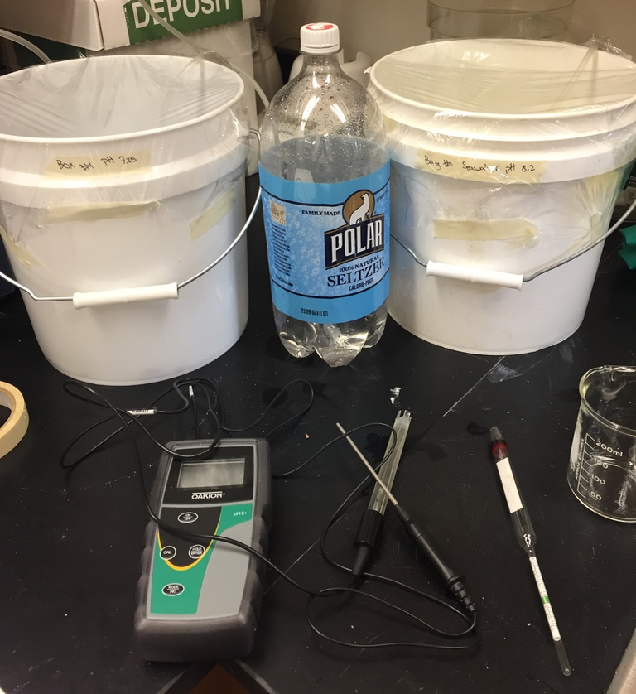
Experiments
Notes:
Tumbler- replicate rocky intertidal
~124 (~5 days) hours works out to 140 kilometers of distance tumbled
-also added sediment to some rounds in the tumbler, as well as instant ocean
Acid baths- ocean acidification
-normal – pH 8.4 (from Poughkeepsie tap)
Acidified- pH 7.2
And highly acidified closer to pH 6
Did this with carbonic acid from seltzer and tested with pH meter and pH strips
Added instant ocean salt to replicate normal seawater saltiness
-does ocean acidification cause more loss of information?

Slide 10
Initial population from Harpswell, Maine split into four samples of 30 individuals each, scored for taphonomic damage and RF
Sample #1: soaked in normal seawater
(pH 8.4) for 5 days
Sample #2: soaked in acidic seawater
(pH 7.2) for 5 days
Sample #3: tumbled in normal seawater (pH 8.4) for 5 days
Sample #4: tumbled in acidic seawater (pH 7.2) for 5 days
Individuals within samples re-scored for taphonomic damage and RF
Sample #4: tumbled in acidic seawater (pH 6.0) for 5 days
Re-scored for taphonomic damage and RF
Notes:
Explain our schematic

Slide 11
Museum Collections: Results
Notes:
We see a weak correlation, but we do think there is something going on here

Slide 12
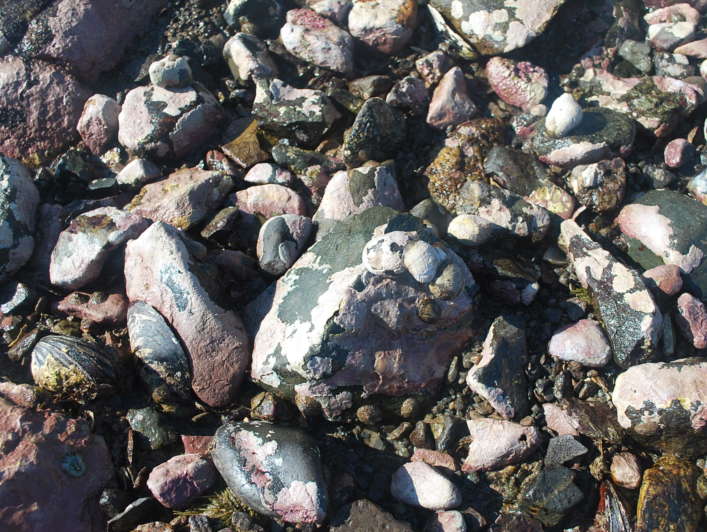
Experimental Work: Results
Sample #1: soaked in normal seawater
(pH 8.4) for 5 days
Sample #2: soaked in acidic seawater
(pH 7.2) for 5 days
Sample #3: tumbled in normal seawater (pH 8.4) for 5 days
Sample #4: tumbled in acidic seawater (pH 7.2) for 5 days
Individuals within samples re-scored for taphonomic damage and RF
Sample #4: tumbled in acidic seawater (pH 6.0) for 5 days
Re-scored for taphonomic damage and RF
Notes:
Explain our schematic

Slide 13
Experimental Work: Results (Taphonomy & RF)
Sample #1: soaked in normal seawater
(pH 8.4) for 5 days
Sample #2: soaked in acidic seawater
(pH 7.2) for 5 days
Sample #3: tumbled in normal seawater (pH 8.4) for 5 days
Sample #4: tumbled in acidic seawater (pH 7.2) for 5 days
Bio= 0.9
Enc= 0.77
Chalk= 1.27
RF=0.13
Bio= 1.1
Enc= 1.07
Chalk= 1.27
RF=0.23
Bio= 1.03 Enc= 1.07
Chalk= 1.5
RF=0.1
Bio= 1.03
Enc= 1.03
Chalk= 1.43
RF=0.1
Bio= 1
Enc= 1.27
Chalk= 1.2 RF=0.21
Bio= 0.97
Enc= 0.8
Chalk= 0
RF=0.1
Sample #4: tumbled in acidic seawater (pH 6.0) for 5 days
Bio= 0.933
Enc= 1.77
Chalk= 1.57
RF=0.13
Bio= 0.77
Enc= 0.47
Chalk= 1 RF=0.03
Bio= 0.645
Enc= 0.03
Chalk= 1
RF=0.07
Notes:
Tumbled came out completely shiny and completely non chalky
Encrustation- from salt maybe
Note: max score for taphonomic categories is a 2

Slide 14
Experimental Work: Results (Linear Measurements)
Sample #1: soaked in normal seawater
(pH 8.4) for 5 days
Sample #2: soaked in acidic seawater
(pH 7.2) for 5 days
Sample #3: tumbled in normal seawater (pH 8.4) for 5 days
Sample #4: tumbled in acidic seawater (pH 7.2) for 5 days
L=21.9
W=18.5 Th=0.9
L=20.7
W=18.2
Th=0.9
L=20.4
W=17.4
Th=0.9
L=21.7
W=18.2
Th=0.9
L=20.5
W=17.6
Th=0.9
L=19.2
W=17.1
Th=0.8
Sample #4: tumbled in acidic seawater (pH 6.0) for 5 days
L=21.9
W=19.1
Th=1.0
L=20.0
W=17.7
Th=0.8
L=17.7
W=16.5
Th=0.5
Linear measurements in mm
Notes:
General trend- lose material

Slide 15
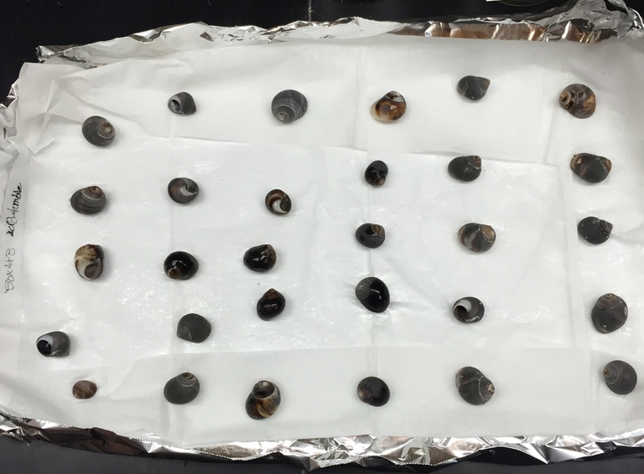
Conclusions
More taphonomic damage hinders our ability to identify repair scars
but not necessarily in a predictable manner
Notes:
We are still working out the details, and it is unclear whether we will be able to pinpoint how much information is lost and in what ways this happens, but it is clearly happening
Generally saw scores go down, but in one case they went up
Modify our ability, and it’s a problem, but working to see how bad

Slide 16
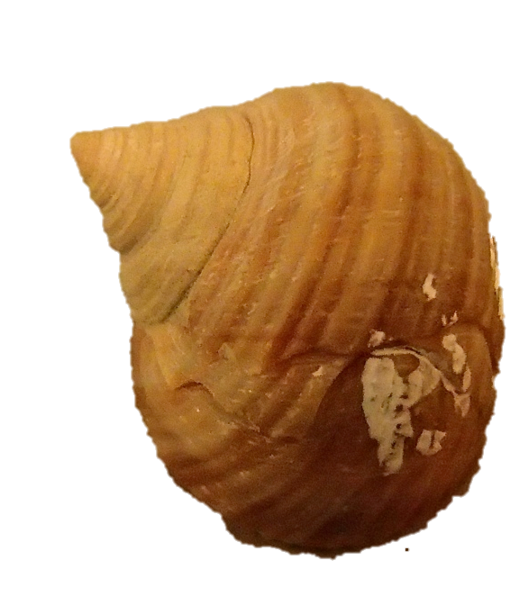
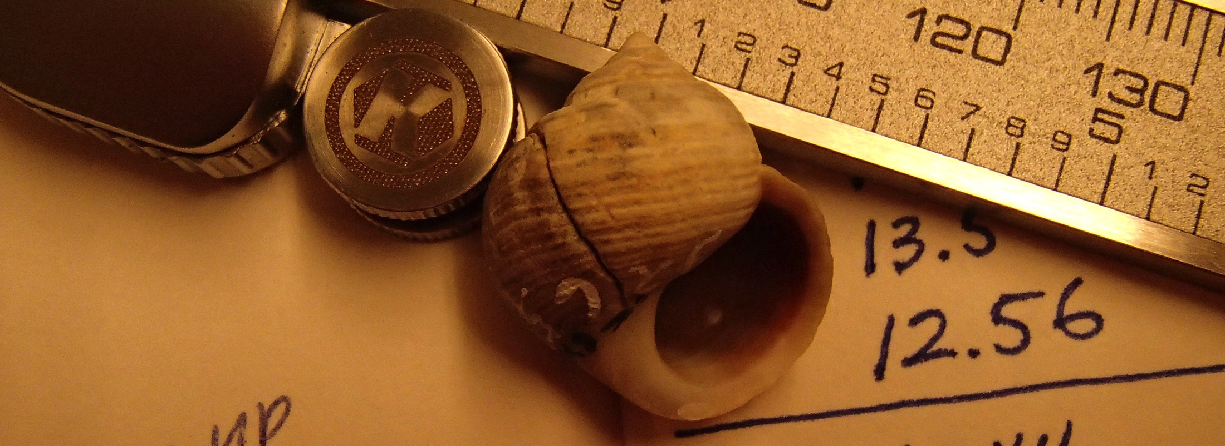
Future Work
Encrustation should be restricted in future work to fossilizable material (hard algae, serpulid worm tubes, etc.)
More experimental work
Notes:
Was doing encrustation as anything adhering to shell surface, but in future we would do only fossilizable material

Slide 17
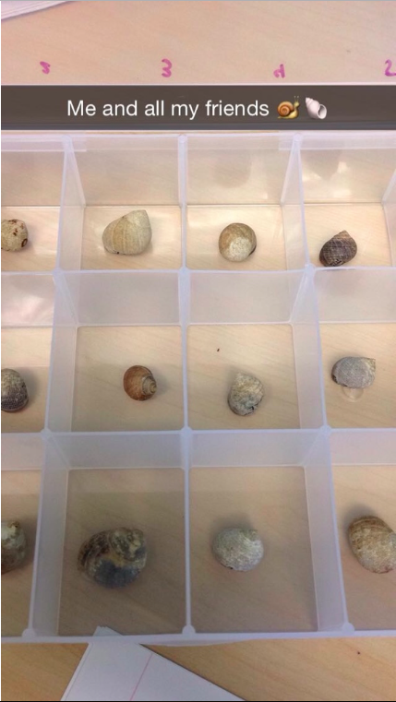
Acknowledgments
Greg Dietl at the Paleontological Research Institution
Bruce Rueger at Colby College
Kirsten Menking
Notes:
PRI and for shell loans Bruce Rueger destroyable snails
Kirsten for letting me take over her lab

