Slide 1
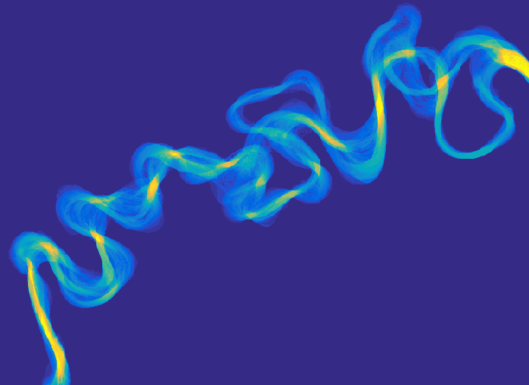
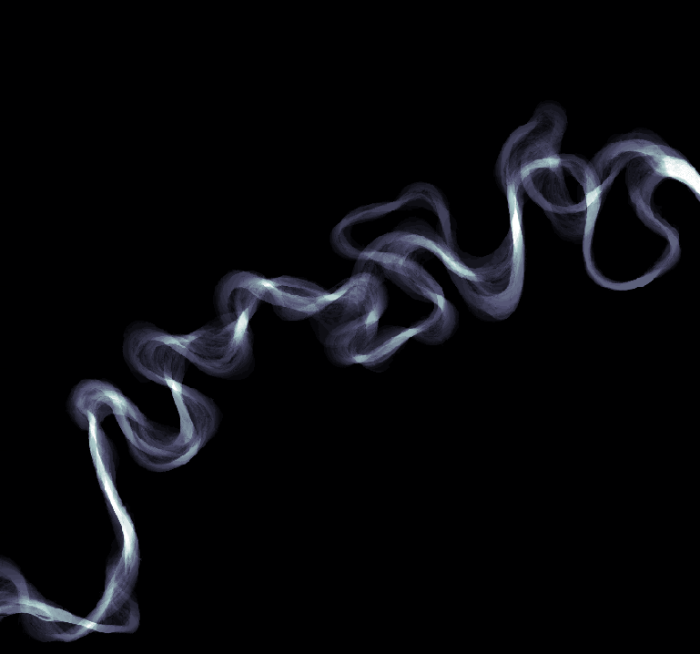
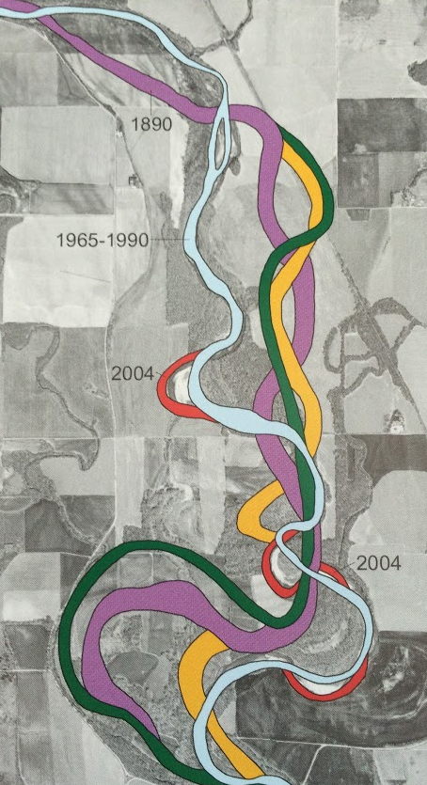
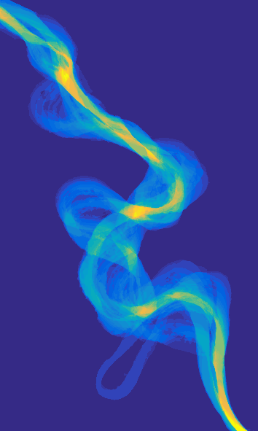
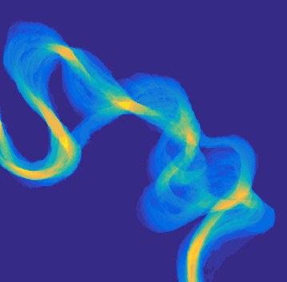
?
The Secret Lives of Meander Bends
?
?
?
Jon Schwenk, Ankush Khandelwal, Mulu Fratkin, Vipin Kumar, and
Efi Foufoula-Georgiou
?
?
?
  GSA, 2016
Credit: American Geographical Society

Slide 2
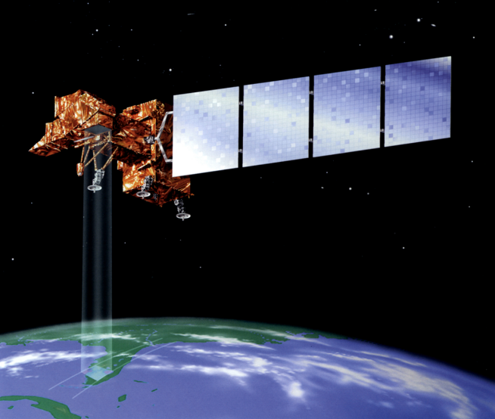
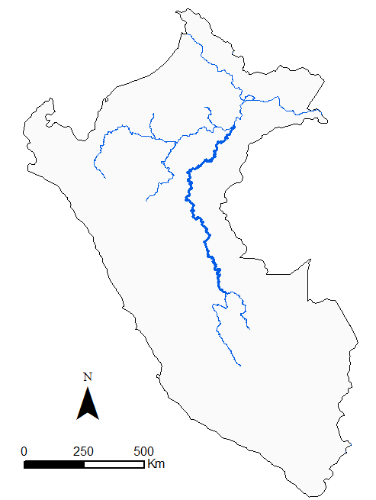
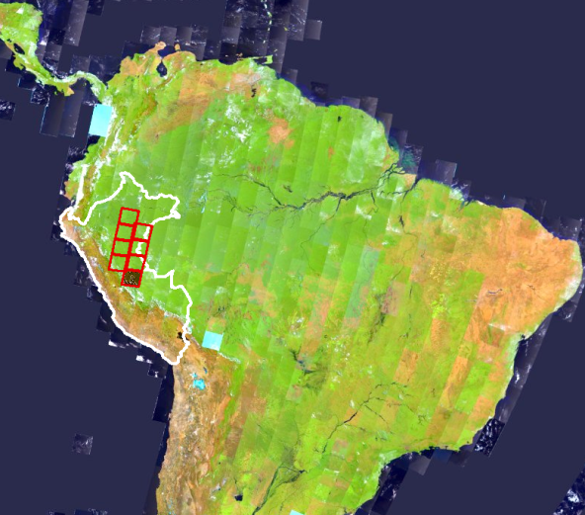
Landsat
1984-2016
Every 18 days
30 m resolution
Iquitos
Amazon River
Marañon
River
B
Ucayali River,
Peru
Pucallpa
Ucayali River
Atalaya
Tambo River
170 km x 185 km
250 km
Credit: NASA
250 km
ESRI Landsat 8 Views

Slide 3
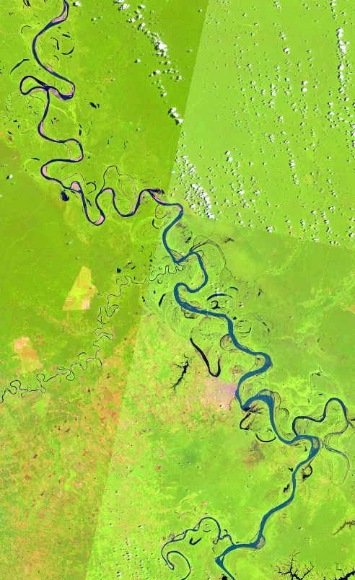
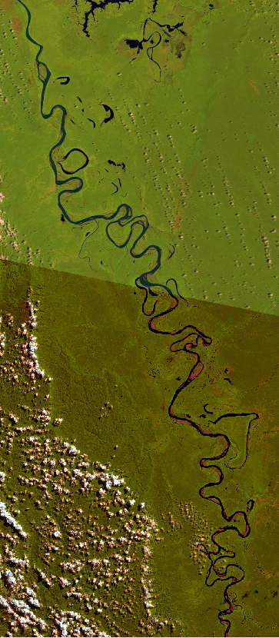
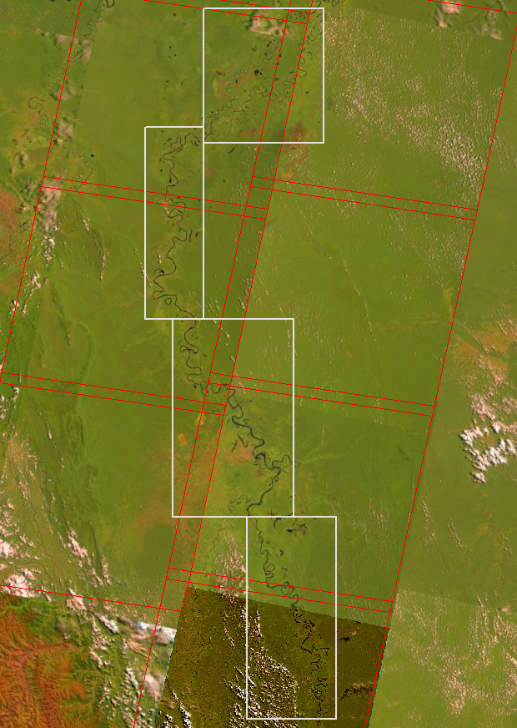
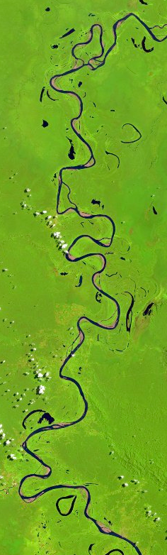
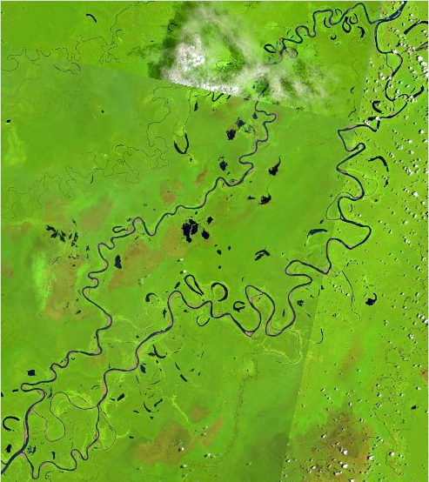
R6
R5
R6
R5
Path 7
R3
Path 6
R4
R4
R4
Row 65
R5
Row 66
R3
R3
R6
100 km
~135,000 Landsat images
R5

Slide 4
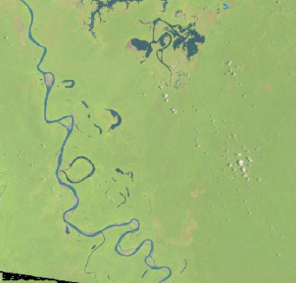
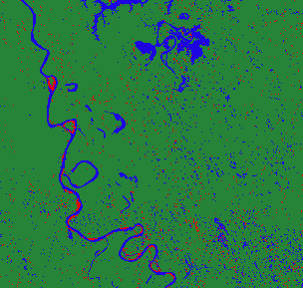
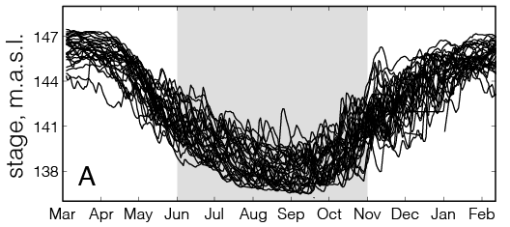
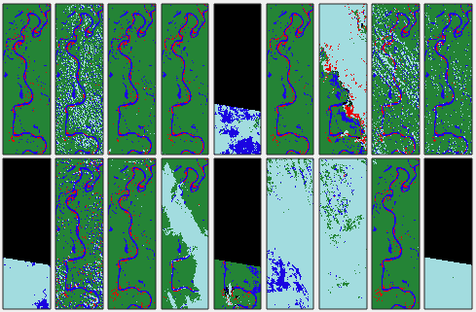
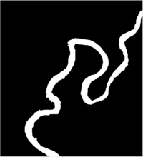
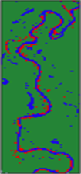
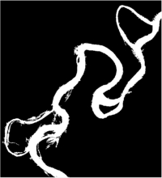
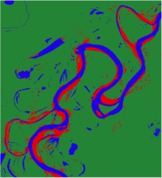
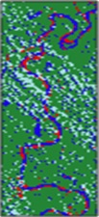
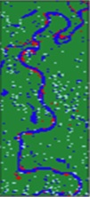
Step 1: Classify all images (~5,510 after filtering)
Objective: one composite image per year, independent of stage
water
sediment
land
Landsat
Classified
cloud
unknown
Step 2: Make image bank for each year
Step 7: Single-thread channel mask
Step 3: Select images for compositing
Step 4: Stack images
Step 6: Channel mask
Step 5: Make composite

Slide 5
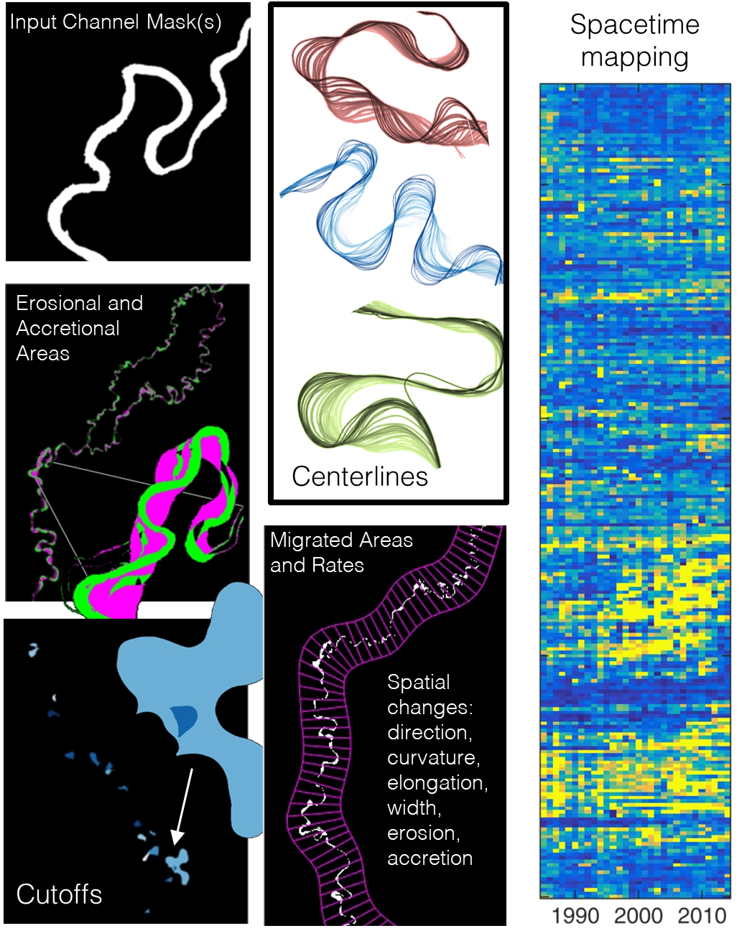
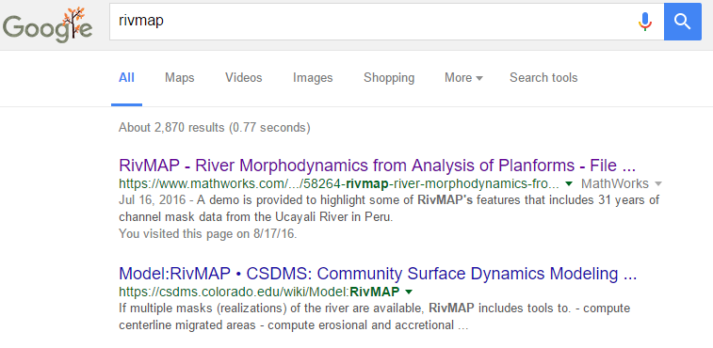
RivMAP
River Morphodynamics from Analysis of Planforms
(Matlab)
To download RivMAP with demo of the Ucayali River, Google “rivmap”.
Also hosted at CSDMS.

Slide 6
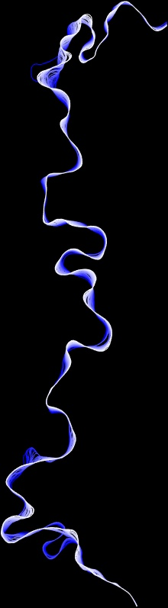
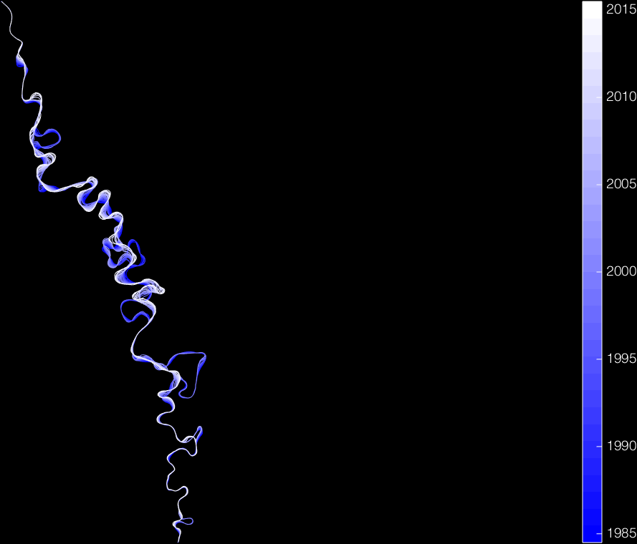
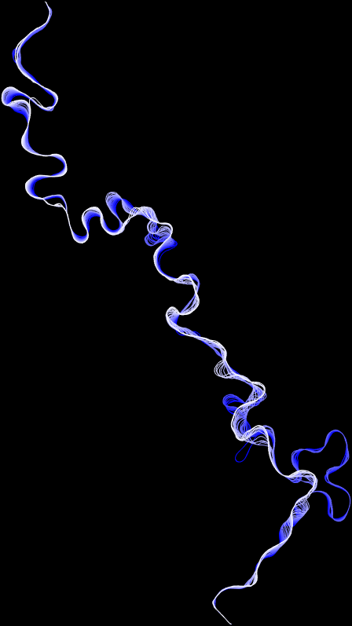
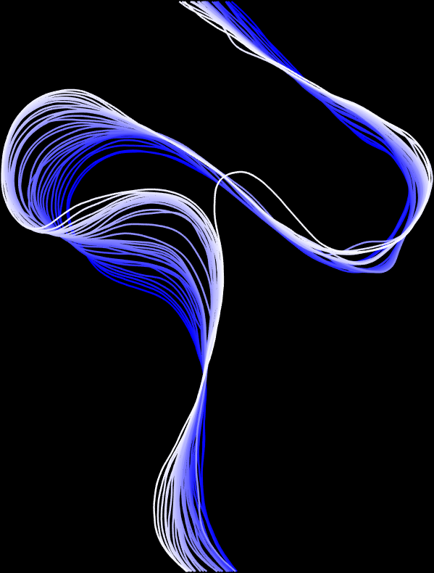
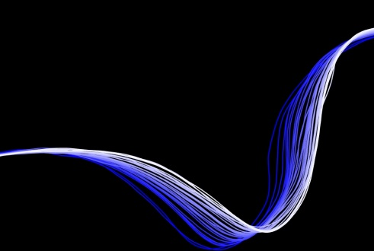
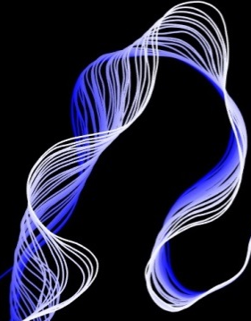
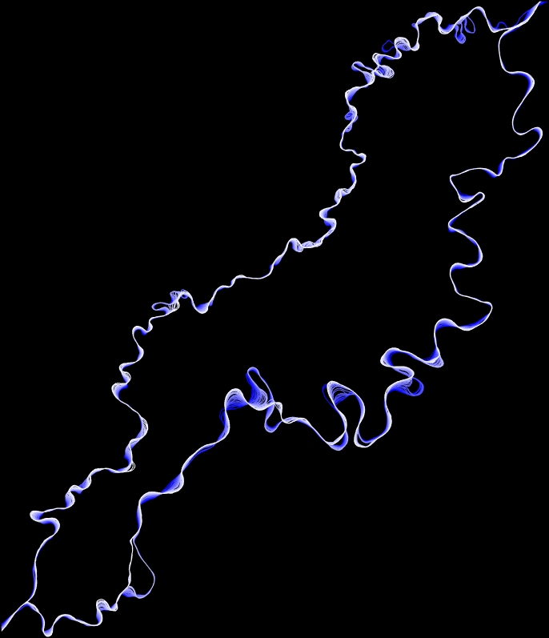
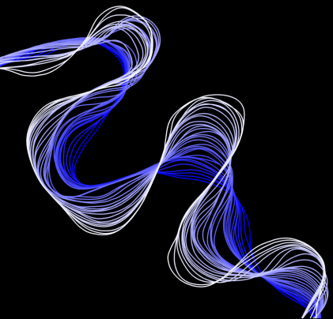
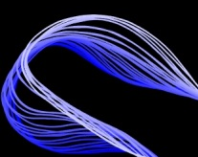
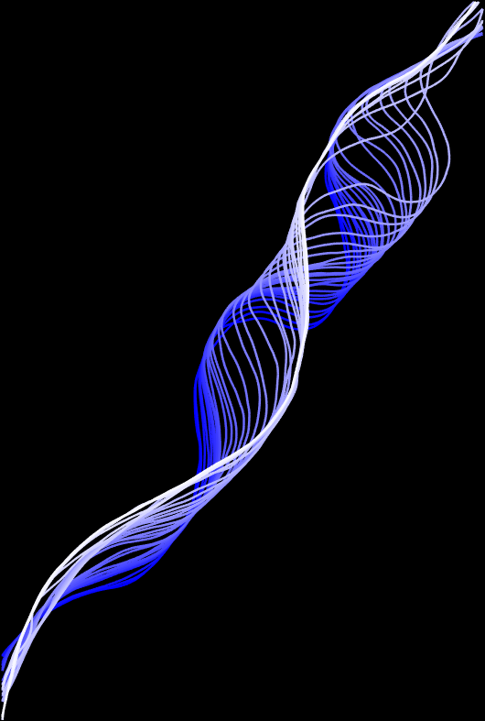
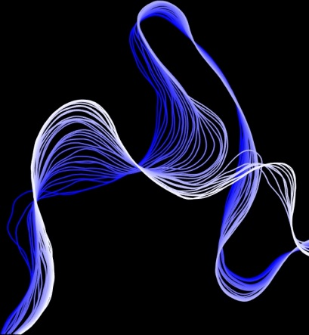
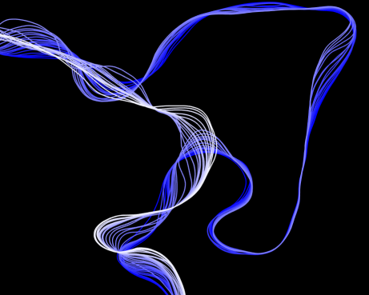
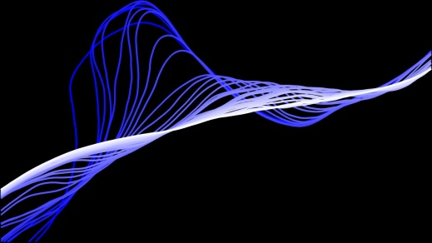
2015
2010
2005
2000
flow
1995
1990
1985
R6
R5
R4
R3
25 km
downstream

Slide 7

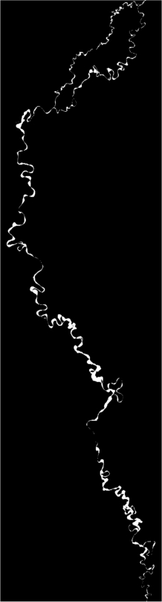
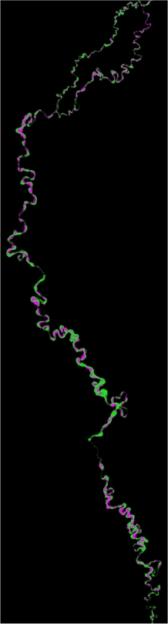
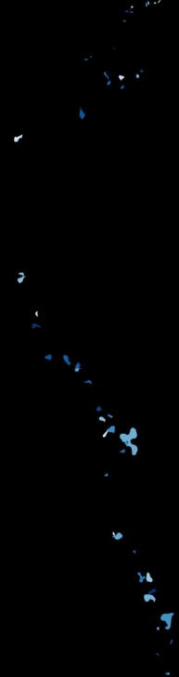

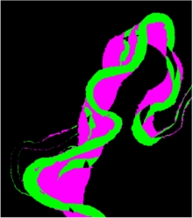
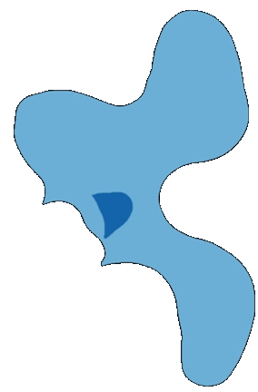
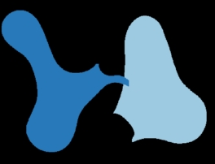

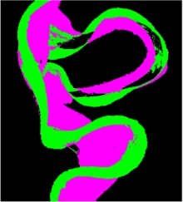
Secret Lives…
Over 40 cutoffs
The Ucayali River,
1985-2015
migrated area
erosion
accretion
100 km
flow

Slide 8
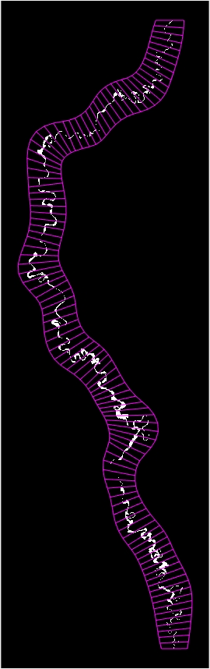
channel belt boundaries
Controls on
Migration
flow

Slide 9
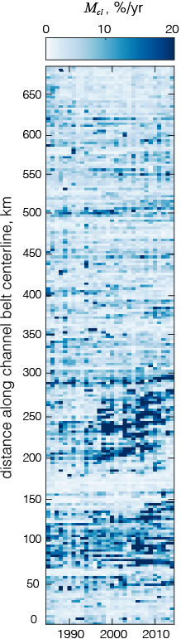
R3
channel belt boundaries
Controls on
Migration
flow

Slide 10
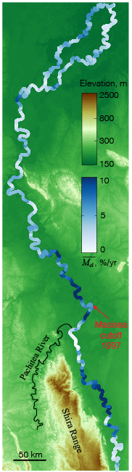
R3
channel belt boundaries
Controls on
Migration
flow

Slide 11
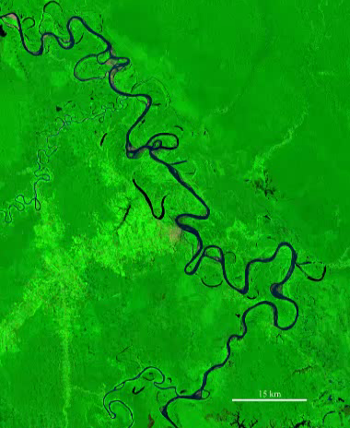
Response to
Cutoffs
Masisea cutoff
1997
Video: Alex Bryk via Google Earth Engine
15 km

Slide 12
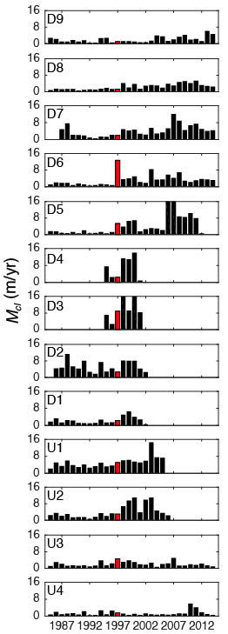

D_{M}
D_{M}
and
downstream
upstream

Slide 13

and
D_{W}
D_{M}
downstream
upstream

Slide 14

L_{cut}
L_{cut}
Change in length of river due to cutoff:
L_{chute}
L_{chute}
ΔL = L_{cut} - L_{chute}
ΔL ~
change in slope
due to cutoff

Slide 15

(downstream)
influence on accelerated migration
Response to
Cutoffs

Slide 16
(downstream)
influence on accelerated migration
Response to
Cutoffs
(downstream)
influence on channel widening

Slide 17





Potential
Controls on river migration
Responses to natural and
human-induced perturbations
Meander migration
theory and modeling
Floodplain dynamics
cutoffs
Photo: J.R. Balsley
Bar morphodynamics
gold mining

Slide 18




Mamoré River,
Bolivia/Brazil
Huallaga & Marañón Rivers, Peru
Limitations?
Large and active rivers
All videos courtesy Alex Bryk
Madre de Dios River,
Perul
Beni River,
Bolivia

Slide 19


Thank you!
Special thanks to
Eric McCaleb
Mace Blank
Anuj Kapartne
UMN Computer Science Department

