Slide 1
GEOLOGY, GROUNDWATER RESOURCES, & WATER QUALITY OF PARK COUNTY, COLORADO
Lesley A. Sebol, P. Barkmann, E. Johnson, F.S. Fitzgerald & W. Curtiss
Colorado Geological Survey

Slide 2
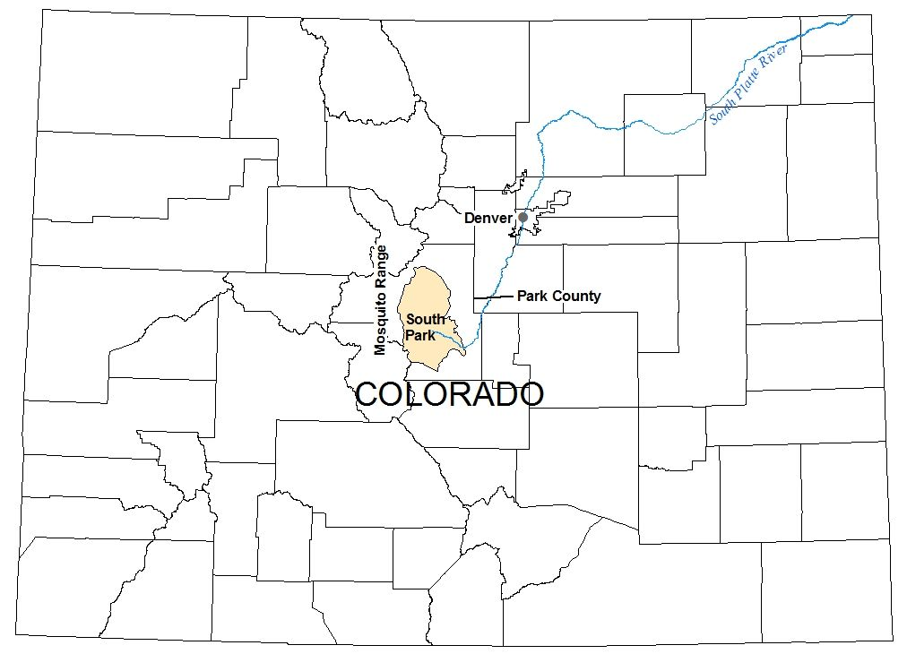
Overview:
Project History
Geologic Mapping
Groundwater Resources
Water Quality Mapping

Slide 3
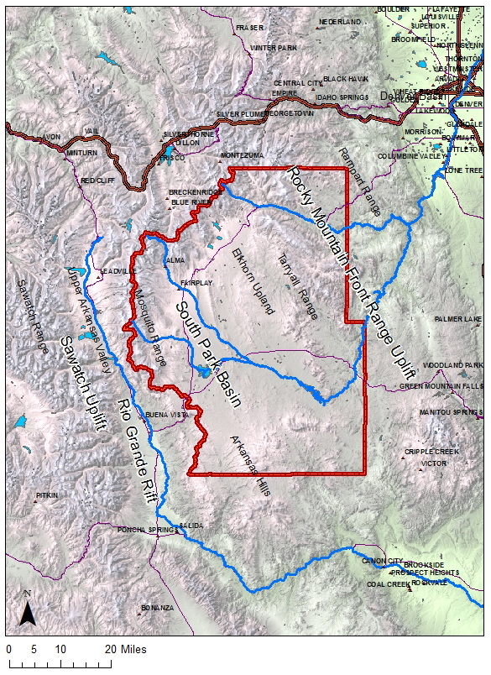
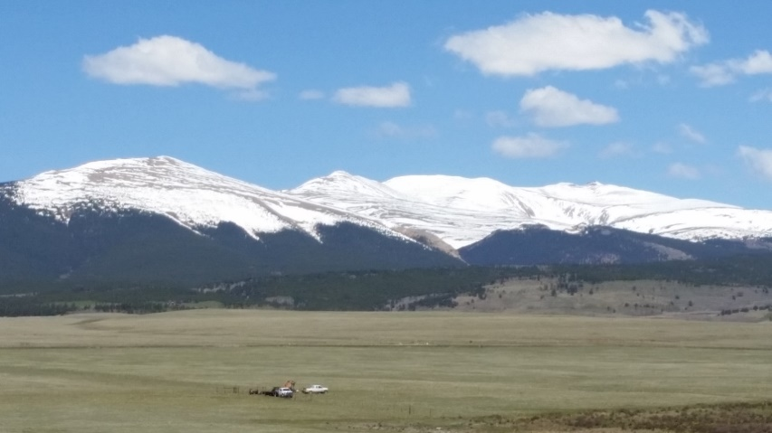
Park County
Notes:
- Park County consists of South Park Basin (50 by 35 miles) surrounded by mountains (Laramide Front Range and Sawatch uplifts).
- South Park Basin has varied rocks of igneous and metamorphic, sedimentary, and volcanic origin.
- East: Front Range and Elkhorn Upland is Precambrian cored igneous and metamorphic rocks that have been highly deformed.
- West: Mosquito Range - glaciated.
- South: Arkansas Hills and Thirtynine Mile Volcanics.

Slide 4
Project History – CGS & CUSP
2011
2012
2013
2014
2015
2016
- South Park GW & SW Baseline Monitoring
- Addendum to 2011 Report
- South Park GW Quality Scoping Study
- Sampling Round (wells and springs); Compiled Geologic Map with Report
- Compiled & Mapped GW Quality Database
Geologic WQ Data Gap Sampling (wells and springs)
Notes:
Joint project by Coalition of the Upper South Platte (CUSP) and CGS
Purpose: establish pre-O&G exploration baseline GW chemistry
- 2011 CUSP GW & SW Monitoring Project: baseline monitoring initiated due to increased O&G exploration in South Park
- 30 wells and augmented springs, 16 SW samples
- 2012 Addendum Report: additional sampling for seasonal trends and ensure 2011 study captured representative samples
- 10 wells, 11 SW locations (sampled twice - in summer and fall)
- 2013 CUSP scoping study of South Park Basin assisted by CGS & USGS:
(GW use in South Park, general GW flow conditions, aquifers potentially vulnerable to O&G, design MW network for GW quality, and identified data gaps)
- 2014 CUSP sampled 49 wells (spring and fall) and some surface water; CGS compiled geologic map and prepared report entitled: Geology and Water Resources of Park County
- 2015 CGS compiled WQ database and characterized water type (Pie and Stiff Diagrams) and water quality (MCL exceedances) in GIS-based maps; identified WQ data gap area for 5 geologic units
- 2016 CUSP and CGS sampled 30 wells and 10 springs; CGS updated figures for rpt

Slide 5
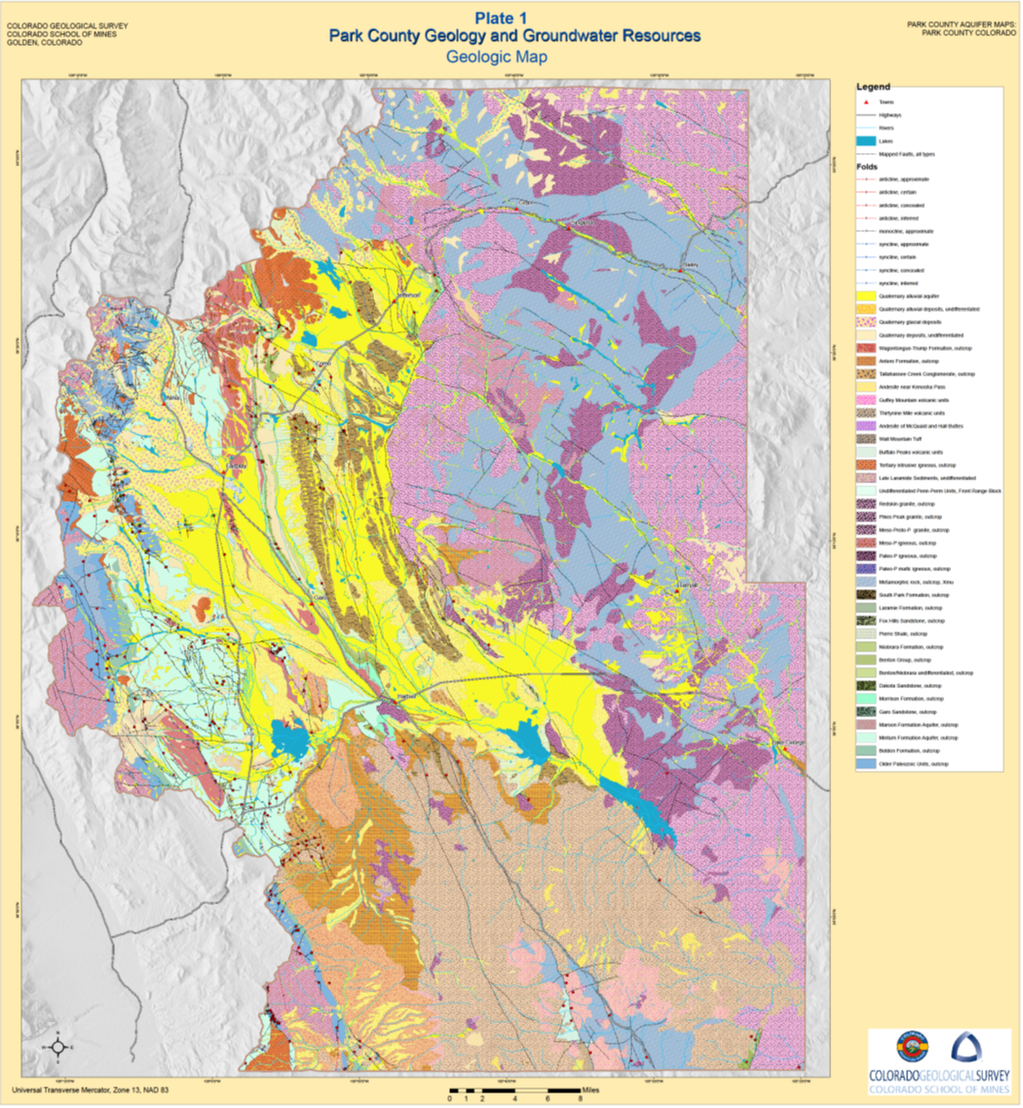
GEOLOGIC MAPPING
Notes:
- Countywide geologic map compiled from 21 geologic maps dated from 1976 to 2012 (1:24,000 to 1:100,000 scale)

Slide 6
Quaternary – Cretaceous Units
Notes:
- Compiled strat column: aquifers/confining units identified in right side column

Slide 7
Jurassic – Precambrian Units

Slide 8
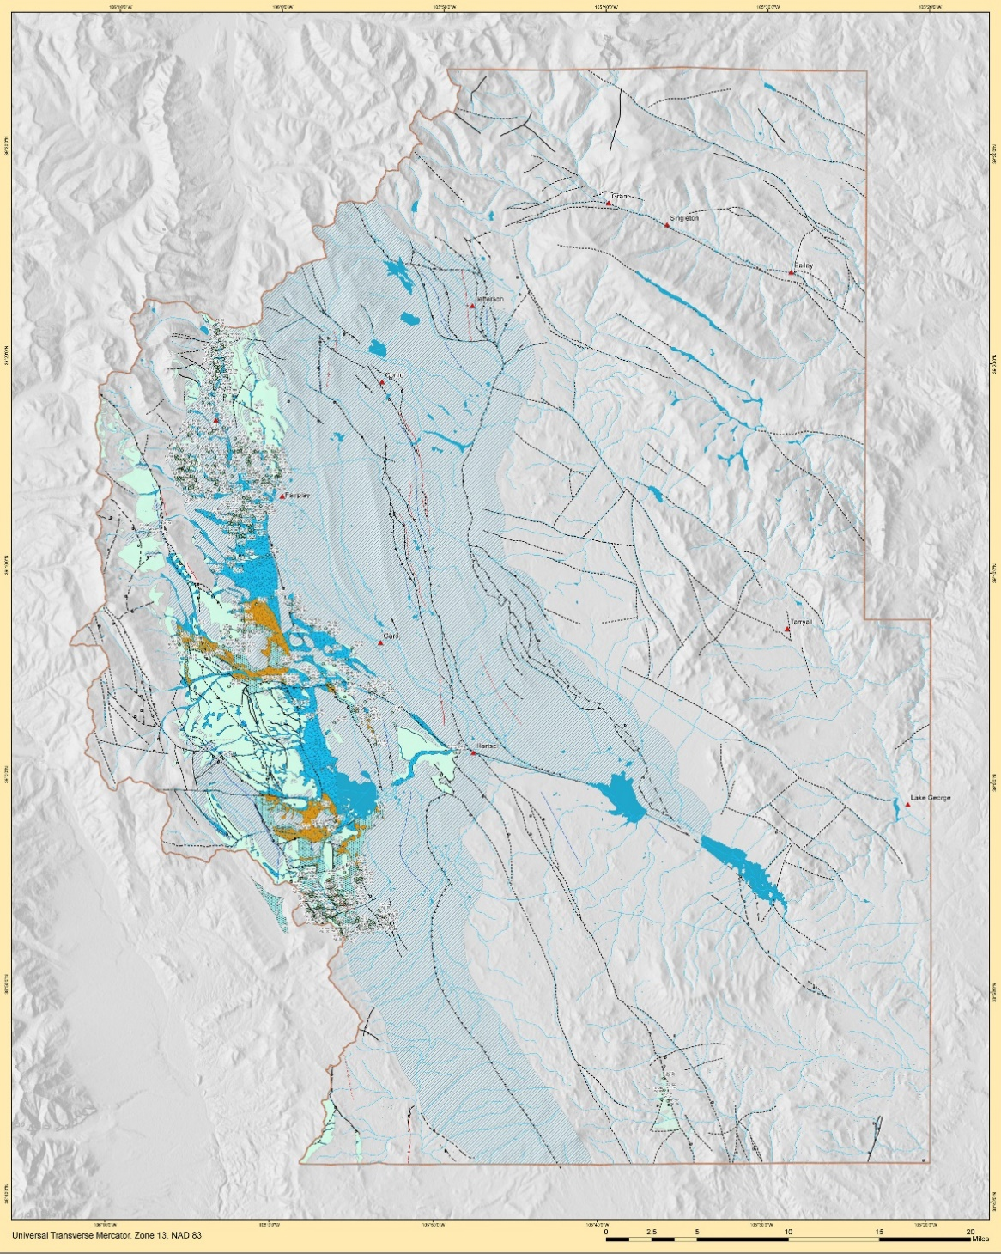
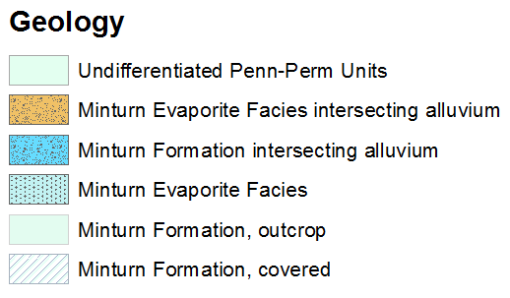
Geologic Maps: Minturn Formation
Notes:
- Series of hydrogeologic unit maps created, each showing outcrop and subcrop patterns and areas where the unit intersects alluvium.
- Minturn Fm contains evaporite facies (halite and gypsum) resulting in high salinity groundwater. The orange pattern is where these facies intersect the alluvium.

Slide 9
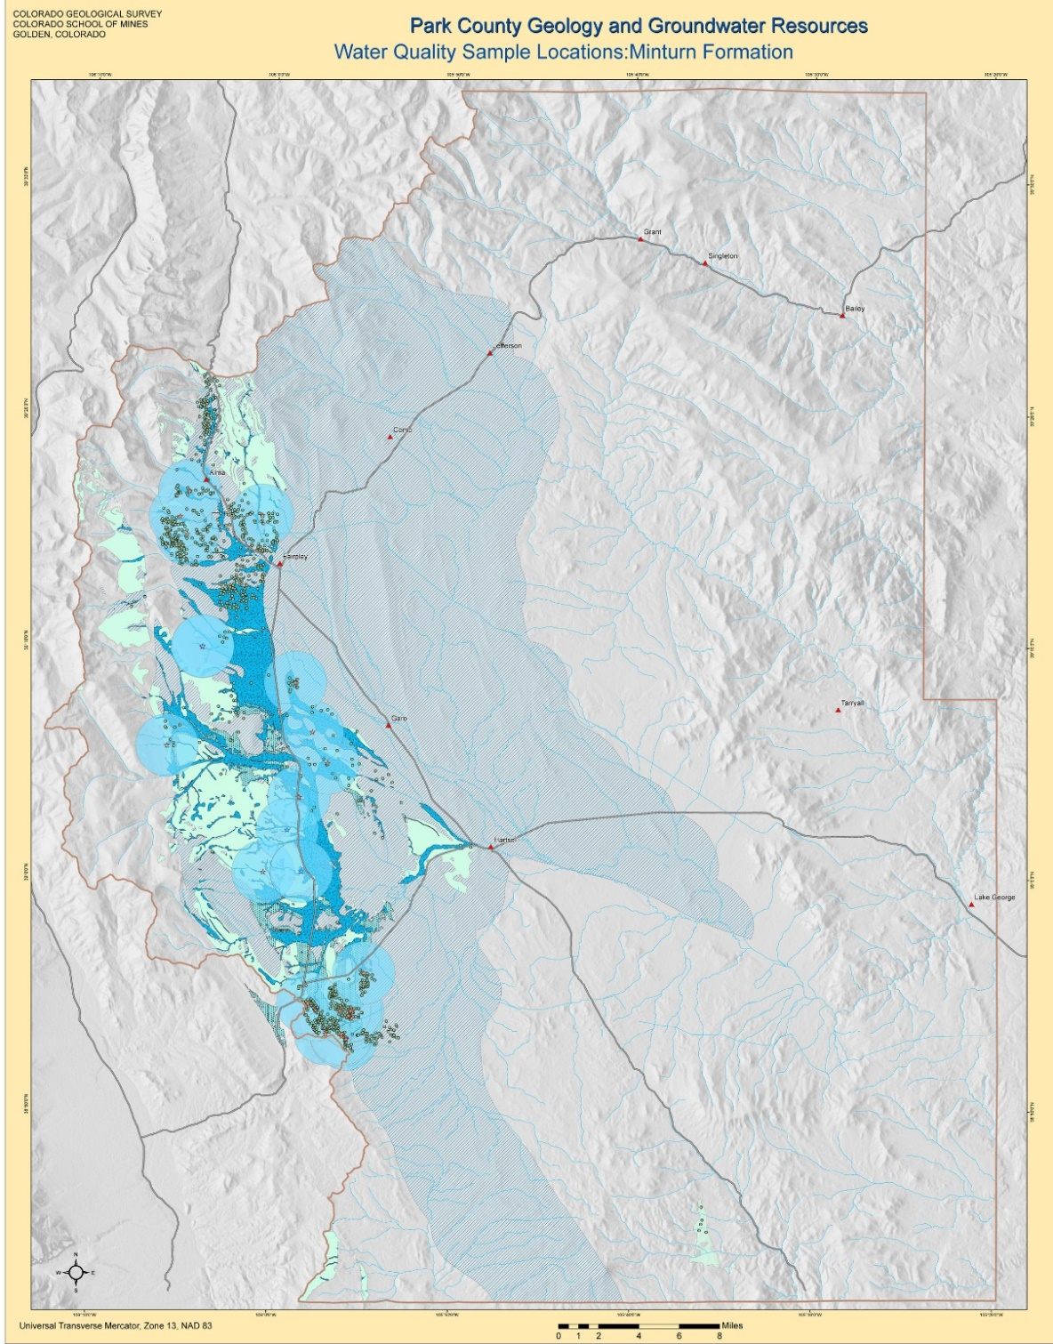
Pre-2016 Sample Locations by Hydrogeologic Unit
Notes:
- Buffer zones created around wells with WQ data. Used to create GIS shape files of data gap areas.

Slide 10
Data Gap by Hydrogeologic Unit
Hydrogeologic Unit | Number of Permitted Water Wells | Representation By Number | Representation By Geography | Estimated Additional Locations
High Priority
Minturn Formation | 1030 | Under | Fair | 10
Maroon Formation | 153 | Under | Poor | 8
Laramie-Fox Hills Aquifer | 62 | Under | Poor | 6
Belden Formation | 47 | Under | Poor | 3
Lower Paleozoic unit | 19 | Under | Poor | 6
Medium Priority
Precambrian crystalline rocks | 4,334 | Good | Fair | 10
South Park Formation | 480 | Good | Fair | 5
Tertiary volcanic rocks | 462 | Good | Fair | 8
Alluvium | 258 | Over | Fair | 3
Antero Formation | 177 | Good | Fair | 8
Wagontongue Formation | 110 | Under | Good | 3
Tallahassee Creek Cong. | 42 | Good | Fair | 3
Late Laramide sediments | 21 | Good | Poor | 3
Morrison Formation | 14 | Over | Poor | 2
Dakota Sandstone | 13 | Good | Fair | 2
Tertiary intrusive rocks | 10 | Over | Poor | 3
Garo Sandstone | 4 | Over | Poor | 2
Low Priority
Benton-Niobrara/ Pierre Shale | 277 | Good | Good | 3
Glacial deposits | 118 | Over | Good
Notes:
- Results of data gap analysis.
- High priority sampled in 2016 sampling event.

Slide 11
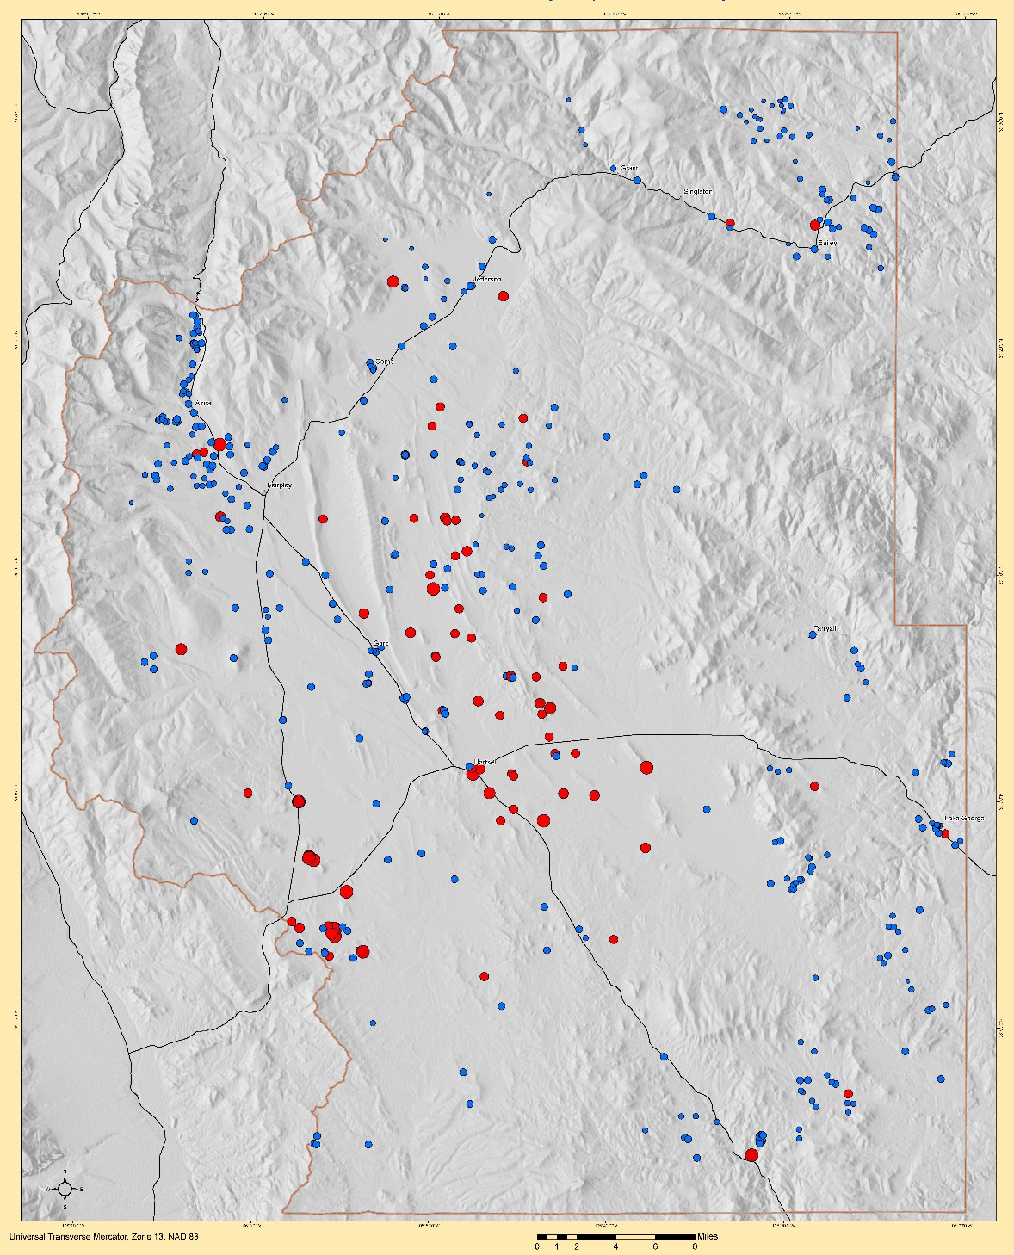
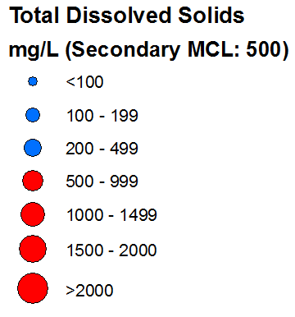
Exceedance Map: TDS
Notes:
- Exceedance maps created for analytes having primary or secondary maximum contaminant levels (MCLs).
- Elevated TDS shows higher salinity waters.

Slide 12
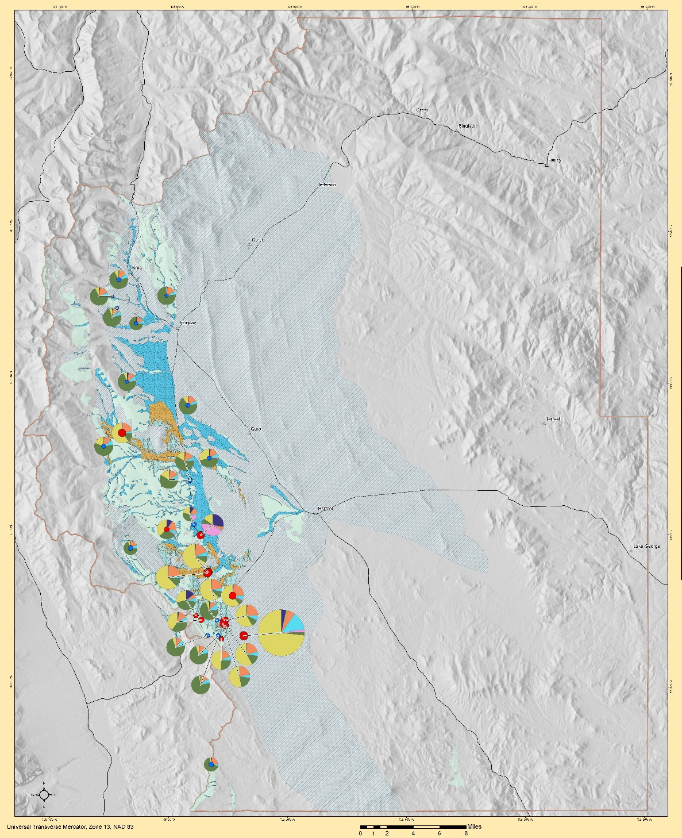
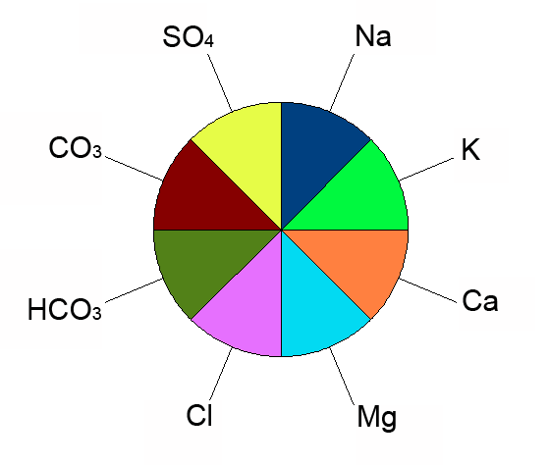
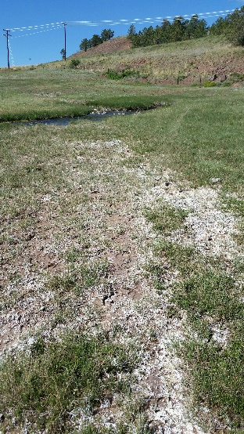
Pie Diagrams of Minturn Formation (scaled to TDS)
Notes:
- Pie diagrams of wells and springs were scaled relative to Total Dissolved Solids (TDS).
- Southern area shows significant impact of Minturn evaporite facies with elevated chloride.
- Picture of Salt Spring – white on ground is evaporated salt. Pie diagram shows high sodium chloride content,

Slide 13
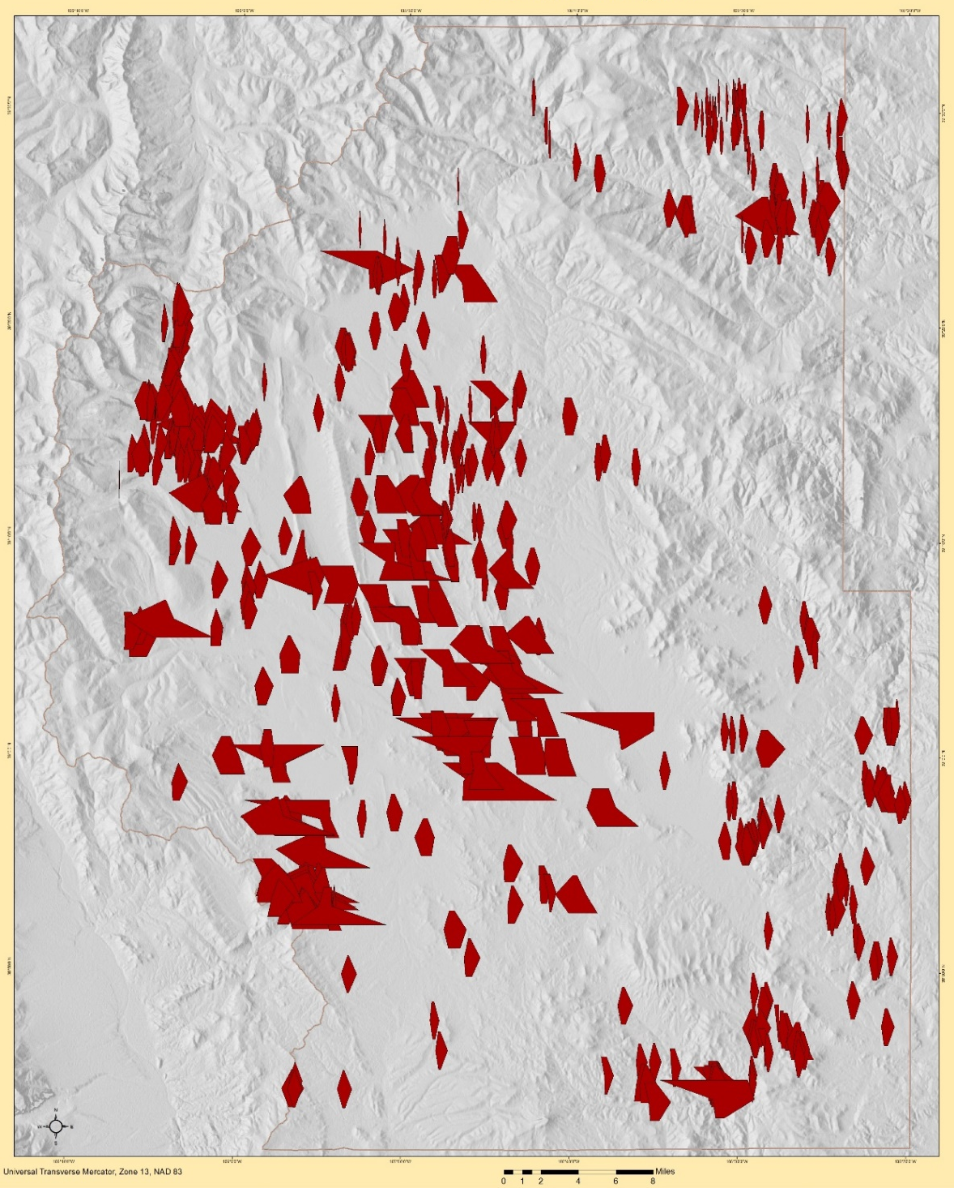
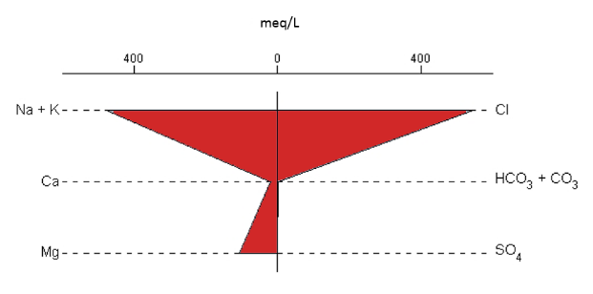
Stiff Diagrams - Park County
Notes:
- Stiff diagram of whole county.
- Explain legend
- Southern area shows significant impact of Minturn evaporite facies with elevated chloride and sulfate.

Slide 14
Thank You

