Slide 1
The 6 November 2011 M5.7 Prague, Oklahoma Aftershock Sequence Studied Using Subspace Detection
Nicole D. McMahon and Richard C. Aster
Dept. of Geosciences, Colorado State University
GSA Annual Meeting 2016
Denver, CO
Acknowledgements
Harley M. Benz¹, Daniel E. McNamara¹, William L. Yeck¹
Caryl E. Johnson²
¹USGS National Earthquake Information Center, ²Introspective Systems LLC
GSA Annual Meeting 2016
Denver, CO

Slide 2
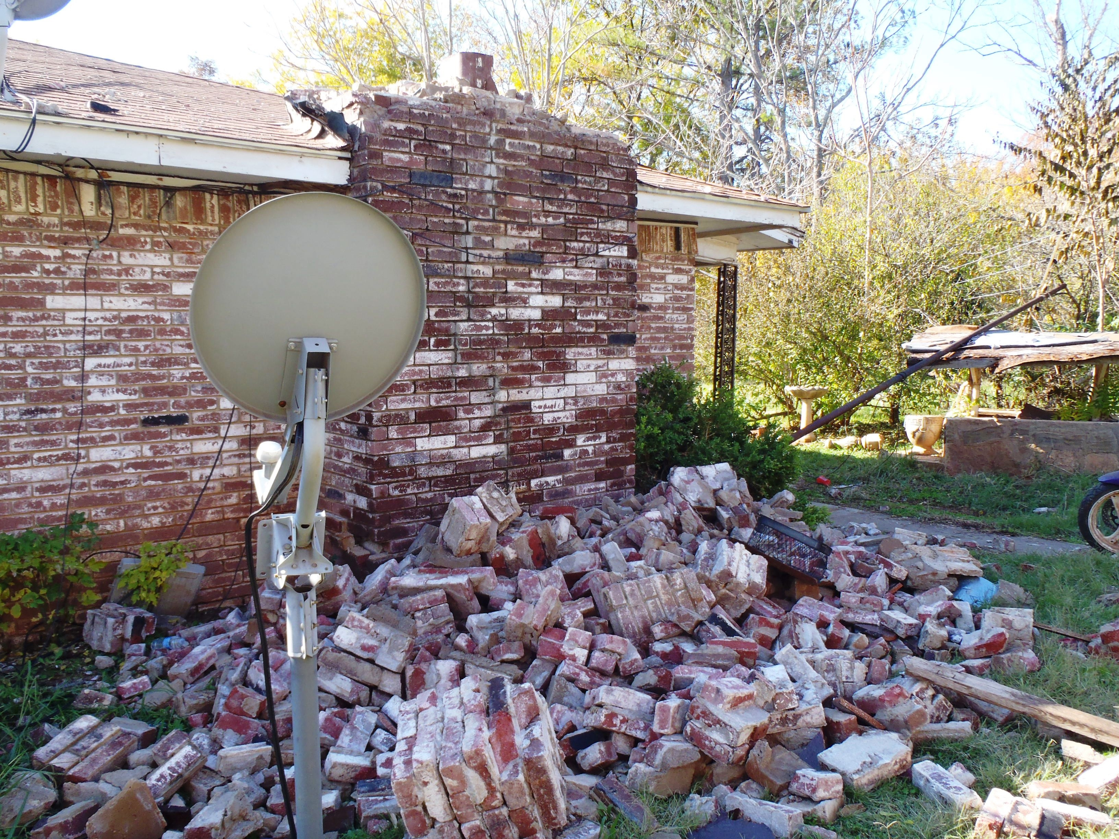
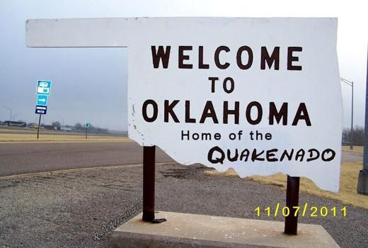
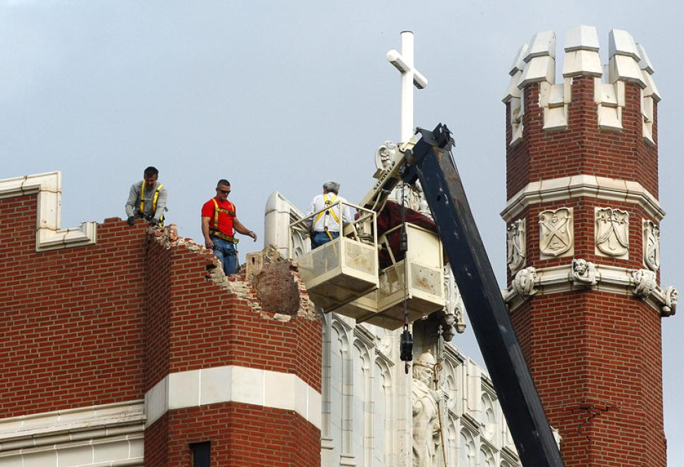
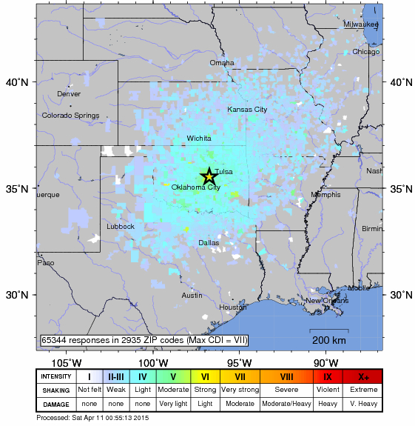
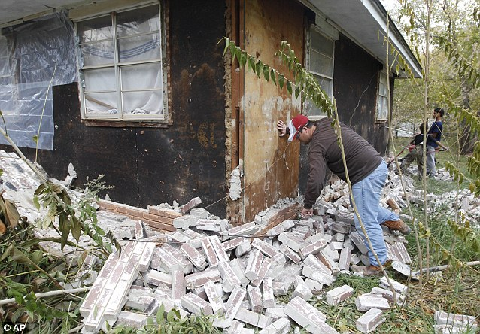
Prague, OK
5 Nov – M4.8
6 Nov – M5.7
8 Nov – M4.8
Prolific aftershock sequence: tens of thousands
Largest in state history at time
2 injuries
14 homes destroyed
17 states felt
MMI VII
Disposal companies sued

Slide 3
Methodology
Event identification
Waveform alignment [Rowe et al., 2002]
Subspace detection [e.g., Harris, 2006]
Phase association (USGS Glass 3.0)
Event location (Bayesloc; McNamara [2015] velocity model)
Magnitude determination (relative to nearest)

Slide 4
Event Identification

Slide 5
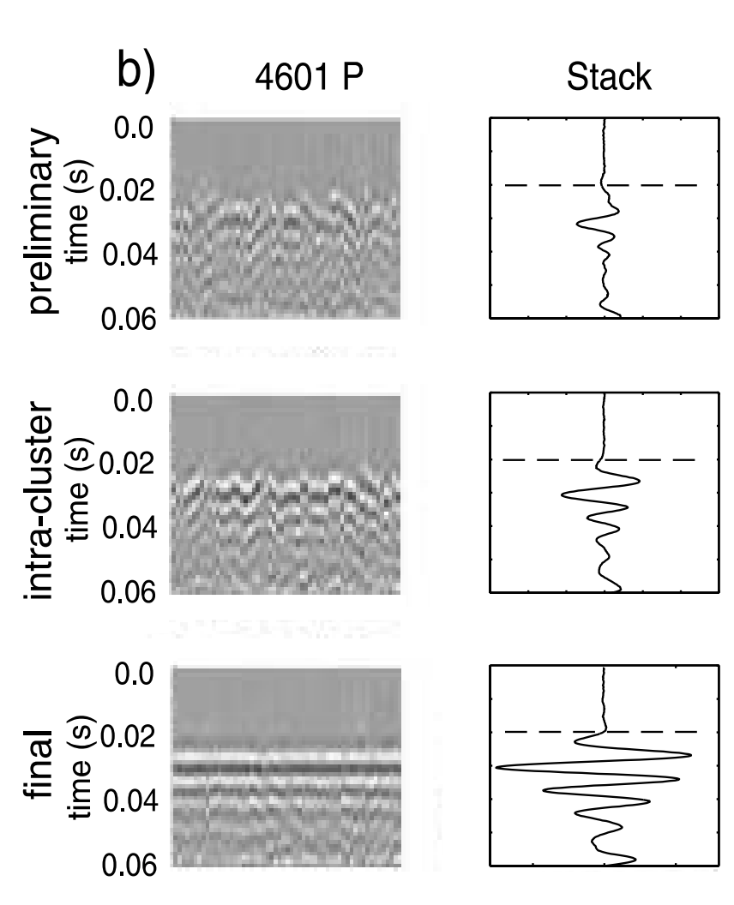
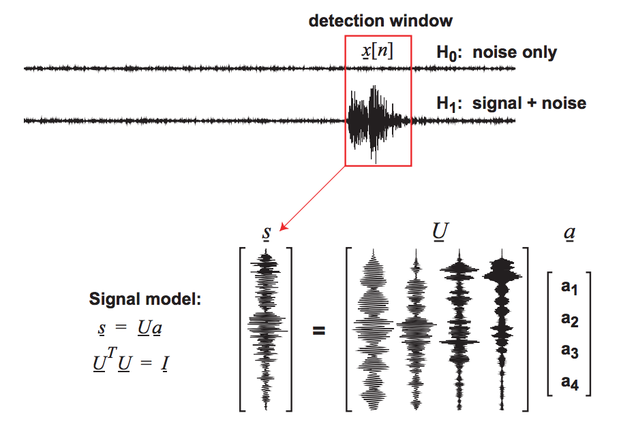
Waveform Alignment and Detection
Rowe et al., 2002
Harris, 2006
D = matrix of aligned waveforms
The number of template columns in U is that required to represent 90% of the energy in D. Templates constitute a multi-channel matched filter .
D = U₀ S V^{T}

Slide 6
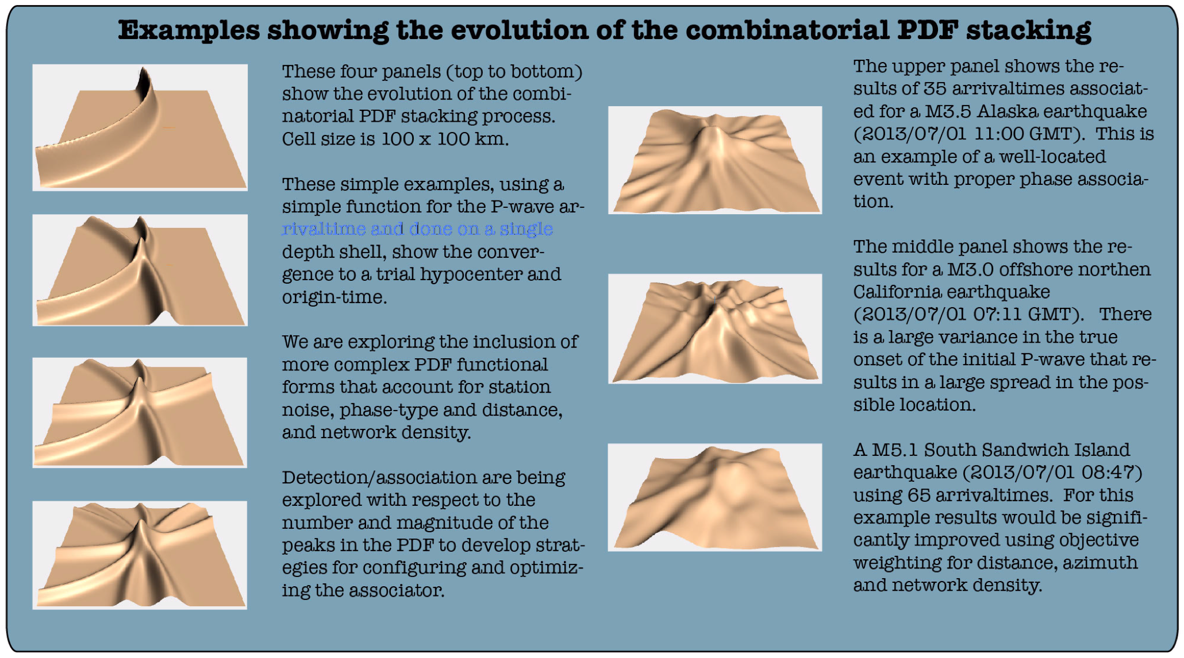
Phase Association
Bayesian Global ASSociator (GLASS) 3.0
Accepts a series of agnostic phase picks to produce a minimum series of earthquake hypocenters and origin times
577,040 detections (S) on 31 seismic stations (~25-fold increase in detection sensitivity)
20,788 events, 5+ stations
Benz et al., 2014

Slide 7
Event Location and Magnitudes

Slide 8
Spatial Patterns
Arbuckle defined by event density
Many (tiny) earthquakes in the Arbuckle (95% <M0.2)
Majority of seismic moment (>99%) in basement
Distance along cross-section (km)
Number of Earthquakes
Moment (dyn-cm)

Slide 9
Spatial Patterns
Arbuckle defined by event density
Events extend away from disp. wells
Distance along cross-section (km)
Number of Earthquakes
Moment (dyn-cm)

Slide 10
Spatial Patterns
Arbuckle defined by event density
Fault strike N55°W, dip 85° NW
Distance along cross-section (km)
Number of Earthquakes
Moment (dyn-cm)

Slide 11
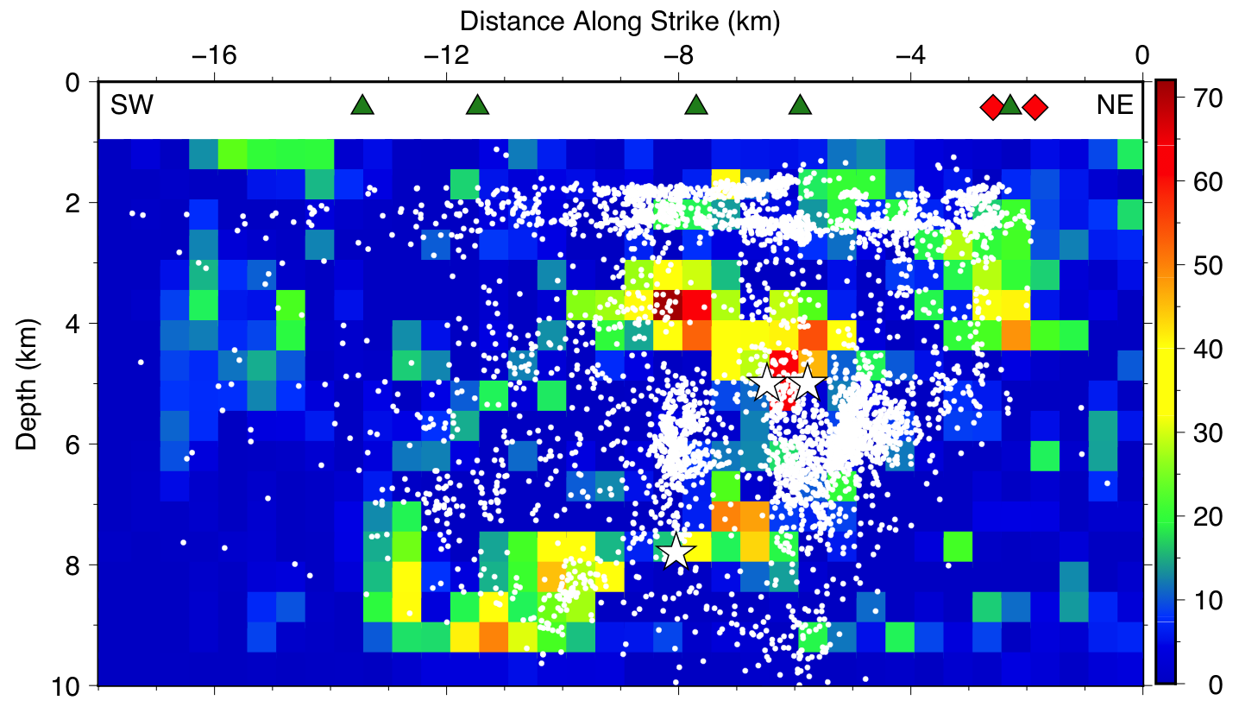
Finite-Fault Slip
Slip (cm)
Finite-fault slip model from Sun and Hartzell (2014)

Slide 12
Temporal Patterns
Diurnal variation seen in detection numbers
Low Omori decay p-values means a relatively slow decay of aftershocks
Possibly due to low heatflow environment and intraplate location

Slide 13
Temporal Patterns
60% more events detected overnight

Slide 14
b-value

Slide 15
Conclusions
6x increase in the number of well-located events
We can locate earthquakes with only S-phase arrivals
Small, but numerous, earthquakes are occurring in the Arbuckle (~40% of catalog)
99.9% of the moment release occurs in the basement
Diurnal detection variation is apparent due to anthropogenic noise
New catalogue complete to M-0.8
i.e. fault plane ~2.2 m² slipping by 1 mm

Slide 16
Other/Future Work
Cushing, OK (published)
McNamara et al. (2015). Reactivated faulting near Cushing Oklahoma: Increased potential for a triggered earthquake in an area of the United States strategic infrastructure, Geophysical Research Letters, 42 (20), 8328-8332.
Guthrie, OK (published)
Benz et al. (2015). Hundreds of earthquakes per day: the 2014 Guthrie, Oklahoma earthquake sequence, Seismological Research Letters, 86 (5), 1318-1325.
Marie Byrd Land, Antarctica (in progress)
Aster et al. (2015). Deep long-period seismicity beneath the Executive Committee Range, Marie Byrd Land, Antarctica, studied using subspace detection. Abstract S43F-07 presented at 2015 Fall Meeting, AGU, San Francisco, Calif., 14-18 Dec.

