Slide 1



Monitoring Plant Growth in Maritan Regolith
Matthew Dobson
Barbra Sobhani, Advisor
The author(s) thank NSF DUE #143-126 Engaging Low-Income/First-Generation Community College Students in STEM and Engineering for supporting this research.

Slide 2

http://s3.foxmovies.com/foxmovies/production/films/104/images/gallery/martian-gallery3-gallery-image.jpg

Slide 3
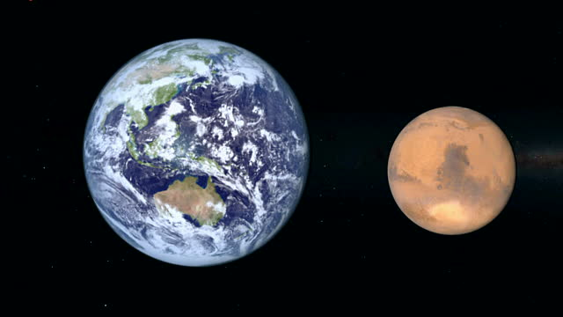

The Why
Foremost pillar of manned mission to Mars is sustainable and renewable food production
Optimizing resource expenditure in extreme environments can impact research on Earth towards adapting to a rapidly-changing climate
Develop modular self-contained, self-sufficient system to monitor plant growth
http://media.gettyimages.com/videos/side-by-side-comparison-of-earth-and-mars-in-outer-space-and-of-video-idmr_00088890?s=640x640
https://a.fastcompany.net/multisite_files/fastcompany/imagecache/1280/poster/2015/06/3047165-poster-p-1-ares-iii-trailer-martian.jpg

Slide 4
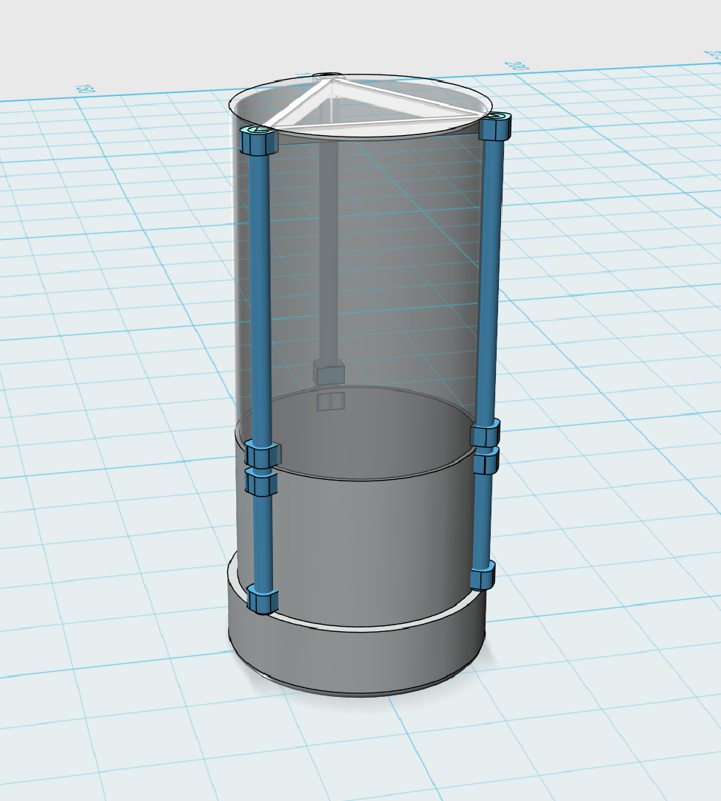
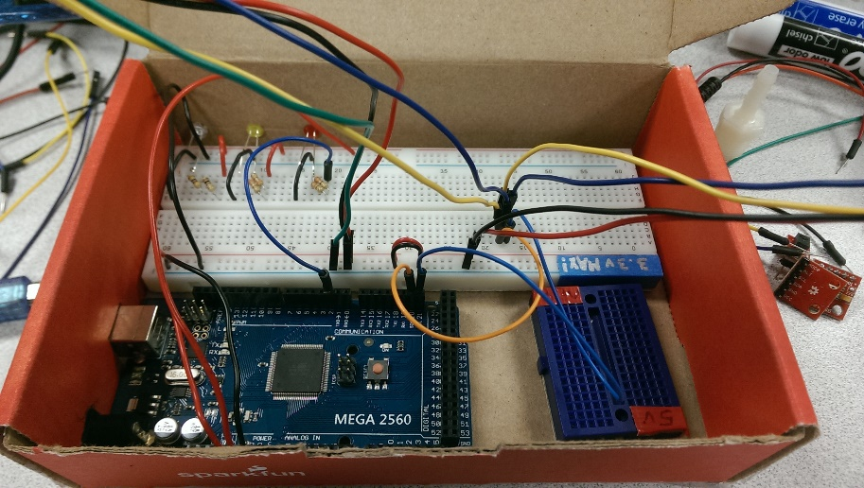
The Design
Self-contained deployable module was deemed momentarily unrealistic
Modular pod design, regulated by sensor package and placed in habitat found to be more viable
Due to constraints, initial project stages transitioned towards analyzing and minimizing resource expenditure

Slide 5
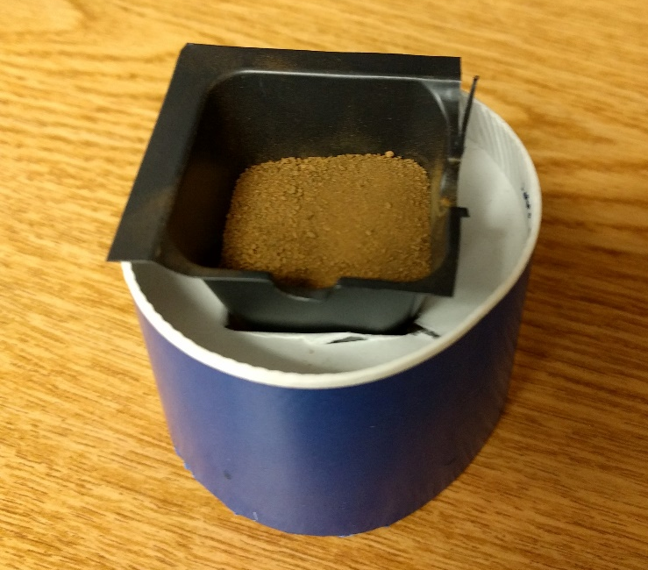
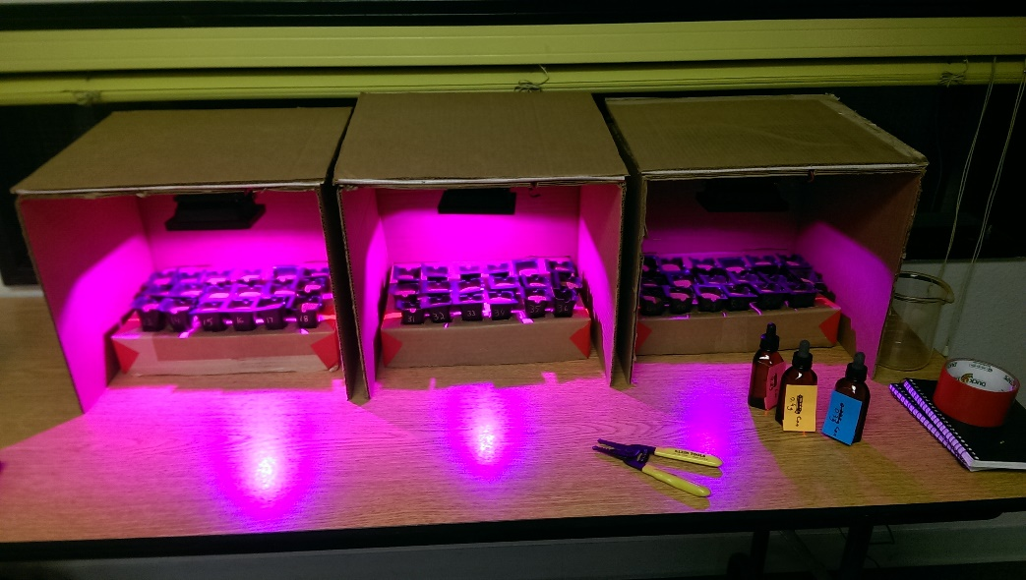
The How
Initial testing grow chambers were constructed to test varied conditions such as light exposure, moisture input and nutrient input in JSC MARS-1 Regolith Simulant
Determining ideal operational conditions was paramount in minimizing resource use (reducing electrical requirements, reducing water requirements, and reducing nitrate, phosphate and potash usage)

Slide 6
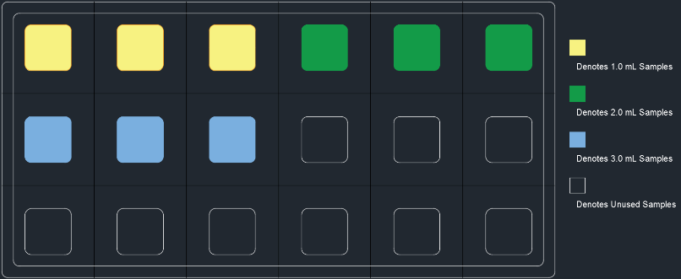
The How

Slide 7
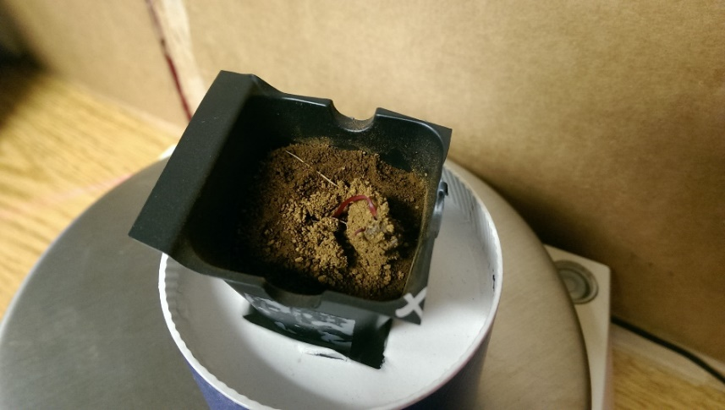
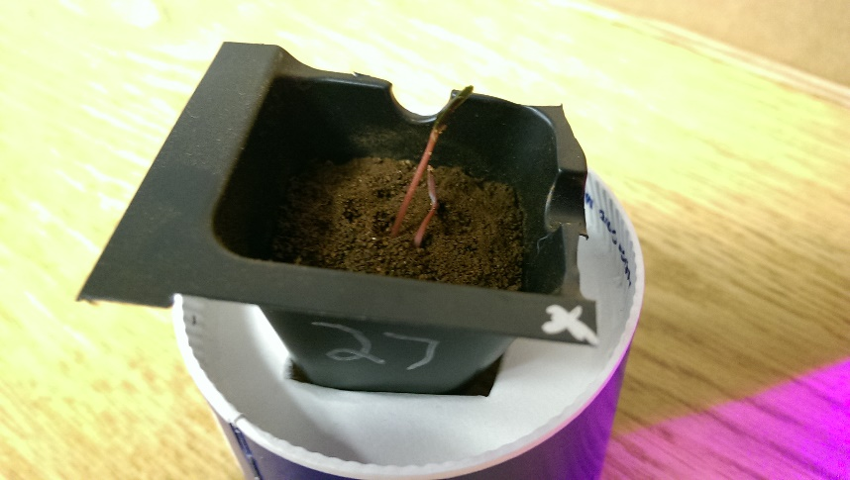

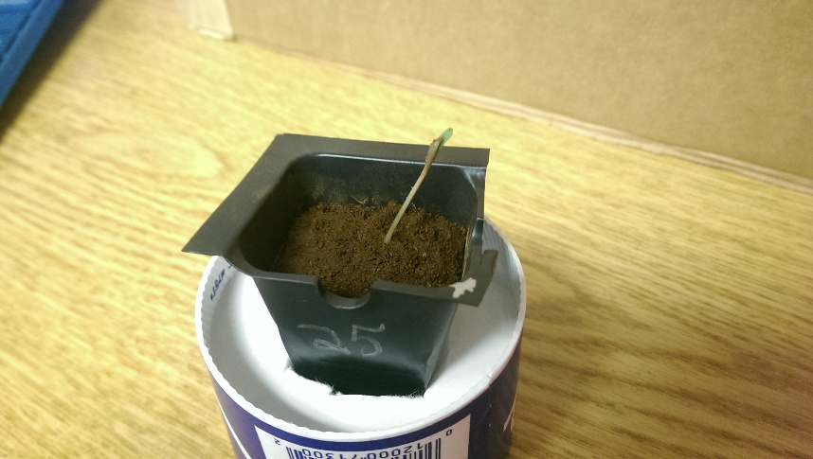
The Results
Phase 1 success!
Positive, healthy growth
https://tribzap2it.files.wordpress.com/2015/08/matt-damon-martian.jpg

Slide 8
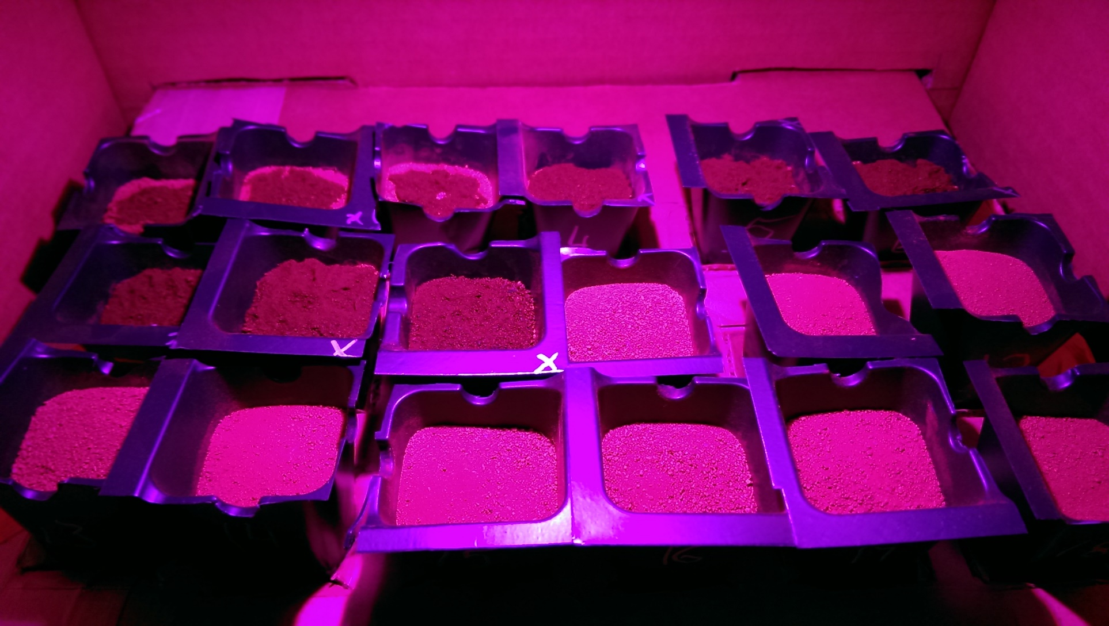
Box 1 Summary
Max light intensity (5.28 w/m²)
No plant growth

Slide 9
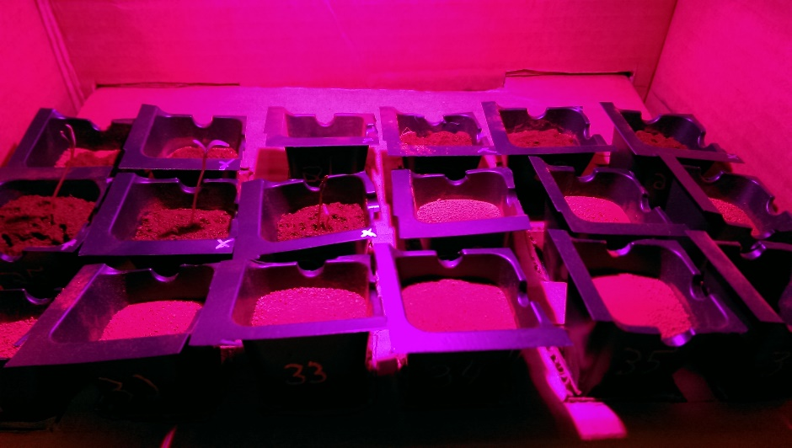
Box 2 Summary
Medium light intensity (0.9074 w/m²)
Most successful box, 7 sprouts after day 10
Longest-lasting and largest sprouts

Slide 10
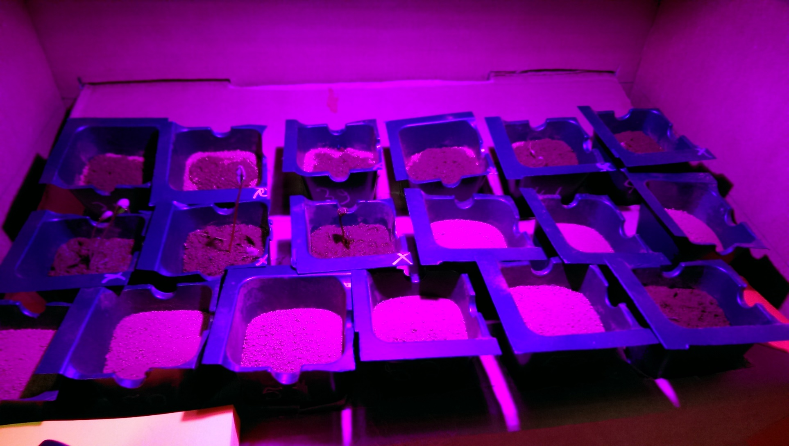
Box 3 Summary
Low light intensity (0.4911 w/m²)
6 sprouts after day 10

Slide 11
The Results
Sample # | Total Nutr. | Nitrogen | Phosphate | Potash | Total Grw.
25 | 15.51mg | 3.7224mg | 1.2408mg | 2.4816mg | 5.41g
26 | 10.344mg | 2.483mg | 0.8272mg | 1.5644mg | 6.68g
27 | 20.691mg | 4.966mg | 1.655mg | 3.3106mg | 6.76g

Slide 12
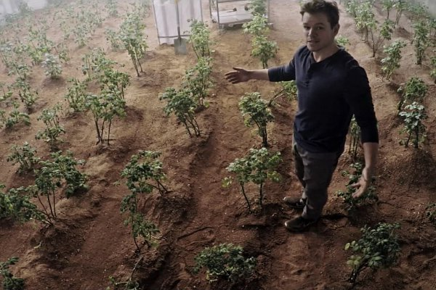
The Summary
Plants can grow in Martian regolith simulant!
Sensor package capable of collecting data constructed for around $60, code is going to be open-source
https://rickihobson.files.wordpress.com/2015/10/matt-damon-is-greatest-botanist-on-mars-in-new-trailer-for-the-martian.jpg

Slide 13
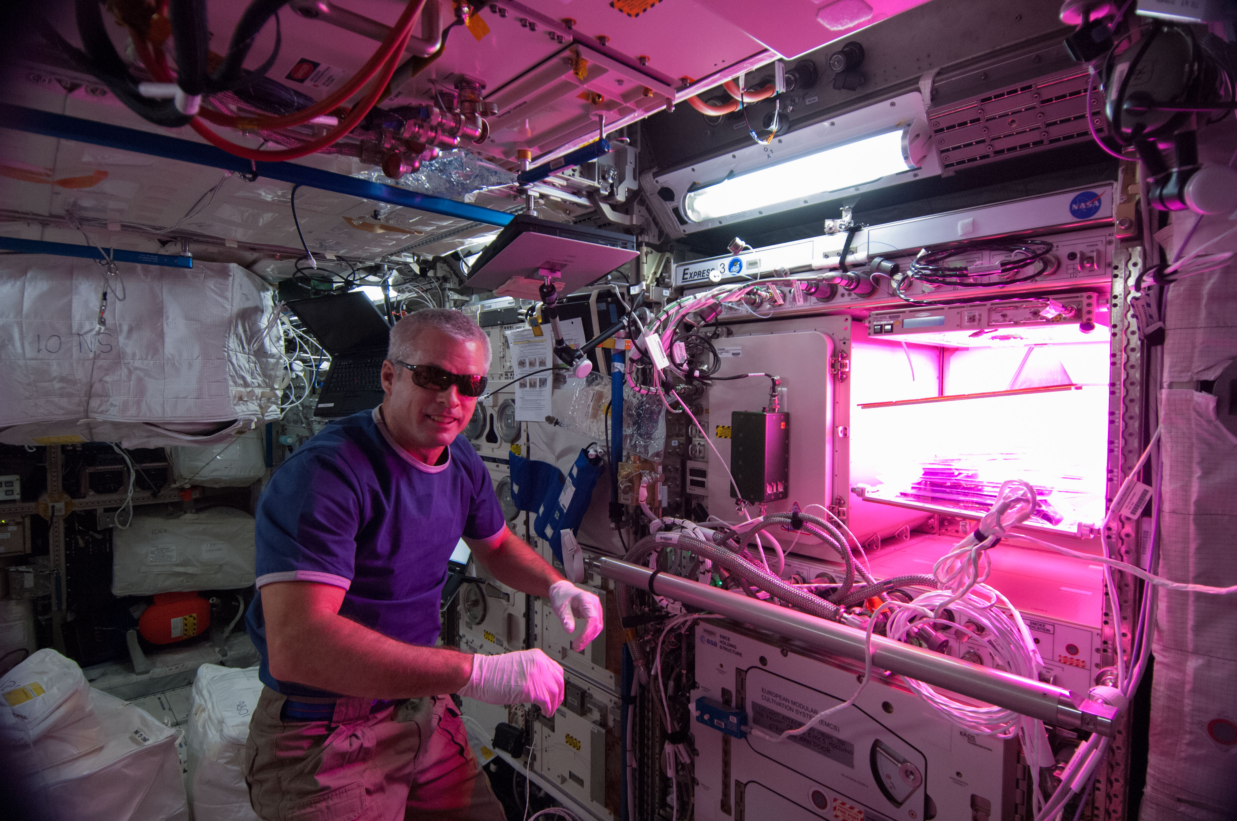
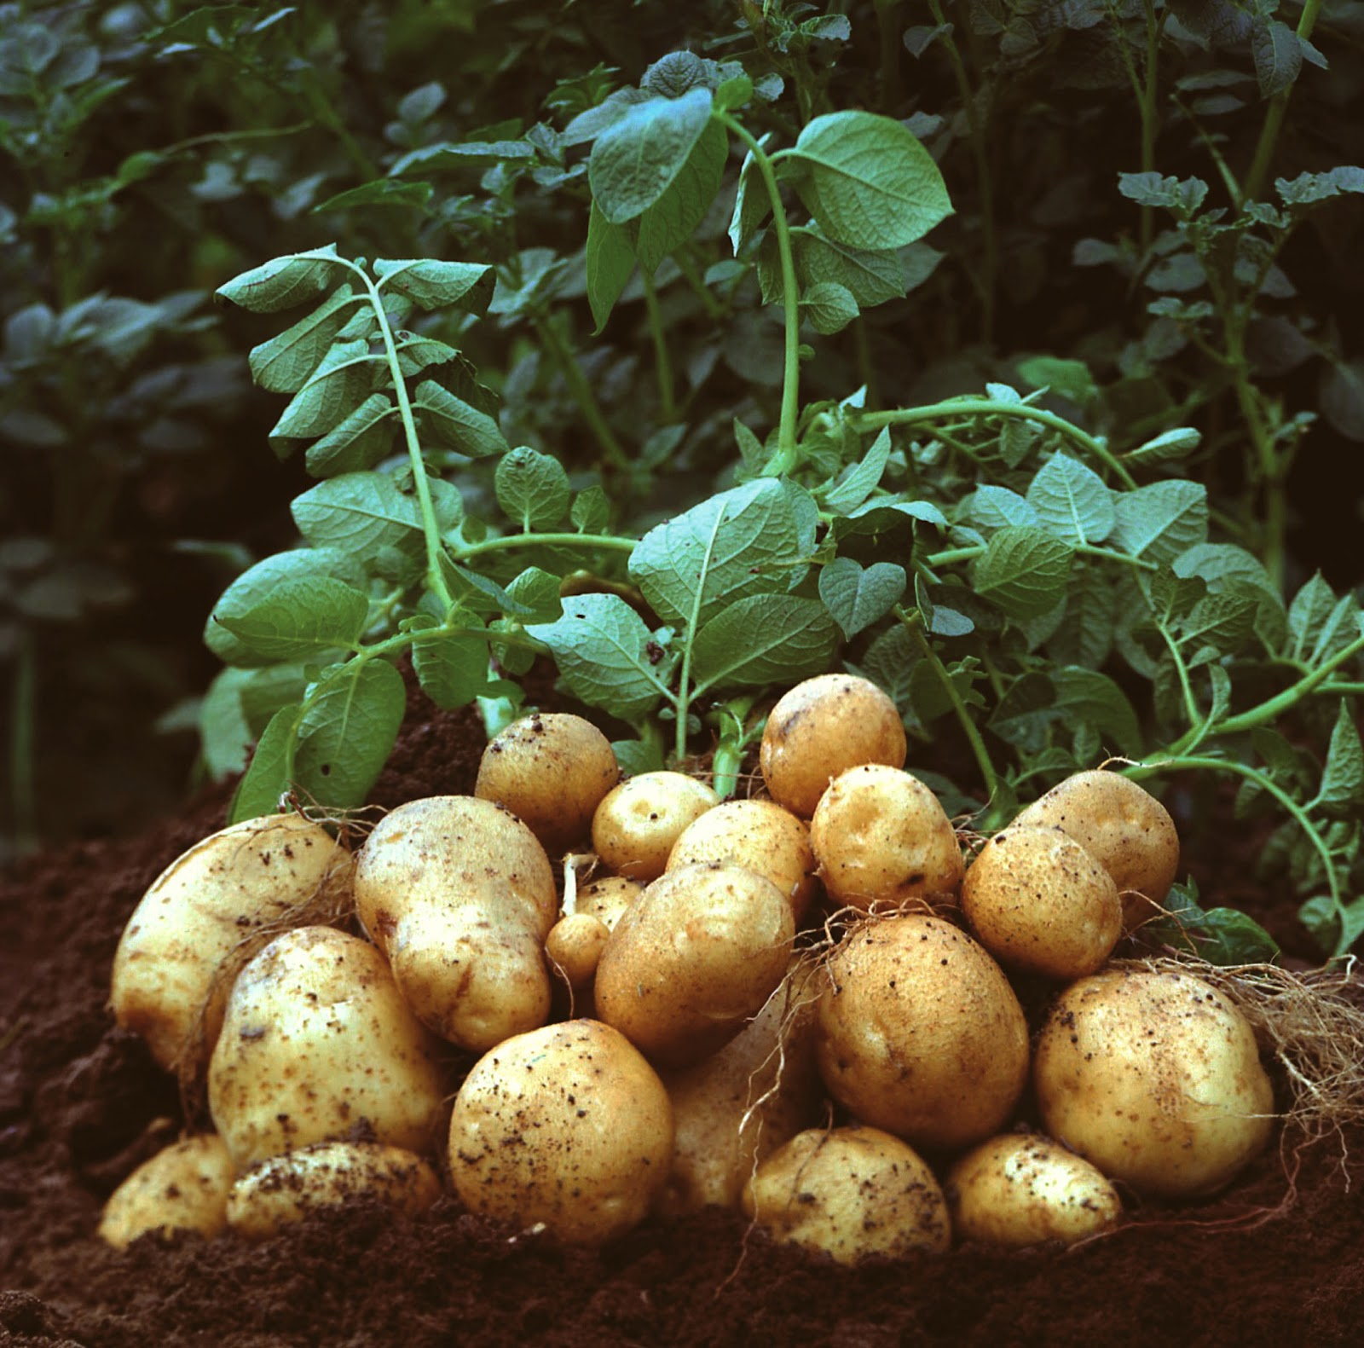
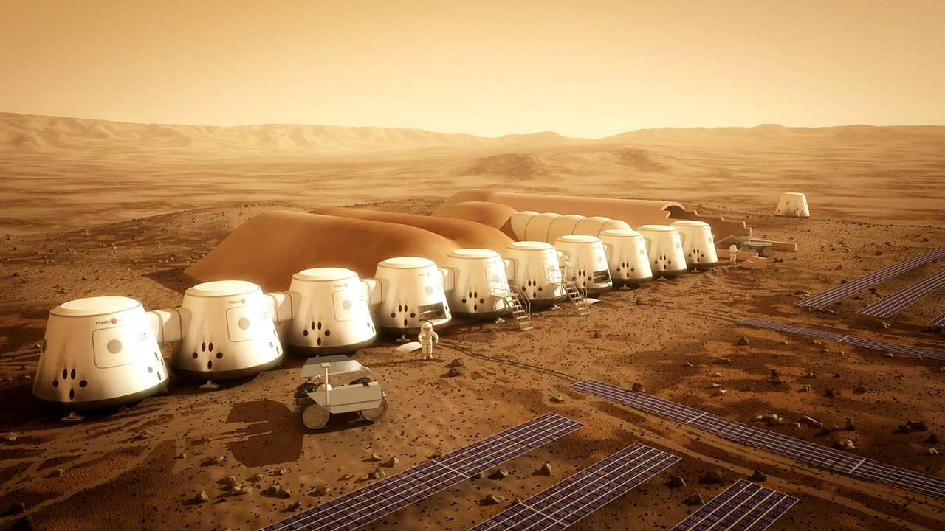
The Future
Preliminary data sets provide a platform for initial development of modular grow chamber system
Test procedure to be honed and conditioned for efficiency, with additional grow cycles to determine correlation between light intensity and moisture evaporation
http://www.nasa.gov/sites/default/files/veggie_steveswanson.jpg
http://www.griffinsgardencentre.ie/images/potato-plant.jpg
http://tech.firstpost.com/wp-content/uploads/2016/05/PFCmiFLcZ9p_0dAAk4LK8pnbRVaM9mke4-dN1pnOZRc.jpg

Slide 14
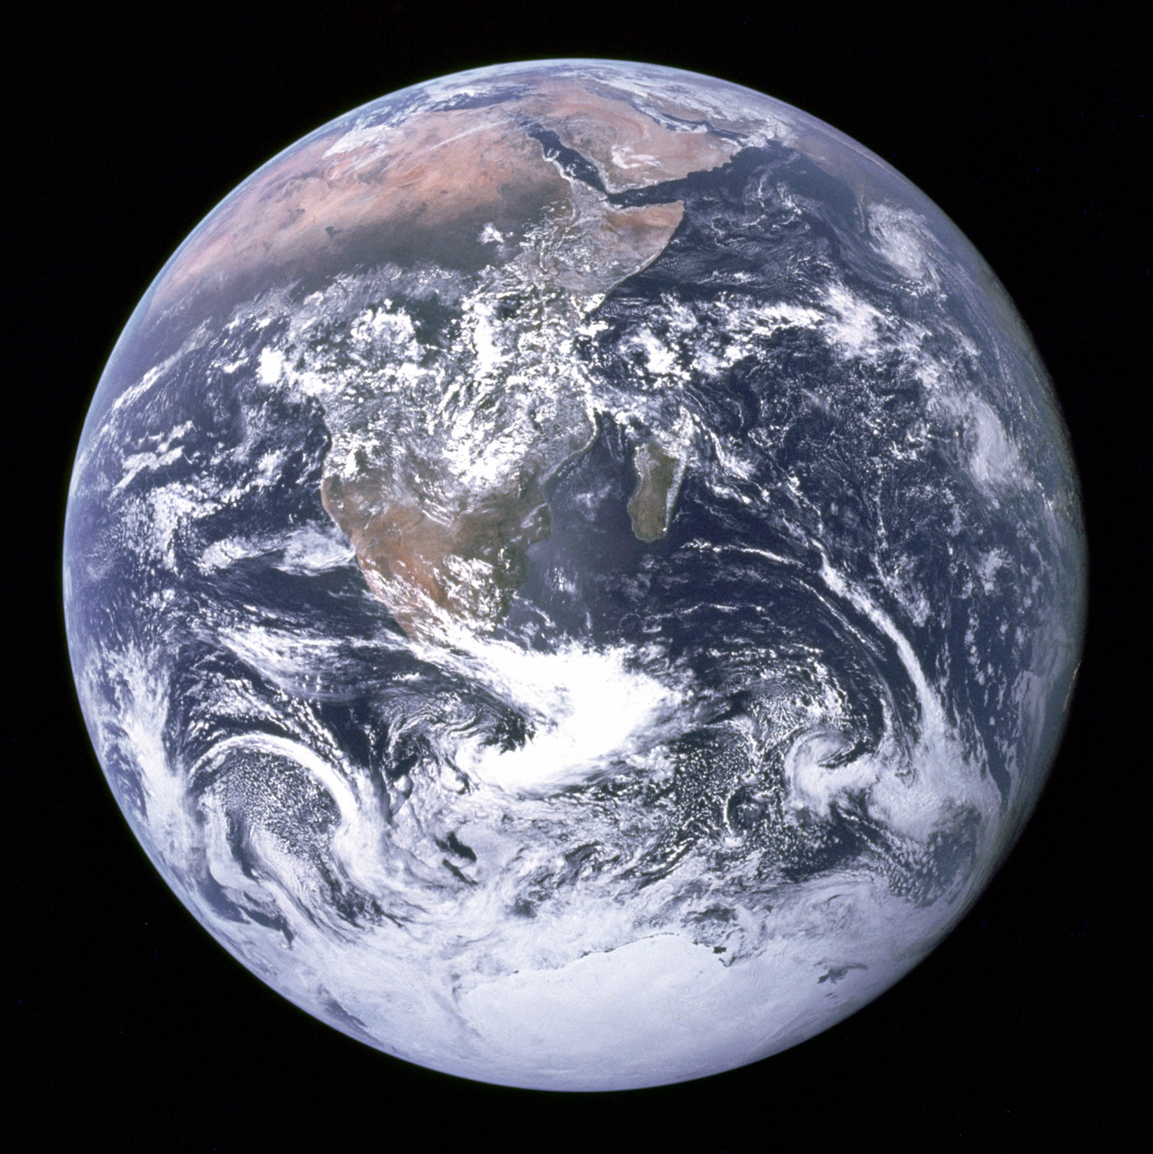
The Blue Marble https://en.wikipedia.org/wiki/Earth

