Slide 1
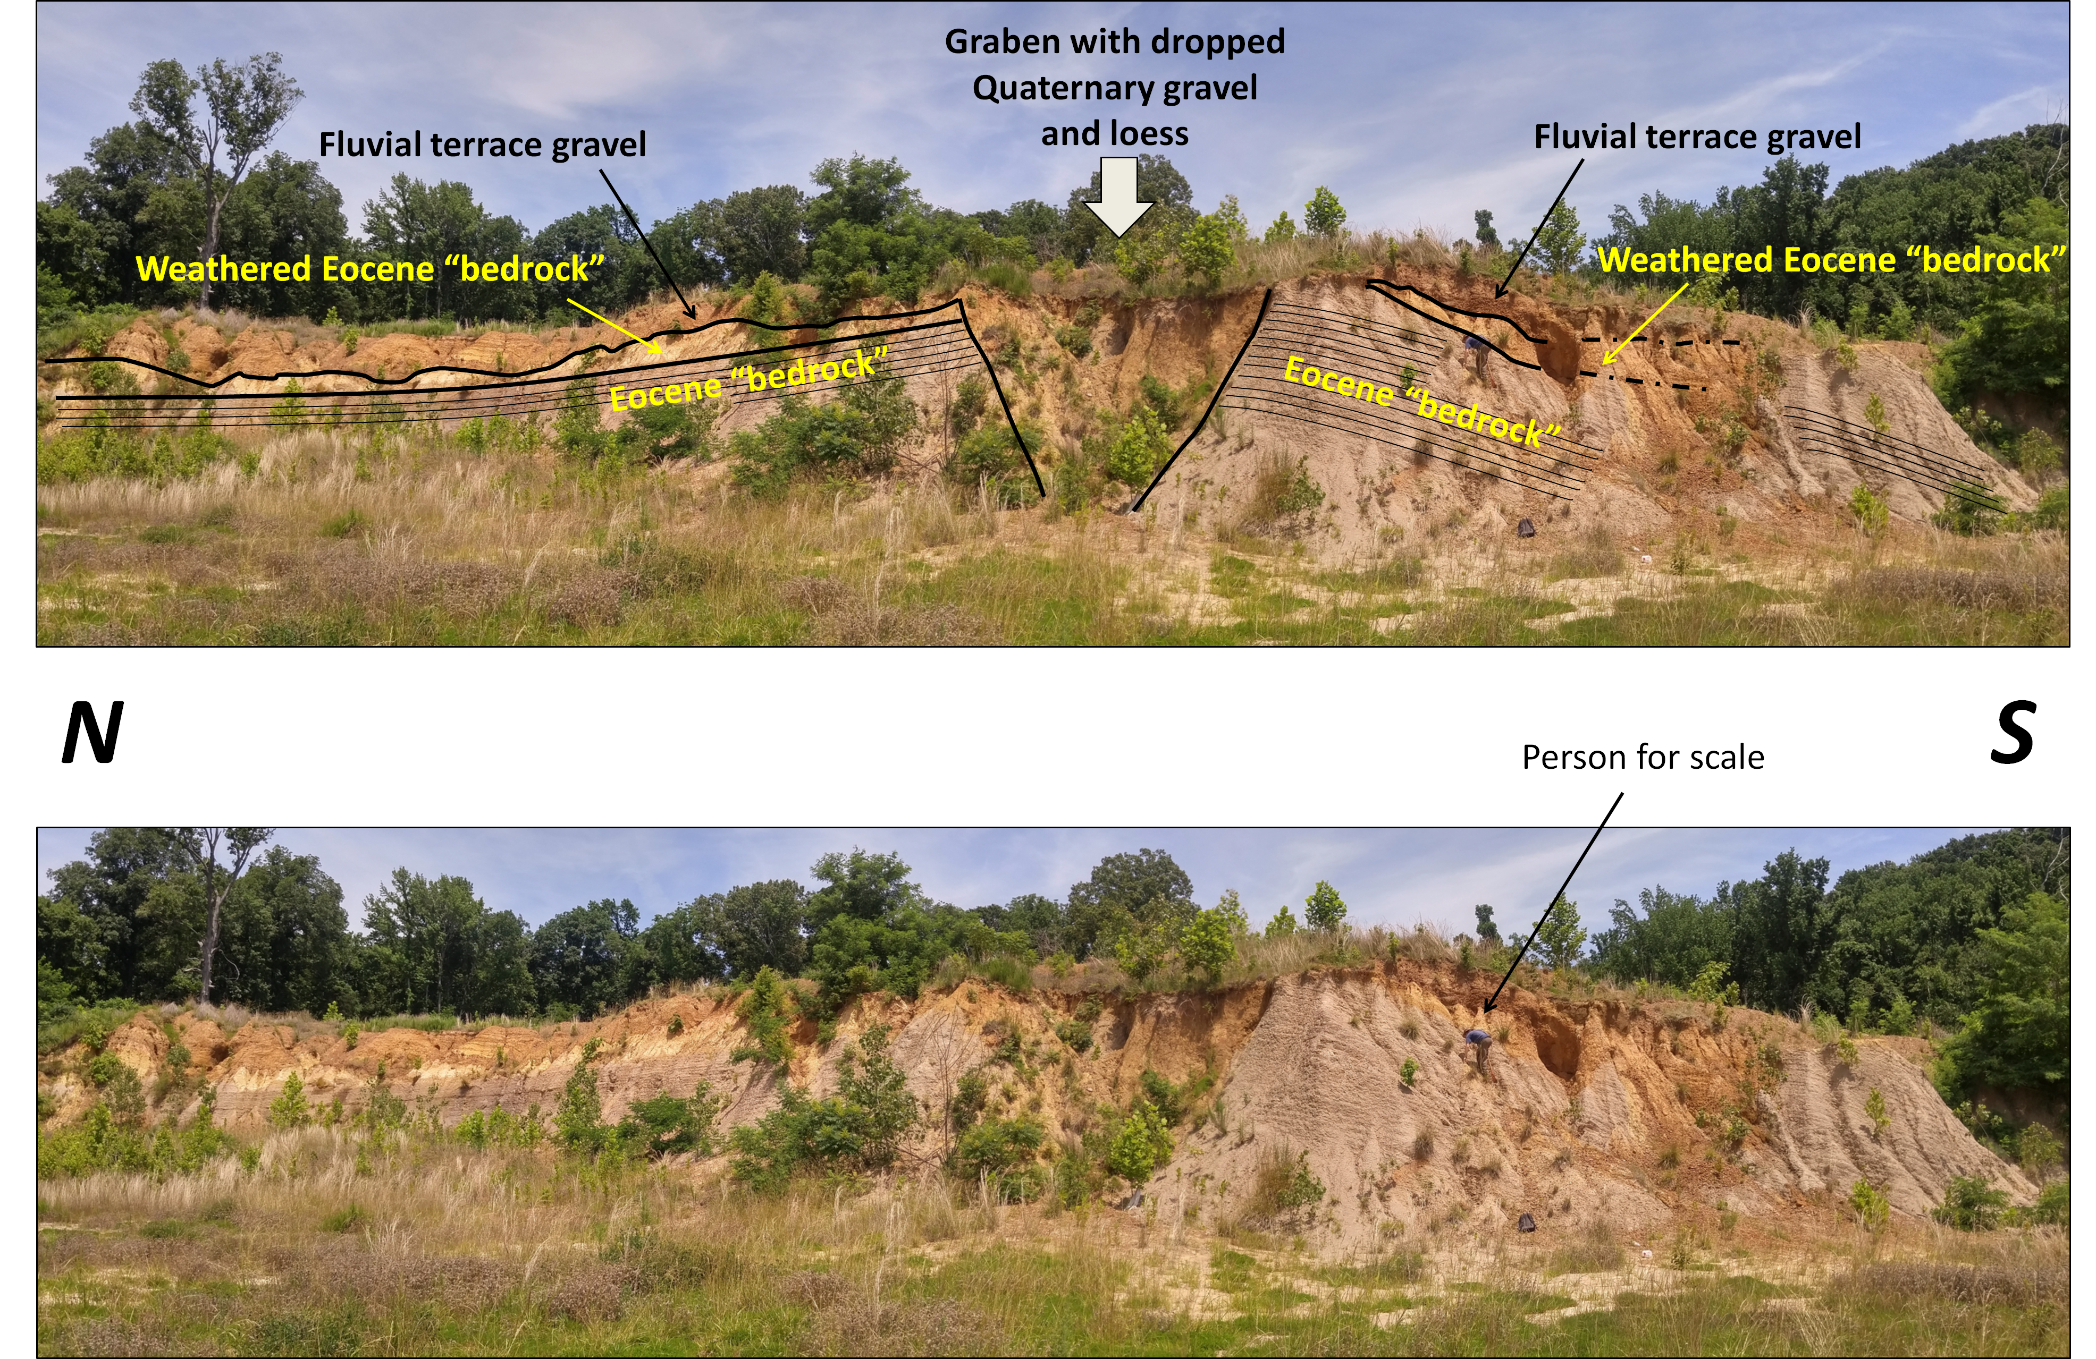
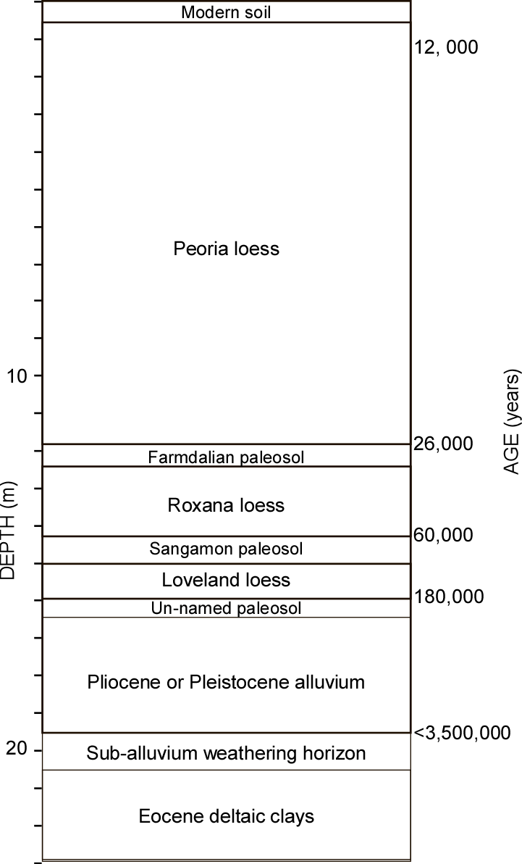
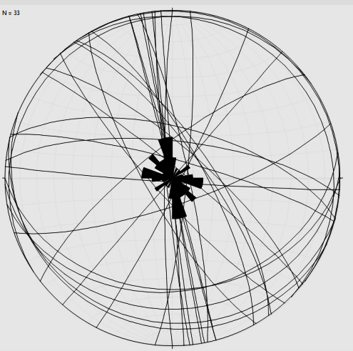
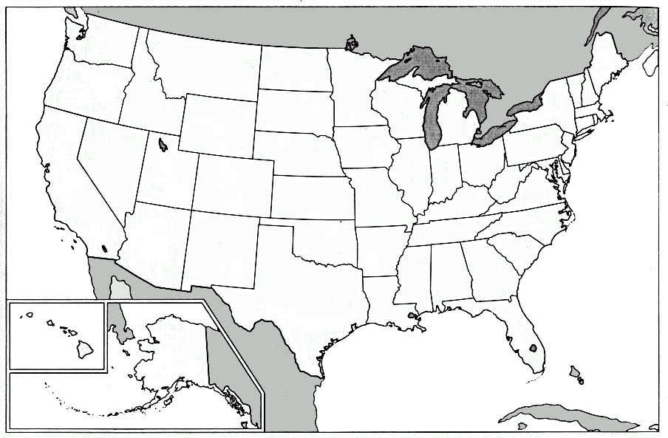
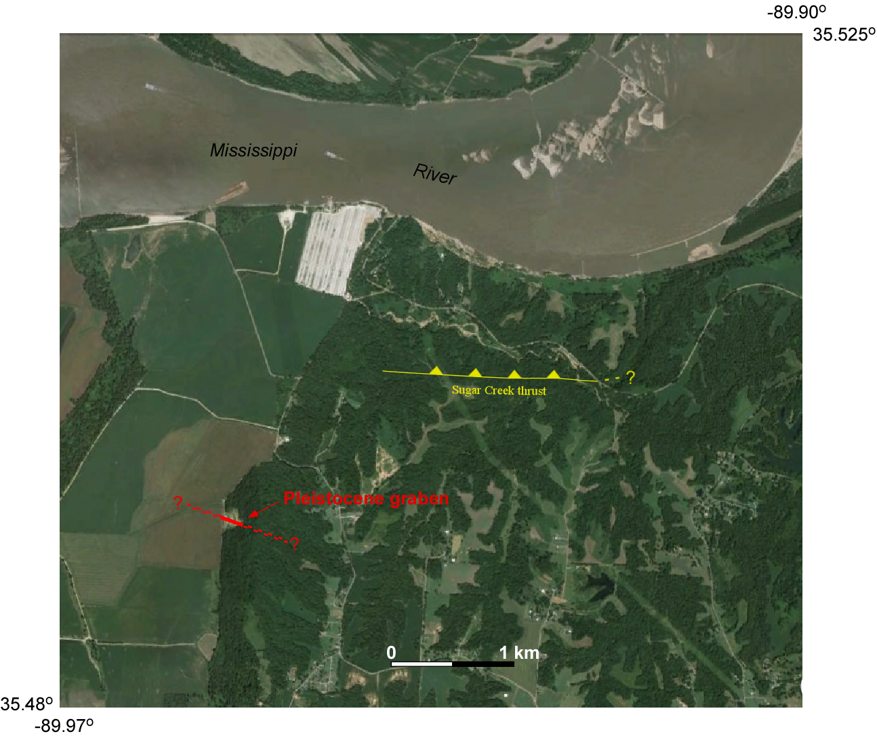
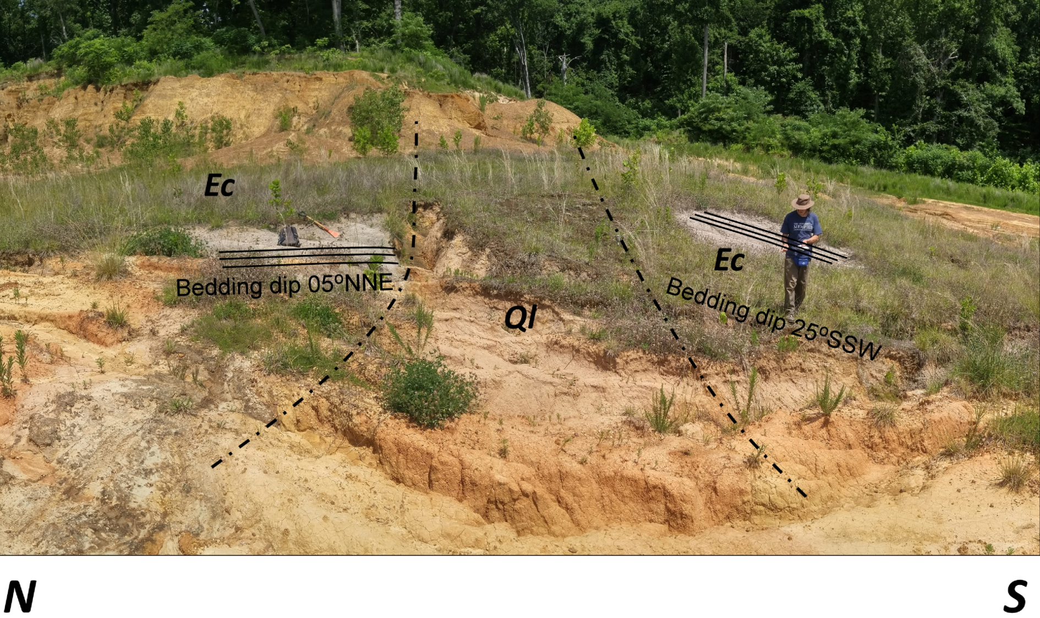
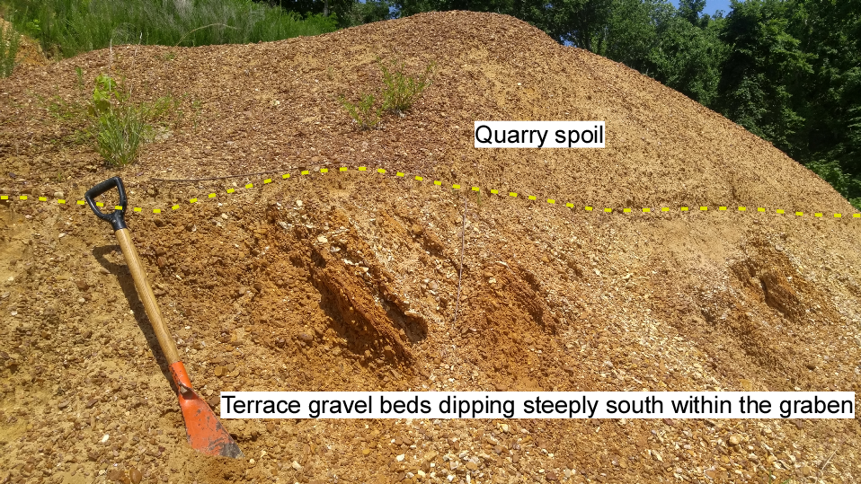
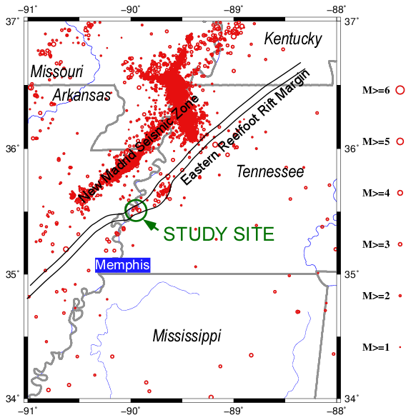
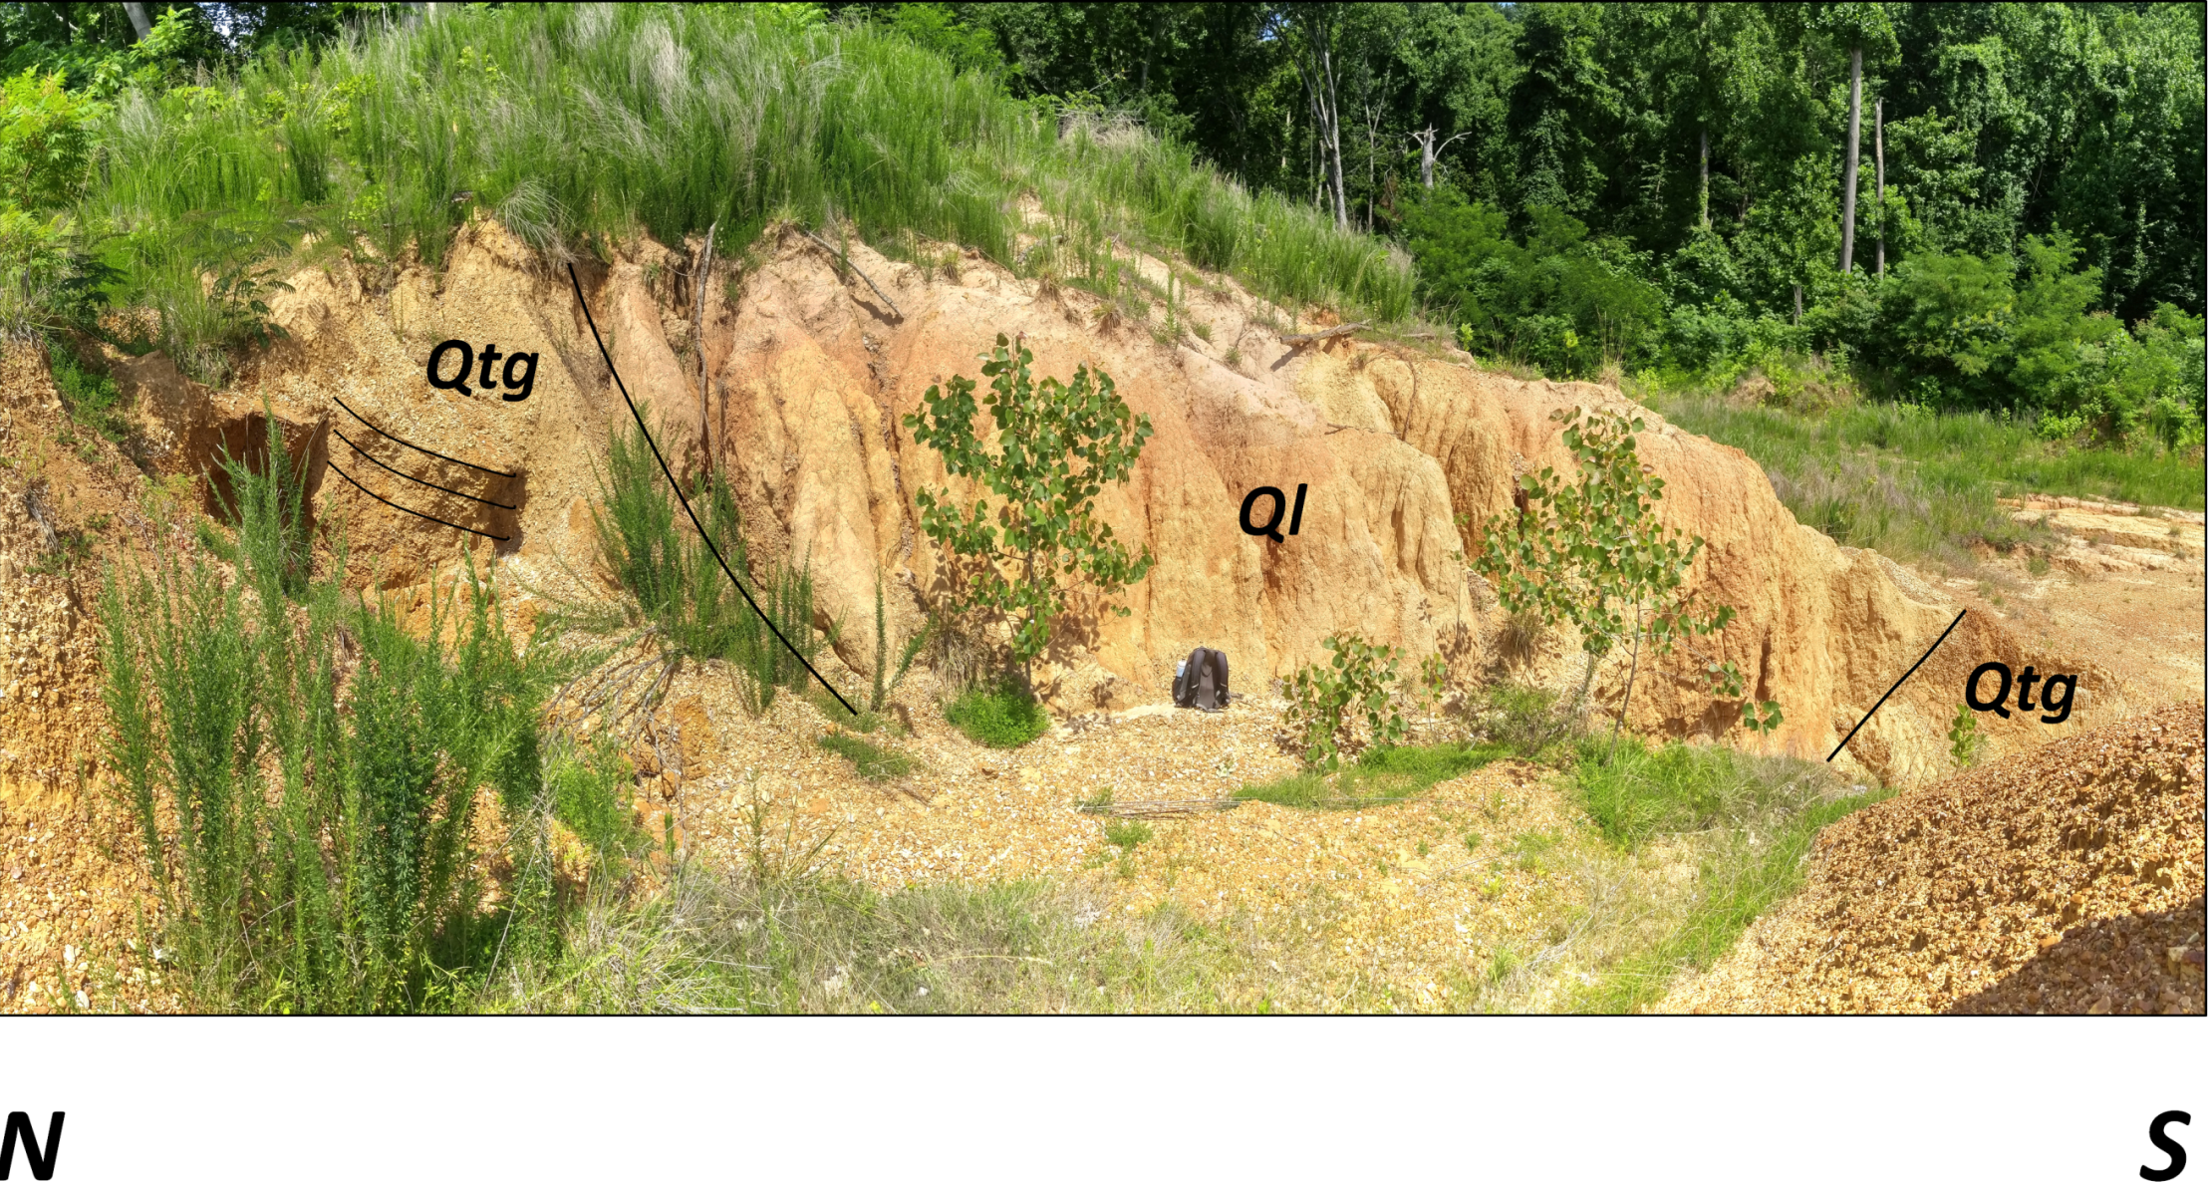
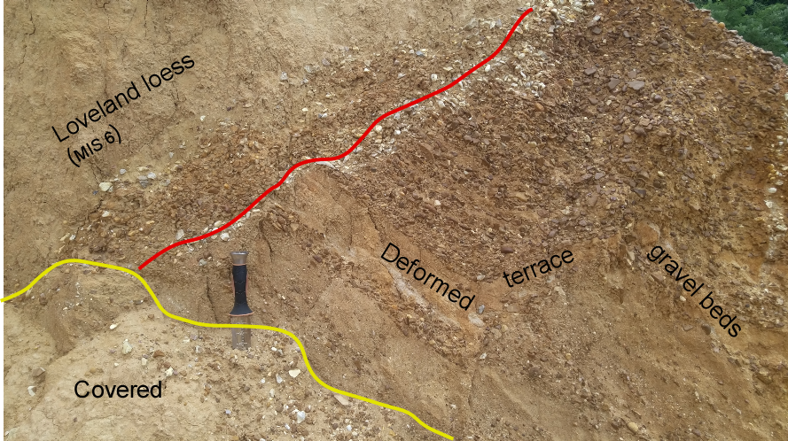


F
QUATERNARY FAULTING ASSOCIATED WITH THE EASTERN REELFOOT RIFT MARGIN IN TIPTON COUNTY, TENNESSEE
Randel Tom Cox, Christopher Vanderlip, Daniel Larsen, Jeffrey Mitchell
Earth Sciences, University of Memphis, Memphis, TN 38152, randycox@memphis.edu, cvndrlip@memphis.edu, dlarsen@memphis.edu, jlmtchl5@memphis.edu
Abstract:
Recently discovered Quaternary faulting is exposed for 90 m along strike in a gravel quarry in western Tipton County, Tennessee, 30 km north of the Memphis metropolitan area along the western margin of the Reelfoot rift complex which contains the New Madrid seismic zone. The quarry exposes a 5 m-wide graben within the hinge zone of a 100º-trending, asymmetric, south-verging anticline (N limb dip: 7ºN; S limb dip: 20ºS) in Eocene deltaic muds. Pliocene-Pleistocene fluvial terrace gravels and Pleistocene loess (pre-Wisconsinan Loveland and Wisconsinan Roxana) are dropped with up to 6 m of throw into the graben along the anticline axis. This graben and smaller peripheral grabens comprise a fault zone ~25 m wide. We interpret the graben as local extensional deformation due to anticlinal flexure. The amplitude of the anticline is >9 m, and the wavelength is >100 m. A zone of weathering at the top of the Eocene largely conforms to the anticlinal folding. This graben and anticline are 1 km south of an E/W-striking, N-dipping thrust fault exposed in the banks of Sugar Creek and its tributaries. The asymmetric anticline fits the geometry of a fault propagation fold above a thrust with the same strike as the Sugar Creek thrust, and thus we speculate these structures may both be en echelon subsidiary splays off a common master fault at depth. The Sugar Creek thrust displaces Eocene fluvial/deltaic sediments >6 m, but the Eocene/Pliocene-Pleistocene contact is not exposed, and post-Eocene thrusting is not documented. Some of the Sugar Creek thrust slip was Eocene because there is an angular unconformity showing that the hanging wall was eroded during Eocene, but before more fault movement. A Eocene sand marker bed on the north limb of the asymmetric anticline is absent on the south limb, suggesting there may be fault displacement across the fold hinge graben that pre-dates the graben faulting and the folding of the weathered zone on the Eocene. This early stage of deformation of the asymmetric anticline may have been coeval with the Eocene movement on the Sugar Creek thrust. Deformation of late Pleistocene loess within the asymmetric anticline and graben show that E/W-striking structures may pose a seismic hazard in the region.
Fig. 4. Surficial stratigraphic column of Tipton County, Tennessee (after Rodbell et al. 1997; Pigati et al. 2015)
Joints related to N-S shortening
Joints related to graben extension
Fig. 5. Joints in Eocene clay at the study site.
STUDY AREA:
In 2016, we discovered a graben containing downthrown Pleistocene loess exposed across a gravel quarry opened in 2013 in western Tipton County, Tennessee. This graben is 40 km north of downtown Memphis, TN and 30 km east of the southern arm of the New Madrid seismic zone (Fig. 1). The graben lies along a secondary NE-trending alignment of seismicity, and it may be part of a system of seismogenic faults (the Eastern Reelfoot Rift Margin) near Memphis.
Discussion:
West Tennessee has experienced strong historic seismicity, and regional liquefaction features show there have been strong prehistoric earthquakes, but exposures of faults in young sediments have been limited to the Reelfoot thrust scarp and a few paleoseismic trenches.
The Tipton County quarry has added an exceptional exposure of Pleistocene faulting and folding above the Eastern Reelfoot Rift Margin basement faults (Fig. 1) and near a surface exposure of thrusted Eocene sediments (“Sugar Creek “ fault on Fig. 2).
Pleistocene terrrace alluvium and overlying Loveland and Roxana loess units are faulted into a graben along the hinge of a south-verging asymmetric anticline (Fig. 3 and 4). This anticline and N-S joints therein (Fig. 5) are kinematically compatible with the Sugar Creek thrusting.
Loveland and Roxana loesses appear to be absent outside the graben and the younger Peoria loess in thinner than expected within the quarry (Fig. 4), and these loesses may have been eroded from the upthrown blocks.
The graben strikes 110º along the axis of the anticline (Figs. 2 and 6), also reflected in E-W joint trends (Fig. 5).
Pleistocene units are deformed and dip steeply within the graben (Figs. 7, 8, and 9).
Fig. 3. Looking east at the western-most wall of the Tipton County, TN gravel quarry that exposes an asymmetric anticline verging south (top = interpreted; bottom = un-interpreted). Pleistocene (and possibly Pliocene ) alluvium is dropped into a graben along the hinge of the anticline. Note that the sub-alluvium weathering zone is folded with the Eocene “bedrock”.
Fig. 7
Fig. 6. Looking east along the graben axis toward the eastern quarry wall. Note change in Eocene dip across graben. Ql = Pleistocene loess; Ec = Eocene clay .
Fig. 7. Steeply-dippng alluvium beds within the graben.
Tentative conclusions (speculations):
Young and potentially seismogenic structures are present in Tipton County, TN.
Thin Peoria loess and the absence of Roxana and Loveland loesses outside the graben suggest the graben developed during Peoria time, and erosion stripped the lower Peoria, the Roxana, and the Loveland loess from the uplifted margins of the graben.
Fig. 2. Local setting of the “Pleistocene graben” study site.
Fig. 8
Acknowledgments:
This project is funded by EDMAP Award No. G16AC00140.
The Warren family is thanked for access to the gravel quarry.
Thanks to numerous students and faculty who have given help and constructive advice.
Fig. 1. Location of study area in the Mississippi Valley. Eastern Reelfoot Rift Margin after Csontos et al. (2008). Red circles denote earthquake epicenters (Center for Earthquake Research and Information catalog, Univ. of Memphis, 2016).
Fig. 8. Looking east at eastern quarry wall showing Pleistocene loess (Ql) dropped between fluvial terrace gravels (Qtg).
Fig. 9. Close up of some deformation within the graben.
References:
Csontos, R., Van Arsale, R., Cox, R., and Waldron, B., 2008, The Reelfoot Rift and its impact on Quaternary deformation in the central Mississippi River valley: Geosphere, 4: 145–158.
Forman, S.L., and Pierson, J. 2002. Late Pleistocene luminescence chronology of loess deposition in the Missouri and Mississippi river valleys, United States: Palaeogeography, Palaeoclimatology, Palaeoecology 186, 25-46.
Markewich, H.W., Wysocki, D.A., Pavich, M.J., and Rutledge, E.M. 2011. Age, genesis, and paleoclimatic interpretation of the Sangamon/Loveland complex in the Lower Mississippi Valley, U.S.A.: Geol. Soc. Am. Bull. 123 (1/2), 21-39, doi: 10.1130/B30208.1.
Rodbell, D.T., Forman, S.L., Pierson, J., and Lynn, W.C., 1997. Loess and paleosol stratigraphy, magnetic susceptibility and chronology of Mississippi Valley loess in western Tennessee: Geol. Soc. Am. Bull. 109 (9), 1134-1148.
Pigati, J.S., McGeehin, J.P., Muhs, D.R., Grimley, D.A., and Nekola, J.C. 2015. Radiocarbon dating loess deposits in the Mississippi Valley using terrestrial gastropod shells (Polygyridae, Helicinidae, and Discidae): Aeolian Research 16, 25–33.

