Slide 1
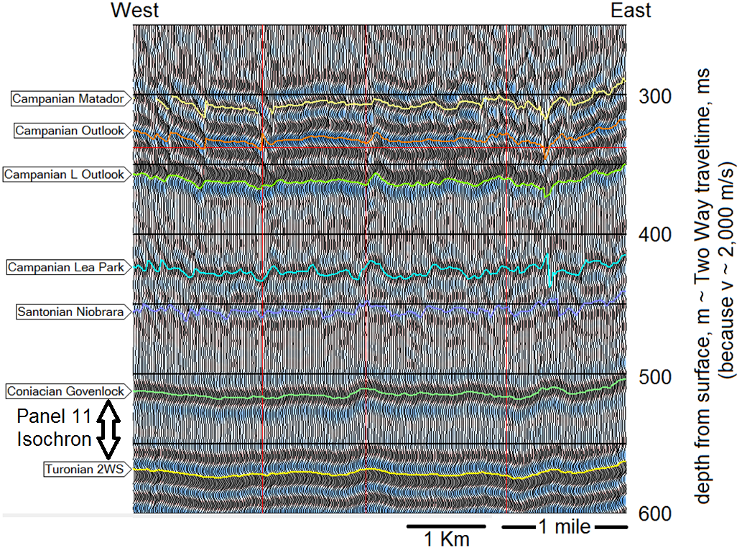
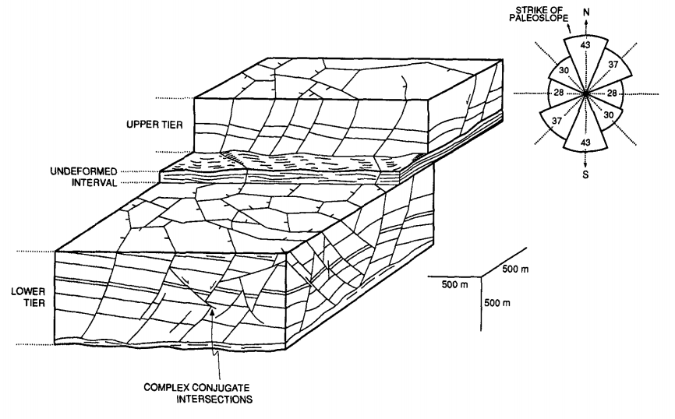
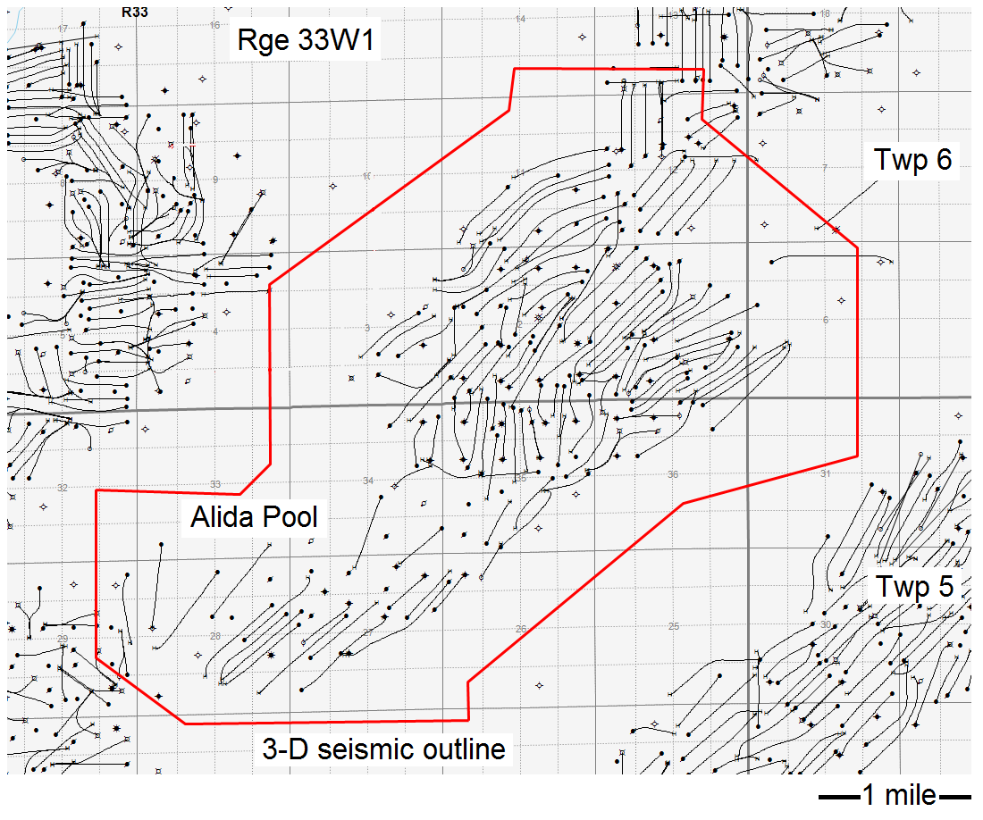
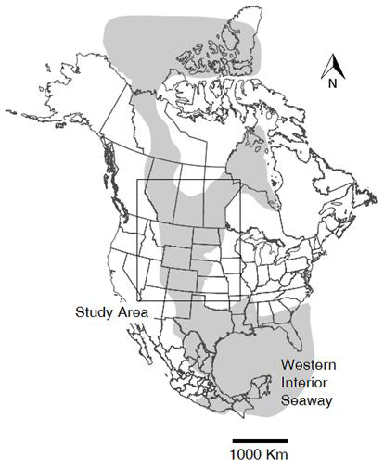
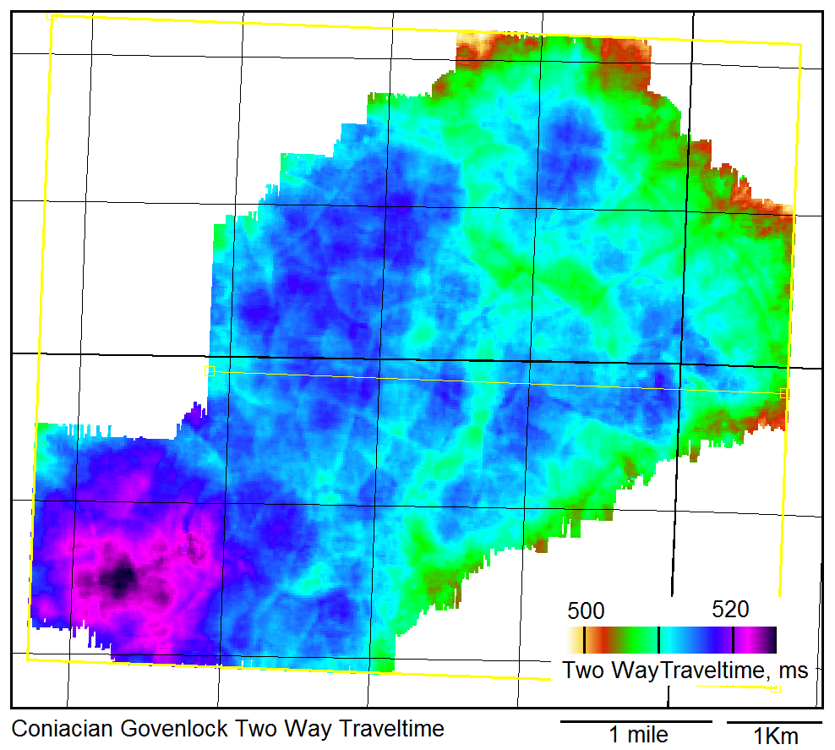
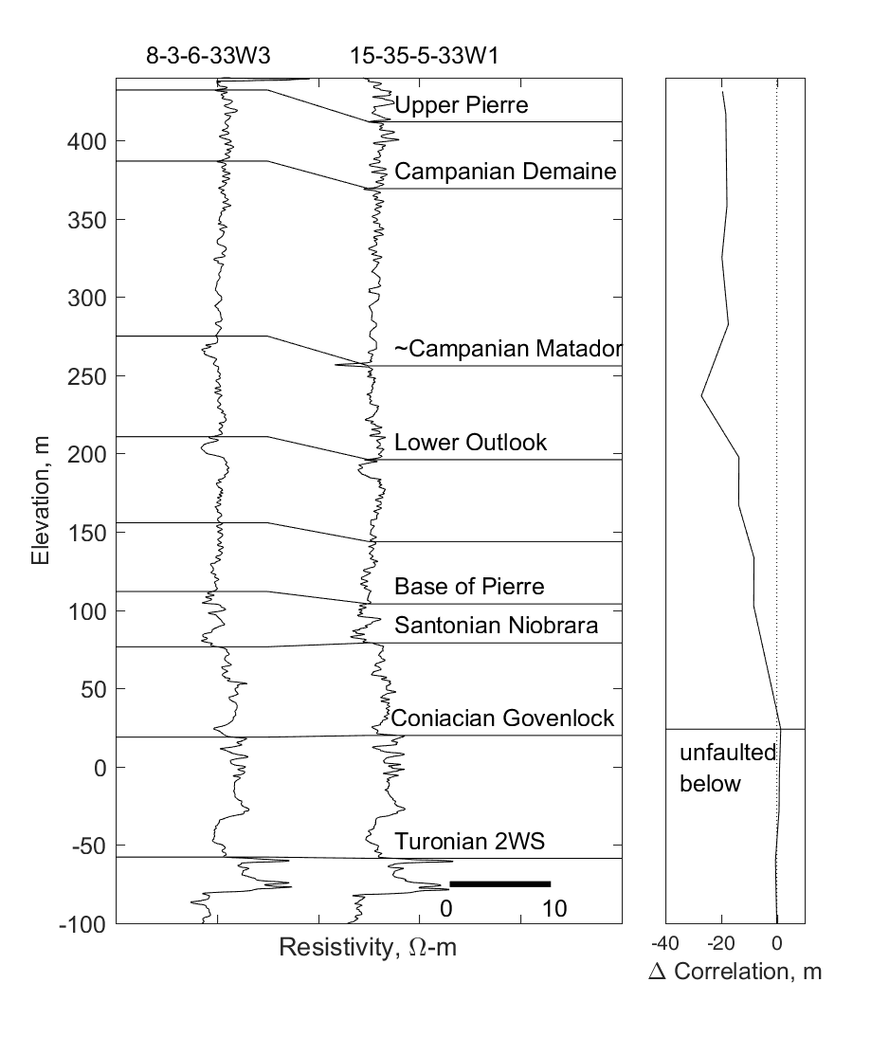
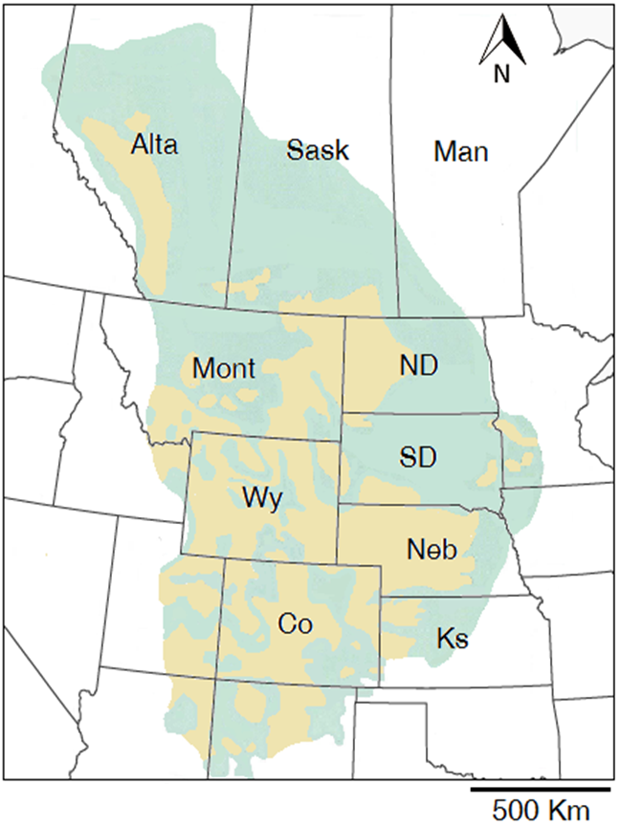
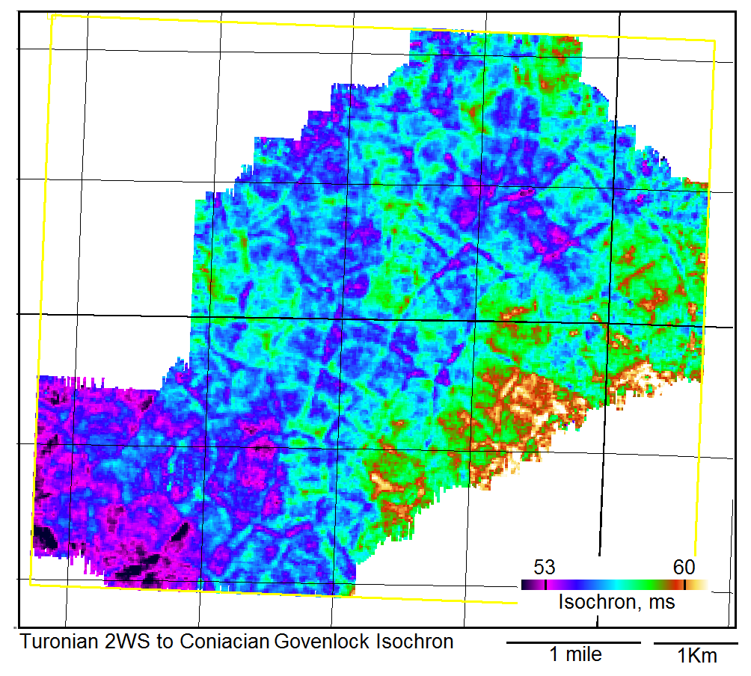
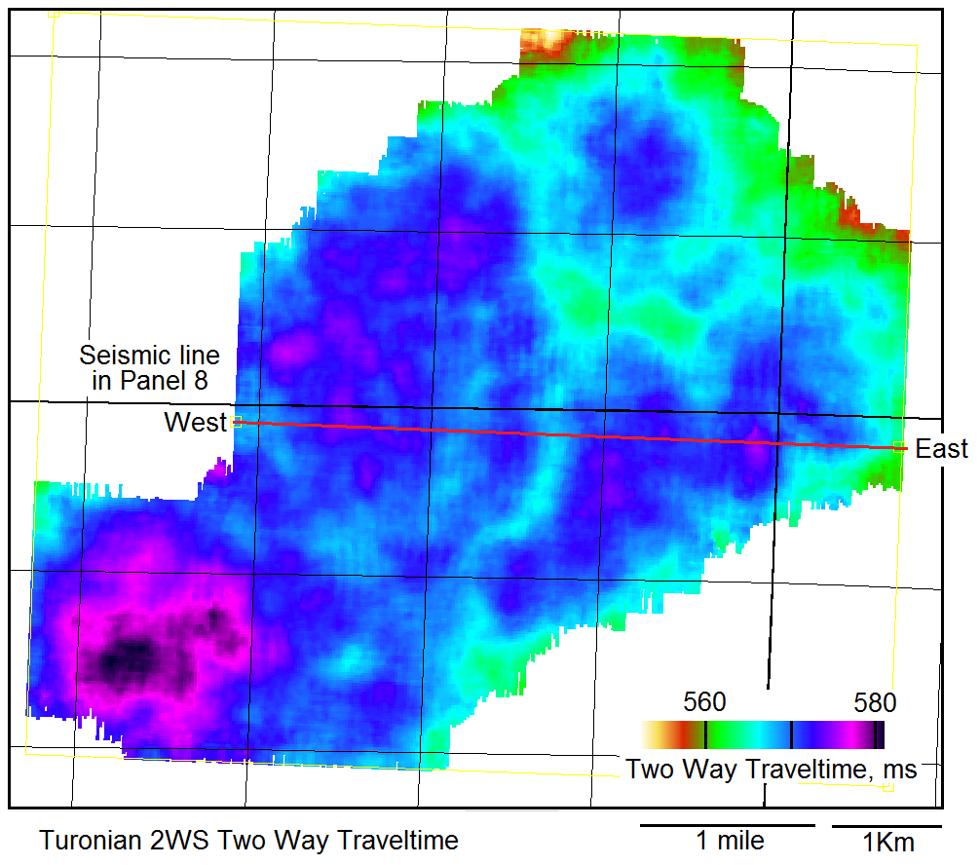
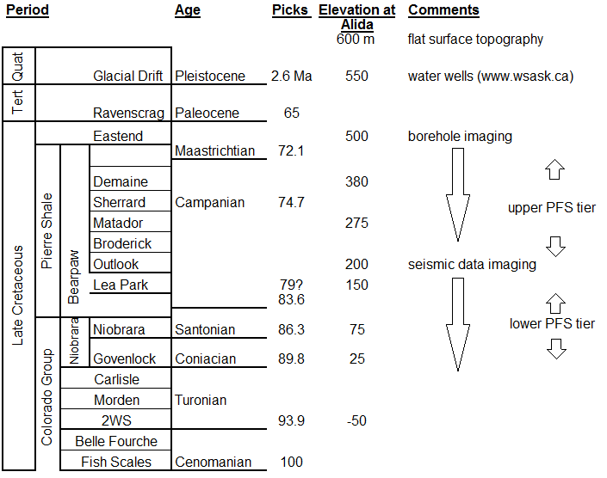
Interpretation of the Great Plains Polygonal Fault
Andy St-Onge, Calgary geophysicist@shaw.ca
(i) Summary.
4) After deposition, the subaqueous muds underwent normal faulting. Cartwright (1994) and others have researched this topic; the cause of the faulting is still being discussed. The work here is focused on the GPPFS presence (the cause is work in progress).
8) West to east seismic line from ~250 – 600 m depth:
Siliceous Cretaceous sediments of the Western Interior Seaway of North America host a previously unreported polygonal fault system (PFS). The Great Plains PFS (GPPFS) is an expansive network of fractures and faults that could be the Earth’s largest PFS. Interpretation of seismic data in the Pierre Shale depositional area has identified faulted strata with a polygonal planform geometry of aggregated fault traces indicative of PFS.
A 3-D seismic dataset from Alida, Saskatchewan provides some insight into fault timing and geometry for the GPPFS. Here, faulting in the GPPFS appears to have occurred in two stages. The lower tier is Coniacian to Campanian, has a base at ~25 m ASL, with larger faults having average throws of ~10-15 m and a fault density of ~10 faults/mile². This tier forms a series of grabens at the top, suggesting Middle Campanian local or regional extension. The upper PFS tier (Upper Campanian) has similar fault throws and areal densities, but the faults are longer in length and the predominant strike azimuth changes. Also, the upper PFS tier has developed into tilted fault blocks that increase in offset up to the base of the Tertiary at 500 m ASL, ~100 m below surface. The data presented here are representative of seismic data, surface geology, landslides, and well control that could be indicating that the GPPFS could be >2,000,000 Km² in area. The engineering geology advances are numerous where the PFS is at outcrop or near outcrop.
5) Let’s examine the results of this phenomenon at Alida, Saskatchewan. The Alida pool is ~830 miles northeast of Denver. It has a 3-D seismic volume, as outlined in red:
9) Summary so far:
The Turonian 2WS two way traveltime map shows a southwest to northeast structural rise consistent with regional dip without faulting.
The west to east seismic line images faults above the Turonian 2WS.
Let’s map the Coniacian Govenlock Two Way Traveltime, the next shallowest reflection above the Turonian 2WS.
1) Start ~ 100 MA (Cenomanian) and deposit siliciclastics in the Western Interior Seaway.
10) The Coniacian Govenlock Two Way Traveltime.
UTMX=293783, UTMY=5480369, NAD 27, UTM Zone 14N
Mississippian age grainstone shoals at ~1200 m have produced 31 MM BOE from 164 producing wells since 1954.
3-D seismic dataset acquired in 1995 to image the Mississippian beds. The 350 m source line interval, 235 m receiver line interval and 25 m bin size resulted in low fold at depths < 500 m.
The Mississippian reservoir is unassociated with any process presented here.
From Blakey, 2014
6) At Alida, the Pierre shale is ~ 400 m thick.
2) From the Cenomanian to the Maastrichtian, siliciclastics were deposited over ~2.6 million Km², up to 2,400 m thick (at Boulder, Colorado, Scott and Cobban, 1965). This is the Pierre Shale.
At Alida, the Upper Pierre is overlain by ~100m of Tertiary and glacial strata above 500 m above sea level (ASL).
Note the faulted Pierre strata in the simple cross-section.
subsurface
11) Coniacian Govenlock to 2WS Isochron (time difference).
outcrop
7) The Turonian 2WS seismic reflection images no detected faulting.
This entire area could host a polygonal fault system.
(from Roberts and Kirschbaum, 1995)
3) Use Age names over the large area:
This map shows Upper Cretaceous fault traces as local isochron thins.
The isochron map shows minor variations in traveltimes that are lost in the dynamic range of the two way traveltime maps in panels 7 and 10.
Let’s map the next adjacent and shallower traveltime interval – the Santonian Niobrara to Coniacian Govenlock Isochron.

Slide 2
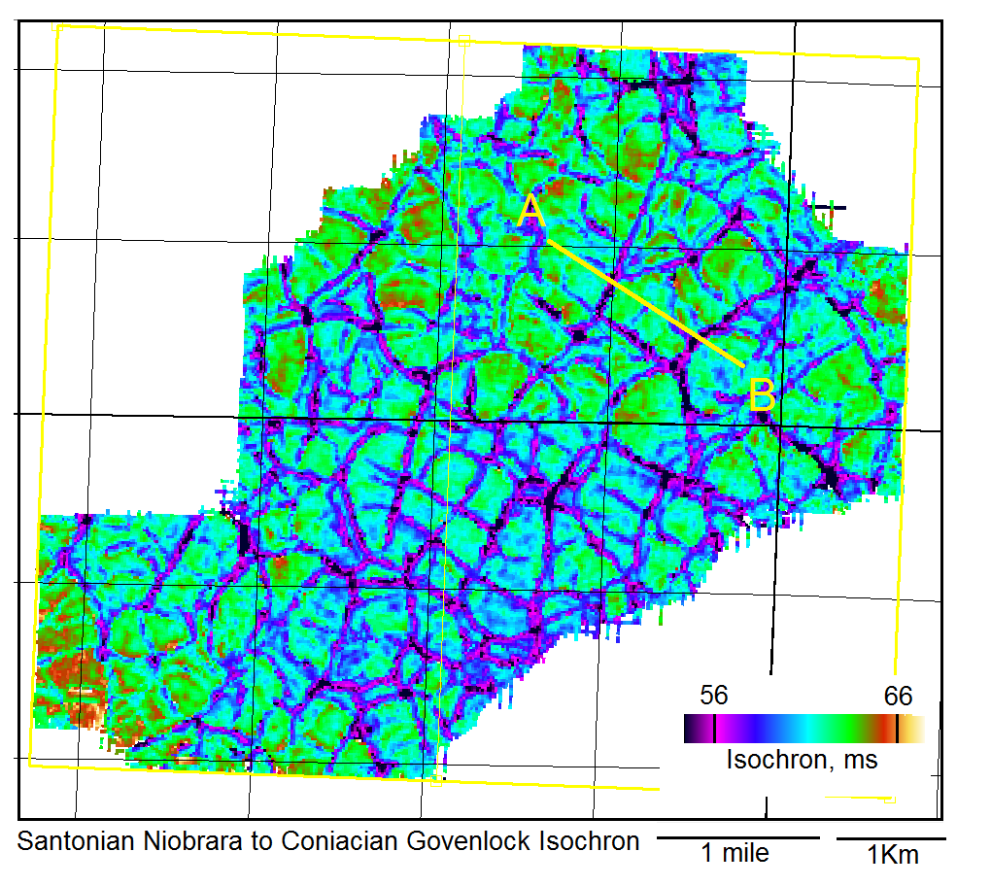
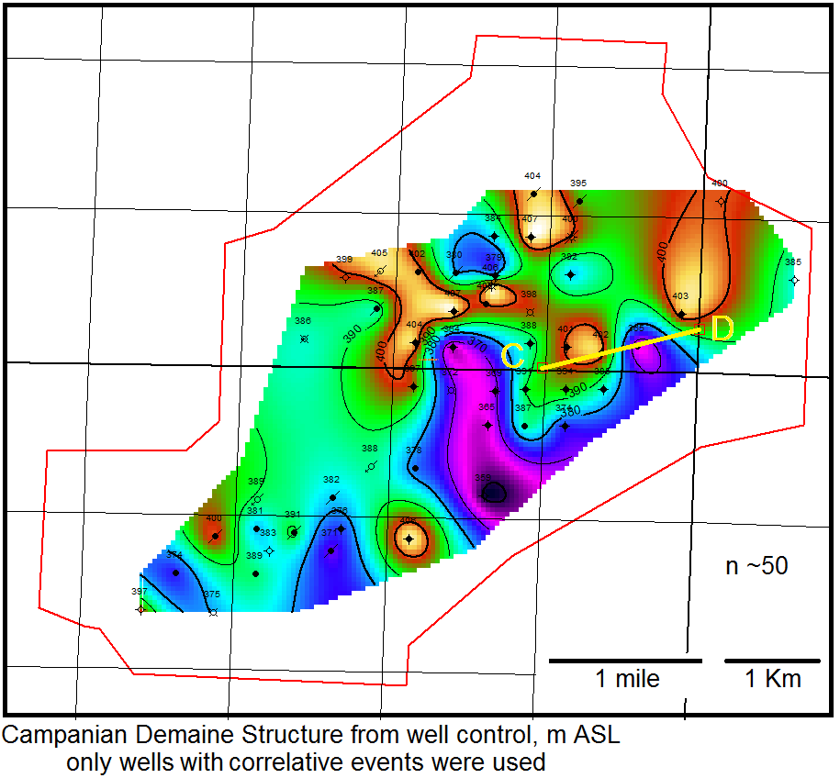
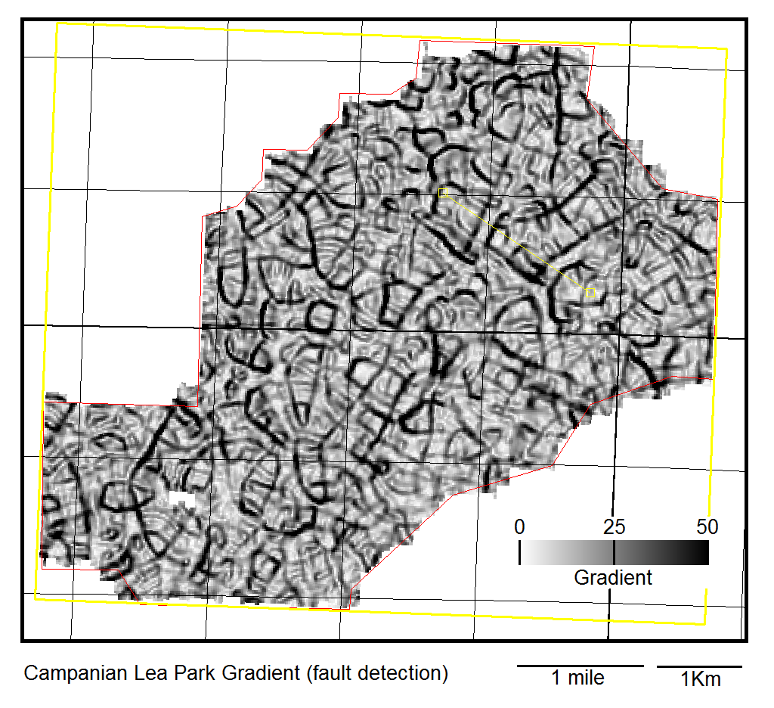
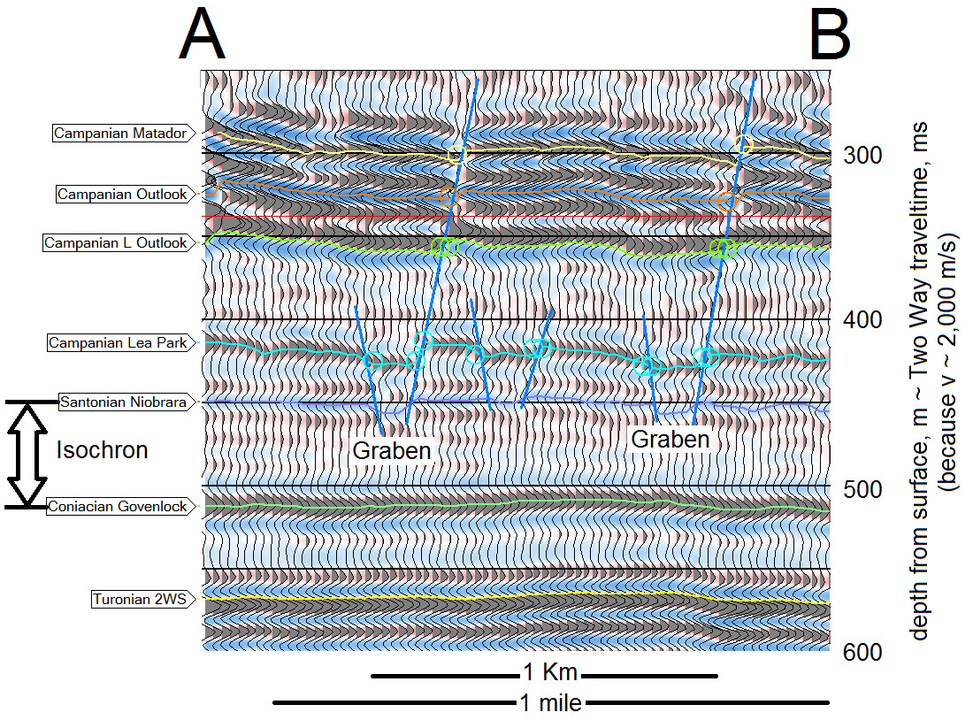
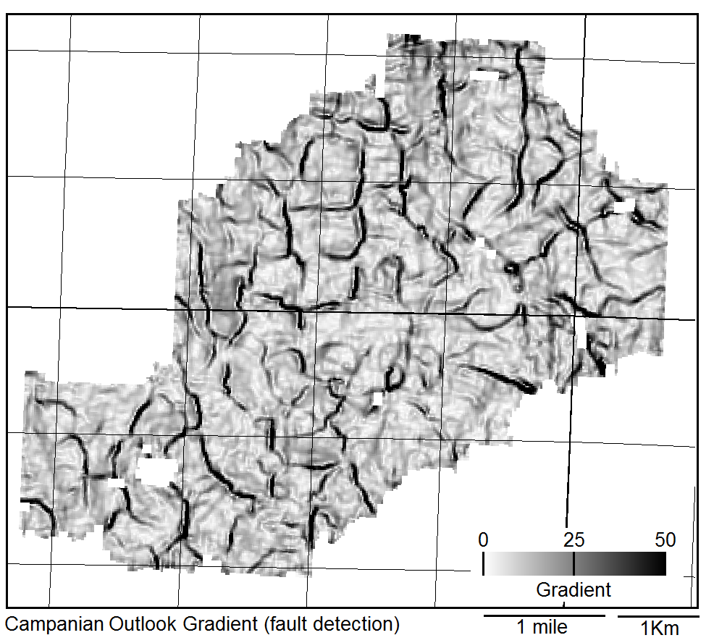
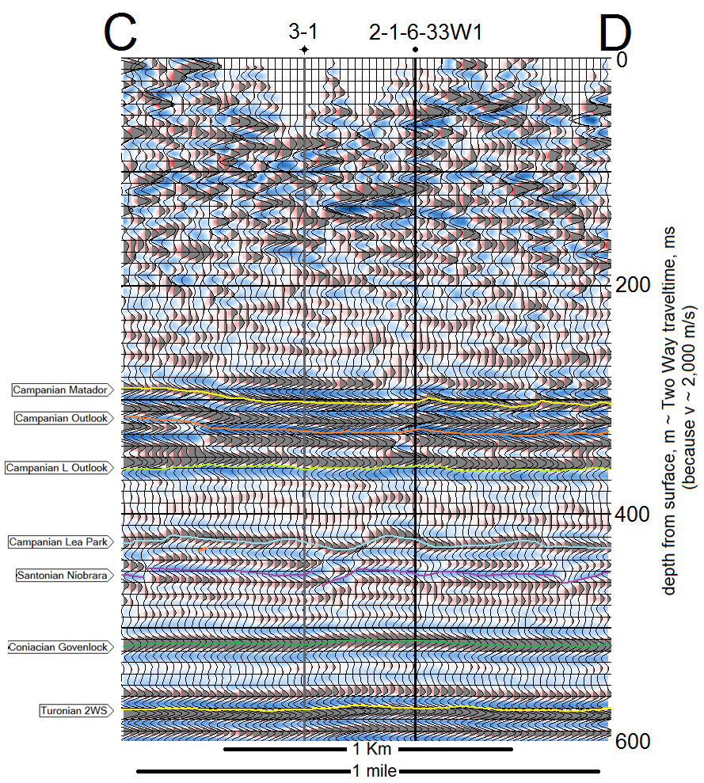
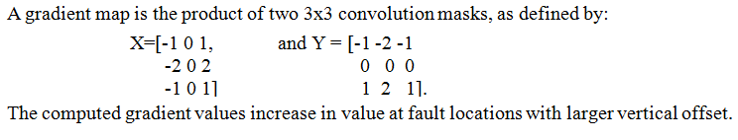
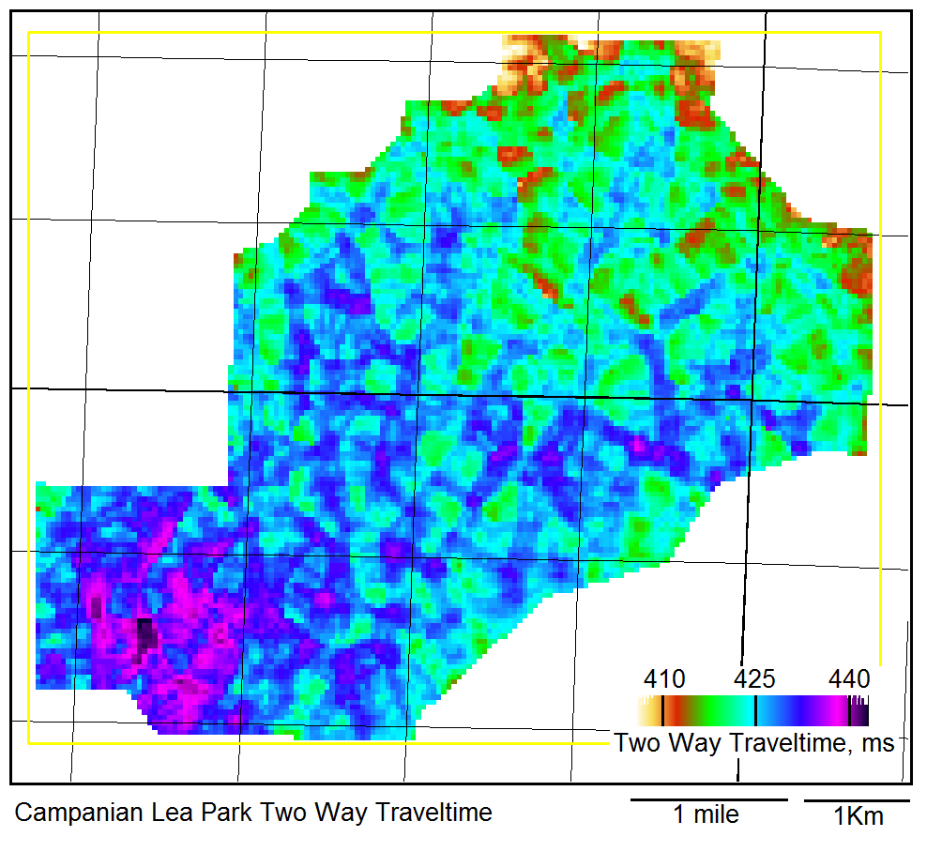
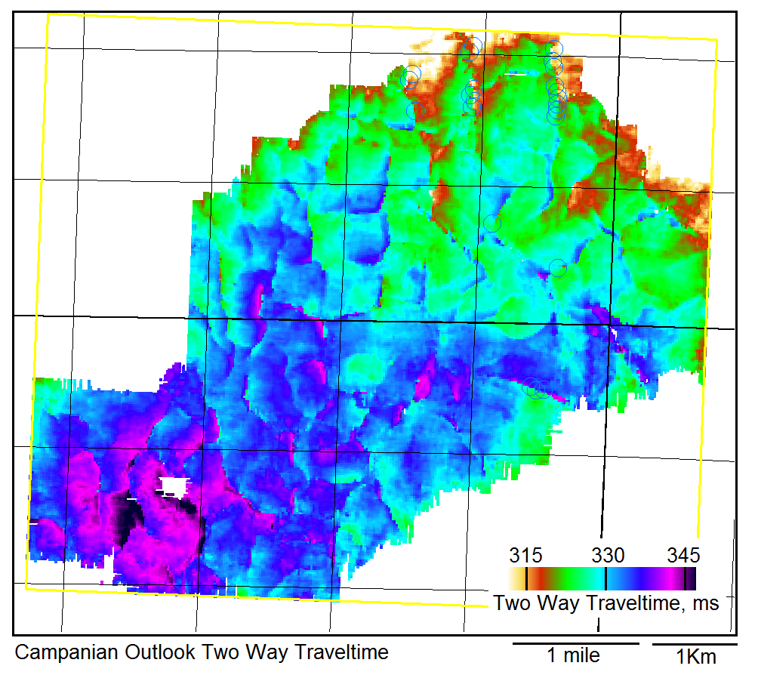
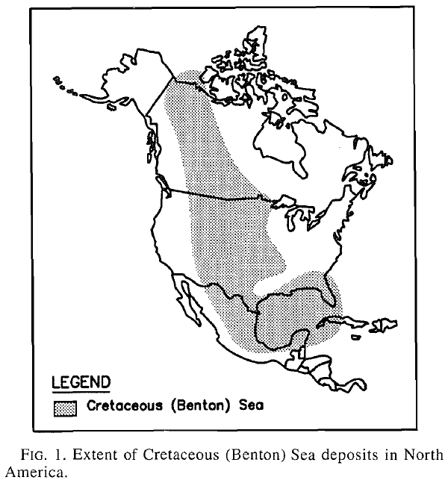
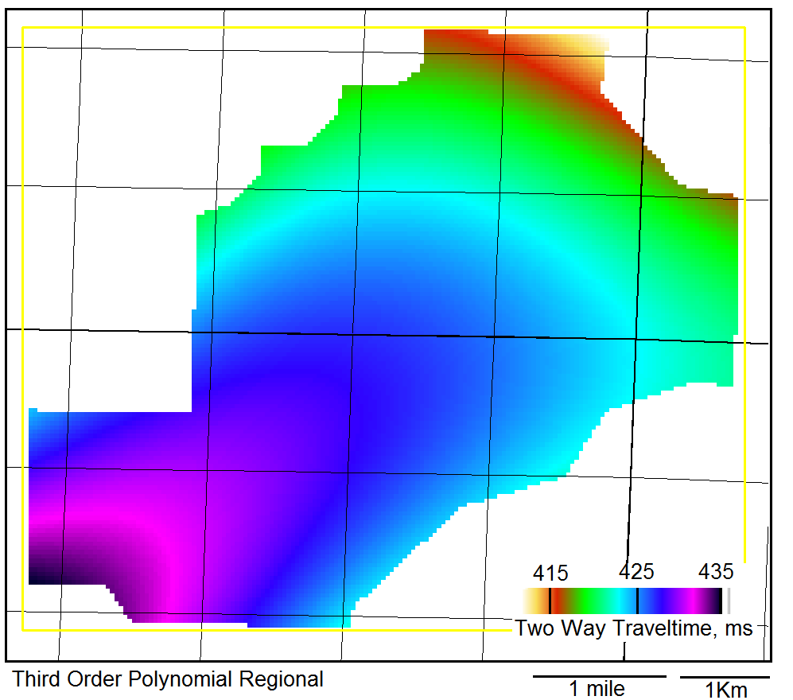
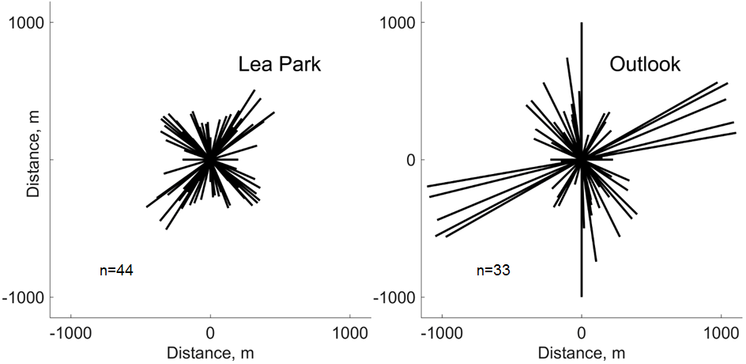
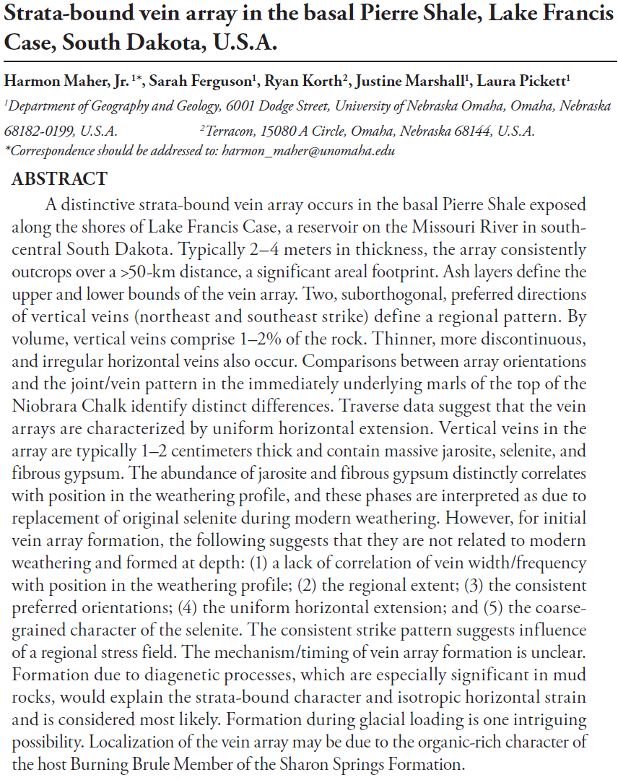
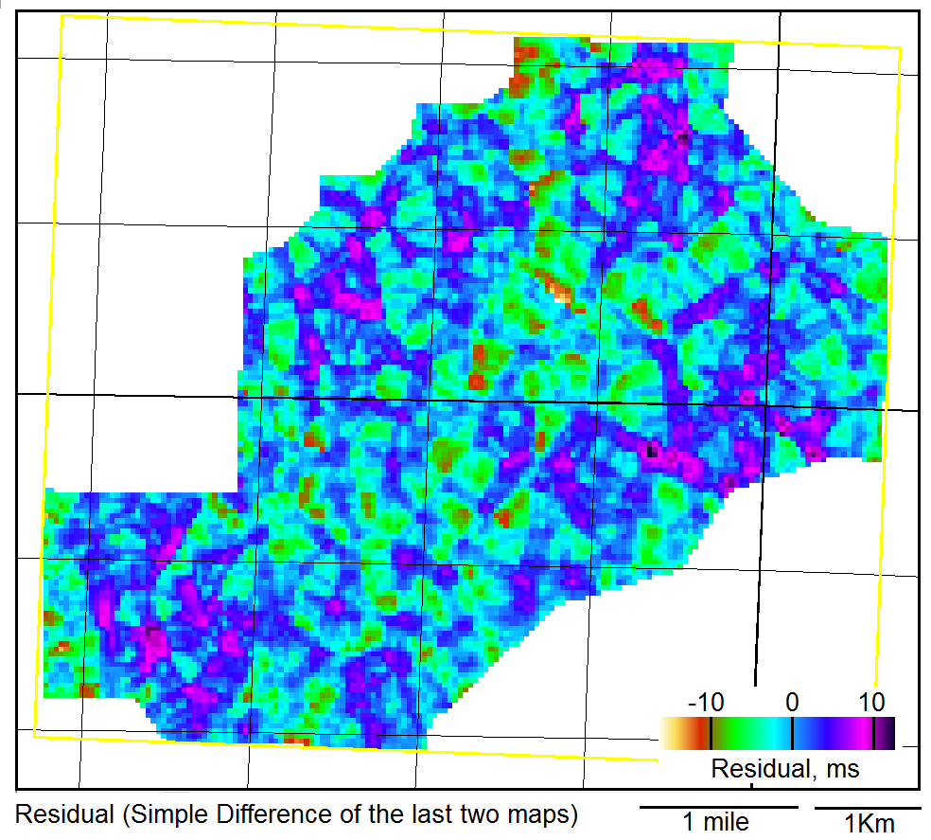
System at Alida, Saskatchewan
12) Santonian Niobrara to Coniacian Govenlock Isochron (time difference).
14) Another way to characterize the faulting is to display horizon gradient maps. Observe the difference between the Campanian Lea Park gradient map and the shallowest continuous horizon, namely the Campanian Outlook.
17) Geology Map.
The Demaine marker (from well control – see Panel 3 and 6 has ~37 m of structural difference between 3-1 and 2-1-5-33W1. Well control mapping probably underestimates the structural complexities.
2-1-6-33W1 is 37 m low to 3-1 at the Demaine strata at this elevation. The 2-1 well could be drilled in a fault trace.
The map and seismic line show the Santonian reflection. Numerous grabens occur after Campanian Lea Park but before the Campanian L Outlook reflection. This is confirmed by well control.
13) a, b, c Three maps show how we can compute a residual map for the Campanian Lea Park to estimate the graben geometries.
15) The Campanian Outlook two way traveltime map resembles tilted fault blocks that were influenced by the Campanian Lea Park grabens (panel 13c, to the left).
18) Geotechnical engineers have studied this area.
Rational design treatment of slides in overconsolidated clays and clay shales
Elmer Brooker and Ralph Peck, R. 1993.
Canadian Geotechnical Journal, 1993, 30(3): 526-544. doi: 10.1139/t93-045. “
During the early part of the past century, engineers were repeatedly surprised by unforeseen movements of valley slopes on overconsolidated, flat-bedded clays and clay shales. Movements have occurred, and still persist, throughout the Cretaceous Sea area of North America. During the past 20 years the profession has been developed to the point where the element of surprise should not be an issue.”
The regional map is defined as the least squares fit of a cubic surface to the Lea park Two Way Traveltime map above.
16) Fault strike direction and length for the largest gradients on the two maps in Panel 14.
19) The GPPFS has been recognized at outcrop.
This map is a difference of the upper two maps.
The Campanian grabens are ~200 m wide, 800 m long and ~10-15 m deep with almost random strike directions.
The Campanian Lea Park reflection has shorter fault traces relative to the shallower PFS. These fault traces strike NW/SE & NE/SW.
The Campanian Outlook reflection has longer strike lengths, oriented ENE/WSW. Some of the deeper faults extend to the shallower layers, as can be seen on the seismic line ‘AB’ in panel 12 above. The process by which some faults extend to shallower layers is under examination.

Slide 3

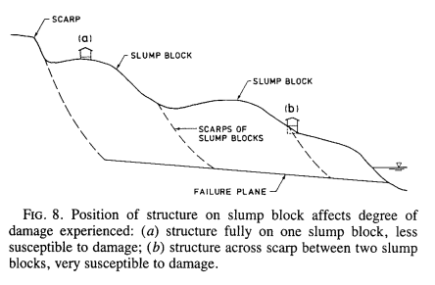
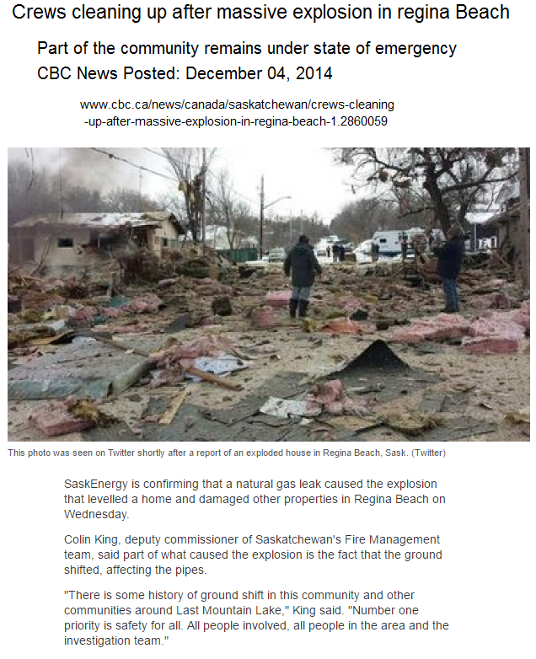
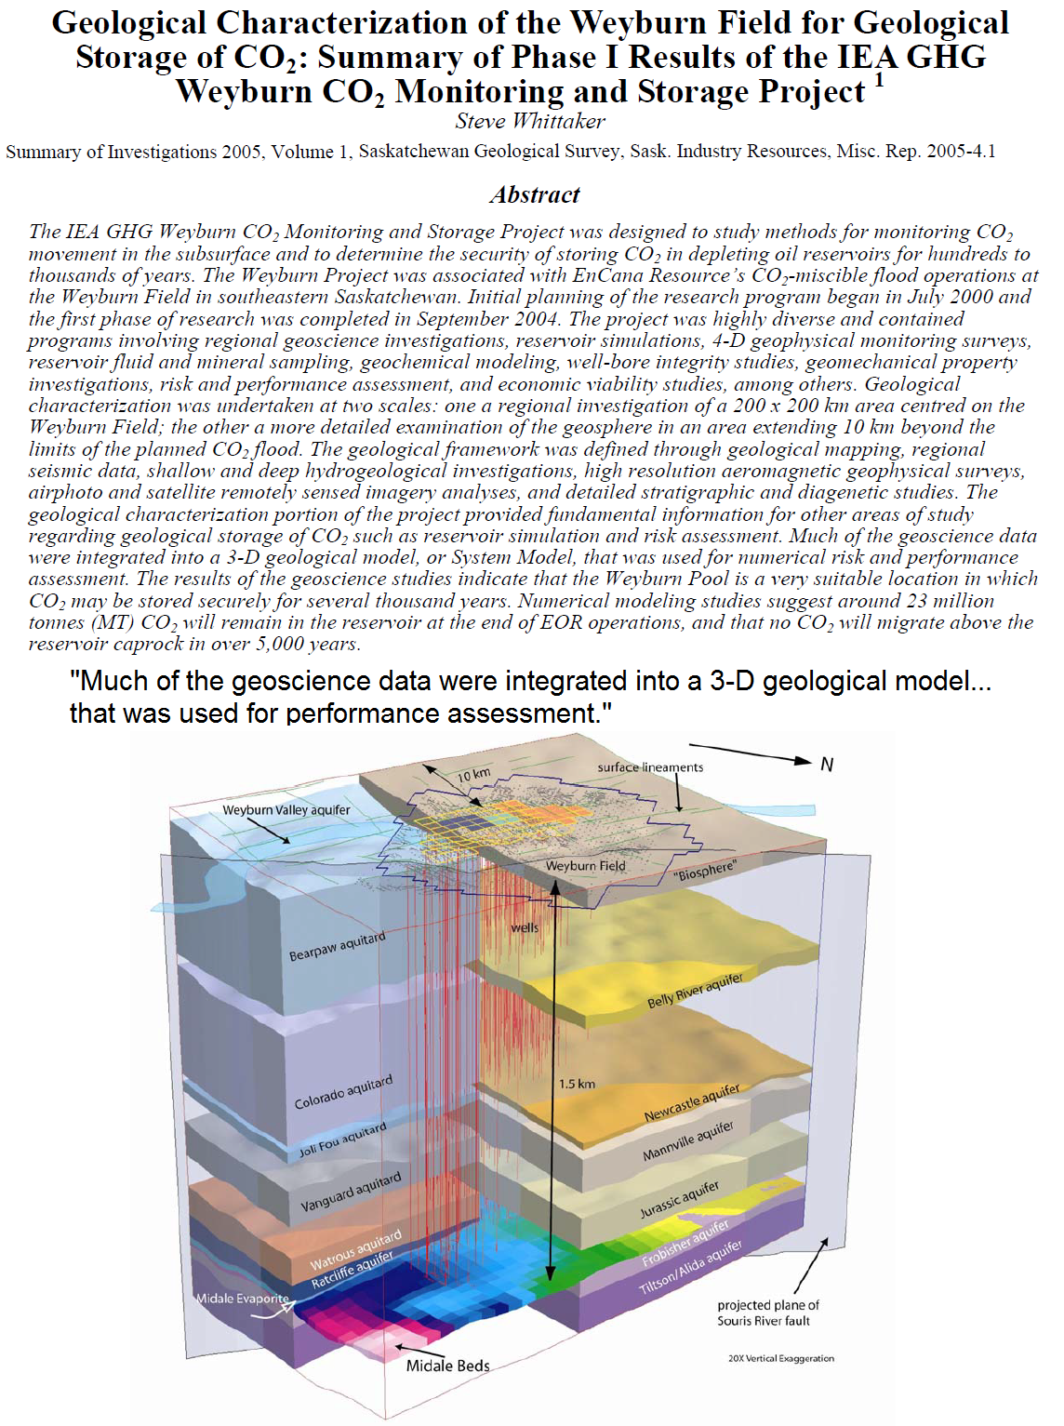
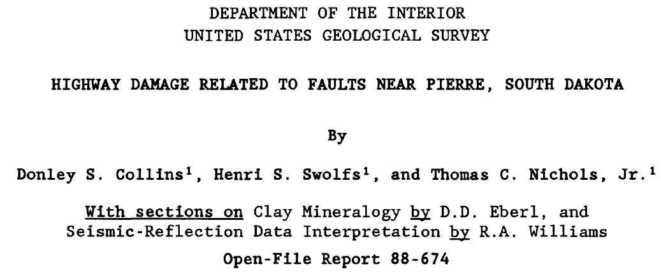
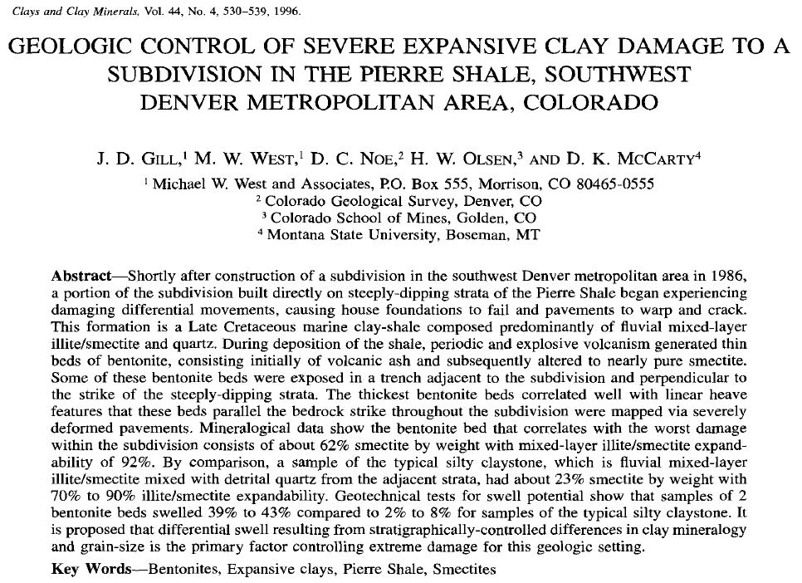
20) Regina Beach is subject to slides from toe slope erosion in the Qu’Apelle Valley, Saskatchewan.
22) Conclusions.
Regina Beach – a town on a landslide
Wayne Clifton, Richard Yoshida and Roy Chursinoff, 1985.
Canadian Geotechnical Journal, 1985, 23, 60-68.
“The town of Regina Beach is constructed on landslides along the Last Mountain Lake valley, a glacial meltwater channel in south-central Saskatchewan, Canada. The landslides are retrogressive in nature and are seated in bentonitic clay shale of the Bearpaw Formation (Pierre shale).”
Siliceous Cretaceous sediments of the Western Interior Seaway of North America host a previously unreported polygonal fault system (PFS). At Alida, Saskatchewan, 3-D seismic data can image the PFS from ~200 m ASL to its origin at ~25 m ASL. The PFS can be geologically mapped below a depth of ~500 m ASL using wellbore logs. Faulting of the Pierre Shale resulted in a graben system and a tilted fault block system at Alida. The graben system is basal Campanian and suggests local or regional extension. These grabens have affected the upper tier of the PFS. Both tiers have faults with similar displacements, but the upper tier average fault strike length is longer and the strike direction is rotated ~30° E. How the graben and tilted fault blocks and shallow bed geometries are related is still under investigation.
The Great Plains PFS could be one of the largest in the world. It is only PFS for those of you reading this with easily accessible outcrop, and the PFS has an estimated 200,000 wellbore penetrations for subsurface work.
23) Implications and further work.
Probably affects groundwater hydraulic conductivity.
Compartmentalization for hydrocarbon reservoirs.
Faults and fractures to near surface or outcrop.
Estimates of millions of faults with strike lengths of ~500m.
Graben formation suggests extension – is this local, forebulge movement, or tectonic?
Present day slumping from toe erosion within incised valleys could reactivate PFS fault traces. Recent earthquake in Saskatchewan?
Surface geology work must be an integral part of this analysis.
24) References.
Blakey, R., 2014. Paleogeography and Geologic Evolution of North America. Arizona, USA, http://cpgeosystems.com/nam.html.
Cartwright, J, 1994, Episodic basin-wide influence expulsion from geopressured shale sequences in the North Sea Basin, Geology, 22: 447-450. doi: 10.1130/0091- 613(1994)022<0447:EBWFEF>2.3.CO;2
CBC News. 2016. Regina Beach, Saskatchewan residents asking for help with slumping land, available at http://www.cbc.ca/news/canada/saskatchewan/regina-beach-residents-frustrated-with-slumping-land-1.3543986 [accessed on 6 August 2016].
Lopez, T., Antoine, R., Darrozes, J., Rabinowicz, M., and Baratoux, D. 2015. Formation of polygonal fracture system as a result of hydrodynamic instabilities in clay-rich deposits Geological Society of America Annual Meeting, Baltimore, Maryland. Available from https://gsa.confex.com/gsa/2015AM/webprogram/Handout/Paper267450/Poster_Clays_GSA15.pdf [accessed on April 16, 2016].
Maher, H., Ferguson, S., Korth, R., Marshall, J., and Pickett, L., 2015, Strata bound vein array in the Pierre Shale, Lake Francis Case, South Dakota, U. S. A., Rocky Mountain Geology, v. 50, no. 2, p. 153–165, doi:10.2113/gsrocky.50.2.153.
Quinn, J., Chin, B., Pernito, M., and Scammell, J. 2014. Geotechnical assessment of Alameda Dam, Canadian Geotechnical Society, Geo Regina 2014.
Roberts, L., and Kirschbaum, M., 1995, Paleogeography of the Late Cretaceous of the Western Interior of Middle North America- Coal distribution and sediment accumulation, USGS Professional Paper 1561, US Government Printing Office, http://pubs.usgs.gov/pp/1561/report.pdf.
Scott, G., and Cobban, W., 1965, Geologic and biostratigraphic map of the Pierre Shale between Jarre Creek and Loveland, Colorado, USGS Imap 439, availiable at https://pubs.er.usgs.gov/publication/i439 [accessed 4 September 2016]
The Qu’Apelle Valley has swelling bentonite and toe slope erosion. The engineering geology advance for this work is that the Pierre shale there is part of a large PFS. The PFS faulting complicates the toe slope erosion model.
21) The Weyburn CO₂ storage model characterizes the overlying Bearpaw and Colorado (Pierre equivalents) as an aquitard. The PFS faulting suggests an aquifer, if the faults are open.
(ii) Appendix – the application of a polygonal fault system model for the Pierre Shale is my recent advance in engineering geology that should help us with future engineering considerations.

