Slide 1
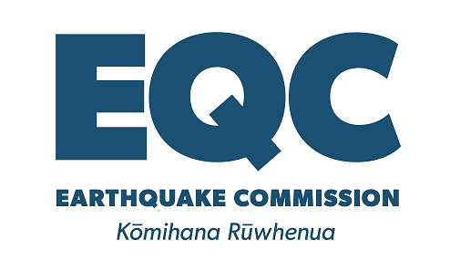
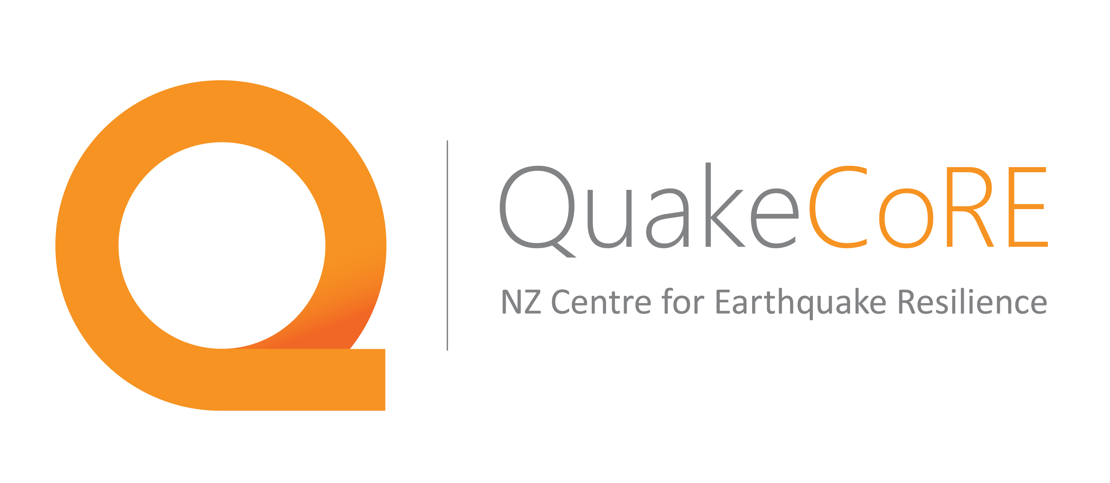
Lessons in Communication: Bringing communication training and research to geoscience academics and professionals
Jacqueline Dohaney
Project Team: Thomas M. Wilson, Ben Kennedy, and Erik Brogt
Emma Hudson-Doyle, Brendon Bradley, David Johnston and Jan Lindsay
Notes:
Geoscience education researcher
Postdoctoral Fellow at Victoria University of Wellington & University of Canterbury in New Zealand
Research is funded by the Earthquake Commission of New Zealand, and a new research cluster called QuakeCoRE

Slide 2
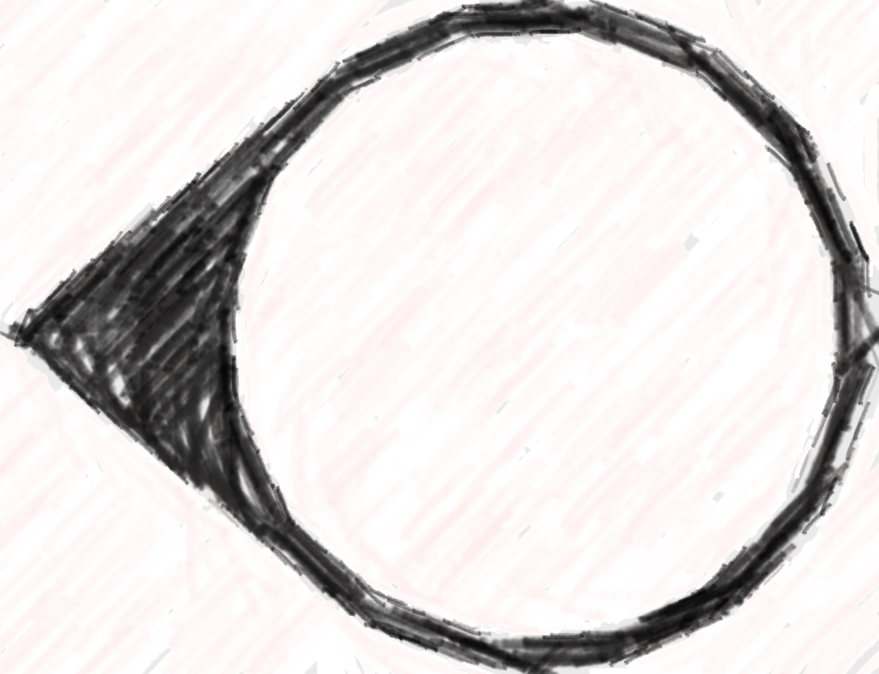
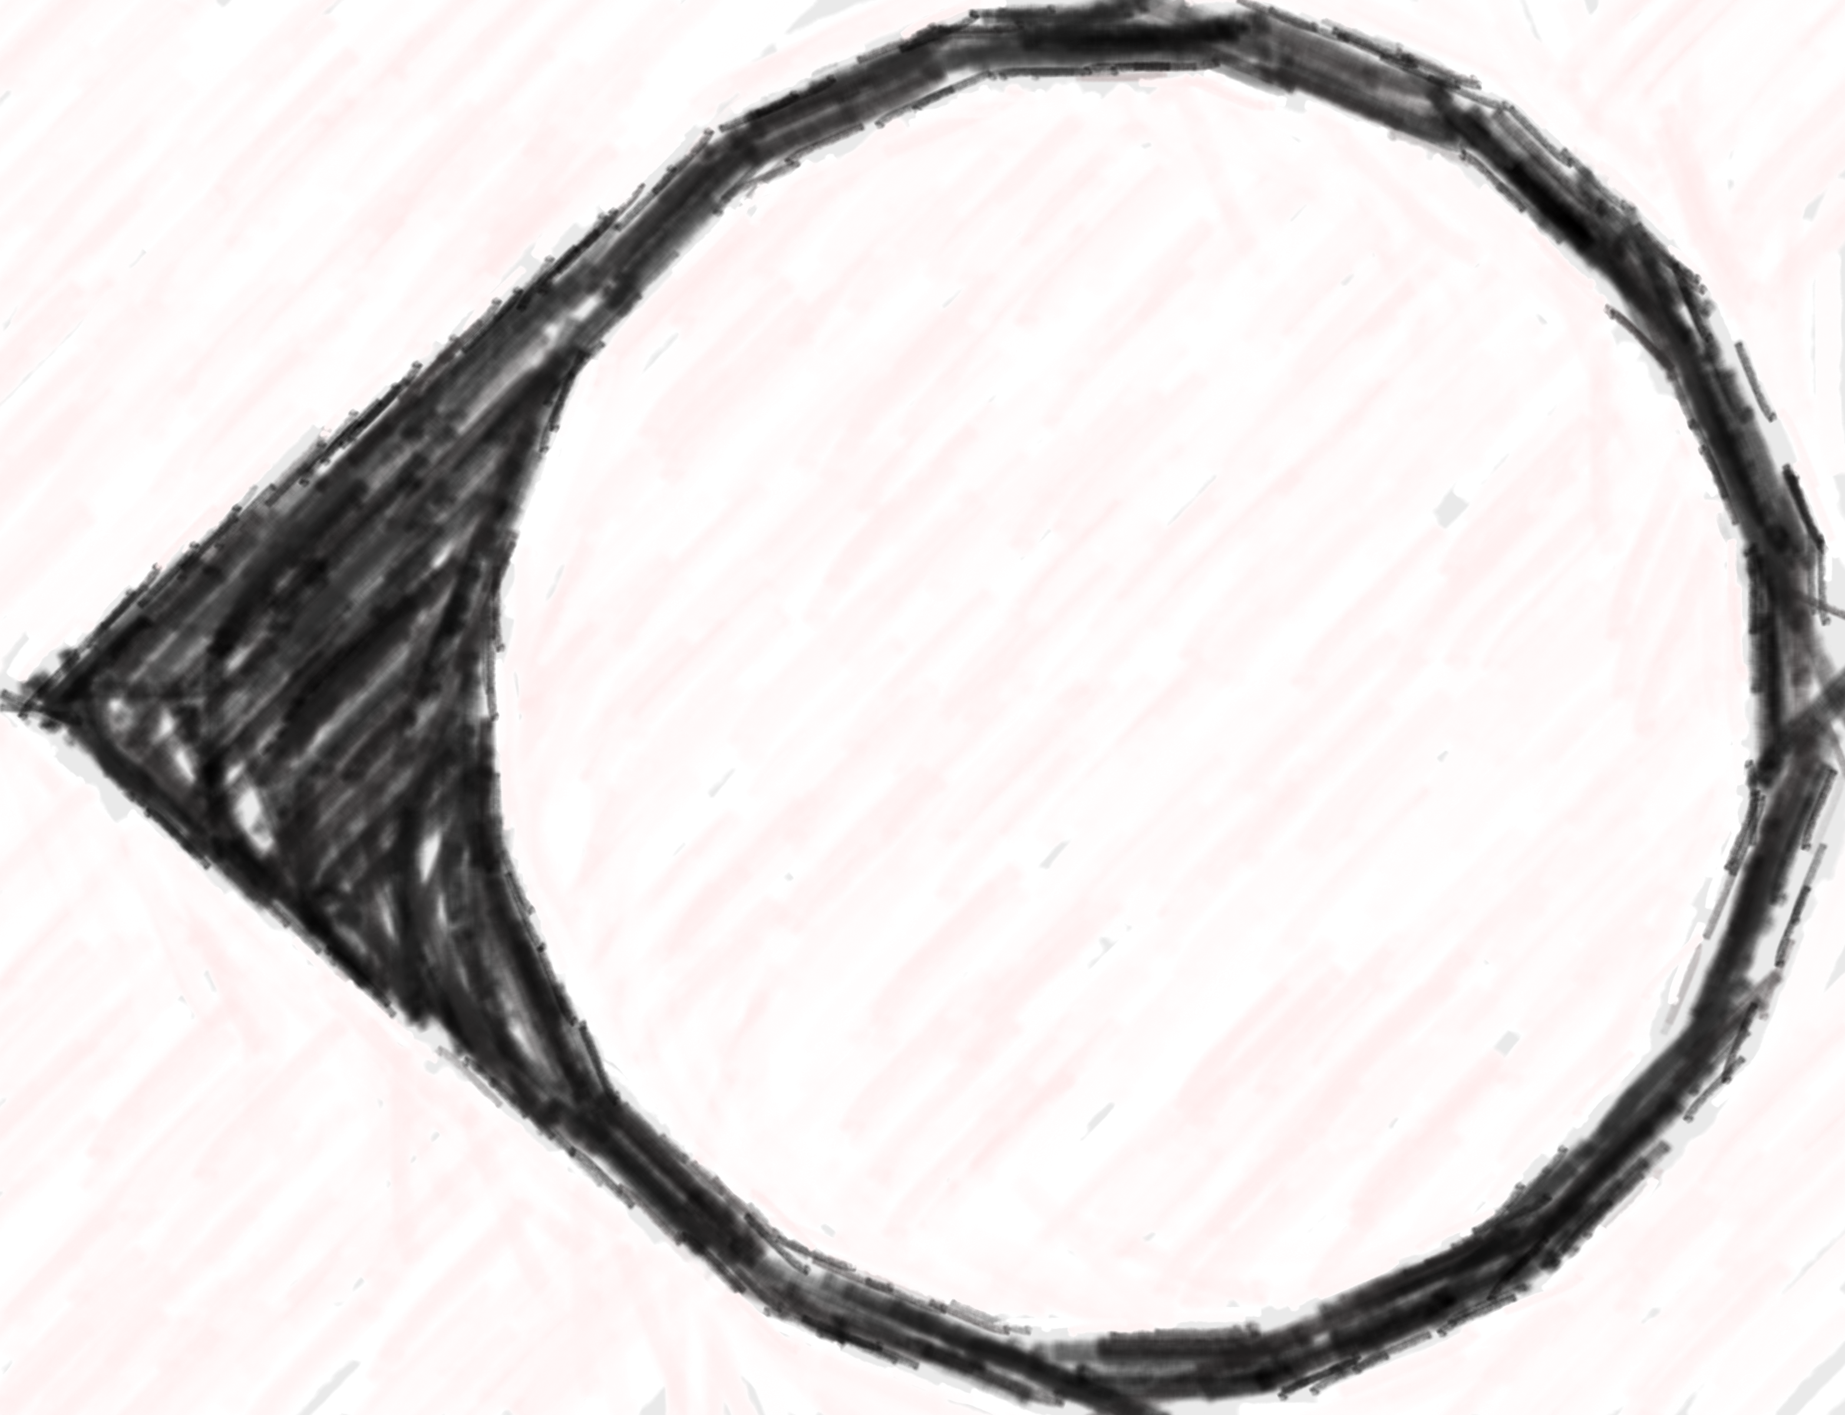
Project Goals:
Engage with professionals in geology, emergency management, and engineering sectors within New Zealand.
People responsible for communicating natural hazards science to the public.
Risk & crisis communication.
Share our experiences with communication training.
Raise awareness of value of role-play & training exercises.
Notes:
6 month project which aims to engage professionals in risk and crisis communication best practice.
Focus is on risk and crisis communication in natural hazards professionals.
Aim to improve communication in the sector

Slide 3
An ever-evolving and dynamic problem
Professionals …
Often receive limited or no formal training in science communication.
May not have time to be up to date with current communication research.
Science communication training is often…
1-dimensional and recipe-style.
Doesn’t explore the contextual and situational nature of communication.
Notes:
Why is this project important?
Our professionals are not trained and up to date with communication literature
We need authentic training for our professionals, which includes

Slide 4
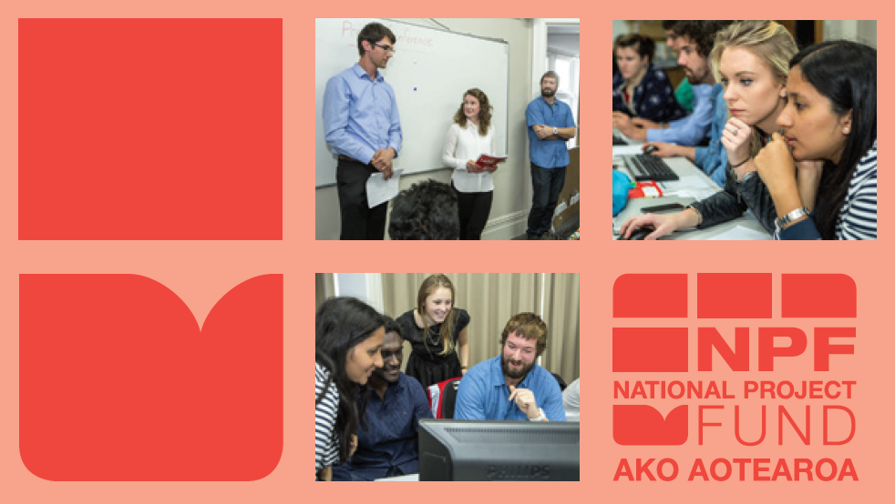
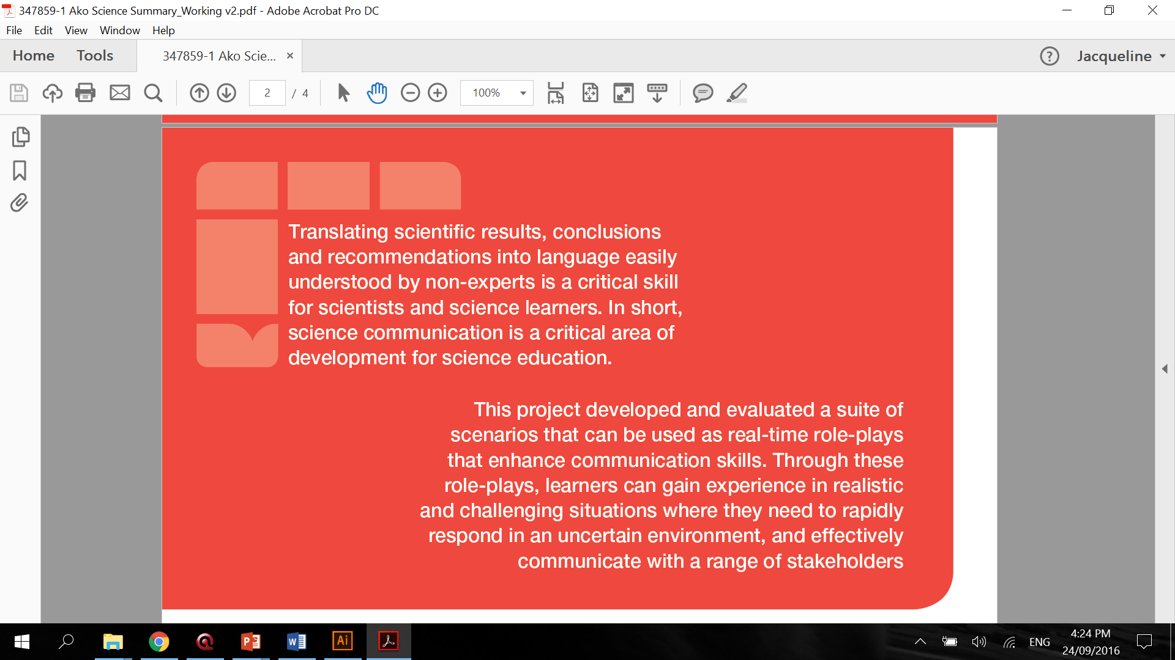
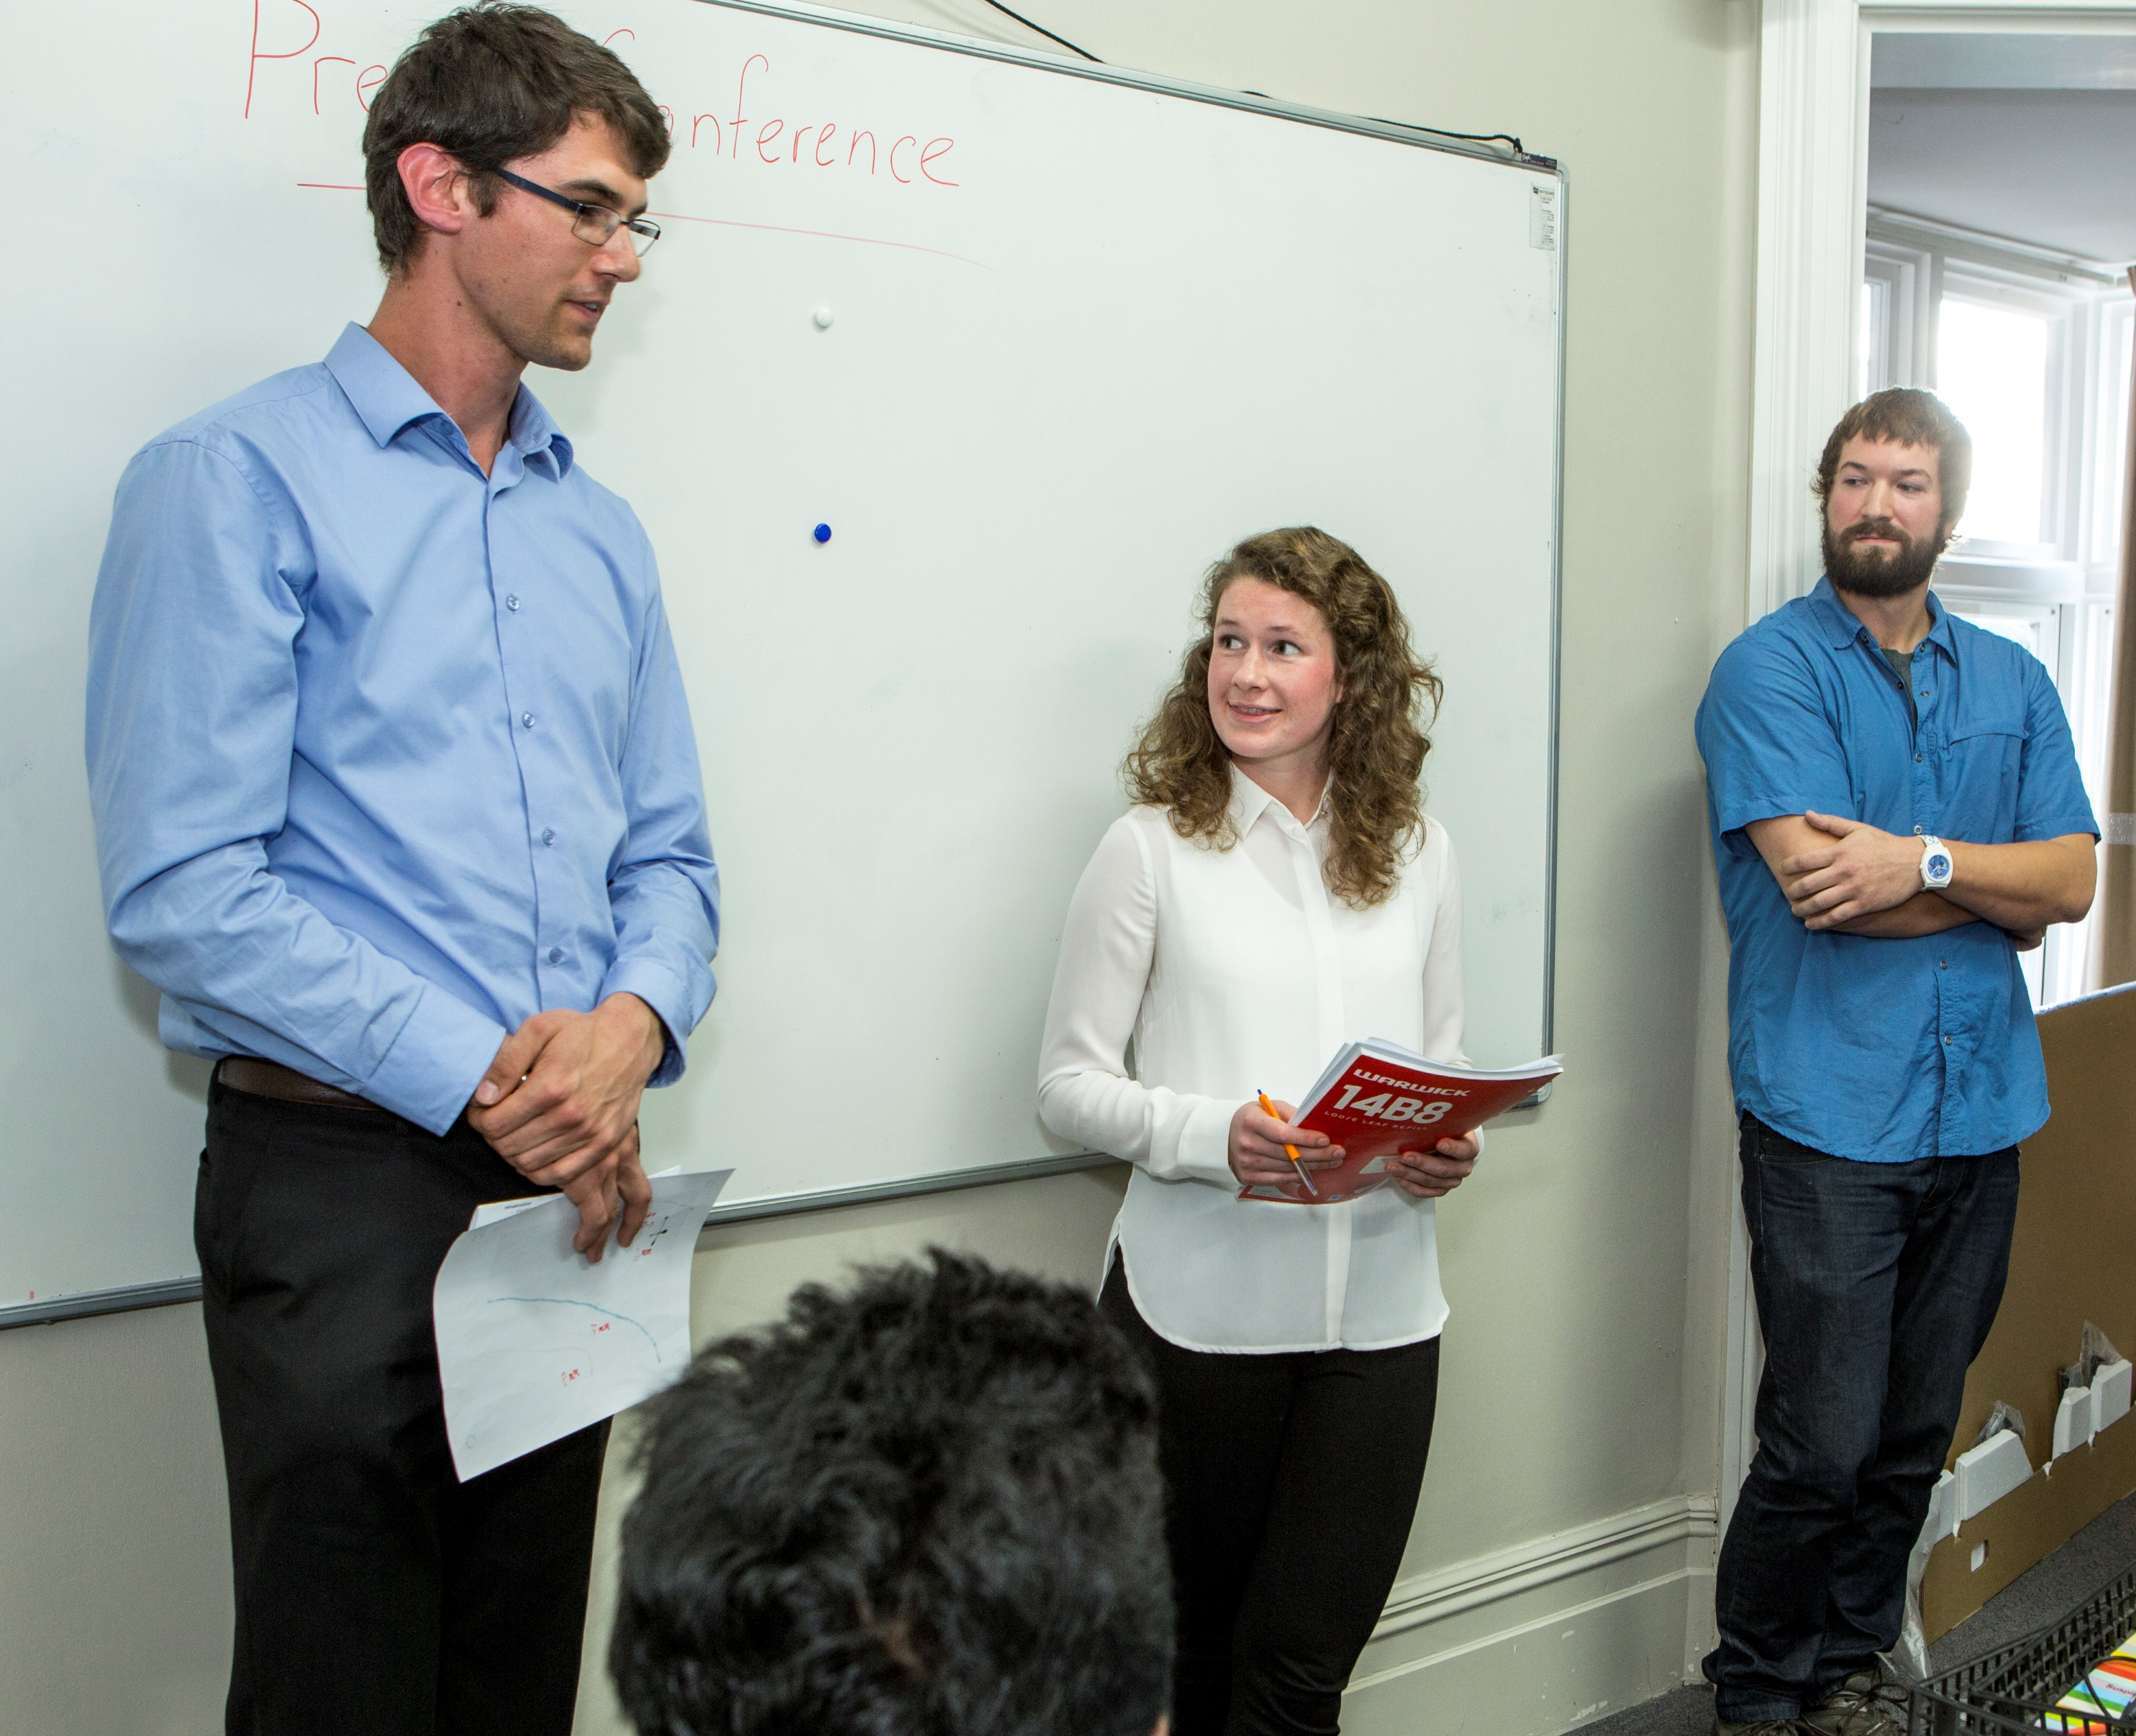
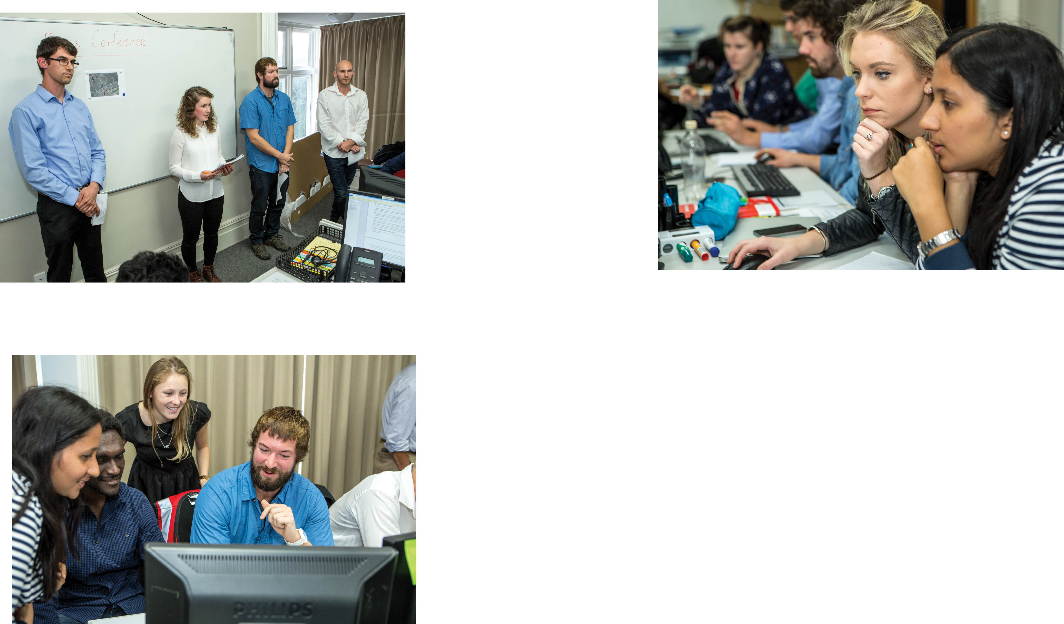
Bringing what we know about teaching communication to the professionals…
Notes:
Why are we qualified to engage professionals in communication?
-We have experience with training undergraduate and postgraduate students.
- We have built and tested several role-plays, (Please see: Dohaney, J., Brogt, E., Kennedy, B. et al. J Appl. Volcanol. (2015) 4: 12)
Ako Aotearoa Project Report is being released within the next two weeks.
https://akoaotearoa.ac.nz/improving-science-communication-skills

Slide 5
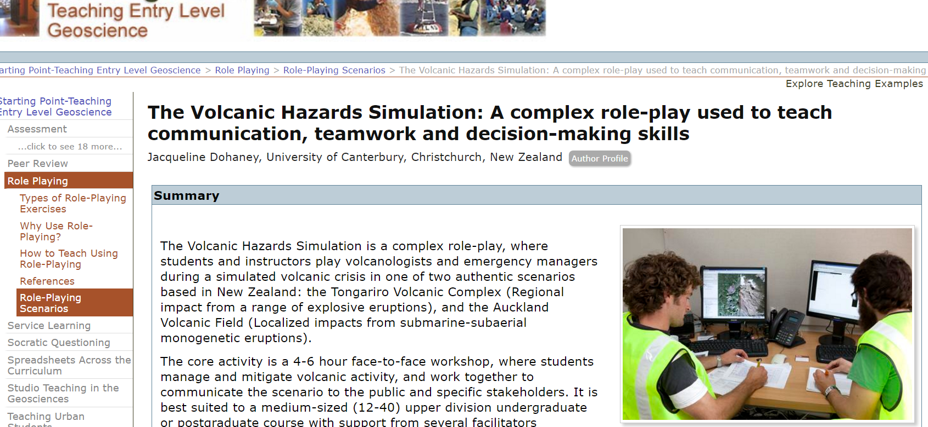
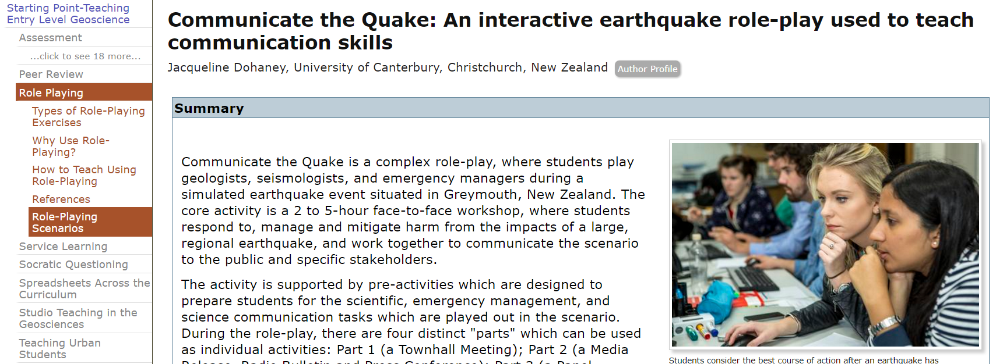
Bringing what we know about teaching communication to the professionals…
Notes:
Our past learning activities can be found on SERC:
Volcanic Hazards Simulation: http://serc.carleton.edu/introgeo/roleplaying/examples/125523.html
Communicate the Quake: http://serc.carleton.edu/introgeo/roleplaying/examples/143264.html

Slide 6
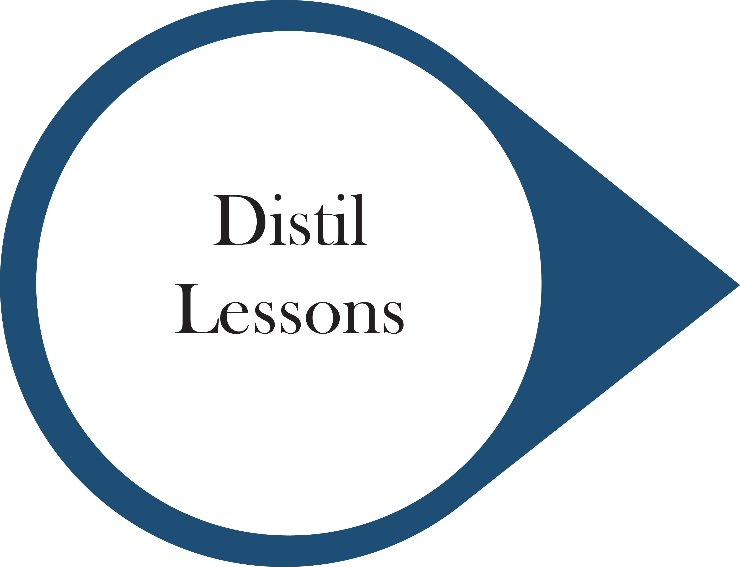
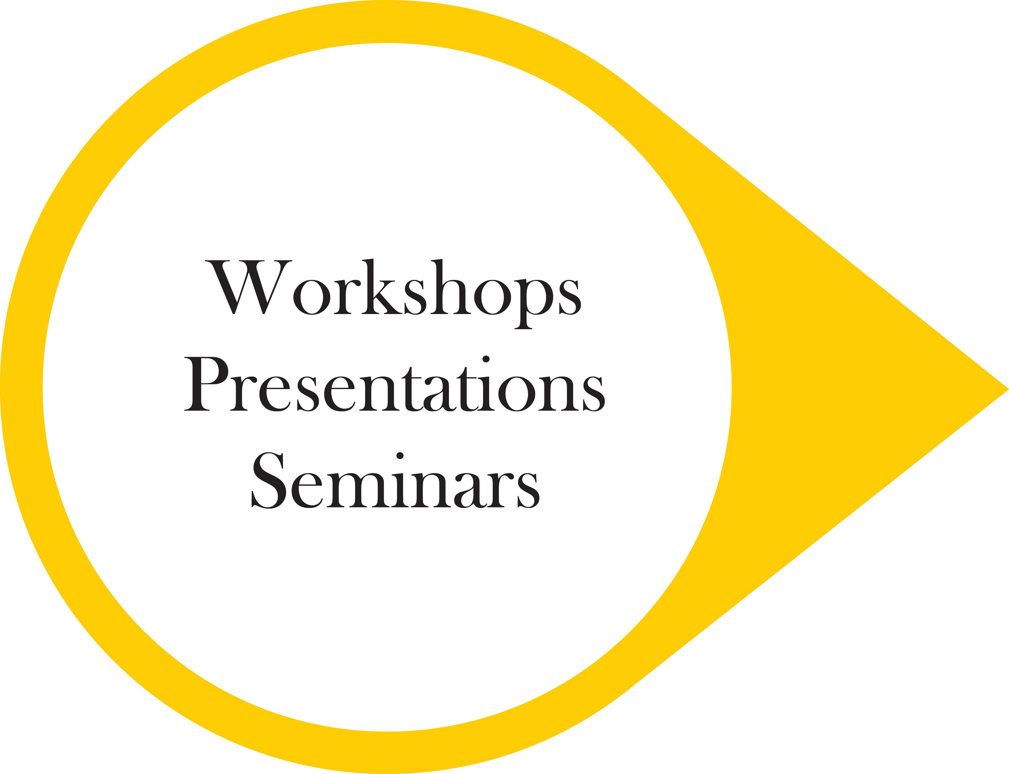

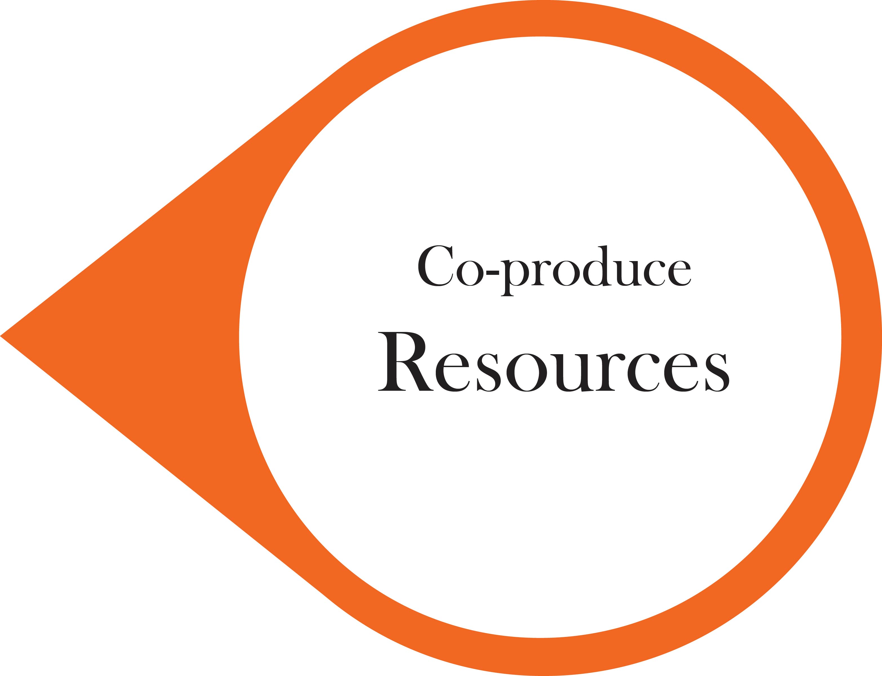
Method
Notes:
Participatory approach to engagement.
Partnering with professionals
Understanding what their communication needs are
Develop customised engagement based on their needs
Create shared resources

Slide 7
Lesson 1. A holistic & interdisciplinary approach
You cannot understand communication without exploring its history and use from many domains (E.g., Public relations, health communication).
Different definitions: risk vs. crisis vs. science communication.
Lesson 2. Communication is cultured and highly contextualised
Communication is no longer viewed as Source -> Receiver. Communication does not occur in a vacuum.
Training should include tasks that allow us to assess the appropriateness of strategies for specific circumstances.
Notes:
In stage 1 of the project, we summarised and identified the major learning from our research into communication training.
Lesson 1.
Communication is studied by many academic disciplines: Public relations, Media and mass communications, emergency management, science communication and public engagement.
Many definitions in the literature: Risk, vs. Crisis, vs. Science, vs. Corporate, vs. Health (sub disciplines). There is learning from all these areas which are helpful for communicating about natural hazards
Lesson 2.
Communication is complex, cultured and highly contextualised.
Training of science communicators should include complexity, incorporating elements from social, political, cultural spheres.

Slide 8
Lesson 3. Communication is multi-faceted
Some scientists approach communication with a narrow view and specific to a public speaking context.
Communication has a range of …
Receivers (strangers, acquaintances, friends)
Contexts (public, meeting, group, paired)
Forms (verbal and non-verbal)
Styles (informative, advocative, persuasive)
Formats (press conferences, seminars, panel discussion, interviews, social media, visual, written)
Notes:
Lesson 3.
Communication occurs in a wide variety of formats, styles and contexts.
A skilled communicator should be familiar and comfortable with communicating in different situations
Therefore, training in communication should incorporate different situations and styles
This allows the communicator to develop situation-specific (i.e., audience-specific) strategies

Slide 9
Lesson 4. Role-play improves perceptions & confidence
There is much anecdotal advice on how to improve communication
*Dohaney et al. (2016, in press) Improving Science Communication through Scenario-Based Role-plays, Ako Aotearoa Research Report
We showed* that by participating in the role-plays, learners…
improved communication confidence
improved their perceptions of best practices in communication
gained valuable experience in a realistic scenario
Notes:
Lesson 4.
Previous research into role-play has revealed that learners show self-reported improvement of communication.
We used valid metrics to measure their improvement: confidence (SPCC, McCroskey and McCroskey 1988) and perceptions (PCC, Dohaney et al 2016, in press). Further research will allow us to compare self-reported measures to performance.

Slide 10
Lesson 6. The value of education research
Lesson 5. Feedback & support is key
Meaningful feedback is the key to improving communication.
It allows learners to try out new strategies and receive specific feedback in a safe learning environment.
Feedback can be done on the spot, through quick-fire comments, or through longer reflection on practice (viewing self, viewing others).
Science communication training is often built adhoc and is not evaluated.
Build and design communication from known theory.
Use appropriate and evidence-based methods of evaluation.
Notes:
Lesson 5.
Research tells us that rehearsal, reinforcement and feedback are core to improving confidence in communication.
Curricula which incorporates real, meaningful feedback and multiple opportunities for feedback, allows students to respond and develop new strategies
Feedback should be provided in a supportive fashion, acknowledging that learners have different styles and have a range of prior experiences which influence their ability to communicate.
Lesson 6.
Training exercises are typically built from what people think works, and often do not consult communication education research.
We know that people learn more from active learning, and that different pedagogical experiences are more effective than others.
Evaluate your communication training. Use valid measures to do so, and build new instruments to suite your learning goals.

Slide 11
Interviews with professionals
Participatory engagement approach
Professionals (n=14) in geology, emergency management, and engineering sectors within New Zealand
Aim to interview a range of professionals
People currently active in risk and crisis communication
Snowball sampling approach
Interview protocol designed to identify specific communication needs and styles of engagement which is suited to the professionals
Notes:
In stage 2 of the project, we have interviewed professionals across a range of science organisations who communicate about natural hazards
Interviewing is ongoing
Aim is to collect a range of views

Slide 12
Results: Communication needs
Most commonly mentioned theme: strategic planning
Programme or campaign-level strategy
Support and acknowledgement that communication work matters
Targeted (i.e., to specific groups) communication strategies
Evaluation strategies
Risk and resilience basics
Participatory approaches to communication
Notes:
Content analysis was carried out on the available data. Themes are being checked using constant comparison, and refined as new data is included.
Most professionals reported that their organisation did not have a coherent strategy for communication (overall).
Want/needs for senior leadership to endorse a wider communication strategy
Targeted approach which allows scientists to communicate better to specific audiences, particularly vulnerable populations
Help developing the means and strategies for evaluating what has already been done, and see what works
Audiences struggle to understand what risk and resilience are, and have differing meanings. It would be good to develop basic strategies to help translate risk and resilience to the wider community
Use communication as part of a participatory approach to engagement with their communities

Slide 13
Results: Shared knowledge
Many of the professionals interviewed are active communicators and communication researchers. Several key resources have already been identified:
100 recommendations to scientists communicating about earthquakes (Bryner, 2016)
16Cs and 7Ts of communication best practice (Bryner, 2016)
Reflective self-audit for communicators (McBride, 2016)
Communication and crossing the disciplinary boundary (McBride, 2016)
IAP2 spectrum of public participation (IAP2)
Tips for communication training (Dohaney, this work)
Notes:
One major aim of the interviewing process is to identify key resources that can be used, as part of a collection to be provided to the science and risk communication community.
Several interviewees are active communication researchers and have directed us to some work that we can share.
Older version of the 16Cs, and 7Ts:
https://www.youtube.com/watch?v=grhrLT8tfjg
IAP2 Spectrum (existing):
http://c.ymcdn.com/sites/www.iap2.org/resource/resmgr/imported/IAP2%20Spectrum_vertical.pdf

Slide 14
Results: Engagement style
Aim: To work to a level of engagement that is suited to the different organisations
“All of the above” Final reporting
Workshops
Presentations
1-pagers
Short videos
Website
Notes:
Engagement choices were discussed with the professionals
Professionals valued the entire range of options, and said “if we had time” then it would be great to have all of the above
Workshops and videos stood out as the most commonly mentioned and favoured.

Slide 15
Where to from here?
Notes:
Complete the remaining interviews (i.e., work with the engineering sector)
Plan engagement with professionals at specific organisations
Develop resources (together)
Host resources in an accessible location, and highlight these resources during face-to-face engagement

Slide 16
Thank you! Questions?
Jacqueline Dohaney - jdohaney@gmail.com
University of Canterbury, Christchurch, New Zealand
Project Team: Thomas M. Wilson, Ben Kennedy, and Erik Brogt
Emma Hudson-Doyle, Brendon Bradley, David Johnston and Jan Lindsay
Notes:
Thank you. Any questions?

