Slide 1

Session T84: Planning to Make a Difference through the Next Generation Science Standards: Part 1 K-12 Initiatives
Presentation -- NGSS: The 2016 Election Has Gone State by State, and the Winner is…...
Professor Michael Wysession
Department of Earth and Planetary Sciences
Washington University, St. Louis, MO
michael@seismo.wustl.edu

Slide 2
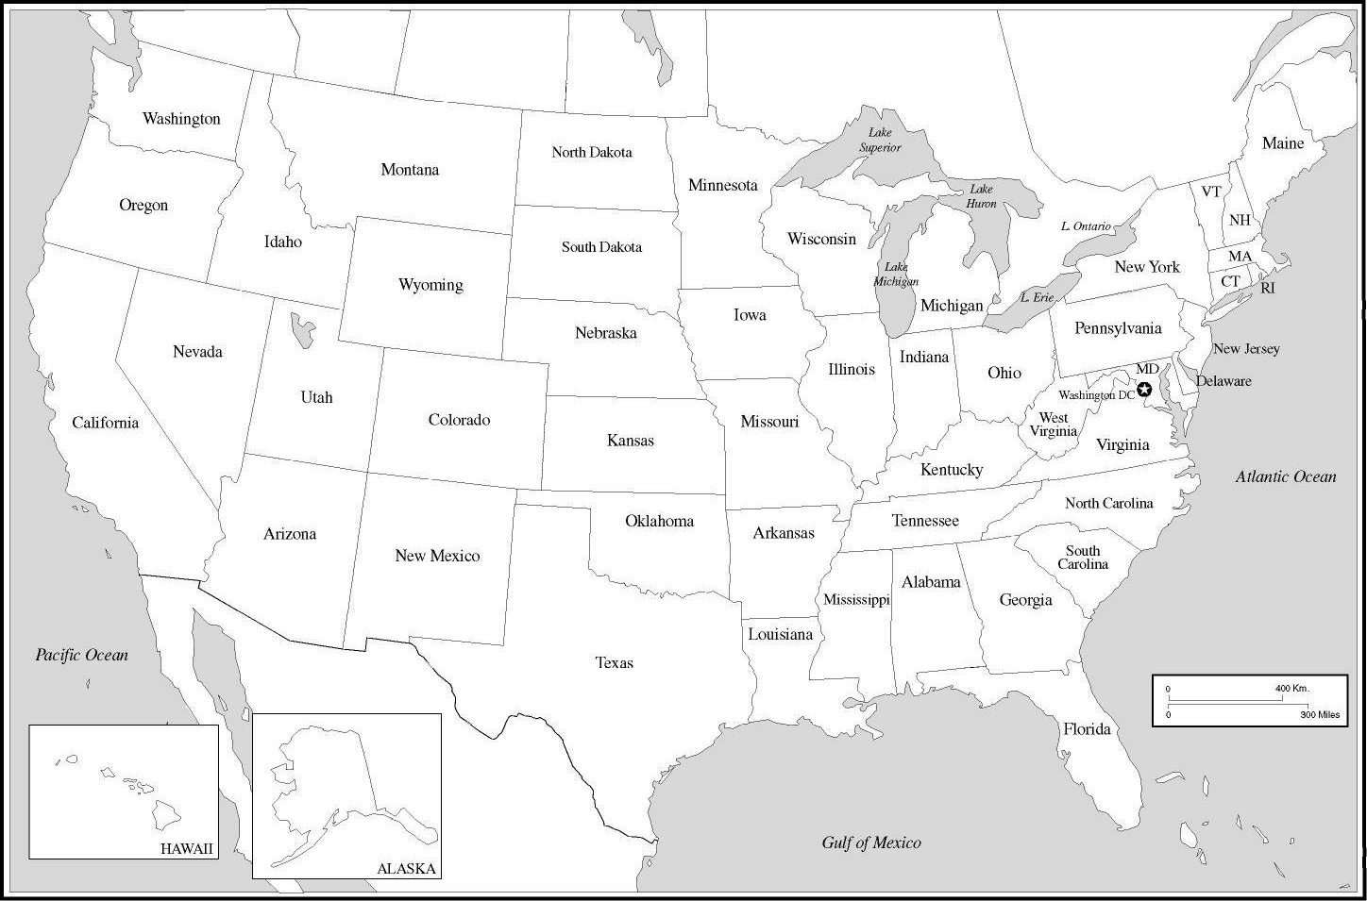
NGSS State-wise Adoption
Adopting
States:
Arkansas
California
Connecticut
Delaware
Hawaii
Illinois
Iowa
Kansas
Kentucky
Maryland
Michigan
Nevada
New Jersey
Oregon
Rhode Isl.
Vermont
Washington
(and DC)
Adopting/Adapting States: >40% of US Children
Additional Districts/Schools: ~35% of US Children
So Far: >80% of US Children are being impacted by the NGSS
(In process of adapting the NGSS: Alabama, Massachusetts, Missouri, Oklahoma, South Carolina, South Dakota, West Virginia, …..)
Notes:
But maybe 60% are being substantially impacted (Sep, 2016 – Aneesha Badrinarayan)

Slide 3
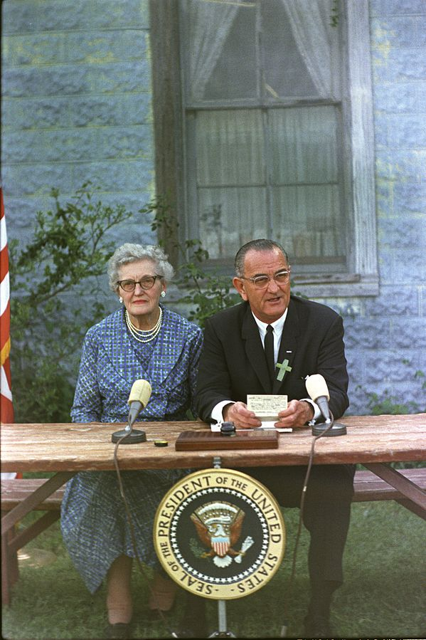
The 1965 Elementary and Secondary Education Act,
signed by President Lyndon Johnson as part of his “War on Poverty.”
→ Expressly forbids a national curriculum.
Notes:
Democrats don’t like some implications of standards. Republicans don’t like “National” (state’s rights)

Slide 4
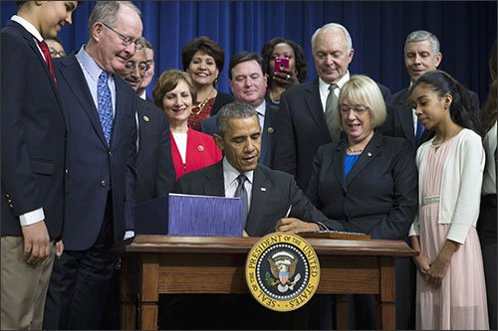
The new 2015 “Every Student Succeeds Act” (ESSA), which replaces No Child Left Behind, continues the shift towards states-rule.
Allows states to decide which subjects will be used for assessments (they “can” use science) and how those assessments will be written
Notes:
Democrats don’t like some implications of standards. Republicans don’t like “National” (state’s rights)

Slide 5
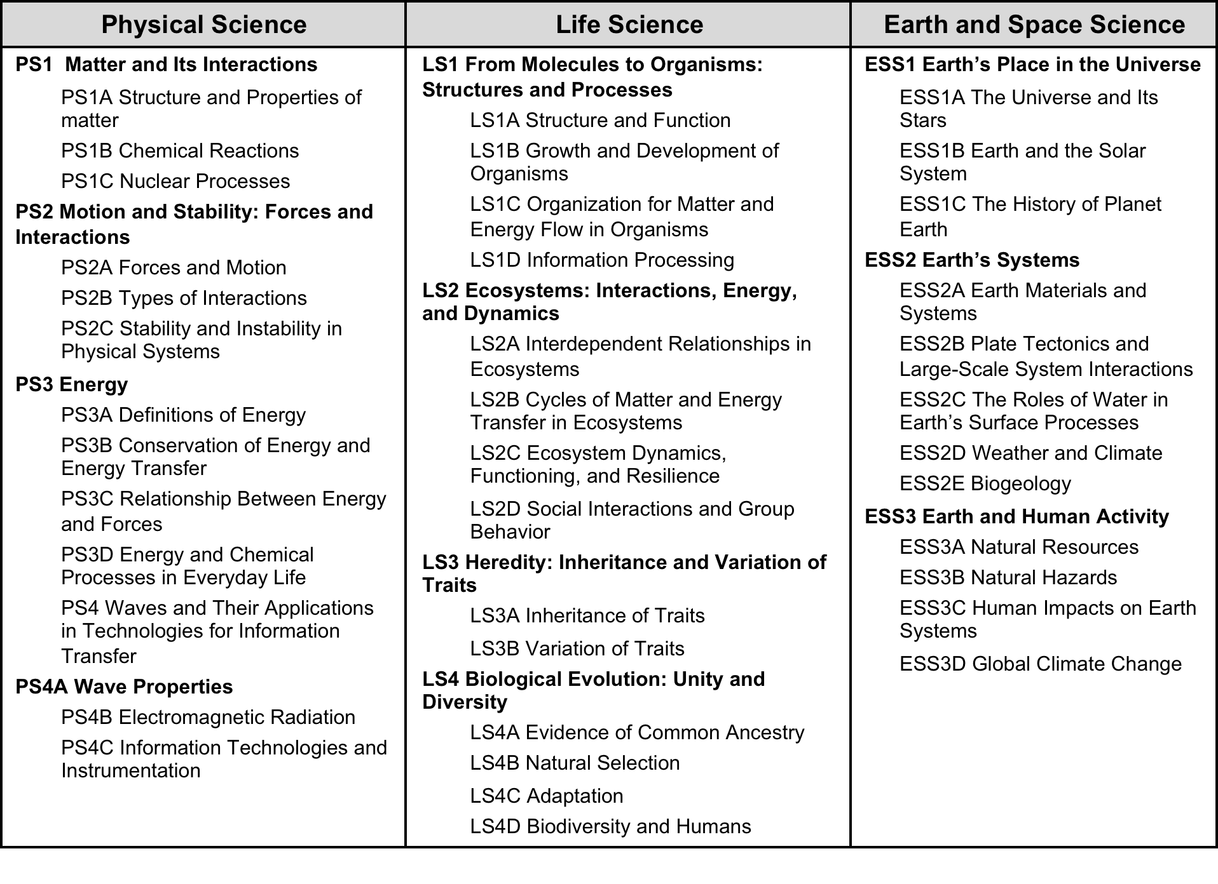
Challenge: Inclusion of Climate Change

Slide 6
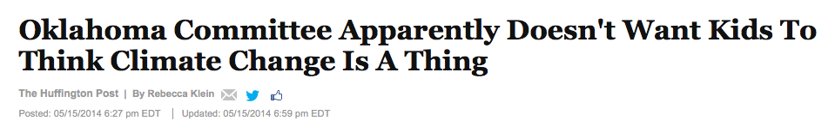
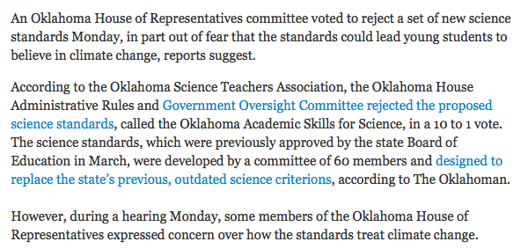
Notes:
Except for Roger Wicker, (R) Mississippi

Slide 7
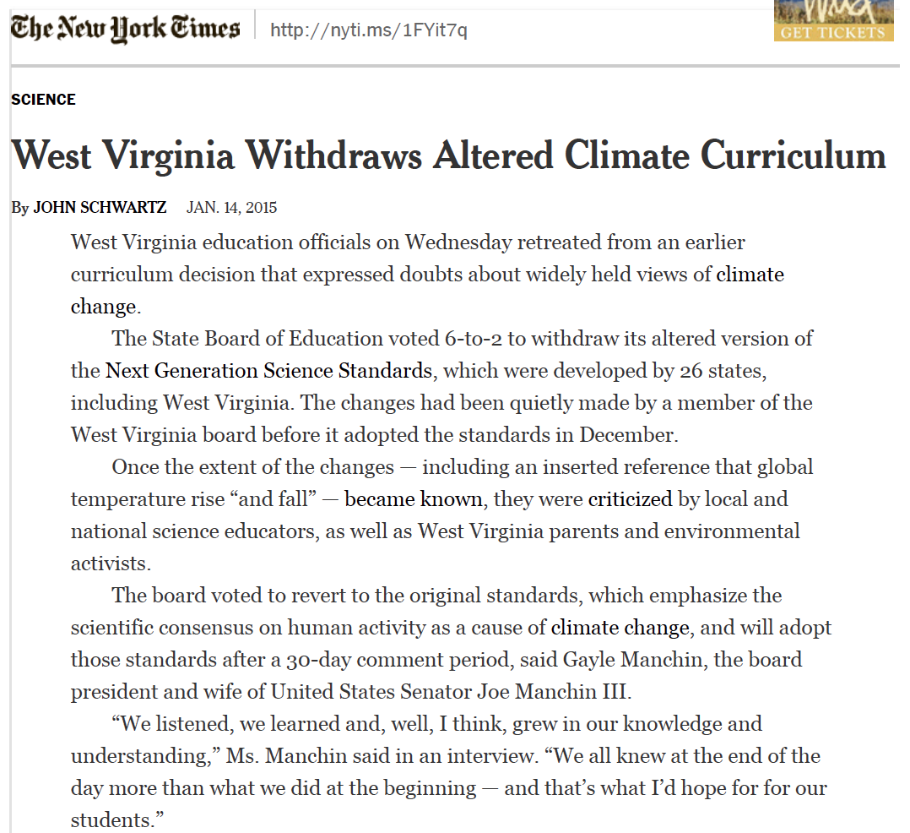
Notes:
Joe Manchin (Democrat)

Slide 8
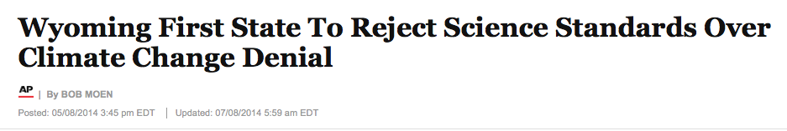
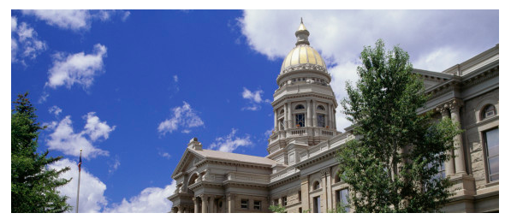
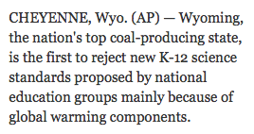
Notes:
Except for Roger Wicker, (R) Mississippi

Slide 9
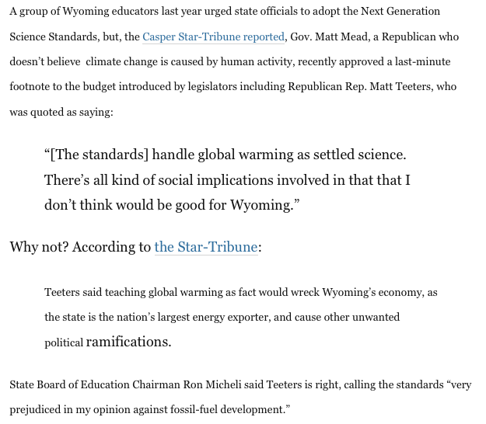
Notes:
Except for Roger Wicker, (R) Mississippi

Slide 10
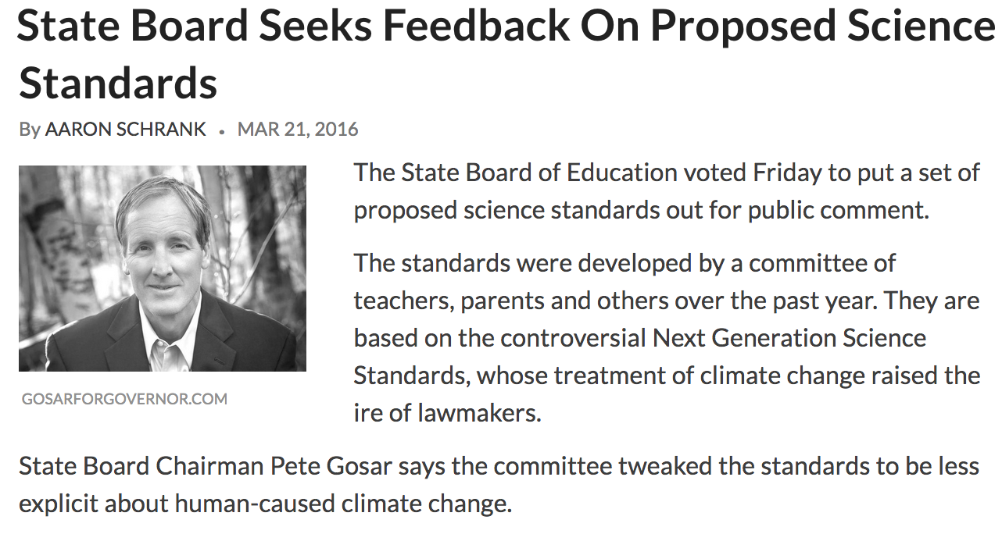
Notes:
Except for Roger Wicker, (R) Mississippi

Slide 11
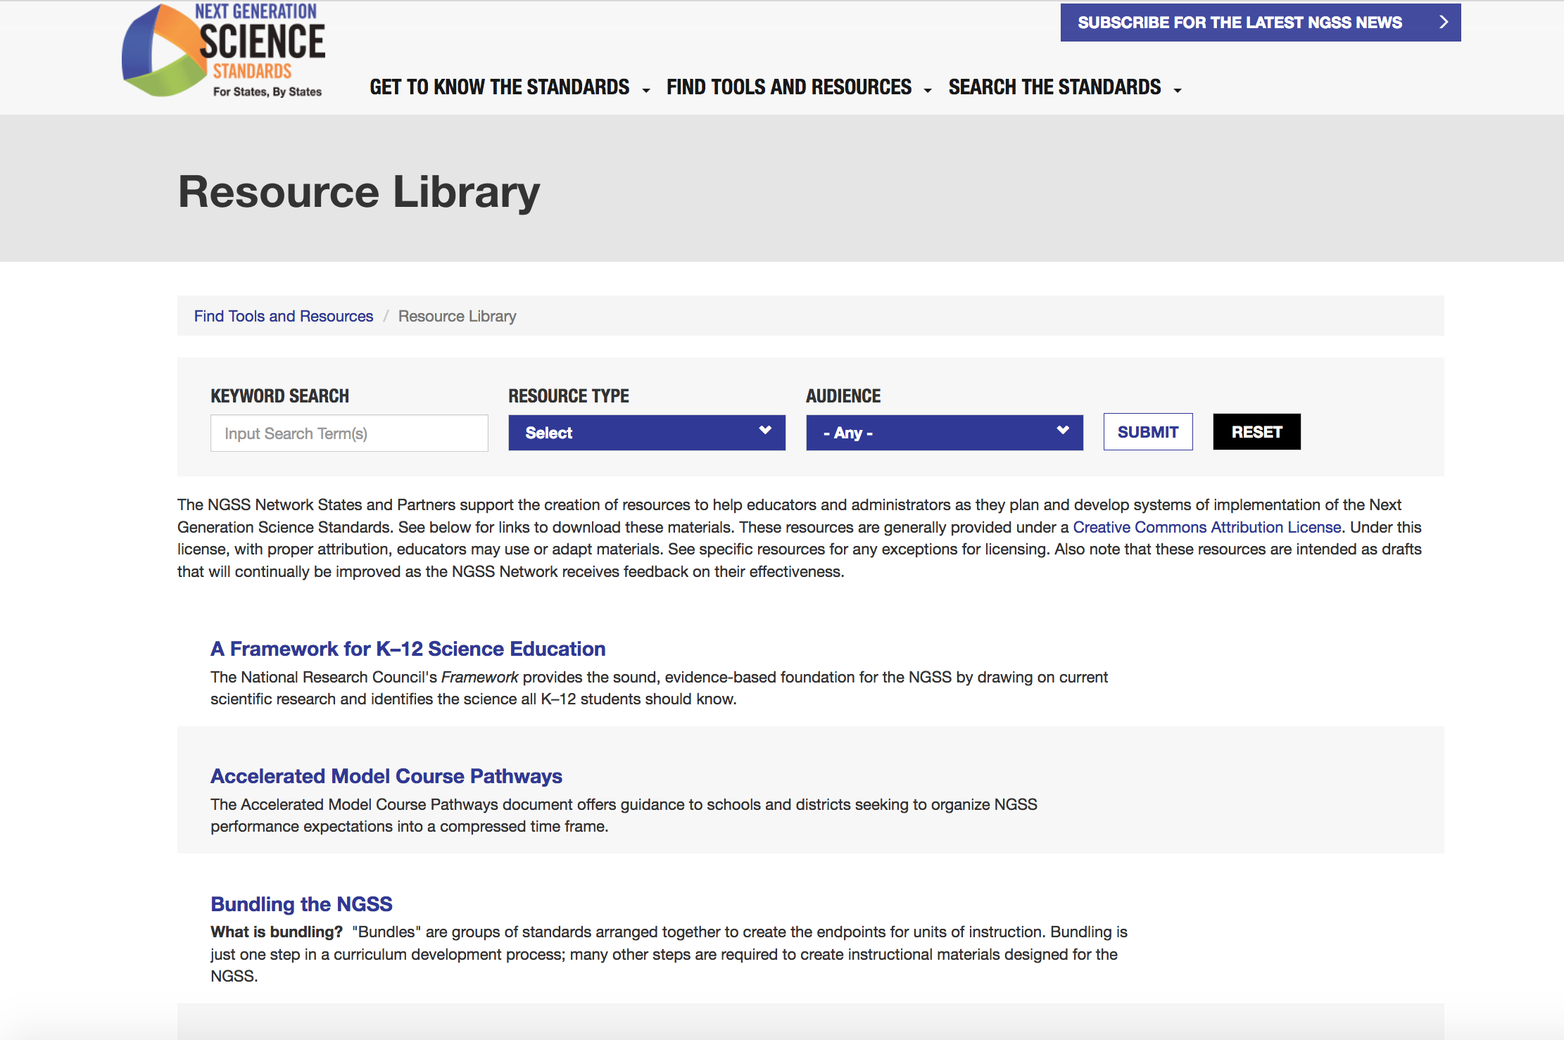
Resources at Achieve:
Notes:
Democrats don’t like some implications of standards. Republicans don’t like “National” (state’s rights)

Slide 12
Resources at Achieve:
Notes:
Democrats don’t like some implications of standards. Republicans don’t like “National” (state’s rights)

Slide 13
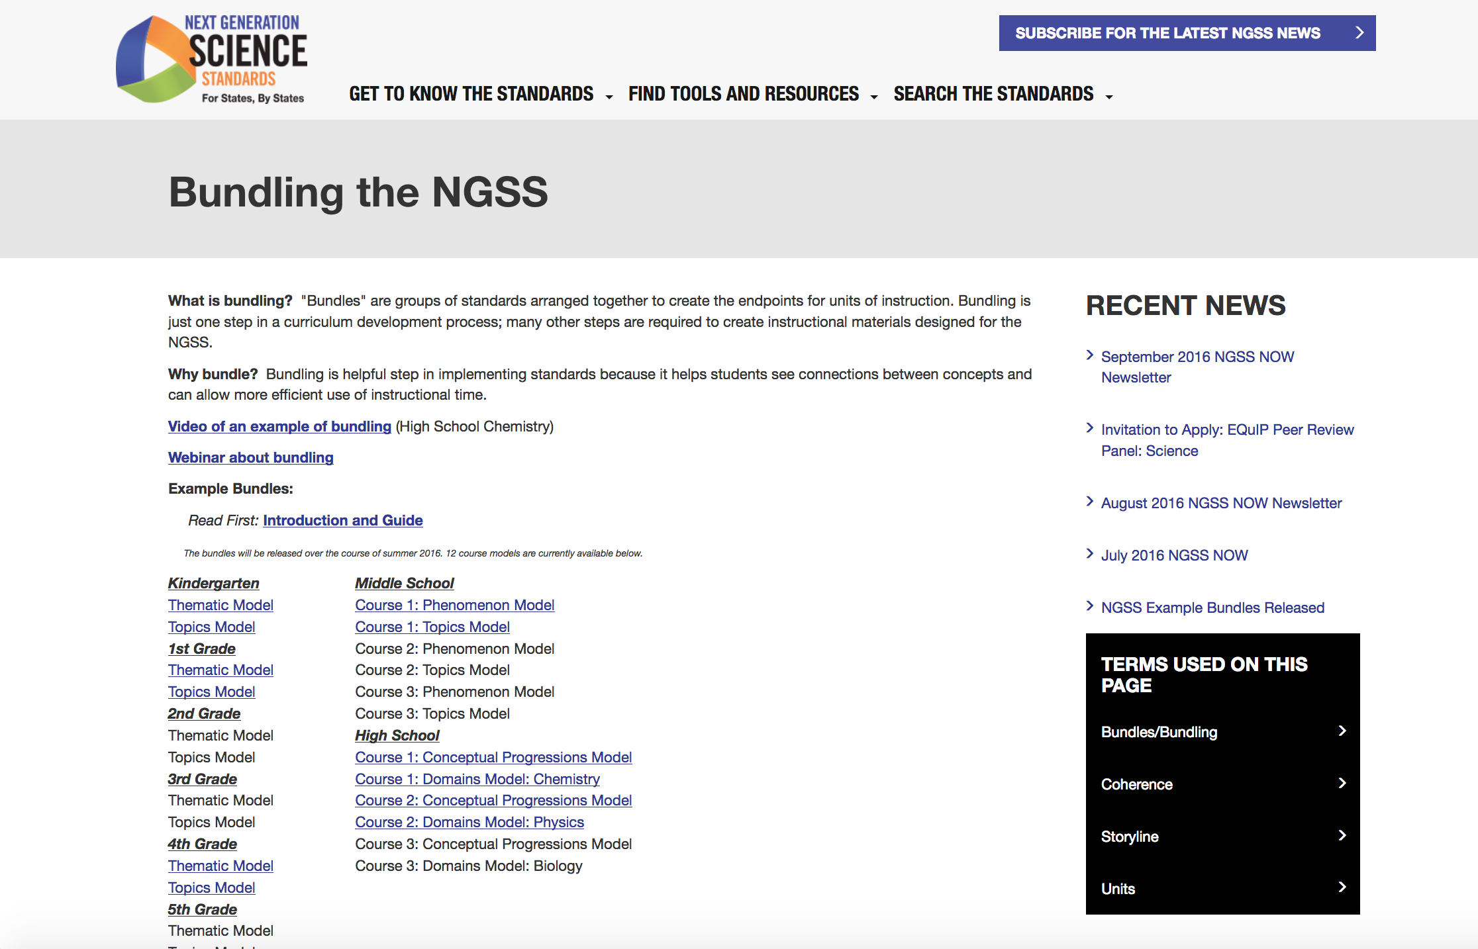
Notes:
Democrats don’t like some implications of standards. Republicans don’t like “National” (state’s rights)

Slide 14

Resources at Achieve:
Notes:
Democrats don’t like some implications of standards. Republicans don’t like “National” (state’s rights)

Slide 15
Resources at Achieve:
Notes:
Democrats don’t like some implications of standards. Republicans don’t like “National” (state’s rights)

Slide 16
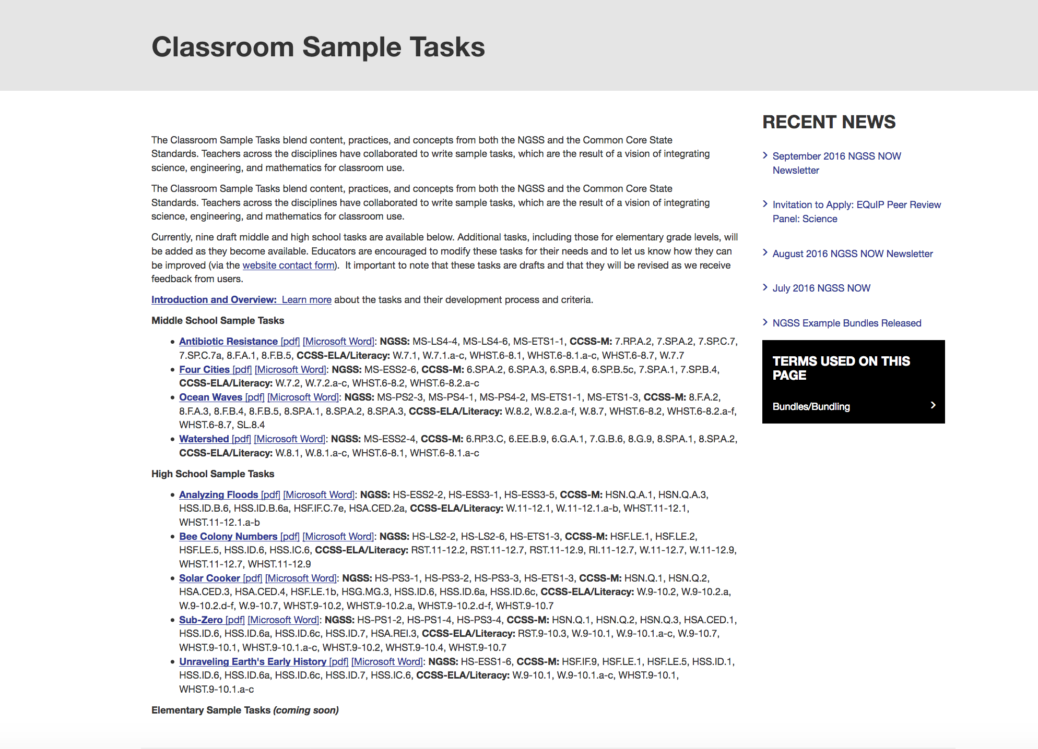
Notes:
Democrats don’t like some implications of standards. Republicans don’t like “National” (state’s rights)

Slide 17
Resources at Achieve:
Notes:
Democrats don’t like some implications of standards. Republicans don’t like “National” (state’s rights)

Slide 18
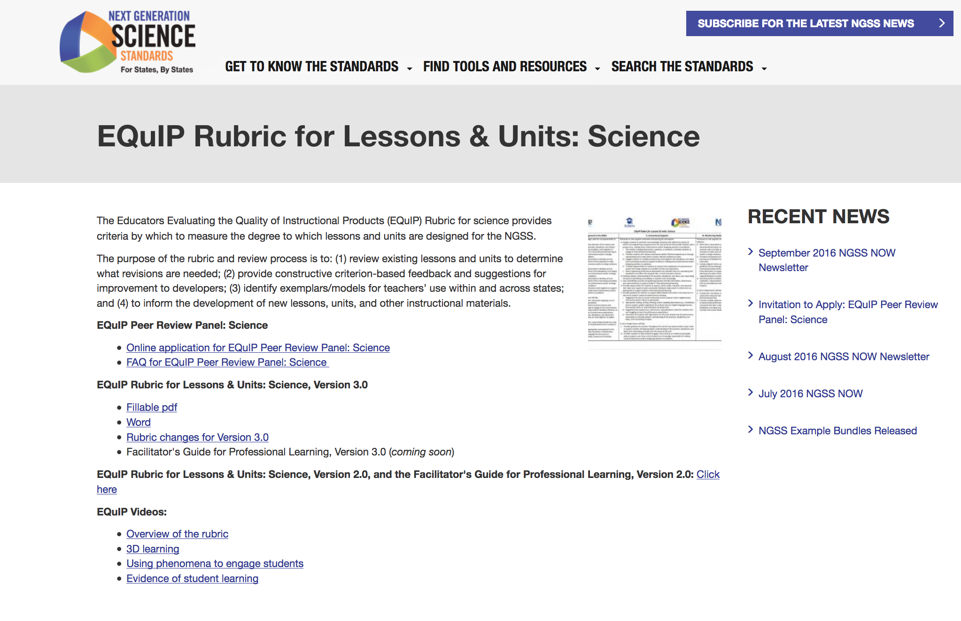
Notes:
Democrats don’t like some implications of standards. Republicans don’t like “National” (state’s rights)

Slide 19


Timeline for the NGSS
Teacher Development
Curricula
Instructional Materials
Instruction
Assessment
2009
2011
2013
2016

Slide 20
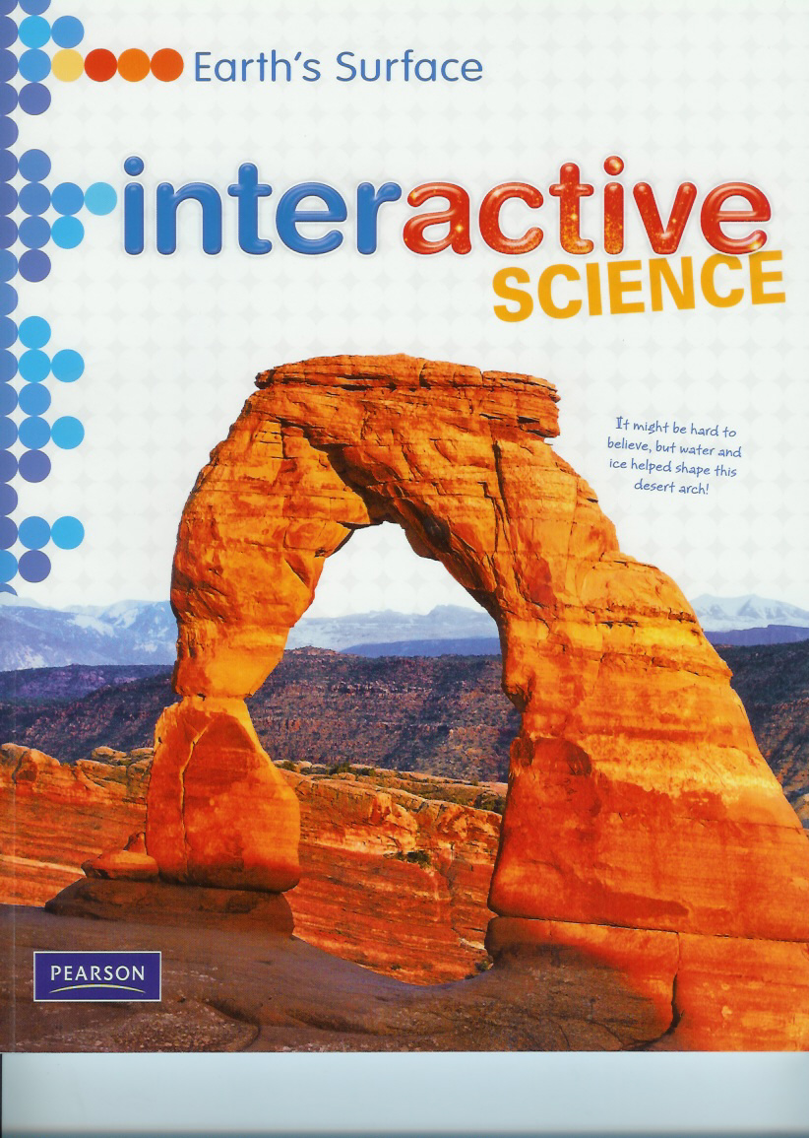
Turning an NGSS-like “Interactive Science” program into a new NGSS-aligned program

Slide 21
Performance Expectations
Elementary School: Grade-Level Standards, K-5
Middle School: Grade-Banded Standards, 6-8
1 year of Life Science
1 year of Physical Science (Chemistry & Physics)
1 year of Earth and Space Science
High School: Grade-Banded Standards, 9-12
1 year of Life Science
1 year of Physical Science (Chemistry & Physics)
1 year of Earth and Space Science
How to justify this?

Slide 22
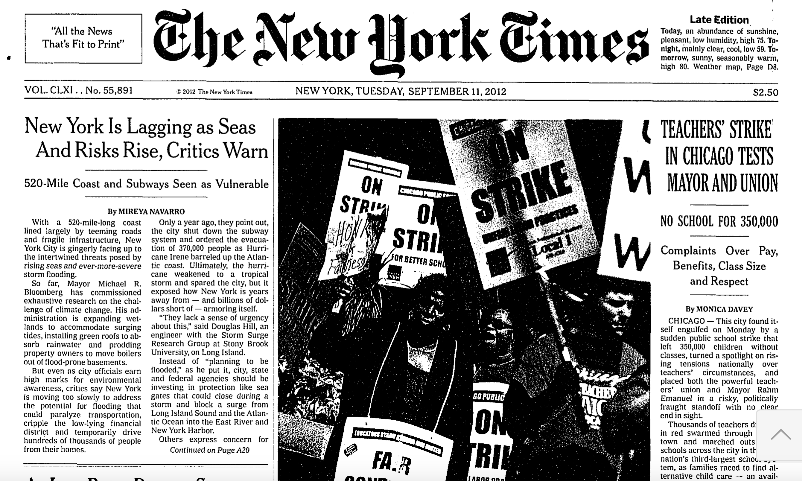
Study of how science, as presented in the media (i.e., New York Times) aligns with the NGSS, using the year 2012 as an example.
Notes:
Democrats don’t like some implications of standards. Republicans don’t like “National” (state’s rights)

Slide 23
Study of how science, as presented in the media (i.e., New York Times) aligns with the NGSS, using the year 2012 as an example.
→ A total of 1702 articles, taken from the daily front page and the weekly “Science Times” section.
Notes:
Democrats don’t like some implications of standards. Republicans don’t like “National” (state’s rights)

Slide 24
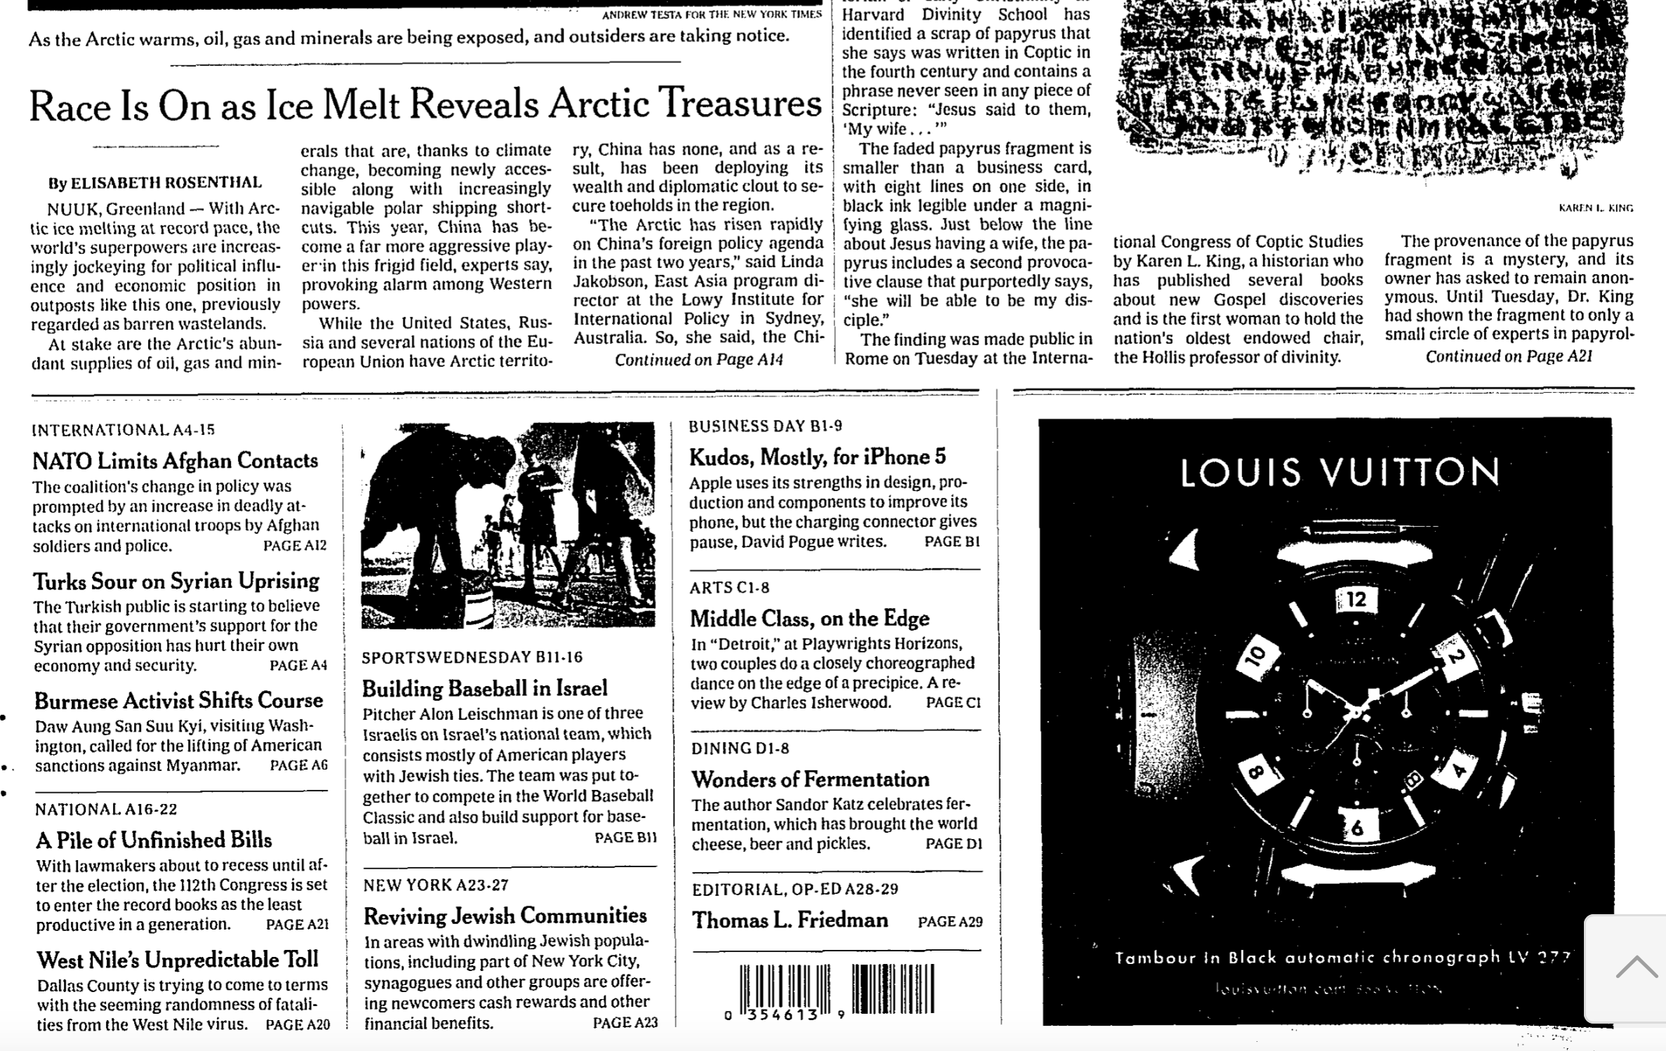
The front page articles come in two forms:
Notes:
Democrats don’t like some implications of standards. Republicans don’t like “National” (state’s rights)

Slide 25
The front page articles come in two forms: (A) The starts of articles,
Notes:
Democrats don’t like some implications of standards. Republicans don’t like “National” (state’s rights)

Slide 26
The front page articles come in two forms: (A) The starts of articles, and (B) call-outs to articles later in the paper
Notes:
Democrats don’t like some implications of standards. Republicans don’t like “National” (state’s rights)

Slide 27
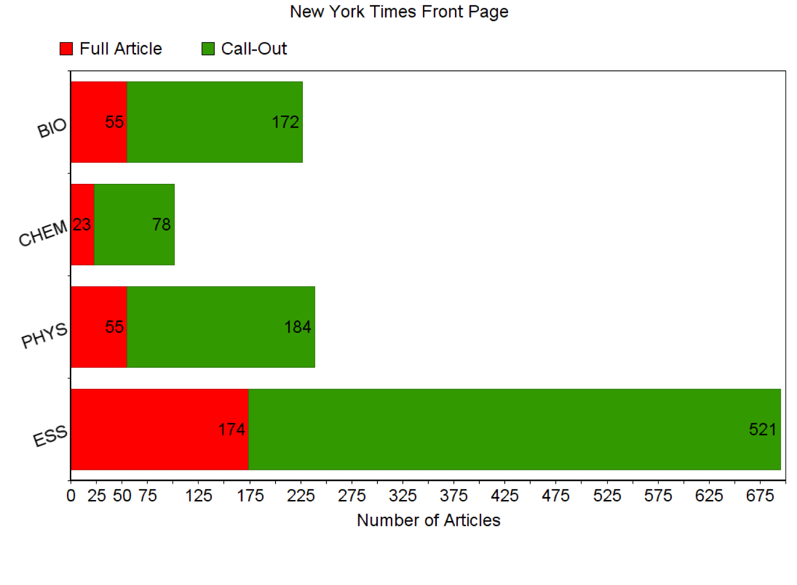
Notes:
Democrats don’t like some implications of standards. Republicans don’t like “National” (state’s rights)

Slide 28
Daily Weather
Notes:
Democrats don’t like some implications of standards. Republicans don’t like “National” (state’s rights)

Slide 29
Study of how science, as presented in the media (i.e., New York Times) aligns with the NGSS, using the year 2012 as an example.
Notes:
Democrats don’t like some implications of standards. Republicans don’t like “National” (state’s rights)

Slide 30
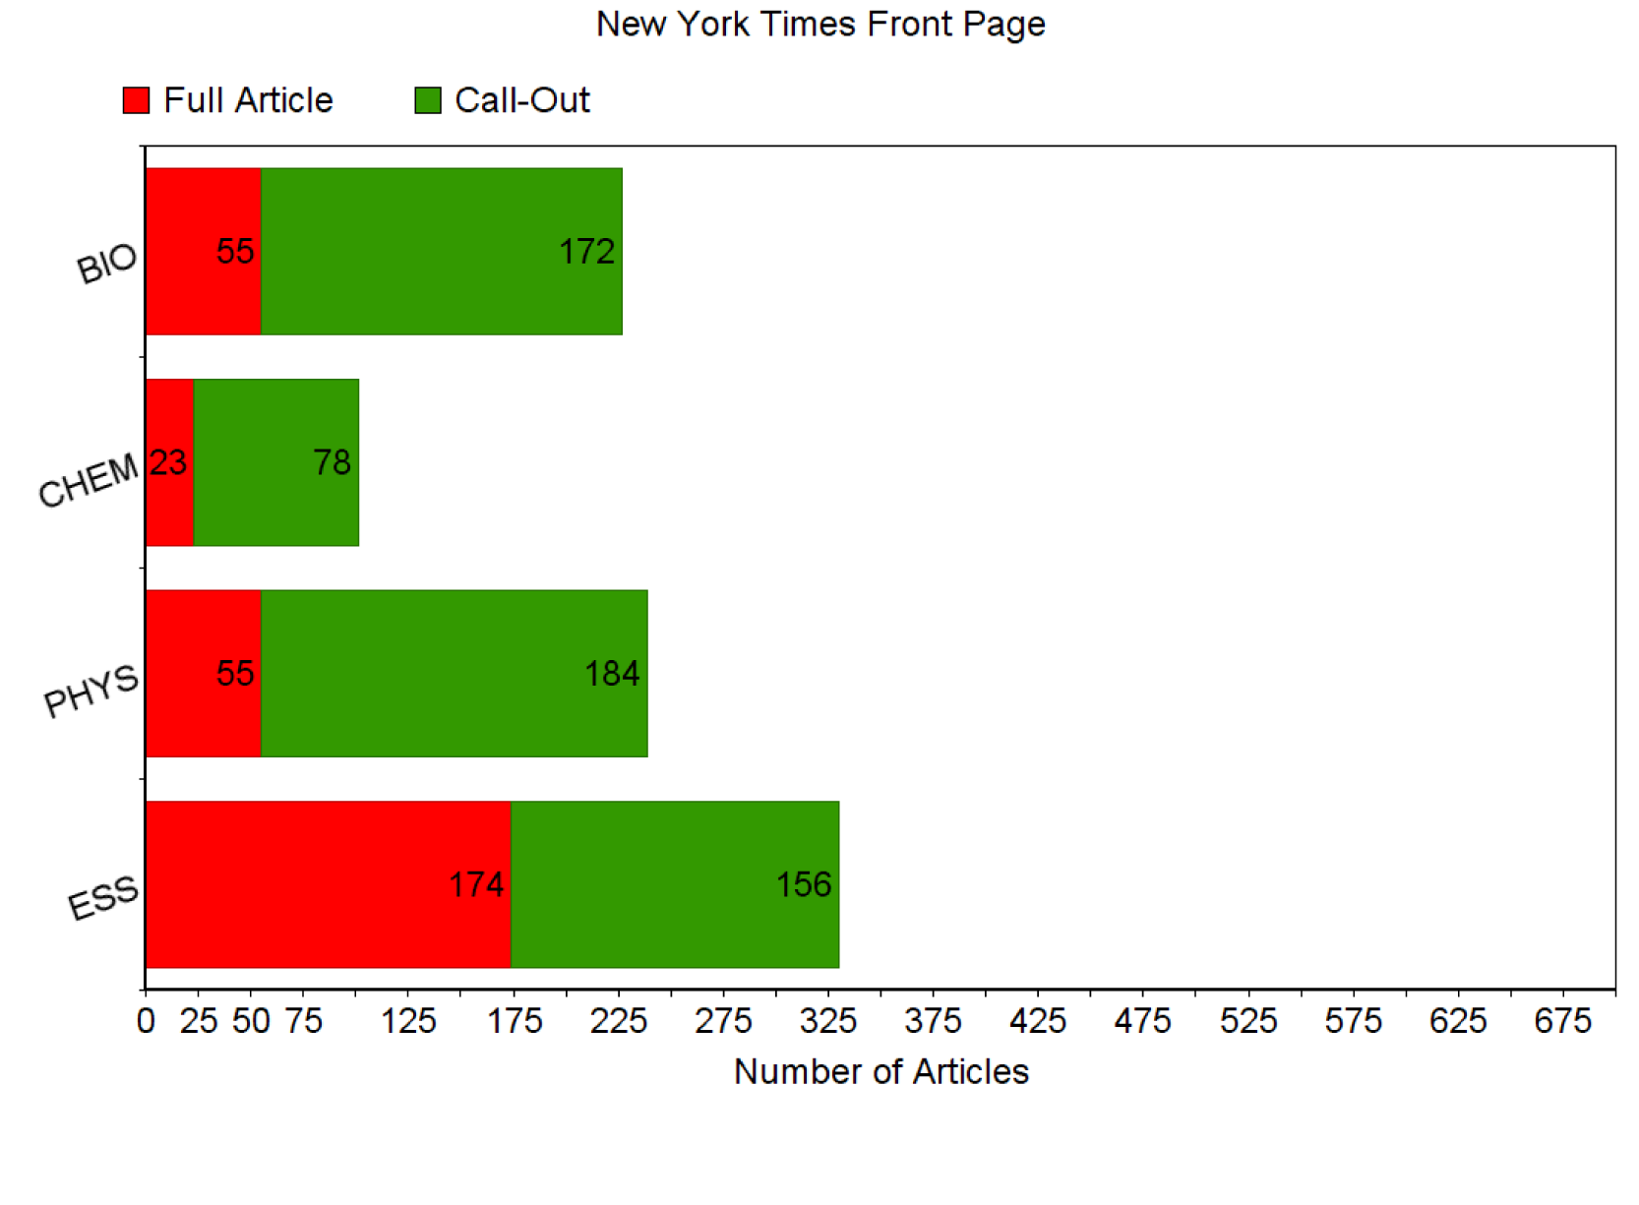
Notes:
Democrats don’t like some implications of standards. Republicans don’t like “National” (state’s rights)

Slide 31
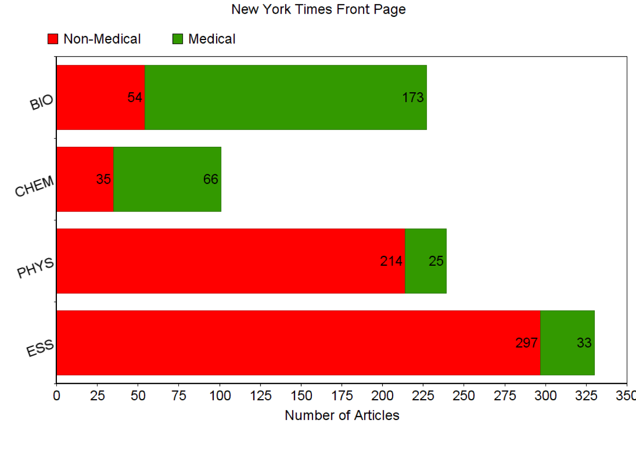
Notes:
Democrats don’t like some implications of standards. Republicans don’t like “National” (state’s rights)

Slide 32
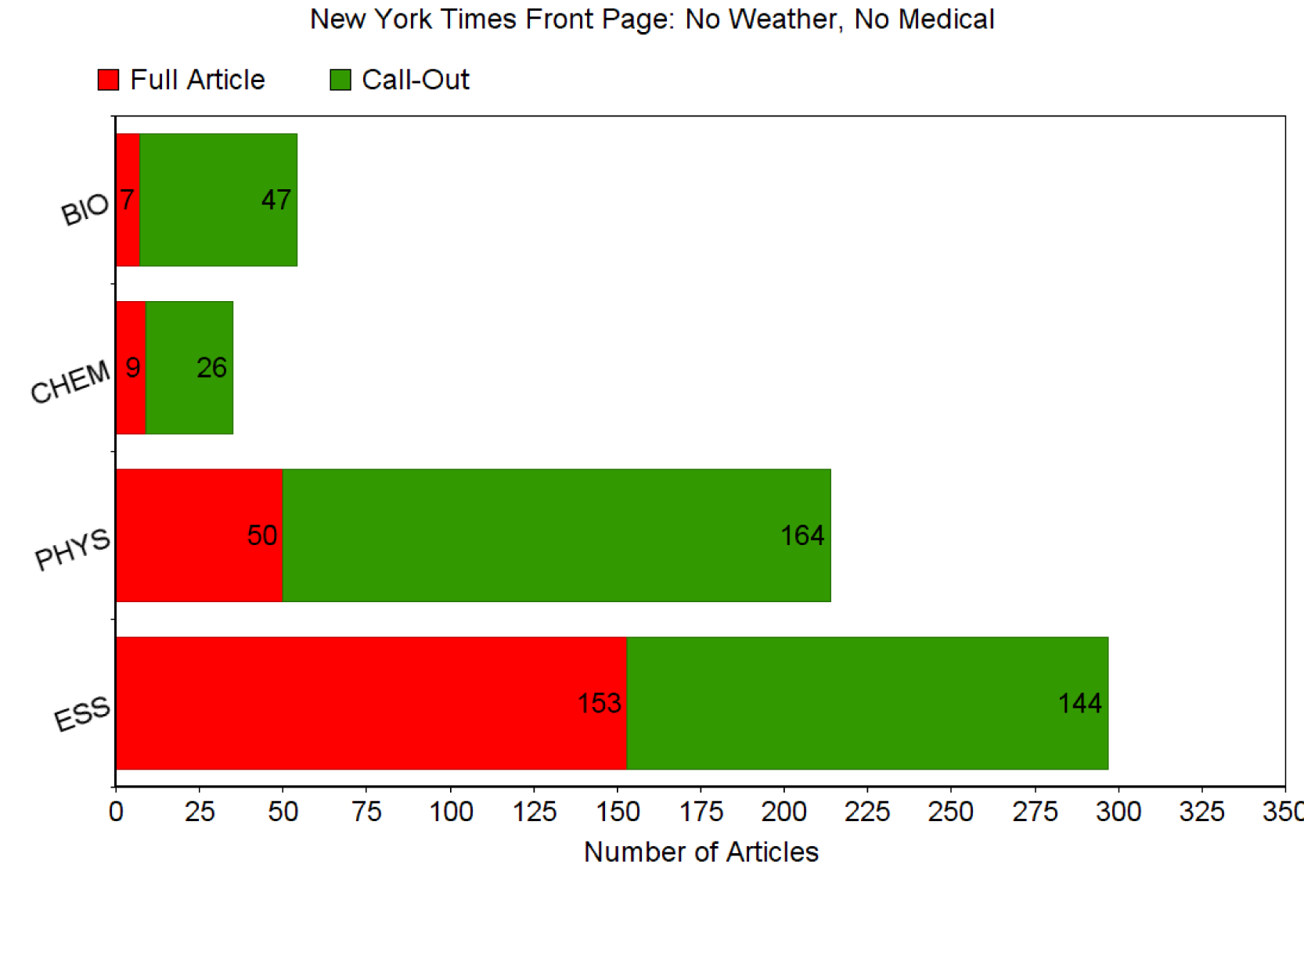
Notes:
Democrats don’t like some implications of standards. Republicans don’t like “National” (state’s rights)

Slide 33
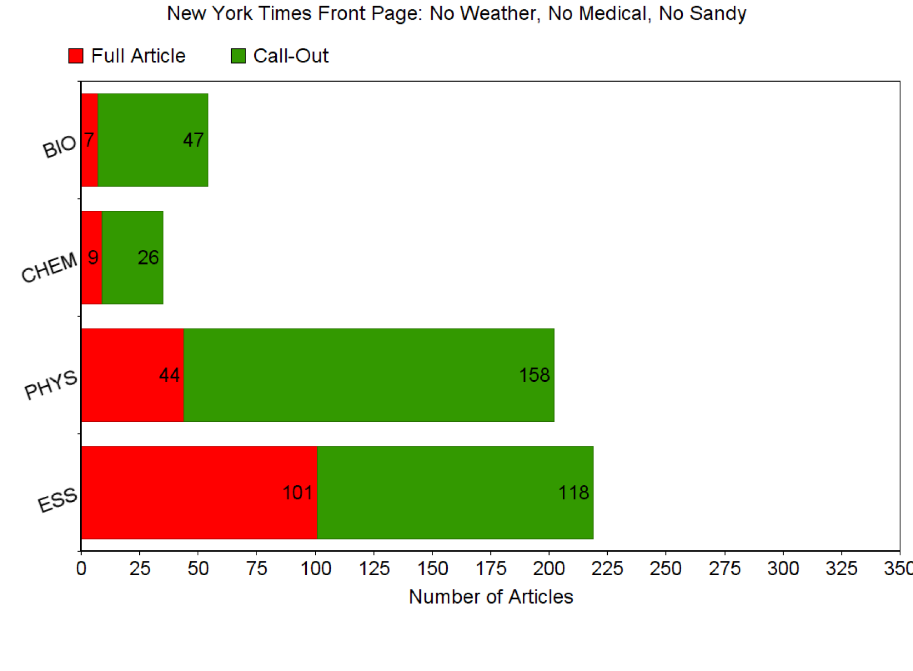
Notes:
Democrats don’t like some implications of standards. Republicans don’t like “National” (state’s rights)

Slide 34
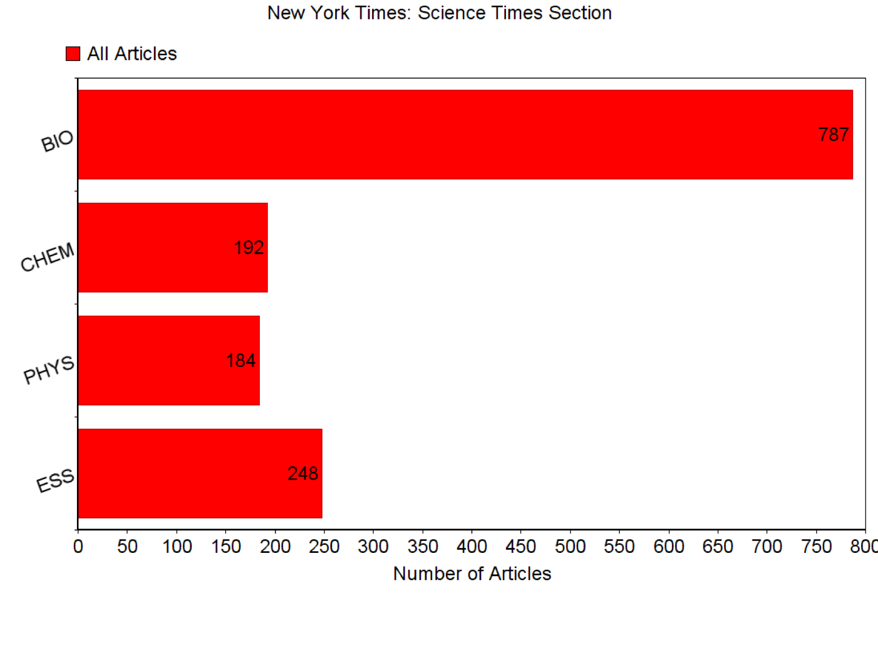
Notes:
Democrats don’t like some implications of standards. Republicans don’t like “National” (state’s rights)

Slide 35
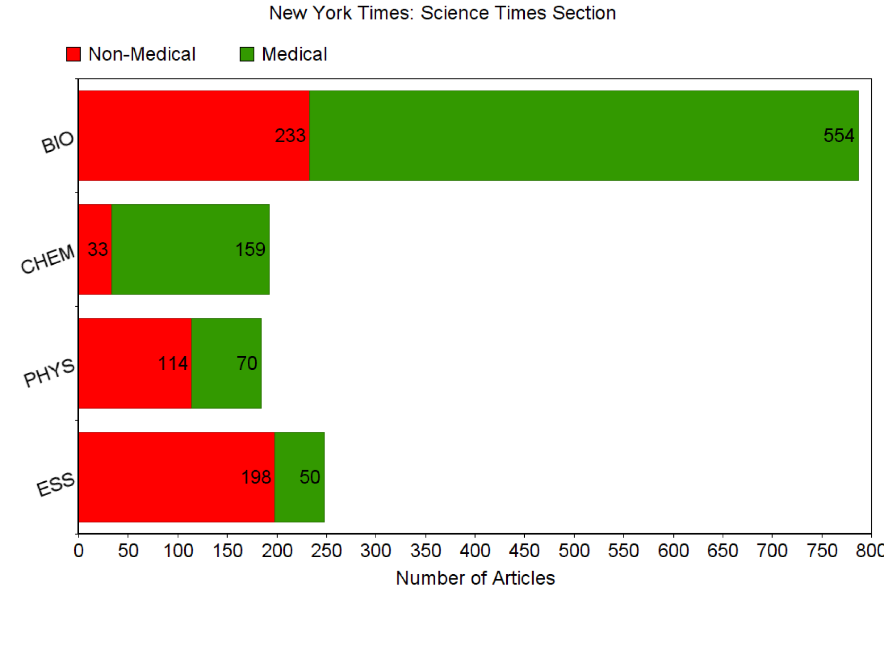
Notes:
Democrats don’t like some implications of standards. Republicans don’t like “National” (state’s rights)

Slide 36
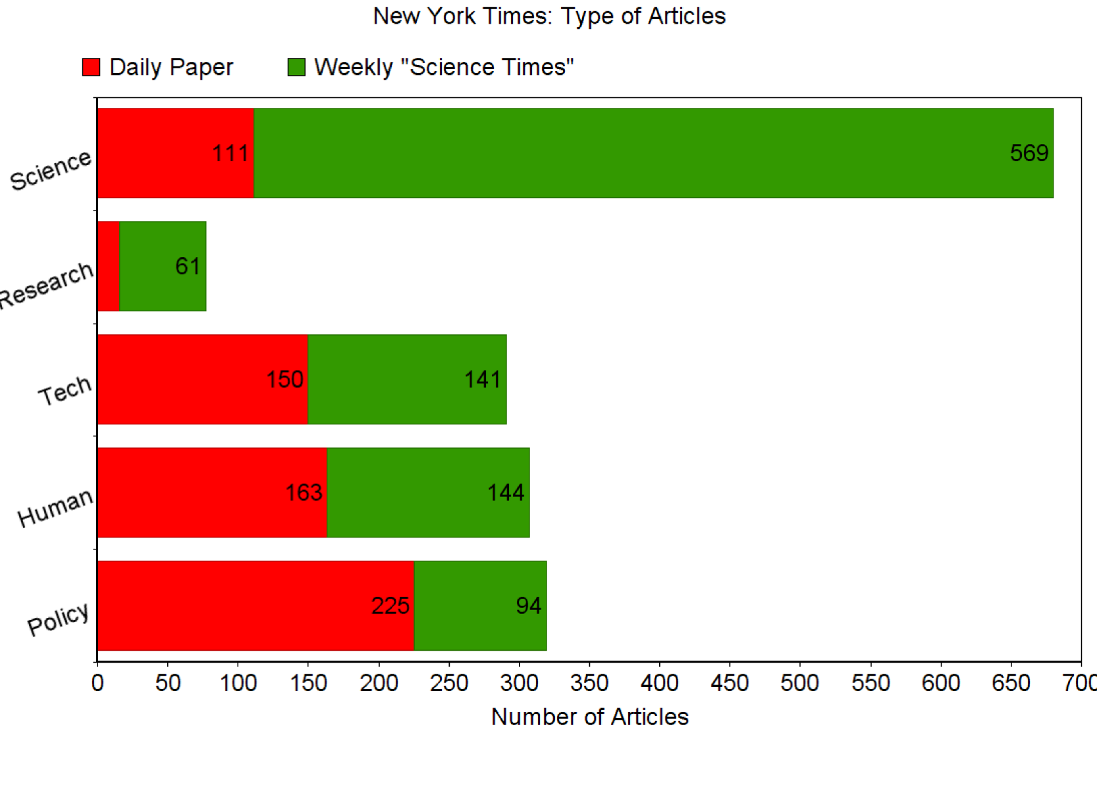
Notes:
Democrats don’t like some implications of standards. Republicans don’t like “National” (state’s rights)

Slide 37
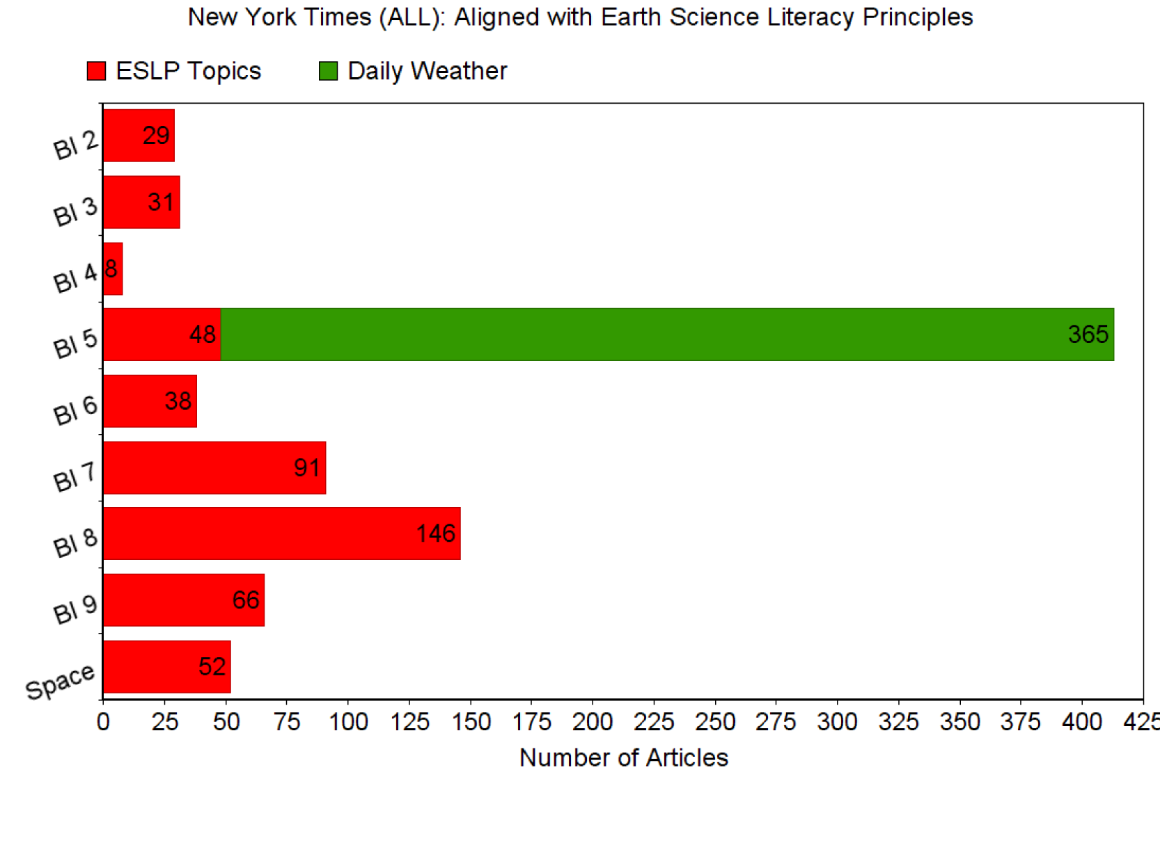
Notes:
Democrats don’t like some implications of standards. Republicans don’t like “National” (state’s rights)

Slide 38
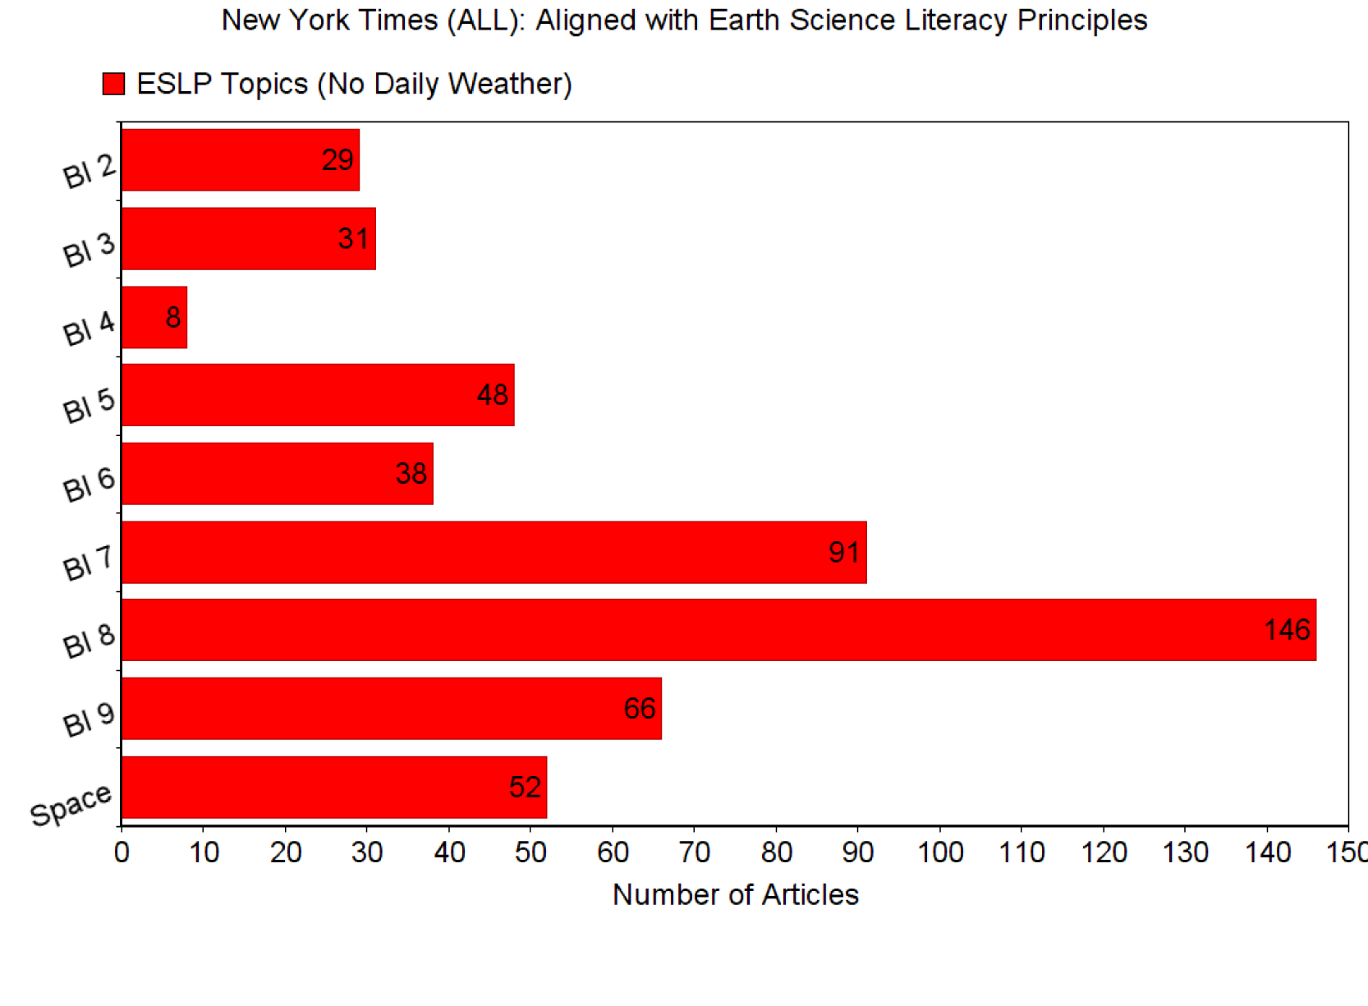
Geologic Time
Earth Systems
Changing Earth Systems
Hydrosphere
Biosphere
Natural Resources
Natural Hazards
Human Impacts
Space and Planetary Science
Notes:
Democrats don’t like some implications of standards. Republicans don’t like “National” (state’s rights)

Slide 39
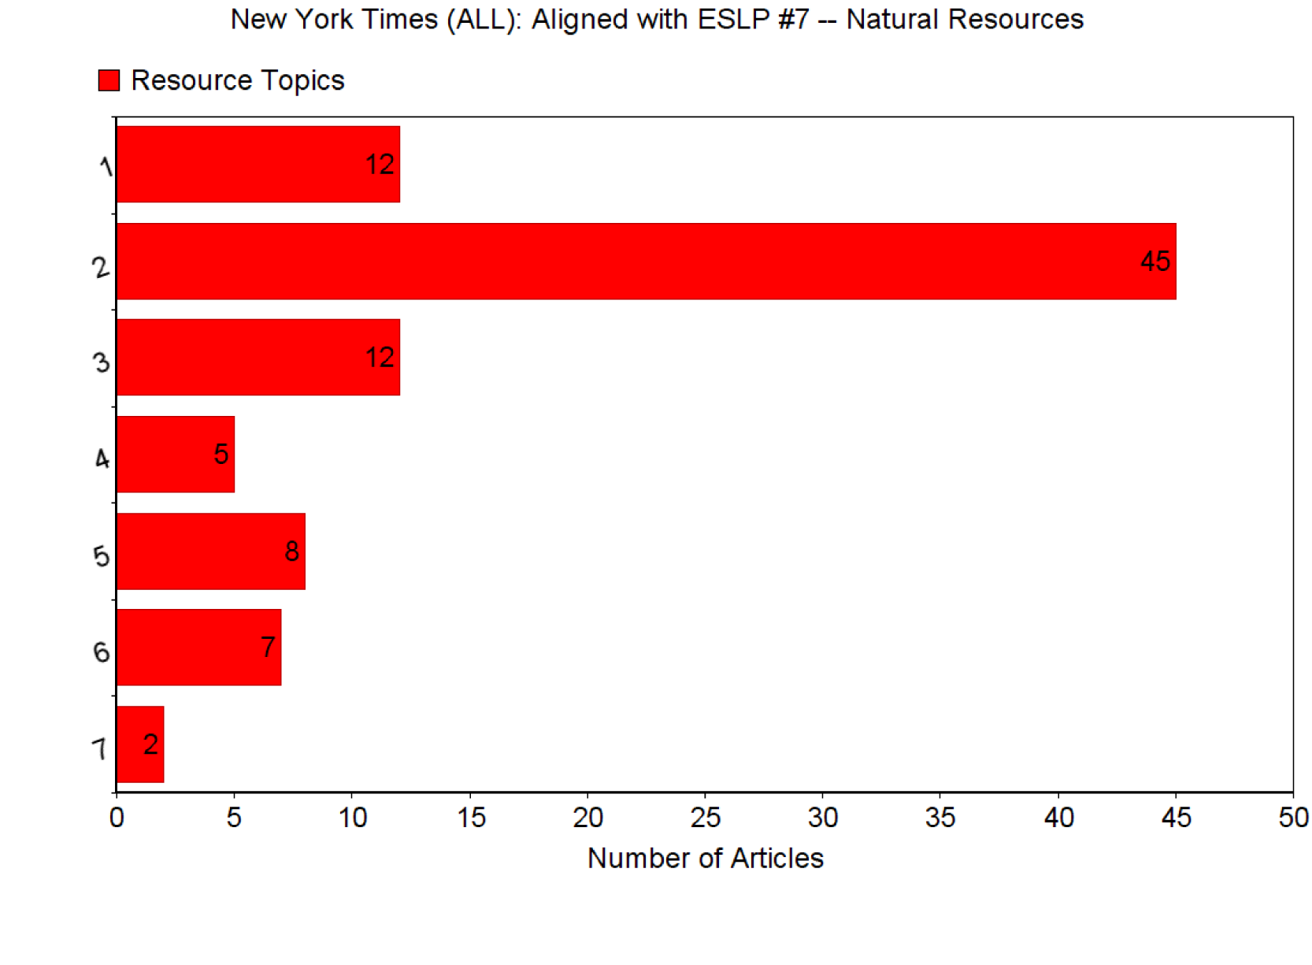
Energy/Electricity
Fossil Fuel Sources
Renewable Energy Sources
Nuclear Power
Minerals
Food
Water
Notes:
Democrats don’t like some implications of standards. Republicans don’t like “National” (state’s rights)

Slide 40
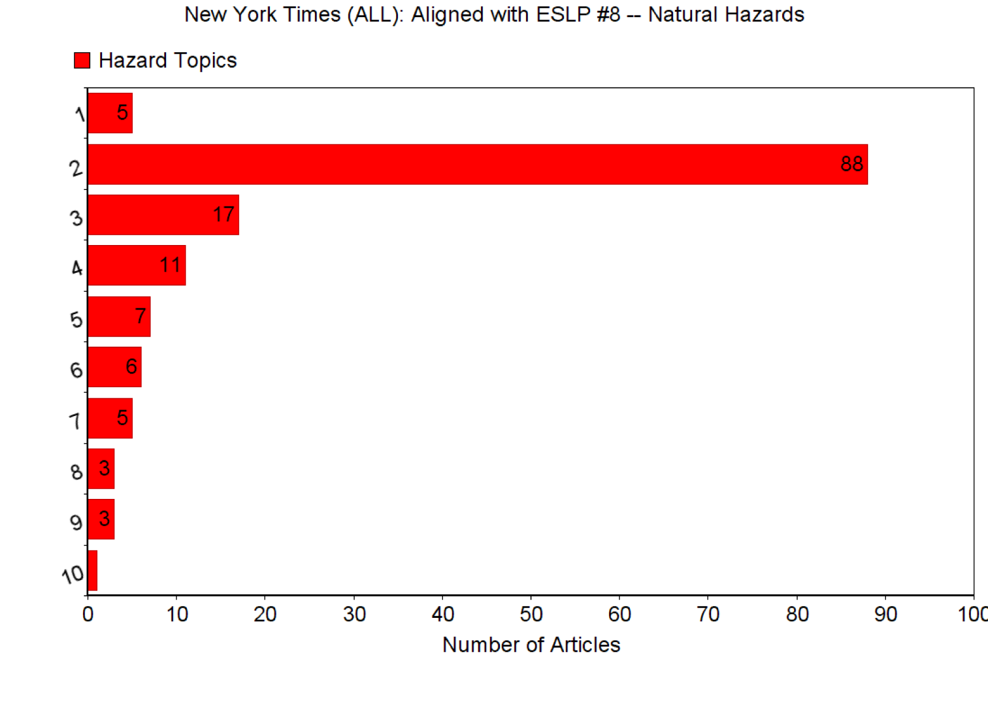
Natural Hazards (General)
Hurricane Sandy
Storms/Hurricanes
Droughts
Earthquakes/Tsunamis
Floods
Avalanches
Forest Fires
Tornadoes
Ice Bergs
Notes:
Democrats don’t like some implications of standards. Republicans don’t like “National” (state’s rights)

Slide 41
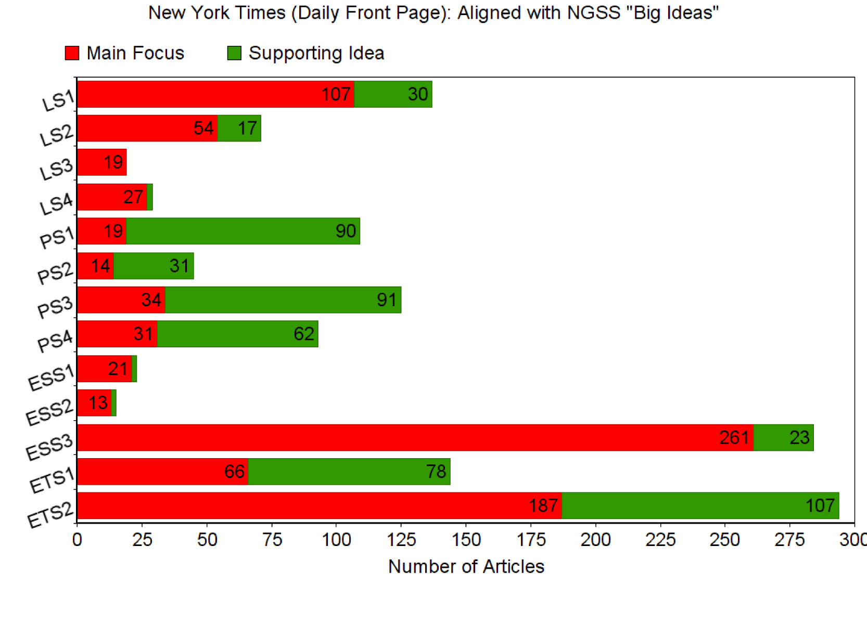
Notes:
Democrats don’t like some implications of standards. Republicans don’t like “National” (state’s rights)

Slide 42
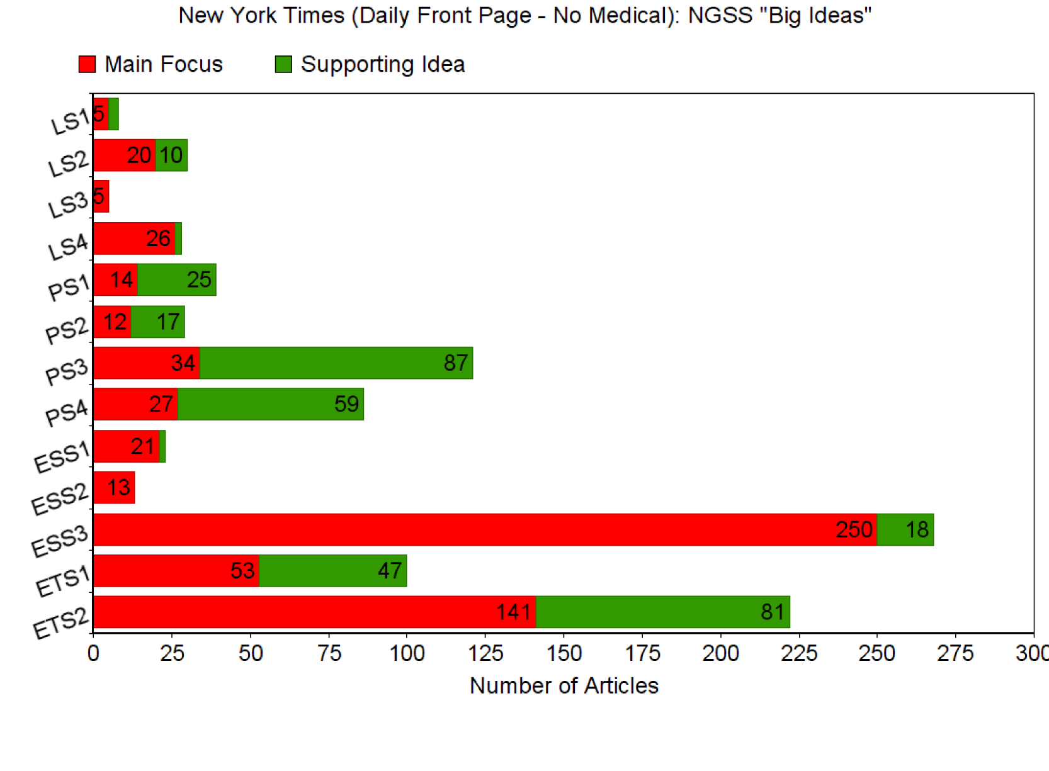
Notes:
Democrats don’t like some implications of standards. Republicans don’t like “National” (state’s rights)

Slide 43
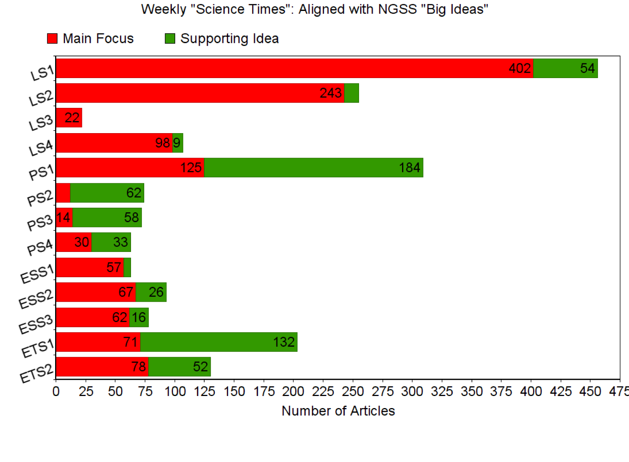
Notes:
Democrats don’t like some implications of standards. Republicans don’t like “National” (state’s rights)

Slide 44
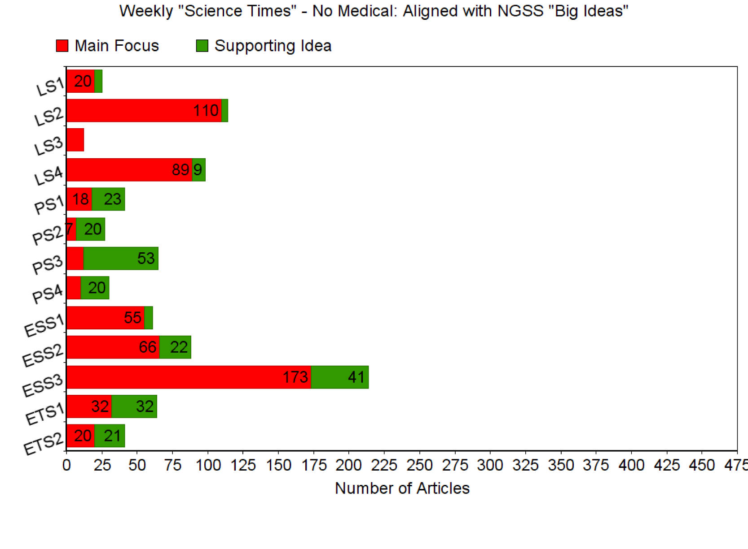
Notes:
Democrats don’t like some implications of standards. Republicans don’t like “National” (state’s rights)

Slide 45
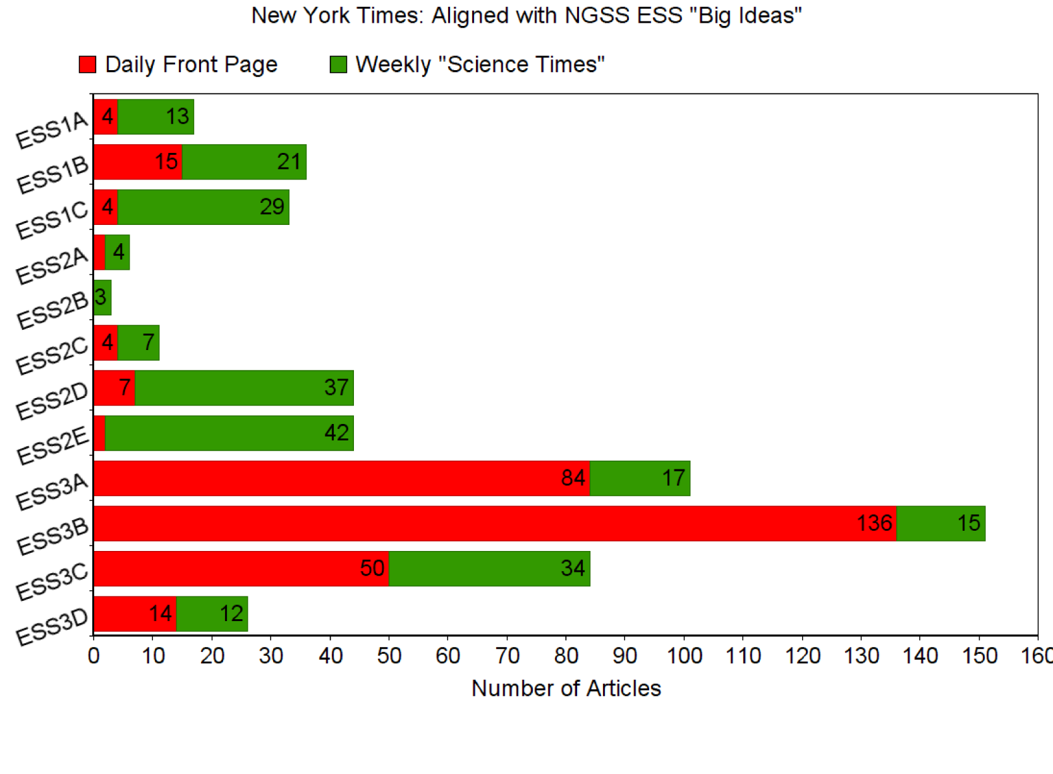
Universe & Stars
Solar System
Geologic Time
Earth Materials & Systems
Plate Tectonics
Water
Weather and Climate
Biogeology
Natural Resources
Natural Hazards
Human Impacts
Global Climate Change
Notes:
Democrats don’t like some implications of standards. Republicans don’t like “National” (state’s rights)

